Slide 1
DIABETES Canada Guidelines
UPDATE 2024
Alex Meadley MBBS, FRCPC
Internal Medicine
Orillia Soldiers Memorial Hospital

Slide 2
DISCLOSURES
I have received honoraria and participated in ad boards within the past 2 years
  BI/Lilly
  Novo Nordisk

Slide 3
Many of the slides were captured during the recent Diabetes Canada 2024 professional conference

Slide 4
Objectives
Review and discuss the new guidelines/recommendations from Diabetes Canada
  Hyperglycemic management
  Diabetic nephropathy
  Perioperative management
  T1DM

Slide 5
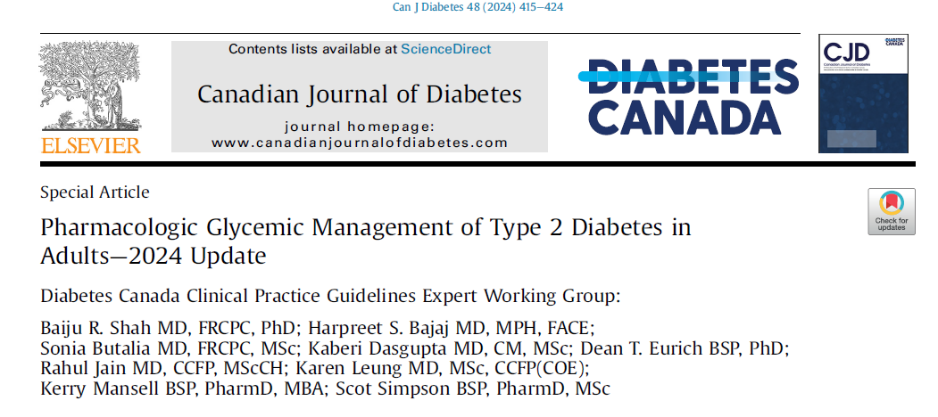
Hyperglycemic Management

Slide 6
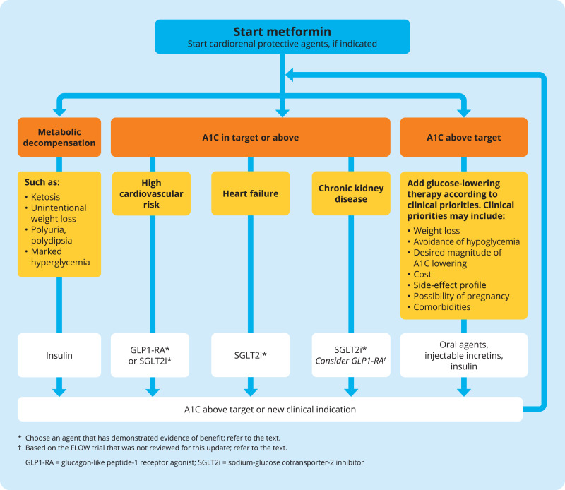
Hyperglycemic Management

Slide 7
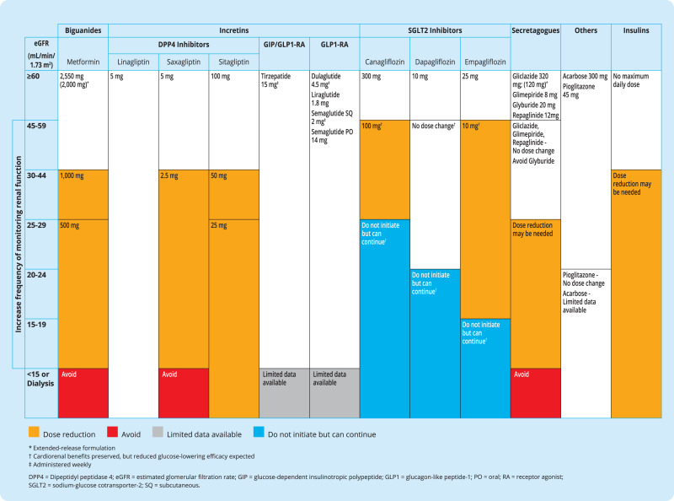
Renal Dosing

Slide 8
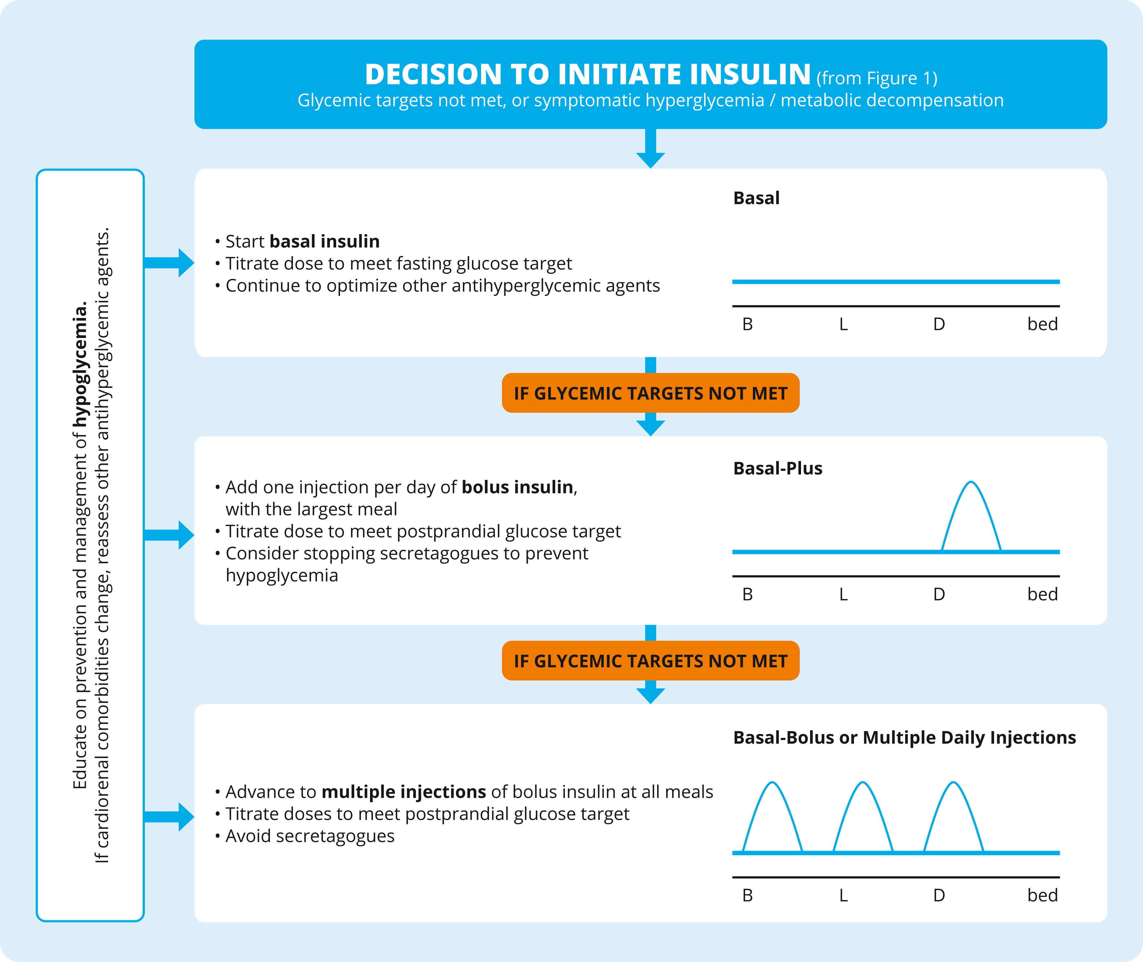
Initiation of Insulin

Slide 9
Key Messages:
Hyperglycemic management has been updated based upon new data and consensus statements
  Clarification of goals and priorities when prescribing
  Changes in thresholds for renal dosing
    Metformin
    SGLT2i

Slide 10
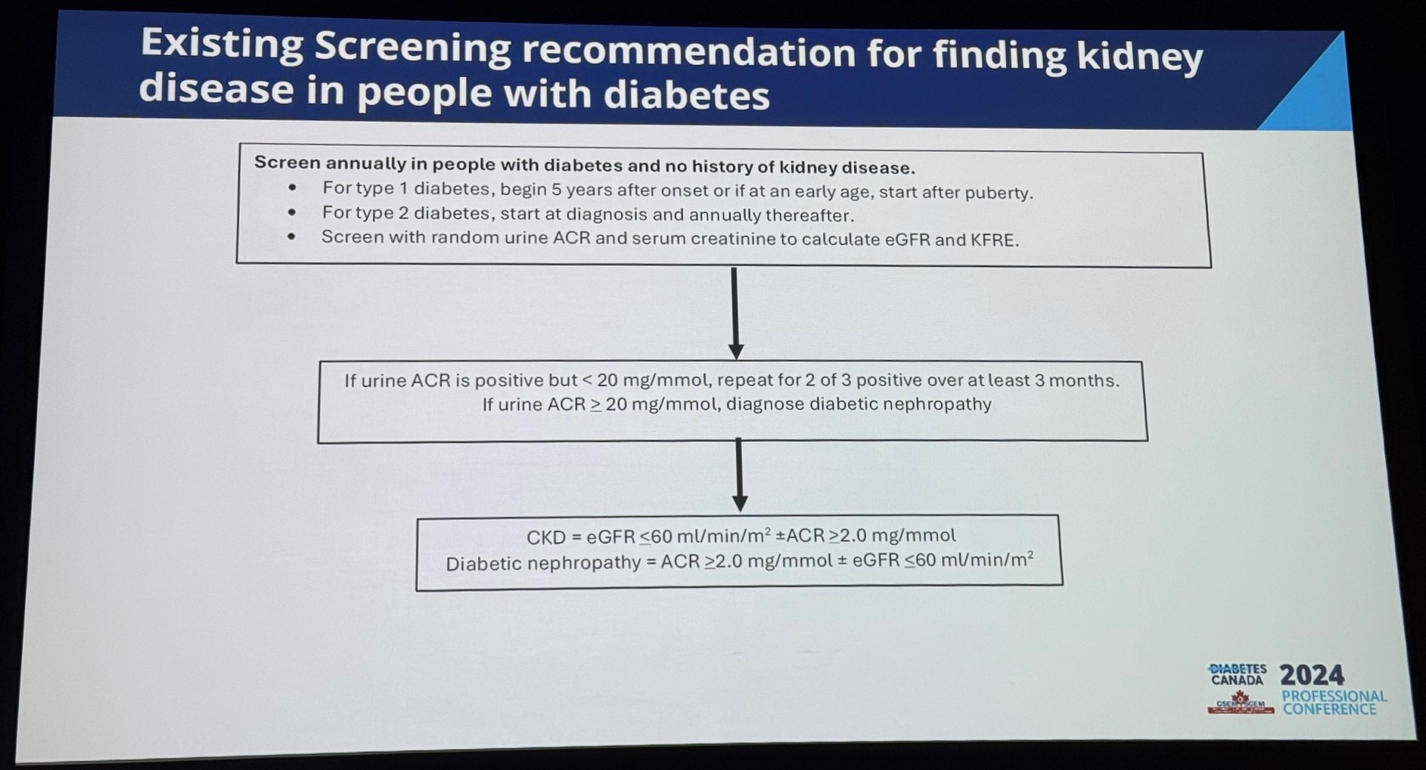
Nephropathy

Slide 11
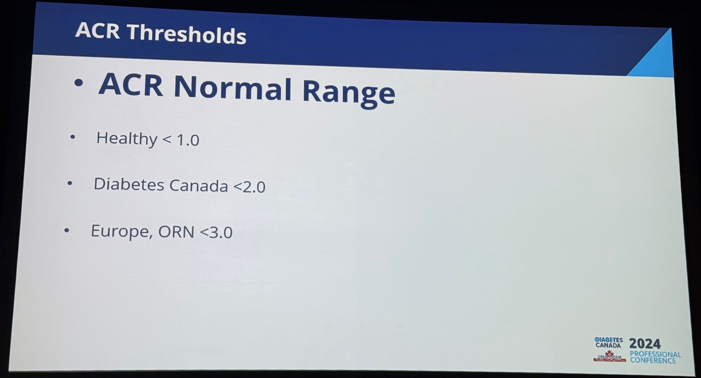
Nephropathy

Slide 12
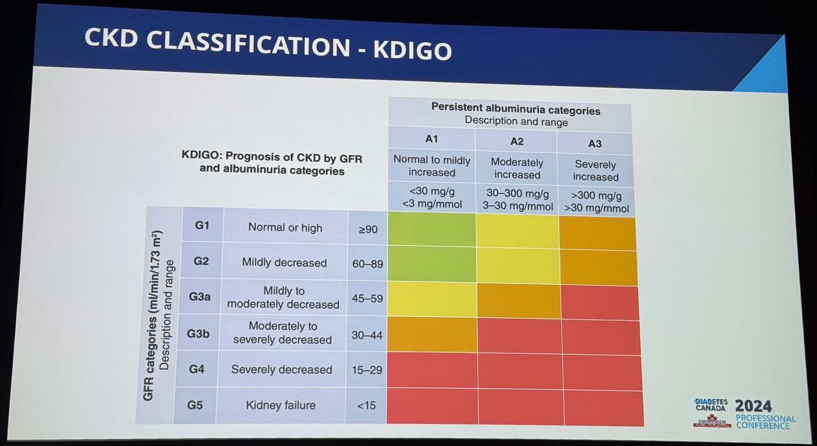
Nephropathy

Slide 13
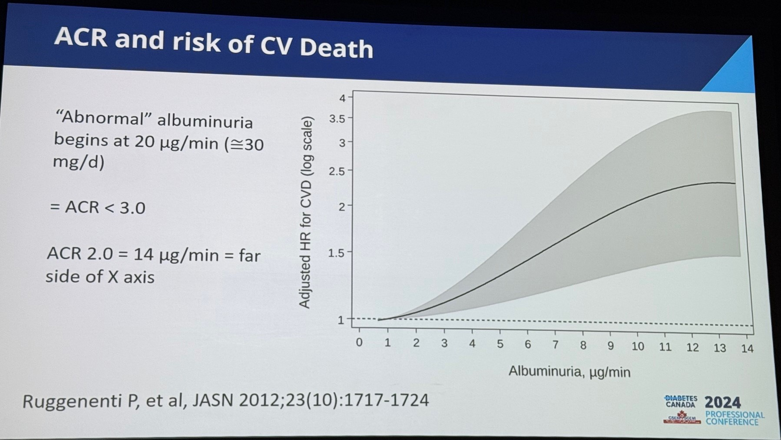
Nephropathy

Slide 14
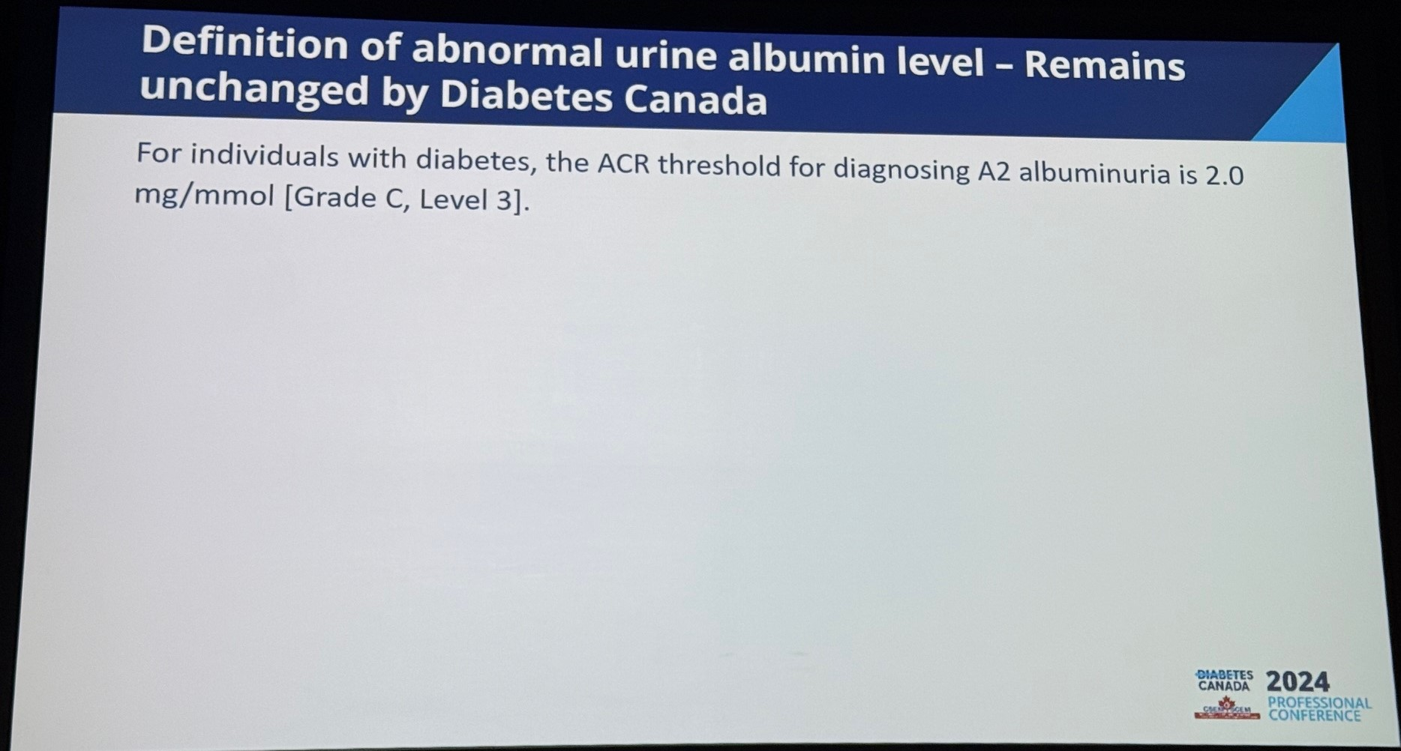
Nephropathy

Slide 15
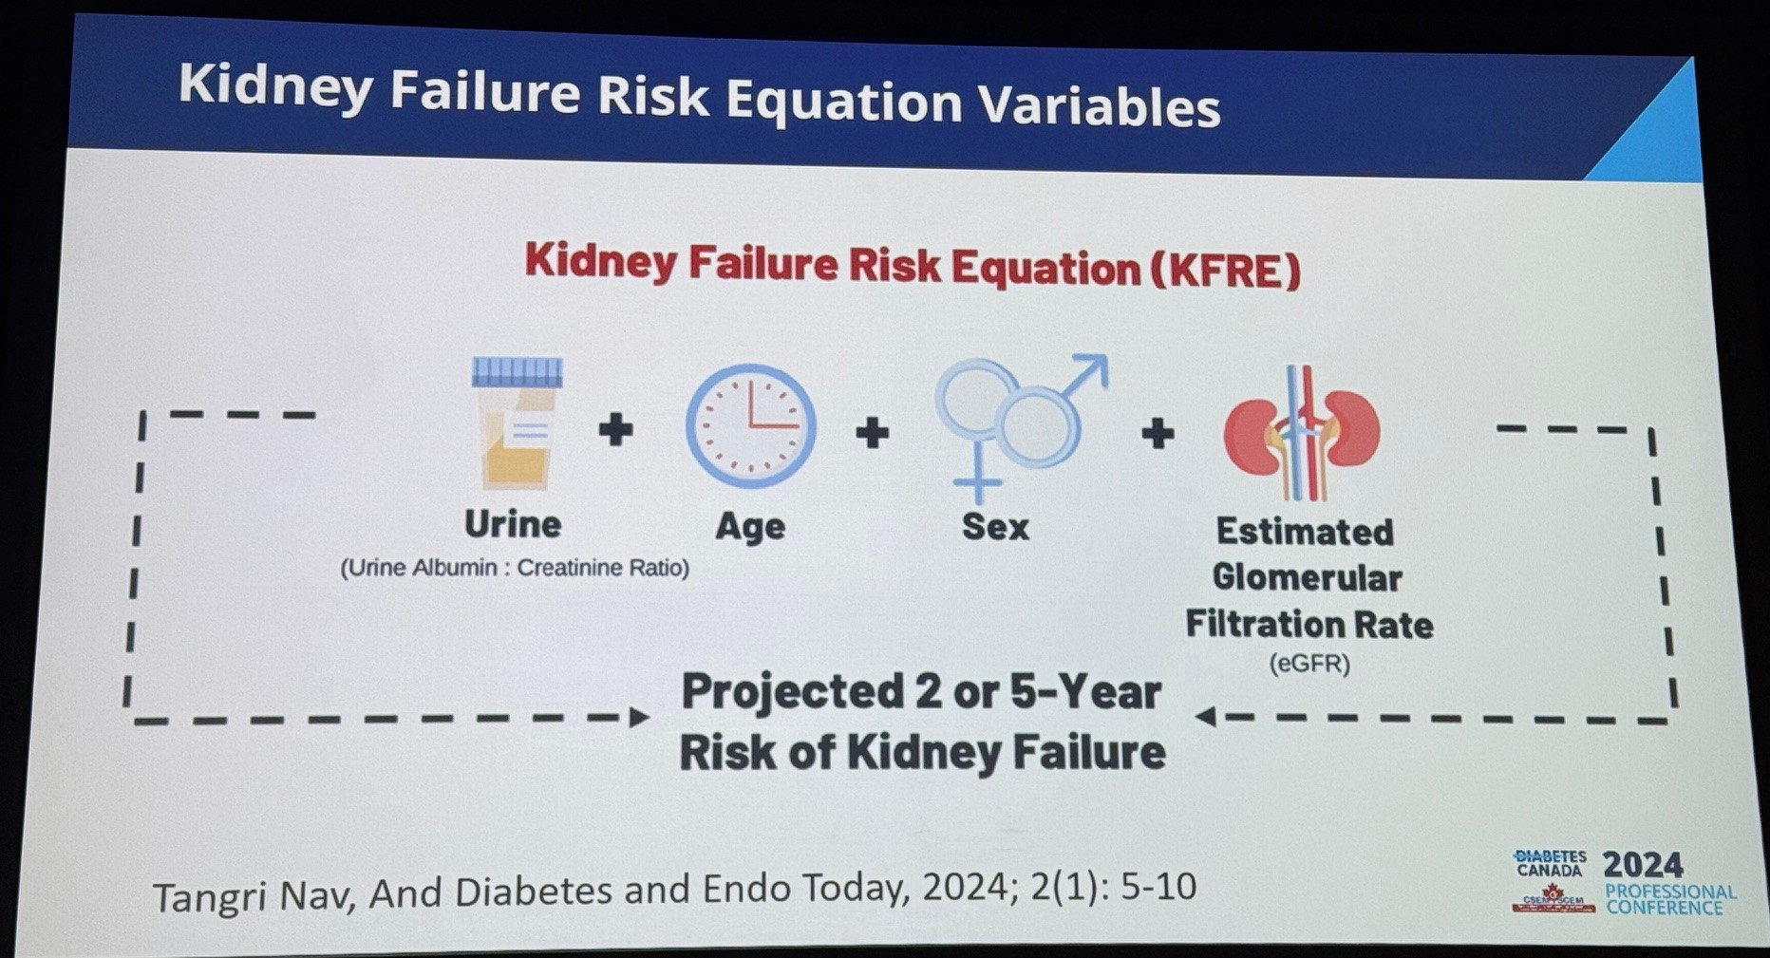
Nephropathy

Slide 16
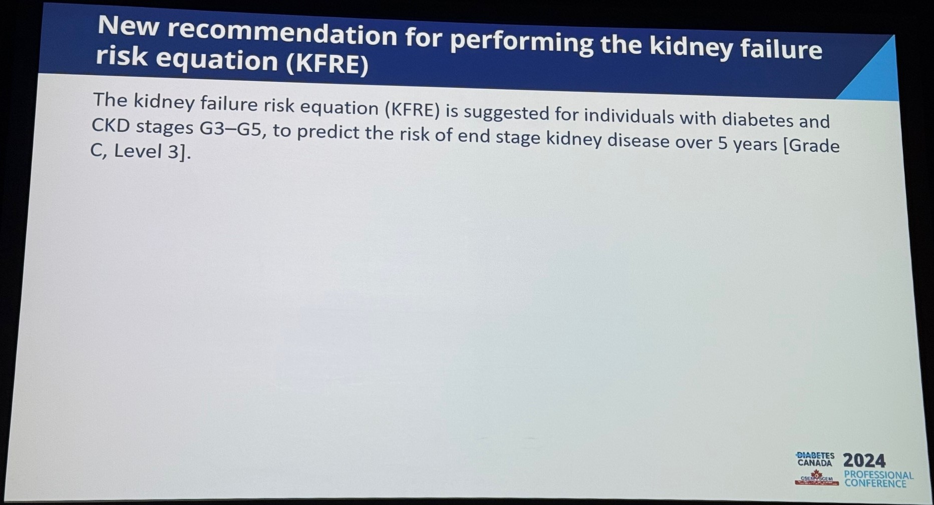
Nephropathy

Slide 17
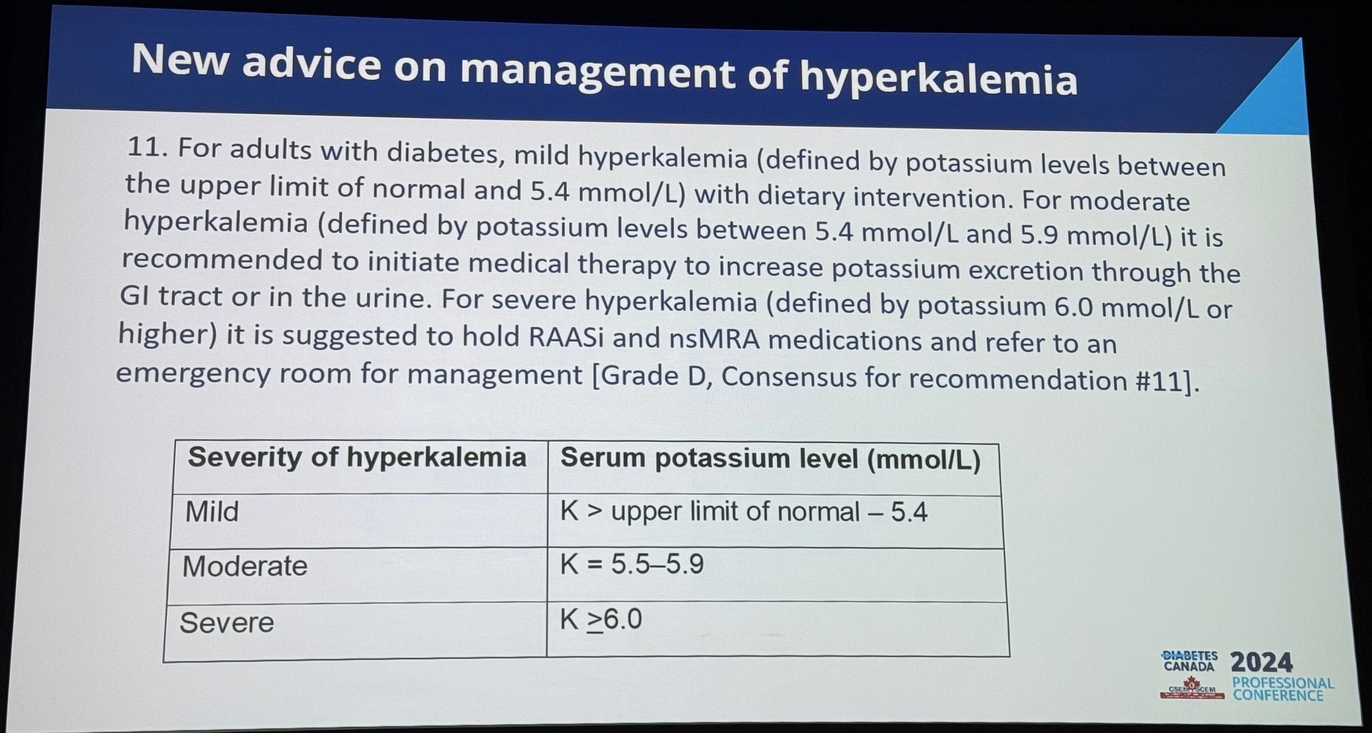
Nephropathy

Slide 18
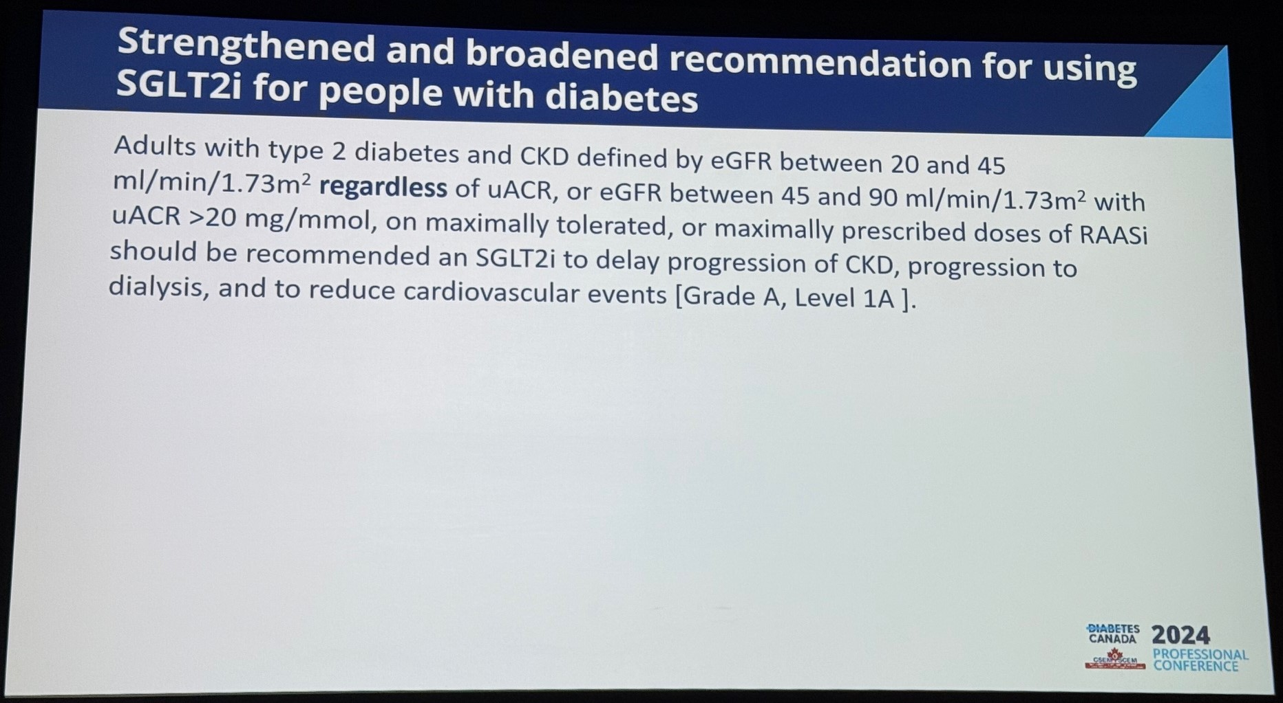
Nephropathy
Notes:
If on max/target dose of ACEi/ARB and eGFR 20-45, or ACR >20….use SGLT2i

Slide 19
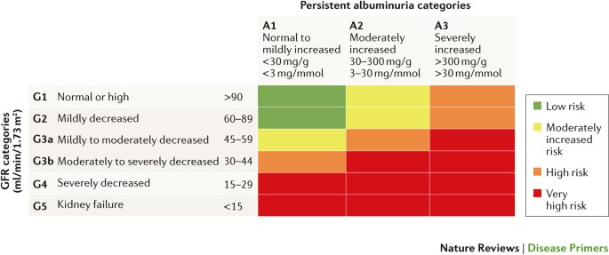
Nephropathy
x
>20
x
>20
x
>20
Notes:
If on max/target dose of ACEi/ARB and eGFR 20-45, or ACR >20….use SGLT2i

Slide 20
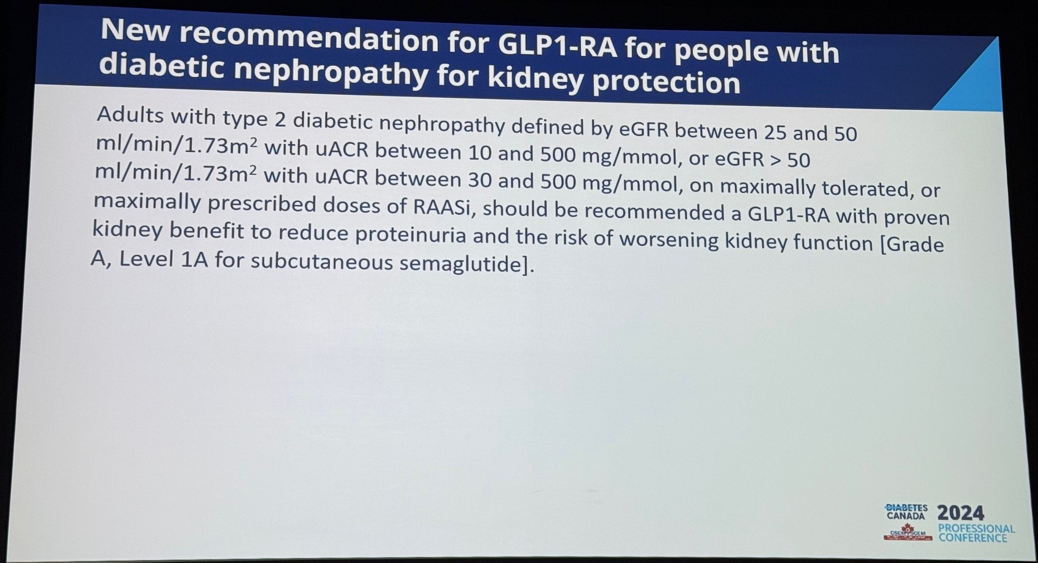
Nephropathy
Notes:
ACEi/ARB max tolerated or at target; use subcut semaglutide when ACR >10 and eGFR 25-50 or ACR >30 if eGFR >50

Slide 21
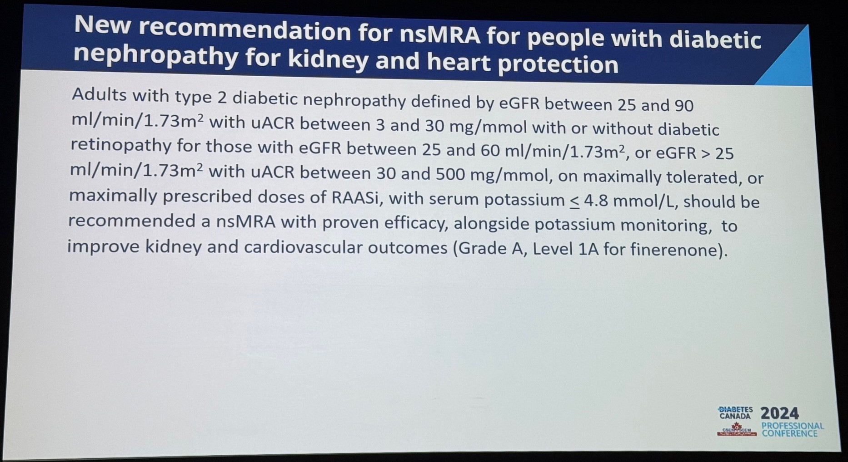
Nephropathy
Notes:
Max tolerated or at target dose ACEi/ARB; finerinone if eGFR 25-60 OR >25 with ACR >30

Slide 22

Nephropathy
Notes:
Max tolerated or at target dose ACEi/ARB; finerinone if eGFR 25-60 OR >25 with ACR >30

Slide 23
Key Messages:
ACR and creatinine for diagnosis and prediction for progression of diabetic nephropathy

Slide 24
Key Messages:
ACR and creatinine for diagnosis and prediction for progression of diabetic nephropathy
Management of hyperkalemia
  Suggested to hold ACEi/ARB and MRA if K+ >6.0

Slide 25
Key Messages:
ACR and creatinine for diagnosis and prediction for progression of diabetic nephropathy
Management of hyperkalemia
  Suggested to hold ACEi/ARB and MRA if K+ >6.0
Diabetic nephropathy can be treated with multiple agents to prevent progression
  ACEi or ARB is first line therapy
  SGLT2i
  GLP1a
  nsMRA

Slide 26
Perioperative Management Update
GLP1 agonist use:
  Is there a risk of retained gastric contents and aspiration in the perioperative period?
  How do we manage these medications in the preoperative setting?

Slide 27
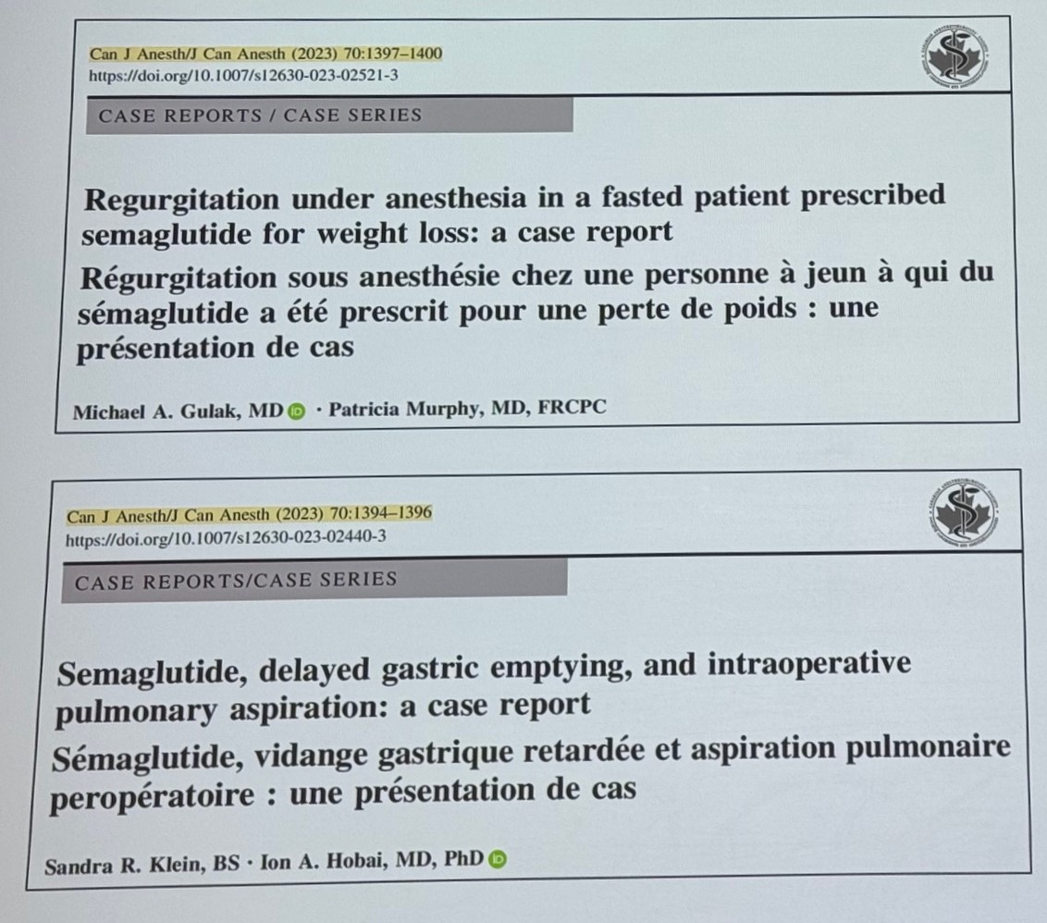
Perioperative Management Update

Slide 28
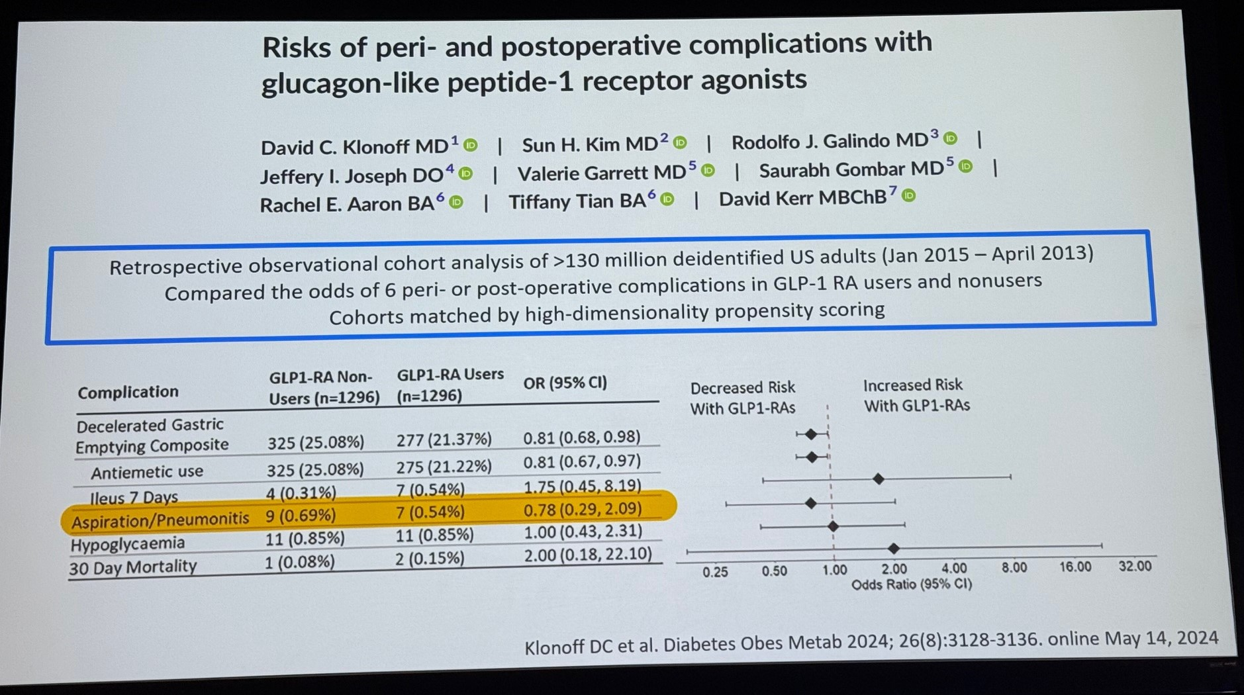
Perioperative Management Update

Slide 29
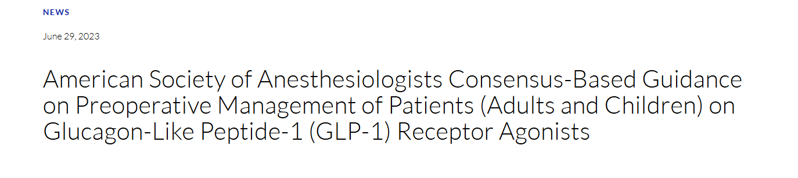
Perioperative Management Update
https://www.asahq.org/about-asa/newsroom/news-releases/2023/06/american-society-of-anesthesiologists-consensus-based-guidance-on-preoperative

Slide 30
Perioperative Management Update
Day(s) Prior to the Procedure:
  For patients on daily dosing consider holding GLP-1 agonists on the day of the procedure/surgery. For patients on weekly dosing consider holding GLP-1 agonists a week prior to the procedure/surgery.
https://www.asahq.org/about-asa/newsroom/news-releases/2023/06/american-society-of-anesthesiologists-consensus-based-guidance-on-preoperative

Slide 31
Perioperative Management Update
Day(s) Prior to the Procedure:
  For patients on daily dosing consider holding GLP-1 agonists on the day of the procedure/surgery. For patients on weekly dosing consider holding GLP-1 agonists a week prior to the procedure/surgery.
  This suggestion is irrespective of the indication (type 2 diabetes mellitus or weight loss), dose, or the type of procedure/surgery.
https://www.asahq.org/about-asa/newsroom/news-releases/2023/06/american-society-of-anesthesiologists-consensus-based-guidance-on-preoperative

Slide 32
Perioperative Management Update
Day(s) Prior to the Procedure:
  For patients on daily dosing consider holding GLP-1 agonists on the day of the procedure/surgery. For patients on weekly dosing consider holding GLP-1 agonists a week prior to the procedure/surgery.
  This suggestion is irrespective of the indication (type 2 diabetes mellitus or weight loss), dose, or the type of procedure/surgery.
  If GLP-1 agonists prescribed for diabetes management are held for longer than the dosing schedule, consider consulting an endocrinologist for bridging the antidiabetic therapy to avoid hyperglycemia.
https://www.asahq.org/about-asa/newsroom/news-releases/2023/06/american-society-of-anesthesiologists-consensus-based-guidance-on-preoperative

Slide 33
Perioperative Management Update
Day of the Procedure:
  If gastrointestinal (GI) symptoms such as severe nausea/vomiting/retching, abdominal bloating, or abdominal pain are present, consider delaying elective procedure, and discuss the concerns of potential risk of regurgitation and pulmonary aspiration of gastric contents with the proceduralist/surgeon and the patient.
https://www.asahq.org/about-asa/newsroom/news-releases/2023/06/american-society-of-anesthesiologists-consensus-based-guidance-on-preoperative

Slide 34
Perioperative Management Update
Day of the Procedure:
  If gastrointestinal (GI) symptoms such as severe nausea/vomiting/retching, abdominal bloating, or abdominal pain are present, consider delaying elective procedure, and discuss the concerns of potential risk of regurgitation and pulmonary aspiration of gastric contents with the proceduralist/surgeon and the patient.
  If the patient has no GI symptoms, and the GLP-1 agonists have been held as advised, proceed as usual.
https://www.asahq.org/about-asa/newsroom/news-releases/2023/06/american-society-of-anesthesiologists-consensus-based-guidance-on-preoperative

Slide 35
Perioperative Management Update
Day of the Procedure:
  If gastrointestinal (GI) symptoms such as severe nausea/vomiting/retching, abdominal bloating, or abdominal pain are present, consider delaying elective procedure, and discuss the concerns of potential risk of regurgitation and pulmonary aspiration of gastric contents with the proceduralist/surgeon and the patient.
  If the patient has no GI symptoms, and the GLP-1 agonists have been held as advised, proceed as usual.
  If the patient has no GI symptoms, but the GLP-1 agonists were not held as advised, proceed with ‘full stomach’ precautions or consider evaluating gastric volume by ultrasound, if possible and if proficient with the technique. If the stomach is empty, proceed as usual. If the stomach is full or if gastric ultrasound inconclusive or not possible, consider delaying the procedure or treat the patient as ‘full stomach’ and manage accordingly. Discuss the concerns of potential risk of regurgitation and pulmonary aspiration of gastric contents with the proceduralist/surgeon and the patient.
https://www.asahq.org/about-asa/newsroom/news-releases/2023/06/american-society-of-anesthesiologists-consensus-based-guidance-on-preoperative

Slide 36
Perioperative Management Update
Day of the Procedure:
  If gastrointestinal (GI) symptoms such as severe nausea/vomiting/retching, abdominal bloating, or abdominal pain are present, consider delaying elective procedure, and discuss the concerns of potential risk of regurgitation and pulmonary aspiration of gastric contents with the proceduralist/surgeon and the patient.
  If the patient has no GI symptoms, and the GLP-1 agonists have been held as advised, proceed as usual.
  If the patient has no GI symptoms, but the GLP-1 agonists were not held as advised, proceed with ‘full stomach’ precautions or consider evaluating gastric volume by ultrasound, if possible and if proficient with the technique. If the stomach is empty, proceed as usual. If the stomach is full or if gastric ultrasound inconclusive or not possible, consider delaying the procedure or treat the patient as ‘full stomach’ and manage accordingly. Discuss the concerns of potential risk of regurgitation and pulmonary aspiration of gastric contents with the proceduralist/surgeon and the patient.
  There is no evidence to suggest the optimal duration of fasting for patients on GLP-1 agonists. Therefore, until we have adequate evidence, we suggest following the current ASA fasting guidelines
https://www.asahq.org/about-asa/newsroom/news-releases/2023/06/american-society-of-anesthesiologists-consensus-based-guidance-on-preoperative

Slide 37
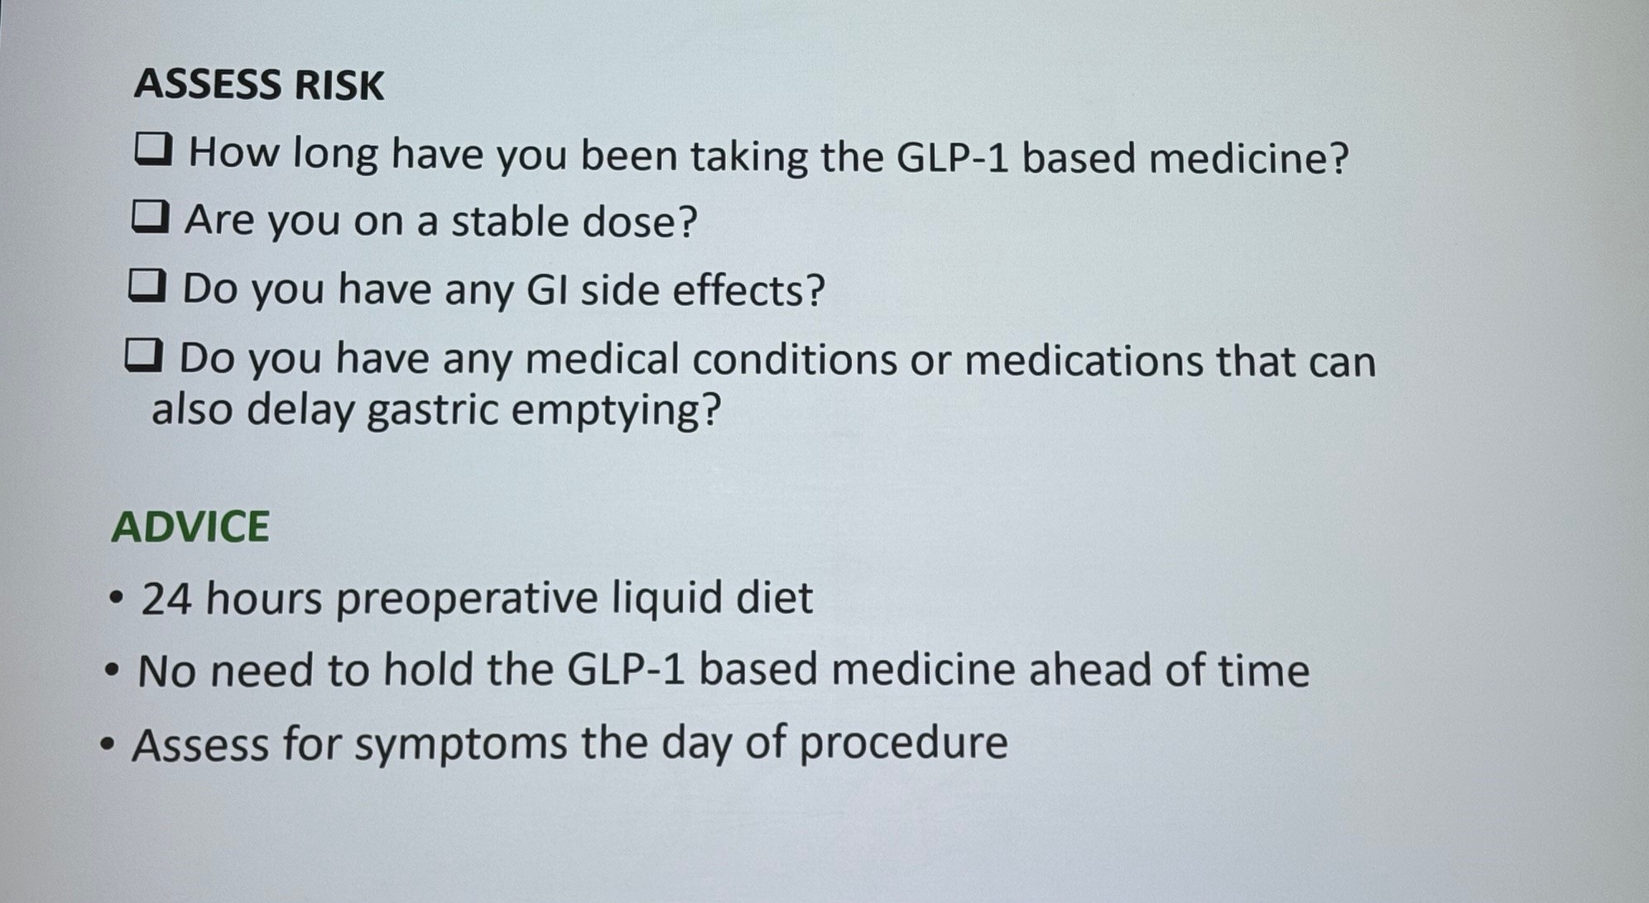
Perioperative Management Update

Slide 38
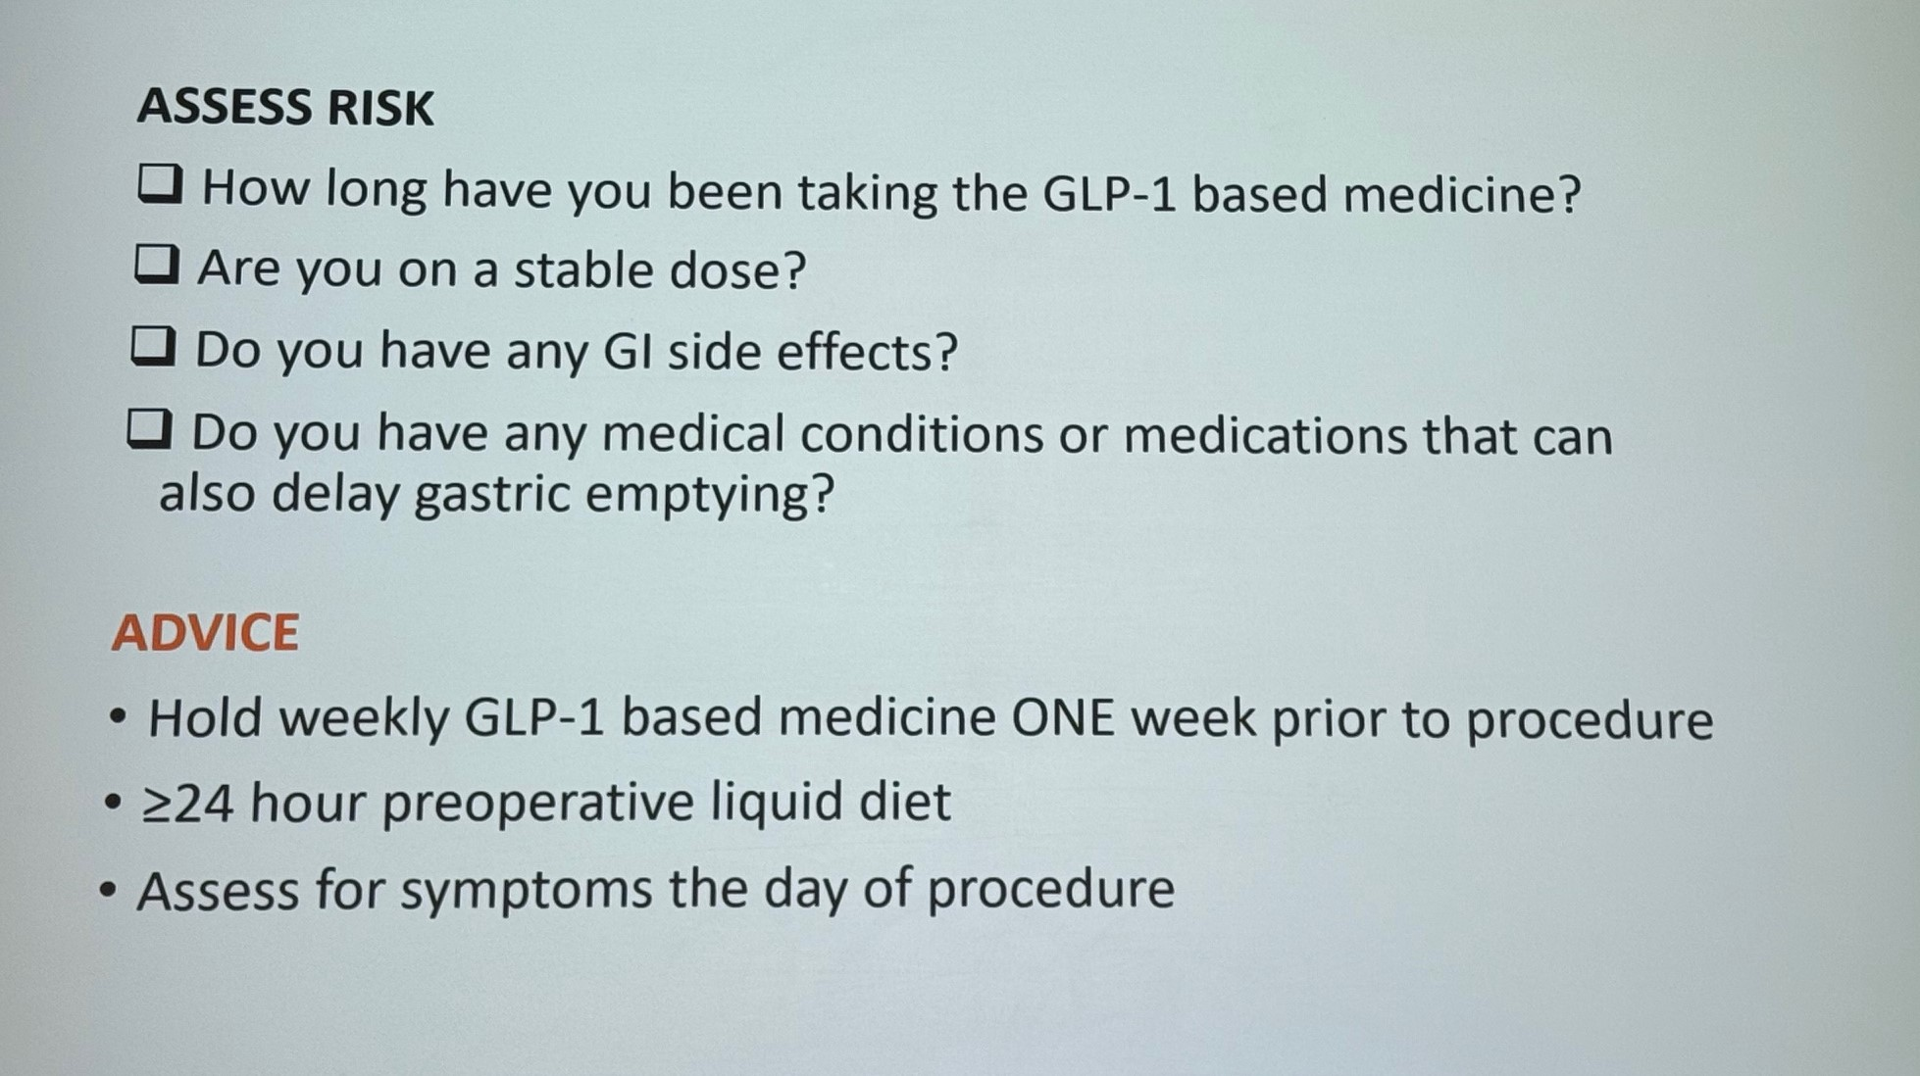
Perioperative Management Update

Slide 39
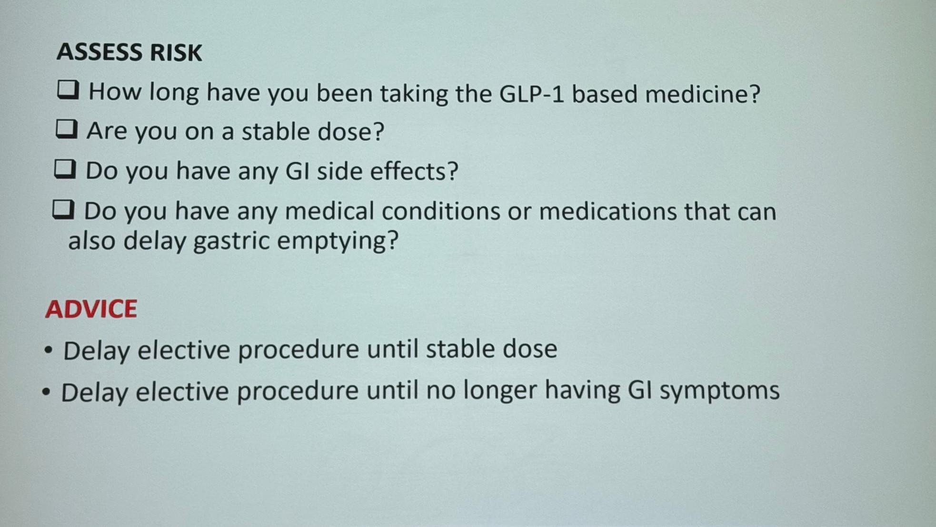
Perioperative Management Update

Slide 40
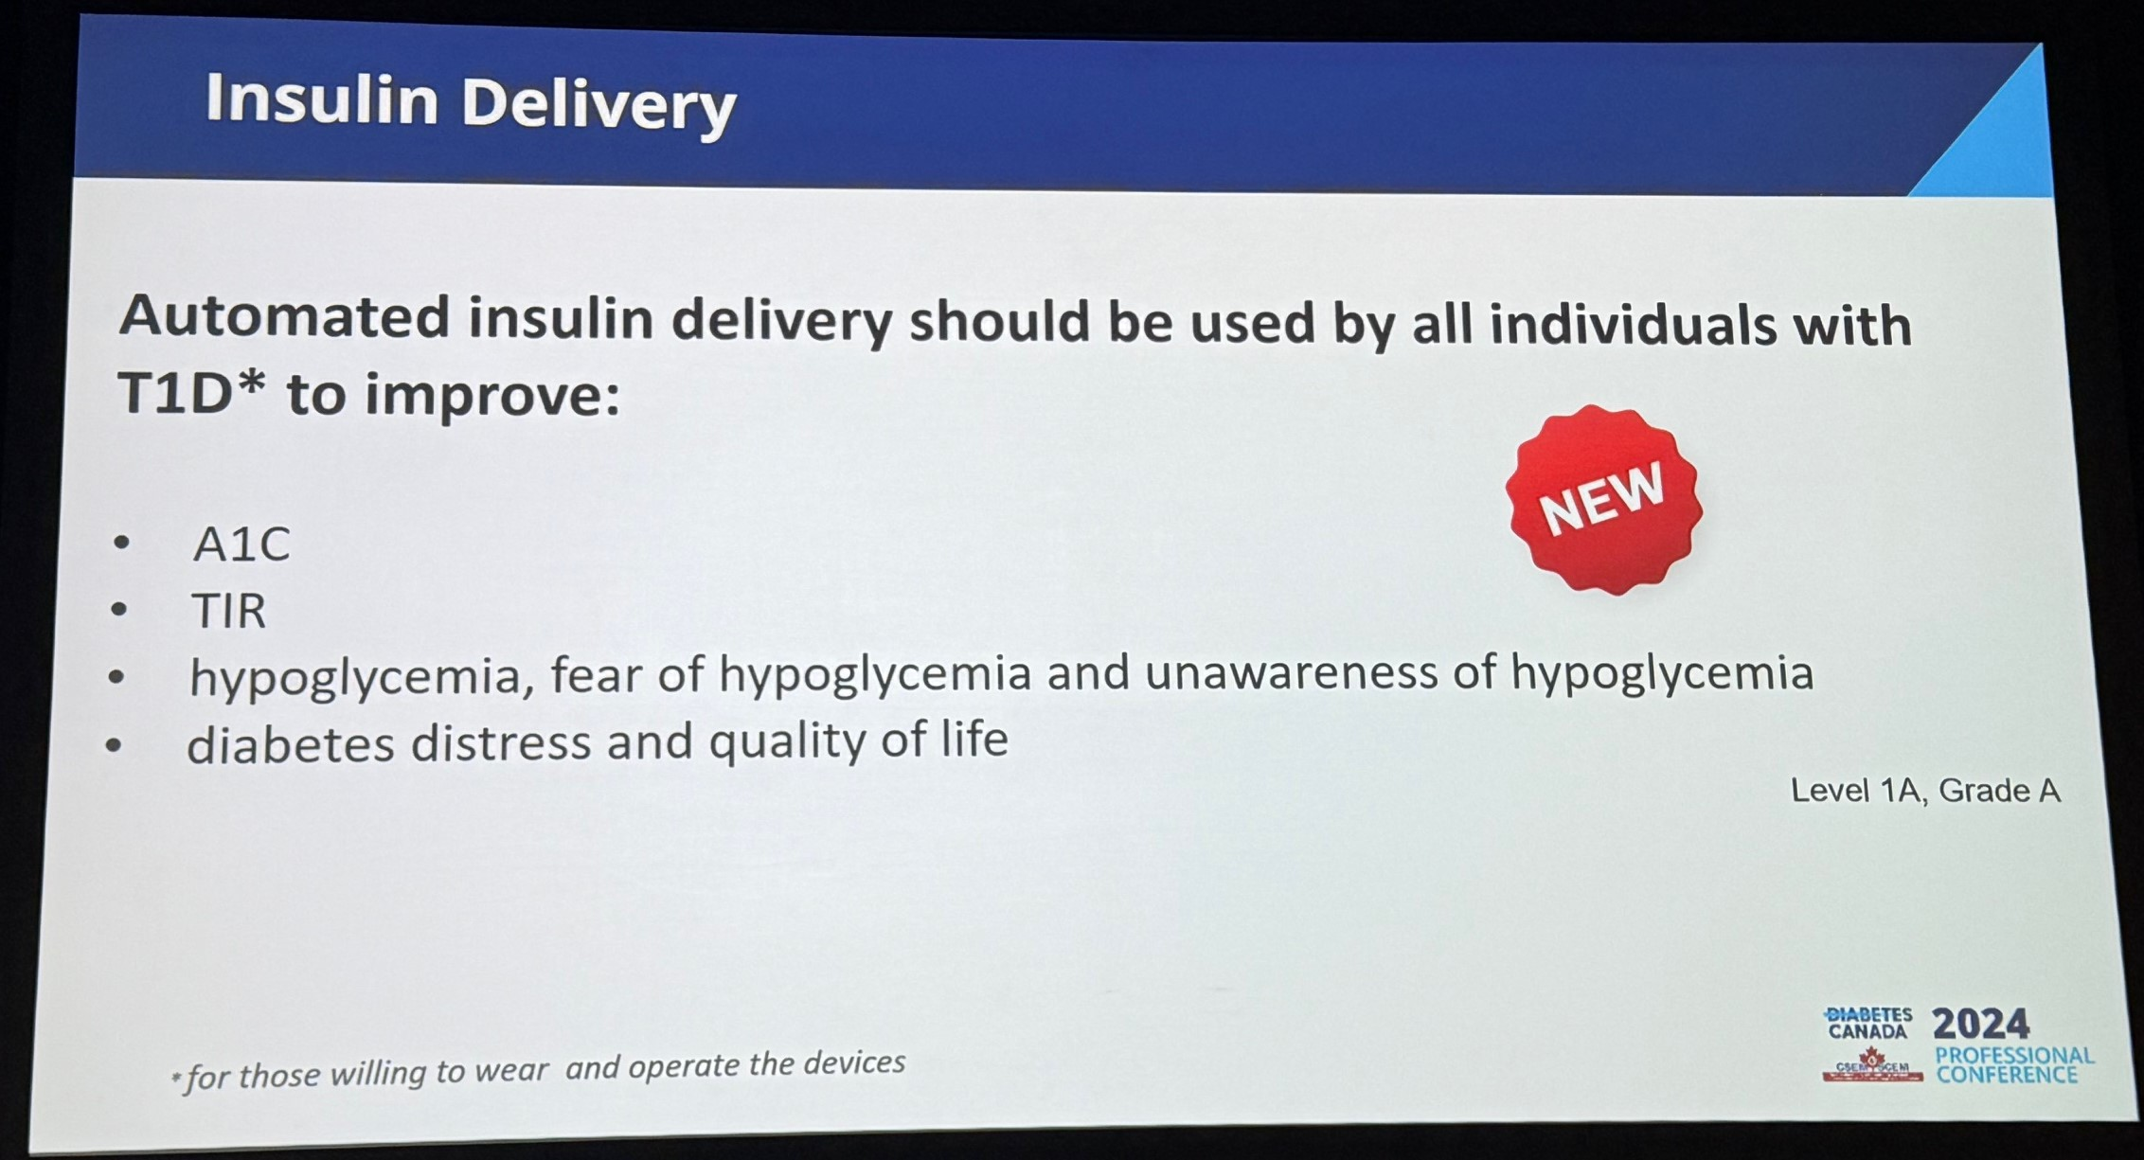
New Statements For T1DM

Slide 41
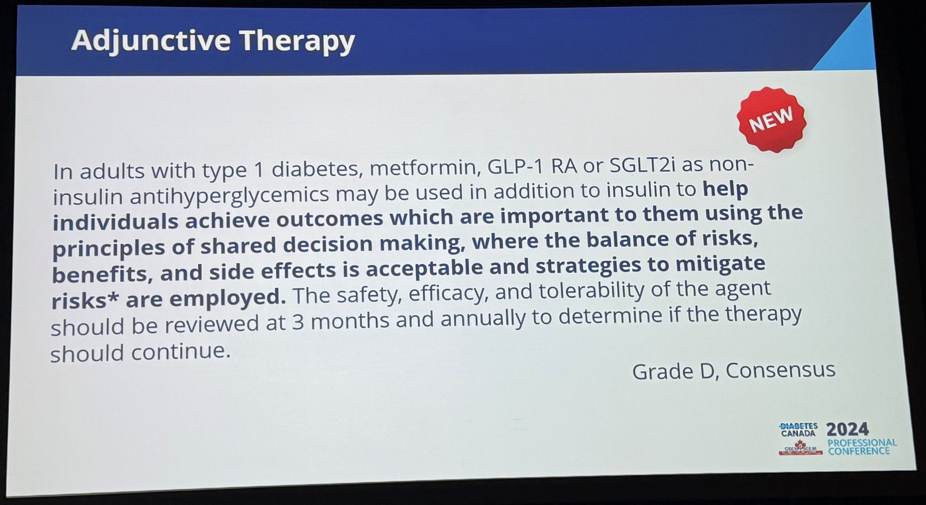
New Statements For T1DM

Slide 42
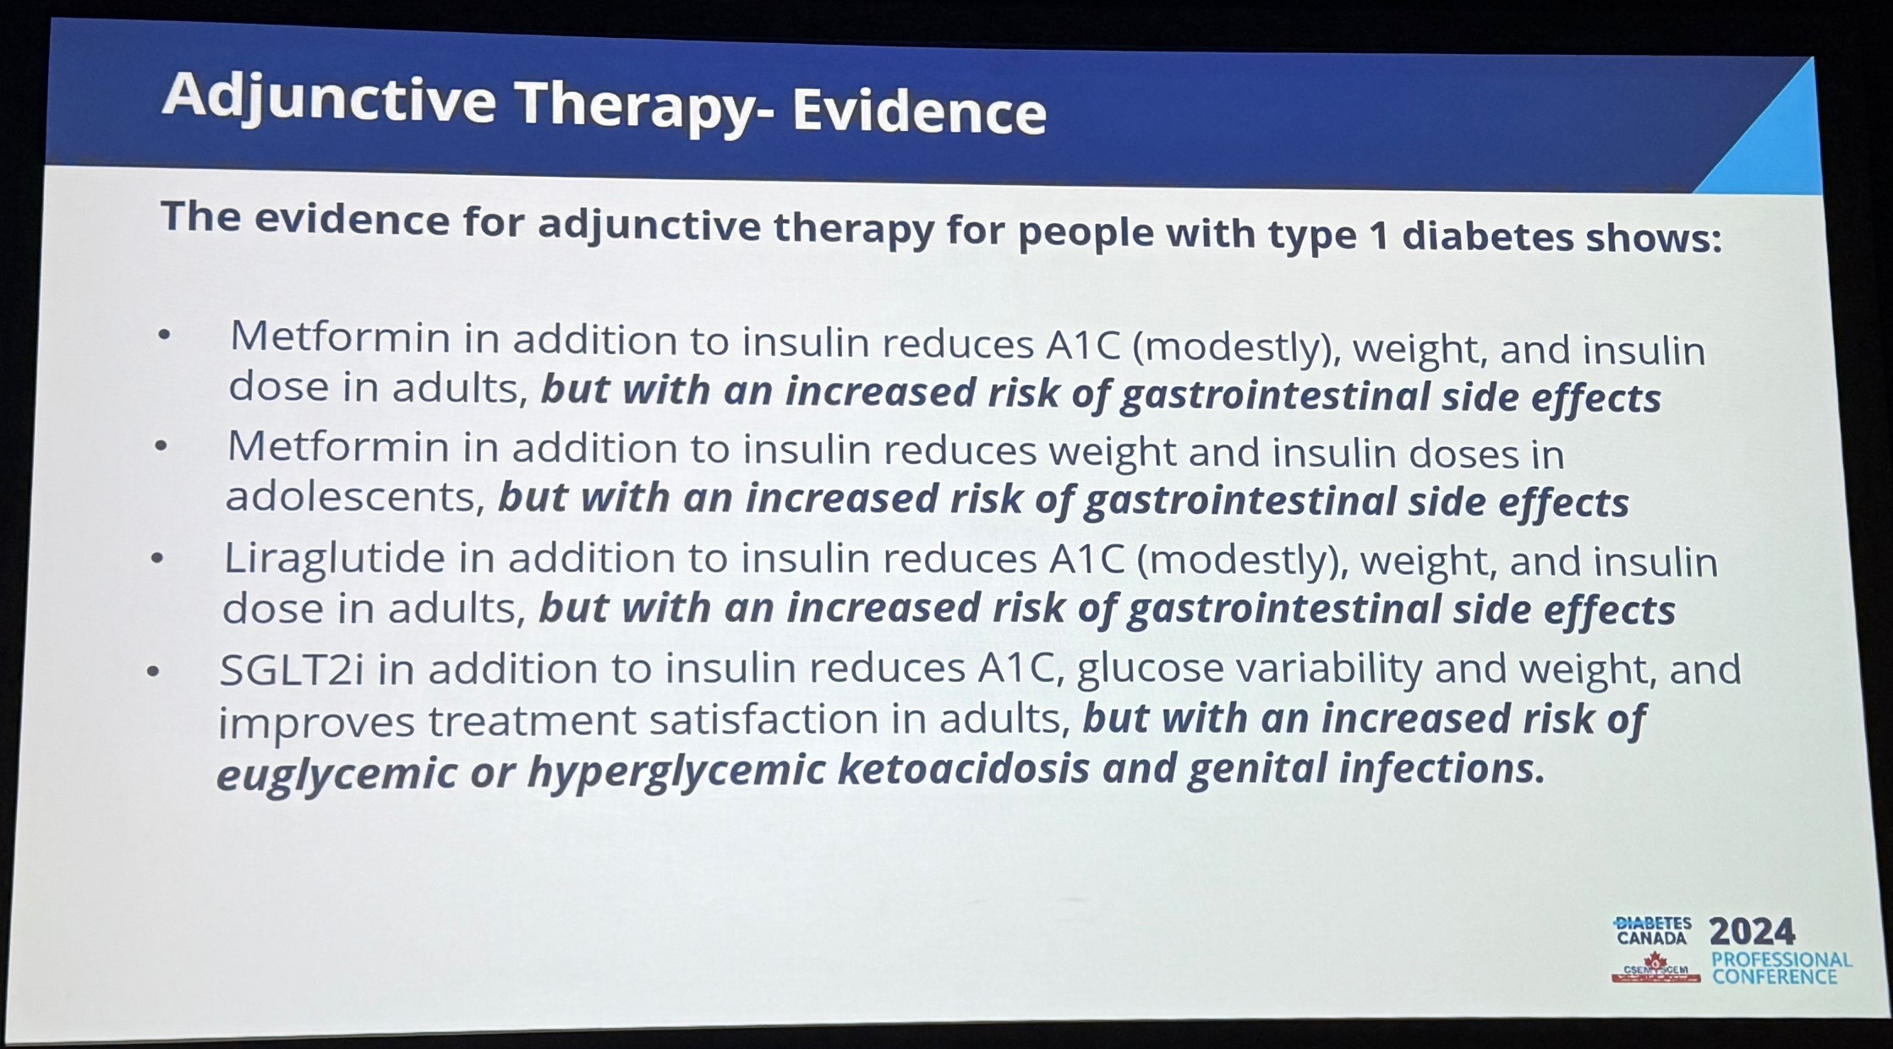
New Statements For T1DM

Slide 43
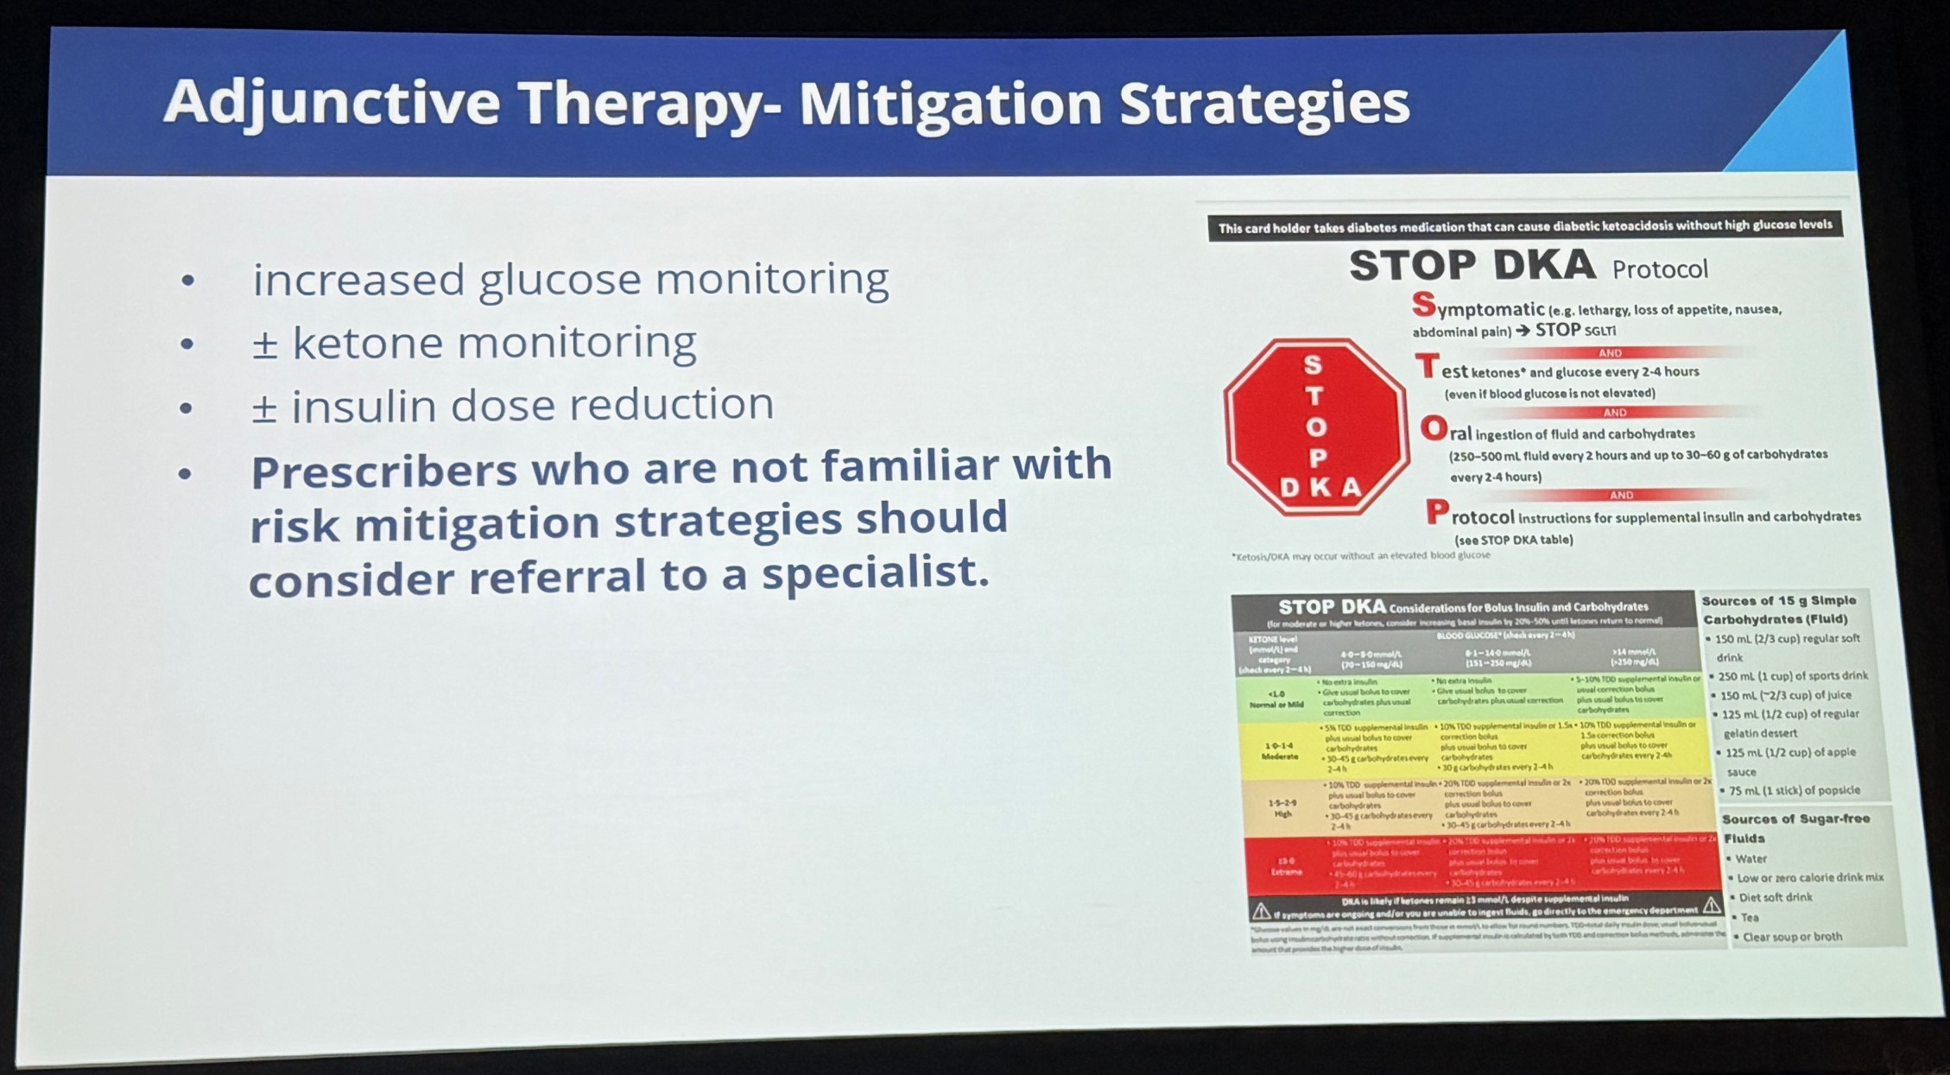
New Statements For T1DM

Slide 44
Summary
Hyperglycemic management
  Choice of agents evolving with new evidence
  Updates to renal adjusted dosing of individual medications

Slide 45
Summary
Hyperglycemic management
  Choice of agents evolving with new evidence
  Updates to renal adjusted dosing of individual medications
Diabetic nephropathy
    ACEi or ARB is primary agent
    SGLT2i, GLP1a or nsMRA should be considered for significant reduction in eGFR and/or proteinuria

Slide 46
Summary
Hyperglycemic management
  Choice of agents evolving with new evidence
  Updates to renal adjusted dosing of individual medications
Diabetic nephropathy
    ACEi or ARB is primary agent
    SGLT2i, GLP1a or nsMRA should be considered for significant reduction in eGFR and/or proteinuria
Perioperative management
  GLP1a are thought to increase risk of aspiration during anesthesia
  Poor/limited evidence exists to guide management

Slide 47
Summary
Hyperglycemic management
  Choice of agents evolving with new evidence
  Updates to renal adjusted dosing of individual medications
Diabetic nephropathy
    ACEi or ARB is primary agent
    SGLT2i, GLP1a or nsMRA should be considered for significant reduction in eGFR and/or proteinuria
Perioperative management
  GLP1a are thought to increase risk of aspiration during anesthesia
  Poor/limited evidence exists to guide management
T1DM
    Consider metformin, SGLT2i and GLP1a as adjunctive agents to insulin

Slide 48
Questions?

