Slide 1
Terzepatide Costs

Slide 2
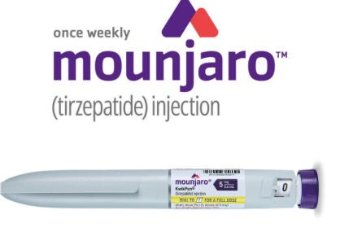
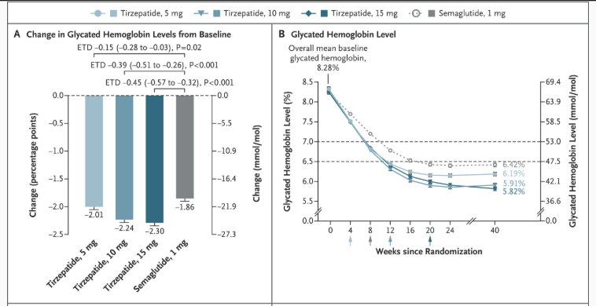
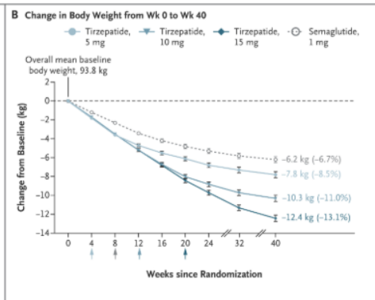

Slide 3

But isn’t Mounjaro very expensive?

Slide 4
But isn’t Mounjaro very expensive?
2.5 – 5 mg pen - $471.60
7.5-10 mg pen - $655.05
12.5 – 15 mg pen - $930.21

Slide 5
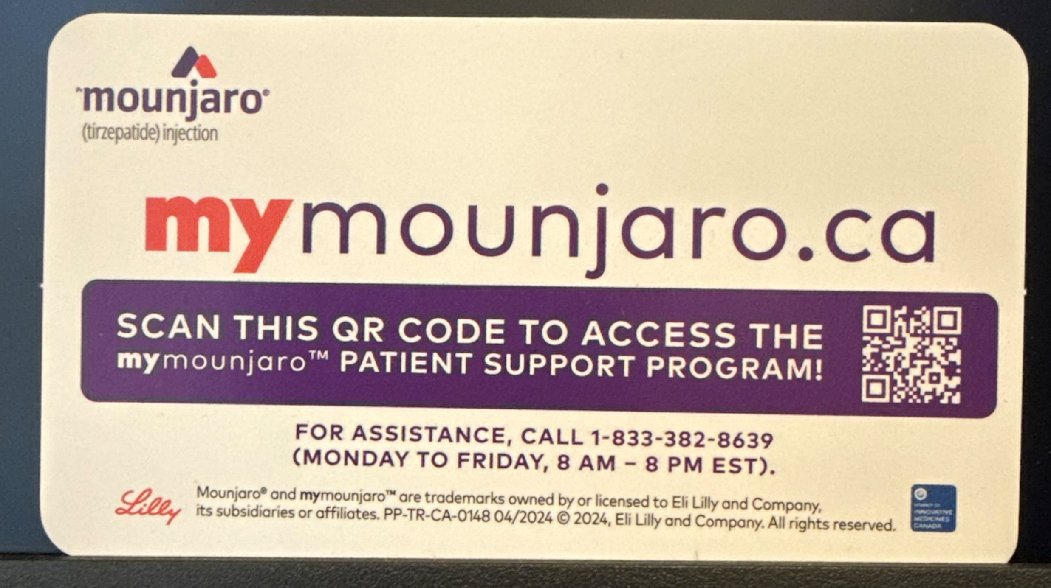
Mymounjaro.ca

Slide 6
But isn’t Mounjaro very expensive
Pen | RetailCost per pen (month) | MyMounjaro Per pen | Cost per dose | Cost per 5 mg | Cost per 2.5 mg
2.5 mg | $471.60 | $300 | $75 | N/A | $75
5 mg | $471.60 | $300 | $75 | $75 | $37.50
7.5 mg | $655.05 | $375 | $93.75 | $62.50 | $31.25
10 mg | $655.05 | $375 | $93.75 | $48.88 | $24.44
12.5 mg | $930.21 | $450 | $112.50 | $45.00 | $22.50
15 mg | $930.21 | $450 | $112.50 | $37.50 | $18.75

Slide 7
What about Mounjaro/Terzepatide?
But shouldn’t I be on the maximal dose of 15 mg?

Slide 8
? Mounjaro 2.5 mg ow

Slide 9

The following is not a paid advertisement and does not express the views or opinions of the FOX Business Network,

Slide 10


Slide 11
The following is not a paid advertisement and does not express the views or opinions of the FOX Business Network,
or Lily for that matter,

Slide 12
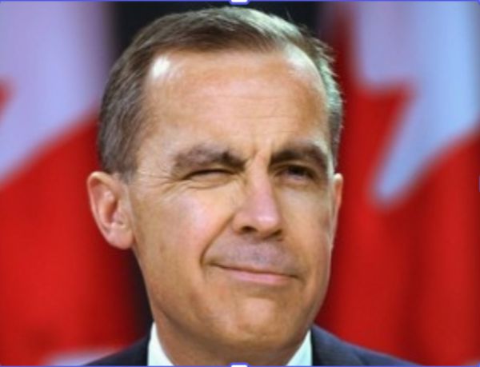

Slide 13
The following is not a paid advertisement and does not express the views or opinions of the FOX Business Network,
or Lily for that matter,
or Novo Nordisk

Slide 14


Slide 15
The following is not a paid advertisement and does not express the views or opinions of the FOX Business Network,
or Lily for that matter,
or Novo Nordisk
or Dr MacFadyen.

Slide 16

Counting Clicks
15 mg pen = 4 x 15 mg = 0.6 ml per dose
Each click is 0.01 ml
60 clicks = 15 mg
20 clicks = 5 mg = 3 months

Slide 17
Why not count clicks/microdose?
Shelf life
- expiry date – in refrigerator
Once used – 30 days – at room temperature, or 4 doses
But same expiry if in refrigerator
Ozempic is 56 days at room temperature
Potential to introduce infection
- but has preservatives and you already puncture x 4
- less than if already microdosing
Not on Product Monograph
- use all the time with Ozempic (also not recommended)

Slide 18
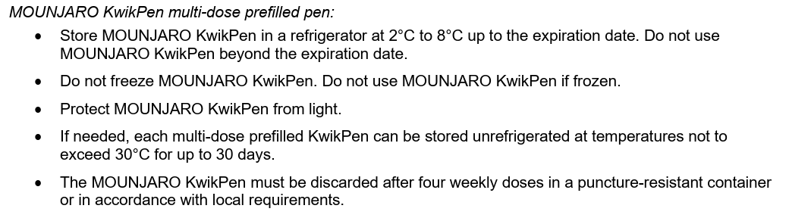
Mounjaro
30 days = 5 doses (Day 0, 7, 14, 21, 28)

Slide 19
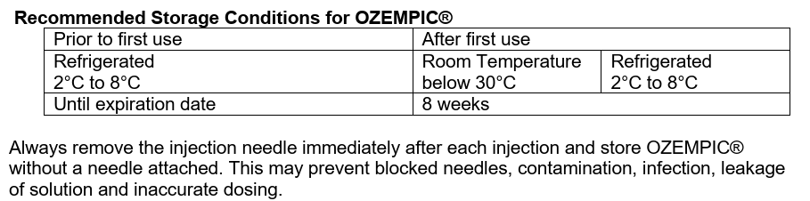
Ozempic

Slide 20
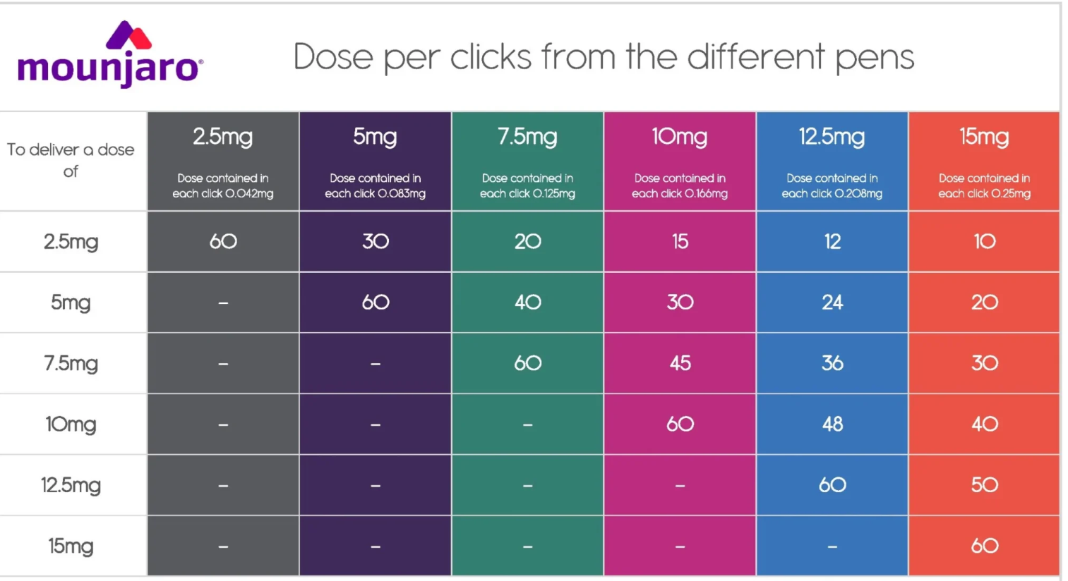

Slide 21
Ozempic Clicks
To deliver a dose of | 0.5 mg pen | 1.0 mg pen
0.25 mg | 38 | 19
0.5 mg | 76 | 38
0.75 mg |  | 57
1 mg |  | 76

Slide 22
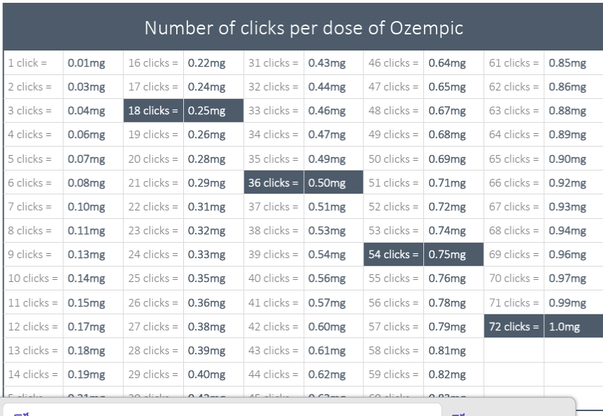

Slide 23


DJ Trump

Slide 25
You said the pen has 4 x 0.6 ml doses
but the pen says 3 ml
What happened to the left over 0.6 ml?

Slide 26
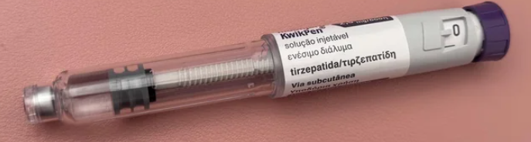
The Golden Dose

Slide 27


Slide 28


Slide 29
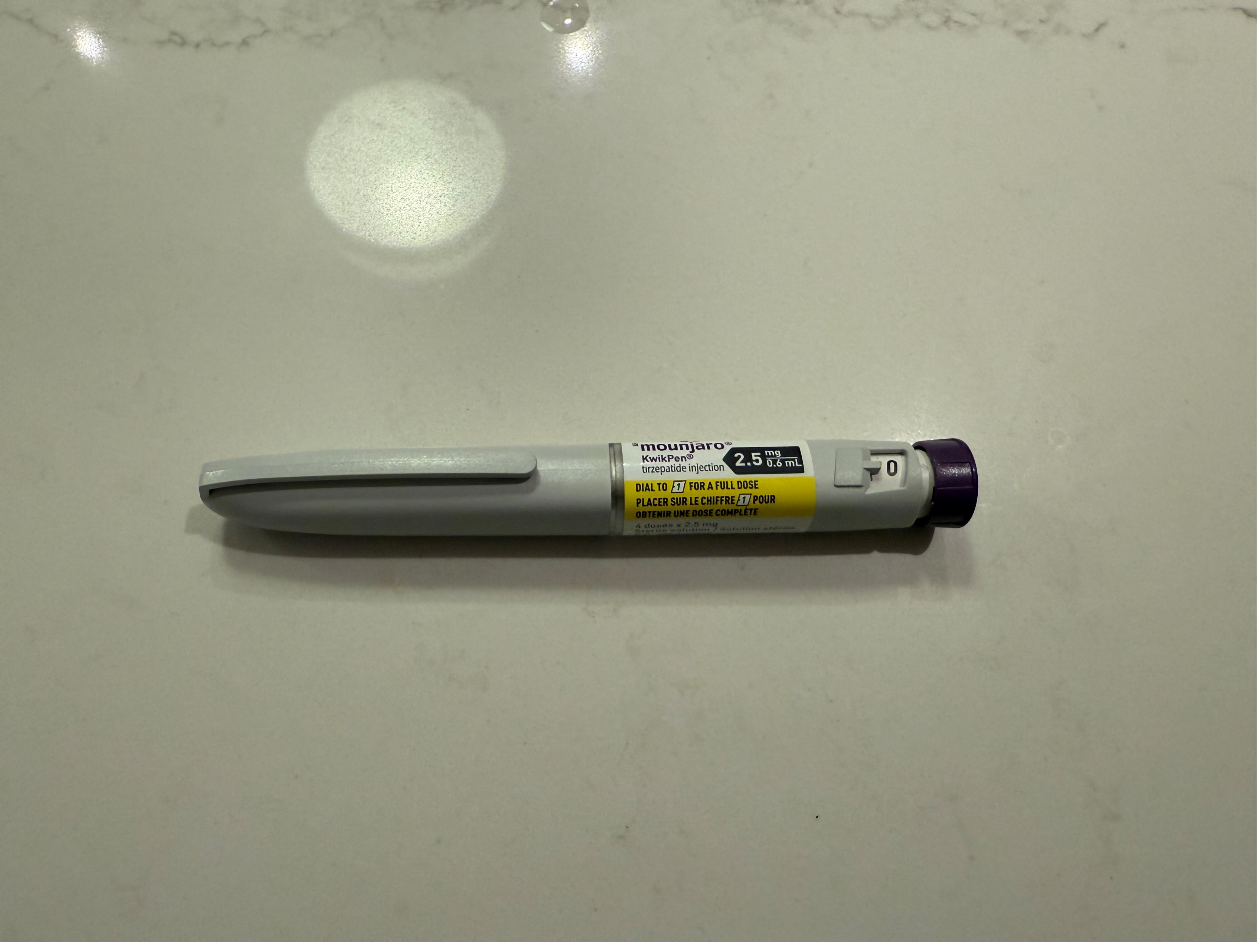

Slide 30
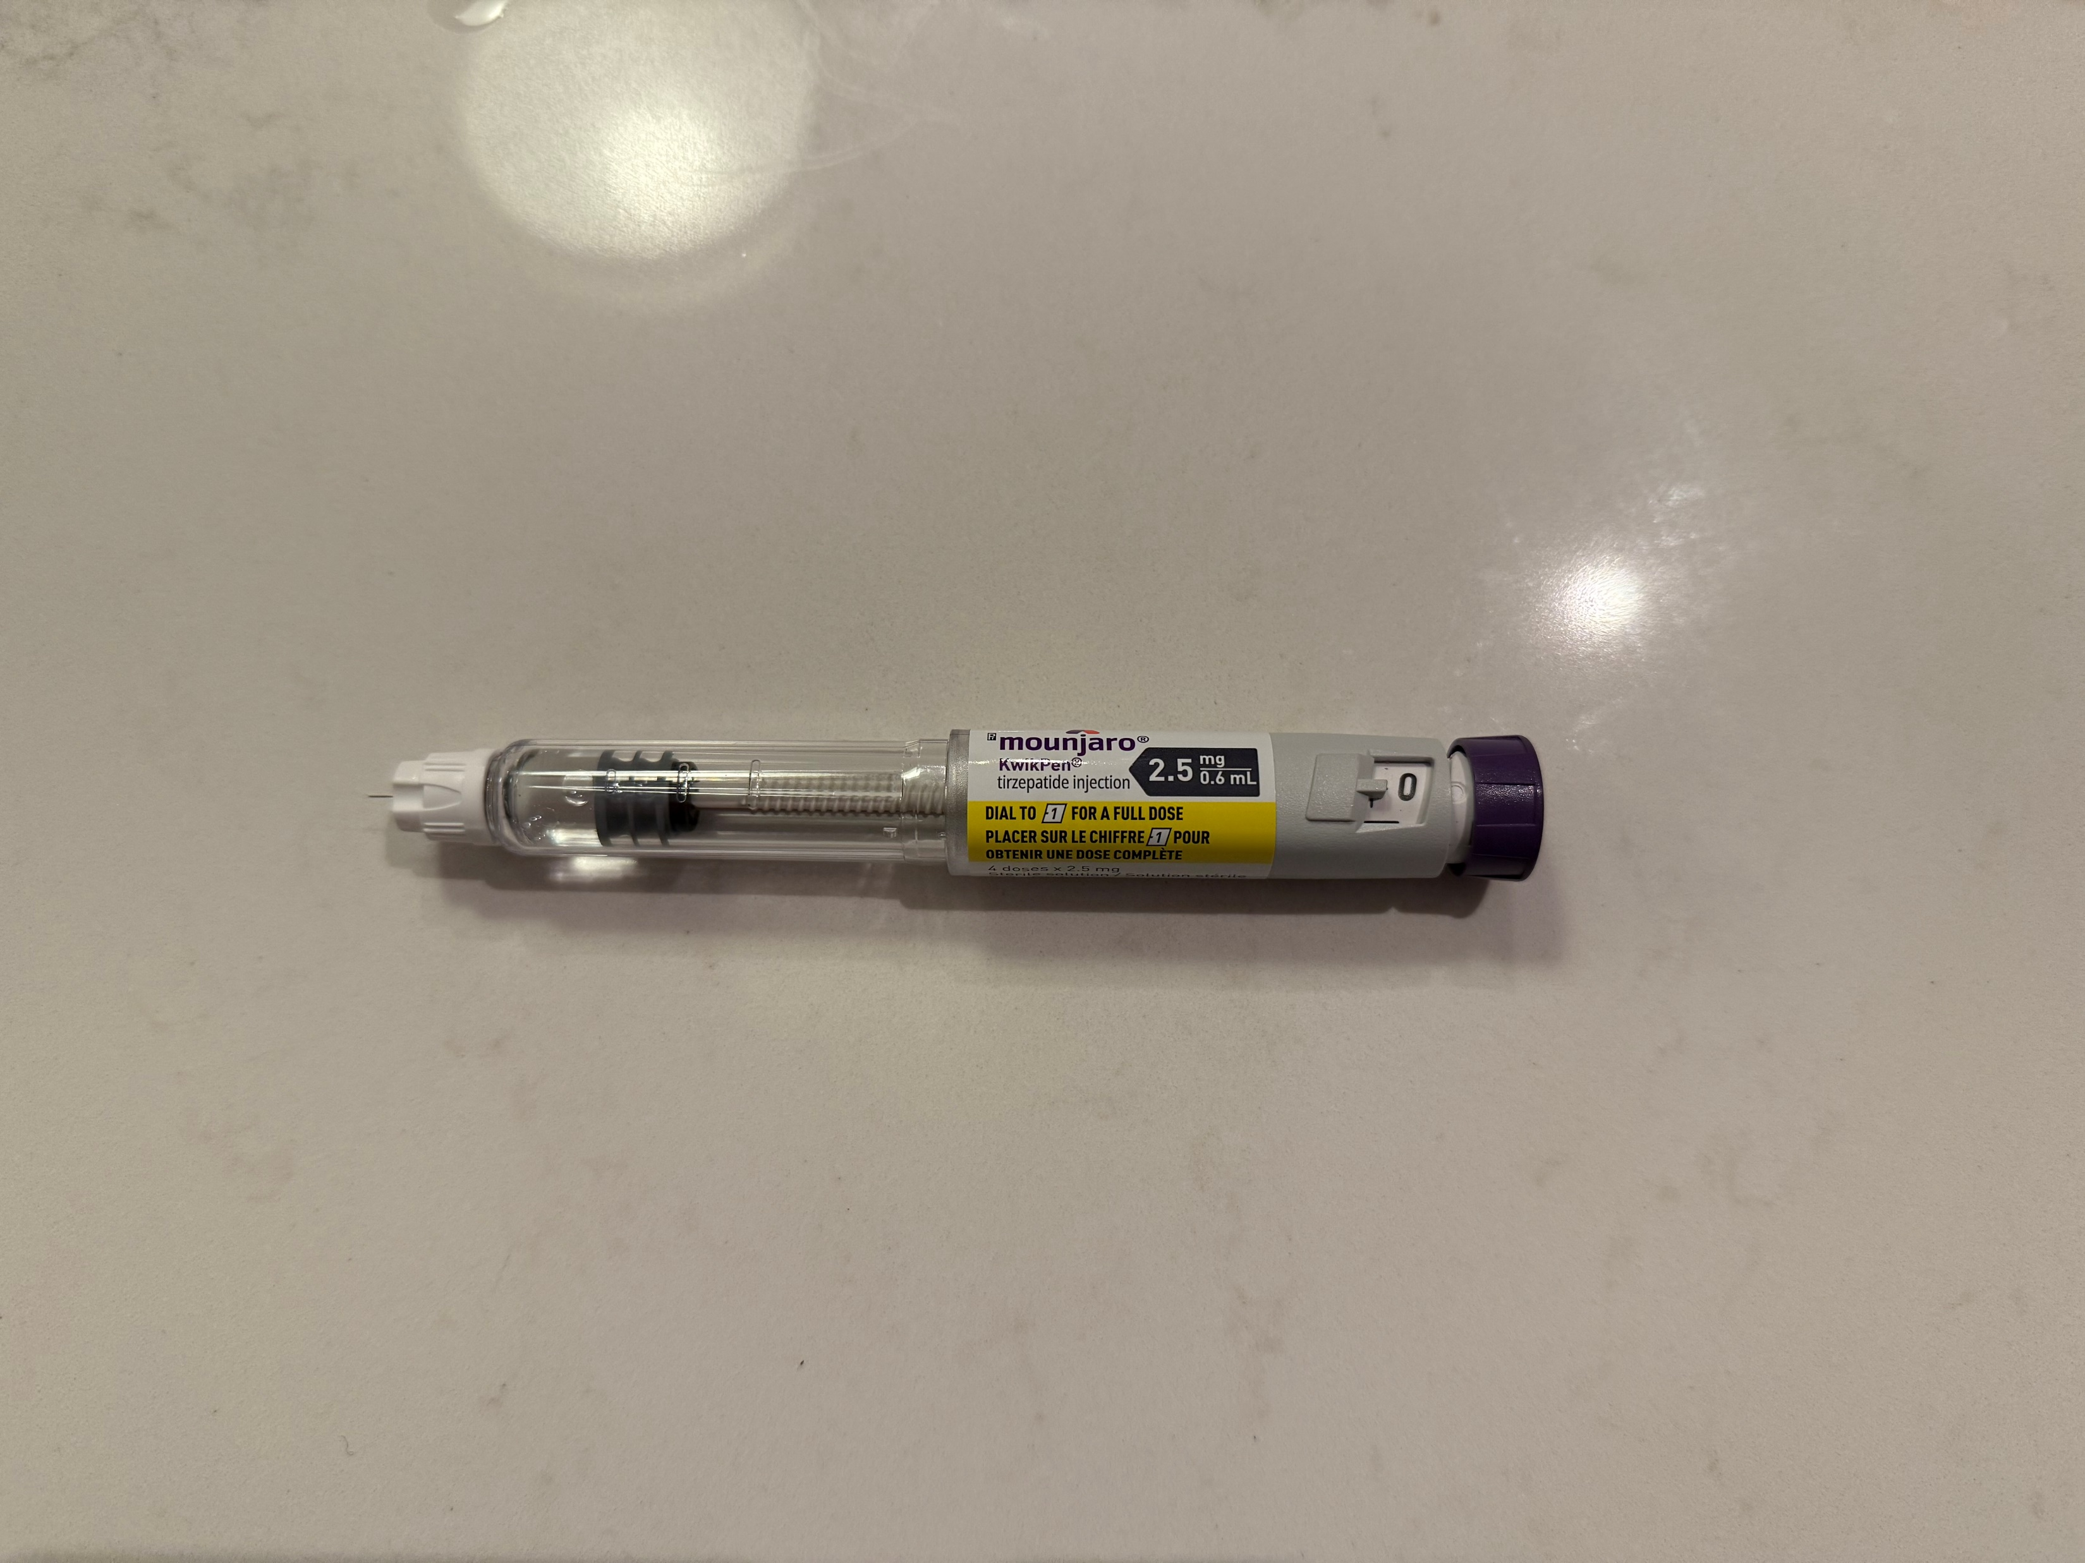

Slide 31
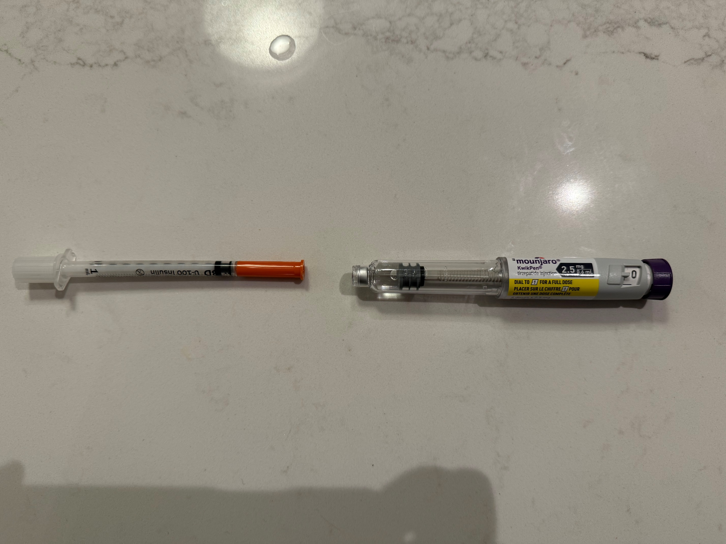

Slide 32
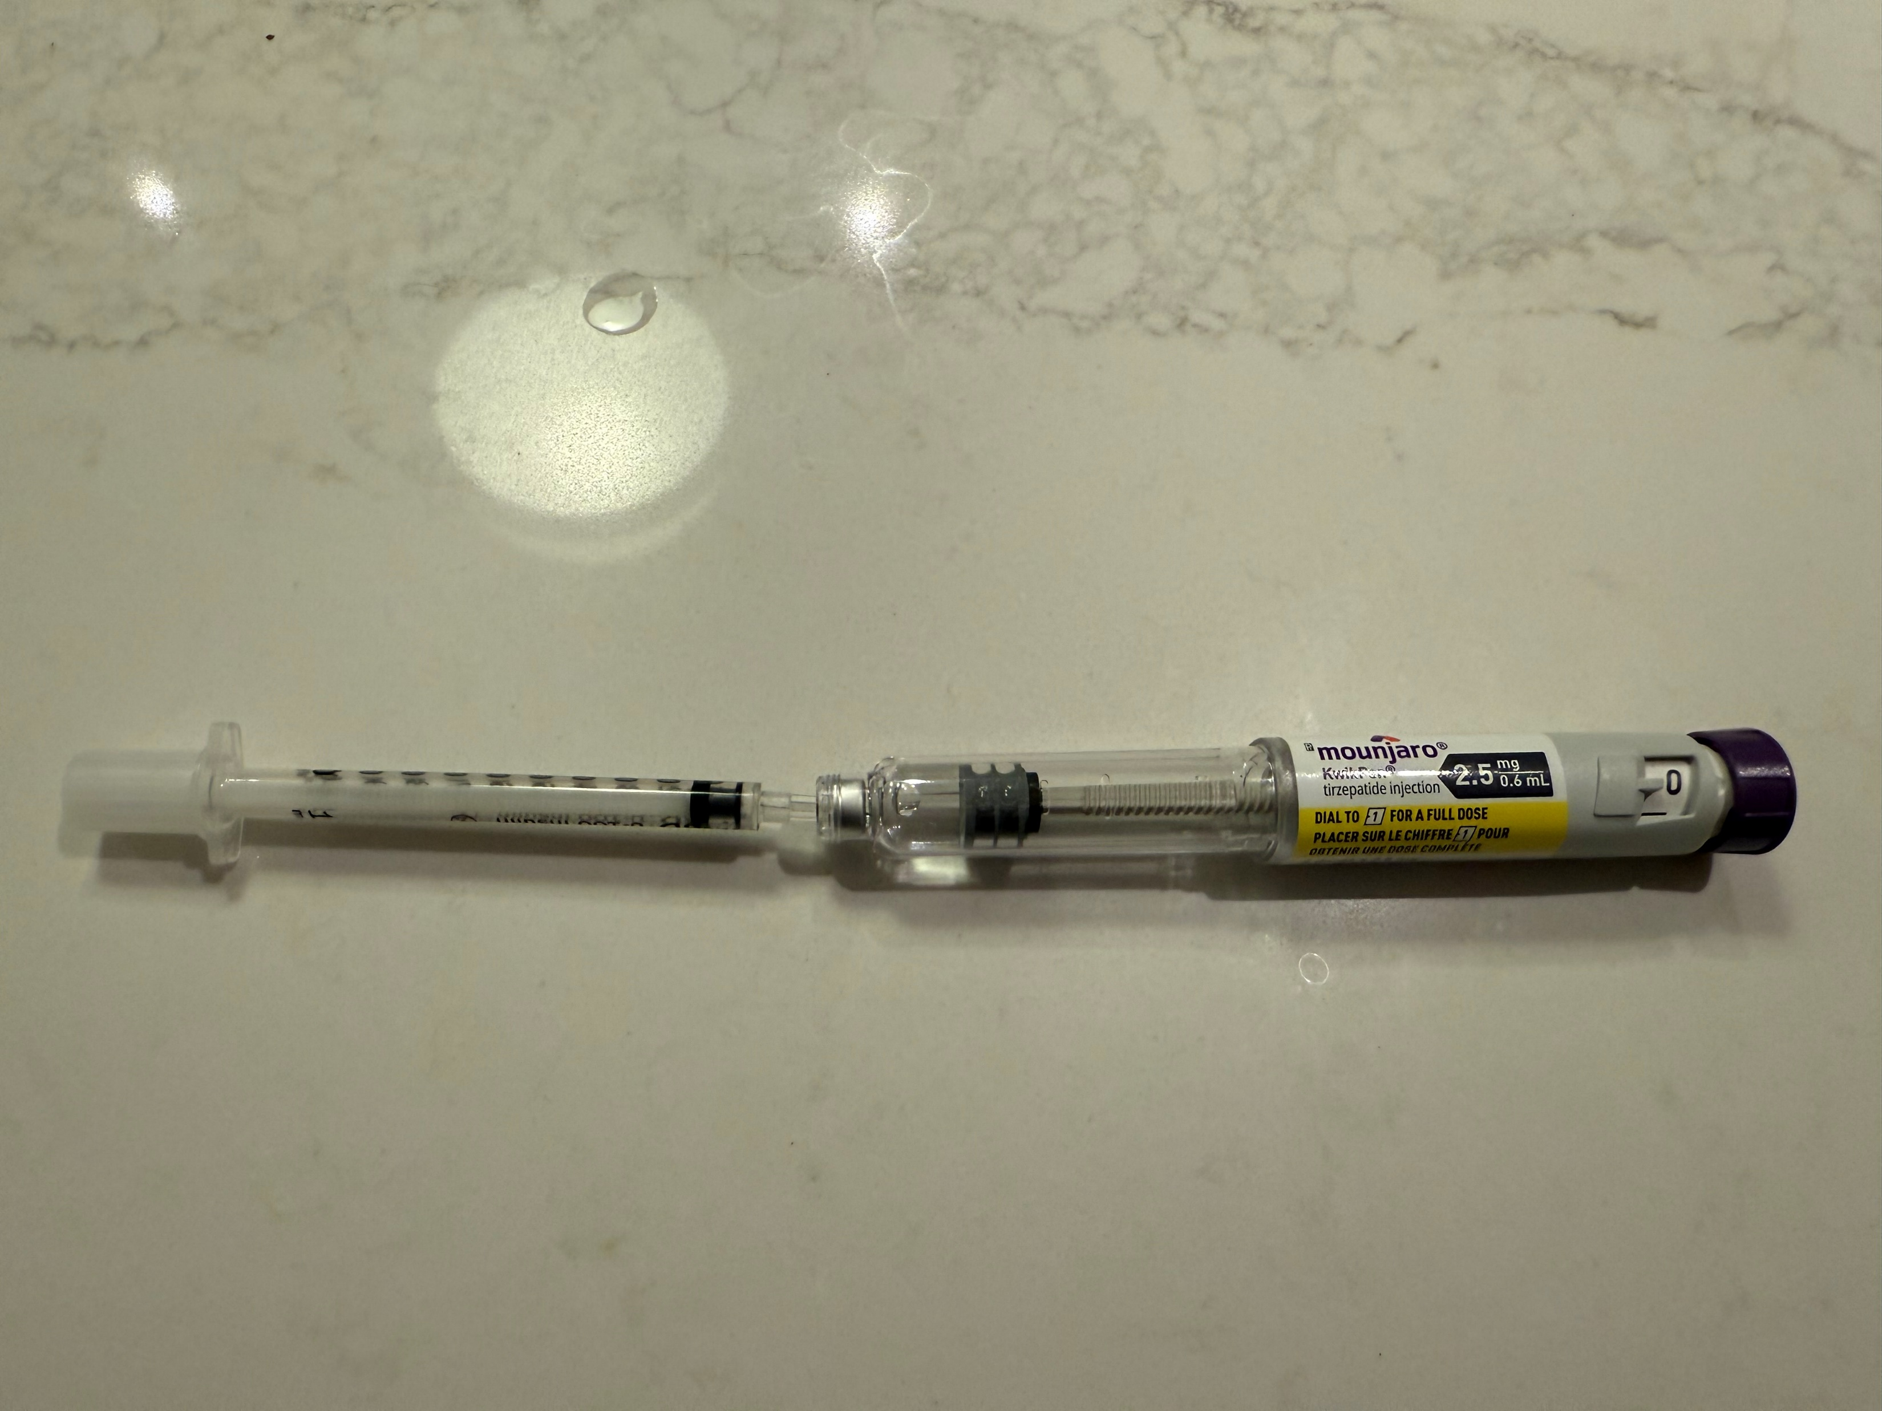

Slide 33
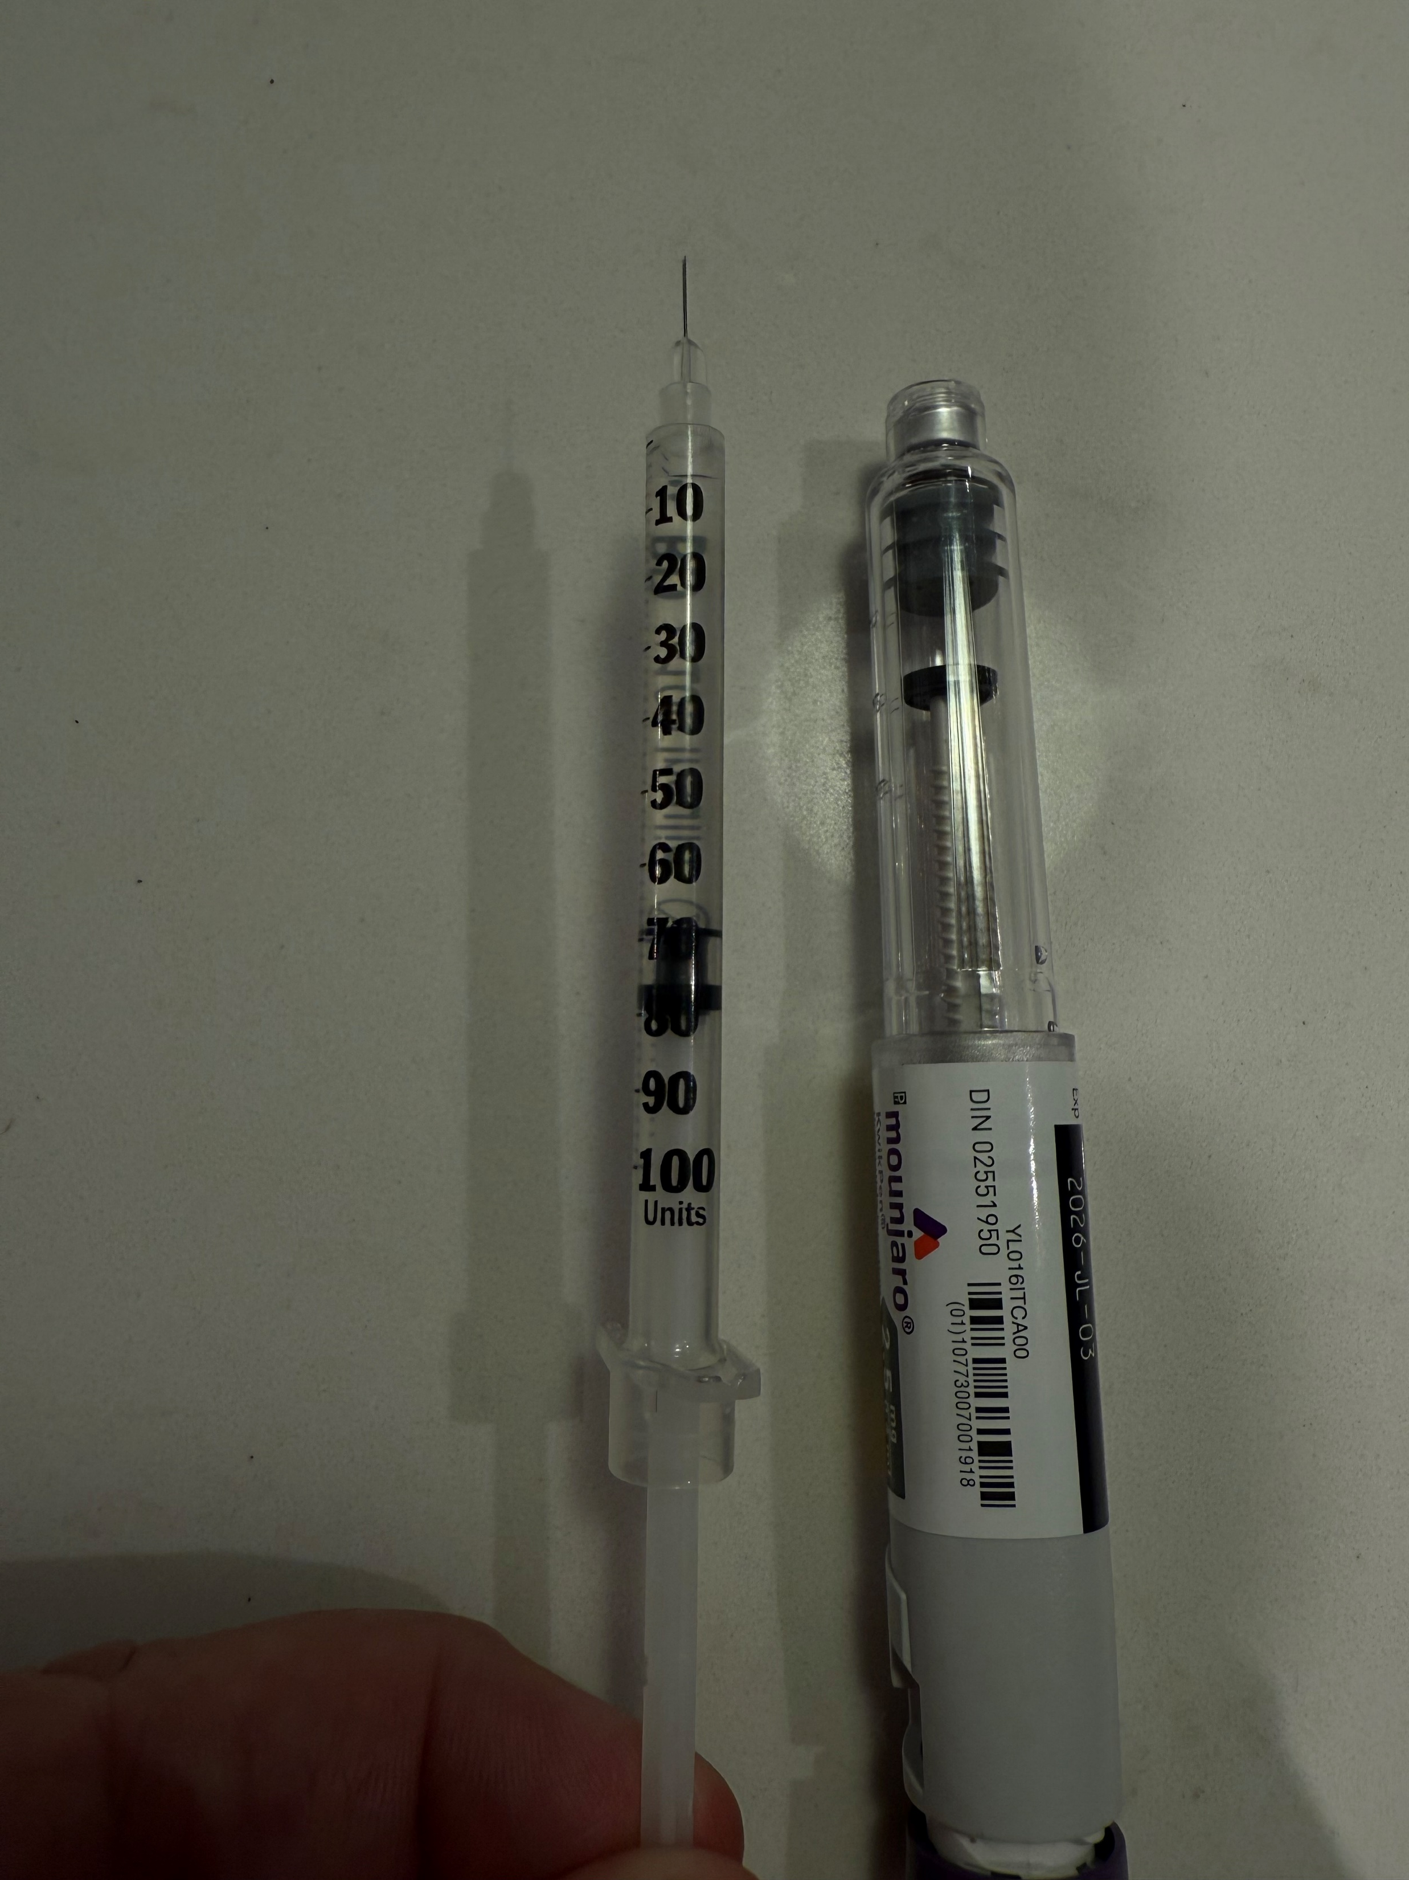
0.6 ml = 60 units

Slide 34
Why not count clicks/microdose?
Shelf life
- expiry date – in refrigerator
Once used – 30 days – at room temperature, or 4 doses
But same expiry if in refrigerator
Ozempic is 56 days at room temperature
Potential to introduce infection
- but has preservatives and you already puncture x 4
- less than if already microdosing
Not on Product Monograph
- use all the time with Ozempic (also not recommended)
But the dose may be higher or lower , Not Accurate/Worse side effects
Priming dose
Golden dose – will no longer exist – Eli Lilly

Slide 35
