Slide 1
Advances in Diabetes Nephropathy
Diabetic Nephropathy
J.C. MacFadyen
MD, FRCPC, MHPE
JC MacFadyen MD FRCPC MHPE

Slide 2

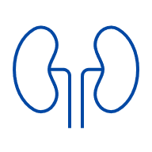

CKD is common in T2D and most have early stage disease – opportunity to intervene
30-minutes
60-minutes
54% of T2D patients have stage 1 or 2 CKD
Mean eGFR: 67 ml/min/1.73 m²
~1 in 2
Percent of patients with CKD
47.9% of adults with T2D may have CKD
CKD, chronic kidney disease; CVD, cardiovascular disease; T2D, type 2 diabetes.
Chu L, Fuller M, Jervis K, et al. Clin Ther. 2021 Sep;43(9):1558-1573.

Slide 3
What is UACR?
30-minutes
60-minutes
Urine albumin-creatinine ratio is an estimate of total urine albumin loss¹
Healthy kidney
Damaged kidney
Blood
Blood
Filter
Filter
Urine
Urine
Albumin
UACR, urine albumin creatinine ratio.
1. Kidney Disease: Improving Global Outcomes (KDIGO) CKD Work Group. Kidney Int 2024;105(4S):S117–S314. 2. Image adapted from: NIDDK. Urine albumin-creatinine ratio (uACR). https://www.kidney.org/kidney-topics/urine-albumin-creatinine-ratio-uacr. Accessed February 2025.
Notes:
UACR is the urine albumin-creatinine ratio.
While creatinine is a normal waste product eliminated in urine, when kidney function is impaired, albumin can “leak” through filters and enter the urine. Increasing levels of albumin in the urine therefore reflect a decline in kidney function.
NIDDK. Urine albumin-creatinine ratio (uACR). https://www.kidney.org/kidney-topics/urine-albumin-creatinine-ratio-uacr. Accessed February 2025.

Slide 4
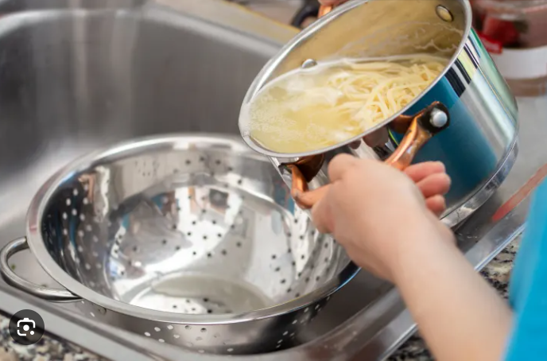

Slide 5
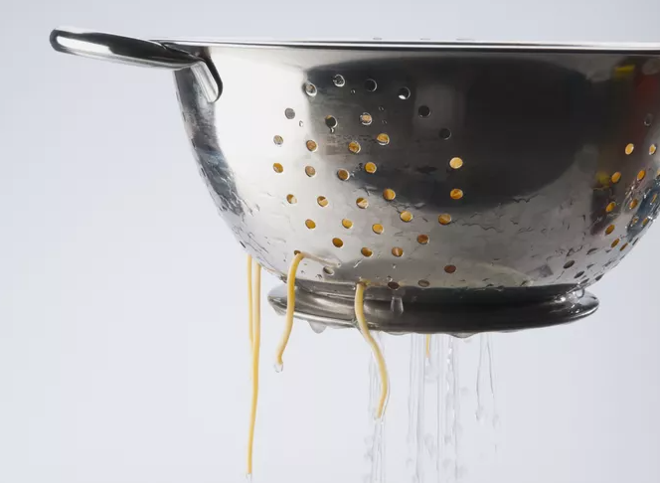

Slide 6
ACR Thresholds
ACR Normal Range
Healthy < 1.0
Diabetes Canada <2.0
KDIGO <3.0
Notes:
When we looked at the data, because people with ACR’s from 2.0 to 2.9 have much greater risk of progression then people with ACR < 2.0, it would mean that waiting until their ACR rose to 3.0 or higher, that they would miss out on time on therapy. The earlier we can alter the trajectory of the decline of kidney function the better. Moving the ACR level higher, would not make anyone better, and in fact, would make people who on screening have ACR levels from 2.0 to 2.9 worse off. Therefore, we left the ACR threshold for normal for people with diabetes in Canada at less than 2.0 mg/mmol.

Slide 7
Diabetes Canada 2025: Screening for kidney disease in individuals with diabetes
30-minutes
60-minutes
Screen annually in people with diabetes and no history of kidney disease.
For type 1 diabetes, begin 5 years after onset or, if at an early age, start after puberty.
For type 2 diabetes, start at diagnosis and annually thereafter.
Screen with random urine ACR and serum creatinine to calculate eGFR and KFRE.
If urine ACR is positive but <20 mg/mmol, repeat for 2 of 3 positive over at least 3 months.
If urine ACR ≥20 mg/mmol, diagnose diabetic nephropathy
CKD = eGFR <60 mL/min/m² ± ACR ≥2.0 mg/mmol
Diabetic nephropathy = ACR ≥ 2.0 mg/mmol ± eGFR <60 mL/min/m²
ACR, albumin-to-creatinine ratio; CKD, chronic kidney disease; eGFR, estimated glomerular filtration rate; KFRE, kidney failure risk equation
Tobe SW, Bajaj HS, Tangri N, et al. Canadian Journal of Diabetes, Volume 49, Issue 2, 73 - 86.e14.

Slide 8

UACR and GFR provide different information
30-minutes
60-minutes
UACR:
How fast you’re going
GFR: How close you are to the cliff
Patient’s kidneys
Dialysis
GFR, glomerular filtration rate; UACR, urinary albumin to creatinine ratio.
1. Opinion of the Expert Steering Committee 2. Adapted from: NIDDK. Quick Reference on UACR & GFR. https://www.niddk.nih.gov/health-information/professionals/advanced-search/quick-reference-uacr-gfr. Accessed June 2025.

Slide 9
Diabetes Canada 2025: As CKD progresses, patient prognosis declines
30-minutes
60-minutes
Albuminuria categories*,† Description and range
A1 Normal | A2 Microalbuminuria | A3 Macroalbuminuria
<2 mg/mmol | 2-19 mg/mmol | >20 mg/mmol
Screen 1 | Treat 1 | Treat and refer 3
Screen 1 | Treat 1 | Treat and refer 3
Treat 1 | Treat 2 | Treat and refer 3
Treat and refer 3 | Treat and refer 3 | Treat and refer 4+
Treat and refer 4+ | Treat and refer 4+ | Treat and refer 4+
CKD is classified based on GFR (G) and albuminuria (A)
GFR categories (ml/min/1.73 m²) Description and range | G1 | Normal or high | ≥90
 | G2 | Mildly decreased | 60–89
 | G3 | Moderately decreased | 30–59
 | G4 | Severely decreased | 15–29
 | G5 | Kidney failure | <15
Early stage of CKD = optimal therapeutic window
Opportunity missed if no UACR done and therapeutic pillars not applied
Later stage: irreversible CKD
Therapeutic window of opportunity greatly narrowed or lost
Low risk (if no other markers of kidney disease, no CKD)
High risk
Moderately increased risk
Very high risk
*Diabetes Canada considers albuminuria ≥2 mg/mmol abnormal.
†The numbers in the boxes are a consensus guide to the frequency of screening or monitoring annually, the need for treatment for kidney and heart protection (e.g. blood pressure, diabetes, dyslipidemia, proteinuria), and when to refer to nephrology.
CKD, chronic kidney disease; GFR, glomerular filtration rate.
Tobe SW, Bajaj HS, Tangri N, et al. Canadian Journal of Diabetes, Volume 49, Issue 2, 73 - 86.e14.
Additional information adapted from: Kidney Disease: Improving Global Outcomes (KDIGO) CKD Work Group. Kidney Int 2024;105(4S):S117–S314

Slide 10
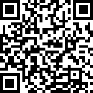
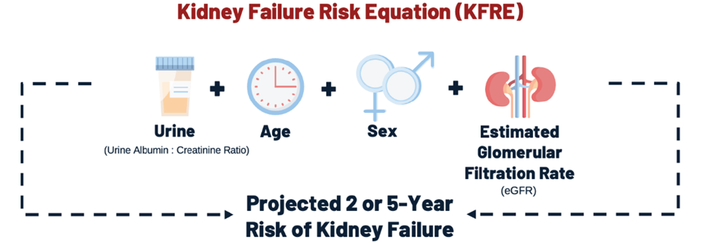
Kidney Failure Risk Equation Variables
Tangri Nav, And Diabetes and Endo Today, 2024; 2(1): 5-10
Notes:
KFRE is a formula that predicts the risk of kidney failure over time. Nephrologists use the KFRE2 or the risk of end stage kidney disease in 2 years. The KFRE5 is for primary care. It is the risk of ending up on dialysis in the next 5 years. All you have to remember is that if the KFRE is 5 or over, then that person has a risk of needing dialysis in the next 5 years. The significance, is that a KFRE of 5 or greater identifies when a referral to your local nephrologist is needed.
The components of the KFRE are shown above. Each of these is available to the lab when you order a urine ACR and a serum creatinine.

Slide 11
Diabetic Nephropathy ARBs
Primary renal outcome RRR 16% to 20%
Large unmet need overall
CV mortality 4% to 5% annually, ARBs did not reduce CV events!
Slope of GFR was improved <1 ml/min/year
Doubling of serum creatinine, ESKD, or death
RENAAL
IDNT
Risk reduction, 16%
P = 0.02
Risk reduction, 20%
P = 0.02
Losartan
Irbesartan
Placebo
Amlodipine
Placebo
Unmet Need
Unmet Need
N-1513
N=1715
Months of Study
Months of Follow-up
Notes:
Key Message: Traditional Therapy for DKD leaves a large unmet need
We can see that with traditional therapy, while there is some risk reduction, there is still room for improvement in reducing the risk of renal outcomes.

Slide 12


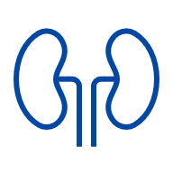



SGLT2i are associated with kidney and CV benefits Meta-analysis of large placebo-controlled trials of patients with and without diabetes (13 trials, N=90,413)
30-minutes
60-minutes
In patients with and without diabetes, compared with placebo, SGLT2i:¹
Metabolic benefits of SGLT2i²
↓37%
risk of kidney disease progression
RR 0.63, 95% CI 0.58–0.69
Similar RRs in patients with and without diabetes
A1C†
-0.69%
↓23%
risk of acute kidney injury
RR 0.77, CI 0.70–0.84
Body weight†
-2.1 kg
↓23%
risk of CV death or HHF
RR 0.77, CI 0.74–0.81
Similar RRs in patients with and without diabetes
Systolic BP
-3.9 mmHG
Absolute benefits of SGLT2 inhibition outweigh any serious hazards of ketoacidosis or amputation
*Based on meta-analysis of RCT data of SGLT2i at the highest approved doses relative to placebo in patients with normal kidney function.
†Unlike renal and CV benefits, the A1C lowering and weight loss effect of SGLT2i are reduced at lower eGFR levels
A1C, glycated hemoglobin; BP, blood pressure; CI, confidence interval; CV, cardiovascular; HHF, hospitalization for heart failure; RR: relative risk; SGLT2i, sodium glucose co-transporter 2 inhibitor.
1. Adapted from Nuffield Department of Population Health Renal Studies Group; SGLT2 inhibitor Meta-Analysis Cardio-Renal Trialists' Consortium. Lancet. 2022;400(10365):1788-1801. 2. Storgaard H, Gluud LL, Bennett C, et al. PLoS One. 2016 Nov 11;11(11):e0166125.

Slide 13
Strengthened and broadened recommendation for using SGLT2i for people with diabetes
Adults with type 2 diabetes and CKD defined by eGFR between 20 and 45 ml/min/1.73m² regardless of uACR, or eGFR between 45 and 90 ml/min/1.73m² with uACR >20 mg/mmol, on maximally tolerated, or maximally prescribed doses of RAASi should be recommended an SGLT2i to delay progression of CKD, progression to dialysis, and to reduce cardiovascular events [Grade A, Level 1A ].
Notes:
Here is the recommendation for the use of SGLT2i for kidney protection. I have simplified the wording from the actual manuscript to make this recommendation more implementable.
For adults with type 2 diabetes, and CKD on RAASi, if their eGFR is < 60 ml/min, they have an indication for SGLT2i, with or without abnormal urine albumin levels. If the eGFR is 60 or more, the indication for SGLT2 is for patients with A3 albuminuria. It is quite reasonable to extrapolate this recommendation to start and SGLT2i earlier when the ACR is in the A2 range.

Slide 14


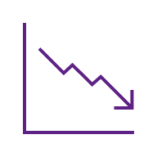



Semaglutide demonstrated kidney and CV benefits in FLOW
30-minutes
60-minutes
Primary outcome
Confirmatory secondary outcomes
↓24%
RR of major kidney disease events
Composite of onset of kidney failure*, ≥50% reduction in GFR, or death from kidney or CV causes
↓18%
RR of First
Major CV Event
Composite of nonfatal MI, nonfatal stroke, or CV death
HR: 0.76
95% CI 0.66 to 0.88
p=0.0003
HR: 0.82
95% CI 0.68 to 0.98
p=0.029
≥50%
↓20%
RR of death from any cause
↓21%
↓29%
HR: 0.82
95% CI 0.67 to 0.95
p=0.001
RR of composite of kidney-specific components
(HR 0.79; 95% CI, 0.66 to 0.94)
RR of CV death
(HR 0.71; 95%
CI, 0.56 to 0.89)
+1.16
GFR preserved annually
Fewer semaglutide patients had serious adverse events
Reported by 53.8% of placebo- vs. 49.5% of semaglutide-treated patients
ml/min/1.73 m^{2/ year} p<0.001
*Onset of kidney failure defined as dialysis, transplantation, or an GFR of <15 ml/min/1.73 m².
CI, confidence interval; CKD, chronic kidney disease; CV, cardiovascular; GFR, glomerular filtration rate; HR, hazard ratio; RR, relative risk.
Perkovic V, Tuttle KR, Rossing P, et al. N Engl J Med. 2024;391(2):109-121.

Slide 15
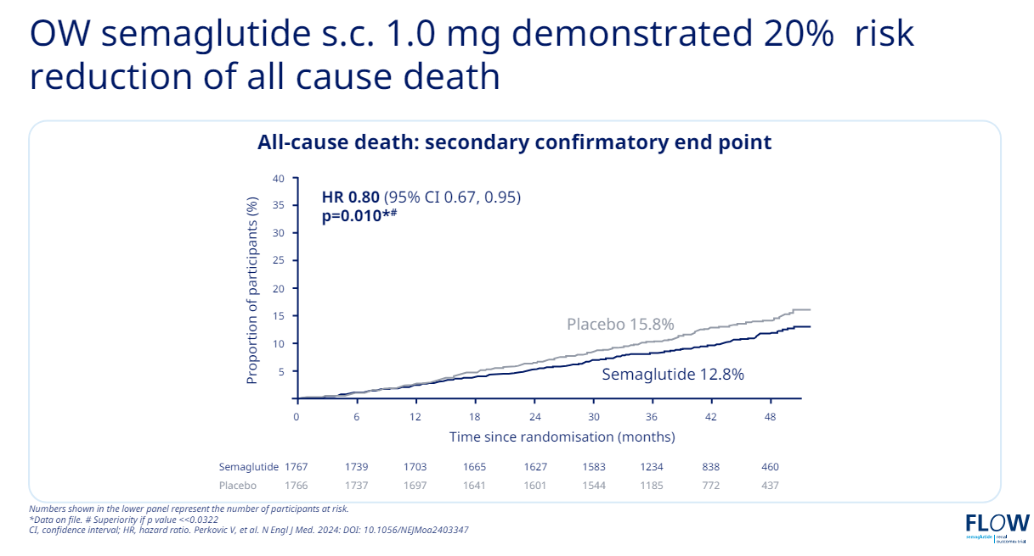
FLOW Trial

Slide 16
New recommendation for GLP1-RA for people with diabetic nephropathy for kidney protection
Adults with type 2 diabetic nephropathy defined by A2 or A3 albuminuria and eGFR 25 ml/min/1.73m² and above, on maximally tolerated, or maximally prescribed doses of RAASi, should be recommended a GLP1-RA (subcutaneous semaglutide) with proven kidney benefit to reduce proteinuria and the risk of worsening kidney function.
Notes:
Here is the recommendation for the use of subcutaneous semaglutide for kidney protection. I have simplified the wording from the actual manuscript to make this recommendation more implementable.
For adults with type 2 diabetes, and CKD on RAASi, if their eGFR is 25 ml/min or greater, and they have abnormal albuminuria, then they have an indication for subcutaneous semaglutide.

Slide 17
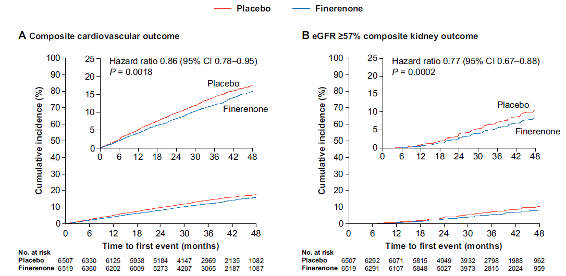
Composite CV and Kidney Outcome – FIDELITY Analysis
Agarwal R, Eur Heart J 2021 https://doi.org/10.1093/eurheartj/ehab777
Notes:
The non-steroid mineralocorticoid receptor antagonist or nsMRA finerenone (Kerendia) was studied in people with type 2 diabetes and A2 and A3 albuminuria in the FIGARO and FIDELIO studies. A pre-planned analysis put the two studies together in a pooled analysis called FIDELITY. In this analysis, finerenone demonstrated a 23% improvement in the composite kidney outcome and a 14% improvement in the cardiac outcome. Remember, this is on top of existing RAASi therapy and blood pressure control.

Slide 18

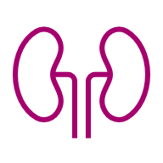

Finerenone reduced the risk of clinically important CV and kidney outcomes in FIDELITY
30-minutes
60-minutes
14%
reduced risk of CV morbidity and mortality (HR=0.86; 95% CI 0.78–0.95; p=0.002)¹
23%
reduced risk of CKD progression# (HR=0.77; 95% CI 0.67–0.88; p=0.0002)¹
Prespecified pooled analysis
of FIDELIO-DKD and FIGARO-DKD
>13,000 patients across the disease continuum of CKD and T2D (CKD stage 1–4) with moderate-to-severely elevated albuminuria (UACR ≥30 mg/g)
22%
reduced risk of first HHF* (HR=0.78; 95% CI 0.66–0.92; p=0.003)¹
20%
reduced risk of ESKD (HR=0.80; 95% CI 0.64–0.99; p=0.040)^{1,‡}
32%
reduction in UACR (ratio of LS mean change from baseline 0.68; 95% CI 0.66–0.70)¹
Finerenone was generally well tolerated and the increased incidence of hyperkalemia had a minimal clinical impact in the studies (1.7% permanent discontinuation due to HK; after 4th month of treatment, Δ K+ was +0.21 mmol/L with finerenone)
*First HHF defined as first event after randomization.
#ESKD or an eGFR <15 ml/min/1.73 m2; events were classified as renal death if: (1) the patient died; (2) KRT had not been initiated despite being clinically indicated; and (3) there was no other likely cause of death; ‡analysis for p-value not prespecified. CKD, chronic kidney disease; CV, cardiovascular; HHF, hospitalization for heart failure; HK, hyperkalemia; LS, least-squares; T2D, type 2 diabetes; UACR, urine albumin-creatinine ratio.
Agarwal R, Filippatos G, Pitt B, et al. Eur Heart J. 2022;43(6):474-484.

Slide 19
New recommendation for nsMRA for people with diabetic nephropathy for kidney and heart protection
Adults with type 2 diabetic nephropathy defined by A2 or A3 albuminuria and eGFR between 25 and 75 ml/min/1.73m², on maximally tolerated, or maximally prescribed doses of RAASi, with serum potassium < 4.8 mmol/L, should be recommended a nsMRA with proven efficacy alongside potassium monitoring, to improve kidney and cardiovascular outcomes).
Notes:
Here is the recommendation for the use of the nsMRA finerenone for kidney protection. I have simplified the wording from the actual manuscript to make this recommendation more implementable.
For adults with type 2 diabetes, and CKD on RAASi, if their eGFR is 25 ml/min or greater, and they have abnormal albuminuria, then they have an indication for finerenone if their potassium level is < 4.8 mmol/L.

Slide 20
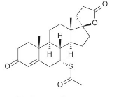
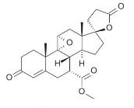
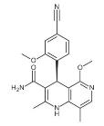
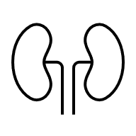

Finerenone is a different MRA
30-minutes
60-minutes
 | Steroidal |  | Nonsteroidal
 | Spironolactone | Eplerenone | Finerenone
SELECTIVITY TO THE MR¹ | + | ++ | +++
HALF-LIFE¹ | >20 h | 4–6 h | 2–3 h
ACTIVE METABOLITES¹ | ++ | - | -
TISSUE DISTRIBUTION²
SEXUAL SIDE EFFECTS¹ | ++ | + | -
EFFECT ON BP¹ | +++ | ++ | +
INDICATION FOR HTN³⁻⁵ | Yes | Yes | No
INDICATION FOR HEART FAILURE WITH EJECTION FRACTION ≤40%³⁻⁵ | Yes | Yes | No
BP, blood pressure; CKD, chronic kidney disease; CV, cardiovascular; eGFR, estimated glomerular filtration rate; ESKD, end-stage kidney disease; HTN, hypertension; MR, mineralocorticoid receptor; MRA, mineralocorticoid receptor antagonist; SoC, standard of care; T2D, type 2 diabetes .
1. Kintscher U, et al. Br J Pharmacol. 2021 Nov 22. 2. Kolkhof P, et al. Handb Exp Pharmacol 2017;243:271–305. 3. Aldactone® (spironolactone) Product Monograph. 2022. Pfizer Canada. 4. Inspra® (eplerenone) Product Monograph. 2020. Pfizer Canada. 5. Kerendia® (finerenone) monograph. 2022. Bayer Inc

Slide 21
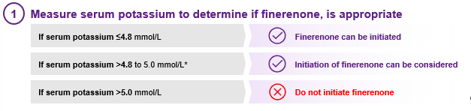

Slide 22
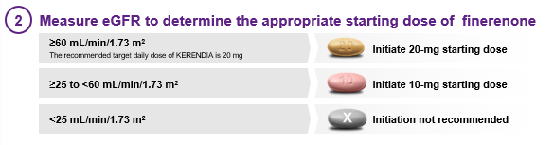

Slide 23
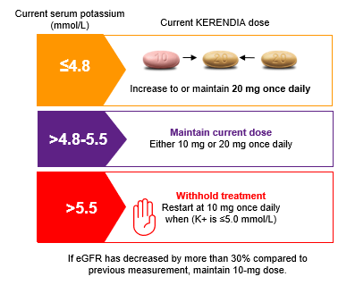

Slide 24
Simultaneous initiation of finerenone and empagliflozin led to early and additive reduction of UACR in the CONFIDENCE trial
1.2
Trial medication stopped
1.0
0.8
Empagliflozin
Least-squares mean ratio of the change from baseline
Finerenone
0.6
0.4
Empagliflozin + Finerenone
0.0
Base- line
14
30
60
90
120
150
180
210
Days
CI, confidence interval; SGLT2i, sodium-glucose cotransporter-2 inhibitor; UACR, urine albumin creatine ratio.
Agarwal R, Green JB, Heerspink HJL, et al. N Engl J Med. Published online June 5, 2025.

Slide 25
Diabetes Canada 2025 guideline recommendations*
60-minutes
RAASi: Grade A, Level 1A for ACEi use in type 1 and type 2 diabetes, and for ARB use in type 2 diabetes
SGLT2i: Grade A, Level 1A in adults with type 2 diabetes and CKD on maximally tolerated, or maximally prescribed doses of RAASis
GLP1-RA: Grade A, Level 1A for subcutaneous semaglutide in adults with type 2 diabetic nephropathy on maximally tolerated, or maximally prescribed doses of RAASis†
nsMRA: Grade A, Level 1A for finerenone in adults with type 2 diabetic nephropathy on maximally tolerated, or maximally prescribed doses of RAASis with serum potassium ≤4.8 mmol/L
*Full recommendations are available later in the slide deck.
†Semaglutide has not yet received a Health Canada indication for renal protection.
ACEi, angiotensin converting enzyme inhibitor; ARB, angiotensin receptor blocker; CKD, chronic kidney disease; GLP1-RA, glucagon-like peptide-1 receptor agonists; nsMRA, non-steroidal mineralocorticoid receptor antagonist; RAASi, renin angiotensin aldosterone system inhibitor; SGLT2i, sodium-glucose transport 2 inhibitor.
Tobe SW, Bajaj HS, Tangri N, et al. Canadian Journal of Diabetes, Volume 49, Issue 2, 73 - 86.e14.
Notes:
RAASi:
Adults with diabetes and CKD with either hypertension or albuminuria should be recommended a RAASi (an ACEi or ARB) to delay progression of CKD. Grade A, Level 1A for ACEi use in type 1 and type 2 diabetes, and for ARB use in type 2 diabetes Grade D, Consensus for ARB use in type 1 diabetes
SGLT2i:
Adults with type 2 diabetes and CKD defined by eGFR between 20 and 45 mL/min per 1.73 m² regardless of uACR, or eGFR between 45 and 90 mL/min per 1.73 m² with uACR >20 mg/ mmol, on maximally tolerated, or maximally prescribed doses of RAASis, should be recommended an SGLT2i to delay progression of CKD and progression to dialysis, and to reduce likelihood of cardiovascular events. Grade A, Level 1A
GLP1-RA:
Adults with type 2 diabetic nephropathy defined by eGFR between 25 and 50mL/min per 1.73 m² with uACR between 10 and 500 mg/mmol, or if eGFR is >50 mL/min per 1.73 m² with uACR between 30 and 500 mg/mmol, on maximally tolerated, or maximally prescribed doses of RAASi, should be recommended a GLP1-RA with proven kidney benefit to reduce proteinuria and risk of worsening kidney function Grade A, Level 1A for subcutaneous semaglutide
nsMRA:
Adults with type 2 diabetic nephropathy defined by eGFR between 25 and 90 mL/min per 1.73 m² with uACR between 3 and 30 mg/mmol with or without diabetic retinopathy, for those with eGFR between 25 and 60 mL/min per 1.73 m², or if eGFR is >25 mL/min per 1.73 m² with uACR between 30 and 500 mg/mmol, on maximally tolerated, or maximally prescribed doses of RAASi, with serum potassium ≤4.8 mmol/L, should be recommended a nsMRA with proven efficacy alongside potassium monitoring to improve kidney and cardiovascular outcomes Grade A, Level 1A for finerenone

Slide 26
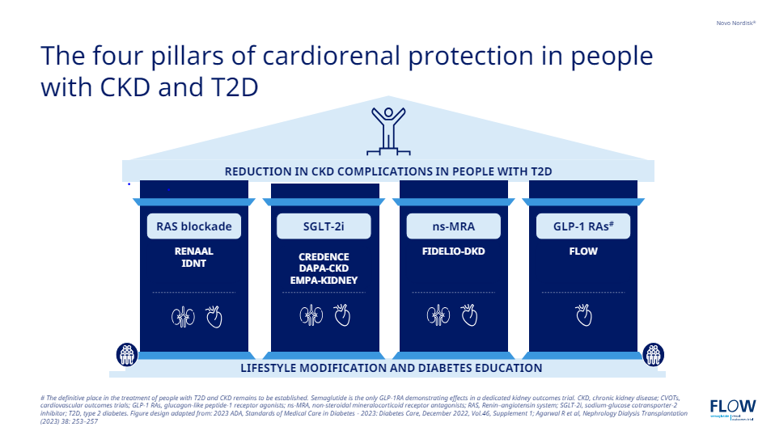

Slide 27
DB
68 yo male
Type 2 DM x 20 years
PVD
CKDx
OSA on CPAP
Jardiance
Ozempic
Irbesartan
Finerenone
Diamicron MR
Metformin 500 mg bid
Crestor/ASA/Xarelto 2.5 mg bid
BP -118/76, Wt: 116 kg
eGFR 32
K+ 4.6
ACR 100.3

Slide 28
“Time is kidney”: Starting SGLT2i therapy early can change the trajectory of kidney disease progression
Hypothetical potential impact on time to kidney replacement therapy of the different eGFR slopes for patients on placebo vs. empagliflozin based on data from EMPA-KIDNEY*
85
Placebo
Empagliflozin
eGFR (ml/min/1.73 m²)
3.5
5.4
20.8
47.5
Difference: 1.9 years
Difference: 26.6 years
Time to kidney replacement therapy (years)
*Hypothetical lines have been traced starting from extremes of the baseline eGFR inclusion criteria values (20 and 85 ml/min/1.73 m²) to eGFR 10 ml/min/1.73 m², corresponding to chronic eGFR slopes of participants on placebo and on empagliflozin within each baseline eGFR subgroup
eGFR, estimated glomerular filtration rate; SGLT2i, sodium-glucose co-transporter 2 inhibitor.
Fernández-Fernandez B et al. Clin Kidney J 2023;16(8):1187.
Notes:
Graphical presentation of representative chronic eGFR slopes from baseline to kidney failure.
Hypothetical lines have been traced starting from extremes of the baseline eGFR inclusion criteria values (20 and 85 ml/min/1.73 m²) to eGFR 10 ml/min/1.73 m², corresponding to chronic eGFR slopes of participants on placebo and on empagliflozin within each baseline eGFR subgroup

Slide 29
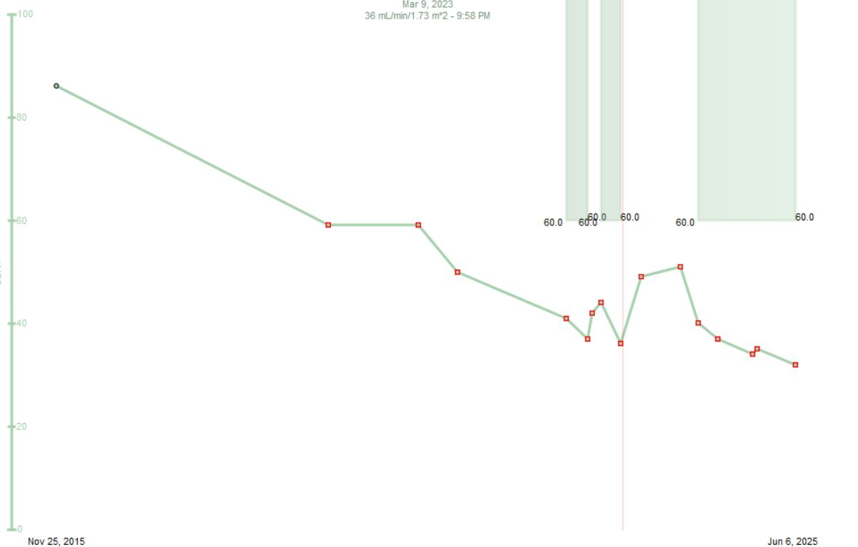
eGFR
Irbesartan
Jardiance
Ozempic
Finerenone
2015
2020
2024

Slide 30
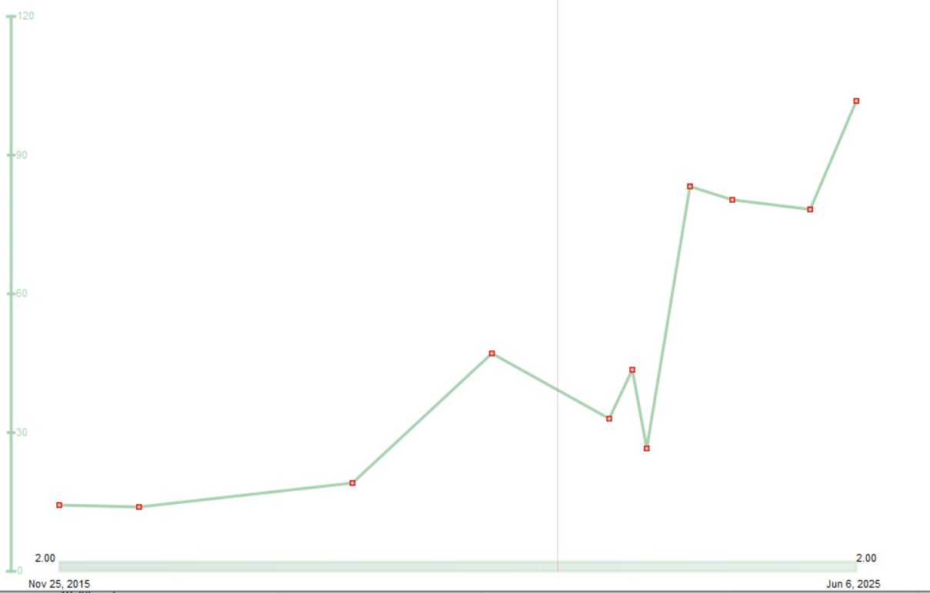
uACR
Irbesartan
Jardiance
Ozempic
Finerenone
2015
2020
2024

Slide 31
What if his K+ was………
5.4

Slide 32
New advice on management of hyperkalemia
For adults with diabetes, mild hyperkalemia (defined by potassium levels between the upper limit of normal and 5.4 mmol/L) with dietary intervention. For moderate hyperkalemia (defined by potassium levels between 5.4 mmol/L and 5.9 mmol/L) it is recommended to initiate medical therapy to increase potassium excretion through the GI tract or in the urine. For severe hyperkalemia (defined by potassium 6.0 mmol/L or higher) it is suggested to hold RAASi and nsMRA medications and refer to an emergency room for management [Grade D, Consensus for recommendation #11].
Notes:
For the first time, we have a recommendation about the management of hyperkalemia. In addition to the CKD guideline publication, there is a supplement included that outlines the management of hyperkalemia including picture sheets that can be given to patients along with dietary advice.
We have simplified the classification of hyperkalemia. However, we have made your job a little harder. That is because we want you to continue kidney protection medications that may be raising the potassium if the potassium level is less than 6. We have a table of advice for keeping the potassium under control, as well as the information in the hyperkalemia management supplement. It is only when the potassium is 6 or higher, that the patient’s RAASi should be held, and they should be sent to the ER for emergency management.
So remember, mild or moderate hyperkalemia, need to be managed, at the same time that you keep the patient on RAASi and their kidney protective medications.

Slide 33
Hyperkalemia
Consider Facticious/Lab error
Diet
Diuretic if vol overloaded – Lasix/HCT
Reduced incidence with SGLT-2 Inh
Chlorthalidone 50/HCT 50mg od
Reduce meds – ACE/ARB
Consider Kayexalate/Lokelma
Notes:
Here is a checklist of foods I like to ask the patient about when the lab reports a high potassium level. Bananas, oranges, orange juice, tomatoes, tomato juice, highly refined foods etc.

Slide 34
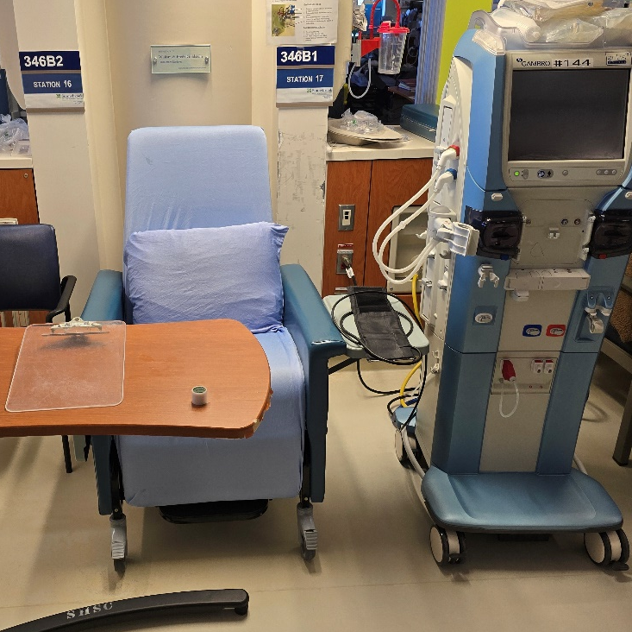
Aspirational Messaging
Our expectation is that implementation of the recommendations of this chapter with the new pharmacotherapy chapter, will dramatically change the natural history of diabetic nephropathy for the better
Notes:
Please look at this picture of a recent day in the dialysis unit midway through my morning dialysis shift. What do you notice? (read the message)

Slide 35
CM
63 yo female
CVA 2016
CAD with MI 2020 – PCI LAD
DM – A1C 9.0
CKD – eGFR 32, ACR - 46
Meds –Candasartan 16mg od/Lasix40 mg od
- Gliclizide MR 120/ Metformin 500 mg bid
Prev intolerance to Semmaglutide (0.25 mg x 2 weeks – ER - N& V)
Stopped Dapagliflozin 10 mg 1 month ago due to recurrent GM1 and polyuria, dizziness
No drug plan – unable to afford Finerenone
KFRE 5 year – 17.2%
? Recommendations

Slide 36
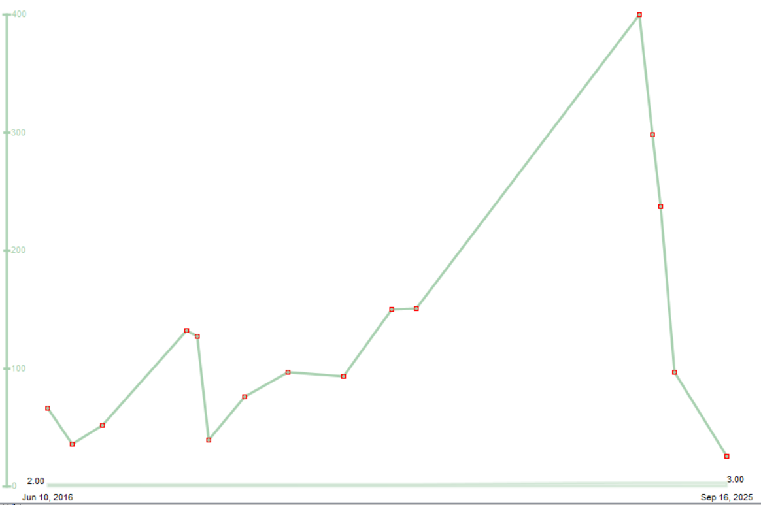
WM 72 yo male
DM 2010
CVA 2014
Current Meds
Crestor 40 mg 1 time daily
Jardiance 25 mg 1 time daily
bisoprolol fumarate 10 mg q am 5 mg at supper
Norvasc 10 mg 1 time daily
ECASA 81 mg 1 time daily
Avalide 300-25 mg
metformin 2 tabs BID
terazosin 1 tab
furosemide 1 tab daily
Tresiba FlexTouch 100 units 1 time daily
Ozempic 0.5 mg 1 time weekly
BP 161/78
eGFR 49, ACR 298 , A1C 9, K+ 3.2
KFRE 6
Recommendations?

Slide 37
Spironolactone

Slide 38
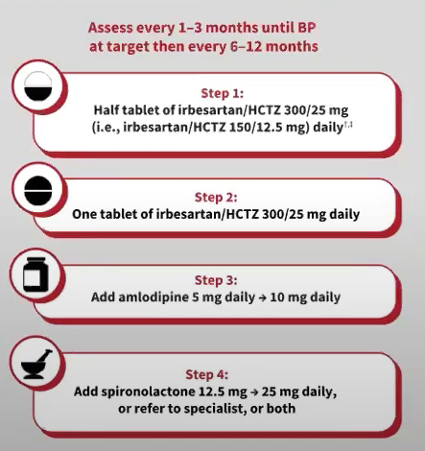

Slide 39
WC
75 yo male
Type 1 DM x 55 yrs
No CAD
Meds -
Telmesartan /HCT 80/12.5
Amlodipine 10
Rosuvasatin 20
Tresibe 25
Admelog 1:8 ICR
EGFR 50
ACR – 35
A1C 6.9
Recommendations

Slide 40
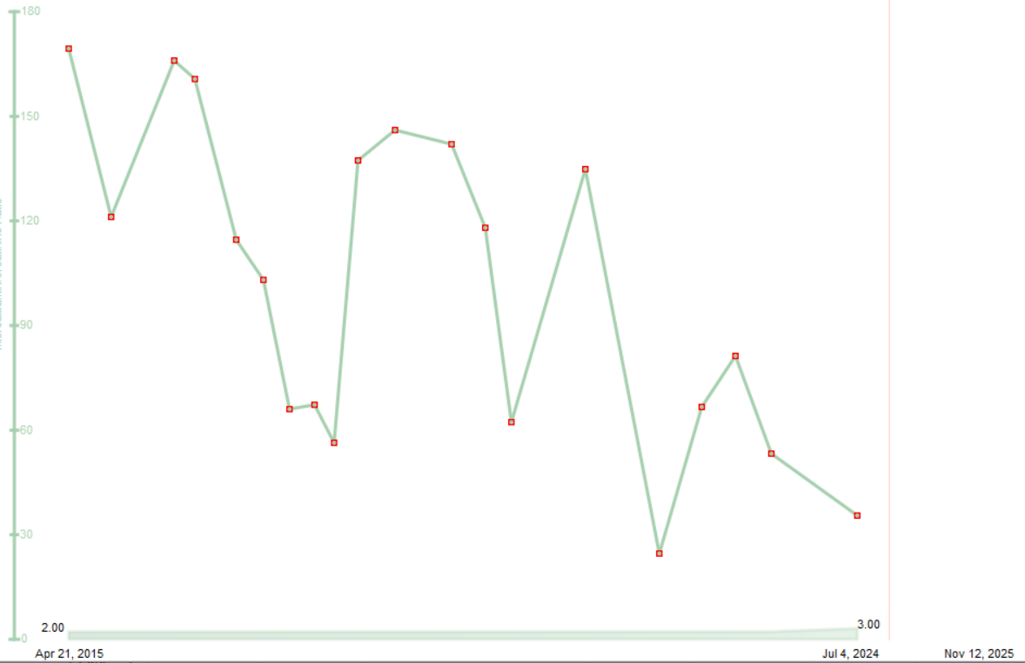
WC
75 yo male
Type 1 DM x 55 yrs
No CAD
Meds -
Telmesartan /HCT 80/12.5
Amlodipine 10
Rosuvasatin 20
Tresibe 25
Admelog 1:8 ICR
EGFR 50
ACR – 35
A1C 6.9

Slide 41
“Time is kidney”: Starting SGLT2i therapy early can change the trajectory of kidney disease progression
Hypothetical potential impact on time to kidney replacement therapy of the different eGFR slopes for patients on placebo vs. empagliflozin based on data from EMPA-KIDNEY*
85
Placebo
Empagliflozin
eGFR (ml/min/1.73 m²)
3.5
5.4
20.8
47.5
Difference: 1.9 years
Difference: 26.6 years
Time to kidney replacement therapy (years)
*Hypothetical lines have been traced starting from extremes of the baseline eGFR inclusion criteria values (20 and 85 ml/min/1.73 m²) to eGFR 10 ml/min/1.73 m², corresponding to chronic eGFR slopes of participants on placebo and on empagliflozin within each baseline eGFR subgroup
eGFR, estimated glomerular filtration rate; SGLT2i, sodium-glucose co-transporter 2 inhibitor.
Fernández-Fernandez B et al. Clin Kidney J 2023;16(8):1187.
Notes:
Graphical presentation of representative chronic eGFR slopes from baseline to kidney failure.
Hypothetical lines have been traced starting from extremes of the baseline eGFR inclusion criteria values (20 and 85 ml/min/1.73 m²) to eGFR 10 ml/min/1.73 m², corresponding to chronic eGFR slopes of participants on placebo and on empagliflozin within each baseline eGFR subgroup

Slide 42
Diabetes Canada 2025 guideline recommendations*
60-minutes
RAASi: Grade A, Level 1A for ACEi use in type 1 and type 2 diabetes, and for ARB use in type 2 diabetes
SGLT2i: Grade A, Level 1A in adults with type 2 diabetes and CKD on maximally tolerated, or maximally prescribed doses of RAASis
GLP1-RA: Grade A, Level 1A for subcutaneous semaglutide in adults with type 2 diabetic nephropathy on maximally tolerated, or maximally prescribed doses of RAASis†
nsMRA: Grade A, Level 1A for finerenone in adults with type 2 diabetic nephropathy on maximally tolerated, or maximally prescribed doses of RAASis with serum potassium ≤4.8 mmol/L
*Full recommendations are available later in the slide deck.
†Semaglutide has not yet received a Health Canada indication for renal protection.
ACEi, angiotensin converting enzyme inhibitor; ARB, angiotensin receptor blocker; CKD, chronic kidney disease; GLP1-RA, glucagon-like peptide-1 receptor agonists; nsMRA, non-steroidal mineralocorticoid receptor antagonist; RAASi, renin angiotensin aldosterone system inhibitor; SGLT2i, sodium-glucose transport 2 inhibitor.
Tobe SW, Bajaj HS, Tangri N, et al. Canadian Journal of Diabetes, Volume 49, Issue 2, 73 - 86.e14.
Notes:
RAASi:
Adults with diabetes and CKD with either hypertension or albuminuria should be recommended a RAASi (an ACEi or ARB) to delay progression of CKD. Grade A, Level 1A for ACEi use in type 1 and type 2 diabetes, and for ARB use in type 2 diabetes Grade D, Consensus for ARB use in type 1 diabetes
SGLT2i:
Adults with type 2 diabetes and CKD defined by eGFR between 20 and 45 mL/min per 1.73 m² regardless of uACR, or eGFR between 45 and 90 mL/min per 1.73 m² with uACR >20 mg/ mmol, on maximally tolerated, or maximally prescribed doses of RAASis, should be recommended an SGLT2i to delay progression of CKD and progression to dialysis, and to reduce likelihood of cardiovascular events. Grade A, Level 1A
GLP1-RA:
Adults with type 2 diabetic nephropathy defined by eGFR between 25 and 50mL/min per 1.73 m² with uACR between 10 and 500 mg/mmol, or if eGFR is >50 mL/min per 1.73 m² with uACR between 30 and 500 mg/mmol, on maximally tolerated, or maximally prescribed doses of RAASi, should be recommended a GLP1-RA with proven kidney benefit to reduce proteinuria and risk of worsening kidney function Grade A, Level 1A for subcutaneous semaglutide
nsMRA:
Adults with type 2 diabetic nephropathy defined by eGFR between 25 and 90 mL/min per 1.73 m² with uACR between 3 and 30 mg/mmol with or without diabetic retinopathy, for those with eGFR between 25 and 60 mL/min per 1.73 m², or if eGFR is >25 mL/min per 1.73 m² with uACR between 30 and 500 mg/mmol, on maximally tolerated, or maximally prescribed doses of RAASi, with serum potassium ≤4.8 mmol/L, should be recommended a nsMRA with proven efficacy alongside potassium monitoring to improve kidney and cardiovascular outcomes Grade A, Level 1A for finerenone

Slide 43

sdcrc.ca
OTN
virtualhallway.ca
jcmacfad@gmail.com

