Slide 1
Cardiac Update 2026
Nomad Galleries
June 3, 2026

Slide 2
Stuff You Should Know
Cardiac Services in Orillia
Arrythmia Detection Technology
To Caf or not to Caf
Vaccines
New Cholesterol Stuff
Cardiorenal
  Managing side effects
  Costs

Slide 3
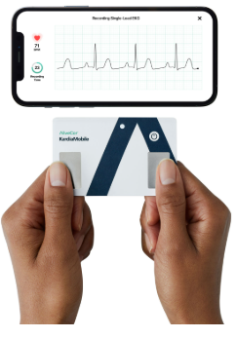

Slide 4
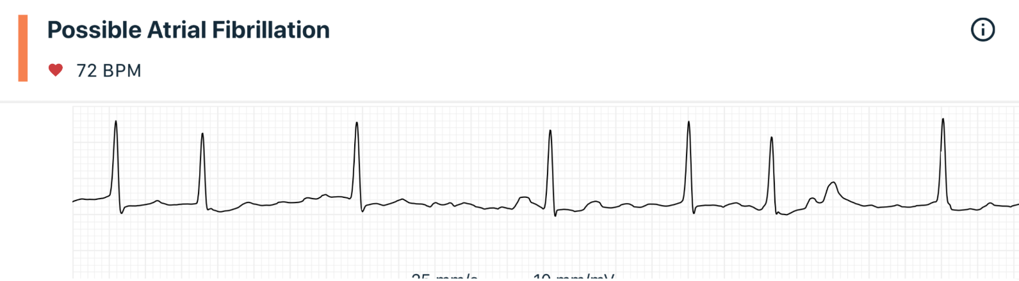
Kardia Device – Credit Card

Slide 5
CM
63 yo male
Paroxysmal atrial fibrillation x 2
1 ER – Responded to Propafenone
No electrical cardioversion
Wishes to avoid Ablation

Slide 6
You recommend
Stop drinking coffee
Drink coffee but decaf
Drink the same amount of coffee
It doesn’t matter what you do – you will need to see Dr Tsang eventually anyway

Slide 7
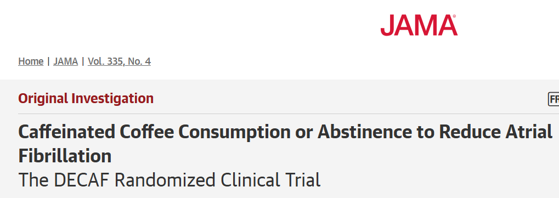

Slide 8
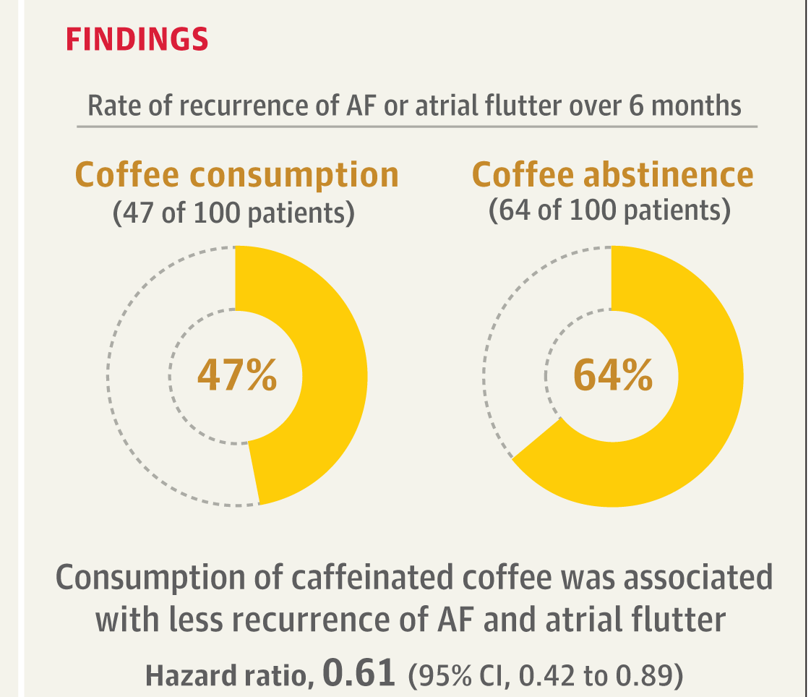

Slide 9
BT
61 yo female
Pci stemi 2021
Pci non stemi 2025
Wary of vaccines and concerned about her developing autism

Slide 10
What do you recommend for BT?
Don’t get the vaccine because of cardiac concerns
No indication with lack of hx of previous exposure
Get the vaccine – it helps the heart
Get the vaccine – no concerns about cardiac safety

Slide 11
American College of Cardiology (ACC) TriNetX Analysis (2026)
246,822 adults from the USA, using healthcare data from the TriNetX database.
Investigators compared rates of serious cardiac events in individuals who had received a shingles vaccination (123,411) vs. those who had not.

Slide 12
Key findings
Within 1–12 months following vaccination, individuals who received the shingles vaccine had a lower risk of cardiovascular events compared with those who were not vaccinated:
  46% lower risk of major adverse cardiovascular events
  32% lower risk of myocardial infarction
  25% lower risk of stroke
  25% lower risk of developing heart failure
  66% lower risk of all-cause mortality
The Korean National Cohort Study (2025)
The European Society of Cardiology Global Meta-Analysis (2025)

Slide 13
ACC Guidelines 2025
  Pneumovax - once all cardiac patients > 50
  Shingles - 2 inj., all cardiac patients > 50
  RSV - once - cardiac patients > 50
  COVID - all cardiac Patients annually
  Influenza – all cardiac patient annually

Slide 14
Which of the following medications has been shown to reduce MACE in Statin-Intolerant patiens
Repatha/Evolocumab
Leqvio/Iniclisarin
Ezetrol/Ezetamide
Nilemdo/Bempedoic Acid
Magnocardiotrumpoforte/Ivermectin

Slide 15
Which of the following medications has been shown to reduce MACE in Statin-Intolerant patiens
Repatha/Evolocumab
Leqvio/Iniclisarin
Ezetrol/Ezetamide
Nilemdo/Bempedoic Acid
Magnocardiotrumpoforte/Ivermectin

Slide 16
How It Works vs. Statins
Bempedoic acid blocks cholesterol synthesis in the exact same pathway as statins, but it relies on an enzyme specific to the liver for activation. Because this activating enzyme is essentially absent in skeletal muscle, bempedoic acid avoids the muscle-related side effects often associated with statins

Slide 17
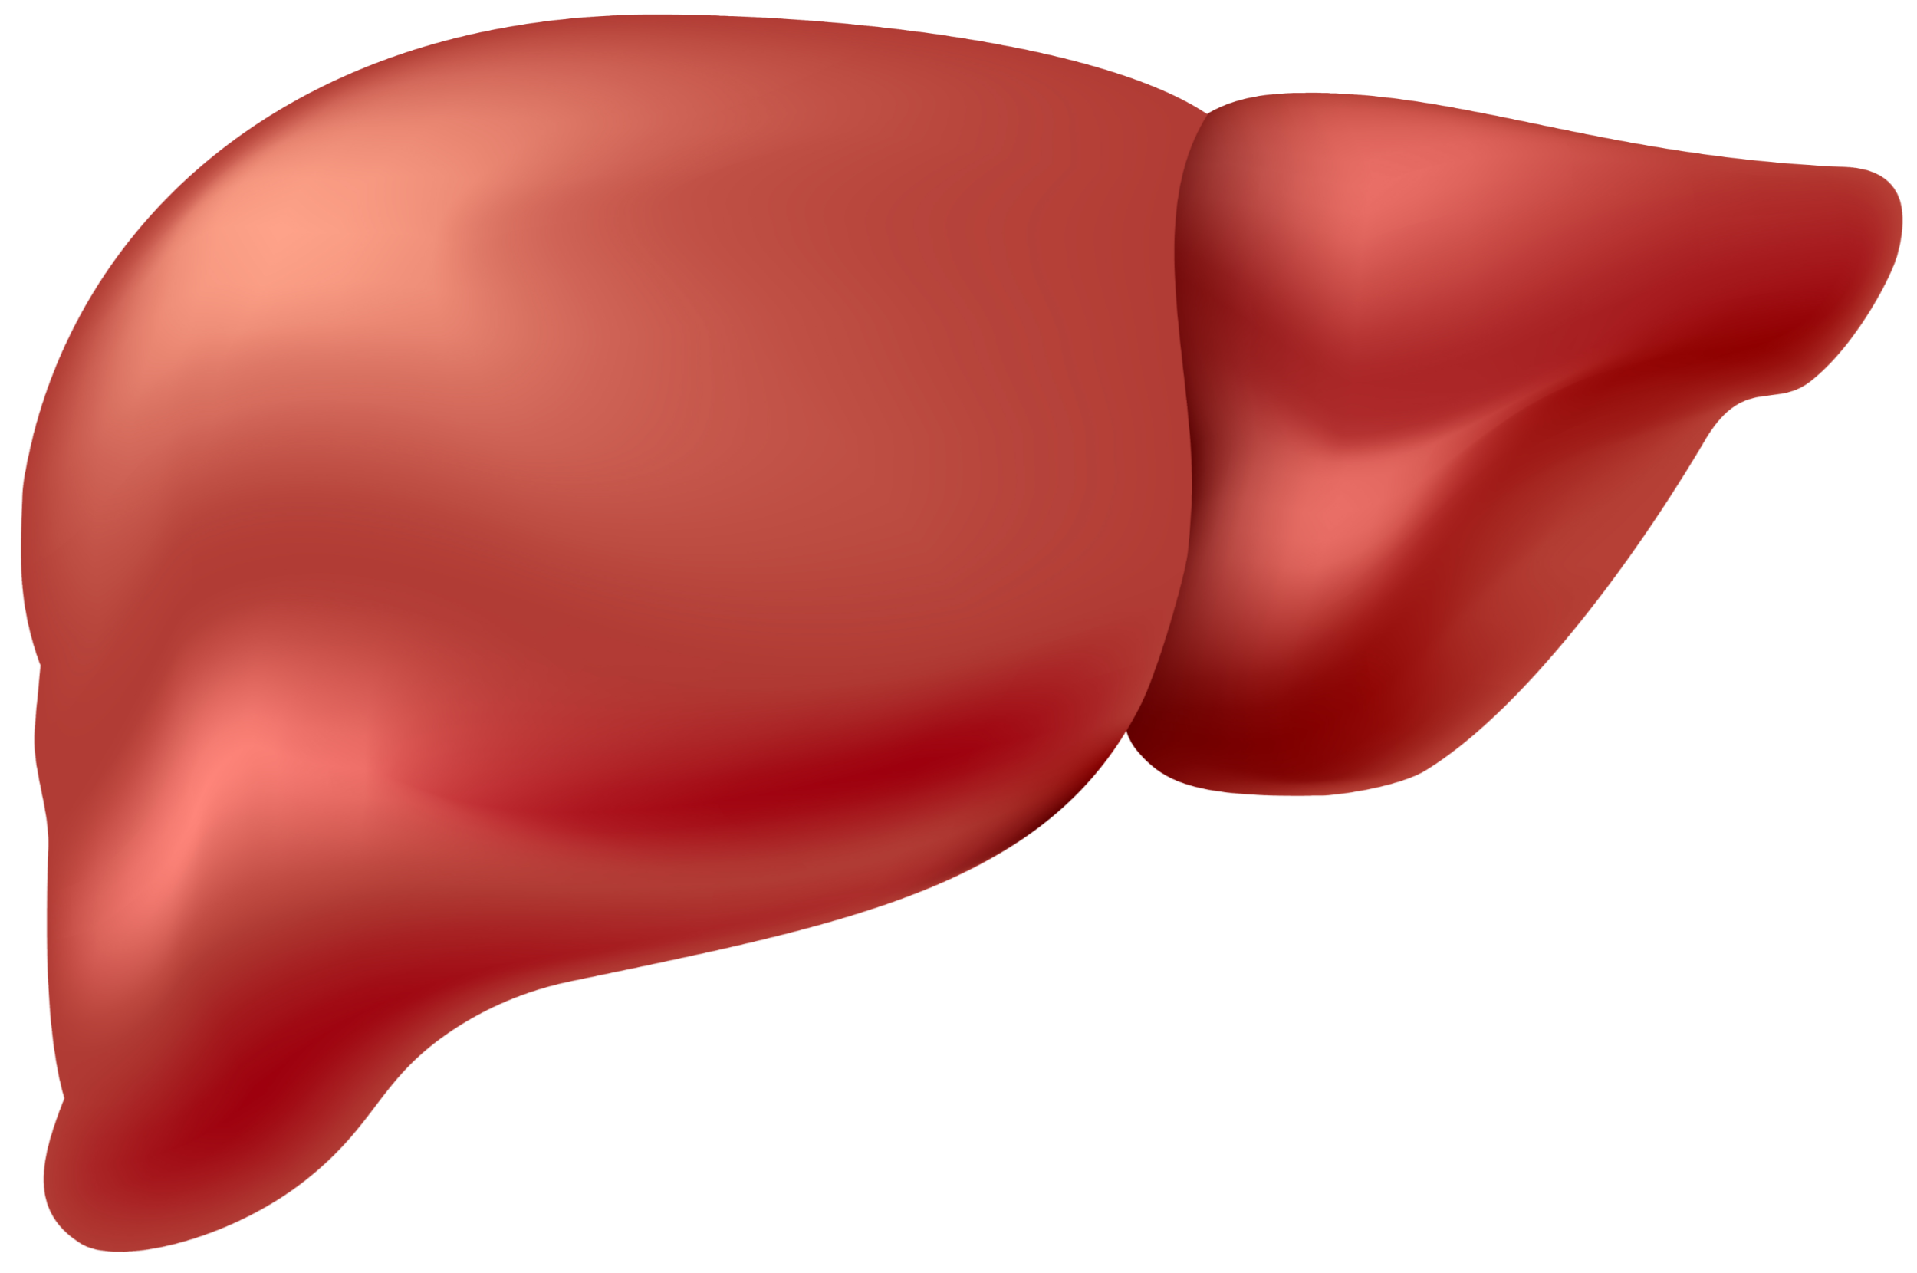
Bempedoic acid, reduces cholesterol synthesis by inhibiting ACL (ATP citrate lyase)
Bempedoic acid and statins work in the same cholesterol synthesis pathway^{1,2}
Citrate
Cholesterol
synthesis
pathway
Activated bempedoic acid
Bempedoic acid
(inactive)
Liver
ACL
Conversion
enzyme
ACSVL1
HMGR
Statin
(active)
Cholesterol
LDLR
LDL-C
Bempedoic acid lowers LDL-C by increasing LDLR expression

Slide 18
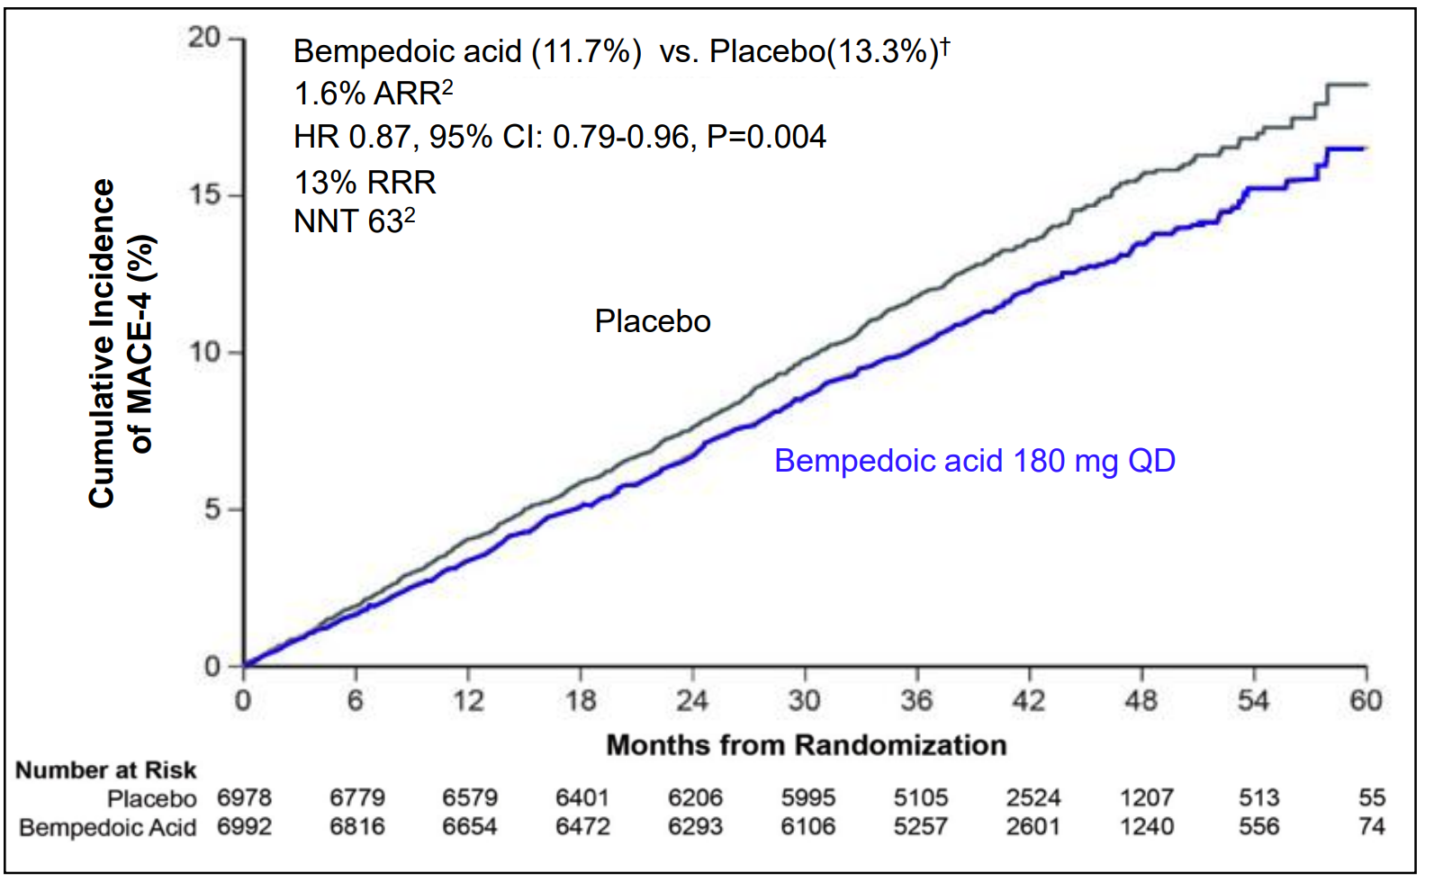
CLEAR Outcomes: Primary Composite Endpoint
Composite of CV death, nonfatal MI, nonfatal stroke or coronary revascularization
†Number of events: Bempedoic acid 819 vs placebo 927
*The primary efficacy endpoint (MACE-4) is the time to first occurrence of an adjudicated event for a composite that includes death from cardiovascular cases, nonfatal MI, nonfatal stroke, or coronary revascularization. ARR = absolute risk reduction; RRR = relative risk reduction; NNT = number needed to treat; QD = once daily; CI = confidence interval; MACE = major adverse cardiovascular events
CLEAR = Cholesterol Lowering via Bempedoic Acid, an ACL-Inhibiting Regimen; ACL = adenosine triphosphate citrate lyase
Nissen SE., et al. N Eng J Med. 2023; 388:1353-1364. Data on file, Esperion Therapeutics

Slide 19
American Heart Association (AHA) and American College of Cardiology (ACC) 2026
strong Class 1 recommendations for the use of bempedoic acid (Nexletol).
heavily endorsed as a primary non-statin option for patients with documented statin intolerance or those who need additional help reaching their LDL-C goals. (primary or secondary prevention
LDL Goal secondary prevention < 1.4 mmol/L
Cost – 127.50/month
  Sunlife, Canada Life
    No preauthorization forms

Slide 20
Incliserin - Leqvio
Drug Class: PCSK9 inhibitor. small interfering RNA (siRNA) therapy designed specifically to lower low-density lipoprotein (LDL)] by roughly 50% compared to statins alone.
Administration: SC injection
  Doses are given initially, at 3 months, and then every 6
  Cost $8,500 first year then $5,800 annual
?Benefit – ?MACE Reduction

Slide 21
LU Coverage - 737 – Repatha - Evolocumab
To reduce elevated low-density lipoprotein cholesterol (LDL-C) in adult patients with atherosclerotic cardiovascular disease (ASCVD) when all of the following criteria apply:
1. Patient is aged 18 years or older;
AND 2. Patient has experienced a recent acute coronary syndrome (ACS) event,
AND 3. Patient is unable to meet cholesterol targets, defined as having an LDL-C level 1.8mmol/L or greater, OR a non-HDL-C level 2.6mmol/L or greater, OR an Apo-B level 0.7g/L or greater, despite taking maximally tolerated dose of statins*;
*Maximally tolerated dose of statins includes one moderate-to-high intensity statin (i.e., at least atorvastatin 20mg daily or equivalent) for at least 4 weeks before treatment OR documented intolerance to at least 2 statins OR contraindication to statin therapy.
AND 4. Patient has received an adequate trial (i.e., at least 4 weeks) of ezetimibe
\ **For clarity, an adequate trial of ezetimibe is not required for patients with an LDL-C level greater than 2.2mmol/L despite taking a maximally tolerated statin dose.
5. Prescribed by a healthcare practitioner with expertise managing patients in the post-ACS setting;

Slide 22
Cardio-Renal Metabolic Issues

Slide 23
EMPA-REG OUTCOME
Primary Outcome: CV Death, Non-fatal MI or Non-fatal Stroke
EMPA-REG OUTCOME included adult patients (>18 years) with type 2 diabetes and established CVD who were receiving standard of care therapy for diabetes
Empagliflozin (pooled)
HR 0.86
(95.02% CI 0.74, 0.99)
p=0.04* for superiority
p<0.001 for noninferiority
Placebo
Empagliflozin
Patients with event (%)
Empagliflozin 10 mg
HR 0.85 (95% CI 0.72, 1.01), p=0.07
Empagliflozin 25 mg
HR 0.86 (95% CI 0.73, 1.02), p=0.09
Months
No. of patients
Empagliflozin
Placebo
4687
2333
4580
2256
4455
2194
4328
2112
3851
1875
2821
1380
2359
1161
1534
741
370
166
Cumulative incidence function. MACE: major adverse cardiovascular event; HR: hazard ratio; MI: myocardial infarction; SGLT2: sodium glucose cotransporter 2
*Two-sided tests for superiority were conducted (statistical significance was indicated if p≤0.0498)
Note: Empagliflozin is an SGLT2 inhibitor. Data from: Zinman B, et al. N Engl J Med. 2015; 373:2117-2128.

Slide 24
Primary endpoint: First adjudicated CV death or hospitalisation for heart failure – Emperor Reduced
40
RRR
25%
ARR
5.2%
NNT = 19
30
Placebo
Estimated cumulative incidence function (%)
20
HR 0.75
(95% CI 0.65, 0.86)
p<0.001
Empagliflozin
10
0
0
90
180
270
360
450
540
630
720
810
Empagliflozin:
361 patients with event
Rate: 15.8/100 patient-years
Placebo:
462 patients with event
Rate: 21.0/100 patient-years
Days after randomisation
Patients at risk
Placebo
Empagliflozin
1867
1715
1612
1345
1108
854
611
410
224
109
1863
1763
1677
1424
1172
909
645
423
231
101
Cox regression model including covariates age, baseline eGFR, geographic region, baseline diabetes status, sex, LVEF and treatment
CV, cardiovascular; eGFR, estimated glomerular filtration rate; LVEF, left ventricular ejection fraction; ARR, absolute risk reduction; RRR, relative risk reduction. NNT: Number needed to treat
Packer et al. NEJM 2020. DOI: 10.1056/NEJMoa2022190.

Slide 25
A New Evidence-based Treatment Option for HFpEF: Empagliflozin (EMPEROR-Preserved)¹
Placebo
Dapa
Empa
Enalapril
LCZ696
Cana
Composite primary endpoint: CV death or HHF
25
20
RRR
21%
ARR
3.3%
NNT*=31
Placebo
15
Estimated cumulative incidence (%)
HR: 0.79
(95% CI: 0.69, 0.90)
p<0.001
10
Empagliflozin
5
Empagliflozin is now indicated “In adults as an adjunct to standard of care therapy for the treatment of chronic heart failure” (irrespective of diabetes status and ejection fraction)²
0
0
3
6
9
12
15
18
21
24
27
30
33
36
Months since randomization
*During a median trial period of 26 months.
ARR: absolute risk reduction; CI: confidence interval; HR: hazard ratio; NNT: number needed to treat; RRR: relative risk reduction.
Anker SD, et al. N Engl J Med. 2021; 385(16):1451-61; 2. Boehringer Ingelheim (Canada) Ltd. ^{Pr}JARDIANCE® product monograph. Apr. 6, 2022.
Notes:
Speak to slide

Slide 26
SUSTAIN-6: Primary Endpoint (CV Death, Non-fatal Myocardial infarction, Non-fatal Stroke)
HR: 0.74
(95% CI, 0.58, 0.95)
Events: 108 semaglutide; 146 placebo
P < 0.001 for non-inferiority
P = 0.02 for superiority*
Placebo, 8.9%
Semaglutide
(pooled), 6.6%
109
No. at risk
Semaglutide | 1,648 | 1,619 | 1,601 | 1,584 | 1,568 | 1,543 | 1,524 | 1,513
Placebo | 1,649 | 1,616 | 1,586 | 1,567 | 1,534 | 1,508 | 1,479 | 1,466
* SUSTAIN-6 was not designed with prespecified testing for superiority. However, the treatment effect of semaglutude and the accrual
of more events than estimated resulted in a significantly lower risk of the primary outcome among patients in the semaglutide group.
CI, confidence interval; CV, cardiovascular; HR, hazard ratio
Marso S et al. Semaglutide and Cardiovascular Outcomes in Patients with Type 2 Diabetes N Engl J Med September 2016 doi: 10.1056/NEJMoa1607141
Notes:
This study involved 3,297 patients with type 2 diabetes who were on a standard-care regimen. They were randomized to receive once-weekly semaglutide (0.5 mg or 1.0 mg) or placebo for 104 weeks. The primary composite outcome was the first occurrence of cardiovascular death, nonfatal myocardial infarction, or nonfatal stroke. This outcome occurred in 108 of 1648 patients (6.6%) in the pooled semaglutide groups and in 146 of 1649 patients (8.9%) in the placebo group (hazard ratio, 0.74; 95% confidence interval [CI], 0.58 to 0.95; p<0.001 for noninferiority, p=0.02 for superiority).
Reference:
Marso SP, Bain SC, Consoli A, et al. Semaglutide and Cardiovascular Outcomes in Patients with Type 2 Diabetes. N Engl J Med 2016; 375(19):1834-44.

Slide 27
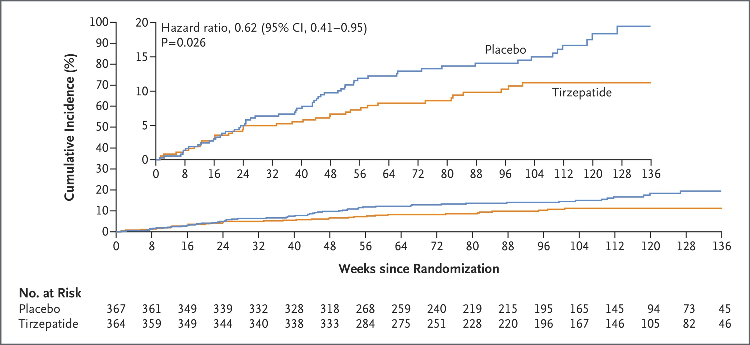

SUMMIT TRIAL – Terzepatide
Composite of Death from Cardiovascular Causes or a Worsening Heart-Failure Event.
Packer M et al. N Engl J Med2025;392:427-437
Notes:
Figure 1 Composite of Death from Cardiovascular Causes or a Worsening Heart-Failure Event. Shown is the cumulative incidence of death from cardiovascular causes or a worsening heart-failure event (the composite primary end point), assessed in a time-to-first-event analysis, among 364 patients who received tirzepatide and 367 patients who received placebo. The inset shows the same data on an expanded y axis.

Slide 28
FIDELITY Pooled Analysis: Finerenone Reduced the Risk of Clinically Important CV and Kidney Outcomes
Kidney
Composite*
CV
Composite†
Dialysis
HHF
23%
HR 0.77
95% CI 0.67 to 0.88
20%
HR 0.80
95% CI 0.64 to 0.99
NNT: 47
22%
HR 0.78
95% CI 0.66 to 0.92
14%
HR 0.86
95% CI 0.78 to 0.95
*Composite kidney endpoint: time to onset of kidney failure or decrease of GFR ≥40% from baseline or renal death.
†Composite CV endpoint: time to CV death or non-fatal CV events (MI, stroke and HF hospitalisation).
CI, confidence interval; CV, cardiovascular; HHF, hospitalization for heart failure; HR, hazard ratio; NNT, number needed to treat.
Agarwal R, Filippatos G, Pitt B, et al. Eur Heart J. 2022 Feb 10;43(6):474-484.

Slide 29
TBA -June 5, 2026
FINE CKD
Non Diabetic : acr> 20, eGFR > 25
Primary Endpoint Met
Finerenone achieved a statistically significant reduction in the mean annual rate of eGFR decline (eGFR slope) over 32 months. [1, 2]

Slide 30
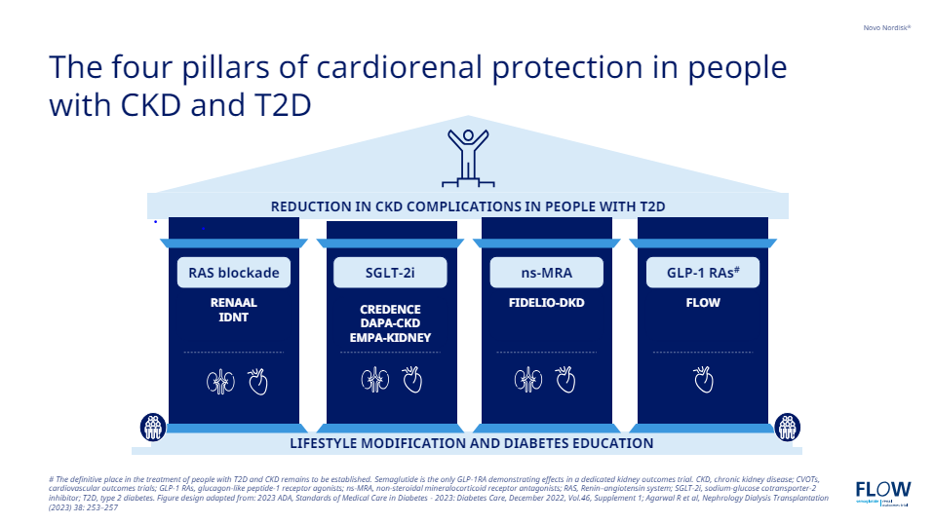

Slide 31
What are the barriers to success?
Side Effects
  GMI
  GI
  Hyperkalemia
Cost
Patient education
Time/Motivation/Specialty Silos

Slide 32
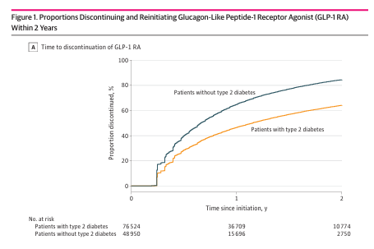
GLP1 Discontinuation Rates

Slide 33
DM
73 yo male
DM
DKD
HT
No vasc Dx
Cr - eGFR –
ACR
A1C 6.9
BP 123/76
Current Meds:
Crestor 10 mg 1 time daily
Coversyl Plus HD 8/2.5 mg od
Forxiga 10 mg 1 time daily
Viagra
Diamicron MR 120 mg 1 time daily
Ozempic 1 mg 1 time weekly
finerenone 10 mg 1 tablet 1 time daily LU 700

Slide 34
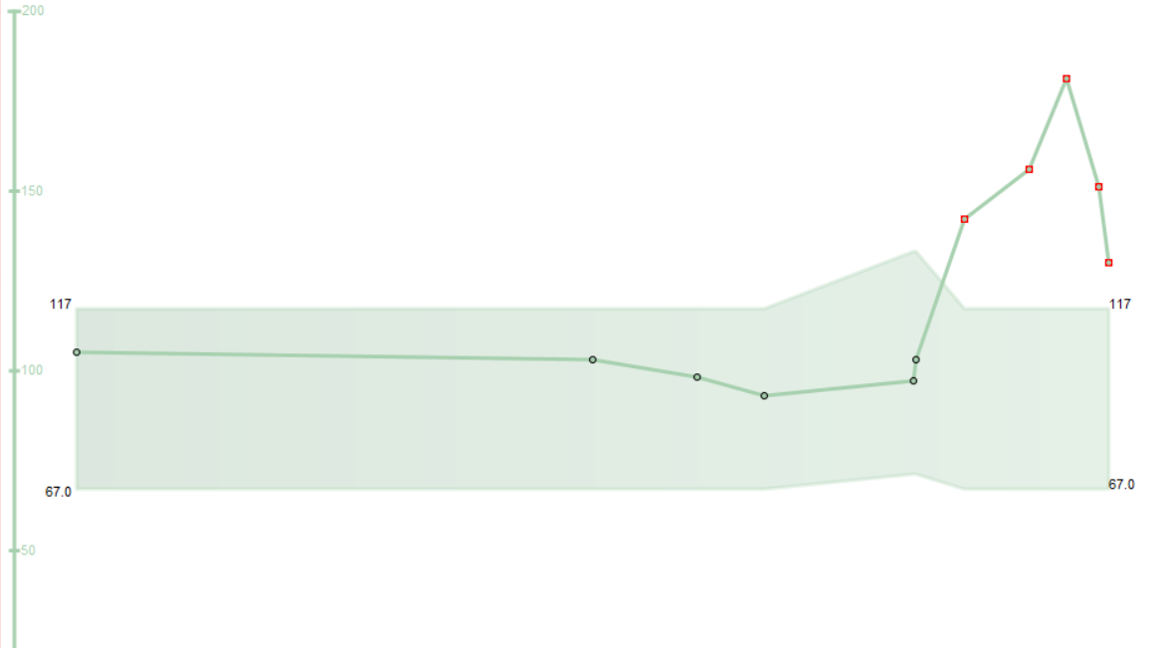
Cr

Slide 35
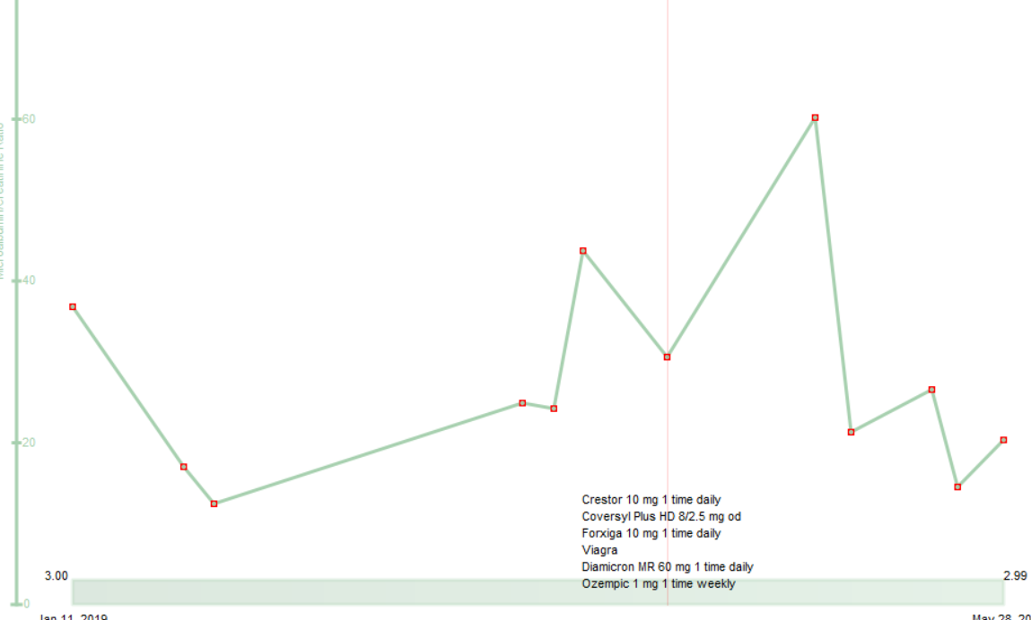
ACR

Slide 36
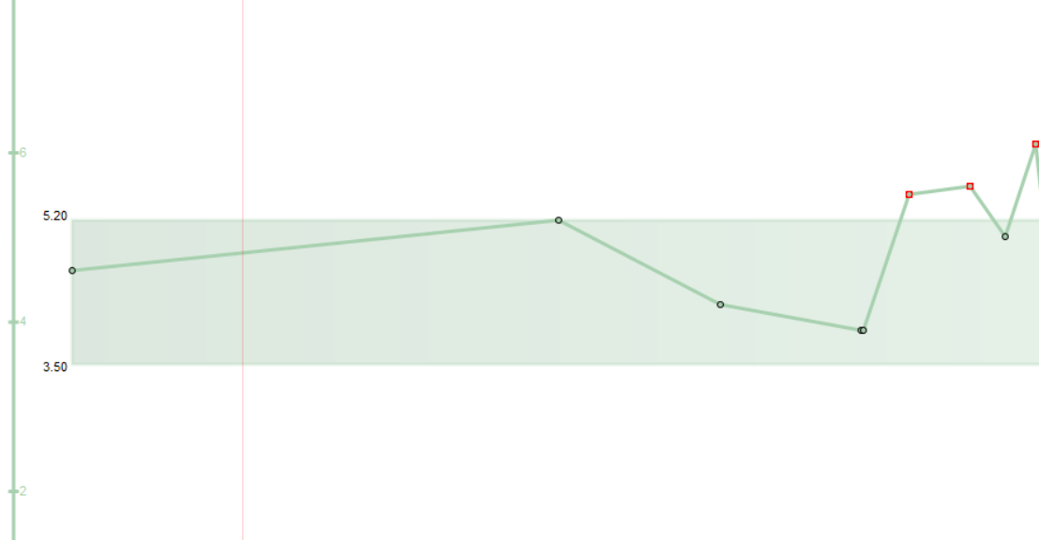
RM

Slide 37
RM
Monday 11 pm
K+ 5.9

Slide 38
What would you do initially to address this patients hyperkalemia ?
Choose one best answer
Send patient to ER
Call patient to start Kayexalate
Repeat Bloodwork
Stop Finerenone
Educate patient on low K+ diet

Slide 39
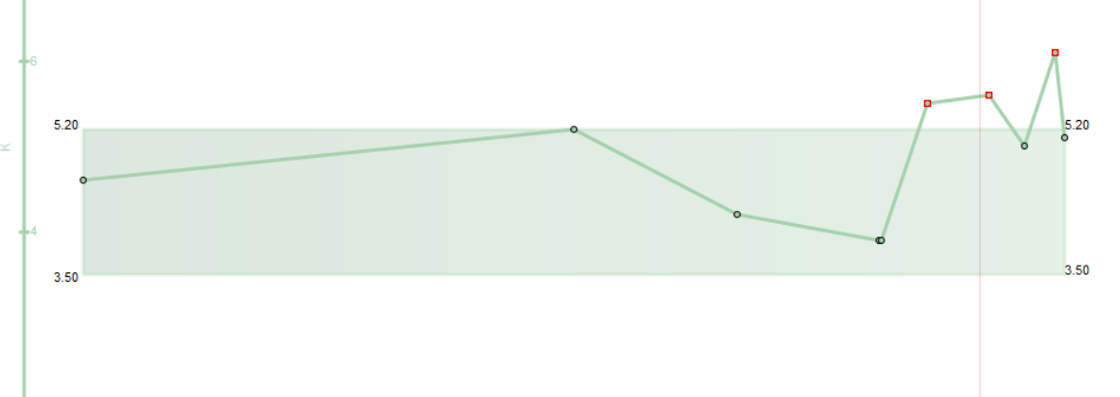

Slide 40
What would you do initially to address this patients hyperkalemia ?
Choose one best answer
Send patient to ER
Call patient to start Kayexalate
Repeat Bloodwork
Stop Finerenone
Educate patient on low K+ diet

Slide 41
Causes Of Hyperkalemia
Pseudo Hyperkalemia
  Typically wide variability in repeat measurement
  Bloodletting trauma
  Muliple fist clenching
  Delay in processing
Metabolic/Respiratory Acidosis
Insulin deficiency
Reduced renal excretion
  ACE-I/ARBs, NSAIDs
  MRA – Spironolactone/Amiloride/ Finerenone
  AKI/CKD

Slide 42
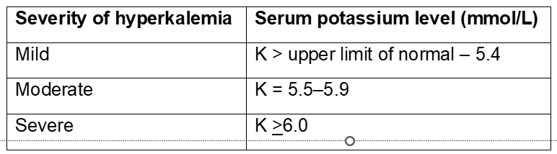

Slide 43
Practical Tips: Potassium (K+) and Creatinine (Cr)
2018 Diabetes Canada CPG – Chapter 29. Chronic Kidney Disease in Diabetes
Mild to moderate stable hyperkalemia
  Counsel on a low potassium diet
  If persistent, consider adding non-potassium sparing diuretics and/or oral sodium bicarbonate (in those with metabolic acidosis)
  Consider temporarily holding or discontinuing ACEi, ARB or Direct Renin Inhibitor (DRI)
Severe hyperkalemia
  Hold or discontinue ACEi, ARB or DRI
  Emergency management strategies
Notes:
43

Slide 44
When to Refer…..
2018 Diabetes Canada CPG – Chapter 29. Chronic Kidney Disease in Diabetes
Chronic, progressive loss of kidney function
ACR persistently >60 mg/mmol
eGFR <30 mL/min/1.73 m²
Unable to remain on renal-protective therapies due to adverse effects such as hyperkalemia or a >30% increase in serum Cr within 3 months of starting ACEi or ARB
Unable to achieve target BP (could be referred to any specialist in hypertension)
BP, blood pressure; Cr, creatinine
Notes:
44

Slide 45
AE
52 yo male, accountant
Household income $100,000
Type 2 DM and CAD , PCI 3 months ago
Meds
  Ozempic 2 mg ow
  Tresiba 100 mg od
  Admelog 40 u tid
  Crestor 40
  Ezetrol 10
On Libre 3 meter
ACR – 42, eGFR 45
LDL 3.5

Slide 46
What are his current yearly cost of management?
$3,200
$6,400
$8,800
$12,000

Slide 47
What are his current yearly cost of management?
$3,200
$6,400
$8,800
$12,000

Slide 48
AE
52 yo male, accountant
Household income $100,000
Type 2 DM and CAD , PCI 3 months ago
Meds
  Ozempic 2 mg ow $ 160/month)
  Tresiba 100 mg od $ 0.078 u = $233/month (glargine – 0.056 = $168/month)
  Admelog 40 u tid 0.033/unit = $119/month
  Crestor 40 = $ 5.70
  Ezetrol 10 = $ 5.40
On Libre 3 meter $ 200/month
= $6,277.2 + Disp fee
Total
ACR – 42, eGFR 45
LDL 3.5

Slide 49
You suggest Repatha and Finerenone
Recommendations?
$ additional $ 7,600 + $1,186 =
= $15,186
Apply for Trillium
Don’t apply for Trillium – makes too much money to qualify
Don’t apply – unable to afford deductible
Get another job with benefits 75% deductible

Slide 50
You suggest Repatha and Finerenone
Recommendations?
$ additional $ 7,600 + $1,186 =
= $15,186
Apply for Trillium
Don’t apply for Trillium – makes too much money to qualify
Don’t apply – unable to afford deductible
Get another job with benefits 75% deductible

Slide 51
You suggest Repatha and Finerenone
Recommendations?
Apply for Trillium
Don’t apply for Trillium – makes too much money to qualify
Don’t apply – unable to afford deductible
Get another job with benefits 75% deductible

Slide 52
Explain the deductible
The Coverage: You pay for your medications out-of-pocket at the pharmacy until you hit that quarter's target. After that, the government covers the rest of the cost for eligible drugs, and you only pay a $2 co-pay per prescription for the rest of that quarter
4% of your net income per year is what you pay – the govt pays the rest. Adjusted for household income > $100,000
  Eg - $4,000

Slide 53
Reducing Costs
Pharma Programs – my mounjaro, InnoviCares
Trillium Application
DTC
Office Samples
? Generics
  Ozempic – Cost 1 mg pen = 0.5 mg pen
  36 clicks = 0.5 mg ow
  Generic SGLT-2s, DPPIV
  Admelog/Trurapi/Basaglar
Cut Pills
  Jardiance – ½ of 25 mg tablet
  Synjardy 12.5/500 mg od
  Finerenone 20 mg = $3.25
Different Pharmacy

Slide 54
Don’t use SGLT-2 Inh with
Type 1 diabetes
Hx DKA/Pancreatic Insufficiency/Pancreatic resection
  Unless you have a c-peptide
eGFR < 20
GLP-1 – GB disease

Slide 55
Practical tips: Genital Mycotic Infections (GMI’s)
Uncomplicated
  (Healthy, non-pregnant, <3 inf/year, mild/mod symptoms)
  Fluconazole 150 po single dose
Balinitis
  Topical/clotrimazole prn
Complicated
  Severe signs, > 3/ year, poorly controlled DM, immunocompromised
  Fluconazole 150 mg po q 3 days , 2-3 doses
    +/1 clotrimazole/betamethasone x 48 hrs
    Or Topicals – 7-14 days
Recurrent – >3 year
  Fluconazole 150 mg po q 72 hrs x 3, then once weekly x 6 months

Slide 56

Ozempic Micro-Dosing
There are many “clicks” between the marked doses on the Ozempic pen. There are 38 “clicks” between 0 and 0.25mg and 38 “clicks” between 0.25mg and 0.5mg. On the 1mg pen there are 76 “clicks” between 0 and 1mg.
Use ____ clicks once a week and if tolerating well, continue to increase by ____ clicks every _____ weeks, until at the recommended dose of ______mg once weekly.
Once you are on a dose of 0.25 mg weekly, please discontinue your ___________ (Onglyza/Trajenta/Januvia)

Slide 57
Management of common side effects required for long-term success

Slide 58
GLP-1/GIP Costs

Slide 59
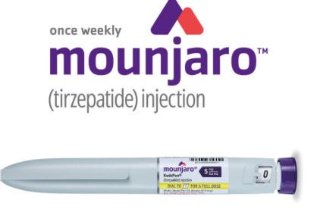
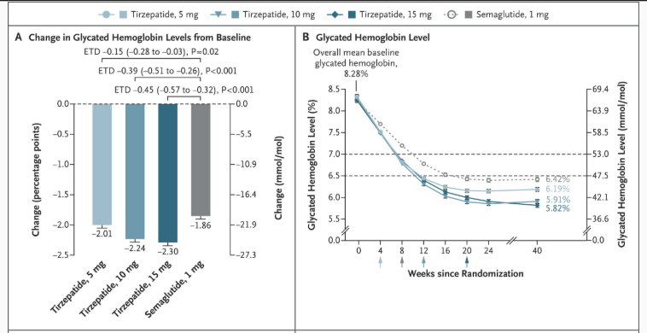
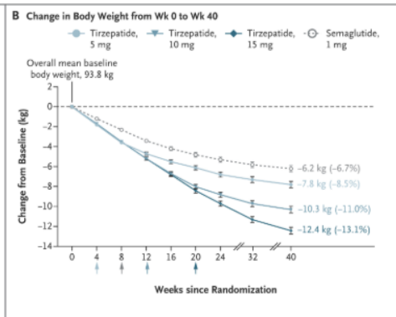
Determine Goals – Match the Dose

Slide 60
What about Mounjaro/Terzepatide?
But shouldn’t I be on the maximal dose of 15 mg?

Slide 61
? Mounjaro 2.5 mg ow

Slide 62

Counting Clicks
15 mg pen = 4 x 15 mg = 0.6 ml per dose
Each click is 0.01 ml
60 clicks = 15 mg
20 clicks = 5 mg = 3 months

Slide 63
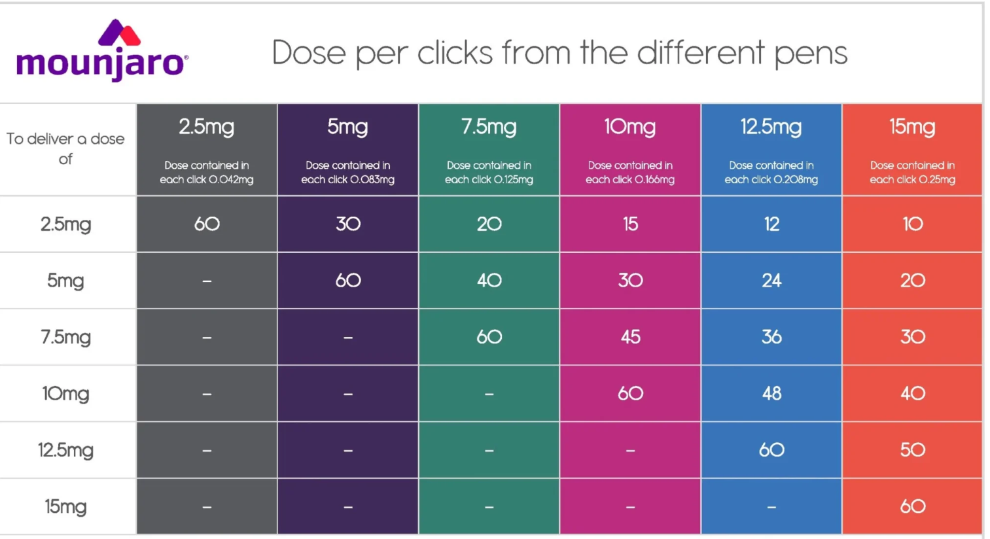

Slide 64
Ozempic Clicks
To deliver a dose of | 0.5 mg pen | 1.0 mg pen
0.25 mg | 38 | 19
0.5 mg | 76 | 38
0.75 mg |  | 57
1 mg |  | 76

Slide 65
You said the pen has 4 x 0.6 ml doses
but the pen says 3 ml
What happened to the left over 0.6 ml?

Slide 66
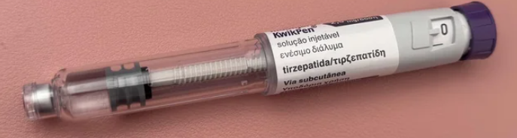
The Golden Dose

Slide 67

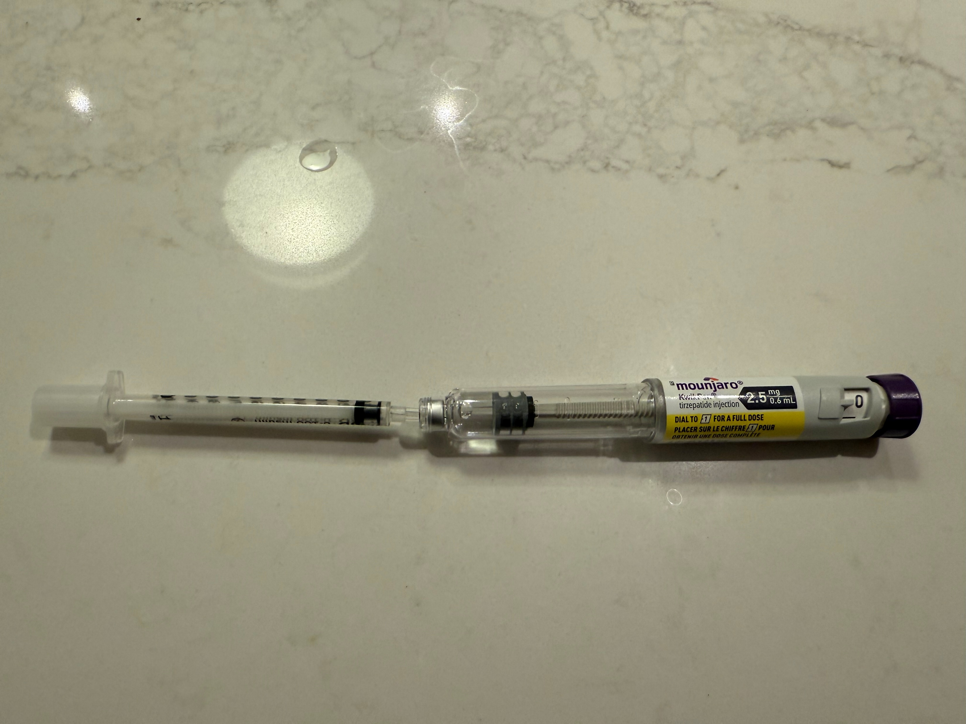

Slide 68
Cardio Renal Metabolic
Keys to Success
  Identifying Pts at Risk
  4 - 5 Pillars/Medications – with crossover between indications
  Barriers
    Side Effects
      Hyperkalemia
      GMI
      GI
    Costs
      Tricks GLP1’s
      Trillium

Slide 69

Whose Job Is It Anyways?
Cardio
Endo
Nephro

