Slide 1

CHF Update 2025
J.C. MacFadyen
MD, FRCPC, MHPE
JC MacFadyen
Heart Function Program CFHT

Slide 2
What’s new in heart failure?
Objectives
  CHF Clinical Trials
  Management guidelines
  Interpretation of NT Pro NP
  Management of side effects

Slide 3

Original Article
Finerenone in Heart Failure with Mildly Reduced or Preserved Ejection Fraction
Scott D. Solomon, M.D., John J.V. McMurray, M.D., Muthiah Vaduganathan, M.D., M.P.H., Brian Claggett, Ph.D., Pardeep S. Jhund, M.B., Ch.B., Ph.D., Akshay S. Desai, M.D., M.P.H., Alasdair D. Henderson, Ph.D., Carolyn S.P. Lam, M.B., B.S., Ph.D., Bertram Pitt, M.D., Michele Senni, M.D., Sanjiv J. Shah, M.D., Adriaan A. Voors, M.D., Ph.D., Faiez Zannad, M.D., Ph.D., Imran Zainal Abidin, M.D., Marco Antonio Alcocer-Gamba, M.D., Ph.D., John J. Atherton, M.B., B.S., Ph.D., Johann Bauersachs, M.D., Ma Chang-Sheng, M.D., Chern-En Chiang, M.D., Ph.D., Ovidiu Chioncel, M.D., Vijay Chopra, M.B., B.S., M.D., Josep Comin-Colet, M.D., Ph.D., Gerasimos Filippatos, M.D., Cândida Fonseca, M.D., Ph.D., Grzegorz Gajos, M.D., Ph.D., Sorel Goland, M.D., Eva Goncalvesova, M.D., Seokmin Kang, M.D., Ph.D., Tzvetana Katova, M.D., Ph.D., Mikhail N. Kosiborod, M.D., Gustavs Latkovskis, M.D., Ph.D., Alex Pui-Wai Lee, M.D., Gerard C.M. Linssen, M.D., Ph.D., Guillermo Llamas-Esperón, M.D., Vyacheslav Mareev, M.D., Felipe A. Martinez, M.D., Vojtěch Melenovský, M.D., Béla Merkely, M.D., Ph.D., Savina Nodari, M.D., Mark C. Petrie, M.B., Ch.B., Clara Inés Saldarriaga, M.D., Jose Francisco Kerr Saraiva, M.D., Ph.D., Naoki Sato, M.D., Ph.D., Morten Schou, M.D., Ph.D., Kavita Sharma, M.D., Richard Troughton, M.B., Ch.B., Ph.D., Jacob A. Udell, M.D., M.P.H., Heikki Ukkonen, M.D., Ph.D., Orly Vardeny, Pharm.D., Subodh Verma, M.D., Ph.D., Dirk von Lewinski, M.D., Leonid Voronkov, M.D., Mehmet Birhan Yilmaz, M.D., Shelley Zieroth, M.D., James Lay-Flurrie, M.Sc., Ilse van Gameren, B.Sc., Flaviana Amarante, M.D., Peter Kolkhof, Ph.D., Prabhakar Viswanathan, M.B., B.S., Ph.D., for the FINEARTS-HF Committees and Investigators
N Engl J Med
Volume 391(16):1475-1485
October 24, 2024

Slide 4
FINE-ARTS
Entry Criteria
HF on diuretics x 30 days
EF> 40
NT-proBNP
  NSR – NT Pro BNP ≥300 pg/mL
      A Fib NT-proBNP ≥900 pg/ml

Slide 5
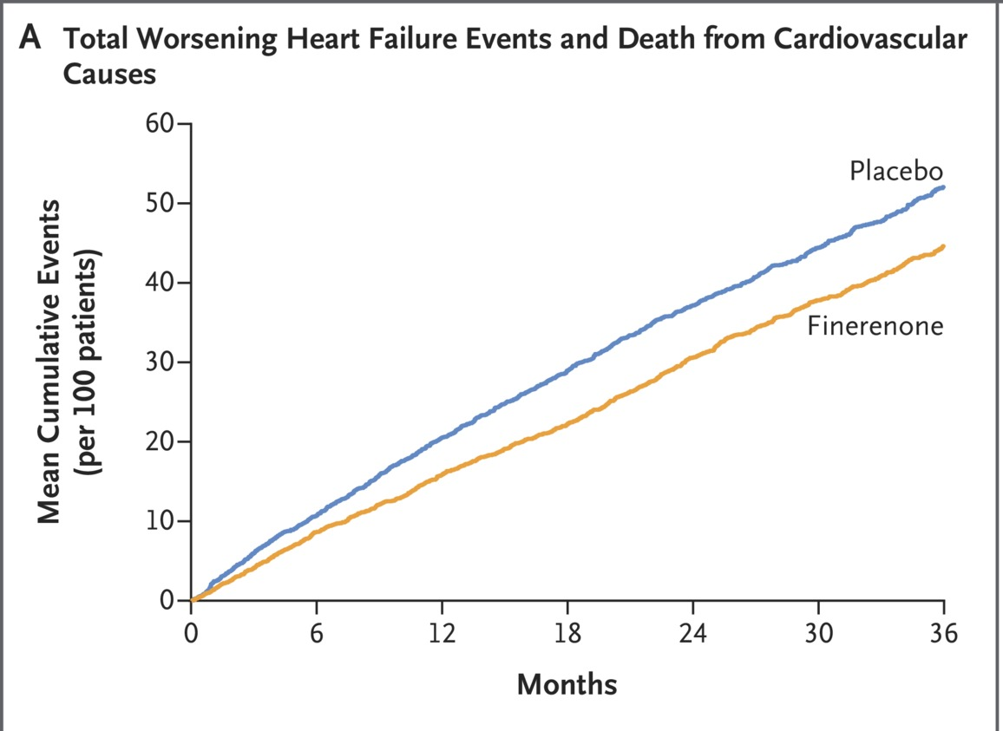
Primary Outcome and Its Components.
Solomon SD et al. N Engl J Med2024;391:1475-1485
Notes:
Figure 1 Primary Outcome and Its Components. Panel A shows the cumulative-incidence plot for the composite of total worsening heart failure events and death from cardiovascular causes (the primary outcome). Panel B shows the cumulative-incidence plot for total worsening heart failure events. Panel C shows the Kaplan–Meier plot for death from cardiovascular causes. The inset shows the same data on an enlarged y axis. Panel D shows the Kaplan–Meier plot for the composite of the first worsening heart failure event or death from cardiovascular causes.

Slide 6
Original Article
Tirzepatide for Heart Failure with Preserved Ejection Fraction and Obesity
Milton Packer, M.D., Michael R. Zile, M.D., Christopher M. Kramer, M.D., Seth J. Baum, M.D., Sheldon E. Litwin, M.D., Venu Menon, M.D., Junbo Ge, M.D., Govinda J. Weerakkody, Ph.D., Yang Ou, Ph.D., Mathijs C. Bunck, M.D., Karla C. Hurt, B.S.N., Masahiro Murakami, M.D., Barry A. Borlaug, M.D., for the SUMMIT Trial Study Group
N Engl J Med
Volume 392(5):427-437
January 30, 2025

Slide 7
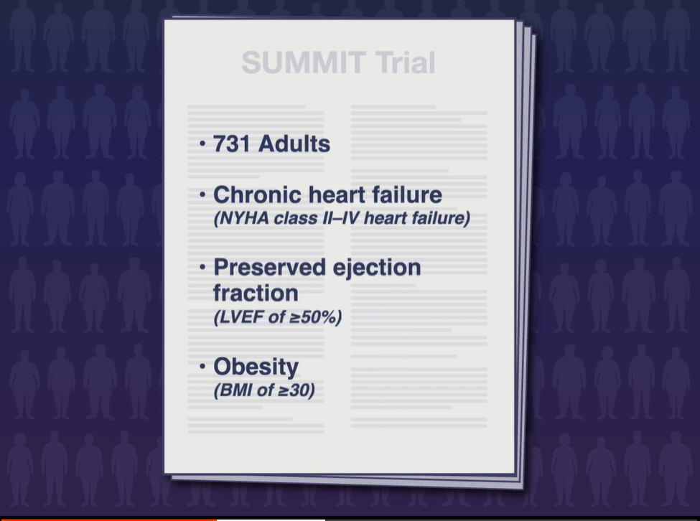

Slide 8
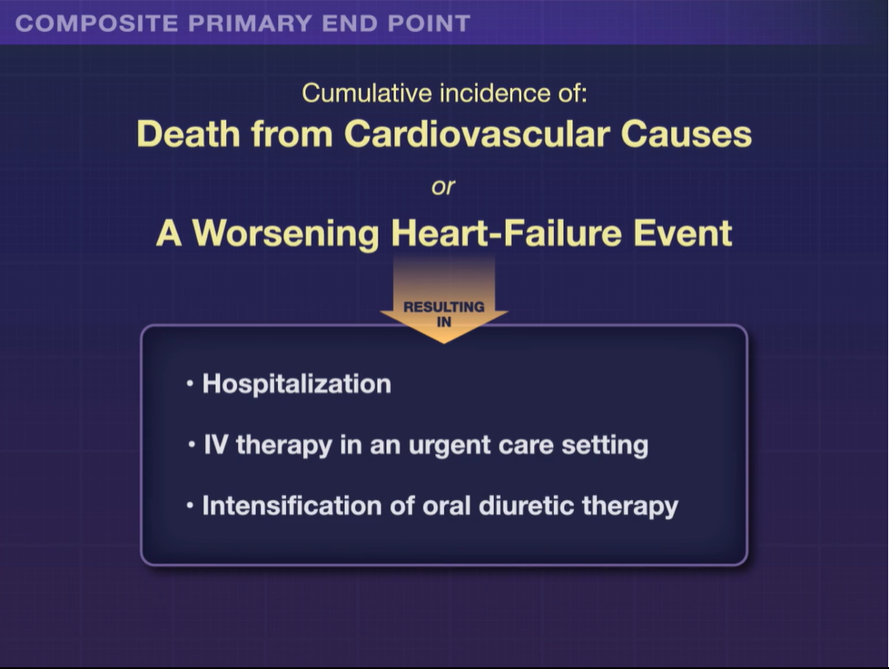

Slide 9
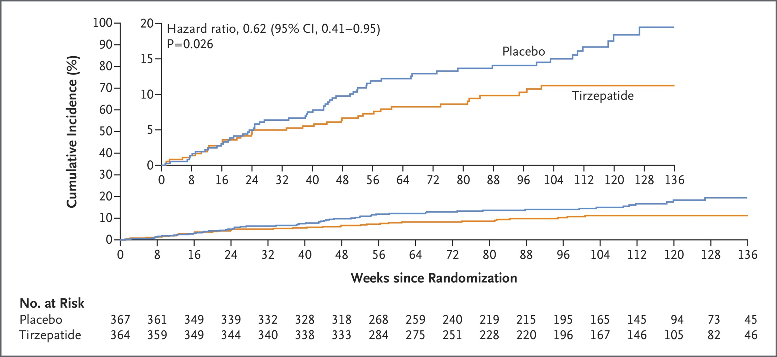
Composite of Death from Cardiovascular Causes or a Worsening Heart-Failure Event.
Packer M et al. N Engl J Med2025;392:427-437
Notes:
Figure 1 Composite of Death from Cardiovascular Causes or a Worsening Heart-Failure Event. Shown is the cumulative incidence of death from cardiovascular causes or a worsening heart-failure event (the composite primary end point), assessed in a time-to-first-event analysis, among 364 patients who received tirzepatide and 367 patients who received placebo. The inset shows the same data on an expanded y axis.

Slide 10
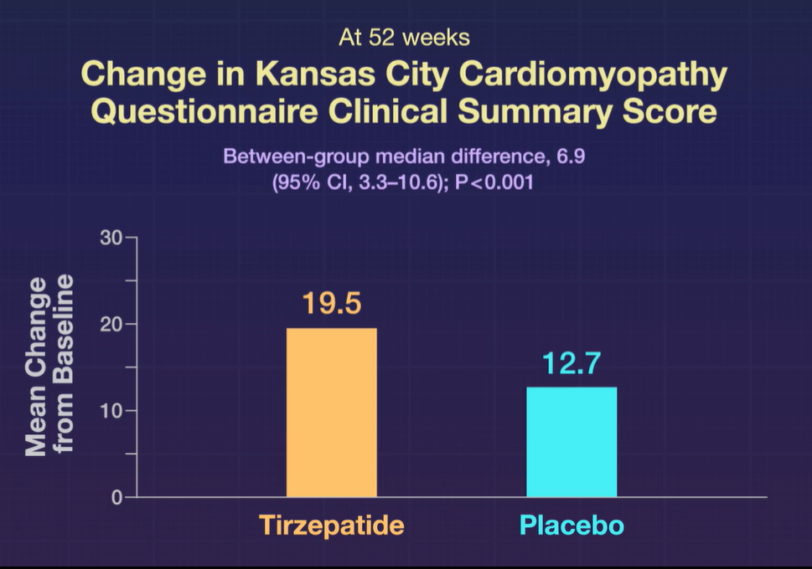

Slide 11
Original Article
Semaglutide in Patients with Heart Failure with Preserved Ejection Fraction and Obesity
Mikhail N. Kosiborod, M.D., Steen Z. Abildstrøm, Ph.D., Barry A. Borlaug, M.D., Javed Butler, M.D., Søren Rasmussen, Ph.D., Melanie Davies, M.D., G. Kees Hovingh, M.D., Ph.D., Dalane W. Kitzman, M.D., Marie L. Lindegaard, M.D., D.M.Sc., Daniél V. Møller, M.D., Ph.D., Sanjiv J. Shah, M.D., Marianne B. Treppendahl, M.D., Ph.D., Subodh Verma, M.D., Ph.D., Walter Abhayaratna, M.D., Ph.D., Fozia Z. Ahmed, M.D., Vijay Chopra, M.D., Justin Ezekowitz, M.Sc., Michael Fu, M.D., Ph.D., Hiroshi Ito, M.D., Małgorzata Lelonek, M.D., Ph.D., Vojtech Melenovsky, M.D., Ph.D., Bela Merkely, Ph.D., D.Sc., Julio Núñez, M.D., Ph.D., Eduardo Perna, M.D., Morten Schou, M.D., Ph.D., Michele Senni, M.D., Kavita Sharma, M.D., Peter Van der Meer, M.D., Ph.D., Dirk von Lewinski, M.D., Dennis Wolf, M.D., Mark C Petrie, M.D., for the STEP-HFpEF Trial Committees and Investigators
N Engl J Med
Volume 389(12):1069-1084
September 21, 2023

Slide 12
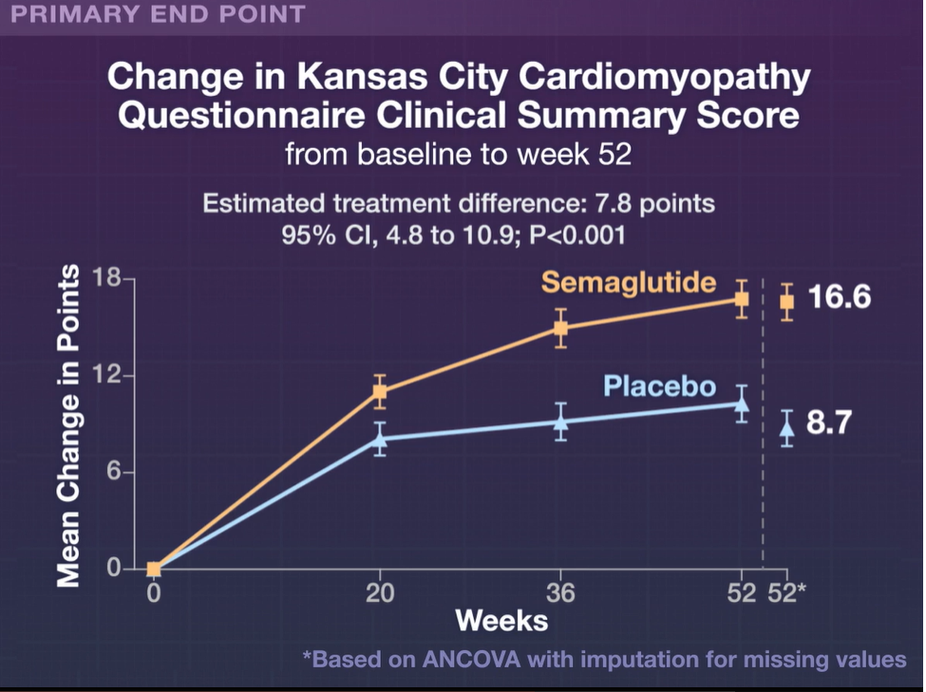

Slide 13
PATIENT CASE
65M new CHF
orthopnea, edema resolve with diuresis
NYHA II
PMHX
  Afib/Flutter, HT
Meds:
  Bisoprolol
  Apixaban
  Amiodarone 200mg daily
  Lasix 40mg daily PRN
Exam: BP 105/70, HR 65 reg
  JVD distended
  Bilat crackles
Investigations:
  Creat 70, K 4.8
  2D echo
    LVEF 55 %
    No valvular disease
Questions:
  How do you categorize his CHF?
  Management?

Slide 14
CHF Jargon
HFrEF
  Reduced ejection fraction defined as LVEF <40%

Slide 15
CHF Jargon
HFrEF
  Reduced ejection fraction defined as LVEF <40%
HFnrEF
  Non-reduced ejection fraction defined as any CHF >40%
  HFpEF was previously used for >55%
  HFmrEF previously used to describe 40-55%

Slide 16
CHF Jargon
HFrEF
  Reduced ejection fraction defined as LVEF <40%
HFnrEF
  Non-reduced ejection fraction defined as any CHF >40%
  HFpEF was previously used for >55%
  HFmrEF previously used to describe 40-55%
HFimpEF
  HFrEF improved to >40%, with at least 10% increase from baseline LVEF

Slide 17
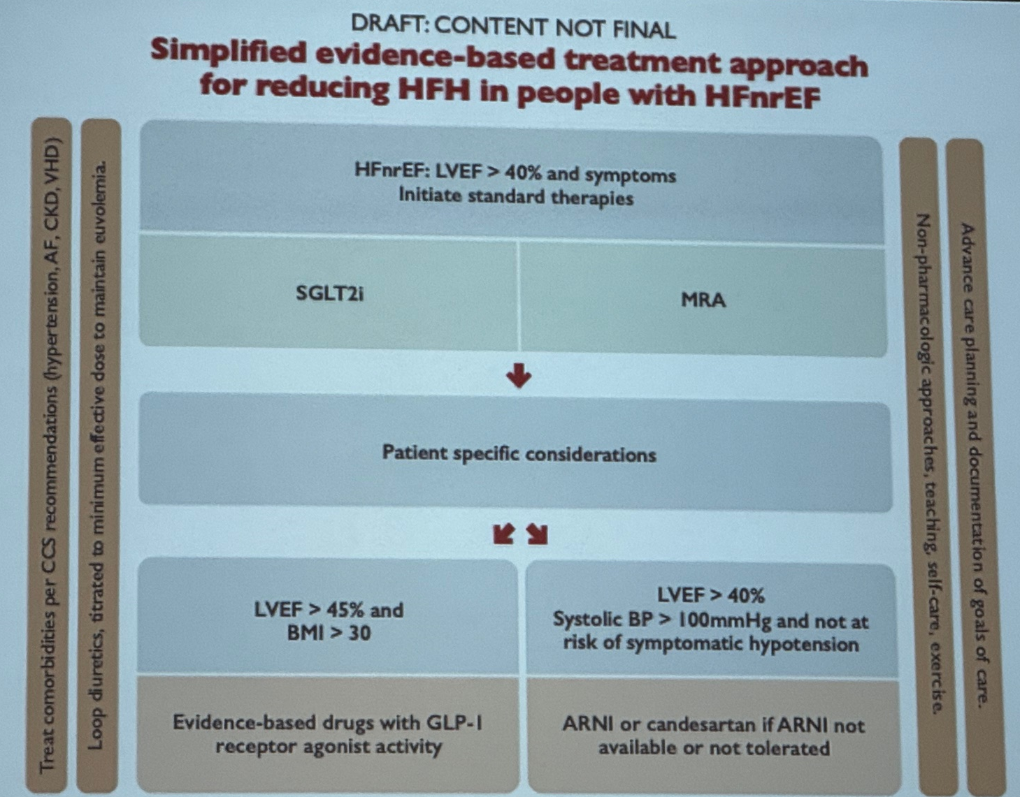
HFnrEF Management

Slide 18
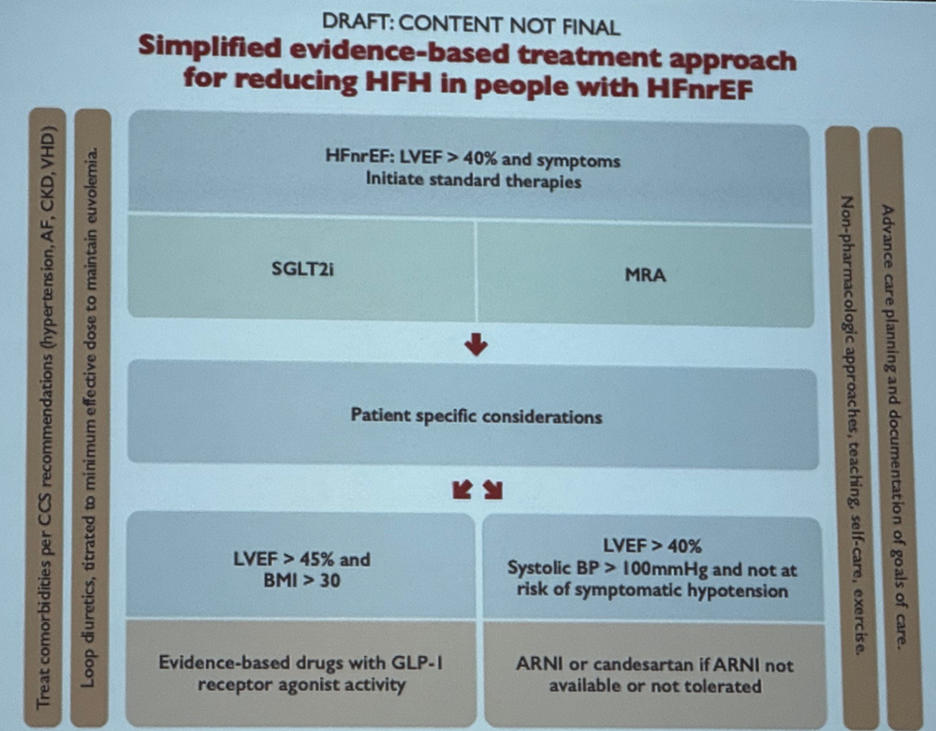
HFnrEF Management
Treat comorbidities
  AF, HTN, CKD, VHD

Slide 19
HFnrEF Management
Treat comorbidities
  AF, HTN, CKD, VHD
Loop diuretics to maintain euvolemia

Slide 20
HFnrEF Management
Treat comorbidities
  AF, HTN, CKD, VHD
Loop diuretics to maintain euvolemia
Non-pharmacologic interventions
  Self management
  Exercise

Slide 21
HFnrEF Management
Treat comorbidities
  AF, HTN, CKD, VHD
Loop diuretics to maintain euvolemia
Non-pharmacologic interventions
  Self management
  Exercise
Advanced care planning
  Document goals of care

Slide 22
HFnrEF Management
HFnrEF: LVEF >40% and symptoms
  SGLT2i
  MRA

Slide 23
HFnrEF Management
HFnrEF: LVEF >40% and symptoms
  SGLT2i
  MRA
LVEF >45% and BMI >30
  Evidenced based GLP1a
    Weak recommendation, moderate evidence

Slide 24
HFnrEF Management
HFnrEF: LVEF >40% and symptoms
  SGLT2i
  MRA
LVEF >45% and BMI >30
  Evidenced based GLP1a
    Weak recommendation, moderate evidence
LVEF >40% with sufficient BP
  ARNI (candesartan if not tolerable)
    Weak recommendation, moderate evidence

Slide 25
PATIENT CASE
65M new CHF
orthopnea, edema resolve with diuresis
NYHA II
PMHX
  Afib/Flutter, HT
Meds:
  Bisoprolol
  Apixaban
  Amiodarone 200mg daily
  Lasix 40mg daily PRN
Exam: BP 105/70, HR 65 reg
  JVD distended
  Bilat crackles
Investigations:
  Creat 70, K 4.8
  2D echo
    LVEF 55 %
    No valvular disease
Questions:
  How do you categorize his CHF?
  Management?

Slide 26
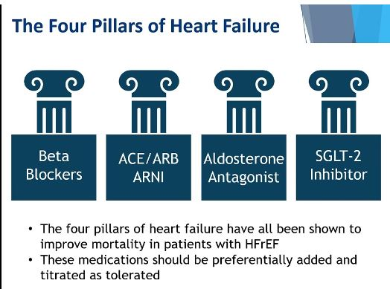
HFpEF
HFp-EF
?
GLP-1 Agonist

Slide 27
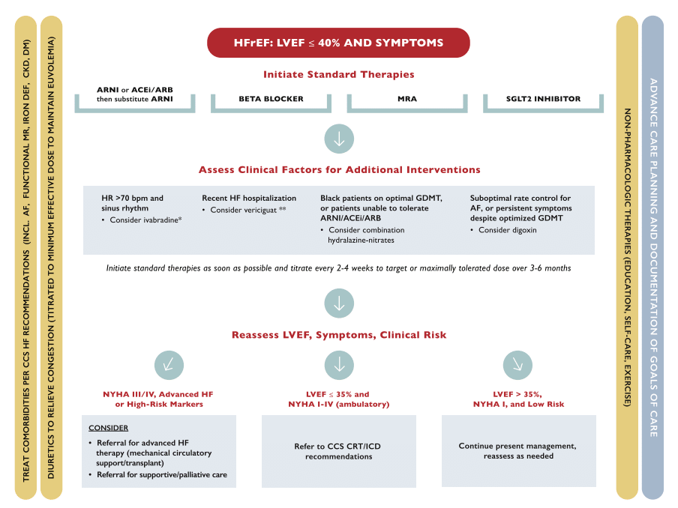
HFrEF Background: CCS Guidelines
Michael McDonald, Sean Virani, Michael Chan, et al. CCS/CHFS Heart Failure Guidelines Update: Defining a New Pharmacologic Standard of Care for Heart Failure With Reduced Ejection Fraction. Can J Cardiol. 2021 Apr;37(4):531-546

Slide 28
HFrEF
HFrEF

Slide 29
Patients have multiple co morbidities - HFrEF
Diabetes
CAD
Nephropathy
EtOH use disorder
As we are looking to change multiple endpoints
GLP-1 agonists may be also indicated

Slide 30
Interpretation of NT Pro BNP

Slide 31
Doris
83 yo female
Hx HT/DM/a fib
No known CAD
SOBOE 2 blocks with ankle swelling – stable
No ER visits
Echo – EF 51%
Meds
  Metformin 250 mg bid
  Empagliflozin 10 mg od
  Ramipril 10 mg od
  Lasix prn
  Apixaban 2.5 mg bid
O/E BP – 134/80
  Wt 57 kg – HR 73 irreg
  Mild periph. edema, ? JVP
  eGFR 35
  NT Pro BNP 456

Slide 32
Two Key Diagnostic Tests: BNP and Echo
NT-proBNP
or BNP
(if available*)
Echocardiography
and/or
To look for borderline-high
to high natriuretic peptides
To look for abnormal ventricular structure and function
No abnormalities → HFpEF unlikely → work up other diagnoses
Abnormalities → HFpEF likely → treat accordingly
*Natriuretic peptides are not available in all jurisdictions in Canada.
BNP: B-type natriuretic peptide; HF: heart failure; HFpEF: heart failure with preserved ejection fraction; NT-proBNP: N-terminal pro-B-type natriuretic peptide.
Adapted from Ezekowitz JA, et al. Can J Cardiol. 2017;33(11):1342-433
Notes:
The more objective evidence you have that supports the HFpEF diagnosis, the greater the likelihood of the patient having HFpEF. Individually, these are not definitive, but the sum of patient history, physical exam, and investigations allows clinicians to make a definitive diagnosis.

Slide 33
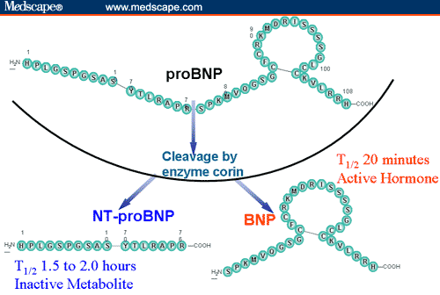
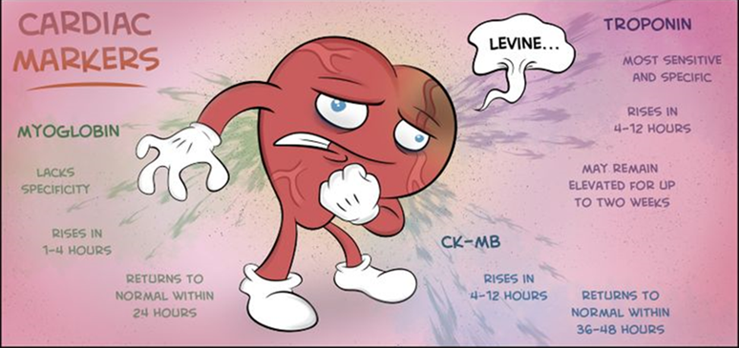
BNP and NT-proBNP
Notes:
BNP reduces SVR and induces natriuresis and diuresis
Nesiritide:
In patients with acute heart failure (HF), nesiritide increases rates of hypotension, does not alter rates of death or rehospitalization at 30 days, and shows a borderline significant trend toward reducing dyspnea.

Slide 34
NT-proBNP
Marker of myocardial stretch
  Right ventricular failure (PE, pulm HTN)
  Coronary artery disease
  Myocardial trauma (contusion, cardiac surgery, cardioversion)
  Cancer chemotherapy
  Myocardial injury
  Renal insufficiency
  Critical illness/sepsis
Continuous vs dichotomous variable
Notes:
Heart failure with reduced or preserved ejection fraction
◾Right ventricular failure (PE, pulm HTN)
◾Coronary artery disease
◾Myocardial trauma (contusion, cardiac surgery, cardioversion)
◾Cancer chemotherapy
Critical illness/Sepsis
Renal insufficiency

Slide 35
NT-proBNP
Most useful with an intermediate pretest probability of HF (eg, symptoms of dyspnea in a patient with predisposing conditions for HF, no evidence of fluid retention).
High levels support a diagnosis of acute HF.
Intermediate NT-proBNP levels are neither sensitive nor specific for detecting or excluding acute HF.
  Other diagnoses (pulmonary embolism, left ventricular dysfunction without exacerbation, cor pulmonale, etc) should also be considered
In general, NT-proBNP levels <300 pg/mL are optimal for excluding a diagnosis of HF

Slide 36
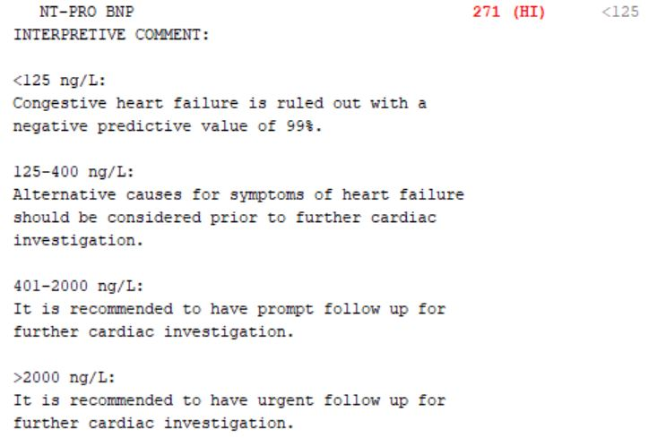

Slide 37
How Do We Interpret BNP or
NT-proBNP assay results?
Serum BNP and NT-proBNP levels (in pg/mL)
Unlikely HF
Lower specificity
Higher specificity
 | Sinus Rhythm* | Atrial fibrillation* |  | Sinus Rhythm* | Atrial fibrillation*
NT-proBNP | <125 | <375 |  | >220 | >660
BNP | <35 | <105 |  | >80 | >240
Normal levels
Diagnosis of HF unlikely¹
Normal NP levels do not exclude HFpEF because of possible confounding factors²
Major criterion for HFpEF recommended by the Heart Failure Association of ESC²
Echo required
*Definitive cut-offs to diagnose HFpEF are not well established, and trials have used different values
e.g., EMPEROR-Preserved: >300 pg/mL for sinus rhythm, >900 pg/mL for atrial fibrillation³
Average NP levels are found to be 3x higher in patients with AF than in patients in SR. The Heart Failure Association of ESC recommends values in patients with AF that are three times higher than used for patients in SR.
AF: atrial fibrillation; BNP: B-type natriuretic peptide; CV: cardiovascular; ESC: European Society of Cardiology; HF: heart failure; HFpEF: heart failure with preserved ejection fraction;
NP: natriuretic peptides; NT-proBNP: N-terminal B-type pro natriuretic peptide; SR: sinus rhythm
1. Ezekowitz JA, et al. Can J Cardiol. 2017;33(11):1342-433; 2. Pieske B et al. Eur Heart J. 2019;40(40):3297–317; 3. Anker SD, et al. N Engl J Med. 2021; 385(16):1451-61.
Notes:
Speak to slide

Slide 38
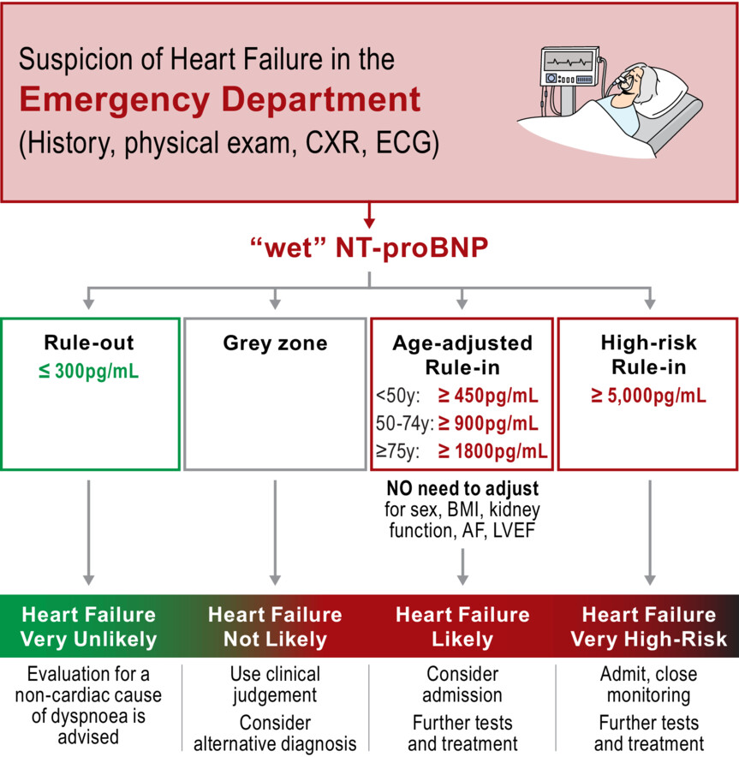
Practical algorithms for early diagnosis of heart failure and heart stress using NT‐proBNP: A clinical consensus statement from the Heart Failure Association of the ESC
European J of Heart Fail, Volume: 25, Issue: 11, Pages: 1891-1898, First published: 15 September 2023, DOI: (10.1002/ejhf.3036)
Notes:
NT‐proBNP for diagnosis of heart failure in the emergency department. AF, atrial fibrillation/flutter; BMI, body mass index; CXR, chest x‐ray; ECG electrocardiogram; LVEF, left ventricular ejection fraction; NT‐proBNP, N‐terminal pro‐B‐type natriuretic peptide.
IF THIS IMAGE HAS BEEN PROVIDED BY OR IS OWNED BY A THIRD PARTY, AS INDICATED IN THE CAPTION LINE, THEN FURTHER PERMISSION MAY BE NEEDED BEFORE ANY FURTHER USE. PLEASE CONTACT WILEY'S PERMISSIONS DEPARTMENT ON PERMISSIONS@WILEY.COM OR USE THE RIGHTSLINK SERVICE BY CLICKING ON THE 'REQUEST PERMISSIONS' LINK ACCOMPANYING THIS ARTICLE. WILEY OR AUTHOR OWNED IMAGES MAY BE USED FOR NON-COMMERCIAL PURPOSES, SUBJECT TO PROPER CITATION OF THE ARTICLE, AUTHOR, AND PUBLISHER.

Slide 39
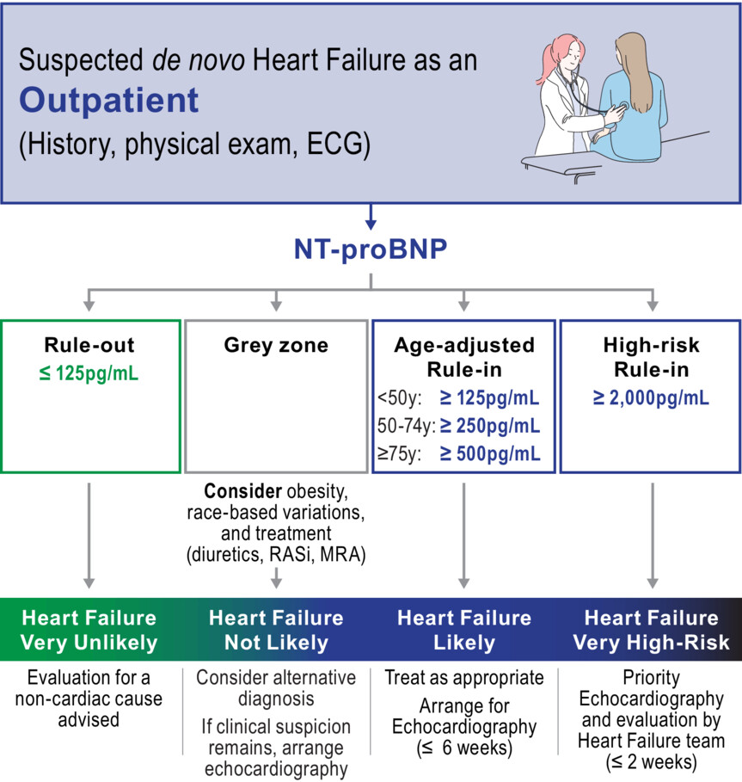
Practical algorithms for early diagnosis of heart failure and heart stress using NT‐proBNP: A clinical consensus statement from the Heart Failure Association of the ESC
European J of Heart Fail, Volume: 25, Issue: 11, Pages: 1891-1898, First published: 15 September 2023, DOI: (10.1002/ejhf.3036)
Notes:
NT‐proBNP for diagnosis of de novo heart failure in the outpatient setting. ECG electrocardiogram; MRA, mineralocorticoid receptor antagonist; NT‐proBNP, N‐terminal pro‐B‐type natriuretic peptide; RASi, renin–angiotensin system inhibitor.
IF THIS IMAGE HAS BEEN PROVIDED BY OR IS OWNED BY A THIRD PARTY, AS INDICATED IN THE CAPTION LINE, THEN FURTHER PERMISSION MAY BE NEEDED BEFORE ANY FURTHER USE. PLEASE CONTACT WILEY'S PERMISSIONS DEPARTMENT ON PERMISSIONS@WILEY.COM OR USE THE RIGHTSLINK SERVICE BY CLICKING ON THE 'REQUEST PERMISSIONS' LINK ACCOMPANYING THIS ARTICLE. WILEY OR AUTHOR OWNED IMAGES MAY BE USED FOR NON-COMMERCIAL PURPOSES, SUBJECT TO PROPER CITATION OF THE ARTICLE, AUTHOR, AND PUBLISHER.

Slide 40
Modifications for Co-morbid conditions
Age
Atrial Fib
  HR < 90 50%
  HR > 90 100%
Obesity BMI
  30-35 25%
  35-40 – 30%
  > 40 - 40%
CRF -
  <30 35%
  30-45 25%
  45-60 15%

Slide 41
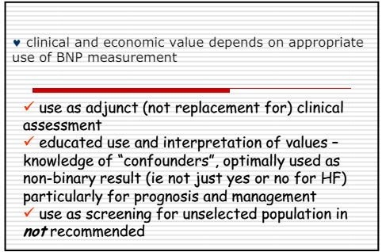

Slide 42
CM
63 yo female
  CVA 2016
  CAD with MI 2020 – PCI LAD
  CHF with EF 54%, Hosp x2
  DM
Meds –
  Bisoprolol 5 mg od
  Candasartan 16 mg od
  Lasix 80 mg od
  Rosuvastatin 40 mg po od
  ECASA
  lnagliptin Metformin 500 bid/Gliclizide
? Recommendations
Prev intolerance to Semmaglutide (0.25 mg x 2 weeks – ER - N& V)
Stopped spironolactone k+ 6.0
Stopped Dapagliflozin 10 mg due to recurrent GM1 and polyuria
Postural dizziness
O/E
  BMI 35
  BP 98/54
Labs
  eGFR 30, K+ 5.2
  uACR 25
  A1C 9.0
Drug Plan $2,500 per year

Slide 43
What medications would you like to put her on?
Finerenone
  HFpEF/Diabetic Nephropathy
  But she has K+ 5.2, cost
SGLT 2 Inh
  HFpEF/HFrEF/CV Protection post MI/Nephropathy/A1C/Wt
  But she can’t tolerate with GMI/Postural dizziness/cost
GLP-1
  HFpEF/Diabetic Nephropathy/CV protection post MI/A1C
  But prev intolerance/costs

Slide 44
Optimizing GDMT with Hyperkalemia
? Hemolysed
Discontinue K+ replacements
Dietary Education
Use HCT/Chlorthalidone 50 mg od or furosemide
Use SGLT-2 Inh
Switch MRA -> decrease MRA -> decrease ARB
Hold MRA if K+ > 5.5 -> rechallenge
Initiate K+ Binders

Slide 45
The Motivational Speech - Polyuria
Indication is for CV/Renal Protection
  – 30% mortality reduction
  35% reduction CHF
  50% reduction Kidney Failure
Benefits
  Glucose/Wt/BP
Downside
  GMI
  polyuria

Slide 46
The Motivational Speech - Polyuria
Indication is for CV/Renal Protection
  – 30% mortality reduction
  35% reduction CHF
  50% reduction Kidney Failure
Benefits
  Glucose/Wt/BP
Downside
  GMI
  polyuria
“ Peeing with a Purpose”
“Pee with benefits”

Slide 47
Postural Symptoms/Pre-Renal Failure
Avoid overdiuresis
  Lasix to 40 + 40
Delete anti-hypertensives without CV benefit
  Amlodipine/ BB
Reduce RAAS/ Inh
  . with predominantly RV Failure
Low dose SGLT -2 Inh – max Empagliflozin 10 mg od

Slide 48
Practical tips: Genital mycotic infections (GMIs)
Uncomplicated
  (Healthy, non-pregnant, <3 inf/year, mild/mod symptoms)
  Fluconazole 150 po single dose
Complicated
  Severe signs, > 3/ year, poorly controlled DM, immunocompromised
  Fluconazole 150 mg po q 3 days , 2-3 doses
    +/1 clotrimazole/betamethasone x 48 hrs
    Or Topicals – 7-14 days
Recurrent – >3 year
  Fluconazole 150 mg po q 72 hrs x 3, then once weekly x 6 months
Balanitis – ask if circumsized
  Advise of potential SE
  Topical cream/po fluconazole considered

Slide 49
Fluconazole
Prescription -$3.94 per 150 mg tabs
  + dispensing fee eg. $12.99
  Annual Cost – 1/ month - $60.27
Ontario -LU Code 235
150 mg tab q 25 days prn for vaginal Candidiasis
  Annual Cost – 1/month = $48
  Annual Cost - $4.00 + dispensing fee
50 mg x 3 covered

Slide 50




Simple strategies to help patients manage
GLP-1 RA-related GI side effects
Eat smaller meals
Avoid fatty and spicy foods
Take on an empty stomach or before bed time
Stay hydrated
?
What tips or recommendations
for managing side effects have your patients found useful?

Slide 51

Ozempic Micro-Dosing
There are many “clicks” between the marked doses on the Ozempic pen. There are 18 “clicks” between 0 and 0.25mg and 18 “clicks” between 0.25mg and 0.5mg. On the 1mg pen there are 74 “clicks” between 0 and 1mg.
Use ____ clicks once a week and if tolerating well, continue to increase by ____ clicks every _____ weeks, until at the recommended dose of ______mg once weekly.
Once you are on a dose of 0.25 mg weekly, please discontinue your ___________ (Onglyza/Trajenta/Januvia)

Slide 52
Summary
CHF is a complex syndrome
Clinical diagnosis

Slide 53
Summary
CHF is a complex syndrome
Clinical diagnosis
Often unclear categorization upon presentation (i.e. unknown LVEF)

Slide 54
Summary
CHF is a complex syndrome
Clinical diagnosis
Often unclear categorization upon presentation (i.e. unknown LVEF)
Substantial overlap of initial management regardless of LVEF
  non-pharmacological management
  Loop diuretics
  SGLT2i
  MRA

Slide 55
Summary
CHF is a complex syndrome
Clinical diagnosis
Often unclear categorization upon presentation (i.e. unknown LVEF)
Substantial overlap of initial management regardless of LVEF
  non-pharmacological management
  Loop diuretics
  SGLT2i
  MRA
CHF management is complex
  Orillia Heart Function is a multidisciplinary clinic aimed at addressing this

Slide 56
Summary
CHF is a complex syndrome
Clinical diagnosis
Often unclear categorization upon presentation (i.e. unknown LVEF)
Substantial overlap of initial management regardless of LVEF
  non-pharmacological management
  Loop diuretics
  SGLT2i
  MRA
CHF management is complex
  Orillia Heart Function is a multidisciplinary clinic aimed at addressing this
Management matters!
  Outcomes improve with pharm/non-pharm management even in the sickest individuals

Slide 57

sdcrc.ca
OTN
virtualhallway.ca
jcmacfad@gmail.com

