Slide 1
Advances in Device therapy
Highlights of CCS 2026 CIED Guidelines
Bernice Tsang Southlake Regional Health
Division Head of Electrophysiology

Slide 2
Sinus Bradycardia – Practical tips
There is NO MINIMUM HR or pause duration to indicate permanent pacing is absolutely indicated in the absence of symptoms.
Pacing not recommended for asymptomatic nocturnal sinus pauses or sinus bradycardia
With Tachybrady syndrome, consider underlying cause before pacemaker implantation (e.g. PVI for conversion pause of AF)

Slide 3
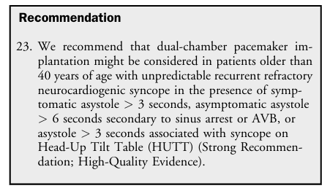
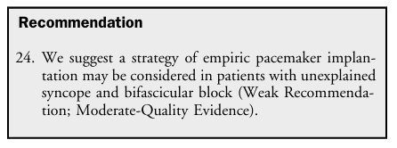



syncope
In all age groups > neurocardiogenic syncope is COMMON (vasodepressor, vasovagal)
Canadian Syncope Risk Score
Negative predictive accuracy of PES for syncope and bifasicular block is only 70% suggesting EPS inaccurate guide to ppm implantation

Slide 4
Pacing for AV block – Practical tips
AV block can occur at or above level of AV node or below (infranodal – intra-His or Infra-His)
Important to determine if transient 2:1 AV block is supranodal or infranodal when considering need for pacemaker
Worsening AV block with exertion can indicate infranodal block
For AF: Pacemaker is recommended for >6 second pause or SUSTAINED slow ventricular response (<40bpm) WHILE AWAKE
Pacing is not recommended for asymptomatic nocturnal bradycardia (ALL types - regardless of length)

Slide 5
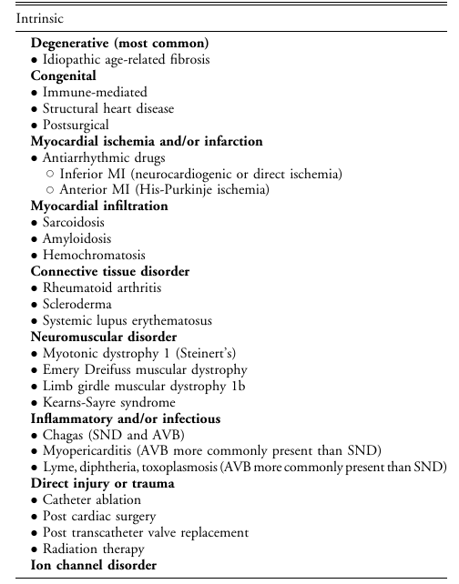

Slide 6
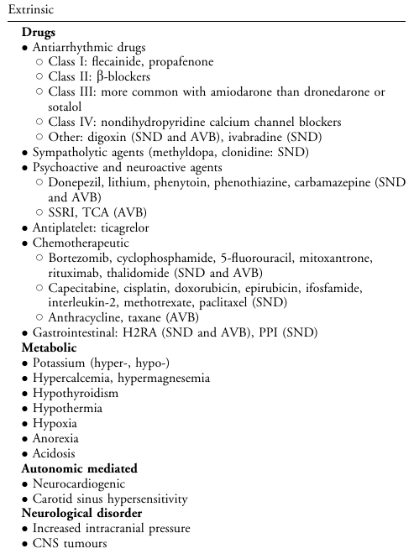

Highlights:
exclude sarcoid in patients <70 yo. Careful hx about past lung/ systemic sarcoid disease, investigate with CT chest
  Coexists with RBBB, RV dysfunction, LV dysfunction, PVC, NSVT
  Sarcoid patients are at risk of ventricular arrhythmias and should have ICD
Consider amyloid – common AV block with LVH, coexist with AF
Consider lyme disease – which can affect one of any age, with any exposure
Consider meds: ticagrelor, psychoactive and neuroactive including donepezil
  Review the comprehensive list
Post TAVI

Slide 7
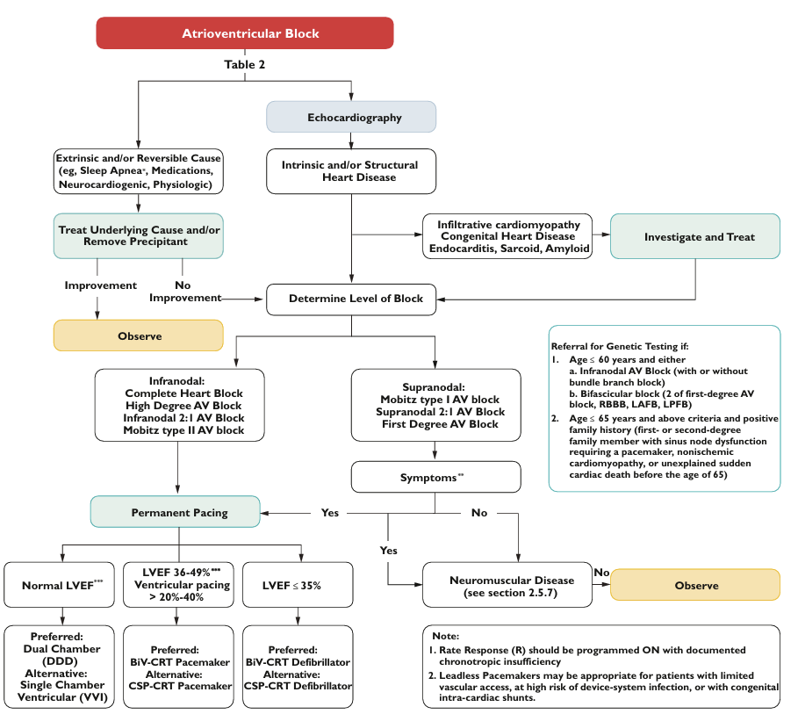

Slide 8
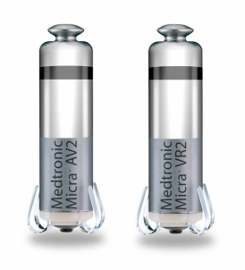
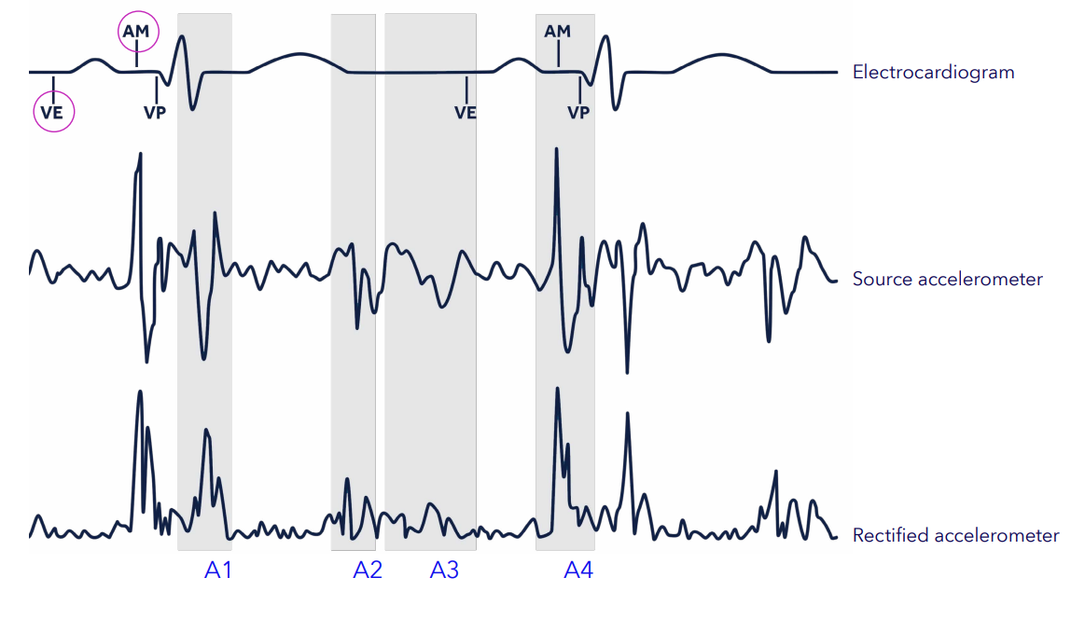
Micra leadless pacemaker: VR2 and AV2-2nd Generation
Micra VR2 has a projected median longevity of 16.7 years — which is 36% more than its predecessor (12.2 years)
Micra AV2 has a projected median longevity of 15.6 years — which is 44% more than its predecessor (10.8 years)
Atrial mechanical (AM) marker: Marker that indicates the device detected the atrial mechanical contraction or A4.
Notes:
Now after 10 years on the market the second generation of Micra has been released boasting…
Time will tell whether this bears out

Slide 9
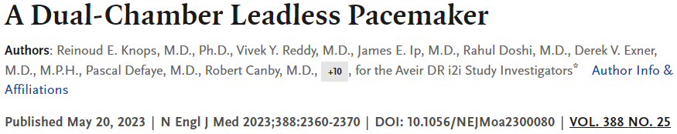
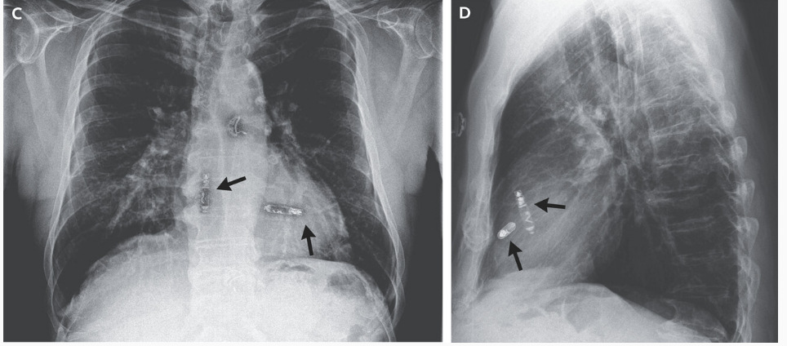
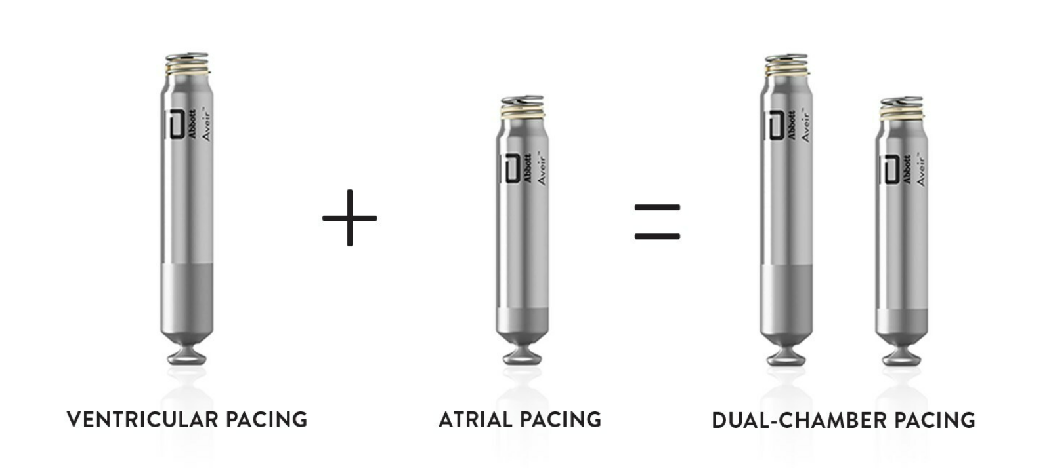

Slide 10
Minimize ventricular pacing
Avoiding ventricular pacing if underlying conduction is sick sinus / sinus node chronotropic incompetence
  Minimize pacing induced cardiomyopathy
  Reduction of atrial fibrillation
  Preference to dual chamber pacemaker > allow AV synchronous pacing if ventricular pacing required >minimize pacemaker syndrome especially in presence of tricuspid regurgitation

Slide 11
Cardiac resynchronization: Biventricular vs Physiological / Conduction system pacing
Recommend revision to BiV-CRT for patients with an existing pacemaker or ICD with reduced LVEF ≤ 45%, frequent RV pacing, and NYHA class II-IVa HF
CSP might be considered alternative to biV pacing in EF 36-50% and alternative to RV pacing in EF>50%
Left V left study & Left HF study amongst others pending
Why?
  Fewer leads >lowers risk of venous stenosis, DVT, infection, pneumothorax.
  Longer battery life
  Avoidance of LV lead which results in potential inadequate thresholds, diaphragmatic stimulation, poor placement

Slide 12
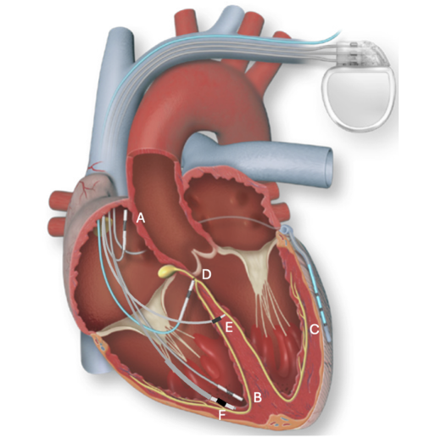
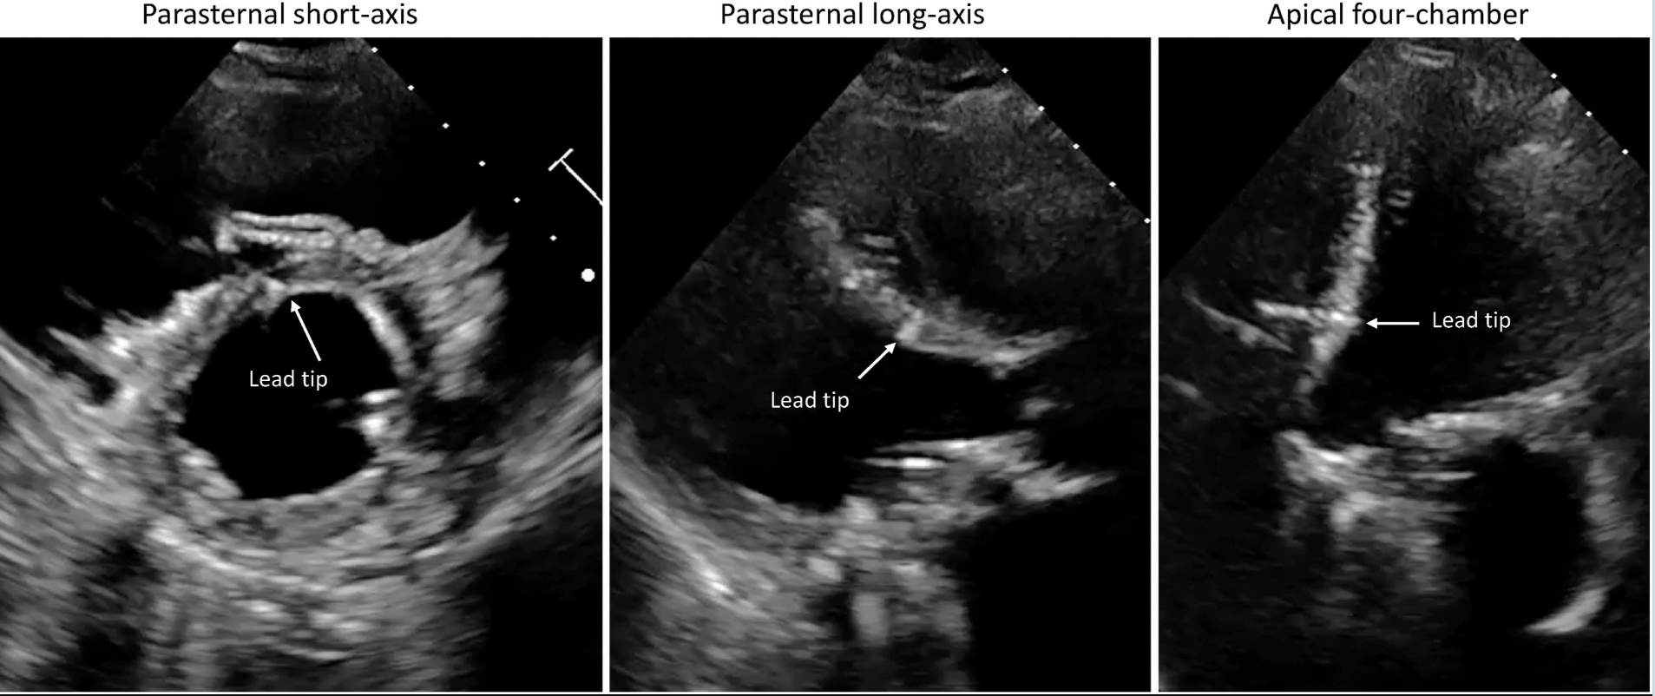
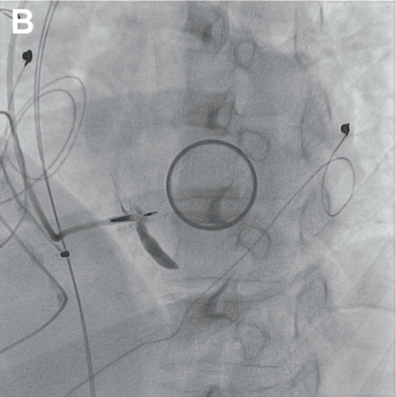

Slide 13
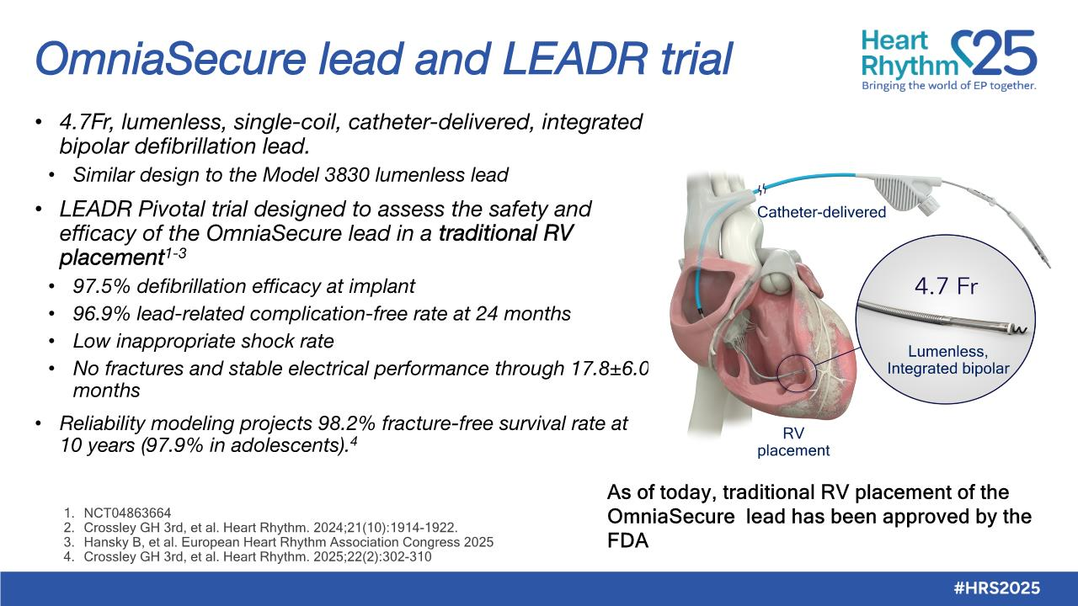
Notes:
Currently, as you saw with my previous description, cardiac resynchronization defibrillator system with LBBAP would require 2 leads in the RV.
An advancement would be if the defibrillator coil would be integrated into the LBBAP pacing lead.
And the lead for this job might be the omnisecure which has been studied as a defibrillator lead in the traditional RV placement in a study presented last year.
This trial which we also participated in demonstrated that the lead was safe and efficacious for defibrillation and pacing in the RV endocardium with low inappropriate shock and low lead related complications

Slide 14
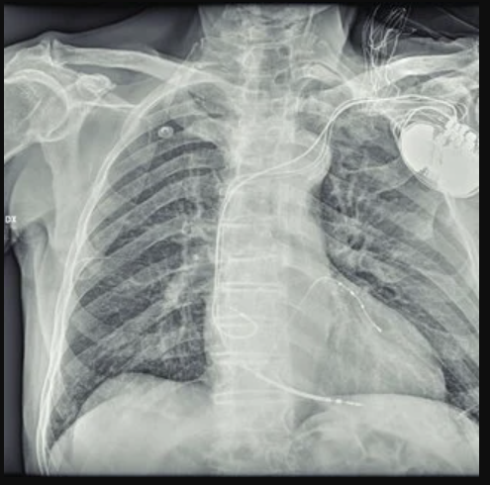
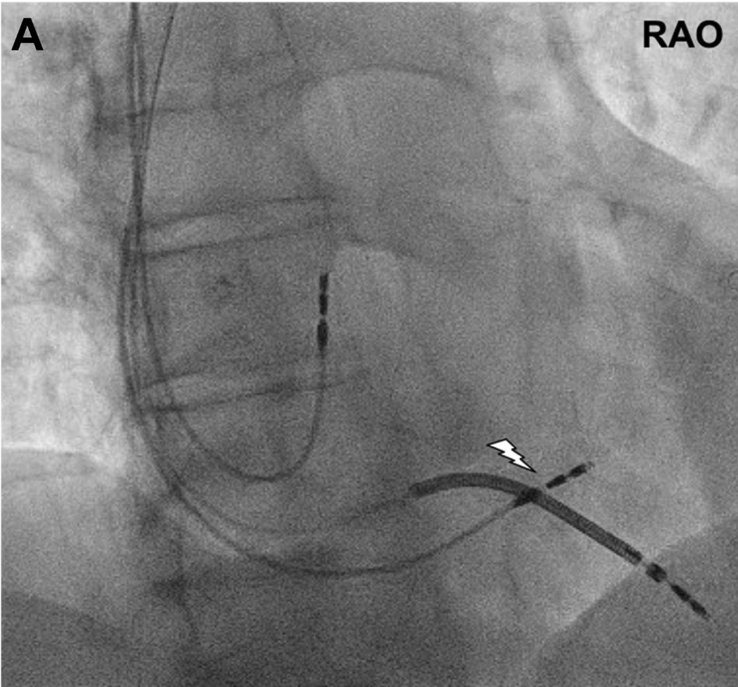
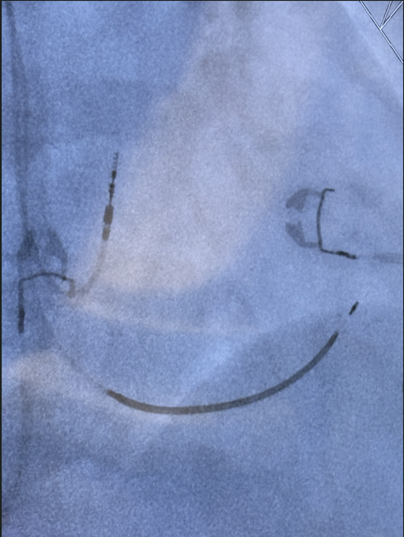
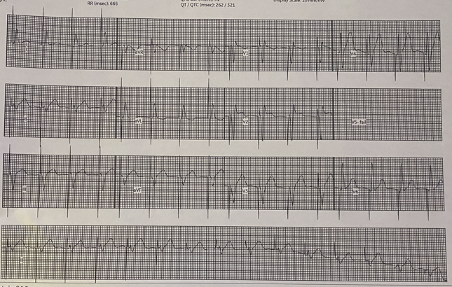
Omnia secure lead

Slide 15
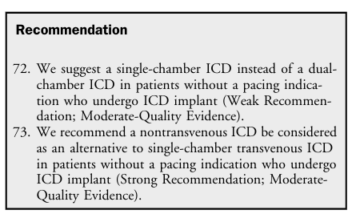
Defibrillator Selection – Transvenous vs not
Patients with difficulties in vascular access (occlusion or stenosis of the upper extremity venous system) or limited pocket sites
Patients with high risk of infection, particularly patients with indwelling vascular catheters, are dialysis dependent, have previous infection or extraction, or are immunocompromised
Patients with moderate to severe tricuspid regurgitation where surgical or percutaneous tricuspid valvular repair or replacement is being considered

Slide 16
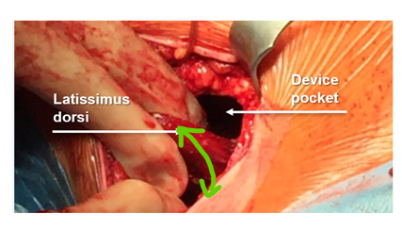
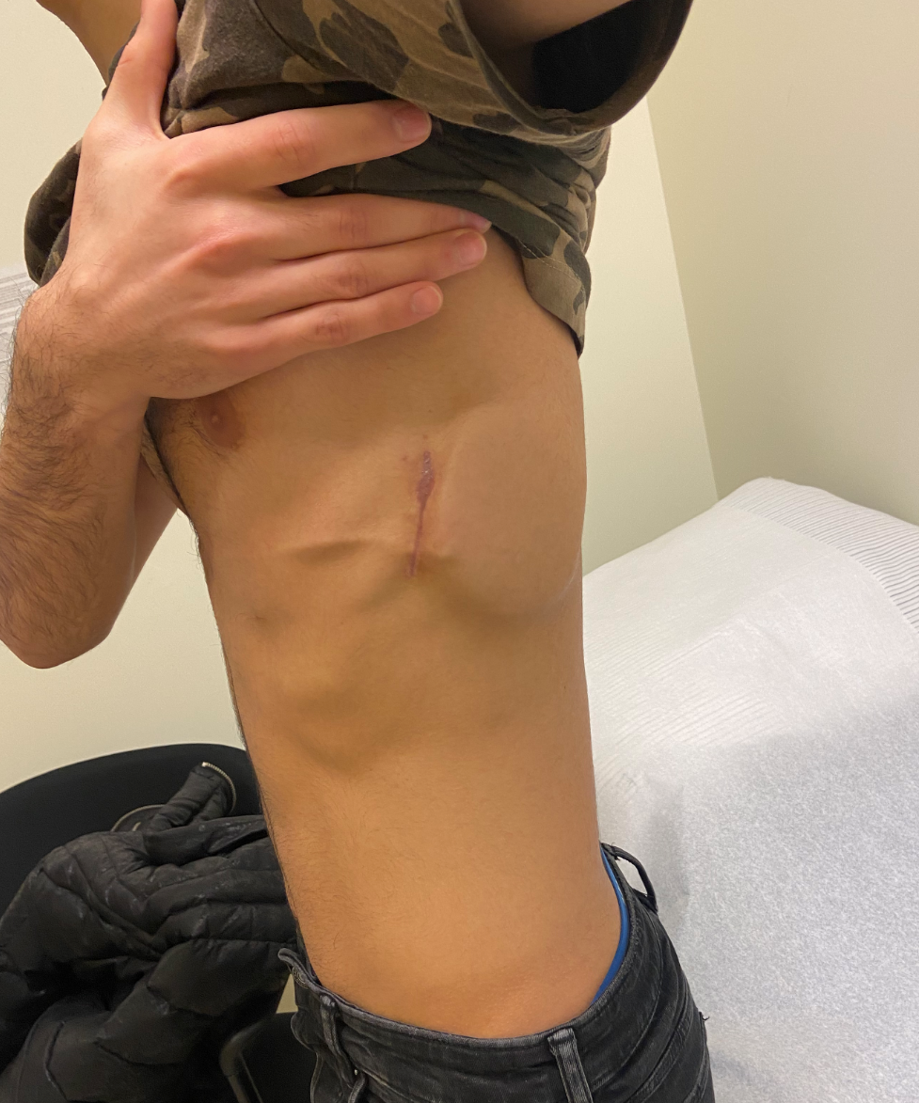
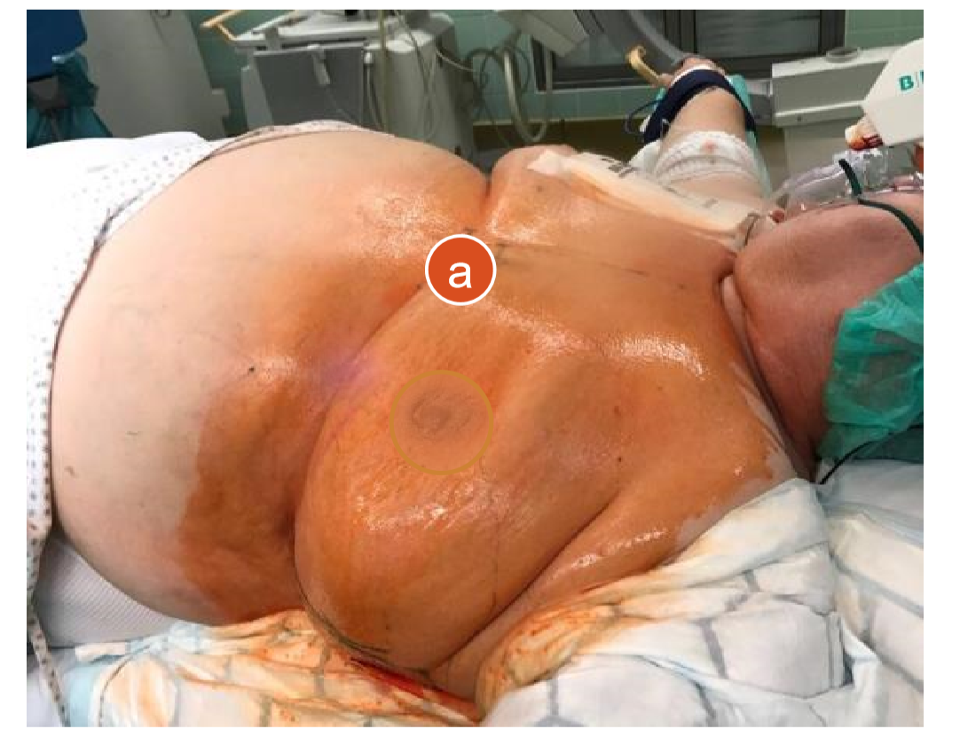
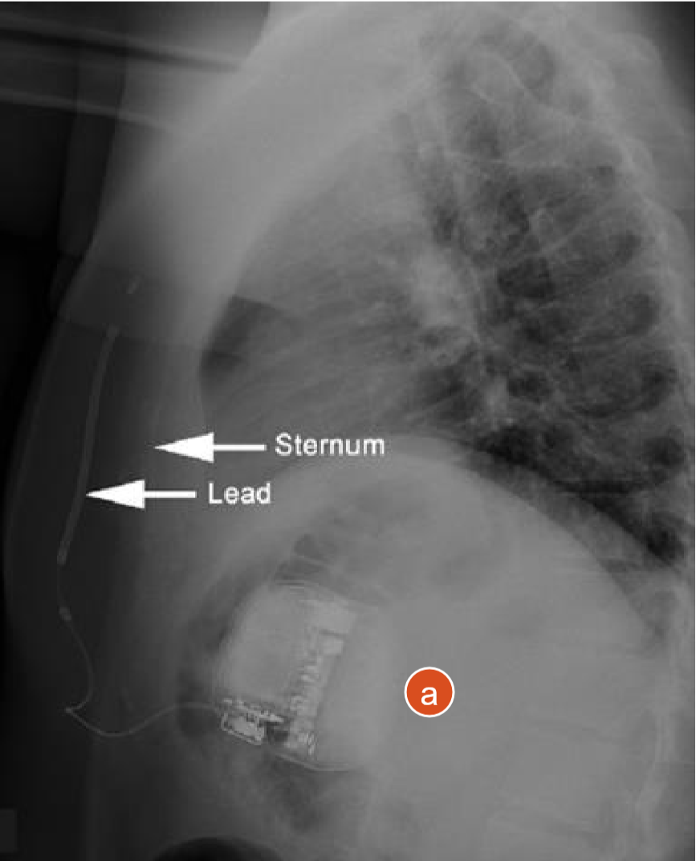
SICD or EV-ICD Then?
Patient Size and Implant Technique

Slide 17
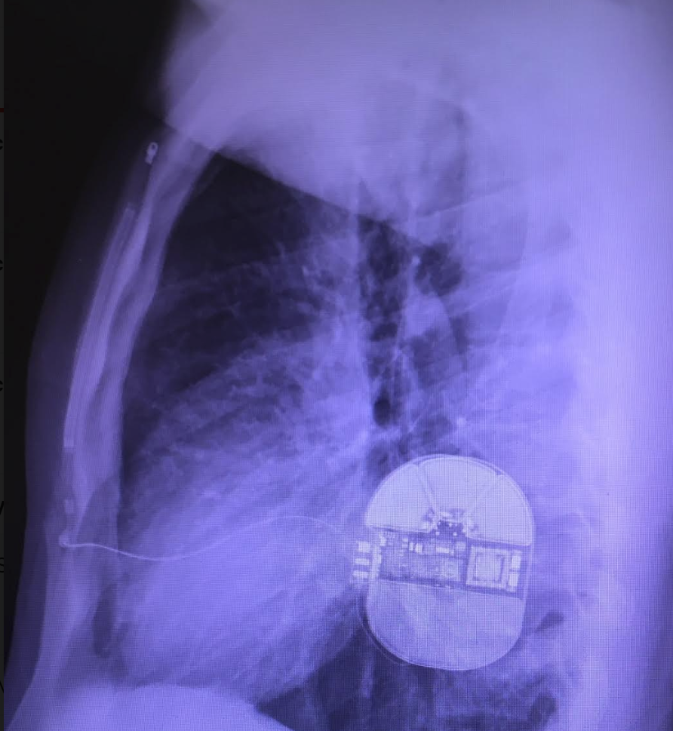
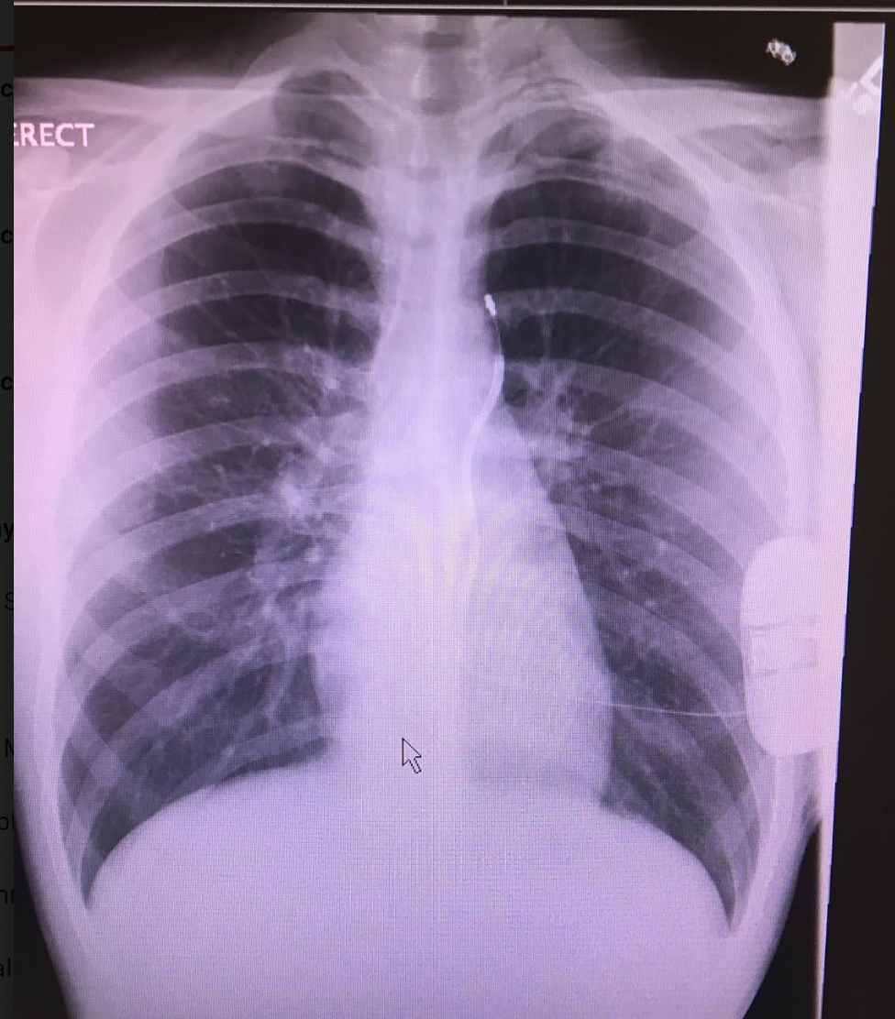
Notes:
Lycklama, s dec 2016

Slide 18
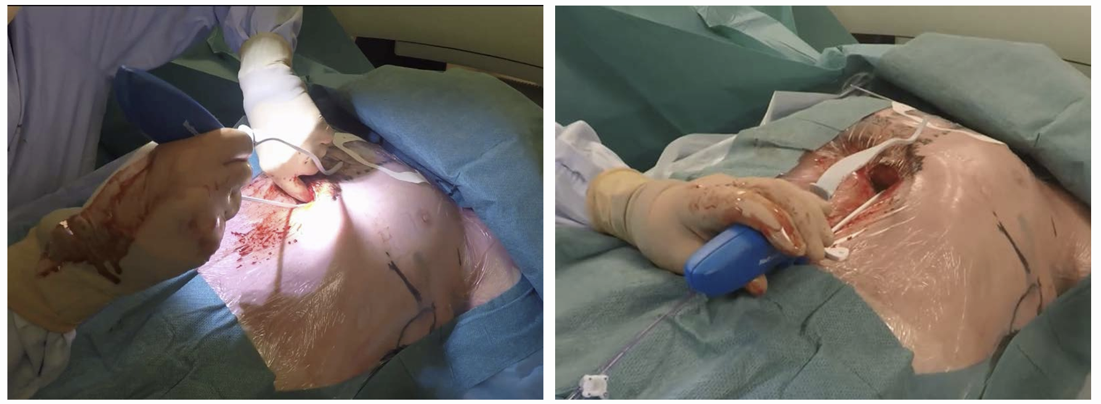
EV – ICD implant technique

Slide 19
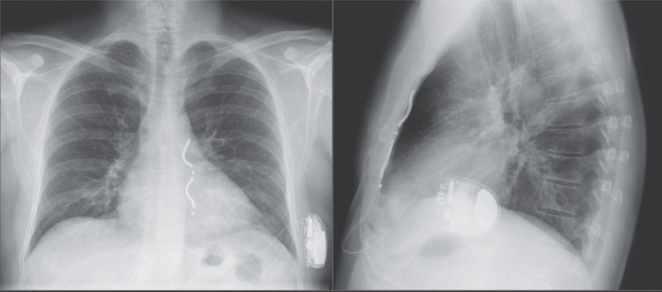
Efficacy and Safety of an extravascular ICD
Friedman P Et al NEJM 2022;387:1292-1302

Slide 20
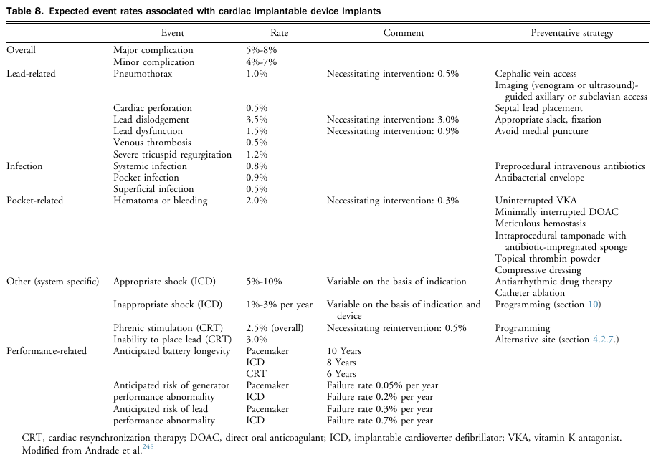

Slide 21
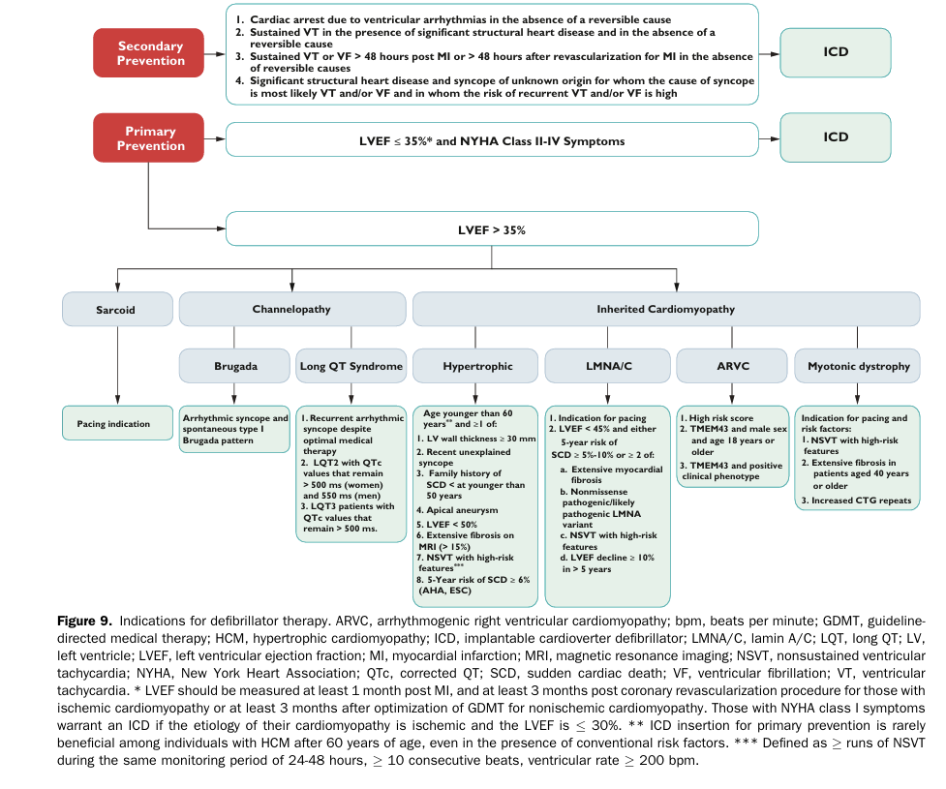

Slide 22
