Slide 1
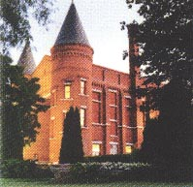
Continuous Glucose Monitoring
A Practical Case-based Approach
-
J.C. MacFadyen
MD, FRCPC, MHPE
May 24, 2023
John MacFadyen MD, FRCPC, MHPE

Slide 2
Faculty/Presenter Disclosure
CFPC CoI Templates: Slide 1
Faculty: John MacFadyen, MD, FRCPC, MHPE
Relationships with commercial interests:
  Grants/Research Support: None
  Speakers Bureau/Honoraria: Boehringher Ingelheim, Astra Zeneca, Sanofi, Pfizer, Lilly, Merck, Jansen, Novo-Nordisk, Abbott, Dexcom
  Consulting Fees: Jansen, Astra Zeneca, Liily, Novo-nordisk
Notes:
This slide must be visually presented to the audience AND verbalized by the speaker.

Slide 3

















John MacFadyen Disclosures

Slide 4
Disclosure of Commercial Support
CFPC CoI Templates: Slide 2
This program has received financial support from Abbott Canada.
Potential for conflict(s) of interest:
  John MacFadyen has received funding Lilly, Novonordisk,Boehringer Ingelheim, Astra Zeneca, Abbott, Sanofi, Dexcom and Jansen whose products are being discussed in this program
Notes:
This slide must be visually presented to the audience AND verbalized by the speaker.

Slide 5
Mitigating Potential Bias
CFPC CoI Templates: Slide 3
  A significant number of slides were derived from three slide decks from Sanofi, Abbott and from a presentation at the Diabetes Update 2022 selected by myself. Cases were developed from my clinical practice..
The information presented provides an unbiased overview of all products related to treating patients with diabetes.
All slides are consistent with the CDA 2022 Guidelines.
Notes:
This slide must be visually presented to the audience AND verbalized by the speaker.

Slide 6
Bias vs Credibility
Clinical Practice x 25 years
Medical Director OSMH DEC 1999 – present
  Actively follow >3,500 pts with Diabetes
CDA Guidelines Committee – 2013
Active Pts on SGLT-2 Inhibitors > 2000
Medical Director Heart Function Program - CFHT

Slide 7
Bias vs Credibility
Clinical Practice x 25 years
Medical Director OSMH DEC 1999 – present
  Actively follow >3,500 pts with Diabetes
CDA Guidelines Committee – 2013
Active Pts on SGLT-2 Inhibitors > 2000
Medical Director Heart Function Program – CFHT
GLP-1 Agonists– 1,347 patients
SGLT-2 Inh. - 2,445 patients

Slide 8
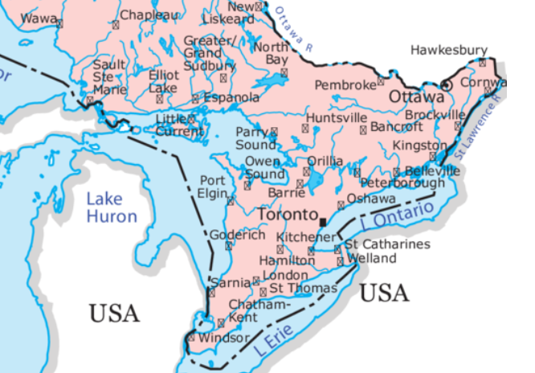
Speaker Origins

Slide 9
MacFadyen’s
Clinical Backgound
North Of Barrie
South Of Barrie

Slide 10
Speaker Origins

Slide 11
MacFadyen’s
Clinical Backgound
North Of Bancroft
South Of Bancroft

Slide 12
Objectives
Discuss how glucose sensor technology can help facilitate virtual and in-person diabetes care within a primary care setting
Explain how sensor data , such as time in range, can be used in conjunction with A1C to guide diabetes management decisions
Describe the impact that glucose sensing technology can have on diabetes self-management and outcomes.
Interpret data from isCGMS to facilitate clinical decision making

Slide 13


Slide 14

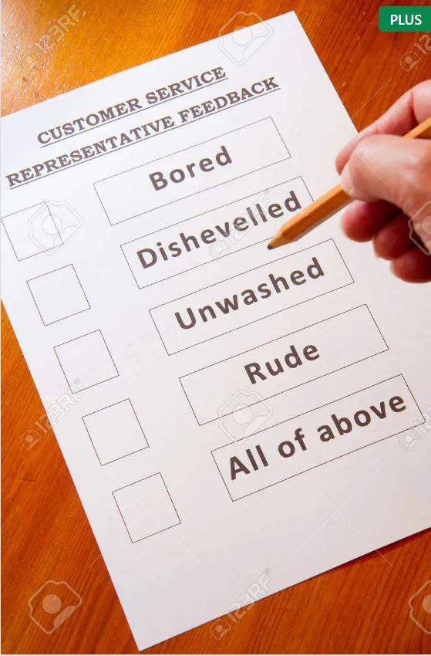

Housekeeping Items

Slide 15
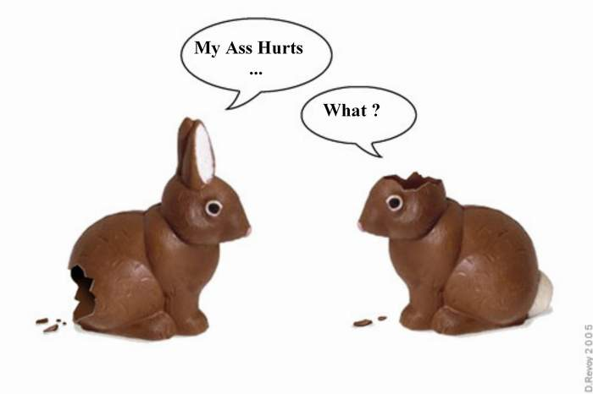
Questions?

Slide 16
A1C: A Snapshot of the Full Story
Finger pricks are a major obstacle to glucose monitoring^{1,2}
Patients do not test as often as they should because of the pain and hassle of finger pricks^{1,2}
Only 1/3 adhere to
blood glucose monitoring as recommended by their HCP¹
And 2/3 report skipping
blood glucose testing because it is invasive to their lives²
1. Vincze G. Diabetes Educ (2004): https://doi.org/10.1177/014572170403000119 2. Wagner J. Diabetes Technol Ther (2005): https://doi.org/10.1089/dia.2005.7.612
Notes:
Key Messages:
CBG is a device widely use however patients are not using it as they should hence the outcome fail short to optimal levels.

Slide 17




Potential Benefits of Sensor-Based Monitoring Technologies
How do newer monitoring technologies like rtCGM and isCGM help?
4 finger stick tests
or
Daily pattern from rtCGM or isCGM
15
T2D
Click to learn more about the clinical benefits of isCGM use
Glucose (mmol/L)
13
11
Highs unnoticed with finger sticks
Ideal range
9
7
Click to see:
“Diabetes Canada: Flash Glucose Monitoring”
5
Lows unnoticed with finger sticks
3
1
T2D
Click to learn more about the clinical benefits of rtCGM use
0
6
12
18
24
Time (h)
Click to see:
“Diabetes Canada: Blood Glucose Monitoring in Adults and Children with Diabetes: Update 2021”
Click to see:
“Diabetes Canada:
Continuous Glucose Monitoring”

Slide 18
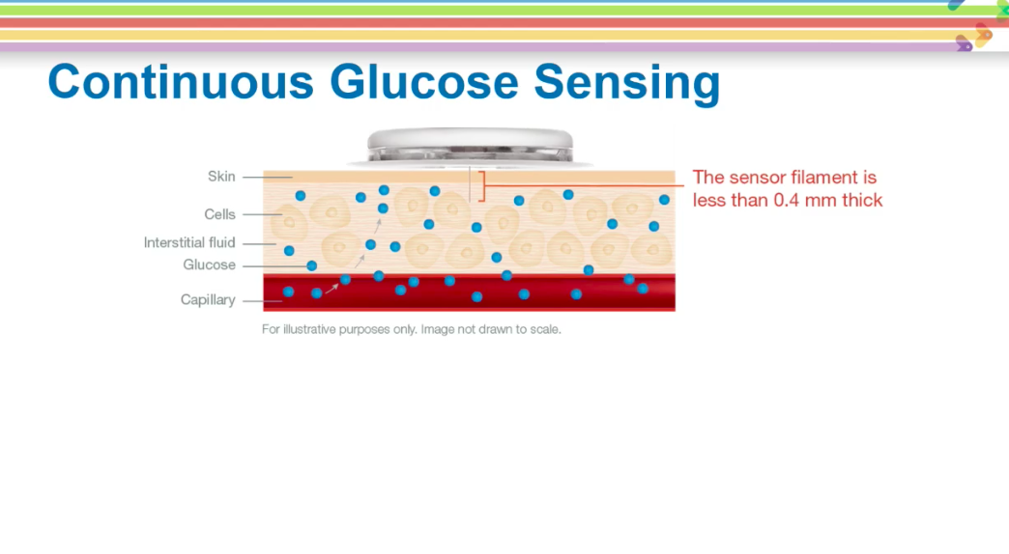

Slide 19
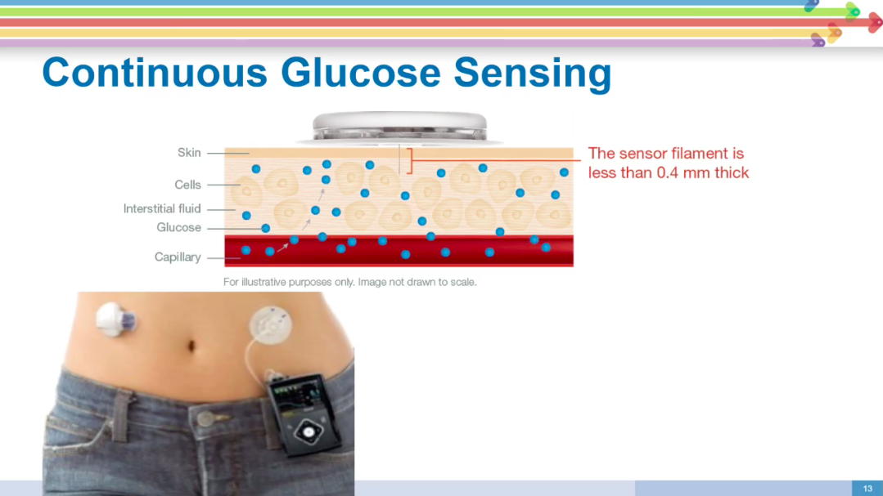

Slide 20
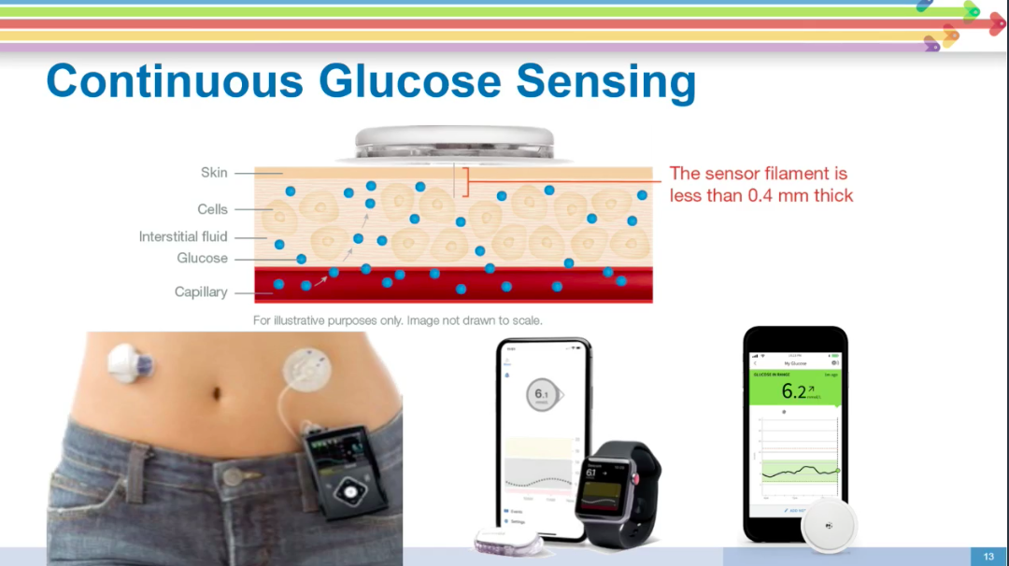

Slide 21
Comparison Between Glucose Monitoring Methods
Capillary blood glucose (CBG)
Intermittently scanned CGM (isCGM)
Real-time CGM
(rtCGM)
Target population | Essential part of self-management for those using insulin >1x/day; should be done ≥3x/day | May be used in people with T1Dª to increase time in range and reduce hypoglycemia May be used in people with T2D^{b} as an alternative to CBG to reduce hypoglycemia | Should be used in people with T1Dª to improve glycemic control (reduce A1C and increase time in range) and reduce hypoglycemia May be used in people with T2D^{b} to improve glycemic control (reduce A1C) and reduce hypoglycemia
Cost | $ | $$ | $$$
Glucose measurement | Capillary blood | Interstitial fluid | Interstitial fluid
Data updated | – | When sensor is scanned | Every 5 minutes
Alarms and alerts | No | Available for FreeStyle Libre 2 Not available for FreeStyle Libre (1) | Yes
Insulin pump connection | No | No | Yes (most devices)
Click to see:
“Diabetes Canada: Blood Glucose Monitoring in Adults and Children with Diabetes: Update 2021”
Finger sticks may be required with isCGM and rtCGM under certain circumstances

Slide 22






Use of isCGM in T2D: REPLACE Study
isCGM use in T2D with intensive insulin therapy has been shown to significantly reduce time spent in hypoglycemia, with reduced nocturnal hypoglycemia and glycemic variability, while improving quality of life
REPLACE study
(RCT)
isCGM vs CBG
% reduction of time in hypoglycemia*
T2D patients:
N=224
≥18 years
T2D for ≥6 months
Bolus only, or basal-bolus, or insulin pump regimen for ≥3 months
A1C 7.5%–12.0%
CBG >10 times/week for ≥2 months
Anytime:
Nocturnal:
24h
–43%
–53%
–54%
–58%
P=0.0006
˂3.9 mmol/L
P=0.0014
˂3.1 mmol/L
P=0.0001
P=0.0032

Slide 23

Use of rtCGM in T2D: MOBILE Study
rtCGM has been shown to reduce A1C and increase time in glucose target range in adults with T2D using basal insulin therapy (± noninsulin antihyperglycemic agents) in a primary care setting
rtCGM vs CBG Mean change in A1C from baseline and time in range at 8 months
MOBILE study
(RCT)
A1C change
% Time in range (3.9–10 mmol/L)
T2D patients:
N=175
≥30 years
Basal only regimen (1 or 2 daily injections) for ≥6 months ± oral agents or GLP-1 RA
A1C 7.8% to 11.5%
Not under care of endocrinologist; recruited from primary care practice
rtCGM*
(n=116)
CBG†
(n=59)
–0.6%
–1.1%
rtCGM*
(n=116)
CBG†
(n=59)
Adjusted difference:
–0.4 (95% CI: –0.8 to –0.1)
P=0.02
Adjusted difference:
15 (95% CI: 8 to 23)
P<0.001

Slide 24

Libre Coverage

Slide 25
To be eligible for coverage, individuals must meet the following EAP Criteria:
Applicant has type 1 diabetes.
Applicant meets one of the following:
  Applicant is unable to recognize or communicate symptoms of hypoglycemia, or independently perform fingerstick glucose testing, owing to their developmental stage or a previously diagnosed cognitive or physical impairment; or
  Applicant had severe hypoglycemia in the past two (2) years without an obvious precipitant, despite optimized use of insulin therapy and glucose monitoring (at least 4 times/day) which result in one of the following:
    suspension of the applicant’s driving license; or
    hospitalization or emergency room or EMS visit; or
    glucagon administration, unconsciousness, or seizure.
Applicant demonstrates experience with and commitment to managing blood sugar control and an ability to use rtCGM safely and effectively by ALL of the following:
  Applicant demonstrates a commitment to long-term diabetes follow-up through regular assessments by diabetes educators, and prescribers at intervals deemed appropriate by the Diabetes Education Program.

Slide 26
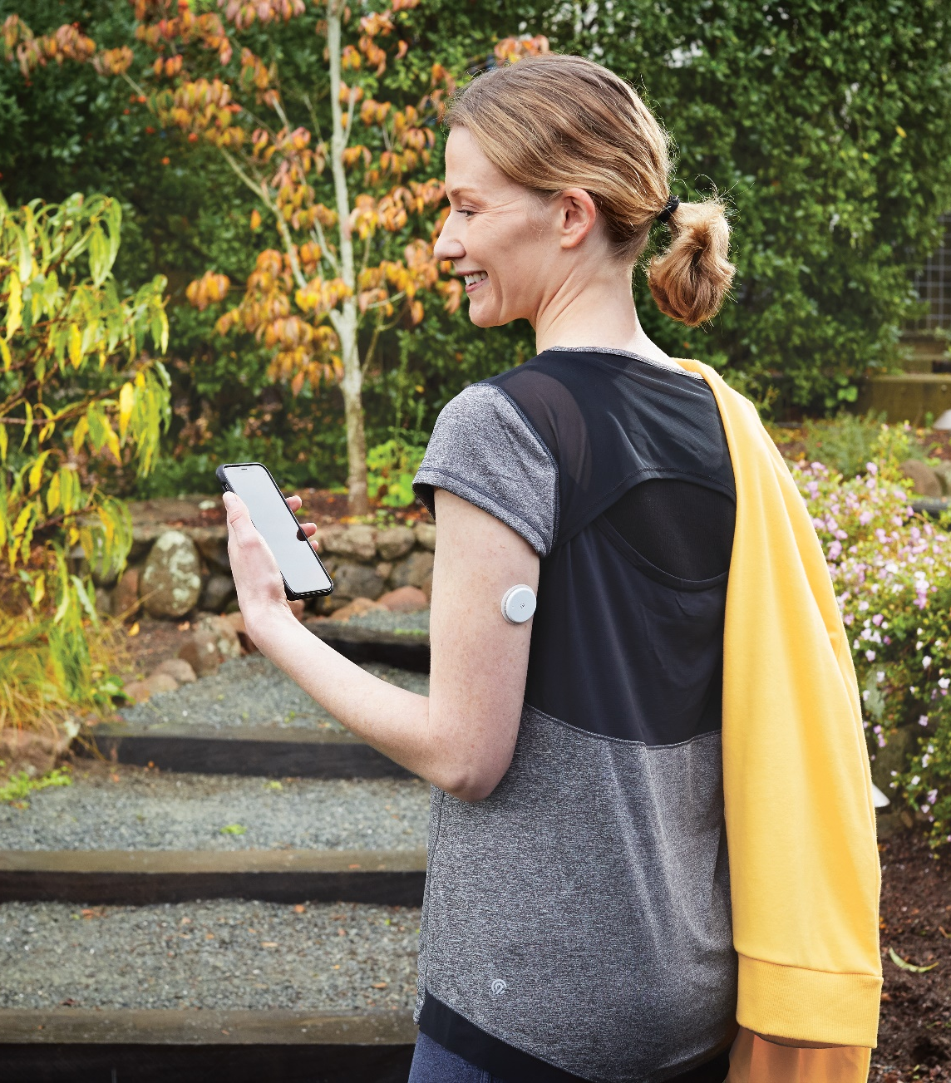



Introducing the
FreeStyle Libre 2 system
WITH OPTIONAL GLUCOSE ALARMS
The FreeStyle Libre 2 app and the FreeStyle Libre 2 reader have similar but not identical features. Finger pricks are required if readings do not match symptoms or expectations. The FreeStyle Libre 2 sensor communicates with the FreeStyle Libre 2 reader that started it or the FreeStyle Libre 2 app that started it. The FreeStyle Libre 2 app is only compatible with certain mobile devices and operating systems. Please check the website for more information about device compatibility before using the app. Use of FreeStyle Libre 2 requires registration with LibreView.

Slide 27
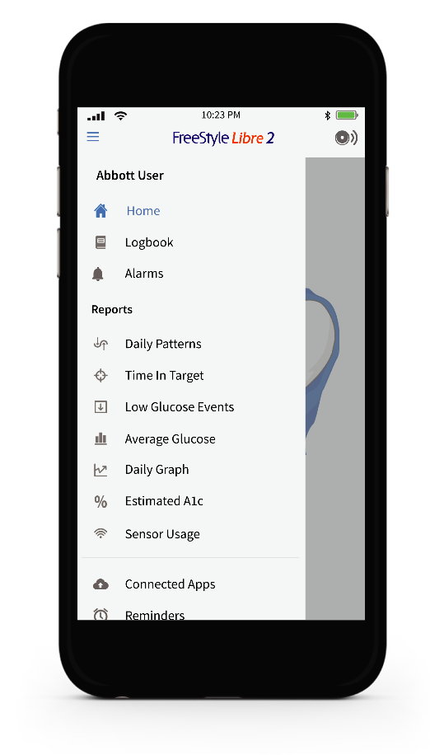
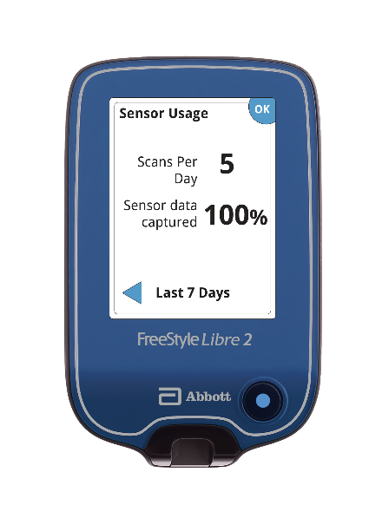
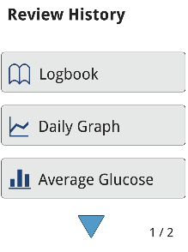
Options for scanning

Slide 28
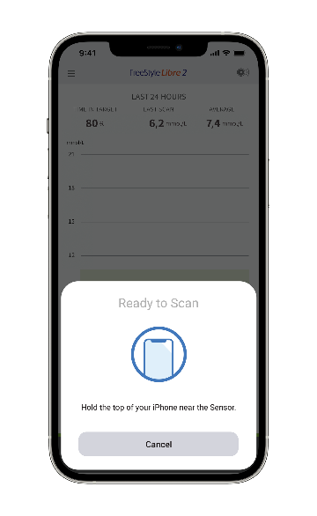
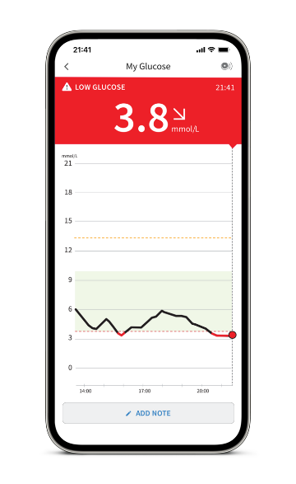
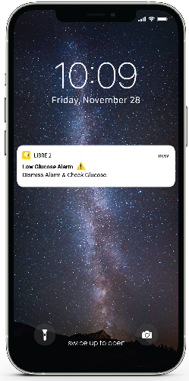
Optional, real time glucose alarms available on the phone or reader*
Alarm
Scan
Act
Automatically† receive an alarm when their glucose is too low or too high
Scan your FreeStyle Libre 2 sensor to see your glucose reading,
trend arrow, and 8-hour history
Use the information to take appropriate action as needed
* Patients choose which device they want to receive alarms: FreeStyle Libre 2 reader or FreeStyle Libre 2 app. They must start their FreeStyle Libre 2 sensor with that selected device. Once the patient scans their
FreeStyle Libre 2 sensor with that device, they can receive alarms only on that device.
† The FreeStyle Libre 2 system has optional glucose alarms. Alarms need to be turned on in order to receive low and high glucose alarms.

Slide 29
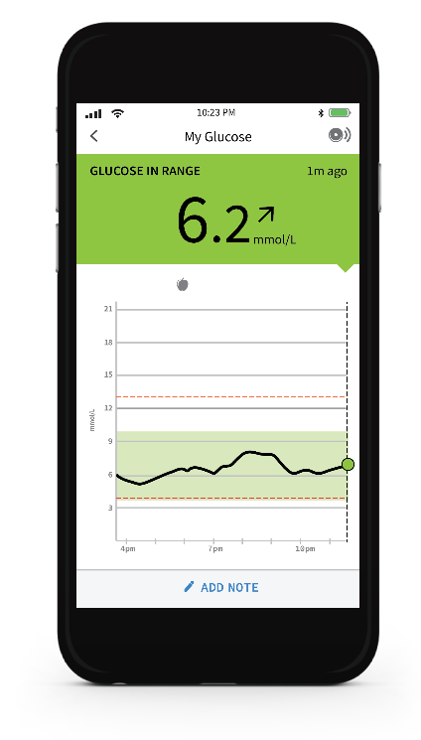
Understanding daily scan
Glucose
message
Current Glucose provides your patient with an accurate glucose reading
A
Glucose
trend arrow
D
A
B
Glucose trend arrow shows your patients where their glucose is heading
Current
glucose
B
Glucose graph shows your patients an 8-hour history of their glucose levels
C
C
Glucose
graph
Glucose message tells your patients if their glucose is in or out of target range
D
Notes:
Facilitator:
Each point - say what it is, then say “Why patients find this to be valuable is…” (share what is in it for them - value statements)
Let them know you will take a few minutes to explain each point individually

Slide 30

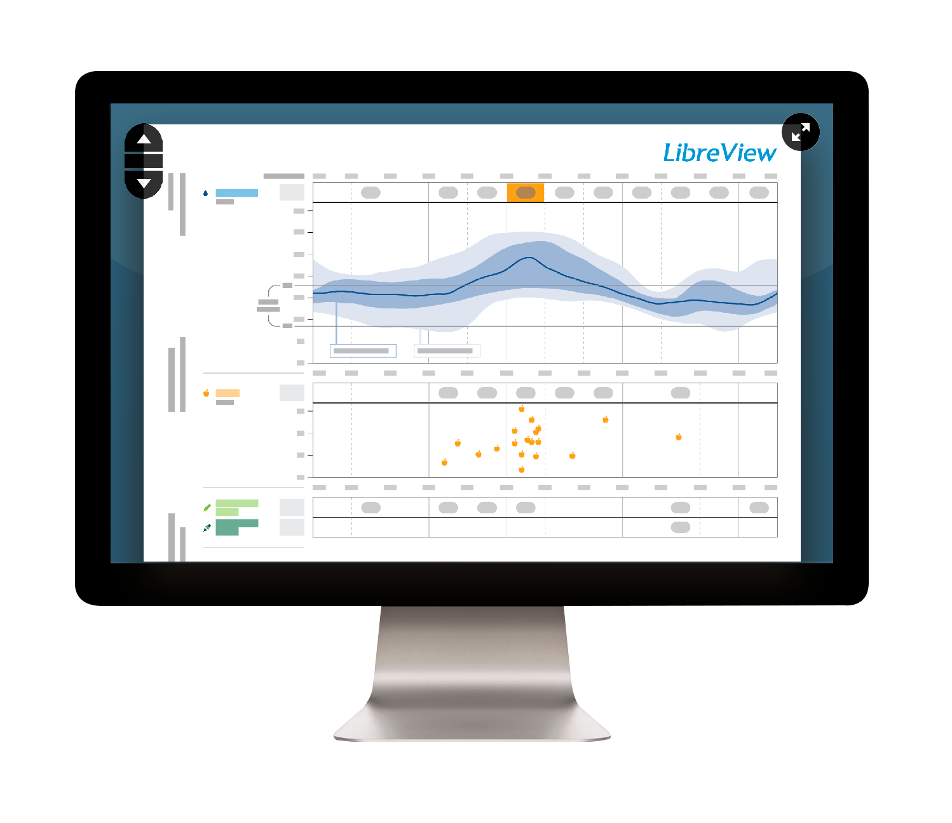


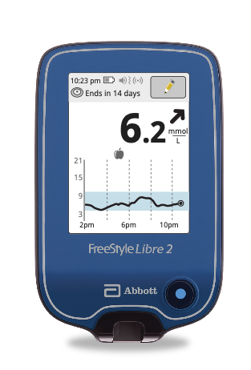
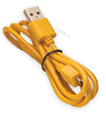



How data is captured by LibreView*
The LibreLinkUp app is only compatible with certain mobile device and operating systems. Please check www.librelinkup.com for more information about device compatibility before using the app. Use of LibreLinkUp and FreeStyle LibreLink requires registration with LibreView. The LibreLinkUp mobile app is not intended to be a primary glucose monitor: home users must consult their primary device(s) and consult a healthcare professional before making any medical interpretation and therapy adjustments from the information provided by the app.
*The LibreView website is only compatible with certain operating systems and browsers. Please check www.libreview.com for additional information.

Slide 31
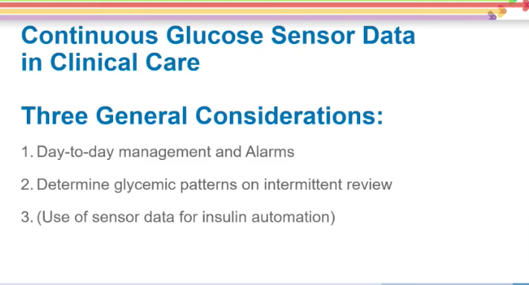

Slide 32
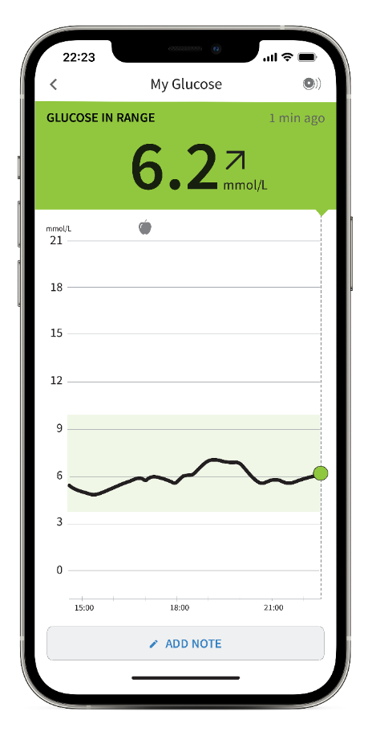
Understanding your scan
Glucose
message
Glucose
trend arrow
D
B
Current Glucose provides you with an accurate glucose reading
A
A
Current
glucose
Glucose trend arrow shows you where your glucose is heading
B
Glucose graph shows you an 8-hour history of your glucose levels
C
C
Glucose
graph
Glucose message tells you if your glucose is in or out of target range
D
The FreeStyle Libre 2 app is only compatible with certain mobile devices and operating systems. Please check the website for more information about device compatibility before using the app. Use of FreeStyle Libre 2 app requires registration with LibreView.
Notes:
Facilitator:
Each point - say what it is, then say “Why patients find this to be valuable is…” (share what is in it for them - value statements)
Let them know you will take a few minutes to explain each point individually

Slide 33
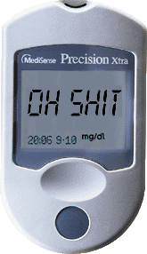
DT’s glucometer after Lunch.

Slide 34
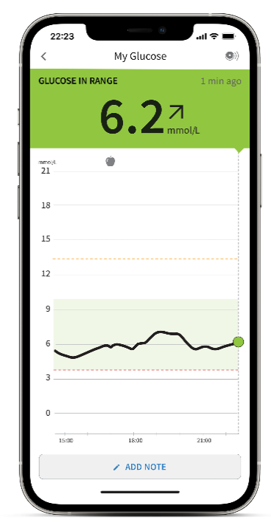

Understanding the trend arrow
B
Glucose
trend arrow
The glucose trend arrow tells you where your glucose is going

Slide 35
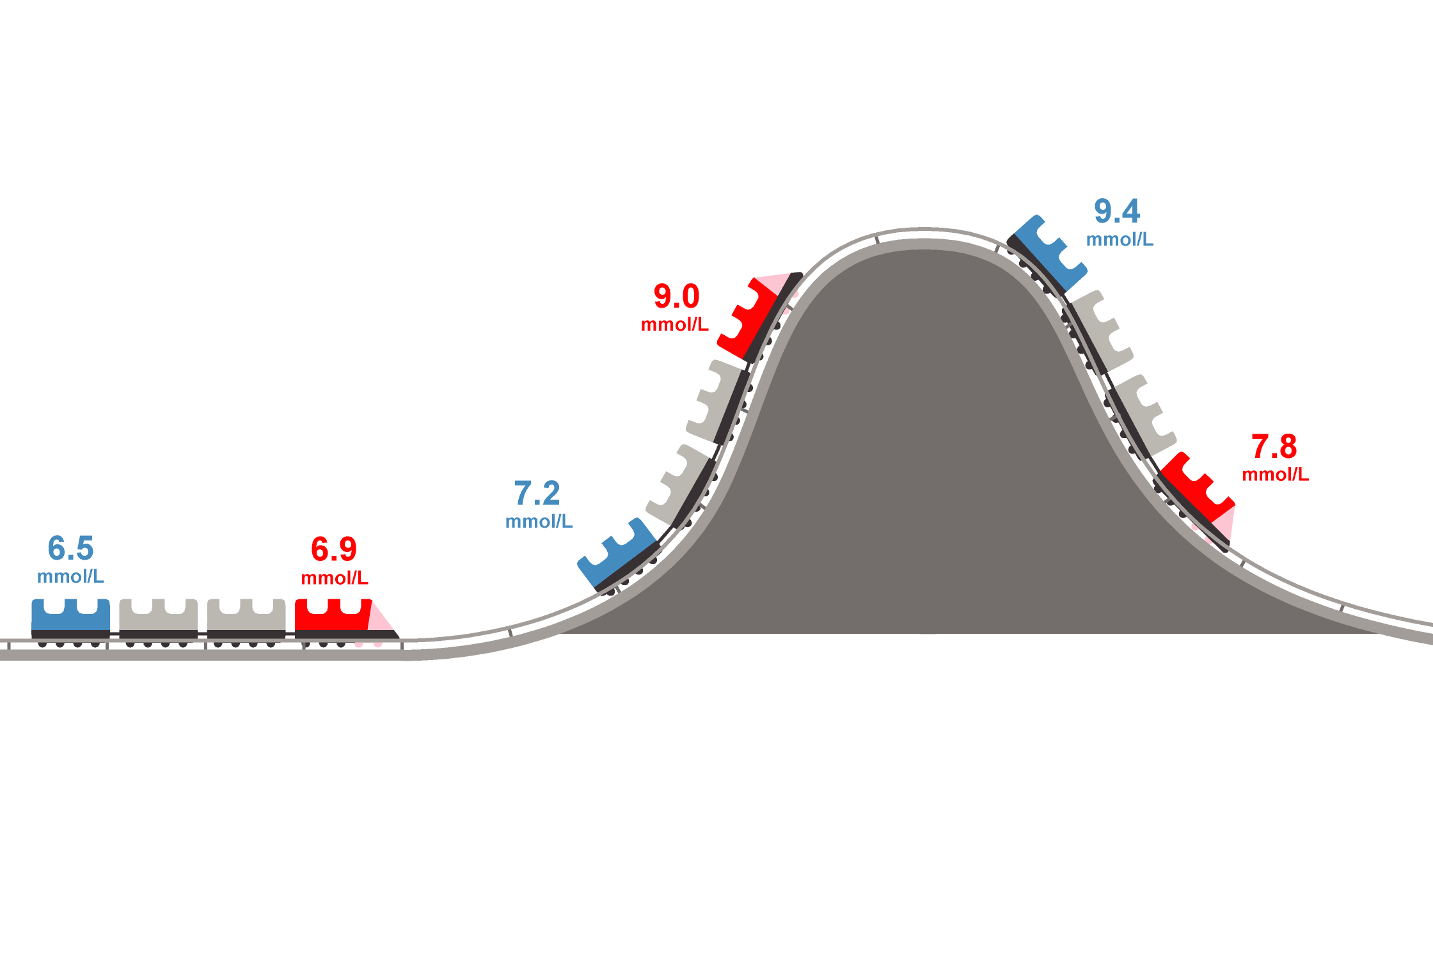
Understanding the difference between blood glucose and sensor glucose
THIS EXAMPLE ILLUSTRATES THE LAG BETWEEN GLUCOSE AND SENSOR GLUCOSE
When glucose level
is stable, the sensor readings and blood glucose readings are similar
When glucose level is trending up, the sensor readings may be lower than blood glucose readings
When glucose level
is trending down, the sensor readings may be higher than blood glucose readings
Sensor (ISF) Glucose
Blood Glucose
Glucose Levels

Slide 36
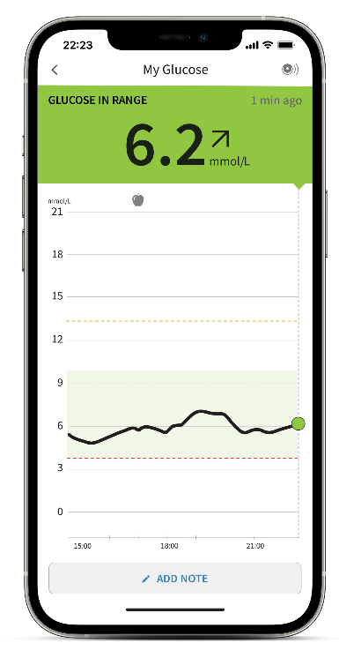




Different trend arrows and what they mean
Glucose is rising rapidly
Glucose is rising
Glucose is changing slowly
Glucose is falling
Glucose is falling rapidly
The FreeStyle Libre 2 app is only compatible with certain mobile devices and operating systems. Please check the website for more information about device compatibility before using the app. Use of FreeStyle Libre 2 app requires registration with LibreView.

Slide 37
Understanding daily scan
Glucose
message
Current Glucose provides your patient with an accurate glucose reading
A
Glucose
trend arrow
D
A
B
Glucose trend arrow shows your patients where their glucose is heading
Current
glucose
B
Glucose graph shows your patients an 8-hour history of their glucose levels
C
C
Glucose
graph
Glucose message tells your patients if their glucose is in or out of target range
D
Notes:
Facilitator:
Each point - say what it is, then say “Why patients find this to be valuable is…” (share what is in it for them - value statements)
Let them know you will take a few minutes to explain each point individually

Slide 38







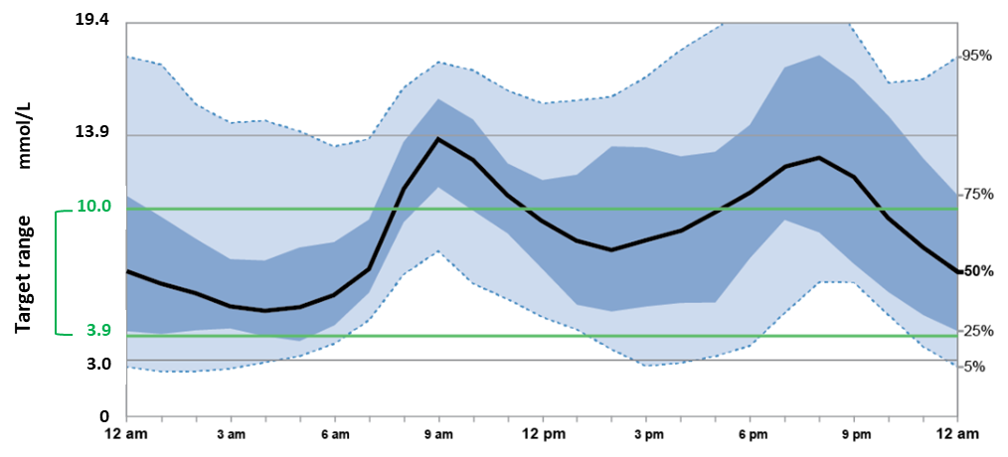





Reviewing Glucose Data Directly from Mobile Devices
Reviewing Glucose Data Without a Printed Report:
In the absence of an AGP report, glucose data can be reviewed directly from a patient’s sensor-based device or associated smartphone application.
In reviewing a patient’s data directly from their device, focus on 4 key reports:
DAILY PATTERNS
26 Feb – 10 March 2019
7 days 14 days 30 days
Sensor usage time
Time in target range
Daily glucose patterns
Low glucose events

Slide 39
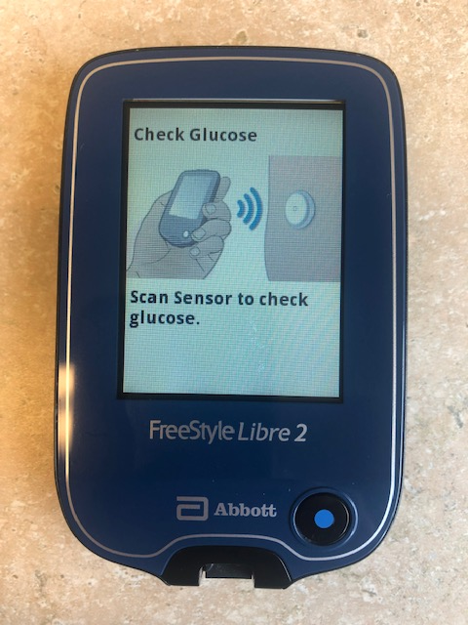
IMG_2184

Slide 40
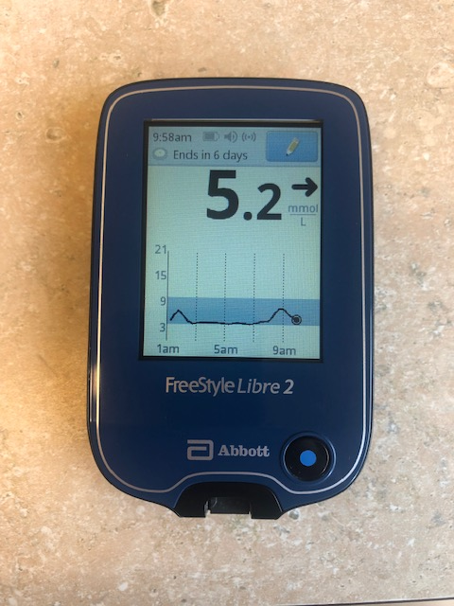

Slide 41
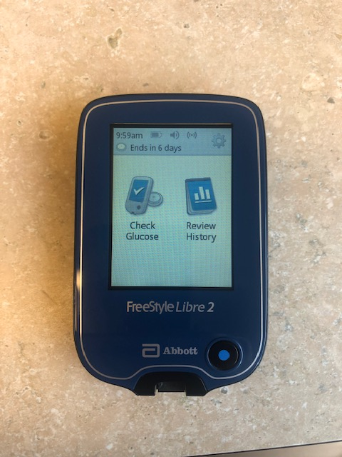

Slide 42
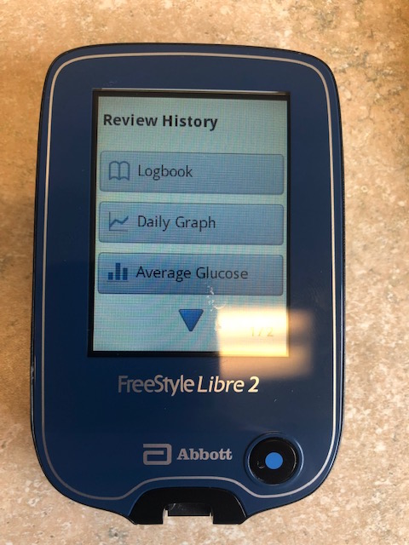

Slide 43
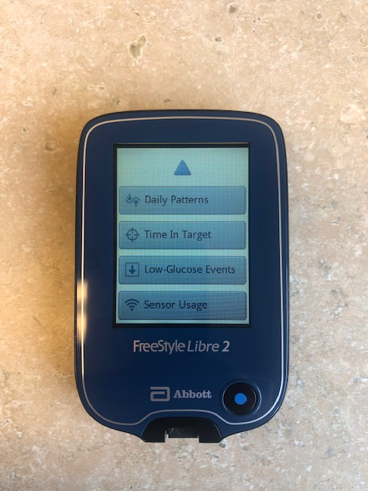
Time in Target Report

Slide 44
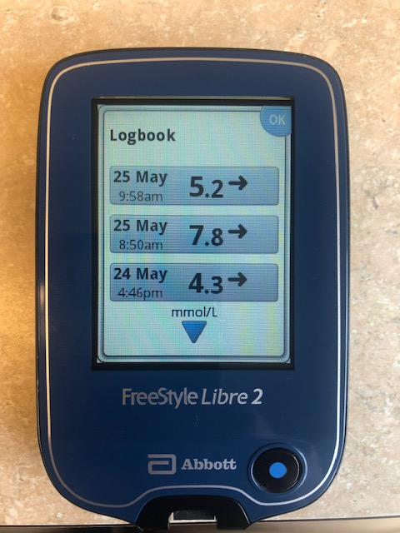
Logbook

Slide 45
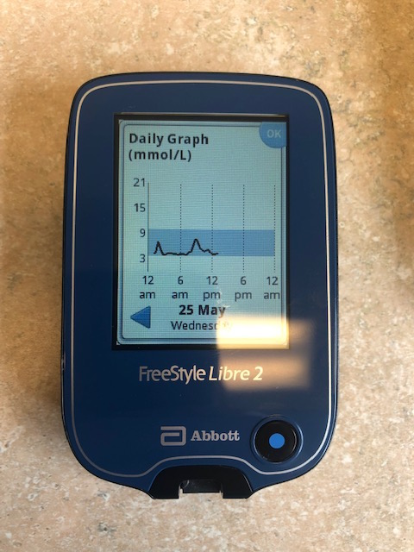
Daily Graph

Slide 46
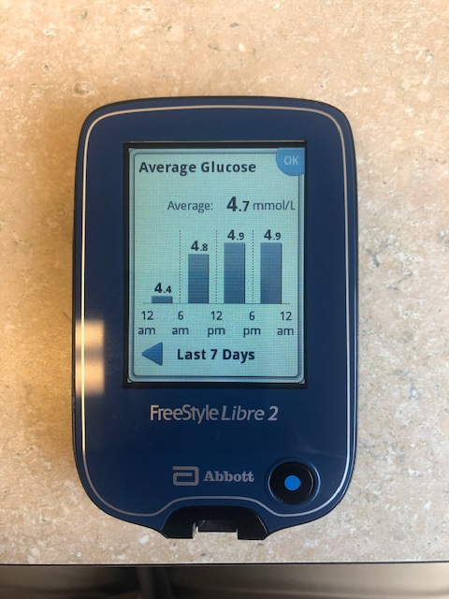
Ave Glucose

Slide 47
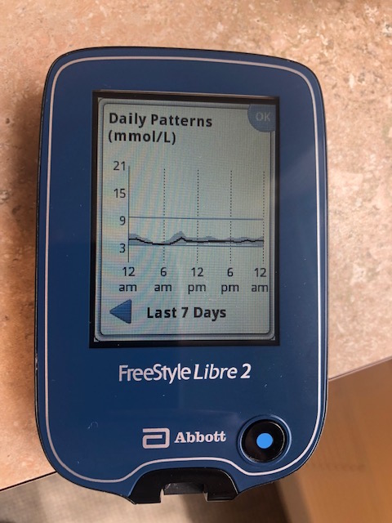
Daily
Patterns

Slide 48
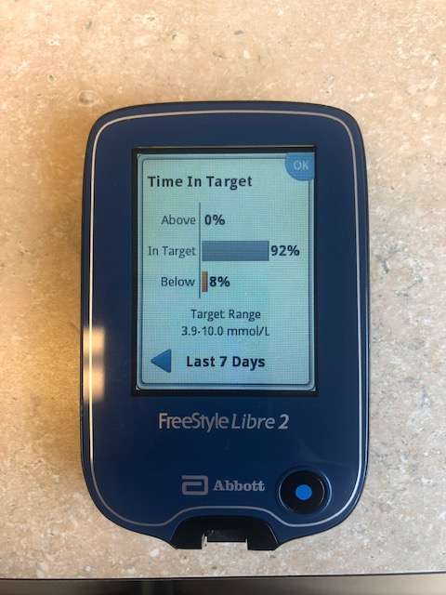
Time in
Range

Slide 49
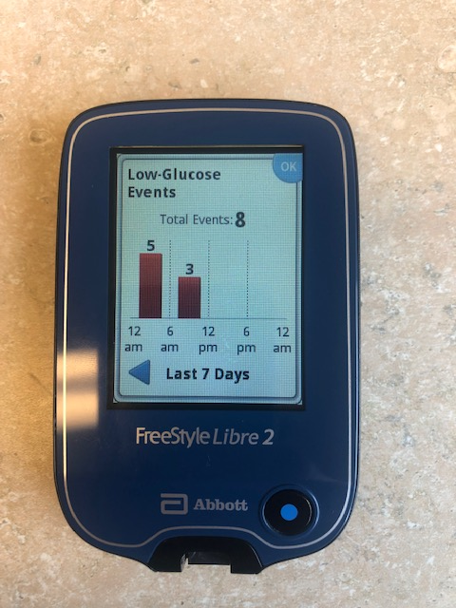
Low Glucose
Events

Slide 50
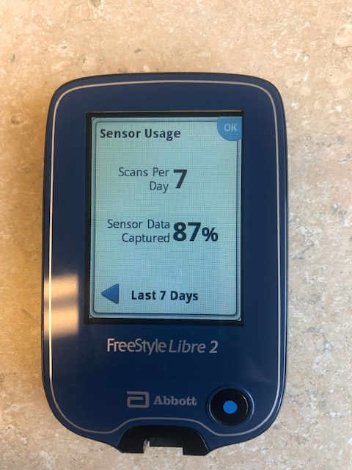
Sensor
Usage

Slide 51
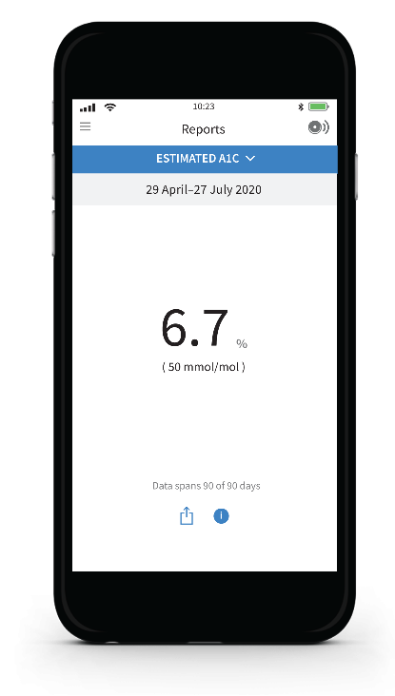
Estimated A1C
This report shows your estimated A1C level based on available sensor glucose data from the last 90 days
This report is available exclusively on the app

Slide 52
A1c | Average glucose
6% | 7.0
7% | 8.6
8% | 10.1
9% | 11.7
10% | 13.3
11% | 14.9
12% | 16.5
ABG in mmol/L = (1.583 * A1c) – 2.52 Nathan D, et al. Diab Care 31(8):1473-8, 2008.

Slide 53



Dysglycemia in Diabetes
Chronic hyperglycemia
Hypoglycemia
Glycemic variability
Hallmark of diabetes that causes insulin resistance
Often associated with tight
glycemic control
Short- or long-term fluctuations
in glucose levels
Directly contributes to short/long-term microvascular complications
Long-term role in the development of macrovascular disease
Unpleasant/potentially dangerous
Can be difficult to predict/capture with CBG
Often prevents people from achieving A1C target
Secondary to daily activities and hypoglycemic therapies
Affected by dietary choices, physical activity, stress
Optimal glycemic control is important to reduce the incidence and progression of
microvascular complications and, in the long term, is associated with reduced CV outcomes

Slide 54
Optimizing glycemic management
1
INCREASE
TIME IN RANGE^{1,2}
(AVOID HYPOGLYCEMIA)
2
BETTER DIABETES MANAGEMENT
3
LIMIT
GLYCEMIC VARIABILITY³
IMPROVE A1C⁴
† Data collected with the FreeStyle Libre system. The FreeStyle Libre 2 system has the same features as the FreeStyle Libre system but with optional real-time glucose alarms. Therefore, study data are applicable to both products.
References: 1. Bolinder J, Antuna R, Geelhoed-Duijvestijn P, Kröger J, Weitgasser R. Novel glucose-sensing technology and hypoglycemia in type 1 diabetes: a multicentre, non-masked, randomized controlled trial. Lancet. 2016;388(10057):2254-2263. 2. Haak T, Hanaire H, Ajjan R, et al. Flash glucose-sensing technology as a replacement for blood glucose monitoring for the management of insulin-treated type 2 diabetes: a multicenter, open-label randomized controlled trial. Diabetes Ther. 2017;8(1):55-73. 3. Ajjan R. Insights from real world use of flash continuous glucose monitoring. Symposium conducted at: American Diabetes Association 78th Scientific Sessions; June 22-26, 2018; Orlando, FL. 4. Seibold A, Ells S, Schlaeger C, Welsh Z. A meta-analysis of real world observational studies on the impact of flash glucose monitoring on glycemic control as measured by A1c. Poster presented at: American Diabetes Association 78th Scientific Sessions; June 22-26; Orlando, FL.
Notes:
The Triangle of Diabetes Care is a model of diabetes care that is centred on a trio of treatment goals rather than the single focus on medium-term glucose exposure, measured a HbA1c. In other words, the simplified notion that the “lower the HbA1c the better” should be updated to incorporate additional aspects of glucose management.
The Triangle of Diabetes Care looks at three aspects of a patient’s glucose experience.
To improve overall glucose levels as currently measured by HbA1c
To reduce or limit glucose variability, that is the degree of swings between lows and highs.
To reduce the frequency of hypoglycemia.
Even if one treatment goal cannot be achieved, an improvement in one or both of the other two is likely to have a positive effect on the overall health for the patient.

Slide 55
Metrics of Glycemic Variability (GV) and Time in Range
“Time in ranges” is a metric of glycemic control that provides more actionable information than A1C alone; it includes the percentage of readings and time per day in target range (TIR), time below target range (TBR), and time above target range (TAR).
The coefficient of variation (CV) is a measure of GV and is ideally ≤36%.
17
15
Time
The key advantage of these newer metrics that go beyond just A1C is that they allow for more personalized diabetes management with
person-centric glycemic control.
Improvement in GV metrics may improve long-term outcomes.
Glucose (mmol/L)
13
Amplitude
11
Ideal range
Extent of BG fluctuations
9
Amplitude
7
5
3
Time
1
0
6
12
18
24
30
36
42
48
54
60
66
72
Duration of various events
Time (h)
Reliable measurement of GV can be done with newer glucose monitoring technologies like rtCGM and isCGM devices, which allow users to better track their sugar levels, either in real-time or intermittently
Notes:
CV (%) = standard deviation (SD) of glucose / mean glucose × 100
(Monnier L et al. Diabetes Care. 2017 Jul;40(7):832-838)

Slide 56
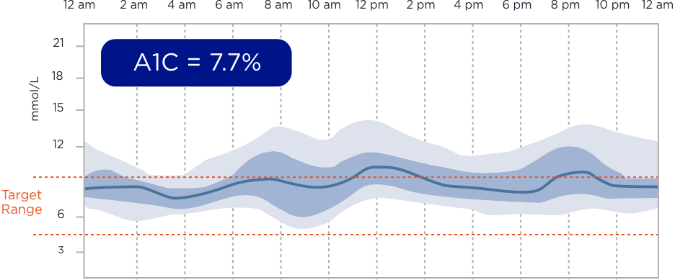
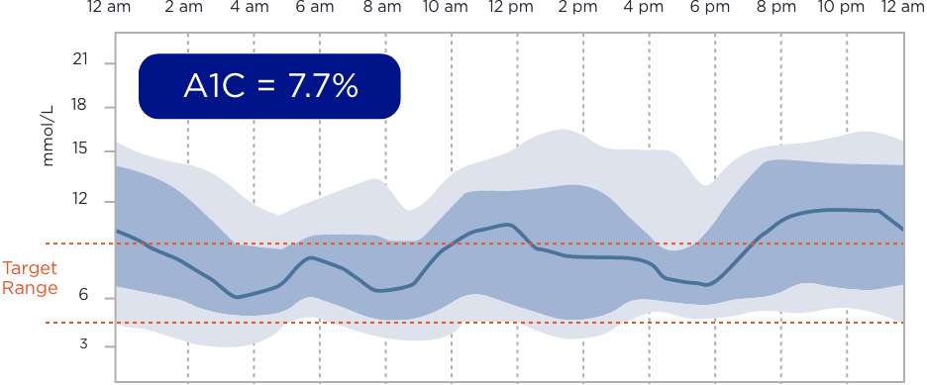
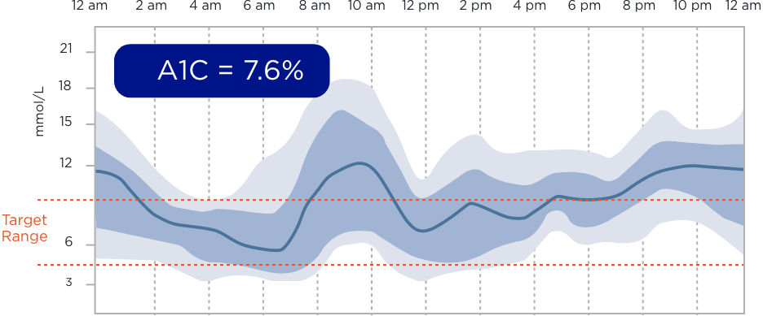
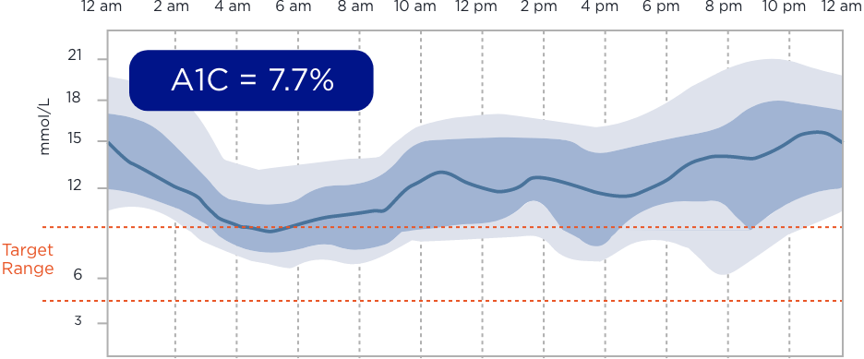
Flash glucose monitoring helps you look beyond A1C for the story behind your patients’ glucose results
Four patients with the same A1C (7.6-7.7%) can have very different
glucose variability¹
PATIENT 1
PATIENT 2
PATIENT 3
PATIENT 4
For illustrative purposes only. Not actual patient data.
Reference: 1. Dunn TC, Hayter GA, Doniger KJ, Wolpert HA. Development of the likelihood of low glucose (LLG) algorithm for evaluating risk of hypoglycemia: a new approach for using continuous glucose data to guide therapeutic decision making. J Diabetes Sci Technol. 2014;8(4):720-730.

Slide 57







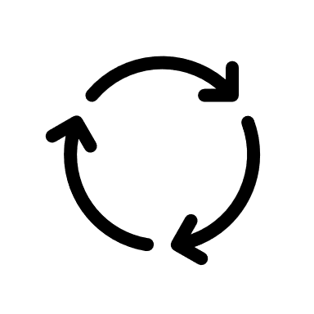
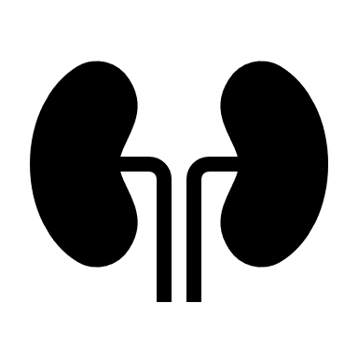
Potential Causes for Glycemic Variability
Lifestyle factors
Insulin factors
Medical factors
Diet:
Pattern
Composition, quality
Insulin regimen:
Premixed vs basal-bolus
Insulin pumps
Timing of injections
Gastrointestinal:
Gastroparesis
Malabsorption, dehydration
Physical activity:
Frequency
Intensity
Time
Type
Preparations:
Type of basal insulin
Type of bolus insulin
Neuroendocrine:
Hypoglycemia unawareness
Counter-regulatory hormone dysfunction
Stress management:
Sleep cycle
Psychological stress
Delivery:
Lipodystrophy
Injection site rotation
Drug metabolism/excretion:
Renal impairment
Hepatic impairment

Slide 58
Glucose Variability – Self management
What are they –
Doing? – glucose testing
- activity - FITT
- injection sites
Taking? – adherence to meds/insulin
- varying dose of insulin
- treatment of highs/lows
- prospective vs retrospective diabetes management
Eating? – CHO counting/ varying size of meals
- snacking
Diabetes Burnout/Distress?

Slide 59
How do you decide how much insulin to take?

Slide 60
Use of rtCGM in T2D: MOBILE Study
rtCGM has been shown to reduce A1C and increase time in glucose target range in adults with T2D using basal insulin therapy (± noninsulin antihyperglycemic agents) in a primary care setting
rtCGM vs CBG Mean change in A1C from baseline and time in range at 8 months
MOBILE study
(RCT)
A1C change
% Time in range (3.9–10 mmol/L)
T2D patients:
N=175
≥30 years
Basal only regimen (1 or 2 daily injections) for ≥6 months ± oral agents or GLP-1 RA
A1C 7.8% to 11.5%
Not under care of endocrinologist; recruited from primary care practice
rtCGM*
(n=116)
CBG†
(n=59)
–0.6%
–1.1%
rtCGM*
(n=116)
CBG†
(n=59)
Adjusted difference:
–0.4 (95% CI: –0.8 to –0.1)
P=0.02
Adjusted difference:
15 (95% CI: 8 to 23)
P<0.001

Slide 61


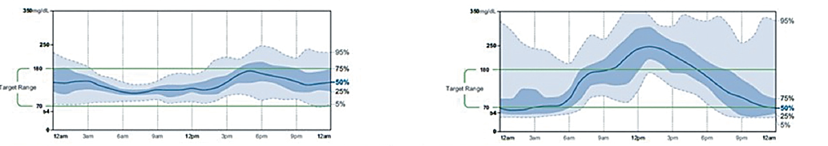
Individuals With the Same A1C May Have Different Glucose Patterns
 | Patient A | Patient B
A1C | 7.5% | 7.5%
%CV | 29% | 56%
TIR | 85% | 41%
TAR | 14% | 37%
TBR | 1% | 22%
AGP
95%
mmol/L
mmol/L
95%
10.0
75%
10.0
Target
50%
Target
3.9
25%
3.9
75%
5%
50%
25%
5%
A1C is a suboptimal glycemic metric for managing individual patients on a day-to-day basis

Slide 62


Time in Range Targets for People With Diabetes
What time in range goals should my patients aim for?
Time in range goals will be different for every person and may depend on medication, diabetes type, diet, age, general health, and hypoglycemia risk. Thus, targets can be personalized to meet individual needs.
Most people with diabetes:
Older/high-risk people with diabetes:
>13.9 mmol/L
<5%
>13.9 mmol/L
<10%
>10.0 mmol/L
<25%*
>10.0 mmol/L
<50%*
Target range:
3.9–10.0 mmol/L
Click for information on factors that impact the daily life of people with type 2 diabetes
>70%
Target range:
3.9–10.0 mmol/L
>50%
<3.9 mmol/L
<4%**
<3.0 mmol/L
<1%
<3.9 mmol/L
<1%
Primary goal for effective and safe glucose control is to time in range and time below range

Slide 63

Association Between Time in Range and A1C
A time in range (TIR)* of 70% correlates with an A1C of 7%¹
TIR
70%
A1C
7%
Every 10% ↑ in TIR* corresponds to a clinically relevant improvement in A1C¹
10%
TIR
0.5% to 0.8%
A1C
Each 5% ↑ in TIR* is clinically beneficial²
Time in range correlates with A1C outcomes in patients with diabetes

Slide 64


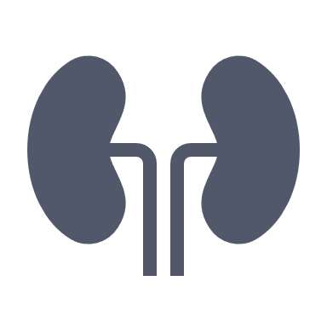

Association of Time in Range and Microvascular Outcomes in Diabetes
There has been growing evidence of the association between reduction in time in range and development of microvascular complications in people with diabetes
DCCT data set¹
(N=1,440)
Diabetic retinopathy
With each 10% in time in range…^{1,2}
T1D
Microalbuminuria
64% in risk of retinopathy
CANDY study²
(USA; N=105)
40% in risk of microalbuminuria
Diabetic peripheral neuropathy (DPN)
25% in risk of DPN
T2D

Slide 65

A1C vs Average Glucose
A1C is the gold standard, primary marker of long-term average glycemic control, but a wide range of mean glucose concentrations can be associated with a given A1C
A1C:
Estimated mean glucose concentration (mmol/L)
6%
7%
8%
9%
10%
5.6 – 9.0
7.1 – 10.5
8.6 – 12.1
10.1 – 13.8
11.6 – 15.2

Slide 66
Optimizing glycemic management
1
INCREASE
TIME IN RANGE^{1,2}
(AVOID HYPOGLYCEMIA)
2
BETTER DIABETES MANAGEMENT
3
LIMIT
GLYCEMIC VARIABILITY³
IMPROVE A1C⁴
† Data collected with the FreeStyle Libre system. The FreeStyle Libre 2 system has the same features as the FreeStyle Libre system but with optional real-time glucose alarms. Therefore, study data are applicable to both products.
References: 1. Bolinder J, Antuna R, Geelhoed-Duijvestijn P, Kröger J, Weitgasser R. Novel glucose-sensing technology and hypoglycemia in type 1 diabetes: a multicentre, non-masked, randomized controlled trial. Lancet. 2016;388(10057):2254-2263. 2. Haak T, Hanaire H, Ajjan R, et al. Flash glucose-sensing technology as a replacement for blood glucose monitoring for the management of insulin-treated type 2 diabetes: a multicenter, open-label randomized controlled trial. Diabetes Ther. 2017;8(1):55-73. 3. Ajjan R. Insights from real world use of flash continuous glucose monitoring. Symposium conducted at: American Diabetes Association 78th Scientific Sessions; June 22-26, 2018; Orlando, FL. 4. Seibold A, Ells S, Schlaeger C, Welsh Z. A meta-analysis of real world observational studies on the impact of flash glucose monitoring on glycemic control as measured by A1c. Poster presented at: American Diabetes Association 78th Scientific Sessions; June 22-26; Orlando, FL.
Notes:
The Triangle of Diabetes Care is a model of diabetes care that is centred on a trio of treatment goals rather than the single focus on medium-term glucose exposure, measured a HbA1c. In other words, the simplified notion that the “lower the HbA1c the better” should be updated to incorporate additional aspects of glucose management.
The Triangle of Diabetes Care looks at three aspects of a patient’s glucose experience.
To improve overall glucose levels as currently measured by HbA1c
To reduce or limit glucose variability, that is the degree of swings between lows and highs.
To reduce the frequency of hypoglycemia.
Even if one treatment goal cannot be achieved, an improvement in one or both of the other two is likely to have a positive effect on the overall health for the patient.

Slide 67




Case Study: Leo
T2D for 10 years
Age: 56
BMI: 31 kg/m²
Occupation: Business owner
Current values:
?
A1C: 7.6%
  Would you consider isCGM/rtCGM in this patient?
  Yes
  No
FPG: 5–8 mmol/L
Patient History
No clinical CVD; taking statin for protection
Normal renal function and normal ACR
Morning headaches
Current Diabetes Medications
Metformin
SGLT2i
Insulin glargine U-100 for 5 years (OD evening, 42U)
GLP-1 RA for 2 years

Slide 68

Case Study: Leo
Recall…
What if?
After using isCGM, Leo notices not only nocturnal hypoglycemia but his sugars swinging up and down
A1C is limited in assessing short-term outcomes and day-to-day glucose fluctuations
T2D for 10 years
Age: 56
BMI: 31 kg/m²
Occupation: Business owner
Current values:
Patient A
A1C: 7.5%
Mean glucose: 7 mmol/L
Patient B
A1C: 7.5%
Mean glucose: 7 mmol/L
High GV
Low GV
Glucose (mmol/L)
11
Within-day:
Glucose (mmol/L)
11
Within-day:
9
9
A1C: 7.6%
?
7
7
5
5
FPG: 5–8 mmol/L
3
3
0
2
4
6
8
10
12
14
16
18
20
0
2
4
6
8
10
12
14
16
18
20
Time (h)
Time (h)
Glucose (mmol/L)
11
Day-to-day:
Glucose (mmol/L)
11
Day-to-day:
No health issues
9
9
7
7
Metformin
SGLT2i
Insulin glargine U-100 (OD, 42U)
GLP-1 RA
5
5
3
3
0
2
4
6
8
10
12
14
16
18
20
0
2
4
6
8
10
12
14
16
18
20
Time (days)
Time (days)
Patients with similar A1C and mean glucose values can have markedly different patterns of glycemic variability

Slide 69
Use of rtCGM in T2D: MOBILE Study
rtCGM has been shown to reduce A1C and increase time in glucose target range in adults with T2D using basal insulin therapy (± noninsulin antihyperglycemic agents) in a primary care setting
rtCGM vs CBG Mean change in A1C from baseline and time in range at 8 months
MOBILE study
(RCT)
A1C change
% Time in range (3.9–10 mmol/L)
T2D patients:
N=175
≥30 years
Basal only regimen (1 or 2 daily injections) for ≥6 months ± oral agents or GLP-1 RA
A1C 7.8% to 11.5%
Not under care of endocrinologist; recruited from primary care practice
rtCGM*
(n=116)
CBG†
(n=59)
–0.6%
–1.1%
rtCGM*
(n=116)
CBG†
(n=59)
Adjusted difference:
–0.4 (95% CI: –0.8 to –0.1)
P=0.02
Adjusted difference:
15 (95% CI: 8 to 23)
P<0.001

Slide 71

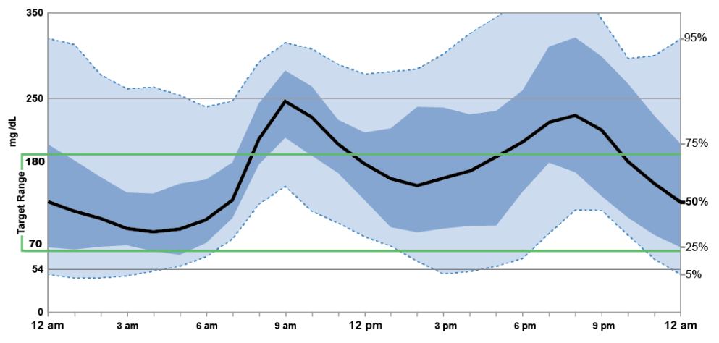
Case Study: Leo - AGP
?
What if?
We now examine Leo’s isCGM report…
19.4
Average glucose:
9.6 mmol/L
mmol/L
13.9
Time above range
20%
>13.9 mmol/L
10.0
23%
10.1–13.9 mmol/L
Target range
Time
in range
47%
Target range:
3.9–10.0 mmol/L
3.9
3.0
Time below range
4%
3.0–3.8 mmol/L
0
6%
<3.0 mmol/L
  What specific information are you looking for when looking at data like this?

Slide 72
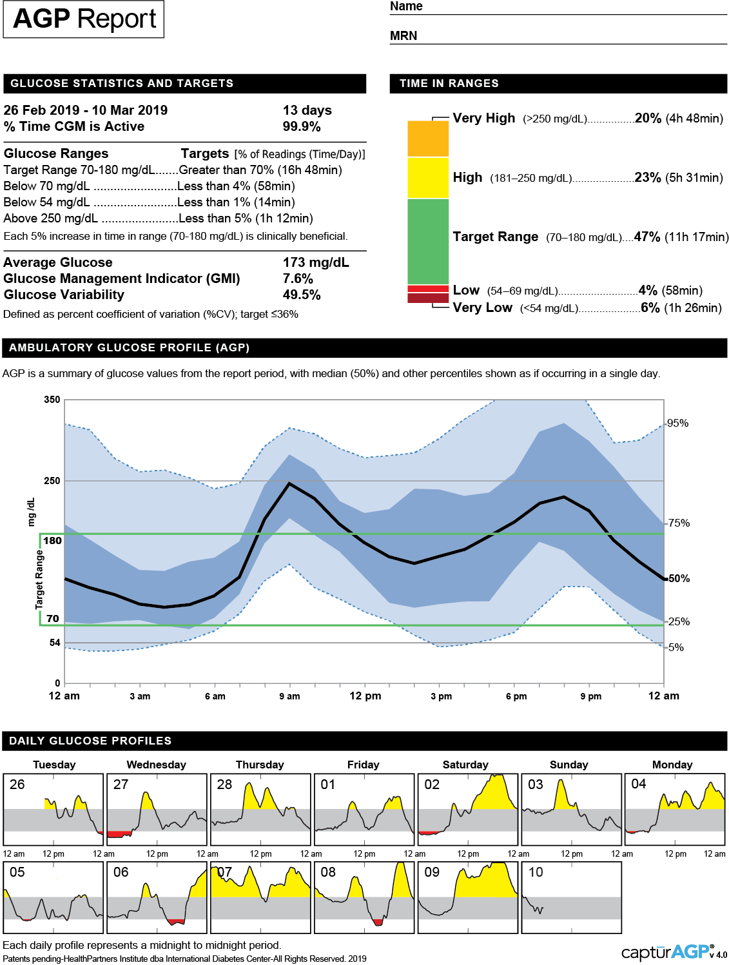
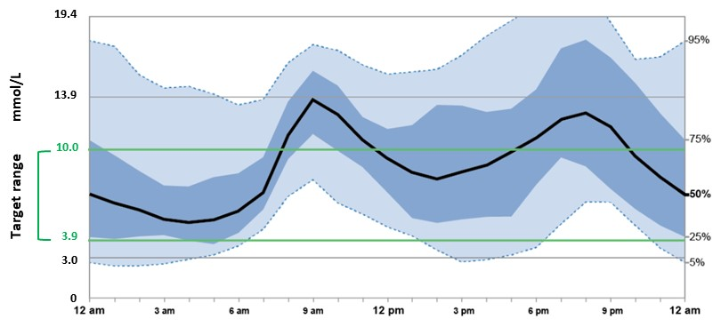
The AGP Report in Clinical Practice
Leo R.
26 Feb 2019 – 10 March 2019
% Time Sensor is Active
14 Days
99.9%
>13.9 mmol/L
% Time Sensor is Active
Glucose Statistics and Targets
Glucose Ranges
Target Range 3.9–10.0 mmol/L
Below 3.9 mmol/L
Below 3.0 mmol/L
Above 10.0 mmol/L
Above 13.9 mmol/L
Targets % of Readings (Time/Day)
Greater than 70% (16h 48min)
Less than 4% (58min)
Less than 1% (14min)
Less than 25% (6h)
Less than 5% (1h 12min)
Time in Ranges
10.1–13.9 mmol/L
3.9–10.0
mmol/L
Average Glucose
Glucose Management Indicator (GMI)
Glucose Variability
9.6 mmol/L
7.6%
49.5%
3.0–3.8 mmol/L
Defined as percent coefficient of variation (%CV); target ≤36%
<3.0 mmol/L
Ambulatory Glucose Profile (AGP)
Daily Glucose Profiles

Slide 73

The AGP Report in Clinical Practice
The AGP comprises 4 key features:
Click to expand
19.4
What is an AGP report?
mmol/L
13.9
10.0
4
The AGP is a standardized report for summarizing and interpreting a wealth of glycemic data in a visual format
Target range
Median line:
Reflects the average glucose at each point in the day
3.9
1
3.0
0
Allows identification of patterns and trends in daily glucose control:
  Times of greater risk of hypoglycemia
  Times of glycemic variability
Data from multiple days are collapsed and plotted as an average 24-hour period
Target range:
Reflects where most of the readings should be
Ideally, this would stay within the green lines
3
2
5–95th percentile:
Shows glucose variation that is happening on some days but not others and reflects less common departures from the daily average
IQR (25–75th percentile):
Shows the 50% of all glucose readings levels that are closest to the median line and how variable they are from day-to-day
Ideally, values stay within the green lines
Ideally, the space between is narrow
(i.e. the wider this light blue band is, the more variable are these occasional readings)
Ideally, the space between is narrow
(i.e. the thinner the darker blue-shaded band is, the less day-to-day variability)

Slide 74
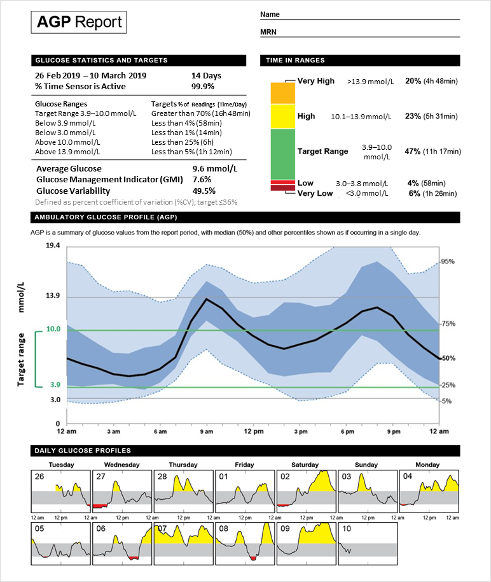
Glucose Monitoring Data Interpretation
What steps should I take when reviewing and interpreting glucose monitoring data with patients?
Make sure there is adequate data (≥10 days; ideally 14 days); make sure sensor active at least 70% of time; look at TIR, TAR, TBR, CV; look at GMI as a measure of estimated A1C
5
Look for patterns of HIGH glucose levels
1
6
Look for areas of wide GV
Mark up the report, noting factors that may affect diabetes management (e.g. medication, exercise, meals)
2
Compare current to past reports and discuss progress
7
Ask the patient to briefly describe and explain what they see in their report
Agree on an action plan with the patient
3
8
Look for patterns of LOW glucose levels
Print a copy of the marked up report for the patient and store a copy for yourself
4
9
The ability to quickly assess overall glycemia and identify patterns of concern facilitates more informed therapy decision-making, and also helps patients better understand interactions between their medications, meals, and exercise

Slide 75
Individuals With the Same A1C May Have Different Glucose Patterns
 | Patient A | Patient B
A1C | 7.5% | 7.5%
%CV | 29% | 56%
TIR | 85% | 41%
TAR | 14% | 37%
TBR | 1% | 22%
AGP
95%
mmol/L
mmol/L
95%
10.0
75%
10.0
Target
50%
Target
3.9
25%
3.9
75%
5%
50%
25%
5%
A1C is a suboptimal glycemic metric for managing individual patients on a day-to-day basis

Slide 76
Case Study: Leo
?
What if?
We now examine Leo’s isCGM report…
19.4
Average glucose:
9.6 mmol/L
mmol/L
13.9
Time above range
20%
>13.9 mmol/L
10.0
23%
10.1–13.9 mmol/L
Target range
Time
in range
47%
Target range:
3.9–10.0 mmol/L
3.9
3.0
Time below range
4%
3.0–3.8 mmol/L
0
6%
<3.0 mmol/L
  What specific information are you looking for when looking at data like this?

Slide 77
Potential Causes for Glycemic Variability
Lifestyle factors
Insulin factors
Medical factors
Diet:
Pattern
Composition, quality
Insulin regimen:
Premixed vs basal-bolus
Insulin pumps
Timing of injections
Gastrointestinal:
Gastroparesis
Malabsorption, dehydration
Physical activity:
Frequency
Intensity
Time
Type
Preparations:
Type of basal insulin
Type of bolus insulin
Neuroendocrine:
Hypoglycemia unawareness
Counter-regulatory hormone dysfunction
Stress management:
Sleep cycle
Psychological stress
Delivery:
Lipodystrophy
Injection site rotation
Drug metabolism/excretion:
Renal impairment
Hepatic impairment

Slide 78
Glucose Variability – Self management
What are they –
Doing? – glucose testing
- activity - FITT
- injection sites
Taking? – adherence to meds/insulin
- varying dose of insulin
- treatment of highs/lows
- prospective vs retrospective diabetes management
Eating? – CHO counting/ varying size of meals
- snacking
Diabetes Burnout/Distress?

Slide 79
Potential Causes for Glycemic Variability
Lifestyle factors
Insulin factors
Medical factors
Diet:
Pattern
Composition, quality
Insulin regimen:
Premixed vs basal-bolus
Insulin pumps
Timing of injections
Gastrointestinal:
Gastroparesis
Malabsorption, dehydration
Physical activity:
Frequency
Intensity
Time
Type
Preparations:
Type of basal insulin
Type of bolus insulin
Neuroendocrine:
Hypoglycemia unawareness
Counter-regulatory hormone dysfunction
Stress management:
Sleep cycle
Psychological stress
Delivery:
Lipodystrophy
Injection site rotation
Drug metabolism/excretion:
Renal impairment
Hepatic impairment

Slide 80
Use of isCGM in T2D: REPLACE Study
isCGM use in T2D with intensive insulin therapy has been shown to significantly reduce time spent in hypoglycemia, with reduced nocturnal hypoglycemia and glycemic variability, while improving quality of life
REPLACE study
(RCT)
isCGM vs CBG
% reduction of time in hypoglycemia*
T2D patients:
N=224
≥18 years
T2D for ≥6 months
Bolus only, or basal-bolus, or insulin pump regimen for ≥3 months
A1C 7.5%–12.0%
CBG >10 times/week for ≥2 months
Anytime:
Nocturnal:
24h
–43%
–53%
–54%
–58%
P=0.0006
˂3.9 mmol/L
P=0.0014
˂3.1 mmol/L
P=0.0001
P=0.0032

Slide 81
Case Study: Leo
?
We now examine Leo’s isCGM report…
19.4
Average glucose:
9.6 mmol/L
mmol/L
13.9
Time above range
20%
>13.9 mmol/L
10.0
23%
10.1–13.9 mmol/L
Target range
Time
in range
47%
Target range:
3.9–10.0 mmol/L
3.9
3.0
Time below range
4%
3.0–3.8 mmol/L
0
6%
<3.0 mmol/L
  What specific information are you looking for when looking at data like this?

Slide 82

Case Study: Leo
6 months later…
Based on his original AGP report and morning headaches, you decided to switch Leo to a second-generation basal insulin analogue to lessen his hypoglycemia.
T2D for 10 years
Age: 56
BMI: 31 kg/m²
Occupation: Business owner
Current values:
↔
Switching to a second-generation basal insulin analogue
insulin detemir
insulin glargine U-100 (Gla-100)
NPH
insulin degludec (IDeg)
insulin glargine U-300 (Gla-300)
A1C: 7.2%
FPG: 4–8 mmol/L
No more morning headaches
↓A1C, ↓FPG, ↑TIR ↓TBR (less hypo)
Click to expand Leo’s latest AGP report
Metformin
SGLT2i
Insulin glargine U-300 (OD, 42U)
GLP-1 RA
From once-daily basal insulin: Convert unit for unit and give Gla-300 or IDeg once daily
From twice daily basal insulin: Use 80% of the total daily dose of basal insulin and give once daily Gla-300 or IDeg
↔

Slide 83
Leo

Slide 84


Slide 85


Slide 86


Slide 87


Slide 88


Slide 89


Slide 90


Slide 91
Libre Cases

Slide 92


Slide 93


Slide 94

ST 65 yo female Type 2
metformin 2 tablets 2 times daily
Jardiance 10 mg 1 time daily
A1C 7.7
Wt 89 kg

Slide 95

ST-65 yo female Type 2
metformin 2 tablets 2 times daily
Jardiance 10 mg 1 time daily
Ozempic 0.25mg once weekly
A1C 6.9
Wt 87 kg

Slide 96

MS 56 yo male
Toujeo 40 u acSu
Humalog 10 u acSu
Metformin 1 g bid
Intolerant to Ozempic
Onglyza 5 mg od

Slide 97

ML
Invokana 300 mg po od
Coversyl 4 mg od
Lantus 26 u hs
Diamicron MR 60 mg 2 tablets 1 time daily
metformin 500 mg 1 tablet 2 times daily
Ozempic 1.0 mg weekly

Slide 98
ML
Invokana 300 mg po od
Coversyl 4 mg od
Toujeo 24 u hs
Diamicron MR 60 mg 2 tablets 1 time daily
metformin 500 mg 1 tablet 2 times daily
Ozempic 1.0 mg weekly
Increase testing at hs

Slide 99

DS Type 2 A1C 9.0
Invokana 300 mg po od
Tresiba FlexTouch 30 units od
Diamicron MR 60 mg 2 tablets 1 time daily
metformin 500 mg 1 tablet 2 times daily
Ozempic Prev. not tolerated
A1c 9.0

Slide 100

Ozempic Micro-Dosing
There are many “clicks” between the marked doses on the Ozempic pen. There are 18 “clicks” between 0 and 0.25mg and 18 “clicks” between 0.25mg and 0.5mg. On the 1mg pen there are 74 “clicks” between 0 and 1mg.
Use ____ clicks once a week and if tolerating well, continue to increase by ____ clicks every _____ weeks, until at the recommended dose of ______mg once weekly.
Once you are on a dose of 0.25 mg weekly, please discontinue your ___________ (Onglyza/Trajenta/Januvia)

Slide 101

DS Post A1C 7.4
Invokana 300 mg po od
Tresiba FlexTouch 20 units od
Diamicron MR 60 mg 2 tablets 1 time daily
metformin 500 mg 1 tablet 2 times daily
Ozempic 0.5 mg weekly
A1c 7.2

Slide 102

JS – 72 yo male type 2
Metformin 1 g bid
Tresiba 46 acBr
Ozempic 1.0
Diamicron MR 120
Jardiance 10 mg od
A1c9.0

Slide 103
JS – 72 yo male type 2
Metformin 1 g bid
Tresiba 46 acBr
Ozempic 1.0
Diamicron MR 120
Jardiance 10 mg od
A1c9.0
Add insulin acBr and acSu

Slide 104

DC – 56 yo female – Type 1 DM
MDI
Tresiba 20 u
NR 1: 8 CF 1:3 target 7

Slide 105

FT – 38 yo female Type 1
No spec f/u x 5 years, moved to Haliburton
NovoRapid 1:11 / 1:10 / 1:9 with CF 1:2 if >8
Tresiba 31 units
A1C 7.2

Slide 106
Glucose Variability – Self management
What are they –
Doing? – glucose testing
- activity - FITT
- injection sites
Taking? – adherence to meds/insulin
- varying dose of insulin
- treatment of highs/lows
- prospective vs retrospective diabetes management
Eating? – CHO counting/ varying size of meals
- snacking
Diabetes Burnout/Distress?

Slide 107


Slide 108

FT – 38 yo femaleType 1 – Send to DEC

Slide 109

VG 63 female type 2 DM
Tresiba 88 units daily
Ozempic 1 mg weekly
Diamicron 120 od
Metformin intolerant
Jardiance 10 od
Prolonged episodes of hypoglycemia

Slide 110
VG 63 female type 2 DM
Tresiba 88 units daily
Ozempic 1 mg weekly
Diamicron 120 od
Metformin intolerant
Jardiance 10 od
Treats lows with cheese and PB
Reduce tresiba

Slide 111

DB
Lantus x/x/x/46
Forxiga 10 mg po od
Diamicron MR 30 mg 4 tablets 1 time daily
Ozempic 1 mg weekly
metformin hydrochloride 500 2 tablets 2 times daily

Slide 112

PM – 43 yo Female – Awaiting Hysterectomy
Type 2 DM x 15 years
PCI, prev PE
A1C 10.4
States no recent changes
No DrugPlan – libre trial
Metformin 2.5 g daily
Tresiba 120 units 1 time daily
Humalog 15u with meals
Ozempic TAKE 0.5 mg sc Sunday and 0.5 mg sc Wed.
Crestor /Plavix/Eliquis/Jardiance

Slide 113
PM – 43 yo Female – Awaiting Hysterectomy
Discrepant A1C
Type 2 DM x 15 years
PCI, prev PE
A1C 10.4
States no recent changes
No DrugPlan – libre trial
Metformin 2.5 g daily
Tresiba 120 units 1 time daily
Humalog 15u with meals
Ozempic TAKE 0.5 mg sc Sunday and 0.5 mg sc Wed.
Crestor /Plavix/Eliquis/Jardiance

Slide 114

AM
Glumetza 2,000 daily
Tresiba FlexTouch 70 units od
Ozempic 1 mg 1 time weekly
Forxiga 5 mg
A1C -9.0

Slide 115
AM – Discrepant A1C
Glumetza 2,000 daily
Tresiba FlexTouch 70 units od
Ozempic 1 mg 1 time weekly
Forxiga 5 mg
A1C -9.0

Slide 116

GF
A1C 10.7
Janumet XR 100/1000
Diamicron MR 120 od
Jardiance 10 mg od
Doesn’t want injections

Slide 117

GF – Type 2

Slide 118

TS -26 yo male Type 1
Nov 2019
  2 month wt loss/polyuria
  Glu 45, HCO3 16, pH 7.3
Lantus 6 u hs
Apidra – 2 u ac meals
BMI - 25

Slide 119
TS -26 yo male Type 1
Nov 2021
  2 month wt loss/polyuria
  Glu 45, HCO3 16, pH 7.3
Lantus 6 u hs
Apidra – 2 u ac meals
BMI - 25
C peptide – 1350
  Glu 6.3

Slide 120
CV – Type 2
20 yo male autism
Diamicron 120 od
Trajenta 5 mg od
Metformin 1 g bid
Actos 30 mg od

Slide 121

HB – 66 yo male
Type 1 DM x 20 years
Tresiba 95 u sc hs
Humalog 45-70 u ac meals
Prev Ozempic - Pancreatitis

Slide 122
HB – 66 yo male
Type 1 DM x 20 years
Tresiba 95 u sc hs
Humalog 45-70 u ac meals
Prev Ozempic – Pancreatitis
NPH 20 u hs

Slide 123
MJ - 70 yo Female
Type 2 DM x 24 years
Widow x 4 years
A1C 13.0
Previous Ozempic 0.25 mg ow not tolerated nausea/diarrhea
Wt 76.7 kg
Empagliflozin 10 mg od
Metformin 1 g bid
Saxagliptin 10 mg od
Toujeo 120 u sc hs
Rosuvastatin 40 mg od
Gliclizide MR 120 mg od
? Recommendations

Slide 124

MJ 70 yo female – Ozempic super responder
A1C – 7.1
Ozempic 0.5 mg ow
  Microdosed
Wt 74 kg

Slide 125

KW – 54 yo male
Type 2 DM – A1C 6.8
? Sarcoidosis
Prednisone 40 mg od decrease 5 mg per week
rosuvastatin 20 mg 1 time daily
empagliflozin 10 mg 1 time daily
levothyroxine 0.125 mcg od
gliclazide 120 mg 1 time daily

Slide 126

KW Male Type 2 – Sarcoidosis – 1 week later
Mix 25 Insulin
  3 u per pill of Prednisone (5 mg)

Slide 128

SL 69 yo male
Type 2 DM x years
Schizo in LTC x years
Ozempic, Jardiance
Metformin
Basaglaar 18 hs
Novorapid 7 ac meals
A1C 9.8
What is going on?

Slide 129
PM – 43 yo Female – Awaiting Hysterectomy
Type 2 DM x 15 years
PCI, prev PE
A1C 10.4
States no recent changes
No DrugPlan – libre trial
Metformin 2.5 g daily
Tresiba 120 units 1 time daily
Humalog 15u with meals
Ozempic TAKE 0.5 mg sc Sunday and 0.5 mg sc Wed.
Crestor /Plavix/Eliquis/Jardiance

Slide 130

CW 59 yo male
Type 2 DM x 6 months
Cirrhosis – prev encephalopathy
EtOH pancreatitis
A1C 10.4
C-Peptide 879
Metformin/Jardiance
Tresiba 10 u acBr

Slide 131

CW 59 yo Male cirrhosis 2 weeks later
Gliclazide 60 mg od added

Slide 132

FS – 68 yo female
Type 2 DM followed x 20 years
  “she has a relative disinterest in diabetes”
Humalog insulin 50 u tid
metformin hydrochloride 1000 mg 2 times daily
Actos 30 mg 1 time daily
Tresiba FlexTouch 200 unit/mL (3 mL) 110 units 1 time daily
Ozempic 1 mg 1 time weekly

Slide 133


FS 69 yo Female – 8 months later – off insulin

Slide 134

BS – 63 yo male
DM 2016 – DKA
  “lucky to be alive”
Off all meds in 2017
C peptide – 986
Jardiance 2021 – DKA
Tresiba 12 u
Ozempic 0.5 mg ow
Metformin 1 g bid
A1C – 5.5

Slide 135


BS 63 yo Male – stop metformin – 1 week later

Slide 136

BS 63 yo Male – metformin restarted

Slide 137

GW – 80 yo male
Type 1 DM since age 13
A1C 8.8
Recurrent lows
  “sensed well” loss of vision
Tresiba 44 u
NR 14/14/26 CF 1:1 Target 10

Slide 138
Glucose Variability – Self management
What are they –
Doing? – glucose testing
- activity - FITT
- injection sites
Taking? – adherence to meds/insulin
- varying dose of insulin
- treatment of highs/lows
- prospective vs retrospective diabetes management
Eating? – CHO counting/ varying size of meals
- snacking
Diabetes Burnout/Distress?

Slide 139


GW – 80 yo male
Type 1 DM since age 13
A1C 9.8 –
Recurrent lows
  “sensed well” loss of vision
Tresiba 44 u
NR 14/14/26 CF 1:1 Target 10
acBr 3.5-4.7 or 7.6-11.7
AC L5.1-8.3
AC S 6.7-7.2 or 12-22
HS 5-8 or 11-15

Slide 140

GW – 80 yo male
Type 1 DM since age 13
A1C 9.8 –
Recurrent lows
  “sensed well” loss of vision
Tresiba 24 u
NR 5-6 6-8, 6-8

Slide 141

DM 58 yo male
Type 2 DM x 30 years
No recent DEC
CKD eGFR 19
Insulin x 10 years MDI 12 years
Trajenta, Jardiance
Wt 56kg
Recurrent lows thru night
Tresiba 20 u hs
NR 4-8 acmeals
CF ?

Slide 142


Slide 143
Glucose Variability – Self management
What are they –
Doing? – glucose testing
- activity - FITT
- injection sites
Taking? – adherence to meds/insulin
- varying dose of insulin
- treatment of highs/lows
- prospective vs retrospective diabetes management
Eating? – CHO counting/ varying size of meals
- snacking
Diabetes Burnout/Distress?

Slide 144
DM 58 yo male
his sugars are elevated by 10pm and therefore corrects with bolus15-20 units and then consumes "handful of skittles to keep me stable through the night"
Does not take any insulin at meals"unless I need to“
He does describe episodes of hypoglycemia which he states he senses well "by checking to see if I am having any sweating by running my hand over my chest"
"I have been doing this a long time and this is what I am comfortable with“

Slide 145

Before and After

Slide 146


Slide 147
Summary - CGMS
Powerful tool for patients to
  to empower patient decision making
  identify and reduce the risk of lows
Powerful tool for Diabetic care providers to
  identify patterns of glycemic control
  assist in decision making
  assess response to therapeutic changes
  allow individualization of management
  make diabetes management more interesting

Slide 148


Slide 149


Slide 150


Slide 151

Diabetes Trials 1998-2015

Slide 152
A1c | Average glucose
6% | 7.0
7% | 8.6
8% | 10.1
9% | 11.7
10% | 13.3
11% | 14.9
12% | 16.5
ABG in mmol/L = (1.583 * A1c) – 2.52 Nathan D, et al. Diab Care 31(8):1473-8, 2008.

Slide 153

DT’s Dog

Slide 154
KS – First Patient – PACE Diabetes March 31, 2017
70 yo male, ref for CV risk management
Type 2 DM x 30 yrs, insulin x 10 yrs and mixed insulin x 6 yrs
Prev Glyburide, NPH, Levemir
Tests bid, lows if missed/late meals 2-3/month, no sec assistance
PMHx – CABG x 2, 1992, 1998,
Mulitple PCI – last 2016 LM with presentation with CHF, Norm LVF
Prev smoker – quit 2016

Slide 155
KS
Current meds
  Mix 25 Insulin - 100 ac Br, 125 acSu
  Metformin 1000 mg bid
  Lasix 20 mg po od
  Simvistatin 20 mg od, Ezetrol 10 mg od
  Atenolol 25 mg bid
BP- 136/94, wt 112 kg
  Abdo – reuse of injection sites
A1C – 7.5, Cr 97, K+ - 4.4
MAU – 323, ACR 43
? Recommendations

Slide 156


Slide 157
KS - Recommendations
Stop Mix 25 Insulin
Jardiance 10 mg od
Lantus 80 u od, uptitrate as necessary, goal < 8
Change Lasix 20 mg to prn
Phone F/U 3 days for glucoses
Lytes Cr 2 weeks

Slide 158

Insert Applause Here

Slide 159

? Questions?

Slide 160
sdcrc.ca
OTN
virtualhallway.ca

