Slide 1

Chronic Disease Management During the COVID 19 Pandemic
- CHF
J.C. MacFadyen, MD, FRCPC, MHPE
Medical Director – OSMH Adult Diabetes Clinic

Slide 2
Objectives
Review general objectives and principles for chronic disease management during the COVID 19 pandemic
Review remote patient care with advice on symptom treatment, patient-self management, and self-isolation
Review potential tools that could be used for support
Provide guidance on disease specific concerns
This is not a talk about management of patients with COVID 19

Slide 3


Disclosures
Tresiba (Insulin Degludec)
Novorapide (Insulin Asparte)
Ozempic (Semmaglutide)
Victoza (Liraglutide)
Diovan (Valsartan)
Entresto (Sacubitril/Valsartan

Slide 4
Disclaimer
I will attempt to identify specific recommendations from Canadian Cardiovascular Society when available
I will identify issues that are not directly related or approved in the Product Monographs
Presentation Doesn't Address Emergency Federal Actions Related to COVID

Slide 5
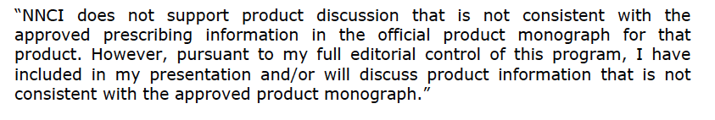
Disclaimer

Slide 6
Why this is important
By changing the behavior of even one person, we can prevent a multitude of infections and deaths.
All of my patients are high risk if they are exposed
Proactive not reactive
Keep patients out of the ER/Hospital
As HCP, people intrinsically trust HCPs – use your voice to reinforce self isolation
Don’t loose focus on Non-COVID diease

Slide 7
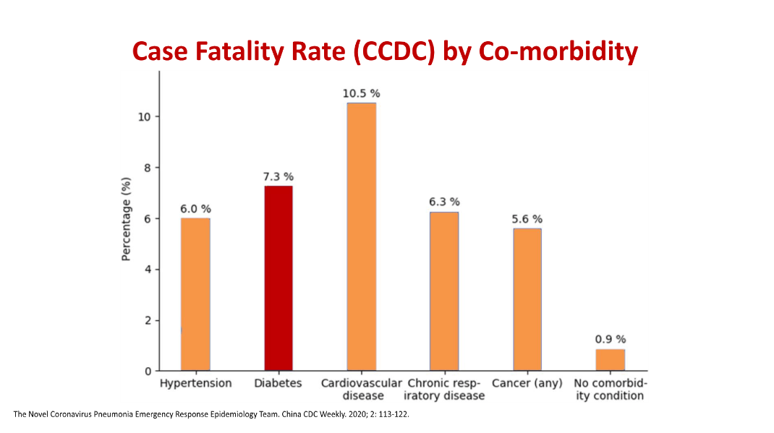
Data – Wuhan Province

Slide 8
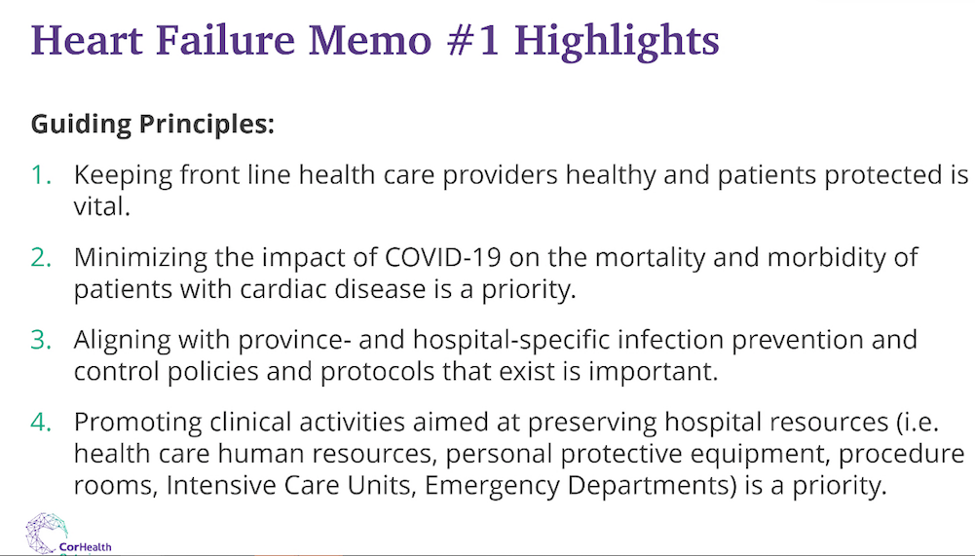

Slide 9
Case # 1
75 yo female
Hx dilated CM, EF improved from 18% to 40% in 2017
NYHA Class 1-2
No diabetes
Meds
  Lasix 20 mg prn – infrequently
  Bisoprolol 5 mg od
  Coversyl 4 mg od
  Spironolactone 12.5 ( prev incr K+)
BP – 120/70, HR 80
eGFR 75, K+ 4.9
? Recommendations

Slide 10
Case # 2
66 yo. male
Hx. Ischemic CM , EF 38 %
NYHA Class 2
  MI 2006, CABG 2012 no recent angina
  no PND/orthopnea/minor ankle swelling,
  Hosp. May & Oct 2019 with CHF
DM – x 5 yrs, A1C 6.9%
PVDx, no amputation
Incr. Cr with prev. attempts to increase ACE-I
Meds
  Lasix 40 mg od
  Ramipril 2.5 mg od
  Bisoprolol 10 mg od
  Spironolactone 25 mg od
  Rosuvastatin 10 mg od
  DPP-IV/SU
  ASA
BP- 105/60
eGFR -73, K+ 4.5. A1C 8.0
? Recommendations

Slide 11
Case # 3
80 yo female, known HFrEF
- EF 25%
Now admitted to hospital with CHF
- 2 week progressive ankle swelling/PND) No CP.
Hx. MI/CABG 2017
No diabetes
Current Meds
ACE-I max dose
Bisoprolol 2.5 mg
Spironolactone 25 mg od
Lasix 80 mg od
O/E BP 123/67, HR 85 NSR
Periph. edema
eGFR 55
Trop 0.9
Recommendations?

Slide 12
Priorities for CHF Management
Ongoing Monitoring of the Heart Failure Condition
Assess symptoms of COVID vs. CHF
Reinforce self isolation principles
4. Assess Pharmacological Optimization and Up-titration
5. Initiate therapies to reduce short term events in high risk patients
- self management diuretics
6. Follow-up high risk patients

Slide 13
Priority # 1
Ongoing Monitoring of the Heart Failure Condition

Slide 14
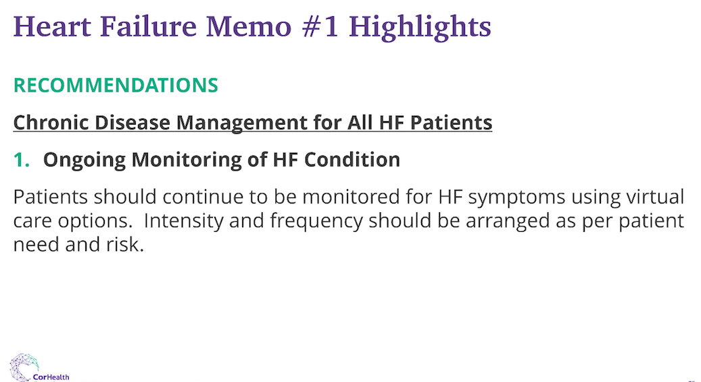
Diabetes

Slide 15
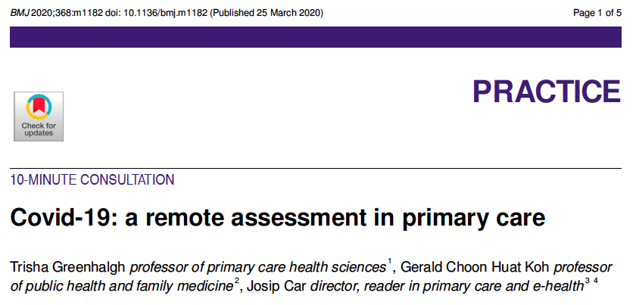

Slide 16
So how should we be monitoring patients?
Most patient can be managed remotely with advice on symptom treatment, self-management and self-isolation
Video conferencing may provide additional clues for diagnosis and also provide a therapeutic reassurance
Establishing criteria for seeking medical attention in the setting of clinical deterioration is crucial

Slide 17
Telephone or video
Consider video for patients with symptoms or significant co-morbid conditions, or if a degree of physical assessment is required.
Video conferencing may not be available for all patients and may require additional resources that are not available or accessible.
Before you connect
Have telephone checklist on hand and access to patient chart, labs and medications available
Have the most current “stay at home” guideline at hand

Slide 18
Establishing Connection
Ensure audio or video functioning ;“Can you hear me?”
Confirm patient identity
Identify any initial concerns or anxiety
Confirm purpose of the visit

Slide 19
Obtain History
Use a COVID specific checklist (attached for DM and CHF)
Include COVID symptom screening, usual information re chronic disease and also disease specific COVID concerns (e.g. Sick Day management for Diabetes)
Consider if the patient might need someone present with them during your assessment to assist with the exam (example: ask caregiver to be present, arrange assessment when homecare provider in the home to complete an assessment with you virtually)
Assess for shortness of breath, by asking questions related to changes in breathing (usual vs new symptoms)
Ask patients and caregivers to describe their symptoms in their own words. Ask more than one follow up question to ensure you have the details e.g. You say you are short of breath when you walk, has this changed in the last week? what are you doing when you are SOB?
Assess mental status including how they are coping with distress and anxiety

Slide 20
Obtain History
Assess for shortness of breath, by asking questions related to changes in breathing (usual vs new symptoms)
Ask patients and caregivers to describe their symptoms in their own words. Ask more than one follow up question to ensure you have the details e.g. You say you are short of breath when you walk, has this changed in the last week? what are you doing when you are SOB?
Assess mental status including how they are coping with distress and anxiety

Slide 21
Remote Exam
Consider access to monitoring/home BP measurements, biomarkers using FIT BIT like devices or Apple WATCH or similar products.
Consider if clear need for direct physical assessment or if other health care providers could assist to limit need to break self-isolation

Slide 22
Ensure Disease Specific Safety
Access to supply of medications
Review self-management issues for CHF (diuretics prn), Asthma/COPD (prn puffers, may ask for demonstration of technique) and Diabetes (adjustment of orals/Insulin to avoid hypoglycemia)

Slide 23
Ensure Disease Specific Safety
Consider implementing or up-titrating medications that would change short-term outcomes, especially if limited follow-up or labs required
Consider deferring medications that do not have a short-term clear benefit, or require additional follow-up or laboratory monitoring to implement
Consider delaying implementation of medications whose side-effect may mimic COVID symptoms (e.g. ACE-I cough) or choose alternatives

Slide 24
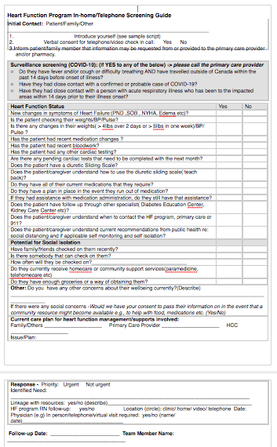
COVID CHF Visit Tool

Slide 25
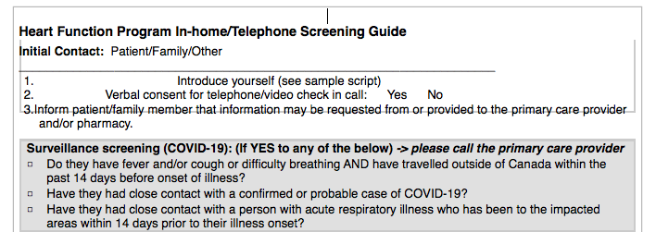
Introduction and COVID Screening

Slide 26
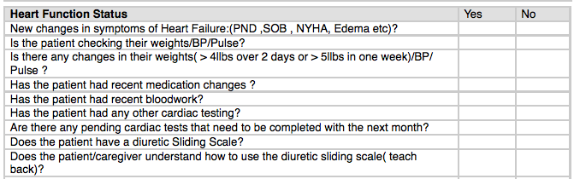
Disease Specific Questions

Slide 27
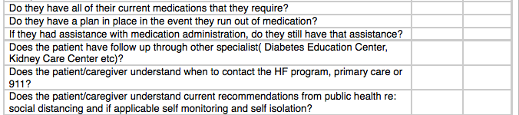
Safety/Access Issues

Slide 28
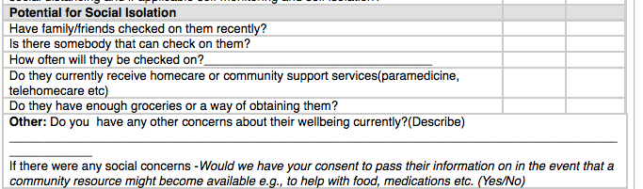
Social Isolation

Slide 29
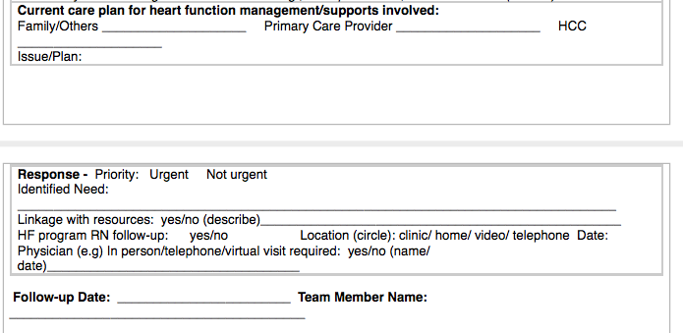
Triage Follow-up

Slide 30
Priority #2
Assess symptoms of COVID vs. CHF

Slide 31


Slide 32
Factors that increase Probability of COVID vs CHF
Individual risk
  Degree of self-isolation/distancing
  Amount of community spread
  Traditional risk factors – travel/exposure/groups/Toronto)
Presence of fever/cough/myalgia – 50-80% have fever
Absence of typical Symptoms of CHF
  Wt gain/edema
  Comparison to previous sympt./exacer. (PND/Abdo swelling)
Lack of response to diuresis (recheck 24/48 hrs)
BNP/Trop/Oximetry not helpful to distinguish

Slide 33
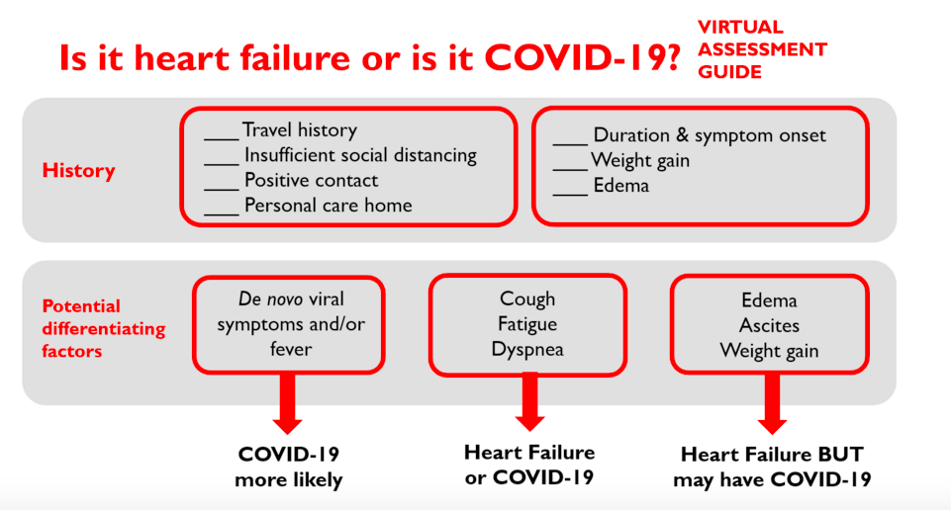
From CCS COVID Response Team April 1,2020

Slide 34
Priority #3
Reinforce self isolation principles

Slide 35
Promote Self-Isolation
Reinforce during phone conversation
  ? Supports < 60 with no chronic Disease
  Reduce/eliminate going outside the home
  Deliveries for medications ? 1 month limit
  Lab work by home visit ? Need lead time

Slide 37
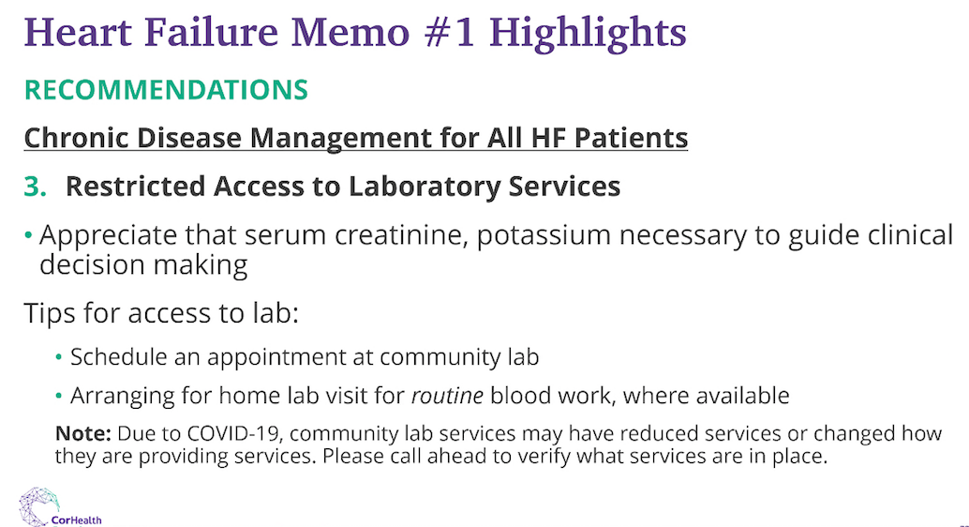
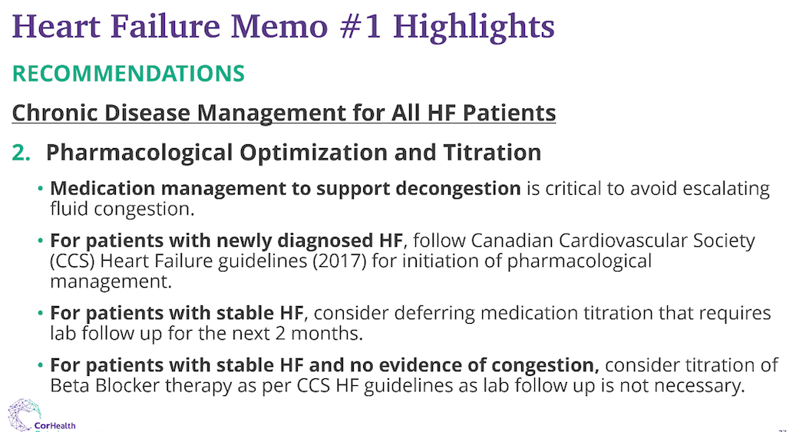

Slide 38
Can routine labs be delayed?
Labs within 6 months with normal or stable lytes/cr
No incr > 30% Cr unless clear case (dehydration/med/etc)
No recent change in meds affecting lytes/Cr
If patient meets criteria – defer testing until after COVID social distancing/isolation removed

Slide 39
Is lab testing required to prevent ER Visit?
Known hx abnormal labs requiring intervention
Increase in Cr 30% without cause
Recent new meds that effect lites/Cr
Recent ER visit/admission
Symptoms suggesting lytes/Cr abnormality muscle cramps palpitation dehydration
If so – arrange for home labs if available
  Or pre-book appointment with labs and maintain social distancing

Slide 40
Priority # 4
Assess Pharmacological Optimization and Up-titration

Slide 41
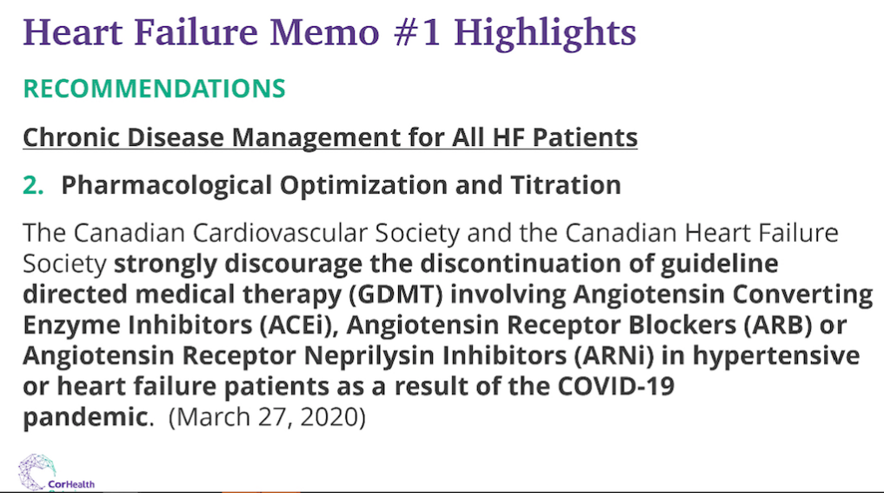

Slide 42
Withdrawal of agents
ACE inhibitors
  Clinical worsening in 70%
  Minor change in EF
  Exception seems to be in renal dysfunction
Beta Blockers
  In both NICM and ICM
  Odds ratio of return of HF 26 in one study if BB stopped
  About 70% chance of lower EF, often with symptoms
MRA:
  No real data
Diuretics
  Increased likelihood of return of symptoms
PPCM
  Low incidence of HF if EF returned to normal

Slide 43
Therapeutic approach to patients with HFrEF
Patient with LVEF ≤ 40% and Symptoms
Advance Care Planning and Documentation
of Goals of Care
Triple Therapy ACEI (or ARB if ACEI intolerant), BB, MRA
Titrate to target doses or maximum tolerated evidence-based dose
REASSESS SYMPTOMS
Non-pharmacologic therapies
(teaching self-care, exercise)
NYHA I
Continue triple therapy
NYHA II-IV
SR, HR ≥ 70 bpm
ADD ivabradine and SWITCH ACEI or ARB to sac/val for eligible patients
NYHA II-IV
SR with HR < 70 bpm or AF or pacemaker
SWITCH ACEI or ARB to sac/val for eligible patients
Diuretics to relieve congestion
Titrated to minimum effective dose to maintain euvolemia
REASSESS SYMPTOMS AND LVEF

Slide 44
2019 HF Guidelines Update
OFF LABEL FOR THOSE WITHOUT DIABETES!

Slide 45
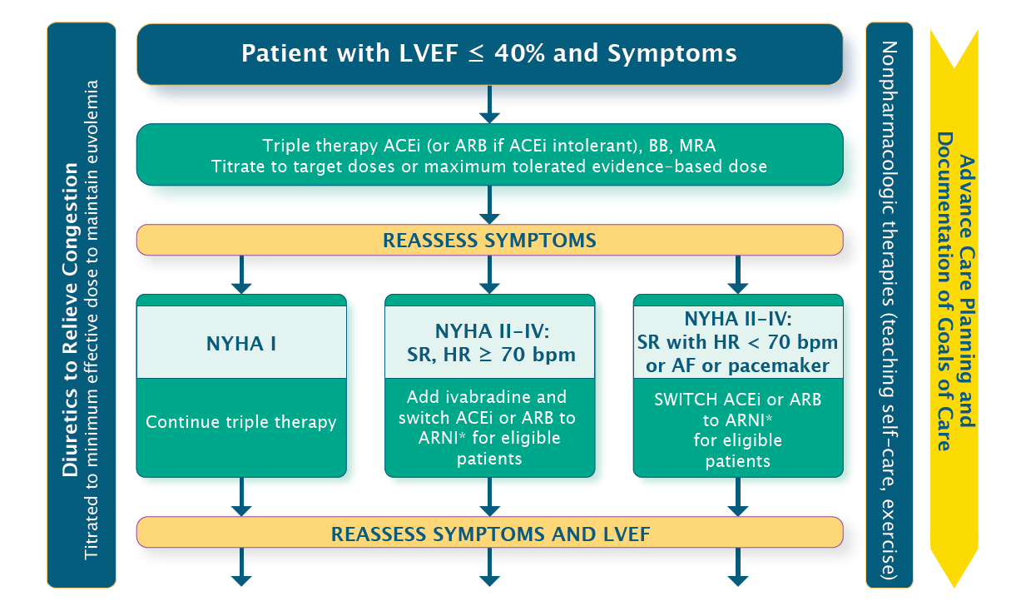
Therapeutic Approach to Patients with HFrEF
Where do we
put SGLT2i?

Slide 46
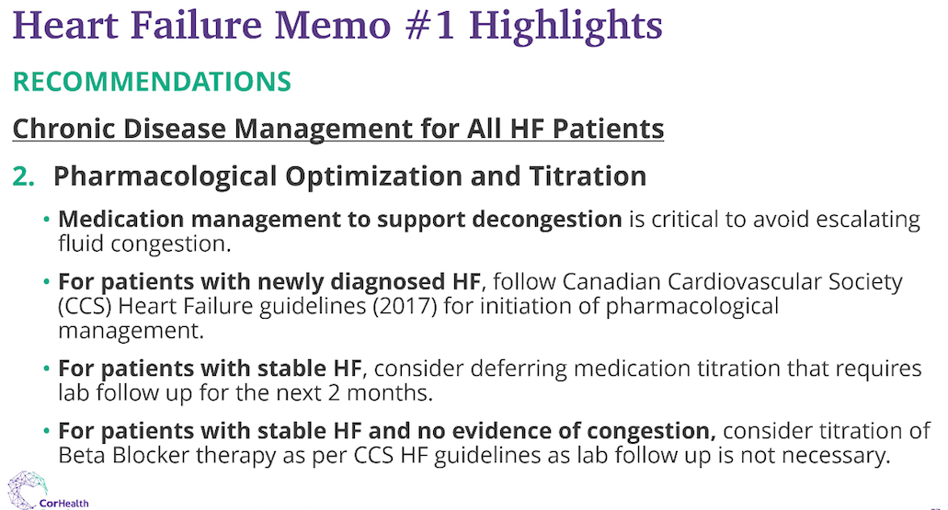

Slide 47
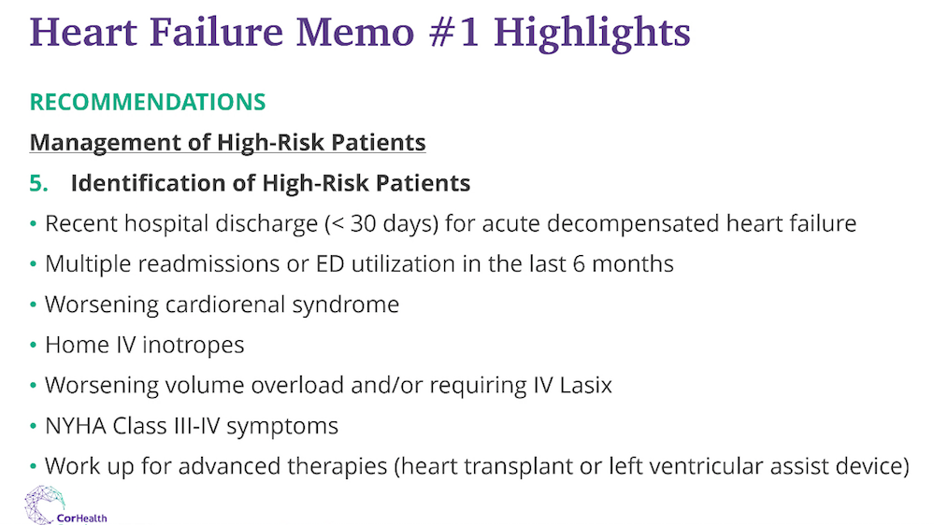

Slide 48
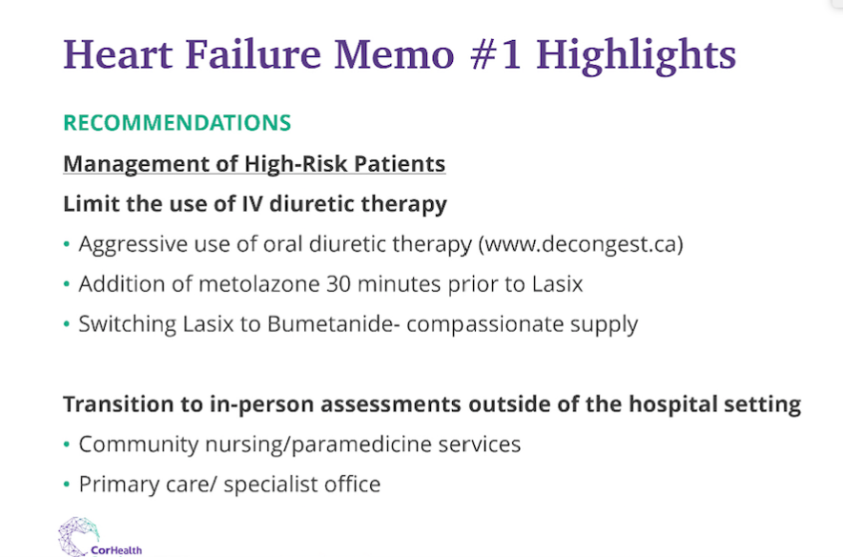

Slide 49
Which medications are most likely to have short-term benefits?

Slide 50
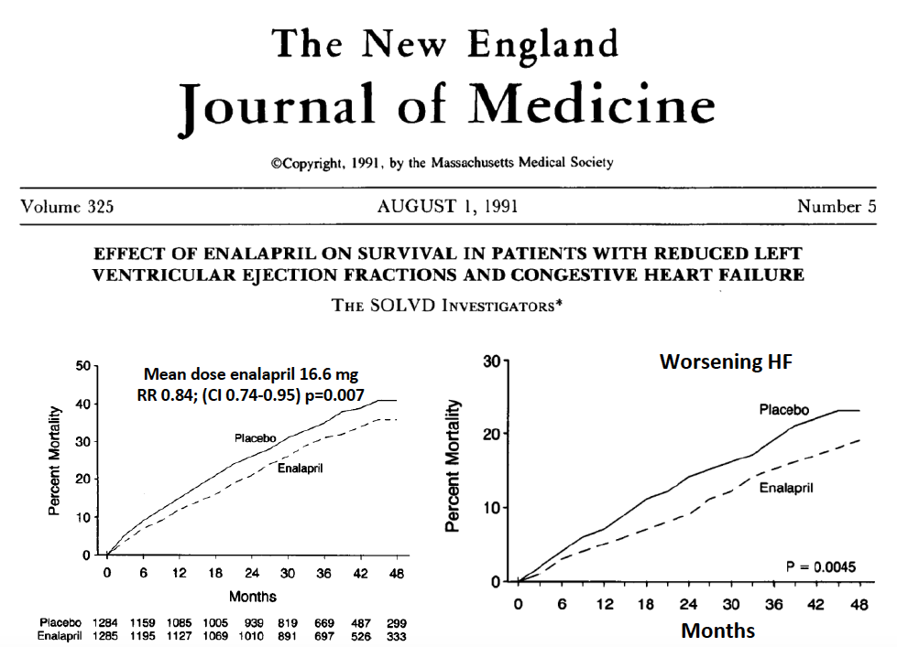
ACE-I/ARB’s

Slide 51
Key Evidence for ß-blockers in HF
MERIT-HF
Cumulative percentage
of total mortality*
CIBIS II
Survival curves**
COPERNICUS
Time to death or hospitalization***
20
1-0
100
Placebo
80
15
Bisoprolol
Carvedilol
Metoprolol
0-8
60
Mortality (%)
Survival (%)
Event-free survival (%)
10
Placebo
40
Placebo
5
0-6
20
p = 0.0062 (adjusted)
p = 0.00009 (nominal)
p = 0.0001
p = 0.000004
0
0
0
0
0.5
1.0
1.5
2.0
2.5
3.0
3.5
0
0.5
1.0
1.5
2.0
2.5
3.0
3.5
0
0.5
1.0
1.5
2.0
2.5
3.0
3.5
)
*MERIT-HF Study Group. Lancet 1999; 353:2001-7.
**CIBIS II Investigators. Lancet 1999; 353:9-13.
***Packer M et al. Circulation 2002; 106:2194-9.
Arnold JM et al. Can J Cardiol 2006; 22(1):23-45.
Notes:
References:
Arnold JMO et al. Canadian Cardiovascular Society consensus conference recommendations on heart failure 2006:diagnosis and management. Can J Cardiol 2006 Jan; 22(1):23-45.
MERIT-HF Study Group. Effect of metoprolol CR/XL in chronic heart failure: Metoprolol CR/XL Randomized Intervention Trial in Congestive Heart Failure (MERIT-HF). Lancet 1999 June 12; 353:2001-7.
CIBIS II Investigators and Committee. The Cardiac Insufficiency Bisoprolol Study II: a randomized trial. Lancet 1999 Jan 02; 353:9-13.
Packer M et al, for the Carvedilol prospective randomised cumulative survival (COPERNICUS) study group. Effect of carvedilol on the morbidity of patients with severe chronic heart failure: results of the carvedilol prospective randomised cumulative survival (COPERNICUS) study. Circulation 2002 Oct 22; 106:2194-9.

Slide 52
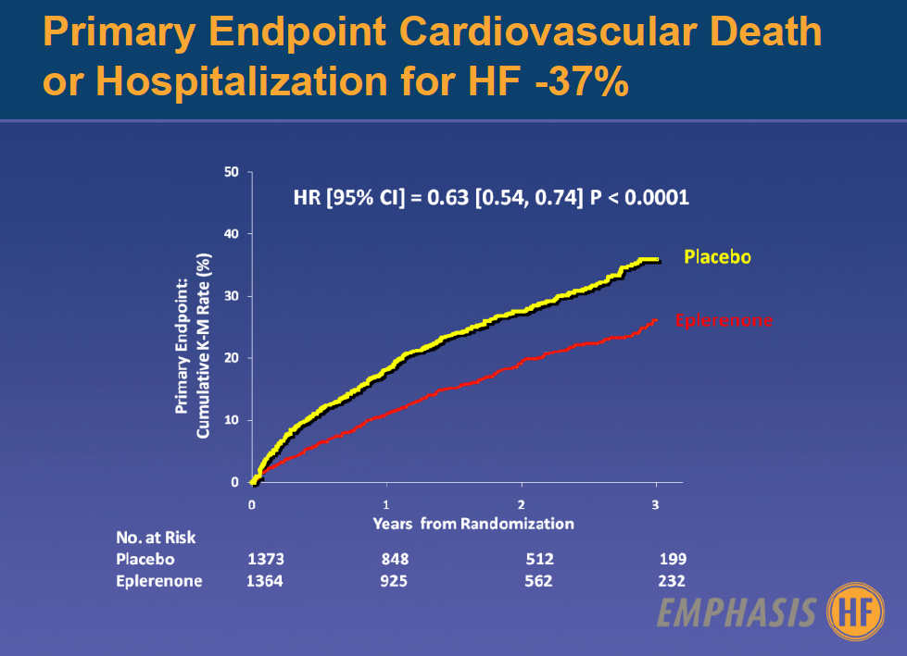
MRA

Slide 53
PARADIGM-HF: Primary Endpoint: Death From CV Causes Or First Hospitalization For HF
1.0
Hazard ratio = 0.80
(95% CI: 0.73–0.87)
p<0.001
NNT to prevent
one primary
event: 21
0.6
HR: 20% difference favoring sacubitril/valsartan
Cumulative probability
0.4
0.2
Enalapril
0
Sacubitril/Valsartan
0
180
360
240
720
900
1080
1260
Days since randomization
No. at risk
4187 | 3922 | 3663 | 3018 | 2257 | 1544 | 896 | 249 | Sacubitril/Valsartan
4212 | 3883 | 3579 | 2922 | 2123 | 1488 | 853 | 236 | Enalapril
*The numbers of patients who would need to have been treated (NNT) to prevent one primary event was evaluated over the duration of the trial
McMurray et al. N Engl J Med 2014;371 (11):993–1004.

Slide 54
PIONEER-HF: Exploratory Serious Clinical Composite Endpoint*, Open-Label Phase (Week 8-12)
30
HR: 0.67 (95% CI, 0.48 to 0.94)
20
to Sacubitril/Valsartan
% of Patients with Serious
Composite Clinical Endpoint
to Sacubitril/Valsartan
Enalapril
10
Sacubitril/Valsartan
0
Baseline
1
2
3
4
5
6
7
8
9
10
1
1
12
13
N at Risk
Weeks from Randomization
Enalapril (n)
441
429
418
408
394
378
366
357
353
348
347
340
293
62
Sacubitril/Valsartan (n)
440
434
419
414
404
398
388
385
381
375
366
362
299
74
During the initial 8-week period, the serious clinical composite endpoint reduction was known to have been driven by a reduction in HF hospitalization and death.
*Composite of Death, HF re-hospitalization, requirement of LVAD and listing for cardiac transplant
DeVore AD et al. Late Breaker ACC 2019. New Orleans LA, USA March 16-18, 2019
MED/ENT/0409

Slide 55
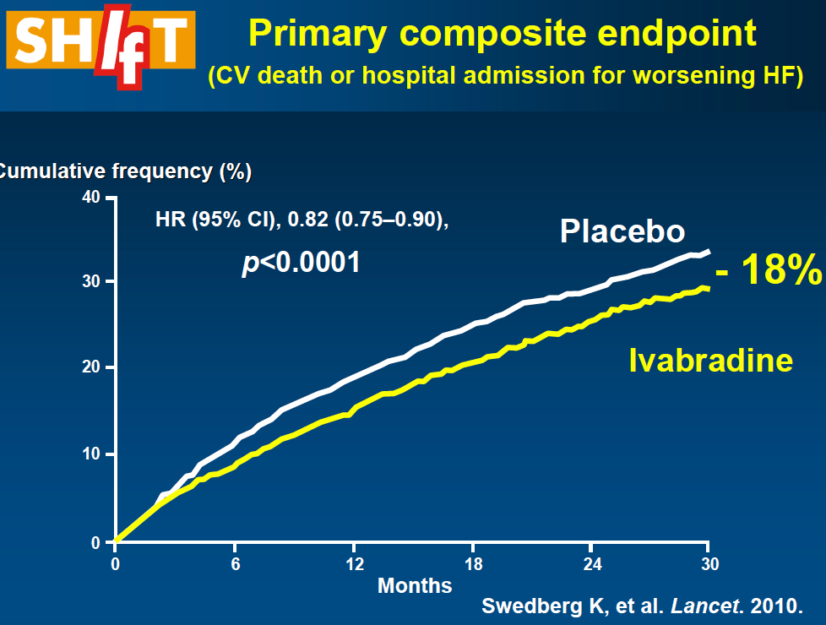
Ivabradine

Slide 56
EMPA-REG OUTCOME
Primary Outcome: CV Death, Non-fatal MI or Non-fatal Stroke
EMPA-REG OUTCOME included adult patients (>18 years) with type 2 diabetes and established CVD who were receiving standard of care therapy for diabetes
Empagliflozin (pooled)
HR 0.86
(95.02% CI 0.74, 0.99)
p=0.04* for superiority
p<0.001 for noninferiority
Placebo
Empagliflozin
Patients with event (%)
Empagliflozin 10 mg
HR 0.85 (95% CI 0.72, 1.01), p=0.07
Empagliflozin 25 mg
HR 0.86 (95% CI 0.73, 1.02), p=0.09
Months
No. of patients
Empagliflozin
Placebo
4687
2333
4580
2256
4455
2194
4328
2112
3851
1875
2821
1380
2359
1161
1534
741
370
166
Cumulative incidence function. MACE: major adverse cardiovascular event; HR: hazard ratio; MI: myocardial infarction; SGLT2: sodium glucose cotransporter 2
*Two-sided tests for superiority were conducted (statistical significance was indicated if p≤0.0498)
Note: Empagliflozin is an SGLT2 inhibitor. Data from: Zinman B, et al. N Engl J Med. 2015; 373:2117-2128.

Slide 57
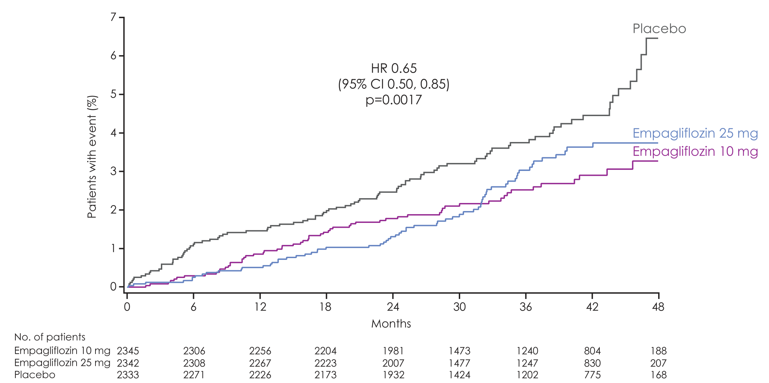
Hospitalisation for heart failure
Empagliflozin 10 mg
HR 0.62
(95% CI 0.45, 0.86)
p=0.0044
Empagliflozin 25 mg
HR 0.68
(95% CI 0.50, 0.93)
p=0.0166

Slide 58
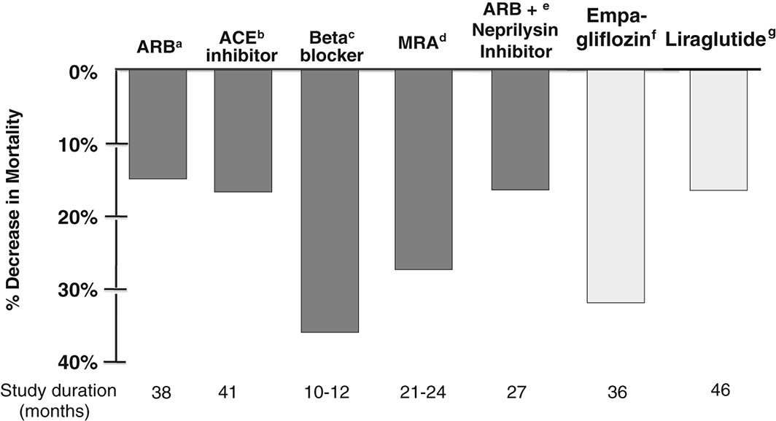
Heart failure outcomes in clinical trials of glucose‐lowering agents in patients with diabetes
European Journal of Heart Failure
Volume 19, Issue 1, pages 43-53, 21 SEP 2016 DOI: 10.1002/ejhf.633
http://onlinelibrary.wiley.com/doi/10.1002/ejhf.633/full#ejhf633-fig-0005
Notes:
Comparison of all‐cause mortality reduction observed in heart failure trials with the EMPA‐REG OUTCOME and LEADER cardiovascular outcome trials in patients with diabetes. ªSOLVD Treatment, ^{b}CHARM Alternative, ^{c}COPERNICUS and MERIT‐HF, ^{d}RALES and EMPHASIS‐HF, ^{e}PARADIGM, ^{f}EMPA‐REG OUTCOME, ^{g}LEADER.
IF THIS IMAGE HAS BEEN PROVIDED BY OR IS OWNED BY A THIRD PARTY, AS INDICATED IN THE CAPTION LINE, THEN FURTHER PERMISSION MAY BE NEEDED BEFORE ANY FURTHER USE. PLEASE CONTACT WILEY'S PERMISSIONS DEPARTMENT ON PERMISSIONS@WILEY.COM OR USE THE RIGHTSLINK SERVICE BY CLICKING ON THE 'REQUEST PERMISSIONS' LINK ACCOMPANYING THIS ARTICLE. WILEY OR AUTHOR OWNED IMAGES MAY BE USED FOR NON-COMMERCIAL PURPOSES, SUBJECT TO PROPER CITATION OF THE ARTICLE, AUTHOR, AND PUBLISHER.

Slide 59
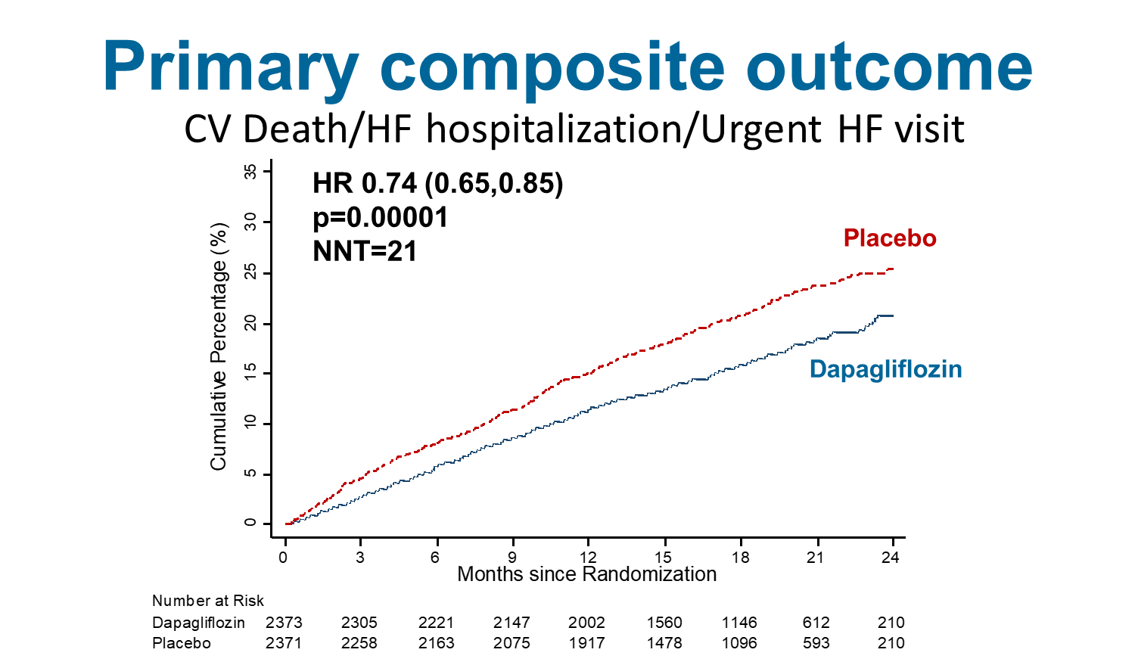

Slide 60
Practical Type 2 Diabetic Algorithm for Cardio-Renal Protection for Non-Diabetologists
Yes
Vascular Disease/
Significant Nephropathy/CHF
No
Priority is glycemic control
Priority is Vascular/Renal Protection
< 8.5
Unknown or
Hypoglycemia
D/C SU, Reduce Basal 50%
Basal Insulin*/SU
Yes
A1C
> 8.5
Cont. SU, Reduce Basal 20%
No
Concerns re hypovolemia/
SBP< 120/eGFR < 45
Adjust HT meds/diuretics
Consider refer if eGFR 30- 45,
Consider Liraglutide if eGFR < 30
Follow CR
Yes
No
If eGFR > 30
Start SGLT-2 Inh
Check Cr /Sick Day//GMI Management if +’ve Hx
Algorithm developed by JC MacFadyen, MD. FRCPC, MHPE
*If on mealtime insulin – refer (may have insulin deficiency or Type 1 diabetes)

Slide 61
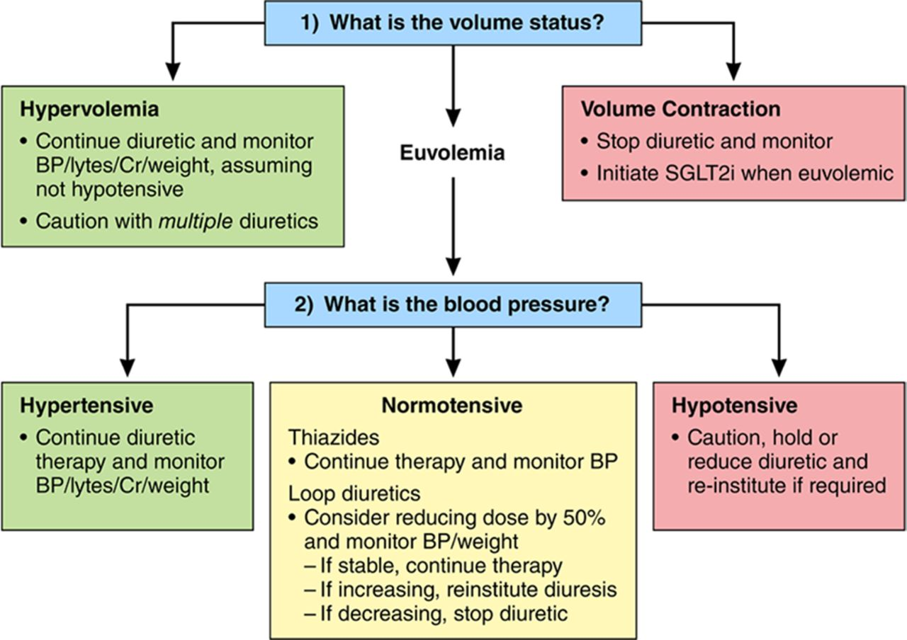

Proposed management of concomitant diuretics when initiating a sodium glucose cotransport-2 inhibitor (SGLT2i) in high-risk patients with type 2 diabetes mellitus (T2DM).
Copyright © American Heart Association, Inc. All rights reserved.
David Z.I. Cherney, and Jacob A. Udell Circulation. 2016;134:1915-1917
Notes:
Proposed management of concomitant diuretics when initiating a sodium glucose cotransport-2 inhibitor (SGLT2i) in high-risk patients with type 2 diabetes mellitus (T2DM). Green boxes represent scenarios in which the practitioner can typically proceed with initiation of SGLT2i therapy among stable outpatients with T2DM. Red boxes represent scenarios in which the practitioner should not initiate SGLT2i therapy given the potential for deleterious natriuresis/hemodynamic effects in these settings. Yellow boxes represent scenarios in which the practitioner may proceed with caution with initiation of SGLT2i therapy and monitor for natriuresis/hemodynamic effect. Clinical monitoring includes consideration of checking blood pressure (BP), renal function, electrolytes, and weight response to therapy within the first 2 weeks. Similar recommendations may be applicable in patients taking angiotensin II receptor-neprilysin inhibition (ARNI) therapy, and additional data on SGLT2i-ARNI combinations are required. Cr indicates creatinine.

Slide 62
Don’t use SGLT-2 Inh with
Type 1 diabetes
Hx DKA/Pancreatic Insufficiency/Pancreatic resection
eGFR < 30% (25%)
Frail elderly – unless you are treating CHF
  replaces some diuretics

Slide 63
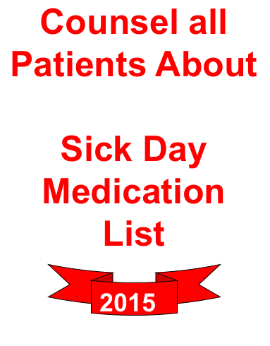
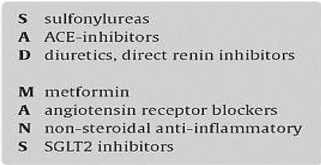

Slide 64
COMPASS Design
Stable CAD or PAD
27,395 participants randomized
Rivaroxaban 2.5 mg bid + Aspirin 100 mg od
Run-in* (aspirin plus rivaroxaban) placebo)
R
Rivaroxaban 5 mg bid
Aspirin 100 mg od
Expected mean follow up: 3-4 years
*excluding patients enrolled 4-14 days post CABG
Bosch JJ, et al. Can J Cardiol 2017; 33:1027-1035.

Slide 65
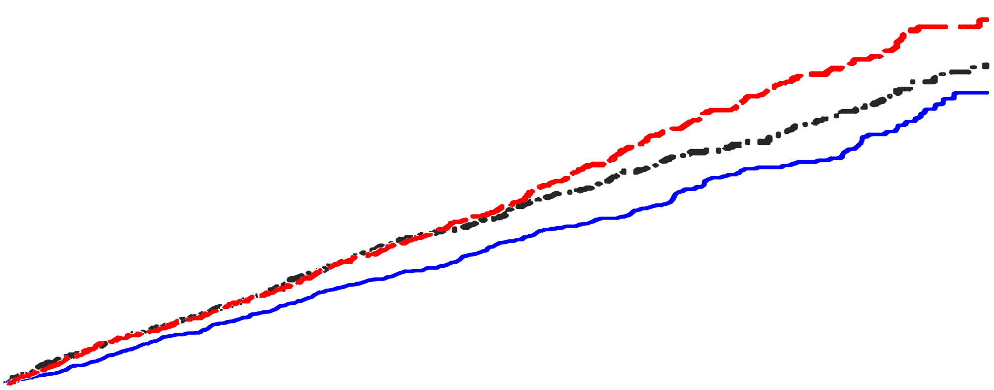
COMPASS Trial Primary outcome
Rivaroxaban + aspirin vs. placebo plus aspirin
Hazard ratio, 0.76 (95% CI, 0.66-0.86)
Aspirin alone
P<0.001
Rivaroxaban alone vs. placebo plus aspirin
Rivaroxaban alone
Hazard ratio, 0.90 (95% CI, 0.79-1.03)
Rivaroxaban + aspirin
P=0.12
Cumulative Risk of Cardiovascular Death, Myocardial Infarction, or Stroke
Year
Eikelboom JW, et al. N Engl J Med 2017; 377:1319-30.

Slide 66
CV Death, Myocardial Infarction, or Stroke
Diabetes (N=6,922)
Diabetes
HR 0.74, 95% CI: 0.61-0.90, p=0.002
ARR 2.3%
Aspirin Alone
Rivaroxaban plus Aspirin
No Diabetes (N=11,356)
10.7%
Aspirin Alone
Rivaroxaban plus Aspirin
8.4%
7.2%
Cumulative Hazard
P value for interaction=0.77
5.8%
No Diabetes
HR 0.77, 95% CI: 0.64-0.93, p=0.005
ARR 1.4%
Months
Bhatt DL, Eikelboom JW, Connolly SJ, et al, Yusuf S. Circulation. 2020.

Slide 67
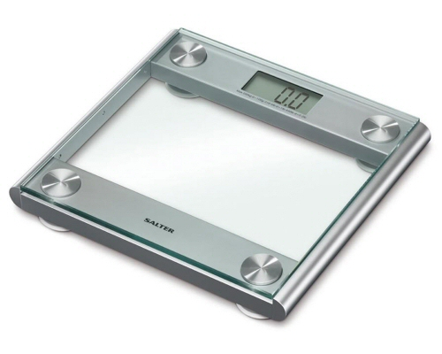
Device Therapy for CHF Therapy

Slide 68
Pt Self management - Diuretics
“Sliding Scale”
  Balance of volume overload/dehydration
  Varies with renal function
  Allows pt to self-manage/avoid ER visit
  Needs to be reviewed re- change in real wt.
  Estimate ideal wt – varies with vol status and Cr

Slide 69
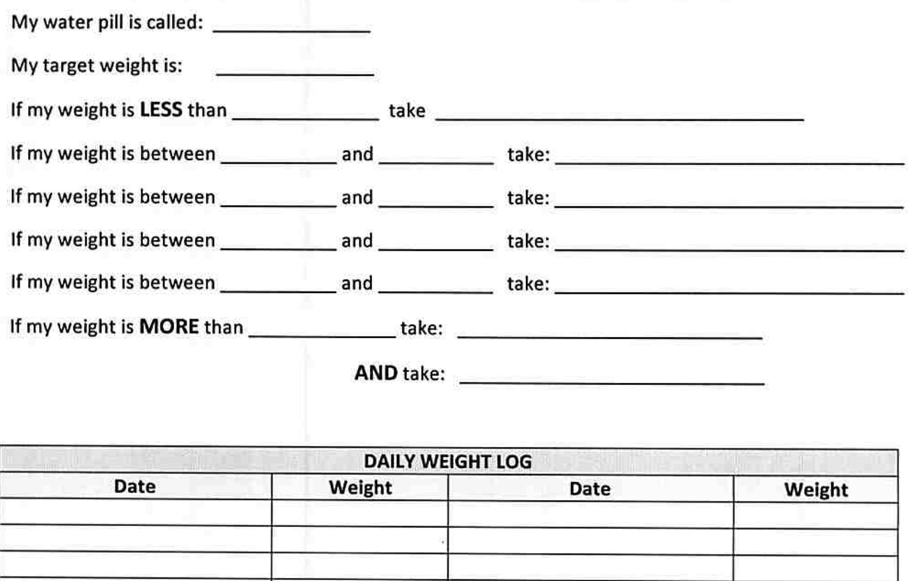
Patient Sliding Scale for Diuretics

Slide 70
Priority # 5
Follow-up high risk patients

Slide 72
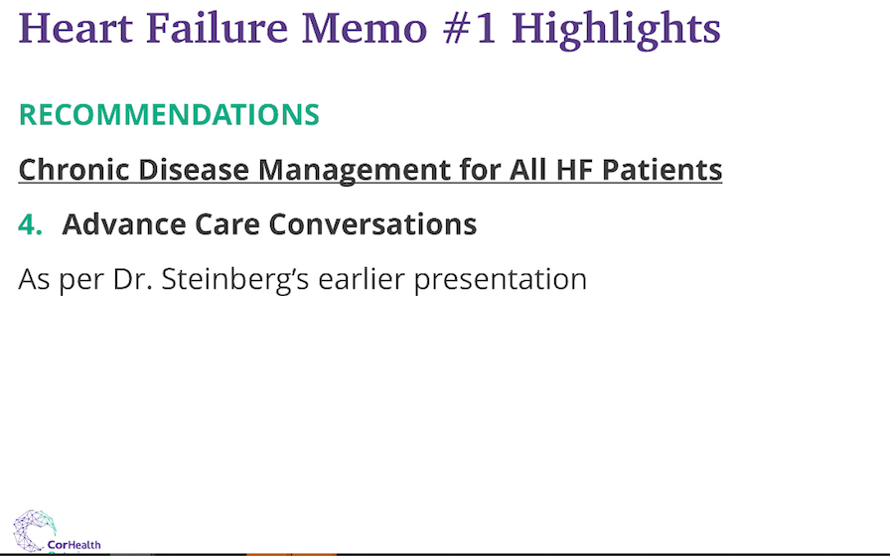

Slide 73
Case # 1
75 yo female
Hx dilated CM, EF improved from 18% to 40% in 2017
NYHA Class 1-2
No diabetes
Meds
  Lasix 20 mg prn – infrequently
  Bisoprolol 5 mg od
  Perindopril 4 mg od
  Spironolactone 12.5 ( prev incr K+)
BP – 120/70, HR 80
eGFR 75, K+ 4.9
? Recommendations

Slide 74
Case # 1
Use COVID CHF Checklist Tool
Reinforce self isolation
No labs required
No changes - Patient stable
  ? Incr BB
Consider prn Lasix for symptom control
Follow-up – when COVID restriction lifted

Slide 75
Case # 2
66 yo. male
Hx. Ischemic CM , EF 38 %
NYHA Class 2
  MI 2006, CABG 2012 no recent angina
  no PND/orthopnea/minor ankle swelling,
  Hosp. May & Oct 2019 with CHF
DM – x 5 yrsPVDx, no amputation
Incr. Cr with prev. attempts to increase ACE-I
Meds
  Lasix 40 mg od
  Ramipril 2.5 mg od
  Bisoprolol 10 mg od
  Spironolactone 25 mg od
  Rosuvastatin 10 mg od
  DPP-IV/SU
  ASA
BP- 105/60
eGFR -73, K+ 4.5. A1C 8.0
Recommendations

Slide 76
Case # 2
Use COVID CHF Checklist Tool
Reinforce self isolation
Review SADMANS (Diabetes)
Medication changes
  SGLT-2 Inh
  Reduce SU
  Lasix self management – 40 mg prn or 20 mg od + 20 mg prn
  Xarelto 2.5 mg bid with ASA
A1C is not a priority
Follow-up – 2-4 weeks
May require labs 2-4 weeks

Slide 77
Practical Type 2 Diabetic Algorithm for Cardio-Renal Protection for Non-Diabetologists
Yes
Vascular Disease/
Significant Nephropathy/CHF
No
Priority is glycemic control
Priority is Vascular/Renal Protection
< 8.5
Unknown or
Hypoglycemia
D/C SU, Reduce Basal 50%
Basal Insulin*/SU
Yes
A1C
> 8.5
Cont. SU, Reduce Basal 20%
No
Concerns re hypovolemia/
SBP< 120/eGFR < 45
Adjust HT meds/diuretics
Consider refer if eGFR 30- 45,
Consider Liraglutide if eGFR < 30
Follow CR
Yes
No
If eGFR > 30
Start SGLT-2 Inh
Check Cr /Sick Day//GMI Management if +’ve Hx
Algorithm developed by JC MacFadyen, MD. FRCPC, MHPE
*If on mealtime insulin – refer (may have insulin deficiency or Type 1 diabetes)

Slide 78
Case # 2
Use COVID Checklist
Reinforce self isolation
Review SADMANS (Diabetes)
Medication changes
  SGLT-2 Inh
  Reduce SU
  Lasix self management – 40 mg prn or 20 mg od + 20 mg prn
  Xarelto 2.5 mg bid with ASA
A1C is not a priority
Follow-up – 2-4 weeks
May require labs 2-4 weeks

Slide 79
Case # 3
80 yo female, known HFrEF
- EF 25%
Now admitted to hospital with CHF
- 2 week progressive ankle swelling/PND) No CP.
Hx. MI/CABG 2017
No diabetes
Current Meds
ACE-I max dose
Bisoprolol 2.5 mg
Spironolactone 25 mg od
Lasix 80 mg od
O/E BP 123/67, HR 85 NSR
Periph. edema
eGFR 55
Trop 0.9
Recommendations?

Slide 80
Case # 3
Use COVID Checklist
Reinforce self isolation
Medications
  Uptitrate BB
  Sacubitril/Valsartan
  +/- SGLT-2
  Lasix – self-management - weight/symptom-based
Labs required 1-2 weeks
Follow-up – phone f/u ? Video 48-72 hrs. post discharge

Slide 81
Summary
Most patient can be managed remotely with advice on symptom treatment, self-management and self-isolation
Shortness of breath is difficult to assess. No validated tool but consider CHF vs COVID screening tool.
Establishing criteria for seeking medical attention in the setting of clinical deterioration is crucial
Consider meds and up-titration that have short-term impact especially if close f/u not required or available
Consider the impact upon management that increases need for f/u and labs as it will break barrier of social isolation

Slide 82
Messaging re CHF
Continue to be aggressive, but not too aggressive
Depends on risk to patient
  Class 1 – minimal adjustments
  Class 2 – need to know prn diuretics, uptitrate BB
  Class 3-4/ hospitalized/recently hospitalized
    Still be aggressive but be careful esp in eGFR < 45%

Slide 83

Documents Available
www.sdcrc.ca

