Slide 1
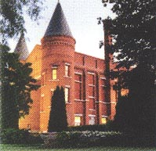
ER Rounds
April 11, 2024
J.C. MacFadyen
MD, FRCPC, MHPE
JC MacFadyen MD FRCPC MHPE

Slide 2
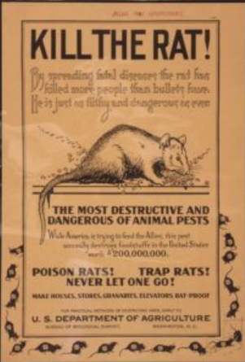
Having Fun
With Coumadin

Slide 3
NL
68yo female
Mech AVR 2011
DM
Insulin, Bisoprol, furosemide, empagliflozin, Fluconazole prn
Feb 2023 – 300 tabs x 1 mg 10 repeats
Typical dose 6-7 mg daily
Coumadin - followed over the phone
  Challenges with adherence
    Typically will reduce dose as advised x 3 days then resume previous
    5 mg in blister pack with 1 mg tabs out of blister pack
    March 18 – in office – multiple bruises
    Changed to 1 mg bcapsules - take 6
    Feb 26 INR 7.6 - hold x 3 days then reduce by 1 mg, labs 1 week
    March 14 – 6.2
    hold x 2 days then reduce by 1 mg
    Multiple attempte=s reduce 1 mg and next INR still high

Slide 4
NL
  Challenges with adherence
    Multiple attempts reduce 1 mg and next INR still high
    Typically will reduce dose as advised x 3 days then resume previous
    Last prescribed 300 x 1 mg tabs 10 repeats Jan 2023
    Feb 26 INR 7.6 - hold x 3 days then reduce by 1 mg, labs 1 week
    March 14 – 6.2
    hold x 2 days then reduce by 1 mg

Slide 5
NL
March 22 – to ER, fall at a funeral
More bruising
Multiple Xrays no #’s
Coumadin “2 mg”
INR – 6.3
Reduce coumadin to 1 ½ mg od

Slide 6
NL
Office next day
Meds reviewed – 5 mg tabs in blister pack, 1 mg tabs outside
Hold Coumadin 2 days then reduce by one mg to 4 mg
Written instructions
One week later
April 3 – INR 1.1
- Coumadin 6 mg, labs 1 week

Slide 7
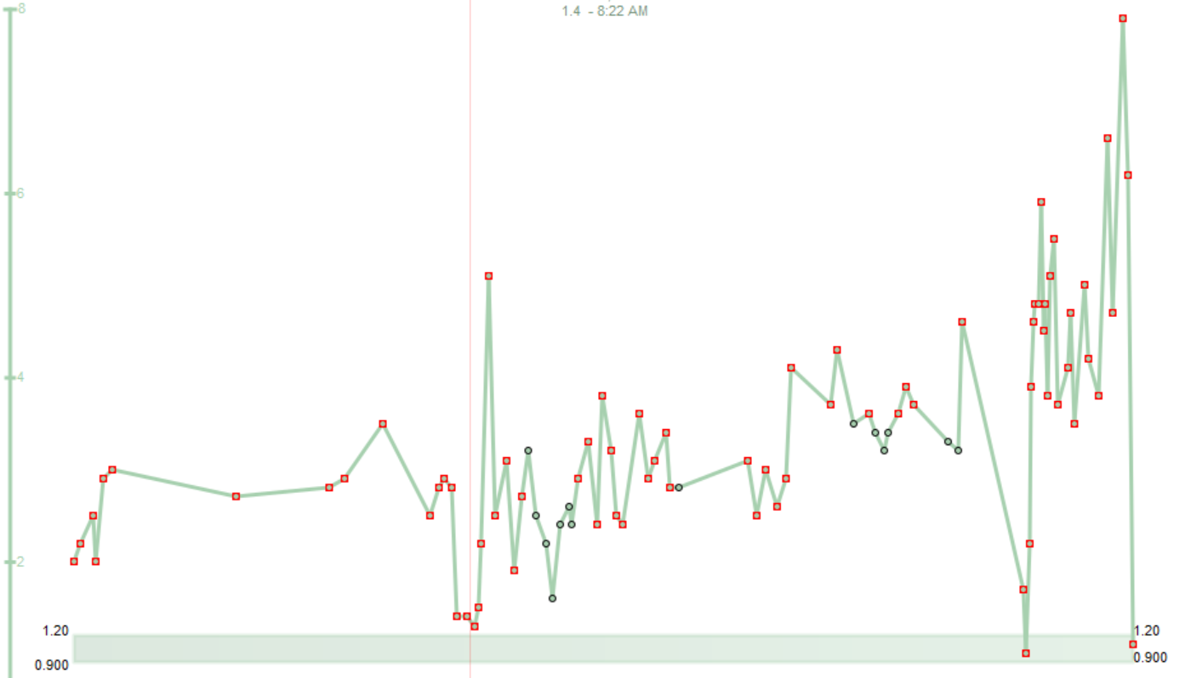

Slide 8
History
1921, Frank Schofield, a Canadian veterinary pathologist, determined that the cattle were ingesting moldy silage made from sweet clover.
12/25 bulls died from hemorhage after castration
RTC – rabbits
Wisconsin Alumni Research Foundation", plus "-arin", indicating its link with coumarin

Slide 9
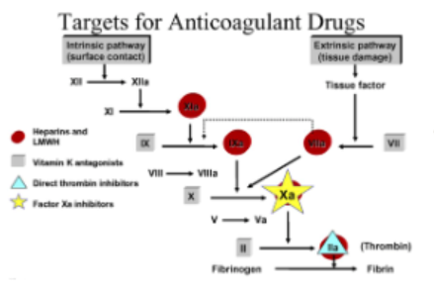

Slide 10
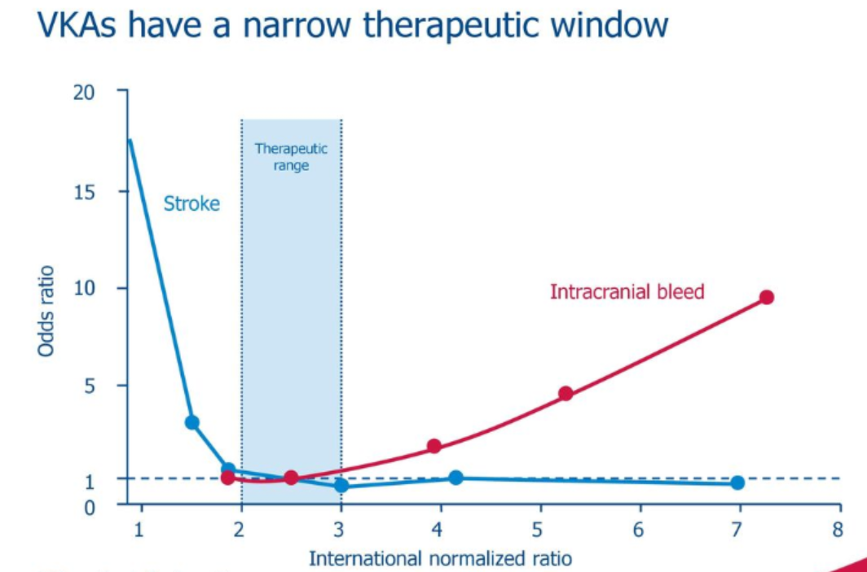

Slide 11
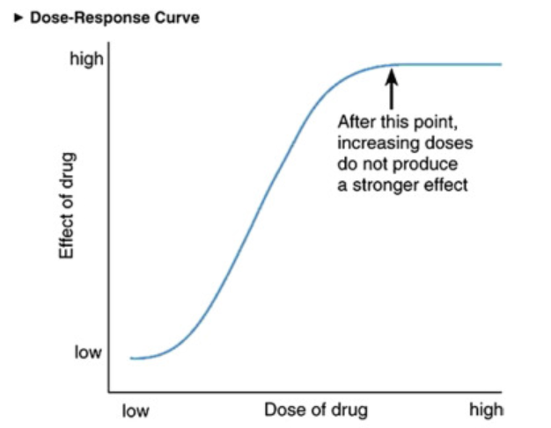
4 5 mg

Slide 12
Identify cause of supratherapeutic INR
Tell me what warfarin doses you’ve taken in the past 2 weeks. The patient may have mistakenly taken a different dosage regimen than what was prescribed.
Have you missed any doses in the past week? If yes, how many? How do you ensure that all doses have been taken? Do you use a calendar to record doses? A pill box?
Have you started or stopped any medication or supplements (prescription or non-prescription) recently? Any new antibiotics? Any dose changes of your medications? Do you take Tylenol? How many per day?
How is your appetite? Have you been eating regularly? Have there been any recent changes in your diet?
How often and how much alcohol do you drink? Do you drink just on weekends?
Overall, how has your health been? Any infection? Fever? Diarrhea? Flu? Recent cold?

Slide 13
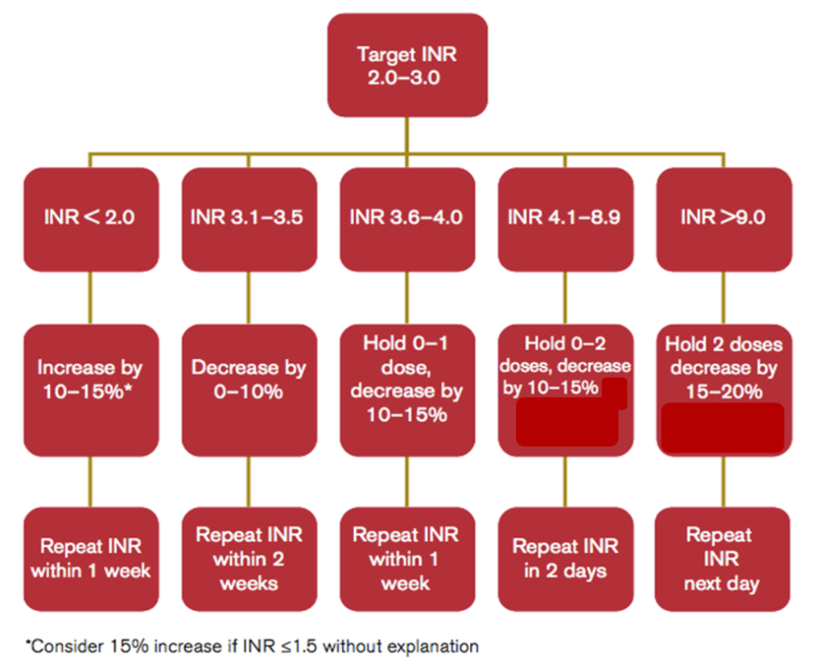
Figure: Warfarin Dose Adjustment in Non-bleeding Patients by % Dose Change of Total Weekly Dose (adapted from Cushman et al, 2014)

Slide 14
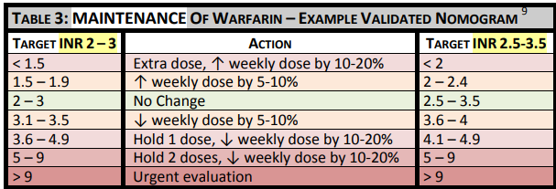

Slide 15
PN
68 yo male
Mechanical AVR 2007
Coumadin 6 alt 7 mg od
  -Norvasc/Lipitor/Coversyl
Hb 144
No prev MI/CVA/CHF/DM

Slide 16
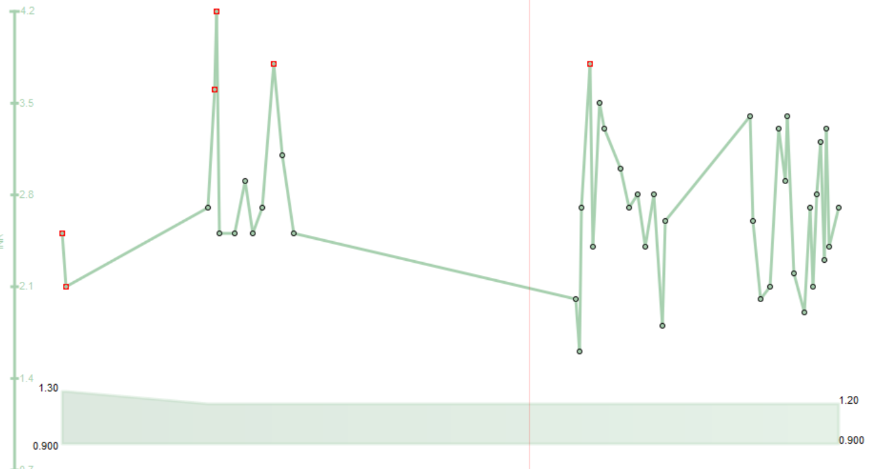

Slide 17
PN
ER Visit - March 16 - 3 week hx cough sl productive
CXR – WNL
No labs
Prescribed Amoxil 500 mg qid

Slide 18
PN
March 23 – malaise/abdo pain/gross hematuria
INR > 10
Hb 135
GGT 130, Lipase 76
CT – “focal fat haziness adjacent to pancreas ?
? Focal pancreatitis
? L psoas asymmetry
D/C Home – skip next dose Coumadin
See Fam Dr in 48 hours
restart 3 mg od and repeat INR in 2 days

Slide 19
PN
March 25 - 3 am– returned to ER
Abdominal pain worse, postural syncope, hematuria worse
O/E – unwell, BP – 126/55, HR 55
diffuse echymosies, L rectus mass
Hb -112
INR > 10
CT scan –multiple muscular hematomas incl rectus sheath – 5x8x18cm
psoas and pulp space of Retzius, all increased in size
Vit K – 5 mg po
admitted

Slide 20
PN
6 hours later
- unwell/pale, frank blood in foley bag
BP 98/55, HR 50
Mechanical HS
L rectus mass

Slide 21
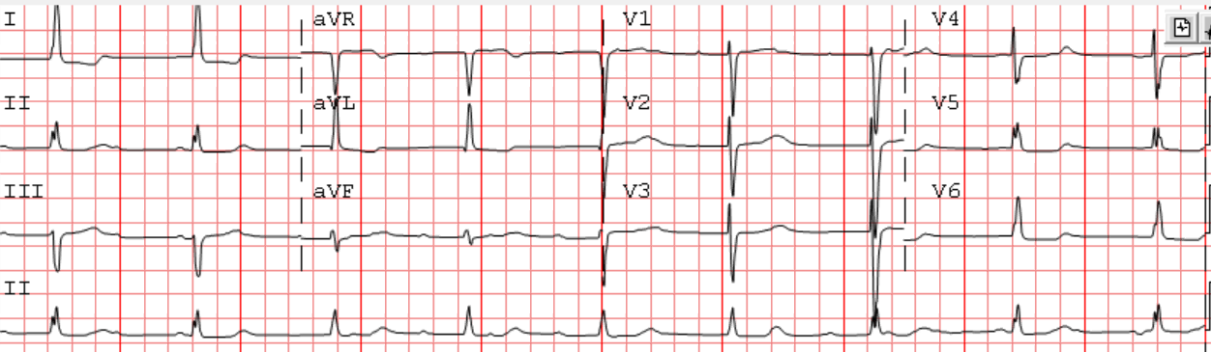
PN

Slide 22
PN
Octaplex, already received Vit K
Hb 83 4 hours later – transfused 2 u pRBC’s
INR post Octaplex1.2
4 days later – INR 2.6 stable , restarted coumadin 6 mg po od

Slide 23
Most common drugs that can increase INR:
Antibiotics: sulfamethoxazole/trimethoprim, metronidazole, quinolones (ciprofloxacin, levofloxacin), amoxicillin, erythromycin, clarithromycin, azithromycin
Azole antifungals: fluconazole, voriconazole
Cardiac drugs: amiodarone, some statins (atorvastatin and pravastatin are least likely to interact), fenofibrate
Acetaminophen >1 g/day
Levothyroxine dose changes– full effect observed after 4-6 weeks of dose change

Slide 24
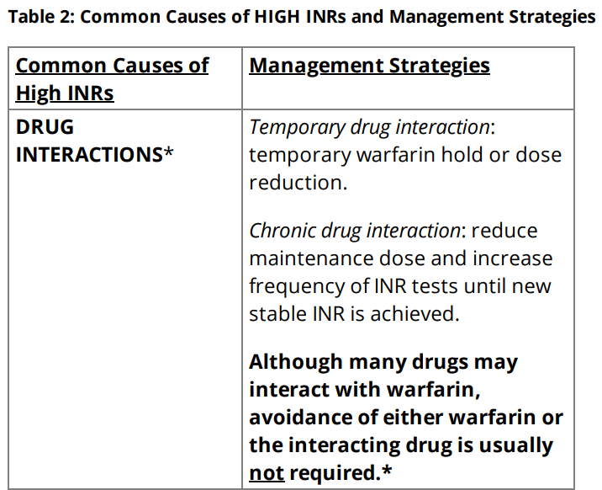

Slide 25
Management for Out of Range INRs
Warfarin can be challenging to manage due to its narrow therapeutic range, variable dose-response among patients and common interactions with drugs, diet, alcohol, and other factors.
For patients with INRs of >4.5 but <10 and without clinically relevant bleeding, temporary cessation of VKA alone without the addition of vitamin K is suggested. Vitamin K may be given if INR >10, even in the absence of bleeding, depending on individual patient circumstances (e.g. risk factors for bleeding, risk for thrombosis if over-correction of INR, ability to have repeat INR testing).

Slide 26
Mech valves INR > 10
Vit K 1 – 2.5 mg po, daily INRs
Hold coumadin

Slide 27
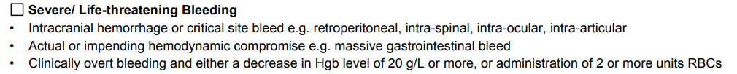
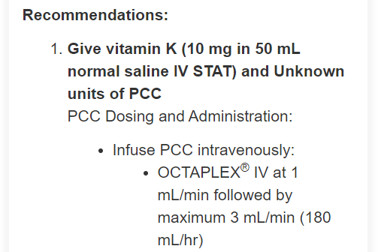

Slide 28
Drug Interactions with Coumadin
Avoid interacting drugs when possible
verify indications, select non‐/less interacting alternatives.
Assume there is an interaction with any drug start, stop, or dose change.

Slide 29
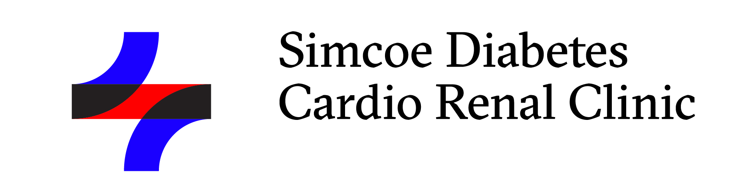
sdcrc.ca
OTN
virtualhallway.ca

