Slide 1
an emerging concept: type 2 diabetes remission
Alex Meadley MBBS, FRCPC
Internal Medicine
Orillia Soldiers Memorial Hospital

Slide 2
DISCLOSURES
I have received honoraria and participated in ad boards within the past 2 years
  Sanofi
  BI/Lilly
  Novo Nordisk

Slide 3
Objectives
To review and discuss the emerging concept of TYPE 2 DIABETES REMISSION
  Definitions
  A1C targets
  Weight loss targets
  Weight loss recommendations

Slide 4
Diabetes Canada Clinical Practice Guidelines Expert Committee. Diabetes Canada 2018 Clinical Practice Guidelines for the Prevention and Management of Diabetes in Canada. Can J Diabetes. 2018;42(Suppl 1):S1-S325

Slide 5
CASE
72F in office
PMHx
  DM2 since 2015
    Briefly on insulin but oral Rx since
  Ex smoker (2013)
  NSCLC remission since 2017
Meds
  Janumet XR 100/1000 mg daily
  Rosuvastatin 20 mg daily
  Vitamin D3
BMI 32
BP 130-140/70-80 at home
Labs:
  A1C 6.4%
  ACR 1.2
  eGFR 46
    51 in 2017, 44 in 2021
    Kidney Failure risk Equation:
      2 year 0.2%, 5 year 0.6%
  LDL 0.87, Tg 2.98 (non-fasting)

Slide 6
What is Type 2 Diabetes Remission?
Achieving specified glycated hemoglobin (A1C) thresholds without any antihyperglycemic medications for a minimum of 3 months:
  remission to prediabetes (A1C between 6.0% and 6.4%)
  remission to normal glucose concentrations (A1C <6.0%)

Slide 7
Remission for which patient?
an option for individuals with early type 2 diabetes who are overweight or obese
weight loss with the goal of de-escalation and/or elimination of antihyperglycemic agents
  Caution in patients with significant eating or mental health disorders
De-escalation should not include agents with additional benefit to the patient:
  atherosclerotic cardiovascular disease (ASCVD),
  heart failure (HF)
  and/or chronic kidney disease (CKD).

Slide 8
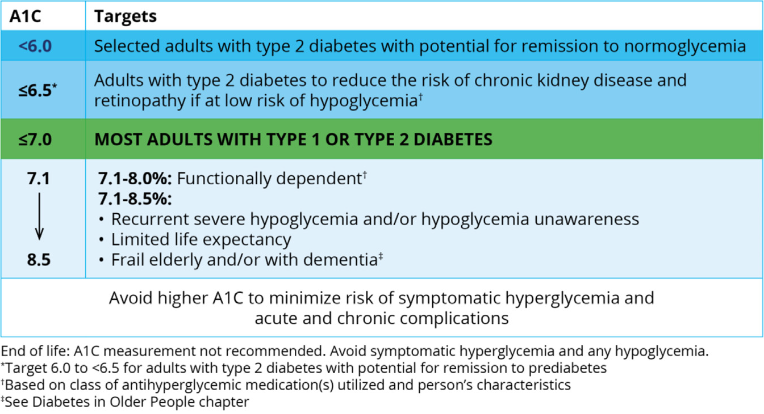
A1C targets:

Slide 9
Deprescribing and Monitoring Success:
The approach to deprescribing antihyperglycemic agents should be individualized and incorporate the principles of minimizing the risk for hypoglycemia and avoiding medications with potential for weight gain/regain [Grade D, Consensus].
If type 2 diabetes remission criteria are met, A1C (or, if A1C unreliable, FPG or OGTT) should be performed at a minimum interval of every 6 months to assess persistence of diabetes remission or relapse of diabetes [Grade D, Consensus].

Slide 10
Key Messages:
Type 2 diabetes remission following weight loss may be possible in a subset of these individuals through a variety of interventions, including bariatric surgery and low-calorie meal plans under the supervision of a trained dietitian or other health-care provider (HCP).
Sustained weight loss of ≥15 kg of initial body weight is associated with the greatest probability of type 2 diabetes remission.

Slide 11
Bariatric Surgery:
Bariatric surgery should be recommended to nonpregnant adults with type 2 diabetes and a BMI ≥35 kg/m2 as an option to potentially induce type 2 diabetes remission [Grade A, Level 1A] (26,30,63–66).
  Muller-Stich et al systematic review and meta-analysis of 5 RCTs involving participants with BMI <35 kg/m2, surgery was associated with a greater type 2 diabetes remission rate (107/221 vs 6/178; OR, 13.0; 95% CI, 4.48–37.41) than non-surgical medical treatment.
  Muller-Stich BP, Senft JD, Warschkow R, Kenngott HG, Billeter AT, Vit G, et al.
  Surgical versus medical treatment of type 2 diabetes mellitus in nonseverely obese patients:
  a systematic review and meta-analysis. Annals of surgery. 2015;261(3):421-429.

Slide 12
Health Behaviour Interventions
Low-calorie (∼800 to 850 kcal/day) diets with meal replacement products
  3 to 5 months
  Target >15 kg body weight loss
Followed by structured food reintroduction and increased physical activity for weight loss maintenance
The above “should be recommended as an option to potentially induce type 2 diabetes remission to selected nonpregnant adults with a BMI between 27 and 45 kg/m2, type 2 diabetes duration <6 years, A1C <12% and not using insulin [Grade A, Level 1A] (35–37).”

Slide 13
Health Behaviour Interventions
Exercise training
  240 to 420 min/week of structured physical activity spread over 5 days per week
  combined with a calorie-restricted diet
  ∼5% to 7% of initial body weight
The above “may be recommended as an option to potentially induce type 2 diabetes remission to selected nonpregnant adults with a BMI >25 kg/m2, type 2 diabetes duration <10 years, A1C <9% and not using insulin [Grade C, Level 2] (38).”

Slide 14
CASE: is remission a target?
72F in office
PMHx
  DM2 since 2015
    Briefly on insulin but OHA since
  Ex smoker (2013)
  NSCLC remission since 2017
Meds
  Janumet XR 100/1000 mg daily
  Rosuvastatin 20 mg daily
  Vitamin D3
BMI 32
BP 130-140/70-80 at home
Labs:
  A1C 6.4%
  ACR 1.2
  eGFR 46
    51 in 2017, 44 in 2021
    Kidney Failure Risk Equation:
      2 year 0.2%, 5 year 0.6%
  LDL 0.87, Tg 2.98 (non-fasting)

Slide 15
Summary
Remission of type 2 diabetes is possible for some individuals
  achieving A1C in non-diabetes range after stopping glucose-lowering medication(s)
Achieving remission is more likely for individuals:
  diagnosed with type 2 diabetes for a shorter time (e.g. less than 6 years);
  overweight/obese, who are able and inclined to lose weight;
  blood glucose levels closer to target;
  and who do not take insulin.
Consider continuing certain glucose-lowering medication(s) with proven benefits on reducing heart and/or kidney disease complications

Slide 16
Discussion:
“there are no trials of sufficient quality to support a recommendation to use pharmacotherapy as a means of inducing type 2 diabetes remission.”
Newer agents with more promising weight loss may bring A1C target vs weight target into the conversation
Is it still remission if you are on agents for other benefits (weight loss, CV, renal)?
  This may make future research for outcomes and targets more challenging

