Slide 1
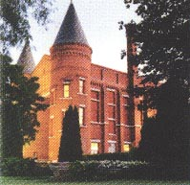
Grand Rounds
March 21, 2024
J.C. MacFadyen
MD, FRCPC, MHPE
JC MacFadyen MD FRCPC MHPE

Slide 2
NP
30 yo female, Type 1 DM since age 3, DKA X 2/year
  Followed by Fam Dr/DEC external
Home meds – Lantus – 20, Hum 1:5, CF 1:2 target 5
  Chlorthalidone/Gabapentin
4 day hx productive cough/fever/chills
  -nausea/vomiting
  feeling tired – has to use wheel-chair
  O/E – unwell, HR 108, BP 128/60

Slide 3
NB
Labs
  Glu 27, HCO3- 6 , AG - 21
  Cr 156
  Na+ 130
  K-5.7
  Ketones – 5.3, Lactate 1.0
  Suggestions?

Slide 4
Associated diagnoses/ Identified precipitants
  New diagnosis diabetes
    Type 1
    Type 2
    LADA
  Insulin Omission
  Insulin Pump Malfunction
  SGLT 2 Inhibitors
  Infection
  Myocardial Infarction
  CVA
  Trauma
  Pancreatitis/Abdominal Crisis
  Post-Cardiac Surgery
  Drugs – Glucocorticoids/Diuretics/Lithium/Atypical antipsychotics

Slide 5
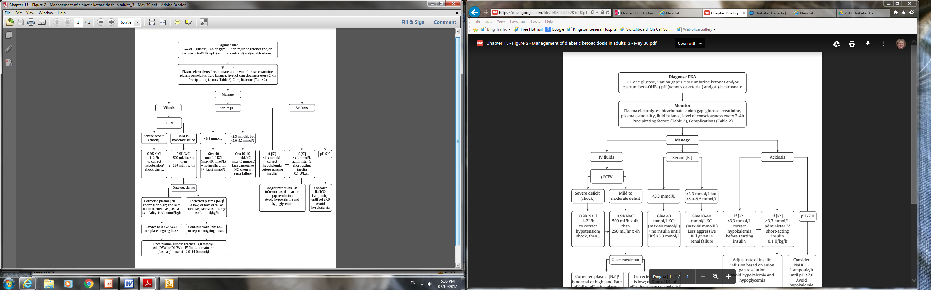
Management of DKA in Adults
2018 Diabetes Canada CPG – Chapter 15. Hyperglycemic Emergencies in Adults
DKA, diabetic ketoacidosis

Slide 6
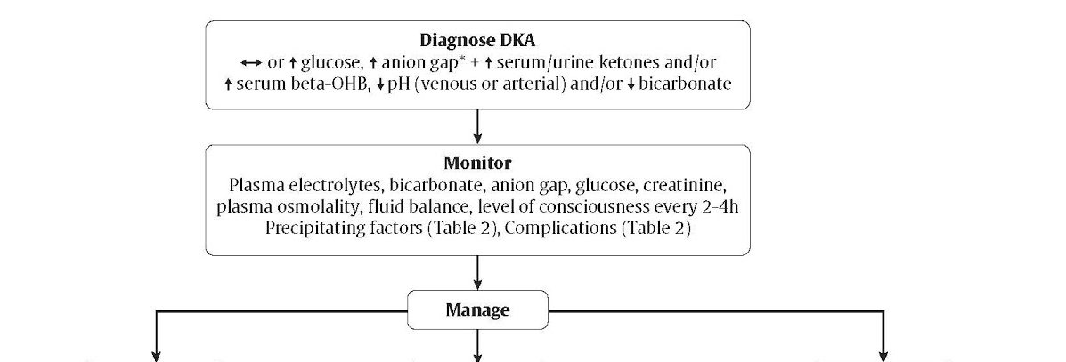
Fluids, Potassium, Acidosis are the Pillars of Treatment
2018 Diabetes Canada CPG – Chapter 15. Hyperglycemic Emergencies in Adults
IV fluids
Serum Potassium
Acidosis
Notes:
3 urgent priorities: restoring ECF volume, resolution of acidosis, replacement of potassium and electrolyte balance
Monitoring of volume status (including fluid intake and output), vital signs, neurologic status, plasma concentrations of electrolytes, anion gap, osmolality, and glucose need to be monitored closely, initially as often as every 2 hours
6

Slide 7
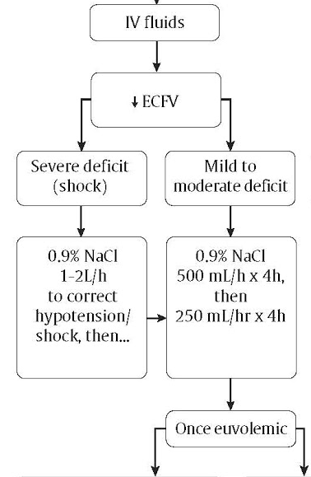
Replace Fluids with IV 0.9% NaCl until Euvolemic
Notes:
7

Slide 8
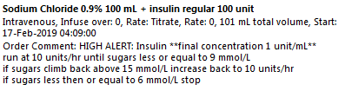
Initial Insulin Orders – 4:09 am
then 2 u/hr
IV 0.9% saline at 250 cc/hr
Once Glu < 15, change IV solution to D5/.45 at 100 cc/hr
Add 10 meQ KCL/l once K= < 5.0

Slide 9
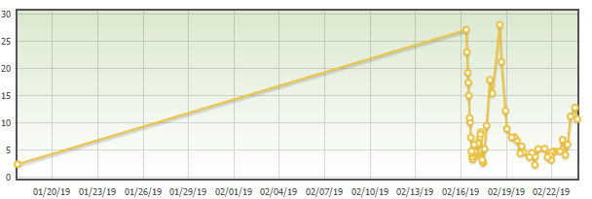
Glucose

Slide 10
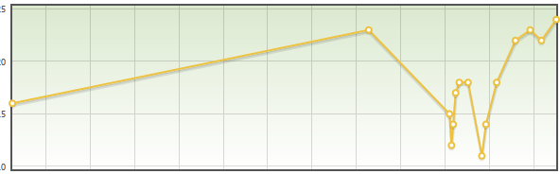
HCO3

Slide 11
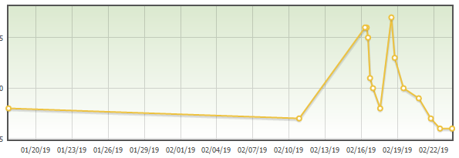
Anion Gap

Slide 12
Features
Treatment begins in ER and continues on admission with same order set
Improved simplicity/clarity for K+, IV fluids and Insulin
Very similar to UK order set but less aggressive and likely less hypo
Standard IV insulin less complicated
No need for IV insulin bolus
More aggressive D10W to reduce hypo and resolve acidosis
Continue patients basal insulin
Goal - resolution of DKA < 12 hours 80% of the time
Anticipate more d/c from ER or CDU

Slide 13
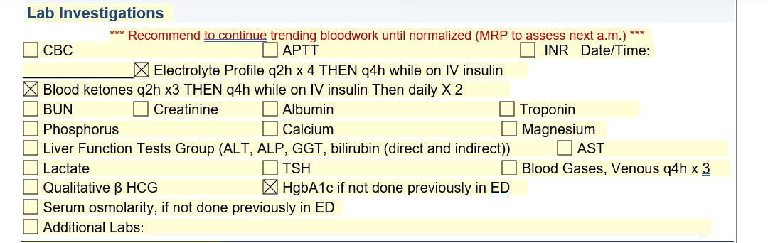
Labs

Slide 14
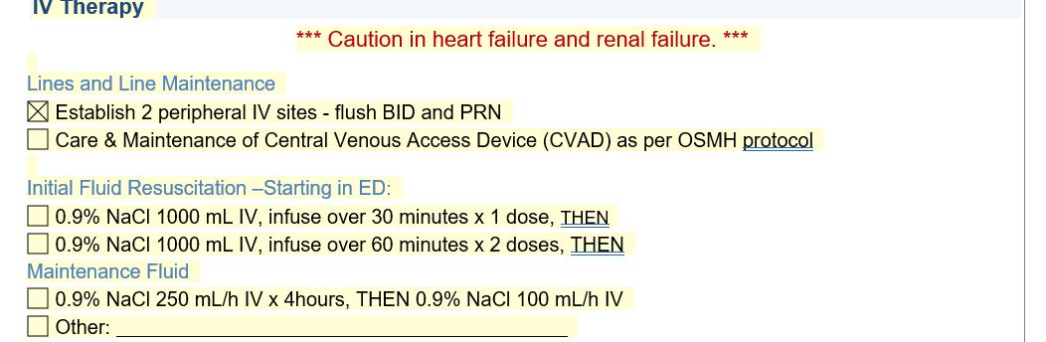
IV Resuscitation

Slide 15
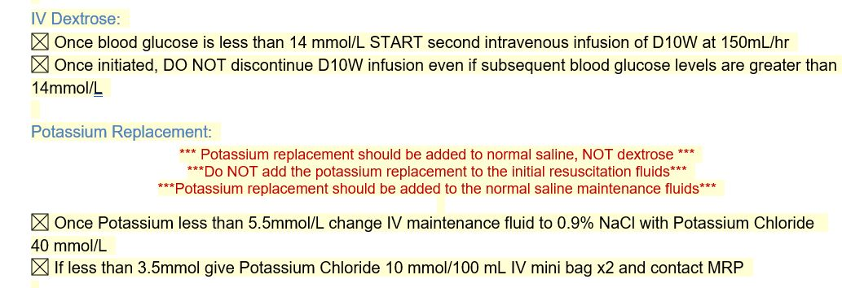
Dextrose and Potassium

Slide 16
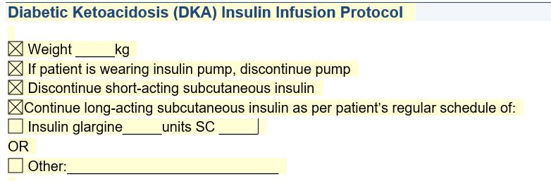

Slide 17
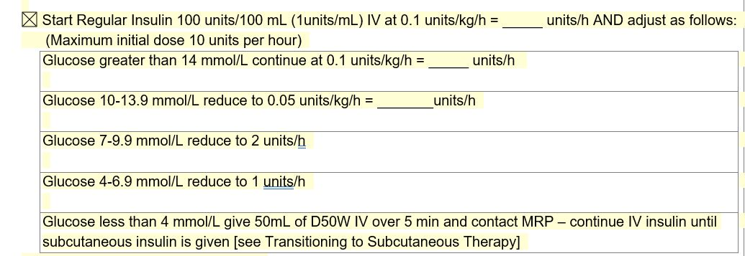
IV Insulin

Slide 18
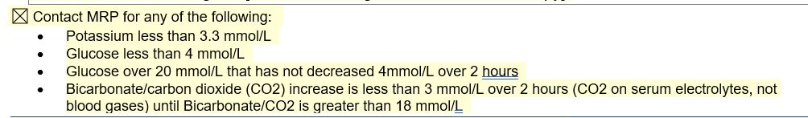
Contact MRP

Slide 19
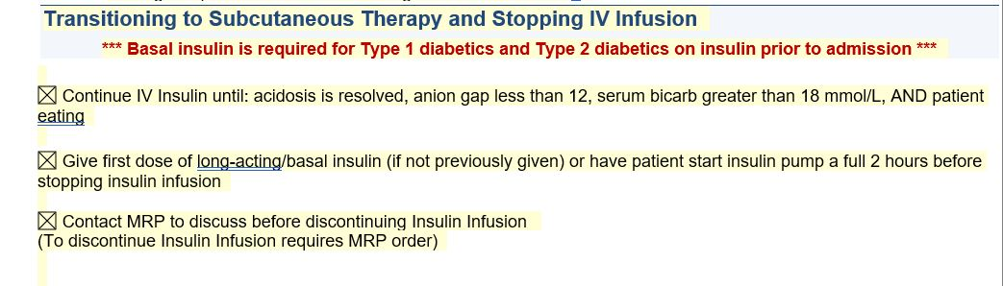
Transition

Slide 20
Fluids, Potassium, Acidosis are the Pillars of Treatment
2018 Diabetes Canada CPG – Chapter 15. Hyperglycemic Emergencies in Adults
IV fluids
Serum Potassium
Acidosis
Notes:
3 urgent priorities: restoring ECF volume, resolution of acidosis, replacement of potassium and electrolyte balance
Monitoring of volume status (including fluid intake and output), vital signs, neurologic status, plasma concentrations of electrolytes, anion gap, osmolality, and glucose need to be monitored closely, initially as often as every 2 hours
20

Slide 21
DKA Prevention
Patient education
- avoid basal insulin omission
- Insulin pump training – pump failure
- hold SGLT2 Inh. sick day/peri-op
- serum ketone testing
DEC/Specialist Referral
- local

Slide 22
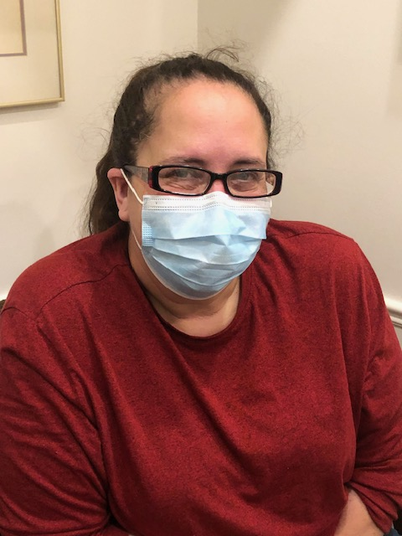
MR – 64 yo female
No prev. CAD
Jan 30 , 2024 – MI Rx PCI to LAD
No hx DM/HT/Hyperlipidemia
Smoker 1 ppd – quit Jan 30
Meds –
  Rosuvastatin 40 mg od
  ASA
  Ticagrelor 75 mg bid
  Ramipril 10 mg od
  Bisoprolol 10 mg od
No drug plan
O/E
  BP 120/60, HR 60 reg
  Ht – 5’5” in, Wt. – 164 lbs, BMI 27.2
  Chest/CVS - WNL
  ECG Ant Q waves
  Echo – EF 55%
  LDL 1.79, HDL 1.1, TG 1.49
  Cr 62, K+ 4.9, ACR < 2.0 mg/mmol
  ? Recommendations

Slide 23
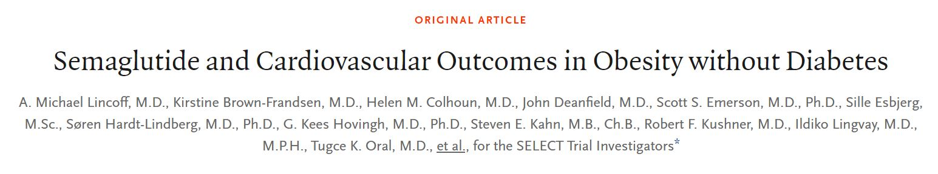
Select Trial

Slide 24
Select Trial
RCT – 17, 604 pts.
  1:1 Semaglutide 2.4 mg ow vs placebo
Entry Criteria
  age >45
  BMI > 27
  MI, CVA or PVD
Exclusion Criteria
  Diabetes
  CRF, Class IV CHF
Primary Outcome - MACE
Secondary Outcomes – MI/CVA/CHF
Duration – 39.8 months

Slide 25
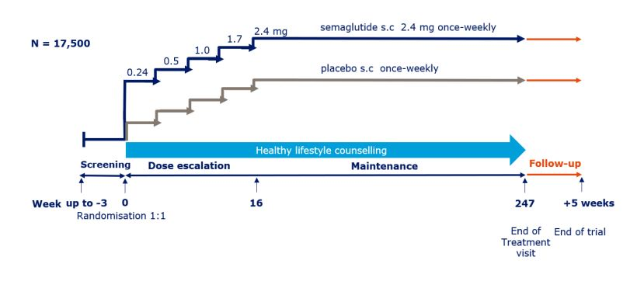
Select Trial

Slide 26
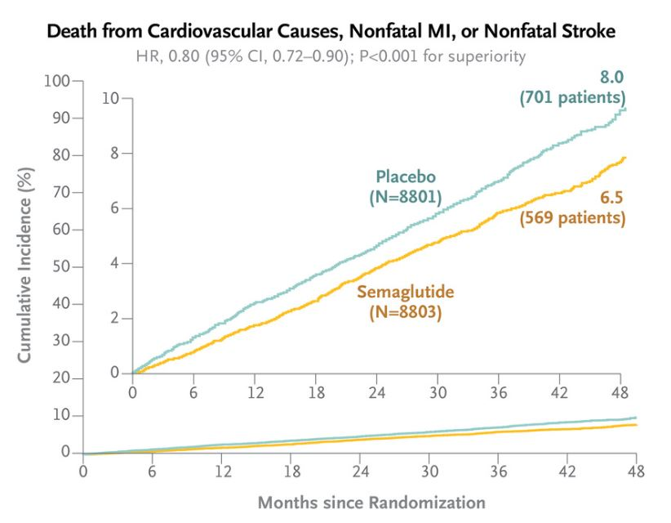
Select Trial

Slide 27
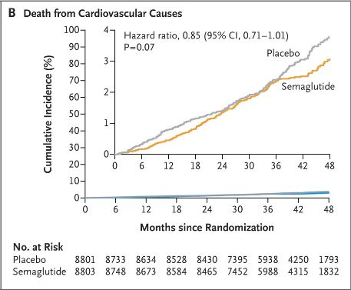
Select Trial

Slide 28
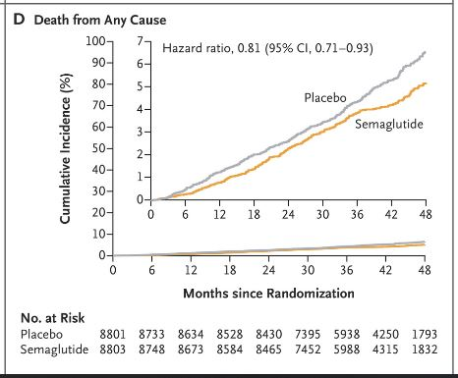
Select Trial

Slide 29
Select Trial
Wt loss 9%
SBP – decrease 3 mmHg
HR + 3 BPM
Hs CRP -- 36%
Renal outcomes RRR 20% , ARR 0.4%

Slide 30
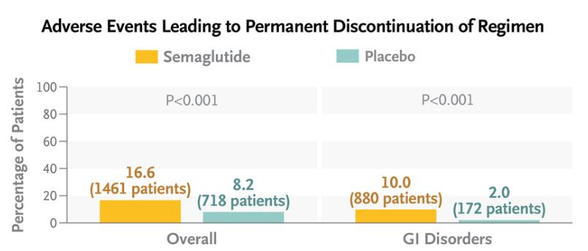
Select Trial

Slide 31
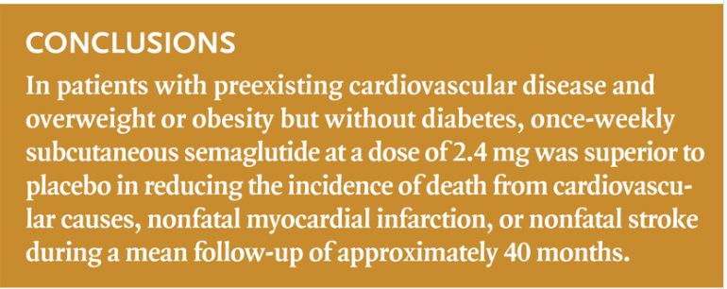

Slide 32
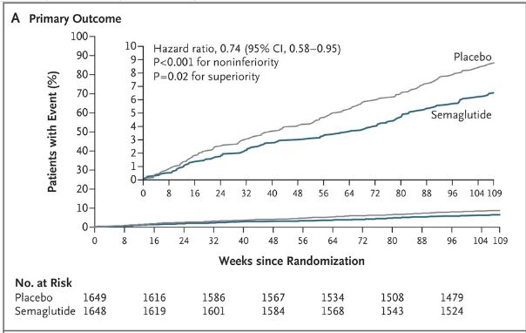
Sustain 6 DM and CVD

Slide 33
Cost of Interventions
Select Trial- Obesity + CVD - NNT x 40 months = 66.7 MACE (111.1 All cause mortality)
\
Cost per event saved ( C$420/month) = C$1,120,000
US = C$1,790/month = C$4,772,000 per event saved
Sustain 6 - DM + CVD–- NNT x 25 months = 43.5 MACE
Cost per event saved (C$210/month) = C$230,202
EmpaReg - DM with CAD NNTx 37 months = 62.5 MACE (38 All cause Mortality)
Cost per event saved = $82/month= $195,183.75 or $48,265 (generic Dapa)
+ CHF and CRF benefits

Slide 34
Diabetic Nephropathy

Slide 35
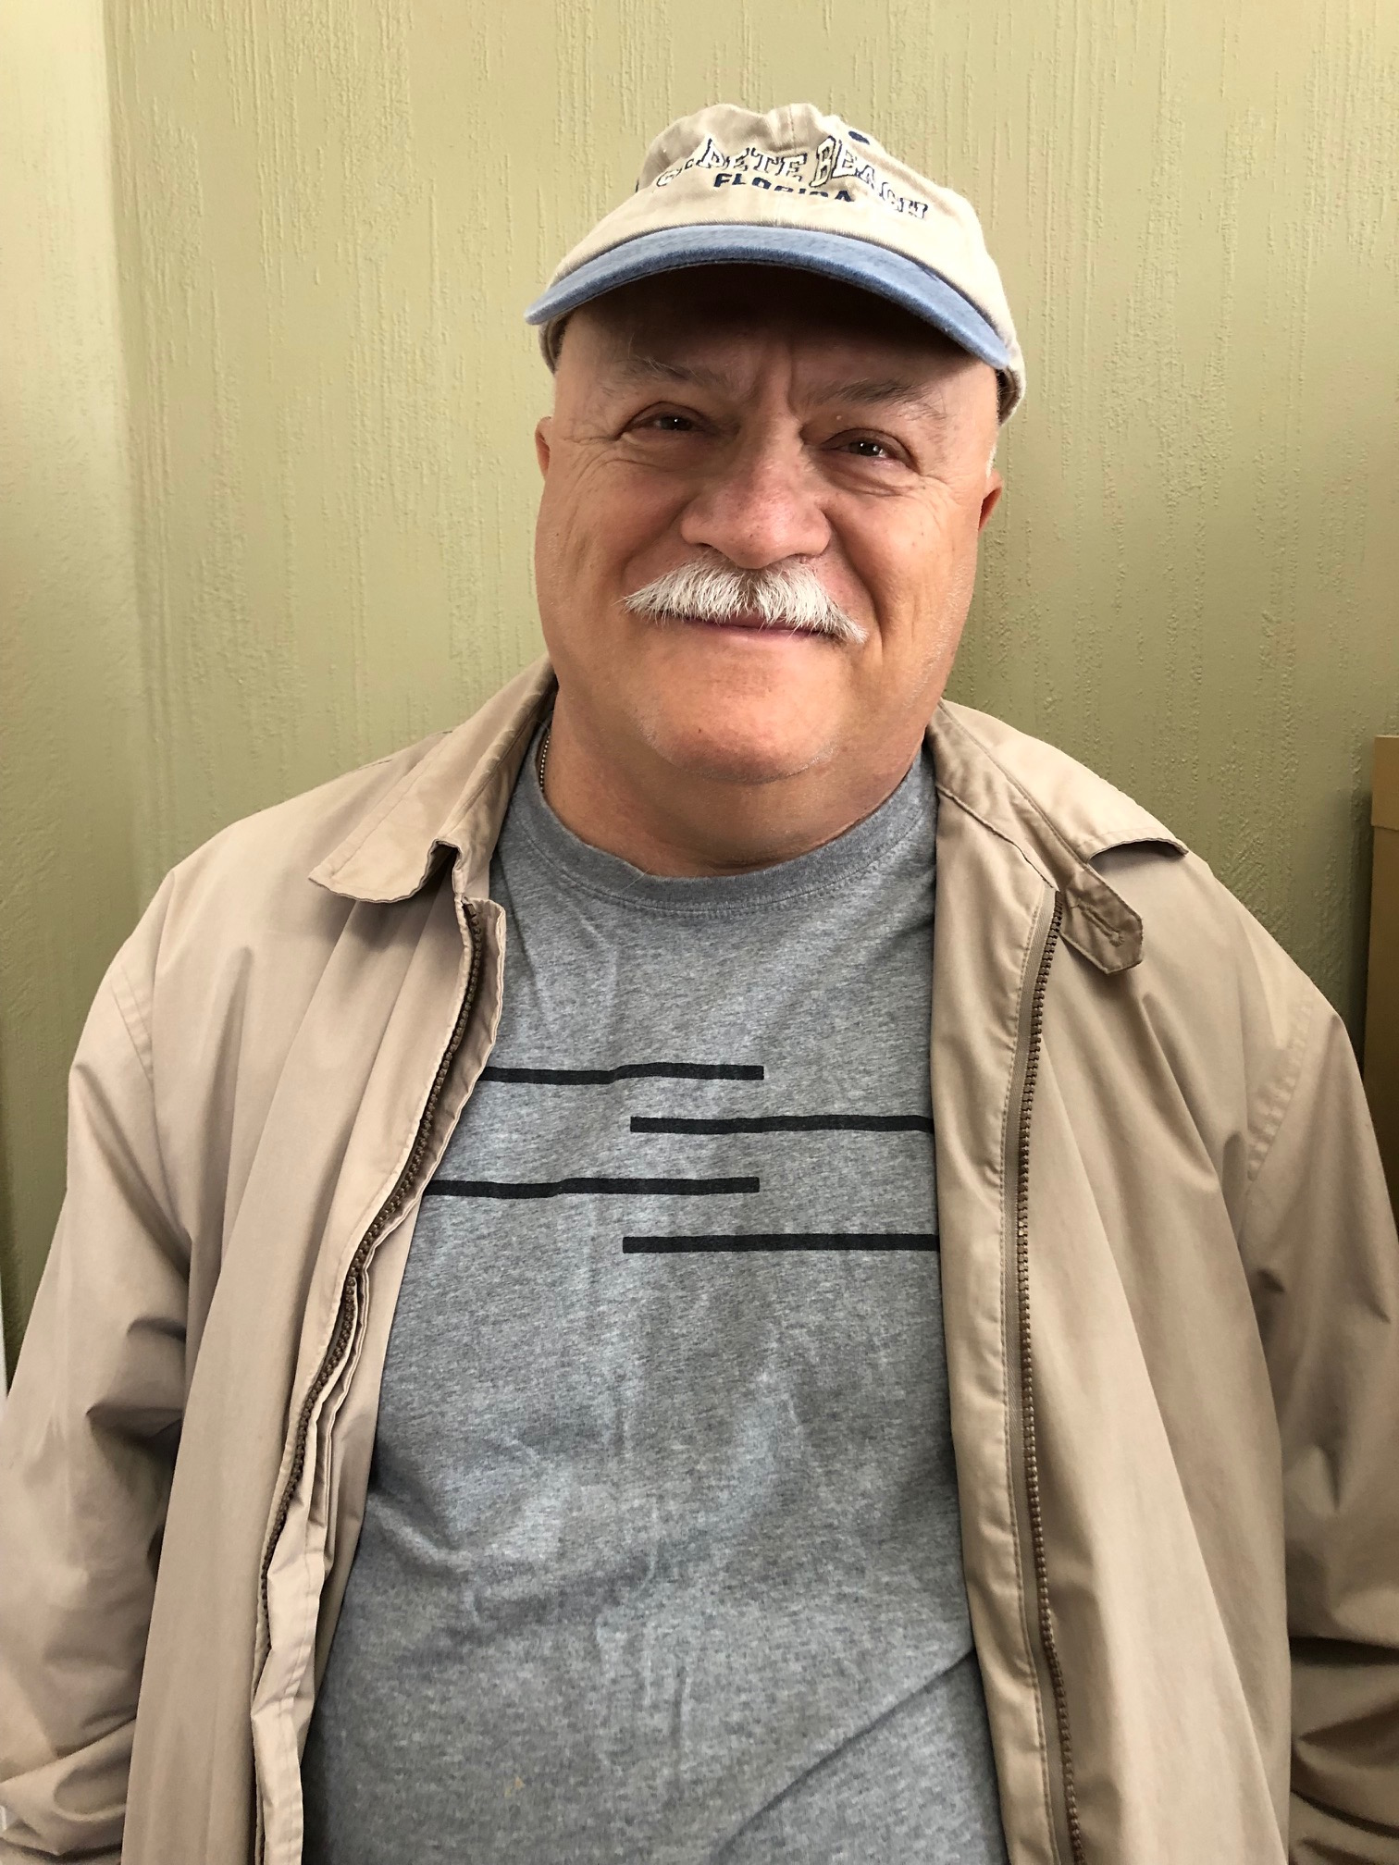
SN
62 yo male,
Type 2 DM x 22 years
Meds – Perindopril 8 mg od
  Amlodipine 10 mg od
  Metformin 500 mg bid
  Rosuvastatin 20 mg od
BP – 108/79
A1C – 6.6
Cr – 180, eGFR 30, MAU – 1961, ACR 246
What is his risk for dialysis?

Slide 36
SN
62 yo male,
Type 2 DM x 22 years
Meds – Perindopril 8 mg od
  Amlodipine 10 mg od
  Metformin 500 mg bid
  Rosuvastatin 20 mg od
  Insulin aspartate 10 u bid, Insulin Detemir 30 od
BP – 108/79
A1C – 6.6
Cr – 180, eGFR 30, MAU – 1961, ACR 246
5 year risk - 48%
If MAU neg – 7.5%
What can we do to prevent ESRD/Dialysis?

Slide 37
In DAPA-CKD and CREDENCE, the risk of kidney composite outcomes was reduced
DAPA-CKD^{1,a}
CREDENCE^{2,b}
Patients with CKD, with and without T2D
Patients with CKD and T2D
24
20
20
HR: 0.61
(95% CI: 0.51, 0.72)
HR: 0.70
(95% CI: 0.59, 0.82)
Placebo
15
Placebo
16
39%​
RRR
30%​
RRR
12
Cumulative incidence (%)
Patients with an event (%)
10
8
Dapagliflozin
5
Canagliflozin
4
0
0
0
4
8
12
16
20
24
28
32
0
6
12
18
24
30
36
42
No. at Risk
Months since randomization
No. at Risk
Months since randomization
Placebo
2152
1993
1936
1858
1791
1664
1232
774
270
Placebo
2199
2178
2132
2047
1725
1129
621
170
Dapagliflozin
2152
2001
1955
1898
1841
1701
1288
831
309
Canagliflozin
2202
2181
2145
2081
1786
1211
646
196
No direct comparison of efficacy can be made or is intended as study designs and populations differ in these two studies
Notes:
IMPORTANT slide
References:
Heerspink HJL, et al. Dapagliflozin in Patients with Chronic Kidney Disease. N Engl J Med. 2020;383:1436–1446.
Perkovic V, et al. Canagliflozin and Renal Outcomes in Type 2 Diabetes and Nephropathy.N Engl J Med. 2019;380:2295–2306.

Slide 38
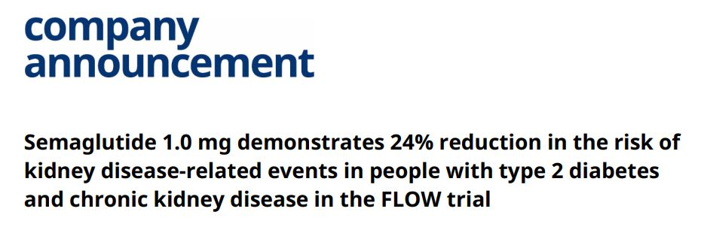
Flow Trial – March 5, 2024

Slide 39
FIDELITY Pooled Analysis:
Finerenone Reduced the Risk of Clinically Important CV and Kidney Outcomes
Kidney
Composite*
CV Composite†
Dialysis
HHF
23%
HR 0.77
95% CI 0.67 to 0.88
20%
HR 0.80
95% CI 0.64 to 0.99
NNT: 47
22%
HR 0.78
95% CI 0.66 to 0.92
14%
HR 0.86
95% CI 0.78 to 0.95
*Composite kidney endpoint: time to onset of kidney failure or decrease of GFR ≥40% from baseline or renal death.
†Composite CV endpoint: time to CV death or non-fatal CV events (MI, stroke and HF hospitalisation).
CI, confidence interval; CV, cardiovascular; HHF, hospitalization for heart failure; HR, hazard ratio; NNT, number needed to treat.
Agarwal R, Filippatos G, Pitt B, et al. Eur Heart J. 2022 Feb 10;43(6):474-484.

Slide 40
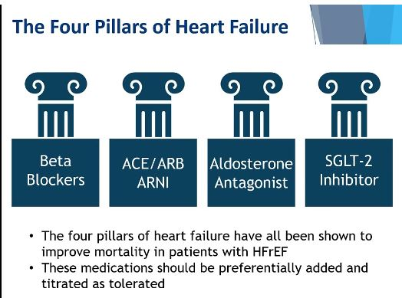

Slide 41
Diabetic Nephropathy
GLP1

Slide 42
SN
62 yo male,
Type 2 DM x 22 years
Meds – Perindopril 8 mg od
  Amlodipine 10 mg od
  Metformin 500 mg bid
  Rosuvastatin 20 mg od
  Insulin aspartate 10 u bid, Insulin Detemir 30 od
BP – 108/79
A1C – 6.6
Cr – 200, eGFR 25, MAU – 1961, ACR 246
What can we do to prevent ESRD/Dialysis?

Slide 43
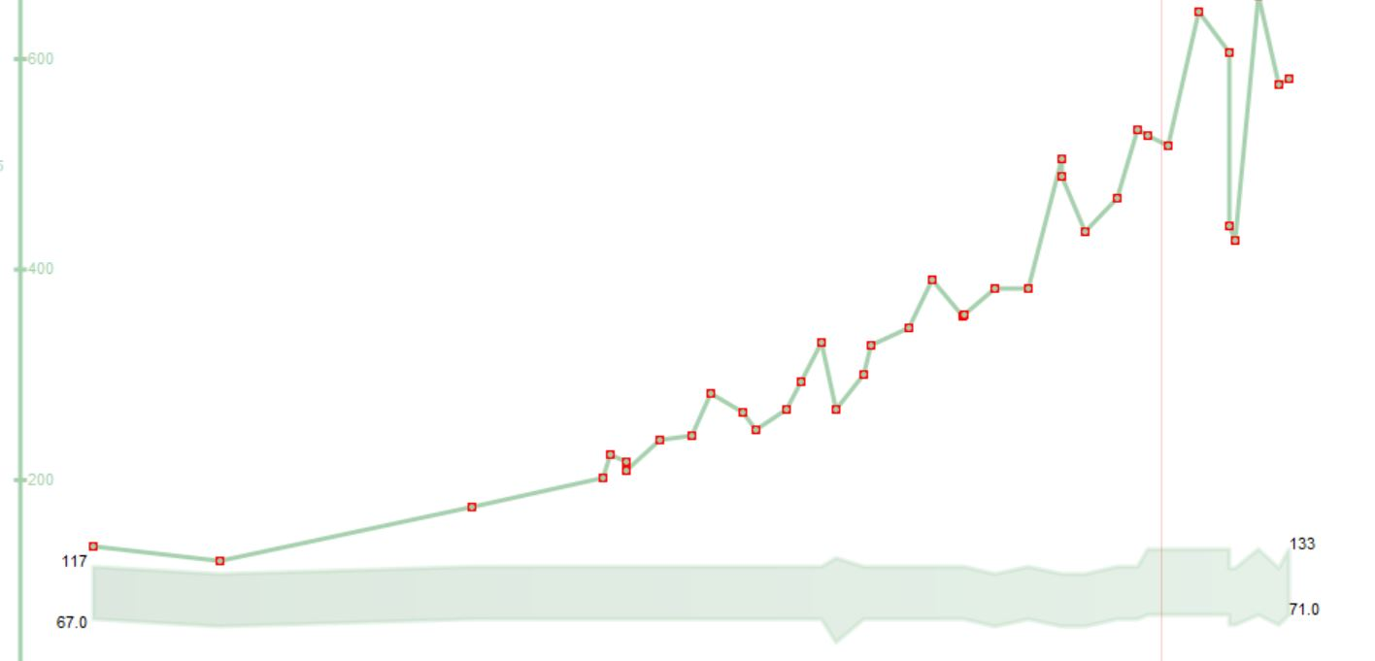
SN

Slide 44
Managing Side Effects of SGLT2 Inh and GLP1 agonists

Slide 45

What about Yeast Infections and Vomiting?
🤮

Slide 46
Fluconazole
Prescription -$3.94 per 150 mg tabs
  + dispensing fee eg. $12.99
  Annual Cost – 1/ month - $60.27
Ontario -LU Code 235
150 mg tab q 25 days prn for vaginal Candidiasis
  Annual Cost – 1/month = $48
  Annual Cost - $4.00 dispensing fee

Slide 47
Practical tips: Genital Mycotic Infections (GMI’s)
Uncomplicated
  (Healthy, non-pregnant, <3 inf/year, mild/mod symptoms)
  Fluconazole 150 po single dose
Complicated
  Severe signs, > 3/ year, poorly controlled DM, immunocompromised
  Fluconazole 150 mg po q 3 days , 2-3 doses
    +/1 clotrimazole/betamethasone x 48 hrs
    Or Topicals – 7-14 days
Recurrent – >3 year
  Fluconazole 150 mg po q 72 hrs x 3, then once weekly x 6 months

Slide 48

Ozempic Micro-Dosing
There are many “clicks” between the marked doses on the Ozempic pen. There are 18 “clicks” between 0 and 0.25mg and 18 “clicks” between 0.25mg and 0.5mg. On the 1mg pen there are 74 “clicks” between 0 and 1mg.
Use ____ clicks once a week and if tolerating well, continue to increase by ____ clicks every _____ weeks, until at the recommended dose of ______mg once weekly.
Once you are on a dose of 0.25 mg weekly, please discontinue your ___________ (Onglyza/Trajenta/Januvia)

Slide 49
Peri-procedural Issues
Risk of DKA
Hold SGLT2 x 2 days/Metformin/Diuretics ? day before procedure ( or day of) and restart when eating/drinking
Not an Inpatient drug
Euglycemic DKA
  Precipitants
    Major surgery
    Bariatric surgery
    Insulin reduction
    Fasting/low CHO diet
    EtOH ‘ic
Hold Ozempic 1-2 weeks before GA/Surgery

Slide 50
Management of common side effects required for long-term success

Slide 51
Summary
DKA Order Set
Consider Semaglutide in high Risk CV patients with obesity
Semaglutide and Finerenone for Diabetic Nephropathy

Slide 52
1998
It doesn’t matter how you improve the A1C
It matters that you improve the A1C

Slide 53
2024
It doesn’t matter that you improve the A1C
,
It matters how you reduce the A1C

Slide 54
sdcrc.ca
OTN
virtualhallway.ca

