Slide 2
BK
45 yo male
Type 2 DM x 5 years
Metformin 1 g bid/ Crestor 10 mg od
No CVD/HT/Non-smoker
BMI 30
A1C 7.8, MAU Negative
? Recommendations?

Slide 3
Any diabetes related endpoint
overweight
patients
M v C
p=0.0023
M v I
p=0.0034

Slide 4

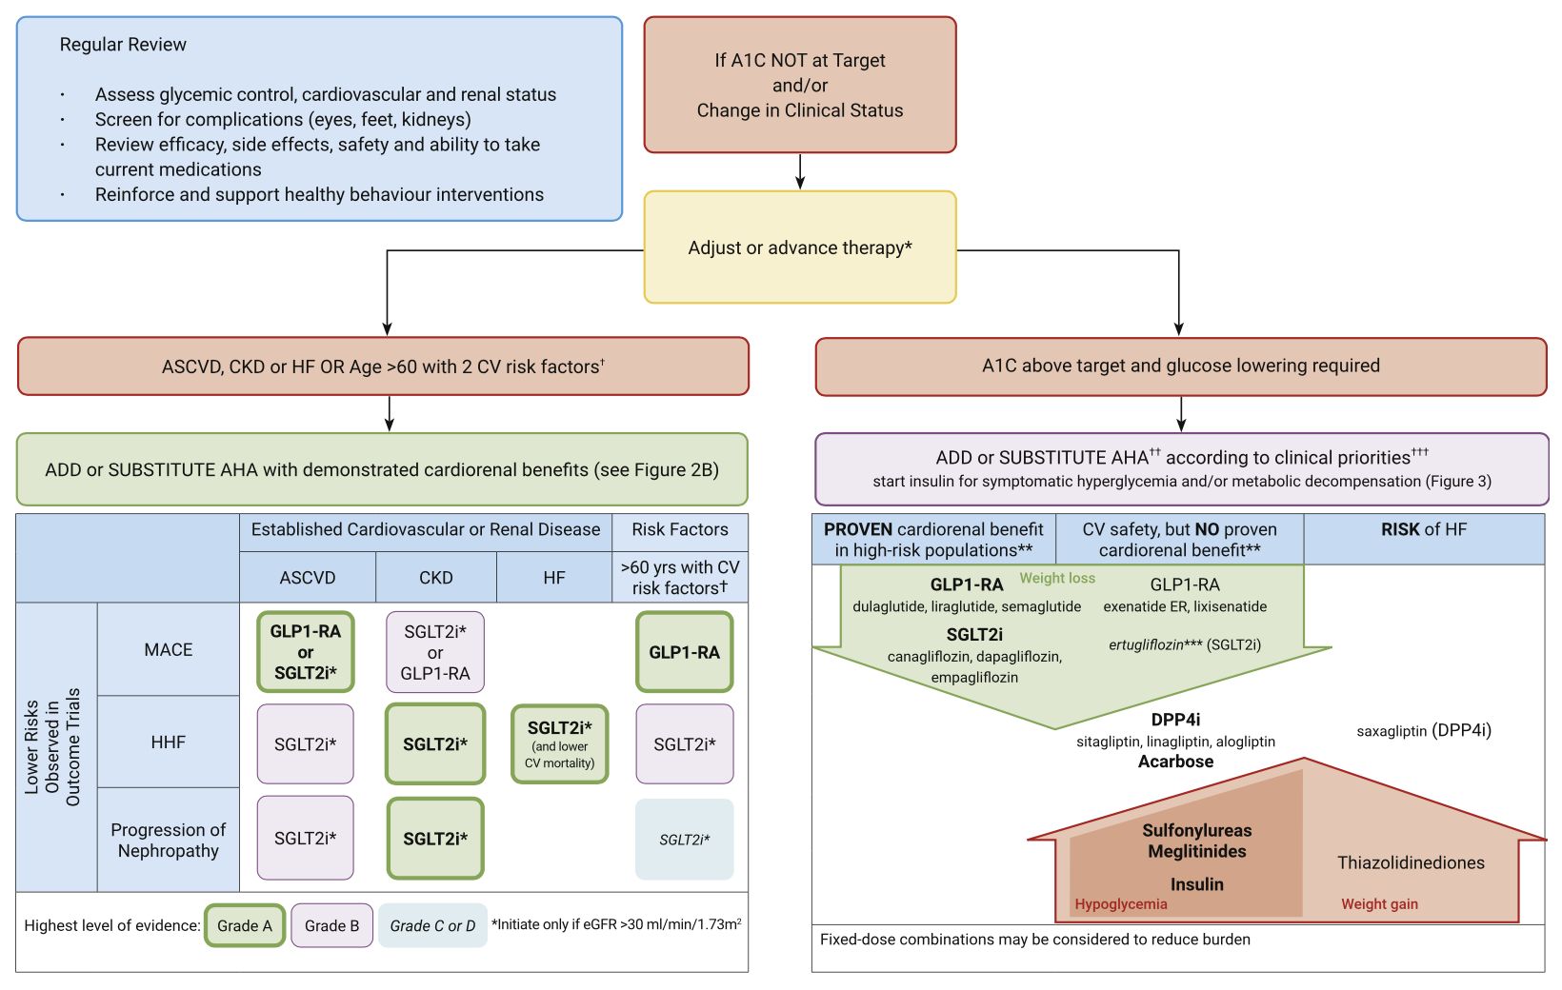
Reviewing, adjusting or advancing therapy in type 2 diabetes:
Diabetes Canada Clinical Practice Guidelines Expert Committee. Can J Diabet 2020;44:575-591.
Notes:
When it comes to the guidelines algorithm, instead of considering the branch of the guidelines for patients with CV risk factors, [CLICK] we would move to the other arm of the guidelines.

Slide 5
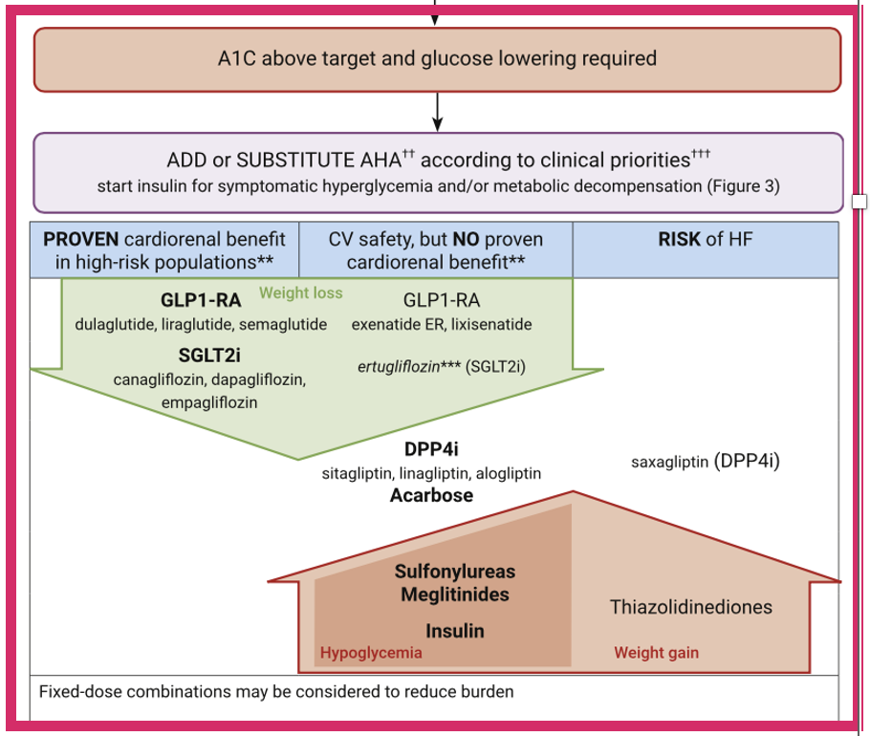

Slide 6
Question
Which of the following diabetic medications is least likely to maintain benefit on A1C after 5 years?
DPP IV Inh
Lantus
Gliclizide MR
Liraglutide
Notes:
Correct answer: C

Slide 7

Original Article
Glycemia Reduction in Type 2 Diabetes — Glycemic Outcomes
The GRADE Study Research Group
N Engl J Med
Volume 387(12):1063-1074
September 22, 2022

Slide 8
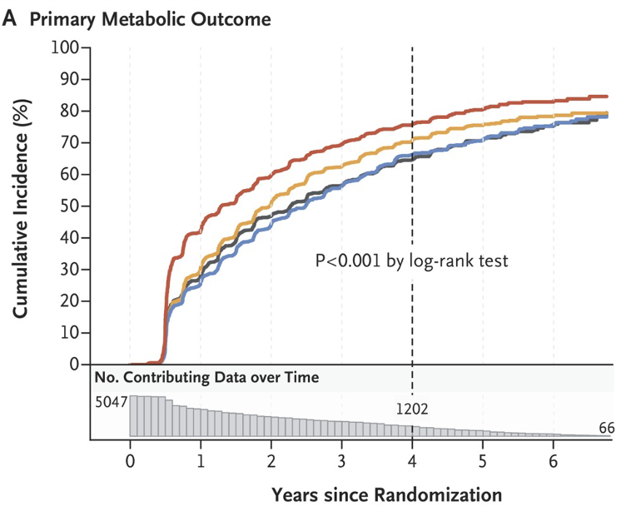

Slide 9
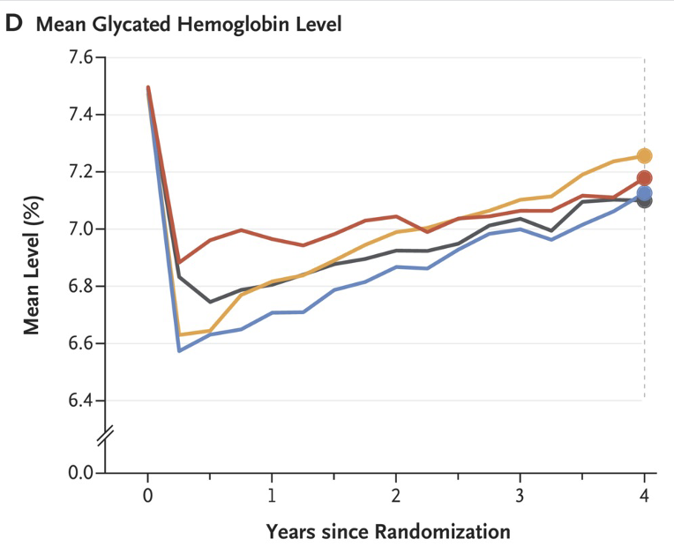

Slide 10
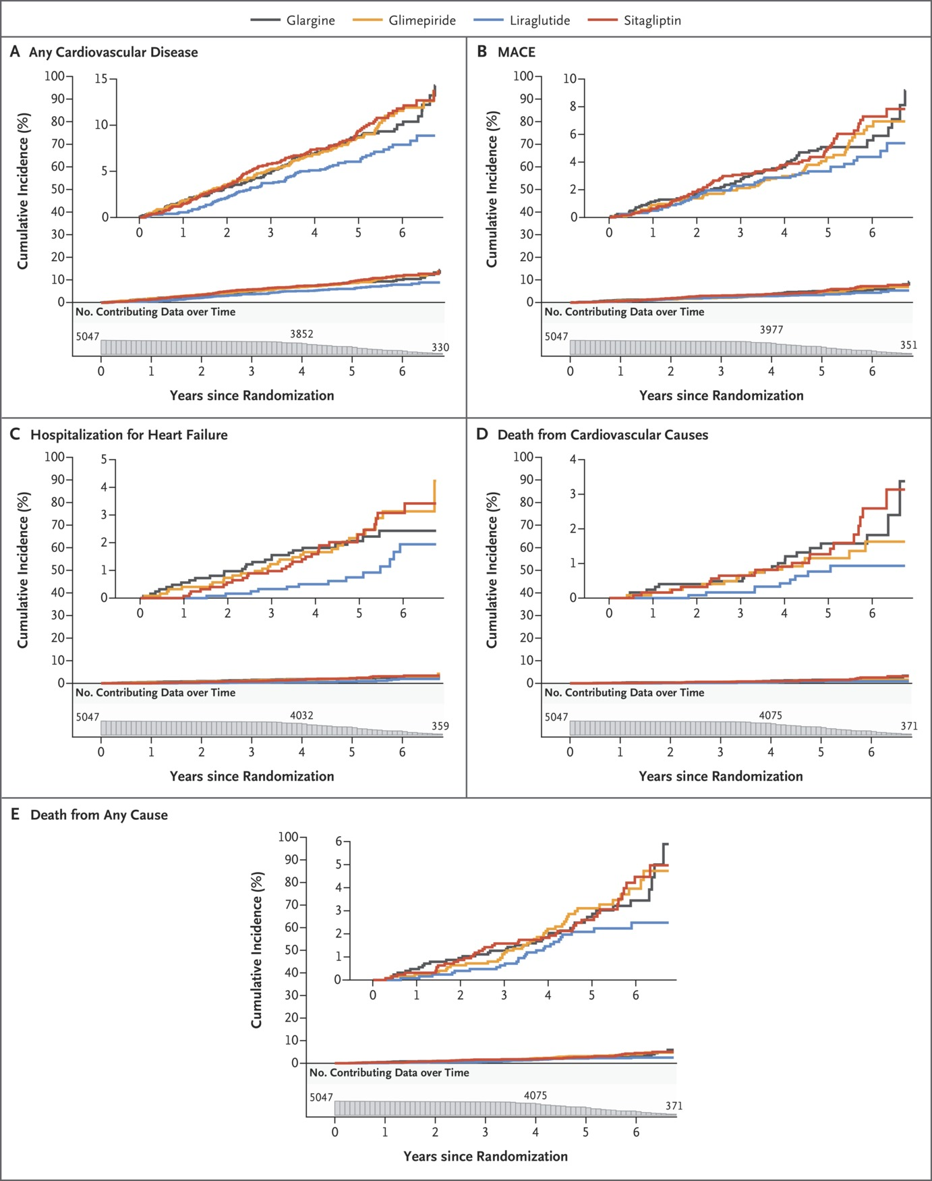
Cumulative Incidences of Cardiovascular Outcomes and Mortality in the Intention-to-Treat Analyses.
The GRADE Study Research Group. N Engl J Med2022;387:1075-1088
Notes:
Figure 3 Cumulative Incidences of Cardiovascular Outcomes and Mortality in the Intention-to-Treat Analyses. Shown are the cumulative incidences of any cardiovascular disease (Panel A), a major adverse cardiovascular event (MACE) (Panel B), hospitalization for heart failure (Panel C), death from cardiovascular causes (Panel D), and death from any cause (Panel E) over 6.5 years of follow-up. The numbers plotted below the x axis of each panel are the participants at risk for the outcome at each follow-up time point (i.e., the number of participants in whom a specified outcome event had not developed by that time).

Slide 11
Conclusions
All four medications, when added to metformin, decreased glycated hemoglobin levels.
However, glargine and liraglutide were significantly, albeit modestly, more effective in achieving and maintaining target glycated hemoglobin levels.

Slide 12
Original Article
Glycemia Reduction in Type 2 Diabetes — Microvascular and Cardiovascular Outcomes
The GRADE Study Research Group
N Engl J Med
Volume 387(12):1075-1088
September 22, 2022

Slide 13
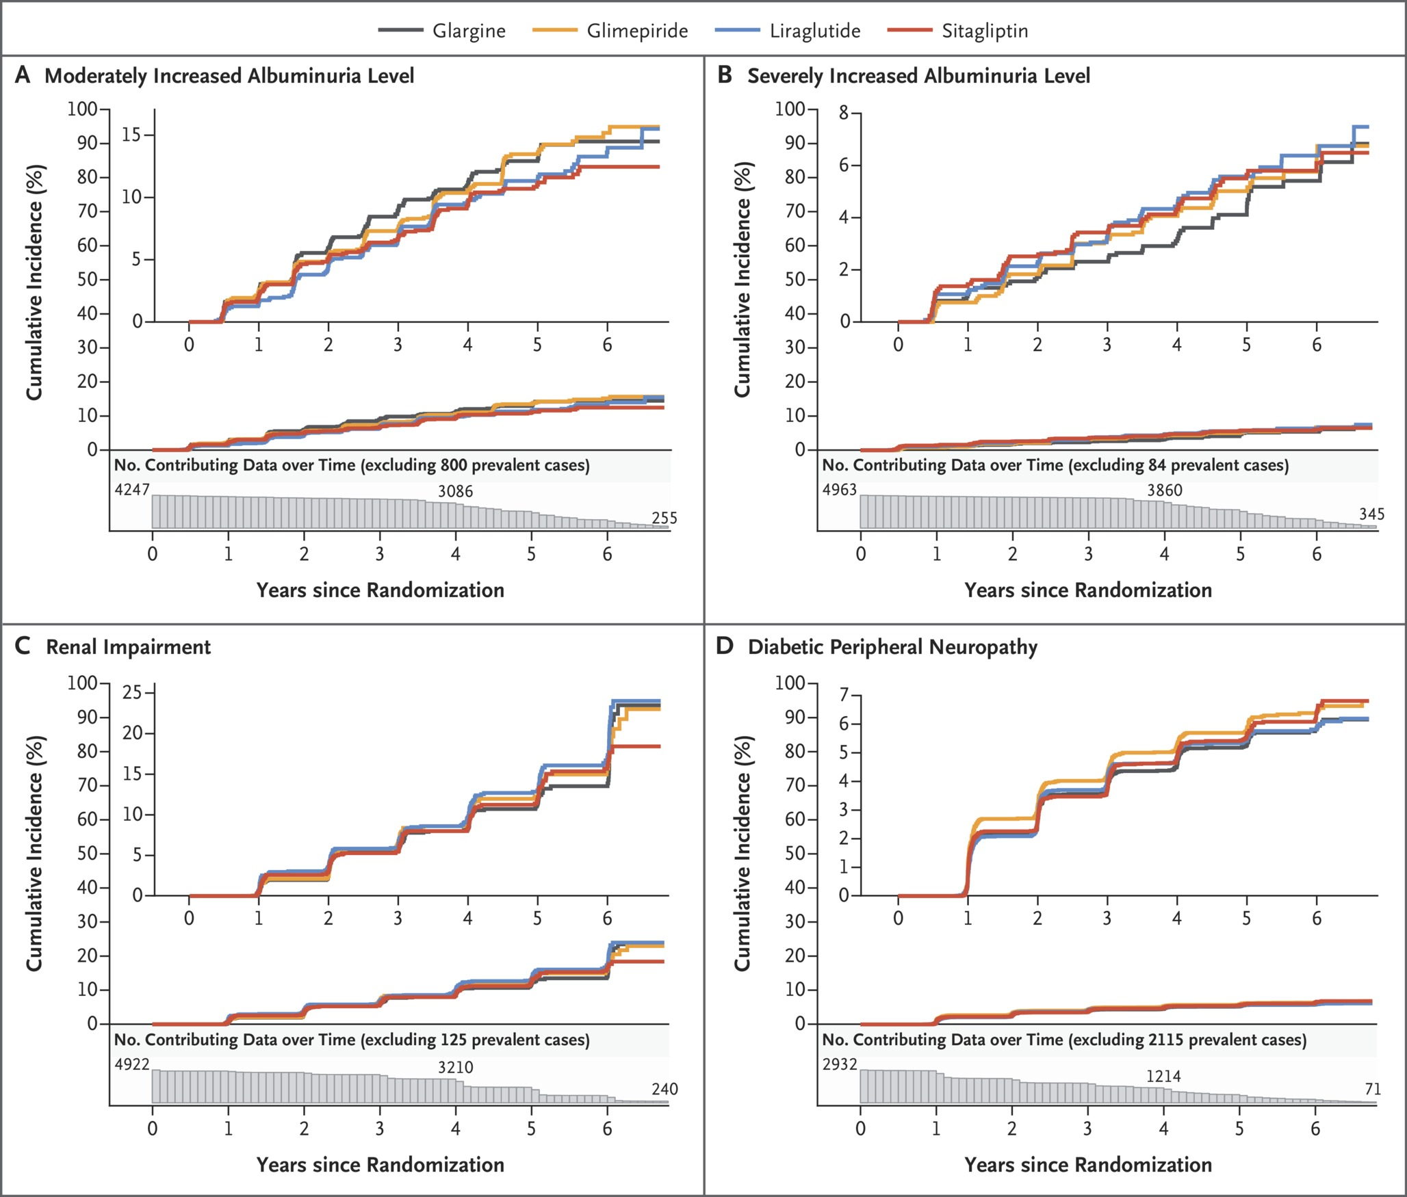
Cumulative Incidences of Microvascular Outcomes in the Intention-to-Treat Analyses.
The GRADE Study Research Group. N Engl J Med2022;387:1075-1088
Notes:
Figure 2 Cumulative Incidences of Microvascular Outcomes in the Intention-to-Treat Analyses. Shown are the cumulative incidences of the following conditions over 6.5 years of follow-up among participants who did not have one of these conditions at baseline: confirmed moderately increased albuminuria level (≥30 mg of albumin per gram of creatinine) or dialysis, transplantation, or death due to end-stage kidney disease (Panel A); severely increased albuminuria level (≥300 mg of albumin per gram of creatinine) or dialysis, transplantation, or death due to end-stage kidney disease (Panel B); renal impairment (estimated glomerular filtration rate of <60 ml per minute per 1.73 m² of body-surface area) (Panel C); and diabetic peripheral neuropathy (Panel D). The numbers plotted below the x axis of each panel are the participants at risk for the outcome at each follow-up time point (i.e., the number of participants in whom a specified outcome event had not developed by that time). The insets show the same data on an enlarged y axis.

Slide 14
Study Overview
In a secondary analysis comparing the effect of insulin glargine, glimepiride, liraglutide, and sitagliptin, added to metformin, on the incidences of microvascular complications and death, no material between-group differences were seen.

Slide 15
Long-acting GLP-1 RAs vs. DPP-4is:
Glycemic efficacy
DURATION 4
26 weeks
(Drug-naïve patients with T2DM)
AWARD 5
52 weeks
(Add-on to MET)
SUSTAIN 2
56 weeks
(Add-on to MET±TZD)
LIRA-DPP-4
26 weeks
(Add-on to MET)
Baseline A1C (%):
8.5 | 8.5 | 8.5 | 8.5
8.1 | 8.1 | 8.1
8.1 | 8.1 | 8.1
8.4 | 8.4 | 8.5
EXEN 2 mg QW
SEMA 1.0 mg QW
LIRA 1.8 mg QD
“The efficacy of GLP-1 RAs is generally greater than DPP-4is, owing to the supraphysiological concentrations of GLP-1 after administration of the former. […] GLP-1 RAs are effective as a second-line therapy in improving glycemic parameters in patients with T2D.”
—Levin PA, et al.
(Diabetes Metab Syndr Obes. 2017;10:123-139.)
*
*
p<0.001 (low-dose comparison); p<0.001 (high-dose comparison)
†
†
†
†
p<0.0001 (low-dose comparison); p<0.0001 (high-dose comparison)
NF
NF
p<0.0001 (low-dose comparison); p<0.0001 (high-dose comparison)
*
p<0.001

Slide 16
Lesson #3
Metformin is first line

Slide 17
Lesson #3
Metformin is first line
There is no ”BEST” second line therapy
Individualize Therapy

Slide 18
RL
38 yo male, Developmentally Delay, attended with worker,
Type 2 DM x 10 yrs
Meds –
  Diamicron MR 60 mg bid
  Glargine 40 u hs
  Metformin 500 mg qid
  Canagloflozin 300 mg od
  Saxagliptin 5 mg od
  Crestor 20 mg hs
  Ramipril 5 mg bid

Slide 19
RL
Difficulty monitoring meds administration
Tests infrequently
O/E Wt 104 kg, BP 123/76
A1C 8.5
Cr 85, LDL 3.1
? Recommendations

Slide 20
RL - Recommendations
Diabetes Once Daily – DOD
  Janumet XR 50/1000mg x 2
  Tresiba/Toujeo 40 u acBr
  Diamicron MR 120 od
  Canagloflozin 300 mg od
  Crestor 20 mg acBr
  Ramipril 10 mg od
  Test od – supervised

Slide 21
RL - Recommendations
Diabetes Once Daily – DOD
  Janumet XR 50/1000mg x 2
  Trtesiba/Toujeo 40 u acBr
  Diamicron MR 120 od
  Canagloflozin 300 mg od
  Crestor 20 mg acBr
  Ramipril 10 mg od
  Test od – supervised
Next Step - Ozempic

Slide 22
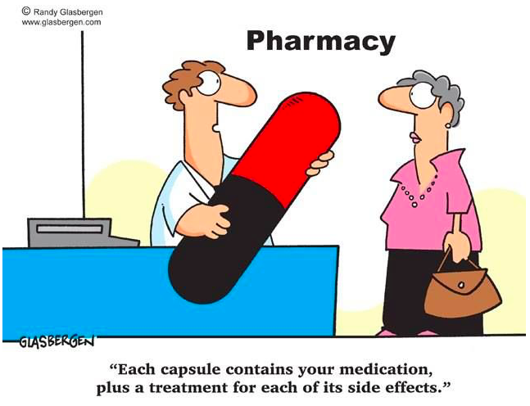

Slide 23
Lesson #4
Diabetes Once Daily

Slide 24
DP
77 yo female, DM 1990, insulin x 32 years
Current Meds:
  Crestor 20 mg 1 time daily Atacand 8 mg 1 time daily
  NovoMix 30 Penfill U-100 38 x 28 x
  Recurrent lows hs, nocturnal
  acBr 12-14, hs 4-8

Slide 25
DP
O/E wt – 111 kg, BP-118/65
Inj sites - reused
A1C 8.2
Cr 85, LDL 1.7
No ACR
Recommendations

Slide 26
DP
Stop Novomix 30 – TDD 66 units ( 43 u NPH – 23 u NR)
  Reduce basal by 20%
Tresiba 28 NR 8 8 8, CF 1:2 target 8

Slide 27
DP
Stop Novomix 30 – TDD 66 units ( 43 u NPH – 23 u NR)
  Reduce basal by 20%
Tresiba 28 NR 8 8 8, CF 1:2 target 8
3 months later
  C-peptide 1275
  A1C 8.9

Slide 28
DP
Stop Novomix 30 – TDD 66 units ( 43 u NPH – 23 u NR)
  Reduce basal by 20%
Tresiba 30 NR 8 8 8, CF 1:2 target 8
3 months later
  C-peptide 1275
  A1C 8.9
  Start Ozempic

Slide 29
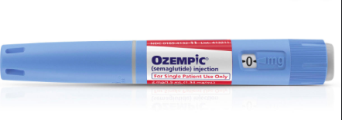
  If - A1C < 1.5 over goal
    Reduce basal insulin 20-40 % - (ie if goal 8.5 – reduce if >9.5)
    Reduce SU/Diamicron 50%
    Reduce bolus insulin 50%
  A1C > 1.5 over goal
    counsel re lows
    Consider reduce meds for Glu < 7 on pattern review
  Replace DPP-IV once > 0.25
  eGFR - > 15

Slide 30
DP
Ozempic 0.25-0.5 mg
Change NR to CF only
Reduce Tresiba 20% - 22, taper to goal glu < 8
6 months later
  Off insulin, A1C 7.8
  ACR 65
  Start empagliflozin

Slide 31
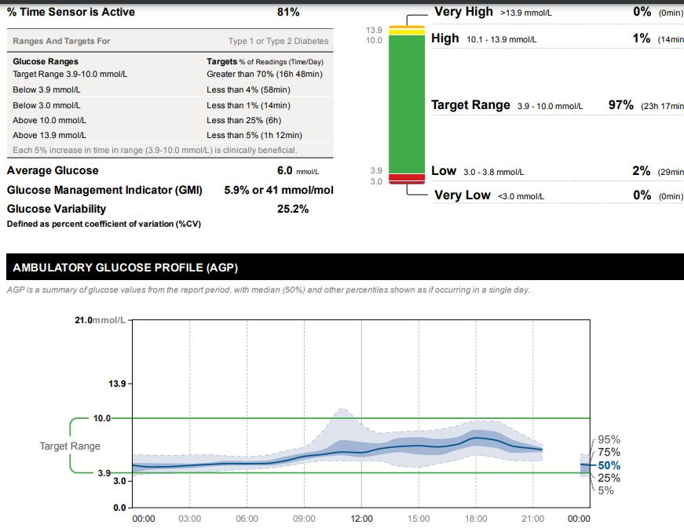

Slide 32
DP
Sept 2022
  Ozempic 1 mg weekly
  Jardiance 10 mg od
  ACR 11.3, A1C 6.3
  Wt 87 kg – wt loss 24 kg
Libre

Slide 33
MacFadyen’s First 55 – SGLT-2 Inhibitors

Slide 34

Just because you can do something doesn’t mean you should….

Slide 35
Don’t use SGLT-2 Inh with
Type 1 diabetes
Hx DKA/Pancreatic Insufficiency/Pancreatic resection
eGFR < 25%
Frail elderly – unless you are treating CHF
  replaces some diuretics

Slide 36
Lesson #5 & #6
Identify patients on MDI insulin to start new agents
  C-peptide if needed
  Beneficial to Identify Super Responders

Slide 37
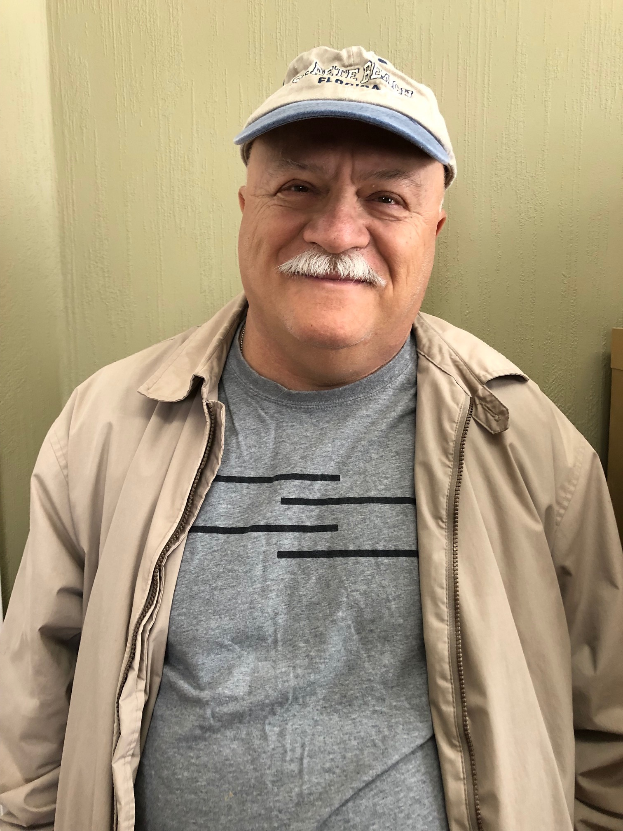
SN
62 yo male,
Type 2 DM x 22 years
Meds – Perindopril 8 mg od
  Amlodipine 10 mg od
  Metformin 500 mg bid
  Rosuvastatin 20 mg od
BP – 108/79
A1C – 6.6
Cr – 180, eGFR 30, MAU – 1961, ACR 246
What is his risk for dialysis?

Slide 38

Use the Kidney Failure Risk Equation to determine risk of kidney failure and how various strategies reduce risk
HOW CAN I REDUCE MY RISK OF KIDNEY FAILURE?
There are things you can do to reduce your risk of kidney failure over the next five years.
Click below to see how the following will decrease
Your current 5-year risk based on the answers provided is 26.8%
Achieving good blood pressure control can reduce your 5-year risk from 26.8% to 21.17%.
An ACE inhibitor (pril) or ARB (sartan) can reduce your 5-year risk from 26.8% to 18.76%.
An SGLT2 inhibitor (gliflozin) can reduce your 5-year risk
from 26.8% to 14.74%.
The benefits of these changes can add up over time.
5-YEAR RISK
14.74%
LEARN MORE ABOUT YOUR RESULTS
WATCH THE FOLLOWING VIDEO
KidneyFailureRisk.com
Notes:
They are the most widely used equations to predict the risk of dialysis in the US and in the world

Slide 39
SN
62 yo male,
Type 2 DM x 22 years
Meds – Perindopril 8 mg od
  Amlodipine 10 mg od
  Metformin 500 mg bid
  Rosuvastatin 20 mg od
  Insulin aspartate 10 u bid, Insulin Detemir 30 od
BP – 108/79
A1C – 6.6
Cr – 180, eGFR 30, MAU – 1961, ACR 246
5 year risk - 48%
If MAU neg – 7.5%
What can we do to prevent ESRD/Dialysis?

Slide 40
In DAPA-CKD and CREDENCE, the risk of kidney composite outcomes was reduced
DAPA-CKD^{1,a}
CREDENCE^{2,b}
Patients with CKD, with and without T2D
Patients with CKD and T2D
24
20
20
HR: 0.61
(95% CI: 0.51, 0.72)
HR: 0.70
(95% CI: 0.59, 0.82)
Placebo
15
Placebo
16
39%​
RRR
30%​
RRR
12
Cumulative incidence (%)
Patients with an event (%)
10
8
Dapagliflozin
5
Canagliflozin
4
0
0
0
4
8
12
16
20
24
28
32
0
6
12
18
24
30
36
42
No. at Risk
Months since randomization
No. at Risk
Months since randomization
Placebo
2152
1993
1936
1858
1791
1664
1232
774
270
Placebo
2199
2178
2132
2047
1725
1129
621
170
Dapagliflozin
2152
2001
1955
1898
1841
1701
1288
831
309
Canagliflozin
2202
2181
2145
2081
1786
1211
646
196
No direct comparison of efficacy can be made or is intended as study designs and populations differ in these two studies
Notes:
IMPORTANT slide
References:
Heerspink HJL, et al. Dapagliflozin in Patients with Chronic Kidney Disease. N Engl J Med. 2020;383:1436–1446.
Perkovic V, et al. Canagliflozin and Renal Outcomes in Type 2 Diabetes and Nephropathy.N Engl J Med. 2019;380:2295–2306.

Slide 41
In DAPA-CKD, the risk of all-cause mortality was significantly reduced
The effect of dapagliflozin versus placebo on
all-cause mortality in the DAPA-CKD trial population
12
HR: 0.69
(95% CI: 0.53, 0.88)
P=0.004
10
Placebo
8
31%​
RRR
Cumulative incidence (%)
6
4
Dapagliflozin
2.1% ARR
2
0
0
4
8
12
16
20
24
28
32
No. at Risk
Time from randomization (months)
Placebo
2152
2035
2018
1993
1972
1902
1502
1009
379
Dapagliflozin
2152
2039
2029
2017
1998
1925
1531
1028
398
DAPA-CKD was stopped early due to efficacy benefit. Because of this unplanned early stop, the secondary endpoint is considered nominal.
Notes:
References:
Heerspink HJL, et al. Dapagliflozin in Patients with Chronic Kidney Disease. N Engl J Med. 2020;383:1436–1446.

Slide 42
SN
62 yo male,
Type 2 DM x 22 years
Meds – Perindopril 8 mg od
  Amlodipine 10 mg od
  Metfromin 500 mg bid
  Rosuvastatin 20 mg od
  Insulin aspartate 10 u bid, Insulin Detemir 30 od
  Lasix 40 mg od
BP – 108/79
A1C – 6.6
Cr – 180, eGFR 30, MAU – 1961, ACR 246
Started Forxiga 10 mg od
What if his eGFR drops to 24 in 1 month

Slide 43
CREDENCE – Patients with eGFR <30 mL/min
Repeat of slide 95
In the CREDENCE trial, some patients had eGFR values <30 mL/min/1.73 m² at treatment initiation
In a sub-analysis, canagliflozin 100 mg was associated with a reduction in the rate of eGFR decline relative to placebo in these patients
No between-group differences were observed in the risk of acute kidney injury
Safety profile among these patients was consistent with previous studies of canagliflozin
CANA
26.3
PBO
26.5
Mean baseline, mL/min/1.73m²
35
30
25
20
eGFR (mL/min/1.73 m²)
15
10
5
0
0
3
13
26
52
78
104
130
156
182
CANA, n | 82 | 82 | 77 | 78 | 71 | 57 | 50 | 36 | 22 | 7
PBO, n | 89 | 88 | 85 | 81 | 76 | 65 | 59 | 33 | 21 | 8
Bakris G, et al. Presented at the American Society of Nephrology (ASN) Kidney Week 2019 Annual Meeting; November 5-10; Washington, D.C.
Abstract TH-PO1202

Slide 44








Do All Patients Have this eGFR Dip?
Optional Slide
Unhide slide to include it in your presentation
vs. 13% with placebo
Post hoc analysis of EMPA-REG Outcome (n=4443):
31%
41%
27%
1%
“eGFR dip” at week 4:
Small Dip
Modest Dip
Big Dip
Zero Dip
<10%
10-30%
>30%
eGFR, estimated glomerular filtration rate.
Kraus BJ, et al. Kidney International 2021;99:750-762.
Notes:
Do all patients have this dip? The answer is no.
[CLICK] Recently, a post-hoc analysis was done looking at the amount of eGFR drop patients had in the first four week of treatment in the EMPA-REG Outcome trial with empagliflozin.
[CLICK] Roughly one third of patients treated with empagliflozin had zero dip in eGFR [CLICK] and another 41% had a small dip of less than 10% of their baseline eGFR. [CLICK] Roughly a quarter had a more substantial dip of between 10 and 30 percent, [CLICK] and 1 in 100 patients had a dip that was over 30%.
[CLICK] For comparison, 13% of patients treated with placebo had a dip of over 10%.
Let’s look at that 1% of patients who had a big dip in eGFR.

Slide 45

Characteristics of Patients Experiencing eGFR Decline >30% at Week 4
Optional Slide
Unhide slide to include it in your presentation
Advanced CKD (i.e., “high” and “very high” KDIGO risk)
Use of diuretic (especially loop diuretic or thiazide)
More comorbidities and CV risk factors vs. patients with less/no eGFR dip
Stabilization of long-term mean eGFR
in all dipping categories,
including the subset with a >30% eGFR decline.
eGFR, estimated glomerular filtration rate; CKD, chronic kidney disease; KDIGO, Kidney Disease: Improving Global Outcomes; CV, cardiovascular.
Kraus BJ, et al. Kidney International 2021;99:750-762.
Notes:
What set these patients apart?
[CLICK] Compared to patients who had a small dip or zero dip, they tended to have higher risk of kidney disease progression according to the KDIGO heat map. [CLICK] They also tended to be using diuretics, especially loop diuretic or thiazides. [CLICK] They also tended to have more comorbitidies and cardiovascular risk factors.
[CLICK] But no matter what eGFR dip patients had at Week 4, there was a stabilization of long-term mean eGFR in all dipping categories, including the subset with a >30% eGFR decline.

Slide 46
Cumulative Incidence of AKI
10
Hazard Ratio, 0.68 (95% CI, 0.49-0.94)
8
Placebo
4.2%
(n=91)
6
Cumulative Incidence %
4
2
Dapagliflozin 10 mg
2.9%
(n=63)
0
0
4
8
12
16
20
24
28
32
N at Risk
Months from Randomization
Dapagliflozin 10 mg
2152
2031
2017
1998
1965
1881
1484
1000
375
AKI = acute kidney injury; CI = confidence interval
Heerspink HJL et al. Presented at: ERA-EDTA Congress; June 5-8, 2021; Virtual.
Placebo
2152
2015
1989
1958
1930
1850
1445
969
358
Notes:
Reference(s):
Heerspink HJL, Cherney D, Postmus D, et al, for the DAPA-CKD Trial Committees and Investigators. Dapagliflozin and acute kidney injury in patients with chronic kidney disease [presentation]. Presented at: European Renal Association – European Dialysis and Transplant Association Congress; June 5-8, 2021; Virtual.

Slide 47
CREDENCE – eGFR Changes by Baseline eGFR
Repeat of slide 96
Adjusted mean eGFR (ml/min per 1.73 m²)
90
Canagliflozin
Placebo
80
70
60
60 to <90 ml/min per 1.73 m²
50
40
45 to <60 ml/min per 1.73 m²
30
30 to <45 ml/min per 1.73 m²
20
Months since randomization
10
0
0
6
12
18
24
30
36
42
No. at risk
eGFR 60 to <90 | Canagliflozin Placebo | 899 895 | 833 829 | 803 801 | 758 755 | 710 679 | 490 471 | 288 270 | 98 100
eGFR 45 to <60 | Canagliflozin Placebo | 635 635 | 589 575 | 563 535 | 531 483 | 490 435 | 333 278 | 202 168 | 80 58
eGFR 30 to <45 | Canagliflozin Placebo | 645 648 | 583 581 | 553 546 | 493 482 | 448 422 | 293 257 | 162 145 | 63 52
Jardine M, et al. JASN 2020; 31: 1128–9. doi: https://doi.org/10.1681/ASN.2019111168

Slide 48
Medications in CKD
SGLT-2 Inhibitors
For CKD with ACR > 22/33
    Dapagliflozin 10 mg od – eGFR > 25
      DAPA CKD and Product Monograph
    Canaglfozin > 30
    Credence and Product Mongraph
For CHF
    Empagliflozin 10 mg od – eGFR > 20
      - Emperor Reduced and Preserved – Not Product Monograph
    Dapagliflozin 10 mg od – eGFR > 25
      - DAPA HF
GLP-1 Agonist
    eGFR < 15 or up to dialysis
    Sustain 6/Rewind Trial and Product Monograph with caution

Slide 49


Reviewing, adjusting or advancing therapy in type 2 diabetes:
Diabetes Canada Clinical Practice Guidelines Expert Committee. Pharmacologic glycemic management of type 2 diabetes in adults: 2020 update. Can J Diabet 2020;44:575-591.
Notes:
Patients who meet these risk criteria should be taking an SGLT-2 inhibitor or a GLP-1 receptor agonist.
These drugs have been proven to reduce the incidence of major adverse cardiovascular events, hospitalization for heart failure, and progression of nephropathy.
[CLICK] In other words, they’ve been proven to protect the heart and kidneys.

Slide 50
SN
62 yo male,
Type 2 DM x 22 years
Meds – Perindopril 8 mg od
  Amlodipine 10 mg od
  Metfromin 500 mg bid
  Rosuvastatin 20 mg od
  Insulin aspartate 10 u bid, Insulin Detemir 30 od
BP – 108/79
A1C – 6.6
Cr – 180, eGFR 30, MAU – 1961, ACR 246
What can we do to prevent ESRD/Dialysis?

Slide 51
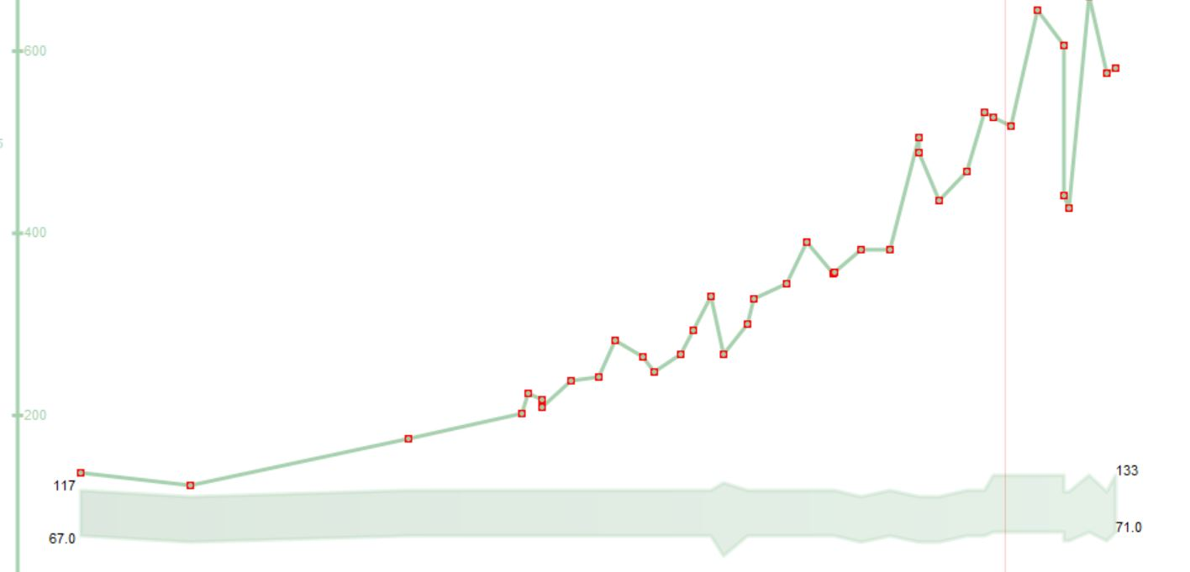
SN

Slide 52
At diagnosis of type 2 diabetes:
Diabetes Canada Clinical Practice Guidelines Expert Committee. Can J Diabet 2020;44:575-591.
Notes:
There is no need to review this slide in detail. The purpose is simply to illustrate that the Diabetes Canada guidelines [CLICK] reaffirm metformin as first-line therapy for patients without symptomatic hyperglycemia or metabolic decompensation.

Slide 53
Lesson # 7
Use SGLT-2 Inh. ESPECIALLY in the setting of CKD

Slide 54
RD
82 yo female, HT, no Diabetes
Recurrent hospitalizations for CHF
Echo - EF 58% , no valve dx, prev neg angios
Meds
- furosemide 40 mg od
- candesartan 16 mg od
- spironolactone 25 mg od
O/E – BP 136/72, HR 76
eGFR – 35, Mau ACR 13.2
Recommendations?

Slide 55
Reviewing, adjusting or advancing therapy in type 2 diabetes:
T2D, type 2 diabetes.
Diabetes Canada Clinical Practice Guidelines Expert Committee. Pharmacologic glycemic management of type 2 diabetes in adults: 2020 update. Can J Diabet 2020;44:575-591.
Notes:
For patients like James, treatment with a GLP-1 receptor agonist or an SGLT2 inhibitor is recommended. [CLICK] Both have been proven to reduce the risk of major adverse cardiovascular events, and SGLT2 inhibitors have been proven to reduce the risk of hospitalization for heart failure and to delay the progression of renal disease.

Slide 56

Primary results: CV death, hHF, or Urgent HF
30
DAPA | Placebo | HR (95% CI) | p-value²
16.3% | 21.2% | 0.74 (0.65-0.85) | 0.00001
25
Placebo
26%
RRR
20
DAPA 10 mg
Cumulative Incidence (%)
15
4.9% ARR
NNT=21
10
5
0
0
3
6
9
12
15
18
21
24
Months from Randomization
Number at Risk
DAPA 10 mg
2373
2305
2221
2147
2002
1560
1146
612
210
Placebo
2371
2258
2163
2075
1917
1478
1096
593
210
Notes:
References:
McMurray JJV, Solomon SD, Inzucchi SE, et al. for the DAPA-HF Committees and Investigators. Dapagliflozin in patients with heart failure and reduced ejection fraction. N Engl J Med. 2019;381:1995–2008.
McMurray J. DAPA-HF-The Dapagliflozin And Prevention of Adverse-outcomes in Heart Failure Trial [presentation]. Presented at: European Society of Cardiology Congress; August 31-September 4, 2019; Paris, France.

Slide 57
Individual components of the primary endpoint
Worsening HF Eventª
CV Death
20
DAPA | PBO | HR (95% CI) | p-value²
10.0% | 13.7% | 0.70 (0.59-0.83) | 0.00003
20
DAPA | PBO | HR (95% CI) | p-value²
9.6% | 11.5% | 0.82 (0.69-0.98) | 0.029
Placebo
15
15
Placebo
DAPA 10 mg
DAPA 10 mg
Cumulative Incidence (%)
Cumulative Incidence (%)
10
10
30%
RRR
18%
RRR
5
5
ARR 3.7%
ARR 1.9%
0
0
0
3
6
9
12
15
18
21
24
0
3
6
9
12
15
18
21
24
Number at Risk
Months from Randomization
Number at Risk
Months from Randomization
DAPA 10 mg
2373
2305
2221
2147
2002
1560
1146
612
210
DAPA 10 mg
2373
2339
2293
2248
2127
1664
1242
671
232
Placebo
2371
2258
2163
2075
1917
1478
1096
593
210
Placebo
2371
2330
2279
2230
2091
1636
1219
664
234
Notes:
Additional Information:¹
Events for hHF or urgent HF visit (n/N):
Events_{DAPA}= 237/2373
Events_{PBO}= 326/2371
References:
McMurray JJV, Solomon SD, Inzucchi SE, et al. for the DAPA-HF Committees and Investigators. Dapagliflozin in patients with heart failure and reduced ejection fraction. N Engl J Med. 2019;381:1995–2008.
McMurray J. DAPA-HF-The Dapagliflozin And Prevention of Adverse-outcomes in Heart Failure Trial [presentation]. Presented at: European Society of Cardiology Congress; August 31-September 4, 2019; Paris, France.

Slide 58
Primary endpoint: First adjudicated CV death or hospitalisation for heart failure
40
RRR
25%
ARR
5.2%
NNT = 19
30
Placebo
Estimated cumulative incidence function (%)
20
HR 0.75
(95% CI 0.65, 0.86)
p<0.001
Empagliflozin
10
0
0
90
180
270
360
450
540
630
720
810
Empagliflozin:
361 patients with event
Rate: 15.8/100 patient-years
Placebo:
462 patients with event
Rate: 21.0/100 patient-years
Days after randomisation
Patients at risk
Placebo
Empagliflozin
1867
1715
1612
1345
1108
854
611
410
224
109
1863
1763
1677
1424
1172
909
645
423
231
101
Cox regression model including covariates age, baseline eGFR, geographic region, baseline diabetes status, sex, LVEF and treatment
CV, cardiovascular; eGFR, estimated glomerular filtration rate; LVEF, left ventricular ejection fraction; ARR, absolute risk reduction; RRR, relative risk reduction. NNT: Number needed to treat
Packer M et al. N Engl J Med 2020. DOI:10.1056/NEJMoa2022190

Slide 59



There are four foundational therapies for the treatment of patients with HFrEF^{1–3}
As highlighted in recent consensus papers and guidelines from:
ACEi/
ARNI
Beta
blocker
MRA
SGLT2i
ACEi, angiotensin-converting enzyme inhibitor; ARNI, angiotensin receptor–neprilysin inhibitor; HFrEF, heart failure with reduced ejection fraction; MRA, mineralocorticoid receptor antagonist; SGLT2i, sodium-glucose co-transporter-2 inhibitor.
1. Maddox TM et al. J Am Coll Cardiol. 2021;77:772; 2. McDonald M et al. Can J Cardiol. 2021;37:531; 3. McDonagh TA et al. Eur Heart J. 2021;42:3599.
59

Slide 60
EMPEROR-Preserved
SC-CRP-08811

Slide 61
Empagliflozin demonstrated a significant 21% RRR in the composite primary endpoint of CV death or HHF
25
RRR
21%
ARR
3.3%
NNT*=31
20
Placebo
15
Estimated cumulative incidence (%)
Empagliflozin
HR: 0.79
(95% CI: 0.69, 0.90)
p<0.001
10
5
0
Empagliflozin:
415 (13.8%) patients with event
Rate: 6.9/100 patient-years
Placebo:
511 (17.1%) patients with event
Rate: 8.7/100 patient-years
0
3
6
9
12
15
18
21
24
27
30
33
36
Months since randomization
Patients at risk
Placebo
Empagliflozin
2991
2997
2888
2928
2786
2843
2706
2780
2627
2708
2424
2491
2066
2134
1821
1858
1534
1578
1278
1332
961
1005
681
709
400
402
*During a median trial period of 26 months.
ARR, absolute risk reduction; CI, confidence interval; HR, hazard ratio; NNT, number needed to treat; RRR, relative risk reduction.
Anker S et al. N Engl J Med. 2021. DOI:10.1056/NEJMoa2107038

Slide 62

Primary Composite Outcome:
Sustained ≥50% eGFR Decline, ESKD, Renal or CV Death^{a,1}
24
Placebo
312 events
DAPA 9.2% | Placebo 14.5% | HR (95% CI) 0.61 (0.51-0.72) | p-value² 0.000000028
20
39%​
RRR
16
5.3% ARR
Cumulative Incidence %
NNT=19^{b}
12
DAPA 10 mg
197 events
8
4
0
0
4
8
12
16
20
24
28
32
N at Risk
Months from Randomization
DAPA 10 mg
2152
2001
1955
1898
1841
1701
1288
831
309
Placebo
2152
1993
1936
1858
1791
1664
1232
774
270
ªESKD defined as the need for maintenance dialysis (peritoneal or hemodialysis) for at least 28 days and renal transplantation or sustained eGFR <15mL/min/1.73m² for at least 28 days. Renal death was defined as death due to ESKD when dialysis treatment was deliberately withheld for any reason.³; ^{b}95% CI, 15 to 27.
ARR = absolute risk reduction; CV = cardiovascular; DAPA = dapagliflozin; eGFR = estimated glomerular filtration rate; ESKD = end-stage kidney disease; HR = hazard ratio; ; NNT = number needed to treat; RRR = relative risk reduction.
1. Heerspink HJL et al. N Engl J Med. 2020; 383:1436-1446; 2. Heerspink HJL. Presented at: ESC Congress – The Digital Experience; August 29 – September 1, 2020;
3. Heerspink HJL et al. Nephrol Dial Transplant. 2020;35:274–282.
Notes:
Speaker Notes:
A significant reduction in the risk of the primary composite outcome (sustained ≥50% eGFR decline, ESKD, renal or CV death) was observed with dapagliflozin compared to placebo (197 vs. 312 events; HR 0.61; 95% CI 0.51-0.72; p=0.000000028).^{1,2}
Additional Information³
ESKD was defined as the need for maintenance dialysis (peritoneal or hemodialysis) for at least 28 days and renal transplantation or sustained eGFR <15mL/min/1.73m² for at least 28 days.
Renal death was defined as death due to ESKD when dialysis treatment was deliberately withheld for any reason.
References:
Heerspink HJL, Stefánsson BV, Correa-Rotter R, et al, for the DAPA-CKD Trial Committees and Investigators. Dapagliflozin in patients with chronic kidney disease. N Engl J Med. 2020; 383:1436-1446.
Heerspink HJL. Dapagliflozin in patients with chronic kidney disease [presentation]. Presented at: European Society of Cardiology Congress – The Digital Experience; August 29 - September 1, 2020.
Heerspink HJL, Stefansson BV, Chertow GM, et al for the DAPA-CKD Investigators. Rationale and protocol of the dapagliflozin and prevention of adverse outcomes in chronic kidney disease (DAPA-CKD) randomized controlled trial. Nephrol Dial Transplant. 2020;35:274–282.
ARR calculated from event rates:14.5% - 9.2% = 5.3%
Event rates: DAPA: 197/2152 = 9.2%; PBO: 312/2152 = 14.5%

Slide 63
Secondary Outcome:
All-cause Mortality¹
12
DAPA 4.7% | Placebo 6.8% | HR (95% CI) 0.69 (0.53-0.88) | p-value² 0.0035
10
Placebo
146 events
8
31%​
RRR
Cumulative Incidence %
6
2.1% ARR
DAPA 10 mg
101 events
4
2
0
0
4
8
12
16
20
24
28
32
N at Risk
Months from Randomization
DAPA 10 mg
2152
2039
2029
2017
1998
1925
1531
1028
398
ARR = absolute risk reduction; DAPA = dapagliflozin; HR = hazard ratio; RRR = relative risk reduction.
1. Heerspink HJL et al. N Engl J Med. 2020; 383:1436-1446; 2. Heerspink HJL. Presented at: ESC Congress – The Digital Experience; August 29 – September 1, 2020.
Placebo
2152
2035
2018
1993
1972
1902
1502
1009
379
Notes:
Speaker Notes:
A significant reduction in the risk of all-cause mortality was observed with dapagliflozin compared to placebo (101 vs. 146 events; HR 0.69; 95% CI 0.53-0.88; p=0.0035).^{1,2}
Reference(s):
Heerspink HJL, Stefánsson BV, Correa-Rotter R, et al, for the DAPA-CKD Trial Committees and Investigators. Dapagliflozin in patients with chronic kidney disease. N Engl J Med. 2020; 383:1436-1446.
Heerspink HJL. Dapagliflozin in patients with chronic kidney disease [presentation]. Presented at: European Society of Cardiology Congress – The Digital Experience; August 29 - September 1, 2020.
ARR calculated from event rates:6.8% – 4.7% = 2.1%
Event rates: DAPA: 101/2152 = 4.7%; PBO: 146/2152 = 6.8%

Slide 64
EMPA-KIDNEY: Primary composite outcome^{1,2}
Kidney disease progression or CV death
40
Placebo
HR 0.72
(95% CI 0.64, 0.82)
P<0.001
Empagliflozin 10 mg
30
Participants with Event (%)
RRR
28%
20
Placebo N(%):
558 (16.9%)
Events/100 PY: 8.96
10
Empagliflozin N(%):
432 (13.1%)
Events/100 PY: 6.85
NNT=28*
0
0
0.5
1
1.5
2
2.5
Patients at risk, n
Years of Follow-up
Placebo | 3305 |  | 3250 |  | 3129 |  | 2243 |  | 1496 |  | 592
Empagliflozin | 3304 |  | 3252 |  | 3163 |  | 2275 |  | 1538 |  | 624
*NNT: 28 (95% CI 19, 53) per 2 years at risk
ARR for the primary composite outcome of kidney disease progression or CV death is 3.6% per patient year at risk
Kidney disease progression defined as end-stage kidney disease, a sustained decline in eGFR to <10 ml/min/1.73 m², renal death, or a sustained decline of ≥40% in eGFR from randomization
ARR, absolute risk reduction; CI, confidence interval; CV, cardiovascular, eGFR, estimated glomerular filtration rate; HR, hazard ratio; NNT, number needed to treat; PY, patient-years; RRR, relative risk reduction; UACR, urine albumin-to-creatinine ratio
1. The EMPA-KIDNEY Collaborative Group. N Engl J Med. 2022 [published online ahead of print]; doi: 10.1056/NEJMoa2204233.; 2. Data on file

Slide 65
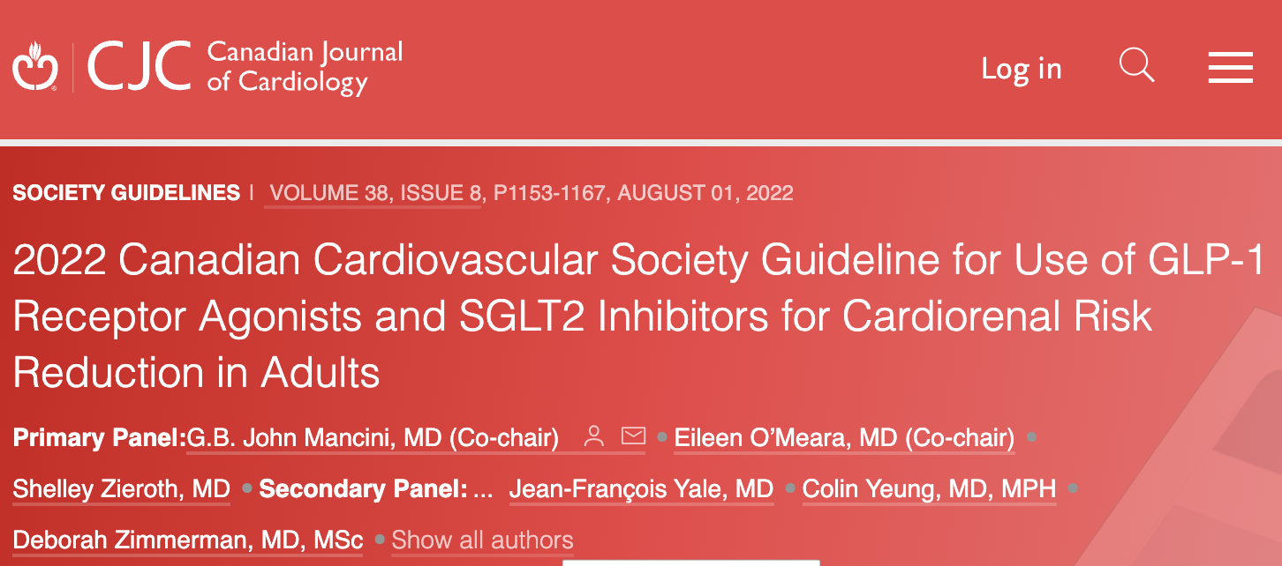

2022 Canadian Cardiovascular Society Guideline for Use of GLP-1 Receptor Agonists and SGLT2 Inhibitors for Cardiorenal Risk Reduction in Adults
G.B. John Mancini, MD (Co-chair), Eileen O’Meara, MD (Co-chair), Shelley Zieroth, MD, Mathieu Bernier, MD, Alice Y.Y. Cheng, MD, David Z.I. Cherney, MD, PhD, Kim A. Connelly, MD, Justin Ezekowitz, MBBCh, MSc, Ronald M. Goldenberg, MD, Lawrence A. Leiter, MD, Gihad Nesrallah, MD, MSc, Breay W. Paty, MD, Marie-Eve Piché, MD, PhD, Peter Senior, MBBS, PhD, Abhinav Sharma, MD, Subodh Verma, MD, PhD, Vincent Woo, MD, Pol Darras, MD, Jonathan Y. Gabor, MD, Jean Grégoire, MD, Eva Lonn, MD, James A. Stone, MD, PhD, Jean-François Yale, MD, Colin Yeung, MD, MPH, Deborah Zimmerman, MD, MSc
Canadian Journal of Cardiology
Volume 38 Issue 8 Pages 1153-1167 (August 2022)
DOI: 10.1016/j.cjca.2022.04.029
Copyright © 2022 Elsevier Inc. Terms and Conditions

Slide 66
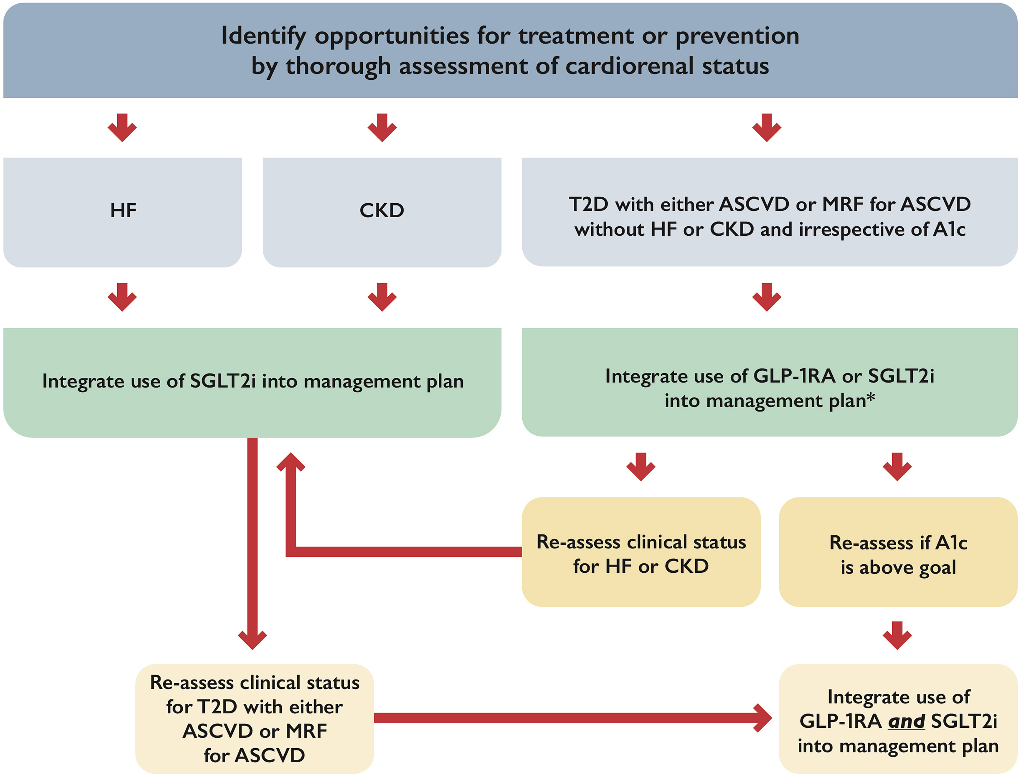
Figure 1
Notes:
Integration of glucagon-like peptide-1 receptor antagonists (GLP-1RA) and sodium-glucose co-transporter 2 inhibitors (SGLT2i) into cardiovascular practice. ASCVD, atherosclerotic cardiovascular disease; CKD, chronic kidney disease; HF, heart failure; MRF, multiple risk factors; T2D, type 2 diabetes. ∗ In patients with high stroke risk, or history of transient ischemic attack/stroke, consider initial integration of GLP-1RA into management plan followed by integration of SGLT2i on the basis of changes in heart failure or kidney status or for further glycosylated hemoglobin (A1c)-lowering.

Slide 67
Lesson # 8
SGLT2 Inhibitors clearly indicated for
- CHF – Reduced and Preserved
- CKD with with or without significant Proteinuria
In Diabetics and Non-Diabetics

Slide 68
The Motivational Speech
“This is a diabetic medication that helps protect the kidneys/heart”

Slide 69
The Motivational Speech
“This is a diabetic medication that helps protect the kidneys/heart”
“This is a kidney/heart protection medication that helps the diabetes”

Slide 70
CM
63 yo female
  CVA 2016
  CAD with MI 2020 – PCI LAD
  CHF with EF 38%, NYHA Class 2
  DM – A1C 9.0
Meds – Bisoprolol/ Spiro/Candasartan/Lasix
- Trajenta 5 mg od/Metformin 500 bid/Diamicron MR 120
Prev intolerance to Ozempic (0.25 mg x 2 weeks – ER - N& V)
Stopped Forxiga 10 mg 1 month ago due to recurrent GM1 and polyuria
? Recommendations

Slide 71
The Motivational Speech - Polyuria
Indication is for CV/Renal Protection
  – 30% mortality reduction
  35% reduction CHF
  50% reduction Kidney Failure
Benefits
  Glucose/Wt/BP
Downside
  GMI
  polyuria

Slide 72
The Motivational Speech - Polyuria
Indication is for CV/Renal Protection
  – 30% mortality reduction
  35% reduction CHF
  50% reduction Kidney Failure
Benefits
  Glucose/Wt/BP
Downside
  GMI
  polyuria
“ Peeing with a Purpose”
“Pee with benefits”

Slide 73
Practical tips: Genital mycotic infections (GMIs)
Uncomplicated
  (Healthy, non-pregnant, <3 inf/year, mild/mod symptoms)
  Fluconazole 150 po single dose
Complicated
  Severe signs, > 3/ year, poorly controlled DM, immunocompromised
  Fluconazole 150 mg po q 3 days , 2-3 doses
    +/1 clotrimazole/betamethasone x 48 hrs
    Or Topicals – 7-14 days
Recurrent – >3 year
  Fluconazole 150 mg po q 72 hrs x 3, then once weekly x 6 months

Slide 74
Practical tips: Genital mycotic infections (GMIs)
Uncomplicated
  Fluconazole 150 PO single dose +/- topical for symptom relief
    Or suppositories/creams
  Balanitis often responds to topicals, however may need PO
Complicated
  Fluconazole 150 mg PO q 3 days, 2–3 doses
    +/- clotrimazole/betamethasone x 48 hrs
Recurrent
  Fluconazole 150 mg PO q 72 hrs x 3, then once weekly x 6 months
PO, by mouth; q, every
CDC. 2015 Sexually Transmitted Diseases Guidelines. Vulvovaginal Candidiasis. Available at https://www.cdc.gov/std/tg2015/candidiasis.htm

Slide 75
Managing SGLT2i side effects - DKA
Sick Day
Medication List³
Diabetic ketoacidosis (DKA) is rare in patients taking SGLT2i medications¹
Common precipitants of DKA include inappropriate insulin reduction or omission, infection, infarction (myocardial), acute illness, bariatric or other surgery, excessive alcohol intake, excessive physical exertion/exercise, and dietary restriction (low-carbohydrate)²
SGLT2i-associated DKA may be euglycemic²
The sick day medication list is meant to help your patients avoid adverse events such as DKA²
S | Sulfonylureas
A | ACE inhibitors
D | Diuretics, direct renin inhibitors
M | Metformin
A | Angiotensin receptor blockers
N | Nonsteroidal anti-inflammatory
S | SGLT2 inhibitors
1. Zelnicker, et al. Lancet. 2019 Jan 5;393(10166):31-39
2. Goldenberg et al. Clin Ther. 2016 Dec;38(12):2654-2664.e1
3. Diabetes Canada Clinical Practice Guidelines Expert Committee. 2018 Clinical Practice Guidelines
Quick Reference Guide. 2018. Available at: https://guidelines.diabetes.ca/docs/cpg/Appendix-8.pdf. Accessed 29/01/2020.

Slide 76
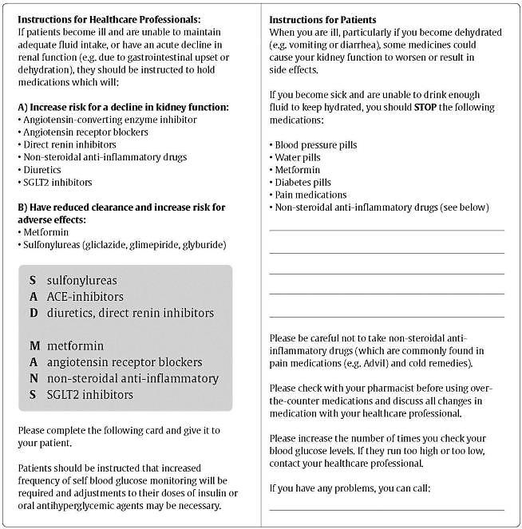
Counsel all Patients About
Sick Day Medication List
2015

Slide 77
Peri-procedural Issues
Risk of DKA
Hold Jardiance x 2 days/Metformin/Diuretics ? day before procedure ( or day of) and restart when eating/drinking
Not an Inpatient drug
Euglycemic DKA
  Precipitants
    Major surgery
    Bariatric surgery
    Insulin reduction
    Fasting/low CHO diet
    EtOH ‘ic

Slide 78
Just because you can do something doesn’t mean you should….

Slide 79
Don’t use SGLT-2 Inh with
Type 1 diabetes
Hx DKA/Pancreatic Insufficiency/Pancreatic resection
  Unless you have a c-peptide
eGFR < 20
Frail elderly – unless you are treating CHF/CKD
  replaces some diuretics

Slide 80
What about Intolerance to Ozempic

Slide 81

GLP-1 RA side effects
Most common side effects are nausea, vomiting, and diarrhea¹
Low hypoglycemia risk compared to sulfonylureas and insulin¹
GLP-1 RAs are associated with:
  Rare cases of acute gallstone disease¹
  Acute pancreatitis¹
GLP-1 RAs are contraindicated in patients with:
  Personal/family history of medullary thyroid cancer (MTC)
  Multiple endocrine neoplasia syndrome type 2 (MEN2)¹
Recent Canadian observational study of
>1.5 million people found no increased risk of pancreatitis with incretin-based therapies vs. other agents¹
GLP-1 RAs promote the development of pancreatic cancer and MTC in rodents, but an increased risk has not been seen in humans¹
Why does weight loss occur? GLP-1 RAs slow gastric emptying and cause a sense of satiety, leading to reduced food intake and weight loss. Weight loss is independent of GI side effects^{2,3}

Slide 82




Simple strategies to help patients manage
GLP-1 RA-related GI side effects
Eat smaller meals
Avoid fatty and spicy foods
Take on an empty stomach or before bed time
Stay hydrated
?
What tips or recommendations
for managing side effects have your patients found useful?

Slide 83

Ozempic Micro-Dosing
There are many “clicks” between the marked doses on the Ozempic pen. There are 18 “clicks” between 0 and 0.25mg and 18 “clicks” between 0.25mg and 0.5mg. On the 1mg pen there are 74 “clicks” between 0 and 1mg.
Use ____ clicks once a week and if tolerating well, continue to increase by ____ clicks every _____ weeks, until at the recommended dose of ______mg once weekly.
Once you are on a dose of 0.25 mg weekly, please discontinue your ___________ (Onglyza/Trajenta/Januvia)

Slide 84


Slide 85
Lesson # 9
Management of common side effects required for long-term success

Slide 86
DS
63 yo female, DM, MI 2 years ago
Meds – Empagloflozin 25 mg od , Ozempic 1.0 mg q weekly ASA/Ramipril/Rosuvastatin/Metformin
GMI q 2 months treated with Fluconazole 150 mg po prn
A1C – 7.0
What if her husband lost his job and the drug plan they shared?

Slide 87
The Motivational Speech
Indication is for CV/Renal Protection
  – 30% mortality reduction
  35% reduction CHF
  30-50% reduction Kidney Failure
Benefits
  Glucose/Wt/BP
Downside
  GMI
  polyuria

Slide 88
Reducing Costs
Pharma Programs
Trillium Application
Office Samples
Ozempic – Cost 1 mg pen = 0.5 mg pen
  36 clicks = 0.5 mg ow = cost of DPP-IV Inh
Jardiance – ½ of 25 mg tablet
  Synjardy 12.5/500 mg od
Admelog/Trurapi/Basaglar
Crestor ½ tab 40 mg
Different Pharmacy

Slide 89


Your Choice – $1.48/day

Slide 90
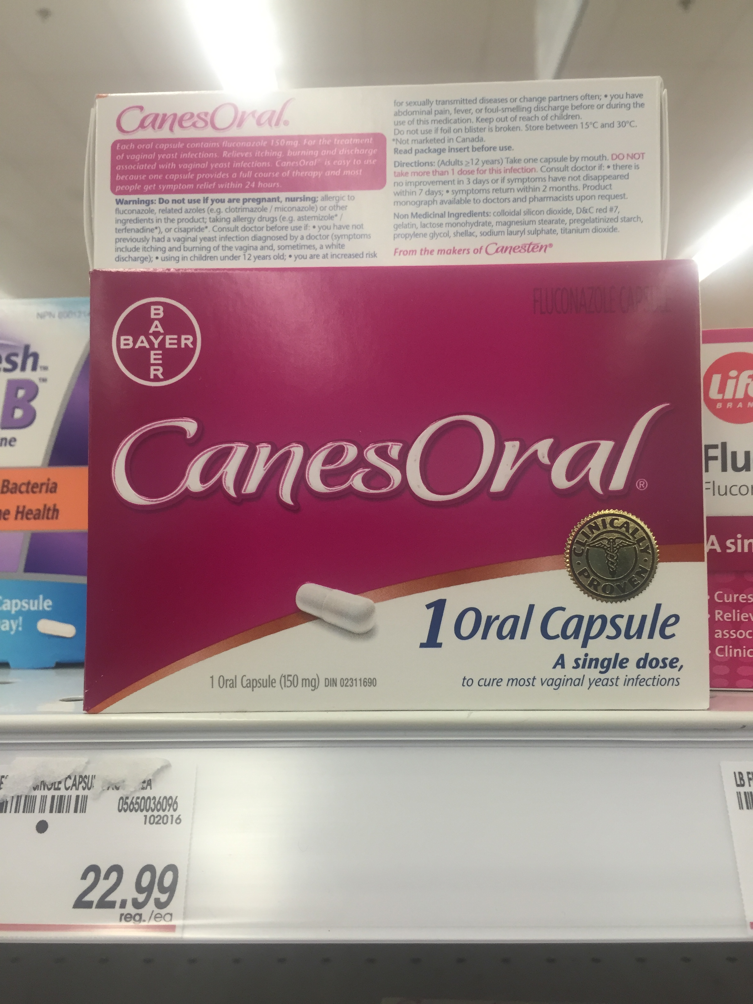
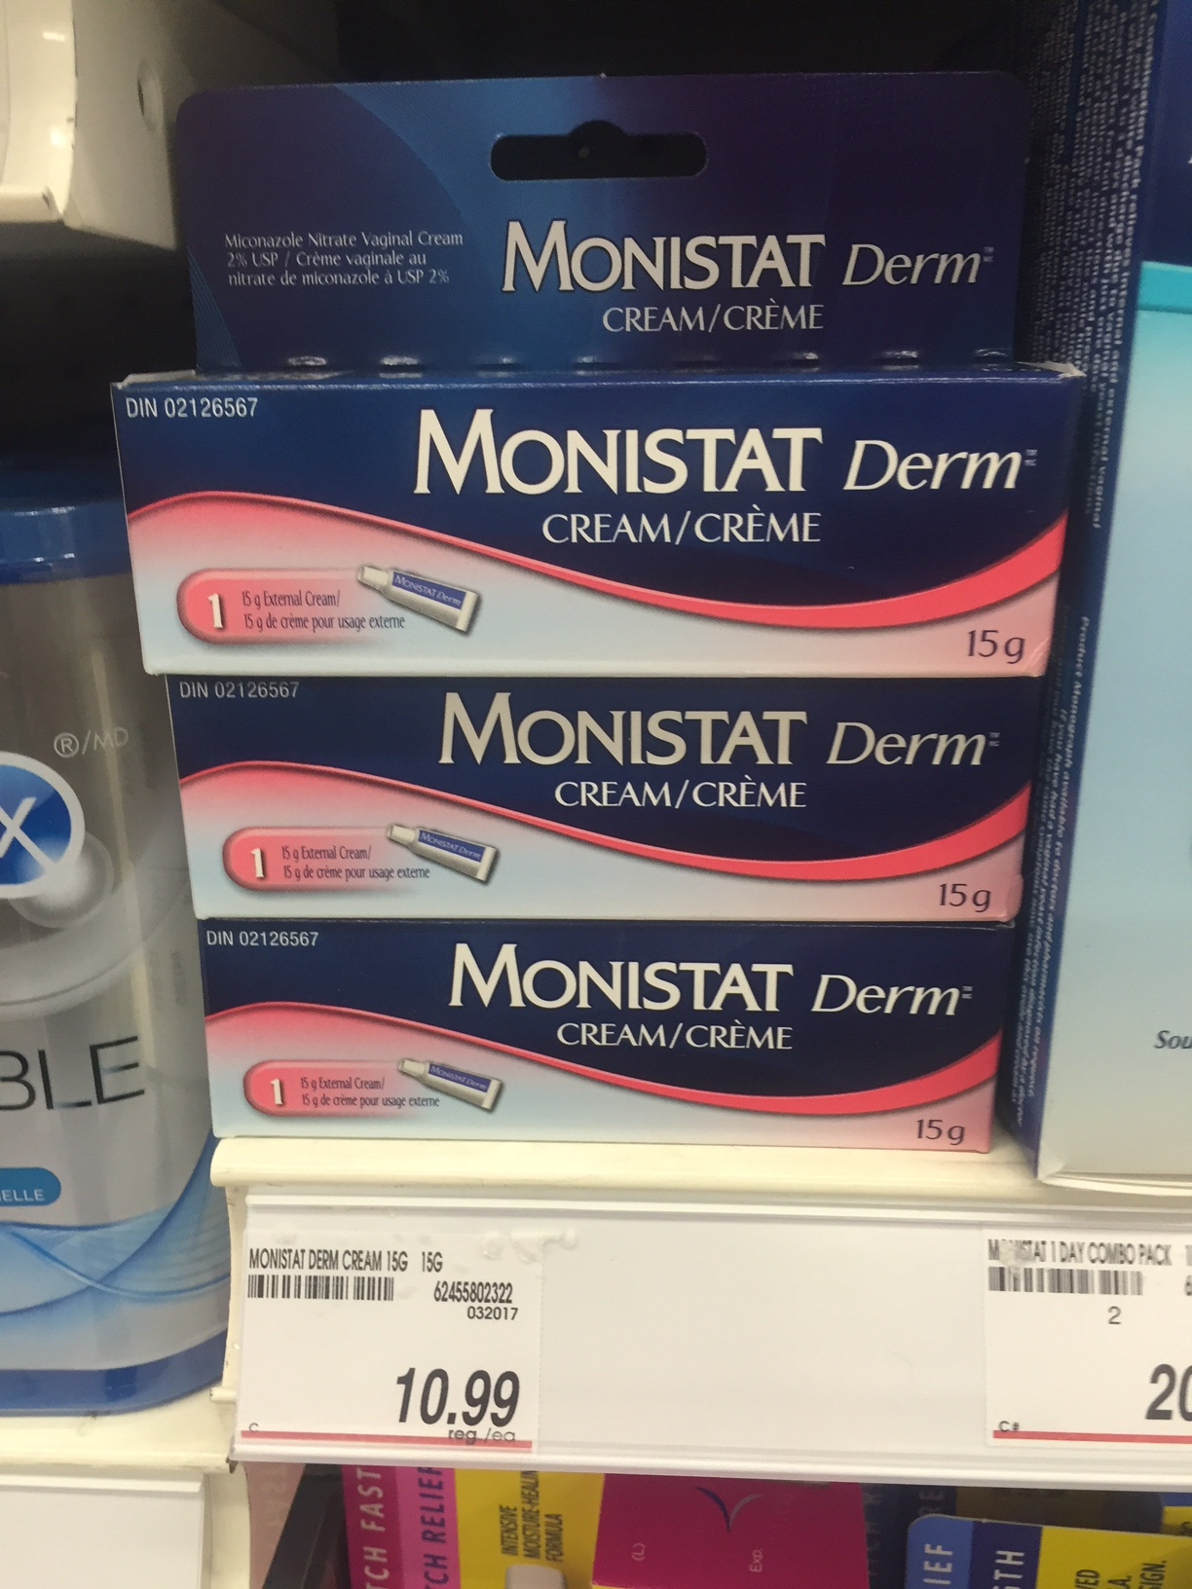
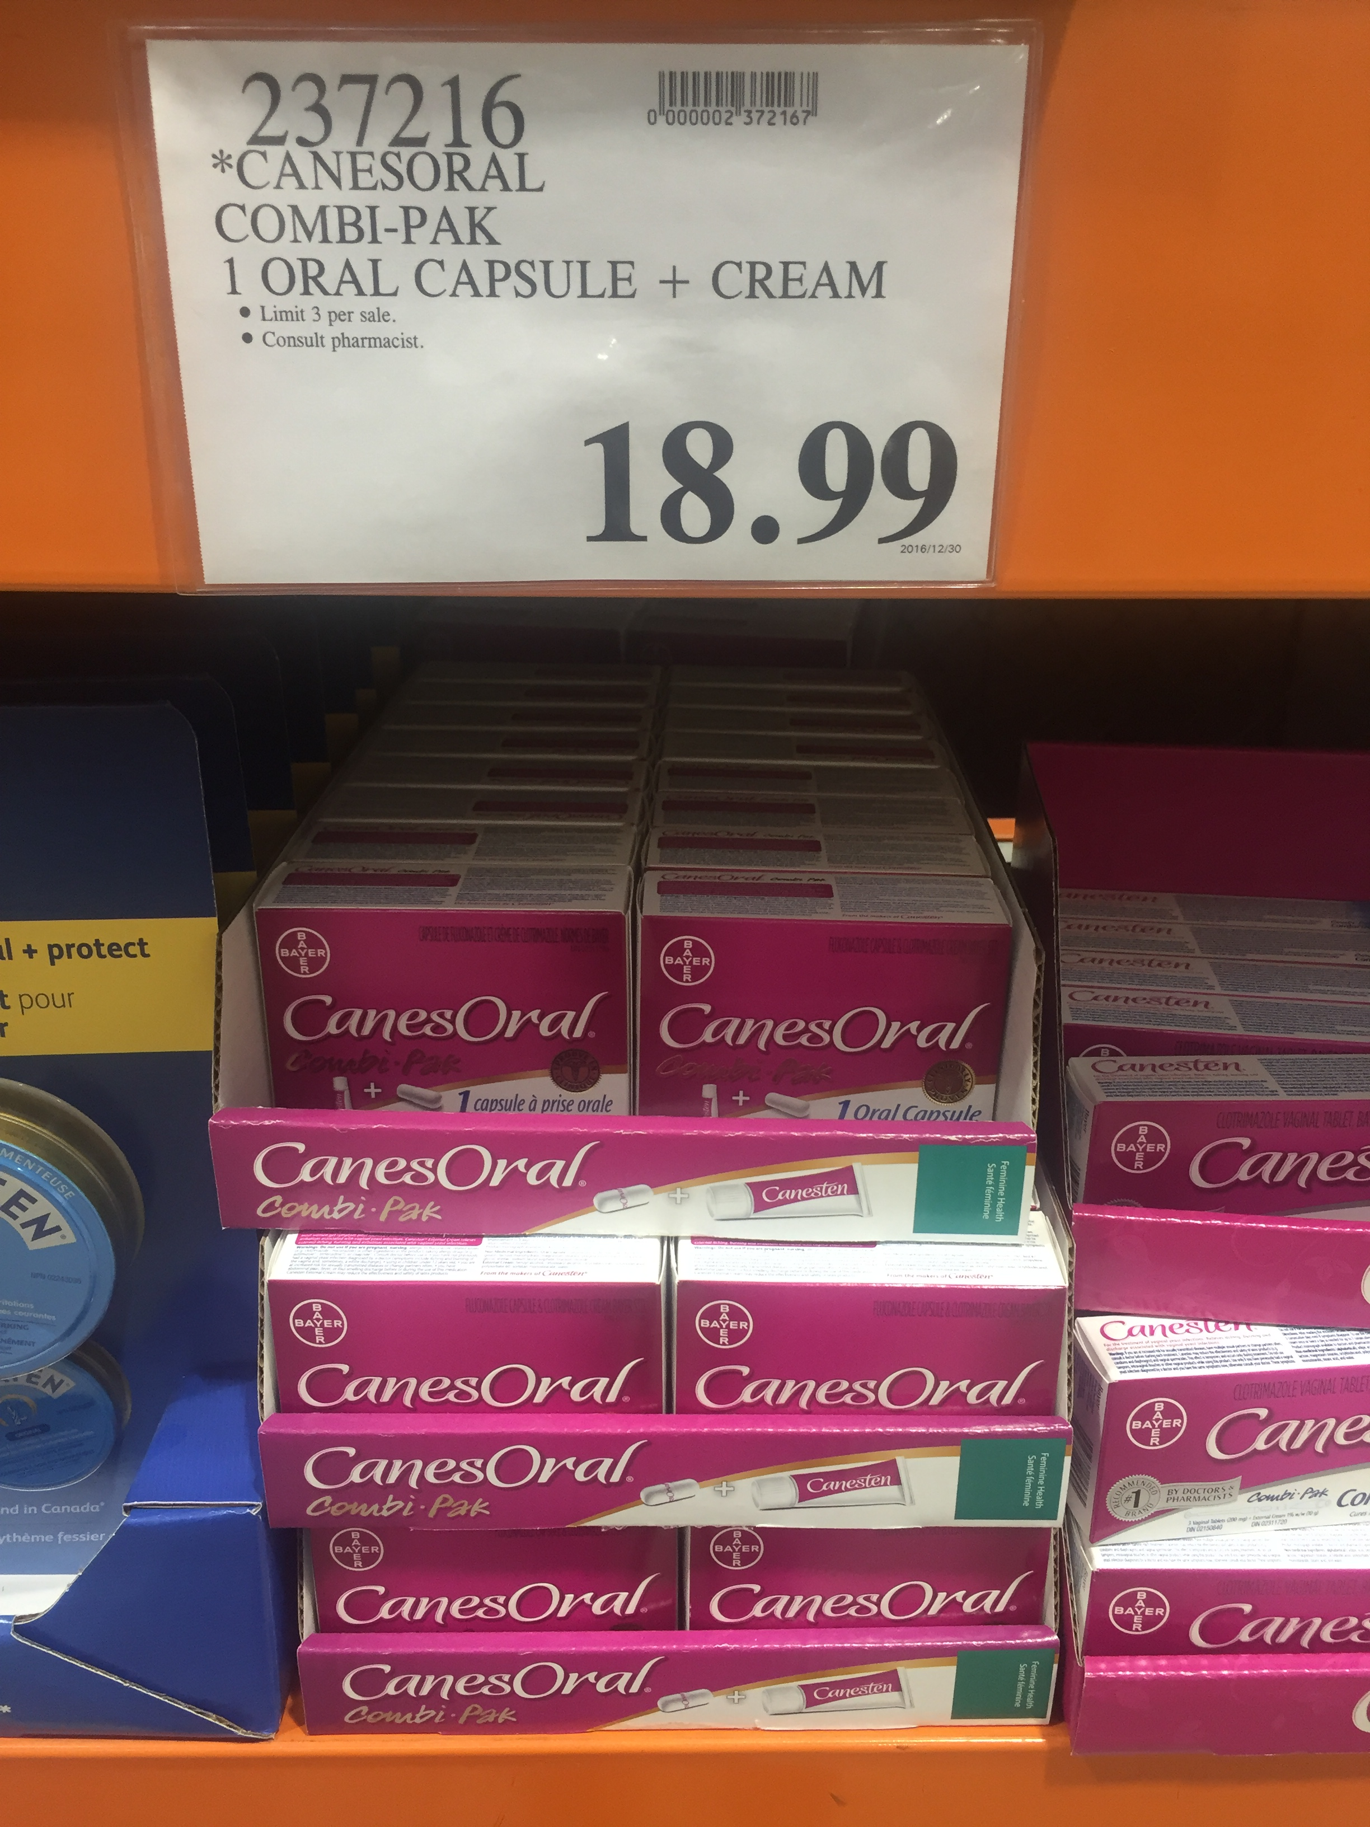
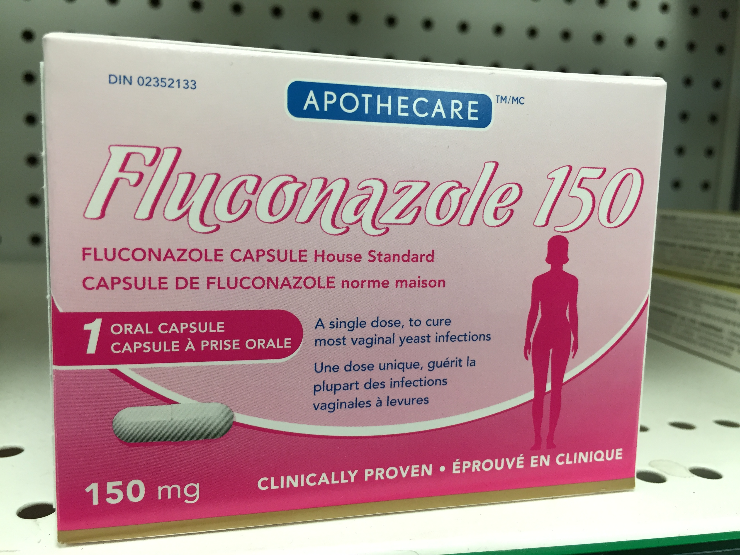
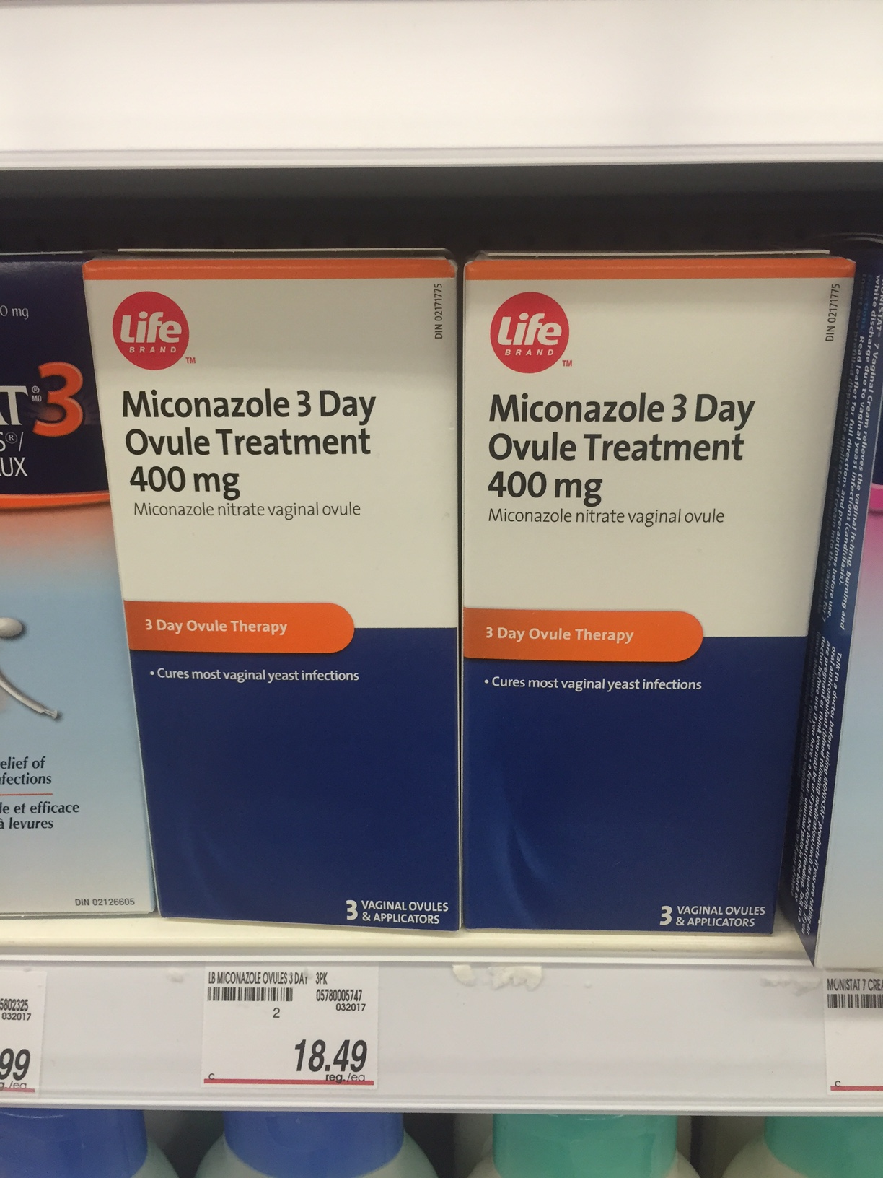
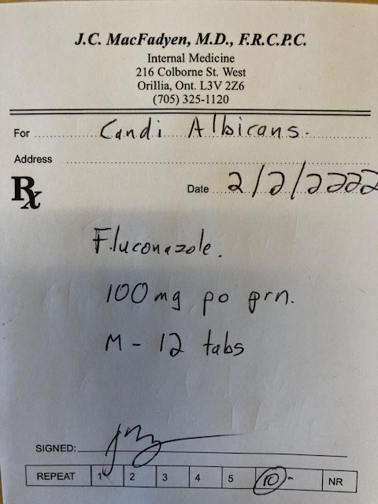
Which treatment is the most cost-effective for GMI?

Slide 91
Which treatment is the most cost-effective for GMI?

Slide 92
Fluconazole
Prescription -$3.94 per 150 mg tabs
  + dispensing fee eg. $12.99
  Annual Cost – 1/ month - $60.27
Ontario -LU Code 235
150 mg tab q 25 days prn for vaginal Candidiasis
  Annual Cost – 1/month = $48
  Annual Cost - $4.00 dispensing fee

Slide 93
Ozempic ODB Coverage
For the treatment of type 2 diabetes in combination with metformin and a sulfonylurea, when diet and exercise plus dual therapy with metformin and a sulfonylurea do not achieve adequate glycemic control.

Slide 94
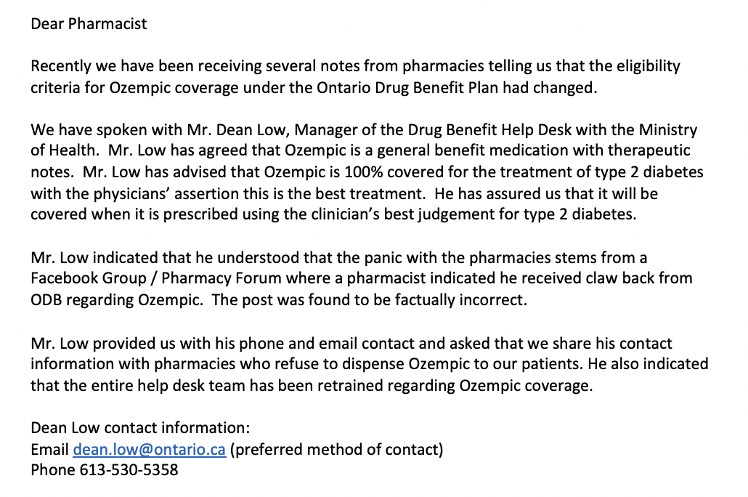

Slide 95
Lesson # 10
Strategies to reduce patient costs will increase utilization of cardio-protective agents

Slide 96
MS
45 yo male, Type 2 DM x 10 years
Meds – Diamicron MR 120 mg od
Invokana 300 mg od
Janumet XR 50/1000 mg bid
Crestor 40 mg od/ Ramirpil 10 mg od
Has drug plan, tests od – acBr 10-13
Wt 118 kg
A1C - 10.8, MAU – 8.6
Needle phobic – refuses Injection

Slide 97

Insulin Injection Demonstration

Slide 98
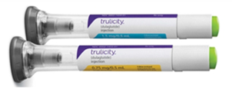

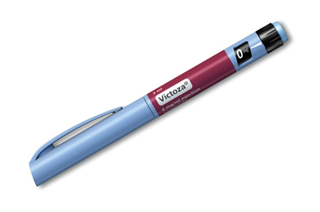
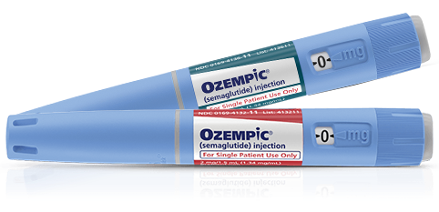
Teaching patients how to inject
 | Needle size/ gauge | Dosing schedule | Hidden needle
Dulaglutide | 5 mm 29 G | 0.75 mg QW; 1.5 mg QW for additional glycemic control | ✓
Exenatide QW | 7 mm 23 G | 2 mg QW | ✗
Liraglutide | 4 mm 32 G | 0.6 mg QD for 1 week; increase to 1.2 mg QD for 1 week; max dose 1.8 mg QD | ✗
Semaglutide | 4 mm 32 G | 0.25 mg QW for 4 weeks; increase to 0.5 mg QW; max dose 1.0 mg QW for additional glycemic control | ✗
Demonstrate how to self-inject
  Teach-back method with “dry” injection can increase confidence and reduce patient anxiety
  Proper injection technique may lead to less pain
Show the needle
  Needle size is positively correlated with injection pain
Dosing frequency
  Patients may prefer longer-acting
  QW options
Hidden needles
  Patients with needle anxiety may prefer not handling needles
Larger gauge = smaller diameter

Slide 99

? Size of the Needle ?

Slide 100
Consider Rybelsus

Slide 101
  If - A1C < 1.0 over goal
    Reduce basal insulin 20-40 % - (ie if goal 8.5 – reduce if >9.5)
    Reduce SU/Diamicron 50%
    Reduce bolus insulin 50%
  A1C > 1.0-1.5 over goal
    counsel re lows
    Consider reduce meds for Glu < 7 on pattern review
  Replace DPP-IV
  eGFR - > 15

Slide 102
  If - A1C < 1.0 over goal
    Reduce basal insulin 20-40 % - (ie if goal 8.5 – reduce if >9.5)
    Reduce SU/Diamicron 50%
    Reduce bolus insulin 50%
  A1C > 1.0-1.5 over goal
    counsel re lows
    Consider reduce meds for Glu < 7 on pattern review
  Replace DPP-IV
  eGFR - > 15

Slide 103
MS started Ozempic
45 yo male, Type 2 DM x 10 years
Meds – Ozempic 0.5 mg ow
Synjardy 5/500 mg bid
Crestor 40 mg od/ Ramipril 10 mg od
Has drug plan, tests od – acBr 6-9
Wt 112 kg – 6 kg wt loss
A1C - 7.8, MAU – 4.2
Needle phobia resolved

Slide 104
Lesson #11
Self – demonstration of injections will breakdown barriers

Slide 105
DS
Invokana 300 mg po od
Tresiba FlexTouch 30 units od
Diamicron MR 60 mg 2 tablets 1 time daily
metformin 500 mg 1 tablet 2 times daily
Forxiga 10 mg od
Ozempic Prev. not tolerated
A1c 9.0
Tests infrequently – glu 8 acBr today
Recommendations?

Slide 106
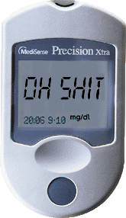
DS glucometer after Lunch.

Slide 107
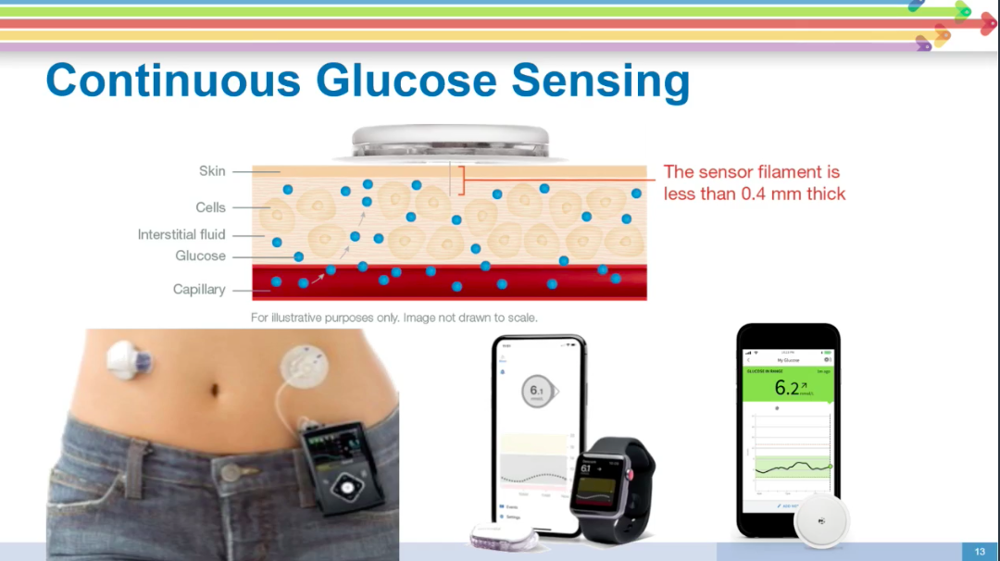

Slide 108

Libre 2 Coverage

Slide 109




Potential Benefits of Sensor-Based Monitoring Technologies
How do newer monitoring technologies like rtCGM and isCGM help?
4 finger stick tests
or
Daily pattern from rtCGM or isCGM
15
T2D
Click to learn more about the clinical benefits of isCGM use
Glucose (mmol/L)
13
11
Highs unnoticed with finger sticks
Ideal range
9
7
Click to see:
“Diabetes Canada: Flash Glucose Monitoring”
5
Lows unnoticed with finger sticks
3
1
T2D
Click to learn more about the clinical benefits of rtCGM use
0
6
12
18
24
Time (h)
Click to see:
“Diabetes Canada: Blood Glucose Monitoring in Adults and Children with Diabetes: Update 2021”
Click to see:
“Diabetes Canada:
Continuous Glucose Monitoring”

Slide 110


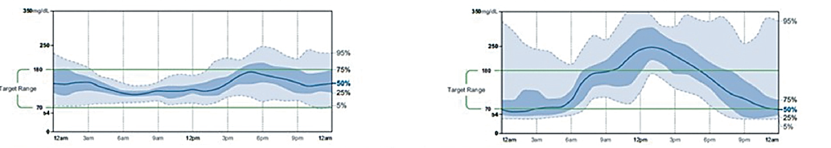
Individuals With the Same A1C May Have Different Glucose Patterns
 | Patient A | Patient B
A1C | 7.5% | 7.5%
%CV | 29% | 56%
TIR | 85% | 41%
TAR | 14% | 37%
TBR | 1% | 22%
AGP
95%
mmol/L
mmol/L
95%
10.0
75%
10.0
Target
50%
Target
3.9
25%
3.9
75%
5%
50%
25%
5%
A1C is a suboptimal glycemic metric for managing individual patients on a day-to-day basis

Slide 111
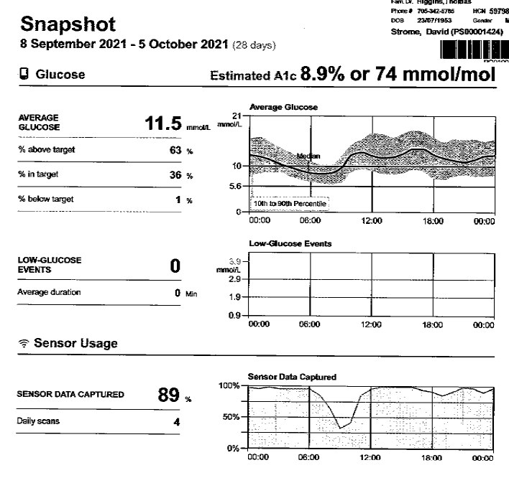
DS Type 2 A1C 9.0
Invokana 300 mg po od
Tresiba FlexTouch 30 units od
Diamicron MR 60 mg 2 tablets 1 time daily
metformin 500 mg 1 tablet 2 times daily
Forxiga 10 mg od
Ozempic Prev. not tolerated
A1c 9.0

Slide 112
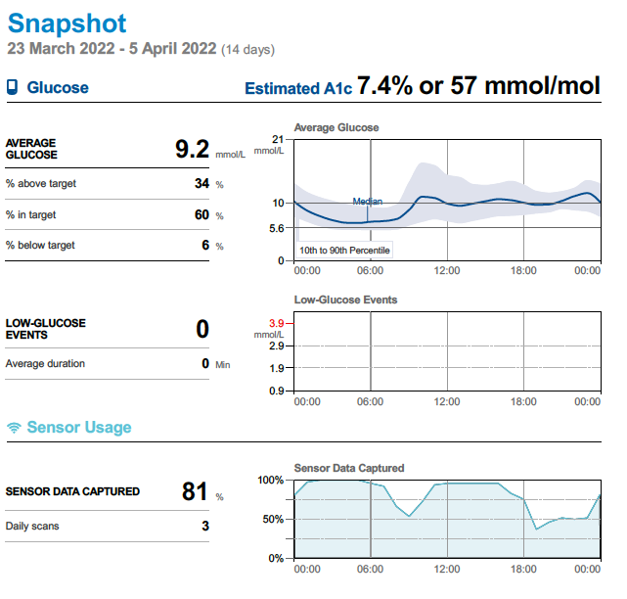
DS Post A1C 7.4
Invokana 300 mg po od
Tresiba FlexTouch 20 units od
Diamicron MR 60 mg 2 tablets 1 time daily
metformin 500 mg 1 tablet 2 times daily
Ozempic 0.5 mg weekly
A1c 7.2

Slide 113
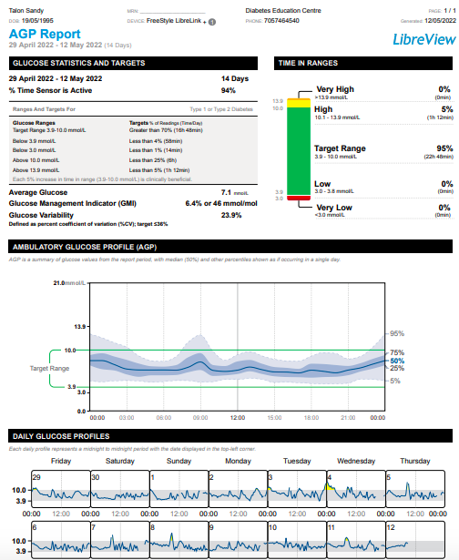
TS -26 yo male Type 1
Nov 2021
  2 month wt loss/polyuria
  Glu 45, HCO3 16, pH 7.3
Lantus 6 u hs
Apidra – 2 u ac meals
BMI - 25

Slide 114
TS -26 yo male Type 1
Nov 2021
  2 month wt loss/polyuria
  Glu 45, HCO3 16, pH 7.3
Lantus 6 u hs
Apidra – 2 u ac meals
BMI - 25
C peptide – 1350
  Glu 6.3

Slide 115
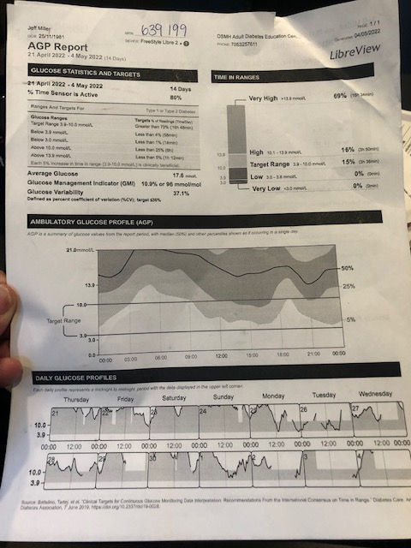
CV – Type 2
20 yo male autism
Diamicron 120 od
Trajenta 5 mg od
Metformin 1 g bid
Actos 30 mg od

Slide 116
DS Post A1C 7.4
Invokana 300 mg po od
Tresiba FlexTouch 20 units od
Diamicron MR 60 mg 2 tablets 1 time daily
metformin 500 mg 1 tablet 2 times daily
Ozempic 0.5 mg weekly
A1c 7.2

Slide 117
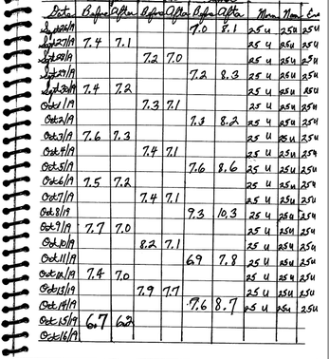
GF
A1C 10.7
Janumet XR 100/1000
Diamicron MR 120 od
Jardiance 10 mg od
Doesn’t want injections

Slide 118
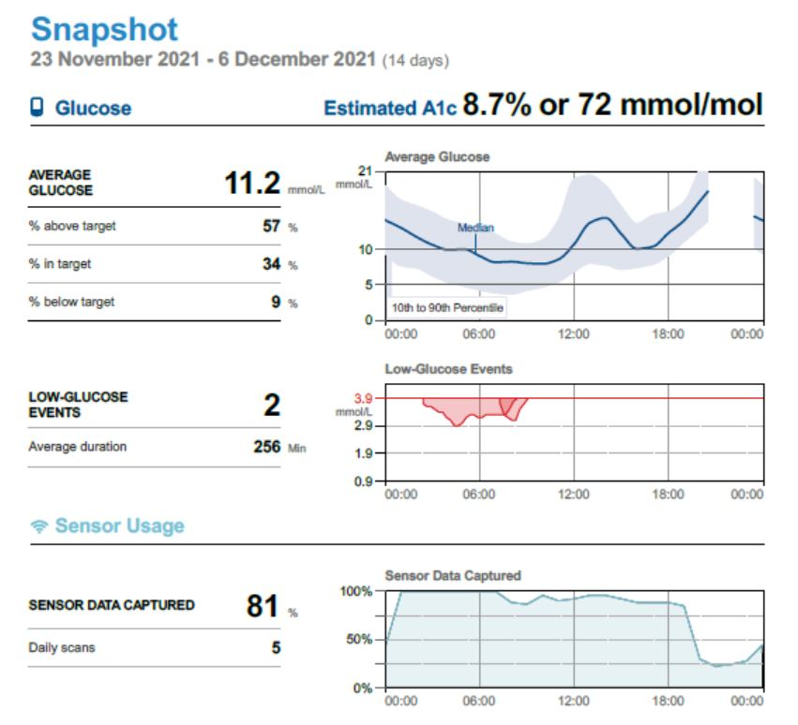
DD
74 yo male
Lantus 33
Ozempic 1.0
Diamicron 120 mg od
Metformin 1 g bid
Jardiance 10 mg od
A1C – 8.9
Recommendations ?

Slide 119
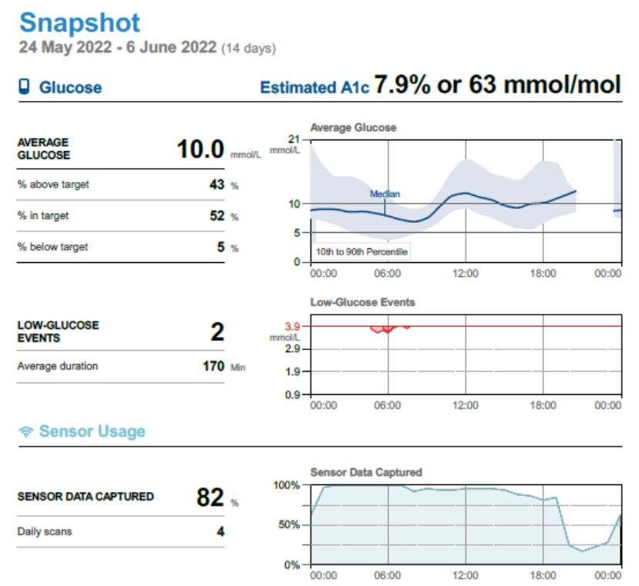
DD
74 yo male
Tresiba 30
NR 7 ac Su
Ozempic 1.0
Diamicron 120 mg od
Metformin 1 g bid
Jardiance 10 mg od
A1C – 7.6

Slide 120
Lesson #12
Use of CGMS improves clinical decisions

Slide 121
Biosimilars

Slide 122

The Tale of Two Hipsters
Humalog
Admelog

Slide 123

Whose Job Is It Anyways?

Slide 124
Whose Job Is It Anyways?
Initiating Cardiac and Renal Protective Strategies for Diabetics
Cardio
Nephro
Endo

Slide 125
Whose Job Is It Anyways?
Initiating Cardiac and Renal Protective Strategies for Diabetics
Cardio
Nephro
Endo
Primary Care

Slide 126
Whose Job Is It Anyways?
Initiating Cardiac and Renal Protective Strategies for Diabetics
Cardio
Nephro
Endo
Primary Care
General
Internist

Slide 127

“Magno-Cardio-Reno-Forte”

Slide 128
“Magno-Cardio-Reno-Forte”
A new diuretic with ACE-I properties that reduces CV death and overall mortality by 38% in cardiac patients with diabetes.
2 significant drug interactions (insulin and sulphonylureas) that may cause hypoglycemia.
Increases risk of GMI’s.

Slide 129
Summary – Lessons Learned
These are Risk lowering medications that reduce A1C
Use Cardio-protective medications independent of A1C
There is no ”BEST” second line therapy- individualize treatments
Diabetes Once Daily
Identify patients on MDI insulin to start new agents
  C-peptide if needed
Beneficial to identify Super-responders

Slide 130
Summary – Lessons Learned
Use SGLT-2 Inh. in the setting of CKD with proteinuria
SGLT 2 improves HFrEF, HFpEF, CKD with significant proteinuria outcomes in DM and Non-DM
Management of common side effects required for long-term success
Strategies to reduce patient costs will increase utilization of cardio-protective agents
Self – demonstration of injections will breakdown barriers
Use of CGMS improves clinical decisions

Slide 131
If you don’t feel comfortable with initiating these medications for individual patients,
Refer the patient on to someone who will.

Slide 132
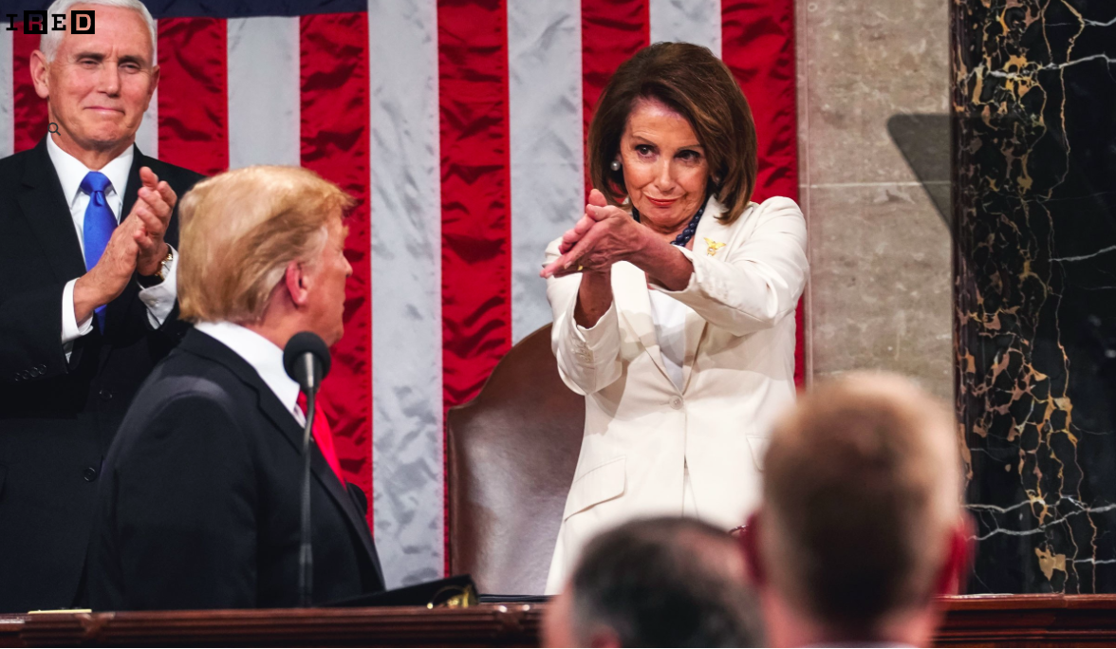
Insert Applause Here

Slide 133

2023

Slide 134

? Questions?

Slide 135
sdcrc.ca
OTN
virtualhallway.ca

Slide 136

Goal – to reduce cardiovascular and renal complications for patients with Diabetes in Simcoe County
Focused intervention over 12 months
    Initiation of diabetic medications proven to reduce cardio-renal complications
    Pt. on insulin/ meds/ co-morbid diseases/initial side effects that limit ability to be initiated on meds
    Pts. Post hospitalization for ACS/CHF seeing Cards/Hospitalists
  f/u thru primary care
Referrals Triaged – goal first visit < 1 month from referral
Initiation of diabetic medications proven to reduce cardio-renal complications
Referral – fax – 705 325 1185 (MacFadyen/Meadley)
www.sdcrc.ca

