Slide 1
Lessons Learned
Short Presentation

Slide 2

Lessons Learned
2015-2023
J.C. MacFadyen
MD, FRCPC, MHPE
JC MacFadyen MD FRCPC MHPE

Slide 3
Objectives
Review recent Guidelines for Pharmacologic Management of Type 2 Diabetes
    Diabetes Canada
    CCS
Review Clinical Trials related to Diabetes Therapies
Integrate Guidelines into Clinical Practice
Review practical strategies to overcome common barriers to Diabetic Care

Slide 4

















John MacFadyen Disclosures

Slide 5
Bias vs Credibility
Clinical Practice x 25 years
Medical Director OSMH DEC 1999 – present
  Actively follow >3,500 pts with Diabetes
CDA Guidelines Committee – 2013
Active Pts on SGLT-2 Inhibitors > 2000
Medical Director Heart Function Program - CFHT

Slide 6
Bias vs Credibility
Clinical Practice x 25 years
Medical Director OSMH DEC 1999 – present
  Actively follow >3,500 pts with Diabetes
CDA Guidelines Committee – 2013
Medical Director Heart Function Program – CFHT
GLP-1 Agonists– 1,600 patients
SGLT-2 Inh. - 2,445 patients

Slide 7
Disclaimer
The views, information and opinions expressed in this program are solely those of the presenter and do not represent those of Novo Nordisk, Lilly or Diabetes Canada. This program does not constitute medical advice and is only meant to educate and inform the listener.

Slide 8


Slide 9

Questions?

Slide 10
BD
65 yo male, DM 2012
  Nov 2022 –Non-STEMI PCI to LAD
Meds
  Degludec x x 22
  Metformin 1 g bid
  Ramipril 10/Rosuvastatin 10 mg od/ASA/Clopidogrel/Amlodipine
Followed by Cardiology,
walks dog 1 hour daily

Slide 11
BD
O/E
  Wt 103 kg, BMI 35
  BP 134/80
  Reuse injection sites – lipohypertrophy
A1C – 11.0, Cr 92, MAU 32 ACR 3.4

Slide 12
BD
O/E
  Wt 103 kg, BMI 35
  BP 134/80
  Reuse injection sites – lipohypertrophy
A1C – 11.0, Cr 92, MAU 32 ACR 3.4
Recommendations?

Slide 13

BD’s Dog

Slide 14
BD
O/E
  Wt 103 kg, BMI 35
  BP 134/80
  Reuse injection sites – lipohypertrophy
A1C – 11.0, Cr 92, MAU 32 ACR 3.4
Recommendations?

Slide 15

UKPDS
Improving Glycemic Control Reduces Risk of Long-term Complications
21%
Deaths related to diabetes*
37%
Microvascular complications, e.g.
kidney disease and blindness*
14%
Heart attack*
43%
Amputation or fatal peripheral
blood vessel disease*
1%
12%
Stroke**
*p<0.0001
**p=0.035
UKPDS: UK Prospective Diabetes Study
Stratton IM, et al. UKPDS 35. BMJ 2000:321;405-12.
Notes:
SPEAKER NOTES:
The landmark UK Prospective Diabetes Study (UKPDS) found that each 1% reduction in updated mean glycated hemoglobin (A1C) significantly decreased the risk of deaths related to diabetes by 21%, of microvascular complications (e.g., renal disease and retinopathy) by 37%, of amputation or death from peripheral vascular disease by 43%, of myocardial infarction by 14%, and of stroke by 12%.
Reference:
Stratton IM, Adler AI, Neil HAW, et al. Association of glycaemia with macrovascular and microvascular complications of type 2 diabetes (UKPDS 35): prospective observational study. BMJ 2000:321;405-12.

Slide 16
Any diabetes related endpoint
overweight
patients
M v C
p=0.0023
M v I
p=0.0034

Slide 17

Diabetes Trials 1998-2015

Slide 18
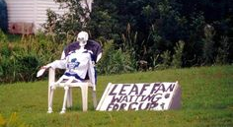
1967 - Present

Slide 19

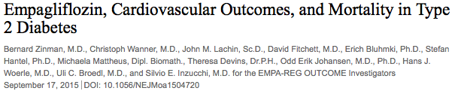

Slide 20


Slide 21
EMPA-REG OUTCOME
Primary Outcome: CV Death, Non-fatal MI or Non-fatal Stroke
EMPA-REG OUTCOME included adult patients (>18 years) with type 2 diabetes and established CVD who were receiving standard of care therapy for diabetes
Empagliflozin (pooled)
HR 0.86
(95.02% CI 0.74, 0.99)
p=0.04* for superiority
p<0.001 for noninferiority
Placebo
Empagliflozin
Patients with event (%)
Empagliflozin 10 mg
HR 0.85 (95% CI 0.72, 1.01), p=0.07
Empagliflozin 25 mg
HR 0.86 (95% CI 0.73, 1.02), p=0.09
Months
No. of patients
Empagliflozin
Placebo
4687
2333
4580
2256
4455
2194
4328
2112
3851
1875
2821
1380
2359
1161
1534
741
370
166
Cumulative incidence function. MACE: major adverse cardiovascular event; HR: hazard ratio; MI: myocardial infarction; SGLT2: sodium glucose cotransporter 2
*Two-sided tests for superiority were conducted (statistical significance was indicated if p≤0.0498)
Note: Empagliflozin is an SGLT2 inhibitor. Data from: Zinman B, et al. N Engl J Med. 2015; 373:2117-2128.

Slide 22
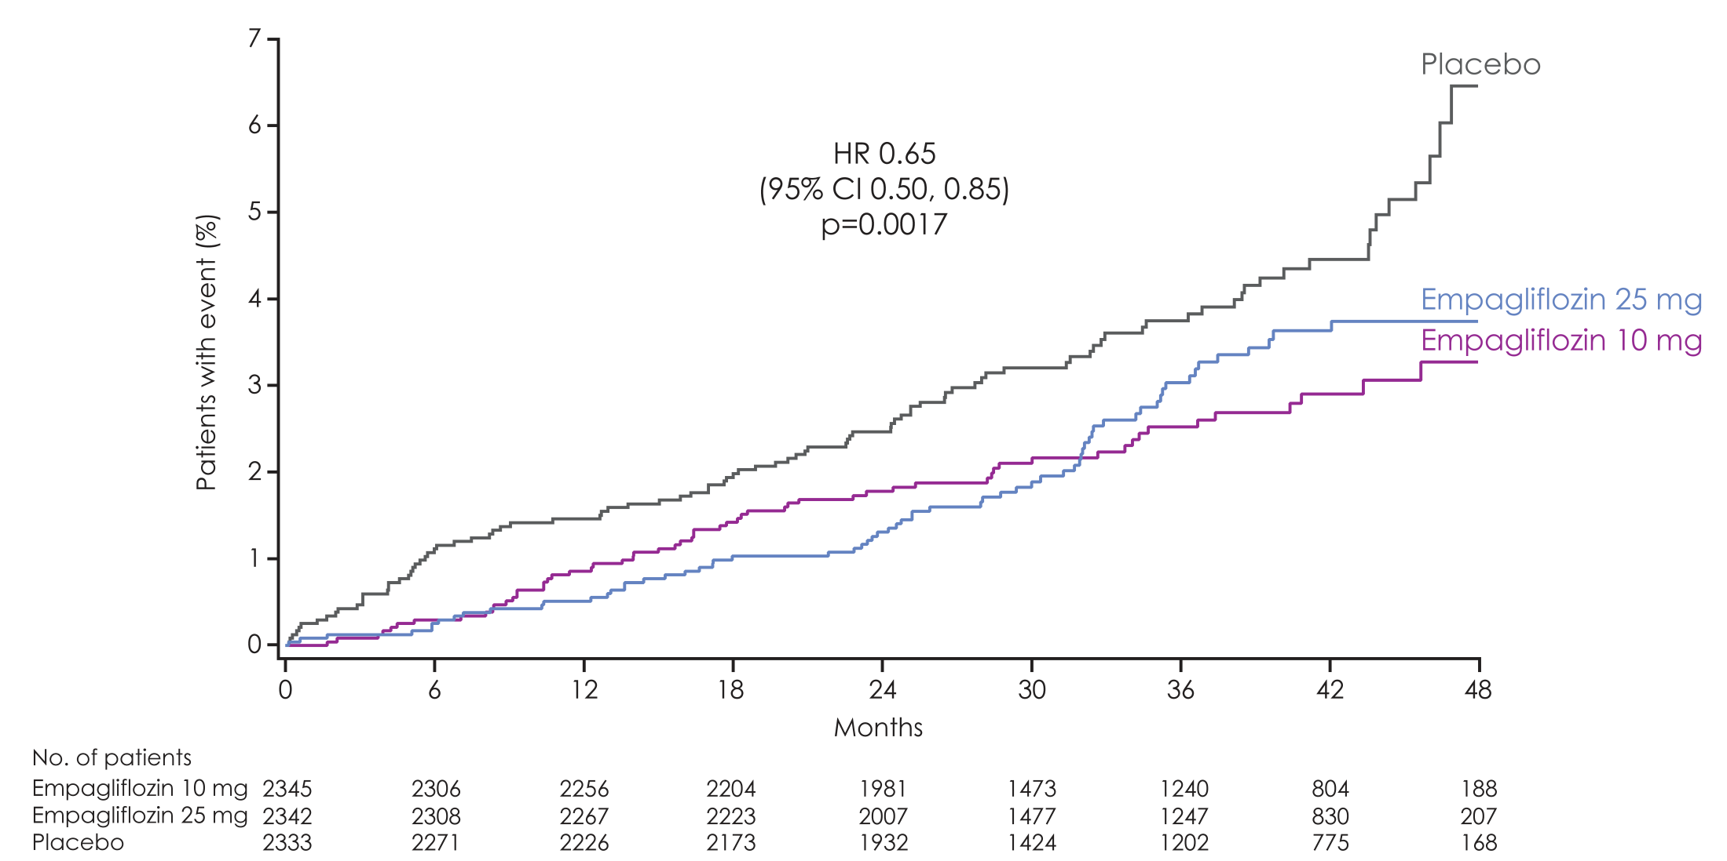
Hospitalisation for heart failure
Empagliflozin 10 mg
HR 0.62
(95% CI 0.45, 0.86)
p=0.0044
Empagliflozin 25 mg
HR 0.68
(95% CI 0.50, 0.93)
p=0.0166

Slide 23
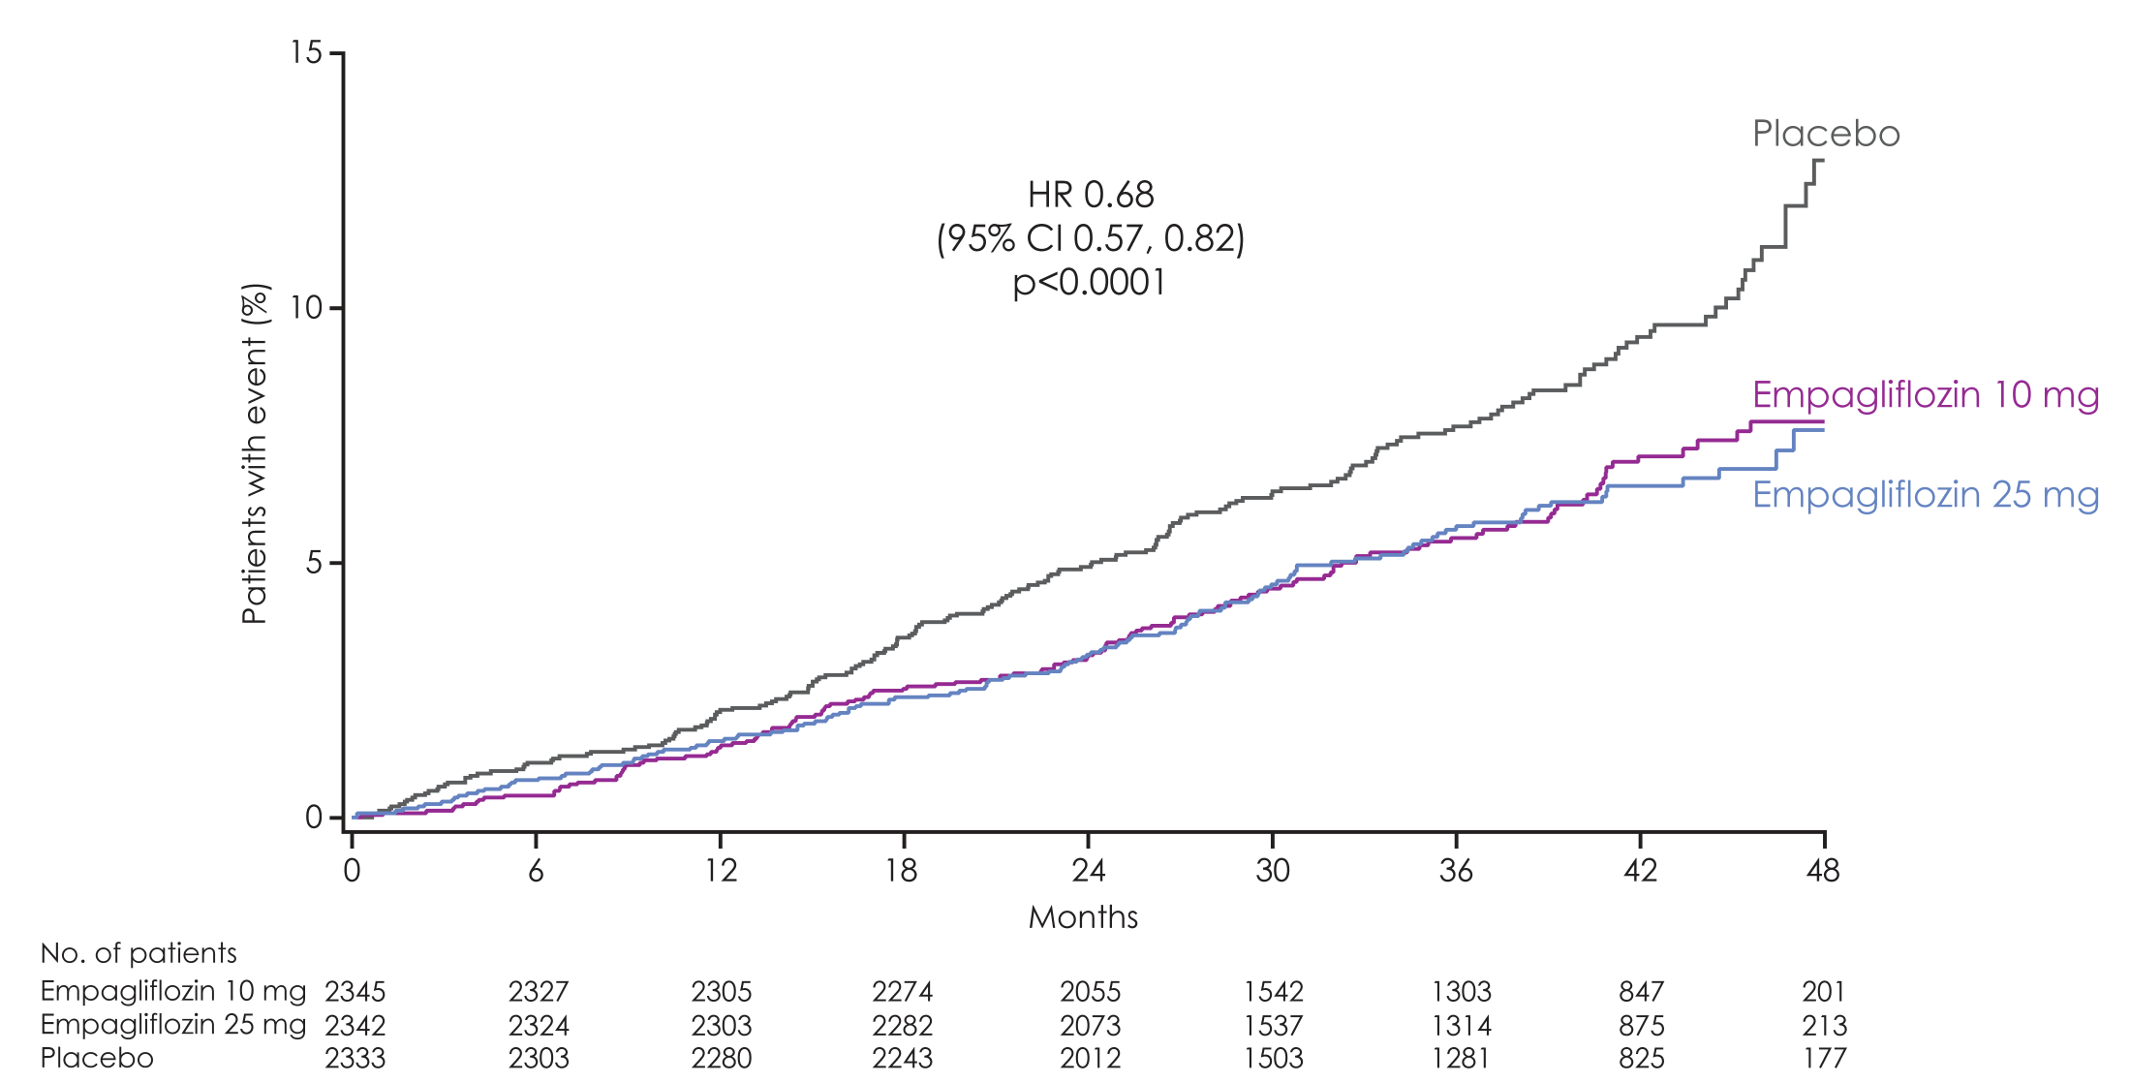
All-cause mortality NNT 38
Empagliflozin 10 mg
HR 0.70
(95% CI 0.56, 0.87)
p=0.0013
Empagliflozin 25 mg
HR 0.67
(95% CI 0.54, 0.83)
p=0.0003
HR 0.68
(95% CI 0.57, 0.82)
p<0.0001

Slide 24
SUSTAIN-6: Primary Endpoint (CV Death, Non-fatal Myocardial infarction, Non-fatal Stroke)
HR: 0.74
(95% CI, 0.58, 0.95)
Events: 108 semaglutide; 146 placebo
P < 0.001 for non-inferiority
P = 0.02 for superiority*
Placebo, 8.9%
Semaglutide
(pooled), 6.6%
109
No. at risk
Semaglutide | 1,648 | 1,619 | 1,601 | 1,584 | 1,568 | 1,543 | 1,524 | 1,513
Placebo | 1,649 | 1,616 | 1,586 | 1,567 | 1,534 | 1,508 | 1,479 | 1,466
* SUSTAIN-6 was not designed with prespecified testing for superiority. However, the treatment effect of semaglutude and the accrual
of more events than estimated resulted in a significantly lower risk of the primary outcome among patients in the semaglutide group.
CI, confidence interval; CV, cardiovascular; HR, hazard ratio
Marso S et al. Semaglutide and Cardiovascular Outcomes in Patients with Type 2 Diabetes N Engl J Med September 2016 doi: 10.1056/NEJMoa1607141
Notes:
This study involved 3,297 patients with type 2 diabetes who were on a standard-care regimen. They were randomized to receive once-weekly semaglutide (0.5 mg or 1.0 mg) or placebo for 104 weeks. The primary composite outcome was the first occurrence of cardiovascular death, nonfatal myocardial infarction, or nonfatal stroke. This outcome occurred in 108 of 1648 patients (6.6%) in the pooled semaglutide groups and in 146 of 1649 patients (8.9%) in the placebo group (hazard ratio, 0.74; 95% confidence interval [CI], 0.58 to 0.95; p<0.001 for noninferiority, p=0.02 for superiority).
Reference:
Marso SP, Bain SC, Consoli A, et al. Semaglutide and Cardiovascular Outcomes in Patients with Type 2 Diabetes. N Engl J Med 2016; 375(19):1834-44.

Slide 25
Renal Endpoints from CVOTs: SGLT2 inhibitors have consistently shown a reduced risk of renal composite endpoints in T2D patients
8
EMPA-REG OUTCOME^{1,a}
CANVAS program^{2,b}
7
10
HR: 00.60 (95% CI: 0.47, 0.77)
Placebo
HR: 0.54 (95% CI, 0.40, 0.75)
9
6
8
5
7
6
4
Patients with
an event (%)
Cumulative probability
of event (%)
Placebo
5
3
4
2
3
1
Empagliflozin
2
Canagliflozin
0
1
0
6
12
18
24
30
36
42
48
0
0
26
52
78
104
130
156
182
208
234
260
286
312
338
Month
Weeks since randomization
DECLARE-TIMI 58 trial^{3,c}
HR: 0.53 (95% CI: 0.43, 0.66)
Cumulative
probability of event
Placebo (2.8%)
Dapagliflozin 10 mg (1.5%)
Time since randomization (years)
ªRenal composite outcome was defined as doubling of SCr accompanied by eGFR ≤45 mL/min/1.73 m², RRT, or renal death; ^{b}Renal composite outcome was defined as: 40% reduction in eGFR, RRT, or death from renal causes; ^{c}Renal composite outcome was defined as: eGFR decrease ≥40% to <60 mL/min/1.73 m², ESRD or renal death;
CVOT, cardiovascular outcome trial; CI, confidence interval; ESKD, end-stage kidney disease; ESRD, end-stage renal disease; HR, hazard ratio; RRT, renal-replacement therapy; SGLT2, sodium–glucose co-transporter 2
1. Wanner C, et al. N Engl J Med 2016;375:323–334; 2. Neal B, et al. N Engl J Med 2017;377:644–657; 3. Mosenzon O, et al. Lancet Diabetes Endocrinol 2019;7:606–617;
Notes:
Wanner C, et al. N Engl J Med 2016;375:323–334;
Neal B, et al. N Engl J Med 2017;377:644–657;
Mosenzon O, et al. Lancet Diabetes Endocrinol 2019;7:606–617;

Slide 26

Reviewing, adjusting or advancing therapy in type 2 diabetes:
T2D, type 2 diabetes.
Diabetes Canada Clinical Practice Guidelines Expert Committee. Pharmacologic glycemic management of type 2 diabetes in adults: 2020 update. Can J Diabet 2020;44:575-591.
Notes:
For patients like James, treatment with a GLP-1 receptor agonist or an SGLT2 inhibitor is recommended. [CLICK] Both have been proven to reduce the risk of major adverse cardiovascular events, and SGLT2 inhibitors have been proven to reduce the risk of hospitalization for heart failure and to delay the progression of renal disease.

Slide 27
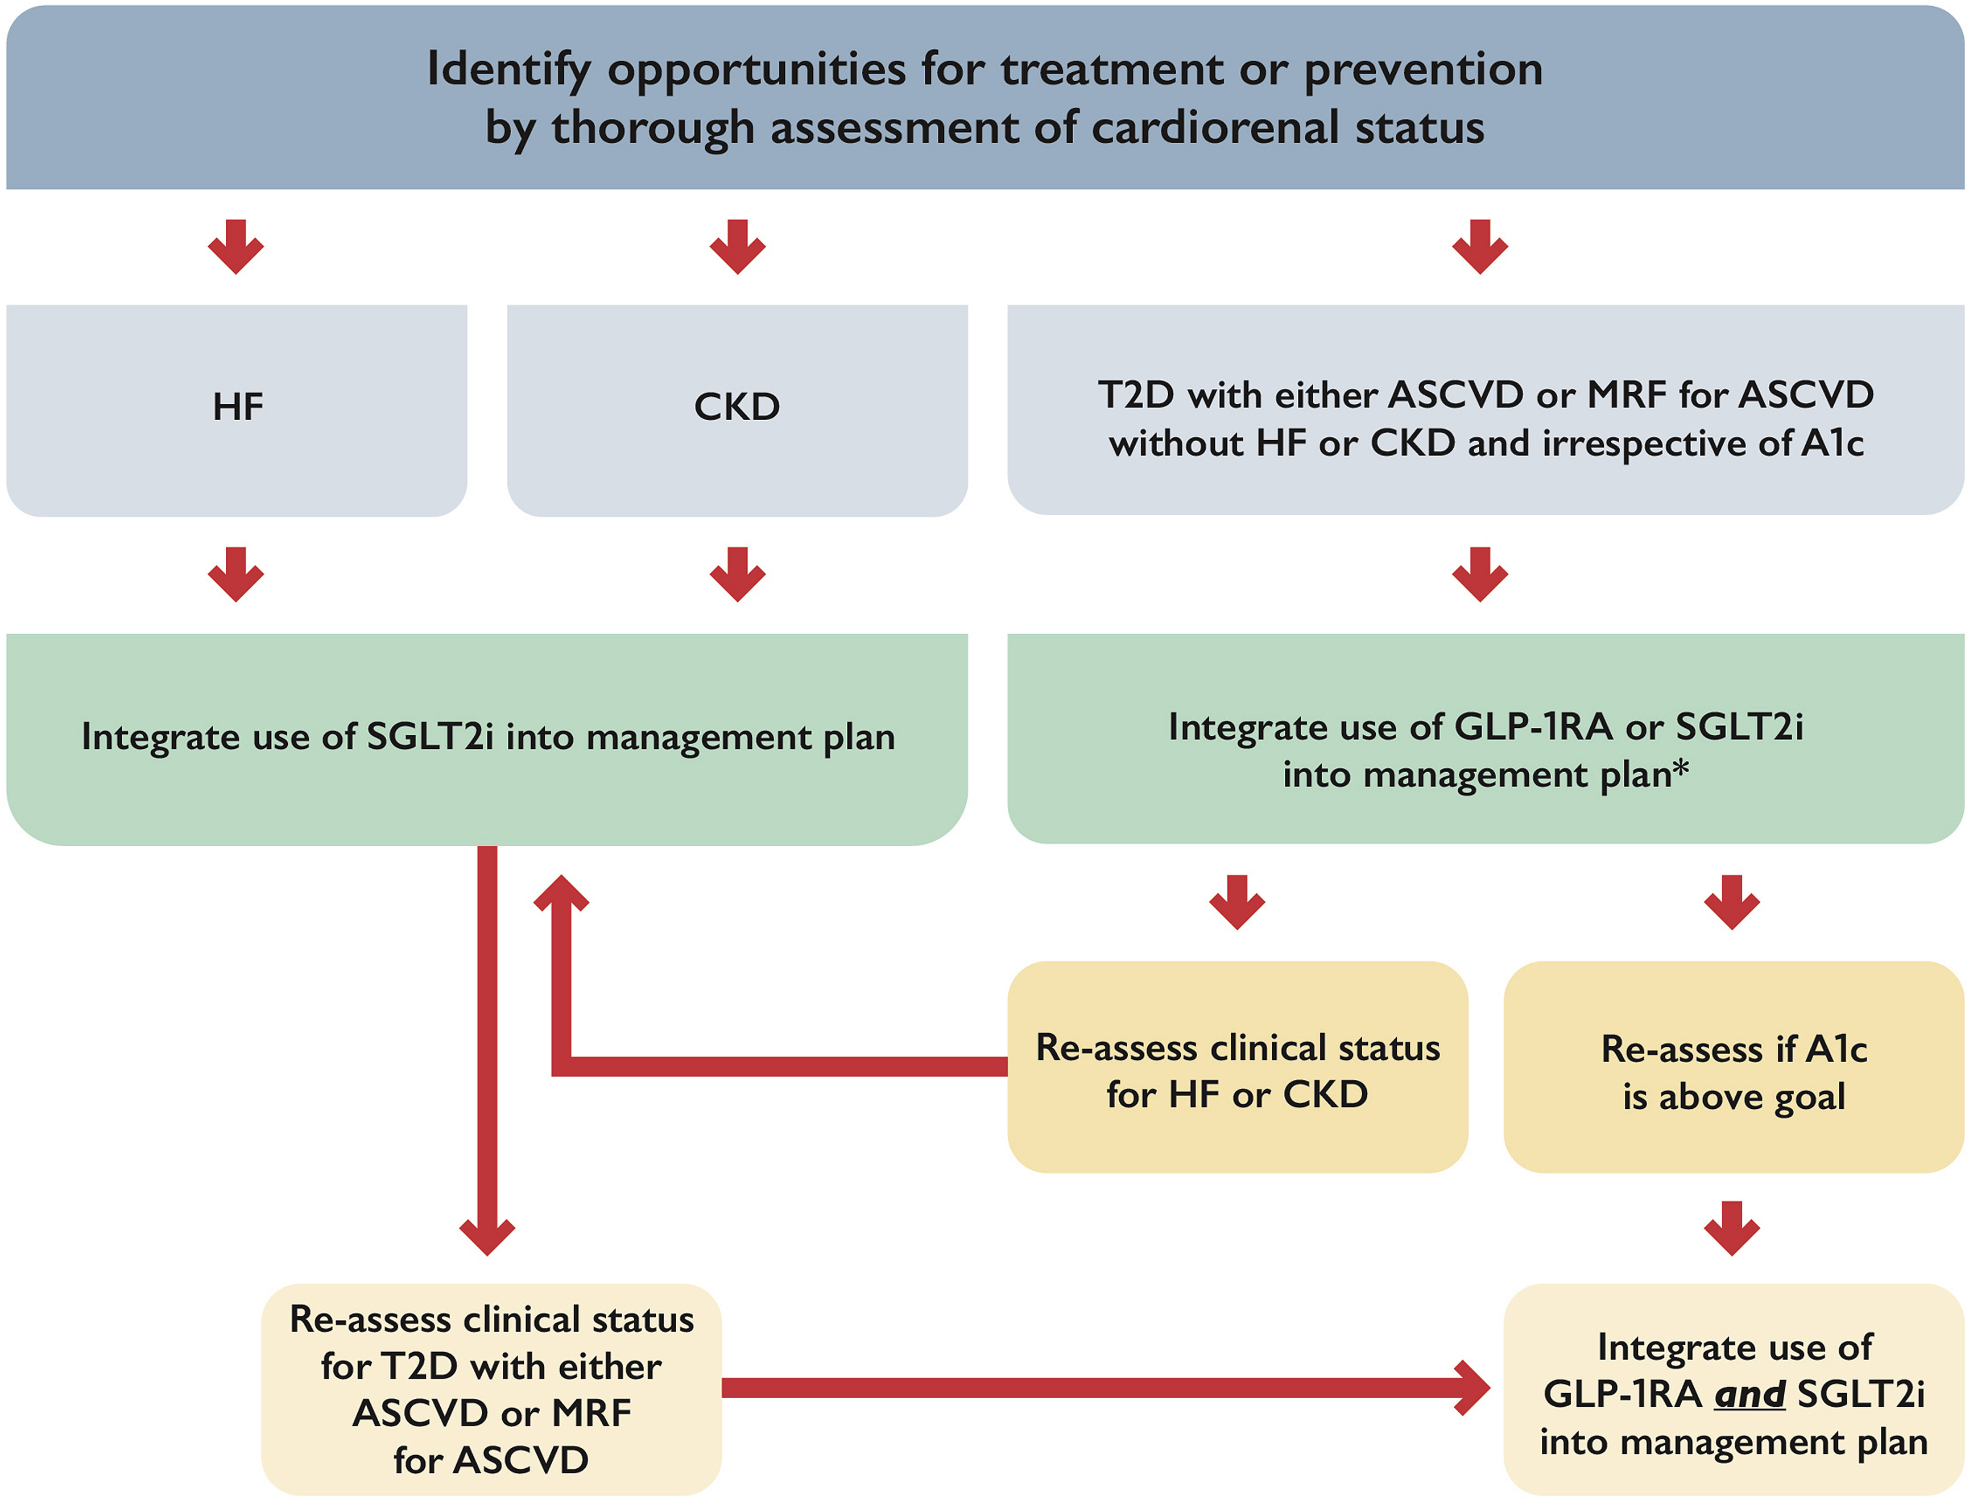

Figure 1
Notes:
Integration of glucagon-like peptide-1 receptor antagonists (GLP-1RA) and sodium-glucose co-transporter 2 inhibitors (SGLT2i) into cardiovascular practice. ASCVD, atherosclerotic cardiovascular disease; CKD, chronic kidney disease; HF, heart failure; MRF, multiple risk factors; T2D, type 2 diabetes. ∗ In patients with high stroke risk, or history of transient ischemic attack/stroke, consider initial integration of GLP-1RA into management plan followed by integration of SGLT2i on the basis of changes in heart failure or kidney status or for further glycosylated hemoglobin (A1c)-lowering.

Slide 28
CV Outcomes According to Baseline UACR
Myocardial Infarction
Hospitalization for HF
10
>34 mmol/mol
8
> 34 mmol/mol
3.4-34
mmol/mol
6
3.4-34 mmol/mol
2-year Kaplan-Meier Estimates (%)
1.1-3.3
mmol/mol
4
1.1-3.3
mmol/mol
2
<1.1 mmol/mol
<1 mmol/mol
0
0
180
360
540
720
900
0
180
360
540
720
900
Time from randomization (days)
Time from randomization (days)
Notes:
Objective:
To evaluate whether UACR offers incremental prognostic benefit beyond risk factors and established plasma cardiovascular biomarkers.
Design, Setting, and Participants:
The Saxagliptin Assessment of Vascular Outcomes Recorded in Patients With Diabetes Mellitus-Thrombolysis in Myocardial Infarction (SAVOR-TIMI) 53 study was performed from May 2010 to May 2013 and evaluated the safety of saxagliptin vs placebo in patients with type 2 diabetes with overt cardiovascular disease or multiple risk factors. Median follow-up was 2.1 years (interquartile range, 1.8-2.3 years).
Main Outcomes and Measures:
Baseline UACR was measured in 15 760 patients (95.6% of the trial population) and categorized into thresholds.
Results:
Of 15 760 patients, 5205 were female (33.0%). The distribution of UARC categories were: 5805 patients (36.8%) less than 10 mg/g, 3891 patients (24.7%) at 10 to 30 mg/g, 4426 patients (28.1%) at 30 to 300 mg/g, and 1638 patients (10.4%) at more than 300 mg/g. When evaluated without cardiac biomarkers, there was a stepwise increase with each higher UACR category in the incidence of the primary composite end point (cardiovascular death, myocardial infarction, or ischemic stroke) (3.9%, 6.9%, 9.2%, and 14.3%); cardiovascular death (1.4%, 2.6%, 4.1%, and 6.9%); and hospitalization for heart failure (1.5%, 2.5%, 4.0%, and 8.3%) (adjusted P < .001 for trend). The net reclassification improvement at the event rate for each end point was 0.081 (95% CI, 0.025 to 0.161), 0.129 (95% CI, 0.029 to 0.202), and 0.056 (95% CI, -0.005 to 0.141), respectively. The stepwise increased cardiovascular risk associated with a UACR of more than 10 mg/g was also present within each chronic kidney disease category. The UACR was associated with outcomes after including cardiac biomarkers. However, the improvement in discrimination and reclassification was attenuated; net reclassification improvement at the event rate was 0.022 (95% CI, -0.022 to 0.067), -0.008 (-0.034 to 0.053), and 0.043 (-0.030 to 0.052) for the primary end point, cardiovascular death, and hospitalization for heart failure, respectively.
Conclusions and Relevance:
In patients with type 2 diabetes, UACR was independently associated with increased risk for a spectrum of adverse cardiovascular outcomes including MI and hHF.

Slide 29
BD
65 yo male, DM 2012
  April 2022 –Non-STEMI PCI to LAD
Meds
  Degludec x x 22
  Metformin 1 g bid
  Ramipril 10/Rosuvastatin 10 mg od/ASA/Clopidogrel/Amlodipine
Followed by Cardiology,
walks dog 1 hour daily

Slide 30
BD
O/E
  Wt 103 kg, BMI 35
  BP 134/80
  Reuse injection sites – lipohypertrophy
A1C – 11.0, Cr 92, MAU 32 ACR 3.4

Slide 31
BD
SGLT-2 Inh
Then GLP-1 Agonist
Or
GLP-1 Agonist
Then SGLT-2 Inh

Slide 32
BD
What if his A1C was 6.5?

Slide 33
-lowering medication that also reduces
Lesson # 1
Our paradigm shift for SGLT-2is and GLP-1 RAs with proven benefits in CVD patients with diabetes:
A1c
risk

Slide 34
-lowering medication that also reduces
Lesson # 2
Use Cardio-protective medications independent of A1C for high risk patients
A1c
risk

Slide 35
Question
Which of the following diabetic medications is least likely to maintain benefit on A1C after 5 years?
DPP IV Inh
Lantus
Gliclizide MR
Liraglutide
Notes:
Correct answer: C

Slide 36

Original Article
Glycemia Reduction in Type 2 Diabetes — Glycemic Outcomes
The GRADE Study Research Group
N Engl J Med
Volume 387(12):1063-1074
September 22, 2022

Slide 37
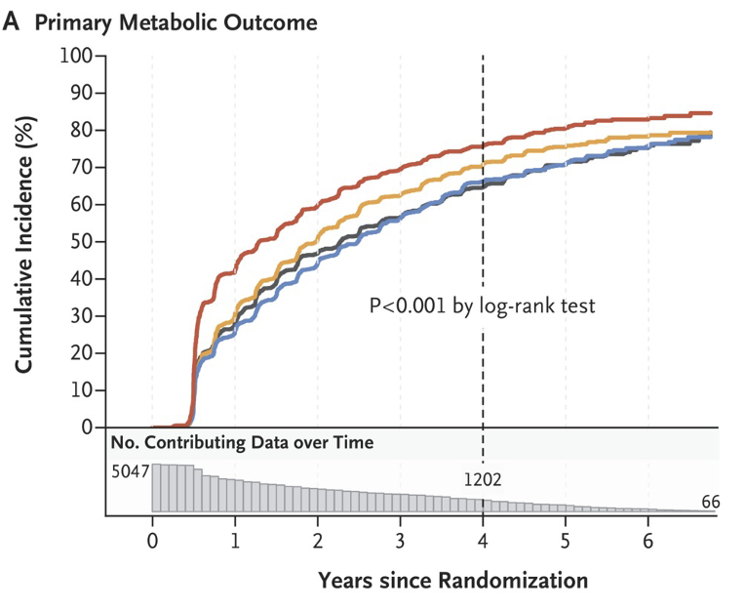

Slide 38
Lesson #3
Metformin is first line

Slide 39
Lesson #3
Metformin is first line
There is no ”BEST” second line therapy
Individualize Therapy

Slide 40
RL
38 yo male, Developmentally Delay, attended with worker,
Type 2 DM x 10 yrs
Meds –
  Gliclizide MR 60 mg bid
  Basaglar 40 u bid
  Metformin 500 mg qid
  Canagloflozin 300 mg od
  Saxagliptin 5 mg od
  Rosuvastatin 20 mg hs
  Ramipril 5 mg bid

Slide 41
RL
Difficulty monitoring meds administration
Tests infrequently
O/E Wt 104 kg, BP 123/76
A1C 8.5
Cr 85, LDL 3.1
? Recommendations

Slide 42
RL - Recommendations
Diabetes Once Daily – DOD
  Sitagliptin/Metformin 50/1000mg bid
  Basaglar 40 u BID
  Gliclizide MR 120 od
  Canagloflozin 300 mg od
  Rosuvastatin 20 mg hs
  Ramipril 10 mg od
  Test od – supervised

Slide 43
RL - Recommendations
Diabetes Once Daily – DOD
  Sitagliptin/Metfomrin XR 50/1000mg x 2
  Tresiba/Toujeou300 80 u acBr
  Gliclizide MR 120 od
  Canagloflozin 300 mg od
  Rosuvastatin 20 mg acBr
  Ramipril 10 mg od
  Test od – supervised
  Next Step - Ozempic

Slide 44
Lesson #4
Diabetes Once Daily

Slide 45
WA
72 yo male
  Type 1 DM – a1c- 7.0-7.5 over past 10 years
CAD - PCI 2021, EF > 55%
Diabetic Nephropathy
Lantus 20 u acBr
Humalog – 2-4 u prn with meals
ASA/Rosuvastatin/Ramipril
A1C 6.9 , Cr 120, ACR 19.6, LDL 1.3
Recommendations

Slide 46
WA
C-peptide – 675, random glu 6.9
Diagnosis – Type 2 Diabetes
Recommendation
  Jardiance 10 mg od
  Ozempic - wean off lantus

Slide 47
DP
77 yo female, DM 1990, insulin x 32 years
Current Meds:
  Rosuvastatin 20 mg 1 time daily Candasartan 8 mg 1 time daily
  NovoMix 30 Penfill U-100 38 x 28 x
  Recurrent lows hs, nocturnal
  acBr 12-14, hs 4-8

Slide 48
DP
O/E wt – 111 kg, BP-118/65
Inj sites - reused
A1C 8.2
Cr 85, LDL 1.7
No ACR
Recommendations

Slide 49
DP
Stop Novomix 30 – TDD 66 units ( 43 u NPH – 23 u NR)
  Reduce basal by 20%
Degludec 28 insulin aspartate 8 8 8, CF 1:2 target 8

Slide 50
DP
Stop Novomix 30 – TDD 66 units ( 43 u NPH – 23 u NR)
  Reduce basal by 20%
Degludec 28 insulin aspartate 8 8 8, CF 1:2 target 8
3 months later
  C-peptide 1275
  A1C 8.9

Slide 51
DP
Stop Novomix 30 – TDD 66 units ( 43 u NPH – 23 u NR)
  Reduce basal by 20%
Degludec 28 insulin aspartate 8 8 8, CF 1:2 target 8
3 months later
  C-peptide 1275
  A1C 8.9
Recommendations?

Slide 52
DP
Stop Novomix 30 – TDD 66 units ( 43 u NPH – 23 u NR)
  Reduce basal by 20%
Tresiba 30 NR 8 8 8, CF 1:2 target 8
3 months later
  C-peptide 1275
  A1C 8.9
  Start Ozempic

Slide 53
Lesson #5 & #6
Identify patients on MDI insulin to start new agents
  C-peptide if needed
  Beneficial to Identify Super Responders

Slide 54
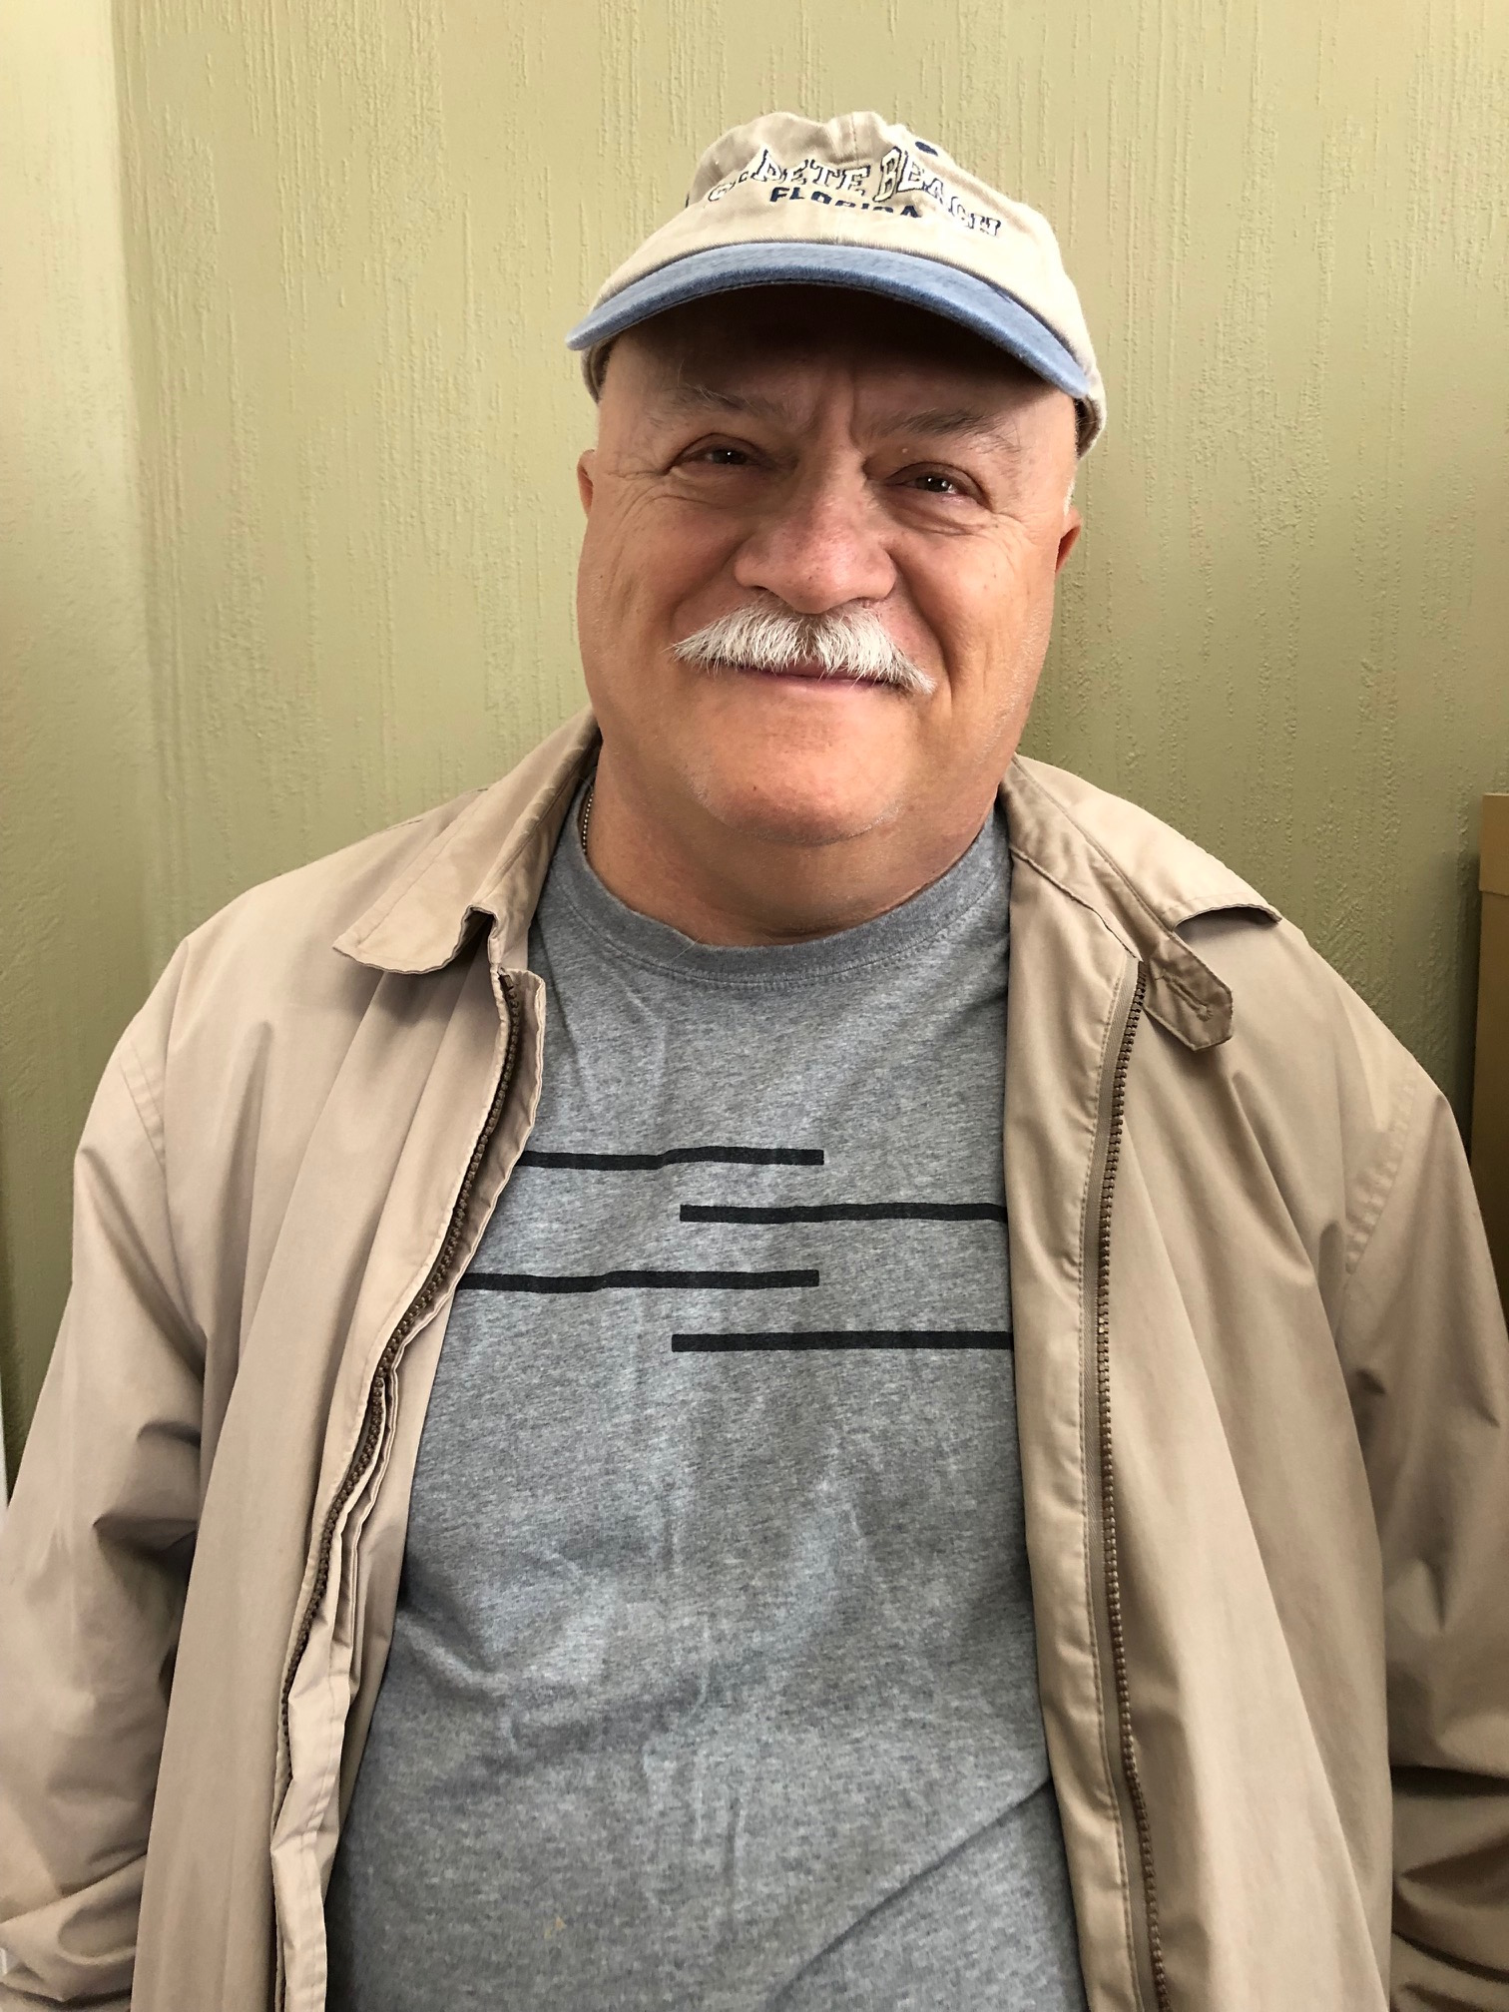
SN
62 yo male,
Type 2 DM x 22 years
Meds – Perindopril 8 mg od
  Amlodipine 10 mg od
  Metformin 500 mg bid
  Rosuvastatin 20 mg od
BP – 108/79
A1C – 6.6
Cr – 180, eGFR 30, MAU – 1961, ACR 246
What is his risk for dialysis?

Slide 55
SN
62 yo male,
Type 2 DM x 22 years
Meds – Perindopril 8 mg od
  Amlodipine 10 mg od
  Metformin 500 mg bid
  Rosuvastatin 20 mg od
  Insulin aspartate 10 u bid, Insulin Detemir 30 od
BP – 108/79
A1C – 6.6
Cr – 180, eGFR 30, MAU – 1961, ACR 246
5 year risk - 48%
If MAU neg – 7.5%
What can we do to prevent ESRD/Dialysis?

Slide 56
In DAPA-CKD and CREDENCE, the risk of kidney composite outcomes was reduced
DAPA-CKD^{1,a}
CREDENCE^{2,b}
Patients with CKD, with and without T2D
Patients with CKD and T2D
24
20
20
HR: 0.61
(95% CI: 0.51, 0.72)
HR: 0.70
(95% CI: 0.59, 0.82)
Placebo
15
Placebo
16
39%​
RRR
30%​
RRR
12
Cumulative incidence (%)
Patients with an event (%)
10
8
Dapagliflozin
5
Canagliflozin
4
0
0
0
4
8
12
16
20
24
28
32
0
6
12
18
24
30
36
42
No. at Risk
Months since randomization
No. at Risk
Months since randomization
Placebo
2152
1993
1936
1858
1791
1664
1232
774
270
Placebo
2199
2178
2132
2047
1725
1129
621
170
Dapagliflozin
2152
2001
1955
1898
1841
1701
1288
831
309
Canagliflozin
2202
2181
2145
2081
1786
1211
646
196
No direct comparison of efficacy can be made or is intended as study designs and populations differ in these two studies
Notes:
IMPORTANT slide
References:
Heerspink HJL, et al. Dapagliflozin in Patients with Chronic Kidney Disease. N Engl J Med. 2020;383:1436–1446.
Perkovic V, et al. Canagliflozin and Renal Outcomes in Type 2 Diabetes and Nephropathy.N Engl J Med. 2019;380:2295–2306.

Slide 57
Semaglutide: New or Worsening Nephropathy*
(SUSTAIN-6)
100
8
HR: 0.64
(95% CI, 0.46-0.88)
Events: 62 Semaglutide; 100 Placebo
P=0.005
Placebo
90
36%
6
80
70
4
60
Semaglutide
Patients with an event (%)
2
50
40
0
30
0
8
16
24
32
40
48
56
64
72
80
88
96
104
109
20
10
0
0
8
16
24
32
40
48
56
64
72
80
88
96
104
109
Weeks since randomization
No. at Risk
Semaglutide | 1,648 | 1,630 | 1,605 | 1,580 | 1,563 | 1,541 | 1,525
Placebo | 1,649 | 1,629 | 1,570 | 1,545 | 1,518 | 1,498 | 1,471
*New onset of persistent macroalbuminuria, or persistent doubling of serum creatinine level and creatinine clearance per MDRD <45 mL/min/1.73 m2, or the need
for continuous renal replacement therapy (in the absence of an acute reversible cause) or death due to renal disease.
Supplemental appendix to: Marso S, et al. N Engl J Med 2016; 375(19):1834-44
Notes:
In this study, 3,297 patients with type 2 diabetes on a standard-care regimen were randomized to receive once-weekly semaglutide (0.5 mg or 1.0 mg) or placebo for 104 weeks. This study was primarily a cardiovascular outcome study, but one of the prespecified secondary endpoints was the rate of new or worsening nephropathy, defined as new onset of persistent macroalbuminuria, or persistent doubling of serum creatinine level and creatinine clearance per MDRD <45 mL/min/1.73 m² or the need for continuous renal replacement therapy (in the absence of an acute reversible cause) or death due to renal disease.
For this endpoint, semaglutide was associated with a 36% risk reduction (hazard ratio 0.64, 95% CI 0.46 to 0.88, p=0.005).
It should be noted, however, that not all microvascular risk was lowered with semaglutide in this study. In fact, rates of retinopathy complications (vitreous hemorrhage, blindness, or conditions requiring treatment with an intravitreal agent or photocoagulation) were significantly higher with semaglutide compared to placebo (hazard ratio, 1.76; 95% CI, 1.11 to 2.78; p=0.02).
Reference:
Marso SP, Bain SC, Consoli A, et al. Semaglutide and Cardiovascular Outcomes in Patients with Type 2 Diabetes. N Engl J Med 2016; 375(19):1834-44 (including supplemental appendix).

Slide 58
SN
62 yo male,
Type 2 DM x 22 years
Meds – Perindopril 8 mg od
  Amlodipine 10 mg od
  Metformin 500 mg bid
  Rosuvastatin 20 mg od
  Insulin aspartate 10 u bid, Insulin Detemir 30 od
BP – 108/79
A1C – 6.6
Cr – 200, eGFR 25, MAU – 1961, ACR 246
What can we do to prevent ESRD/Dialysis?

Slide 59
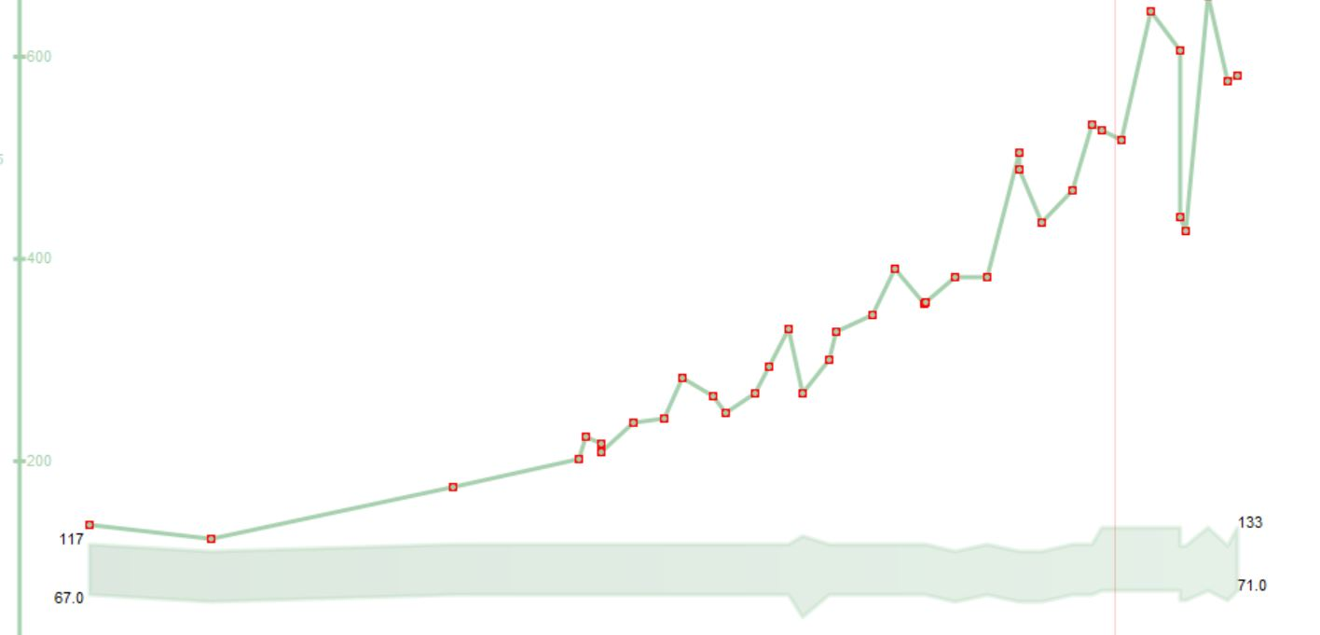
SN

Slide 60
Lesson # 7
Use SGLT-2 Inh. ESPECIALLY in the setting of CKD
Even in the absence of diabetes

Slide 61
RD
82 yo female, HT, no Diabetes
Recurrent hospitalizations for CHF
Echo - EF 58% , no valve dx, prev neg angios
Meds
- furosemide 40 mg od
- candesartan 16 mg od
- spironolactone 25 mg od
O/E – BP 136/72, HR 76
eGFR – 35, Mau ACR 13.2
Recommendations?

Slide 62

Primary results: CV death, hHF, or Urgent HF
30
DAPA | Placebo | HR (95% CI) | p-value²
16.3% | 21.2% | 0.74 (0.65-0.85) | 0.00001
25
Placebo
26%
RRR
20
DAPA 10 mg
Cumulative Incidence (%)
15
4.9% ARR
NNT=21
10
5
0
0
3
6
9
12
15
18
21
24
Months from Randomization
Number at Risk
DAPA 10 mg
2373
2305
2221
2147
2002
1560
1146
612
210
Placebo
2371
2258
2163
2075
1917
1478
1096
593
210
Notes:
References:
McMurray JJV, Solomon SD, Inzucchi SE, et al. for the DAPA-HF Committees and Investigators. Dapagliflozin in patients with heart failure and reduced ejection fraction. N Engl J Med. 2019;381:1995–2008.
McMurray J. DAPA-HF-The Dapagliflozin And Prevention of Adverse-outcomes in Heart Failure Trial [presentation]. Presented at: European Society of Cardiology Congress; August 31-September 4, 2019; Paris, France.

Slide 63



There are four foundational therapies for the treatment of patients with HFrEF^{1–3}
As highlighted in recent consensus papers and guidelines from:
ACEi/
ARNI
Beta
blocker
MRA
SGLT2i
ACEi, angiotensin-converting enzyme inhibitor; ARNI, angiotensin receptor–neprilysin inhibitor; HFrEF, heart failure with reduced ejection fraction; MRA, mineralocorticoid receptor antagonist; SGLT2i, sodium-glucose co-transporter-2 inhibitor.
1. Maddox TM et al. J Am Coll Cardiol. 2021;77:772; 2. McDonald M et al. Can J Cardiol. 2021;37:531; 3. McDonagh TA et al. Eur Heart J. 2021;42:3599.
63

Slide 64
Figure 1
Notes:
Integration of glucagon-like peptide-1 receptor antagonists (GLP-1RA) and sodium-glucose co-transporter 2 inhibitors (SGLT2i) into cardiovascular practice. ASCVD, atherosclerotic cardiovascular disease; CKD, chronic kidney disease; HF, heart failure; MRF, multiple risk factors; T2D, type 2 diabetes. ∗ In patients with high stroke risk, or history of transient ischemic attack/stroke, consider initial integration of GLP-1RA into management plan followed by integration of SGLT2i on the basis of changes in heart failure or kidney status or for further glycosylated hemoglobin (A1c)-lowering.

Slide 65
Lesson # 8
SGLT2 Inhibitors clearly indicated for
- CHF – Reduced and Preserved
- CKD with with or without significant Proteinuria
In Diabetics and Non-Diabetics

Slide 66
Lesson # 8
SGLT2 Inhibitors clearly indicated for
- CHF – Reduced and Preserved
- CKD with with or without significant Proteinuria
In Diabetics and Non-Diabetics
GLP-1 Agonists/Semmaglutide
- reduces vascular events in Diabetics with CVD
- reduces vascular events in obese non-DM with CVD
- probably reduces renal outcomes in DM nephropathy
- improves symptoms in HFpEF obese non-diabetics

Slide 67
The Motivational Speech
“This is a diabetic medication that helps protect the kidneys/heart”

Slide 68
The Motivational Speech
“This is a diabetic medication that helps protect the kidneys/heart”
“This is a kidney/heart protection medication that helps the diabetes”

Slide 69
CM
63 yo female
  CVA 2016
  CAD with MI 2020 – PCI LAD
  CHF with EF 38%, NYHA Class 2
  DM – A1C 9.0
Meds – Bisoprolol/ Spiro/Candasartan/Lasix
- Linagliptin 5 mg od/Metformin 500 bid/Gliclizide MR 120
Prev intolerance to Semmaglutide (0.25 mg x 2 weeks – ER - N& V)
Stopped Dapagliflozin 10 mg 1 month ago due to recurrent GM1 and polyuria
? Recommendations

Slide 70
Practical tips: Genital mycotic infections (GMIs)
Uncomplicated
  (Healthy, non-pregnant, <3 inf/year, mild/mod symptoms)
  Fluconazole 150 po single dose
Complicated
  Severe signs, > 3/ year, poorly controlled DM, immunocompromised
  Fluconazole 150 mg po q 3 days , 2-3 doses
    +/1 clotrimazole/betamethasone x 48 hrs
    Or Topicals – 7-14 days
Recurrent – >3 year
  Fluconazole 150 mg po q 72 hrs x 3, then once weekly x 6 months

Slide 71

Ozempic Micro-Dosing
There are many “clicks” between the marked doses on the Ozempic pen. There are 18 “clicks” between 0 and 0.25mg and 18 “clicks” between 0.25mg and 0.5mg. On the 1mg pen there are 74 “clicks” between 0 and 1mg.
Use ____ clicks once a week and if tolerating well, continue to increase by ____ clicks every _____ weeks, until at the recommended dose of ______mg once weekly.
Once you are on a dose of 0.25 mg weekly, please discontinue your ___________ (Onglyza/Trajenta/Januvia)

Slide 72
sdcrc.ca

Slide 73
Peri-procedural Issues
Risk of DKA
Hold SGLT2 x 2 days/Metformin/Diuretics ? day before procedure ( or day of) and restart when eating/drinking
Not an Inpatient drug
Euglycemic DKA
  Precipitants
    Major surgery
    Bariatric surgery
    Insulin reduction
    Fasting/low CHO diet
    EtOH ‘ic
Hold Ozempic 1-2 weeks before GA/Surgery

Slide 74

Just because you can do something doesn’t mean you should….

Slide 75
Don’t use SGLT-2 Inh with
Type 1 diabetes
Hx DKA/Pancreatic Insufficiency/Pancreatic resection
  Unless you have a c-peptide
eGFR < 20
Frail elderly – unless you are treating CHF/CKD
  replaces some diuretics

Slide 76
Lesson # 9
Management of common side effects required for long-term success

Slide 77
DS
63 yo female, DM, MI 2 years ago
Meds – Empagloflozin 25 mg od , Semmaglutide 1.0 mg q weekly ASA/Ramipril/Rosuvastatin/Metformin
GMI q 2 months treated with Fluconazole 150 mg po prn
A1C – 7.0
What if her husband lost his job and the drug plan they shared?

Slide 78


Slide 79
The Motivational Speech
Indication is for CV/Renal Protection
  – 30% mortality reduction
  35% reduction CHF
  30-50% reduction Kidney Failure
Benefits
  Glucose/Wt/BP
Downside
  GMI
  polyuria

Slide 80
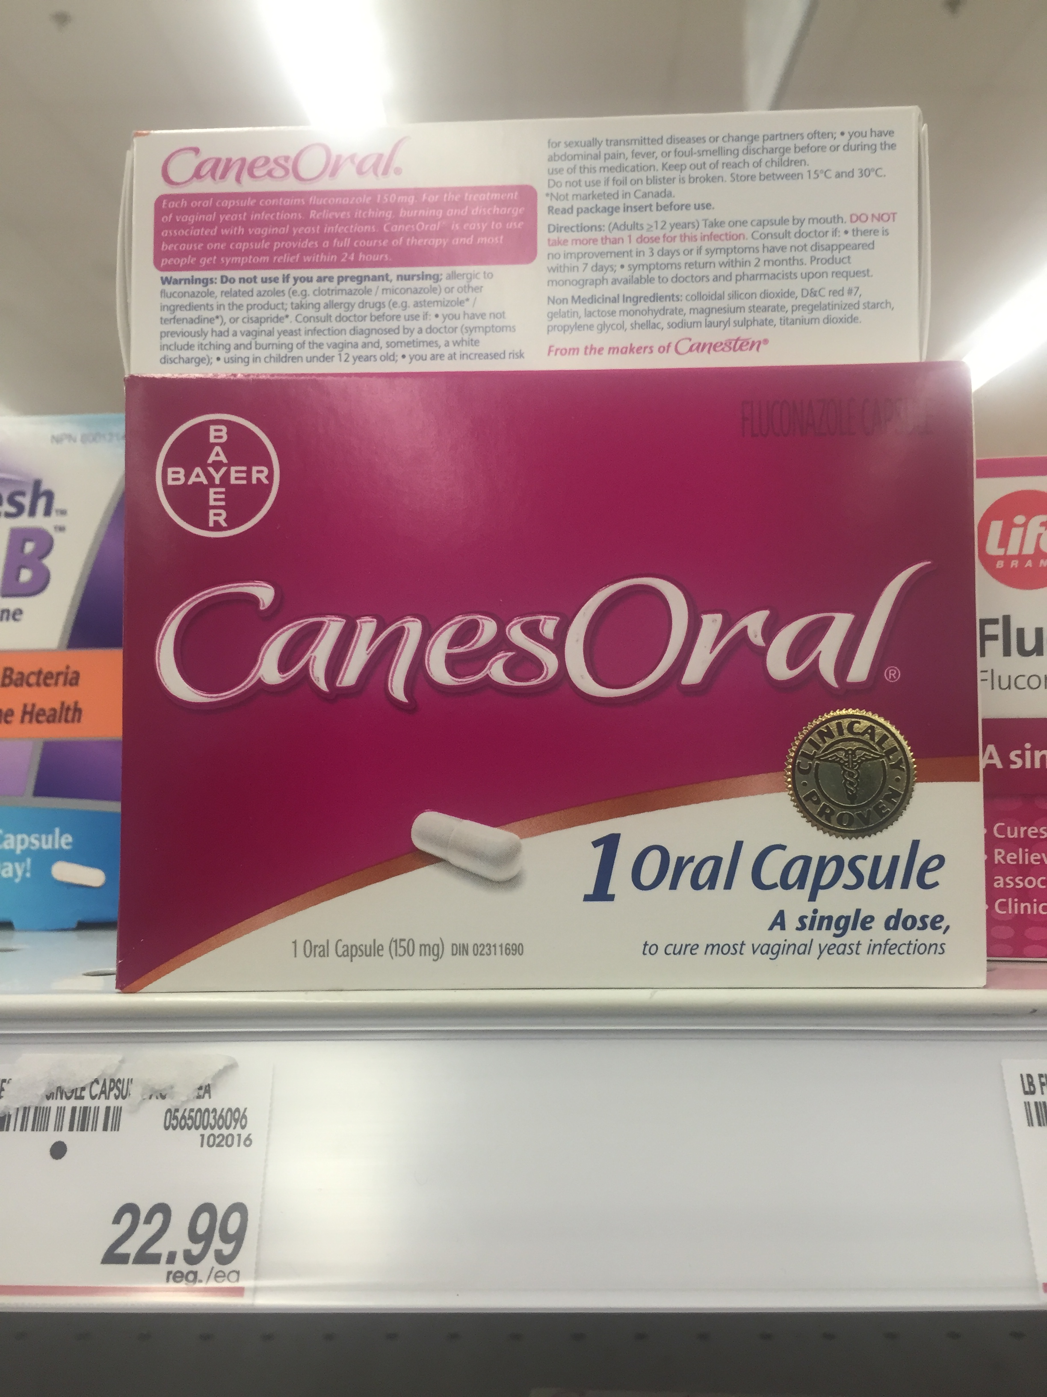
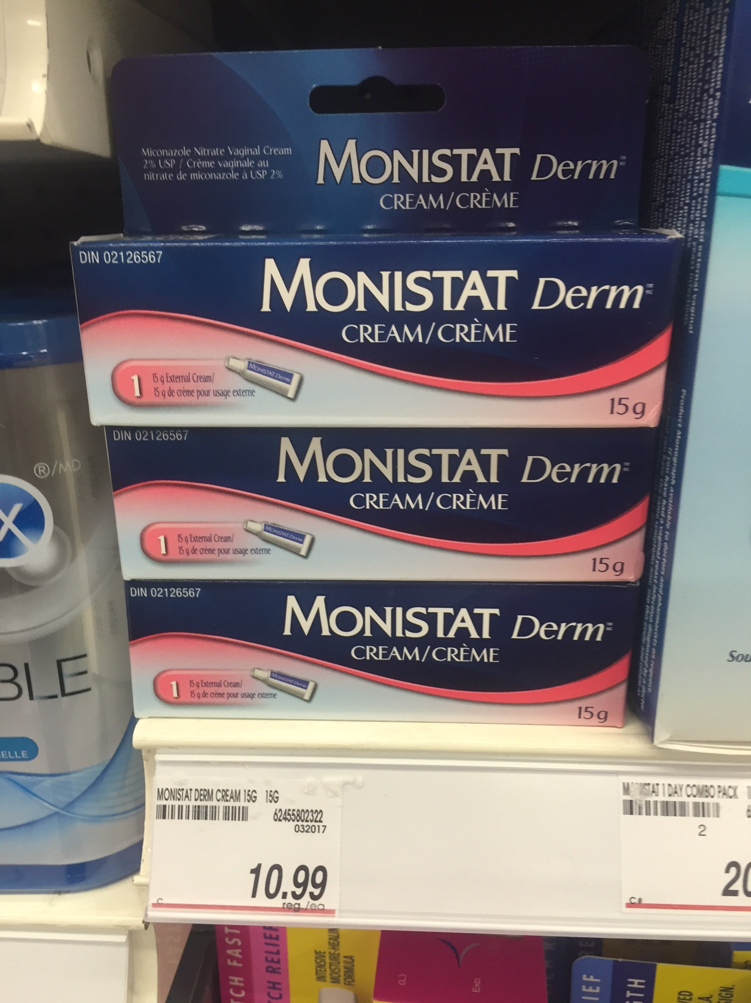
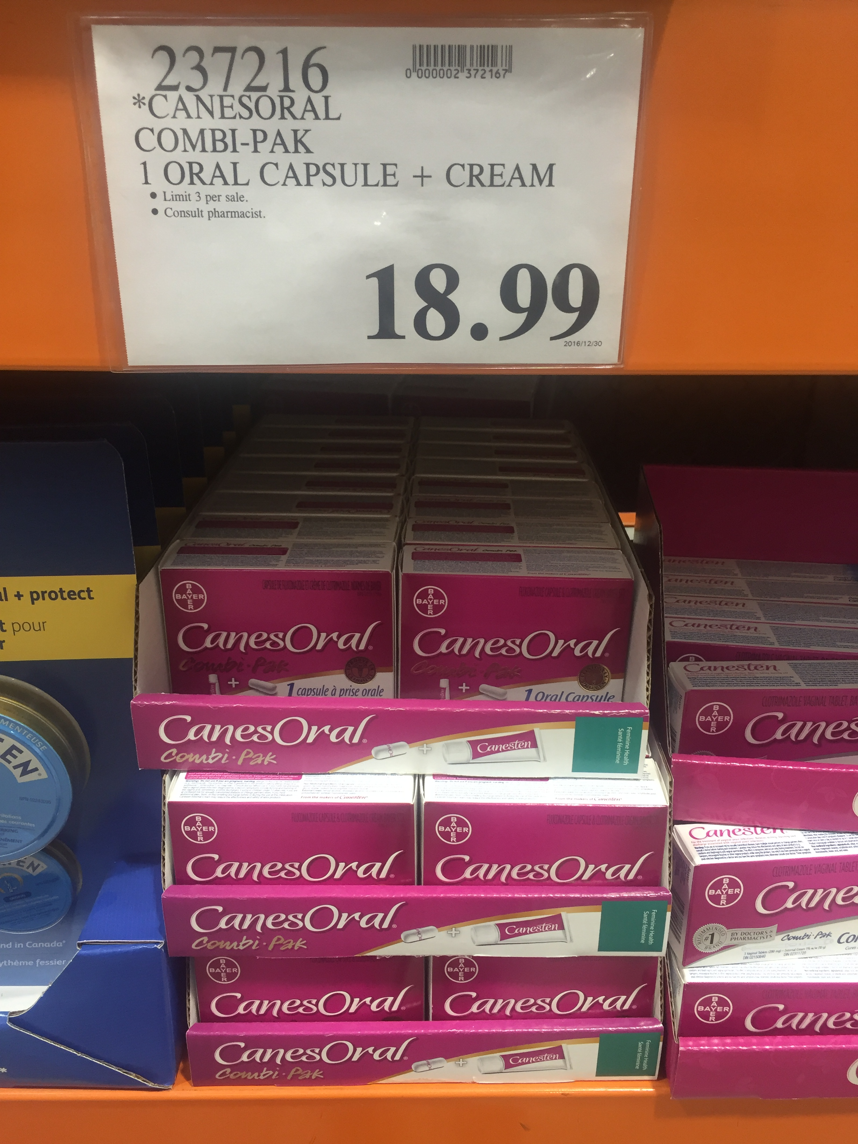
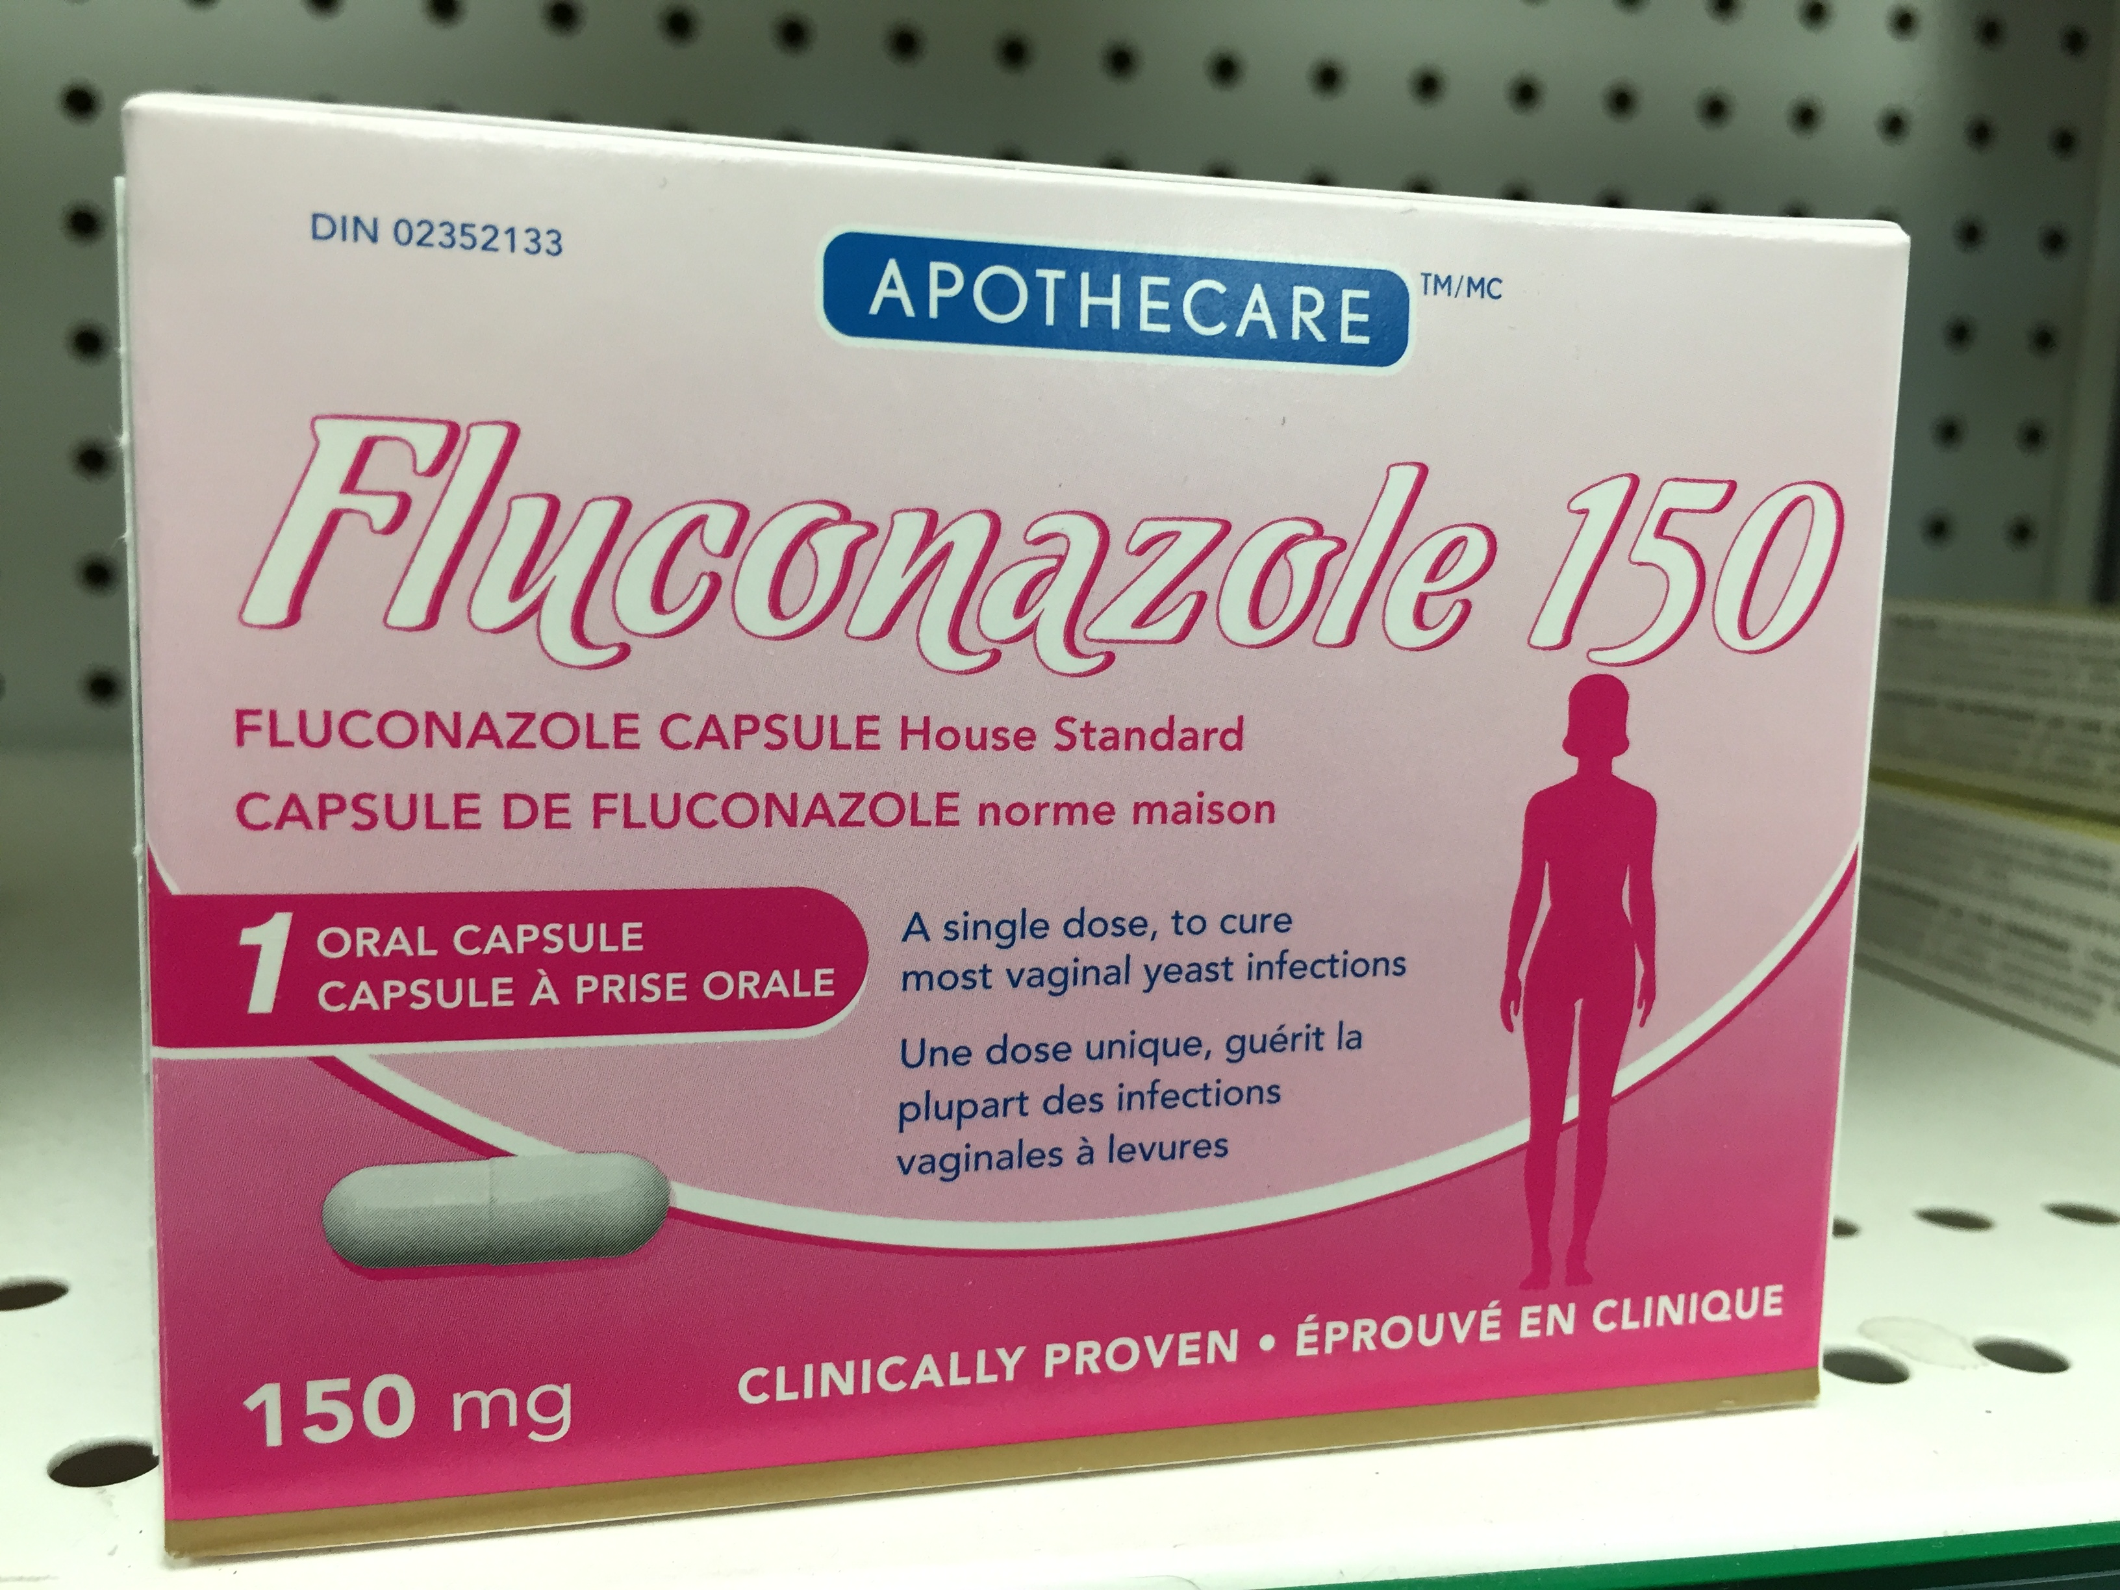
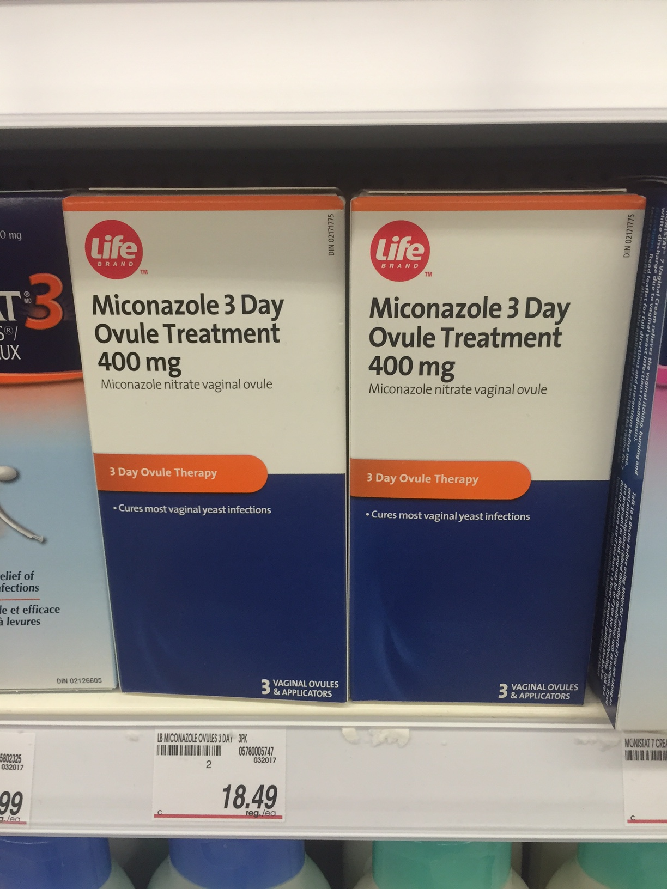
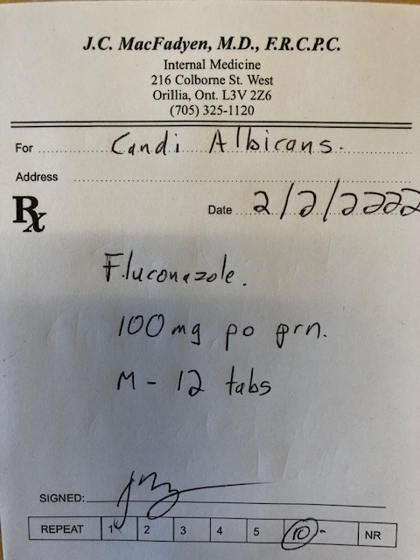
Which treatment is the most cost-effective for GMI?

Slide 81
Which treatment is the most cost-effective for GMI?
$ 10.99

Slide 82
Reducing Costs
Pharma Programs
Trillium Application
Office Samples
Ozempic – Cost 1 mg pen = 0.5 mg pen
  36 clicks = 0.5 mg ow = cost of DPP-IV Inh/SGLT2 Inh
  = 60 units basaglar insulin
Jardiance – ½ of 25 mg tablet
  Synjardy 12.5/500 mg od
Forxiga - generic
Admelog/Trurapi/Basaglar
Crestor ½ tab 40 mg
Different Pharmacy

Slide 83


Your Choice – $0.40/day
Dapagliflozin

Slide 84
Lesson # 10
Strategies to reduce patient costs will increase utilization of cardio-protective agents

Slide 85
MS
Type 2 – max oral agent and A1C 9.6
Does not want to start injection therapy
  “ I gave insulin to my grandmother and it felt very cruel”

Slide 86
MS
Type 2 – max oral agent and A1C 9.6
Does not want to start injection therapy
  “ I gave insulin to my grandmother and it felt very cruel”
  Recommendations?

Slide 87

Insulin Injection Demonstration

Slide 88

? Size of the Needle ?

Slide 89
Lesson #11
Self – demonstration of injections will breakdown barriers

Slide 90
Lesson #12
Use of CGMS improves clinical decisions

Slide 91
BD
55 yo male
Type 2 x 10 years
Meds
  Ozempic 1.0
  Tresiba 100 u od
  Metformin 1 g bid
  Diamicron MR 120 bid
  Jardiance 10 mg od
  Refuses MDI
PMX –
  TIA
A1C – prev. 12.8
- recent 8.9
eGFR - 45
ACR – 42

Slide 92
BD
55 yo male
Type 2 x 10 years
Meds
  Ozempic 1.0
  Tresiba 100 u od
  Metformin 1 g bid
  Diamicron MR 120 bid
  Jardiance 10 mg od
  Refuses MDI
PMX –
  TIA
A1C – prev. 12.8
- recent 8.9
eGFR - 45
ACR – 42
What do you say to him in office visit?

Slide 93
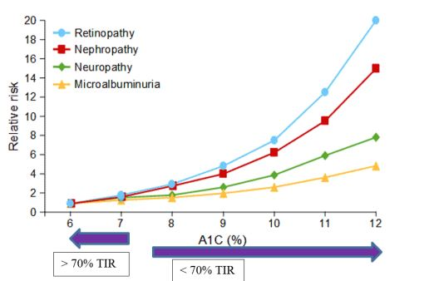

Slide 94
13%

Slide 95
13%
3%

Slide 96
Lesson #13
Going from very crappy to sort of crappy sugars is more beneficial than from going from good to outstanding sugars

Slide 97
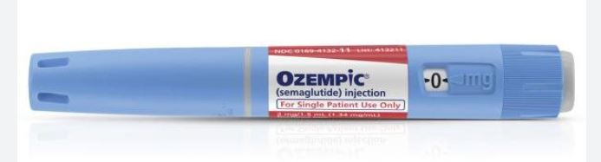
Ozempic Issues

Slide 98


Slide 99
Shortages
Due to
Global supply issues
# scripts for 2 mg dose ( ? 0.5 mg x 4 = 2 mg ow)
Off label use for wt. loss

Slide 100

do not start new patients on these drugs that are in shortage, unless there are no suitable alternatives and there’s a clinical reason to do so
consider prescribing an alternative drug for patients taking one of these drugs that are in shortage, as a continuous supply can’t be guaranteed
conserve the existing supply for patients who are stabilized and have no other treatment options

Slide 101
Ozempic Shortages Options
DO NOT USE OFF LABEL
DO NOT PRESCRIBE/DOUBLE UP A LOWER DOSE PEN
DO NOT START NEW PATIENTS
STOP OZEMPIC IF NO CLEAR A1C RESPONSE
For Glycemic control
- ½ dose of whatever they have
If Coverage/Expense - Consider
– Ryebulsis (or Victoza)
- Monjauro/Terzepetide – 2.5 mg ow if on < 1 mg
5.0 if on 1 mg or greater
- Trulicity/Dulaglutide,
- restart oral meds/insulin
CardioRenal Protection – Trulicity/Dulaglutide

Slide 102
sdcrc.ca

Slide 103

The Tale of Two Hipsters
Humalog
Admelog

Slide 104
Summary – Lessons Learned
These are Risk lowering medications that reduce A1C
Use Cardio-protective medications independent of A1C
Metformiis first line
  There is no ”BEST” second line therapy- individualize treatments
Diabetes Once Daily
Identify patients on MDI insulin to start new agents
  C-peptide if needed
Beneficial to identify Super-responders

Slide 105
Summary – Lessons Learned
Use SGLT-2 Inh. in the setting of CKD with proteinuria
SGLT 2 improves HFrEF, HFpEF, CKD with significant proteinuria outcomes in DM and Non-DM
Management of common side effects required for long-term success
Strategies to reduce patient costs will increase utilization of cardio-protective agents
Self – demonstration of injections will breakdown barriers
Use of CGMS improves clinical decisions
Going from very crappy to sort of crappy sugars is more beneficial than from going from good to excellent sugars.

Slide 106
1998
It doesn’t matter how you improve the A1C
It matters that you improve the A1C

Slide 107
2023
It doesn’t matter that you improve the A1C
,
It matters how you reduce the A1C

Slide 108
If you don’t feel comfortable with initiating these medications for individual patients,
Refer the patient on to someone who will.

Slide 109


Slide 110
Insert Applause Here

Slide 111


Slide 112
sdcrc.ca

