Slide 1

CHF Review 2024
NP Community of Practice
J.C. MacFadyen
MD, FRCPC, MHPE
JC MacFadyen MD FRCPC MHPE

Slide 2

Stefan, A 59-year-old Man with T2D and Heart Failure
Presentation
Presents for first regular follow-up appointment since before the pandemic
History
12-year history of T2D
Acute anterior MI 5 years ago
4-year history of symptomatic heart failure with reduced ejection fraction (HFrEF)
Other
Married, high school teacher
Family history of T2D (father, older brother)
T2D: type 2 diabetes; MI: myocardial infarction

Slide 3



Stefan: Physical Examination, Medications and Recent Investigations
BP 120/78 mmHg
Pulse 70 bpm
BMI 29 kg/m²
A1C: 6.7%
LDL-C: 1.7 mmol/L
TG: 1.0 mmol/L
eGFR: 53 mL/min/1.73 m²
UACR: 25 mg/mmol
Echocardiogram: LVEF 32%
Metformin 500 mg b.i.d.
Ramipril 10 mg/d
Spironolactone 25 mg/d
Bisoprolol 7.5 mg/d
ASA 81 mg/d Furosemide 40 mg od + 40 prn
A1C: glycated hemoglobin; BMI: body mass index; BP: blood pressure; bpm: beats per minute; eGFR: estimated glomerular filtration rate;
LDL-C: low-density lipoprotein cholesterol; LVEF: left-ventricular ejection fraction; TG: triglycerides; UACR: urinary albumin-creatinine ratio

Slide 4
Diabetes Canada 2020 Update
Key Recommendations for Patients with T2D and HF
ASCVD, CKD or HF or age > 60 with 2 CV risk factors
ADD or SUBSTITUTE AHA with demonstrated cardiorenal benefits
 |  | Established CV or renal disease |  |  | Risk factors
 |  | ASCVD | CKD | HF | > 60 years with CV risk factors
Lower risks observed in outcome trials | MACE | GLP1-RA or SGLT2i* | SGLT2i* or GLP1-RA |  | GLP1-RA
 | HHF | SGLT2i* | SGLT2i* | SGLT2i* (and lower CV mortality) | SGLT2i*
 | Progression of nephropathy | SGLT2i* | SGLT2i* |  | SGLT2i*
 |  | Grade A evidence | Grade B evidence | Grade C or D evidence | *Initiate only if eGFR >30mL/min/1.73m²
AHA: antihyperglycemic agent; ASCVD: atherosclerotic cardiovascular diseases; CKD: chronic kidney disease; CV: cardiovascular disease; GLP1-RA: glucagon-like peptide 1 receptor agonist; HF: heart failure; HHF: hospitalization for heart failure; MACE: major adverse cardiovascular events; SGLT2i: sodium glucose co-transporter 2 inhibitor.
Lipscombe L, et al. Can J Diabetes. 2020; 44:575-91.

Slide 5
2021 CCS Heart Failure Guidelines Update
HFrEF: LVEF ≤ 40% AND SYMPTOMS
Initiate Standard Therapies
ARNI or ACEi/ARB
Then substitute ARNI
BETA BLOCKER
MRA
SGLT2 INHIBITOR
Assess Clinical Factors for Additional Interventions
HR >70 bpm and sinus rhythm
Consider ivabradine*
Recent HF hospitalization
Consider vericiguat**
Black patients on optimal GDMT, or patients unable to tolerate ARNI/ACEi/ARB
Consider combination hydralazine-nitrates
Suboptimal rate control for AF, or persistent symptoms despite optimized GDMT
Consider digoxin
TREAT COMORBITITIES PER CCS HF RECOMMENDATIONS (INCL. AF, FUNCTIONAL MR, IRON DEF, CKD, DM)
DIURETICS TO RELIEVE CONGESTION (TITRATED TO MINIMUM EFFECTIVE DOSE TO MAINTAIN EUVOLEMIA)
NON-PHARMACOLOGIC THERAPIES (EDUCATION, SELF-CARE, EXERCISE)
Initiate standard therapies as soon as possible and titrate every 2-4 weeks to target or maximally tolerated dose over 3-6 months
ADVANCE CARE PLANNING AND DOCUMENTATION OF GOALS OF CARE
Reassess LVEF, Symptoms, Clinical Risk
NYHA III/IV, Advanced HF
or High-Risk Markers
LVEF ≤35%
and NYHA I-IV (ambulatory)
LVEF ≤35%
and NYHA I, and Low Risk
CONSIDER
Referral for advanced HF therapy (mechanical circulatory support/transplant)
Referral for supportive/palliative care
Refer to CCS CRT/ICD recommendations
Continue present management, reassess as needed
ACEI: angiotensin converting enzyme inhibitor; ARB: angiotensin receptor blocker; ARNI: angiotensin receptor-neprilysin inhibitor; CCS: Canadian Cardiovascular Society; CKD: chronic kidney disease;
CRT: cardiac resynchronization therapy; DM: diabetes mellitus; GDMT: guideline-directed medical therapy; ICD: implantable cardioverter defibrillator; LVEF: left ventricular ejection fraction;
MRA: mineralocorticoid receptor antagonist; NYHA:, New York Heart Association; SGLT2: sodium glucose transport 2
McDonald M, et al. Can J Cardiol 2021;37(4):531-46.

Slide 6
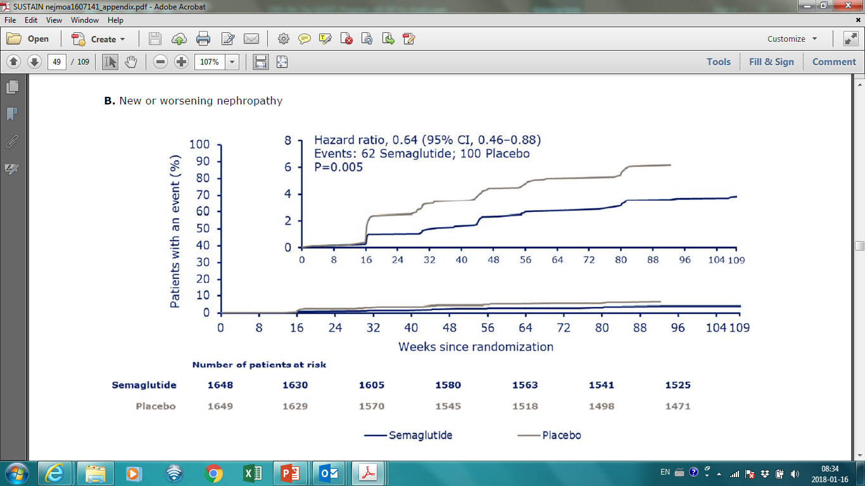
SGLT2 Inhibitors in HFrEF (DAPA-HF & EMPEROR-Reduced): Significant Reductions in the Primary Endpoints
Placebo
Dapa
Empa
DAPA-HF Primary Endpoint:
Worsening heart failure* or CV death¹
EMPEROR-Reduced Primary Endpoint:
HHF or CV death²
100
30
ARR
4.9%
100
RRR 25%
HR 0.75
(95% CI, 0.65-0.86)
p<0.001
Placebo
ARR
5.3%
RRR 26%
HR 0.74
95% CI, 0.65-0.85
p<0.001
Placebo
35
90
25
90
30
80
20
80
25
70
15
NNT (2 years): 20.4
70
20
NNT (~2.2 years): 18.9
60
15
Empagliflozin
10
60
10
Cumulative incidence (%)
Dapagliflozin
Estimated cumulative incidence (%)
50
5
50
5
40
0
40
0
Placebo
30
0
3
6
9
12
15
18
21
24
Placebo
30
0
90
180
270
360
450
540
630
720
810
20
20
Empagliflozin
10
Dapagliflozin
10
0
0
0
3
6
9
12
15
18
21
24
0
90
180
270
360
450
540
630
720
810
Months since randomization
Days since randomization
*Hospitalization or an urgent visit resulting in intravenous therapy for heart failure.
ARR: absolute risk reduction; CI: confidence interval; CV: cardiovascular; HFrEF: heart failure with reduced ejection fraction;
HHF: hospitalization for heart failure; HR: hazard ratio; NNT: number needed to treat; RRR: relative risk reduction.
1. McMurray JJ, et al. N Engl J Med. 2019; 381(21):1995-2008; 2. Packer M, et al. N Engl J Med. 2020; 383(15):1413-24.

Slide 7
Sacubitril/Valsartan in HFrEF (PARADIGM-HF) : Significant Reduction in the Primary Endpoint
Placebo
Dapa
Empa
Enalapril
LCZ696
PARADIGM-HF Primary Outcome Composite of CV death & HHF
1.0
0.6
RRR 20%
HR 0.80
95% CI, 0.73-0.87
p<0.001
0.5
0.4
ARR
4.7%
Enalapril
Cumulative Probability
0.3
NNT (~3.5 years): 21.3
0.2
LCZ696
0.1
0.0
0
180
360
540
720
900
1080
1260
Days since randomization
ARR: absolute risk reduction; CI: confidence interval; CV: cardiovascular; HFrEF: heart failure with reduced ejection fraction;
HHF: hospitalization for heart failure; HR: hazard ratio; NNT: number needed to treat; RRR: relative risk reduction.
McMurray JJ, et al. N Engl J Med 2014;371:993-1004.

Slide 8
Treatment Initiation: ARNi and SGLT2i in HFrEF
Step | ARNi (PARADIGM-HF)¹ | SGLT2i (DAPA-HF)² | SGLT2i (EMPEROR-Reduced)³
1 | If on ACEi: stop for 36h Start sacubitril/valsartan 24/26 mg BID x 2-4 weeks, watch BP, lytes, Cr | Dapagliflozin 10 mg od Assess renal function, watch lytes | Empagliflozin 10 mg od Assess renal function, watch lytes
2 | Increase sacubitril/valsartan to 49/51 mg BID x 2-4 weeks, watch BP, Lytes, Cr
3 | Increase sacubitril/valsartan to 97/103 mg BID watch BP, Lytes, Cr
Cost⁴ | $7.40 / day ($3.70 / tab) | $2.73 / day | $2.74 / day
ACEi: angiotensin-converting enzyme inhibitor; ARNi:angiotensin receptor-neprilysin inhibitor; BID: twice daily; Cr: creatinine; od: once daily
1. McMurray JJ, et al. N Engl J Med 2014; 371:993-1004; 2. McMurray JJ, et al. N Engl J Med 2019; 381(21):1995-2008;
3. Packer M, et al. N Engl J Med 2020; 383(15):1413-24; 4. Costs vary by province and by supplier; Source for these data: Ontario Drug Formulary online : https://www.formulary.health.gov.on.ca/ Accessed March 25, 2022.

Slide 9
What if Stefan did not have T2D (but did have HFrEF) and was on ACEi, BB & MRA?
Would your recommendation be any different? How and Why?
ACEi: angiotensin-converting enzyme inhibitor; BB: beta-blocker; HFrEF: heart failure with reduced ejection fraction; MRA: mineralocorticoid receptor antagonist; T2D: type 2 diabetes

Slide 10
Recommendations from the HFrEF Guidelines
Remain the Same Regardless of Diabetes Status
HFrEF: LVEF ≤ 40% AND SYMPTOMS
Initiate Standard Therapies
ARNI or ACEi/ARB
Then substitute ARNI
BETA BLOCKER
MRA
SGLT2 INHIBITOR
Assess Clinical Factors for Additional Interventions
HR >70 bpm and sinus rhythm
Consider ivabradine*
Recent HF hospitalization
Consider vericiguat**
Black patients on optimal GDMT, or patients unable to tolerate ARNI/ACEi/ARB
Consider combination hydralazine-nitrates
Suboptimal rate control for AF, or persistent symptoms despite optimized GDMT
Consider digoxin
TREAT COMORBITITIES PER CCS HF RECOMMENDATIONS (INCL. AF, FUNCTIONAL MR, IRON DEF, CKD, DM)
DIURETICS TO RELIEVE CONGESTION (TITRATED TO MINIMUM EFFECTIVE DOSE TO MAINTAIN EUVOLEMIA)
NON-PHARMACOLOGIC THERAPIES (EDUCATION, SELF-CARE, EXERCISE)
Initiate standard therapies as soon as possible and titrate every 2-4 weeks to target or maximally tolerated dose over 3-6 months
ADVANCE CARE PLANNING AND DOCUMENTATION OF GOALS OF CARE
Reassess LVEF, Symptoms, Clinical Risk
NYHA III/IV, Advanced HF
or High-Risk Markers
LVEF ≤35%
and NYHA I-IV (ambulatory)
LVEF ≤35%
and NYHA I, and Low Risk
CONSIDER
Referral for advanced HF therapy (mechanical circulatory support/transplant)
Referral for supportive/palliative care
Refer to CCS CRT/ICD recommendations
Continue present management, reassess as needed
ACEI, angiotensin converting enzyme inhibitor; ARB, angiotensin receptor blocker; ARNI, angiotensin receptor-neprilysin inhibitor; CCS, Canadian Cardiovascular Society;
CKD, chronic kidney disease; CRT, cardiac resynchronization therapy; DM, diabetes mellitus; GDMT, guideline-directed medical therapy; ICD, implantable cardioverter defibrillator; LVEF, left ventricular ejection fraction; MRA, mineralocorticoid receptor antagonist; NYHA, New York Heart Association; SGLT, sodium glucose transport
McDonald M, et al. Can J Cardiol 2021;37(4):531-46.

Slide 11
DAPA-HF and EMPEROR-Reduced:
Diabetes or No Diabetes Subgroups
DAPA-HF¹
No significant difference in treatment effect observed for those with or without diabetes at baseline.
Characteristics | Dapagliflozin (n=2373) | Placebo (n=2371) | HR (95% CI) | HR (95% CI)
All Patients | 386/2373 | 502/2371 |  | 0.74 (0.65, 0.85)
T2D at baseline | 215/1075 | 271/1064 |  | 0.75 (0.63, 0.90)
No T2D at baseline | 171/1298 | 231/1307 |  | 0.73 (0.60, 0.88)
0.50
0.80
1.00
1.25
DAPA better
Placebo better
EMPEROR-Reduced²
Subgroup | Empagliflozin | Placebo | HR (95% CI) | HR (95% CI)
 | No. of patients with event / total no.
All Patients | 361/1863 | 462/1867 |  | 0.75 (0.65-0.86)
T2D at baseline | 200/927 | 265/929 |  | 0.72 (0.60-0.87)
No T2D at baseline | 161/936 | 197/938 |  | 0.78 (0.64-0.97)
0.125
0.25
0.5
1.00
2.0
4.0
8.0
CI: confidence interval; HR: hazard ratio; T2D: type 2 diabetes
1. McMurray JJ, et al. N Engl J Med 2019; 381(21):1995-2008.
2. Packer M, et al. N Engl J Med 2020; 383(15):1413-24.
Empagliflozin better
Placebo better

Slide 12
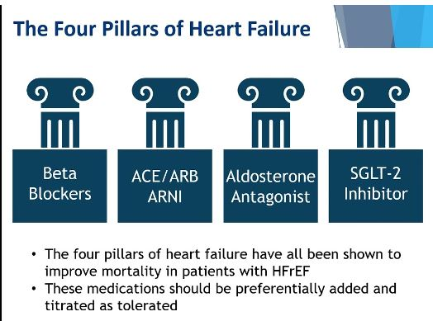

Slide 13
Diabetic Nephropathy
GLP1

Slide 14
SP
76 yo female
Ankle swelling x 3 months
No PND/Orthopnea/CP
? SOBOE
PMH – prev DM/HT/CABG 2015
  A flutter
  Lung Ca resection 2022
Meds
  Lipitor 40 mg od
  Rivaroxaban 20 od
  Lasix 20 mg prn
  Irbesartan 150 mg od –ON HOLD
O/E
  54 Kg
  BP- 139/86
  HR 94 sl irreg
  Chest – decr BS L base
  JVP 2-3 cm
  Mod bilat. ankle edema
Labs
  A1C 5.6
  Cr 78
  K+ 5.4
  ECH – A flutter 3:1 – 4:1 block
  NT ProBNP 436
Echo - ? Mild LVH, EF 65%
  Grade 2 Diastolic dysfunction

Slide 15
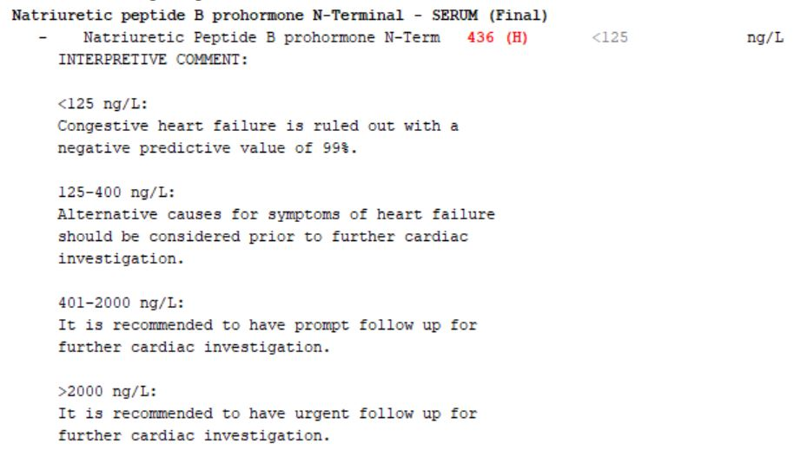

Slide 16
? Does she have CHF

Slide 17
The patient responds well to HF treatment
Treatment:
  Still on IV furosemide (40 mg BID)
  Weight declined by ~ 4 kg
  K⁺ 4.6 mmol/L
  Creatinine 125 μmol/L
Treatment modification:
Other medication changes include:
  Addition of spironolactone 25 mg OD
  Increase valsartan to 160 mg BID
  Addition of metoprolol 50 mg BID to control HR
  Addition of empagliflozin 10 mg OD
  Discontinuation of sitagliptin
  Discontinuation of HCTZ
  Discontinuation of diltiazem
BID, twice a day; HCTZ, hydrochlorothiazide; HR, heart rate; IV, intravenous; K+, potassium; OD, once a day

Slide 18
The New Universal Definition of Heart Failure Classifies the Different Phenotypes According to LVEF¹
Ejection fraction (EF)
≤40%
41–49%
≥50%
HF with reduced EF
(HFrEF)
HF with mildly reduced EF
(HFmrEF)
HF with preserved EF
(HFpEF)
HF with improved EF
(HFimpEF)
HF with a baseline LVEF ≤40%, a ≥10-point increase
from baseline LVEF, and a second measurement of LVEF >40%
Note that definitions have varied over time and clinical trials have used different inclusion thresholds
e.g., EMPEROR-Preserved used a threshold of LVEF > 40%²
HF, heart failure; LVEF, left ventricular ejection fraction.
1. Bozkurt B et al. Eur J Heart Fail. 2021;23:352; 2. Anker SD, et al. N Engl J Med. 2021; 385(16):1451-61.
Notes:
Speak to slide

Slide 19
In HFpEF, the Heart Does Not Fill Up Properly^{1,2}
HFrEF
HFpEF
Normal Heart
~50%
~50%
of HF cases
of HF cases*
Stretched and dilated walls
Stiff (and usually) thick walls
Left ventricle (LV)
Eccentric LV remodelling
Concentric LV remodelling
*Includes all HF with an EF >40%; HF with an EF ≥50% as defined on the previous slide accounts for ~40% of all HF cases.
EF: ejection fraction; HF: heart failure; HFpEF: heart failure with preserved ejection fraction; HFrEF: heart failure with reduced ejection fraction.
1. Groenewegen A, et al. Eur J Heart Fail. 2020; 22(8):1342–56; 2. Borlaug BA. Nat Rev Cardiol. 2020; 17(9):559–73.
Images by Servier Medical Art, licensed under Creative Commons Attribution 3.0, available at www.smart.servier.com.
Notes:
The left ventricle of a normal heart is shown at the left of the slide.
[ANIMATE]
~50% of HF cases are classified as heart failure with reduced ejection fraction (HFrEF), which is characterized by stretched and dilated walls. In HFrEF, there is eccentric left ventricular remodelling. The left ventricle fills with blood but is only able to pump up to 40% of its volume before refilling.
[ANIMATE]
In HFpEF, which accounts for approximately 40% of cases (~50% if you include ejection fractions in the mid-range (40-50% EF)), the primary characteristics are stiff and usually thick walls. There is concentric left ventricular remodelling. HFpEF is characterized by abnormal diastolic function: the increase in the stiffness of the left ventricle causes a decrease in left ventricular relaxation during diastole, with resultant increased pressure and/or impaired filling. So even if the ejection fraction is preserved, the stroke volume is reduced and is insufficient to meet the body’s demands.

Slide 20
Reasons to Investigate HFpEF in Your Practice
1
2
3
Prevalence
Burden
Undetected
>750,000
Canadians are living
with HF^{1,2}
50%
have EF > 40%³
50%
of HF hospitalizations
are for HFpEF⁴⁻⁸
up to 75%
5-year mortality rate⁹
>50%
are undiagnosed¹⁰
EF: ejection fraction; HF: heart failure; HFpEF: heart failure with preserved ejection fraction.
1. Heart and Stroke Foundation of Canada. Heart Failure. Online at https://www.heartandstroke.ca/heart-disease/conditions/heart-failure. Accessed November 29, 2021;
2. Public Health Agency of Canada. Report from the Canadian Chronic Disease Surveillance System: Heart Disease in Canada, 2018; 3. Borlaug BA. Nat Rev Cardiol. 2020 Sep;17(9):559–73; 4. Lenzen MJ, et al. Eur Heart J. 2004;25(14): 1214-20; 5. Mavrea AM, et al. Clin Interv Aging. 2015;10: 979-90; 6. Crespo-Leiro MG et al. Eur J Heart Fail. 2016;18(6): 613-25; 7. Oktay AA, et al. Curr Heart Fail Rep. 2013;10(4):401–10; 8. Fonarow GC, et al. J Am Coll Cardiol. 2007;50(8):768–77; 9. Shah KS, et al. JACC. 2017;70(20):2476–86; 10. Groenewegen A, et al. Eur J Heart Fail. 2020;22(8):1342–56.
Notes:
Speak to slide

Slide 21







HFpEF Risk Factors
Patients with HFpEF are advanced in age, predominantly
women and have multiple comorbidities^{1,2}
Diabetes
↑ Age
Obesity
~50%
of people with HFpEF have ≥ 5 comorbidities^{3,4}
COPD
Hypertension
Sleep apnea
Atrial fibrillation
Anemia
COPD: chronic obstructive pulmonary disease; HFpEF: heart failure with preserved ejection fraction.
1. Adamczak DM, et al. Curr Cardiol Rep. 2020;22(9):82; 2. Lam CSP, et al. Eur J Heart Fail. 2011;13(1):18–28;
3. Chamberlain AM, et al. Am J Med. 2015;128(1):38-45; 4. Ergatoudes C, et al. Clin Res Cardiol. 2019;108(9):1025-33.
Notes:
Patients with HFpEF are advanced in age, predominantly women and have multiple comorbidities, as shown on the slide. A history of obesity, diabetes or metabolic syndrome, atrial fibrillation, all substantially increase the likelihood of HFpEF
Comorbidity is associated with increased severity of HF symptoms and corresponds to a poor quality of life and a worse prognosis¹
Effective management of modifiable risk factors and comorbidities may delay and even prevent the onset of HFpEF.²
References:
1. Baldi I et al. Int J Cardiol. 2017;243:385–388; van Deursen VM. Eur J Heart Fail 2014;16:103–111.
2. Borlaug BA. Nat Rev Cardiol. 2020 Sep;17(9):559–73.

Slide 22
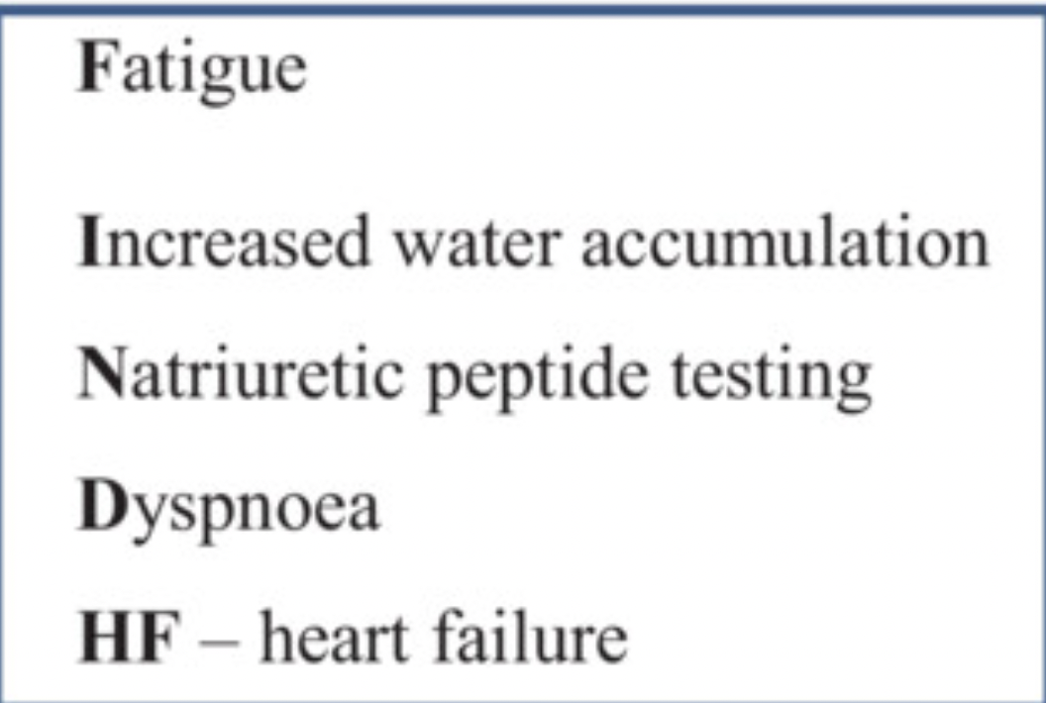
FIND HF

Slide 23
Two Key Diagnostic Tests: BNP and Echo
NT-proBNP
or BNP
(if available*)
Echocardiography
and/or
To look for borderline-high
to high natriuretic peptides
To look for abnormal ventricular structure and function
No abnormalities → HFpEF unlikely → work up other diagnoses
Abnormalities → HFpEF likely → treat accordingly
*Natriuretic peptides are not available in all jurisdictions in Canada.
BNP: B-type natriuretic peptide; HF: heart failure; HFpEF: heart failure with preserved ejection fraction; NT-proBNP: N-terminal pro-B-type natriuretic peptide.
Adapted from Ezekowitz JA, et al. Can J Cardiol. 2017;33(11):1342-433
Notes:
The more objective evidence you have that supports the HFpEF diagnosis, the greater the likelihood of the patient having HFpEF. Individually, these are not definitive, but the sum of patient history, physical exam, and investigations allows clinicians to make a definitive diagnosis.

Slide 24
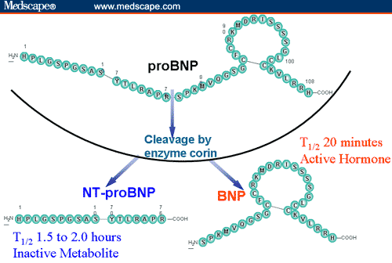
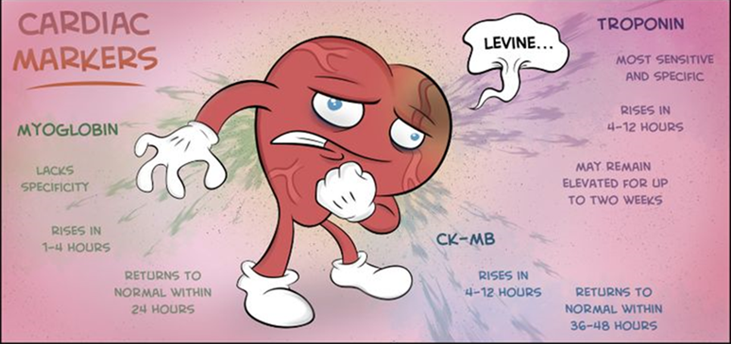
BNP and NT-proBNP
Notes:
BNP reduces SVR and induces natriuresis and diuresis
Nesiritide:
In patients with acute heart failure (HF), nesiritide increases rates of hypotension, does not alter rates of death or rehospitalization at 30 days, and shows a borderline significant trend toward reducing dyspnea.

Slide 25
NT-proBNP
Marker of myocardial stretch
  Right ventricular failure (PE, pulm HTN)
  Coronary artery disease
  Myocardial trauma (contusion, cardiac surgery, cardioversion)
  Cancer chemotherapy
  Myocardial injury
  Renal insufficiency
  Critical illness/sepsis
Continuous vs dichotomous variable
Notes:
Heart failure with reduced or preserved ejection fraction
◾Right ventricular failure (PE, pulm HTN)
◾Coronary artery disease
◾Myocardial trauma (contusion, cardiac surgery, cardioversion)
◾Cancer chemotherapy
Critical illness/Sepsis
Renal insufficiency

Slide 26
NT-proBNP
Most useful with an intermediate pretest probability of HF (eg, symptoms of dyspnea in a patient with predisposing conditions for HF, no evidence of fluid retention).
High levels support a diagnosis of acute HF.
Intermediate NT-proBNP levels are neither sensitive nor specific for detecting or excluding acute HF.
  Other diagnoses (pulmonary embolism, left ventricular dysfunction without exacerbation, cor pulmonale, etc) should also be considered
In general, NT-proBNP levels <300 pg/mL are optimal for excluding a diagnosis of HF

Slide 27
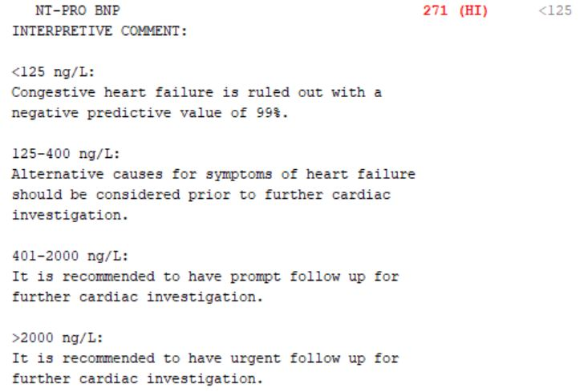

Slide 28
How Do We Interpret BNP or
NT-proBNP assay results?
Serum BNP and NT-proBNP levels (in pg/mL)
Unlikely HF
Lower specificity
Higher specificity
 | Sinus Rhythm* | Atrial fibrillation* |  | Sinus Rhythm* | Atrial fibrillation*
NT-proBNP | <125 | <375 |  | >220 | >660
BNP | <35 | <105 |  | >80 | >240
Normal levels
Diagnosis of HF unlikely¹
Normal NP levels do not exclude HFpEF because of possible confounding factors²
Major criterion for HFpEF recommended by the Heart Failure Association of ESC²
Echo required
*Definitive cut-offs to diagnose HFpEF are not well established, and trials have used different values
e.g., EMPEROR-Preserved: >300 pg/mL for sinus rhythm, >900 pg/mL for atrial fibrillation³
Average NP levels are found to be 3x higher in patients with AF than in patients in SR. The Heart Failure Association of ESC recommends values in patients with AF that are three times higher than used for patients in SR.
AF: atrial fibrillation; BNP: B-type natriuretic peptide; CV: cardiovascular; ESC: European Society of Cardiology; HF: heart failure; HFpEF: heart failure with preserved ejection fraction;
NP: natriuretic peptides; NT-proBNP: N-terminal B-type pro natriuretic peptide; SR: sinus rhythm
1. Ezekowitz JA, et al. Can J Cardiol. 2017;33(11):1342-433; 2. Pieske B et al. Eur Heart J. 2019;40(40):3297–317; 3. Anker SD, et al. N Engl J Med. 2021; 385(16):1451-61.
Notes:
Speak to slide

Slide 29
Modifications for Co-morbid conditions
Age
Atrial Fib
  HR < 90 50%
  HR > 90 100%
Obesity BMI
  30-35 25%
  35-40 – 30%
  > 40 - 40%
CRF -
  <30 35%
  30-45 25%
  45-60 15%

Slide 30
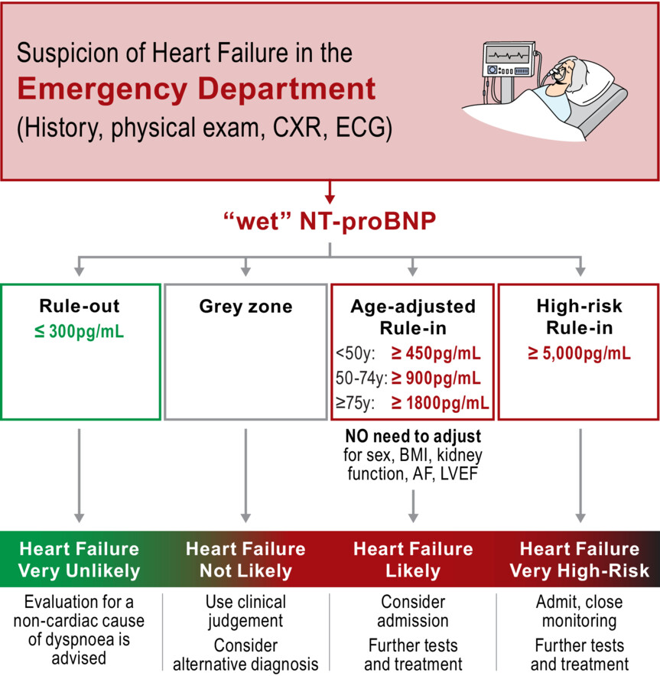
Practical algorithms for early diagnosis of heart failure and heart stress using NT‐proBNP: A clinical consensus statement from the Heart Failure Association of the ESC
European J of Heart Fail, Volume: 25, Issue: 11, Pages: 1891-1898, First published: 15 September 2023, DOI: (10.1002/ejhf.3036)
Notes:
NT‐proBNP for diagnosis of heart failure in the emergency department. AF, atrial fibrillation/flutter; BMI, body mass index; CXR, chest x‐ray; ECG electrocardiogram; LVEF, left ventricular ejection fraction; NT‐proBNP, N‐terminal pro‐B‐type natriuretic peptide.
IF THIS IMAGE HAS BEEN PROVIDED BY OR IS OWNED BY A THIRD PARTY, AS INDICATED IN THE CAPTION LINE, THEN FURTHER PERMISSION MAY BE NEEDED BEFORE ANY FURTHER USE. PLEASE CONTACT WILEY'S PERMISSIONS DEPARTMENT ON PERMISSIONS@WILEY.COM OR USE THE RIGHTSLINK SERVICE BY CLICKING ON THE 'REQUEST PERMISSIONS' LINK ACCOMPANYING THIS ARTICLE. WILEY OR AUTHOR OWNED IMAGES MAY BE USED FOR NON-COMMERCIAL PURPOSES, SUBJECT TO PROPER CITATION OF THE ARTICLE, AUTHOR, AND PUBLISHER.

Slide 31
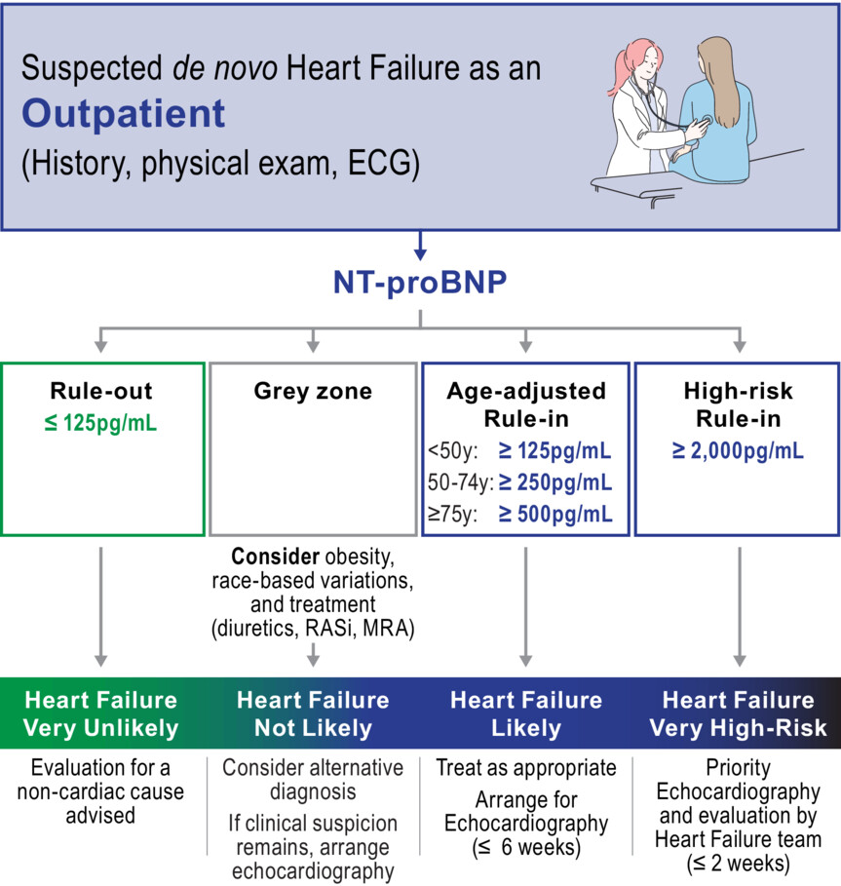
Practical algorithms for early diagnosis of heart failure and heart stress using NT‐proBNP: A clinical consensus statement from the Heart Failure Association of the ESC
European J of Heart Fail, Volume: 25, Issue: 11, Pages: 1891-1898, First published: 15 September 2023, DOI: (10.1002/ejhf.3036)
Notes:
NT‐proBNP for diagnosis of de novo heart failure in the outpatient setting. ECG electrocardiogram; MRA, mineralocorticoid receptor antagonist; NT‐proBNP, N‐terminal pro‐B‐type natriuretic peptide; RASi, renin–angiotensin system inhibitor.
IF THIS IMAGE HAS BEEN PROVIDED BY OR IS OWNED BY A THIRD PARTY, AS INDICATED IN THE CAPTION LINE, THEN FURTHER PERMISSION MAY BE NEEDED BEFORE ANY FURTHER USE. PLEASE CONTACT WILEY'S PERMISSIONS DEPARTMENT ON PERMISSIONS@WILEY.COM OR USE THE RIGHTSLINK SERVICE BY CLICKING ON THE 'REQUEST PERMISSIONS' LINK ACCOMPANYING THIS ARTICLE. WILEY OR AUTHOR OWNED IMAGES MAY BE USED FOR NON-COMMERCIAL PURPOSES, SUBJECT TO PROPER CITATION OF THE ARTICLE, AUTHOR, AND PUBLISHER.

Slide 32
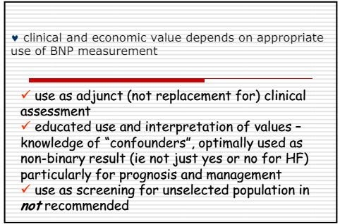

Slide 33
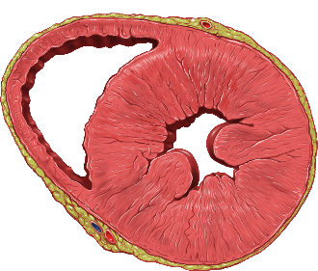
Echocardiography is the 2nd Key Diagnostic
Test in Patients with Suspected HFpEF^{1,2}
Transthoracic echocardiography provides many indicators that support a HFpEF diagnosis, including:
  LA enlargement
  Increased LA pressure
  LV hypertrophy (often not present)
  Abnormal mitral inflow pattern
  Increased LV filling pressure
  Pulmonary hypertension
Left ventricular hypertrophy
(short axis view)³
HFpEF: heart failure with preserved ejection fraction; LA: left atrial; LV: left ventricular
1. Borlaug BA. Nat Rev Cardiol. 2020 Sep;17(9):559–73; 2. Reddy YNV, et al. Circulation. 2018;138(9):861–70; 3. "File:Heart left ventricular hypertrophy sa.jpg" by Patrick J. Lynch, medical illustrator is licensed with CC BY 2.5. To view a copy of this license, visit https://creativecommons.org/licenses/by/2.5.
Notes:
Speak to slide

Slide 34
American College of Cardiology 2022 Heart Failure Guidelines: Recommendations for HFpEF
Treatment of HFpEF
Diuretics, as needed (1)
SGLT2i (2a)
Levels of evidence:
1: Strong: Benefit >>> Risk
2a: Moderate: Benefit >> Risk
2b: Weak: Benefit ≥ Risk
Symptomatic HF with
LVEF ≥50%
ARNi* (2b)
MRA* (2b)
ARB* (2b)
* Greater benefit in patients with LVEF closer to 50%.
HF: heart failure; HFpEF: heart failure with preserved ejection fraction; LVEF: left ventricular ejection fraction; MRA: mineralocorticoid receptor antagonist; SGLT2i: sodium-glucose cotransporter-2 inhibitor
Heidenreich PA, et al. Circulation. 2022 Apr. Epub ahead of print. PMID: 35363500.

Slide 35
Empagliflozin for Heart Failure with Preserved Ejection Fraction: Design of EMPEROR-Preserved
Placebo
Dapa
Empa
Enalapril
LCZ696
Cana
Multinational, multicenter, double-blind, parallel-group, randomized, controlled trial
5,988 patients
≥ 18 years with chronic HFpEF
(NYHA class II-IV, LVEF ˃40%)
T2D or non-T2D
eGFR ≥20 mL/min/1.73m²
NT-proBNP ˃300pg/mL (˃900 pg/mL if
atrial fibrillation at baseline)
Placebo (n=2,991)
1:1
Double-blind
Empagliflozin 10 mg (n=2,997)
In addition to usual therapy, per treating physician
Setting: 622 sites in 23 countries
Enrollment: March 2017 through April 2020
Mean follow-up: 26.2 months (IQR 18.1-3.1)
eGFR: estimated glomerular filtration rate; HFpEF: heart failure with preserved ejection fraction; IQR: interquartile range; LVEF: left-ventricular ejection fraction; T2D: type 2 diabetes
Anker SD, et al. N Engl J Med. 2021; 385(16):1451-61.

Slide 36
A New Evidence-based Treatment Option for HFpEF: Empagliflozin (EMPEROR-Preserved)¹
Placebo
Dapa
Empa
Enalapril
LCZ696
Cana
Composite primary endpoint: CV death or HHF
25
20
RRR
21%
ARR
3.3%
NNT*=31
Placebo
15
Estimated cumulative incidence (%)
HR: 0.79
(95% CI: 0.69, 0.90)
p<0.001
10
Empagliflozin
5
Empagliflozin is now indicated “In adults as an adjunct to standard of care therapy for the treatment of chronic heart failure” (irrespective of diabetes status and ejection fraction)²
0
0
3
6
9
12
15
18
21
24
27
30
33
36
Months since randomization
*During a median trial period of 26 months.
ARR: absolute risk reduction; CI: confidence interval; HR: hazard ratio; NNT: number needed to treat; RRR: relative risk reduction.
Anker SD, et al. N Engl J Med. 2021; 385(16):1451-61; 2. Boehringer Ingelheim (Canada) Ltd. ^{Pr}JARDIANCE® product monograph. Apr. 6, 2022.
Notes:
Speak to slide

Slide 37
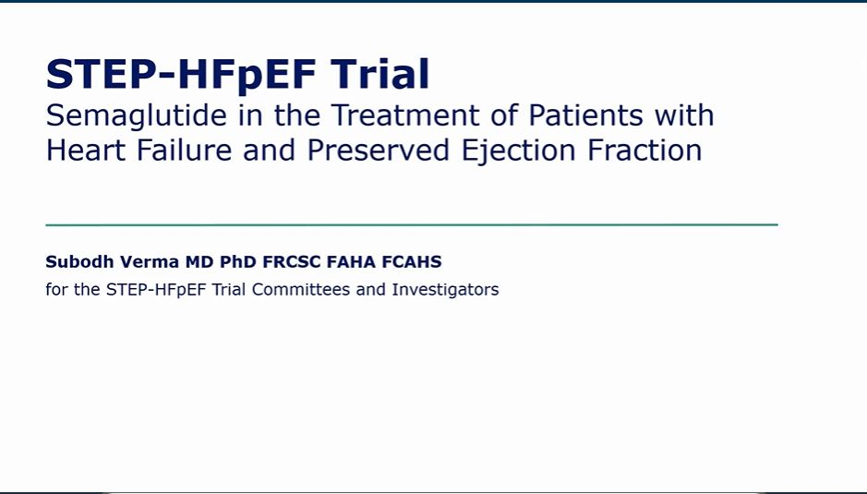

Slide 38
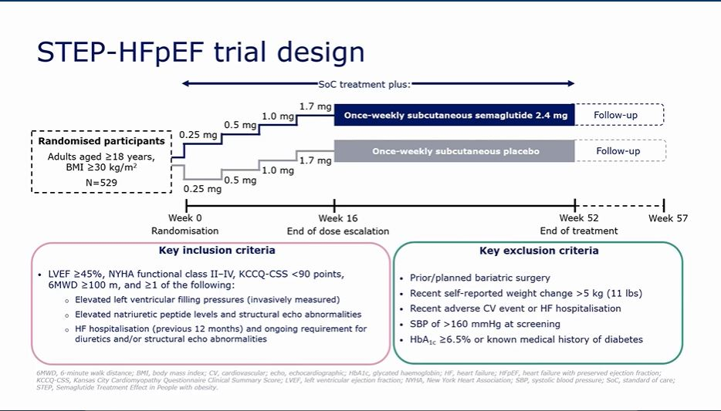

Slide 39
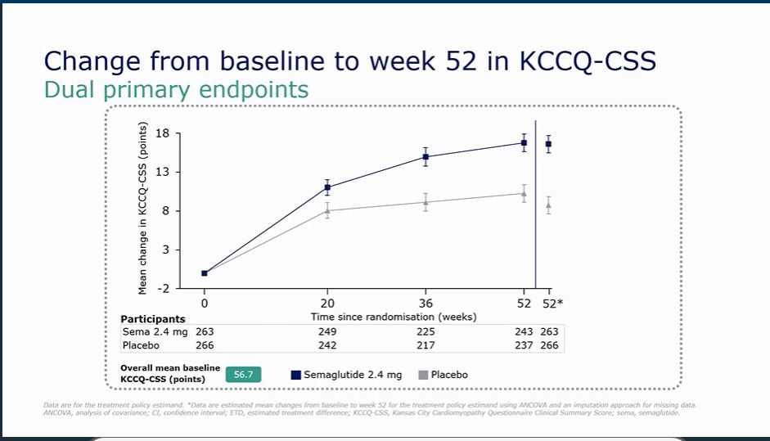

Slide 40
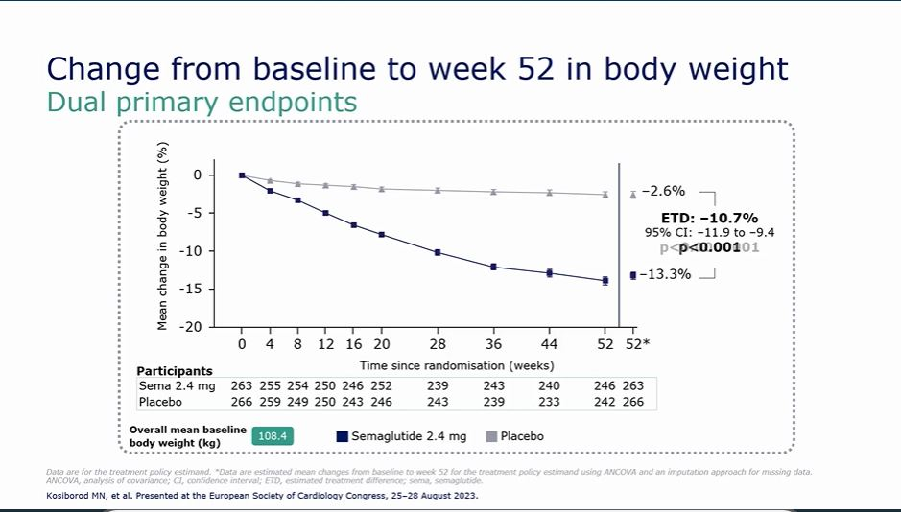

Slide 41
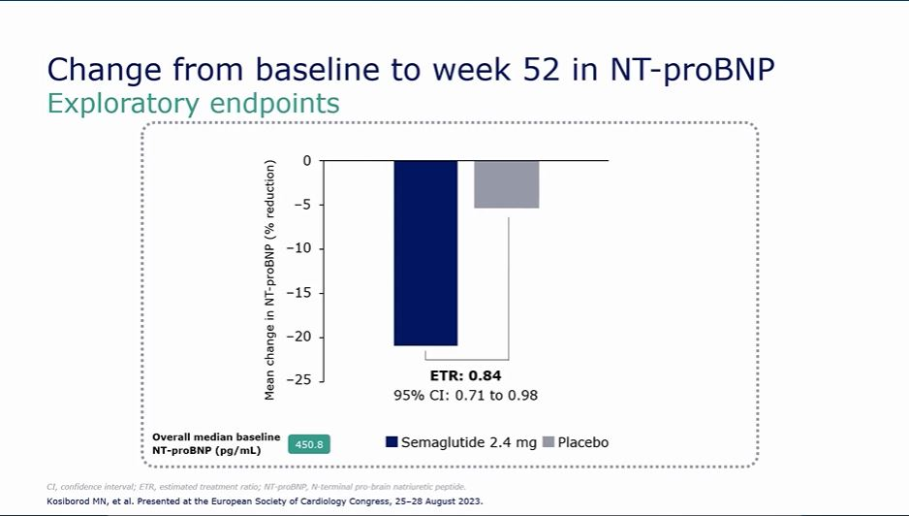

Slide 42
SP
76 yo female
Ankle swelling x 3 months
No PND/Orthopnea/CP
? SOBOE
PMH – prev DM/HT/CABG 2015
  A flutter
  Lung Ca resection 2022
Meds
  Lipitor 40 mg od
  Rivaroxaban 20 od
  Lasix 20 mg prn
  Irbesartan 150 mg od –ON HOLD
O/E
  54 Kg
  BP- 139/86
  HR 94 sl irreg
  Chest – decr BS L base
  JVP 2-3 cm
  Mod bilat. ankle edema
Labs
  A1C 5.6
  Cr 78
  K+ 5.4
  ECH – A flutter 3:1 – 4:1 block
  NT ProBNP 436
Echo - ? Mild LVH, EF 65%
  Grade 2 Diastolic dysfunction

Slide 43


Non-pharmacological Management in Advanced HF
COR | RECOMMENDATIONS
2b | For patients with advanced HF and hyponatremia, the benefit of fluid restriction to reduce congestive symptoms is uncertain
Meta-analysis¹ of 6 RCTs comparing liberal and restricted fluid intake
No difference in mortality
or HF hospitalization
No difference in serum
Na+ or Cr
No difference in duration
of IV diuretics
Abbreviations: Cr indicates creatinine; HF, heart failure; IV, intravenous; Na⁺, sodium; and RCT, randomized clinical trial.

Slide 44
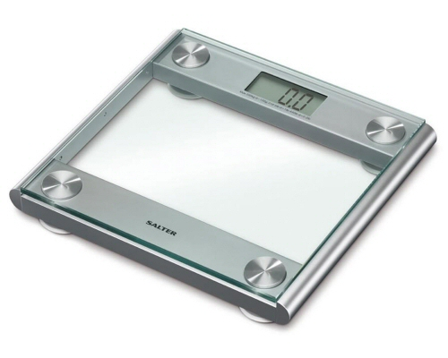
Device Therapy for CHF Therapy

Slide 45
Pt Self management - Diuretics
“Sliding Scale”
  Balance of volume overload/dehydration
  Varies with renal function
  Allows pt to self-manage/avoid ER visit
  Needs to be reviewed re- change in real wt.
  Estimate ideal wt – varies with vol status and Cr

Slide 46
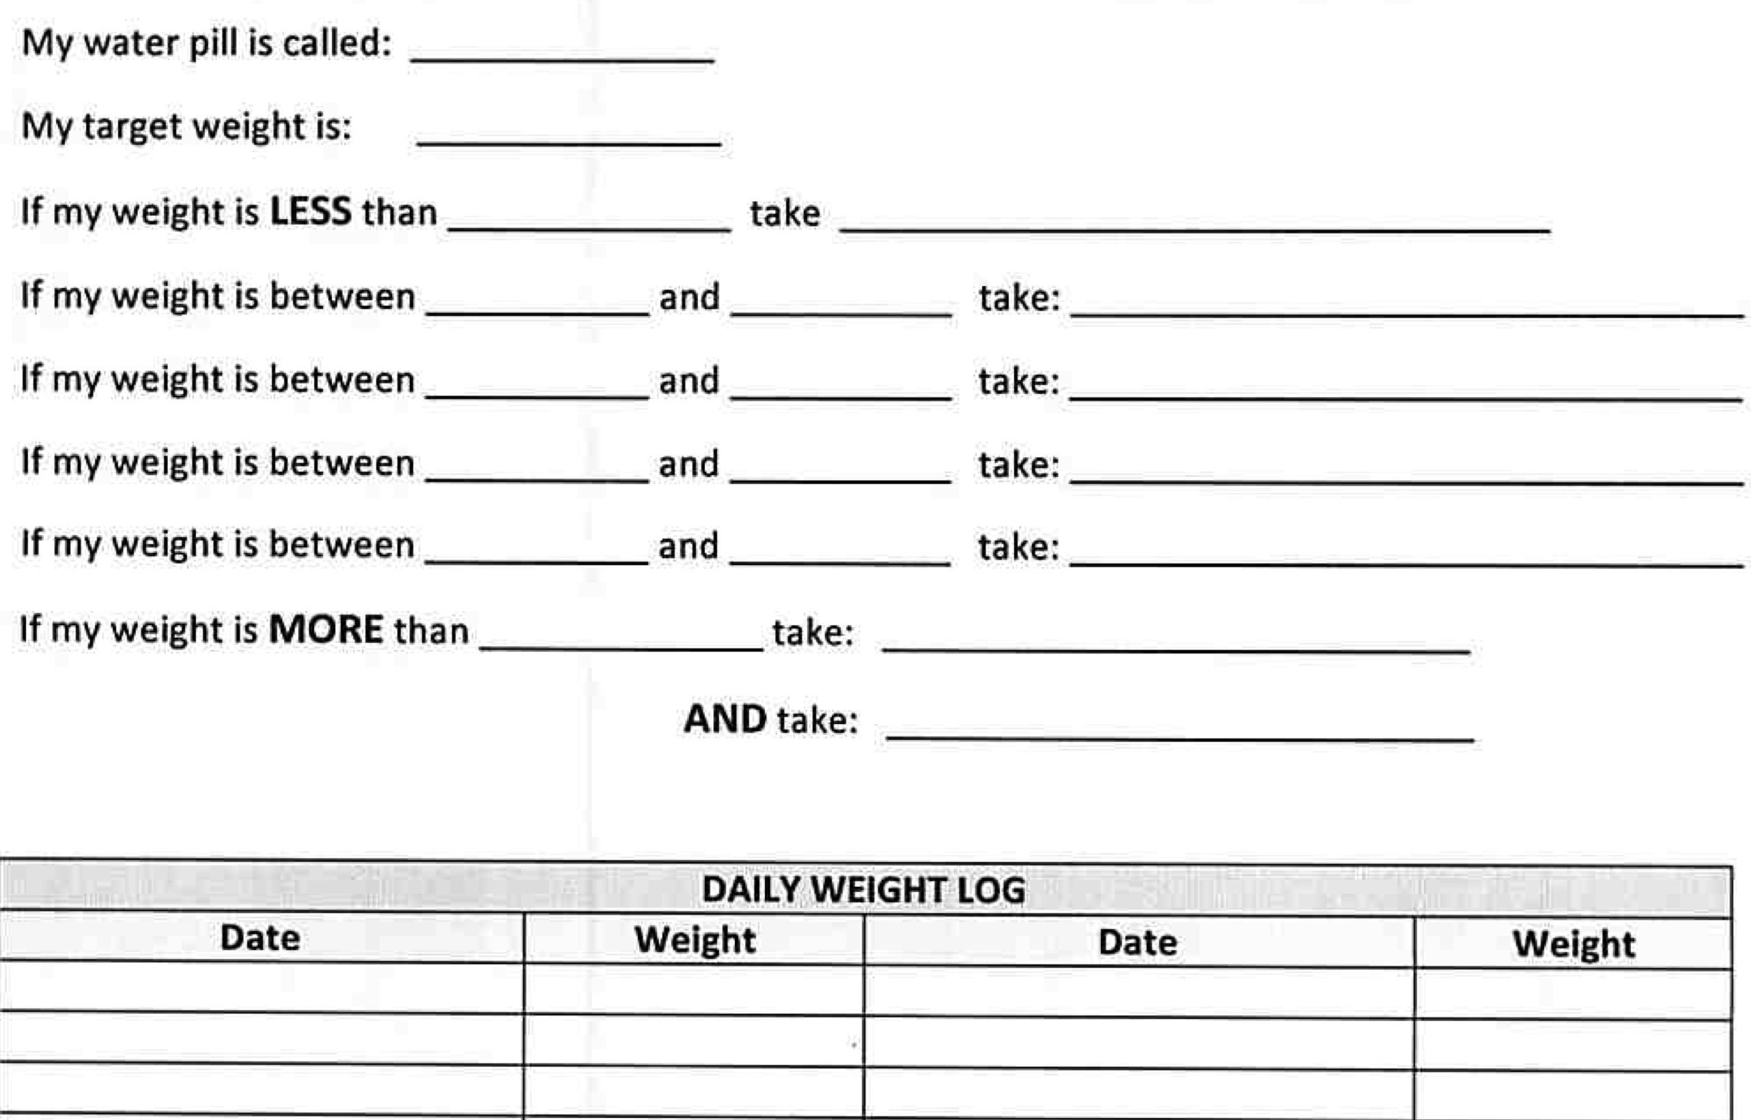
Patient Sliding Scale for Diuretics

Slide 47
Outpatient diuretic management
Assess symptoms, vital signs, volume status and lab values
Volume deplete
Euvolemic
Volume overload
Reduce or hold
diuretic for
2–3 days
Consider stepwise
reduction in
diuretic dose
or frequency
Increase dose by
25–50% depending
on prior response
and scenario

Slide 48
Management of common side effects required for long-term success

Slide 49
Don’t use SGLT-2 Inh with
Type 1 diabetes
Hx DKA/Pancreatic Insufficiency/Pancreatic resection
  Unless you have a c-peptide
eGFR < 20
GLP-1 – GB disease

Slide 50
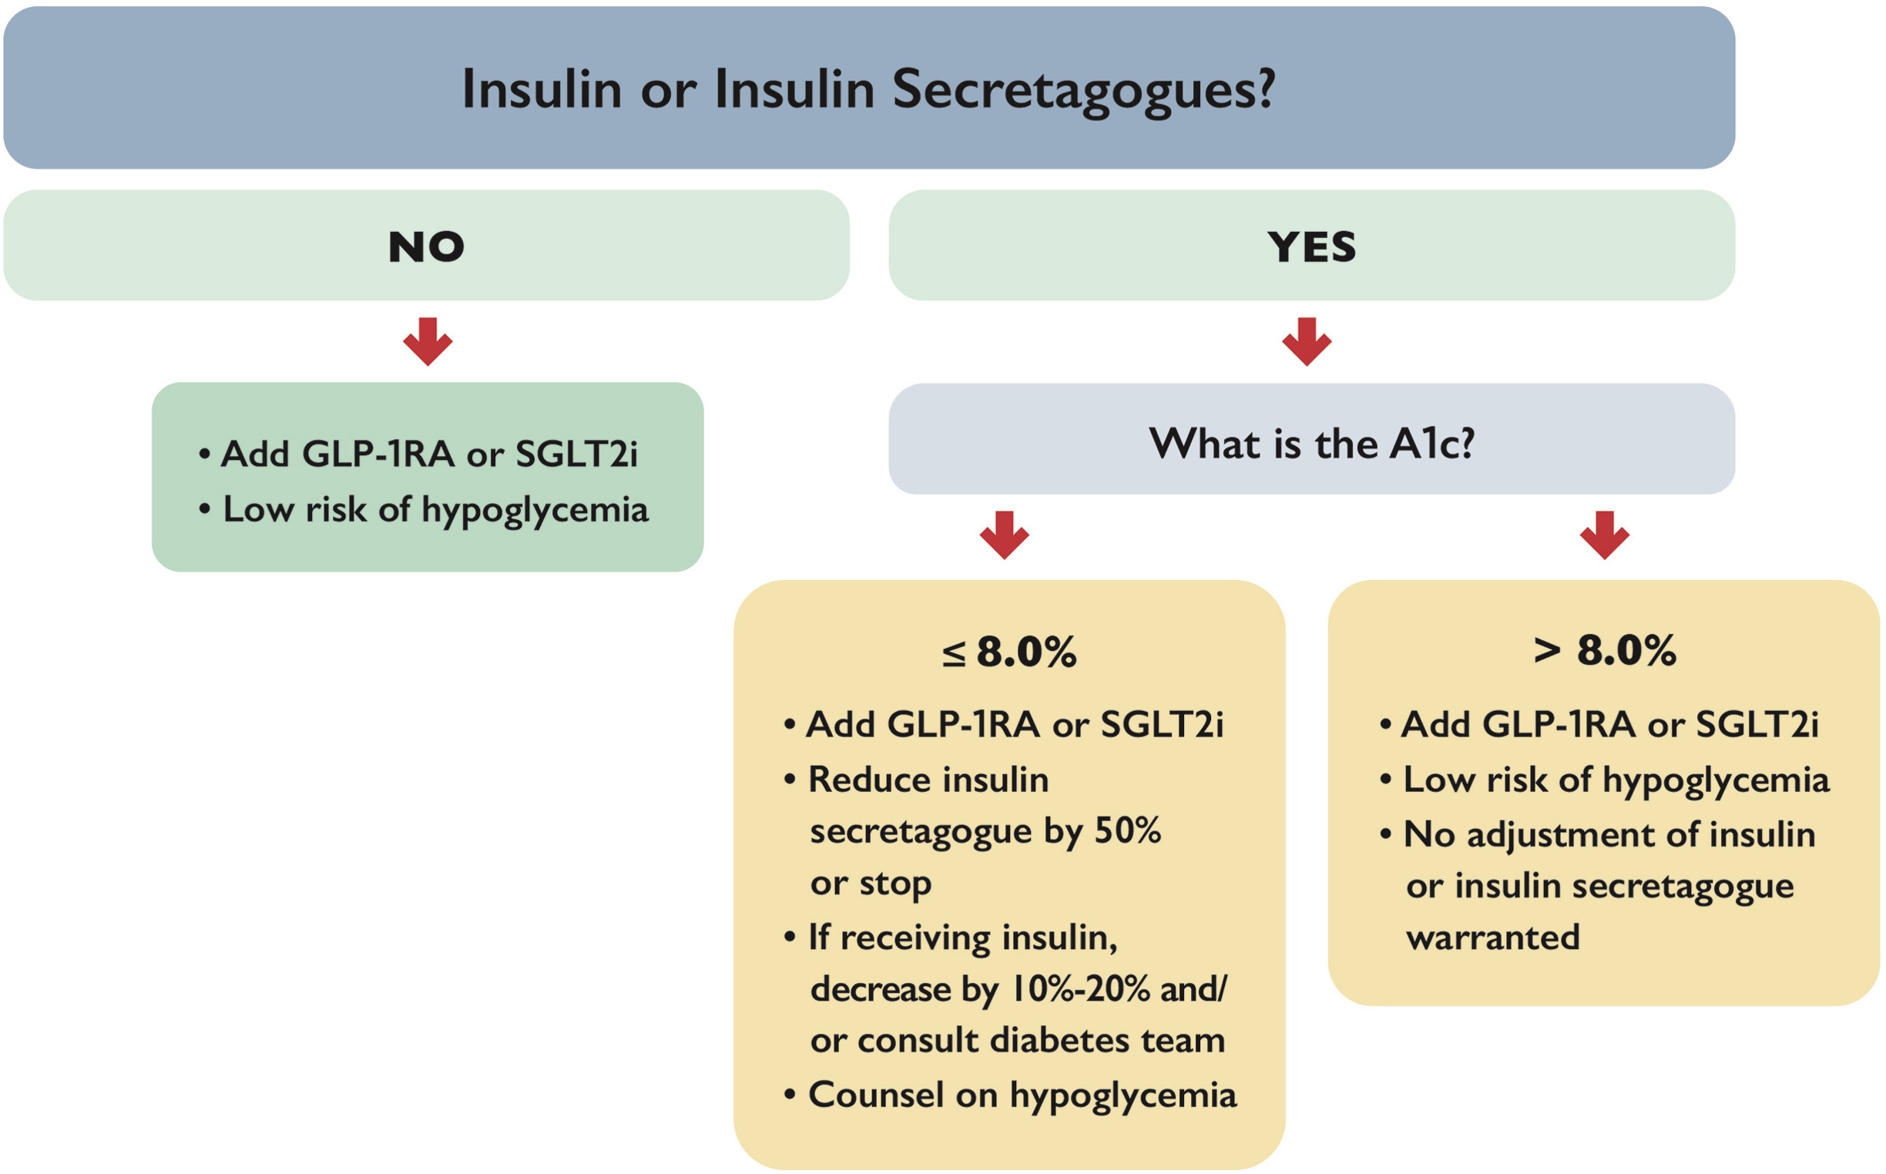

Figure 2
Notes:
Management of antihyperglycemic medications when adding SGLT2i (eGFR ≥ 45 mL/min/1.73 m²) or glucagon-like peptide-1 receptor antagonists (GLP-1RA). A1c, glycosylated hemoglobin; eGFR, estimated glomerular filtration rate; SGLT2i, sodium-glucose co-transporter 2 inhibitors.∗ SGLT2i have markedly reduced glycemic-lowering efficacy when eGFR < 45 mL/min/1.72 m², so there is less concern about hypoglycemia with insulin or insulin secretagogues (meglitinides or sulfonylureas).

Slide 51
Practical tips: Genital Mycotic Infections (GMI’s)
Uncomplicated
  (Healthy, non-pregnant, <3 inf/year, mild/mod symptoms)
  Fluconazole 150 po single dose
Balinitis
  Topical/clotrimazole prn
Complicated
  Severe signs, > 3/ year, poorly controlled DM, immunocompromised
  Fluconazole 150 mg po q 3 days , 2-3 doses
    +/1 clotrimazole/betamethasone x 48 hrs
    Or Topicals – 7-14 days
Recurrent – >3 year
  Fluconazole 150 mg po q 72 hrs x 3, then once weekly x 6 months

Slide 52




Simple strategies to help patients manage
GLP-1 RA-related GI side effects
Eat smaller meals
Avoid fatty and spicy foods
Take on an empty stomach or before bed time
Stay hydrated
?
What tips or recommendations
for managing side effects have your patients found useful?

Slide 53

Ozempic Micro-Dosing
There are many “clicks” between the marked doses on the Ozempic pen. There are 36 “clicks” between 0 and 0.25 mg and 36 “clicks” between 0.25mg and 0.5mg. On the 1mg pen there are 74 “clicks” between 0 and 1mg.
Use ____ clicks once a week and if tolerating well, continue to increase by ____ clicks every _____ weeks, until at the recommended dose of ______mg once weekly.
Once you are on a dose of 0.25 mg weekly, please discontinue your ___________ (Onglyza/Trajenta/Januvia)

Slide 54
Summary
HFrEF – 4 pillars
HFpEF – SGLT2/GLP-1 + diuretics
NT Pro BNP needs clinical context and consideration of:
      Age
      eGFR
      A Fib
      Wt

Slide 55

Goal – to reduce cardiovascular and renal complications for patients with Diabetes in Simcoe County
www.sdcrc.ca

