Slide 1
Local Issues – Nova Scotia
Identification of patients
Management of common side effects
Cost and coverage
SGLT 2 inh. in renal failure
Variable dose diuretics

Slide 2


Slide 3

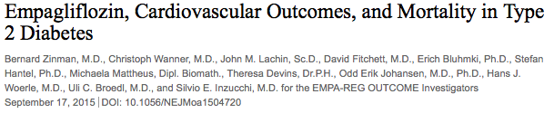

Slide 4
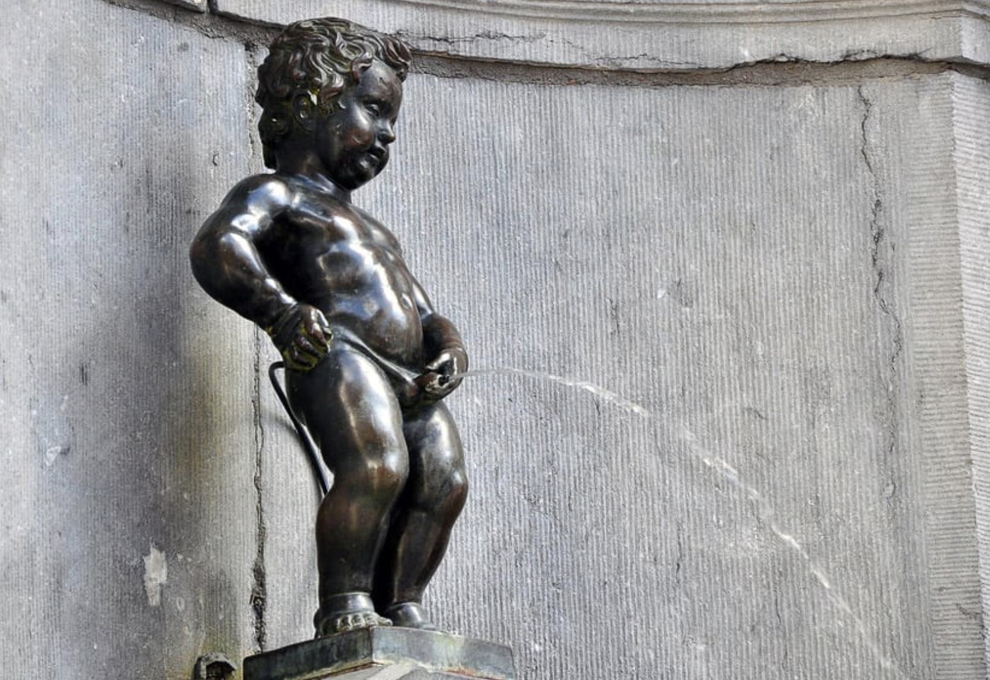

Slide 5
EMPA-REG OUTCOME
Primary Outcome: CV Death, Non-fatal MI or Non-fatal Stroke
EMPA-REG OUTCOME included adult patients (>18 years) with type 2 diabetes and established CVD who were receiving standard of care therapy for diabetes
Empagliflozin (pooled)
HR 0.86
(95.02% CI 0.74, 0.99)
p=0.04* for superiority
p<0.001 for noninferiority
Placebo
Empagliflozin
Patients with event (%)
Empagliflozin 10 mg
HR 0.85 (95% CI 0.72, 1.01), p=0.07
Empagliflozin 25 mg
HR 0.86 (95% CI 0.73, 1.02), p=0.09
Months
No. of patients
Empagliflozin
Placebo
4687
2333
4580
2256
4455
2194
4328
2112
3851
1875
2821
1380
2359
1161
1534
741
370
166
Cumulative incidence function. MACE: major adverse cardiovascular event; HR: hazard ratio; MI: myocardial infarction; SGLT2: sodium glucose cotransporter 2
*Two-sided tests for superiority were conducted (statistical significance was indicated if p≤0.0498)
Note: Empagliflozin is an SGLT2 inhibitor. Data from: Zinman B, et al. N Engl J Med. 2015; 373:2117-2128.

Slide 6

Reviewing, adjusting or advancing therapy in type 2 diabetes:
Diabetes Canada Clinical Practice Guidelines Expert Committee. Pharmacologic glycemic management of type 2 diabetes in adults: 2020 update. Can J Diabet 2020;44:575-591.
Notes:
When it comes to reviewing, adjusting or advancing therapy, the guidelines offer [CLICK] specific instructions for patients with established cardiovascular or renal disease, or with cardiovascular risk factors.
[CLICK] We’re going to focus on the CV risk factor column, [CLICK] because that’s the one that applies to our patient, Susan.

Slide 7
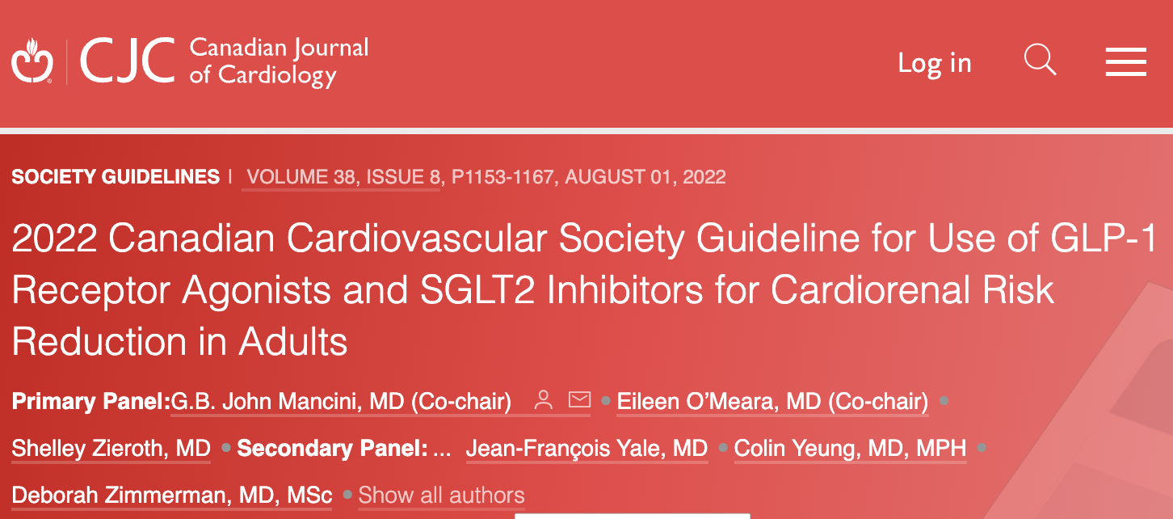

2022 Canadian Cardiovascular Society Guideline for Use of GLP-1 Receptor Agonists and SGLT2 Inhibitors for Cardiorenal Risk Reduction in Adults
G.B. John Mancini, MD (Co-chair), Eileen O’Meara, MD (Co-chair), Shelley Zieroth, MD, Mathieu Bernier, MD, Alice Y.Y. Cheng, MD, David Z.I. Cherney, MD, PhD, Kim A. Connelly, MD, Justin Ezekowitz, MBBCh, MSc, Ronald M. Goldenberg, MD, Lawrence A. Leiter, MD, Gihad Nesrallah, MD, MSc, Breay W. Paty, MD, Marie-Eve Piché, MD, PhD, Peter Senior, MBBS, PhD, Abhinav Sharma, MD, Subodh Verma, MD, PhD, Vincent Woo, MD, Pol Darras, MD, Jonathan Y. Gabor, MD, Jean Grégoire, MD, Eva Lonn, MD, James A. Stone, MD, PhD, Jean-François Yale, MD, Colin Yeung, MD, MPH, Deborah Zimmerman, MD, MSc
Canadian Journal of Cardiology
Volume 38 Issue 8 Pages 1153-1167 (August 2022)
DOI: 10.1016/j.cjca.2022.04.029
Copyright © 2022 Elsevier Inc. Terms and Conditions

Slide 8
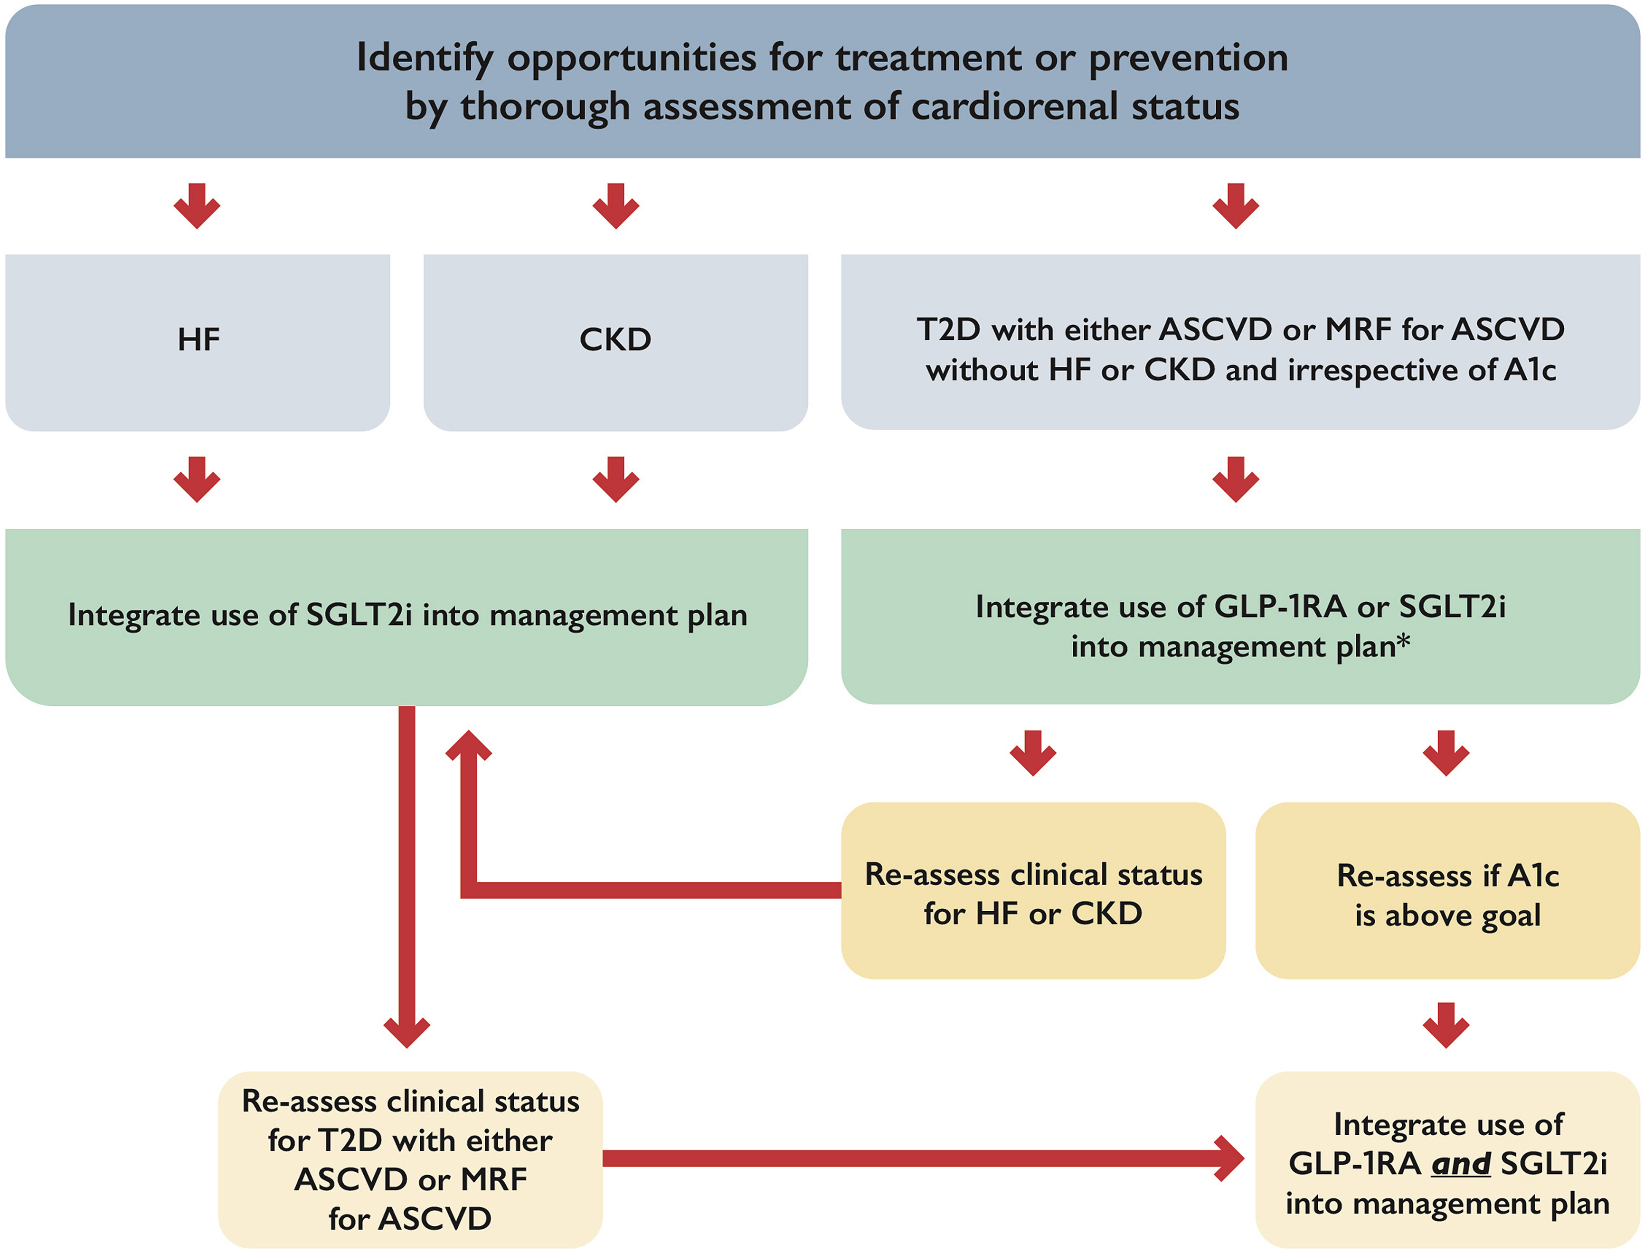
Figure 1
Notes:
Integration of glucagon-like peptide-1 receptor antagonists (GLP-1RA) and sodium-glucose co-transporter 2 inhibitors (SGLT2i) into cardiovascular practice. ASCVD, atherosclerotic cardiovascular disease; CKD, chronic kidney disease; HF, heart failure; MRF, multiple risk factors; T2D, type 2 diabetes. ∗ In patients with high stroke risk, or history of transient ischemic attack/stroke, consider initial integration of GLP-1RA into management plan followed by integration of SGLT2i on the basis of changes in heart failure or kidney status or for further glycosylated hemoglobin (A1c)-lowering.

Slide 9
EMPA-KIDNEY enrolled a broad CKD population¹
Prognosis of CKD by eGFR and albuminuria categories²
 |  |  | Albuminuria stage, description and range (mg/g)
 |  |  | A1 | A2 | A3
 |  |  | Normal-to-mildly increased | Moderately increased | Severely increased
 |  |  | <3 mg/mmol | 3-30 mg/mmol | >30 mg/mmol
eGFR category range (ml/min/1.73 m²) | G1 | ≥90
 | G2 | 60–89
 | G3a | 45–59
 | G3b | 30–44
 | G4 | 15–29
 | G5 | <15
EMPA-KIDNEY population¹
eGFR ≥45 to
<90 ml/min/1.73 m² and
UACR ≥22.6 mg/mmol
or
eGFR ≥20 to <45 ml/min/1.73 m²
Low risk*
Moderately increased risk
High risk
Very high risk
*If no other markers of kidney disease, no CKD. eGFR, estimated glomerular filtration rate; T2D, type 2 diabetes; UACR, urine albumin-to-creatinine ratio
1. The EMPA-KIDNEY Collaborative Group. N Engl J Med. 2022; [published online ahead of print]; doi: 10.1056/NEJMoa2204233.; 2. Kidney Disease: Improving Global Outcomes (KDIGO) CKD Work Group. Kidney Int Suppl 2013;3:1.

Slide 10
EMPA-KIDNEY: Primary composite outcome^{1,2}
Kidney disease progression or CV death
40
Placebo
HR 0.72
(95% CI 0.64, 0.82)
P<0.001
Empagliflozin 10 mg
30
Participants with Event (%)
RRR
28%
20
Placebo N(%):
558 (16.9%)
Events/100 PY: 8.96
10
Empagliflozin N(%):
432 (13.1%)
Events/100 PY: 6.85
NNT=28*
0
0
0.5
1
1.5
2
2.5
Patients at risk, n
Years of Follow-up
Placebo | 3305 |  | 3250 |  | 3129 |  | 2243 |  | 1496 |  | 592
Empagliflozin | 3304 |  | 3252 |  | 3163 |  | 2275 |  | 1538 |  | 624
*NNT: 28 (95% CI 19, 53) per 2 years at risk
ARR for the primary composite outcome of kidney disease progression or CV death is 3.6% per patient year at risk
Kidney disease progression defined as end-stage kidney disease, a sustained decline in eGFR to <10 ml/min/1.73 m², renal death, or a sustained decline of ≥40% in eGFR from randomization
ARR, absolute risk reduction; CI, confidence interval; CV, cardiovascular, eGFR, estimated glomerular filtration rate; HR, hazard ratio; NNT, number needed to treat; PY, patient-years; RRR, relative risk reduction; UACR, urine albumin-to-creatinine ratio
1. The EMPA-KIDNEY Collaborative Group. N Engl J Med. 2022 [published online ahead of print]; doi: 10.1056/NEJMoa2204233.; 2. Data on file

Slide 11
EMPA-KIDNEY: Prespecified tertiary outcome
Annual rate of change in eGFR
Chronic eGFR slope† (ml/min/1.73 m²/year)
 | Empagliflozin | Placebo | Difference (95% CI)
Chronic slope, mean (SE) | -1.37 (0.08) | -2.75 (0.08) | 1.37 (1.16, 1.59)
Baseline
2
Patients, n
Placebo | 3184 |  | 2911 |  | 2861 |  | 2821 |  | 2621 |  | 1723 |  | 1204 |  | 293
Empagliflozin | 3190 |  | 2875 |  | 2809 |  | 2820 |  | 2605 |  | 1752 |  | 1239 |  | 298

Slide 12
Lesson # 1
SGLT2 Inhibitors clearly indicated for
- CHF – Reduced and Preserved
- CKD with Significant Proteinuria
In Diabetics and Non-Diabetics

Slide 13
-lowering medication that also reduces
Our paradigm shift for SGLT-2is and GLP-1 RAs with proven benefits in CVD patients with diabetes:
A1c
risk

Slide 14
“This is a diabetic medication that helps protect the kidneys/heart”

Slide 15
“This is a diabetic medication that helps protect the kidneys/heart”
“This is a kidney/heart protection medication that helps the diabetes”

Slide 16
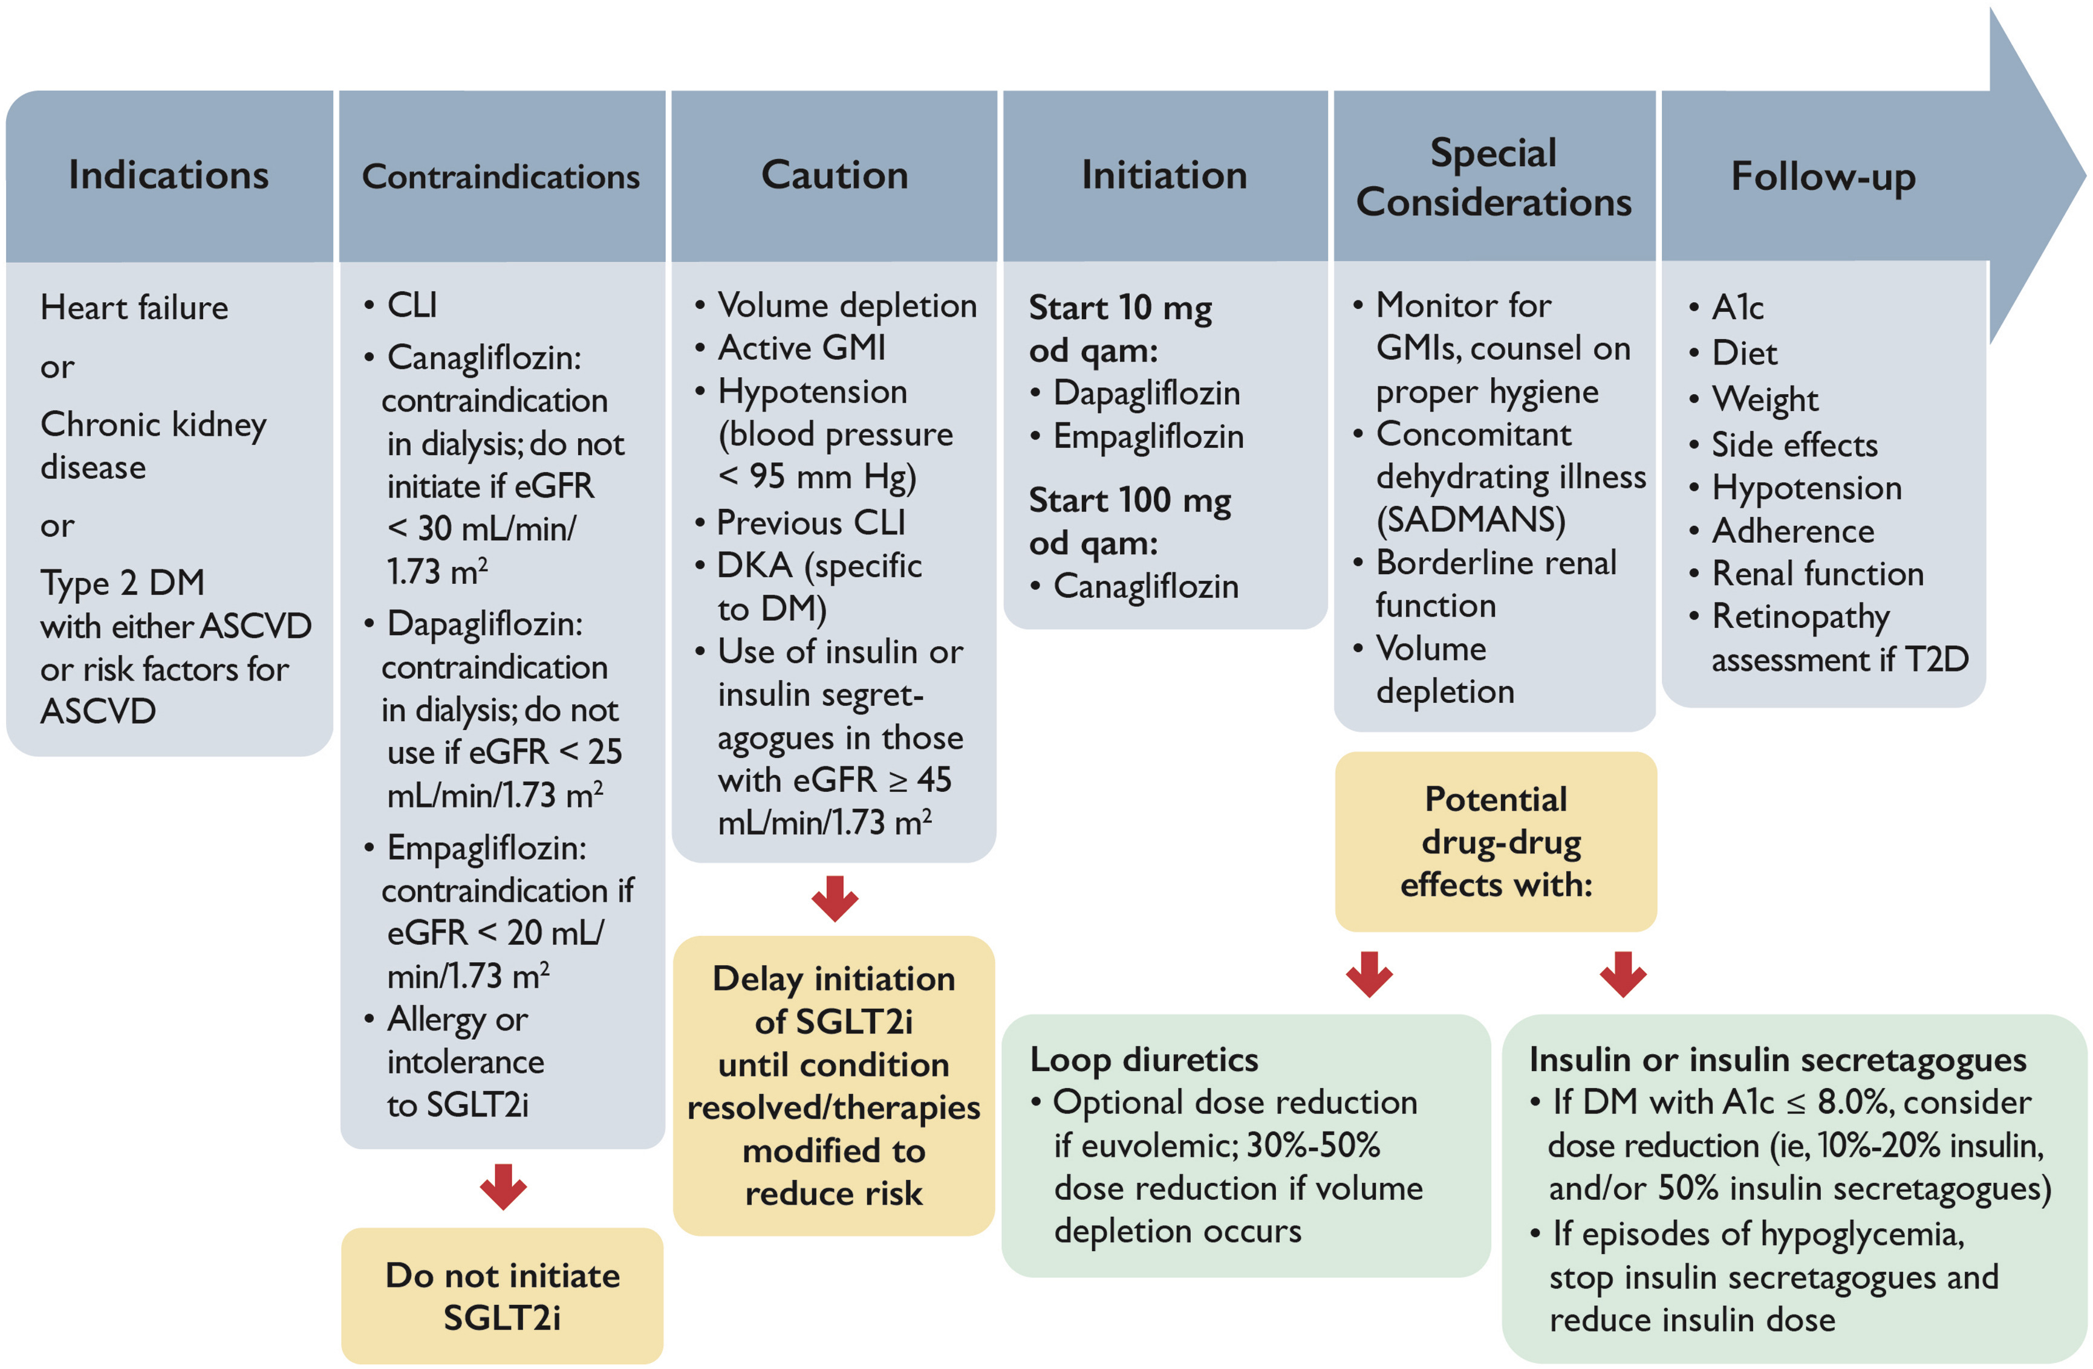
SGLT-2 Inhibitors
Figure 3
Notes:
Practical approach to the use of sodium-glucose co-transporter 2 inhibitors (SGLT2i) for treatment of cardiovascular disease. A1c, glycosylated hemoglobin; ASCVD, atherosclerotic cardiovascular disease; CLI, critical limb ischemia; DKA, diabetic ketoacidosis; DM, diabetes mellitus; eGFR, estimated glomerular filtration rate; GMI, genital mycotic infection; od qam, once daily every morning; SADMANS, sulfonylureas, angiotensin-converting enzyme inhibitors, diuretics and direct renin inhibitors, metformin, angiotensin receptor blockers, nonsteroidal anti-inflammatory drugs, sodium-glucose co-transporter 2 inhibitors; T2D, type 2 diabetes.

Slide 17
Figure 3
Notes:
Practical approach to the use of sodium-glucose co-transporter 2 inhibitors (SGLT2i) for treatment of cardiovascular disease. A1c, glycosylated hemoglobin; ASCVD, atherosclerotic cardiovascular disease; CLI, critical limb ischemia; DKA, diabetic ketoacidosis; DM, diabetes mellitus; eGFR, estimated glomerular filtration rate; GMI, genital mycotic infection; od qam, once daily every morning; SADMANS, sulfonylureas, angiotensin-converting enzyme inhibitors, diuretics and direct renin inhibitors, metformin, angiotensin receptor blockers, nonsteroidal anti-inflammatory drugs, sodium-glucose co-transporter 2 inhibitors; T2D, type 2 diabetes.

Slide 18
Figure 3
Notes:
Practical approach to the use of sodium-glucose co-transporter 2 inhibitors (SGLT2i) for treatment of cardiovascular disease. A1c, glycosylated hemoglobin; ASCVD, atherosclerotic cardiovascular disease; CLI, critical limb ischemia; DKA, diabetic ketoacidosis; DM, diabetes mellitus; eGFR, estimated glomerular filtration rate; GMI, genital mycotic infection; od qam, once daily every morning; SADMANS, sulfonylureas, angiotensin-converting enzyme inhibitors, diuretics and direct renin inhibitors, metformin, angiotensin receptor blockers, nonsteroidal anti-inflammatory drugs, sodium-glucose co-transporter 2 inhibitors; T2D, type 2 diabetes.

Slide 19
Figure 3
Notes:
Practical approach to the use of sodium-glucose co-transporter 2 inhibitors (SGLT2i) for treatment of cardiovascular disease. A1c, glycosylated hemoglobin; ASCVD, atherosclerotic cardiovascular disease; CLI, critical limb ischemia; DKA, diabetic ketoacidosis; DM, diabetes mellitus; eGFR, estimated glomerular filtration rate; GMI, genital mycotic infection; od qam, once daily every morning; SADMANS, sulfonylureas, angiotensin-converting enzyme inhibitors, diuretics and direct renin inhibitors, metformin, angiotensin receptor blockers, nonsteroidal anti-inflammatory drugs, sodium-glucose co-transporter 2 inhibitors; T2D, type 2 diabetes.

Slide 20
Figure 3
Notes:
Practical approach to the use of sodium-glucose co-transporter 2 inhibitors (SGLT2i) for treatment of cardiovascular disease. A1c, glycosylated hemoglobin; ASCVD, atherosclerotic cardiovascular disease; CLI, critical limb ischemia; DKA, diabetic ketoacidosis; DM, diabetes mellitus; eGFR, estimated glomerular filtration rate; GMI, genital mycotic infection; od qam, once daily every morning; SADMANS, sulfonylureas, angiotensin-converting enzyme inhibitors, diuretics and direct renin inhibitors, metformin, angiotensin receptor blockers, nonsteroidal anti-inflammatory drugs, sodium-glucose co-transporter 2 inhibitors; T2D, type 2 diabetes.

Slide 21
Figure 3
Notes:
Practical approach to the use of sodium-glucose co-transporter 2 inhibitors (SGLT2i) for treatment of cardiovascular disease. A1c, glycosylated hemoglobin; ASCVD, atherosclerotic cardiovascular disease; CLI, critical limb ischemia; DKA, diabetic ketoacidosis; DM, diabetes mellitus; eGFR, estimated glomerular filtration rate; GMI, genital mycotic infection; od qam, once daily every morning; SADMANS, sulfonylureas, angiotensin-converting enzyme inhibitors, diuretics and direct renin inhibitors, metformin, angiotensin receptor blockers, nonsteroidal anti-inflammatory drugs, sodium-glucose co-transporter 2 inhibitors; T2D, type 2 diabetes.

Slide 22
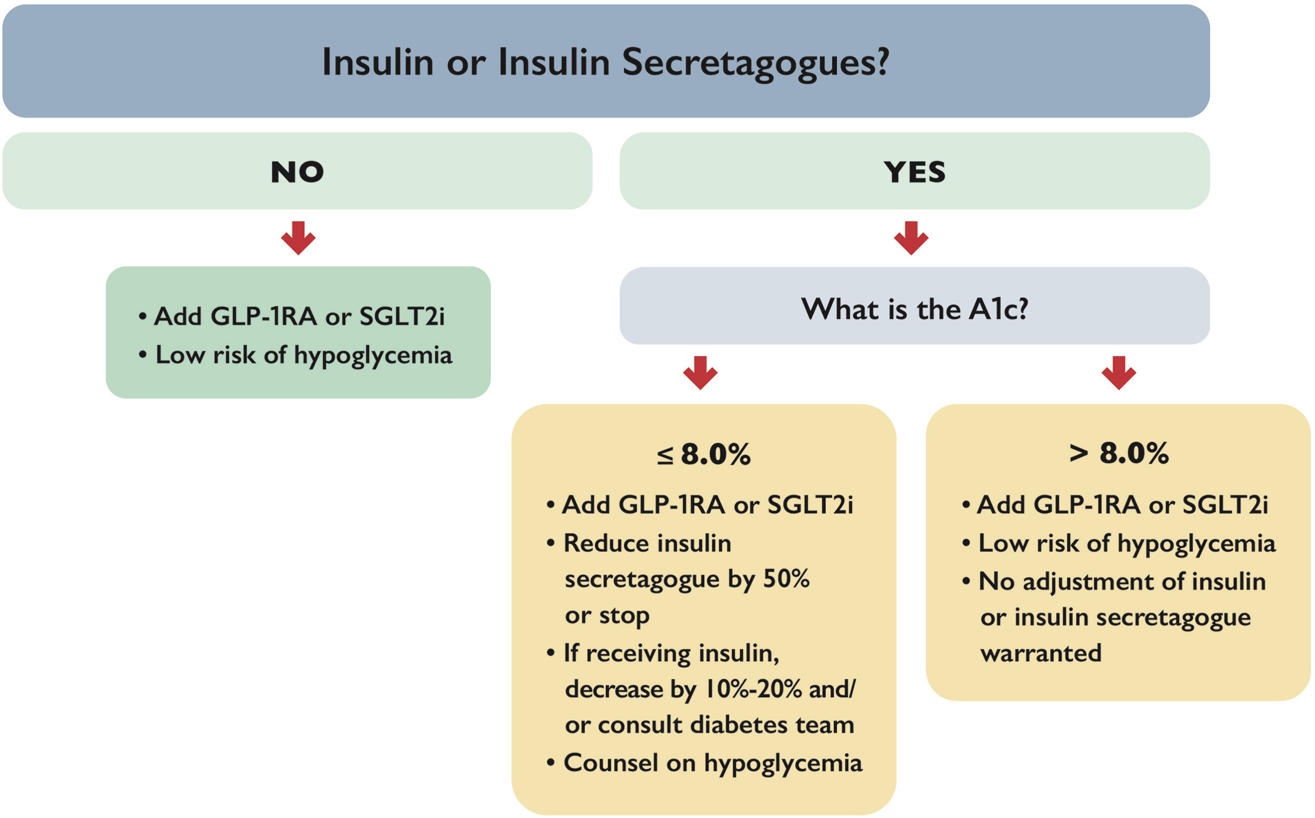
Figure 2
Notes:
Management of antihyperglycemic medications when adding SGLT2i (eGFR ≥ 45 mL/min/1.73 m²) or glucagon-like peptide-1 receptor antagonists (GLP-1RA). A1c, glycosylated hemoglobin; eGFR, estimated glomerular filtration rate; SGLT2i, sodium-glucose co-transporter 2 inhibitors.∗ SGLT2i have markedly reduced glycemic-lowering efficacy when eGFR < 45 mL/min/1.72 m², so there is less concern about hypoglycemia with insulin or insulin secretagogues (meglitinides or sulfonylureas).

Slide 23
Medications in CKD
SGLT-2 Inhibitors
For CKD with ACR > 22
    Dapagliflozin 10 mg od – eGFR > 25
      DAPA CKD and Product Monograph
    Canaglfozin > 30
    Credence and Product Mongraph
    Empagliflozin 10 mg od – eGFR > 20
      - Empa Kidney
    For CHF – Reduced or Preserved
    Empagliflozin 10 mg od – eGFR > 20
      - Emperor Reduced and Preserved – Not Product Monograph
    Dapagliflozin 10 mg od – eGFR > 25
      - DAPA HF, Deliver
GLP-1 Agonist
    eGFR < 15 or up to dialysis
    Sustain 6/Rewind Trial and Product Monograph with caution

Slide 24
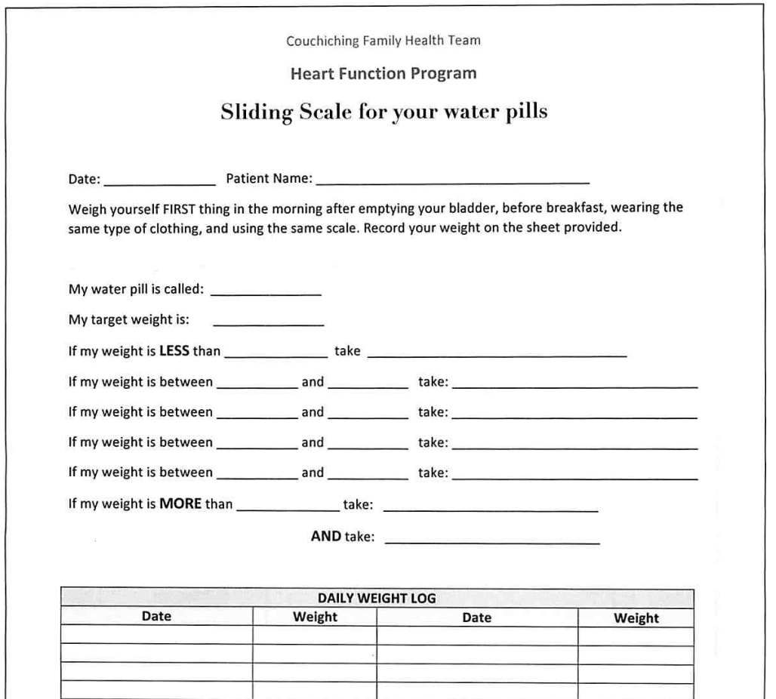

Slide 25
Lesson 2
Management of common side effects required for long-term success

Slide 26
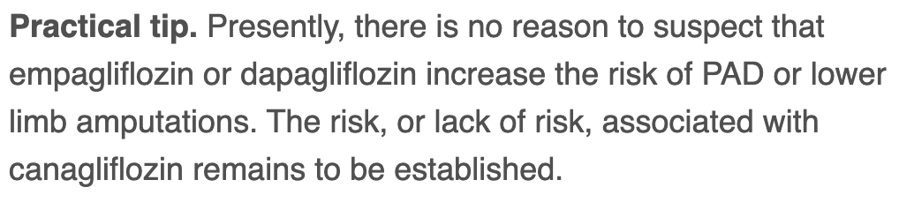
PAD/Ischemia

Slide 27
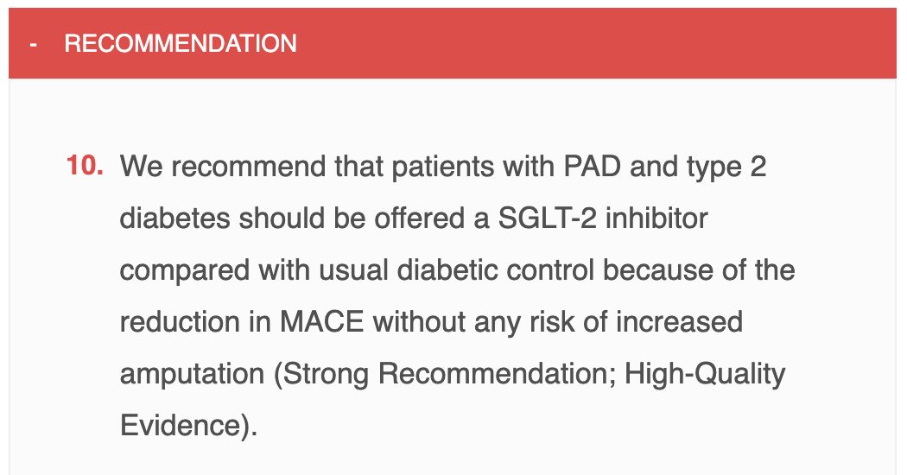

Slide 28
EMPA-KIDNEY: Prespecified tertiary outcome
Annual rate of change in eGFR
Chronic eGFR slope† (ml/min/1.73 m²/year)
 | Empagliflozin | Placebo | Difference (95% CI)
Chronic slope, mean (SE) | -1.37 (0.08) | -2.75 (0.08) | 1.37 (1.16, 1.59)
Baseline
2
Patients, n
Placebo | 3184 |  | 2911 |  | 2861 |  | 2821 |  | 2621 |  | 1723 |  | 1204 |  | 293
Empagliflozin | 3190 |  | 2875 |  | 2809 |  | 2820 |  | 2605 |  | 1752 |  | 1239 |  | 298

Slide 29
Practical tips: Genital mycotic infections (GMIs)
Uncomplicated
  (Healthy, non-pregnant, <3 inf/year, mild/mod symptoms)
  Fluconazole 150 po single dose
Complicated
  Severe signs, > 3/ year, poorly controlled DM, immunocompromised
  Fluconazole 150 mg po q 3 days , 2-3 doses
    +/1 clotrimazole/betamethasone x 48 hrs
    Or Topicals – 7-14 days
Recurrent – >3 year
  Fluconazole 150 mg po q 72 hrs x 3, then once weekly x 6 months

Slide 30

Just because you can do something doesn’t mean you should….

Slide 31
Don’t use SGLT-2 Inh with
Type 1 diabetes
Hx DKA/Pancreatic Insufficiency/Pancreatic resection
eGFR < 20/25%
Frail elderly – unless you are treating CHF/CKD
  replaces some diuretics

Slide 32
SGLT 2 Inh – Costs

Slide 33
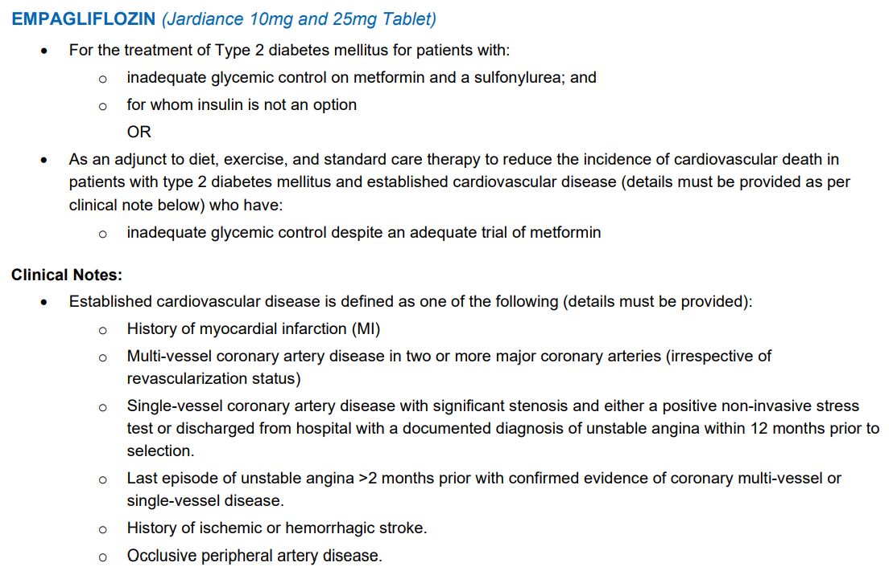
Nova Scotia Formulary – SGLT 2 Inh

Slide 34
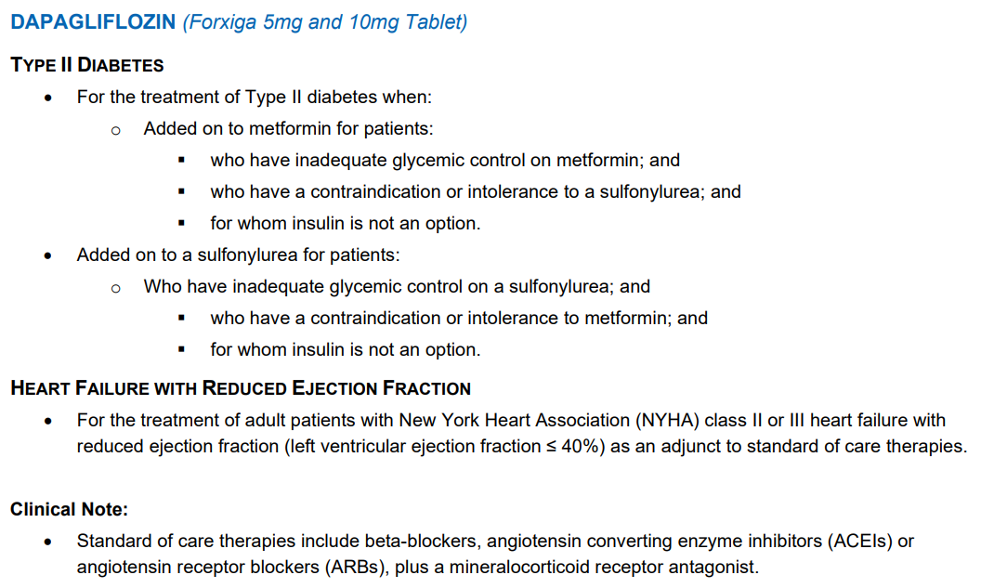
Nova Scotia Formulary

Slide 35
Nova Scotia Formulary
Diabetes Indications – with vascular dx +/- > Target A1C
  Empagliflozin/Dapagliflozin
    Many people have intolerance to Metformin or can’t get below A1C < 6.5
    Intolerance is relative
    Use 10 mg dose only
    Use for renal disease down to eGFR 20
    Insulin never an option when u have CV/Renal Benefit (review prev. patients)
HF and RF indications
  Start before EF measured if clearly CHF (eg Pulm edema, NT ProBNP)(+/- DM)
  Indicated for significant proteinuria (+/- DM).
  Dapa for HF rEF

Slide 36
Nova Scotia Formulary
Entresto Eplerenone require Cardiologist/HF Specialist

Slide 37
Reducing Costs
Pharma Programs
Office Samples
Jardiance – ½ of 25 mg tablet
  Synjardy 12.5/500 mg od
Crestor ½ tab 40 mg
Ozempic – Cost 1 mg pen = 0.5 mg pen
  36 clicks = 0.5 mg ow = cost of DPP-IV Inh
Different Pharmacy

Slide 38


Your Choice – $1.48/day

Slide 39
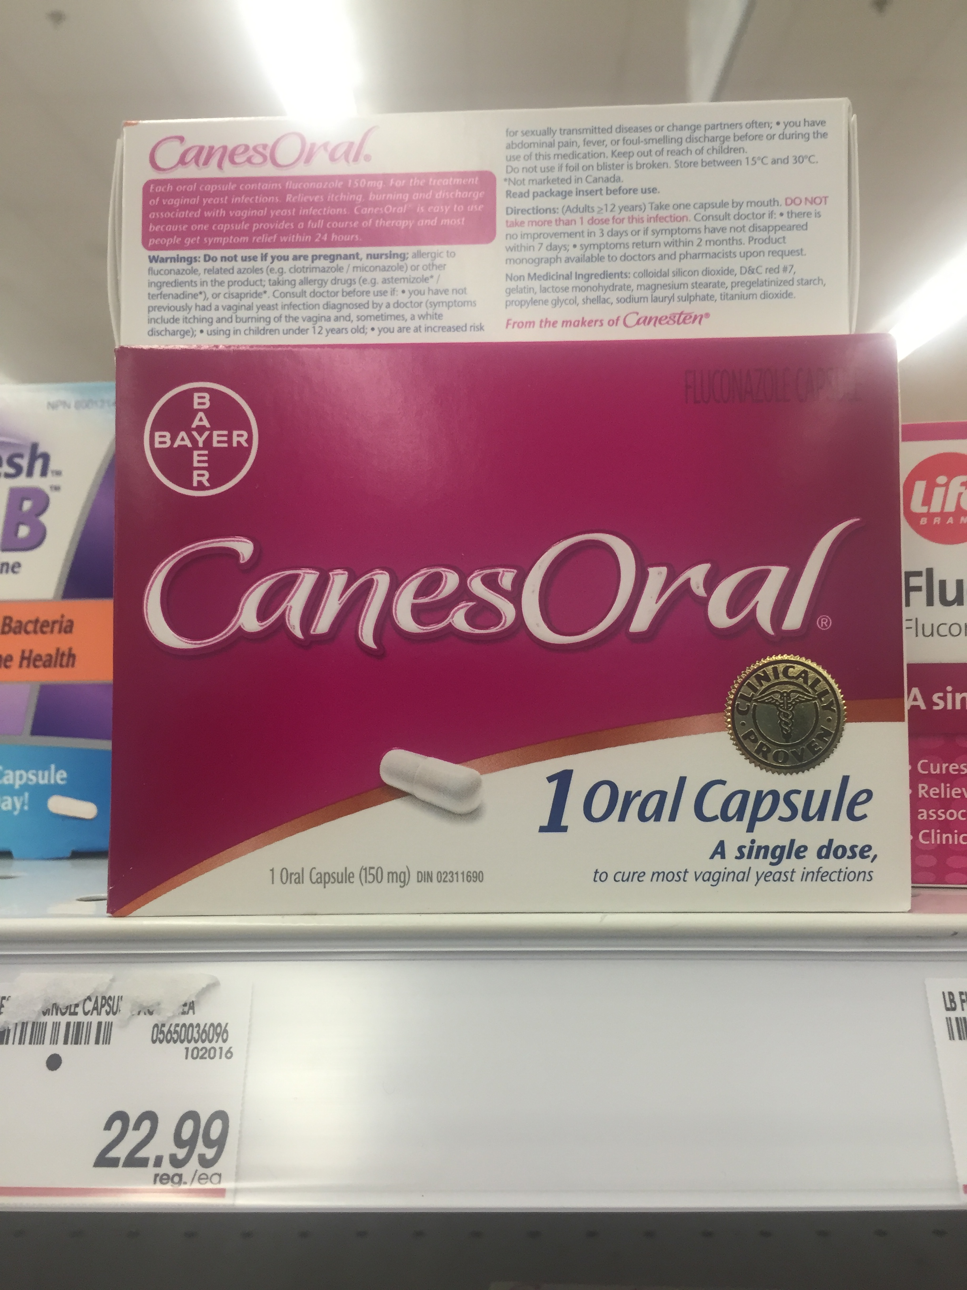
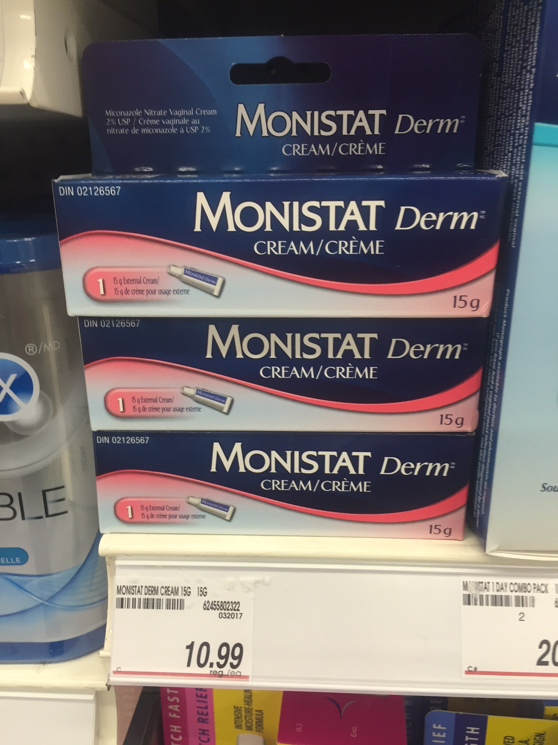
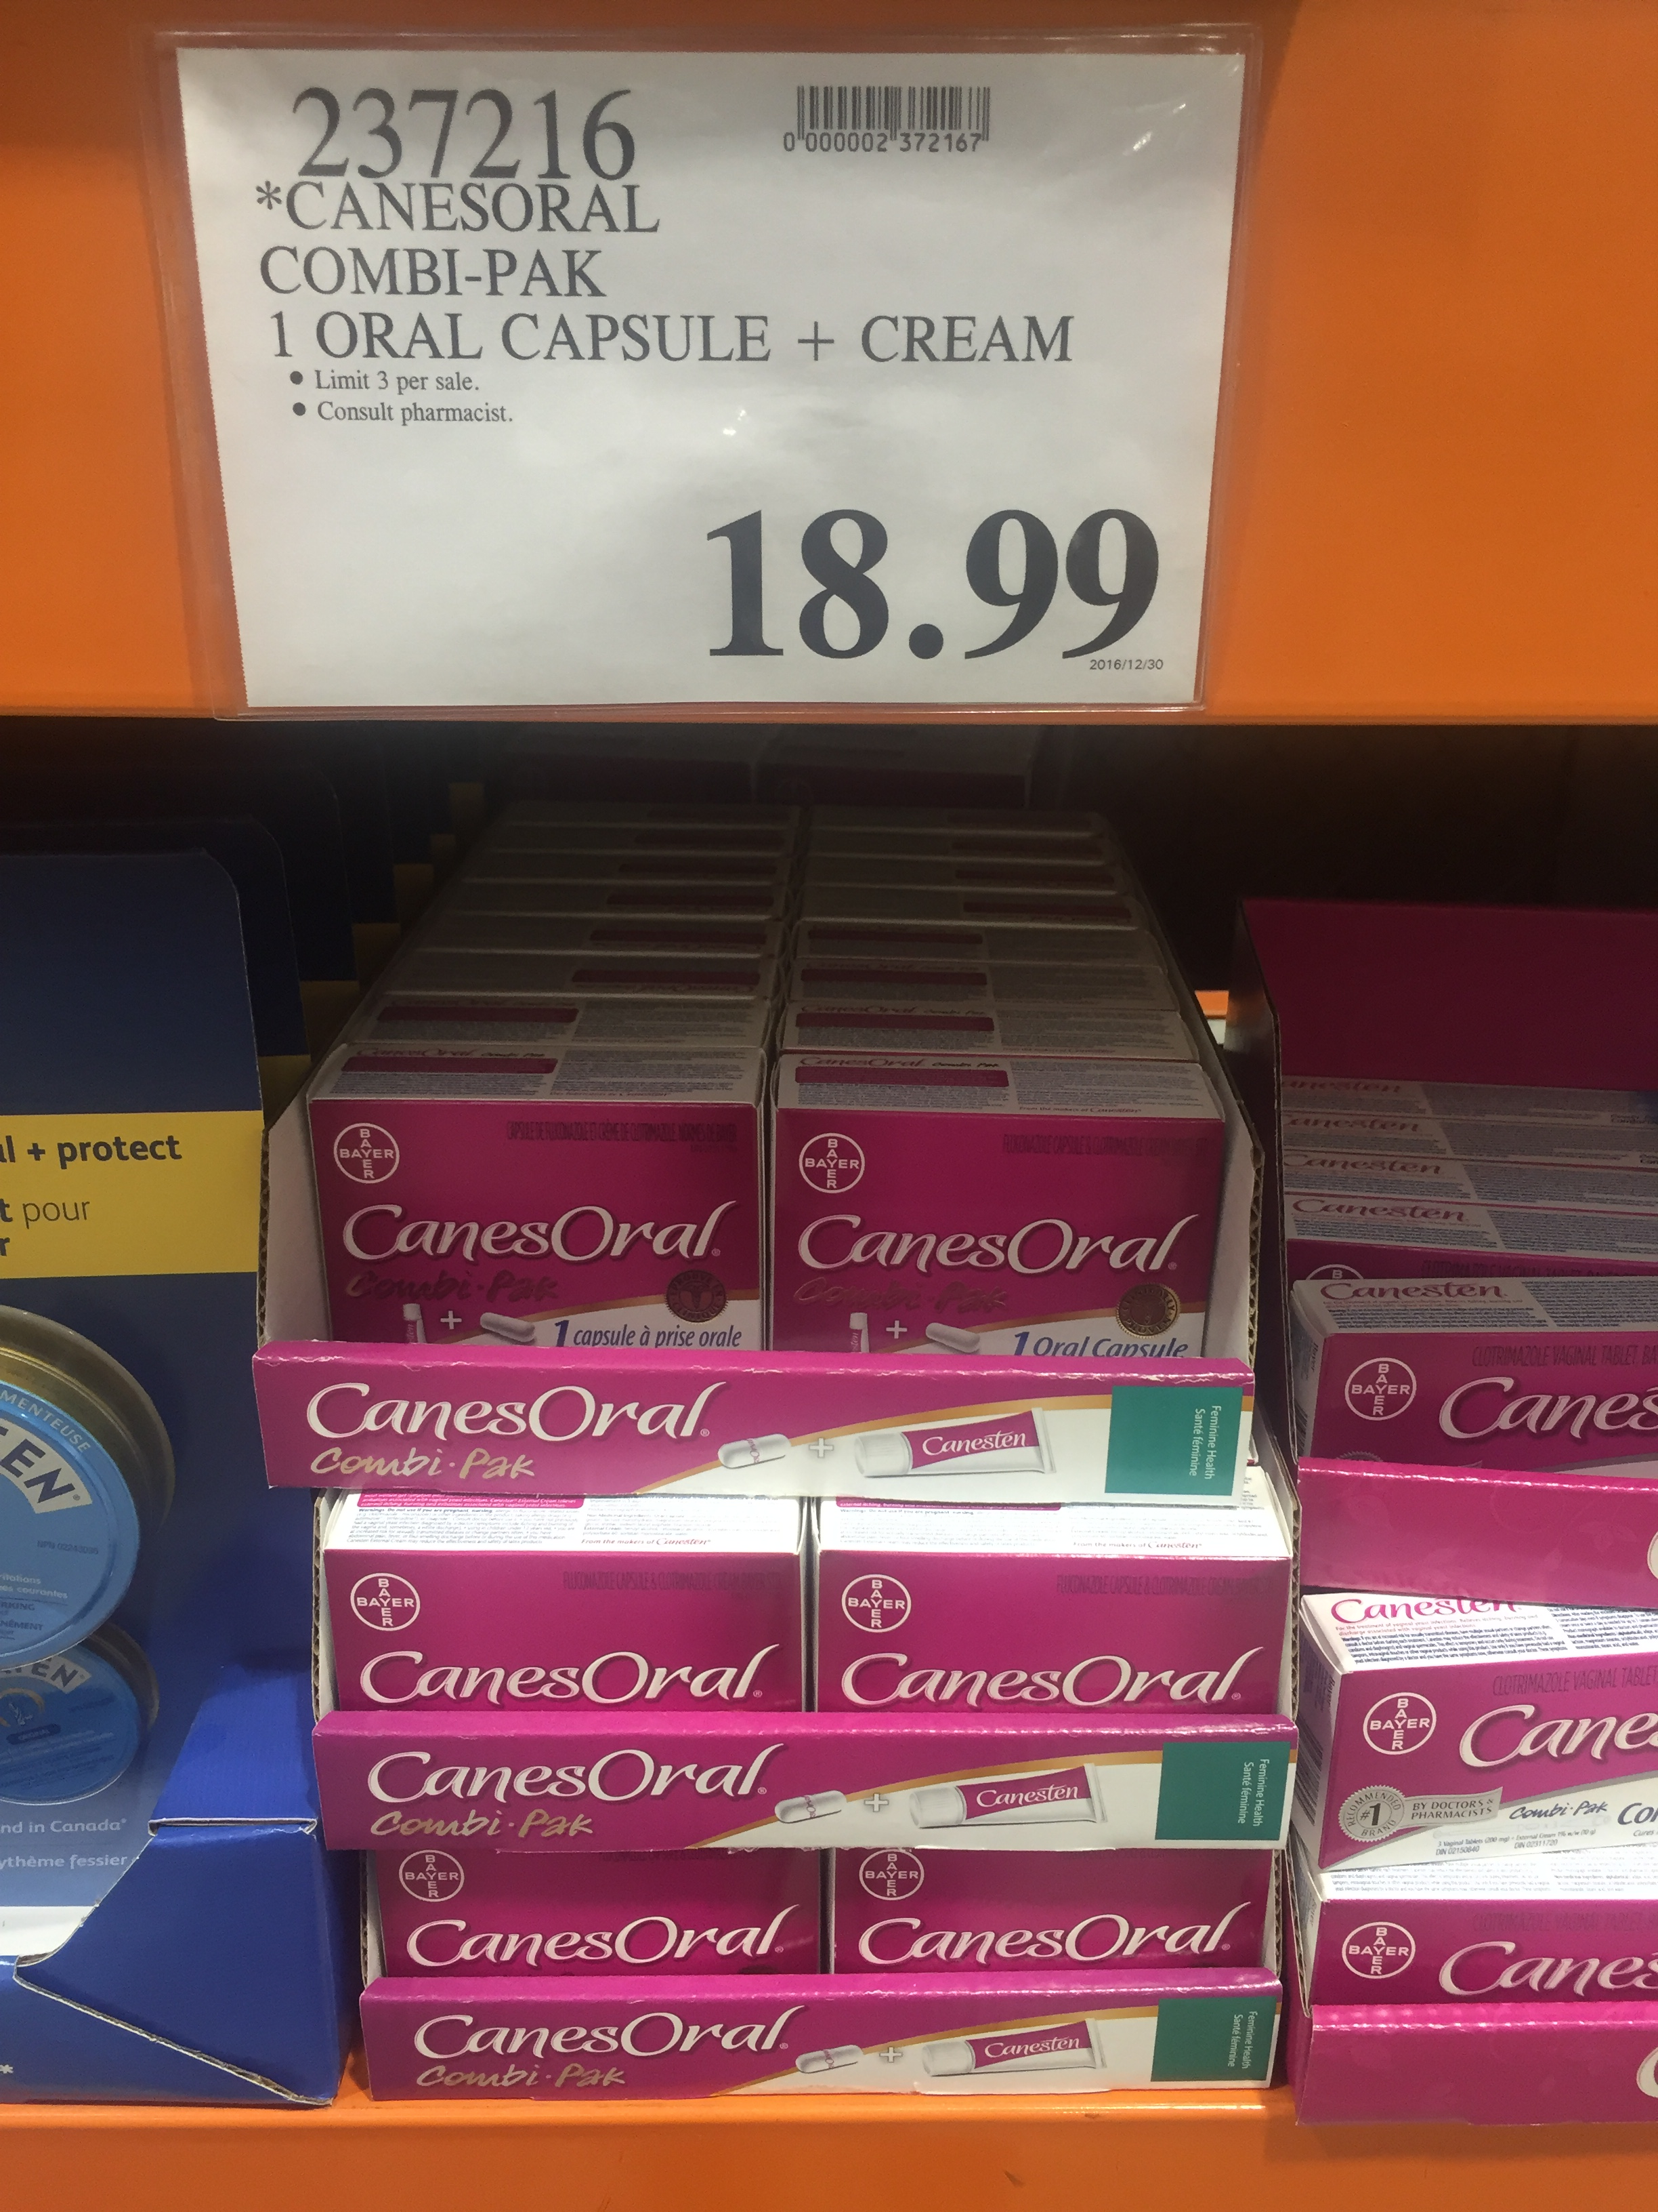
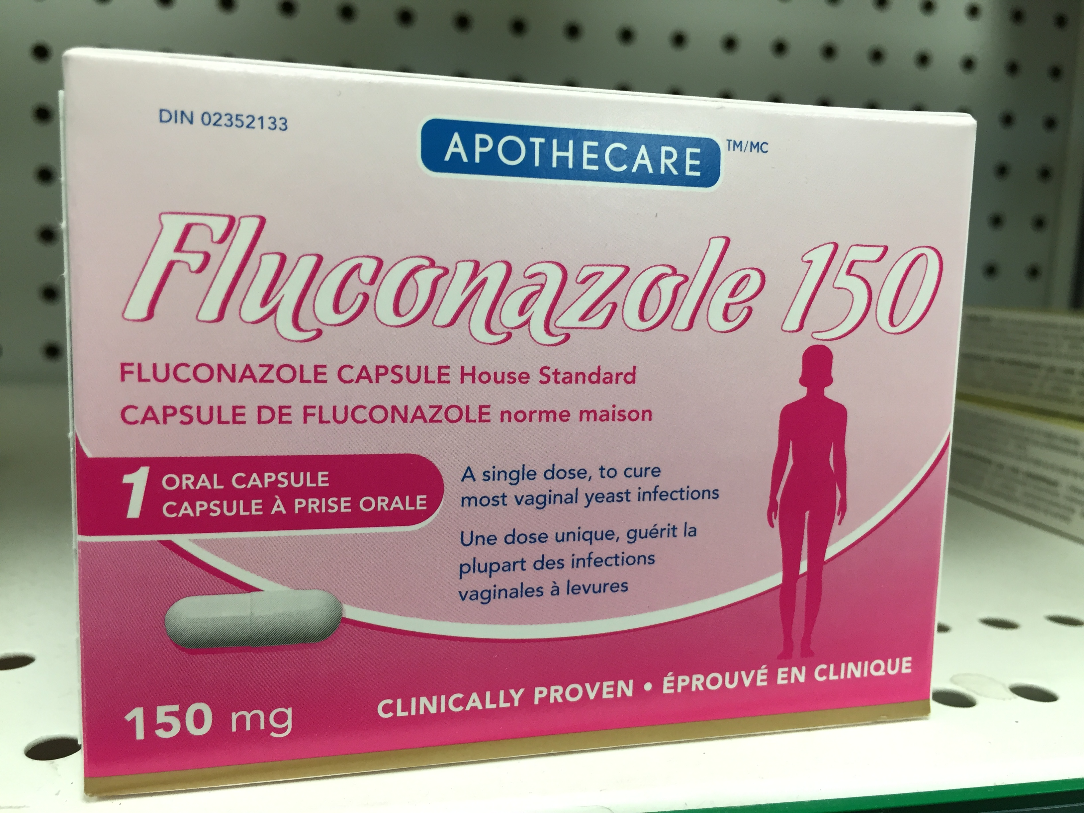
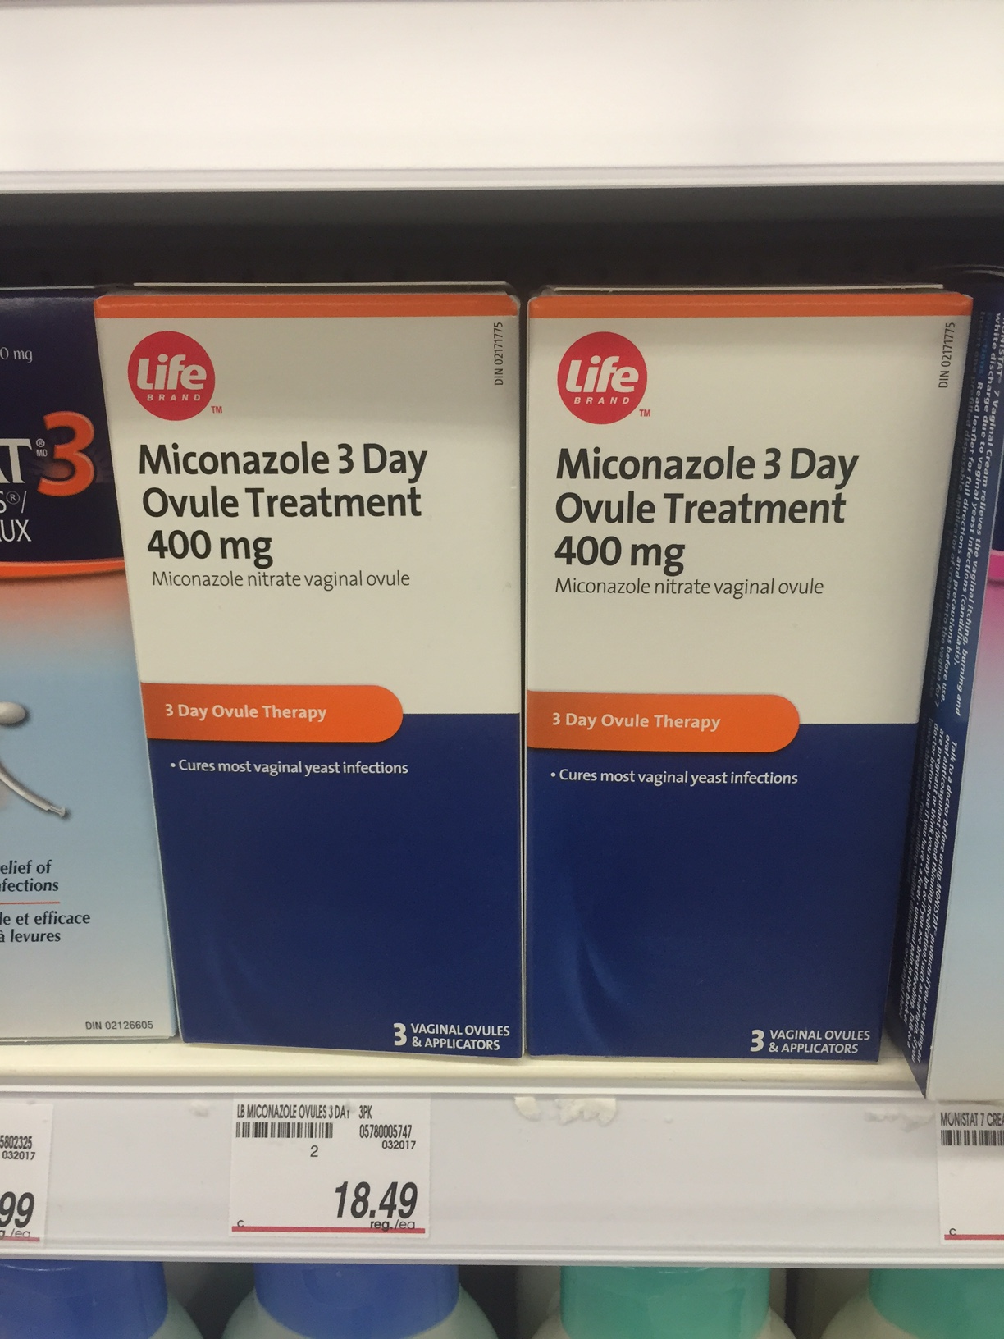
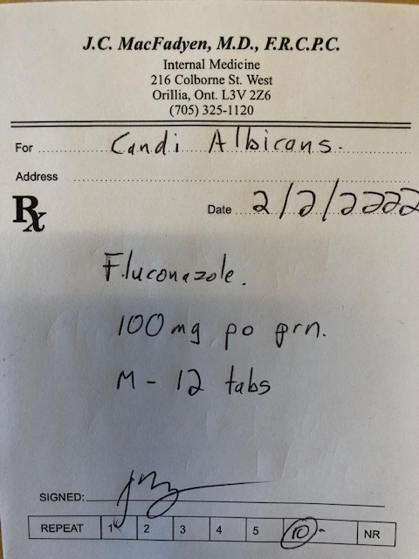
Which treatment is the most cost-effective for GMI?

Slide 40
Which treatment is the most cost-effective for GMI?

Slide 41
Fluconazole
Prescription -$3.94 per 150 mg tabs
  + dispensing fee eg. $12.99
  Annual Cost – 1/ month - $60.27
Pharmacists can prescribe for minor ailments

Slide 42
Lesson 3
Strategies to reduce patient costs will increase utilization of cardio-protective agents

Slide 43
-lowering medication that also reduces
Messaging to Patients
Our paradigm shift for SGLT-2is and GLP-1 RAs with proven benefits in CVD patients with diabetes:
A1c
risk

Slide 44
The Motivational Speech
“This is a diabetic medication that helps protect the kidneys/heart”

Slide 45
The Motivational Speech
“This is a diabetic medication that helps protect the kidneys/heart”
“This is a kidney/heart protection medication that helps the diabetes”

Slide 46
The Motivational Speech
Indication is for CV/Renal Protection
  – 30% mortality reduction
  35% reduction CHF
  30-50% reduction Kidney Failure
Benefits
  Glucose/Wt/BP
Downside
  GMI
  polyuria

Slide 47
Summary
SGLT2 Inhibitors clearly indicated for
- CHF – Reduced and Preserved
- CKD with Significant Proteinuria
In Diabetics and Non-Diabetics

Slide 48

Insert Applause Here

Slide 49

? Questions?

