Slide 1


Slide 2
Faculty/Presenter Disclosure
CFPC CoI Templates: Slide 1
Faculty: John MacFadyen, MD, FRCPC, MHPE
Relationships with commercial interests:
  Grants/Research Support: Novo Nordisk
  Speakers Bureau/Honoraria: Boehringher Ingelheim, Astra Zeneca, Sanofi, Pfizer, Lilly, Merck, Jansen, Novo-Nordisk, Abbott, Dexcom, Bayer.
  Consulting Fees: Jansen, Astra Zeneca, Liily, Novo-nordisk
Notes:
This slide must be visually presented to the audience AND verbalized by the speaker.

Slide 3
Objectives: Vascular Scientific Exchange
Review the major disclosures that took place at the VASCULAR 2023 multidisciplinary conference, and discuss the implications to clinical practice
Facilitate collaborative discussion on new guideline-directed therapies in the landscape of cardiorenal metabolic diseases, and how therapies such as SGLT2is and incretins helps close clinical care gaps.

Slide 4
What I learned on my Montreal Vacation
Review Diabetes Canada Guidelines
Review Recent relevant clinical trials
- STEP HF
- CAP-COD Trial
Cardiovascular Kidney Metabolic Syndrome - AHA
New Technology
-Icodec
CCS Fitness to Drive Guidelines

Slide 5
Diabetes Guidelines Update – Vascular 2023

Slide 6
Diabetes Guidelines Update – Vascular 2023
Organization of Care
Type 1 diabetes across the lifespan
Hypoglycemia Guidelines
NAFLD/MASLD in Diabetes
CKD and Diabetes
Pharmacologic Glycemic Management of Type 2 Diabetes Chapter and Users

Slide 7
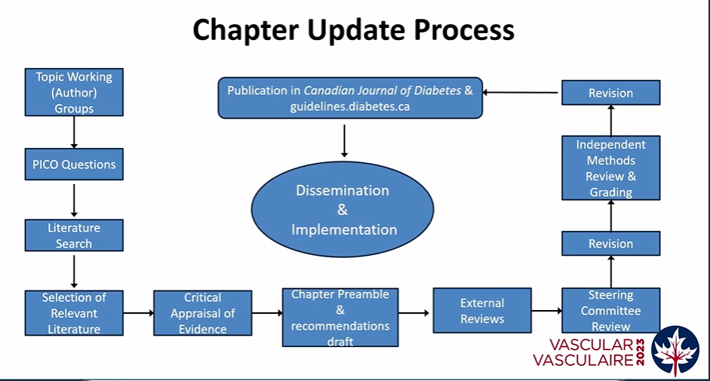

Slide 8
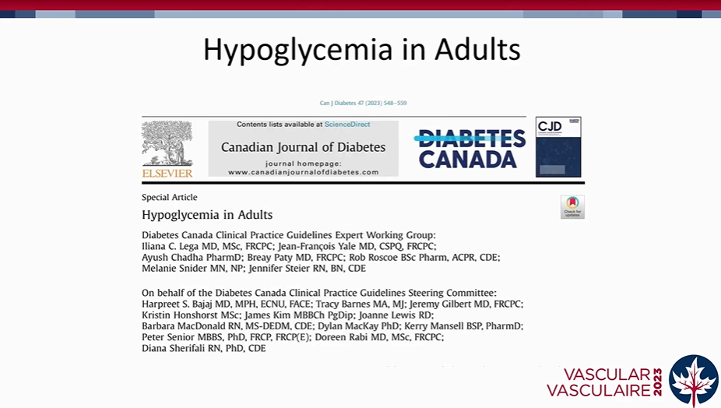
Ch

Slide 9
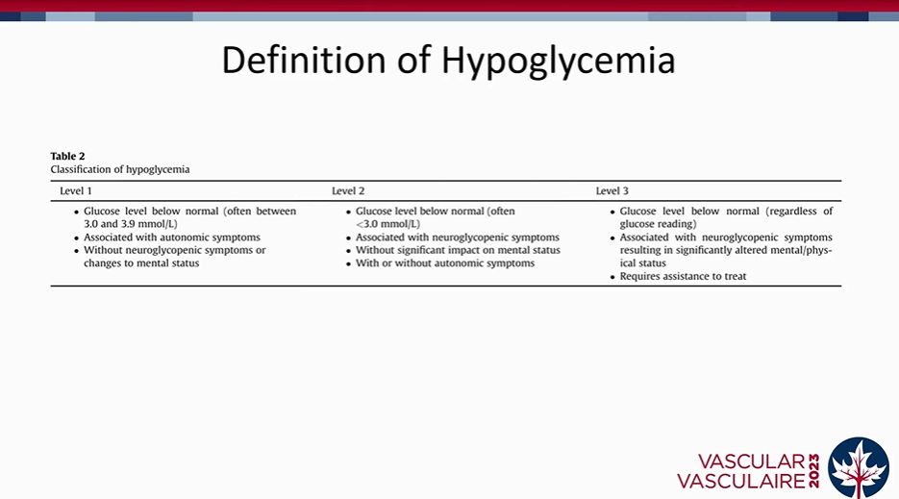

Slide 10
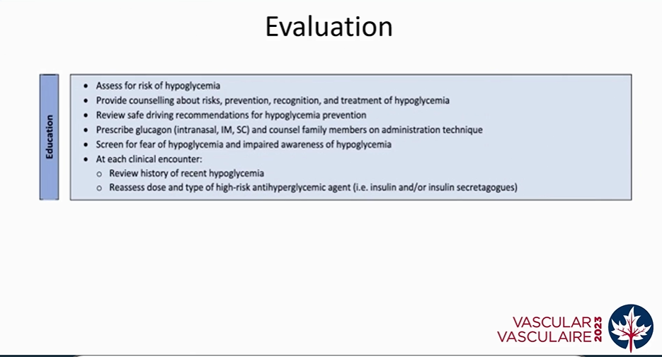

Slide 11
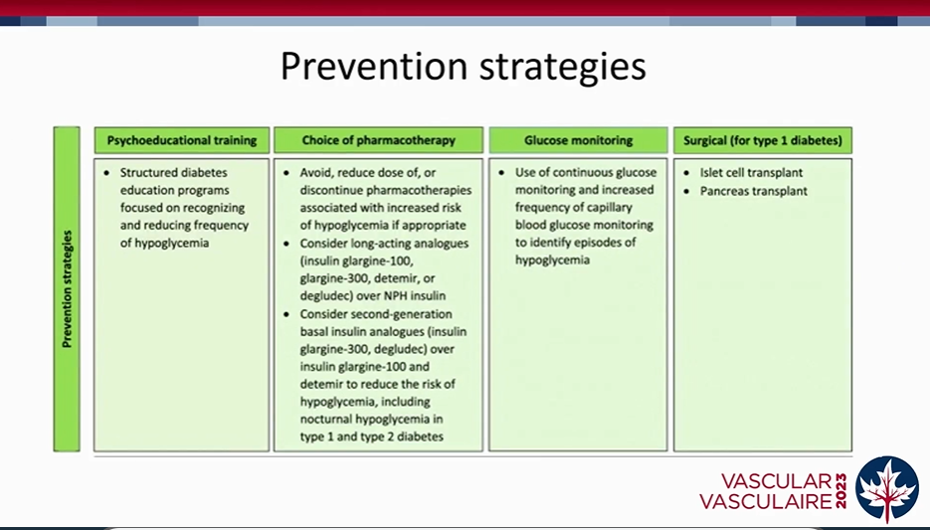

Slide 12
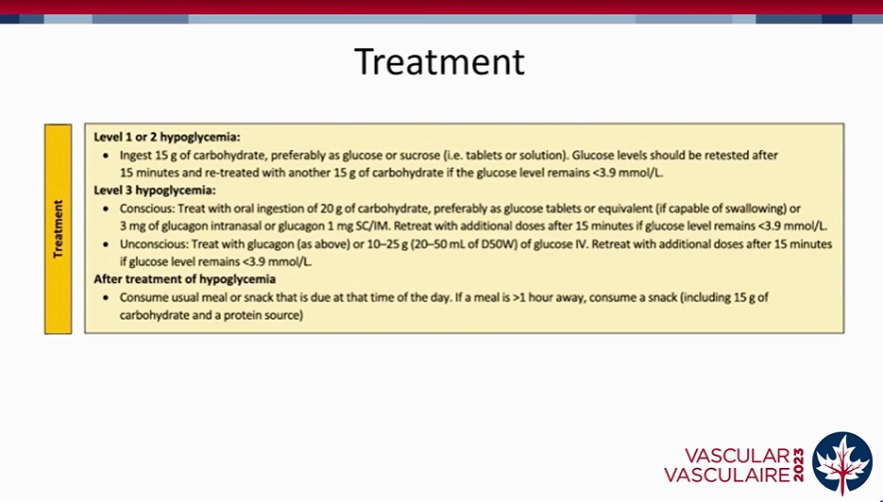

Slide 13
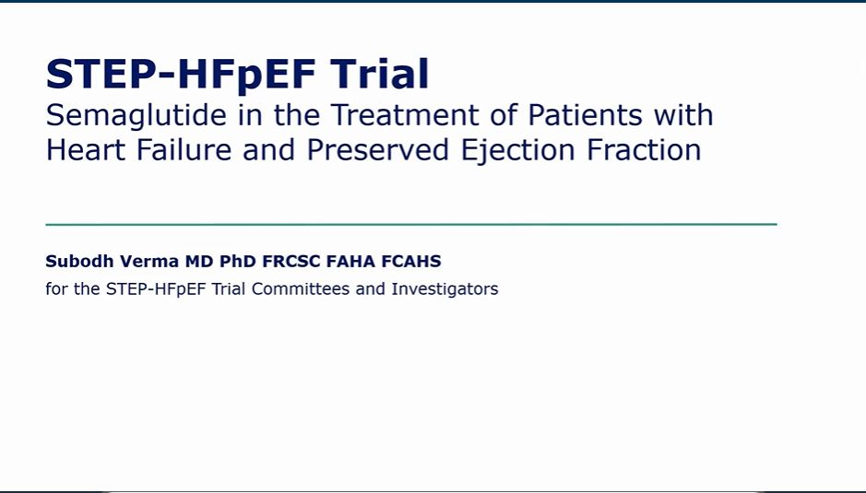

Slide 14
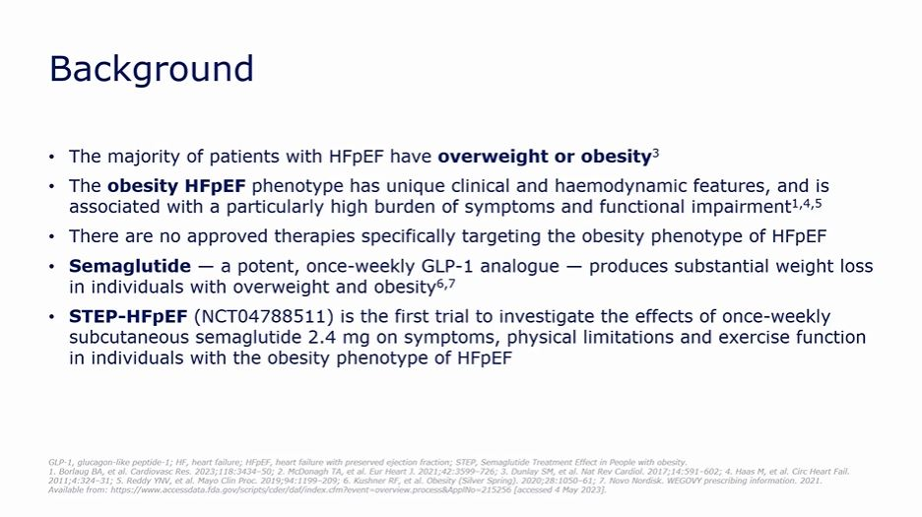

Slide 15
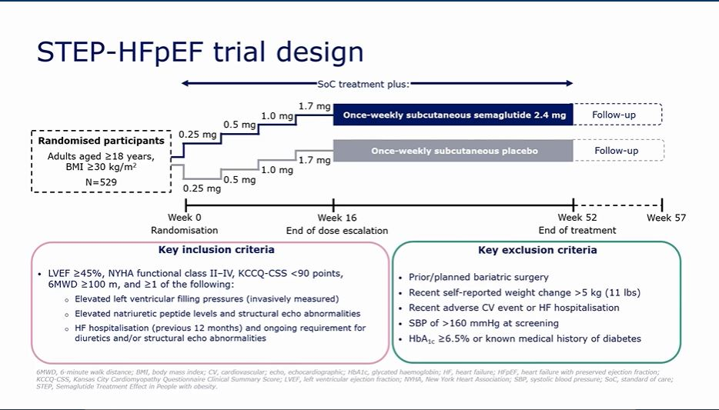

Slide 16
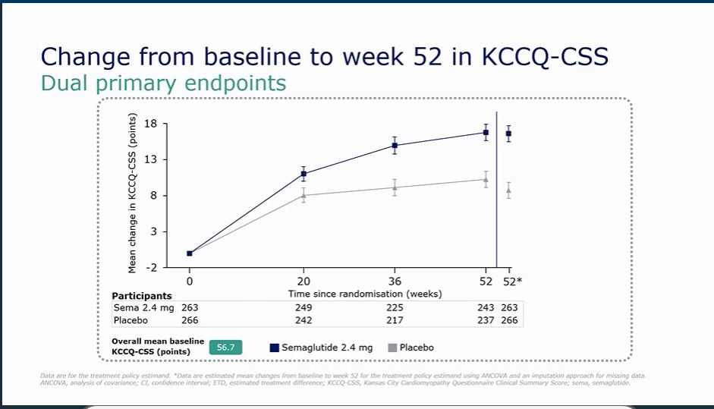

Slide 17
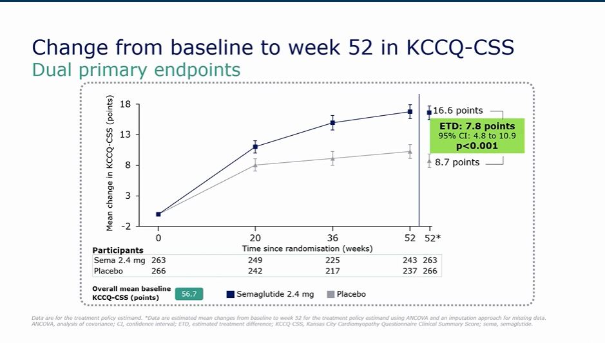

Slide 18
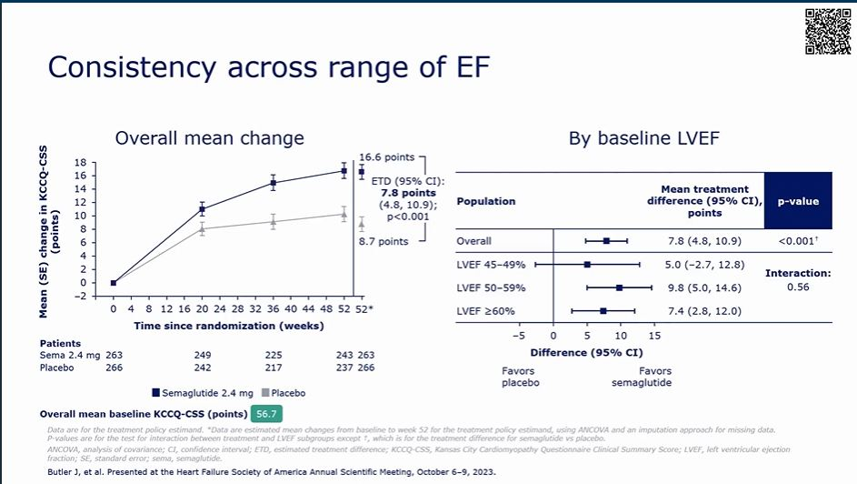

Slide 19
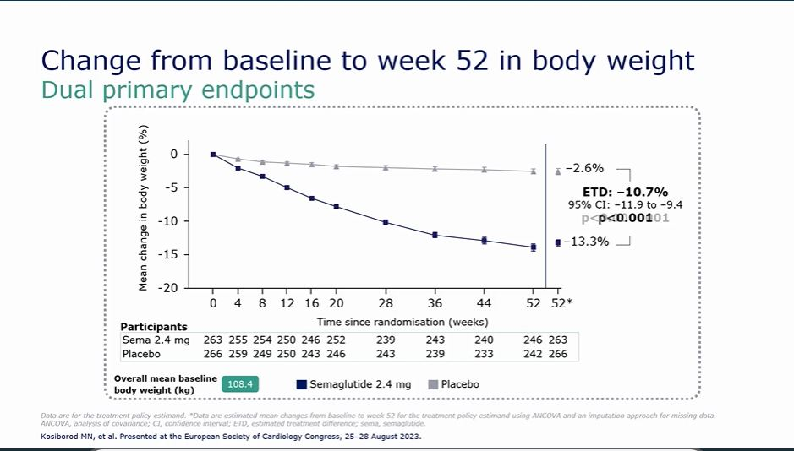

Slide 20
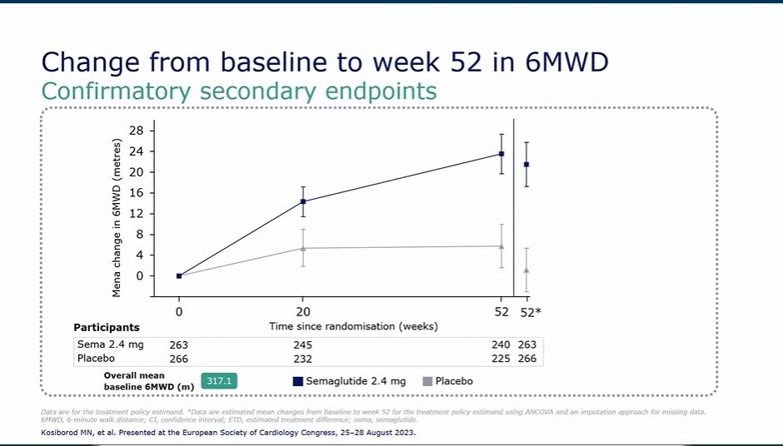

Slide 21
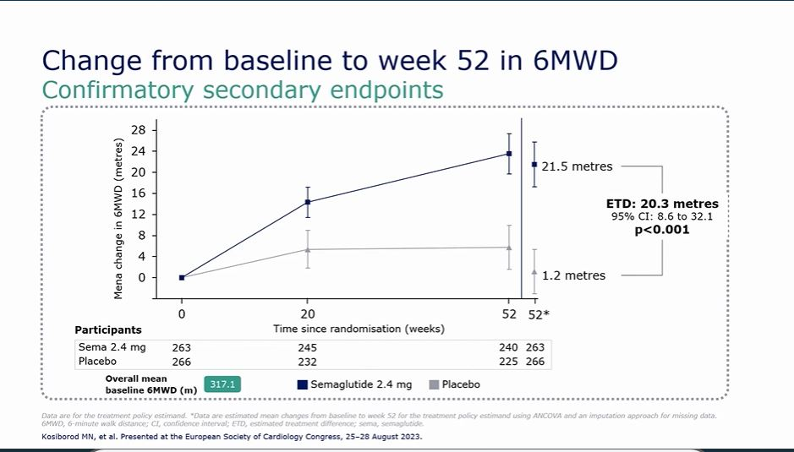

Slide 22
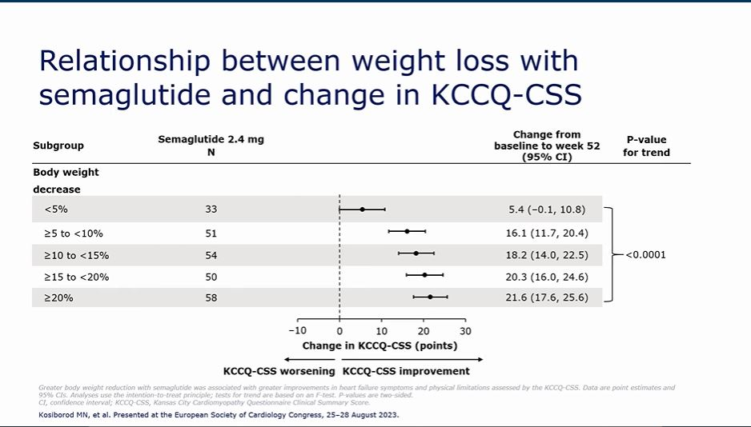

Slide 23
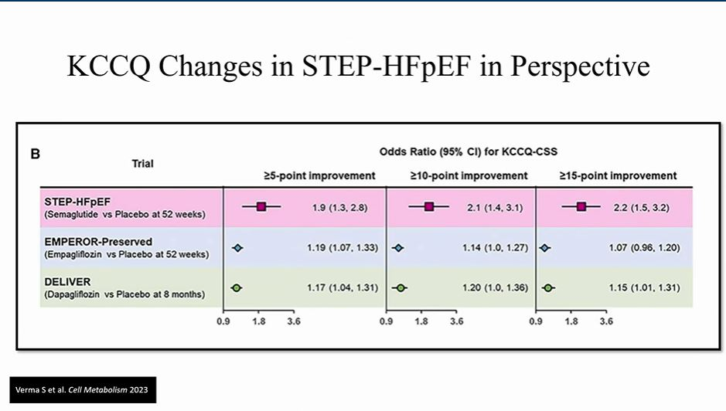

Slide 24
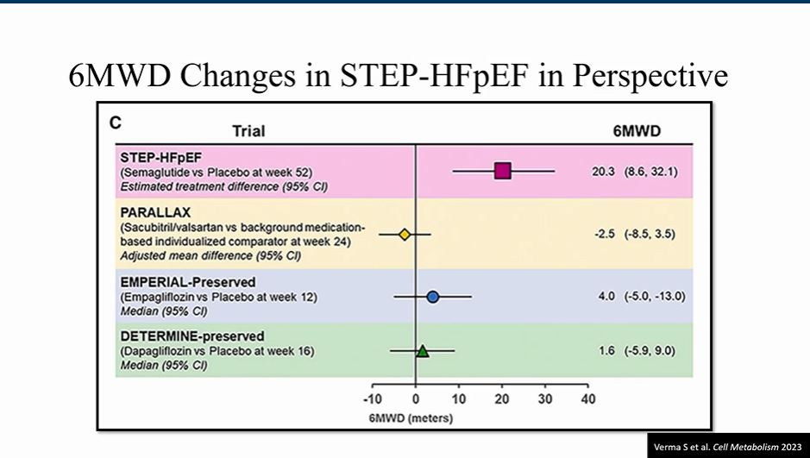

Slide 25
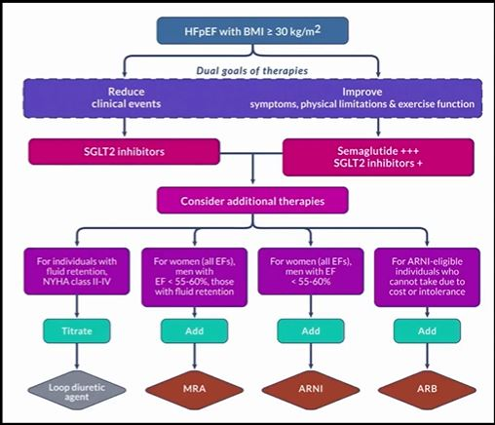

Slide 26
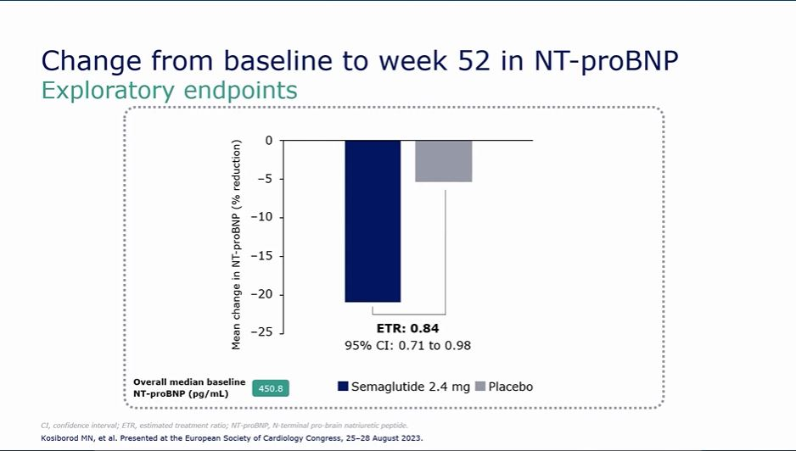

Slide 27
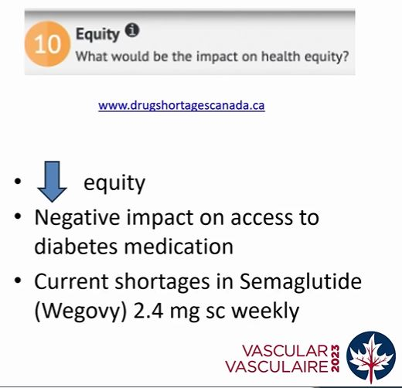

Slide 28
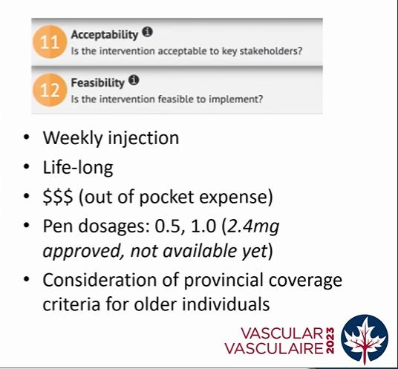

Slide 29
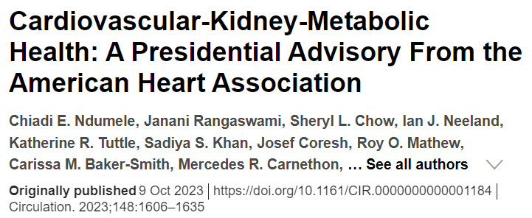
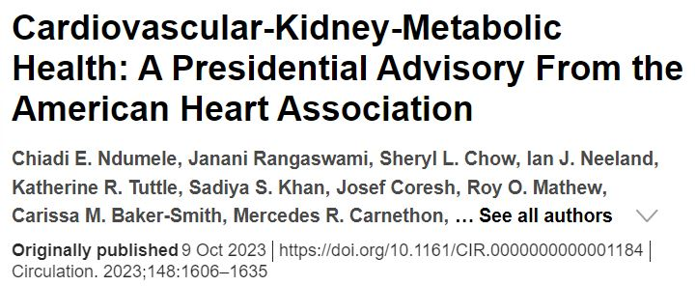

Slide 30
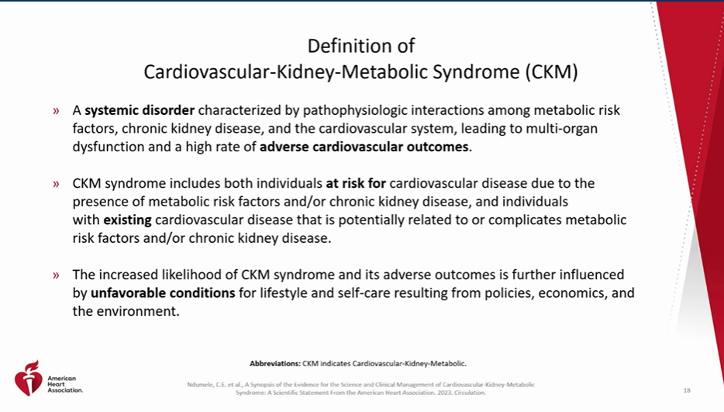

Slide 31


Slide 32

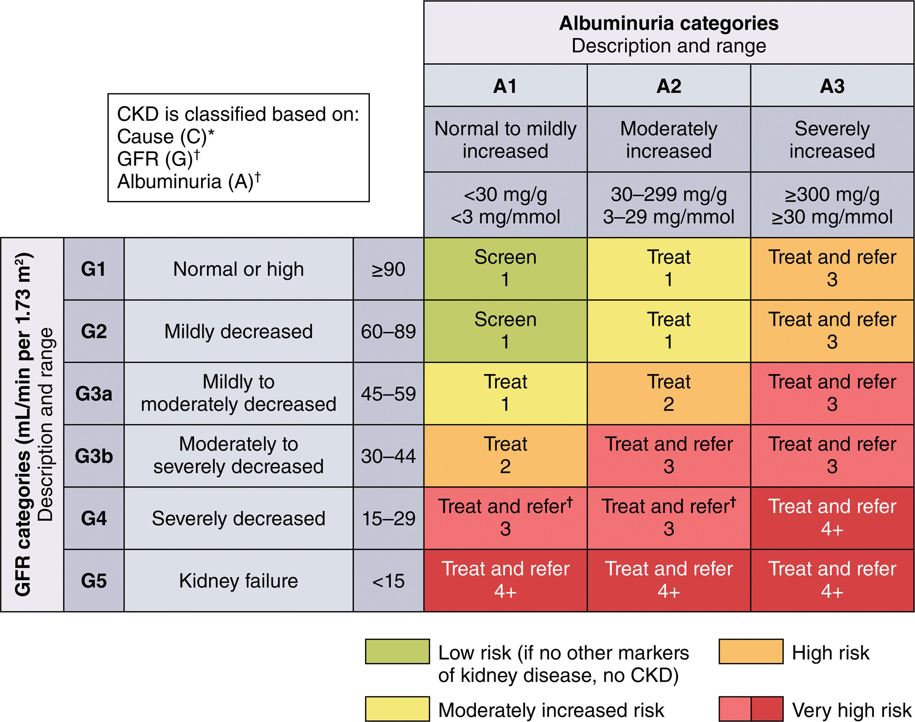

© 2023 American Heart Association, Inc.
Chiadi E. Ndumele. Circulation. Cardiovascular-Kidney-Metabolic Health: A Presidential Advisory From the American Heart Association, Volume: 148, Issue: 20, Pages: 1606-1635, DOI: (10.1161/CIR.0000000000001184)

Slide 33
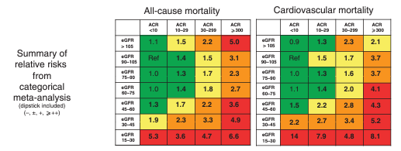

Slide 34
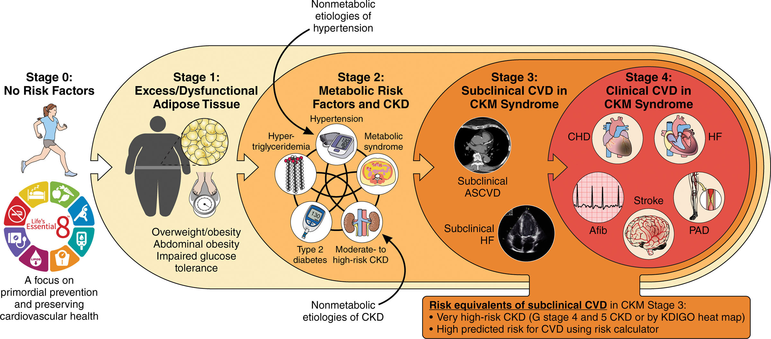
© 2023 American Heart Association, Inc.
Chiadi E. Ndumele. Circulation. Cardiovascular-Kidney-Metabolic Health: A Presidential Advisory From the American Heart Association, Volume: 148, Issue: 20, Pages: 1606-1635, DOI: (10.1161/CIR.0000000000001184)

Slide 35
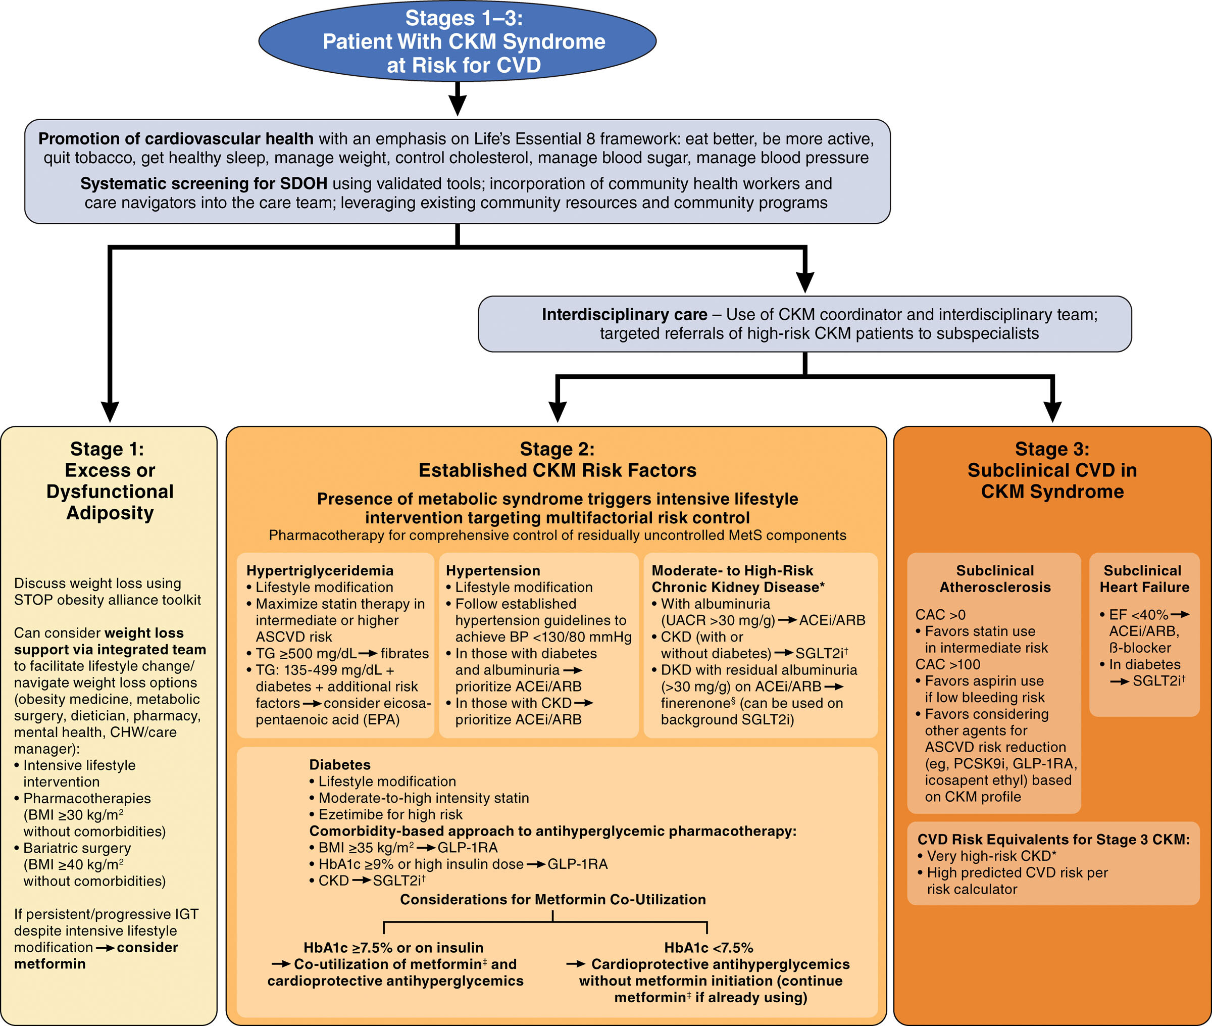
© 2023 American Heart Association, Inc.
Chiadi E. Ndumele. Circulation. Cardiovascular-Kidney-Metabolic Health: A Presidential Advisory From the American Heart Association, Volume: 148, Issue: 20, Pages: 1606-1635, DOI: (10.1161/CIR.0000000000001184)

Slide 36

CKM Syndrome and Metformin

Slide 37
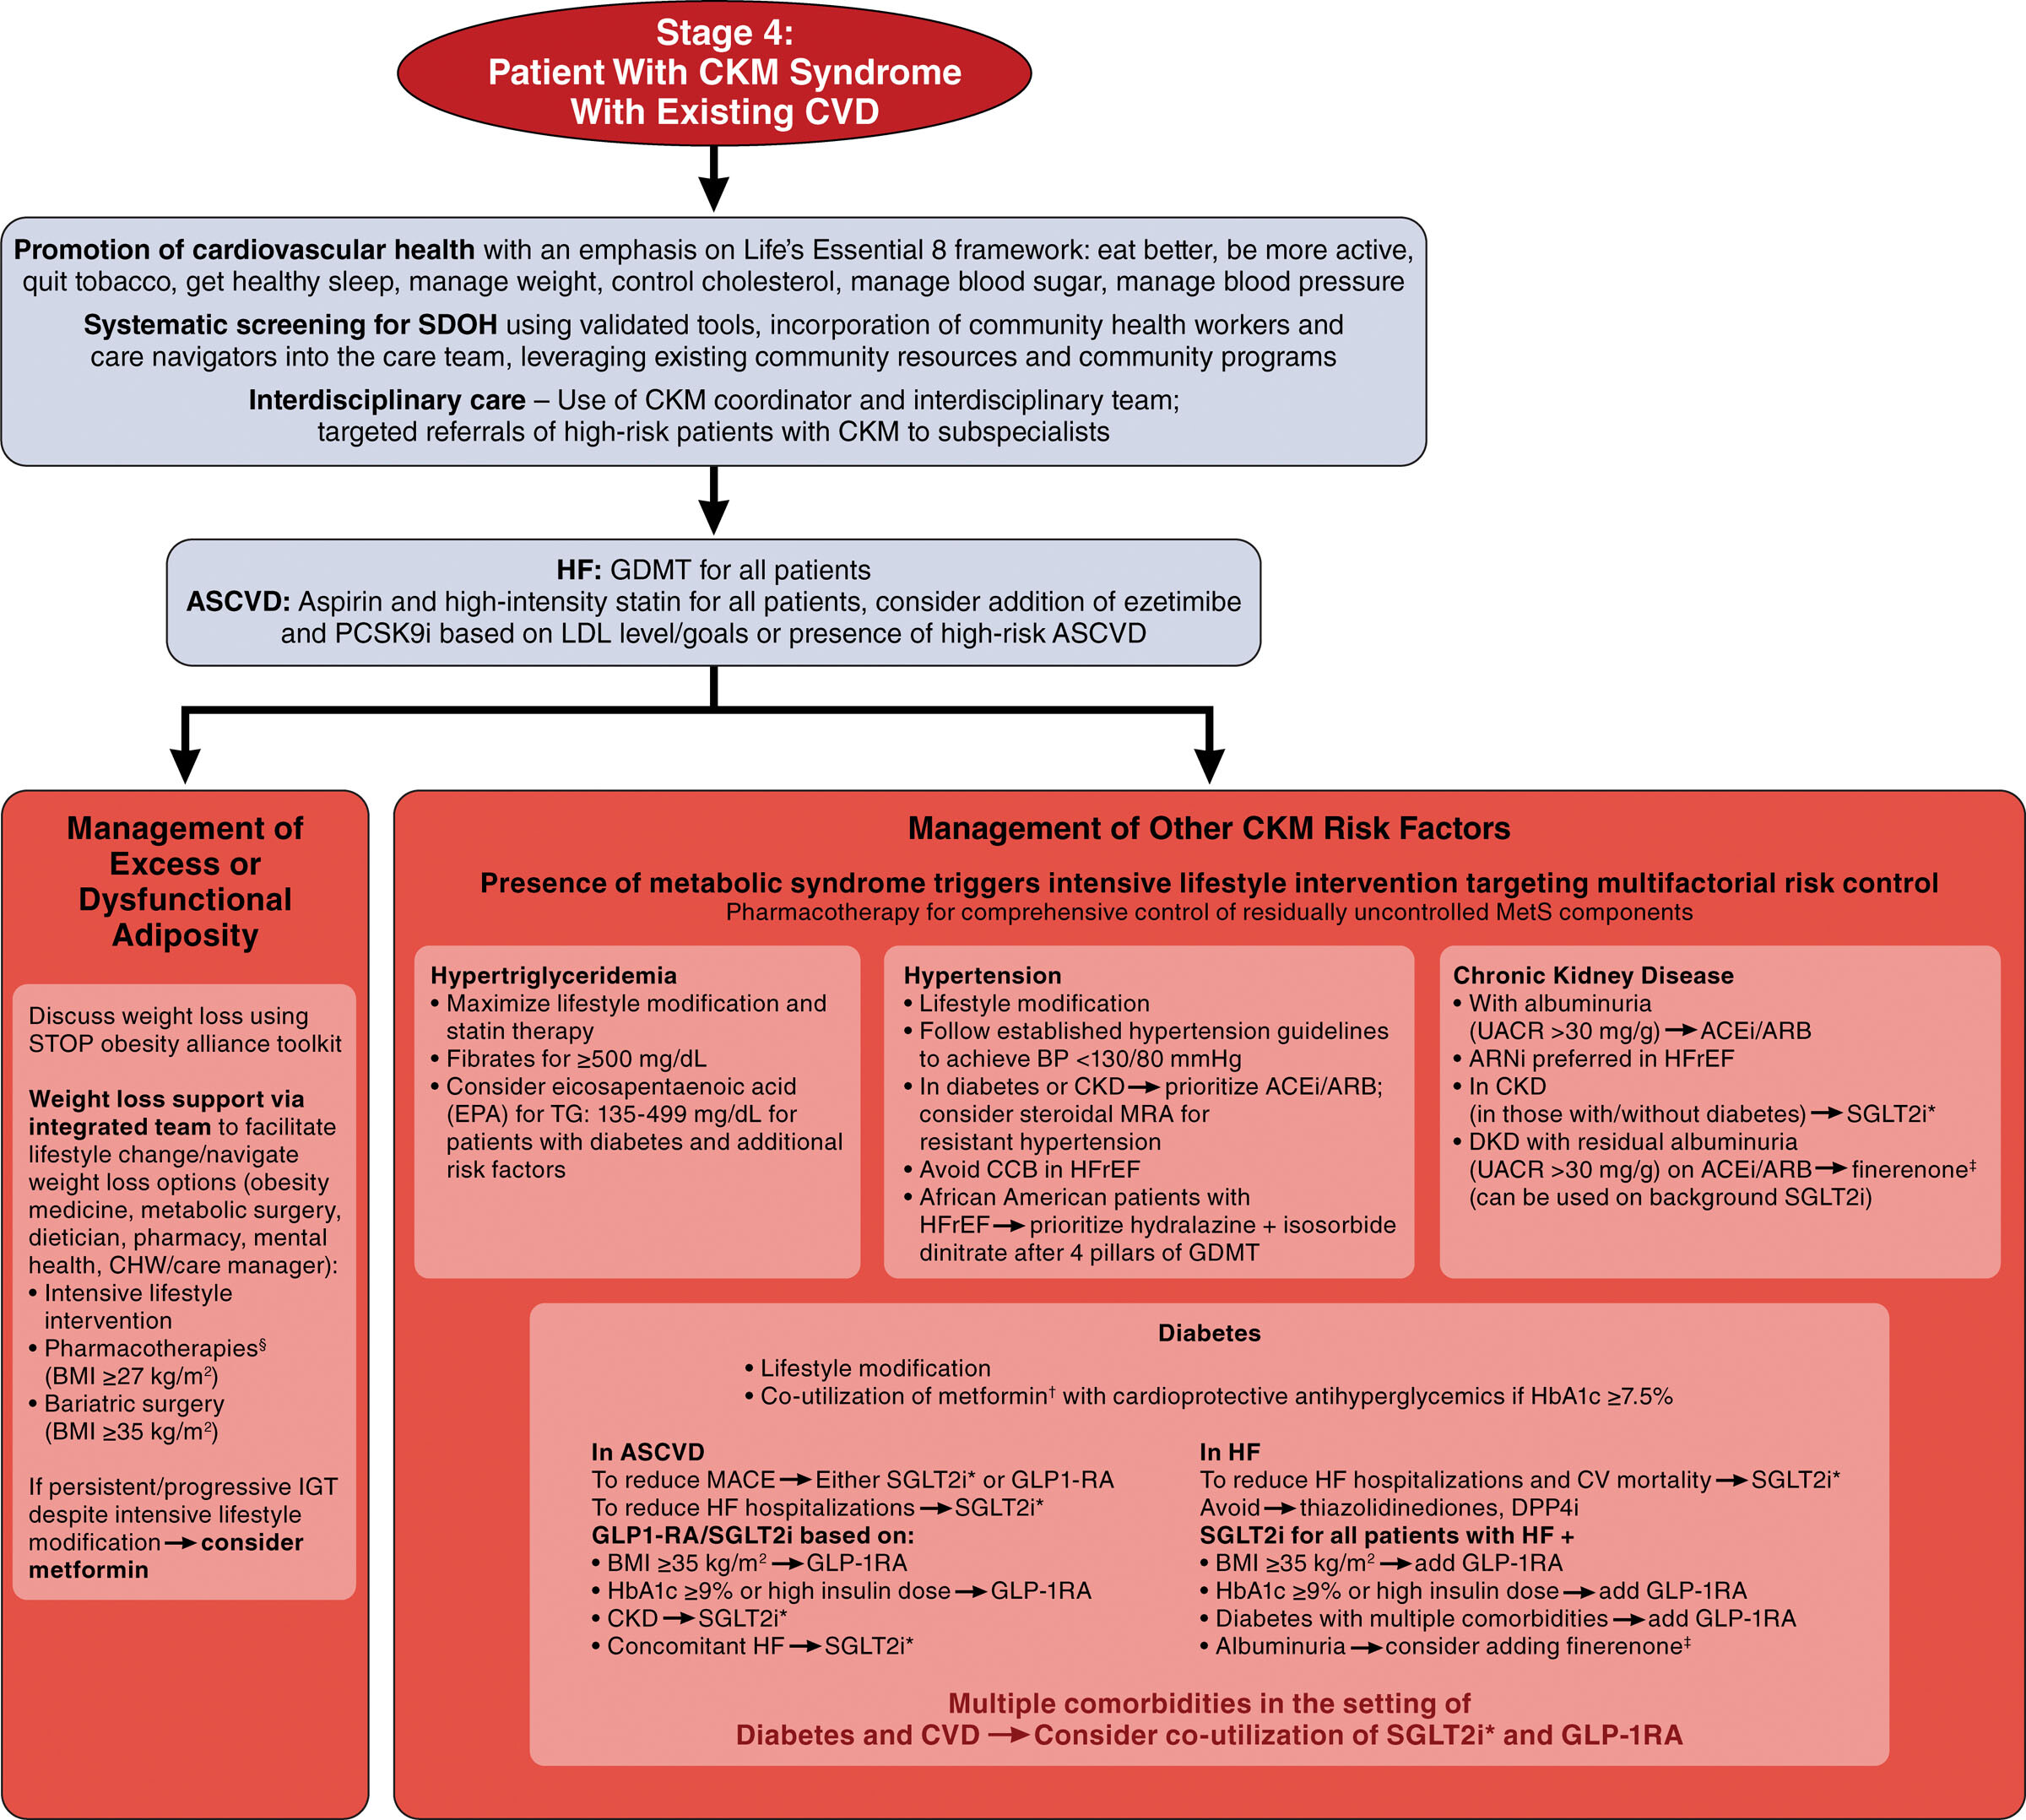
© 2023 American Heart Association, Inc.
Chiadi E. Ndumele. Circulation. Cardiovascular-Kidney-Metabolic Health: A Presidential Advisory From the American Heart Association, Volume: 148, Issue: 20, Pages: 1606-1635, DOI: (10.1161/CIR.0000000000001184)

Slide 38
PREVENT AHA Risk Calculator
Outcomes
          CAD/CVA
            +
          CHF
Risk Factors
  Traditional – Smoking/HT/Chol/Meds/DM
  +
  eGFR, A1C, ACR, SDI (Social Depravation index) +

Slide 39
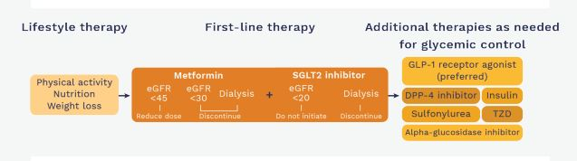
KDIGO – Diabetic Nephropathy

Slide 40
1998
It doesn’t matter how you improve the A1C
It matters that you improve the A1C

Slide 41
2023
It doesn’t matter that you improve the A1C
,
It matters how you reduce the A1C

Slide 42

Whose Job Is It Anyways?

Slide 43
Whose Job Is It Anyways?
Initiating Cardiac and Renal Protective Strategies
Cardio
Nephro
Endo
Primary Care
General
Internist

Slide 44
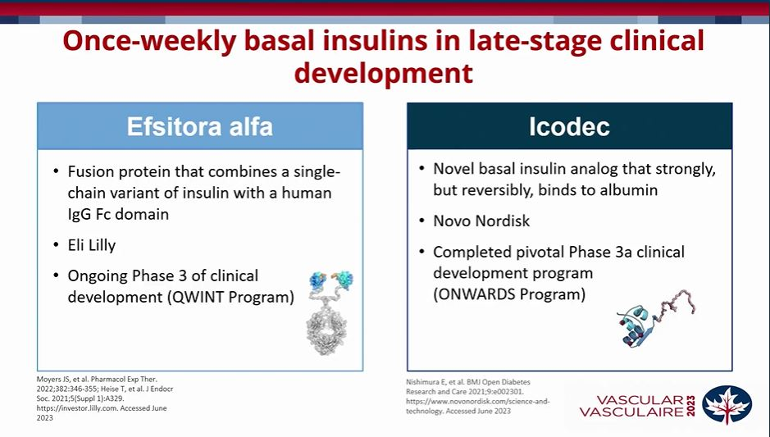

Slide 45
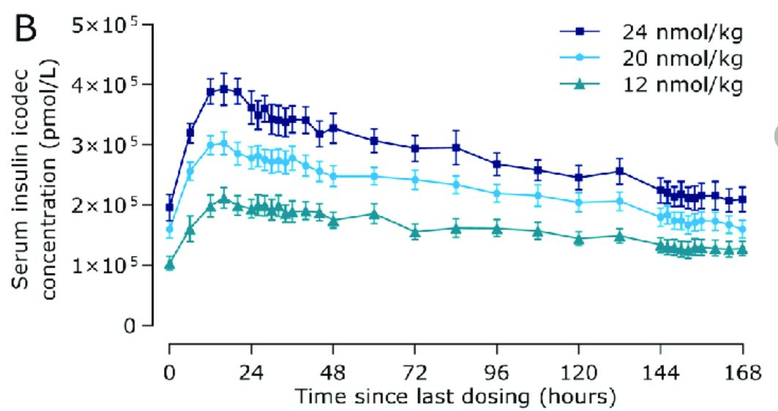

Slide 46
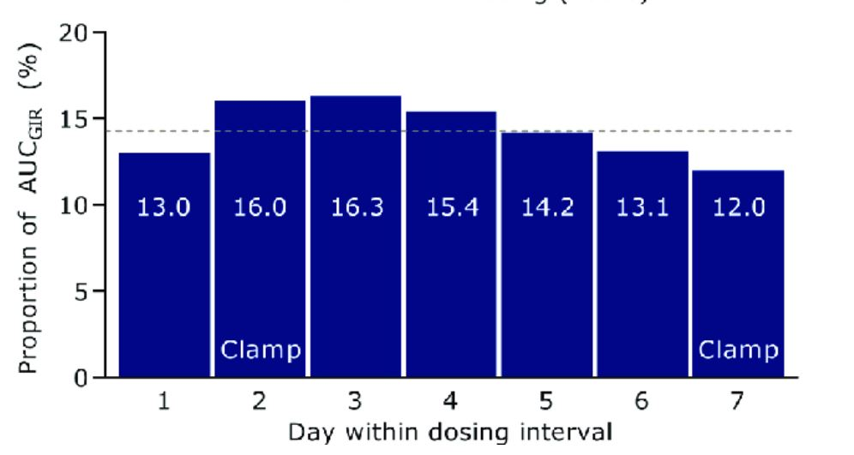

Slide 47
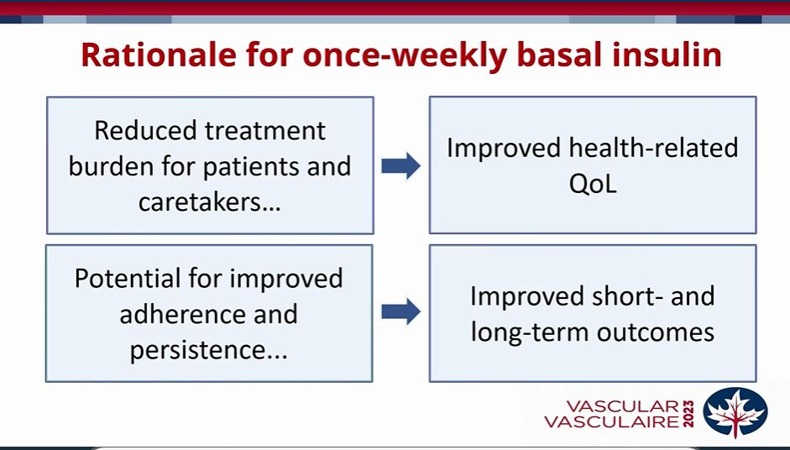

Slide 48
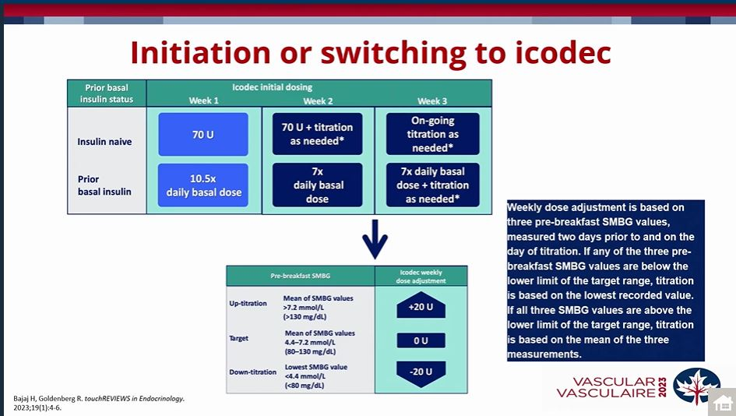

Slide 49
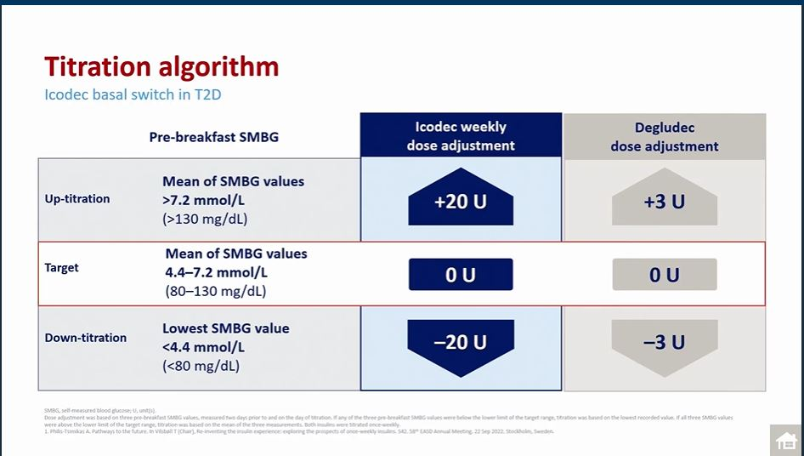

Slide 50
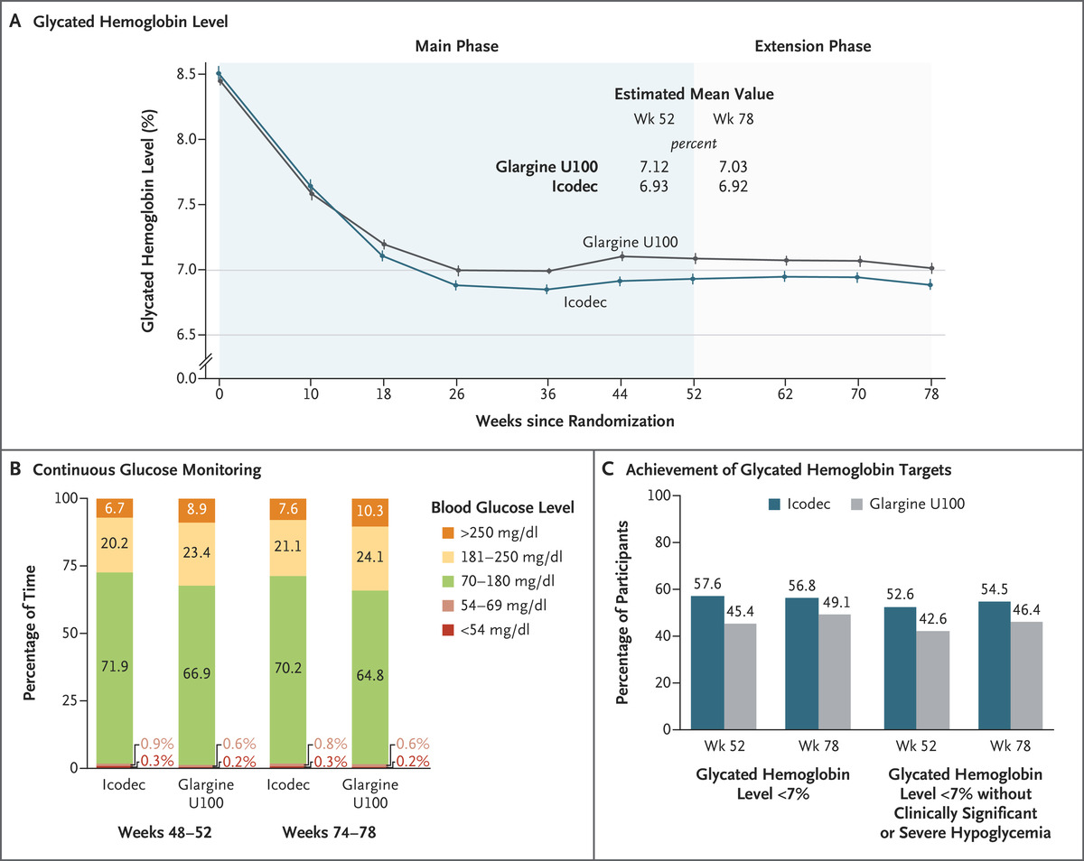

Key End Points.
J Rosenstock et al. N Engl J Med 2023;389:297-308.
Notes:
Figure 1. Key End Points. Panel A shows mean glycated hemoglobin levels from baseline to week 78 among participants who received either once-weekly insulin icodec or once-daily insulin glargine U100. Estimated mean values at weeks 52 and 78 were derived on the basis of multiple imputation. To convert values for glycated hemoglobin to millimoles per mole, multiply by 10.93 and then subtract 23.50. Error bars indicate standard errors. Panel B shows the percentage of time spent at various glucose levels in weeks 48 to 52 and in weeks 74 to 78 as measured by continuous glucose monitoring. The target glycemic range was 70 to 180 mg per deciliter (3.9 to 10.0 mmol per liter). To convert values for glucose to millimoles per liter, multiply by 0.05551. Panel C shows the estimated percentage of participants who reached a glycated hemoglobin level below 7% and the percentage who reached a glycated hemoglobin level below 7% without clinically significant or severe hypoglycemia in the preceding 12 weeks. Clinically significant hypoglycemia (level 2) is defined as a blood glucose level of less than 54 mg per deciliter (<3.0 mmol per liter), confirmed with a blood glucose meter. Severe hypoglycemia (level 3) is defined as hypoglycemia with severe cognitive impairment requiring external assistance for recovery.

Slide 51
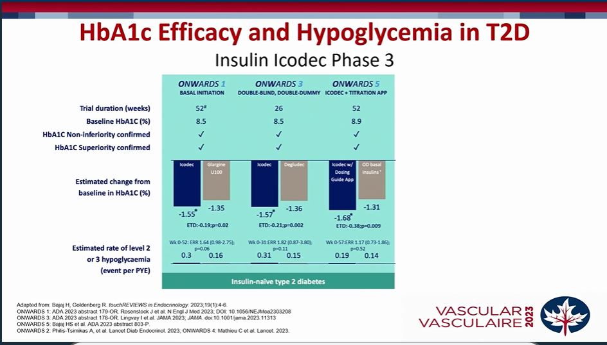

Slide 52
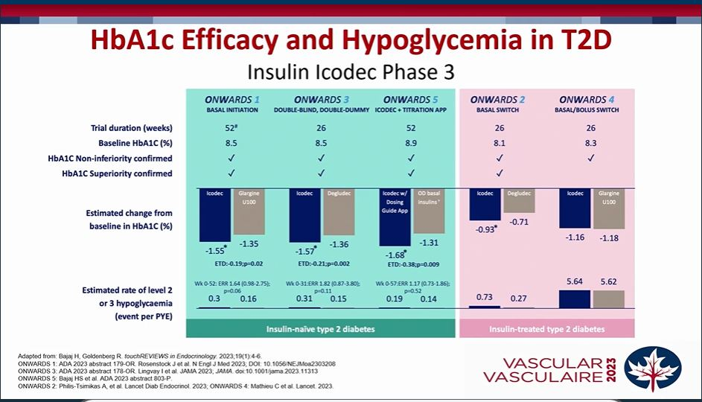

Slide 53
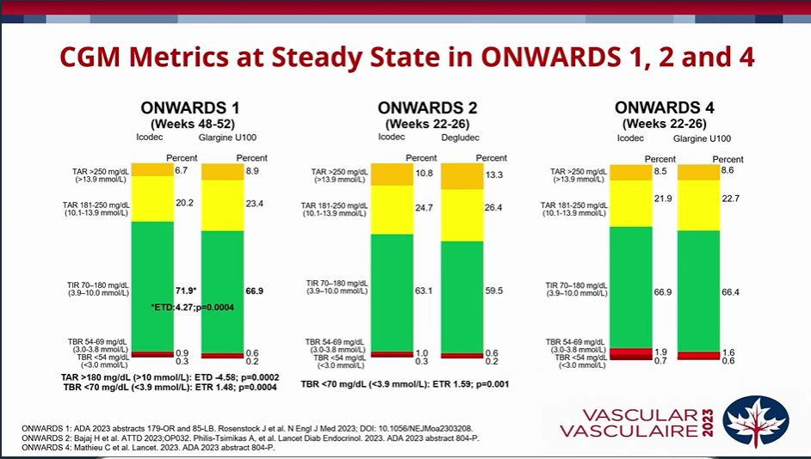

Slide 54

Once-weekly insulin icodec versus once-daily insulin degludec as part of a basal-bolus regimen in individuals with type 1 diabetes (ONWARDS 6): a phase 3a, randomised, open-label, treat-to-target trial
Prof David Russell-Jones, MD, Prof Tetsuya Babazono, MD, Roman Cailleteau, MD, Susanne Engberg, MD, Prof Concetta Irace, MD, Maiken Ina Siegismund Kjaersgaard, PhD, Prof Chantal Mathieu, MD, Julio Rosenstock, MD, Vincent Woo, MD, David C Klonoff, MD
The Lancet
Volume 402 Issue 10413 Pages 1636-1647 (November 2023)
DOI: 10.1016/S0140-6736(23)02179-7
Copyright © 2023 The Author(s). Published by Elsevier Ltd. This is an Open Access article under the CC BY 4.0 license Terms and Conditions

Slide 55
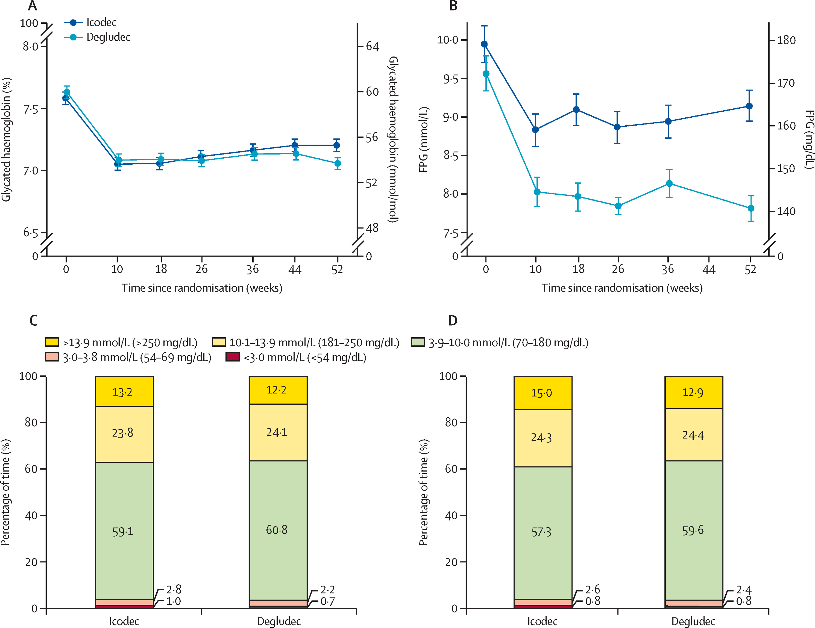
Figure 2
The Lancet 2023 4021636-1647DOI: (10.1016/S0140-6736(23)02179-7)
Copyright © 2023 The Author(s). Published by Elsevier Ltd. This is an Open Access article under the CC BY 4.0 license Terms and Conditions
Notes:
Glycaemic outcomes
(A) Mean HbA1c glycated haemoglobin concentrations over time among participants who received once-weekly icodec and once-daily degludec; graph shows mean (SE: error bars). (B) Mean FPG concentrations over time among participants who received once-weekly icodec and once-daily degludec; graph shows mean (SE: error bars). FPG was measured on the day of insulin titration. (C) Continuous glucose monitoring metrics assessed as observed means during weeks 22–26. The percentage of time is defined as 100 times the number of recorded measurements in a given range, divided by the total number of recorded measurements. Calculated approximate time with glucose concentrations above 10·0 mmol/L (>180 mg/dL): 8 h and 53 min per day for icodec compared with 8 h and 42 min per day for degludec. Calculated approximate time with glucose concentrations of 3·9–10·0 mmol/L (70–180 mg/dL) 14 h and 11 min per day for icodec compared with 14 h and 36 min per day for degludec. Calculated approximate time with glucose concentrations below 3·0 mmol/L (54 mg/dL) 15 min per day for icodec compared with 10 min per day for degludec. (D) Continuous glucose monitoring metrics assessed as observed means during weeks 48–52. The percentage of time is defined as 100 times the number of recorded measurements in a given range, divided by the total number of recorded measurements. Calculated approximate time with glucose concentrations above 10·0 mmol/L (>180 mg/dL) 9 h and 26 min per day for icodec compared with 8 h and 56 min per day for degludec. Calculated approximate time with glucose concentrations of 3·9–10·0 mmol/L (70–180 mg/dL) 13 h and 45 m per day for icodec compared with 14 h and 18 min per day for degludec. Calculated approximate time with glucose concentrations below 3·0 mmol/L (54 mg/dL) 12 min per day for icodec compared with 12 min per day for degludec. Degludec=insulin degludec. FPG=fasting plasma glucose.

Slide 56
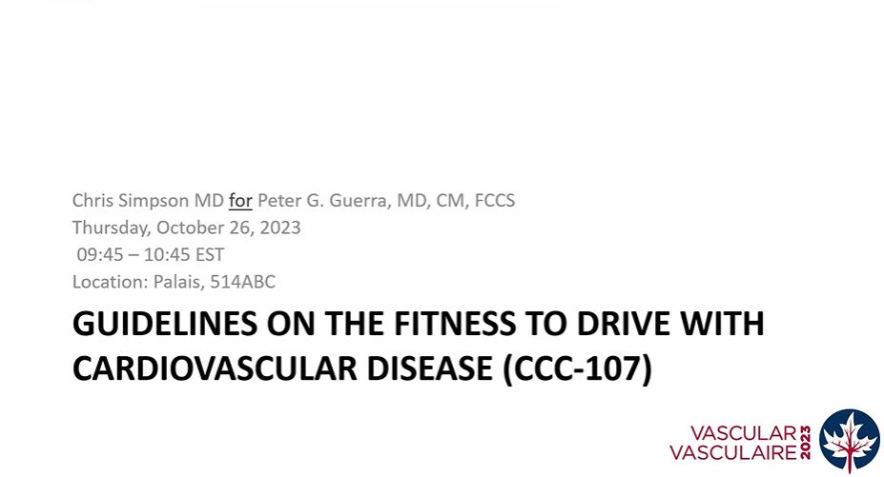

Slide 57
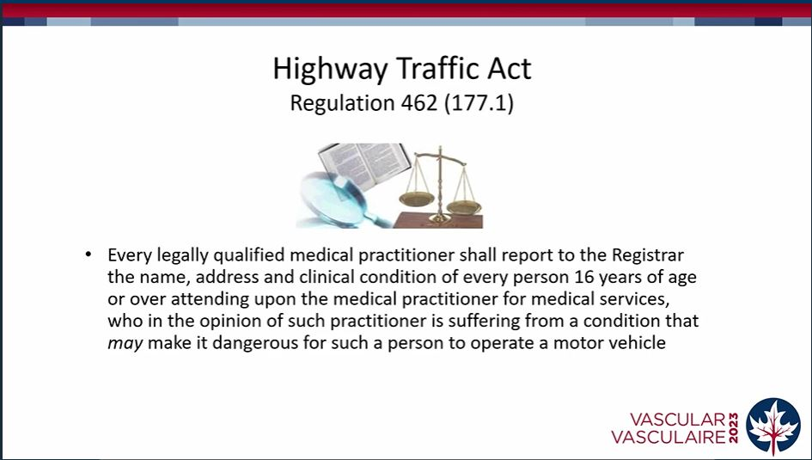

Slide 58
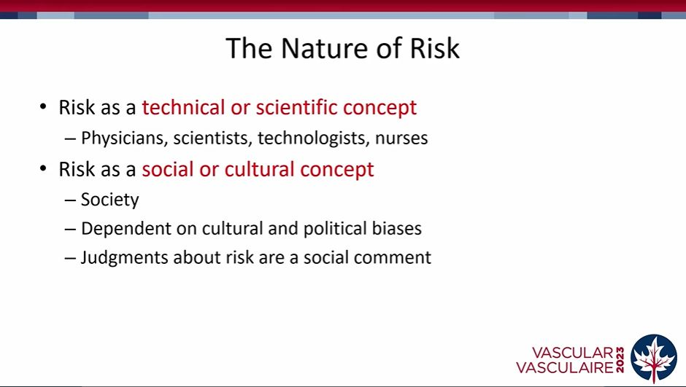

Slide 59
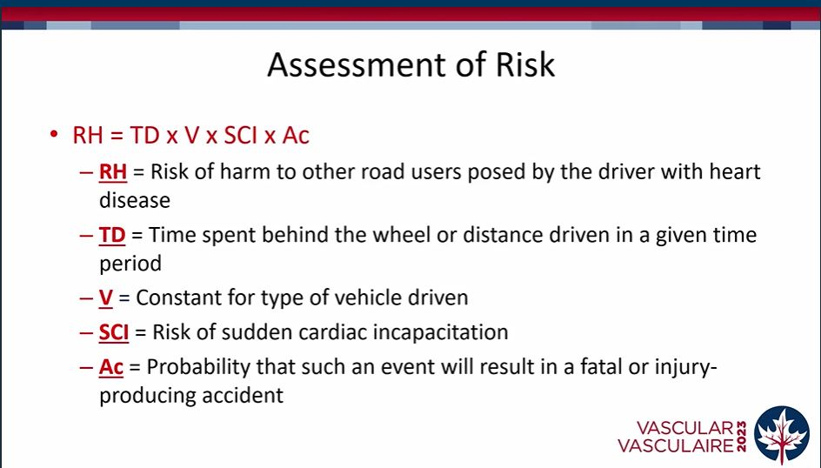

Slide 60
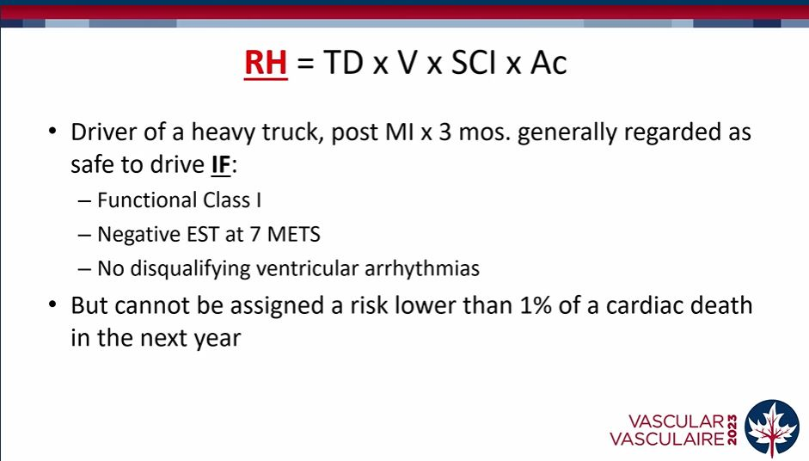

Slide 61
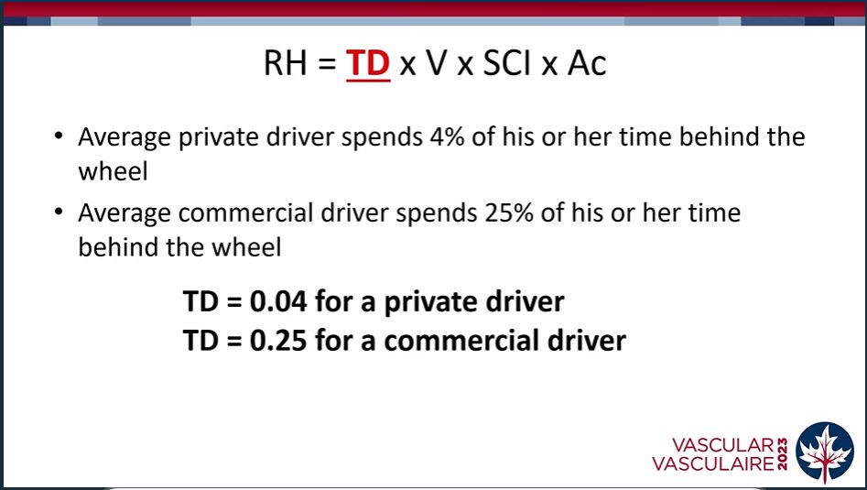

Slide 62
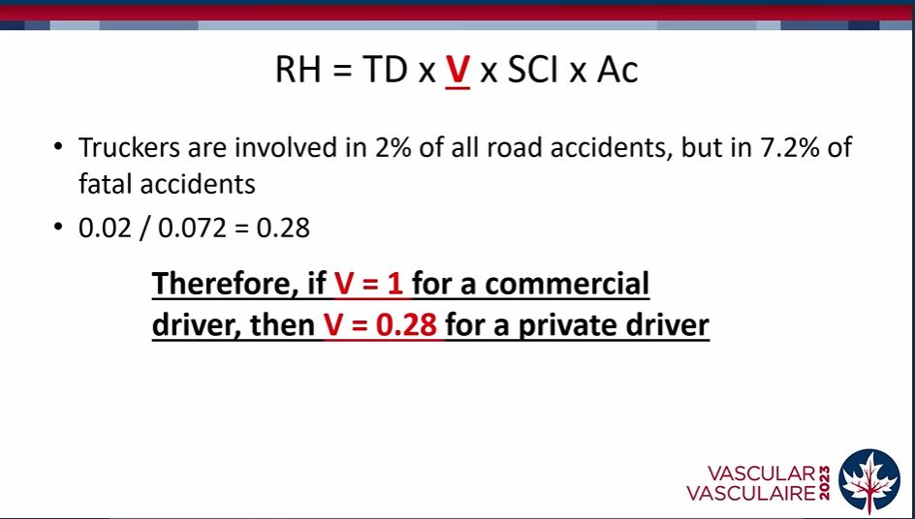

Slide 63
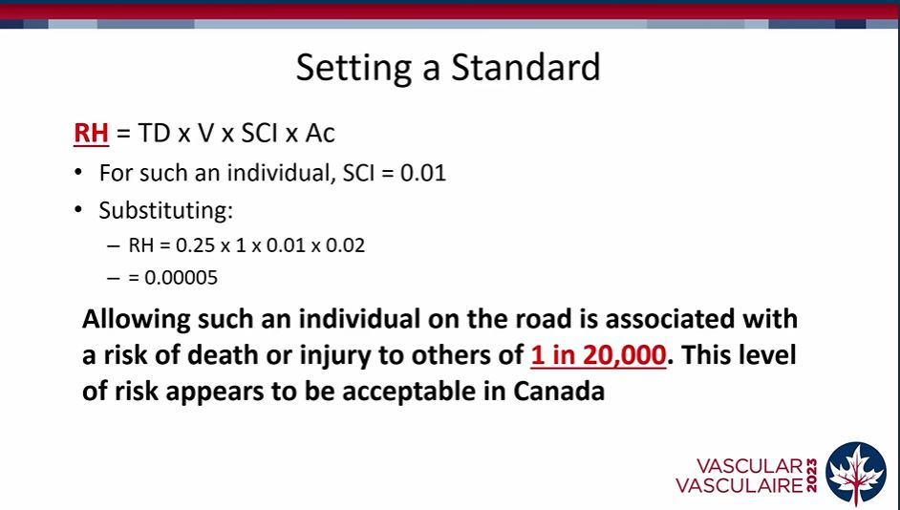

Slide 64


Slide 65


Slide 66


Slide 67


Slide 68


Slide 70


Slide 71


Slide 72


Slide 73


Slide 74


Slide 75


Slide 76

Radomization

Slide 77


Slide 78


Slide 79

Mortality

Slide 80


