Slide 1
Cardiac Update 2025:
What’s New In Heart Failure?
Alex meadley mbbs, FRCPC
Internal medicine

Slide 2
DISCLOSURES
I receive no honorarium for today’s discussion
In the past 2 years I have received honoraria and/or support from
  Boehringer Ingelheim
  Canadian Heart Research Institute
  Lilly
  Novo Nordisk

Slide 3
What’s new in heart failure?
Objectives
  CHF overview
  Management guidelines
    Non-reduced ejection fraction
  HFrEF outcomes

Slide 4
Is Heart Failure Important?
750,000 Canadians live with heart failure
One of the leading causes of hospitalization for those >65 years
Estimated annual healthcare cost of $2.8 billion by 2030
50% mortality at 5 years

Slide 5
PATIENT CASE
65M presents with dyspnea on exertion, orthopnea, edema
PMHX
  Afib/Flutter
  OSA (compliant with CPAP)
  Obesity (BMI 35)
Meds:
  Bisoprolol 5mg daily
  Tamsulosin
  Apixaban
  Amiodarone 200mg daily
Exam: BP 130/75, HR 55 reg
  JVD distended
  Bilateral rales
Investigations:
  CXR shows small bilateral effusions, cardiomegaly
  Diagnosis?
  Management?

Slide 6
Defining CHF
A complex clinical syndrome characterized by the heart's inability to pump blood effectively due to structural or functional impairments.

Slide 7
Defining CHF
A complex clinical syndrome characterized by the heart's inability to pump blood effectively due to structural or functional impairments.
The most common cause of HF is ischemic heart disease
  Hypertension
  valvular disease
  myocarditis

Slide 8
Defining CHF
A complex clinical syndrome characterized by the heart's inability to pump blood effectively due to structural or functional impairments.
The most common cause of HF is ischemic heart disease
  Hypertension
  valvular disease
  myocarditis
HF is classified based on left ventricular ejection fraction (LVEF) and clinical staging.

Slide 9
Diagnosing CHF
Diagnosis is clinical
Relies upon clinical symptoms, physical examination findings, and can be further guided by investigations

Slide 10
Diagnosing CHF
Clinical symptoms include:
  Shortness of breath
  PND/Orthopnea
    Neither are sensitive but both present gives 94% specificity
  Fatigue
  Edema
  Persistent cough
  Wheezing

Slide 11
Diagnosing CHF
Physical exam findings include:
  Jugular vein distention
  Abdominojugular reflux
  Pulmonary rales
  Gallop
  Edema

Slide 12
Diagnosing CHF
Investigations include:
  CXR
    Cardiomegaly
    Kerley B lines
    Peribronchial cuffing
    Effusions
    Vascular redistribution
    Pulmonary infiltrates
  BNP or NTproBNP
  2D echocardiography
    Helpful for etiology and guiding management
  Additional investigations may rule out alternate etiologies for symptoms

Slide 13
PATIENT CASE
65M new CHF
orthopnea, edema resolve with diuresis
NYHA II
PMHX
  Afib/Flutter
  OSA (compliant with CPAP)
  Obesity (BMI 35)
Meds:
  Bisoprolol
  Tamsulosin
  Apixaban
  Amiodarone 200mg daily
  Jardiance 10mg daily
  Lasix 40mg daily PRN
Exam: BP 105/70, HR 65 reg
  JVD not seen
  CTAB
Investigations:
  Creat 70, K 4.8
  2D echo
    LVEF 55 %
    No valvular disease
Questions:
  How do you categorize his CHF?
  Management?

Slide 14
CHF Jargon
HFrEF
  Reduced ejection fraction defined as LVEF <40%

Slide 15
CHF Jargon
HFrEF
  Reduced ejection fraction defined as LVEF <40%
HFnrEF
  Non-reduced ejection fraction defined as any CHF >40%
  HFpEF was previously used for >55%
  HFmrEF previously used to describe 40-55%

Slide 16
CHF Jargon
HFrEF
  Reduced ejection fraction defined as LVEF <40%
HFnrEF
  Non-reduced ejection fraction defined as any CHF >40%
  HFpEF was previously used for >55%
  HFmrEF previously used to describe 40-55%
HFimpEF
  HFrEF improved to >40%, with at least 10% increase from baseline LVEF

Slide 17
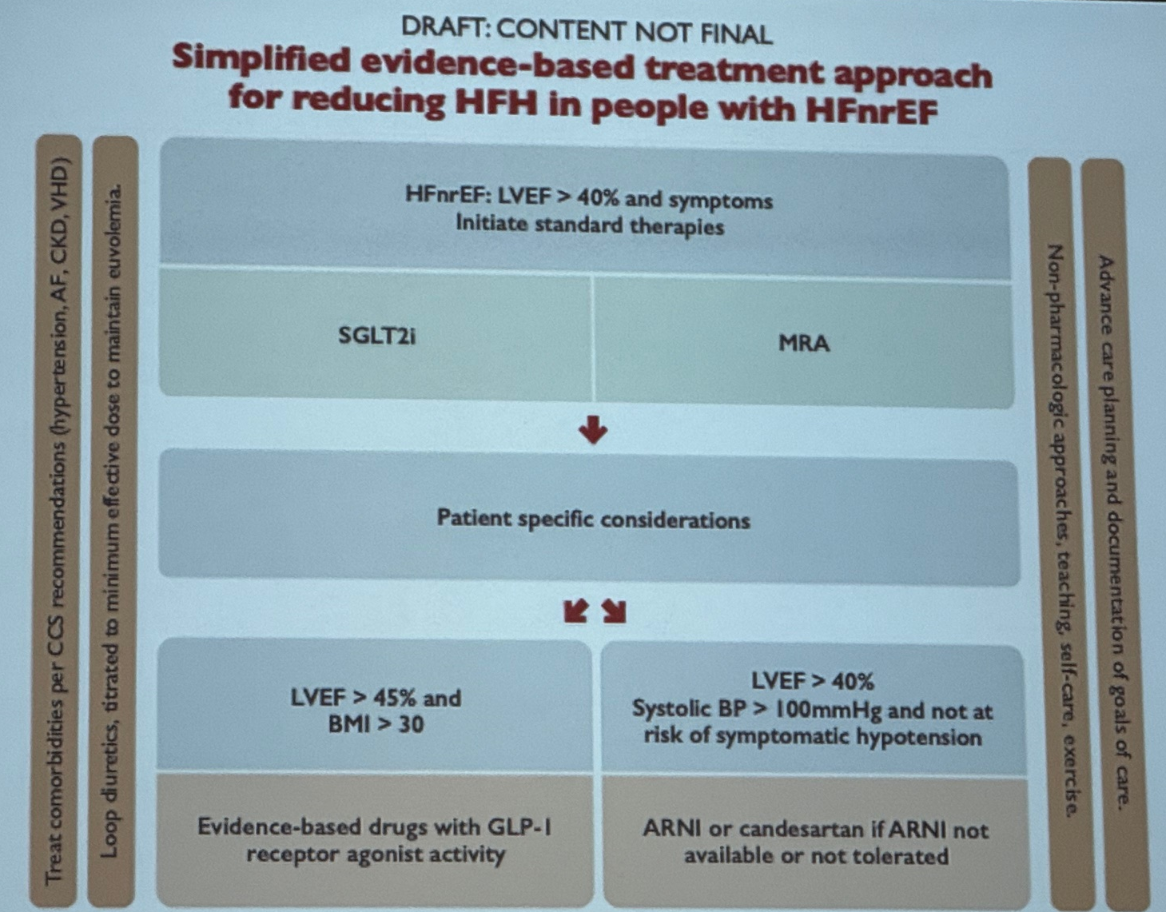
HFnrEF Management

Slide 18
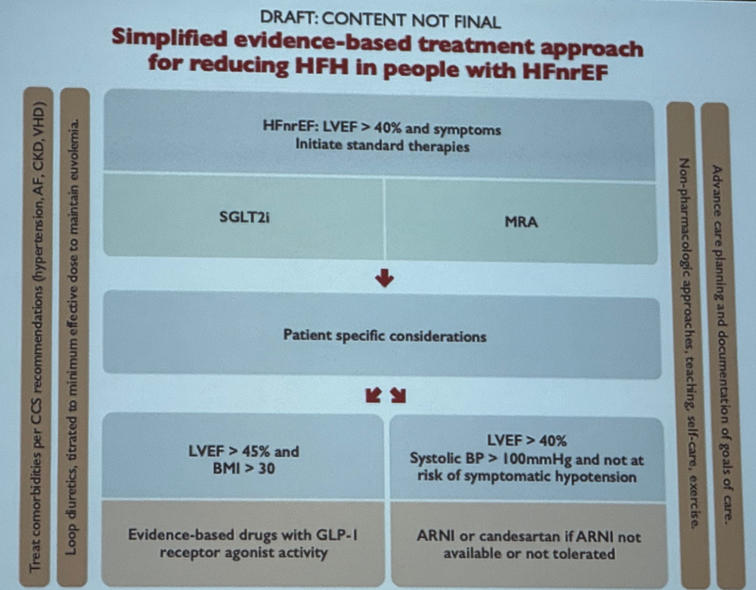
HFnrEF Management
Treat comorbidities
  AF, HTN, CKD, VHD

Slide 19
HFnrEF Management
Treat comorbidities
  AF, HTN, CKD, VHD
Loop diuretics to maintain euvolemia

Slide 20
HFnrEF Management
Treat comorbidities
  AF, HTN, CKD, VHD
Loop diuretics to maintain euvolemia
Non-pharmacologic interventions
  Self management
  Exercise

Slide 21
HFnrEF Management
Treat comorbidities
  AF, HTN, CKD, VHD
Loop diuretics to maintain euvolemia
Non-pharmacologic interventions
  Self management
  Exercise
Advanced care planning
  Document goals of care

Slide 22
HFnrEF Management
HFnrEF: LVEF >40% and symptoms
  SGLT2i
  MRA

Slide 23
HFnrEF Management
HFnrEF: LVEF >40% and symptoms
  SGLT2i
  MRA
LVEF >45% and BMI >30
  Evidenced based GLP1a
    Weak recommendation, moderate evidence

Slide 24
HFnrEF Management
HFnrEF: LVEF >40% and symptoms
  SGLT2i
  MRA
LVEF >45% and BMI >30
  Evidenced based GLP1a
    Weak recommendation, moderate evidence
LVEF >40% with sufficient BP
  ARNI (candesartan if not tolerable)
    Weak recommendation, moderate evidence

Slide 25
PATIENT CASE
65M HFnrEF
PMHX
  Afib/Flutter
  OSA (compliant with CPAP)
  Obesity (BMI 35)
Meds:
  Bisoprolol 2.5mg
  Jardiance 10mg daily
  Lasix 40mg daily PRN
  Tamsulosin
  Apixaban
  Amiodarone 200mg daily
  K too high to tolerate MRA despite dietary modification
NYHA I
Exam: BP 105/70, HR 65 reg
  JVD not seen
  CTAB
  No edema
Investigations:
  Creat 80, K 4.9
  2D echo
    LVEF 55 %
    No valvular disease

Slide 26
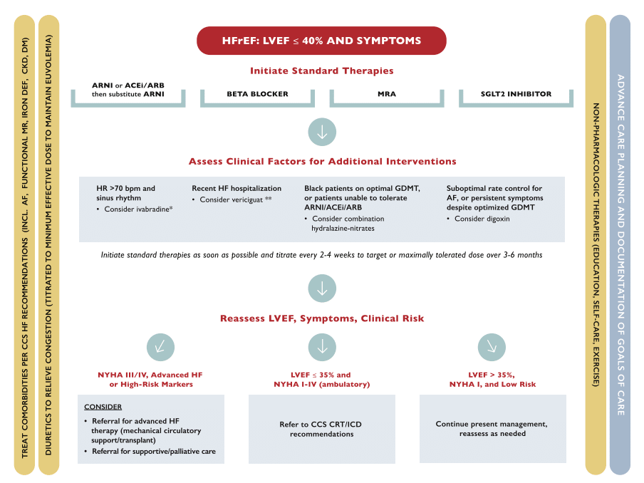
HFrEF Background: CCS Guidelines
Michael McDonald, Sean Virani, Michael Chan, et al. CCS/CHFS Heart Failure Guidelines Update: Defining a New Pharmacologic Standard of Care for Heart Failure With Reduced Ejection Fraction. Can J Cardiol. 2021 Apr;37(4):531-546

Slide 27
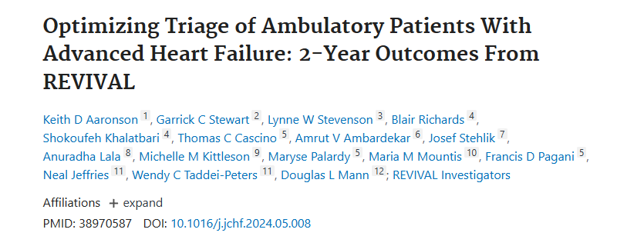
REVIVAL HF

Slide 28
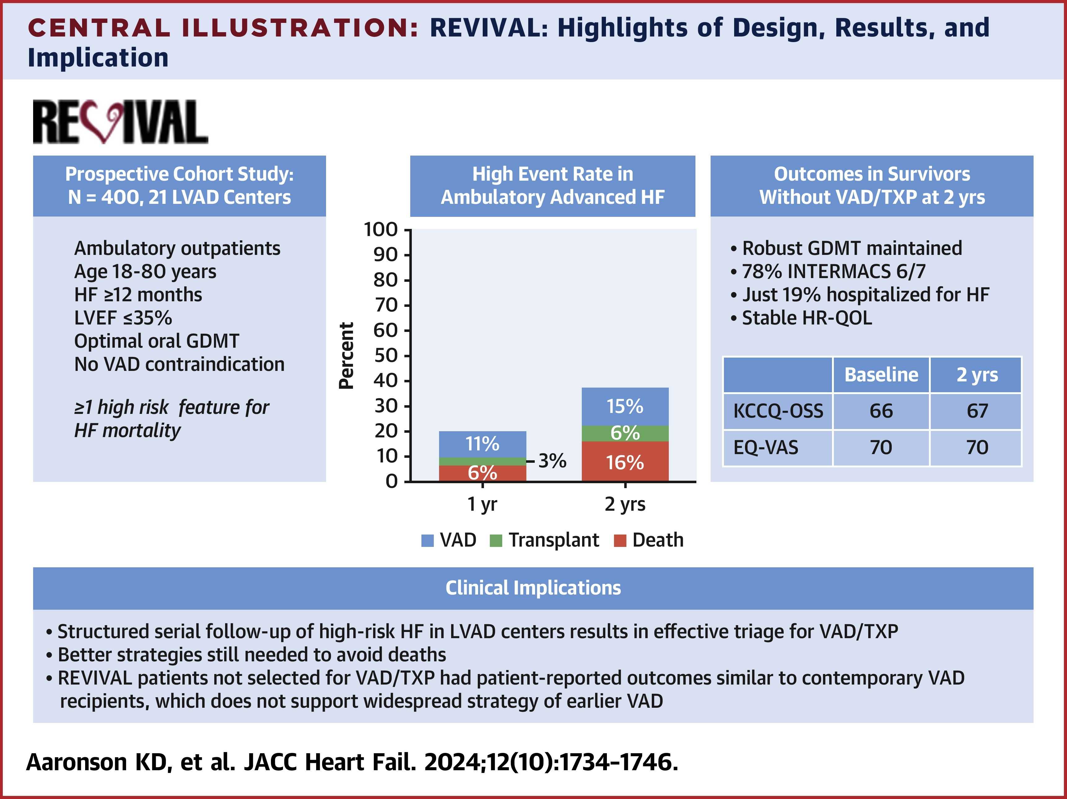
REVIVAL HF

Slide 29
REVIVAL HF
Mean LVEF 21%
NYHA III/IIIb
Able to maintain robust GDMT for the 2 year study
HF hospitalizations were infrequent
  9% at 1 year
  19% at 2 years
  GDMT is effective even in those with advanced or severe/stage-D HF

Slide 30
Summary
CHF is a complex syndrome
Clinical diagnosis

Slide 31
Summary
CHF is a complex syndrome
Clinical diagnosis
Often unclear categorization upon presentation (i.e. unknown LVEF)

Slide 32
Summary
CHF is a complex syndrome
Clinical diagnosis
Often unclear categorization upon presentation (i.e. unknown LVEF)
Substantial overlap of initial management regardless of LVEF
  non-pharmacological management
  Loop diuretics
  SGLT2i
  MRA

Slide 33
Summary
CHF is a complex syndrome
Clinical diagnosis
Often unclear categorization upon presentation (i.e. unknown LVEF)
Substantial overlap of initial management regardless of LVEF
  non-pharmacological management
  Loop diuretics
  SGLT2i
  MRA
CHF management is complex
  Orillia Heart Function is a multidisciplinary clinic aimed at addressing this

Slide 34
Summary
CHF is a complex syndrome
Clinical diagnosis
Often unclear categorization upon presentation (i.e. unknown LVEF)
Substantial overlap of initial management regardless of LVEF
  non-pharmacological management
  Loop diuretics
  SGLT2i
  MRA
CHF management is complex
  Orillia Heart Function is a multidisciplinary clinic aimed at addressing this
Management matters!
  Outcomes improve with pharm/non-pharm management even in the sickest individuals

Slide 35

QUESTIONS?

