Slide 1
Advances in Diabetic Nephropathy es in Diabetes
and Diabetic Nephropathy
JC MacFadyen MD FRCPC MHPE

Slide 2
Faculty/Presenter Disclosure
CFPC CoI Templates: Slide 1
Faculty: John MacFadyen, MD, FRCPC, MHPE
Relationships with commercial interests:
  Grants/Research Support: Novo Nordisk
  Speakers Bureau/Honoraria: Boehringher Ingelheim, Astra Zeneca, Sanofi, Pfizer, Lilly, Merck, Jansen, Novo-Nordisk, Abbott, Dexcom
  Consulting Fees: Jansen, Astra Zeneca, Liily, Novo-nordisk
Notes:
This slide must be visually presented to the audience AND verbalized by the speaker.

Slide 3
SN
62 yo male,
Type 2 DM x 22 years
Meds – Perindopril 8 mg od
  Amlodipine 10 mg od
  Metformin 500 mg bid
  Rosuvastatin 20 mg od
BP – 108/79
A1C – 6.6
Cr – 180, eGFR 30, MAU – 1961, ACR 246

Slide 4
SN
62 yo male,
Type 2 DM x 22 years
Meds – Perindopril 8 mg od
  Amlodipine 10 mg od
  Metformin 500 mg bid
  Rosuvastatin 20 mg od
BP – 108/79
A1C – 6.6
Cr – 180, eGFR 30, MAU – 1961, ACR 246
What is his risk for dialysis?

Slide 5
SN
62 yo male,
Type 2 DM x 22 years
Meds – Perindopril 8 mg od
  Amlodipine 10 mg od
  Metformin 500 mg bid
  Rosuvastatin 20 mg od
  Insulin aspartate 10 u bid, Insulin Detemir 30 od
BP – 108/79
A1C – 6.6
Cr – 180, eGFR 30, MAU – 1961, ACR 246
5 year risk - 48%
If MAU neg – 7.5%

Slide 6

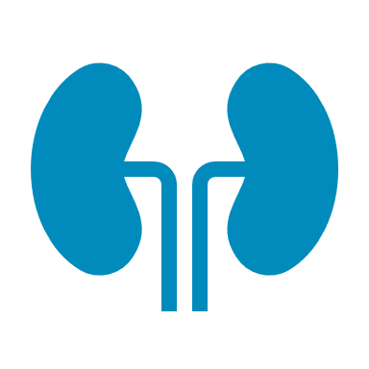

… and with time, this knowledge has grown.
CVD mortality risk by GFR and albuminuria categories
KDIGO 2022: Prognosis of CKD by GFR and albuminuria categories
 |  |  | Albuminuria categories
 |  |  | A1 |  | A2 | A3
 |  |  | <1.13 mg/mmol | 1.13-3.3 mg/mmol | 3.39 to 33.8 mg/mmol | ≥33.9 mg/mmol
GFR categories: Description and range (mL/min/1.73 m²) | G1 | ≥105
 |  | 90-104
 | G2 | 75-89
 |  | 60-74
 | G3a | 45-59
 | G3b | 30-44
 | G4 | 15-29
 | G5 | <10
 |  | Albuminuria categories
 |  | A1 | A2 | A3
 |  | <3 mg/mmol | 3 to 30 mg/mmol | ≥30 mg/mmol
G1 | ≥105
 | 90-104
G2 | 75-89
 | 60-74
G3a | 45-59
G3b | 30-44
G4 | 15-29
G5 | <10
Low risk*
Moderately increased risk
High risk
Very high risk
Click here to compare with KDIGO table showing prognosis of CKD by category
KDIGO Diabetes Work Group. Kidney Int 2022;102(5S):S1-S127.
* If no other markers of kidney disease are present
CKD, chronic kidney disease; CVD, cardiovascular disease; KDIGO, Kidney Disease: Improving Global Outcomes.
Matushita K, et al. Nat Review Nephrol 2022;18:696-707.

Slide 7

UACR is an independent risk factor for progression of CKD and is just as important as eGFR. Both are needed to see the full picture of a patient’s kidney health
UACR:
How fast you’re going
eGFR: How close you are to the cliff
Patient’s kidneys
Dialysis
CKD, chronic kidney disease; eGFR, estimated glomerular filtration rate; NIDDM, non-insulin-dependent diabetes mellitus; UACR, urinary albumin to creatinine ratio.
Mattock MB, Keen H, Barnes DJ, et al. Microalbuminuria: a risk factor for coronary heart disease in non-insulin dependent diabetic men. In:. Cardiovascular Disease Prevention IILTeddington, UK: Hampton Medical Conferences, 1997: 30 (abstr). As cited in: Eastman RC, Keen H. Lancet 1997;350(suppl I):29-32.

Slide 8
SN
62 yo male,
Type 2 DM x 22 years
Meds – Perindopril 8 mg od
  Amlodipine 10 mg od
  Metformin 500 mg bid
  Rosuvastatin 20 mg od
  Insulin aspartate 10 u bid, Insulin Detemir 30 od
BP – 108/79
A1C – 6.6
Cr – 180, eGFR 30, MAU – 1961, ACR 246
5 year risk - 48%
If MAU neg – 7.5%
What can we do to prevent ESRD/Dialysis?

Slide 9
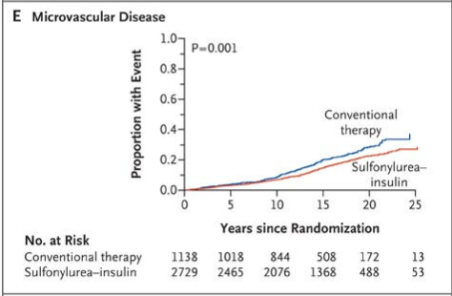
UKPDS 10 Year F/U

Slide 10
Diabetic Nephropathy ARBs
Primary renal outcome RRR 16% to 20%
Large unmet need overall
CV mortality 4% to 5% annually, ARBs did not reduce CV events!
Slope of GFR was improved <1 ml/min/year
Doubling of serum creatinine, ESKD, or death
RENAAL
IDNT
Risk reduction, 16%
P = 0.02
Risk reduction, 20%
P = 0.02
Losartan
Irbesartan
Placebo
Amlodipine
Placebo
Unmet
Need
Unmet
Need
N-1513
N=1715
Months of Study
Months of Follow-up
Notes:
Key Message: Traditional Therapy for DKD leaves a large unmet need
We can see that with traditional therapy, while there is some risk reduction, there is still room for improvement in reducing the risk of renal outcomes.

Slide 11
EMPA-REG OUTCOME
Primary Outcome: CV Death, Non-fatal MI or Non-fatal Stroke
EMPA-REG OUTCOME included adult patients (>18 years) with type 2 diabetes and established CVD who were receiving standard of care therapy for diabetes
Empagliflozin (pooled)
HR 0.86
(95.02% CI 0.74, 0.99)
p=0.04* for superiority
p<0.001 for noninferiority
Placebo
Empagliflozin
Patients with event (%)
Empagliflozin 10 mg
HR 0.85 (95% CI 0.72, 1.01), p=0.07
Empagliflozin 25 mg
HR 0.86 (95% CI 0.73, 1.02), p=0.09
Months
No. of patients
Empagliflozin
Placebo
4687
2333
4580
2256
4455
2194
4328
2112
3851
1875
2821
1380
2359
1161
1534
741
370
166
Cumulative incidence function. MACE: major adverse cardiovascular event; HR: hazard ratio; MI: myocardial infarction; SGLT2: sodium glucose cotransporter 2
*Two-sided tests for superiority were conducted (statistical significance was indicated if p≤0.0498)
Note: Empagliflozin is an SGLT2 inhibitor. Data from: Zinman B, et al. N Engl J Med. 2015; 373:2117-2128.

Slide 12
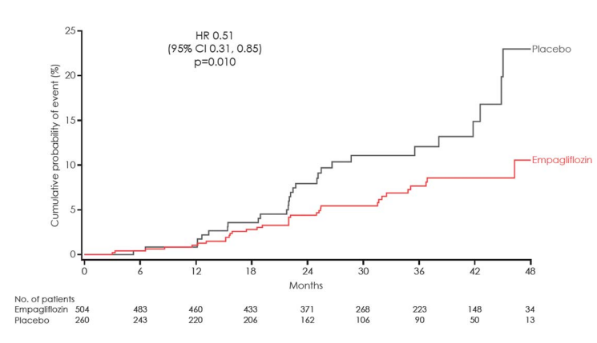
Composite of doubling of serum creatinine, Dialysis, or death due to RD in patients with uACR > 33 at baseline

Slide 13
In DAPA-CKD and CREDENCE, the risk of kidney composite outcomes was reduced
DAPA-CKD^{1,a}
CREDENCE^{2,b}
Patients with CKD, with and without T2D
Patients with CKD and T2D
24
20
20
HR: 0.61
(95% CI: 0.51, 0.72)
HR: 0.70
(95% CI: 0.59, 0.82)
Placebo
15
Placebo
16
39%​
RRR
30%​
RRR
12
Cumulative incidence (%)
Patients with an event (%)
10
8
Dapagliflozin
5
Canagliflozin
4
0
0
0
4
8
12
16
20
24
28
32
0
6
12
18
24
30
36
42
No. at Risk
Months since randomization
No. at Risk
Months since randomization
Placebo
2152
1993
1936
1858
1791
1664
1232
774
270
Placebo
2199
2178
2132
2047
1725
1129
621
170
Dapagliflozin
2152
2001
1955
1898
1841
1701
1288
831
309
Canagliflozin
2202
2181
2145
2081
1786
1211
646
196
No direct comparison of efficacy can be made or is intended as study designs and populations differ in these two studies
Notes:
IMPORTANT slide
References:
Heerspink HJL, et al. Dapagliflozin in Patients with Chronic Kidney Disease. N Engl J Med. 2020;383:1436–1446.
Perkovic V, et al. Canagliflozin and Renal Outcomes in Type 2 Diabetes and Nephropathy.N Engl J Med. 2019;380:2295–2306.

Slide 14
In DAPA-CKD, the risk of all-cause mortality was significantly reduced
The effect of dapagliflozin versus placebo on
all-cause mortality in the DAPA-CKD trial population
12
HR: 0.69
(95% CI: 0.53, 0.88)
P=0.004
10
Placebo
8
31%​
RRR
Cumulative incidence (%)
6
4
Dapagliflozin
2.1% ARR
2
0
0
4
8
12
16
20
24
28
32
No. at Risk
Time from randomization (months)
Placebo
2152
2035
2018
1993
1972
1902
1502
1009
379
Dapagliflozin
2152
2039
2029
2017
1998
1925
1531
1028
398
DAPA-CKD was stopped early due to efficacy benefit. Because of this unplanned early stop, the secondary endpoint is considered nominal.
Notes:
References:
Heerspink HJL, et al. Dapagliflozin in Patients with Chronic Kidney Disease. N Engl J Med. 2020;383:1436–1446.

Slide 15
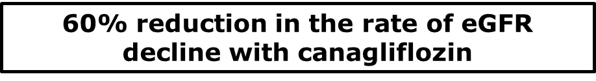
CREDENCE: Effects on eGFR
Placebo (mean baseline eGFR 56.0 mL/min/1.73 m²)
Canagliflozin (mean baseline eGFR 56.4 mL/min/1.73 m²)
If starting at an eGFR of 56 mL/min/1.73 m², modelling suggests that in a 63-year-old patient, dialysis could be delayed by 13 years with initiation of an SGLT2i
–1.85/year
LS mean change (±SE) in
eGFR (mL/min/1.73 m²)
Acute eGFR change (3 weeks)
Placebo: –0.55 ml/min/1.73 m²
Canagliflozin: –3.72 ml/min/1.73 m²
Difference: –3.17
(95% CI, –3.87, –2.47)
–4.59/year
Chronic eGFR slope
Difference: 2.74/year
(95% CI, 2.37–3.11)
6
12
18
24
30
36
42
Months since randomization
No. at risk
Placebo | 2178 | 2084 | 1985 | 1882 | 1720 | 1536 | 1006 | 583
Canagliflozin | 2179 | 2074 | 2005 | 1919 | 1782 | 1648 | 1116 | 652
Notes:
KEY MESSAGE: The study also demonstrated a stabilization in eGFR
As observed in previous studies, canagliflozin treatment was associated with an initial mean decline in eGFR that was significantly greater than the mean decline observed in patients taking placebo (–3.72 vs. –0.55 mL/min/1.73 m²; a difference of 3.17, 95%CI –3.87, –2.47)
Over the long term, however, the rate of eGFR decline per year is significantly higher in patents taking placebo compared to those taking canagliflozin (–1.85/year vs. –4.59/yr, respectively; difference of 2.74/yr, 95%.CI 2.39, 3.11)
Nephrologists consider a difference in slope of 0.5 ml/min/1.73 m² per year to be clinically important (McFarlane P, 2019; personal communication)
Despite the initial drop in eGFR, patients taking canagliflozin showed less decline in renal function at all time points after one year
Rate of decline is almost 60% slower in patients taking canagliflozin
References:
Perkovic V. CREDENCE Primary and Renal Outcomes. Presented at ISN World Congress of Nephrology; April 12-15, 2019; Melbourne, Australia. Session O-360.

Slide 16
“Time is kidney”: Starting SGLT2i therapy early can change the trajectory of kidney disease progression
Hypothetical potential impact on time to kidney replacement therapy of the different eGFR slopes for patients on placebo vs. empagliflozin based on data from EMPA-KIDNEY*
85
Placebo
Empagliflozin
eGFR (ml/min/1.73 m²)
3.5
5.4
20.8
47.5
Difference: 1.9 years
Difference: 26.6 years
Time to kidney replacement therapy (years)
*Hypothetical lines have been traced starting from extremes of the baseline eGFR inclusion criteria values (20 and 85 ml/min/1.73 m²) to eGFR 10 ml/min/1.73 m², corresponding to chronic eGFR slopes of participants on placebo and on empagliflozin within each baseline eGFR subgroup
eGFR, estimated glomerular filtration rate; SGLT2i, sodium-glucose co-transporter 2 inhibitor.
Fernández-Fernandez B et al. Clin Kidney J 2023;16(8):1187.
Notes:
Graphical presentation of representative chronic eGFR slopes from baseline to kidney failure.
Hypothetical lines have been traced starting from extremes of the baseline eGFR inclusion criteria values (20 and 85 ml/min/1.73 m²) to eGFR 10 ml/min/1.73 m², corresponding to chronic eGFR slopes of participants on placebo and on empagliflozin within each baseline eGFR subgroup

Slide 17
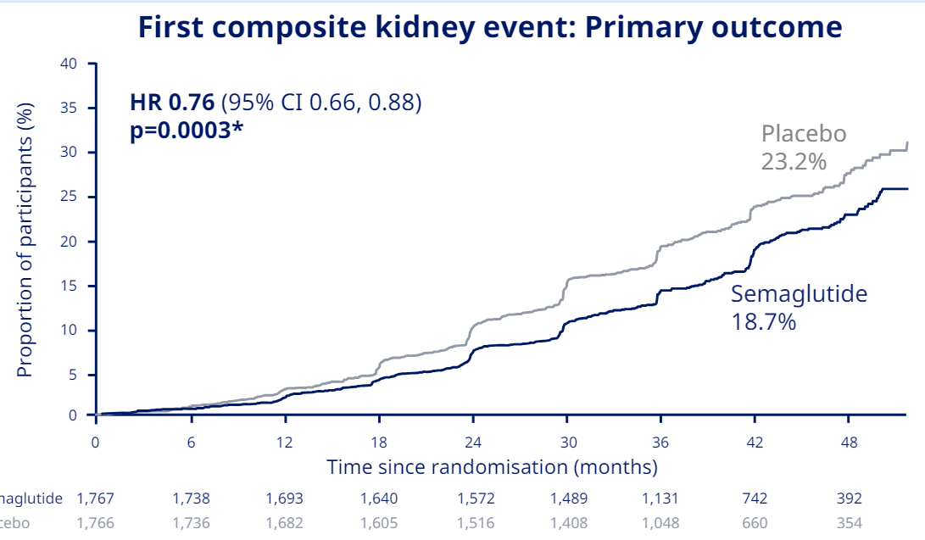
Flow Trial - Semaglutide

Slide 18
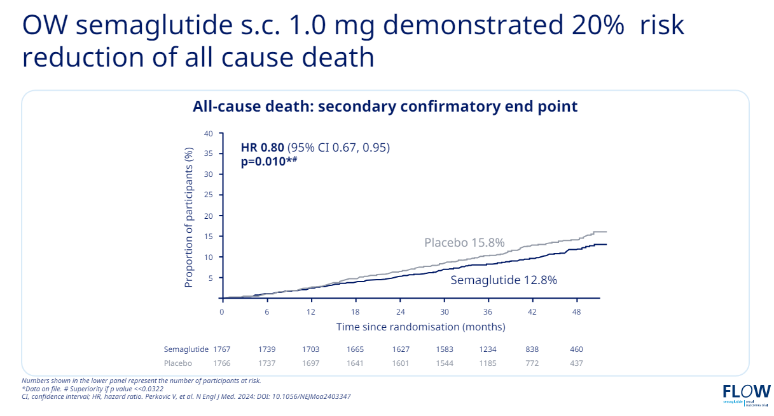
FLOW Trial

Slide 19
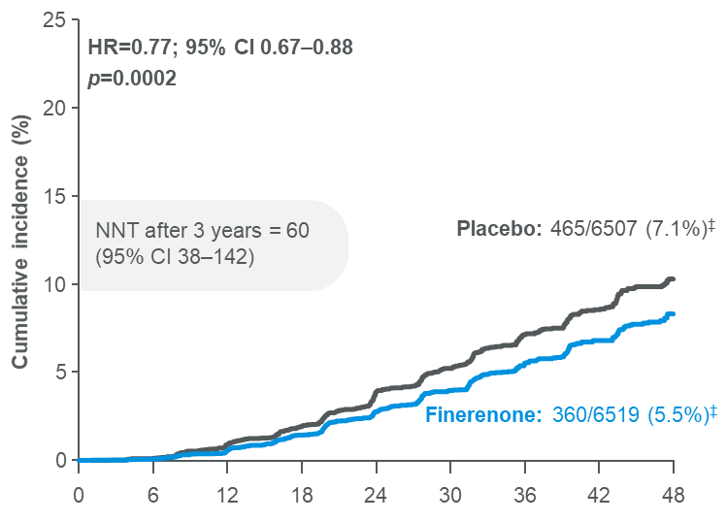
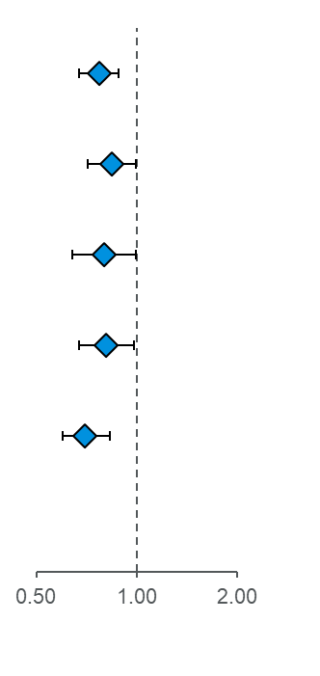


Finerenone significantly reduced the risk of the key kidney composite outcome by 23% and had consistent significant effects on the outcome components
Time to kidney failure,* sustained# ≥57% decrease in eGFR from baseline, or renal death‡
Outcome | Finerenone (n=6519) | Placebo (n=6507) | HR (95% CI) |  | p-value
 | n (%) | n (%)
Kidney composite outcome | 360 (5.5) | 465 (7.1) |  | 0.77 (0.67–0.88) | 0.0002
Kidney failure* | 254 (3.9) | 297 (4.6) |  | 0.84 (0.71–0.99) | 0.039
ESKD | 151 (2.3) | 188 (2.9) |  | 0.80 (0.64–0.99) | 0.040¶
Sustained# decrease in eGFR to <15 ml/min/1.73 m² | 195 (3.0) | 237 (3.6) |  | 0.81 (0.67–0.98) | 0.026¶
Sustained# ≥57% decrease in eGFR from baseline | 257 (3.9) | 361 (5.5) |  | 0.70 (0.60–0.83) | <0.0001
Renal death‡ | 2 (<0.1) | 4 (<0.1) |  | 0.53 (0.10–2.91) | 0.459
No. at risk
Time to first event (months)
Finerenone
6519
6291
6107
5848
5027
3973
2815
2024
959
Placebo
6507
6292
6071
5815
4949
3932
2798
1988
962
Favours finerenone
Favours placebo
Notes:
Notes
Abbreviations
ARR, absolute risk reduction; CI, confidence interval; CV, cardiovascular; eGFR, estimated glomerular filtration rate; ESKD, end-stage kidney disease; HR, hazard ratio; KRT, kidney replacement therapy; NNT, number needed to treat; PY, patient-years
References
Filippatos G, et al. ESC 2021; abstract 7161

Slide 20
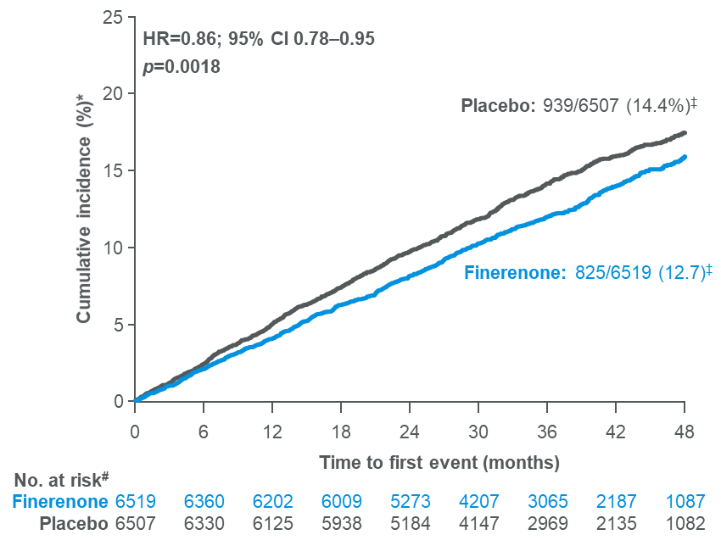
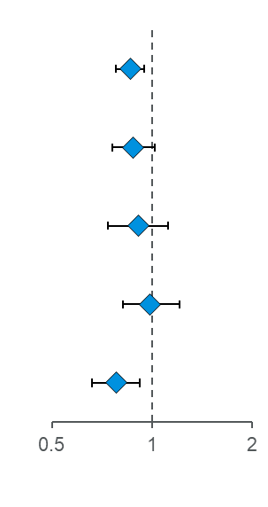
Finerenone significantly reduced the risk of the CV composite outcome by 14% and had consistent effects on CV death, MI and hospitalisation for HF
Time to CV death, non-fatal MI, non‑fatal stroke, or hospitalisation for HF
Outcome | Finerenone (n=6519) | Placebo (n=6507) | Hazard ratio (95% CI) |  | p-value
 | n (%) | n (%)
Composite CV outcome§ | 825 (12.7) | 939 (14.4) |  | 0.86 (0.78–0.95) | 0.0018
CV death | 322 (4.9) | 364 (5.6) |  | 0.88 (0.76–1.02) | 0.0922
Non-fatal MI | 173 (2.7) | 189 (2.8) |  | 0.91 (0.74–1.12) | 0.3601
Non-fatal stroke | 198 (3.0) | 198 (3.0) |  | 0.99 (0.82–1.21) | 0.9460
Hospitalisation for HF | 256 (3.9) | 325 (5.0) |  | 0.78 (0.66–0.92) | 0.0030
NNT after 3 years = 46
(95% CI 29–109)
Favours finerenone
Favours placebo
20
Notes:
Notes
For effect of finerenone on CV outcomes by subgroups, please refer to back-up slides 27–28.
Statistical analyses will be of explorative and descriptive nature. No confirmatory hypothesis tests will be performed. In the case that statistical tests are performed, p-values will be provided in an exploratory manner only. Therefore, no adjustment for multiplicity is necessary
Abbreviations
ARR, absolute risk reduction; CI, confidence interval; CV, cardiovascular; HF, heart failure; HR, hazard ratio; MI, myocardial infarction; NNT, number needed to treat
Script
References
Filippatos G, et al. ESC 2021; abstract 7161

Slide 21
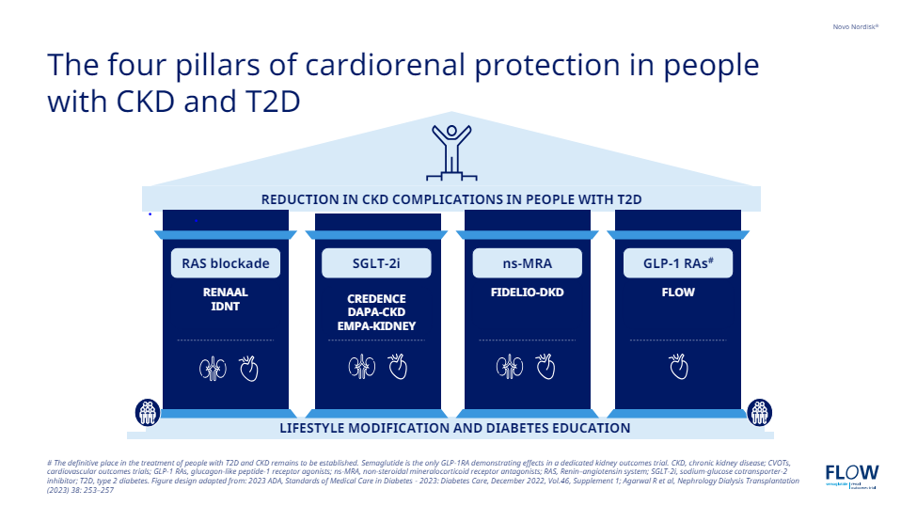

Slide 22
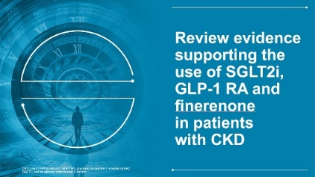
2024 Update: Diabetes Canada Guidance
What medication should this patient with T2D and CKD be taking?
Start metformin
Start cardiorenal protective agents, if indicated
Metabolic decompensation
A1C in target or above
A1C above target
Such as:
Ketosis
Unintentional weight loss
Polyuria, polydipsia
Marked hyperglycemia
High cardiovascular risk
Heart failure
Chronic kidney disease
Add glucose-lowering therapy according to clinical priorities. Clinical priorities may include:
Weight loss
Avoidance of hypoglycemia
Desired magnitude of A1C lowering
Cost
Side-effect profile
Possibility of pregnancy
Comorbidities
Insulin
GLP1-RA* or SGLT2i*
SGLT2i*
SGLT2i* Consider GLP1-RA✝
Oral agents, injectables incretins, insulin
A1C above target or new clinical indication
* Choose an agent that has demonstrated evidence of benefit; refer to the test.
✝ Based on the FLOW trial that was not reviewed for this update; refer to the text
A1C, glycated hemoglobin; CV, cardiovascular; GLP-1-RA, glucagon-like peptide 1 receptor agonist; SGLT2i, sodium glucose co-transporter 2 inhibitor; T2D, type 2 diabetes.
Adapted from Shah BR, et al. Can J Diabetes 2024;48:415-424.

Slide 23
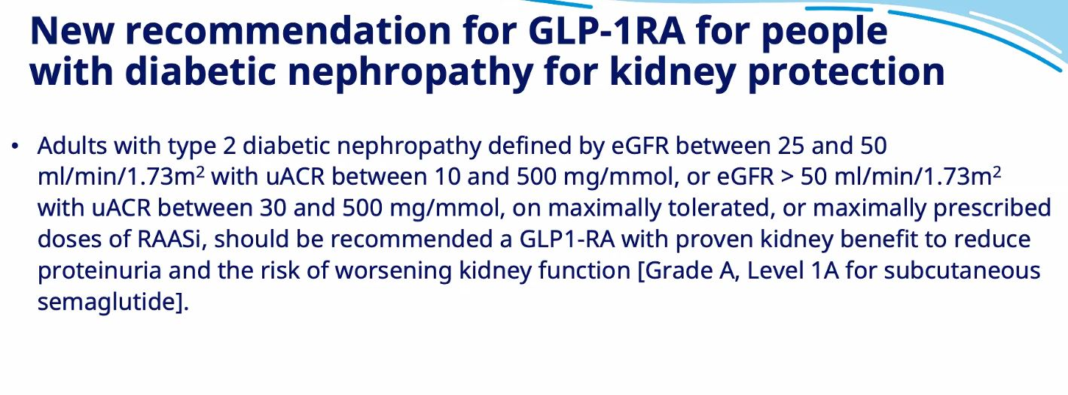

Slide 24
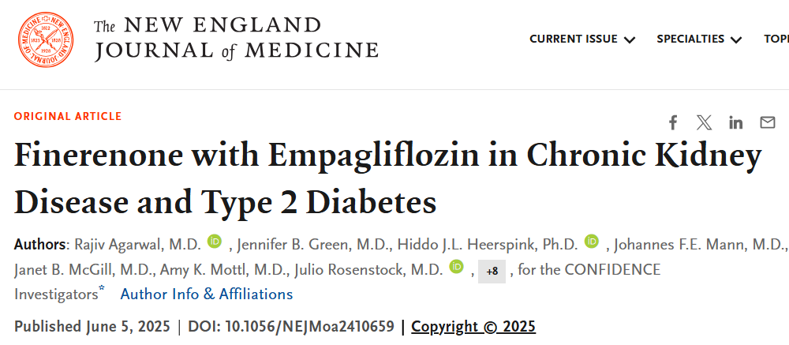

Slide 25
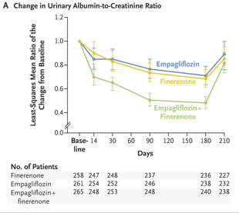

Slide 26
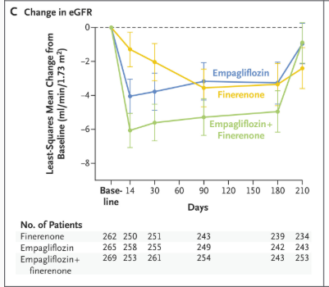

Slide 27
SN
62 yo male,
Type 2 DM x 22 years
Meds – Perindopril 8 mg od
  Amlodipine 10 mg od
  Metformin 500 mg bid
  Rosuvastatin 20 mg od
  Insulin aspartate 10 u bid, Insulin Detemir 30 od
BP – 108/79
A1C – 6.6
Cr – 180, eGFR 30, MAU – 1961, ACR 246
What can we do to prevent ESRD/Dialysis?

Slide 28
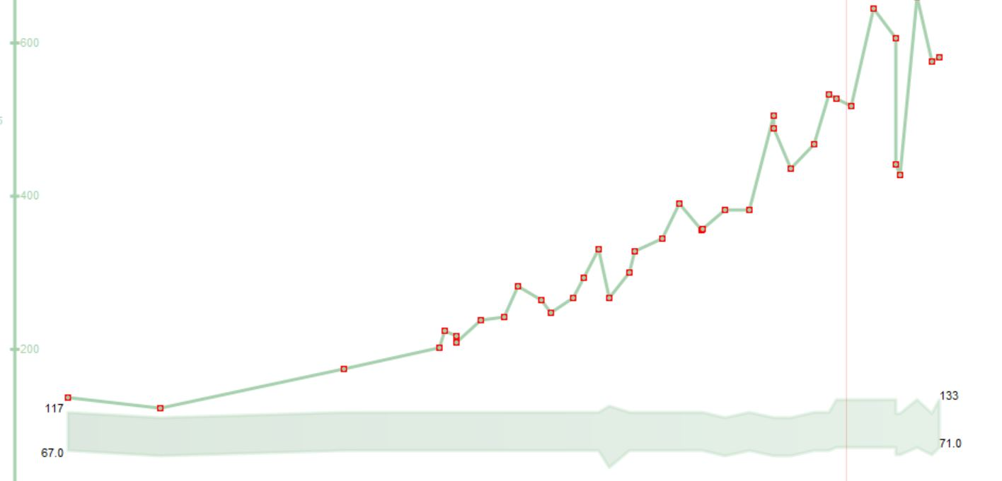
NOTHING
2020
Transplant
2017
Dialysis
2014

Slide 29
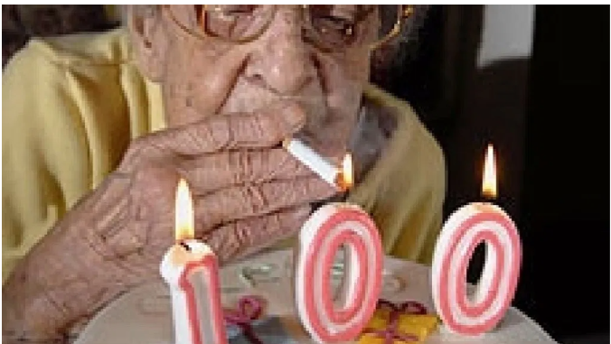

Slide 30
DB
77 yo male
Type 2 DM x 20 years
PVD
CKDx
OSA on CPAP
Jardiance
Ozempic
Irbesrartan
Finerenone
Diamicron MR
Metformin 500 mg bid
BP -118/76, Wt: 116 kg
eGFR 32
K+ 4.6
ACR 100.3

Slide 31
“Time is kidney”: Starting SGLT2i therapy early can change the trajectory of kidney disease progression
Hypothetical potential impact on time to kidney replacement therapy of the different eGFR slopes for patients on placebo vs. empagliflozin based on data from EMPA-KIDNEY*
85
Placebo
Empagliflozin
eGFR (ml/min/1.73 m²)
3.5
5.4
20.8
47.5
Difference: 1.9 years
Difference: 26.6 years
Time to kidney replacement therapy (years)
*Hypothetical lines have been traced starting from extremes of the baseline eGFR inclusion criteria values (20 and 85 ml/min/1.73 m²) to eGFR 10 ml/min/1.73 m², corresponding to chronic eGFR slopes of participants on placebo and on empagliflozin within each baseline eGFR subgroup
eGFR, estimated glomerular filtration rate; SGLT2i, sodium-glucose co-transporter 2 inhibitor.
Fernández-Fernandez B et al. Clin Kidney J 2023;16(8):1187.
Notes:
Graphical presentation of representative chronic eGFR slopes from baseline to kidney failure.
Hypothetical lines have been traced starting from extremes of the baseline eGFR inclusion criteria values (20 and 85 ml/min/1.73 m²) to eGFR 10 ml/min/1.73 m², corresponding to chronic eGFR slopes of participants on placebo and on empagliflozin within each baseline eGFR subgroup

Slide 32
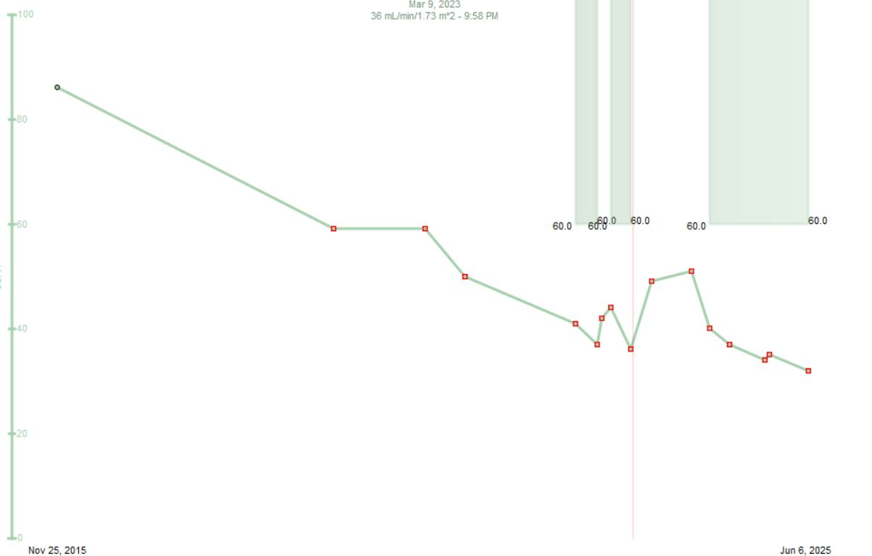
eGFR
Irbesartan
Jardiance
Ozempic
Finerenone
2015
2020
2025

Slide 33
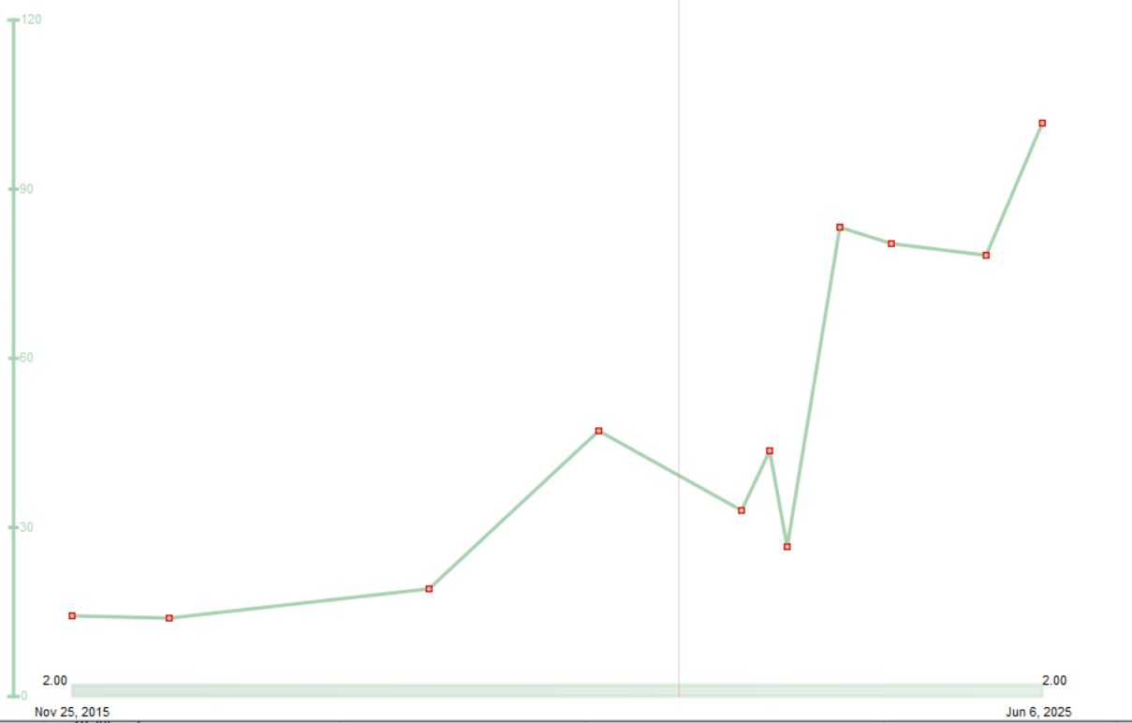
uACR
Irbesartan
Jardiance
Ozempic
Finerenone
2015
2020
2025

Slide 34
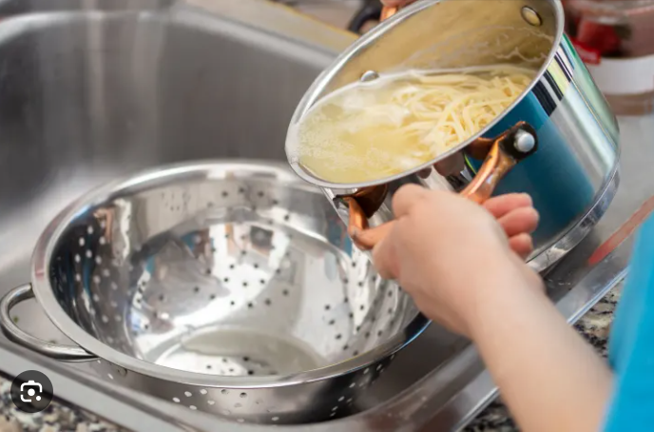

Slide 35
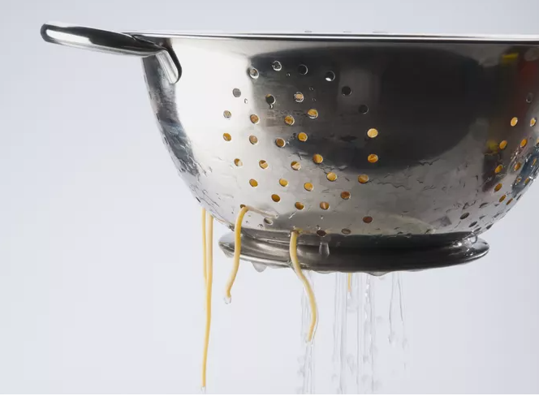

Slide 36
CM
63 yo female
  CVA 2016
  CAD with MI 2020 – PCI LAD
  DM – A1C 9.0
  CKD – eGFR 32, ACR - 46
Meds –Candasartan 16mg od/Lasix40 mg od
- Gliclizide MR 120/ Metformin 500 mg bid
Prev intolerance to Semmaglutide (0.25 mg x 2 weeks – ER - N& V)
Stopped Dapagliflozin 10 mg 1 month ago due to recurrent GM1 and polyuria, dizziness
No drug plan – unable to afford Finerenone
? Recommendations

Slide 37
The Motivational Speech - Polyuria
Indication is for CV/Renal Protection
  – 30% mortality reduction
  35% reduction CHF
  50% reduction Kidney Failure
Benefits
  Glucose/Wt/BP
Downside
  GMI
  polyuria

Slide 38
-lowering medication that also reduces
Our paradigm shift for SGLT-2is and GLP-1 RAs with proven benefits in CVD and in high risk patients with diabetes:
A1c
risk

Slide 39
The Motivational Speech - Polyuria
Indication is for CV/Renal Protection
  – 30% mortality reduction
  35% reduction CHF
  50% reduction Kidney Failure
Benefits
  Glucose/Wt/BP
Downside
  GMI
  polyuria
“ Peeing with a Purpose”
“Pee with benefits”

Slide 40
Postural Symptoms/Pre-Renal Failure
Avoid overdiuresis
  Lasix to 40 + 40
Delete anti-hypertensives without CV benefit
  Amlodipine/ BB
Reduce RAAS/ Inh
  . with predominantly RV Failure
Low dose SGLT -2 Inh – max Empagliflozin 10 mg od

Slide 41
Practical tips: Genital mycotic infections (GMIs)
Uncomplicated
  (Healthy, non-pregnant, <3 inf/year, mild/mod symptoms)
  Fluconazole 150 po single dose
Complicated
  Severe signs, > 3/ year, poorly controlled DM, immunocompromised
  Fluconazole 150 mg po q 3 days , 2-3 doses
    +/1 clotrimazole/betamethasone x 48 hrs
    Or Topicals – 7-14 days
Recurrent – >3 year
  Fluconazole 150 mg po q 72 hrs x 3, then once weekly x 6 months
Balanitis – ask if circumsized
  Advise of potential SE
  Topical cream/po fluconazole considered

Slide 42
Fluconazole
Prescription -$3.94 per 150 mg tabs
  + dispensing fee eg. $12.99
  Annual Cost – 1/ month - $60.27
Ontario -LU Code 235
150 mg tab q 25 days prn for vaginal Candidiasis
  Annual Cost – 1/month = $48
  Annual Cost - $4.00 + dispensing fee
50 mg x 3 covered

Slide 43




Simple strategies to help patients manage
GLP-1 RA-related GI side effects
Eat smaller meals
Avoid fatty and spicy foods
Take on an empty stomach or before bed time
Stay hydrated
?
What tips or recommendations
for managing side effects have your patients found useful?

Slide 44

Ozempic Micro-Dosing
There are many “clicks” between the marked doses on the Ozempic pen. There are 18 “clicks” between 0 and 0.25mg and 18 “clicks” between 0.25mg and 0.5mg. On the 1mg pen there are 74 “clicks” between 0 and 1mg.
Use ____ clicks once a week and if tolerating well, continue to increase by ____ clicks every _____ weeks, until at the recommended dose of ______mg once weekly.
Once you are on a dose of 0.25 mg weekly, please discontinue your ___________ (Onglyza/Trajenta/Januvia)

Slide 45
SD
54 yo female
DM Type 1 x 34 years
Hemodialysis x 2 years
Meds
  Tresiba 28 u hs
  Admelog 4-8 u acmeals
  Recurrent DKA – 3x in past 6 months
    ? Recommendations

Slide 46
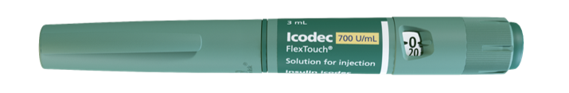
Once weekly icodec 700 units/mL FlexTouch®
Delivers 10 to 700 units, in 10 unit increments
Stable for 12 weeks at room temperature once punctured
Pen sizes:
  Sample = 700 U
  Small = 1050 U
  Large = 2100 U

Slide 47
Modelling shows steady-state glucose-lowering effect after 3-4 weeks, with weekly instead of daily fluctuations
Based on phase 1 clinical data
Icodec
Icodec achieves similar glucose-lowering effect at steady state (after 3–4 weekly doses) with considerably fewer injections compared to once-daily insulin
S
M
T
W
T
F
S
Glargine U100
Glucose-lowering effect (mg/kg/min)
Icodec
0
0
1
2
3
4
5
Time (weeks)
Simulated glucose-lowering effects at comparable insulin dose levels of icodec and glargine U100 (equivalent to 0.4 U/kg/day for both). U, unit(s).
1. Nishimura E. Expanding horizons of treating diabetes: Looking into newer possibilities. Lecture presented at 14th National Insulin Summit 2020; December 12, 2020. https://vimeo.com/489887511. Accessed 11 Jun 2021.

Slide 48
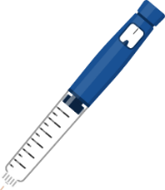
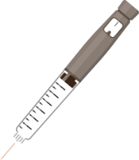
Clinical Application of Icodec
Icodec
Once-daily insulin
One injection per week compared to
seven injections with once-daily insulin
The formulation (700 U/mL) ensures
the injection volume is similar to
once-daily basal insulin
Weekly coverage is achieved by the gradual release of icodec from albumin-bound depot
Dosing schedule
Dosing schedule
S
M
T
W
T
F
S
S
M
T
W
T
F
S
U, unit(s).

Slide 49
Initiation or Switching to Icodec
Initiation with icodec
Start at 70 U for weekly coverage
  In accordance with ADA guideline* for a OD insulin
  A starting dose of 10 U once-daily basal insulin corresponds to 70 U once-weekly icodec
Icodec
Recommendation:
70 U/week
S
M
T
W
T
F
S
Switching from once-daily insulin
  Convert from daily basal insulin dose to weekly dose by multiplying the daily dose by 7
  For the first injection only, add a one-time additional 50% icodec dose
Once-daily
Example
S
M
T
W
T
F
S
Daily dose
= 20 U
Icodec
Weekly dose
= 140 U (20 U x 7)
+ a one-time additional 50% icodec dose
S
M
T
W
T
F
S
*ADA, Standards of Medical Care 2022. ADA, American Diabetes Association; OD, once-daily; U, unit(s).

Slide 50
Titration Algorithm
Switching from OD/BID Basal Insulin to OW Icodec
Glargine U100 daily
dose adjustment
Icodec weekly
dose adjustment
Pre-breakfast SMBG
>7.2 mmol/L
(>130 mg/dL)
+4 U
+28 U
Up-titration
4.4–7.2 mmol/L
(80–130 mg/dL)
0 U
0 U
Target
<4.4 mmol/L
(<80 mg/dL)
–4 U
–28 U
Down-titration
Dose adjustment was based on three pre-breakfast SMBG values, measured two days prior to and on the day of titration. If any of the three pre-breakfast SMBG values were below the lower limit of the target range, titration was based on the lowest recorded value. If all three SMBG values were above the lower limit of the target range, titration was based on the mean of the three measurements.
BID, twice-daily; OD, once-daily; OW, once-weekly; SMBG, self-measured blood glucose; U, unit(s).
1. Bajaj H et al. Diabetes Care. 2021; 44(7):1586–1594.

Slide 51
DOW
Diabetes Once Weekly
Awiqli + Ozempic

Slide 52
Conclusion
Diabetic Nephropathy Management
ARB + SGLT 2 + GLP-1 + Finerenone
  =GDMT x 4
Managing side effects are critical in successfully maintain GDMTx4
Consider once weekly
  Type 1 high risk/adherence
  Type 2 – Awiqli + Ozempic

