Slide 1
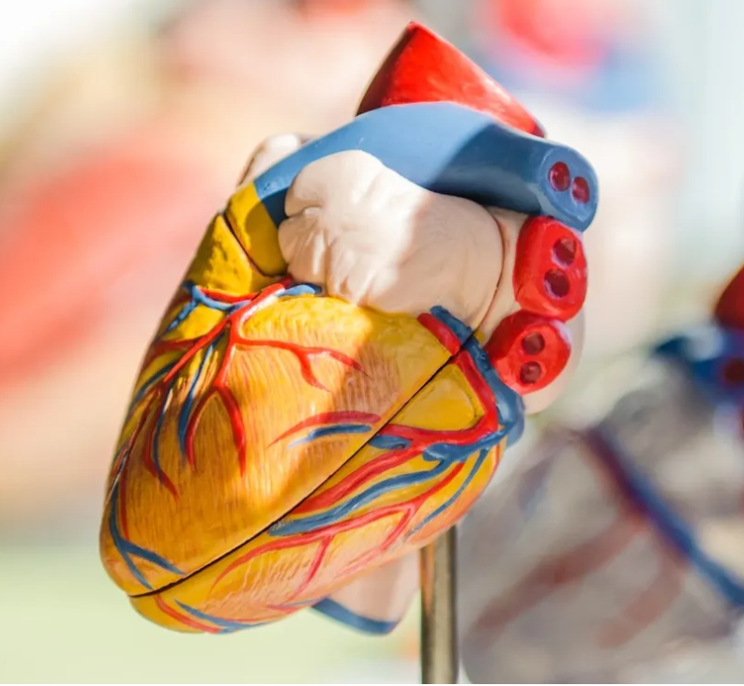
Orillia Cardiac Services

Slide 2
Orillia Cardiac Services
OSMH – Acute Cardiac Evaluation Service
-Urgent CP/CHF/Arrythmia
Holters/EST/Cardiolites
CFHT – Heart Function Program
SDCRC – Chronic Disease Management
OTN/Virtual Hallway
Holters – in Office

Slide 3

Tying it all together

Slide 4
CM
63 yo female
  CVA 2016
  CAD with MI 2020 – PCI LAD
  CHF with EF 54%, Hosp x2
  DM
Meds –
  Bisoprolol 5 mg od
  Candasartan 16 mg od
  Lasix 80 mg od
  Rosuvastatin 40 mg po od
  ECASA
  lnagliptin Metformin 500 bid/Gliclizide
? Recommendations
Prev intolerance to Semmaglutide (0.25 mg x 2 weeks – ER - N& V)
Stopped spironolactone k+ 6.0
Stopped Dapagliflozin 10 mg due to recurrent GM1 and polyuria
Postural dizziness
O/E
  BMI 35
  BP 98/54
Labs
  eGFR 30, K+ 5.2
  uACR 25
  A1C 9.0
Drug Plan $2,500 per year

Slide 5
What medications would you like to put her on?
Finerenone
  HFpEF/Diabetic Nephropathy
  But she has K+ 5.2, cost
SGLT 2 Inh
  HFpEF/HFrEF/CV Protection post MI/Nephropathy/A1C/Wt
  But she can’t tolerate with GMI/Postural dizziness/cost
GLP-1
  HFpEF/Diabetic Nephropathy/CV protection post MI/A1C
  But prev intolerance/costs

Slide 6
How much additional benefit does each cardioprotective therapy give a patient with T2D and CKD?
Estimated lifetime CV, kidney and mortality benefits of combination treatment with SGLT2i, GLP-1 RA, and ns-MRA inhibitors vs. conventional care* in patients with T2D + albuminuria
Outcome
HR (95% CI)
Outcome
HR (95% CI)
MACE
CKD progression
SGLT2i
0.83 (0.75, 0.93)
SGLT2i
0.63 (0.53, 0,77)
GLP-1 RA
0.86 (0.80, 0.93)
ns-MRA
0.90 (0.81, 1.00)
GLP-1 RA
0.86 (0.72, 1.02)
GLP-1 RA + ns-MRA
0.77 (0.68, 0.88)
ns-MRA
0.77 (0.67, 0.88)
SGLT2i + GLP-1 RA
0.72 (0.63, 0.82)
0.66 (0.53, 0.83)
SGLT2i + ns-MRA
0.75 (0.65, 0.87)
GLP-1 RA + ns-MRA
SGLT2i + GLP-1 RA + ns-MRA
0.65 (0.55, 0.76)
SGLT2i + GLP-1 RA
0.54 (0.42, 0.70)
Hospitalization for heart failure
SGLT2i + ns-MRA
0.49 (0.38, 0.61)
SGLT2i
0.64 (0.53, 0.77)
SGLT2i + GLP-1 RA + ns-MRA
0.42 (0.31, 0.56)
GLP-1 RA
0.89 (0.82, 0.98)
ns-MRA
0.78 (0.66, 0.92)
GLP-1 RA + ns-MRA
0.69 (0.57, 0.84)
All-cause mortality
SGLT2i + GLP-1 RA
0.57 (0.47, 0.70)
SGLT2i
0.85 (0.75, 0.96)
SGLT2i + ns-MRA
0.50 (0.39, 0.64)
GLP-1 RA
0.88 (0.82, 0.94)
SGLT2i + GLP-1 RA + ns-MRA
0.45 (0.34, 0.58)
0.89 (0.79, 1.00)
Cardiovascular death
ns-MRA
SGLT2i
0.84 (0.72, 0.97)
GLP-1 RA + ns-MRA
0.78 (0.68, 0.90)
GLP-1 RA
0.87 (0.80, 0.94)
SGLT2i + GLP-1 RA
0.75 (0.65, 0.86)
ns-MRA
0.88 (0.76, 1.02)
SGLT2i + ns-MRA
0.76 (0.64, 0.90)
GLP-1 RA + ns-MRA
0.77 (0.65, 0.91)
SGLT2i + GLP-1 RA + ns-MRA
0.67 (0.55, 0.80)
SGLT2i + GLP-1 RA
0.73 (0.61, 0.86)
SGLT2i + ns-MRA
0.74 (0.60, 0.91)
SGLT2i + GLP-1 RA + ns-MRA
0.64 (0.51, 0.80)
0.25
0.5
0.75
1
1.25
0.25
0.5
0.75
1
1.25
Favors combination therapy
Favors conventional care
Favors combination therapy
Favors conventional care
* Conventional care was renin-angiotensin aldosterone inhibitor therapy plus risk factor control.
CKD, chronic kidney disease; CV, cardiovascular; eGFR, estimated glomerular filtration rate; GLP-1 RA, glucagon-like peptide-1 receptor agonist; MACE, major adverse cardiovascular events; ns-MRA, non-steroidal mineralocorticoid receptor antagonist; SGLT2i, sodium-glucose cotransporter-2 inhibitor; T2D, type 2 diabetes; UACR, urinary albumin to creatinine ratio.
Adapted from Neuen, B et al, Circulation. 2024;149(6):450-462.
Notes:
This cross-trial analysis compared quadruple therapy (RAASi with risk factor control plus additional SGLT2i, GLP1RA, and ns-MRA finerenone) vs. conventional care (RAASi and risk factor control only) in patients with diabetes with CKD (uACR>30mg/g).
Data for conventional care was the placebo arm of the CANVAS and CREDENCE trials.
Data for SGLT2i treatment was the treatment arm of the CANVAS and CREDENCE trials.
Data for GLP1-RA treatment was a trial-level meta-analysis of 8 randomized, double-blind, placebo-controlled cardiovascular outcome trials (ELIXA, LEADER, SUSTAIN-6, EXSCEL, Harmony Outcomes, REWIND, PIONEER 6, and AMPLITUDE-O).
Data for ns-MRA treatment was the treatment arm of the FIDELIO and FIGARO trials.

Slide 7
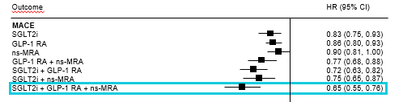
MACE

Slide 8
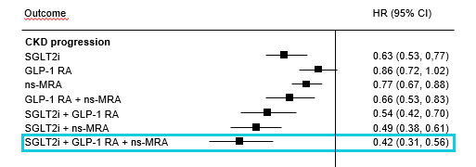
Progression Renal Disease

Slide 9
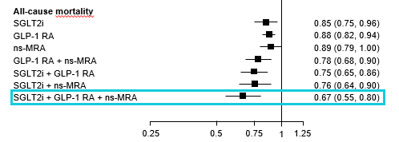
All Cause Mortality

Slide 10
Optimizing GDMT with Hyperkalemia
? Hemolysed
Discontinue K+ replacements
Dietary Education
Use HCT/Chlorthalidone 50 mg od or furosemide
Use SGLT-2 Inh
Switch MRA -> decrease MRA -> decrease ARB
Hold MRA if K+ > 5.5 -> rechallenge
Initiate K+ Binders

Slide 11
The Motivational Speech - Polyuria
Indication is for CV/Renal Protection
  – 30% mortality reduction
  35% reduction CHF
  50% reduction Kidney Failure
Benefits
  Glucose/Wt/BP
Downside
  GMI
  polyuria

Slide 12
The Motivational Speech - Polyuria
Indication is for CV/Renal Protection
  – 30% mortality reduction
  35% reduction CHF
  50% reduction Kidney Failure
Benefits
  Glucose/Wt/BP
Downside
  GMI
  polyuria
“ Peeing with a Purpose”
“Pee with benefits”

Slide 13
Postural Symptoms/Pre-Renal Failure
Avoid overdiuresis
  Lasix to 40 + 40
Delete anti-hypertensives without CV benefit
  Amlodipine/ BB
Reduce RAAS/ Inh
  . with predominantly RV Failure
Low dose SGLT -2 Inh – max Empagliflozin 10 mg od

Slide 14
Practical tips: Genital mycotic infections (GMIs)
Uncomplicated
  (Healthy, non-pregnant, <3 inf/year, mild/mod symptoms)
  Fluconazole 150 po single dose
Complicated
  Severe signs, > 3/ year, poorly controlled DM, immunocompromised
  Fluconazole 150 mg po q 3 days , 2-3 doses
    +/1 clotrimazole/betamethasone x 48 hrs
    Or Topicals – 7-14 days
Recurrent – >3 year
  Fluconazole 150 mg po q 72 hrs x 3, then once weekly x 6 months
Balanitis – ask if circumsized
  Advise of potential SE
  Topical cream/po fluconazole considered

Slide 15
Fluconazole
Prescription -$3.94 per 150 mg tabs
  + dispensing fee eg. $12.99
  Annual Cost – 1/ month - $60.27
Ontario -LU Code 235
150 mg tab q 25 days prn for vaginal Candidiasis
  Annual Cost – 1/month = $48
  Annual Cost - $4.00 + dispensing fee
50 mg x 3 covered

Slide 16
Don’t use SGLT-2 Inh with
Type 1 diabetes
Hx DKA/Pancreatic Insufficiency/Pancreatic resection
  Unless you have a c-peptide
eGFR < 20
Frail elderly – unless you are treating CHF/CKD
  replaces some diuretics

Slide 17

GLP-1 RA side effects
Most common side effects are nausea, vomiting, and diarrhea¹
Low hypoglycemia risk compared to sulfonylureas and insulin¹
GLP-1 RAs are associated with:
  Rare cases of acute gallstone disease¹
  Acute pancreatitis¹
GLP-1 RAs are contraindicated in patients with:
  Personal/family history of medullary thyroid cancer (MTC)
  Multiple endocrine neoplasia syndrome type 2 (MEN2)¹
Recent Canadian observational study of
>1.5 million people found no increased risk of pancreatitis with incretin-based therapies vs. other agents¹
GLP-1 RAs promote the development of pancreatic cancer and MTC in rodents, but an increased risk has not been seen in humans¹
Why does weight loss occur? GLP-1 RAs slow gastric emptying and cause a sense of satiety, leading to reduced food intake and weight loss. Weight loss is independent of GI side effects^{2,3}

Slide 18




Simple strategies to help patients manage
GLP-1 RA-related GI side effects
Eat smaller meals
Avoid fatty and spicy foods
Take on an empty stomach or before bed time
Stay hydrated
?
What tips or recommendations
for managing side effects have your patients found useful?

Slide 19

Ozempic Micro-Dosing
There are many “clicks” between the marked doses on the Ozempic pen. There are 18 “clicks” between 0 and 0.25mg and 18 “clicks” between 0.25mg and 0.5mg. On the 1mg pen there are 74 “clicks” between 0 and 1mg.
Use ____ clicks once a week and if tolerating well, continue to increase by ____ clicks every _____ weeks, until at the recommended dose of ______mg once weekly.
Once you are on a dose of 0.25 mg weekly, please discontinue your ___________ (Onglyza/Trajenta/Januvia)

Slide 20
Reducing Costs
Pharma Programs/Compassionate discounts
Trillium Application
Office Samples
Different Pharmacy

Slide 21
The Motivational Speech
Indication is for CV/Renal Protection
  – 30% mortality reduction
  35% reduction CHF
  30-50% reduction Kidney Failure
Benefits
  Glucose/Wt/BP
Downside
  GMI
  polyuria

Slide 22
Reducing Costs
Ozempic
  Use 1mg pen – click ½ way or 38 clicks = 0.5 mg ow
    $120/month
SGLT 2Inh
  Jardiance - $83.10/month (1/2 of 25 mg pill $41.75/month)
  Dapagliflozin - $20.40/Month
Finerenone
  $97.80/month
    ½ 20 mg pill = $48.90
Annual Cost = $2,391 including dispensing fees

Slide 23

Whose Job Is It Anyways?

Slide 24
Whose Job Is It Anyways?
Initiating Cardiac and Renal Protective Strategies for Diabetics
Cardio
Nephro
Endo

Slide 25
Whose Job Is It Anyways?
Initiating Cardiac and Renal Protective Strategies for Diabetics
Cardio
Nephro
Endo
Primary Care

Slide 26
Whose Job Is It Anyways?
Initiating Cardiac and Renal Protective Strategies for Diabetics
Cardio
Nephro
Endo
Primary Care
General
Internist

Slide 27
If you don’t feel comfortable with initiating these medications for individual patients,
Refer the patient on to someone who will.

Slide 28
If you don’t feel comfortable with initiating these medications for individual patients,
Refer the patient on
Ask someone who will.

Slide 29
Insert Applause Here

Slide 30
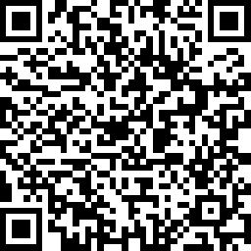
Evaluations

Slide 31


Slide 32

Thank You to Our Sponsors

Slide 33

sdcrc.ca
OTN
virtualhallway.ca
jcmacfad@gmail.com

Slide 34
Save the Date
Diabetes Update 2025 – Nomad Studios
October 22, 2025

