Slide 1
Case Studies in Continuous Glucose Monitors

Slide 2
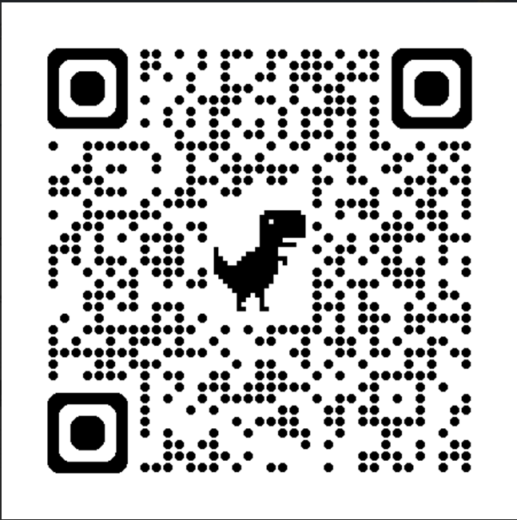
Libre Simulator

Slide 3

Libre 2 Coverage

Slide 4
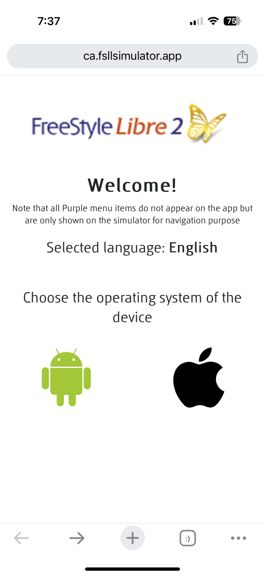

Slide 5
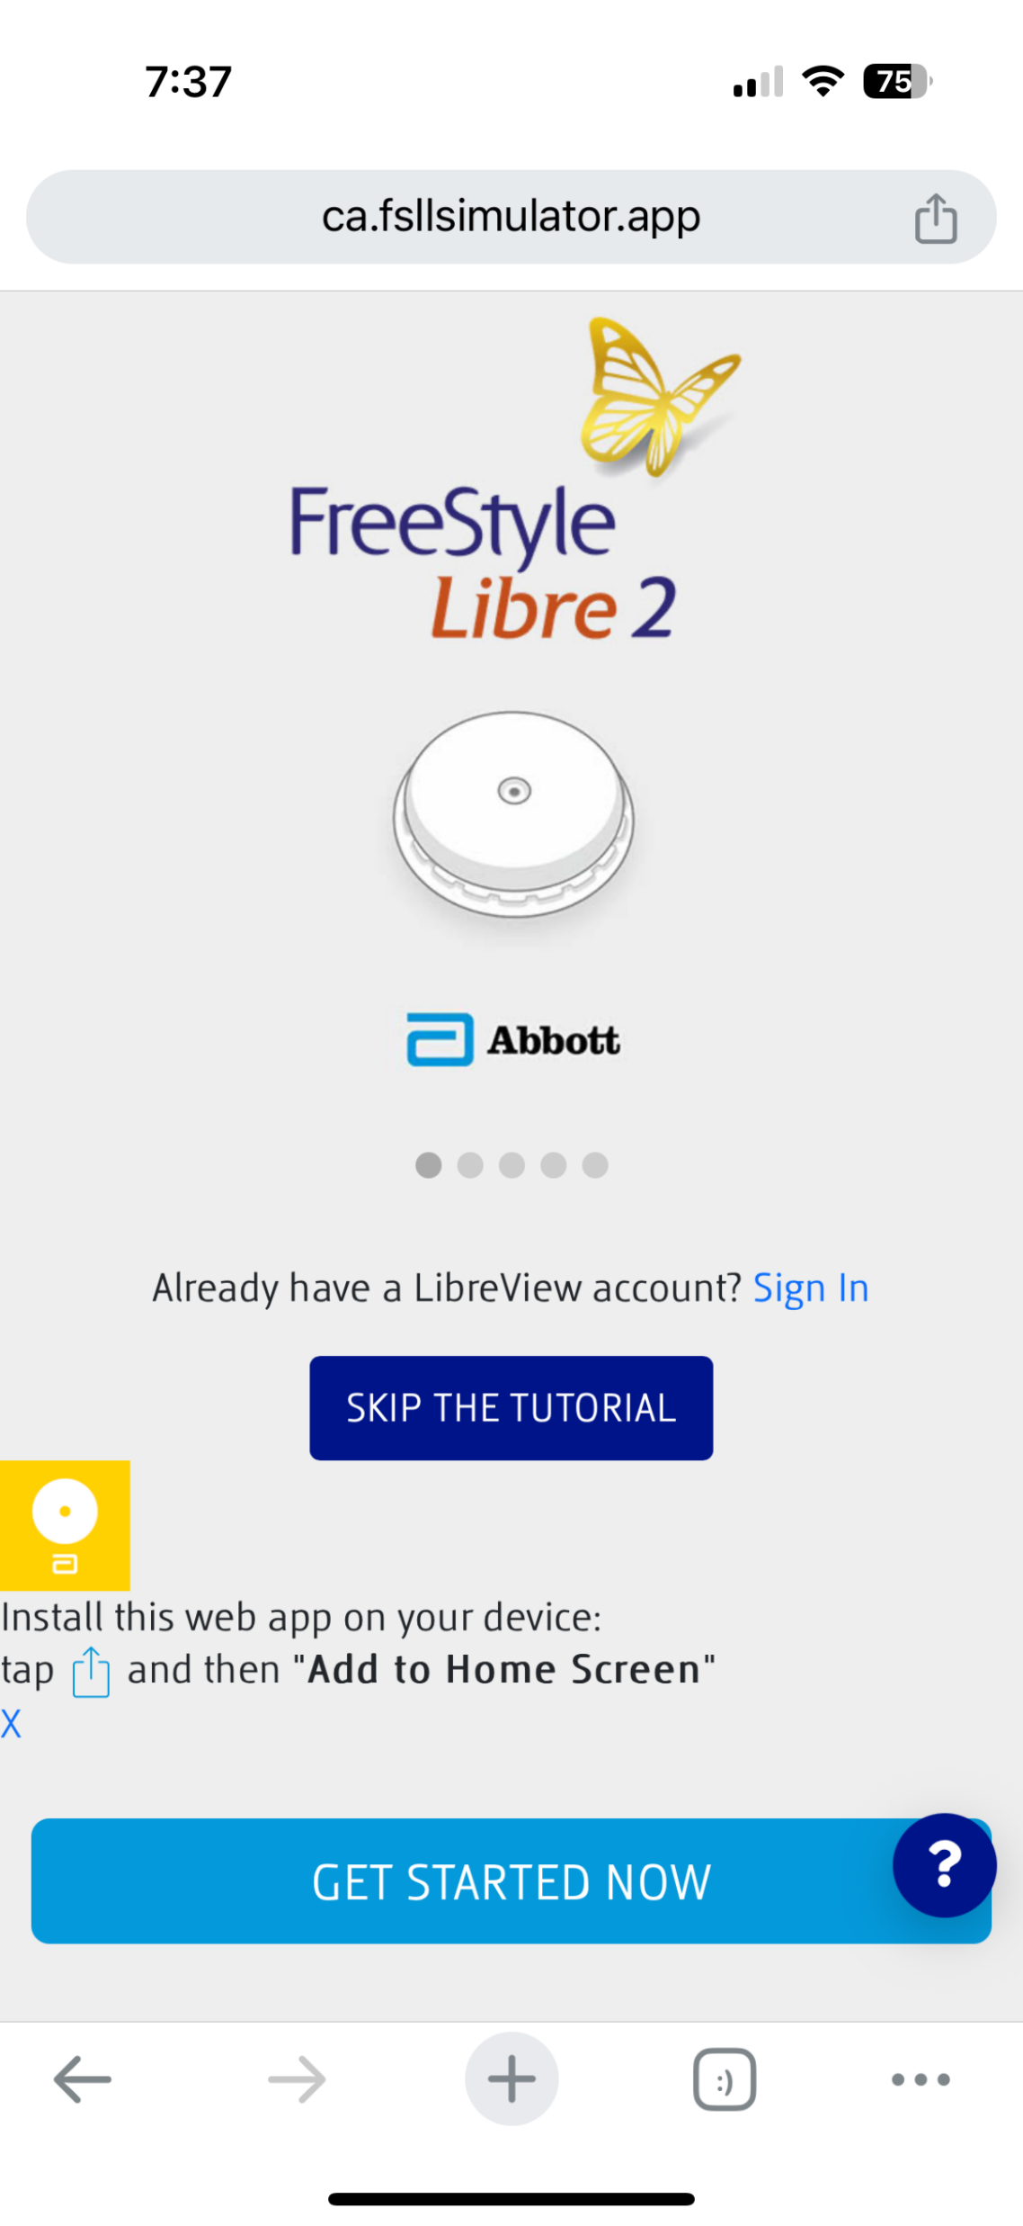

Slide 6
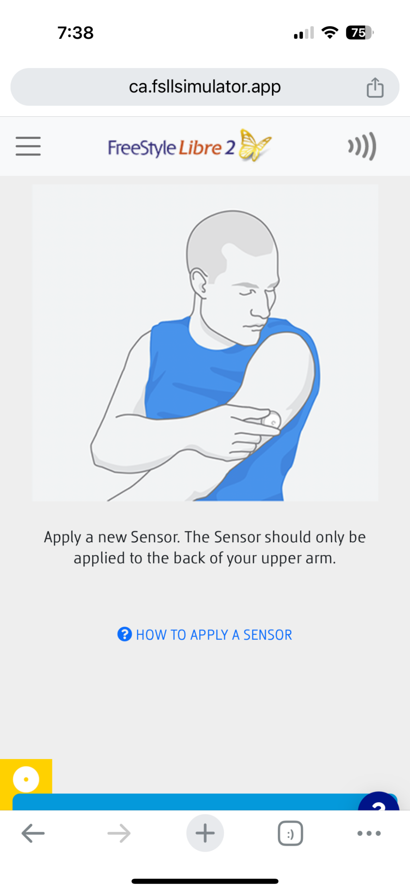

Slide 7
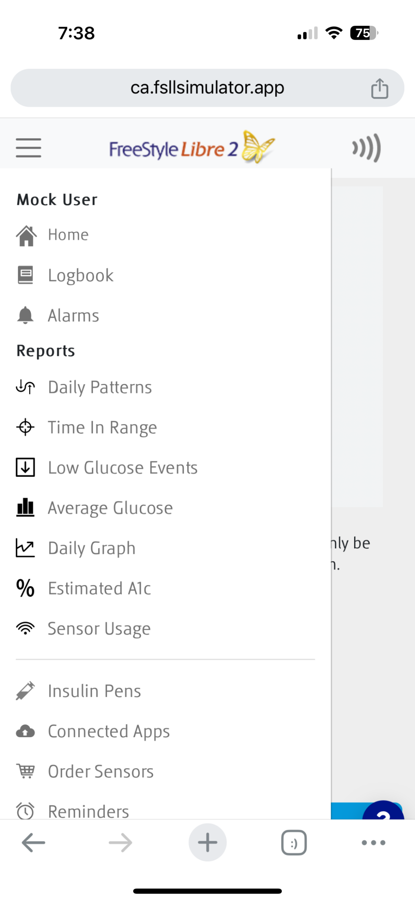

Slide 8
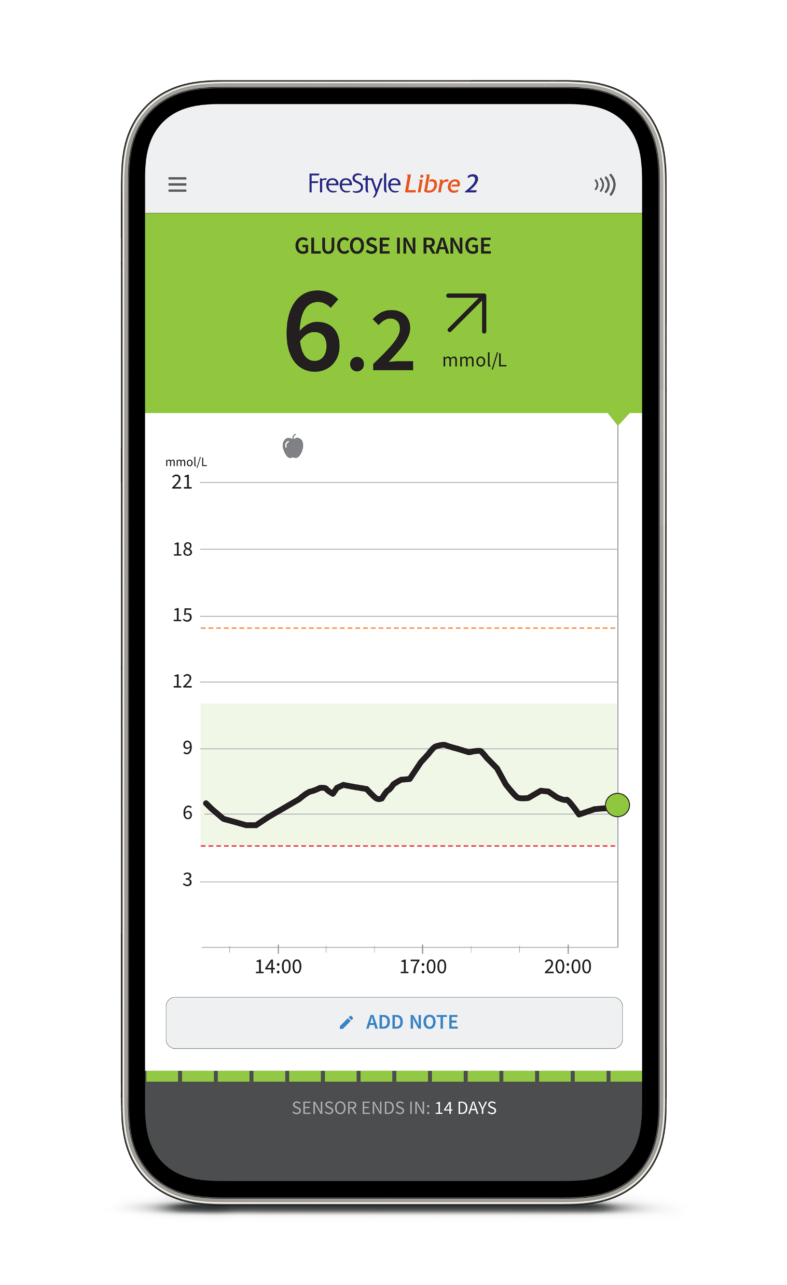
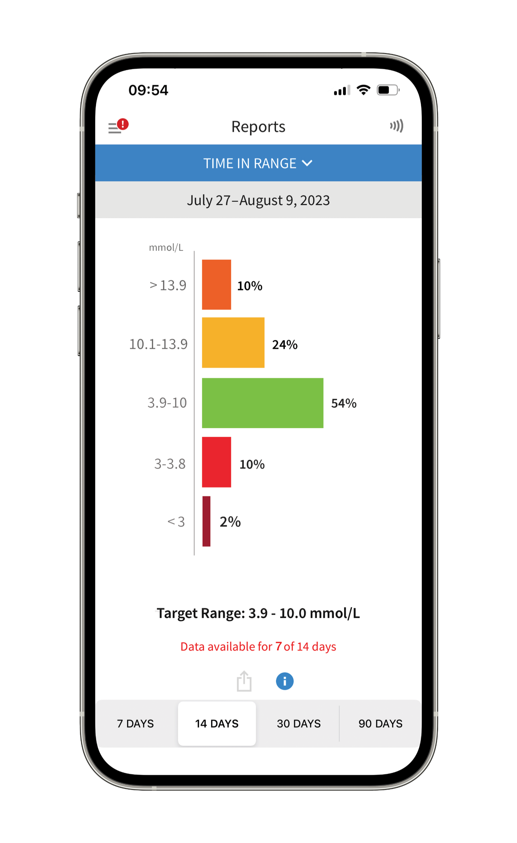
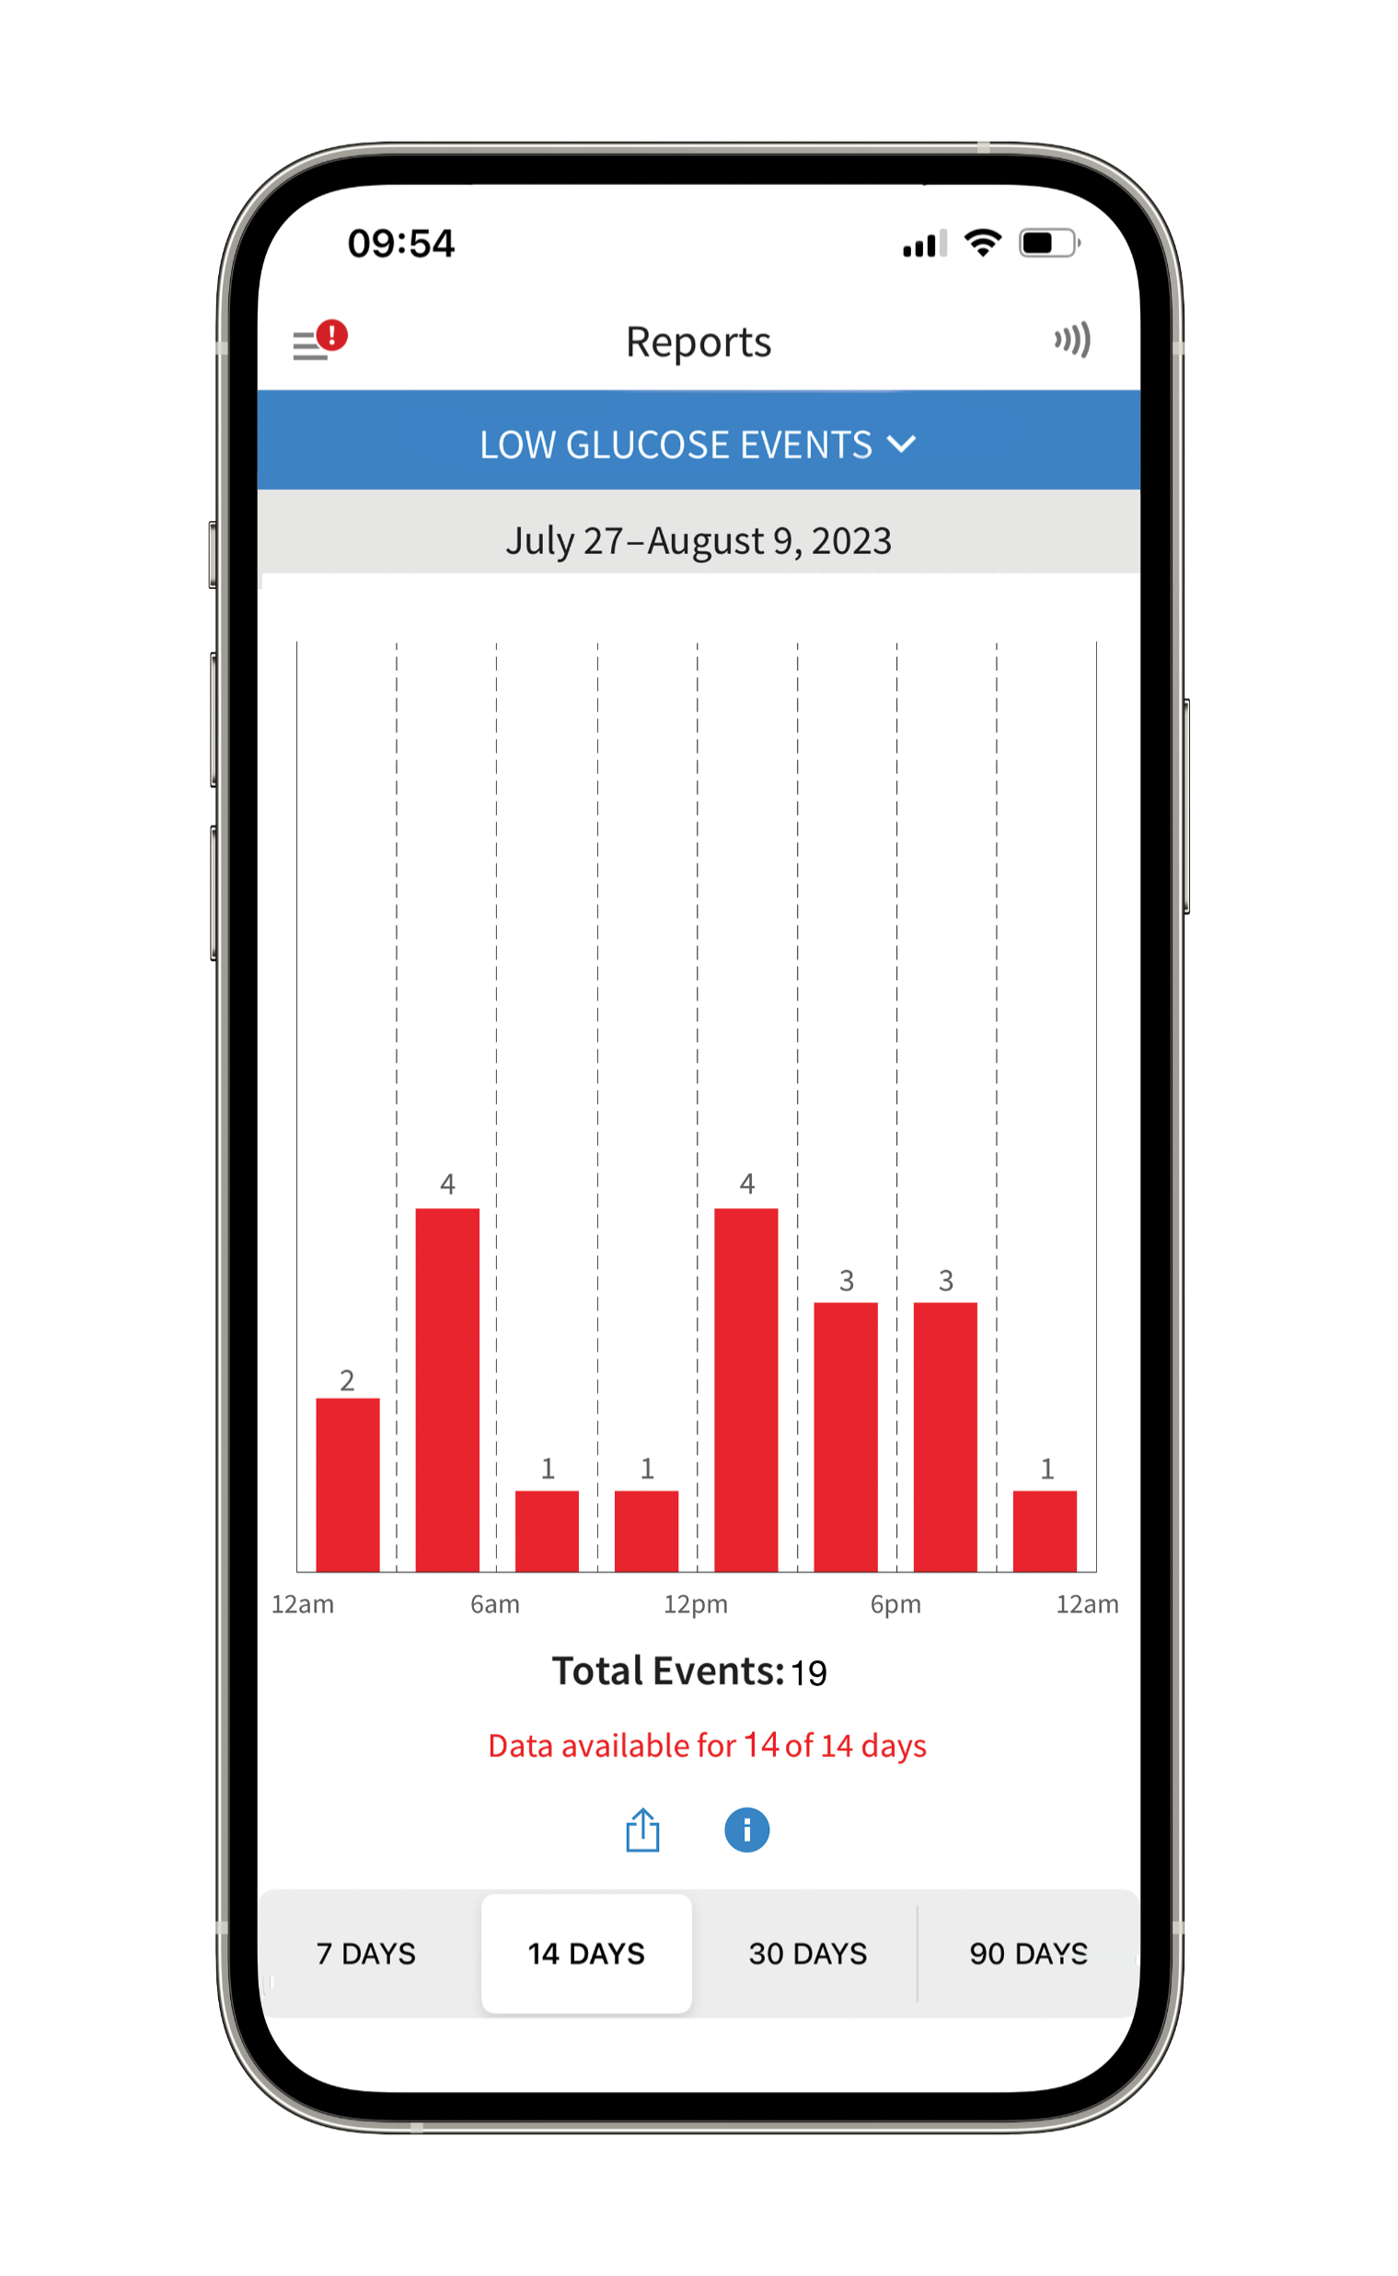
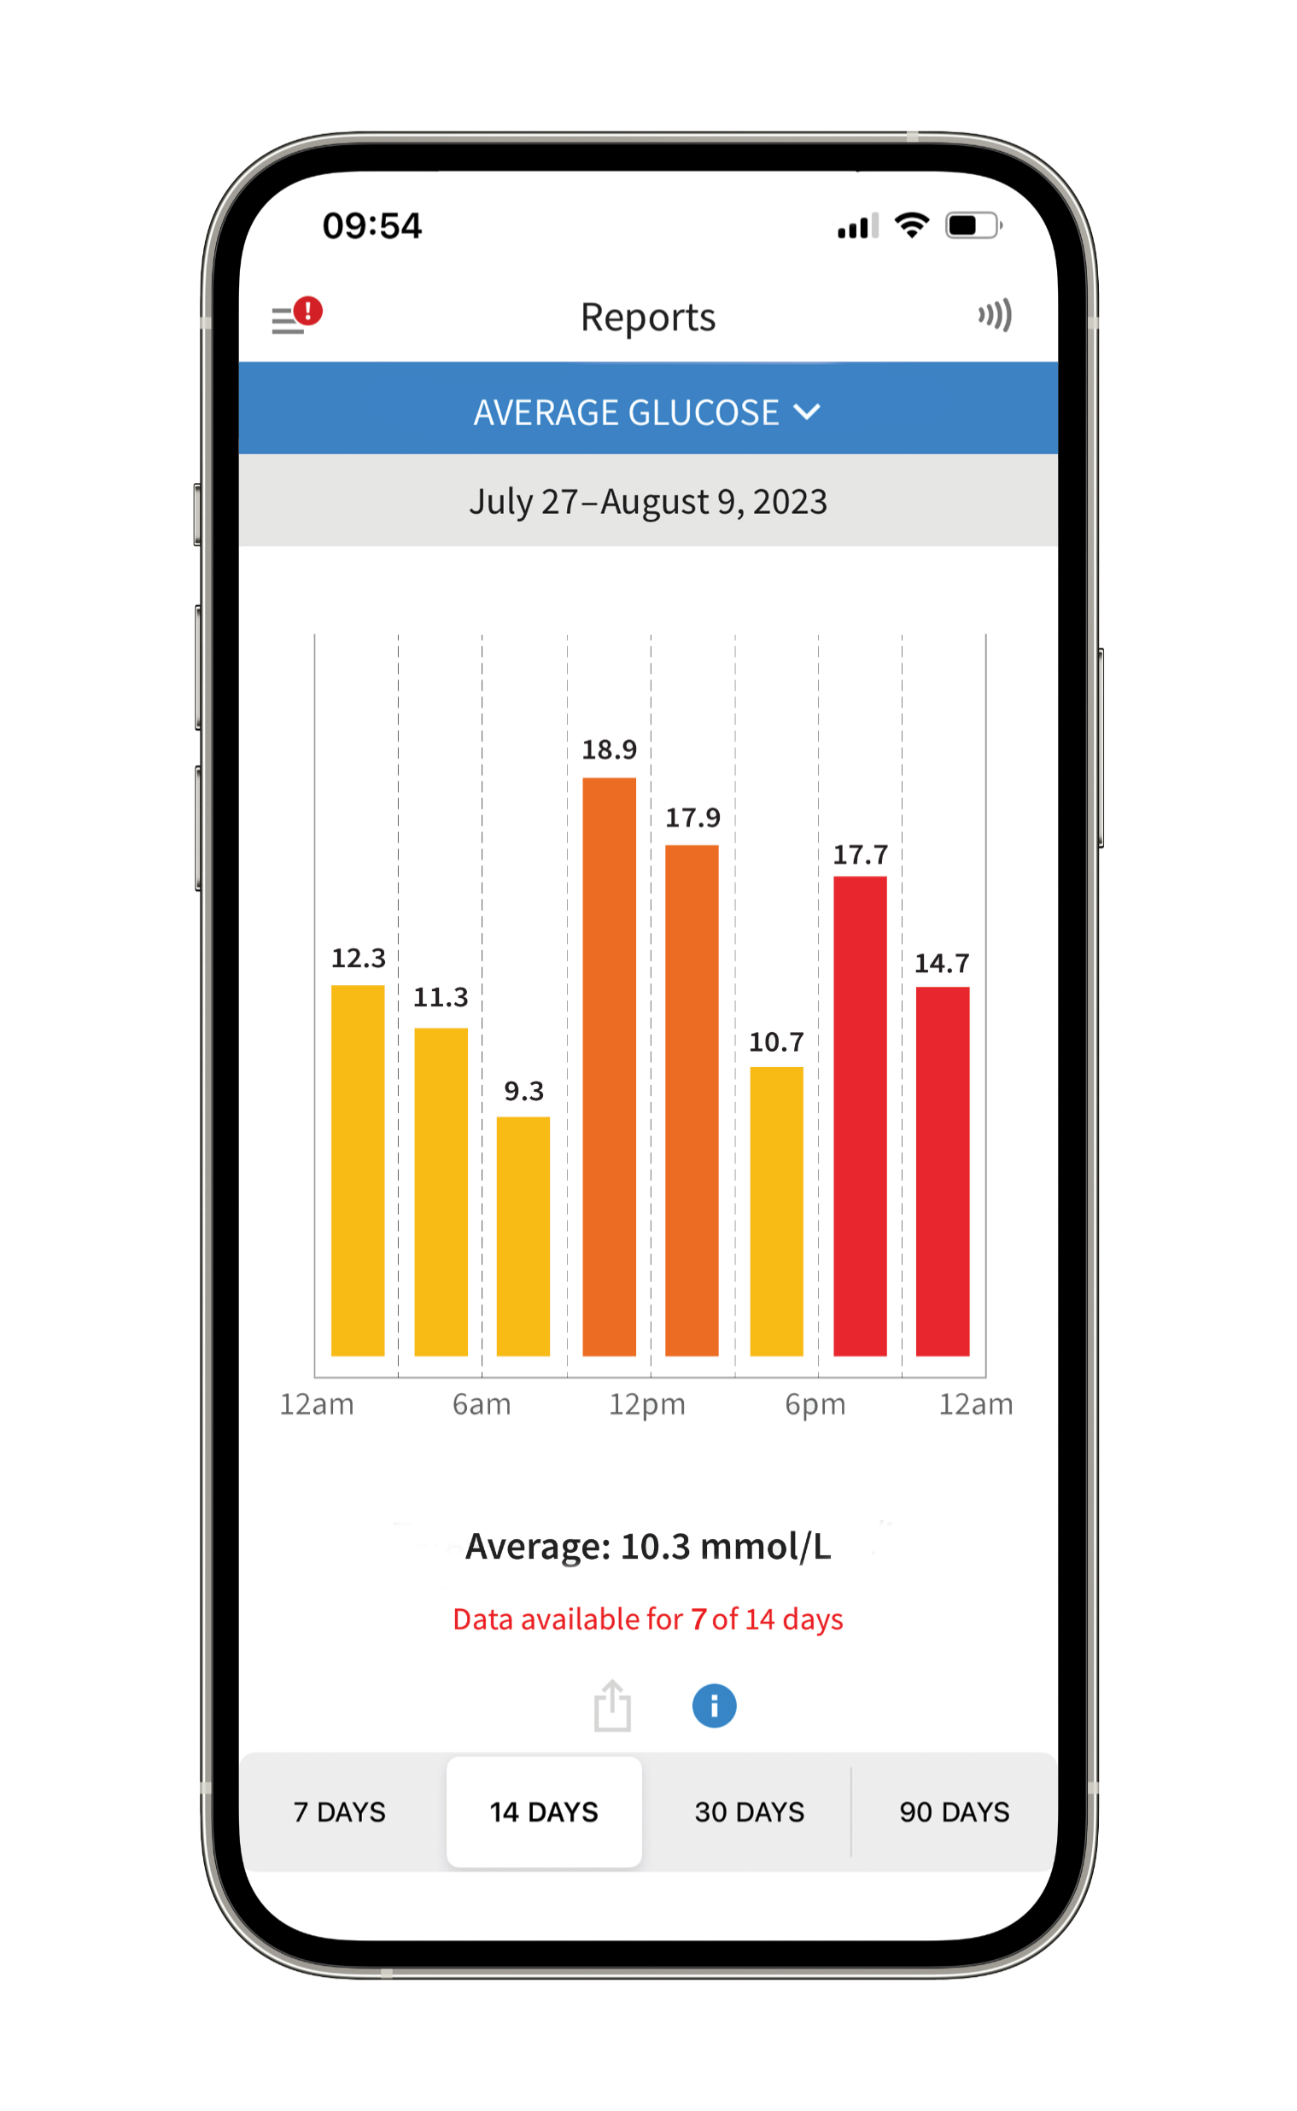
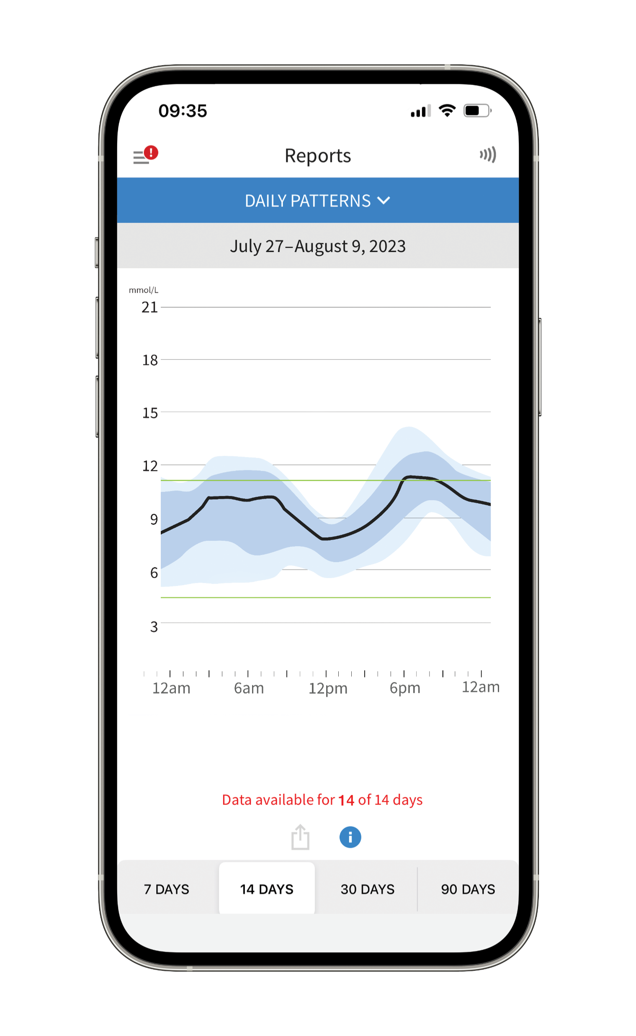
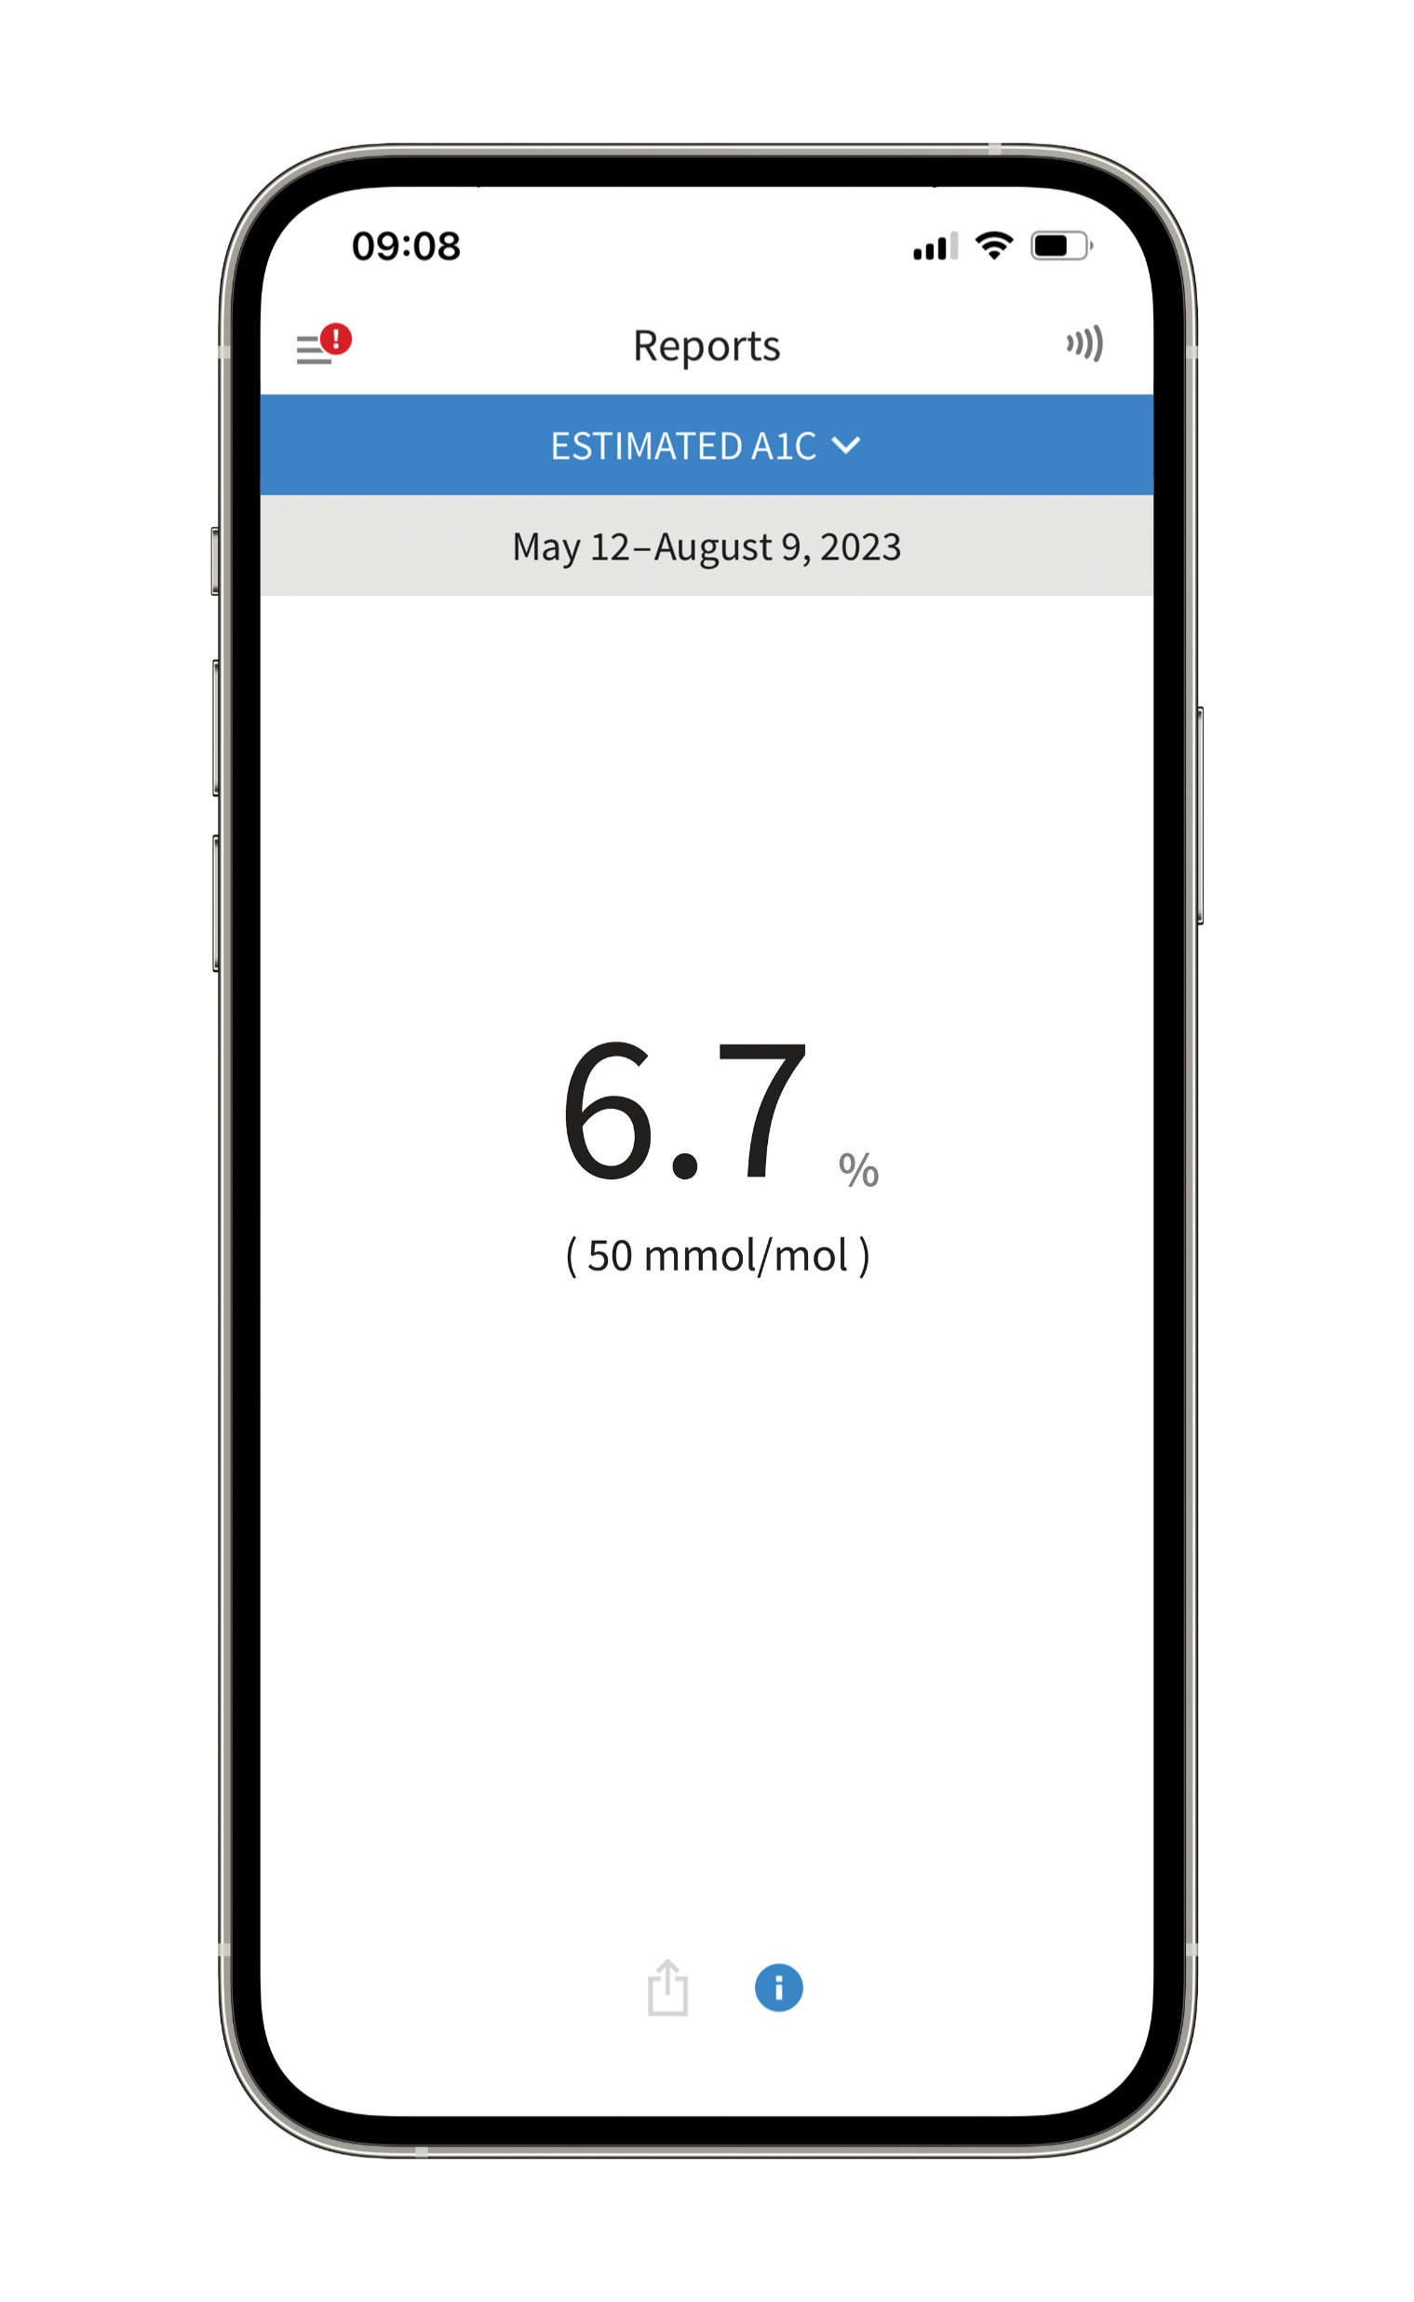
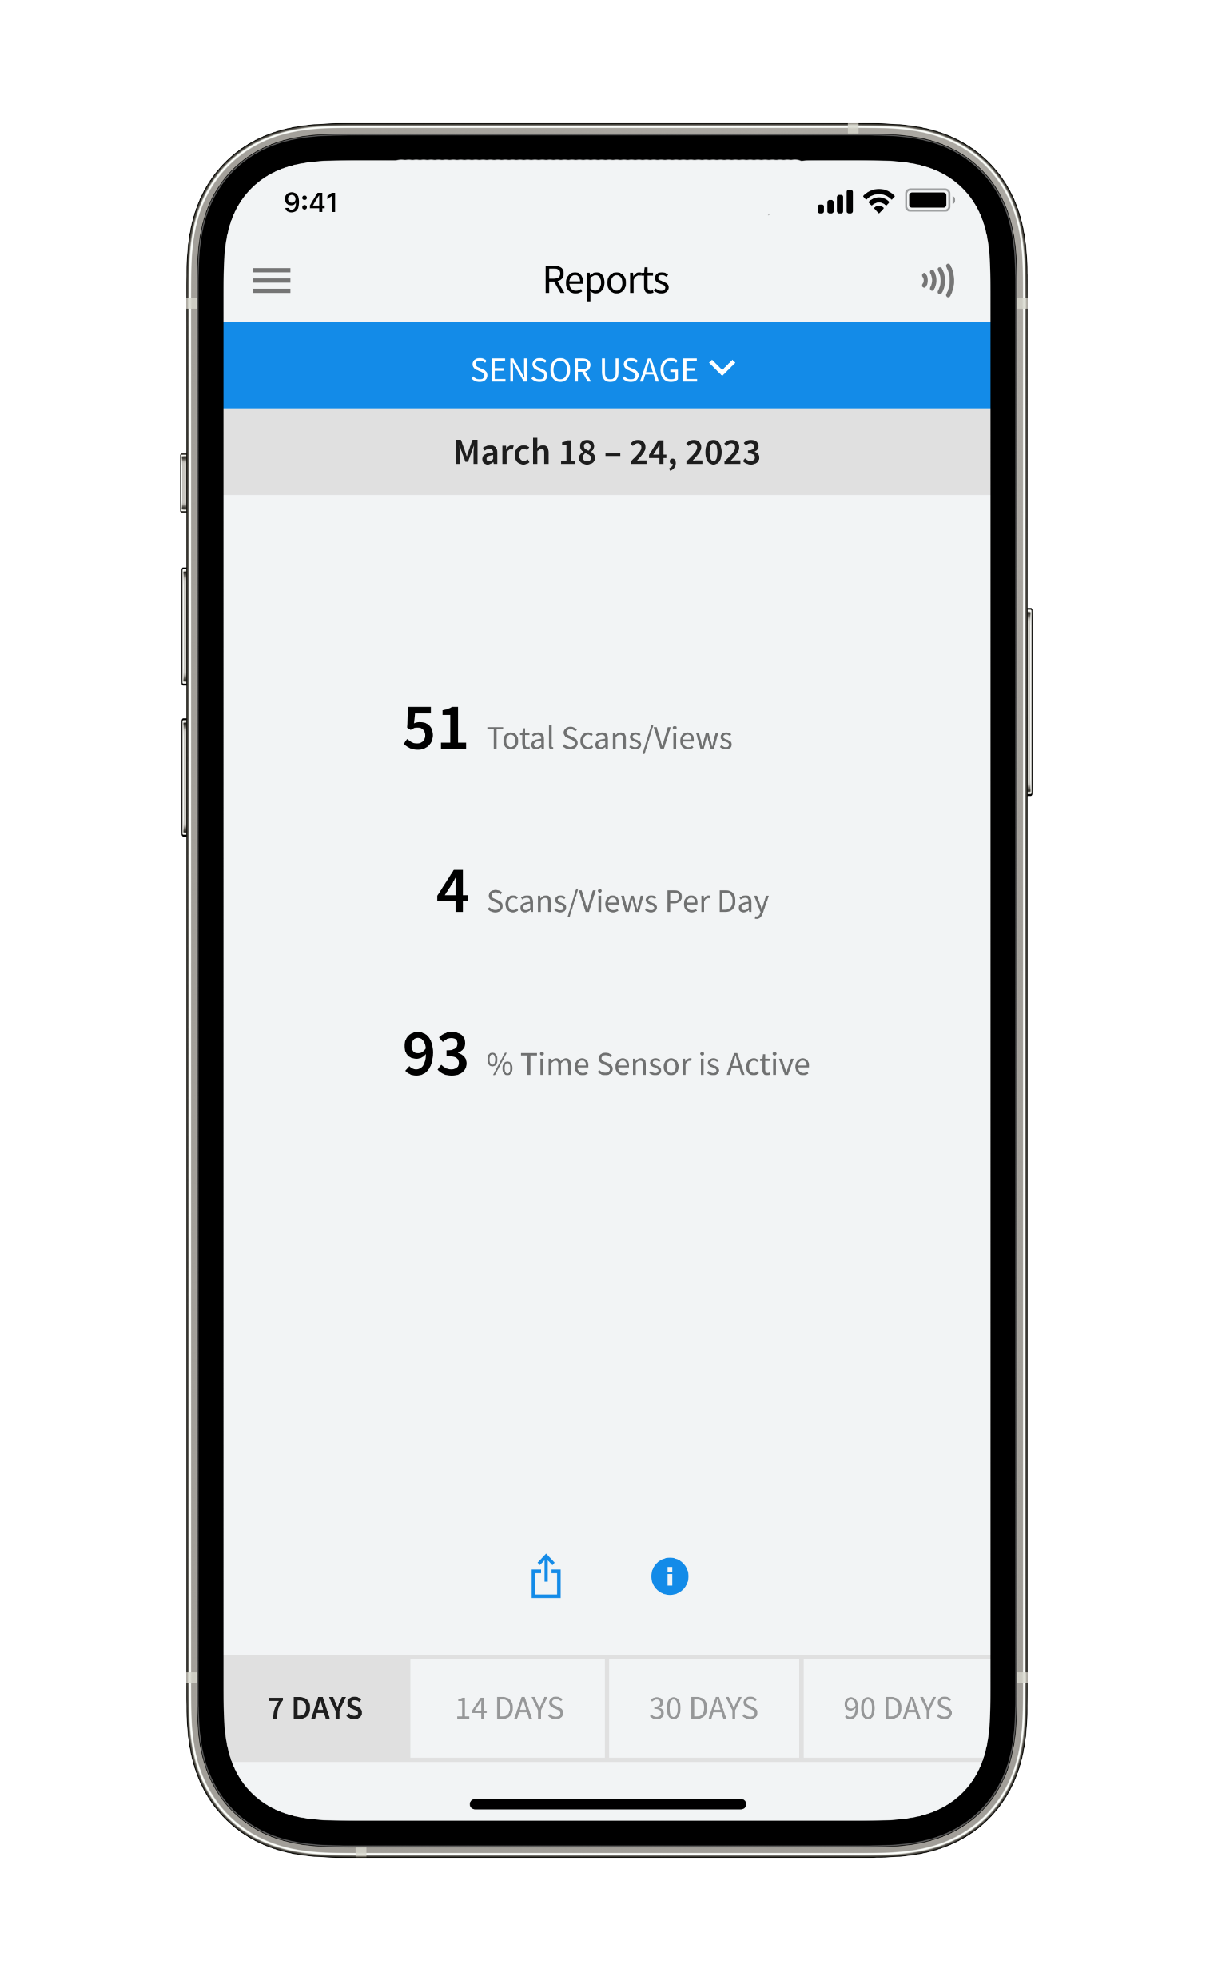
The Power of Technology
Glucose in Range
Time in Range
Low Glucose Events
Average Glucose
Daily Patterns
Estimated A1C
Sensor Usage
For illustration purposes only. Not actual patient data.
The FreeStyle Libre 2 flash glucose monitoring system is indicated for measuring interstitial fluid glucose levels in people aged 4 years and older with diabetes mellitus. Always read and follow the label/insert. The FreeStyle Libre 2 app is only compatible with certain mobile devices and operating systems. Please check the website for more information about device compatibility before using the app. Use of FreeStyle Libre 2 requires registration with LibreView.

Slide 9
The Power of Technology
Glucose in Range
Time in Range
Low Glucose Events
Average Glucose
Daily Patterns
Estimated A1C
Sensor Usage
For illustration purposes only. Not actual patient data.
The FreeStyle Libre 2 flash glucose monitoring system is indicated for measuring interstitial fluid glucose levels in people aged 4 years and older with diabetes mellitus. Always read and follow the label/insert. The FreeStyle Libre 2 app is only compatible with certain mobile devices and operating systems. Please check the website for more information about device compatibility before using the app. Use of FreeStyle Libre 2 requires registration with LibreView.

Slide 10
The Power of Technology
Glucose in Range
Time in Range
Low Glucose Events
Average Glucose
Daily Patterns
Estimated A1C
Sensor Usage
For illustration purposes only. Not actual patient data.
The FreeStyle Libre 2 flash glucose monitoring system is indicated for measuring interstitial fluid glucose levels in people aged 4 years and older with diabetes mellitus. Always read and follow the label/insert. The FreeStyle Libre 2 app is only compatible with certain mobile devices and operating systems. Please check the website for more information about device compatibility before using the app. Use of FreeStyle Libre 2 requires registration with LibreView.

Slide 11
Time in Range (TIR) Targets
What the data tells us
TYPE 1 & TYPE 2
DIABETES
OLDER/HIGH RISK
CONSENSUS RECOMMENDATIONS
To reach an A1C target of 7.0%
the TIR target (3.9-10.0 mmol/L)
is >70%
For older/high risk of hypoglycemia (A1C target of 8.0%) – the TIR target is >50%
TYPE 1 & TYPE 2 DIABETES
AVOIDING TIME BELOW RANGE (TBR)
For most adults:
Try to limit glucose <3.9 mmol/L to
<4% of the time (1 hour/day)
Within that 4%, limit 1% to
<3.0 mmol/L
For older and high risk patients:
Try to limit glucose <3.9 mmol/L to
<1% of the time (15 minutes/day)
Due to the higher risk of complications from hypoglycemia
TARGET
TARGET
<5%
<10%
<25%*
<50%*
>70%
>50%
<4%**
<1%
<1%
Every 10% ↑ in TIR (2.4 hours/day) corresponds to a 0.5-0.8% ↓ in A1C
Battelino, Tadej, et al. “Clinical Targets for Sensor Based Glucose Monitoring Data Interpretation: Recommendations From the International Consensus on Time in Range.” Diabetes Care 42, no. 8 (August 2019): 1593–1603. https://doi.org/10.2337/dci19-0028. Imran, S. Ali, Gina Agarwal, Harpreet S. Bajaj, and Stuart Ross. “Targets for Glycemic Control.” Canadian Journal of Diabetes 42 (April 2018): S42–46. https://doi.org/10.1016/j.jcjd.2017.10.030.

Slide 12
The Power of Technology
Glucose in Range
Time in Range
Low Glucose Events
Average Glucose
Daily Patterns
Estimated A1C
Sensor Usage
For illustration purposes only. Not actual patient data.
The FreeStyle Libre 2 flash glucose monitoring system is indicated for measuring interstitial fluid glucose levels in people aged 4 years and older with diabetes mellitus. Always read and follow the label/insert. The FreeStyle Libre 2 app is only compatible with certain mobile devices and operating systems. Please check the website for more information about device compatibility before using the app. Use of FreeStyle Libre 2 requires registration with LibreView.

Slide 13
The Power of Technology
Glucose in Range
Time in Range
Low Glucose Events
Average Glucose
Daily Patterns
Estimated A1C
Sensor Usage
For illustration purposes only. Not actual patient data.
The FreeStyle Libre 2 flash glucose monitoring system is indicated for measuring interstitial fluid glucose levels in people aged 4 years and older with diabetes mellitus. Always read and follow the label/insert. The FreeStyle Libre 2 app is only compatible with certain mobile devices and operating systems. Please check the website for more information about device compatibility before using the app. Use of FreeStyle Libre 2 requires registration with LibreView.

Slide 14
The Power of Technology
Glucose in Range
Time in Range
Low Glucose Events
Average Glucose
Daily Patterns
Estimated A1C
Sensor Usage
For illustration purposes only. Not actual patient data.
The FreeStyle Libre 2 flash glucose monitoring system is indicated for measuring interstitial fluid glucose levels in people aged 4 years and older with diabetes mellitus. Always read and follow the label/insert. The FreeStyle Libre 2 app is only compatible with certain mobile devices and operating systems. Please check the website for more information about device compatibility before using the app. Use of FreeStyle Libre 2 requires registration with LibreView.

Slide 15
The Power of Technology
Glucose in Range
Time in Range
Low Glucose Events
Average Glucose
Daily Patterns
Estimated A1C
Sensor Usage
For illustration purposes only. Not actual patient data.
The FreeStyle Libre 2 flash glucose monitoring system is indicated for measuring interstitial fluid glucose levels in people aged 4 years and older with diabetes mellitus. Always read and follow the label/insert. The FreeStyle Libre 2 app is only compatible with certain mobile devices and operating systems. Please check the website for more information about device compatibility before using the app. Use of FreeStyle Libre 2 requires registration with LibreView.

Slide 16
The Power of Technology
Glucose in Range
Time in Range
Low Glucose Events
Average Glucose
Daily Patterns
Estimated A1C
Sensor Usage
For illustration purposes only. Not actual patient data.
The FreeStyle Libre 2 flash glucose monitoring system is indicated for measuring interstitial fluid glucose levels in people aged 4 years and older with diabetes mellitus. Always read and follow the label/insert. The FreeStyle Libre 2 app is only compatible with certain mobile devices and operating systems. Please check the website for more information about device compatibility before using the app. Use of FreeStyle Libre 2 requires registration with LibreView.

Slide 17
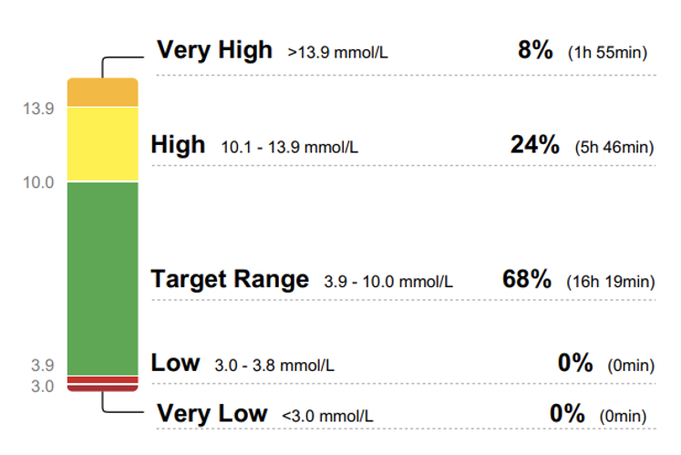
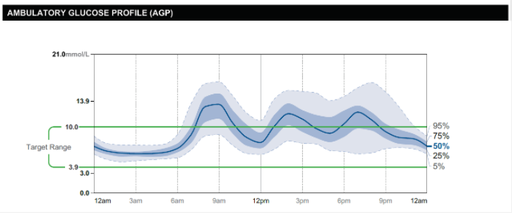
Advantages of Using TIR and AGP Data with Patients
What the data tells us
TIME IN RANGES (TIR)
AMBULATORY GLUCOSE PROFILE (AGP)
ADVANTAGES OF USING AGP
Easy visualization of a tremendous amount of data
Shows areas of glycemic excursions and rapid change
Can be used to educate patient
Empowers patients to see the impact of changes in nutrition, exercise and taking pharmacotherapy
Especially important for patients using insulin
ADVANTAGES OF USING TIR
Easy to interpret for patients
Captures information continuously
Captures glycemic variability
TIR and A1C are complementary
Dunn TC, Hayter GA, Doniger KJ, Wolpert HA. Development of the likelihood of low glucose (LLG) algorithm for evaluating risk of hypoglycaemia: a new approach for using continuous glucose data to guide therapeutic decision making. J Diabetes Sci Technol, (2014); 8(4):720-730: https://doi.org/10.1177/1932296814532200
Notes:
TIR Advantages
TIR is easy to interpret for patients
More ‘green’ less red and yellow
Captures information continuously
Captures lows – time below range
Provides feedback of more recent information (last 2 weeks vs. 3 months)
Glucose Management Indicator (GMI) provides time specific evaluation of patient's actual level of glycemic control (like an estimated A1C)
Captures glycemic variability
Patient can have a ‘perfect’ A1C but this could be due to many glycemic excursions
TIR and A1C are complementary
Both tools can be useful to engaging patients in improving glycemic control
Both signify if a change to the diabetes plan should be done
AGP Advantages
Easy visualization of a tremendous amount of data
Allows for interpretation by the HCP and the patient
Can show areas of glycemic excursions and rapid change
Can be used to educate patient
Empowers patients to see the impact of changes in nutrition, exercise and taking pharmacotherapy
Especially important for patients using insulin
Empowers patient to adjust insulin, identify lows/highs, improves safety

Slide 18
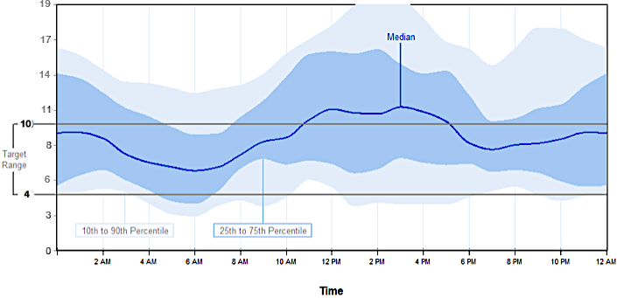
Interpreting Daily Patterns Can Be Done in a Few Steps
What is the shape of the median curve?
  Steep slope shows periods of rapid glucose change
What is the width of the interquartile range? (25th/75th)
  Assesses glucose variability
    Larger range indicates increased variability
3
4
2
Are the readings within the target range?
1
Are there patterns of hypoglycemia?
  Do any curves cross the hypoglycemia line?
Dunn TC, Hayter GA, Doniger KJ, Wolpert HA. Development of the likelihood of low glucose (LLG) algorithm for evaluating risk of hypoglycaemia: a new approach for using continuous glucose data to guide therapeutic decision making. J Diabetes Sci Technol, (2014); 8(4):720-730: https://doi.org/10.1177/1932296814532200

Slide 19
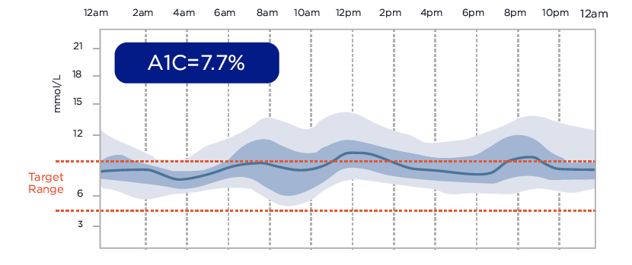
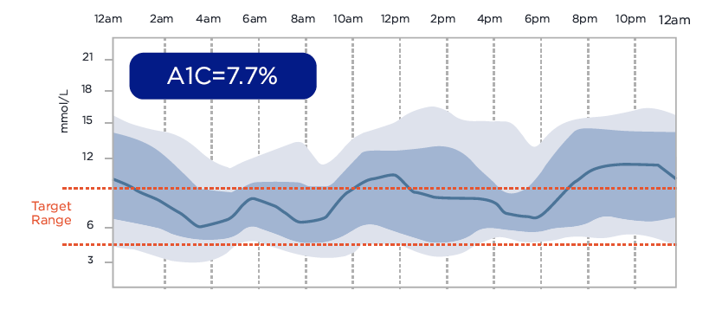
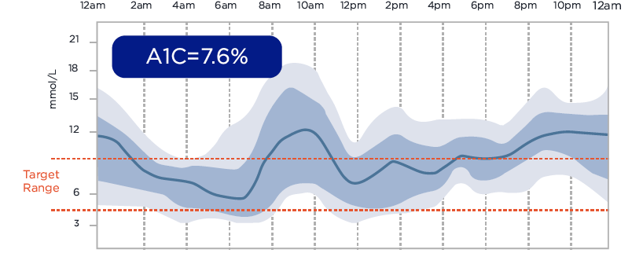
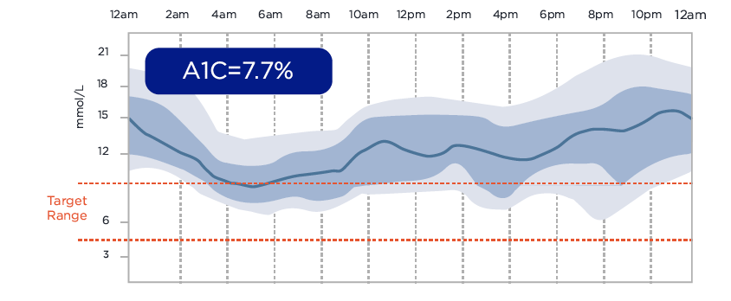
Understanding Your Patients Glycemic Control Beyond A1C
What the data tells us
4 patients with the same A1C (7.6-7.7%) can have very different glucose variability
PATIENT 1
PATIENT 2
A1C=7.7%
A1C=7.7%
PATIENT 3
PATIENT 4
A1C=7.6%
A1C=7.7%
Dunn TC, Hayter GA, Doniger KJ, Wolpert HA. Development of the likelihood of low glucose (LLG) algorithm for evaluating risk of hypoglycaemia: a new approach for using continuous glucose data to guide therapeutic decision making. J Diabetes Sci Technol, (2014); 8(4):720-730: https://doi.org/10.1177/1932296814532200

Slide 20
Understanding Your Patients Glycemic Control Beyond A1C
What the data tells us
2 patients with the same A1C (7.6-7.7%) can have very different glucose variability
PATIENT 1
PATIENT 2
Dunn TC, Hayter GA, Doniger KJ, Wolpert HA. Development of the likelihood of low glucose (LLG) algorithm for evaluating risk of hypoglycaemia: a new approach for using continuous glucose data to guide therapeutic decision making. J Diabetes Sci Technol, (2014); 8(4):720-730: https://doi.org/10.1177/1932296814532200

Slide 21
Glucose Variability – Self management
What are they –
Doing? – glucose testing
- activity - FITT
- injection sites
Taking? – adherence to meds/insulin
- varying dose of insulin
- treatment of highs/lows
- prospective vs retrospective diabetes management
Eating? – CHO counting/ varying size of meals
- snacking
Diabetes Burnout/Distress?

Slide 22
Benefits of CGM
Diagnosis
Hypo/Hyperglycemia
Patient Information
Identify glucose Patterns
Direct Management Decisions
Selection of oral agents/GLP1 agonists
Initiation and titration of basal insulin
Initiation of mealtime/bolus Insulin
Assessing Response to Changes in Therapy
Patient Education
Identifying Need for Change/Intensification
Reinforcing Behaviour Change/Self-Management
Alarms – Hypo and Hyper-Glycemia

Slide 23
DW – Nov 2024
47 yo male
Type 2 DM 2022
  HT/Incr Chol
  Solitary Kidney
  No drug plan
acBr glu – 7-8
A1C – 8.4
Cr 126
ACR – 7.2
metformin 500 mg 1 tablet 2 times daily
Jardiance 12.5 mg 1 time daily
Januvia 100 mg for 3 months of 30 days
Gliclizide 120 mg od
Unable to afford Ozempic
  Prev minimal benefit
? Recommendations

Slide 24
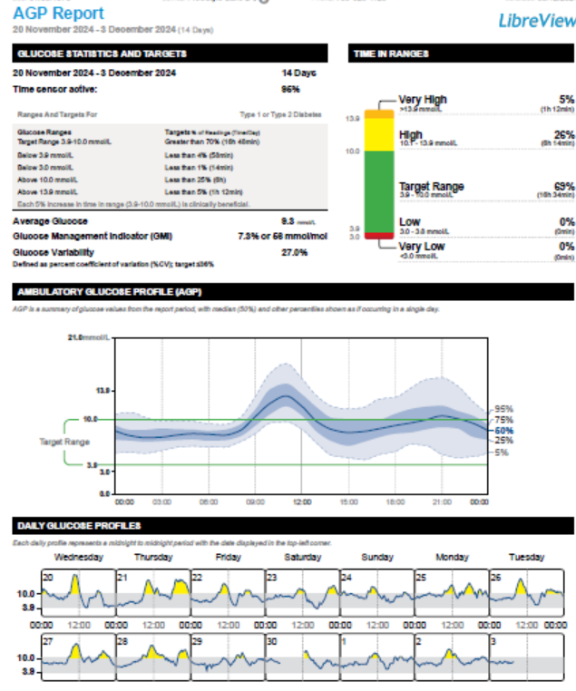

Slide 26
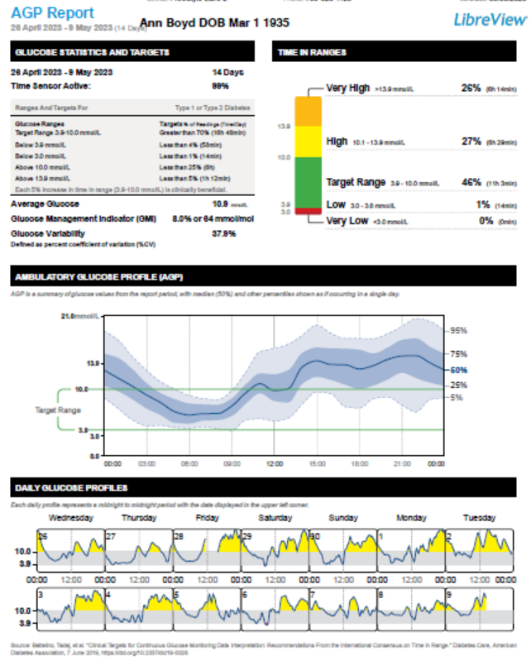
AB – 82 yo female – Type 2 DM
30/70 insulin
  12 u acBr
  8 u acSu
Trajenta
Recurrent nocturnal Hypo’s
A1C 8.2
eGFR 17, ACR 3.1

Slide 27
AB – 82 yo female – Type 2 DM
30/70 insulin
  12 u acBr
  8 u acSu
Trajenta
Recurrent nocturnal Hypo’s
A1C 8.2
eGFR 17, ACR 3.1
  ? Recommendations?

Slide 29
AB – 82 yo female – Type 2 DM
30/70 insulin
  12 u acBr
  8 u acSu
Trajenta
Recurrent nocturnal Hypo’s
A1C 8.2
eGFR 17, ACR 3.1
  ? Recommendations?

Slide 30
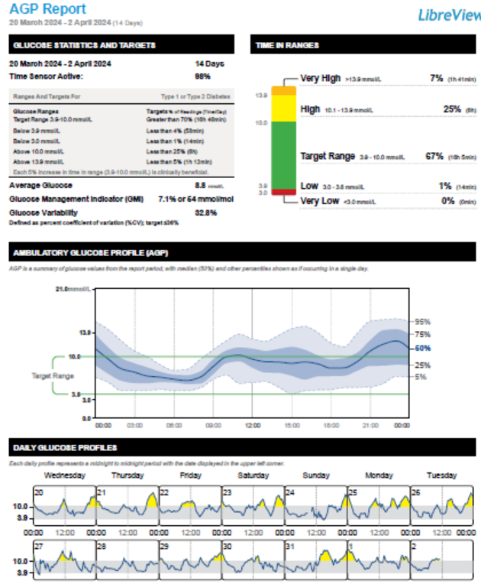
AB – MDI – Tresiba 8, Admelog 4 tid

Slide 31
CA
63 yo female, Type 2 DM
Tests od – states glu typically 6-9 acBr, ocass 8-10 other times
No hypoglycemia
  Metformin 500 bid
  Ozempic 1 mg sc ow
  Forxiga 10
A1C 9.5

Slide 32
CA
63 yo female, Type 2 DM
Tests od – states glu typically 6-9 acBr, ocass 8-10 other times
No hypoglycemia
  Metformin 500 bid
  Ozempic 1 mg sc ow
  Forxiga 10
A1C 9.5
? Recommendations

Slide 33
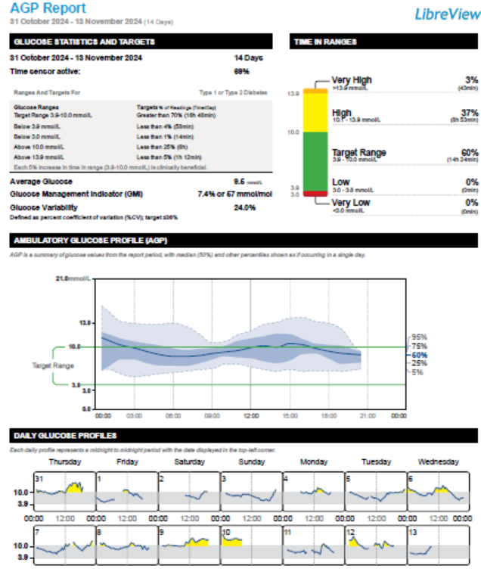
CA

Slide 34
CA -discrepant a1c

Slide 35
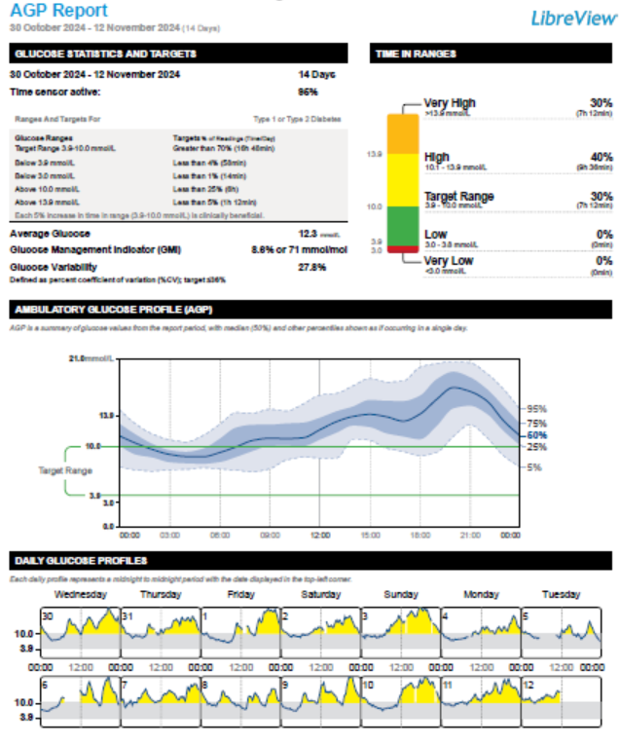
JB - Discrepant A1C 6.9

Slide 36
LG
67 yo male Type 2 DM x 25 years, insulin x 20 years
Referral – Poor glycemic control with recurrent hypoglycemia
Pt reports recurrent acBr hypoglycemia
Meds – Lantus 20 u hs
  Admelog 2-4 u tid
  Crestor/Ezetrol/Ramipril
Intolerant to Ozempic
Not interested in libre
No CVD/CKD

Slide 37
4.0 |  | 8.6 | 12.2
2.5
3.6 |  | 7.8
2.1 | 8.6 |  | 9.2

Slide 38
LG
67 yo male Type 2 DM x 25 years, insulin x 20 years
Referral – Poor glycemic control with recurrent hypoglycemis
Pt reports recurrent acBr hypoglycemia
Meds – Lantus 20 u hs
  Admelog 2-4 u tid
  Crestor/Ezetrol/Ramipril
Intolerant to Ozempic
Not interested in libre
No CVD/CKD
A1C 8.8
Recommendations?

Slide 39
LG
67 yo male Type 2 DM x 25 years, insulin x 20 years
Referral – Poor glycemic control with recurrent hypoglycemia
Pt reports recurrent acBr hypoglycemia
Meds – Lantus 20 u hs
  Admelog 2-4 u tid
  Crestor/Ezetrol/Ramipril
Intolerant to Ozempic
Not interested in libre
No CVD/CKD
A1C 8.8
Recommendations?
Diagnostic Libre

Slide 40
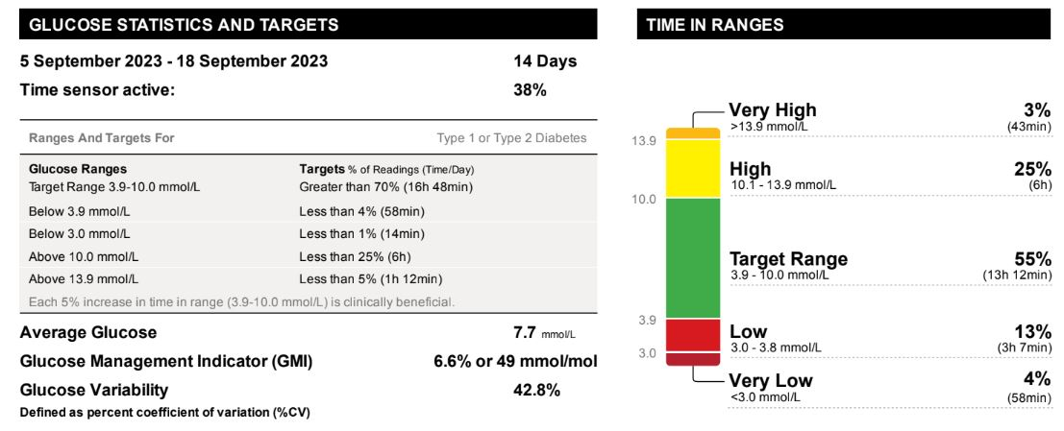

Slide 41
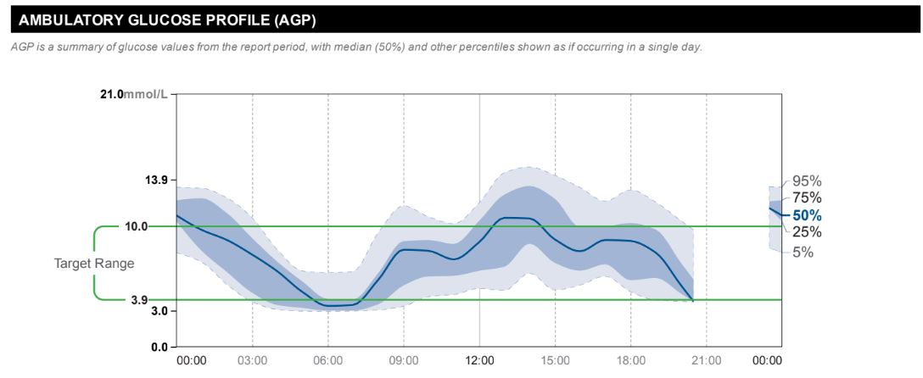

Slide 42
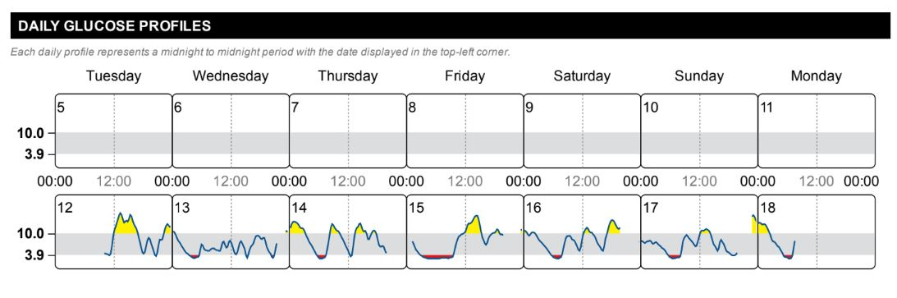

Slide 43
How do you decide how much insulin to take?

Slide 44
How do you decide how much insulin to take?
Takes Admelog only if glucoses > 10
2-3X weekly

Slide 45
LG
67 yo male Type 2 DM x 25 years, insulin x 20 years
Referral – Poor glycemic control with recurrent hypoglycemia
Pt reports recurrent acBr hypoglycemia
Meds – Lantus 20 u hs
  Admelog 2-4 u tid
  Crestor/Ezetrol/Ramipril
Intolerant to Ozempic
Not interested in libre
No CVD/CKD
A1C 8.8
Recommendations?

Slide 46
Recommendations
Ensure no correction at hs
Tresiba
Reduce basal to 16 units
Improve site rotation
Re-introduce oral agents
If on insulin, then routine pre meal

Slide 47
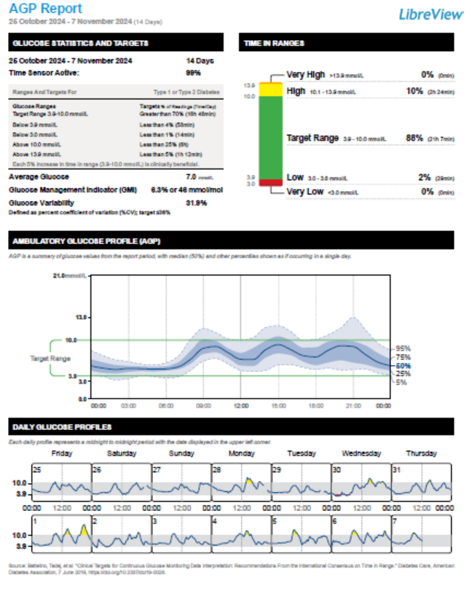
JW – 75 yo male – wants TIR 95%
Tresiba 40 u
Admelog 5-10 units
Low – I took too much insulin

Slide 49
How do you decide how much insulin to take?

Slide 50
How do you decide how much insulin to take?
Takes 5-10 units 2 hrs post meal and hs

Slide 51
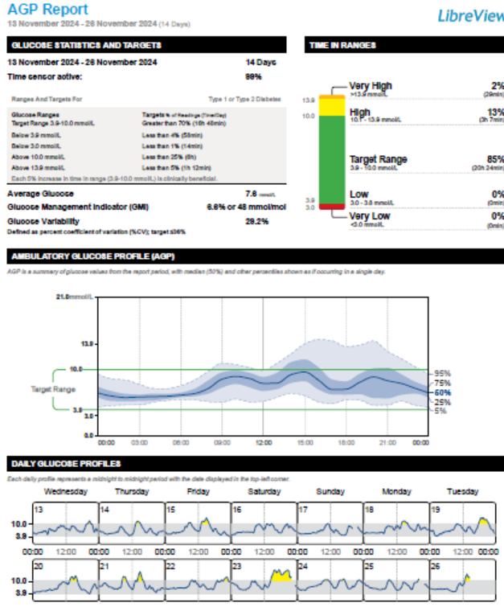

Slide 53
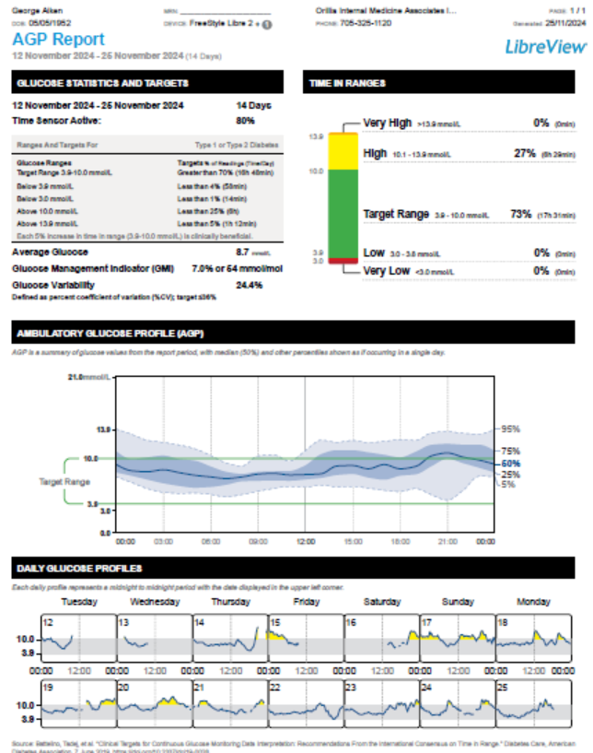
Nov 25 – George Aiken

Slide 54
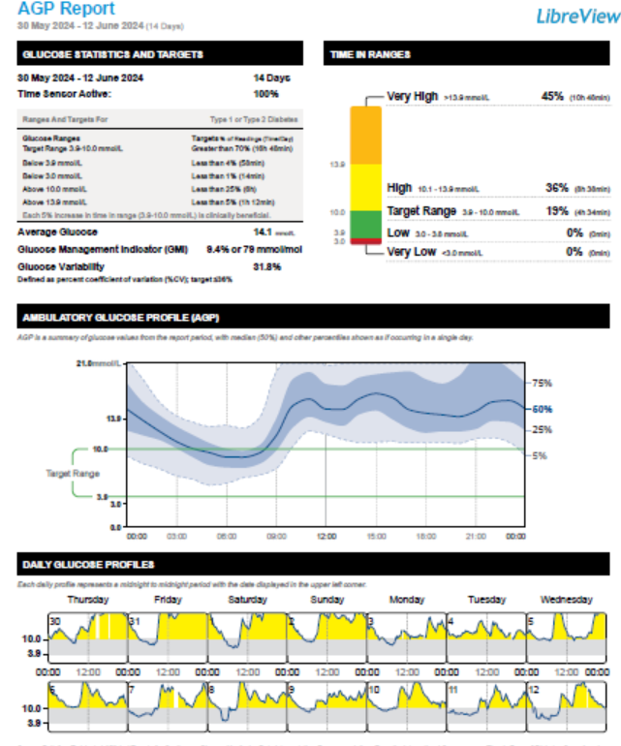
GA 75 yo male, Type 2 DM
Jardiance 10 mg 1 time daily
Ozempic 0.50 mg 1 time weekly
Metformin 500 mg bid

Slide 55
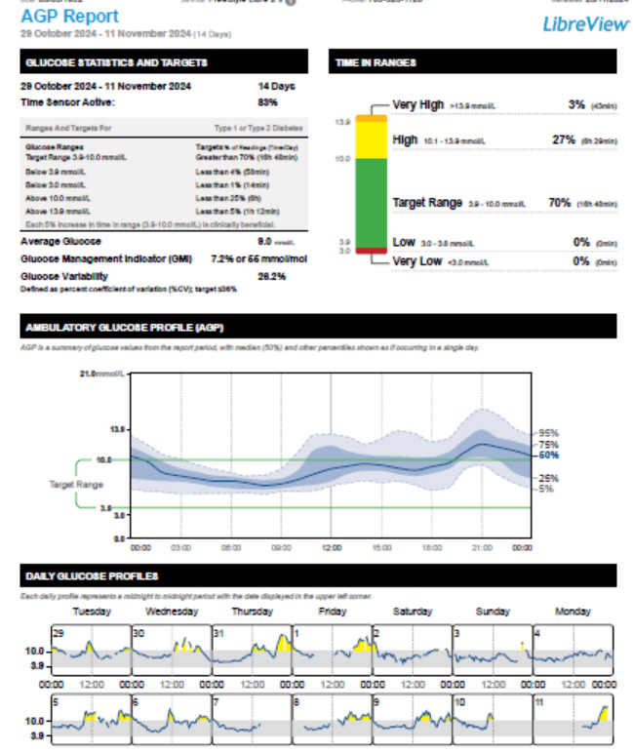
GA – Nov 11 – Diamicron 120 mg od

Slide 56
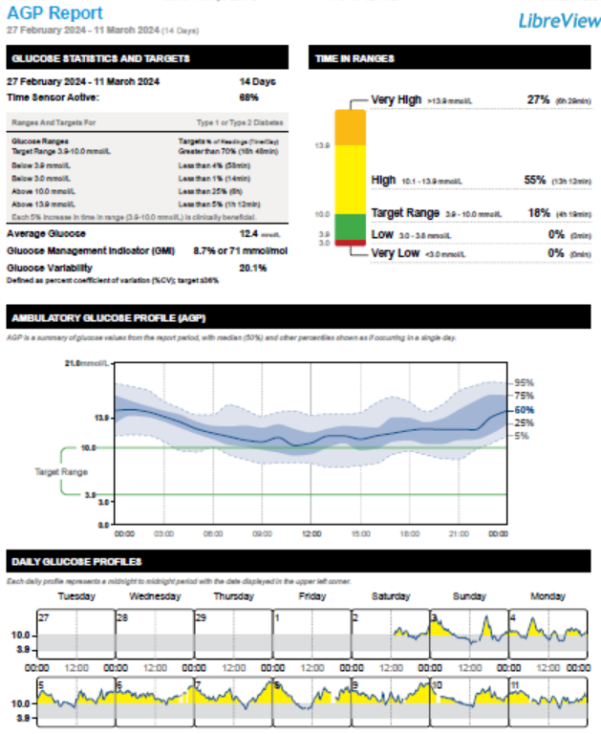
DB
DM x 3 years
Prev a1C 7.2 -> 8.6
Rybelsus 10 mg once daily
  (7 + 3 mg)
Jardiance 10

Slide 57
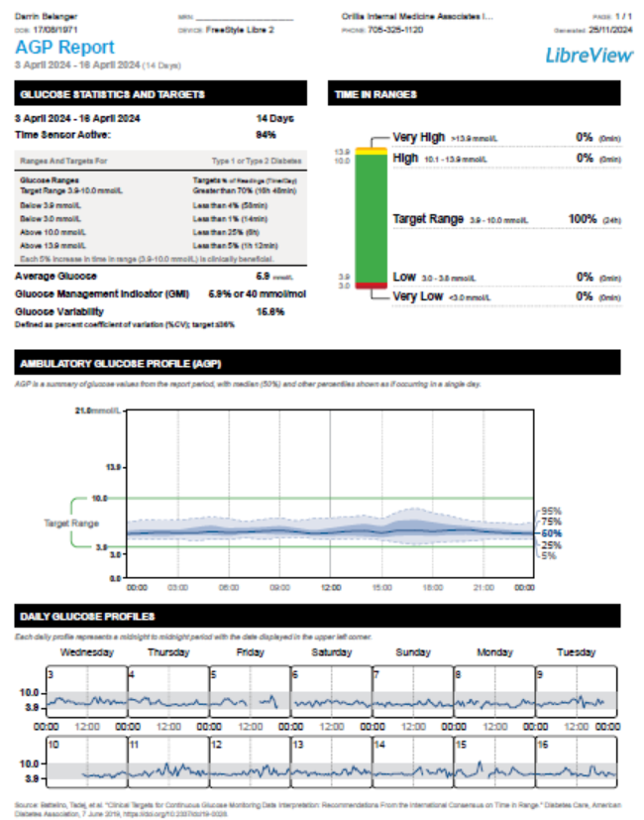
DB – Ozempic 1 mg , Metformin 500 mg bid

Slide 58
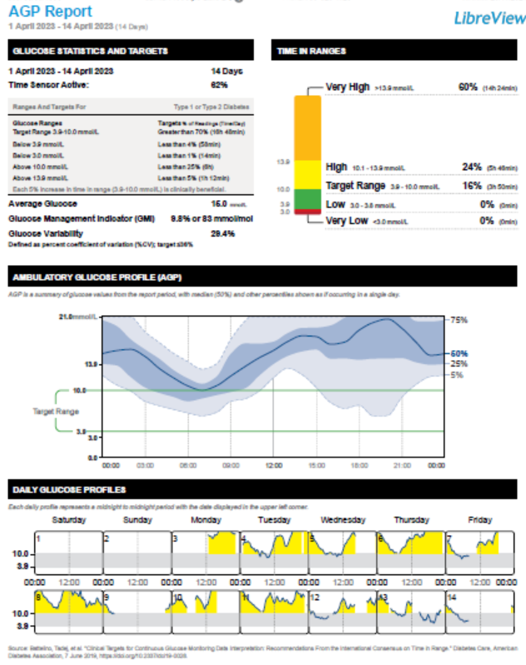
CW 65 yo male– Prev EtOH Pancreatitis
Jardiance 10 mg 1 time daily
metformin 500 mg 2 times daily
Tresiba FlexTouch 200 unit/mL (3 mL) 10 units 1 time daily

Slide 59


Slide 60
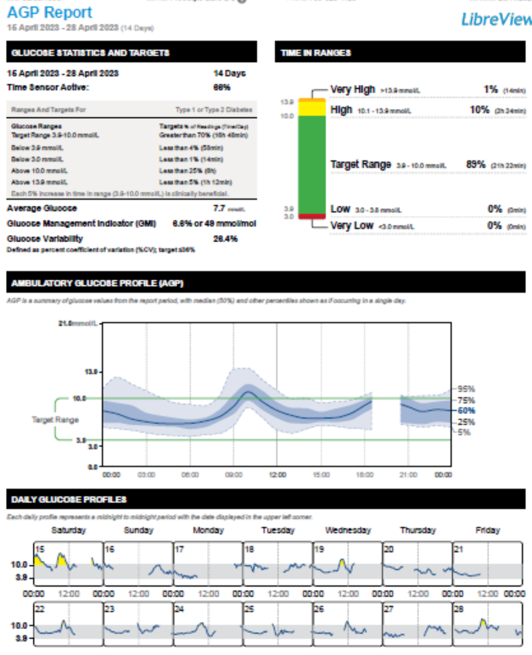
CW One Month later – Diamicron MR

Slide 61
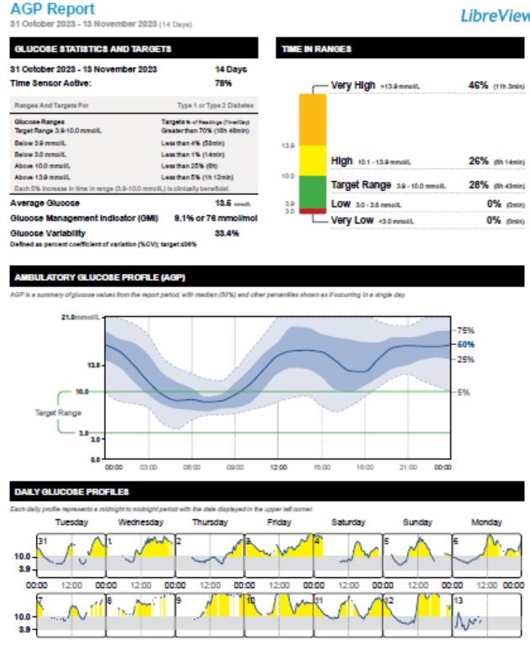
CW -6 months later PMR –Pred 10 mg od
metformin 500 mg 2 times
Diamicron MR 60 mg 2 tablets 1 time daily
Prednisone 10 mg

Slide 62
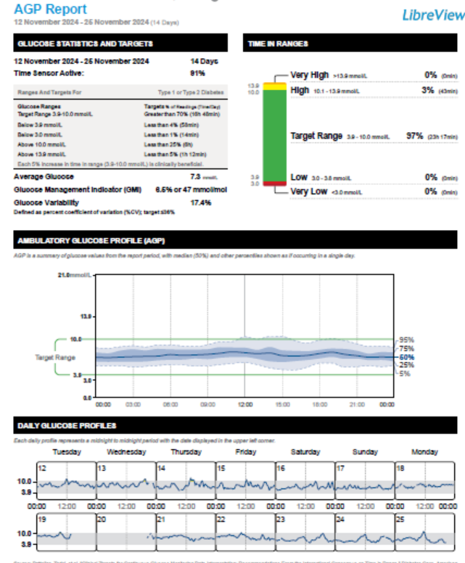
CW - Ozempic ? Fatty Liver Dx

Slide 63
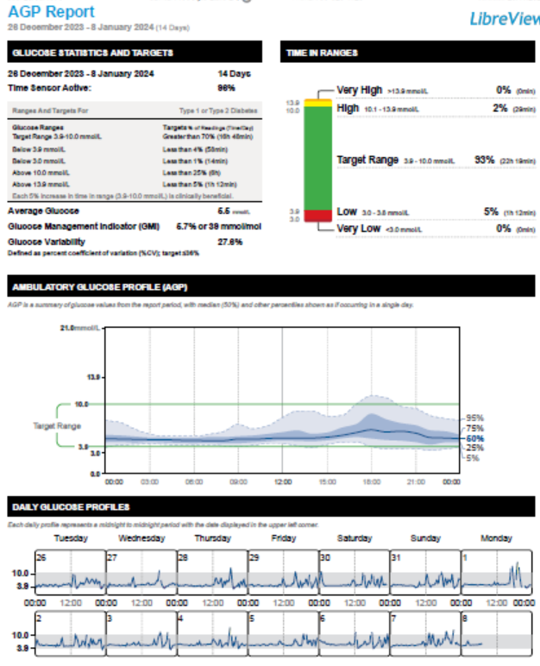
MR – 54 yo female post gastroplasty hypoglycemia

Slide 64
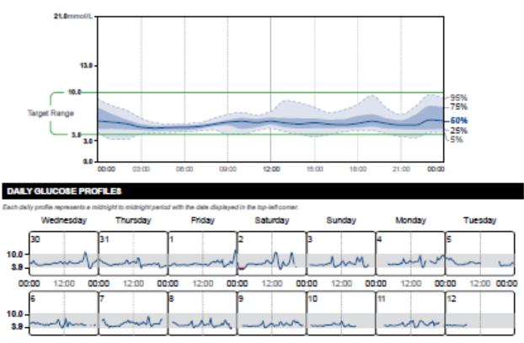
Post Gastrectomy

Slide 66
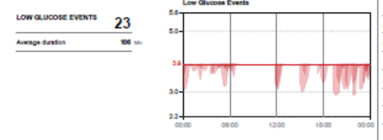

Slide 67
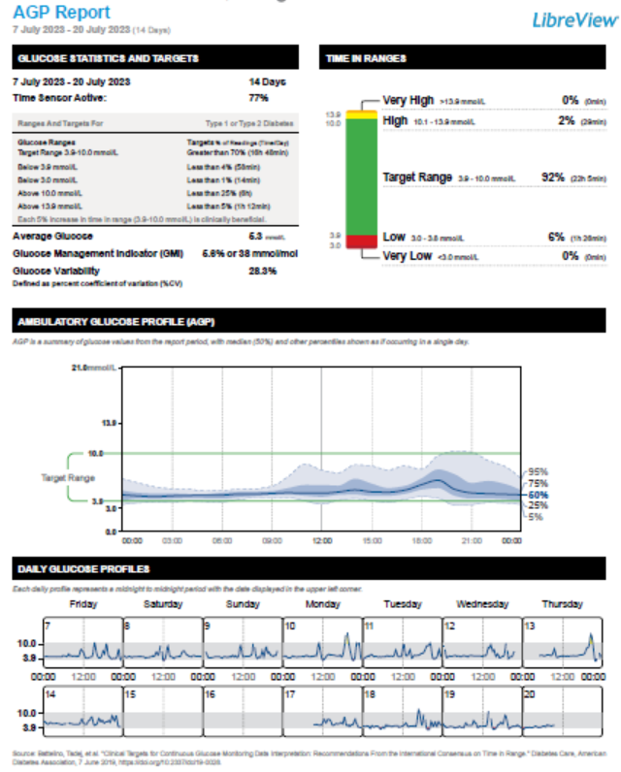
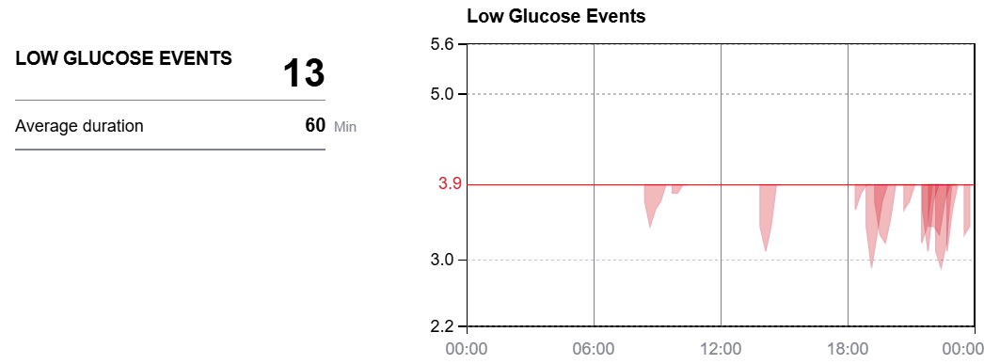
Post Acarbose

Slide 68
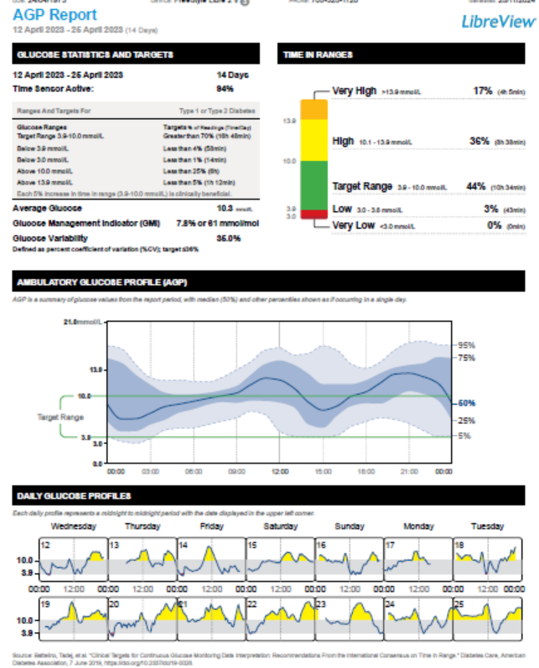
AS – 54 yo male Type 2 - MDI Insulin x 10 yrs
Trurapi SoloSTAR 100 unit/mL (3 mL) 16 units 2 times daily
Tresiba FlexTouch 100 unit/mL (3 mL) 8 units 1 time daily
Metformin 1 g bid
Jardiance 10 mg od
Trajenta 5 mg bid
Ozempic intolerant

Slide 70
Glucose Variability – Self management
What are they –
Doing? – glucose testing
- activity - FITT
- injection sites
Taking? – adherence to meds/insulin
- varying dose of insulin
- treatment of highs/lows
- prospective vs retrospective diabetes management
Eating? – CHO counting/ varying size of meals
- snacking
Diabetes Burnout/Distress?

Slide 71
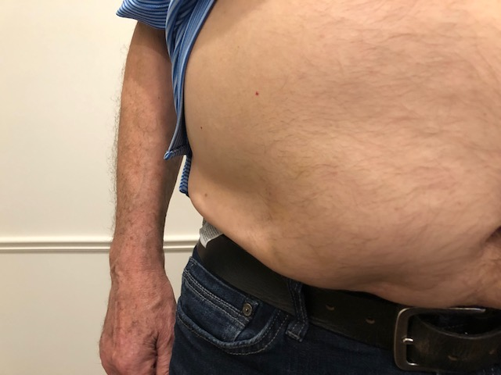

Slide 72
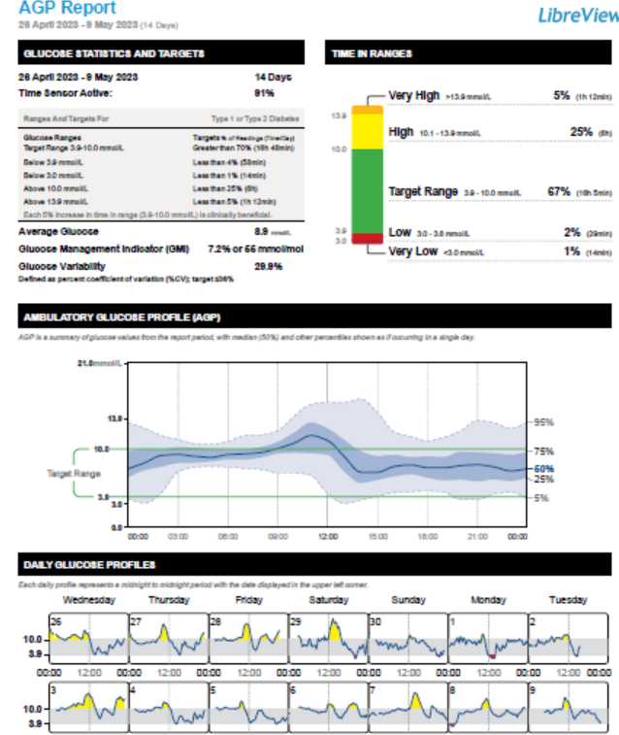
AS - next 2 weeks

Slide 73
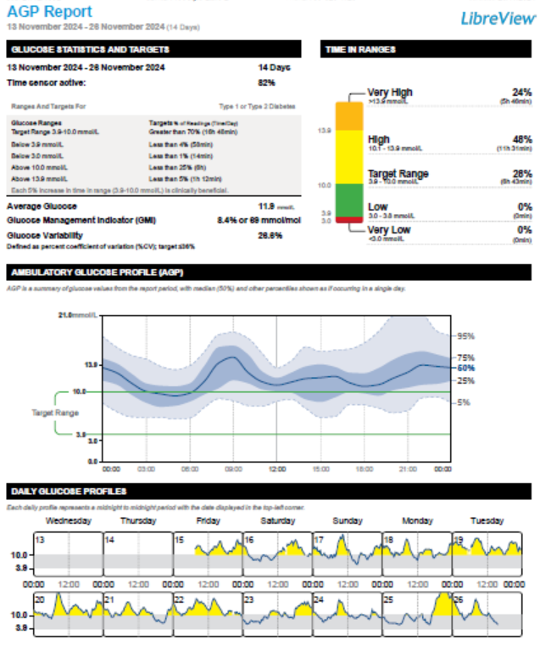
CW – 41 Type 2 since 2008,no complications
Wt 100, a1c 8.7
Glumetza 1000 mg 2 tabs od
Invokana 300 mg 1 time daily
Diamicron MR 30 mg 4 tablets 1 time daily
Ozempic 1mg 1 time weekly
Lantus 44 u hs

Slide 74
CW

Slide 75
Benefits of CGM
Diagnosis
Hypo/Hyperglycemia
Patient Information
Identify glucose Patterns
Direct Management Decisions
Selection of oral agents/GLP1 agonists
Initiation and titration of basal insulin
Initiation of mealtime/bolus Insulin
Assessing Response to Changes in Therapy
Patient Education
Identifying Need for Change/Intensification
Reinforcing Behaviour Change/Self-Management
Alarms – Hypo and Hyper-Glycemia

Slide 76
Tying it all together

Slide 77
LW 71- Nov 26
Type 2 DM - 2014
MI/PVD/MI 2002
CRF, C DIFF AKI Jan 2024
HT, no ETOH
Rx lows – infreq – “Smattering of things”
Pop, Apple turnover, soup
Meds
  Ezetrol 10
  Ozempic 0.5 ow
  Jardiance 10
  Lasix 40 mg bid
Tres 5, tru 3-4 u bid
  Corrects at hs
Wt 100.3, BP 107/74
A1C – 7.8
ACR 17.8, 112 MAU
eGFR 29,
K+ 4.4
Plat 130
AST- 65
ALT - 48
LDL – 2.5

Slide 78
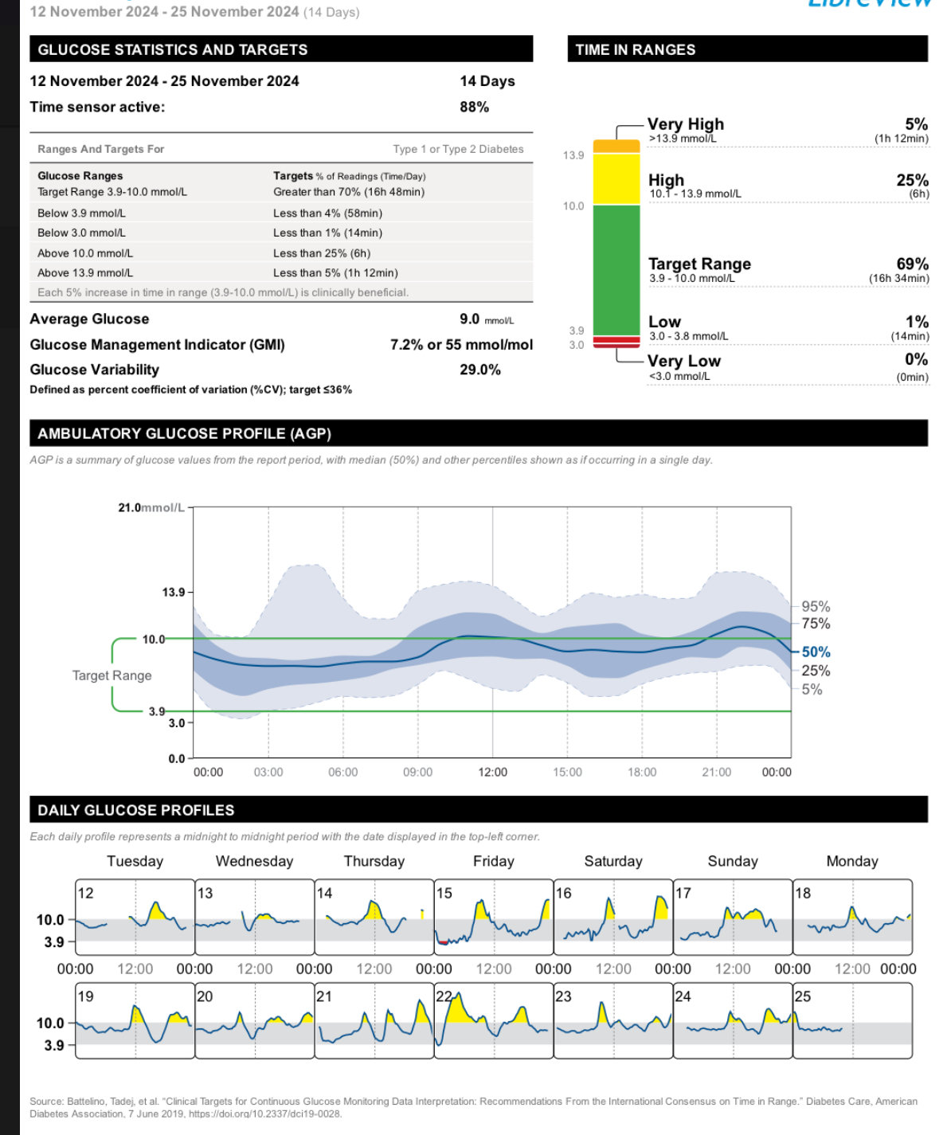
LW - Glycemia

Slide 79
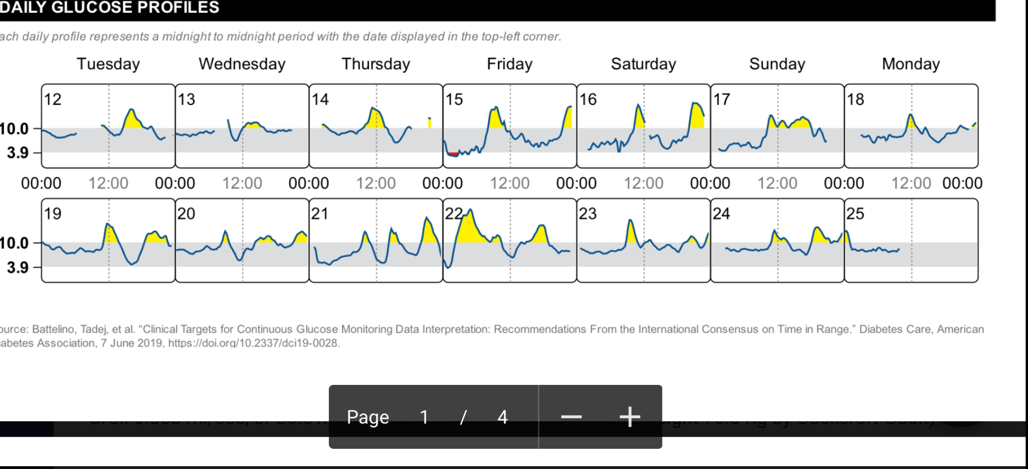

Slide 80
LW Diabetic Nephropathy
Type 2 DM - 2014
MI/PVD/MI 2002
CRF, C DIFF AKI Jan 2024
HT, no ETOH
Rx lows – infreq – “Smattering of things”
Pop, Apple turnover, soup
Meds
  Ezetrol 10
  Ozempic 0.5 ow
  Jardiance 10
  Lasix 40 mg bid
Tres 5, tru 3-4 u bid
  Corrects at hs
Wt 100.3, BP 107/74
A1C – 7.8
ACR 17.8, 112 MAU
eGFR 31,
K+ 4.4
Plat 130
AST- 65
ALT - 48
LDL – 2.5

Slide 81
LW – CKD – Diabetic Nephropathy
Renal – KFRE 5 year 16%
? Why not ACE-I –
  stopped in hospital 2023 – AKI from dehydration
Lasix 40+ 40
Finerenone 10 mg od – K+ 2 weeks
Ozempic 1.0 mg ow
Retrial statin

Slide 82
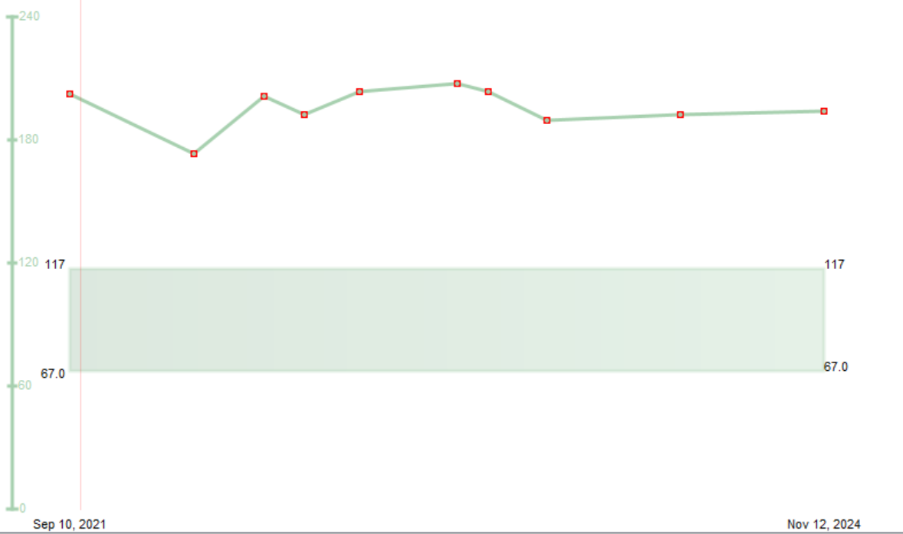
Cr

Slide 83

ACR

Slide 84
LW - MAFLD
MAFLD
  Age 71
  Plat 130
  AST- 65
  ALT - 48
  LDL – 2.5
Recommendations?

Slide 85
LW - MAFLD
MAFLD
  Age 71
  Plat 130
  AST- 65
  ALT - 48
  LDL – 2.5
Fib 4 = 5.12
? Now what?

Slide 86
SL – 55 yo female, BMI 31, No CRF’s
What are my risk factors for cardiovascular disease?
I heard that a 5% loss of weight can help lower the risk of diabetes and improve my heart health
What’s this about Weegovy? My girlfriend in Florida is on it.

Slide 87

Time for a heart-to-heart

Slide 88


Slide 89


Slide 90

Select Trial

Slide 91
Cost of Interventions
Select Trial- Obesity + CVD - NNT x 40 months = 66.7 MACE (111.1 All cause mortality)
\
Cost per event saved ( C$420/month) = C$1,120,000
US = C$1,790/month = C$4,772,000 per event saved
Sustain 6 - DM + CVD–- NNT x 25 months = 43.5 MACE
Cost per event saved (C$210/month) = C$230,202
EmpaReg - DM with CAD NNTx 37 months = 62.5 MACE (38 All cause Mortality)
Cost per event saved = $82/month= $195,183.75 or $48,265 (generic Dapa)
+ CHF and CRF benefits

Slide 92

Evaluations

Slide 93



Thank You to Our Sponsors

Slide 94


Goal – to reduce cardiovascular and renal complications for patients with Diabetes in Simcoe County
Focused intervention over 12 months
    Initiation of diabetic medications proven to reduce cardio-renal complications
    Pt. on insulin/ meds/ co-morbid diseases/initial side effects that limit ability to be initiated on meds
    Pts. Post hospitalization for ACS/CHF seeing Cards/Hospitalists
www.sdcrc.ca

