Slide 1
Stuff you should know Continuous Glucose Monitors
J.C. MacFadyen
MD, FRCPC, MHPE
JC MacFadyen, MD, FRCPC, MHPE

Slide 2
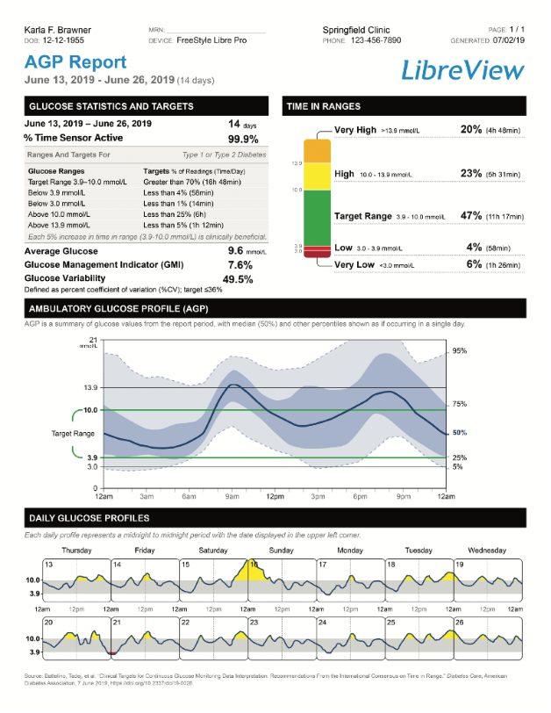
Easily identify glucose patterns and trends in a single-page comprehensive report
The new report shows:
1
2
Glucose Statistics
and Targets
Time In Ranges
The primary goal for effective and safe glucose control is to increase Time In Range while reducing Time Below Range¹
3
Ambulatory Glucose Profile (AGP)
AGP when used with Time In Range can reveal when patients are out of their range
4
Daily Glucose Profiles
Use these daily glucose values profiles to help guide your patients through a clinical and engaging dialogue
For illustrative purposes only. Not actual patient data.
Reference: 1. Battelino T, Danne T, Bergenstal RM, et al. Clinical targets for continuous glucose monitoring data interpretation: recommendations from the international consensus on time in range. Diabetes Care. 2019;42(8):1593-1603.

Slide 3
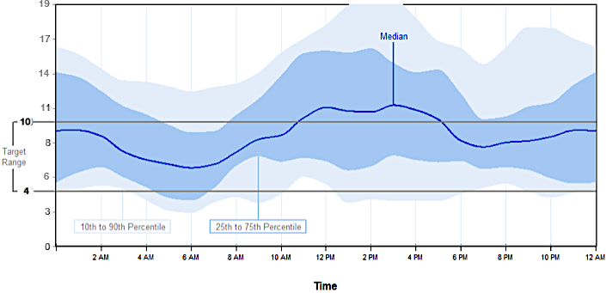
Interpreting Daily Patterns Can Be Done in a Few Steps
What is the shape of the median curve?
Steep slope shows periods of rapid glucose change
What is the width of the interquartile range? (25th/75th)
Assesses glucose variability
Larger range indicates increased variability
3
4
2
Are the readings within the target range?
1
Are there patterns of hypoglycemia?
Do any curves cross the hypoglycemia line?
Dunn TC, Hayter GA, Doniger KJ, Wolpert HA. Development of the likelihood of low glucose (LLG) algorithm for evaluating risk of hypoglycaemia: a new approach for using continuous glucose data to guide therapeutic decision making. J Diabetes Sci Technol, (2014); 8(4):720-730: https://doi.org/10.1177/1932296814532200

Slide 4

Quickly assess your patients’ Time In Range
2
The primary goal for effective and safe glucose control is to increase Time In Range while reducing Time Below Range¹
% of time above target range
% of time within target range
% of time below target range
For illustrative purposes only. Not actual patient data.
Reference: 1. Battelino T, Danne T, Bergenstal RM, et al. Clinical targets for continuous glucose monitoring data interpretation: recommendations from the international consensus on time in range. Diabetes Care. 2019;42(8):1593-1603.

Slide 5
Glucose Variability – Self management
What are they –
Doing? – glucose testing
- activity - FITT
- injection sites
Taking? – adherence to meds/insulin
- varying dose of insulin
- treatment of highs/lows
- prospective vs retrospective diabetes management
Eating? – CHO counting/ varying size of meals
- snacking
Diabetes Burnout/Distress?

Slide 6
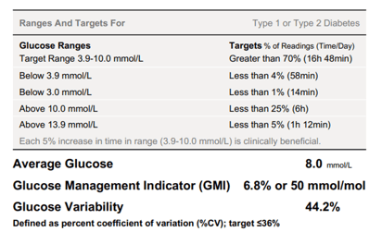
Interpretation of Glycemic Variability (GV)
Intervention 5
LOW GLYCEMIC VARIABILITY (< 36%)
Glucose readings are tight around the mean
Can more confidently identify trends/patterns with low GV
HIGH GLYCEMIC VARIABILITY
Wide range in glucose readings
Less confidence in identifying patterns/trends
median is less useful
For these patients focus on hypoglycemia and self-management behaviours
e.g. adherence to medications, lifestyle)
Factors such as variable physical activity, meals, shift work could be contributing to high glycemic variability
Chan AJ, Halperin IJ. Beyond Glycated Hemoglobin: Harnessing Data From Sensor-Based Technology to Improve Glucose Variability, Time in Range and Hypoglycemia in Adult Patients With Type 1 Diabetes. Canadian Journal of Diabetes. 2021;45(3):269-272.e3. doi:10.1016/j.jcjd.2020.08.103

Slide 7
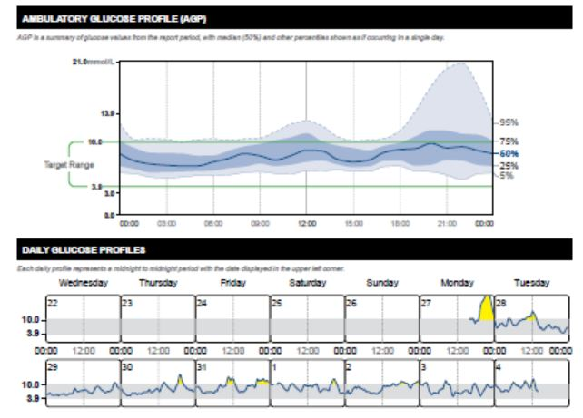
PM – 43 yo Female – Awaiting Hysterectomy Discrepant A1C
Type 2 DM x 15 years
PCI, prev PE
A1C 10.4
States no recent changes
No DrugPlan – libre trial
Metformin 2.5 g daily
Tresiba 120 units 1 time daily
Humalog 15u with meals
Ozempic TAKE 0.5 mg sc Sunday and 0.5 mg sc Wed.
Crestor /Plavix/Eliquis/Jardiance

Slide 8
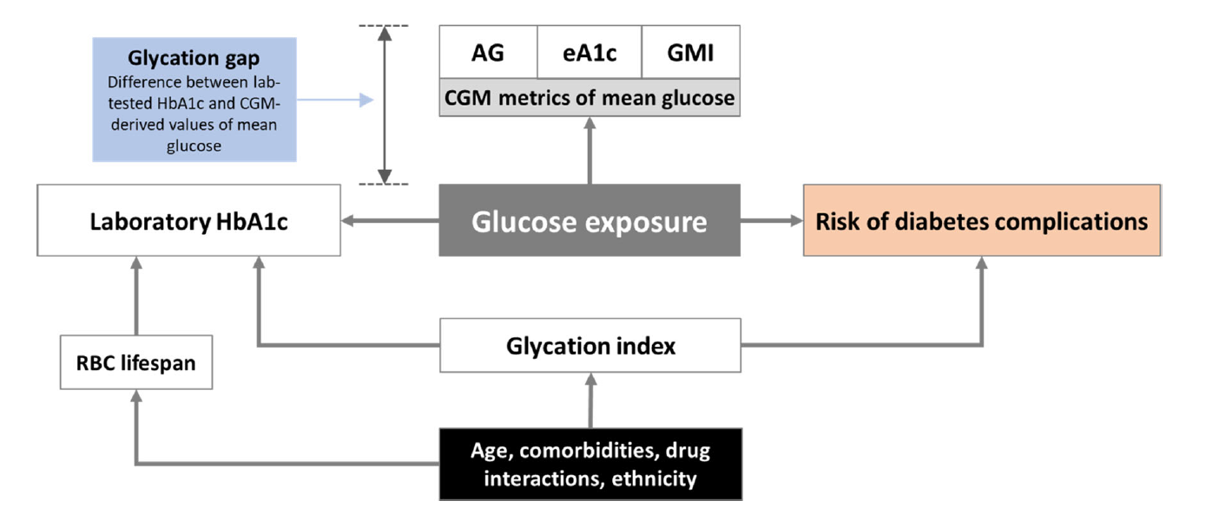



The Great Debate | A1C vs. GMI
A1C
Not a direct measure of glucose exposure
Influenced by numerous factors
GMI
CGM-derived value
Calculated from mean glucose
Gomez-Peralta F, et al. Diabetes Obes Metab. 2022 Apr;24(4):599-608. doi: 10.1111/dom.14638
GMI, glucose management indicator; CGM, continuous glucose monitoring.
Notes:
If the hemoglobin is affected for any reason (anemia, thalassemia, other), it will affect the A1c
The A1c represents 90 days whereas the GMI can be customized
Also: last month accounts for 50% of A1c value
Gomez-Peralta F, Choudhary P, Cosson E, Irace C, Rami-Merhar B, Seibold A. Understanding the clinical implications of differences between glucose management indicator and glycated haemoglobin. Diabetes Obes Metab. 2022 Apr;24(4):599-608. doi: 10.1111/dom.14638. Epub 2022 Feb 8. PMID: 34984825.

Slide 9
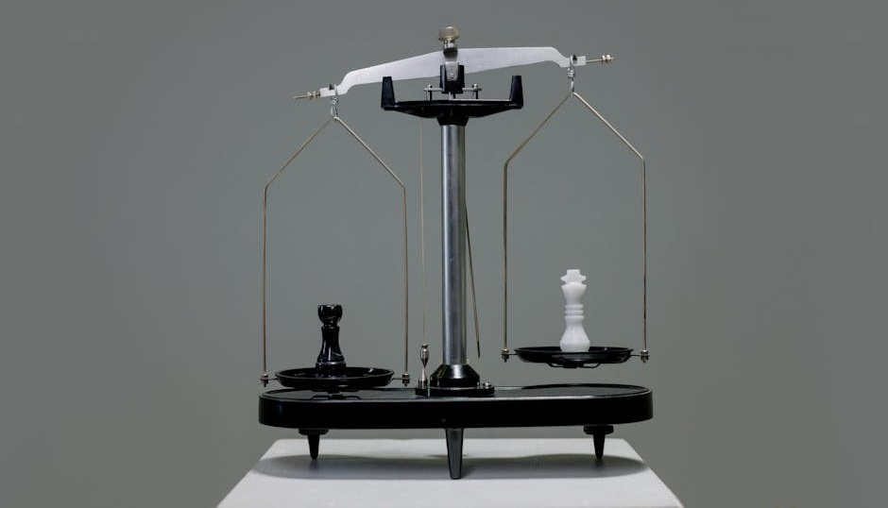
Clinical Implications of GMI vs. A1C
if…
A1C is higher
than GMI
A1C alone should not be a factor when intensifying therapy
Consider hypo risk
if…
GMI is higher
than A1C
Consider therapy intensification
Less risk of hypo
What other considerations do you mention when A1C and GMI differ?
Gomez-Peralta F, et al. Diabetes Obes Metab. 2022 Apr;24(4):599-608. doi: 10.1111/dom.14638
GMI, glucose management indicator.
Notes:
Interesting Fact: Comparative relationship between GMI & A1C is relatively stable over time.
Key Tips:
Consider using a longer 30-day time-period when data may be compromised
ALWAYS review other CGM metrics alongside GMI
To get GMI, need 7+ days of data in Clarity (vs. currently in G7 App Clarity Card, will need 12+ days of data for GMI)
If A1C comes back higher than the GMI perhaps suspect it is not accurately reflecting recent glucose management – if GMI is higher than the A1C that might be a good reason to consider therapy intensification as less likely to be a risk for hypo if the average glucose is higher – still need to be thinking about the risk of hypo.

Slide 10
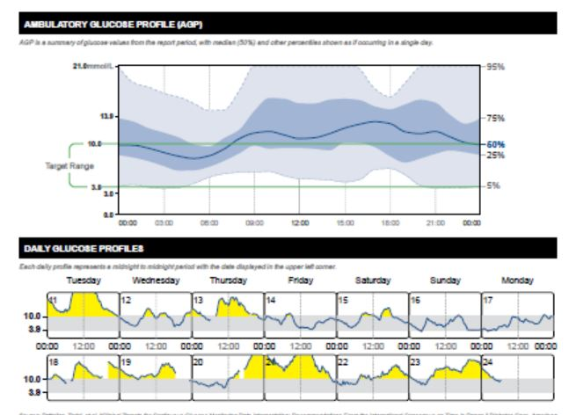
GW – 80 yo male
Type 1 DM since age 13
A1C 8.8
Recurrent lows
“sensed well” loss of vision
Tresiba 44 u
NR 14/14/26 CF 1:1 Target 10

Slide 11
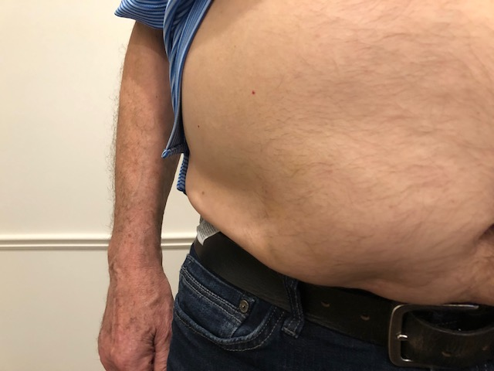

Slide 12
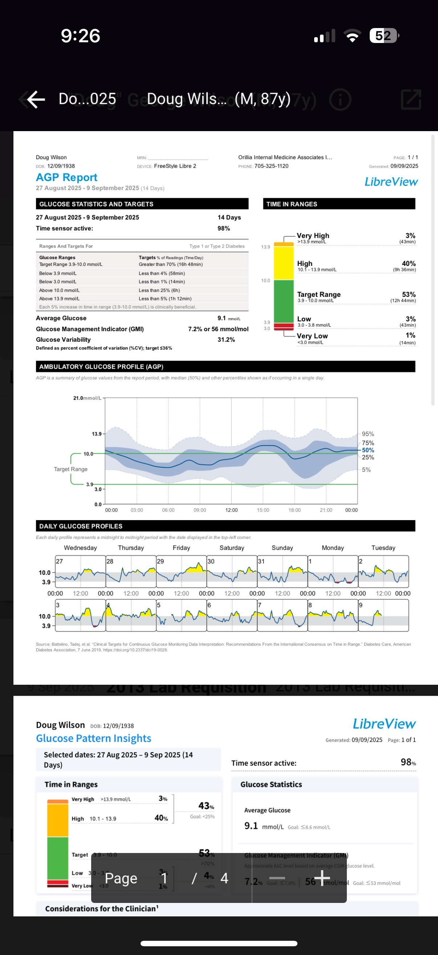
Result of improving sites

Slide 13
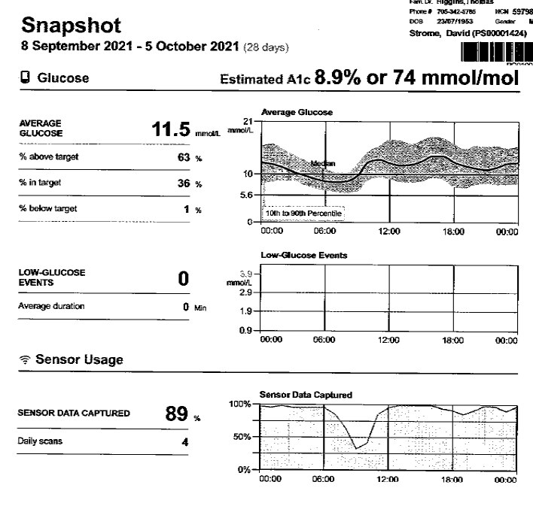
DS Type 2 A1C 9.0
Invokana 300 mg po od
Tresiba FlexTouch 30 units od
Diamicron MR 60 mg 2 tablets 1 time daily
metformin 500 mg 1 tablet 2 times daily
Ozempic Prev. not tolerated
A1c 9.0

Slide 14
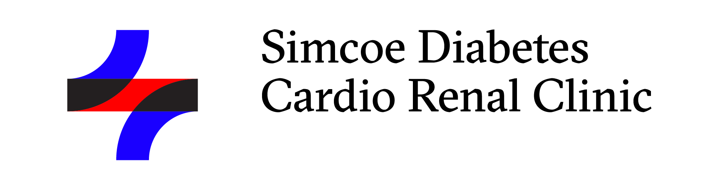
Ozempic Micro-Dosing
There are many “clicks” between the marked doses on the Ozempic pen. There are 38 “clicks” between 0 and 0.25mg and 38 “clicks” between 0.25mg and 0.5mg. On the 1mg pen there are 76 “clicks” between 0 and 1mg.
Use ____ clicks once a week and if tolerating well, continue to increase by ____ clicks every _____ weeks, until at the recommended dose of ______mg once weekly.
Once you are on a dose of 0.25 mg weekly, please discontinue your ___________ (Onglyza/Trajenta/Januvia)

Slide 15
Practical tips: Genital mycotic infections (GMIs)
Uncomplicated
(Healthy, non-pregnant, <3 inf/year, mild/mod symptoms)
Fluconazole 150 po single dose
Complicated
Severe signs, > 3/ year, poorly controlled DM, immunocompromised
Fluconazole 150 mg po q 3 days , 2-3 doses
+/1 clotrimazole/betamethasone x 48 hrs
Or Topicals – 7-14 days
Recurrent – >3 year
Fluconazole 150 mg po q 72 hrs x 3, then once weekly x 6 months
ODB – 50 mg x 3 covered

Slide 16
RL 68 yo male 2023
DM since age 18, insulin since age 30
Intolerant to
SLT2/GLP1
Metformin DPP4 Inh
A1C 9.3
Ongoing diarrhea
Pancreatitis 2010
Basaglar 24 u hs
Admelog 3 u if glu > 11
C petide 42 (glu 4.8)
“tried mealtime insulin – didn’t work”
A1C 9.3
Recurrent AcBr lows

Slide 17
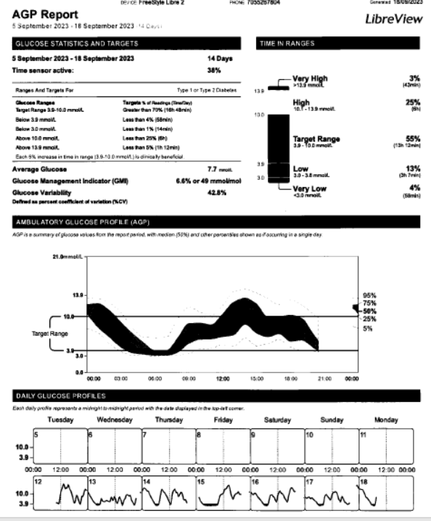

Slide 18
RL
Discrepant A1C –
Change to Tresiba
Encourage mealtime insulin
Reused sites
- improve site rotation

Slide 19
RL 2025
Tresiba 10 u ac br
Admelog 2-4 u acmeals ? CF 1:5 Target 10 ( 100/TDD = CF)
2 u with evening snack
Glu 10-14 acBr pt reports
A1C 9.4
Trying to gain wt 122 lbs
Recent colonoscopy

Slide 20
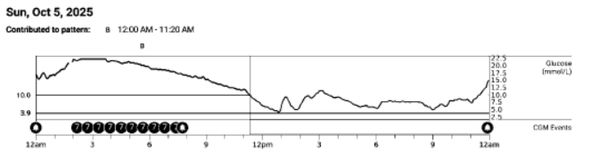
Seen by PCP - increase Tresiba to 14 u

Slide 21
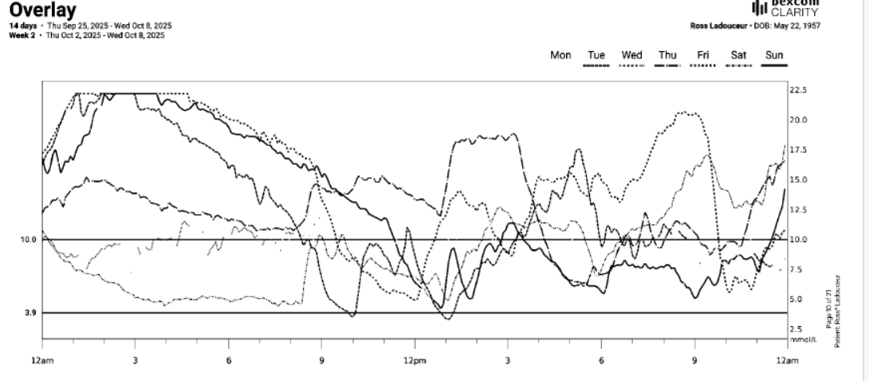

Slide 22
What are you doing
Taking insulin with meals
Lunch and supper
Bedtime snack 11 pm– doesn’t want lows – no insulin
Muffin
Bagel
Crackers and cheese
Evening snack – no insulin
1 sandwich
Suggestions
Take 2-3 u with sandwich
Change snack to cheese and crackers
Reduce Tresiba to 10 u
If you want to make changes, you need to review the data

Slide 23
TO - 27 yo female
Type 1 DM
DKA Nov 2024 – A1C 11.5
HCO3 - < 5, pH 7.0
Prev Substance misuse
Multiple no shows
Follows at DEC sparingly
C Peptide 2,235
Current Meds:
Apidra SoloStar 1:10 g
Tresiba FlexTouch 24 u od
Baqsimi 3 mg/actuation 1 spray 1 time daily, PRN

Slide 24
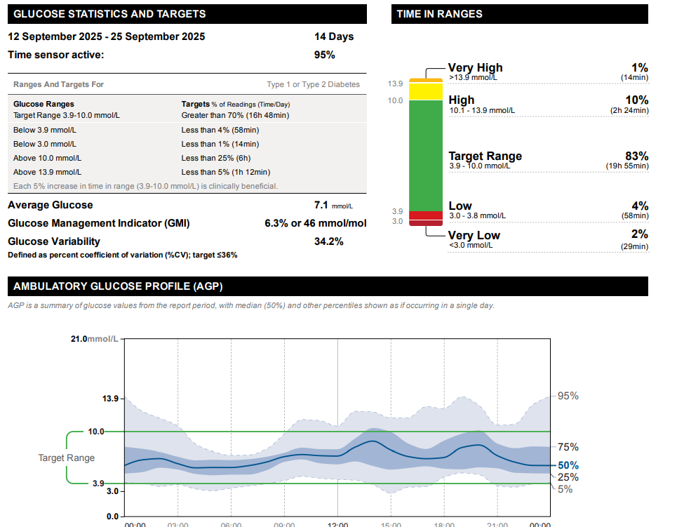
? Suggestions

Slide 25
RD 58 yo male
DM 2010
HTN
No CVD
Neg ACR
Non-smoker
Tests q 2 days – 5-10
A1C 8.5
States will get a low if delayed lunch
Doesn’t like libre
Current Meds:
Crestor 20 mg 1 time daily
HCTZ 25 mg 1 time daily
metformin 500 mg 4 times daily
Tresiba FlexTouch 100 unit/mL (3 mL) 12 units 1 time daily
amlodipine 10 mg \
Forxiga 10 mg po od
Diamicron MR 120 mg 1 time daily
Ozempic 1 mg 1 time weekly

Slide 26
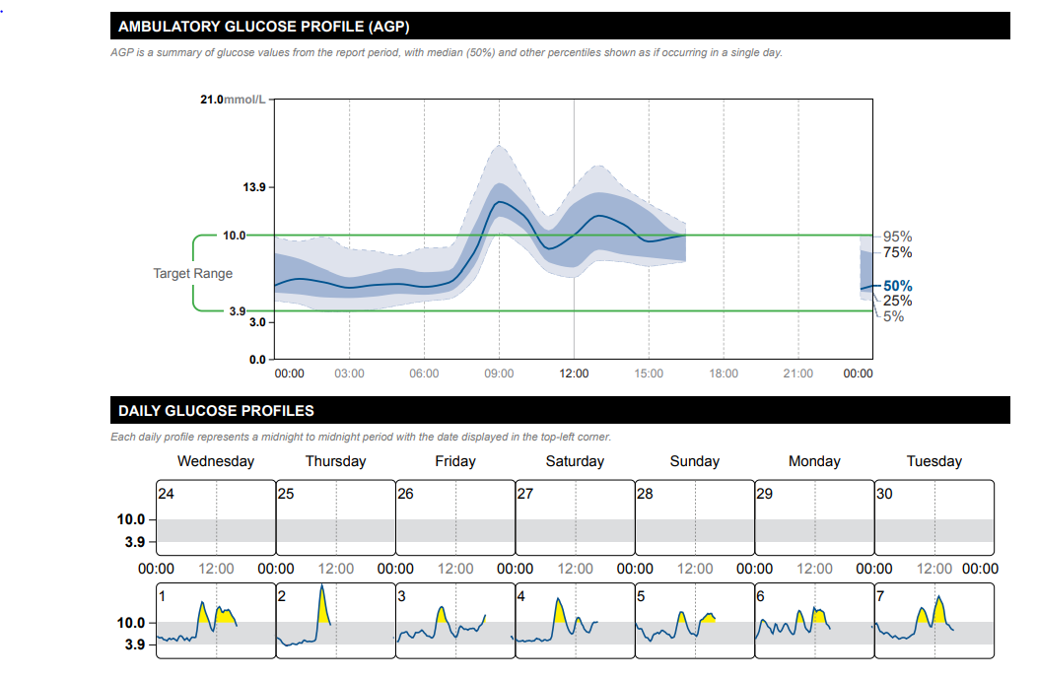

Slide 27
R MacD – 60 yo male
Current Meds:
Crestor 20 mg 1 time daily
Diamicron MR 120 mg 1 time daily
Jardiance 10 mg 1 time daily
Micardis 80 mg 1 time daily
metformin 1000 mg 2 times daily
Ozempic 1 mg 1 time weekly -
A1C 8.6
No drug plan
Farmer
Does not qualify for Trilium
Fatty Liver
OSA
Suggestions?

Slide 28
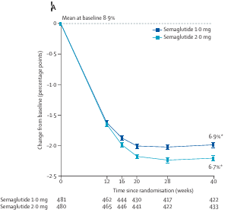
What about increasing Ozempic to 2 mg?
Costs /Access
$220 x 2 = $440/month
? What is the difference in A1C/wt

Slide 29
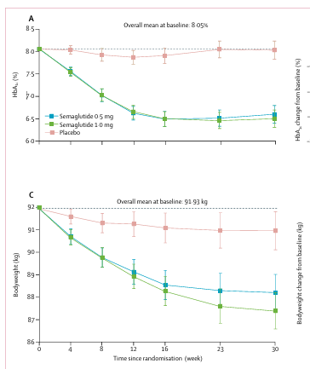
What about decreasing Ozempic to 0.5 mg?

Slide 30
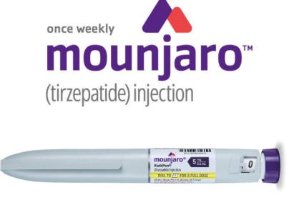
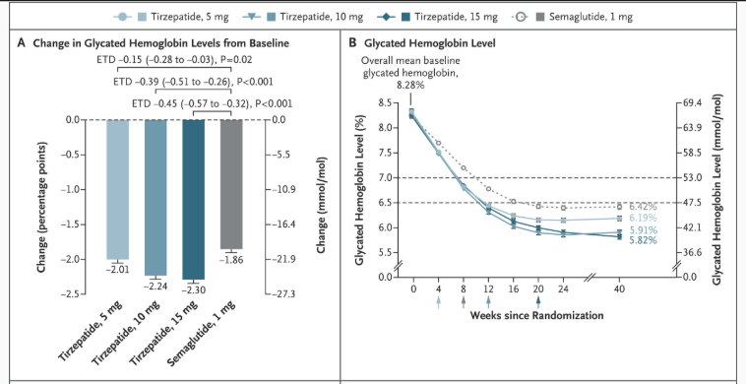
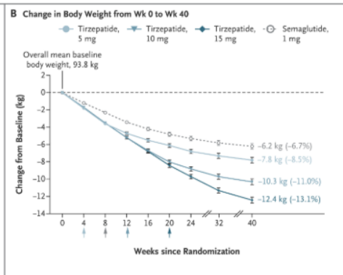

Slide 31
But isn’t Mounjaro very expensive?
2.5 – 5 mg pen - $471.60
7.5-10 mg pen - $655.05
12.5 – 15 mg pen - $930.21
Need support thru Mymounjaro 25-50% discount

Slide 32
But isn’t Mounjaro very expensive
Pen | RetailCost per pen (month) | MyMounjaro Per pen | Cost per dose | Cost per 5 mg | Cost per 2.5 mg
2.5 mg | $471.60 | $300 | $75 | N/A | $75
5 mg | $471.60 | $300 | $75 | $75 | $37.50
7.5 mg | $655.05 | $375 | $93.75 | $62.50 | $31.25
10 mg | $655.05 | $375 | $93.75 | $48.88 | $24.44
12.5 mg | $930.21 | $450 | $112.50 | $45.00 | $22.50
15 mg | $930.21 | $450 | $112.50 | $37.50 | $18.75

Slide 33
? Mounjaro 2.5 mg ow

Slide 34

Counting Clicks
15 mg pen = 4 x 15 mg = 0.6 ml per dose
Each click is 0.01 ml
60 clicks = 15 mg
20 clicks = 5 mg = 3 months

Slide 35
Why not count clicks/microdose?
Shelf life
- expiry date – in refrigerator
Once used – 30 days – at room temperature, or 4 doses
But same expiry if in refrigerator
Ozempic is 56 days at room temperature
Potential to introduce infection
- but has preservatives and you already puncture x 4
- less than if already microdosing
Not on Product Monograph
- use all the time with Ozempic (also not recommended)

Slide 36
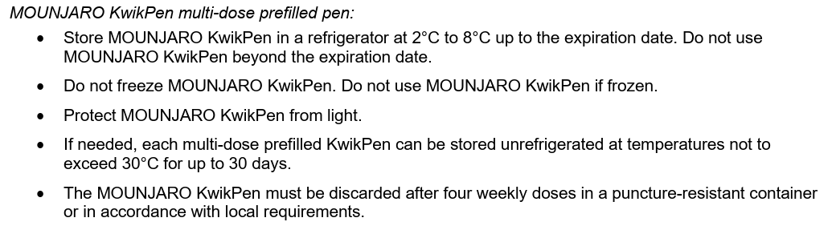
Mounjaro
30 days = 5 doses (Day 0, 7, 14, 21, 28)

Slide 37
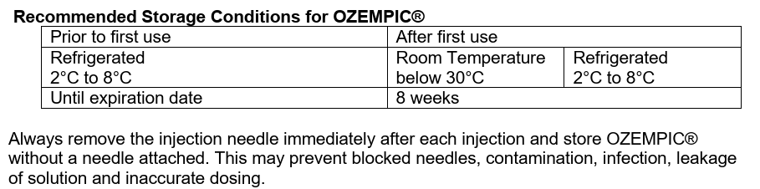
Ozempic

Slide 38
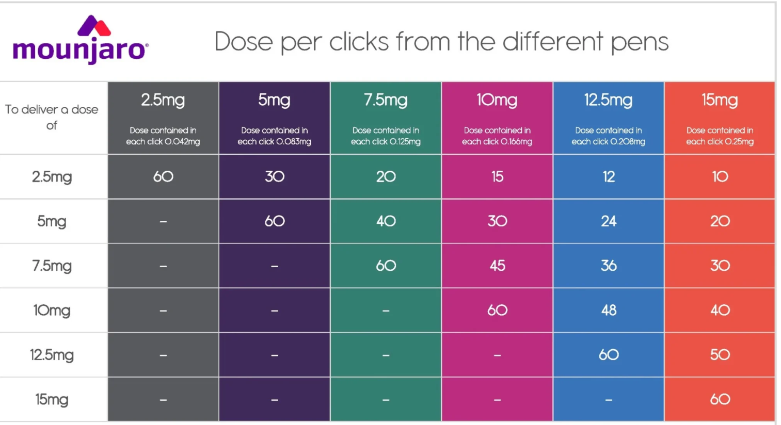

Slide 39
Ozempic Clicks
To deliver a dose of | 0.5 mg pen | 1.0 mg pen
0.25 mg | 38 | 19
0.5 mg | 76 | 38
0.75 mg |  | 57
1 mg |  | 76

Slide 40
You said the pen has 4 x 0.6 ml doses
but the pen says 3 ml
What happened to the left over 0.6 ml?

Slide 41
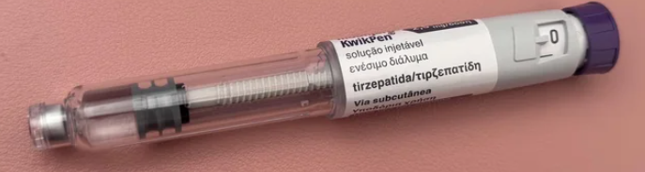
The Golden Dose

Slide 42


Slide 43
Why not count clicks/microdose?
Shelf life
- expiry date – in refrigerator
Once used – 30 days – at room temperature, or 4 doses
But same expiry if in refrigerator
Ozempic is 56 days at room temperature
Potential to introduce infection
- but has preservatives and you already puncture x 4
- less than if already microdosing
Not on Product Monograph
- use all the time with Ozempic (also not recommended)
But the dose may be higher or lower , Not Accurate/Worse side effects
Priming dose
Golden dose – will no longer exist – Eli Lilly

Slide 44
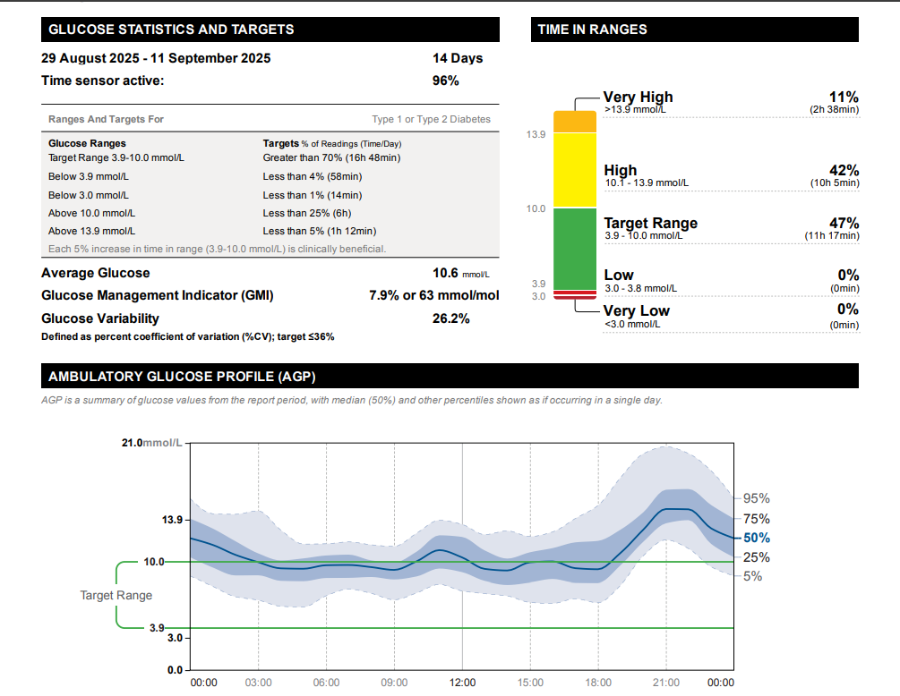

Slide 45
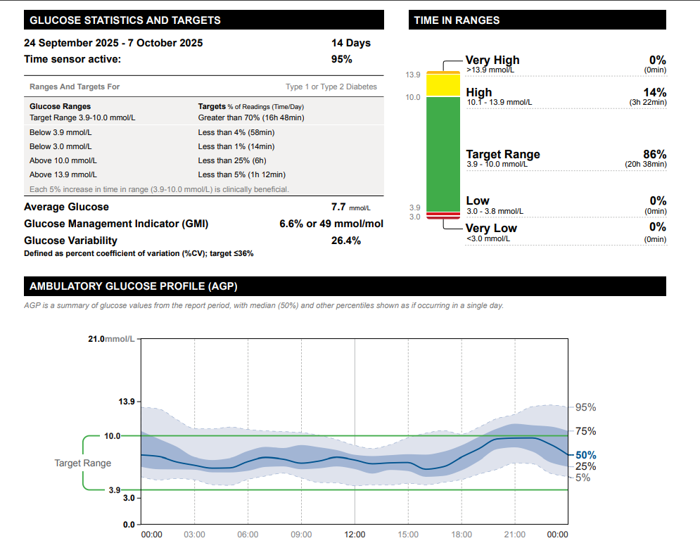

Slide 46
What Does The Future Hold for GLP-1 Agonists
MAFLD
Sleep Apnea
Addiction Treatment
Smokimg Cessation
Asthma
Dementia
Osteoarthritis

