Slide 1

Cardiac Update 2025
J.C. MacFadyen
MD, FRCPC, MHPE

Slide 2

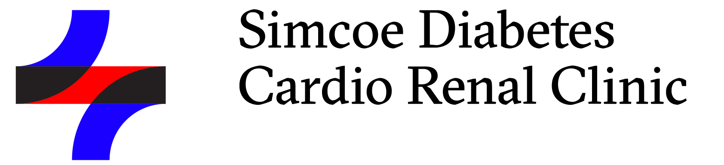
Thank You to Our Sponsors

Slide 3
Objectives
Review recent advances in cardiac care relevant to General Internal Medicine and Primary Care Providers
  Cardiology Trials 2024-25
  HFpEF
  CCS CHF Guidelines 2024
  Practical Tips to Implement New Therapies

Slide 4
Agenda
6:45-7:15 – Clinical Trials in Cardiology – Dr J. MacFadyen, MD, FRCPC, MHPE
7:15 – 7:45 – My patient may have HF preserved EF - Dr. S. Pizzale, MD, FRCPC
Break -8:00 – 8:15
8:00 – 8:30 – CHF Management – Dr A. Meadley, MD, FRCPC
8:30 – 9:00- Tying it together– Dr J. MacFadyen, MD, FRCPC

Slide 5
Goal – to reduce cardiovascular and renal complications for patients with Diabetes in Simcoe County
Focused intervention over 12 months
    Initiation of diabetic medications proven to reduce cardio-renal complications
    Pt. on insulin/ meds/ co-morbid diseases/initial side effects that limit ability to be initiated on meds
    Pts. Post hospitalization for ACS/CHF seeing Cards/Hospitalists
  f/u thru primary care
Referrals Triaged – goal first visit < 1 month from referral
Initiation of diabetic medications proven to reduce cardio-renal complications
Referral – fax – 705 325 1185 (MacFadyen/Meadley)
www.sdcrc.ca

Slide 6
Disclosure of commercial support
This program has received:
Financial support from Novo Nordisk for the meal and space rental
Potential for conflict of interest:
SDCRC received no honoraria.
Novo Nordisk benefit sfrom the sale of products that may be discussed in this program.
  Ozempic
  Ryebelsus

Slide 7
Mitigation of Potential Bias
The steering committee was solely and fully responsible for developing the agenda and was involved at all stages of CME development to achieve scientific integrity, objectivity and balance.
Speakers have received instructions on the Conflict of Interest disclosure requirements and are required to complete all necessary documents. Should any conflict arise, it will be brought to the attention of the Steering Committee and the subsequent course of action will be dependent on the nature of the conflict. Every effort will be made to mitigate any perceived conflicts as well.
Speakers must inform the audience if unapproved or off-label uses of a product are discussed and if any discussions represent the personal opinions of the speakers. Unsolicited questions should be directed to the speakers.

Slide 8
Evaluations
Link to evaluations at end of the evening
- QR Code or link will be emailed to you
Required for CME credits
Feedback for future CME events
Slides Available SDCRC.ca

Slide 9



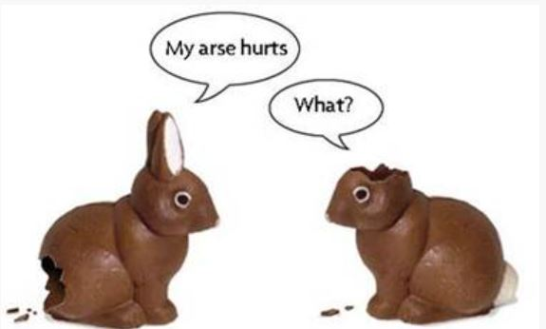
Housekeeping Items

Slide 10
Cardiac Clinical Trials Update 2025
J.C. MacFadyen
MD, FRCPC, MHPE

Slide 11
Faculty/Presenter Disclosure
CFPC CoI Templates: Slide 1
Faculty: John MacFadyen, MD, FRCPC, MHPE
Relationships with commercial interests:
  Grants/Research Support: Novo Nordisk
  Speakers Bureau/Honoraria: Boehringher Ingelheim, Astra Zeneca, Sanofi, Pfizer, Lilly, Merck, Jansen, Novo-Nordisk, Abbott, Dexcom
  Consulting Fees: Jansen, Astra Zeneca, Liily, Novo-nordisk
Notes:
This slide must be visually presented to the audience AND verbalized by the speaker.

Slide 12
Bias vs Credibility
Clinical Practice x 25 years
Medical Director OSMH DEC 1999 – present
  Actively follow >3,500 pts with Diabetes
CDA Guidelines Committee – 2013
Medical Director Heart Function Program – CFHT
GLP-1 Agonists– 1600 patients
SGLT-2 Inh. - 2,445 patients

Slide 13
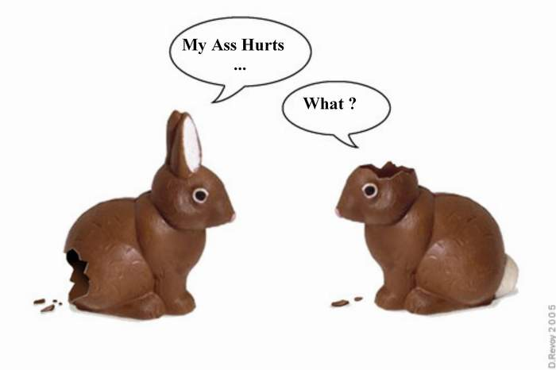
Questions?

Slide 14
Clinical trials 2023
Summarize findings from 5 papers from 2022 that are highly relevant to general internists and primary care
  SPORT Trial – supplements for LDL Cholesterol
  DAPA HF - Frailty sub-analysis
  INVICTUS – Rivaroxaban for Rheumatic A Fib
  FIGARO – Finerenone for CV Outcomes
  Hydrochlorothiazide vs Chlorthalidone

Slide 15
Cardiac Clinical Trial Update 2025
Senior-RITA
  Aggressive Intervention Non-STEMI age> 75
REDUCE – AMI/ ABYSS Trials
  Routine BB Post-MI
SUMMIT/STEP HFpEF
  GLP-I agonists in HFpEF
SELECT Trial
  GLP-1 in Obesity and CV Disease

Slide 16
Patient # 1 - CJ
75 yo female - prev healthy – no CRFs
MOCA 23
In Champlain Manor – walker and unable to do banking
2 hours CP at rest
ECG – Lateral T wave inversion - resolved
Trop 2.0 –
Diagnosis - NON-STEMI
? Recommendations

Slide 17
Patient # 2 - JT
82 yo female,
Hx HT - ACE-I,
Occas walks outside, able to do ADLs
2 hours CP at rest
ECG – Lateral T wave inversion - resolved
Trop 2.0 –
Diagnosis - NON-STEMI
? Recommendations

Slide 18

Original Article
Invasive Treatment Strategy for Older Patients with Myocardial Infarction
Vijay Kunadian, M.D., Helen Mossop, M.Math., Carol Shields, B.T.E.C., Michelle Bardgett, M.Sc., Philippa Watts, M.A., M. Dawn Teare, Ph.D., Jonathan Pritchard, B.Sc., Jennifer Adams-Hall, M.Sc., Craig Runnett, M.D., David P. Ripley, Ph.D., Justin Carter, M.D., Julie Quigley, R.N., Justin Cooke, Ph.D., David Austin, M.D., Jerry Murphy, D.M., Damian Kelly, M.D., James McGowan, M.D., Murugapathy Veerasamy, M.D., Dirk Felmeden, M.D., Hussain Contractor, M.D., Sanjay Mutgi, M.B., B.S., John Irving, M.D., Steven Lindsay, M.D., Gavin Galasko, M.D., Kelvin Lee, Ph.D., Ayyaz Sultan, M.B., B.S., Amardeep G. Dastidar, Ph.D., Shazia Hussain, Ph.D., Iftikhar Ul Haq, M.D., Mark de Belder, M.D., Martin Denvir, M.B., Ch.B., Marcus Flather, M.B., B.S., Robert F. Storey, M.D., David E Newby, Ph.D., Stuart J. Pocock, Ph.D., Keith A.A. Fox, M.B., Ch.B., for the British Heart Foundation SENIOR-RITA Trial Team and Investigators
N Engl J Med
Volume 391(18):1673-1684
November 7, 2024

Slide 19
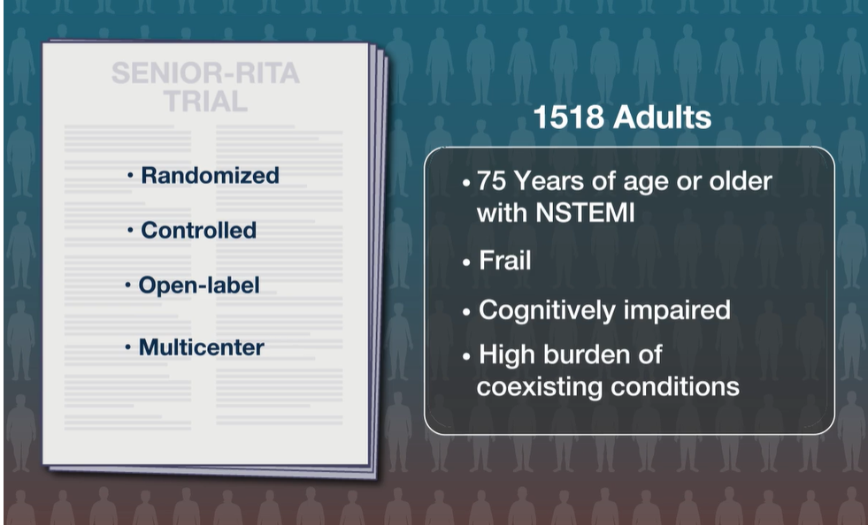
Study Overview
Frail > 5 Rockwood
Cognitively impaired MOCA < 25
Co-existing conditions – Charelstone CI -

Slide 20
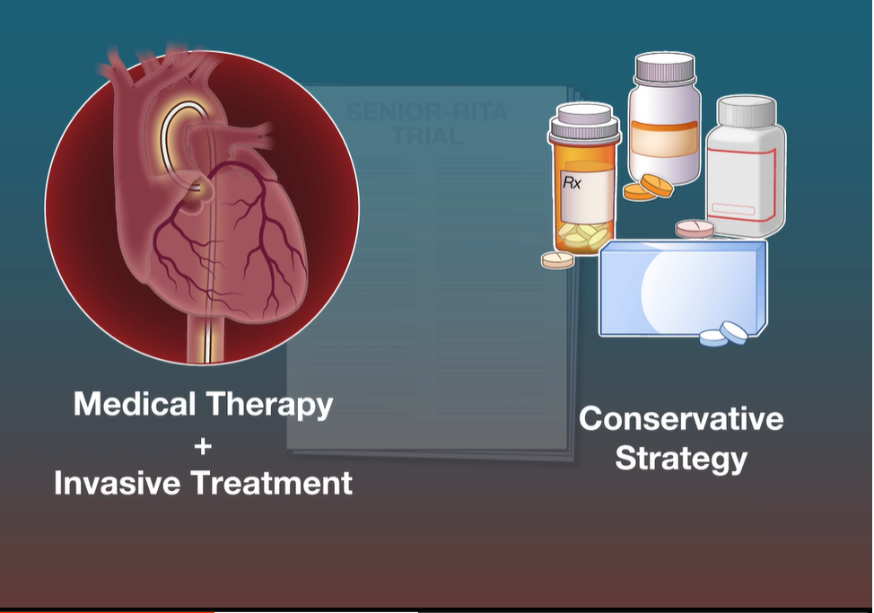

Slide 21
Senior-Rita - Patient Characteristics
Mean age 82
MOCA 63% < 26
Rockwood > 5 – 32 % 13% Very Fit
Charlson Score - mean 5 (eg - > 80 = 4 points}
Intervention – Invasive Group
  49.9 % revascularized
  3.3% CABG
  < 1% cath complications
Excluded STEMI and Unstable Angina
F/U 4.1 years

Slide 22
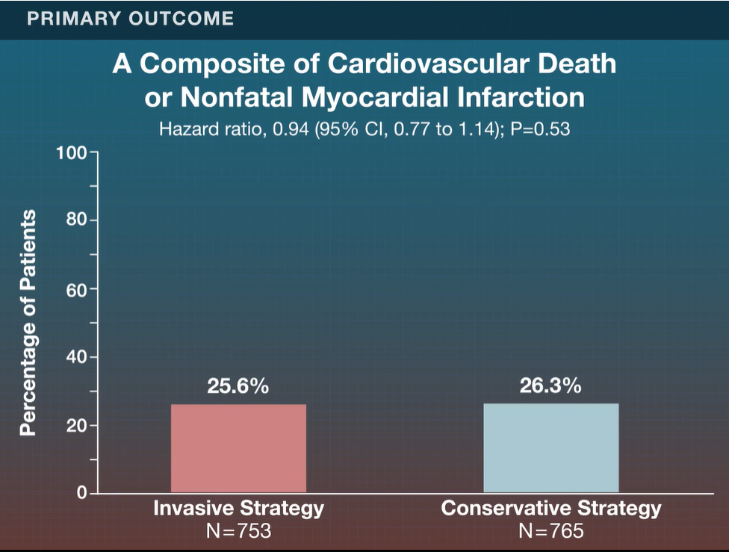

Slide 23
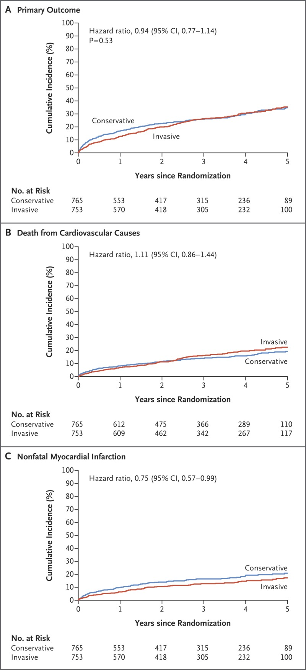
Cumulative Incidence of the Composite Primary-Outcome Events.
Kunadian V et al. N Engl J Med2024;391:1673-1684
Notes:
Figure 1 Cumulative Incidence of the Composite Primary-Outcome Events. Shown are the incidence of cardiovascular death or nonfatal myocardial infarction (the primary outcome) (Panel A) and its components: cardiovascular death (Panel B) and nonfatal myocardial infarction (Panel C). Cumulative incidence was estimated with the Kaplan–Meier method. Hazard ratios were estimated with Cox proportional-hazards models with adjustment for frailty status at randomization. P values were calculated with the use of a log-rank test with stratification for frailty status at randomization.

Slide 24
Cumulative Incidence of the Composite Primary-Outcome Events.
Kunadian V et al. N Engl J Med2024;391:1673-1684
Notes:
Figure 1 Cumulative Incidence of the Composite Primary-Outcome Events. Shown are the incidence of cardiovascular death or nonfatal myocardial infarction (the primary outcome) (Panel A) and its components: cardiovascular death (Panel B) and nonfatal myocardial infarction (Panel C). Cumulative incidence was estimated with the Kaplan–Meier method. Hazard ratios were estimated with Cox proportional-hazards models with adjustment for frailty status at randomization. P values were calculated with the use of a log-rank test with stratification for frailty status at randomization.

Slide 25
Cumulative Incidence of the Composite Primary-Outcome Events.
Kunadian V et al. N Engl J Med2024;391:1673-1684
Notes:
Figure 1 Cumulative Incidence of the Composite Primary-Outcome Events. Shown are the incidence of cardiovascular death or nonfatal myocardial infarction (the primary outcome) (Panel A) and its components: cardiovascular death (Panel B) and nonfatal myocardial infarction (Panel C). Cumulative incidence was estimated with the Kaplan–Meier method. Hazard ratios were estimated with Cox proportional-hazards models with adjustment for frailty status at randomization. P values were calculated with the use of a log-rank test with stratification for frailty status at randomization.

Slide 26
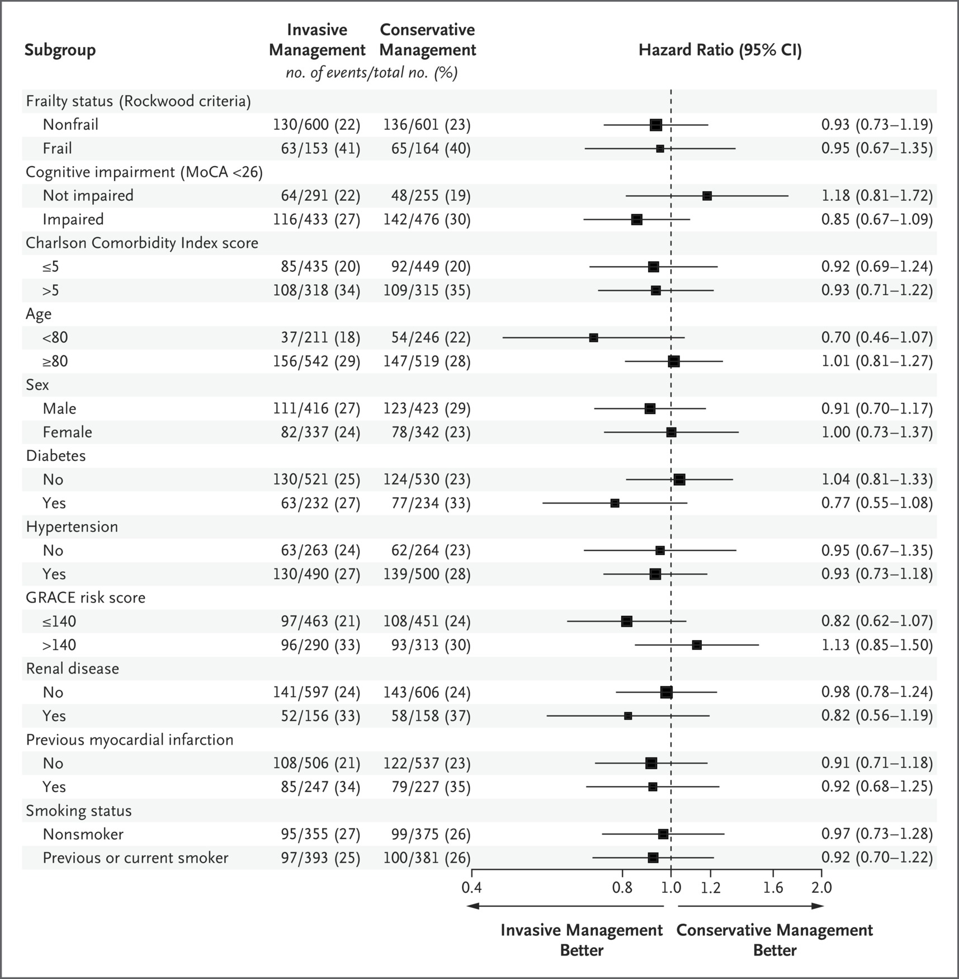
Subgroup Analyses of the Primary Outcome.
Kunadian V et al. N Engl J Med2024;391:1673-1684
Notes:
Figure 2 Subgroup Analyses of the Primary Outcome. Shown are the results of subgroup analyses for the primary outcome, a composite of death from cardiovascular causes (cardiovascular death) or nonfatal myocardial infarction assessed in a time-to-event analysis. The size of the squares is proportional to the number of patients in each subgroup. The widths of the confidence intervals have not been adjusted for multiplicity and should not be used to reject or not reject treatment effects. Scores on the modified Rockwood Clinical Frailty Scale range from 1 (very fit) to 7 (severely frail), with a score of 5 or higher indicating frailty. Scores on the Montreal Cognitive Assessment (MoCA) range from 0 to 30, with a score of 26 or higher indicating normal cognitive function. Scores on the Charlson Comorbidity Index (range 0 to 37, with higher scores indicating a greater burden of coexisting conditions) were adjusted for age. Global Registry of Acute Coronary Events (GRACE) risk scores range from 1 to 372, with higher scores indicating greater risk. CI denotes confidence interval.

Slide 27
Subgroup Analyses of the Primary Outcome.
Kunadian V et al. N Engl J Med2024;391:1673-1684
Notes:
Figure 2 Subgroup Analyses of the Primary Outcome. Shown are the results of subgroup analyses for the primary outcome, a composite of death from cardiovascular causes (cardiovascular death) or nonfatal myocardial infarction assessed in a time-to-event analysis. The size of the squares is proportional to the number of patients in each subgroup. The widths of the confidence intervals have not been adjusted for multiplicity and should not be used to reject or not reject treatment effects. Scores on the modified Rockwood Clinical Frailty Scale range from 1 (very fit) to 7 (severely frail), with a score of 5 or higher indicating frailty. Scores on the Montreal Cognitive Assessment (MoCA) range from 0 to 30, with a score of 26 or higher indicating normal cognitive function. Scores on the Charlson Comorbidity Index (range 0 to 37, with higher scores indicating a greater burden of coexisting conditions) were adjusted for age. Global Registry of Acute Coronary Events (GRACE) risk scores range from 1 to 372, with higher scores indicating greater risk. CI denotes confidence interval.

Slide 28
SUMMARY
Conclusions
In older adults with NSTEMI, an invasive strategy did not result in a significantly lower risk of cardiovascular death or nonfatal myocardial infarction (the composite primary outcome) than a conservative strategy over a median follow-up of 4.1 years.

Slide 29
Patient # 1 - CJ
75 yo female - prev healthy – no CRFs
MOCA 21
In Champlain Manor – walker and unable to do banking
2 hours CP at rest
ECG – Lateral T wave inversion - resolved
Trop 2.0 –
Diagnosis - NON-STEMI
? Recommendations

Slide 30
Patient # 2 - JT
82 yo female,
Hx HT - ACE-I,
Occas walks outside, able to do ADLs
2 hours CP at rest
ECG – Lateral T wave inversion - resolved
Trop 2.0 –
Diagnosis - NON-STEMI
? Recommendations

Slide 31
SENIOR RITA
It frees clinicians from feeling obligated to send every elderly patient to the cath lab, favouring the art of medicine and priorotizing patient values and shared decision making.

Slide 32
MD
66 yo male – prev smoker
STEMI with Primary PCI RCA
EF 65%
Meds – Bisoprolol 5 mg od
  Rosuvastatin 40/ASA/Brilinta/Ramirpil
3 months later
  c/o fatigue/? Depression
  No angina
  BP – 122/78, HR 64

Slide 33
MD
66 yo male – prev smoker
STEMI with Primary PCI RCA
EF 65%
Meds – Bisoprolol 5 mg od
  Rosuvastatin 40/ASA/Brilinta/Ramirpil
3 months later
  c/o fatigue/? Depression
  No angina
  BP – 122/78, HR 64
? Can I reduce my pills/stop my bisoprolol?
  ? Recommendations

Slide 34
Original Article
Beta-Blockers after Myocardial Infarction and Preserved Ejection Fraction
Troels Yndigegn, M.D., Bertil Lindahl, Ph.D., Katarina Mars, M.D., Joakim Alfredsson, Ph.D., Jocelyne Benatar, Ph.D., Lisa Brandin, Ph.D., David Erlinge, Ph.D., Ola Hallen, M.D., Claes Held, Ph.D., Patrik Hjalmarsson, M.D., Pelle Johansson, M.D., Patric Karlström, Ph.D., Thomas Kellerth, M.D., Toomas Marandi, Ph.D., Annica Ravn-Fischer, Ph.D., Johan Sundström, Ph.D., Ollie Östlund, Ph.D., Robin Hofmann, Ph.D., Tomas Jernberg, Ph.D., for the REDUCE-AMI Investigators
N Engl J Med
Volume 390(15):1372-1381
April 18, 2024

Slide 35
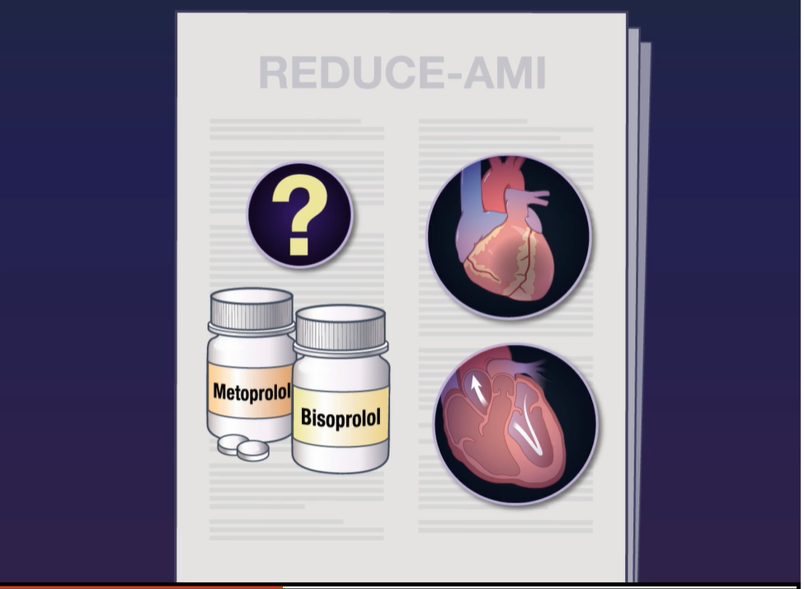

Slide 36
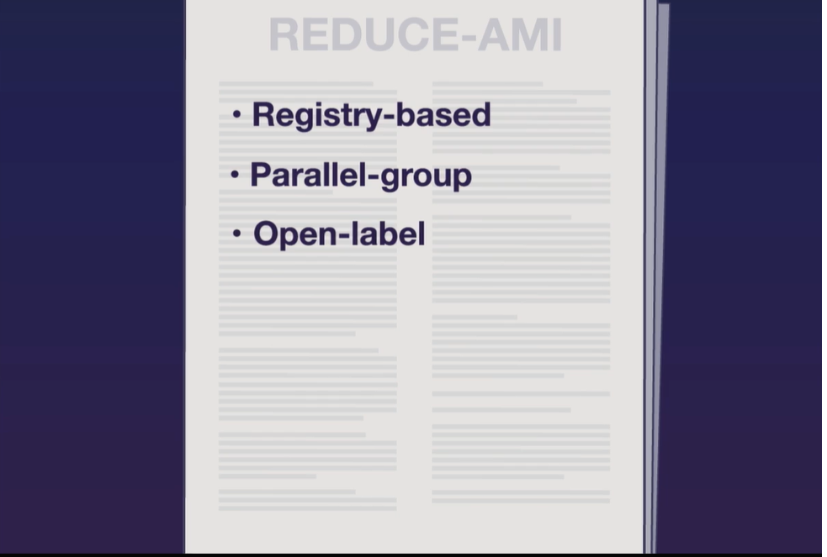

Slide 37
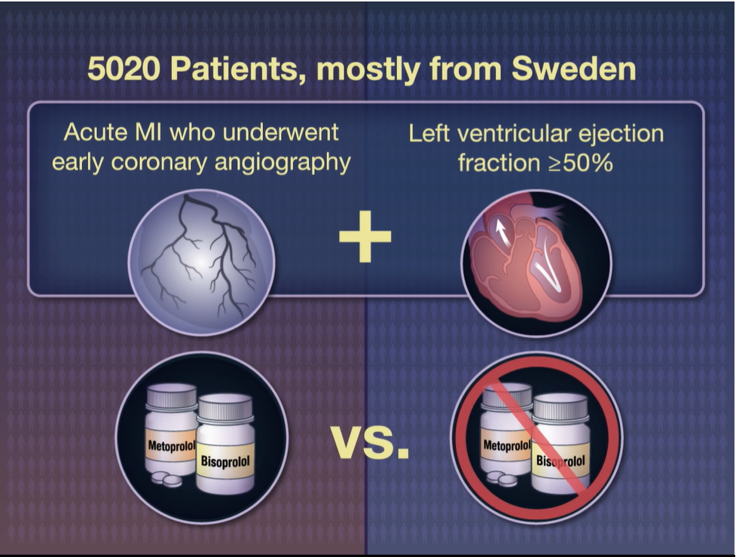

Slide 38
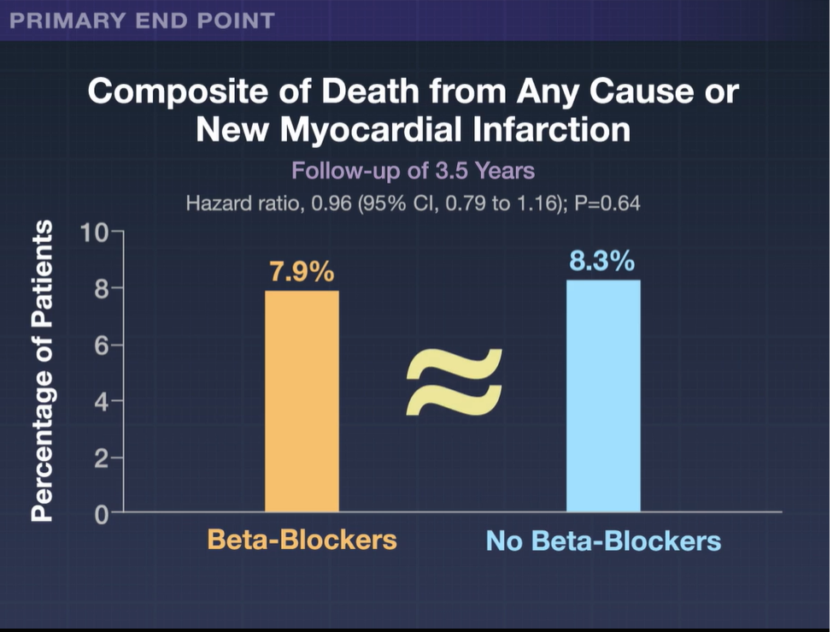

Slide 39
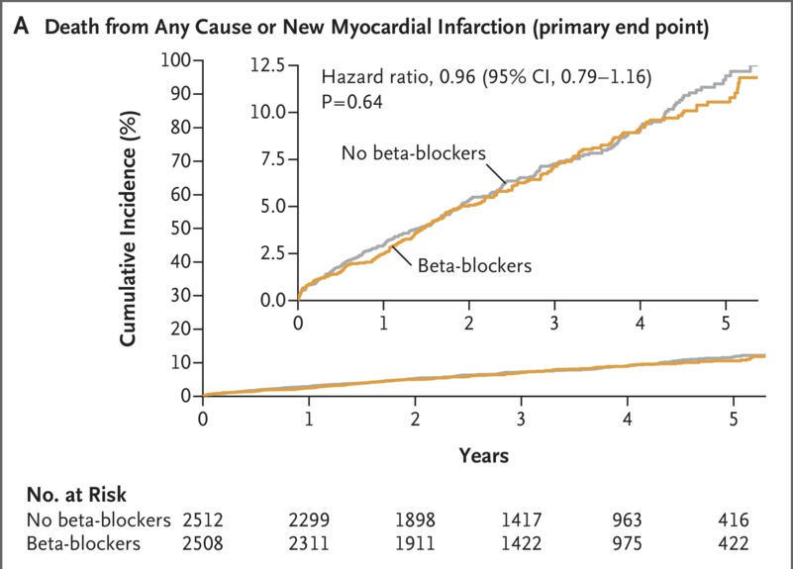
Death from Any Cause and New Myocardial Infarction.
Yndigegn T et al. N Engl J Med2024;390:1372-1381
Notes:
Figure 1 Death from Any Cause and New Myocardial Infarction. The primary end point was a composite of death from any cause or new myocardial infarction. Secondary end points included the individual components of the primary end point. In all panels, the inset shows the same data on an enlarged y axis. CI denotes confidence interval.

Slide 40
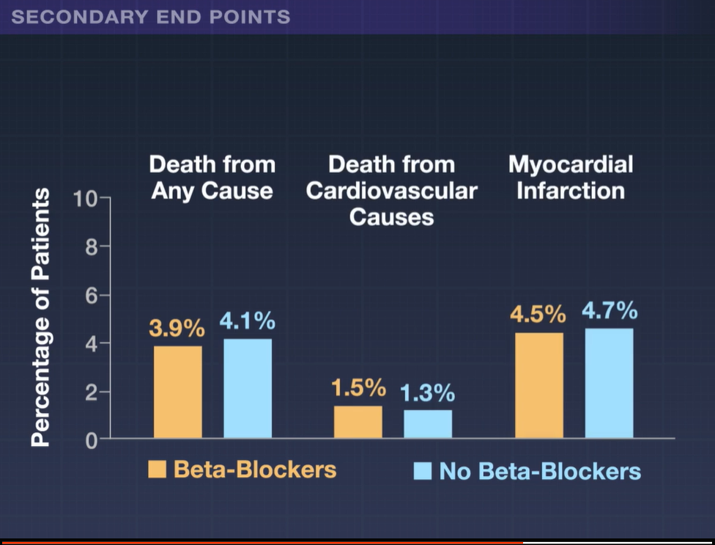

Slide 41
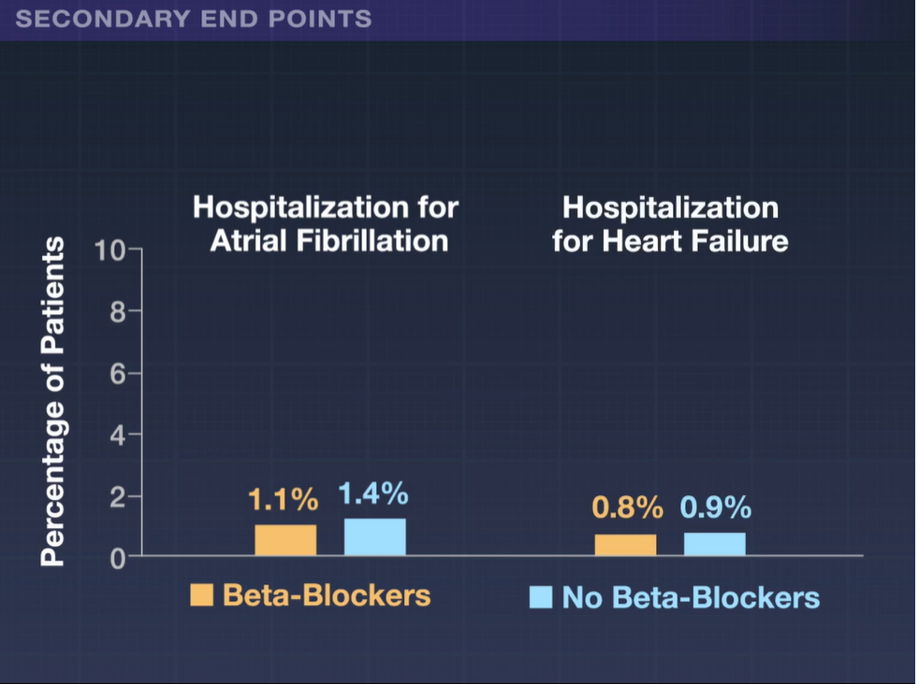

Slide 42
Study Overview
Hospitalized patients with acute myocardial infarction and preserved EF were assigned to receive open-label long-term beta-blocker therapy or not.
Beta-blockers did not lead to a lower risk of death or MI.

Slide 43
Conclusions
Among patients with acute myocardial infarction who underwent early coronary angiography and had a preserved left ventricular ejection fraction (≥50%), long-term beta-blocker treatment did not lead to a lower risk of the composite primary end point of death from any cause or new myocardial infarction than no beta-blocker use.

Slide 44
Original Article
Beta-Blocker Interruption or Continuation after Myocardial Infarction
Johanne Silvain, M.D., Ph.D., Guillaume Cayla, M.D., Ph.D., Emile Ferrari, M.D., Ph.D., Grégoire Range, M.D., Etienne Puymirat, M.D., Ph.D., Nicolas Delarche, M.D., Paul Guedeney, M.D., Ph.D., Thomas Cuisset, M.D., Ph.D., Fabrice Ivanes, M.D., Ph.D., Thibault Lhermusier, M.D., Ph.D., Thibault Petroni, M.D., Ph.D., Gilles Lemesle, M.D., Ph.D., François Bresoles, M.D., Jean-Noël Labeque, M.D., Thibaut Pommier, M.D., Jean-Guillaume Dillinger, M.D., Ph.D., Florence Leclercq, M.D., Ph.D., Franck Boccara, M.D., Ph.D., Pascal Lim, M.D., Ph.D., Timothée Besseyre des Horts, M.D., Thierry Fourme, M.D., François Jourda, M.D., Alain Furber, M.D., Ph.D., Benoit Lattuca, M.D., Ph.D., Nassim Redjimi, M.D., Ph.D., Christophe Thuaire, M.D., Pierre Deharo, M.D., Niki Procopi, M.D., Raphaelle Dumaine, M.D., Michel Slama, M.D., Ph.D., Laurent Payot, M.D., Mohamad El Kasty, M.D., Karim Aacha, M.D., Abdourahmane Diallo, Ph.D., Eric Vicaut, M.D., Ph.D., Gilles Montalescot, M.D., Ph.D., for the ABYSS Investigators of the ACTION Study Group
N Engl J Med
Volume 391(14):1277-1286
October 10, 2024

Slide 45
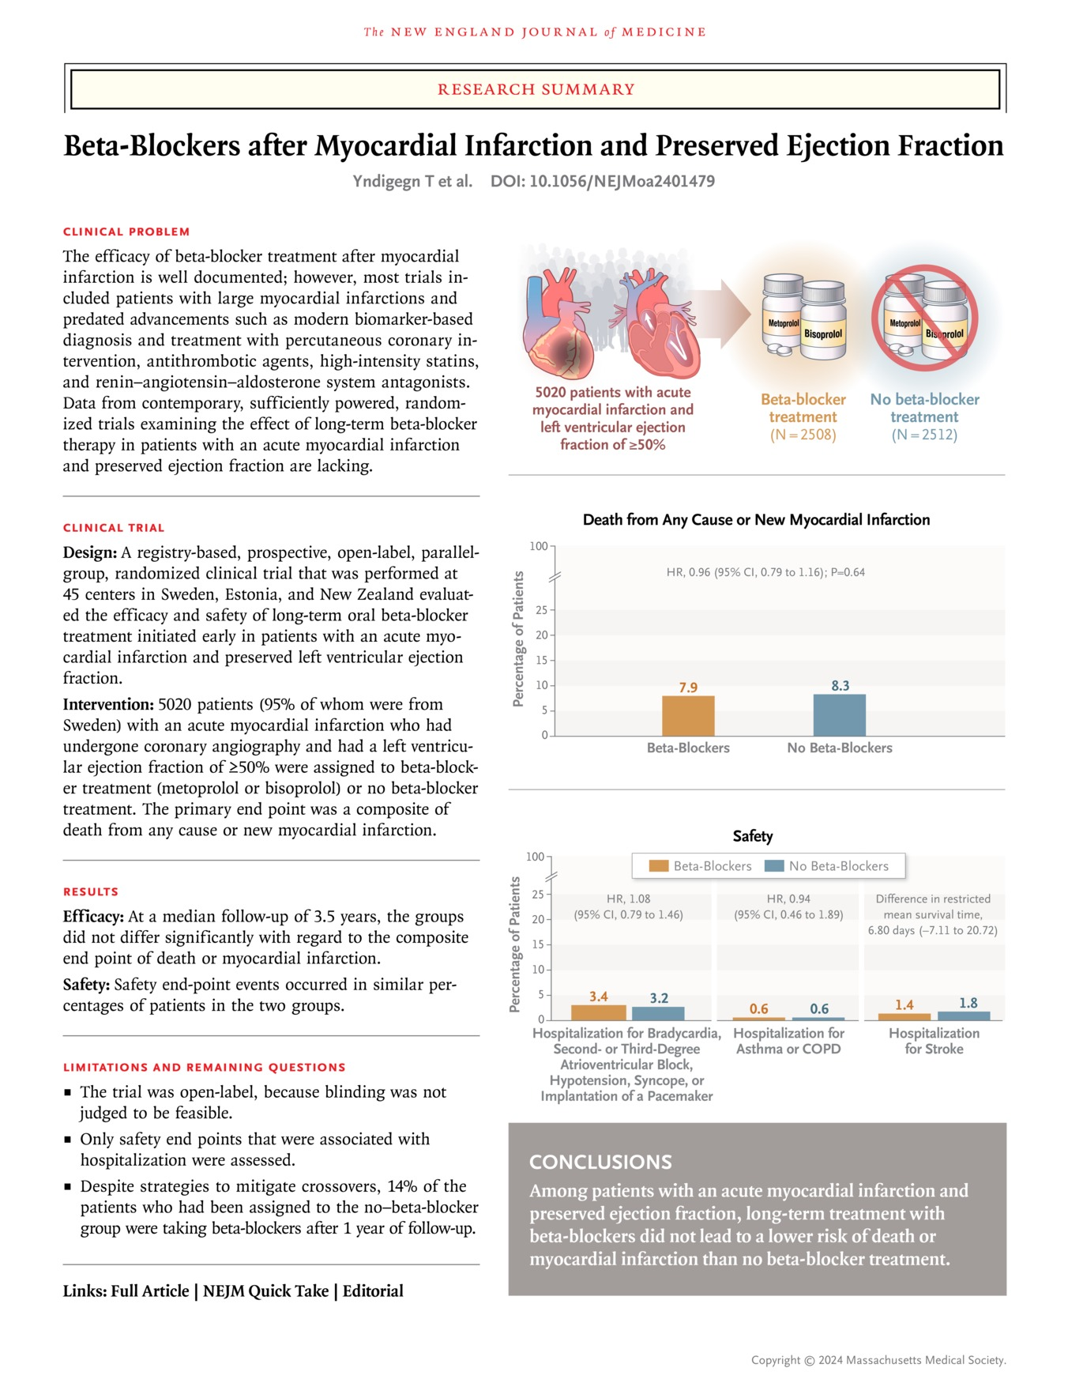
Yndigegn T et al. N Engl J Med2024;390:1372-1381
Notes:
Download a PDF of the Research Summary.

Slide 46
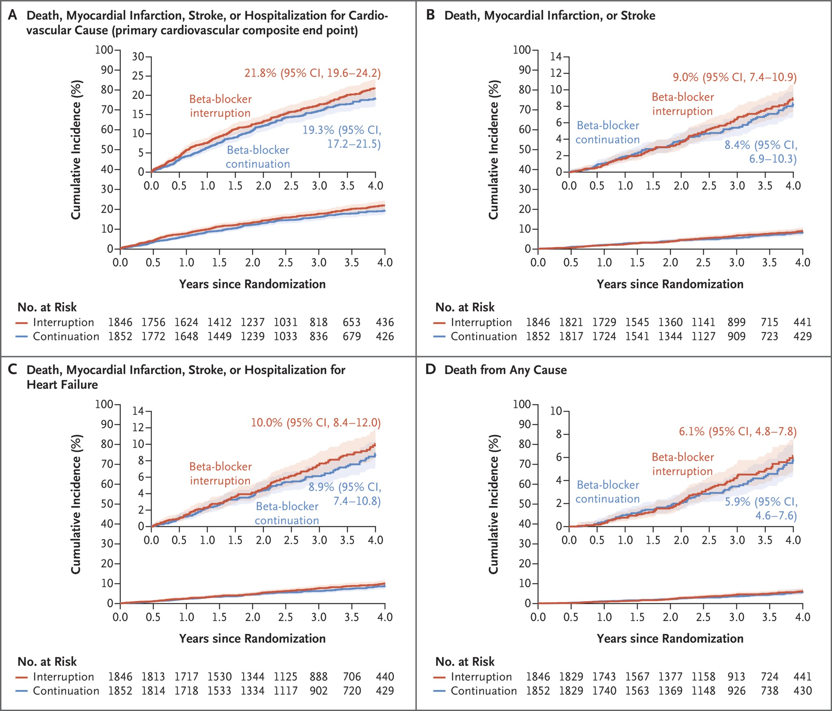
Time-to-Event Analysis of Primary and Confirmatory Secondary Efficacy End Points.
Silvain J et al. N Engl J Med2024;391:1277-1286
Notes:
Figure 2 Time-to-Event Analysis of Primary and Confirmatory Secondary Efficacy End Points. Shown are Kaplan–Meier estimates of the cumulative incidence of the primary cardiovascular composite end point (Panel A); the composite end point of death, nonfatal myocardial infarction, or nonfatal stroke (Panel B); the composite end point of death, nonfatal myocardial infarction, nonfatal stroke, or hospitalization for heart failure (Panel C); and death from any cause (Panel D). The definitions of all end points are provided in the Supplementary Appendix. Results for the secondary end points are reported as point estimates and 95% confidence intervals, which are shown for each curve. The widths of these confidence intervals have not been adjusted for multiplicity and therefore should not be used to infer definitive treatment effects for these secondary end points. In each panel, the inset shows the same data on an enlarged y axis.

Slide 47
Time-to-Event Analysis of Primary and Confirmatory Secondary Efficacy End Points.
Silvain J et al. N Engl J Med2024;391:1277-1286
Notes:
Figure 2 Time-to-Event Analysis of Primary and Confirmatory Secondary Efficacy End Points. Shown are Kaplan–Meier estimates of the cumulative incidence of the primary cardiovascular composite end point (Panel A); the composite end point of death, nonfatal myocardial infarction, or nonfatal stroke (Panel B); the composite end point of death, nonfatal myocardial infarction, nonfatal stroke, or hospitalization for heart failure (Panel C); and death from any cause (Panel D). The definitions of all end points are provided in the Supplementary Appendix. Results for the secondary end points are reported as point estimates and 95% confidence intervals, which are shown for each curve. The widths of these confidence intervals have not been adjusted for multiplicity and therefore should not be used to infer definitive treatment effects for these secondary end points. In each panel, the inset shows the same data on an enlarged y axis.

Slide 48
Conclusions
In patients with a history of myocardial infarction, interruption of long-term beta-blocker treatment was not found to be noninferior to a strategy of beta-blocker continuation.

Slide 49
MD
66 yo male – prev smoker
STEMI with Primary PCI RCA
EF 65%
Meds – Bisoprolol 5 mg od
  Rosuvastatin 40/ASA/Brilinta/Ramirpil
3 months later
  c/o fatigue/? Depression
  No angina
  BP – 122/78, HR 64

Slide 50
BF
60 yo female
BMI 32
No DM, no vascular Dx
Non smoker
PMHx
  HT
  Incr Chol
Meds –
  Rosuvastin/Perindopril/HCT/Amlodipine

Slide 51
BF
What are my risk factors for cardiovascular disease?
I heard that a 5% loss of weight can help lower the risk of diabetes and improve my heart health
What’s this about Weegovy? My girlfriend in Florida is on it.

Slide 52

Time for a heart-to-heart

Slide 53
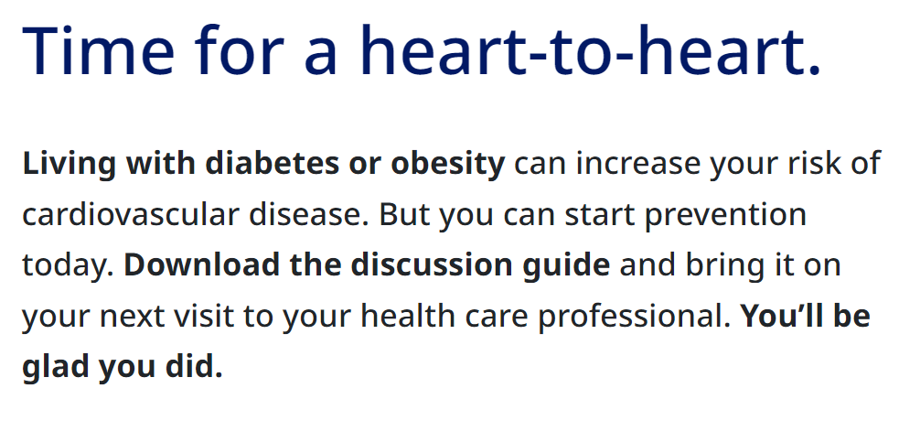

Slide 54
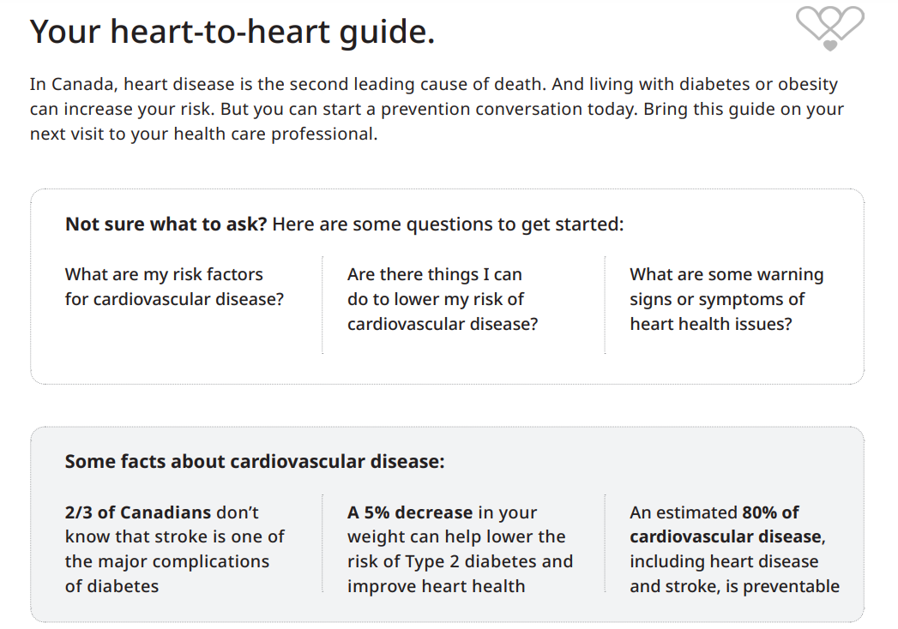

Slide 55
SL – 55 yo female, BMI 31, No CRF’s
What are my risk factors for cardiovascular disease?
I heard that a 5% loss of weight can help lower the risk of diabetes and improve my heart health
What’s this about Weegovy? My girlfriend in Florida is on it.

Slide 56

Wegovy is a weight-loss drug. Health Canada says it can now be used to curb heart-attack risk

Slide 57

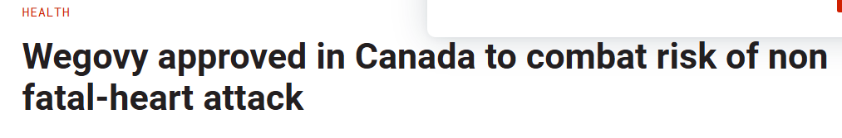
Wegovy is a weight-loss drug. Health Canada says it can now be used to curb heart-attack risk

Slide 58

Wegovy is a weight-loss drug. Health Canada says it can now be used to curb heart-attack risk*
Canada approves new obesity drug to reduce risk of non-fatal heart attack*

Slide 59
Wegovy is a weight-loss drug. Health Canada says it can now be used to curb heart-attack risk*
Canada approves new obesity drug to reduce risk of non-fatal heart attack*

Slide 60
Wegovy Product Monograph
*To reduce the risk of non-fatal MI in adults with established cardiovascular disease in patients with BMI > 27.

Slide 61
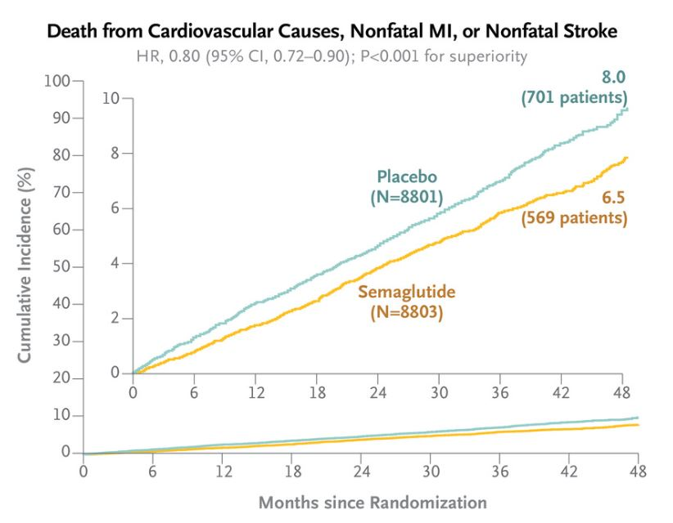
Select Trial
NNT x 40 months = 66.7 MACE
(222/year)

Slide 62
Cost of Interventions
Select Trial- Obesity + CVD - NNT x 40 months = 66.7 MACE (222/year)
Cost per event saved ( C$420/month) = C$1,120,000
US = C$1,790/month = C$4,772,000 per event saved
Sustain 6 - DM + CVD–- NNT x 25 months = 43.5 MACE (91/year)
Cost per event saved (C$210/month) = C$230,202
EmpaReg - DM with CAD NNTx 37 months = 62.5 MACE (193/year)
= 38 All cause Mortality
Cost per event saved = $82/month= $195,183.75 or $48,265 (generic Dapa)
+ CHF and CRF benefits

Slide 63
BF
60 yo female
BMI 32
No DM, no vascular Dx
Non smoker
PMHx
  HT
  Incr Chol
Meds –
  Rosuvastin/Perindopril/HCT/Amlodipine

Slide 64
RW
73 yo male
Hospitalization x 2 HF with Vol overload
Echo – EF 55%
Cath – neg
Hx HT/Incr Chol
SOBOE walking 2 blocks
Meds – Empagliflozin 10 mg od
  Finerenone 20 mg od
  Rosuvastatin 40, Lasix 40 mg prn O/E
  BP 124/70, HR 76 NSR,
BMI 35
Mild pedal edema
eGFR 75, K+ 4.5
NT Pro BNP 1320

Slide 65
Original Article
Tirzepatide for Heart Failure with Preserved Ejection Fraction and Obesity
Milton Packer, M.D., Michael R. Zile, M.D., Christopher M. Kramer, M.D., Seth J. Baum, M.D., Sheldon E. Litwin, M.D., Venu Menon, M.D., Junbo Ge, M.D., Govinda J. Weerakkody, Ph.D., Yang Ou, Ph.D., Mathijs C. Bunck, M.D., Karla C. Hurt, B.S.N., Masahiro Murakami, M.D., Barry A. Borlaug, M.D., for the SUMMIT Trial Study Group
N Engl J Med
Volume 392(5):427-437
January 30, 2025

Slide 66
Study Overview
In patients with heart failure with preserved ejection fraction and obesity, treatment with tirzepatide led to a lower risk of death from cardiovascular causes or worsening heart-failure events than placebo.

Slide 67
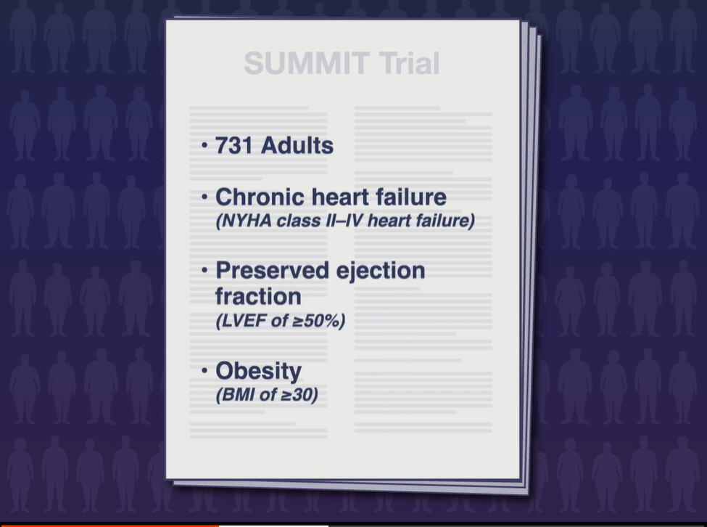

Slide 68
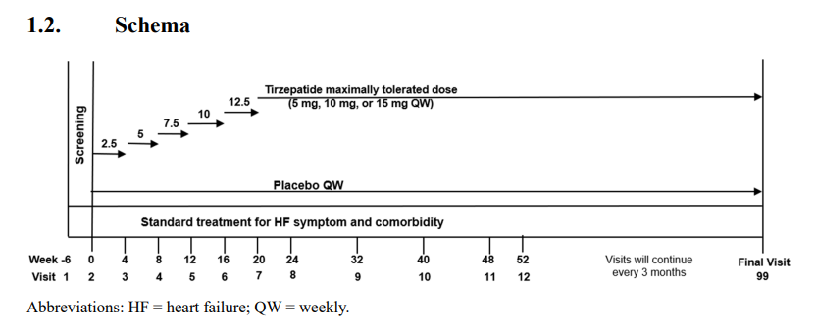

Slide 69
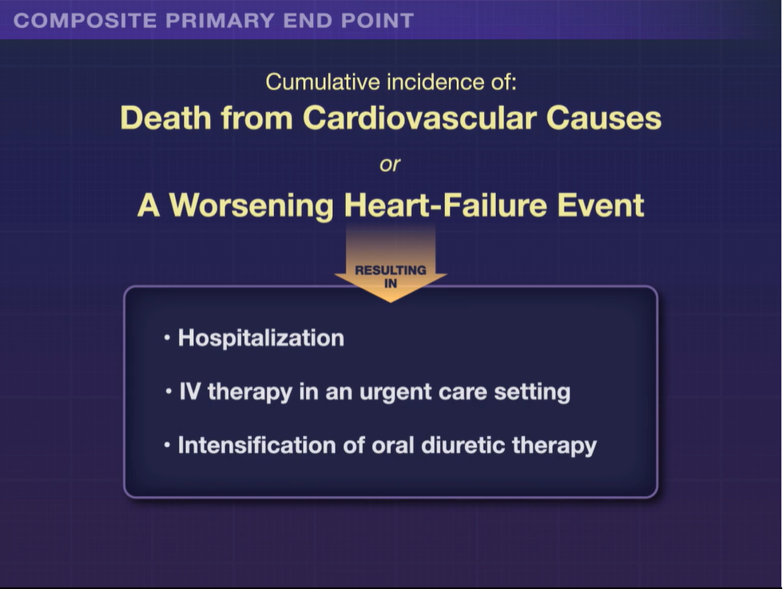

Slide 70
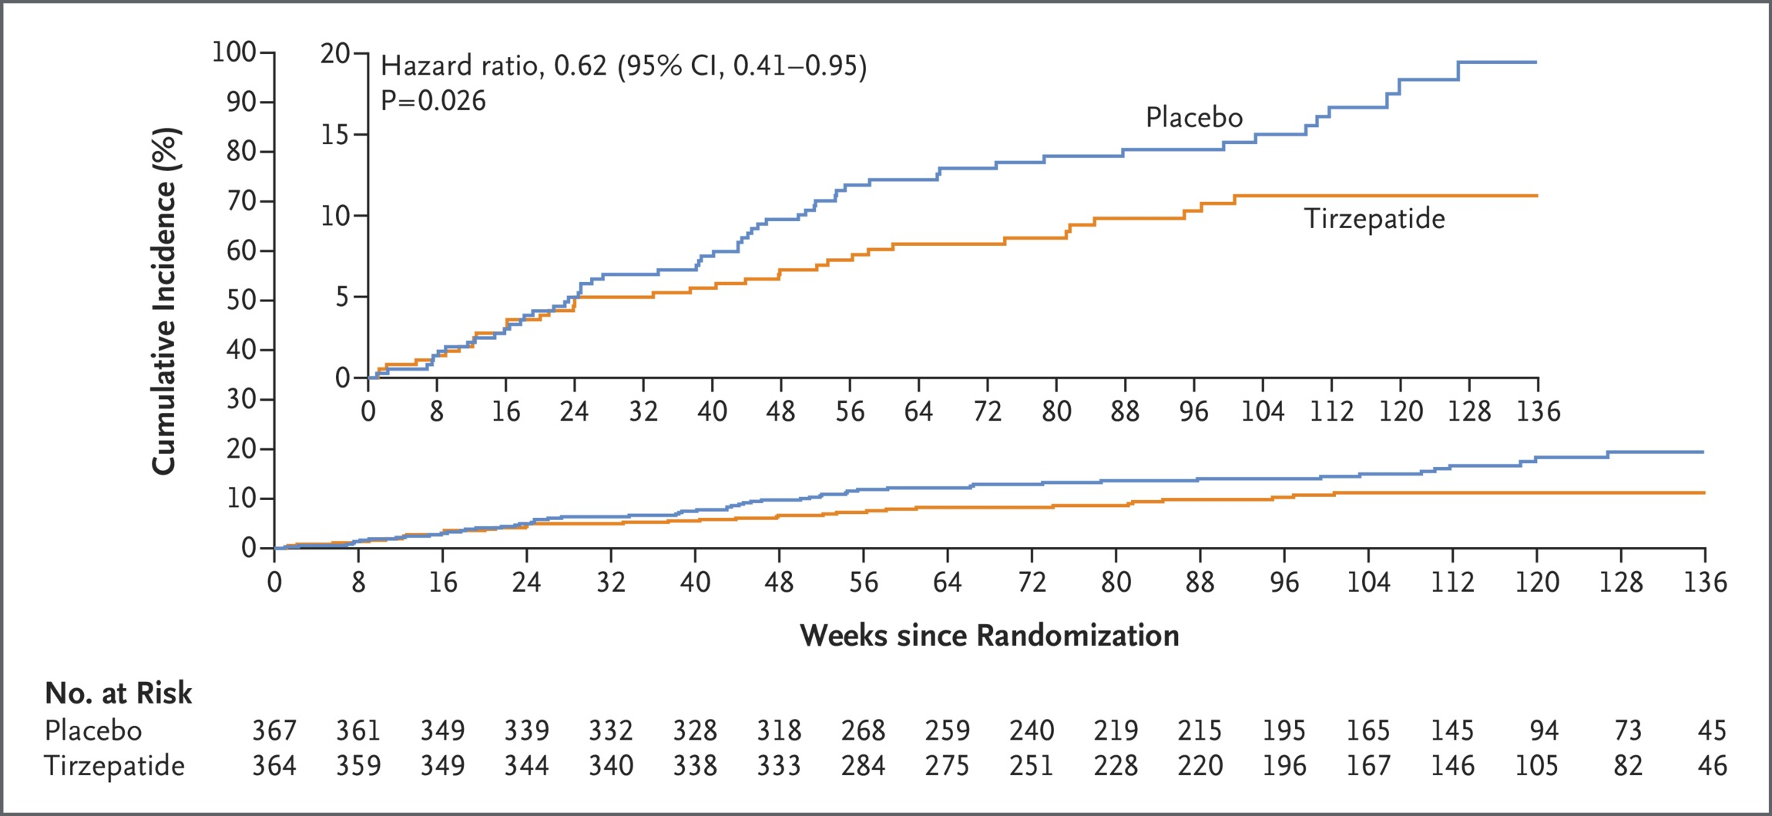
Composite of Death from Cardiovascular Causes or a Worsening Heart-Failure Event.
Packer M et al. N Engl J Med2025;392:427-437
Notes:
Figure 1 Composite of Death from Cardiovascular Causes or a Worsening Heart-Failure Event. Shown is the cumulative incidence of death from cardiovascular causes or a worsening heart-failure event (the composite primary end point), assessed in a time-to-first-event analysis, among 364 patients who received tirzepatide and 367 patients who received placebo. The inset shows the same data on an expanded y axis.

Slide 71
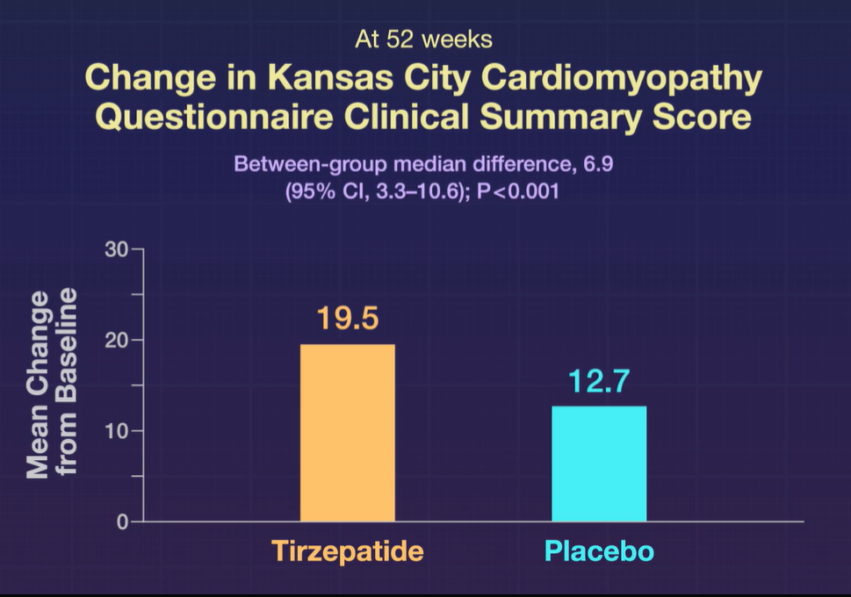

Slide 72
Conclusions
Treatment with tirzepatide led to a lower risk of a composite of death from cardiovascular causes or worsening heart failure than placebo and improved health status in patients with heart failure with preserved ejection fraction and obesity.

Slide 73
Original Article
Semaglutide in Patients with Heart Failure with Preserved Ejection Fraction and Obesity
Mikhail N. Kosiborod, M.D., Steen Z. Abildstrøm, Ph.D., Barry A. Borlaug, M.D., Javed Butler, M.D., Søren Rasmussen, Ph.D., Melanie Davies, M.D., G. Kees Hovingh, M.D., Ph.D., Dalane W. Kitzman, M.D., Marie L. Lindegaard, M.D., D.M.Sc., Daniél V. Møller, M.D., Ph.D., Sanjiv J. Shah, M.D., Marianne B. Treppendahl, M.D., Ph.D., Subodh Verma, M.D., Ph.D., Walter Abhayaratna, M.D., Ph.D., Fozia Z. Ahmed, M.D., Vijay Chopra, M.D., Justin Ezekowitz, M.Sc., Michael Fu, M.D., Ph.D., Hiroshi Ito, M.D., Małgorzata Lelonek, M.D., Ph.D., Vojtech Melenovsky, M.D., Ph.D., Bela Merkely, Ph.D., D.Sc., Julio Núñez, M.D., Ph.D., Eduardo Perna, M.D., Morten Schou, M.D., Ph.D., Michele Senni, M.D., Kavita Sharma, M.D., Peter Van der Meer, M.D., Ph.D., Dirk von Lewinski, M.D., Dennis Wolf, M.D., Mark C Petrie, M.D., for the STEP-HFpEF Trial Committees and Investigators
N Engl J Med
Volume 389(12):1069-1084
September 21, 2023

Slide 74
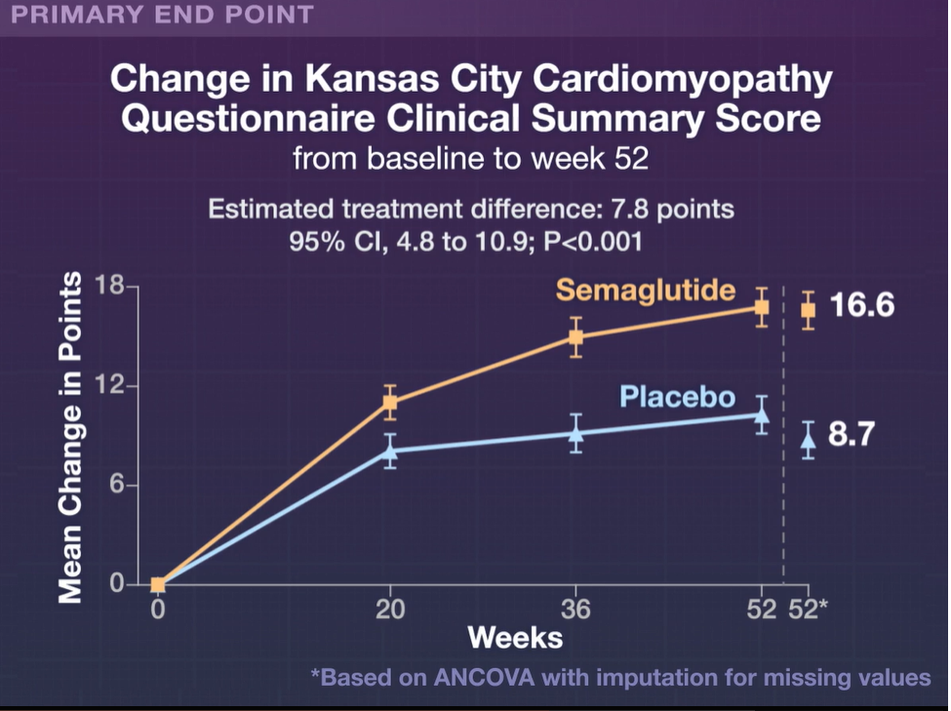

Slide 75
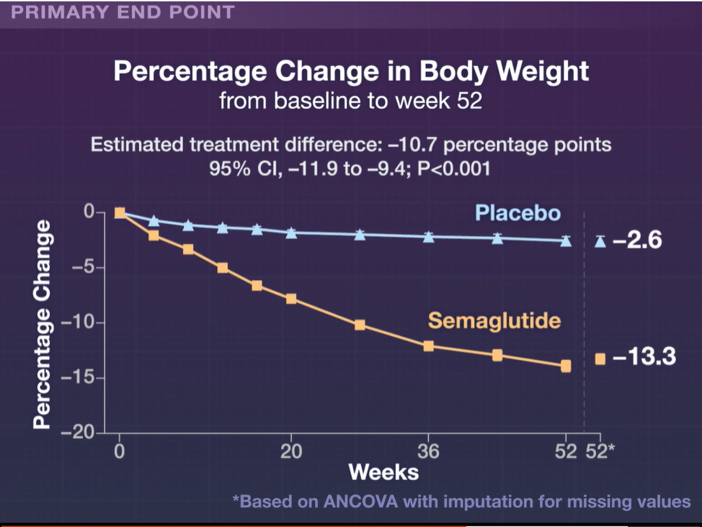

Slide 76

What Does The Future Hold for GLP-1 Agonists

Slide 77
What Does The Future Hold for GLP-1 Agonists ?
Diabetes
Weight loss
Diabetic Nephropathy
HFpEF
OSA
MALD/NASH
Addiction Treatment – EtOH/Drugs/Smoking
Gambling Addiction
Asthma
Dementia
HIV Related Cognitive Decline
OA

Slide 78
Clinical Trials Summary
Senior-RITA
  Maybe not everyone with Non-STEMI needs a cath
IMPACT MI
  Maybe not everyone needs a BB post-MI
SELECT Trial
  Maybe not everyone needs to be on a GLP1 agent
SUMMIT
  GLP-1s look good for HFpEF
    ? HF Reduced EF

