Slide 1
Update in Clinical Trials
Diane Murzin, MD, FRCPC
November 27, 2024 (Orillia)
December 04, 2024 (Barrie)

Slide 2
Presenter Disclosures
Relationships with financial sponsors:
  Grants/Research Support: None
  Speakers Bureau/Honoraria: CCRN, Novo Nordisk, Boehringer Ingelheim
  Consulting Fees: None
  Patents: None
  Other: None

Slide 3
Disclosure of Financial Support
This program has received financial support from Novo Nordisk Canada and Abbott Laboratories Co. in the form of educational funding
This program has received in-kind support from Lilly Canada and Abbott Laboratories Co. in the form of logistical support
Potential for conflict(s) of interest:
  Dr. Diane Murzin has received an honorarium from Abbott Canada
  Lilly Canada has developed products that may be discussed in this program

Slide 4
Discussion Topics
Renal
  FLOW
Cardiovascular
  SOUL
Once weekly insulin
  Awiqli
  Efistora
GLP1ra: surgery and endoscopy

Slide 5
RENAL TRIALS
FLOW

Slide 6

Background
T2DM is the most frequent cause of chronic kidney disease in many countries
Already in use: RAS inhibitors, SGLT2i, finerenone (Kerendia)
  Renal protection
  Reduced CV outcomes
Main cause of death: CV events
N Engl J Med 2024;391:109-121. DOI: 10.1056/NEJMoa2403347. VOL. 391 NO. 2

Slide 7

FLOW
Goal: “to evaluate the efficacy and safety of semaglutide 1 mg weekly for the prevention of kidney failure, substantial loss of kidney function, and death from kidney-related or CV causes in patients with T2DM and CKD”
N Engl J Med 2024;391:109-121. DOI: 10.1056/NEJMoa2403347. VOL. 391 NO. 2

Slide 8
FLOW (2)
WHO: 3,534 patients
eGFR 50-75 ml/min/1.73m² + ACR 300-5000 mg/mmol OR
eGFR 25-50 ml/min/1.73m² + ACR 100-1000 mg/mmol
WHAT: semaglutide 1 mg versus placebo
N Engl J Med 2024;391:109-121. DOI: 10.1056/NEJMoa2403347. VOL. 391 NO. 2

Slide 9

FLOW (3)
Primary endpoint: composite of 5 components
  > 50% reduction in eGFR vs baseline
  Onset of persistent eGFR < 15
  Initiation of chronic kidney replacement
  Death from kidney-related or CV causes
N Engl J Med 2024;391:109-121. DOI: 10.1056/NEJMoa2403347. VOL. 391 NO. 2
Notes:
Secondary endpoints:
Annual rate of change in eGFR
Major adverse CV events (non-fatal MI, non-fatal stroke, CVD)
All cause death

Slide 10
FLOW - Results
October 2023
  Interim analysis triggered after 570 primary events occurred
  Early trial completion recommended
N Engl J Med 2024;391:109-121. DOI: 10.1056/NEJMoa2403347. VOL. 391 NO. 2
Notes:
Mean age 66.6 yo
60:40 M:F
Mean eGFR 47
Median ACR 567.6
68% at very high risk for kidney disease progress, kidney failure, CV events or DEATH based on KDIGO risk calculators

Slide 11
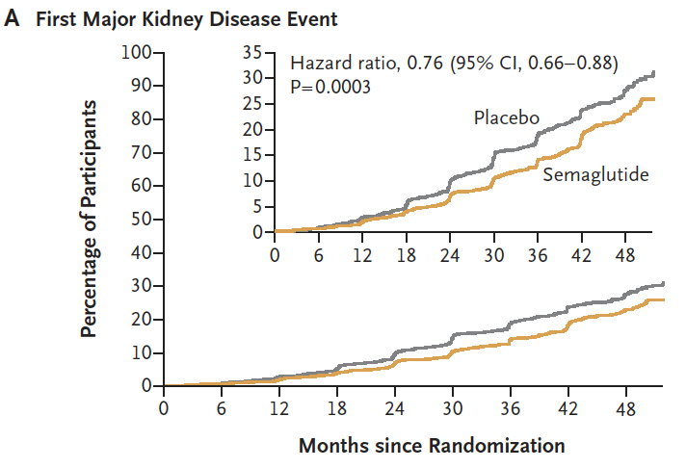
Results (2)
N Engl J Med 2024;391:109-121. DOI: 10.1056/NEJMoa2403347. VOL. 391 NO. 2
Notes:
Primary outcome events occurred less frequently in the sema group than in the placebo group
331 first events vs 410 in the placebo group
24% lower relative risk (HR 0.76; 95% CI, 0.66-0.88; P=0.0003)
NNT over 3 years = 20

Slide 12
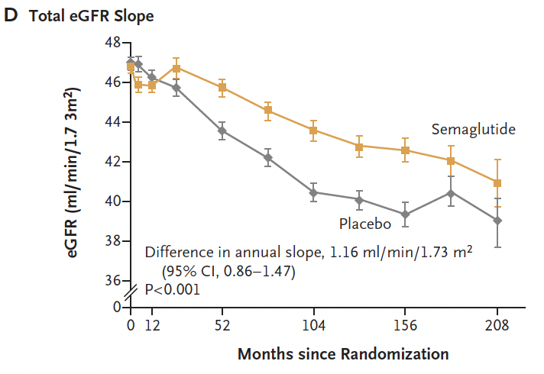
Results (3)
N Engl J Med 2024;391:109-121. DOI: 10.1056/NEJMoa2403347. VOL. 391 NO. 2
Notes:
Also stat significantly lower rick of major CV events and death from any cause

Slide 13
FLOW Summary
Semaglutide 1 mg weekly reduced the risk of clinically important kidney outcomes, major CV events and death from any cause in patients with T2DM and CKD
N Engl J Med 2024;391:109-121. DOI: 10.1056/NEJMoa2403347. VOL. 391 NO. 2
Notes:
Possible theories why: decreased inflammation, oxidative stress and fibrosis
Reduced cellular expression of proinflammatory and profibrotic markers

Slide 14
CARDIOVASCULAR TRIALS
SOUL
Notes:
PIONEER 6 showed CV safety

Slide 15

SOUL
Oral semaglutide cardiovascular outcomes trial
  14 mg weekly
CV outcomes in patients with T2DM and established ASCVD and/or CKD
Double-blind, parallel-group, placebo-controlled RCT
9,650 patients
MACE, major cardiovascular adverse events. 1. SOUL Company Announcement :News Details (novonordisk.com)
Notes:
49% received SGLT2i at some point due to standard of care

Slide 16
SOUL (2)
Primary endpoint:
  Time to first occurrence of MACE
    CV death
    Nonfatal MI
    Nonfatal stroke
MACE, major cardiovascular adverse events. 1. SOUL Company Announcement :News Details (novonordisk.com)

Slide 17
SOUL: Company Announcement
14% reduction in risk of MACE on top of standard of care
All 3 components of MACE contributed
Safe and well-tolerated
MACE, major cardiovascular adverse events. 1. SOUL Company Announcement :News Details (novonordisk.com)

Slide 18
NEW(ish) MEDICATIONS
ONCE WEEKLY BASAL INSULINS

Slide 19
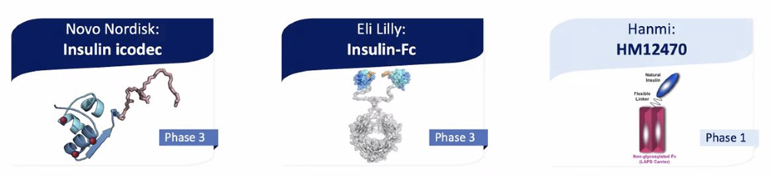
Once Weekly Basal Insulins
Notes:
Increased binding with albumin leads to increased half-life (preclinical studies)

Slide 20
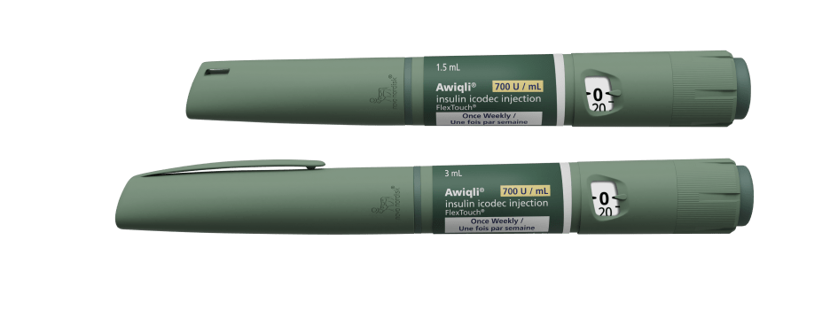
ONWARDS Trials
ONWARDS 1: weekly insulin icodec versus daily insulin glargine U-100 in insulin naïve T2DM
ONWARDS 2: weekly insulin icodec versus daily insulin degludec in basal-insulin treated T2DM
Notes:
ONWARDS 1, 3, 5: insulin naïve patients
1: icodec vs glargine U100
3: icodec vs Tresiba
5: icodec vs any daily basal insulin
ONWARDS 2, 4
2: switched from daily basal to icodec vs Tresiba
4: basal bolus – icodec vs glargine U100
ONWARDS 6
T1DM

Slide 21
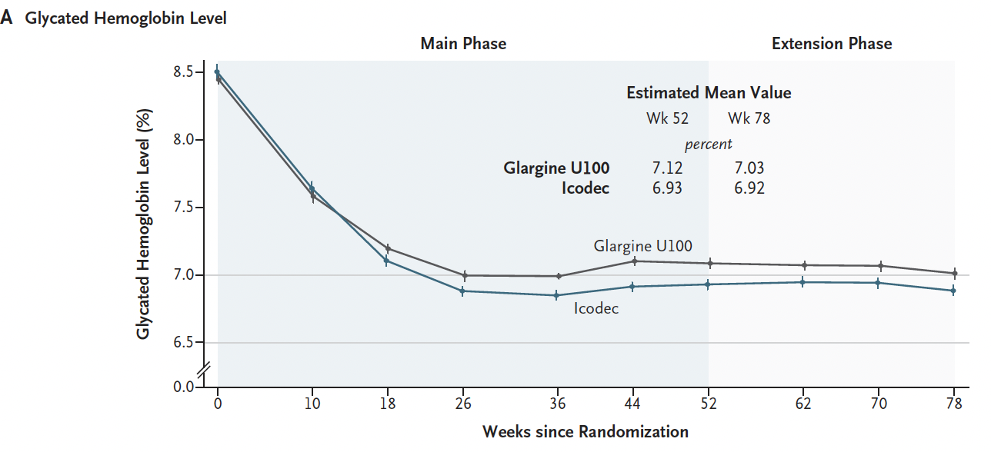
ONWARDS 1
N Engl J Med 2023; 389:297-308, DOI: 10.1056/NEJMoa2303208
Notes:
ONWARDS 1
Primary outcome: change in HbA1c level from baseline to week 52; secondary endpoint of time in range (3.9-10 mmol/L)
492 participants
Baseline mean HbA1c of 8.5% in icodec and 8.4 in glargine groups, respectively
Week 52: 6.93% and 7.12%, respectively (-1.55% with icodec and -1.35% change with glargine; -0.19% difference; confirmed non-inferiority P<0.001 and superiority P=0.02)
Week 78: 6.92% and 7.03%, respectively – reduction in HbA1c sustained at end of extension (CI -0.22 to 0) - **CI touched zero
Significantly greater TIR between weeks 48-52 and weeks 74-78 in icodec group
Weekly insulin regimen facilitates initiation of basal insulin and improved glycemic control, potentially through treatment adherence by reducing injection burden
Strengths: long duration of treatment and follow up, large, multination and diverse patient population (low proportion of black and latino), continuation of background medications (not SU)
Limitations: not double-blinded as goal was to reduce injection burden on patients in icodec group, CGM not maintained throughout the trial, not compared to second generation basal analoges

Slide 22
Overall hypoglycemia over main + extension phase (weeks 0-83)
ONWARDS 1
 | Icodec |  |  |  | Glargine U100
 | N | % | E | R | N | % | E | R
Level 2 | 61 | 12.4 | 226 | 0.30 | 66 | 13.4 | 114 | 0.15
Level 3 | 1 | 0.2 | 1 | 0.001 | 6 | 1.2 | 7 | 0.009
Level 2 + Level 3 | 61 | 12.4 | 227 | 0.30 | 70 | 14.2 | 121 | 0.16
3 of 492 participants (0.6%) accounted for 105 of the 226 events
On-treatment | ERR | 95% CI | p-value
Clinically significant hypoglycemia (level 2) | 1.71 | [1.06; 2.76] | 0.0285
Clinically significant (level 2) or severe (level 3) hypoglycemia | 1.63 | [1.02; 2.61] | 0.0428
Overall observed rates of combined clinically significant or severe hypoglycemia were <1 event per PYE
Statistically significant difference in favor of glargine U100 vs icodec in
overall observed rates of combined clinically significant or severe hypoglycemia
1. Rosenstock J, et al. N Engl J Med 2023: June DOI:10.1056/NEJMoa2303208
On-treatment. Safety analysis set. Hypoglycemia alert value (level 1): Plasma glucose value of < 3.9 mmol/L and ≥ 3.0 mmol/L confirmed by BG meter. Clinically significant hypoglycemia (level 2): Plasma glucose value of < 3.0 mmol/L confirmed by BG meter. Severe hypoglycemia (level 3): Hypoglycemia with severe cognitive impairment requiring external assistance for recovery. %, percentage of participants with one or more events; BG, blood glucose; CI, confidence interval; E, number of events; ERR, excess relative risk; N, number of participants with one or more events; PYE, patient-year of exposure (1 PYE = 365.25 days); R, rate (number of events per patient-year).
Notes:
More patient in icodec group achieved A1c < 7% with or without hypoglycemia vs patients in glargine group
ONWARDS 3: icodec vs degludec in insulin naïve – stat significant diff in HbA1c lower (-1.57 vs 1.36, P < 0.0001 for noninf and 0.0028 for super)
ONWARDS 5: icodec + dosing app vs degludec or glargine (U100 or U300) in insulin naïve – stat significant diff in HbA1c lower (-1.68 vs 1.31, P < 0.0001 for noninf and 0.009 for super)
No stat signif diff in hypoglycemia in either trial

Slide 23
ONWARDS 2
Primary outcome: change in HbA1c from baseline to week 26
HbA1c was reduced to 7.2% in icodec group vs 7.42% in degludec group
  Demonstrated non-inferiority and superiority
Greater weight gain in icodec group
Lancet 2023; 11;6:414-425, DOI: https://doi.org/10.1016/S2213-8587(23)00093
Notes:
Baseline HbA1c of 8.17% and 8.1% in icodec and degludec, respectively
526 patients randomized
T2DM with inadequate control on once-daily or twice-daily basal insulin +/- non-insulin antihyperglycemic agents
Estimated treatment difference of -0.22 % (95% CI, -0.37 to -0.08)

Slide 24
ONWARDS Programme: Topline Results
ONWARDS 1
BASAL INITIATION
ONWARDS 3
BASAL INITIATION
ONWARDS 5
BASAL INITIATION
ONWARDS 2
BASAL SWITCH
ONWARDS 4
BASAL/BOLUS SWITCH
ONWARDS 6
BASAL/BOLUS SWITCH
Trial duration (weeks)
Baseline HbA_{1c}
Non-inferiority confirmed
Superiority confirmed Endpoint assessed (week)
52 (78) | 26 | 52 | 26 | 26 | 26 (52)
8.5 | 8.5 | 8.9 | 8.13 | 8.3 | 7.61
✓ | ✓ | ✓ | ✓ | ✓ | ✓
✓ | ✓ | ✓ | ✓
52 | 26 | 52 | 26 | 26 | 52
Icodec
Glargine
U100
Icodec
Degludec
Icodec + dosing guide app
OD basal insulins*
Icodec
Degludec
Icodec
Glargine
U100
Icodec
Degludec
Estimated change from baseline in HbA_{1c} (%)
Estimated rate of clinically significant or severe hypoglycaemia
(event per PYE)
Insulin-naïve type 2 diabetes
Insulin-treated type 2 diabetes
Type 1 diabetes
*insulin degludec or insulin glargine U100/U300. Clinically significant hypoglycaemia (level 2): blood glucose <3.0 mmol/L (<54 mg/dL ) confirmed by blood glucose meter. Severe hypoglycaemia (level 3): hypoglycaemia with severe cognitive impairment requiring external assistance for recovery. OD, once-daily; RCT, randomised clinical trial.
1. Rosenstock J et al. N Engl J Med. 2020;383:2107–2116; 2. Lingvay I et al. JAMA. 2023:10.1001/jama.2023.11313; 3. Lingvay I et al. 2023 ADA Scientific Sessions. 178-OR; 4. Bajaj H. 2023 ADA Scientific Sessions. 803-P. 5. Philis-Tsimikas A et al. Lancet Diabetes Endocrinol. 2023;11(6):414-425. 6. Mathieu C et al. Lancet. 2023;401(10392):1929-40; 7. Russell-Jones D et al. EASD 2023 Annual Meeting. OP-09; 8. Russell-Jones D et al. Lancet. 2023: DOI: 10.1016/S0140-6736(23)02179-7; 9. Bajaj HS et al. touchREV Endocrinol. 2023;19(1):4-6.
Notes:
References:
OW 1 = Rosenstock J et al. N Engl J Med. 2020;383:2107–2116
OW 3 = Lingvay I et al. JAMA. 2023:10.1001/jama.2023.11313; Lingvay I et al. 2023 ADA Scientific Sessions. 178-OR.
OW 5 = Bajaj H. 2023 ADA Scientific Sessions. 803-P
OW 2 = Philis-Tsimikas A et al. Lancet Diabetes Endocrinol. 2023;11(6):414-425
OW 4 = Mathieu C et al. Lancet. 2023;401(10392):1929-40
OW 6 = Russell-Jones D et al. Lancet. 2023: DOI: 10.1016/S0140-6736(23)02179-7.
Topline results = Bajaj HS et al. touchREV Endocrinol. 2023;19(1):4-6.

Slide 25

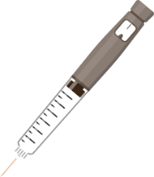
Clinical Application of Icodec
Icodec
Once-daily insulin
One injection per week compared to
seven injections with once-daily insulin
The formulation (700 U/mL) ensures
the injection volume is similar to
once-daily basal insulin
Weekly coverage is achieved by the gradual release of icodec from albumin-bound depot
Dosing schedule
Dosing schedule
S
M
T
W
T
F
S
S
M
T
W
T
F
S
U, unit(s).

Slide 26

Insulin Icodec
Modelled glucose-lowering effect
Dotted line represents equal distribution
across 7 days
Proportion of AUC_{GIR} (%)
Clamp
Clamp
Day within a weekly dosing interval
Close to even distribution of total glucose-lowering effect of insulin icodec over seven days

Slide 27
Initiation or Switching to Icodec
Initiation with icodec
Start at 70 U for weekly coverage
  In accordance with ADA guideline* for a OD insulin
  A starting dose of 10 U once-daily basal insulin corresponds to 70 U once-weekly icodec
Icodec
Recommendation:
70 U/week
S
M
T
W
T
F
S
Switching from once-daily insulin
  Convert from daily basal insulin dose to weekly dose by multiplying the daily dose by 7
  For the first injection only, add a one-time additional 50% icodec dose
Once-daily
Example
S
M
T
W
T
F
S
Daily dose
= 20 U
Icodec
Weekly dose
= 140 U (20 U x 7)
+ a one-time additional 50% icodec dose
S
M
T
W
T
F
S
*ADA, Standards of Medical Care 2022. ADA, American Diabetes Association; OD, once-daily; U, unit(s).

Slide 28
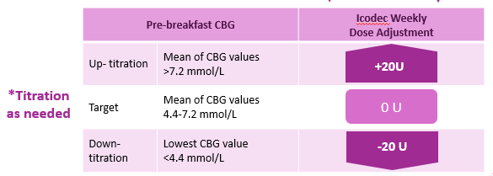
Titration Algorithm
Switching from OD/BID Basal Insulin to OW Icodec
Glargine U100 daily
dose adjustment
Icodec weekly
dose adjustment
Pre-breakfast SMBG
>7.2 mmol/L
(>130 mg/dL)
+4 U
+28 U
Up-titration
4.4–7.2 mmol/L
(80–130 mg/dL)
0 U
0 U
Target
<4.4 mmol/L
(<80 mg/dL)
–4 U
–28 U
Down-titration
Dose adjustment was based on three pre-breakfast SMBG values, measured two days prior to and on the day of titration. If any of the three pre-breakfast SMBG values were below the lower limit of the target range, titration was based on the lowest recorded value. If all three SMBG values were above the lower limit of the target range, titration was based on the mean of the three measurements.
BID, twice-daily; OD, once-daily; OW, once-weekly; SMBG, self-measured blood glucose; U, unit(s).
1. Bajaj H et al. Diabetes Care. 2021; 44(7):1586–1594.

Slide 29

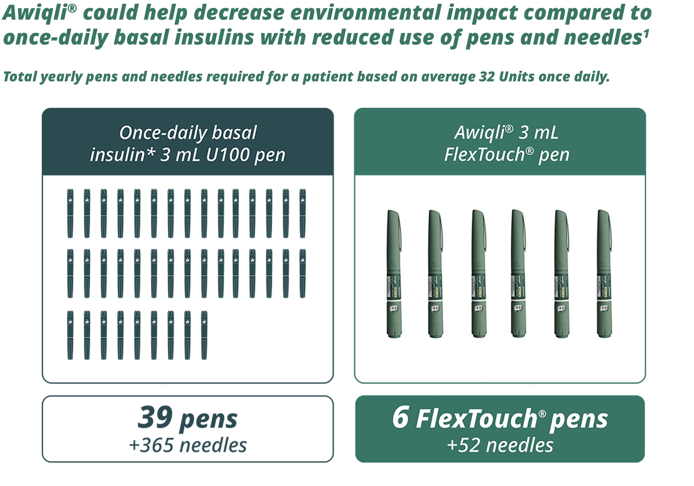
Environmental Impact of Weekly Insulin

Slide 30
QWINT-2: Insulin Efsitora Alfa
WHAT: Insulin Efsitora versus degludec
WHO: 928 insulin-naïve patients with T2DM
Open-label, treat-to-target
Primary end point: change in HbA1c from baseline to week 52
Carol Wysham et al. NEJM. DOI: 10.1056/NEJMoa2403953. Published online Sep 2024.
Notes:
Secondary and safety end points:
Change in HbA1c in subgroups using and not using GLP1ra
Percent TIR (3.9-10) in weeks 48-52
Hypoglycemic episodes

Slide 31
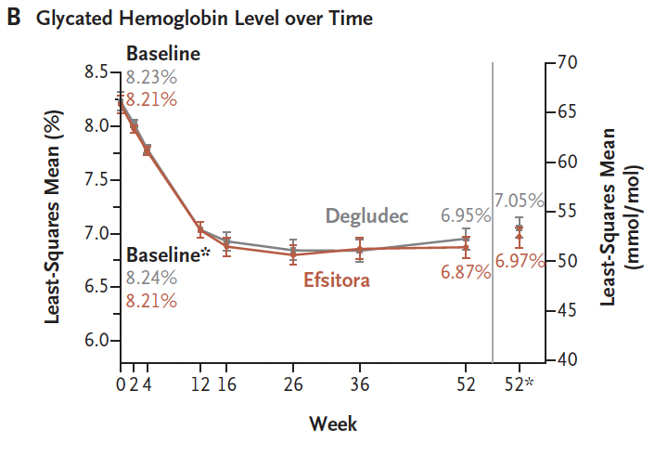
Results
Carol Wysham et al. NEJM. DOI: 10.1056/NEJMoa2403953. Published online Sep 2024.

Slide 32
QWINT-2 Summary
Efsitora was noninferior to degludec with respect to change in HbA1c over 52 weeks
Carol Wysham et al. NEJM. DOI: 10.1056/NEJMoa2403953. Published online Sep 2024.

Slide 33
GLP1ra: SURGERY AND ENDOSCOPY

Slide 34


Pre-Operative Management: GLP1ra
Reports of anesthesiologists encountering full-stomach even with 12h of fasting in patients taking GLP1ra
GLP1ra associated with delayed gastric emptying and may lead to increased aspiration risk

Slide 35
Pre-Operative Management: GLP1ra
Institute of Safe Medication Practices of Canada
  GLP1ra for WEIGHT LOSS: hold medication for 3 half lives prior to planned surgery
    88% of the drug being eliminated by this point
  GLP1ra for DIABETES MELLITUS: benefits vs risks of holding for 3 half lives; consult with endocrinologist
Prolonged fasting NOT recommended
Based on limited clinical data
GLP1ra Pre-Operatively
Improved glycemic control
Low rate of hypoglycemia
SAFE AND EFFECTIVE
Van Zuylen et al. British Journal of Anaesthesia, 132 (4): 644e648 (2024)
Notes:
Case reports
Preoperative GLP1ra Use and Risk of Postoperative Respiratory Complications
Anjali A. Dixit et al. JAMA. 2024;331(19):1672-1673. doi:10.1001/jama.2024.5003
Admin claims from a commercial database. All patients with T2DM and GLP1ra Rx fill who underwent one of 13 emergency surgical procedures on same day as ED visit (no time to hold GLP1ra)
Comparison group was people with T2DM and no GLP1ra since T2DM increases risk of resp complic
Outcome: composite of aspiration pneumonitis, postop rep failure, admission to ICU on postop days 0-7
No significant difference in the incidence of postop resp complic between the 2 groups
Lots of gaps in the study but promising outcomes

Slide 36
Pre-Operative Management: GLP1ra
Revisiting the recommendations
Avoid elective surgery during up-titration phase
Higher dose = higher risk of GI side effects
GI symptoms are predictive of residual gastric contents
Tammy L. Kindel et al. Surgery for Obesity and Related Diseases, https://doi.org/10.1016/j.soard.2024.08.033 (2024)
Van Zuylen et al. British Journal of Anaesthesia, 132 (4): 644e648 (2024)
Notes:
Multisociety clinical practice guidance for the safe use of GLP1ra in the perioperative period
GI symptoms are predictive of residual gastric contents: N/V, abdo pain, dyspepsia, constipation
For emergent cases, treat as “full stomach” and manage accordingly

Slide 37
Pre-Operative Management: GLP1ra
Revisiting the recommendations
Continue GLP1ra if no elevated risk of delayed gastric emptying
If elevated risk, balance against medical risk of withholding GLP1ra
  E.g. hyperglycemia, cost of bridging off GLP1ra, risk of hypoBG with alternate therapy
  If risk > benefit of GLP1ra, duration to hold is unknown
Tammy L. Kindel et al. Surgery for Obesity and Related Diseases, https://doi.org/10.1016/j.soard.2024.08.033 (2024)
Van Zuylen et al. British Journal of Anaesthesia, 132 (4): 644e648 (2024)
Notes:
Multisociety clinical practice guidance for the safe use of GLP1ra in the perioperative period
GI symptoms are predictive of residual gastric contents: N/V, abdo pain, dyspepsia, constipation
Witholding perioperatively only for patients with overweight/obesity is discriminatory and constitutes bias
If holding, go with original suggestion for day of with daily formulations and a week prior for weekly formulations
May need to further adapt in patients with other conditions that can impact gastric emptying (e.g. Parkinson’s, known gastroparesis)
For emergent cases, treat as “full stomach” and manage accordingly

Slide 38
Pre-Operative Management: GLP1ra
Revisiting the recommendations
Consider liquid diet x 24 hours
In the case of GI symptoms, consider POC U/S to assess aspiration risk
Risk confirmed? Shared decision making re: rapid sequence induction of GA for intubation versus procedure cancellation
Tammy L. Kindel et al. Surgery for Obesity and Related Diseases, https://doi.org/10.1016/j.soard.2024.08.033 (2024)
Van Zuylen et al. British Journal of Anaesthesia, 132 (4): 644e648 (2024)
Notes:
Multisociety clinical practice guidance for the safe use of GLP1ra in the perioperative period
GI symptoms are predictive of residual gastric contents: N/V, abdo pain, dyspepsia, constipation
Witholding perioperatively only for patients with overweight/obesity is discriminatory and constitutes bias
If holding, go with original suggestion for day of with daily formulations and a week prior for weekly formulations
For emergent cases, treat as “full stomach” and manage accordingly

Slide 39
Management of GLP1ra around endoscopy
EGD
Food retention in 4/23 (17.4%) on GLP1ra vs 0/46 controls
  OR 21.5; 95% CI, 1.1-419; P=0.01
No food retention when combined with colonoscopy
No aspiration events, respiratory distress or aspiration pneumonia
Jason Nasser et al., JAMA Netw Open. 2024;7(10):e2436783. doi:10.1001/jamanetworkopen.2024.36783
Notes:
Small cross-sectional study: 139 controls, 70 patients on GLP1ra
Had to have taken GLP1ra within 7 days
Could not be on prokinetics or have altered GI anatomy
Protective association of combined procedure is likely linked to 24-hour clear liquid diet + bowel prep protocols

Slide 40
Management of GLP1ra around endoscopy
Colonoscopy
Inadequate bowel prep more common in the GLP1ra group
  21.3% vs 6.5%; OR 3.9; 95% CI, 1.3-11.6; P=0.01
    Difference driven by combined EGD-colonoscopy
    33.3% vs 6.3%, P=0.003
Increased risk for missed lesions, patient dissatisfaction, procedure cancellation, wasted resources
Rebecca Yao et al., Am J Gastroenterol. 2024 Jun 1;119(6):1154-1157.
Jason Nasser et al., JAMA Netw Open. 2024;7(10):e2436783. doi:10.1001/jamanetworkopen.2024.36783
Notes:
Inadequate bowel prep = having to stop the procedure due to stool burden OR Boston Bowel Preparation Scale score < 6 (total possible score of 9) or 0 (total possible score of 3) in any single bowel segment
Retrospective cohort study of patients having screening or surveillance colonoscopy
GLP1ra for T2DM or obesity versus controls (no GKP1ra for > 3 months)
Groups were matched except for presence of diabetes (stat signif more in GLP1ra group)
265 cases, 181 controls
Mean BBPS was significantly higher in controls than cases
Significantly higher number of patients with BBPS < 5 in the cases (15.5 vs 6.6%, P=0.01), and significantly higher number of patients requiring repeat scope in cases (18.9 vs 11.1%, P=0.041)

Slide 41

WRAP UP
Great renal and CV protective medications available
Newer insulins may facilitate improved adherence
Less restrictive measures around use of GLP1ra and surgery than initially recommended
GLP1ra needs adjustment around endoscopy
Notes:
For patient with and without diabetes

