Slide 2

Type 2 Diabetes
Lessons Learned
2015-2023
J.C. MacFadyen
MD, FRCPC, MHPE
JC MacFadyen MD FRCPC MHPE

Slide 3
Faculty/Presenter Disclosure
CFPC CoI Templates: Slide 1
Faculty: John MacFadyen, MD, FRCPC, MHPE
Relationships with commercial interests:
  Grants/Research Support: Novo Nordisk
  Speakers Bureau/Honoraria: Boehringher Ingelheim, Astra Zeneca, Sanofi, Pfizer, Lilly, Merck, Jansen, Novo-Nordisk, Abbott, Dexcom
  Consulting Fees: Jansen, Astra Zeneca, Liily, Novo-nordisk
Notes:
This slide must be visually presented to the audience AND verbalized by the speaker.

Slide 4

















John MacFadyen Disclosures

Slide 5
Bias vs Credibility
Clinical Practice x 25 years
Medical Director OSMH DEC 1999 – present
  Actively follow >3,500 pts with Diabetes
CDA Guidelines Committee – 2013
Active Pts on SGLT-2 Inhibitors > 2000
Medical Director Heart Function Program - CFHT

Slide 6
Bias vs Credibility
Clinical Practice x 25 years
Medical Director OSMH DEC 1999 – present
  Actively follow >3,500 pts with Diabetes
CDA Guidelines Committee – 2013
Medical Director Heart Function Program – CFHT
GLP-1 Agonists– 1,347 patients
SGLT-2 Inh. - 2,445 patients

Slide 7
Disclosure of Commercial Support
CFPC CoI Templates: Slide 2
This program has received financial support from Novo Nordisk
Potential for conflict(s) of interest:
  John MacFadyen has received funding Lilly, Novo Nordisk,Boehringer Ingelheim, Astra Zeneca, Abbott, Sanofi, Dexcom and Jansen whose products are being discussed in this program
Notes:
This slide must be visually presented to the audience AND verbalized by the speaker.

Slide 8
Disclaimer
This event is supported by Novo Nordisk Canada Inc. This program is an unaccredited learning activity. The views, information and opinions expressed in this program are solely those of the individuals involved and do not represent those of Novo Nordisk. This program does not constitute medical advice and is only meant to educate and inform the listener. Novo Nordisk Canada Inc. does not support product discussion that is not consistent with the approved prescribing information in the official product monograph for that product. However, pursuant to my full editorial control of this program, I may choose to discuss product information that is not consistent with the approved product monograph(s).

Slide 9
Mitigating Potential Bias
CFPC CoI Templates: Slide 3
  The slides were derived from multiple slide decks from various Pharma presentations, Diabetes Canada slide sets and CCS slide decks.. Cases were developed from my clinical practice..
The information presented provides an unbiased overview of all products related to treating patients with diabetes.
All slides are consistent with the CDA 2022 Guidelines.
Notes:
This slide must be visually presented to the audience AND verbalized by the speaker.

Slide 10
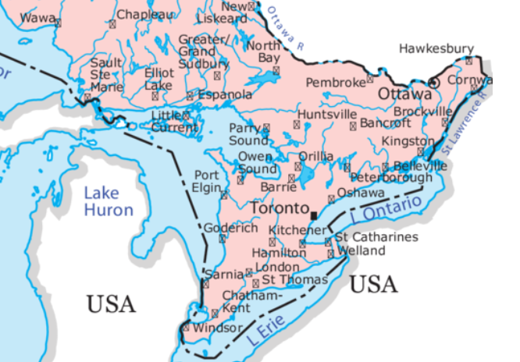
Speaker Origins

Slide 11
MacFadyen’s
Clinical Backgound
North Of Barrie
South Of Barrie

Slide 12
Speaker Origins

Slide 13
MacFadyen’s
Clinical Backgound
North Of Bancroft
South Of Bancroft

Slide 14


Slide 15



Housekeeping Items

Slide 16

Questions?

Slide 17
Objectives
Review recent Guidelines for Pharmacologic Management of Type 2 Diabetes
    Diabetes Canada
    CCS
Review Clinical Trials related to Diabetes Therapies
Integrate Guidelines into Clinical Practice
Review practical strategies to overcome common barriers to Diabetic Care

Slide 18
Obstacles for Primary Care Providers to Prescribe “Diabetic Meds”

Slide 19


Slide 20
BD
65 yo male, DM 2012
  Nov 2022 –Non-STEMI PCI to LAD
  Tests infrequently
Meds
  Tresiba x x 22
  Metformin 1 g bid
  Ramipril 10/Crestor 10 mg od/ASA/Clopidogrel/Amlodipine
Followed by Cardiology,
walks dog 1 hour daily

Slide 21
BD
O/E
  Wt 103 kg, BMI 35
  BP 134/80
  Reuse injection sites – lipohypertrophy
A1C – 11.0, Cr 92, MAU 32 ACR 3.4
LDL 0.9

Slide 22
BD
O/E
  Wt 103 kg, BMI 35
  BP 134/80
  Reuse injection sites – lipohypertrophy
A1C – 11.0, Cr 92, MAU 32 ACR 3.4
LDL 0.9
Recommendations?

Slide 23

BD’s Dog

Slide 24
BD
O/E
  Wt 103 kg, BMI 35
  BP 134/80
  Reuse injection sites – lipohypertrophy
A1C – 11.0, Cr 92, MAU 32 ACR 3.4
LDL 0.9
Recommendations?

Slide 25

MacFadyen’s Diabetes Journey

Slide 26

1993

Slide 27

Welcome to Orillia - 1998

Slide 28

UKPDS
Improving Glycemic Control Reduces Risk of Long-term Complications
21%
Deaths related to diabetes*
37%
Microvascular complications, e.g.
kidney disease and blindness*
14%
Heart attack*
43%
Amputation or fatal peripheral
blood vessel disease*
1%
12%
Stroke**
*p<0.0001
**p=0.035
UKPDS: UK Prospective Diabetes Study
Stratton IM, et al. UKPDS 35. BMJ 2000:321;405-12.
Notes:
SPEAKER NOTES:
The landmark UK Prospective Diabetes Study (UKPDS) found that each 1% reduction in updated mean glycated hemoglobin (A1C) significantly decreased the risk of deaths related to diabetes by 21%, of microvascular complications (e.g., renal disease and retinopathy) by 37%, of amputation or death from peripheral vascular disease by 43%, of myocardial infarction by 14%, and of stroke by 12%.
Reference:
Stratton IM, Adler AI, Neil HAW, et al. Association of glycaemia with macrovascular and microvascular complications of type 2 diabetes (UKPDS 35): prospective observational study. BMJ 2000:321;405-12.

Slide 29
Preventing Complications in Diabetes 2018
Diet
Exercise
Good Sugars
Good Cholesterol
Good Blood Pressure
Don’t Smoke
Get Your Eyes, Kidney’s and Feet Checked

Slide 30
Any diabetes related endpoint
overweight
patients
M v C
p=0.0023
M v I
p=0.0034

Slide 31

Diabetes Trials 1998-2015

Slide 32


Slide 33
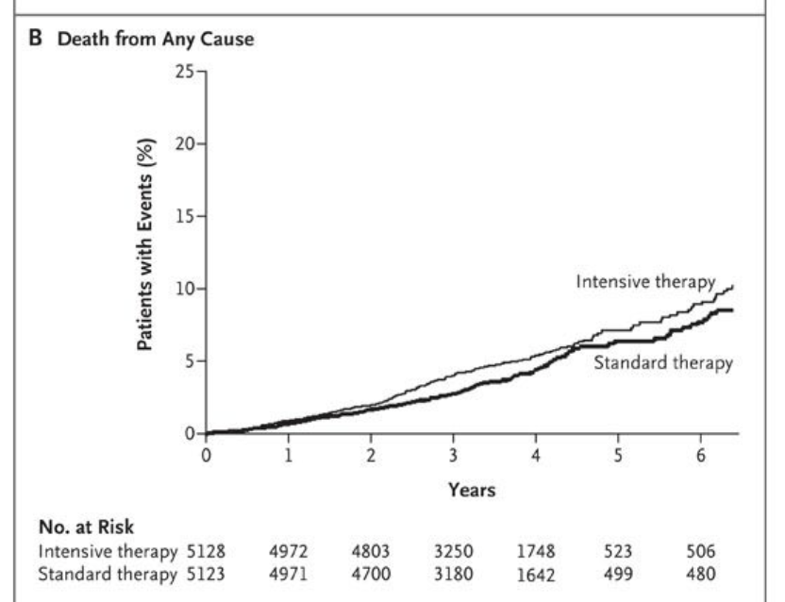
Accord Trial – 2008
Intensive A1C Lowering

Slide 34
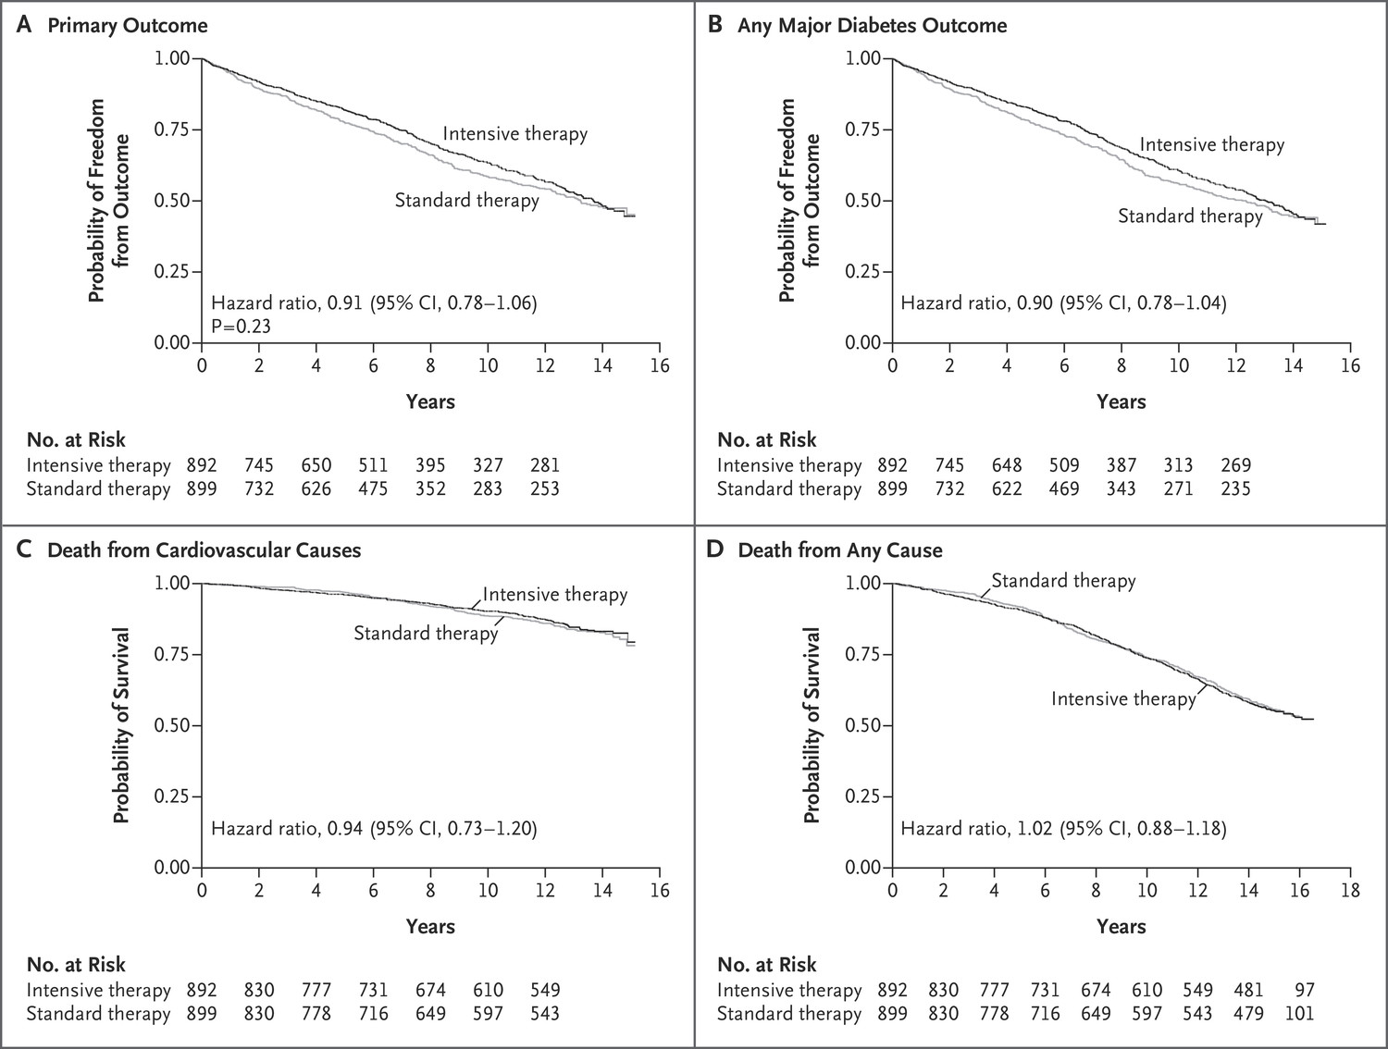

PD Reaven et al. N Engl J Med 2019;380:2215-2224.
VADT - 2009/2019Trial and Follow-up Period.
Notes:
Figure 2. Kaplan–Meier Curves for the Primary and Secondary Outcomes during the Trial and Follow-up Period. The primary outcome was a major cardiovascular event (a composite of myocardial infarction, stroke, new or worsening congestive heart failure, amputation for ischemic gangrene, or death from cardiovascular causes). Secondary outcomes were any major diabetes event (primary composite outcome plus nontraumatic amputation or end-stage renal disease, defined as an estimated glomerular filtration rate [GFR] of <15 during the original trial period or as an estimated GFR of <15 or dialysis or kidney transplantation during the follow-up study), death from cardiovascular causes, and death from any cause.

Slide 35
TECOS: Sitagliptin was non-inferior to placebo on primary 4P-MACE endpoint
Next
Sitagliptin
15
Placebo
100
80
10
60
5
HR (95% CI): 0.98 (0.88–1.09)
p < 0.001
Patients with an event (%)
40
0
0
4
8
12
18
24
30
36
42
48
20
0
0
4
8
12
18
24
30
36
42
48
Patients at risk:
Months in the trial
Sitagliptin | 7257 | 6857 | 6519 | 6275 | 5931 | 5616 | 3919 | 2896 | 1748 | 1028
Placebo | 7266 | 6846 | 6449 | 6165 | 5803 | 5421 | 3780 | 2743 | 1690 | 1005
*CV death, non-fatal MI, non-fatal stroke, hospitalisation for unstable angina.
Green et al. N Engl J Med 2015; DOI: 10.1056/NEJMoa1501352.
Back
Notes:
Notes
Sitagliptin was non-inferior to placebo on the primary outcome: CV death, non-fatal MI, non-fatal stroke, hospitalisation for unstable angina (per protocol analysis for non-inferiority).
Overall in the intention-to-treat population, the primary composite cardiovascular outcome occurred in 839 patients in the sitagliptin group (11.4%, 4.06 per 100 person-years) and 851 in the placebo group (11.6%, 4.17 per 100 person-years). There was no significant between-group difference in the primary composite cardiovascular outcome (hazard ratio in the per-protocol analysis, 0.98; 95% CI: 0.88–1.09; p < 0.001 for non-inferiority; hazard ratio in the intention-to treat analysis, 0.98; 95% CI: 0.89–1.08; p = 0.65 for superiority).
At 4 months, mean HbA_{1c} values were 0.4 percentage points lower in the sitagliptin group than in the placebo group. This difference narrowed during the study period, with an overall least-squares mean difference of
-0.29% in the sitagliptin group (95% CI: -0.32– -0.27), p < 0.0001.
Abbreviations
CI, confidence interval; CV, cardiovascular; HbA_{1C}, glycosylated haemoglobin; HR, hazard ratio; 4P-MACE, 4-point major adverse cardiovascular events
(CV death, non-fatal myocardial infarction, non-fatal stroke or unstable angina requiring hospitalisation); MI, myocardial infarction; TECOS, Trial Evaluating Cardiovascular Outcomes with Sitagliptin.
https://www.dtu.ox.ac.uk/generic/slides.php?Section=13.
Copyright
Green et al. N Engl J Med 2015; DOI: 10.1056/NEJMoa1501352. Figure 3A

Slide 36

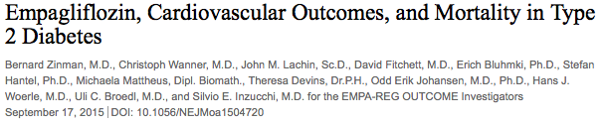

Slide 37


Slide 38
EMPA-REG OUTCOME
Primary Outcome: CV Death, Non-fatal MI or Non-fatal Stroke
EMPA-REG OUTCOME included adult patients (>18 years) with type 2 diabetes and established CVD who were receiving standard of care therapy for diabetes
Empagliflozin (pooled)
HR 0.86
(95.02% CI 0.74, 0.99)
p=0.04* for superiority
p<0.001 for noninferiority
Placebo
Empagliflozin
Patients with event (%)
Empagliflozin 10 mg
HR 0.85 (95% CI 0.72, 1.01), p=0.07
Empagliflozin 25 mg
HR 0.86 (95% CI 0.73, 1.02), p=0.09
Months
No. of patients
Empagliflozin
Placebo
4687
2333
4580
2256
4455
2194
4328
2112
3851
1875
2821
1380
2359
1161
1534
741
370
166
Cumulative incidence function. MACE: major adverse cardiovascular event; HR: hazard ratio; MI: myocardial infarction; SGLT2: sodium glucose cotransporter 2
*Two-sided tests for superiority were conducted (statistical significance was indicated if p≤0.0498)
Note: Empagliflozin is an SGLT2 inhibitor. Data from: Zinman B, et al. N Engl J Med. 2015; 373:2117-2128.

Slide 39
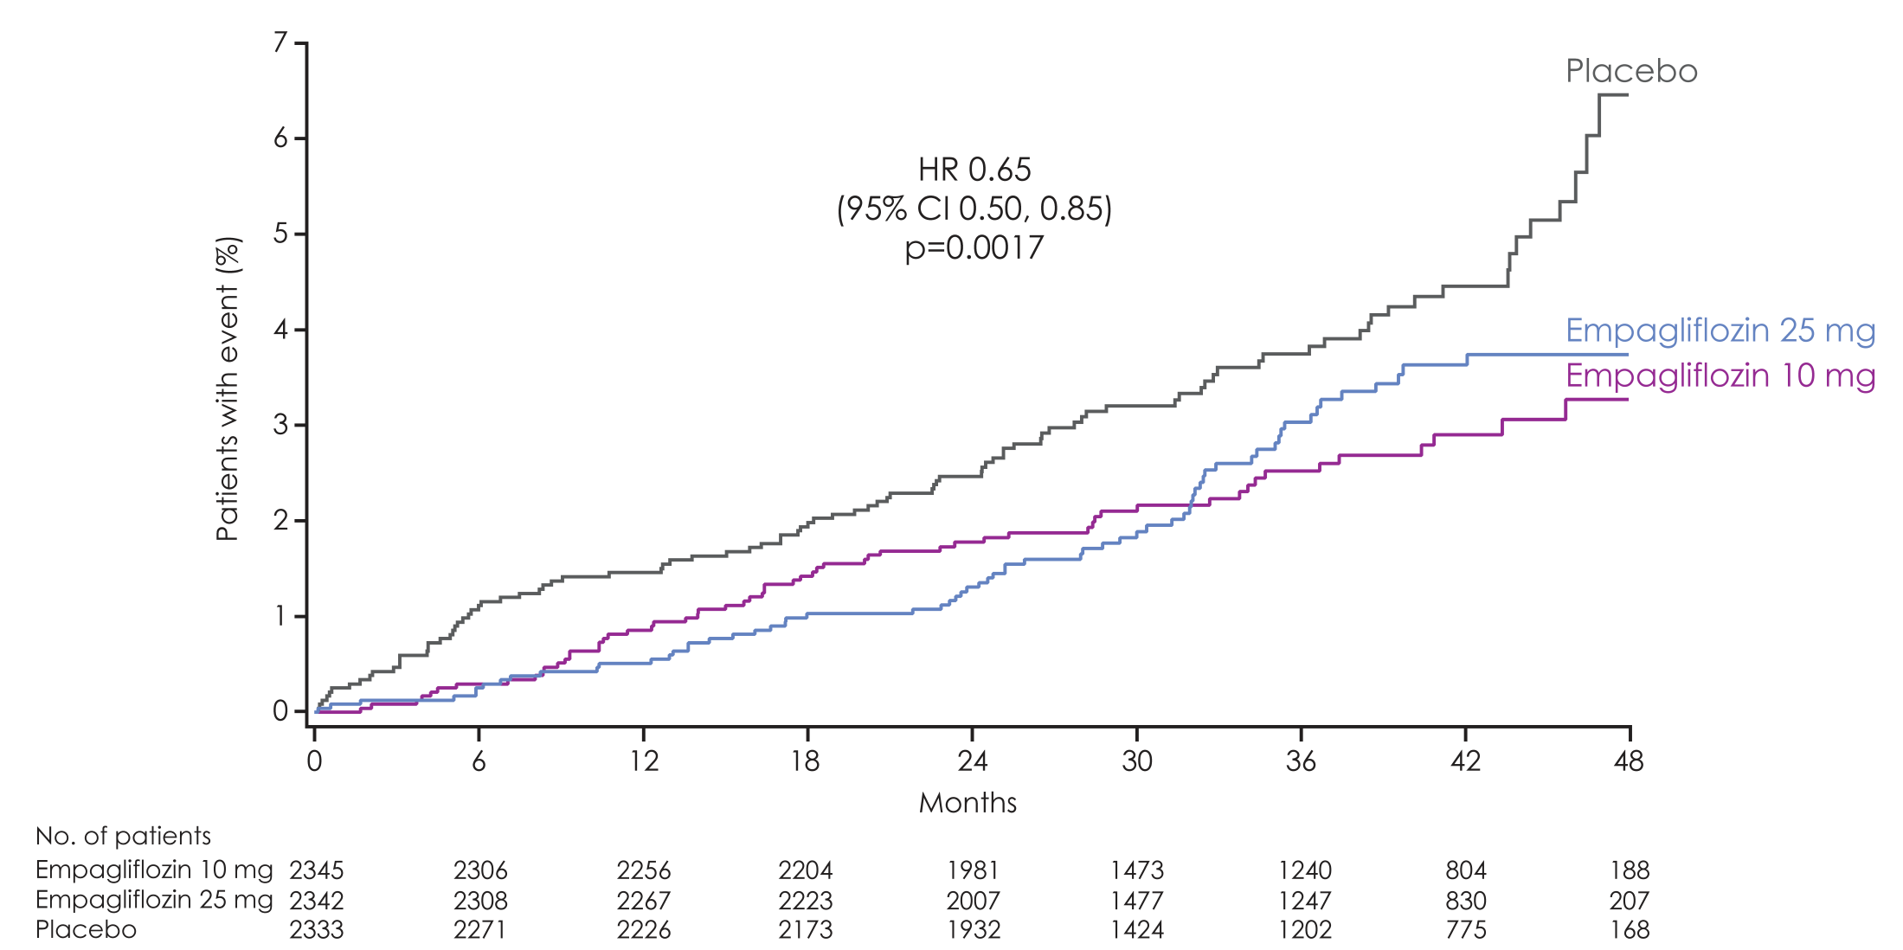
Hospitalisation for heart failure
Empagliflozin 10 mg
HR 0.62
(95% CI 0.45, 0.86)
p=0.0044
Empagliflozin 25 mg
HR 0.68
(95% CI 0.50, 0.93)
p=0.0166

Slide 40
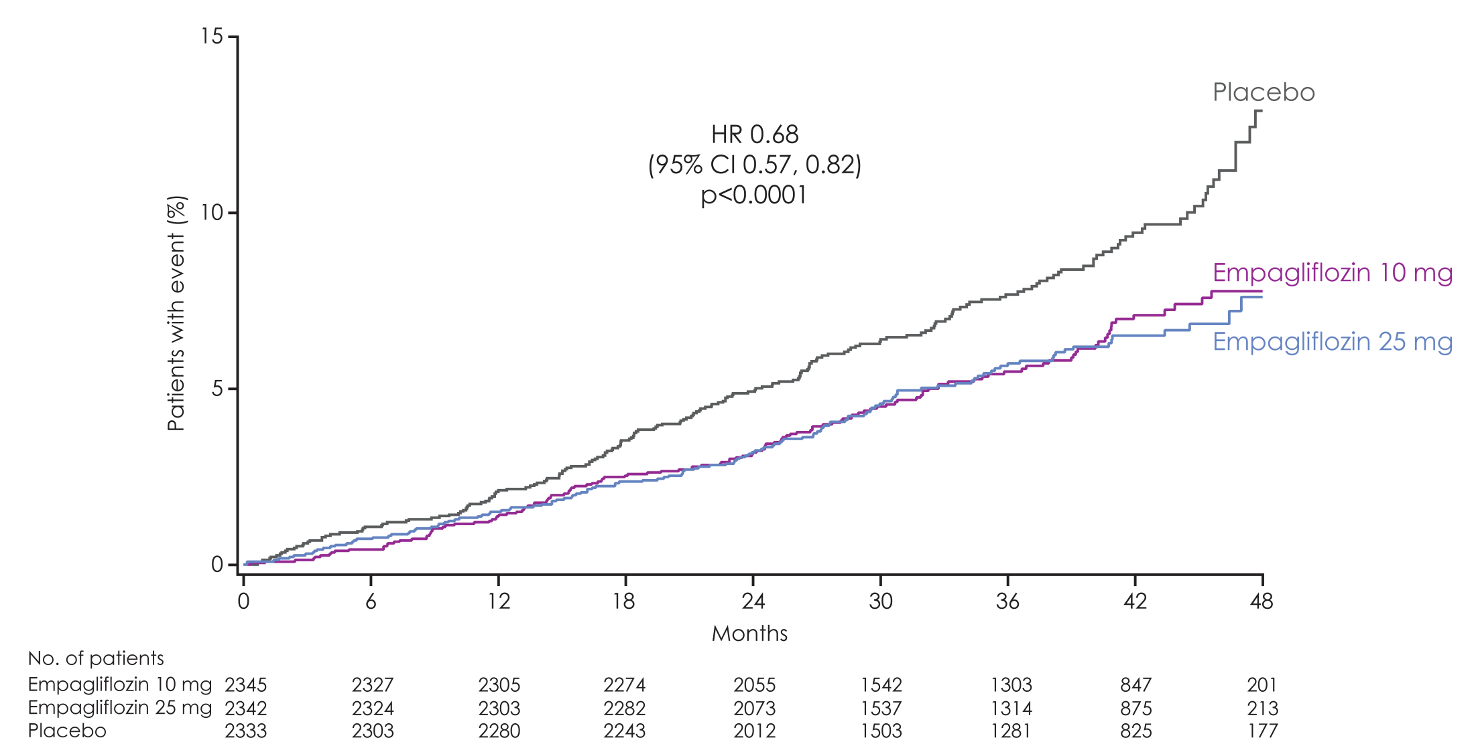
All-cause mortality NNT 38
Empagliflozin 10 mg
HR 0.70
(95% CI 0.56, 0.87)
p=0.0013
Empagliflozin 25 mg
HR 0.67
(95% CI 0.54, 0.83)
p=0.0003
HR 0.68
(95% CI 0.57, 0.82)
p<0.0001

Slide 41
Number needed to treat (NNT) to prevent one death across landmark trials in patients with high CV risk
  Simvastatin¹
  for 5.4 years
Ramipril²
for 5 years
  Empagliflozin
  for 3 years
30
56
39
High CV risk
5% diabetes, 26% hypertension
High CV risk
38% diabetes, 46% hypertension
T2DM with high CV risk
92% hypertension
Pre-ACEi/ARB era
<29% statin
>80% ACEi/ARB
>75% statin
Pre-statin era
1994
2000
2015
Notes:
All cause death
Simva: 182 / 2221 (8,2%), placebo :256 / 2223 (11,5%) HR= 0,71[0,59;0,85]
pooled empa : 269 (5.7%)/2333, placebo : 194 (8.3%)/4687 HR= 0.68 (0.57,0.82)
Ramipril: 482 / 4645 (10,4%), placebo : 569 / 4652 (12,2%) HR=0,85[0,76;0,95]

Slide 42
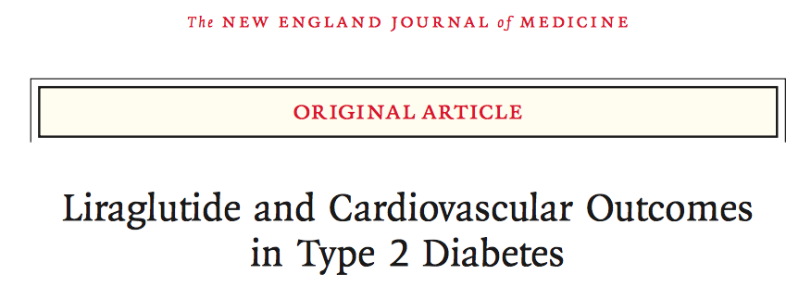

Slide 43
LEADER: Primary Endpoint (CV Death, Non-fatal Myocardial Infarction, Non-fatal Stroke)
HR: 0.87
(95% CI, 0.78, 0.97)
P < 0.001 for non-inferiority
P = 0.01 for superiority
Placebo
Liraglutide
Patient with an event (%)
No. at risk
Time from randomization (months)
Liraglutide | 4,668 | 4,593 | 4,496 | 4,400 | 4,280 | 4,172 | 4,072 | 3,982 | 1,562 | 424
Placebo | 4,672 | 4,588 | 4,473 | 4,352 | 4,237 | 4,123 | 4,010 | 3,914 | 1,543 | 407
The primary composite outcome in the time-to-event analysis was the first occurrence of death from cardiovascular causes, non-fatal myocardial infarction, or non-fatal stroke. The cumulative incidences were estimated with the use of the Kaplan–Meier method, and the hazard ratios with the use of the Cox proportional-hazard regression model. The data analyses are truncated at 54 months, because less than 10% of the patients had an observation time beyond 54 months. CI: confidence interval; CV: cardiovascular; HR: hazard ratio.
Marso S, et al. N Engl J Med 2016; 375(4):311-22.
Notes:
In this study, a total of 9,340 patients with type 2 diabetes and high cardiovascular risk were randomized to liraglutide or placebo, with a median follow-up of 3.84 years. The primary composite outcome was the first occurrence of death from cardiovascular causes, nonfatal myocardial infarction, or nonfatal stroke. This outcome occurred in significantly fewer patients in the liraglutide group (13.0%) than in the placebo group (14.9%: hazard ratio, 0.87; 95% confidence interval [CI], 0.78 to 0.97; p<0.001 for noninferiority; p=0.01 for superiority).
Reference:
Marso SP, Daniels GH, Brown-Frandsen K, et al. Liraglutide and Cardiovascular Outcomes in Type 2 Diabetes. N Engl J Med 2016; 375(4):311-22.

Slide 44
LEADER:
CV Death, MI and Stroke
Patients with event/analysed |  |  |  |  | Hazard ratio (HR) (95% CI)
 | Liraglutide | Placebo | HR | (95% CI) |  | p-value
3-point MACE | 608/4668 | 694/4672 | 0.87 | (0.78–0.97) |  | 0.01
CV death | 219/4668 | 278/4672 | 0.78 | (0.66–0.93) |  | 0.007
Non-fatal MI | 281/4668 | 317/4672 | 0.88 | (0.75–1.03) |  | 0.11
Non-fatal stroke | 159/4668 | 177/4672 | 0.89 | (0.72–1.11) |  | 0.30
0.50
1.00
1.50
Favours Liraglutide
Favours Placebo
Note: Liraglutide is a GLP-1RA; it is not currently indicated for cardiovascular protection in Canada
CV: cardiovascular; MACE: major adverse cardiovascular event; MI: myocardial infarction; GLP-1RA: glucagon-like peptide-1 receptor agonist
Data from: Marso S, et al. N Engl J Med. 2016;375:311-322.

Slide 45
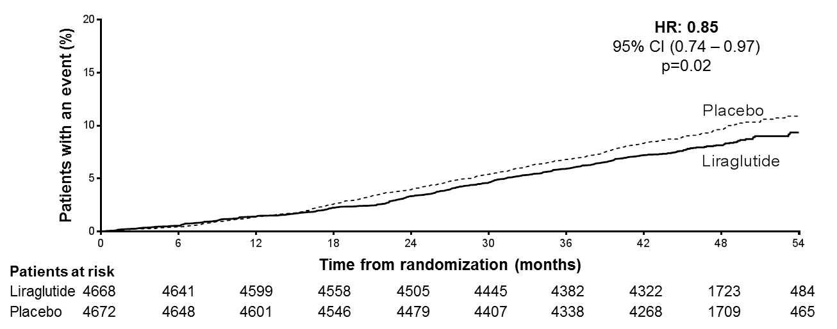
All-cause death
The cumulative incidences were estimated with the use of the Kaplan–Meier method, and the hazard ratios with the use of the Cox proportional-hazard regression model. The data analyses are truncated at 54 months, because less than 10% of the patients had an observation time beyond 54 months. CI: confidence interval; HR: hazard ratio.
Presented at the American Diabetes Association 76th Scientific Sessions, Session 3-CT-SY24. June 13 2016, New Orleans, LA, USA.
Notes:
Reference: Primary manuscript
Source: KM plot: EOT Figure 14.2.86/ID14201920_e_km_all_cause_death_fas.cgm
HR: EOT table 14.2.84/ID14201900_all_cause_death_fas.txt

Slide 46
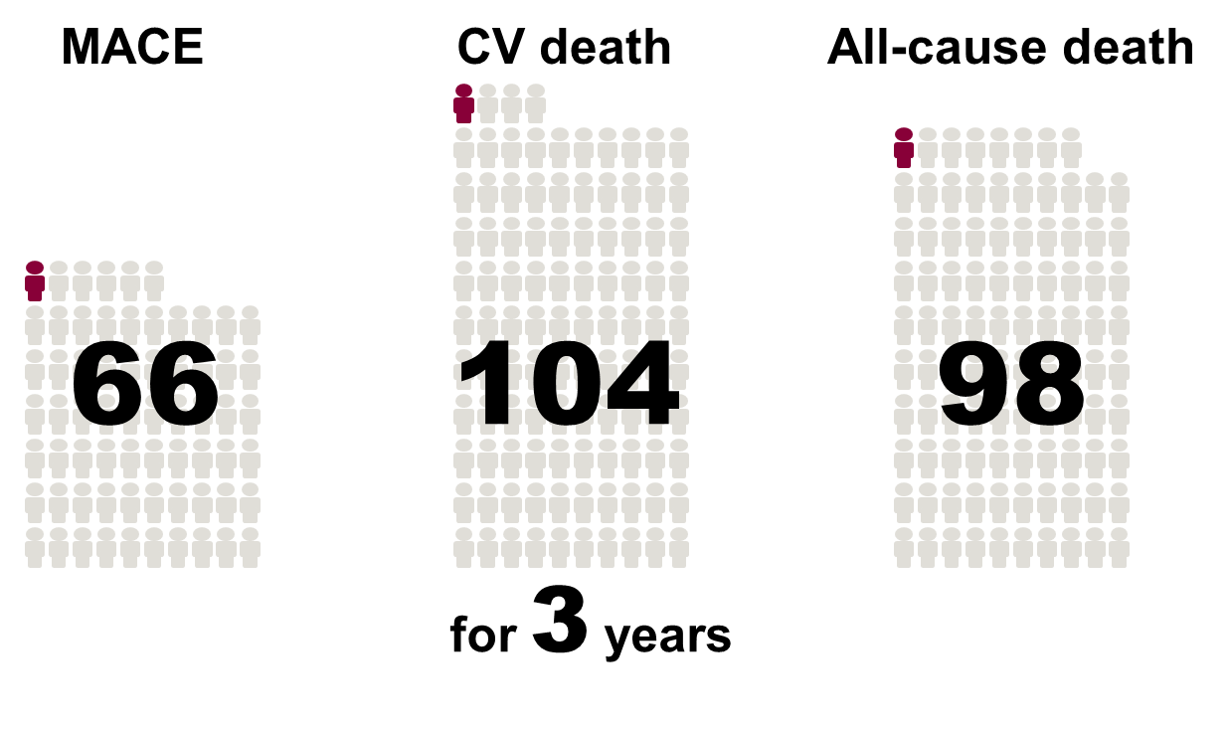
Number needed to treat to prevent one…
CV: cardiovascular; MACE: major adverse cardiovascular event.
Presented at the American Diabetes Association 76th Scientific Sessions, Session 3-CT-SY24. June 13 2016, New Orleans, LA, USA.

Slide 47
SUSTAIN-6: Primary Endpoint (CV Death, Non-fatal Myocardial infarction, Non-fatal Stroke)
HR: 0.74
(95% CI, 0.58, 0.95)
Events: 108 semaglutide; 146 placebo
P < 0.001 for non-inferiority
P = 0.02 for superiority*
Placebo, 8.9%
Semaglutide
(pooled), 6.6%
109
No. at risk
Semaglutide | 1,648 | 1,619 | 1,601 | 1,584 | 1,568 | 1,543 | 1,524 | 1,513
Placebo | 1,649 | 1,616 | 1,586 | 1,567 | 1,534 | 1,508 | 1,479 | 1,466
* SUSTAIN-6 was not designed with prespecified testing for superiority. However, the treatment effect of semaglutude and the accrual
of more events than estimated resulted in a significantly lower risk of the primary outcome among patients in the semaglutide group.
CI, confidence interval; CV, cardiovascular; HR, hazard ratio
Marso S et al. Semaglutide and Cardiovascular Outcomes in Patients with Type 2 Diabetes N Engl J Med September 2016 doi: 10.1056/NEJMoa1607141
Notes:
This study involved 3,297 patients with type 2 diabetes who were on a standard-care regimen. They were randomized to receive once-weekly semaglutide (0.5 mg or 1.0 mg) or placebo for 104 weeks. The primary composite outcome was the first occurrence of cardiovascular death, nonfatal myocardial infarction, or nonfatal stroke. This outcome occurred in 108 of 1648 patients (6.6%) in the pooled semaglutide groups and in 146 of 1649 patients (8.9%) in the placebo group (hazard ratio, 0.74; 95% confidence interval [CI], 0.58 to 0.95; p<0.001 for noninferiority, p=0.02 for superiority).
Reference:
Marso SP, Bain SC, Consoli A, et al. Semaglutide and Cardiovascular Outcomes in Patients with Type 2 Diabetes. N Engl J Med 2016; 375(19):1834-44.

Slide 48
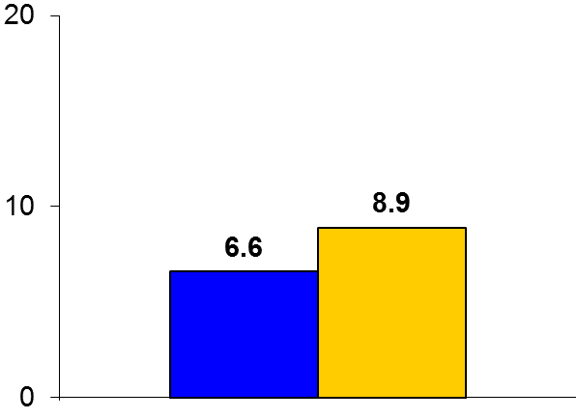

SUSTAIN-6
Trial design: Patients with DM2 at high risk for CV events were randomized in a 1:1:1:1 fashion to either semaglutide 0.5 mg, semaglutide 1 mg, or matching placebo. They were followed for a median of 2.1 years.
Results
p_{noninferiority} < 0.001 p_{superiority} = 0.02
Primary outcome, CV death/MI/stroke: semaglutide vs. placebo: 6.6% vs. 8.9%, HR 0.74, 95% CI 0.58-0.95, p < 0.001 for noninferiority; p = 0.02 for superiority
CV death: 2.7% vs. 2.8%, p = 0.92; all MI: 2.9% vs. 3.9%, p = 0.12; all stroke: 1.6% vs. 2.7%, p = 0.04
HbA1c at week 104: 7.6% vs. 7.3% vs. 8.3%
%
Conclusions
Injectable once a week semaglutide (GLP-1 agonist) was superior to placebo in improving glycemic control and ↓ CV events in high-risk patients with diabetes
There is also a significant reduction in stroke and new or worsening nephropathy with semaglutide, perhaps related to a concomitant reduction in BP, and also a reduction in body weight
Primary outcome
Semaglutide
(n = 1,648)
Placebo
(n = 1,649)
Marso SP, et al. N Engl J Med 2016;375:1834-44

Slide 49
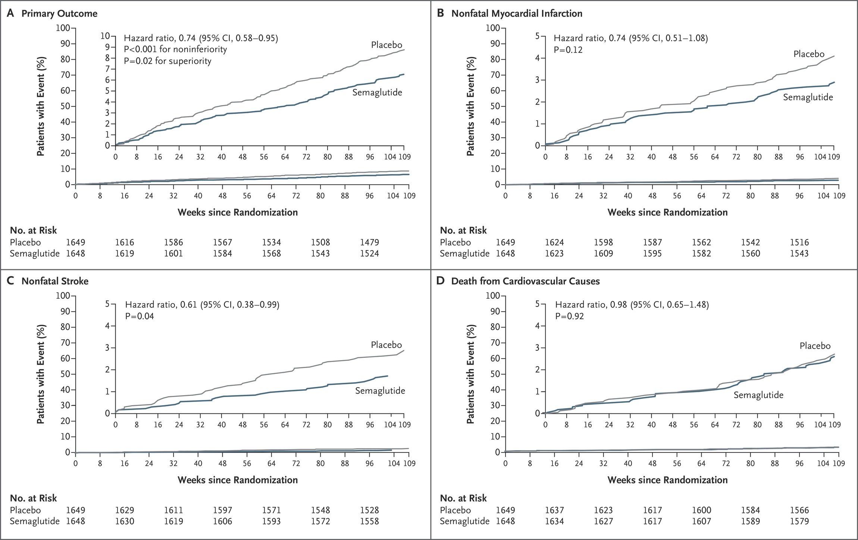

Cardiovascular Outcomes.
Marso SP et al. N Engl J Med 2016;375:1834-1844
Notes:
Figure 1 Cardiovascular Outcomes. Shown are Kaplan–Meier plots of the primary outcome (a composite of cardiovascular death, nonfatal myocardial infarction, or nonfatal stroke) (Panel A), nonfatal myocardial infarction (Panel B), nonfatal stroke (Panel C), and death from cardiovascular causes (Panel D). The trial included a planned observation period of 109 weeks for all patients (a 104-week treatment period with a 5-week follow-up period). In Panel C, there were no events in the semaglutide group after week 104. Insets show the same data on an expanded y axis.

Slide 50
Semaglutide: New or Worsening Nephropathy*
(SUSTAIN-6)
100
8
HR: 0.64
(95% CI, 0.46-0.88)
Events: 62 Semaglutide; 100 Placebo
P=0.005
Placebo
90
36%
6
80
70
4
60
Semaglutide
Patients with an event (%)
2
50
40
0
30
0
8
16
24
32
40
48
56
64
72
80
88
96
104
109
20
10
0
0
8
16
24
32
40
48
56
64
72
80
88
96
104
109
Weeks since randomization
No. at Risk
Semaglutide | 1,648 | 1,630 | 1,605 | 1,580 | 1,563 | 1,541 | 1,525
Placebo | 1,649 | 1,629 | 1,570 | 1,545 | 1,518 | 1,498 | 1,471
*New onset of persistent macroalbuminuria, or persistent doubling of serum creatinine level and creatinine clearance per MDRD <45 mL/min/1.73 m2, or the need
for continuous renal replacement therapy (in the absence of an acute reversible cause) or death due to renal disease.
Supplemental appendix to: Marso S, et al. N Engl J Med 2016; 375(19):1834-44
Notes:
In this study, 3,297 patients with type 2 diabetes on a standard-care regimen were randomized to receive once-weekly semaglutide (0.5 mg or 1.0 mg) or placebo for 104 weeks. This study was primarily a cardiovascular outcome study, but one of the prespecified secondary endpoints was the rate of new or worsening nephropathy, defined as new onset of persistent macroalbuminuria, or persistent doubling of serum creatinine level and creatinine clearance per MDRD <45 mL/min/1.73 m² or the need for continuous renal replacement therapy (in the absence of an acute reversible cause) or death due to renal disease.
For this endpoint, semaglutide was associated with a 36% risk reduction (hazard ratio 0.64, 95% CI 0.46 to 0.88, p=0.005).
It should be noted, however, that not all microvascular risk was lowered with semaglutide in this study. In fact, rates of retinopathy complications (vitreous hemorrhage, blindness, or conditions requiring treatment with an intravitreal agent or photocoagulation) were significantly higher with semaglutide compared to placebo (hazard ratio, 1.76; 95% CI, 1.11 to 2.78; p=0.02).
Reference:
Marso SP, Bain SC, Consoli A, et al. Semaglutide and Cardiovascular Outcomes in Patients with Type 2 Diabetes. N Engl J Med 2016; 375(19):1834-44 (including supplemental appendix).

Slide 51
GLP-1 RA CVOT results to date
Neutral for MACE
Significant secondary outcomes
 |  |  | Hazard ratio (95% CI) | P
Lixisenatide (ELIXA, 4P) |  |  | 1.02 (0.89–1.17) | 0.81
Liraglutide (LEADER, 3P) |  |  | 0.87 (0.78–0.97) | 0.01
Semaglutide (SUSTAIN 6, 3P) |  |  | 0.74 (0.58–0.95) | 0.02
Exenatide QW (EXSCEL, 3P) |  |  | 0.91 (0.83–1.00) | 0.06
Albiglutide QW* (HARMONY, 3P) |  |  | 0.78 (0.68–0.90) | 0.0006
Dulaglutide QW (REWIND, 3P) |  | Demonstrated reduction in MACE
Superior for MACE
  LEADER
   CV death
  (HR=0.78 [0.66–0.93])
   All-cause death
  (HR=0.85 [0.74–0.97])
   Nephropathy
  (HR=0.78 [0.67–0.92)
   Acute gallstone disease
  SUSTAIN 6
   Non-fatal stroke
  (HR=0.61 [0.38–0.99])
   Nephropathy
  (HR=0.64 [0.46–0.88])
   Diabetic retinopathy
  (HR=1.76 [1.11–2.78])
i
  REWIND
  Demonstrated reduction
  in MACE. Not yet published
  (detailed results not provided in press release).
Favours
Treatment
Favours
Placebo
Notes:
Percentage of patients with established CVD:
ELIXA: 100%
LEADER: 81.3%
SUSTAIN 6: 83.0%
EXSCEL: 73%
HARMONY: 100%
REWIND: 31%

Slide 52
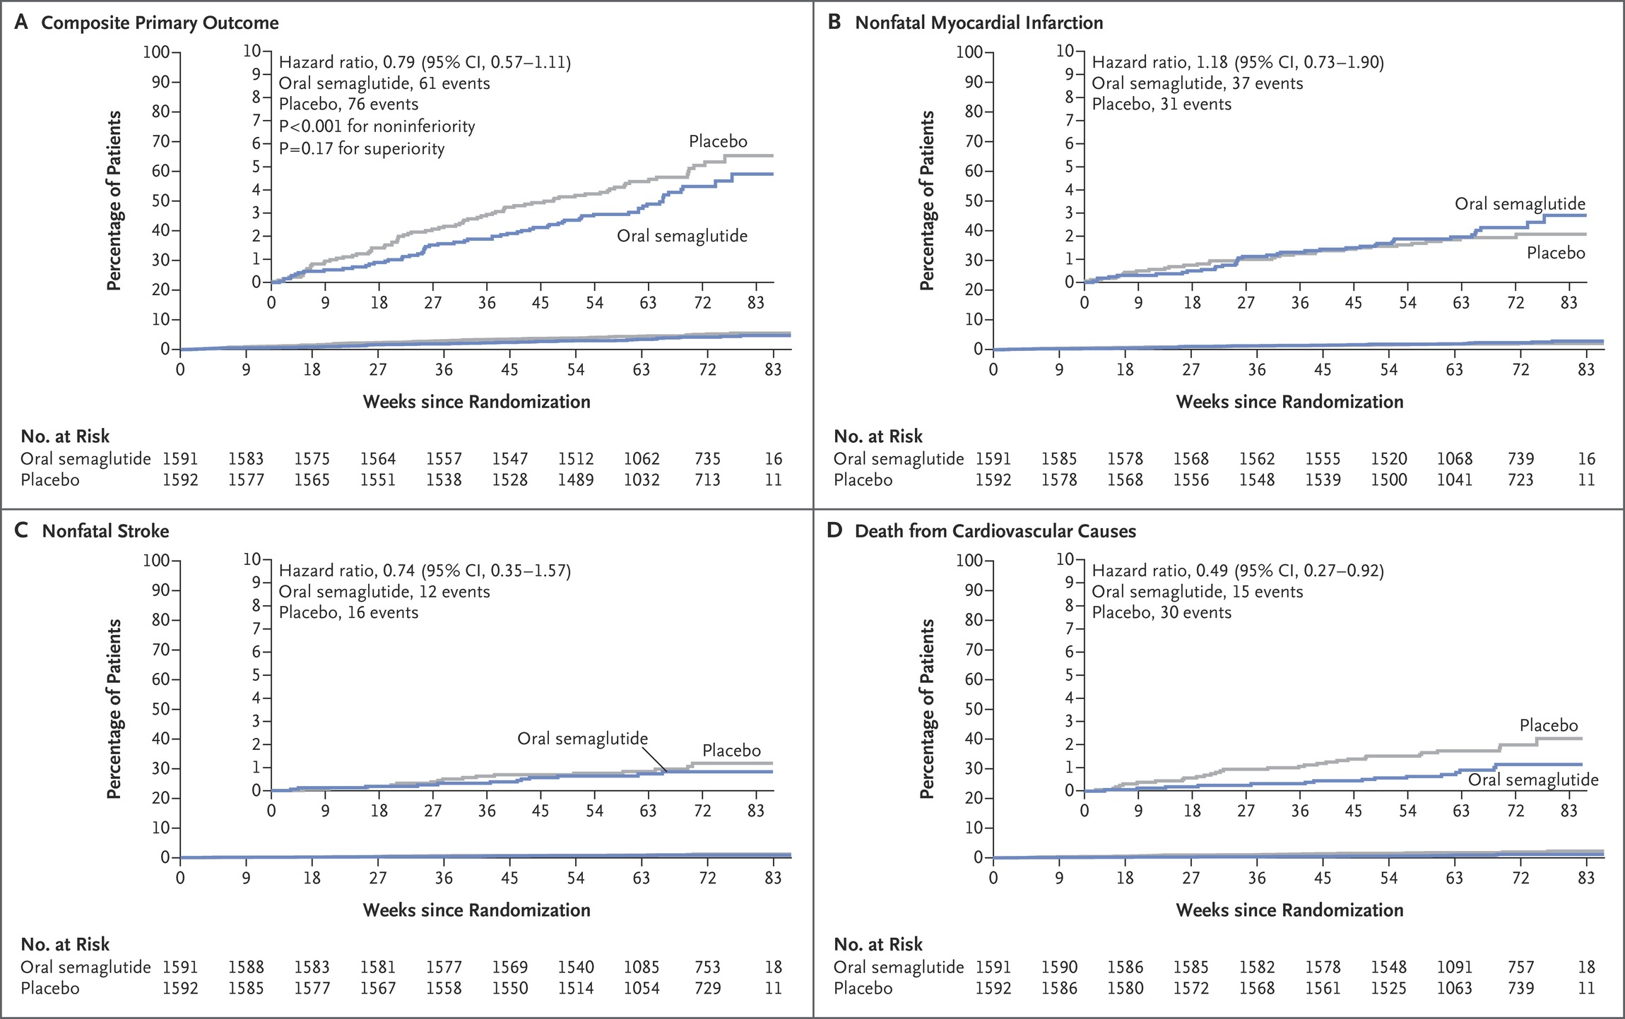
Pioneer 6
CardiovaSuPionPioneereerscular Outcomes.
Husain M et al. N Engl J Med 2019;381:841-851
Notes:
Figure 1 Cardiovascular Outcomes. Shown are cumulative-incidence plots for the primary outcome (first major adverse cardiovascular events, representing a composite of death from cardiovascular causes, nonfatal myocardial infarction, or nonfatal stroke) (Panel A), nonfatal myocardial infarction (Panel B), nonfatal stroke (Panel C), and death from cardiovascular causes (Panel D). Cumulative-incidence estimates are based on time from randomization to first event confirmed by the event-adjudication committee, with death from noncardiovascular causes (Panels A and D) or death from any cause modeled as competing risks. Data for patients were censored at the end of the in-trial observation period (from randomization to the final follow-up visit). Deaths from cardiovascular causes included deaths for which the cause was undetermined. The analysis for confirmation of noninferiority was controlled for multiple comparisons; P values and confidence intervals for other analyses have not been adjusted for multiple comparisons. The insets show the same data on an expanded y axis. CI denotes confidence interval.

Slide 53
Renal Endpoints from CVOTs: SGLT2 inhibitors have consistently shown a reduction in the risk of renal composite endpoints in T2D patients
8
EMPA-REG OUTCOME^{1,a}
CANVAS program^{2,b}
7
10
HR: 00.60 (95% CI: 0.47, 0.77)
Placebo
HR: 0.54 (95% CI, 0.40, 0.75)
9
6
8
5
7
6
4
Patients with
an event (%)
Cumulative probability
of event (%)
Placebo
5
3
4
2
3
1
Empagliflozin
2
Canagliflozin
0
1
0
6
12
18
24
30
36
42
48
0
0
26
52
78
104
130
156
182
208
234
260
286
312
338
Month
Weeks since randomization
DECLARE-TIMI 58 trial^{3,c}
HR: 0.53 (95% CI: 0.43, 0.66)
Cumulative
probability of event
Placebo (2.8%)
Dapagliflozin 10 mg (1.5%)
Time since randomization (years)
ªRenal composite outcome was defined as doubling of SCr accompanied by eGFR ≤45 mL/min/1.73 m², RRT, or renal death; ^{b}Renal composite outcome was defined as: 40% reduction in eGFR, RRT, or death from renal causes; ^{c}Renal composite outcome was defined as: eGFR decrease ≥40% to <60 mL/min/1.73 m², ESRD or renal death;
CVOT, cardiovascular outcome trial; CI, confidence interval; ESKD, end-stage kidney disease; ESRD, end-stage renal disease; HR, hazard ratio; RRT, renal-replacement therapy; SGLT2, sodium–glucose co-transporter 2
1. Wanner C, et al. N Engl J Med 2016;375:323–334; 2. Neal B, et al. N Engl J Med 2017;377:644–657; 3. Mosenzon O, et al. Lancet Diabetes Endocrinol 2019;7:606–617;
Notes:
Wanner C, et al. N Engl J Med 2016;375:323–334;
Neal B, et al. N Engl J Med 2017;377:644–657;
Mosenzon O, et al. Lancet Diabetes Endocrinol 2019;7:606–617;

Slide 54



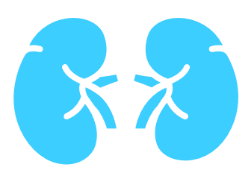
Risk Reduction with SGLT2is (with ASCVD)
MACE
CKD
progression
CV
death
11%
reduction
36%
reduction
17%
reduction*
*In the EMPA-REG OUTCOME trial, CV death in patients with ASCVD was reduced by 38%.
CV, cardiovascular; MACE, major adverse cardiovascular events; CKD, chronic kidney disease; SGLT2i, SGLT2 inhibitor.
McGuire DK, et al. JAMA Cardiol. 2021 Feb 1;6(2):148–58.
Notes:
Based on a meta-analysis of patients with ASCVD from these clinical trials, adding an SGLT2 inhibitor to James’s current treatments could reduce his risk of [CLICK] major adverse cardiovascular events by 11%, [CLICK] his risk of kidney disease progression by more than a third, and [CLICK] his risk of CV death by 17%. In one trial that included only patients with established CVD like James (EMPA-REG OUTCOME trial), the risk of CV death reduced by 38%.
__________________________
NOTE:
Rates for MACE, CKD progression and CV death are based on the McGuire et al. (2021) meta-analysis for cardiovascular outcome trials with SGLT2 inhibitors.

Slide 55


Risk Reduction with GLP-1 RAs (with ASCVD)
MACE
Non-fatal stroke
Non-fatal MI
14%
reduction¹
32-44%
reduction^{2,3*}
9-17%
reduction^{2,3*}
*Values represent patients with established CVD and with no prior MI/stroke.
ASCVD. atherosclerotic cardiovascular disease; CV, cardiovascular; CVD, CV disease; MACE, major adverse cardiovascular events; MI, myocardial infarction.
1. Kristensen SL, et al. Lancet Diab & Endo. 2019;7(10):776–85; 2. Verma S, et al. Circulation. 2018;138(25):2884–94; 3. Leiter LA, et al. Cardiovascular Diabetology. 2019;18(1):73.
Notes:
According to subgroup analyses of the patients with ASCVD in these clinical trials, adding a GLP-1 receptor agonist could also reduce James’ risk of [CLICK] non-fatal stroke by more than a third, and [CLICK] non-fatal MI by up to 17%.
__________________________
NOTE:
Rate for MACE is based on the Kristensen et al. (2019) meta-analysis for cardiovascular outcome trials with GLP1 receptor agonists for patients with ASCVD.¹
Rate for non-fatal stroke are based on the following subgroup analyses:
A post-hoc analysis of LEADER (liraglutide) showing the rate of events in patients with established CVD and with no prior MI/stroke: HR 0.68 (95% CI: 0.45-1.03). In patients with prior MI/stroke, the HR is 0.95 (95% CI 0.71-1.27).²
A post-hoc analysis of SUSTAIN-6 (subcutaneous semaglutide) showing the rate of events in patients with established CVD and with no prior MI/stroke: HR 0.56 (95% CI: 0.27-1.18). In patients with prior MI/stroke, the HR is 0.66 (0.35-1.23).³
Rate for non-fatal MI are based on the following subgroup analyses:
A post-hoc analysis of LEADER (liraglutide) showing the rate of events in patients with established CVD and with no prior MI/stroke: HR 0.91 (95% CI: 0.68-1.22). In patients with prior MI/stroke, the HR is 0.83 (95% CI 0.67-1.03).²
A post-hoc analysis of SUSTAIN-6 (subcutaneous semaglutide) showing the rate of events in patients with established CVD and with no prior MI/stroke: HR 0.83 (95% CI: 0.43-1.58). In patients with prior MI/stroke, the HR is 0.70 (0.44-1.11).³
References:
Kristensen SL, et al. Lancet Diab & Endo. 2019;7(10):776–85;
Verma S, et al. Circulation. 2018;138(25):2884–94;
Leiter LA, et al. Cardiovascular Diabetology. 2019;18(1):73.

Slide 56
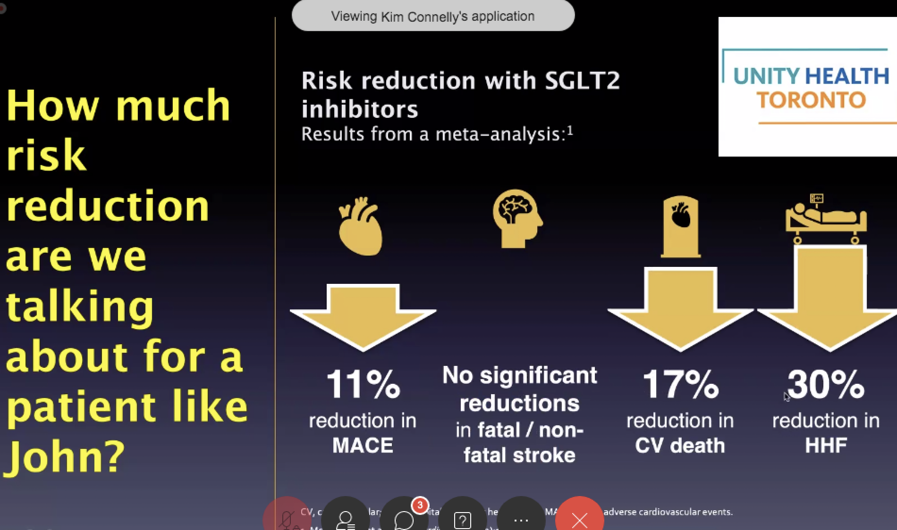

Slide 57
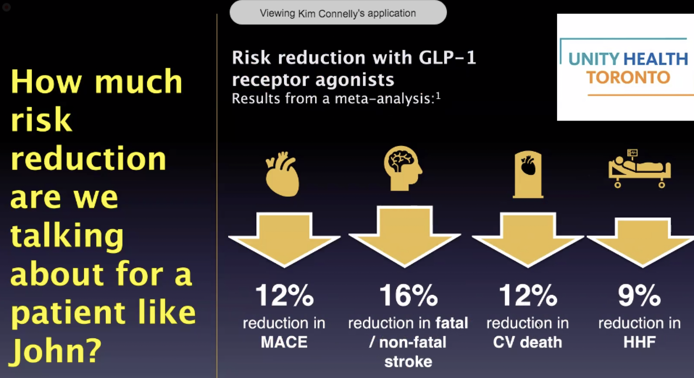

Slide 58

At diagnosis of type 2 diabetes:
Diabetes Canada Clinical Practice Guidelines Expert Committee. Can J Diabet 2020;44:575-591.
Notes:
There is no need to review this slide in detail. The purpose is simply to illustrate that the Diabetes Canada guidelines [CLICK] reaffirm metformin as first-line therapy for patients without symptomatic hyperglycemia or metabolic decompensation.

Slide 59
Reviewing, adjusting or advancing therapy in type 2 diabetes:
Diabetes Canada Clinical Practice Guidelines Expert Committee. Pharmacologic glycemic management of type 2 diabetes in adults: 2020 update. Can J Diabet 2020;44:575-591.
Notes:
When it comes to reviewing, adjusting or advancing therapy, the guidelines offer [CLICK] specific instructions for patients with established cardiovascular or renal disease, or with cardiovascular risk factors.
[CLICK] We’re going to focus on the CV risk factor column, [CLICK] because that’s the one that applies to our patient, Susan.

Slide 60
Reviewing, adjusting or advancing therapy in type 2 diabetes:
T2D, type 2 diabetes.
Diabetes Canada Clinical Practice Guidelines Expert Committee. Pharmacologic glycemic management of type 2 diabetes in adults: 2020 update. Can J Diabet 2020;44:575-591.
Notes:
For patients like James, treatment with a GLP-1 receptor agonist or an SGLT2 inhibitor is recommended. [CLICK] Both have been proven to reduce the risk of major adverse cardiovascular events, and SGLT2 inhibitors have been proven to reduce the risk of hospitalization for heart failure and to delay the progression of renal disease.

Slide 61
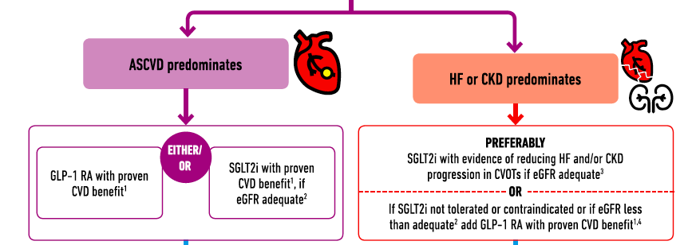

Slide 62


Reviewing, adjusting or advancing therapy in type 2 diabetes:
T2D, type 2 diabetes.
Diabetes Canada Clinical Practice Guidelines Expert Committee. Pharmacologic glycemic management of type 2 diabetes in adults: 2020 update. Can J Diabet 2020;44:575-591.
Notes:
For patients like James, treatment with a GLP-1 receptor agonist or an SGLT2 inhibitor is recommended. [CLICK] Both have been proven to reduce the risk of major adverse cardiovascular events, and SGLT2 inhibitors have been proven to reduce the risk of hospitalization for heart failure and to delay the progression of renal disease.

Slide 63
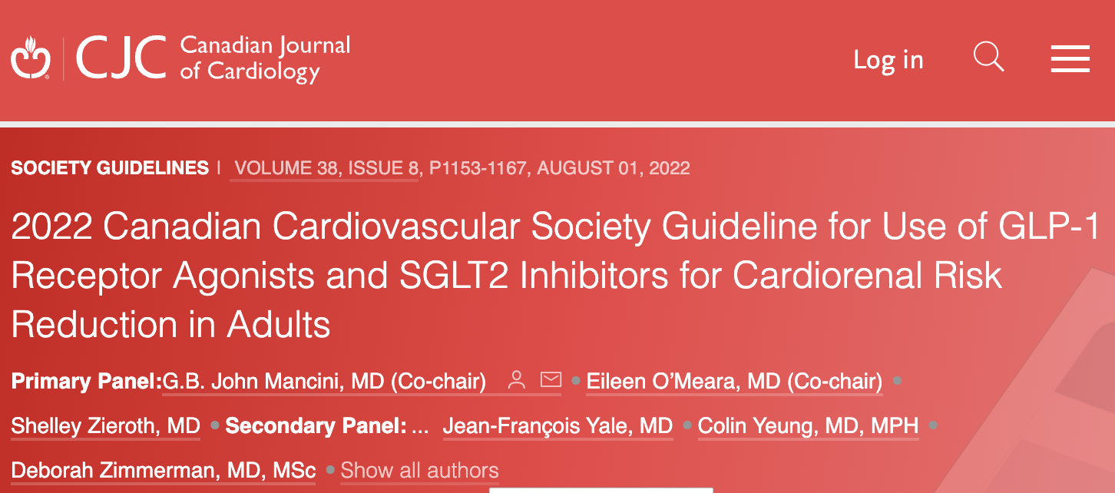

2022 Canadian Cardiovascular Society Guideline for Use of GLP-1 Receptor Agonists and SGLT2 Inhibitors for Cardiorenal Risk Reduction in Adults
G.B. John Mancini, MD (Co-chair), Eileen O’Meara, MD (Co-chair), Shelley Zieroth, MD, Mathieu Bernier, MD, Alice Y.Y. Cheng, MD, David Z.I. Cherney, MD, PhD, Kim A. Connelly, MD, Justin Ezekowitz, MBBCh, MSc, Ronald M. Goldenberg, MD, Lawrence A. Leiter, MD, Gihad Nesrallah, MD, MSc, Breay W. Paty, MD, Marie-Eve Piché, MD, PhD, Peter Senior, MBBS, PhD, Abhinav Sharma, MD, Subodh Verma, MD, PhD, Vincent Woo, MD, Pol Darras, MD, Jonathan Y. Gabor, MD, Jean Grégoire, MD, Eva Lonn, MD, James A. Stone, MD, PhD, Jean-François Yale, MD, Colin Yeung, MD, MPH, Deborah Zimmerman, MD, MSc
Canadian Journal of Cardiology
Volume 38 Issue 8 Pages 1153-1167 (August 2022)
DOI: 10.1016/j.cjca.2022.04.029
Copyright © 2022 Elsevier Inc. Terms and Conditions

Slide 64
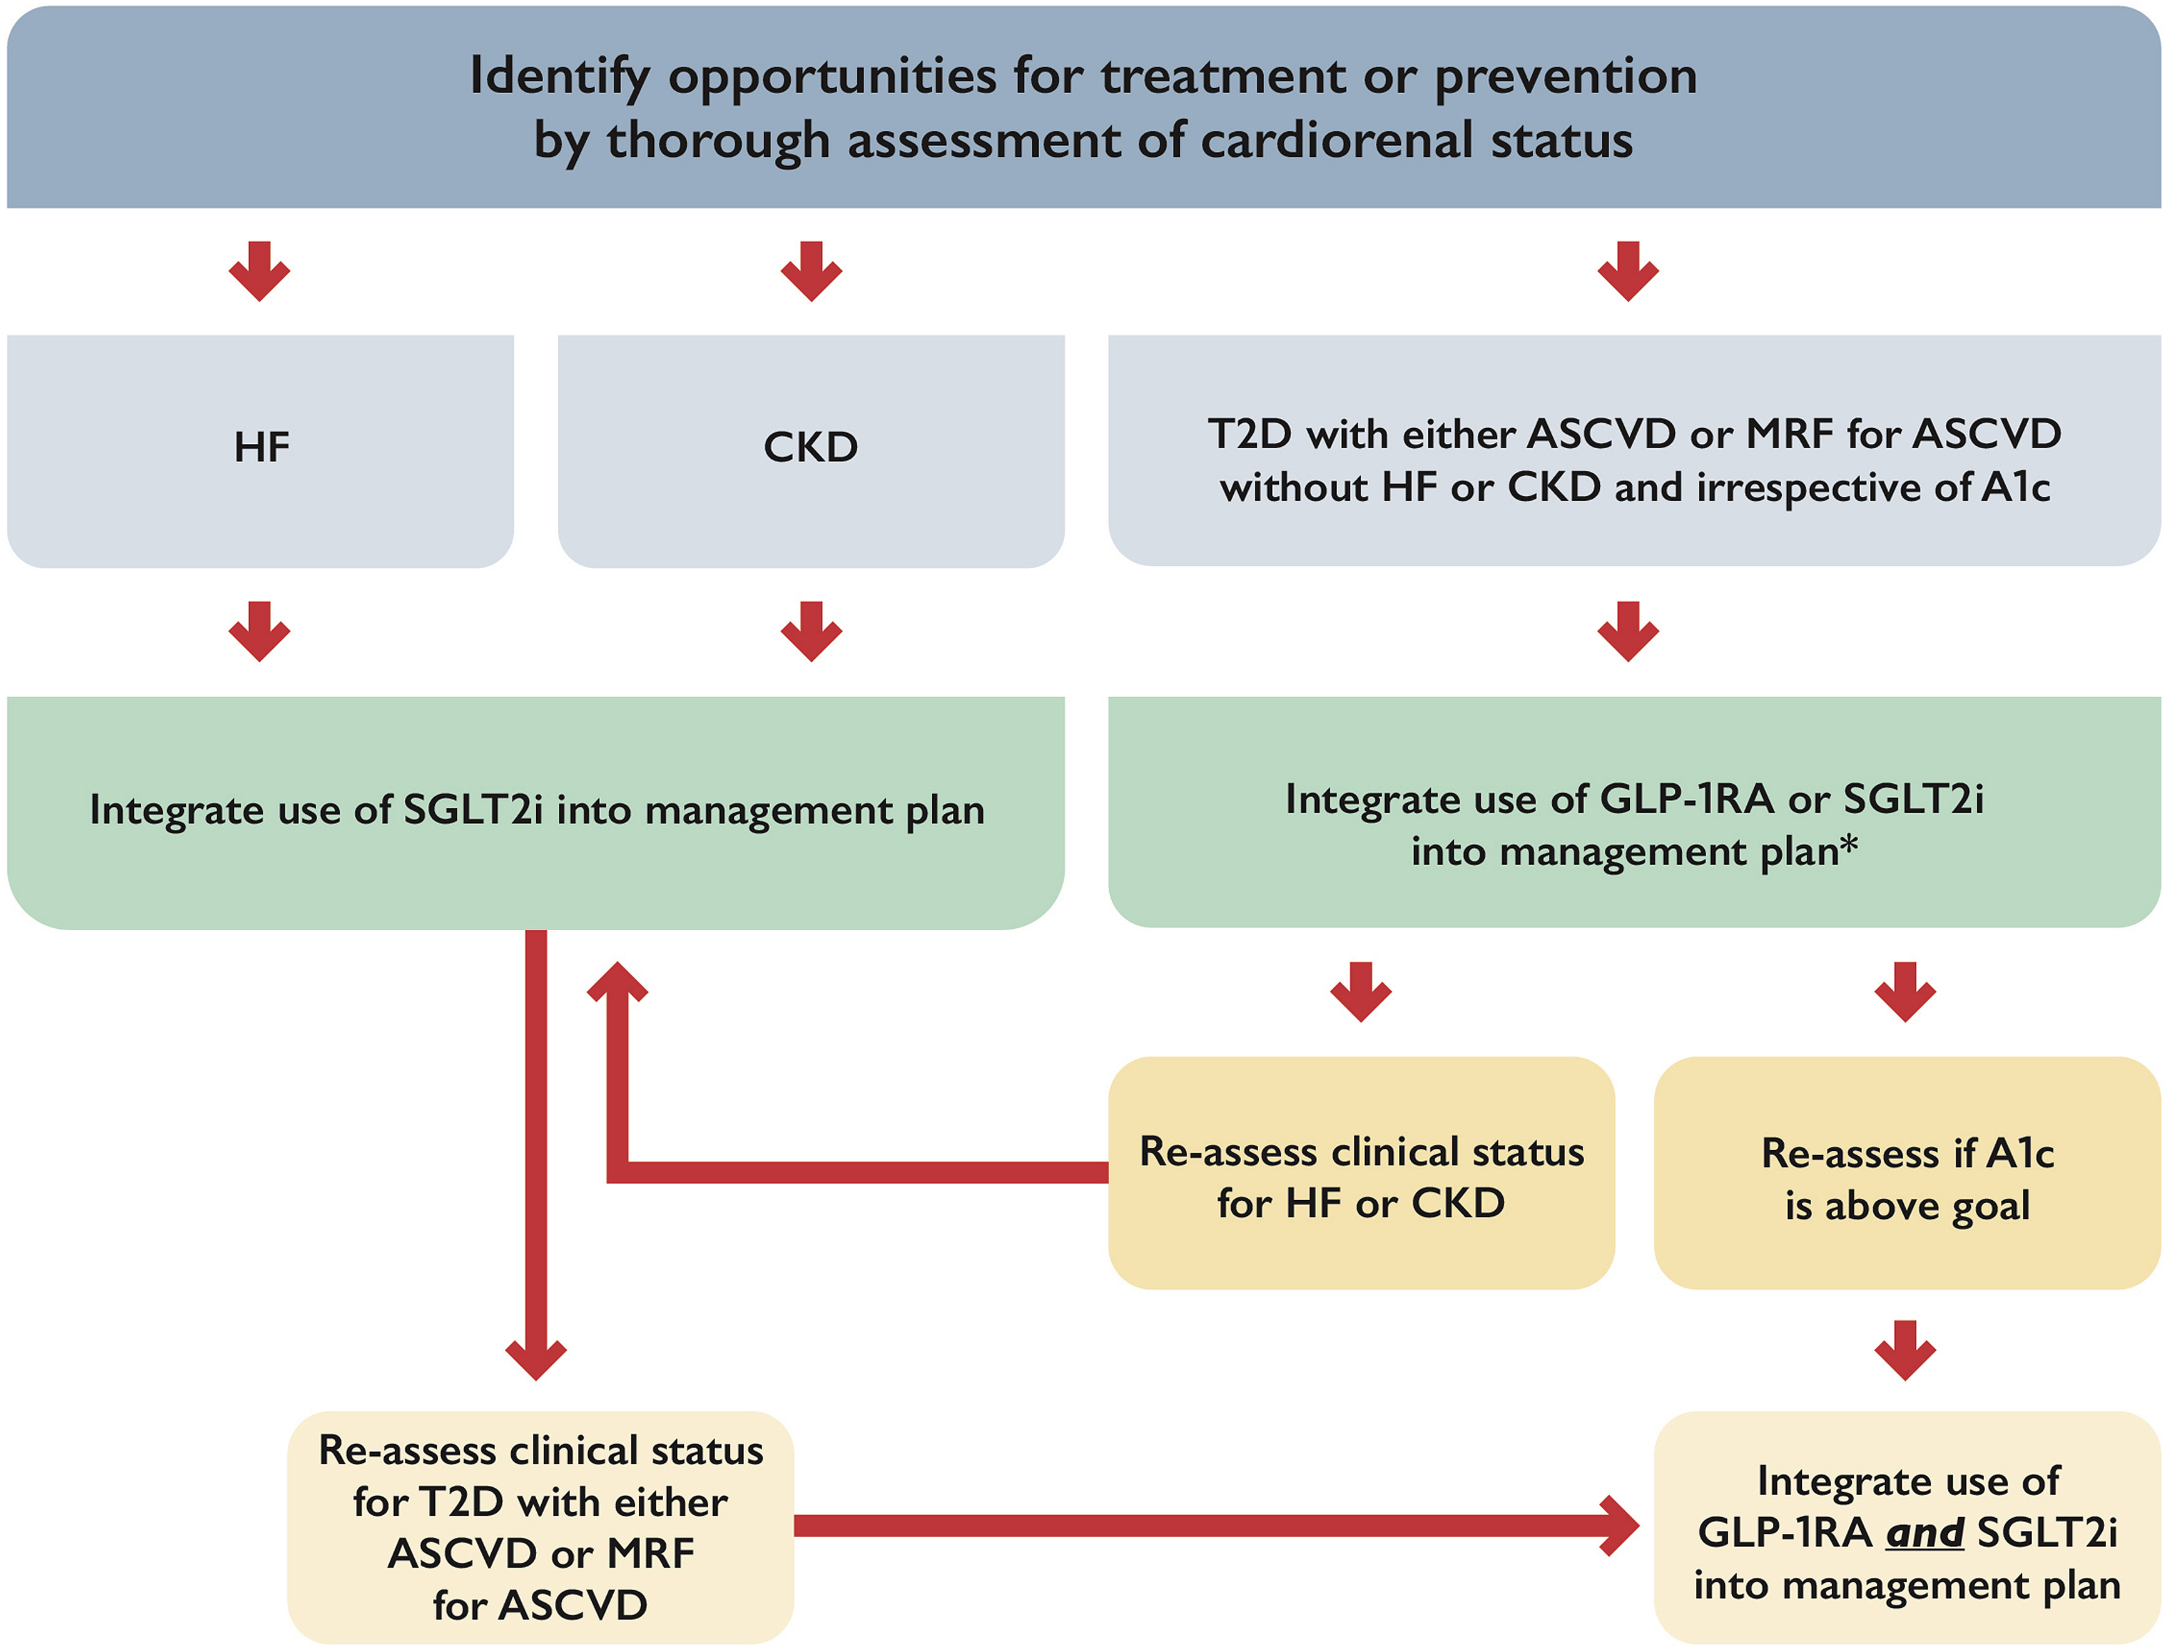
Figure 1
Notes:
Integration of glucagon-like peptide-1 receptor antagonists (GLP-1RA) and sodium-glucose co-transporter 2 inhibitors (SGLT2i) into cardiovascular practice. ASCVD, atherosclerotic cardiovascular disease; CKD, chronic kidney disease; HF, heart failure; MRF, multiple risk factors; T2D, type 2 diabetes. ∗ In patients with high stroke risk, or history of transient ischemic attack/stroke, consider initial integration of GLP-1RA into management plan followed by integration of SGLT2i on the basis of changes in heart failure or kidney status or for further glycosylated hemoglobin (A1c)-lowering.

Slide 65
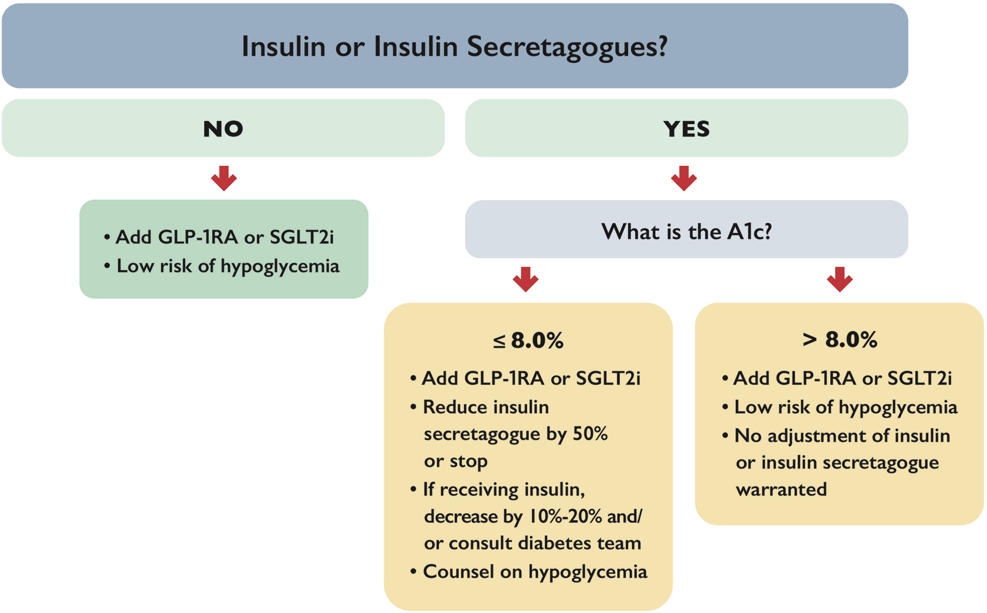
Figure 2
Notes:
Management of antihyperglycemic medications when adding SGLT2i (eGFR ≥ 45 mL/min/1.73 m²) or glucagon-like peptide-1 receptor antagonists (GLP-1RA). A1c, glycosylated hemoglobin; eGFR, estimated glomerular filtration rate; SGLT2i, sodium-glucose co-transporter 2 inhibitors.∗ SGLT2i have markedly reduced glycemic-lowering efficacy when eGFR < 45 mL/min/1.72 m², so there is less concern about hypoglycemia with insulin or insulin secretagogues (meglitinides or sulfonylureas).

Slide 66
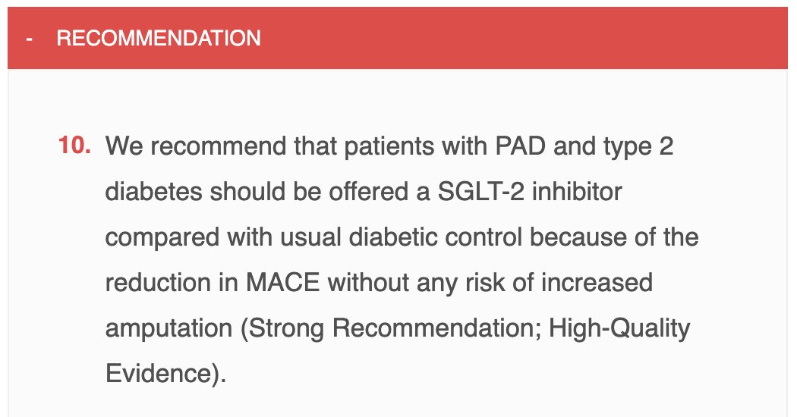

Slide 67
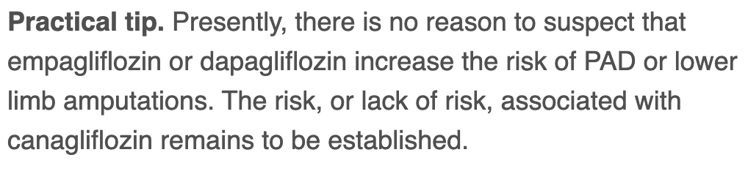

Slide 68
BD
65 yo male, DM 2012
  April 2022 –Non-STEMI PCI to LAD
  Tests infrequently
Meds
  Tresiba x x 22
  Metformin 1 g bid
  Ramipril 10/Crestor 10 mg od/ASA/Clopidogrel/Amlodipine
Followed by Cardiology,
walks dog 1 hour daily

Slide 69
BD
O/E
  Wt 103 kg, BMI 35
  BP 134/80
  Reuse injection sites – lipohypertrophy
A1C – 11.0, Cr 92, MAU 32 ACR 3.4
LDL 0.9

Slide 70
BD
SGLT-2 Inh
Then GLP-1 Agonist
Or
GLP-1 Agonist
Then SGLT-2 Inh

Slide 71
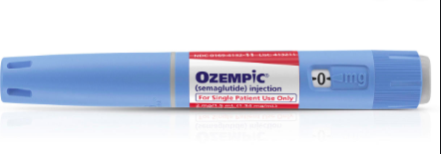
  If - A1C < 1.0 over goal
    Reduce basal insulin 20-40 % - (ie if goal 8.5 – reduce if >9.5)
    Reduce SU/Diamicron 50%
    Reduce bolus insulin 50%
  A1C > 1.0-1.5 over goal
    Counsel re lows
    Consider reduce meds for Glu < 7 on pattern review
  Replace DPP-IV once > 0.25
  eGFR - > 15

Slide 72
-lowering medication that also reduces
Lesson # 1
Our paradigm shift for SGLT-2is and GLP-1 RAs with proven benefits in CVD patients with diabetes:
A1c
risk

Slide 73
SK
63 yo male
DM x 6 years
Meds – Trajenta 5 mg od
  Metformin 1 g bid
  Lipitor 40 mg /Ramipril 10 mg od/Amlodipine 10 mg od
Smoker – 50 pk yrs, 1 ppd
A1C – 6.5, ACR 4.5
Recommendations?

Slide 74
CV Outcomes According to Baseline UACR
Myocardial Infarction
Hospitalization for HF
10
>34 mmol/mol
8
> 34 mmol/mol
3.4-34
mmol/mol
6
3.4-34 mmol/mol
2-year Kaplan-Meier Estimates (%)
1.1-3.3
mmol/mol
4
1.1-3.3
mmol/mol
2
<1.1 mmol/mol
<1 mmol/mol
0
0
180
360
540
720
900
0
180
360
540
720
900
Time from randomization (days)
Time from randomization (days)
Notes:
Objective:
To evaluate whether UACR offers incremental prognostic benefit beyond risk factors and established plasma cardiovascular biomarkers.
Design, Setting, and Participants:
The Saxagliptin Assessment of Vascular Outcomes Recorded in Patients With Diabetes Mellitus-Thrombolysis in Myocardial Infarction (SAVOR-TIMI) 53 study was performed from May 2010 to May 2013 and evaluated the safety of saxagliptin vs placebo in patients with type 2 diabetes with overt cardiovascular disease or multiple risk factors. Median follow-up was 2.1 years (interquartile range, 1.8-2.3 years).
Main Outcomes and Measures:
Baseline UACR was measured in 15 760 patients (95.6% of the trial population) and categorized into thresholds.
Results:
Of 15 760 patients, 5205 were female (33.0%). The distribution of UARC categories were: 5805 patients (36.8%) less than 10 mg/g, 3891 patients (24.7%) at 10 to 30 mg/g, 4426 patients (28.1%) at 30 to 300 mg/g, and 1638 patients (10.4%) at more than 300 mg/g. When evaluated without cardiac biomarkers, there was a stepwise increase with each higher UACR category in the incidence of the primary composite end point (cardiovascular death, myocardial infarction, or ischemic stroke) (3.9%, 6.9%, 9.2%, and 14.3%); cardiovascular death (1.4%, 2.6%, 4.1%, and 6.9%); and hospitalization for heart failure (1.5%, 2.5%, 4.0%, and 8.3%) (adjusted P < .001 for trend). The net reclassification improvement at the event rate for each end point was 0.081 (95% CI, 0.025 to 0.161), 0.129 (95% CI, 0.029 to 0.202), and 0.056 (95% CI, -0.005 to 0.141), respectively. The stepwise increased cardiovascular risk associated with a UACR of more than 10 mg/g was also present within each chronic kidney disease category. The UACR was associated with outcomes after including cardiac biomarkers. However, the improvement in discrimination and reclassification was attenuated; net reclassification improvement at the event rate was 0.022 (95% CI, -0.022 to 0.067), -0.008 (-0.034 to 0.053), and 0.043 (-0.030 to 0.052) for the primary end point, cardiovascular death, and hospitalization for heart failure, respectively.
Conclusions and Relevance:
In patients with type 2 diabetes, UACR was independently associated with increased risk for a spectrum of adverse cardiovascular outcomes including MI and hHF.

Slide 75
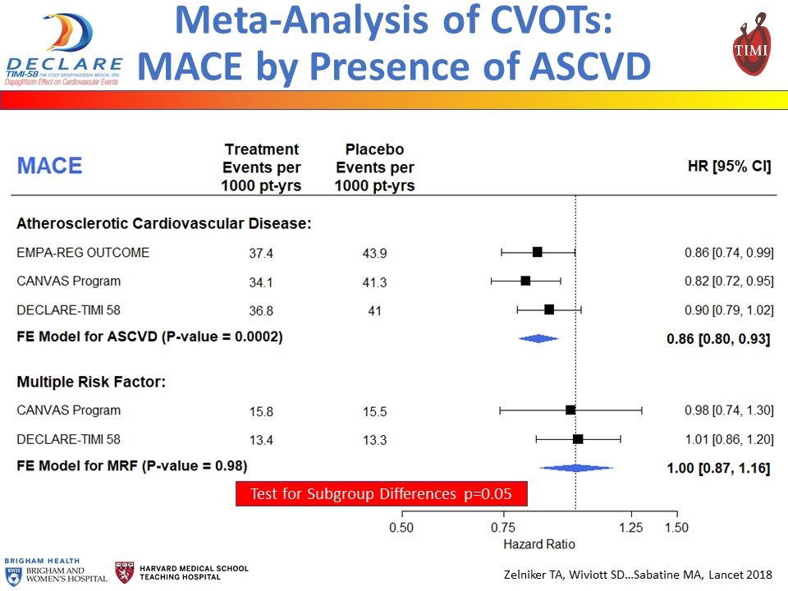

Slide 76
Clinical Trial Evidence with GLP-1 Receptor Agonists:
Major Cardiovascular Events
(Separate Studies — Not Direct Comparisons)
NB:
Preliminary results of the REWIND trial indicate improved CV outcomes with dulaglutide in a mostly primary prevention population⁵
Hazard ratio (95% CI), p value
Liraglutide
LEADER^{1*}
0.87 (0.78-0.97), p=0.01
Semaglutide
SUSTAIN-6^{2*}
0.74 (0.58-0.95), p=0.02
Lixisenatide
ELIXA^{3†}
1.02 (0.89-1.17), p=0.81
Exenatide
EXSCEL^{4*}
0.91 (0.83-1.00), p=0.06
Albiglutide
HARMONY⁵
0.78 (0.68-0.90), p=0·0006
0.3
1
2
Hazard ratio (95% CI)
Favor drug Favor placebo
Holman RR, et al. N Engl J Med 2017; 377(13):1228-39.
Hernandez AF, et al. The Lancet 2018; 392(10157):1519–29.
Eli Lilly and Company. Press Release, November 5, 2018.
*CV death, non-fatal myocardial infarction, non-fatal stroke; †CV death, nonfatal MI, nonfatal stroke, unstable angina
Marso S, et al. N Engl J Med 2016; 375(4):311-22.
Marso S, et al. N Engl J Med 2016; 375(19):1834-44.
Pfeffer MA, et al. N Engl J Med 2015; 373(23):2247-57.

Slide 77
-lowering medication that also reduces
Our paradigm shift for SGLT-2is and GLP-1 RAs with proven benefits in high-risk patients with diabetes:
A1c
risk

Slide 78
Researching CV Events with a Weekly INcretin in Diabetes

Slide 79
Research Question
In men & women with established or newly detected type 2 diabetes who have additional CV risk factors…
… does adding a weekly sc. injection of the GLP-1 RA dulaglutide (1.5 mg) to the medical regimen safely reduce serious CV outcomes more than adding a wkly sc. placebo injection?

Slide 80
Meta-analysis of MACE (GLP-1 RA CVOTs)
Zelniker et al. Circulation 2019:2022

Slide 81
Meta-analysis of MACE (GLP-1 RA CVOTs)
Zelniker et al. Circulation 2019:2022

Slide 82
Research Question
In men & women with established or newly detected type 2 diabetes who have additional CV risk factors…
… does adding a weekly sc. injection of the GLP-1 RA dulaglutide (1.5 mg) to the medical regimen safely reduce serious CV outcomes more than adding a wkly sc. placebo injection?

Slide 83
Key Inclusion Criteria
Type 2 DM - New or previously diagnosed (with stable glucose drugs X 3 mo)
- On 0-2 oral glucose drugs +/- basal insulin or GLP-1 RA
A1C ≤ 9.5% (81 mmol/mol)
BMI > 23 kg/m²
Age ≥ 50 & vascular disease
  (prior MI, stroke, revascularization, or unstable angina + ECG changes or PCI or positive imaging)
  ≥ 55 & subclinical vascular disease
  (positive stress test/image, >50% stenosis, ABI<0.9; eGFR <60; hypertension + LVH, or albuminuria)
  ≥ 60 & 2 CV risk factors
  (tobacco, lipid drug, LDL-C ≥ 3.4 (130 mg/dl), HDL-C < 1.0 (40 mg/dl) for men & < 1.3 (50 mg/dl) for women or TG ≥ 2.3 (200 mg/dl), ≥ 1 BP drug or SBP ≥ 140 or DBP ≥ 95. waist:hip ratio >1.0 for men & > 0.8 for women)

Slide 84
Trial Outcomes
Primary Composite: First Occurrence of a MACE Outcome
  Nonfatal MI (including silent), nonfatal stroke, or CV death
Secondary Outcomes
  Microvascular composite outcome
    Retinopathy: laser Rx/anti VEGF, vitrectomy
    Nephropathy: clinical proteinuria, 30% eGFR fall, renal replacement Rx
  Hospitalization for unstable angina
  Hospitalization or urgent visit for heart failure
  Each component of the primary outcome
  Total mortality

Slide 85
Dulaglutide’s Effect on the CV Composite
Primary Outcome: 1st Occurrence of Nonfatal MI, Nonfatal Stroke, CV Death

Slide 86
Dulaglutide’s Effect on Nonfatal Stroke

Slide 87
Dulagutide’s Effect on All-Cause Death

Slide 88
Reviewing, adjusting or advancing therapy in type 2 diabetes:
Diabetes Canada Clinical Practice Guidelines Expert Committee. Pharmacologic glycemic management of type 2 diabetes in adults: 2020 update. Can J Diabet 2020;44:575-591.
Notes:
Patients who meet these risk criteria should be taking an SGLT-2 inhibitor or a GLP-1 receptor agonist.
These drugs have been proven to reduce the incidence of major adverse cardiovascular events, hospitalization for heart failure, and progression of nephropathy.
[CLICK] In other words, they’ve been proven to protect the heart and kidneys.

Slide 89







“Cardiovascular Risk”:
Over the age of 60
At least 2 of the following:
Smoking (tobacco)
Central obesity
Hypertension
  Above target BP or on
  BP-lowering medication
Dyslipidemia
  Abnormal lipid levels or on lipid-modifying medication
BP, blood pressure.
Diabetes Canada Clinical Practice Guidelines Expert Committee. Pharmacologic glycemic management of type 2 diabetes in adults: 2020 update. Can J Diabet 2020;44:575-591.
Notes:
“Cardiovascular risk” in the Diabetes Canada guidelines is defined as being
[CLICK] over the age of 60 and having at least two of the following risk factors:
[CLICK] tobacco use,
[CLICK] central obesity,
[CLICK] hypertension, which is defined has having high systolic or diastolic blood pressure or taking antihypertensive medication,
[CLICK] or dyslipidemia, which is defined as having abnormal HDL cholesterol, LDL cholesterol or triglycerides, or taking lipid-modifying medication.
[CLICK] Susan is over the age of 60 and has hypertension and dyslipidemia.

Slide 90
SK
63 yo male
DM x 6 years
Meds – Trajenta 5 mg od
  Metformin 1 g bid
  Lipitor 40 mg /Ramipril 10 mg od/Amlodipine 10 mg od
Smoker – 50 pk yrs, 1 ppd
A1C – 6.5, ACR 4.5
Recommendations?
Present Options to Patients
Replace DPP-IV with Ozempic

Slide 91
-lowering medication that also reduces
Lesson # 2
Use Cardio-protective medications independent of A1C for high risk patients
A1c
risk

