Slide 1

Latex Craft
Creation and Care
Hexyc
CFZ 2025

Slide 2





Latex Crafting
Who
Standard human reject
Latex lover
Crafter, creation hobbyist
Always learning!
What
Basics of sheet latex
Equipment
Skills
hexyc.com/latex
Why
Repair
Create

Slide 3



Latex Sheet
Type:
  Medicated (e.g. radical)
  4D (e.g. supatex)
Colour:
  Basic
  Metallic
  Transparent
  Poured effect
Lengths:
  1m wide
  5m long?
Thickness:
  0.2mm – Thin, for fashion
  0.4mm – Average, for wear
  0.6mm – Thick, for feel
  1mm – Heavy, for bondage
  3mm – Tough, for hardware
Cost (roughly £10pm)
supatex.com
radicalrubber.co.uk

Slide 4

Equipment
Sheets
Latex Sheet
Patterning Paper
1300gsm wallpaper filler for patterning
Glue
Rubber Glue (Solvent based): Bostik 3851
Solvent: Bostik Cleaner No.4 (previously Bostik 6009)
Latex Milk (Water based): Radical Glue (previously RadicalBond2)
Washing
Fairy Liquid
Bath/washing machine (delicate, cold)
Vivishine for easy drip shine
Standard (no additive) silicon lube
Talc
Hardware - Cutting
Roller Cutter
Hand roller
Scissors
Cutting board
Long plastic ruler (used for cutting against)
Gel pen for latex marking (metallic pencils as an alt.)
Hardware - Glue
Glue brush
Glue palette knife
Container to mix glue/solvent that is air tight
Heat gun
Washi tape
Non-fibre rags for cleaning

Slide 5
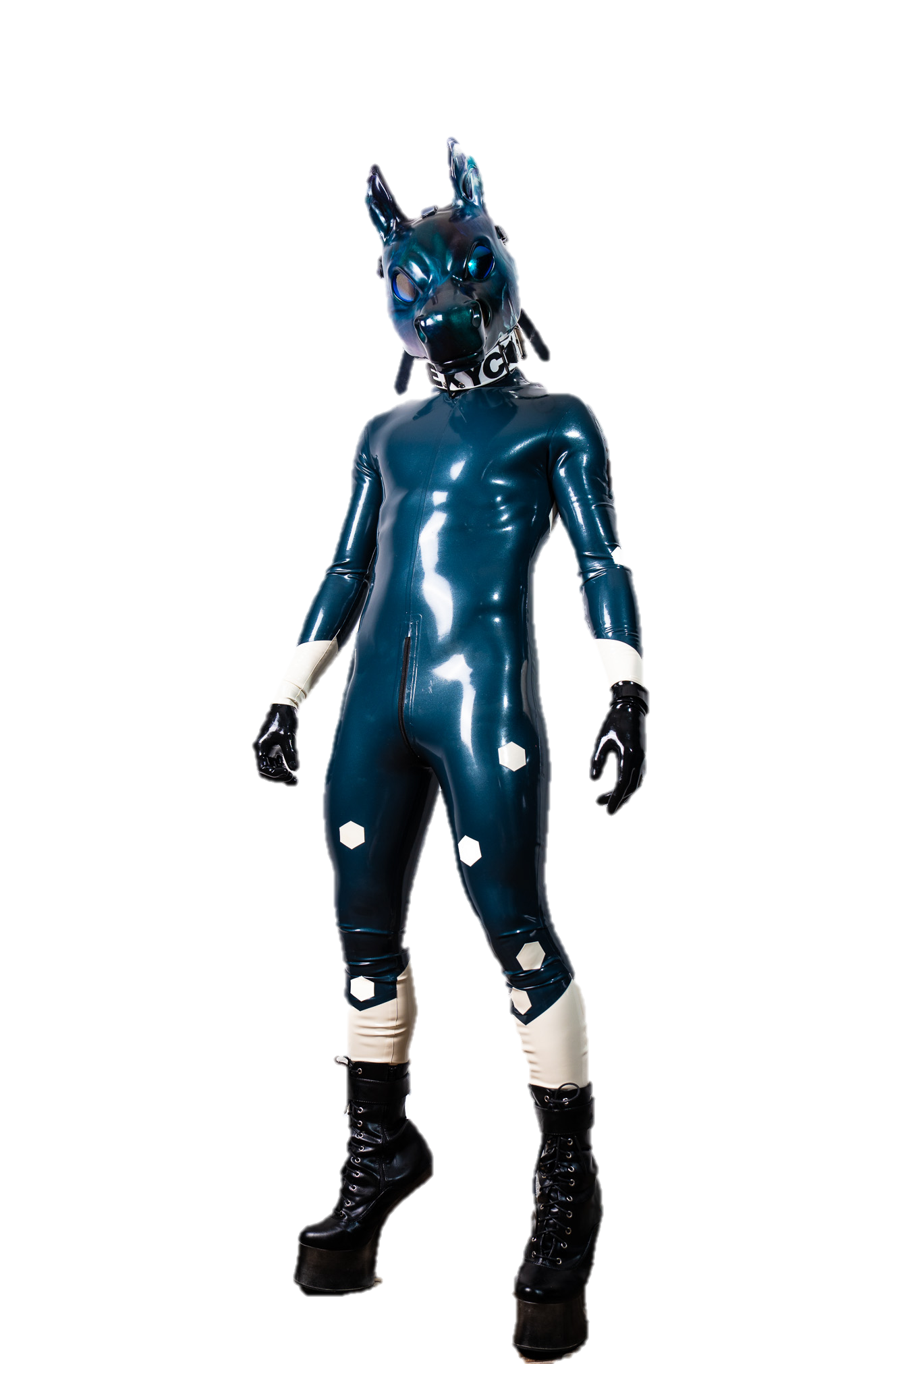
Equipment
Glue shape spudger
Electronic cutter
Ultrasonic welder
Laser cutter
But fancy

Slide 6
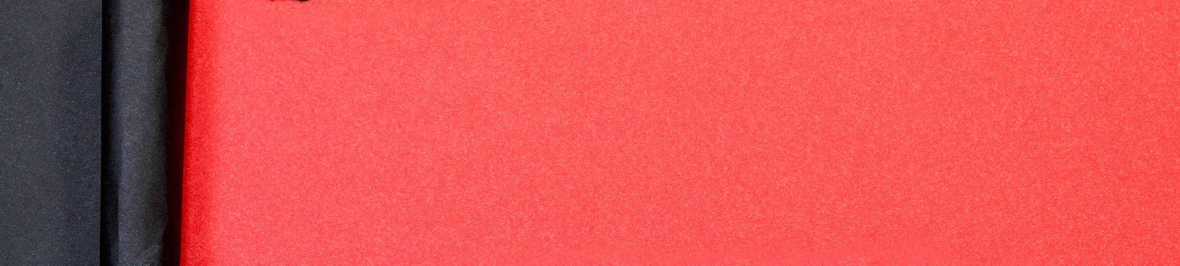
Example

Slide 7
The next steps
Modify & Make
Patches
Accessories
Garments
~0.4mm
Solvent glue
Clean surface
Items:
  Bandana
  Wristbands
  Collars
Hardware
Patterning
Seam:
  Position
  Allowance
Stretch

Slide 8

HAVE FUN
Bluesky & Website
Hexyc.com
Telegram
Hexyc
Twitter
@Hexyck

