Slide 1
Coronavirus Quick Study April 2020 Keeley Research & Analytics

Slide 2
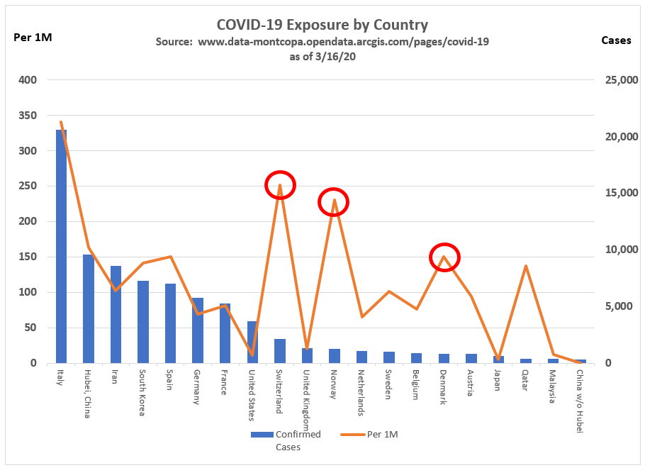
The red circles indicate countries within the top 20 in the world with the greatest number of confirmed cases AND have a high number of cases per million.
For instance, Switzerland has 2,182 confirmed cases which equates to about 252 people per one million people in the country. Compare this to someplace like the U.S., where there are 3,693 confirmed cases but only 11 per one million in ratio. Therefore, places like Switzerland may not have the most cases, but the cases they DO have represents a larger chunk of their relative population.
Another interesting takeaway is when you look at some of the Nordic countries and Qatar. They too have less cases, but way more relative cases to their population (the other two red circles). Italy may have the most cases, but it's directly proportionate to their entire population. Anyplace the orange line is considerably above the blue is currently not an ideal place to be.

Slide 3
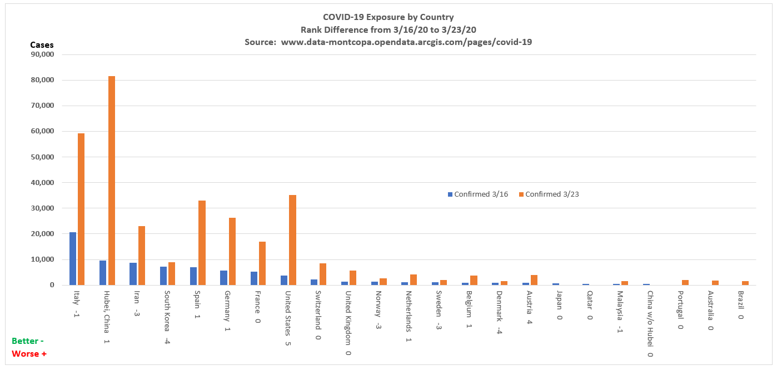
The chart displays the top 20 countries with the highest number of confirmed COVID-19 cases as of 3/16/20 (blue bars) versus 3/23/20 (orange bars). The countries are ranked by their position as of 3/16/20 in descending order with new cases and/or countries as of 3/23/20 included. It's important to keep in mind that the number of reported cases is relative to the country's overall population.
Observations:
-Japan, Qatar, and China w/o Hubei dropped out of the top 20. This doesn't mean they had no change in their overall rank; just relative to the top 20. Portugal, Australia, and Brazil enter the top 20.
-South Korea and Denmark moved 4 ranks better and Iran, Norway, and Sweden each moved 3 ranks better out of the top 20 countries on 3/23/20 versus 3/16/20. This means that as a representative portion of their entire populations, there are less cases being reported on 3/23/20 versus 3/16/20.
-The remaining countries either had one rank change better or worse, or no change at all.
-The United States had the most movement of all the countries in the original top 20 reported on 3/16/20. On that date, the U.S. was ranked 8th most cases where as of 3/23/20 it is ranked number 3.
-China, India, United States, Indonesia, and Pakistan are the most populated countries, respectively, in the world. Yet India (rank #44), Indonesia (rank #37), and Pakistan (rank #27) do not appear in the top 20.

Slide 4
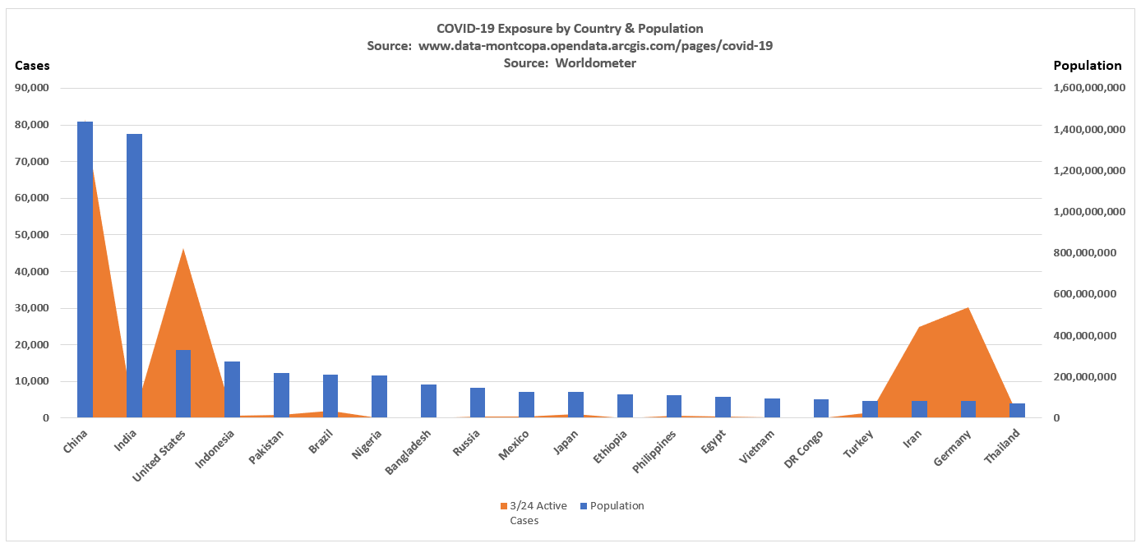
COVID-19 is spreading disproportionately to the populations of China, the United States, Iran, and Germany, who all are within the top 20 most populated countries in the world. India, the #2 most populated country in the world, only has 511 cases out of 1.4B people.

Slide 5
This chart shows the top 20 countries with the most active COVID-19 cases as of 3/29/20. This is displayed by the blue bars in the chart going from left to right. The gray bars show the percentage rank of active cases relative to a particular country's population.
Positive Example: The United States has the most active cases as of today with 124,686 which gives them a #1 rank. The U.S. has the second biggest population out of those top 20 countries with the most cases. As a relative proportion of the active cases to the population, the U.S. ranks #13 out of the top 20 countries with the most cases. This tells you that even though the U.S. has the most active cases, it represents a relatively lower percentage of the total population.
Negative Example: On the contrary, Norway ranks #17 in the world for most active cases at 4,232, but relatively speaking they rank much higher at #6 with a higher relative proportion of active cases to their population.
Summary: Gray bars that are bigger than blue bars for a country in the chart is a better situation.

Slide 6
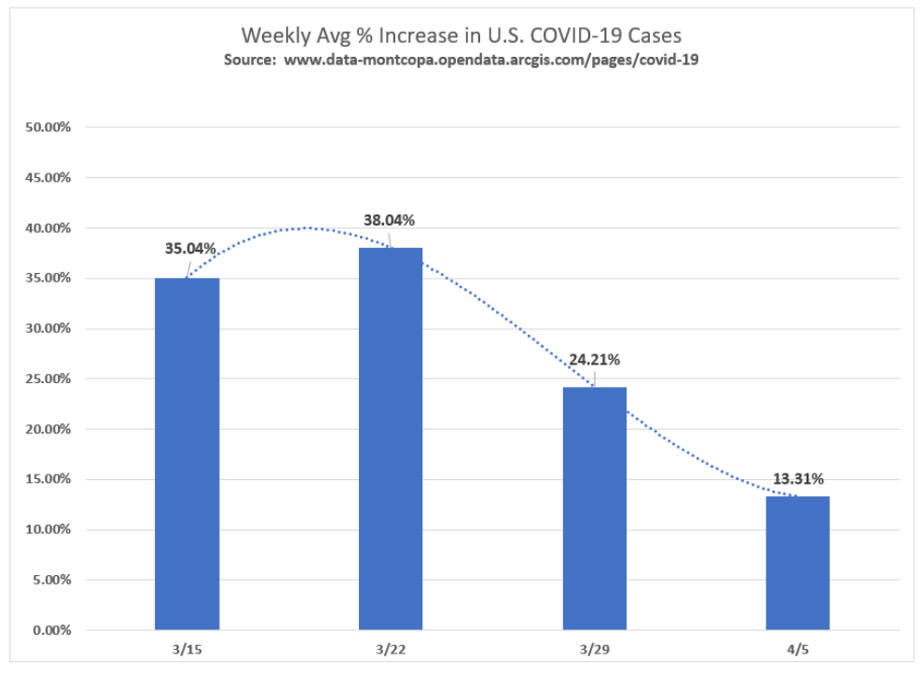
The following graph shows the weekly average percentage increase in COVID-19 cases in the United States for the past four weeks ending 4/5/20. As you can see, the percentage is trending downward. This means that even though there are increasingly more cases in the U.S. presently, the rate at which those cases are growing is slowing.

Slide 7
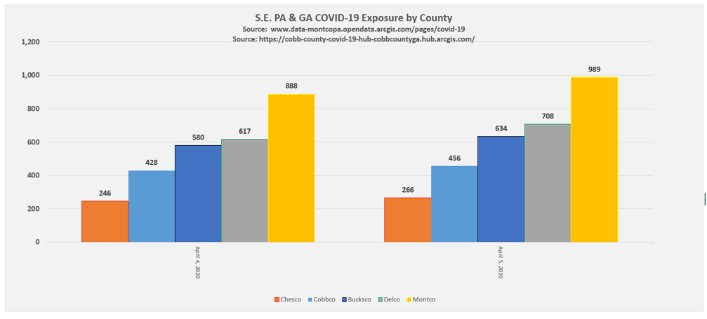
The following graph shows the number of active COVID-19 cases by county for southeastern PA (excluding Philadelphia) and Cobb County, GA (used as a basis for comparison). Presently, Chester County has the least amount of cases at 266 while Montgomery County has the most cases at 989.

Slide 8
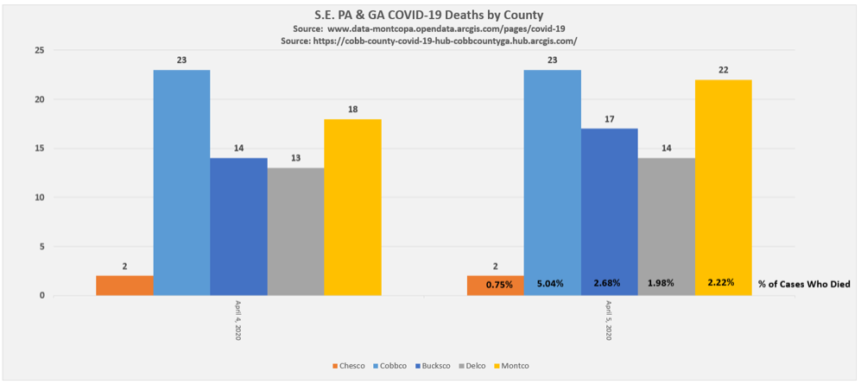
The graph below shows the number of deaths from COVID-19 by county for southeastern PA (excluding Philadelphia) and Cobb County, GA. Although Cobb County was in the middle of the group for exposure to COVID-19 out of the five counties shown in the previous graph, it has the most deaths at 23 and the highest percentage of those affected that died at 5.04%. This means that relative to its population, the people who have COVID-19 in Cobb County are between 2.36% and 4.29% more likely to die than compared to those affected by the virus for the other four counties shown.

