Slide 2
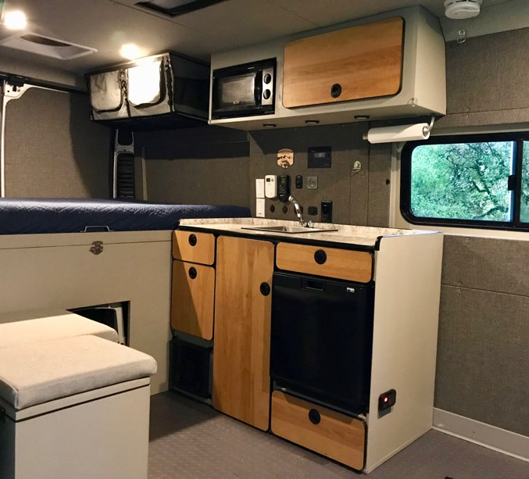
Simple versus Complex Design
It’s easy to make things complex, so we work hard to keep things simple.
Layouts with a more open feel versus more congested.
Many traditional RVs suffer from the “attempt to try and cram every kind of RV feature known to mankind into a tiny space” problem.
Designed for Off-Grid camping rather than staying in RV parks.
A lower carbon footprint compared to a traditional RV. (22 mpg versus 8 mpg)
Careful build process that takes about 18 months to complete.

Slide 3
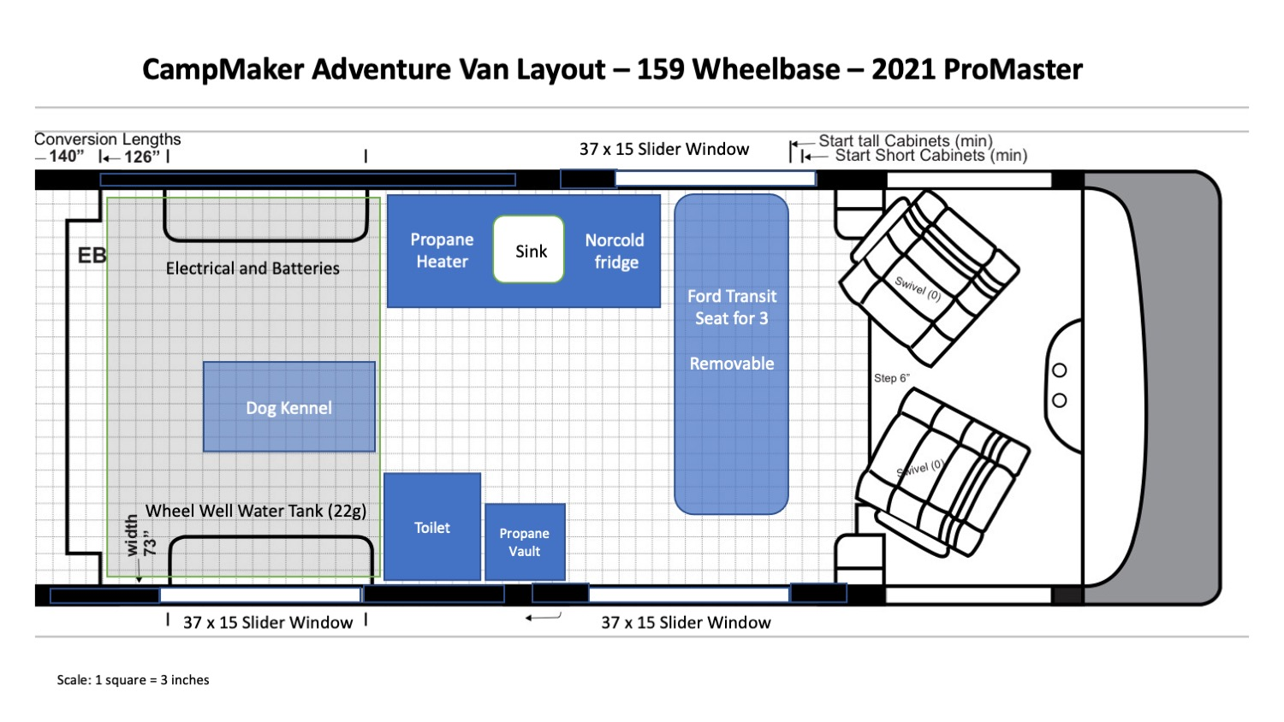

Slide 4
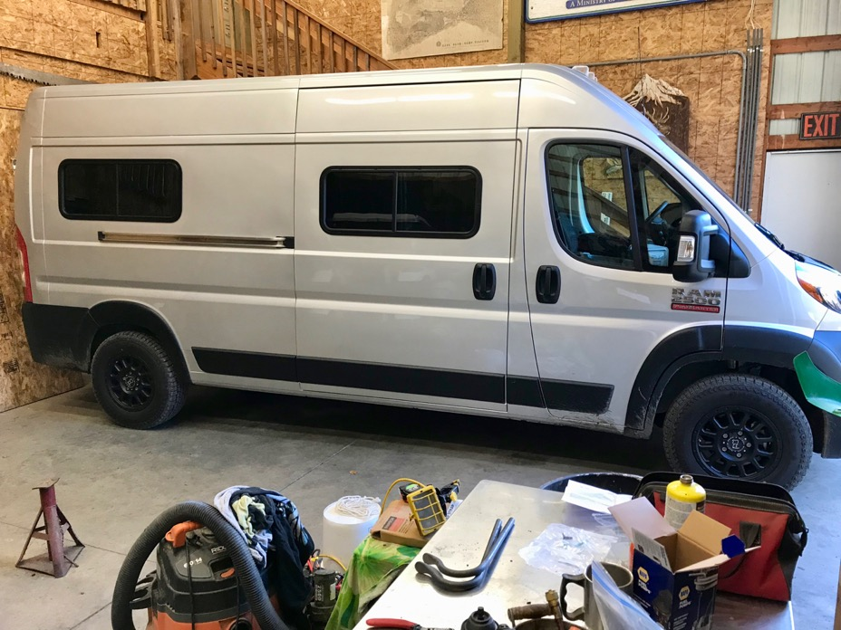
Reduced Weight of the Van Conversion
Helps the engine, transmission, brakes and gas mileage!
16 city, 20 highway
With a lighter van the 280 hp engine is powerful and quick.
If the front wheel drive van doesn’t have too much weight over the back wheels, it improves traction in snow and back roads.
3,700 lbs. front + 3,200 lbs. rear = 7,100 lbs.
This helps keep the van weight far below the 8,900 lbs. gross vehicle weight.

Slide 5
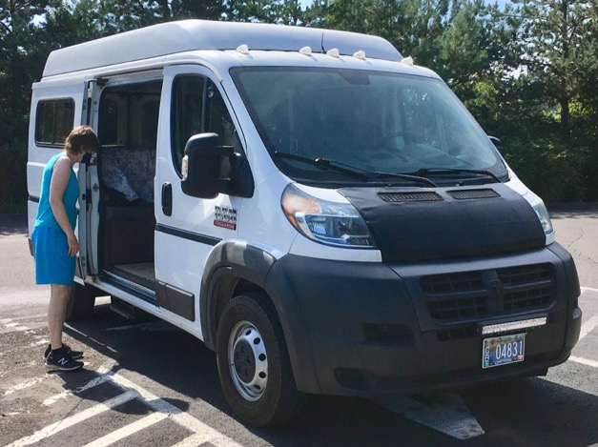
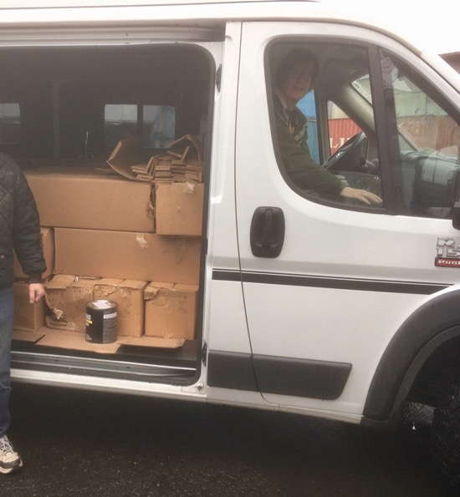
Don’t store the RV! Use it Regularly
A ProMaster van gets the same or better gas mileage as a pickup truck.
Use the van for normal driving needs rather than parking it for the winter. A vehicle that sits idle deteriorates!
Shopping trips.
Hauling things.
Helping people move.
Trailer hitch for hauling.

Slide 6
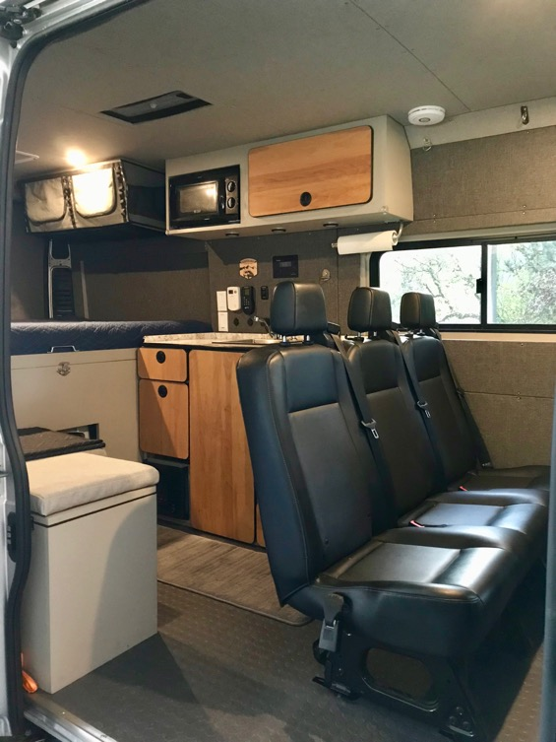
A Family Adventure Van! - Seating for 5 people
Need to transport more than two people.
Have family members join an outing.
“Soccer Mom” family advantages:
Place to wait for activities to finish.
A bed to take a nap for mom or kids.
Sink and refrigerator for snacks and meals.
Convenient toilet for everyone, but especially small children.
Nice heater to stay warm
Plenty of storage to bring along just about anything you might need with you.

Slide 7
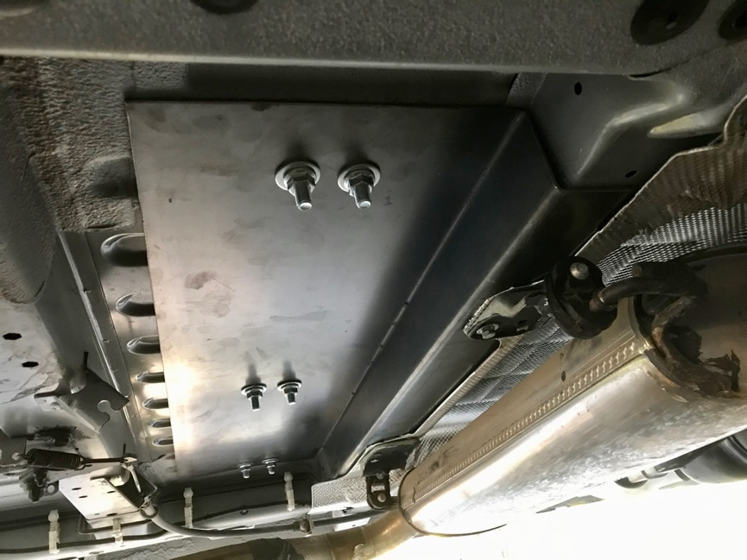
Additional Seating
ProMaster vans do not come from the factory with passenger seats or seat mounting brackets installed.
Many people try to add seating in campervans and they don’t know enough about the forces involved to build a safe anchoring system.
I purchased a new Ford Transit 3-person bench seat with the built in seat belts.
Van Specialties from Tualatin, Oregon mounted the passenger seat bases in my ProMaster.
On the right is a photo of their heavy plate steel seat mounting support.

Slide 8
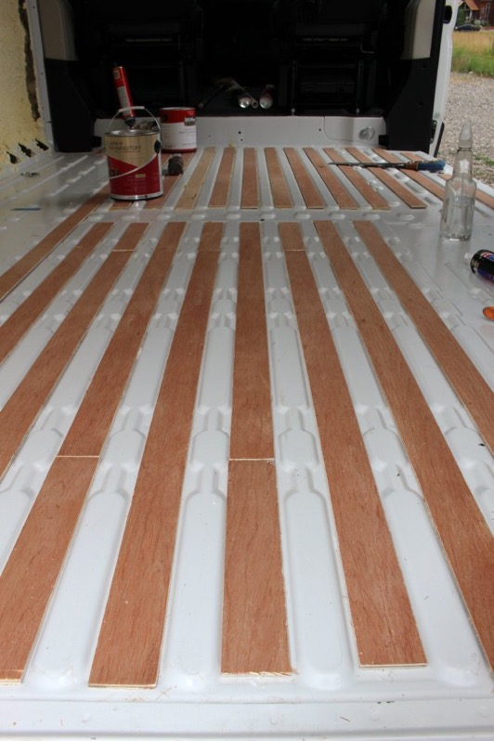
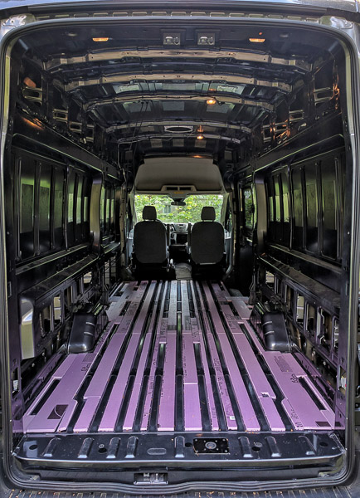
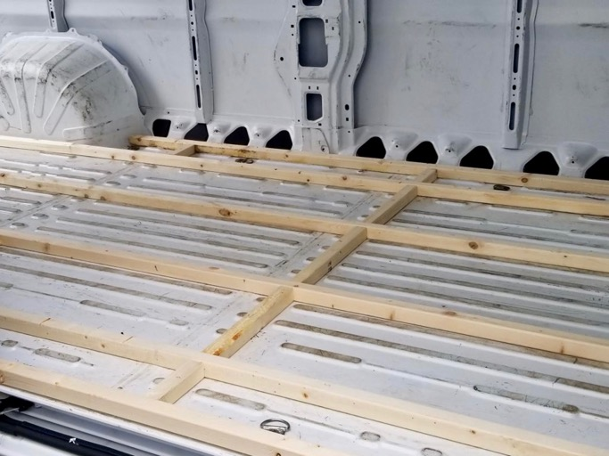
Van builder do too much framing in the flooring

Slide 9
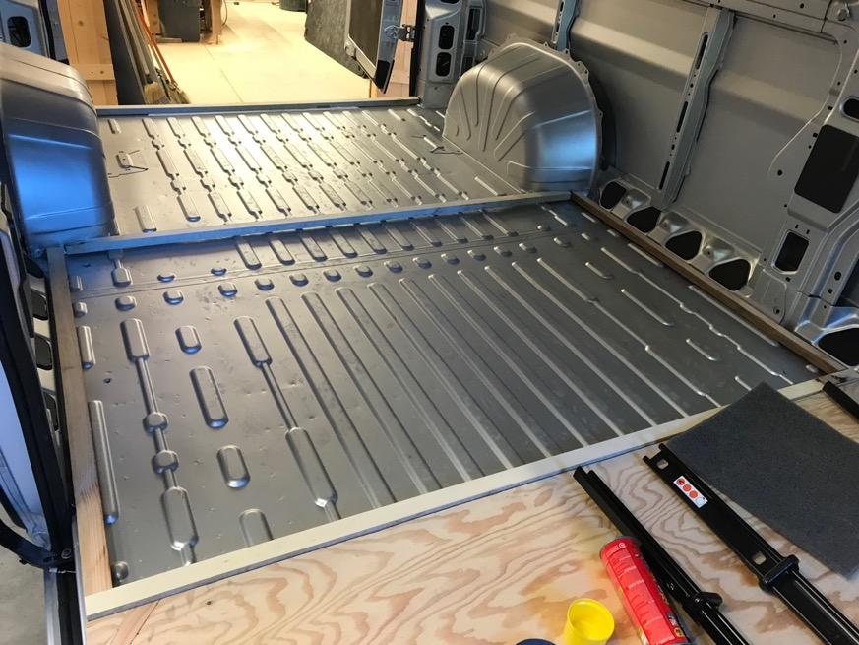
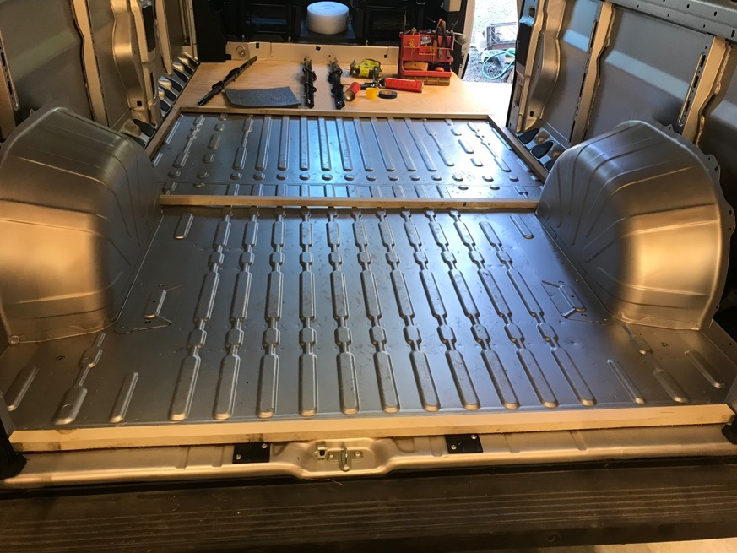
Less Framing in the Flooring

Slide 10
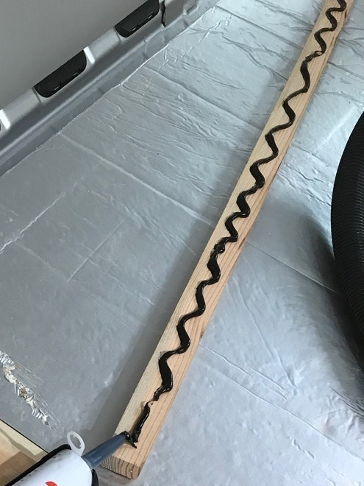
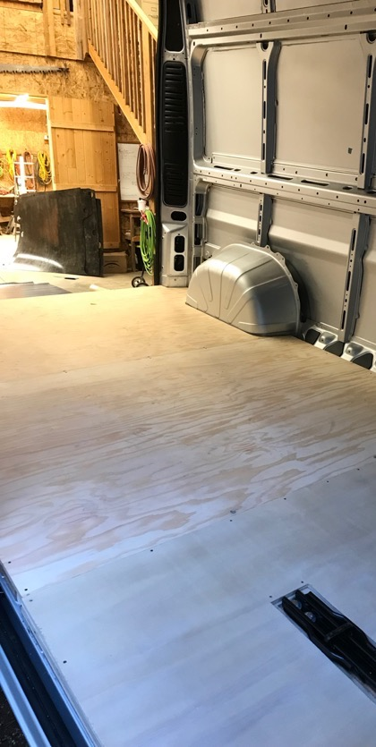
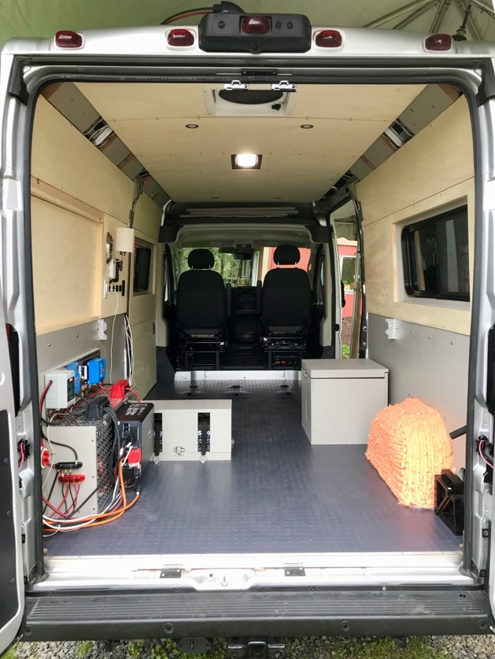
Insulation, Plywood and Vinyl Flooring

Slide 11
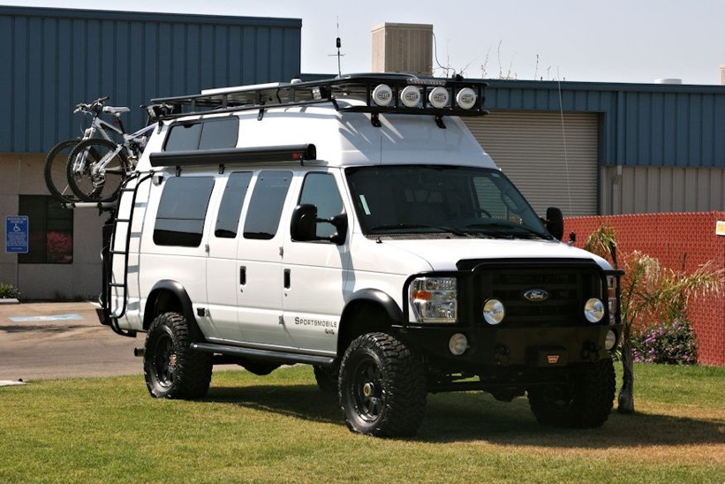
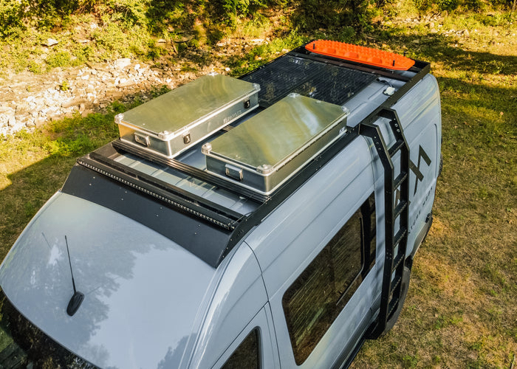
Roof Racks and Gear
There are a lot of different ways to mount a solar panel on the van roof. Many van builds have an extensive roof rack and they load a lot gear up to the roof. This can create a lot of problems with cross winds, safety and significant loss of gas mileage (3? mpg)
Designed with airplane technology, an Air Stream Trailer has a smooth rounded surface to make it easy to pull down the road. Can you imagine adding all this gear to the top of an Air Stream? It’s a similar issue with a ProMaster. It was designed with a fairly smooth airflow and get’s good gas mileage to begin with, but when you add these kinds of items the gas milege can drop from 2 to 4 mpg.
Then people start adding bigger tires and lift kits and you have other issues.

Slide 12
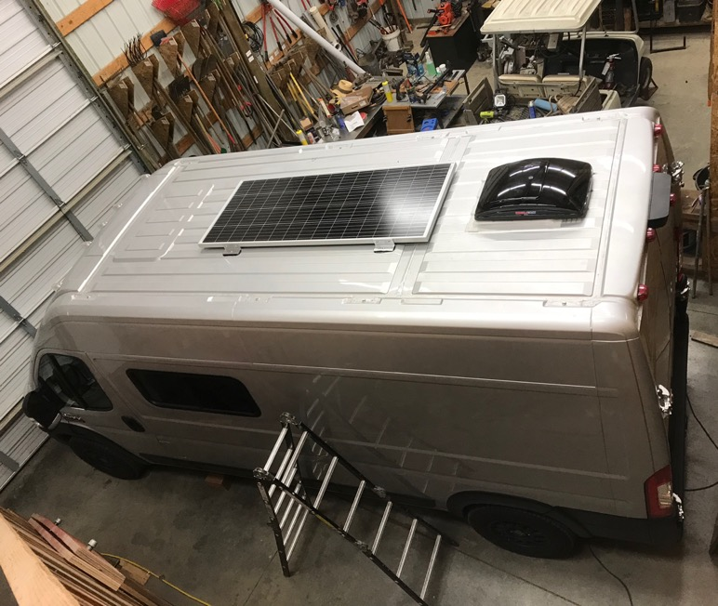
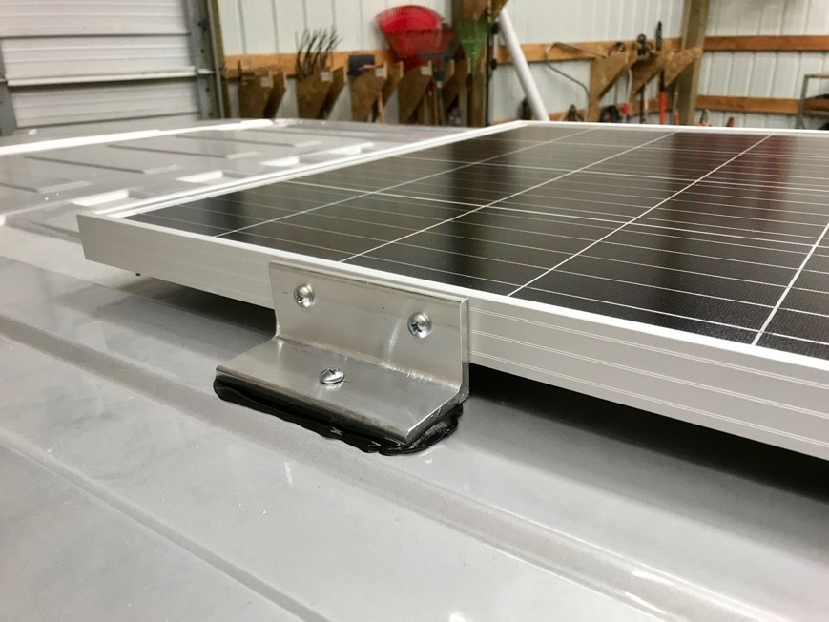
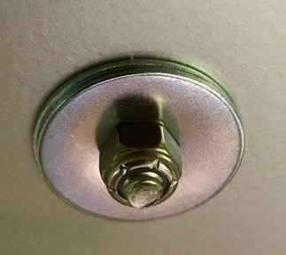
Roof Solar Panel
Instead I have this low-profile panel solar panel and a roof fan. It will have a minimal impact on gas mileage and will be safely secured to the roof for many years. On one trip from Portland to Seattle this year we got 22 mpg average for the trip.

Slide 13
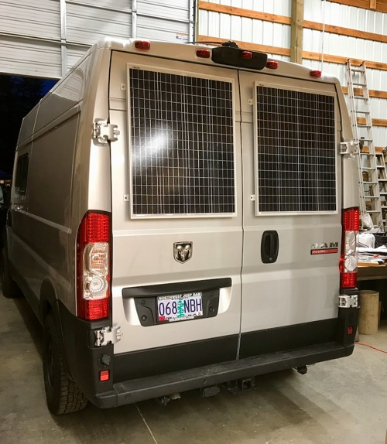
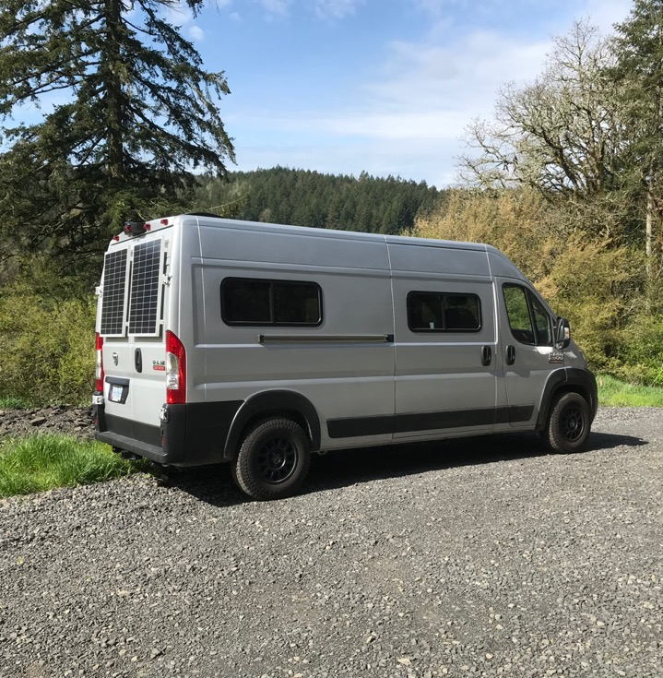
Solar panels on the back doors
I mounted a single 200-watt solar panel on the roof, so there is good summer solar output. With the back door panels, I get better winter output. The main advantage is solar generation for the northern hemisphere. In the non-summer months these panels will get better power than roof mounted panels.
For those who live in snowy regions, the panels on the back doors will usually not have snow on them, unlike the roof mounted panels. They will get direct sun power and reflection from the snow on the ground.
Solar panels mounted on the back have no wind issues or reduction in gas mileage, unlike roof mounted panels.

Slide 14
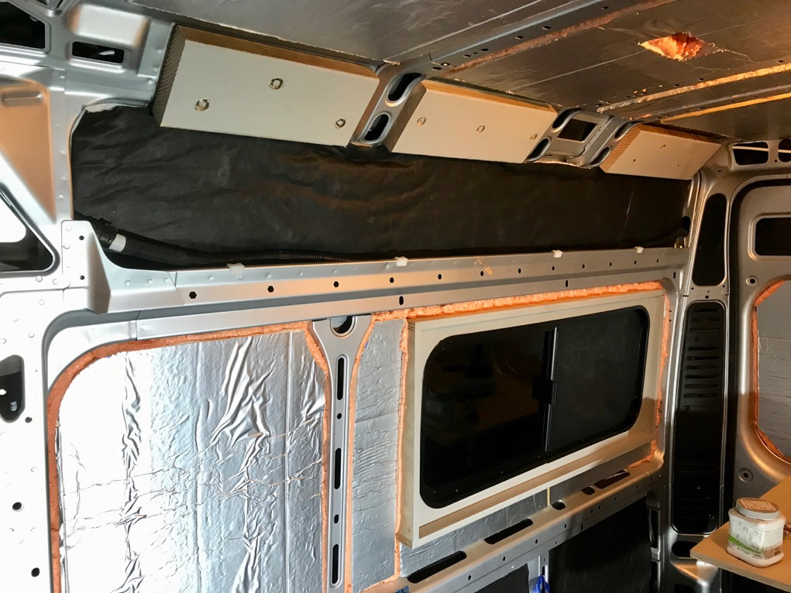
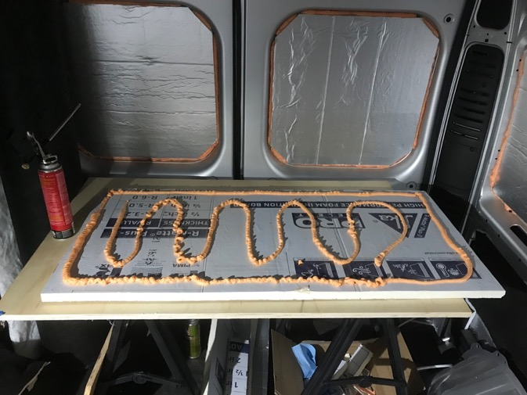
Insulation
There are a lot of different ways to do insulation. Some are better than others. For example, you should not use standard fiberglass insulation.
Many experienced van builders have found the combination below to be practical and effective:
Polyiso foam boards mounted with Gaps and Cracks spray foam is a “tried and true” way to attain R6 insulation and minimize any trapping of moisture. When this technique is applied to the large flat sections of a van build, it is easy to apply and the effective for the long term. About 75% of the surface area can be done this way.
The problem is all the corners and hard to reach areas! That is where I use Thinsulite. It is easy to cut and install and almost as effective against the heat and cold as Polysio. Thinsulate is easier to apply and stays in place better than wool.
See this scientific study of the top three insulation material used in van builds: https://www.buildagreenrv.com/insulation-testing-for-van-conversions/

Slide 15
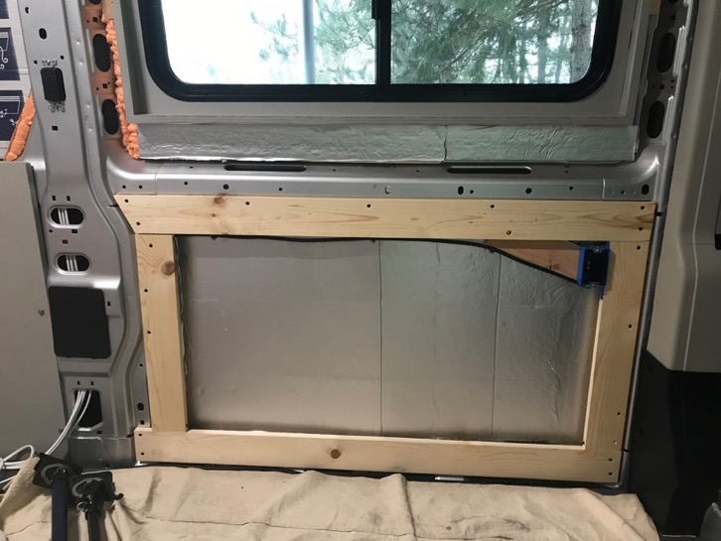
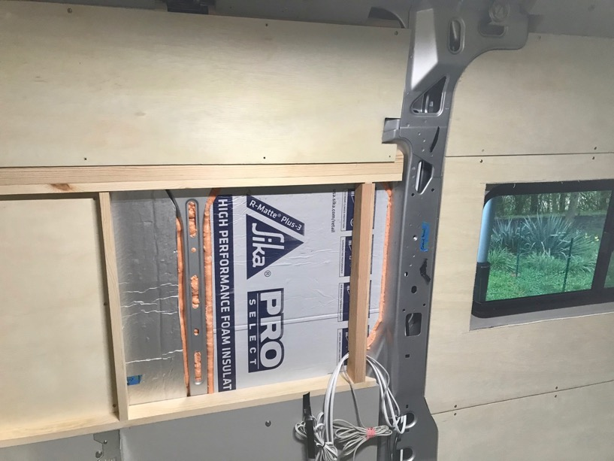
Wall Panels and Building Repair Techniques
Many van builds lose a lot of interior space by the techniques used to “frame” the van.
I do minimal framing to maximize interior space.
A lot of van builders also install "permanent" walls or other things that cause problems in the future.
It’s important to build vans in a way so they can be repaired.
Make it easy for anyone to access maintenance areas all over the van, especially electrical and plumbing components.
Difficult to remove wall panels can turn a 1-hour repair into a multi-day expensive operation.
What if the van buyer wants to do something different? If it was easier to fix and/or change the van is more sellable.

Slide 16
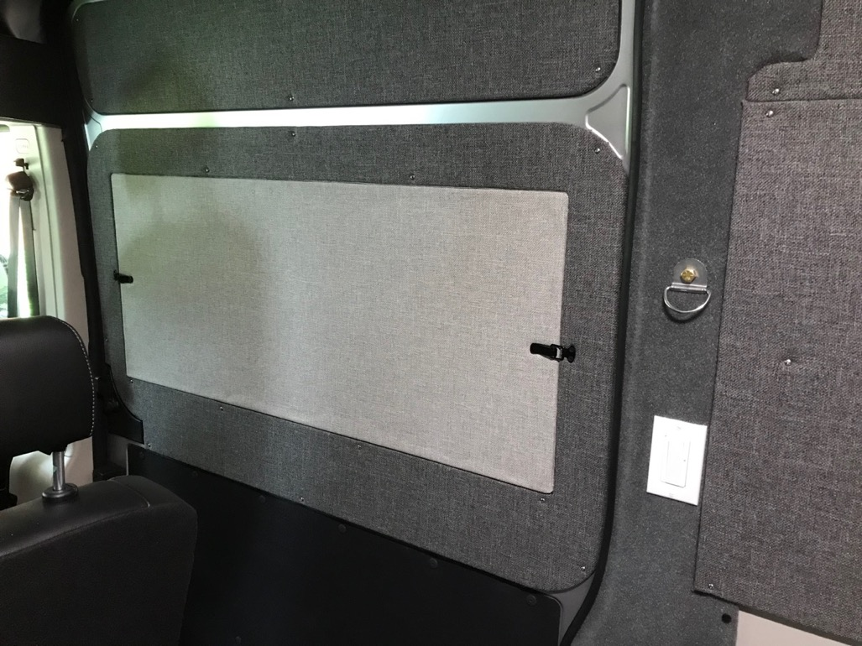
Insulated Window Coverings
Since my van builds are made for off-grid camping, I've spent a lot of time working on the insulation.
I build insulated panels to fit inside the window casing.
Some people avoid doing windows in their van, but these panels make it easier to have larger windows and minimize the drawbacks.
The window panels are easy to store.
They black out all light and have R6 insulation with a tight fit inside each window casing.
These have been tested down to 7 degrees.

Slide 17
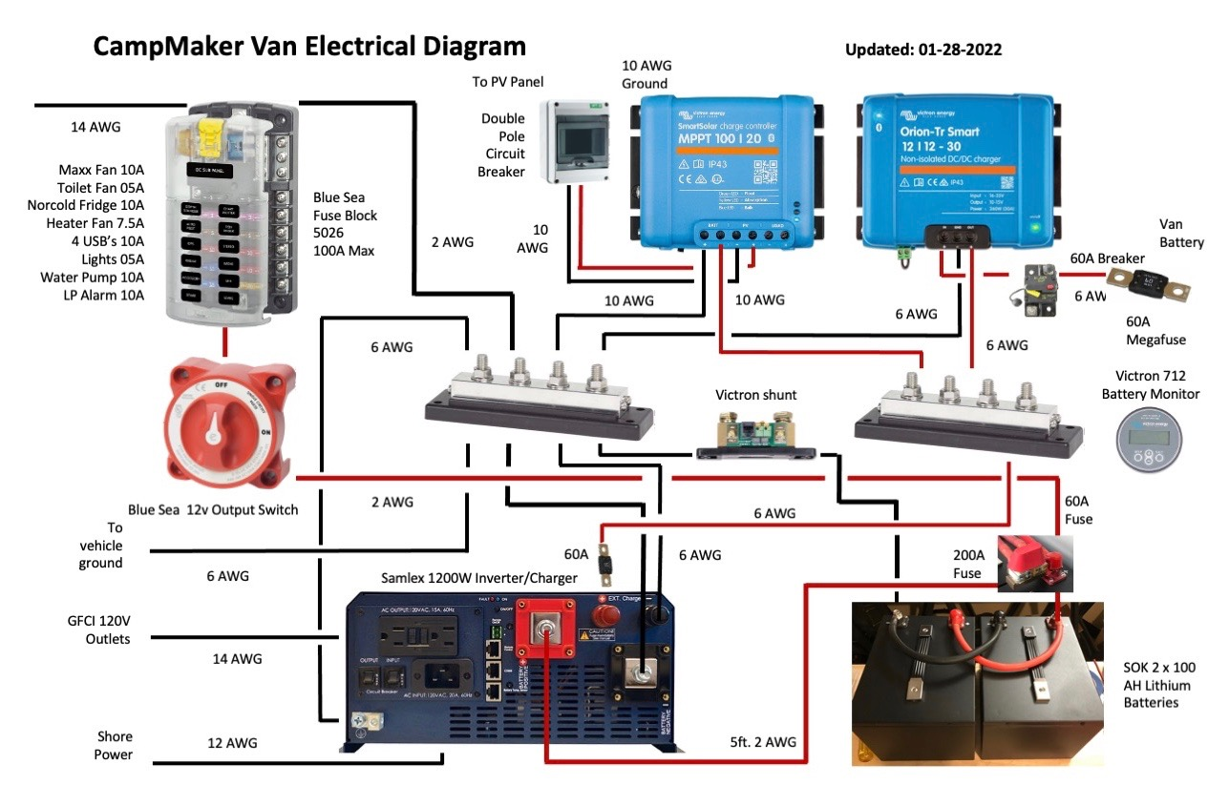
The electrical system is one of the most important parts of the build. This system has been developed with off-grid effectiveness and simplicity in mind. If you were to stay in RV parks with shore power almost all of this isn’t necessary.
Using high quality products like Blue Sea, Victron and SOK for batteries.
A 100% electric van build isn’t very practical because you likely need to use a fossil fuel for heating and cooking.
Many van builders assume a 3000-watt inverter/charger is needed, but this assumption isn’t necessary and creates a large number of issues. Instead this Samlex 1200-watt Inverter/Charger was chosen.

Slide 18
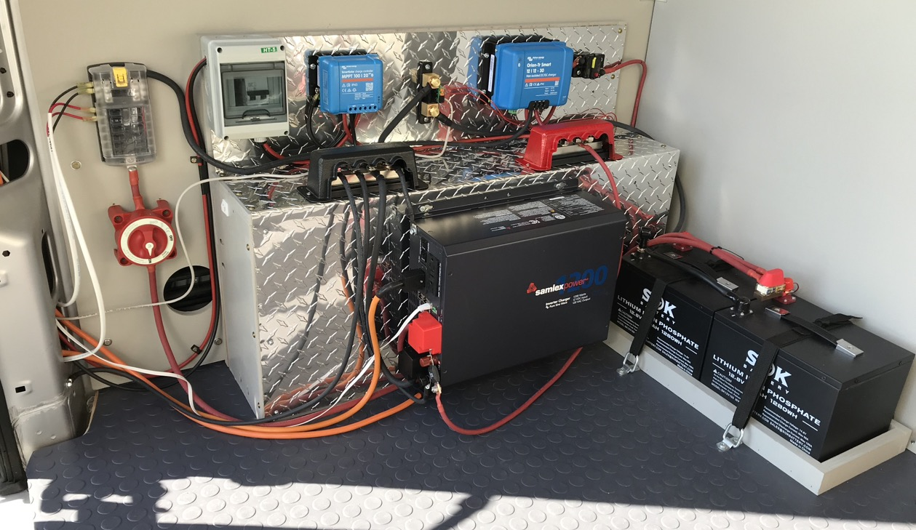

Slide 19
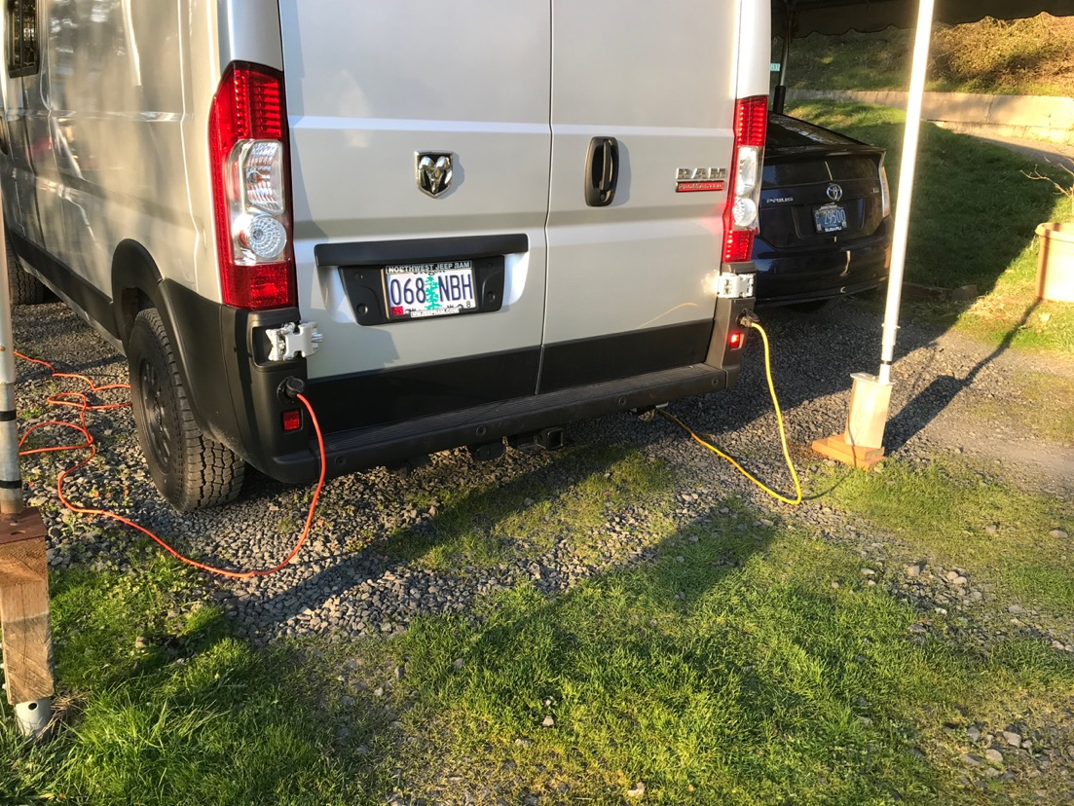
Power Outtages
When there are power outages the van batteries and inverter are very helpful if you have to wait for the grid to come back up. The rear taillight location works well for shore power connections. On the left is shore power input and on the right is an inverter out connection.

Slide 20
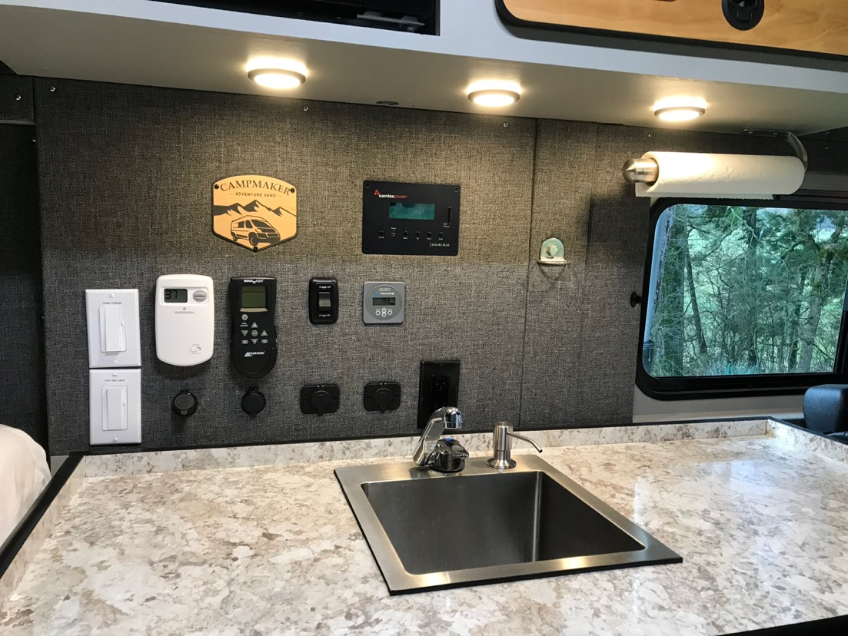
Camper Van Control Panel
Many van builds "hide" their switches and controls all over the van. It is easier if you have these controls in one place.
It is important to minimize the number of LED lights that glow at night in a camper.
This location is ideal for placing cell phones, CPAP, and other items that need to be plugged in at night.
There is a switch to turn off the fridge (if needed) when most of the 12-volt system is powered up.
It is important to know the state of charge of the house battery. The battery monitor shows this at a quick glance.
There are also Bluetooth apps for the battery monitor, solar charging, alternator charging and the propane tank level.

Slide 21
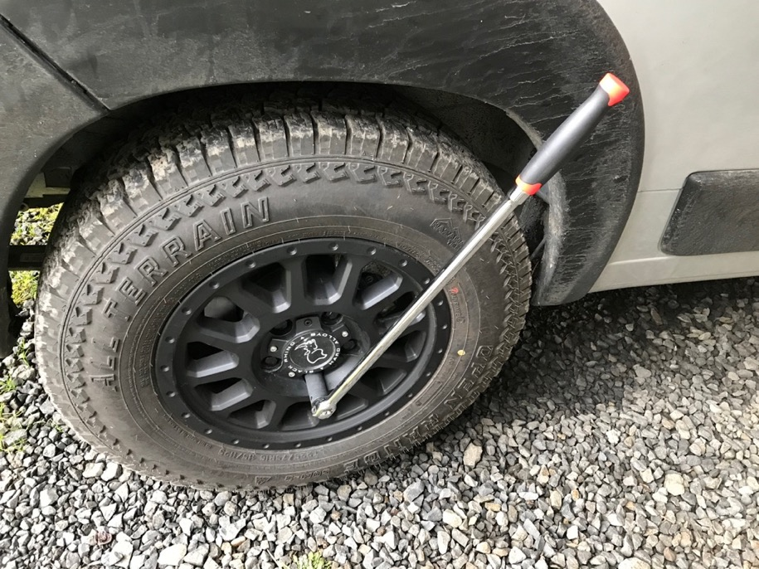
Changing a Tire
The ProMaster doesn’t come with a big enough lug wrench. You don’t want to be stuck on the side of the road a long way from help.
With every van project I add a 24-inch breaker bar to keep in the van. You’ll also need a deep socket to go with the wrench. The OEM size is 21 mm and these aftermarket rims use the 19mm lug nuts.
It’s also a good idea to raise and lower your spare tire at least once a year.

Slide 22
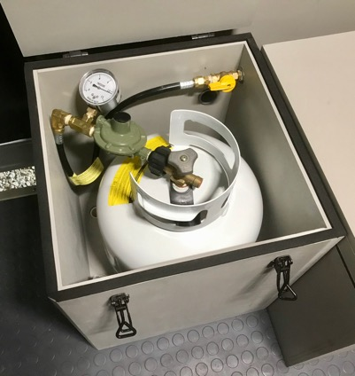
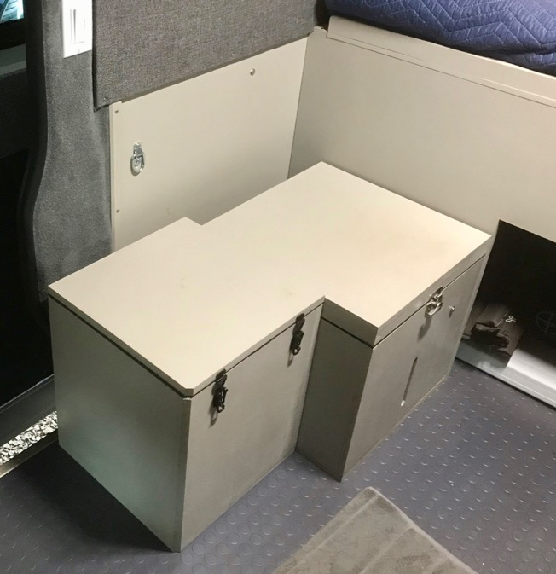
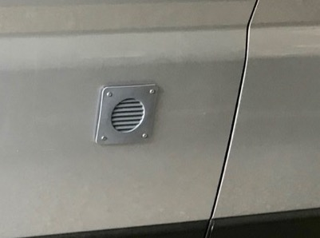
Propane Vault Mounting and Ventilation
Every cabinet or structure in a van build must be anchored securely in case of a crash.
The 5 gallon propane tank needs to be installed inside a vented, vaulted box and anchored to the floor of the van. I anchored this with 2 x 1/2 bolts through the base of the vault and van floor.
The industry standards for building RV's requires a propane vault to have two vents, one flush with the floor and the other near the top of the vault.

Slide 23
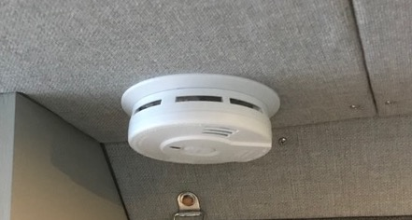
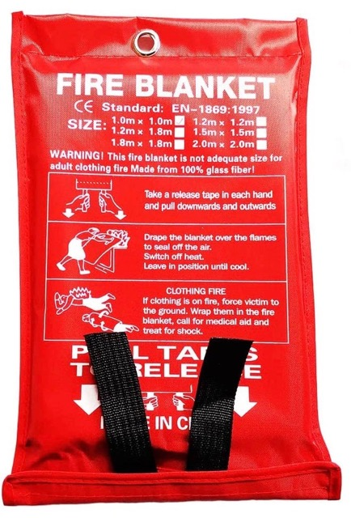
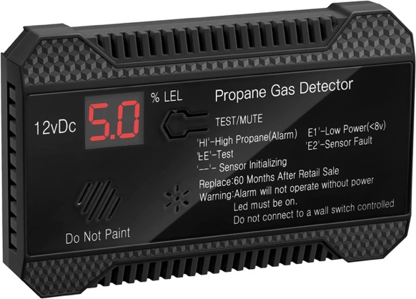
Smoke, CO and Propane Detectors
In many RVs there is a smoke detector on the ceiling and a combination propane (LP) and carbon monoxide (CO) down low.
It is actually safer to have a propane detector down low and a combination smoke/CO detector on the ceiling.
In addition to a fire extinguisher, these fire blankets are helpful especially for a kitchen fire.

Slide 24
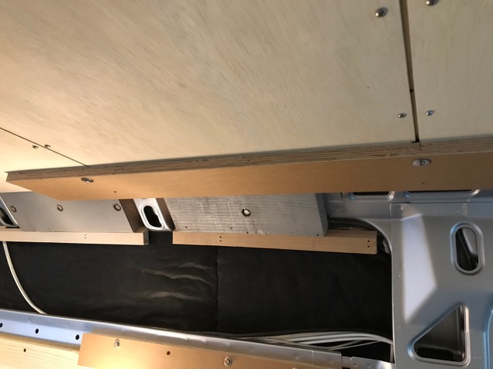
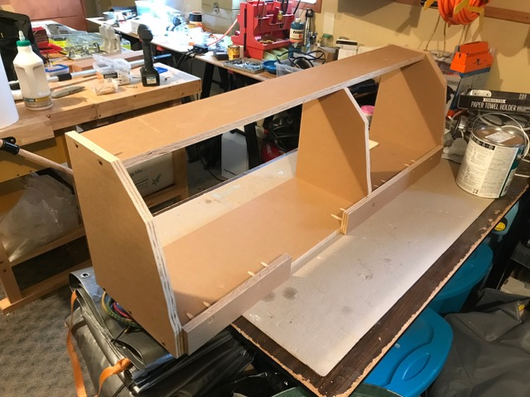
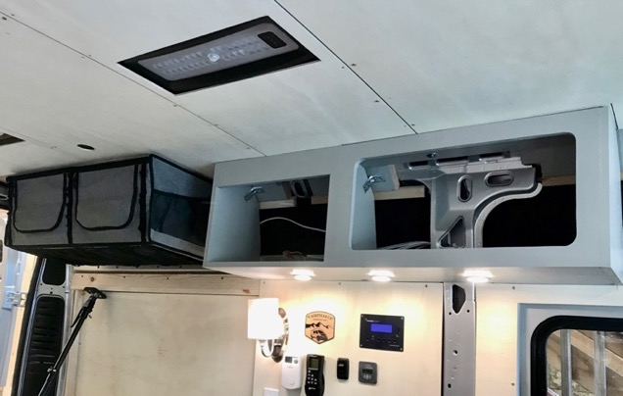
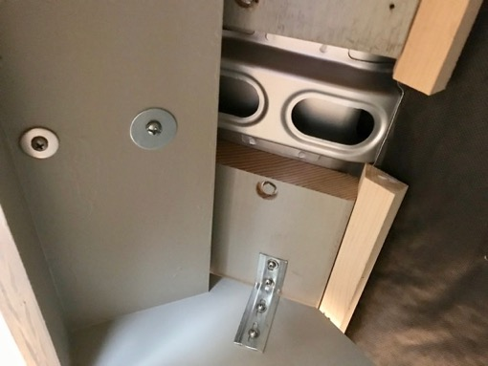
Upper Cabinets
Upper cabinets are one of the harder projects in a van build. They need to be solidly anchored and made from cabinet grade plywood.
One test of a well mounted upper cabinet is that you should be able to do "pull-ups" on it. Then it's probably strong enough.

Slide 25
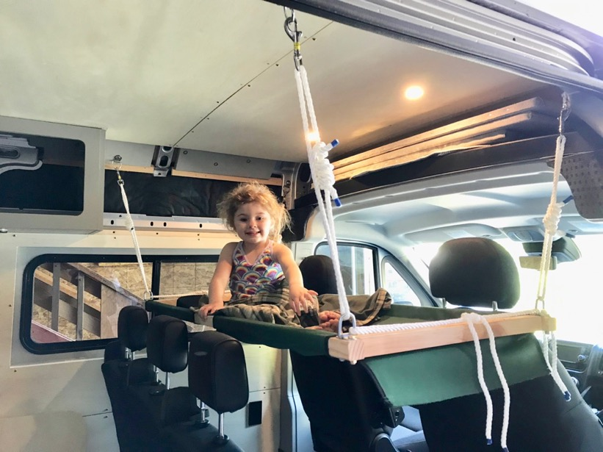
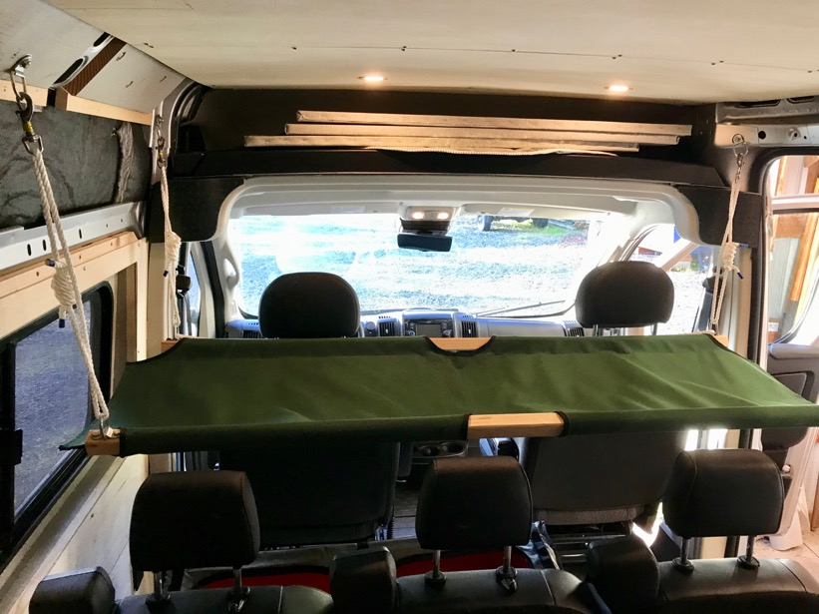
Hanging Cot
I created this hanging cot for kids to have a place to sleep in the van. This can be rolled up and stored under the passenger seat.

Slide 26
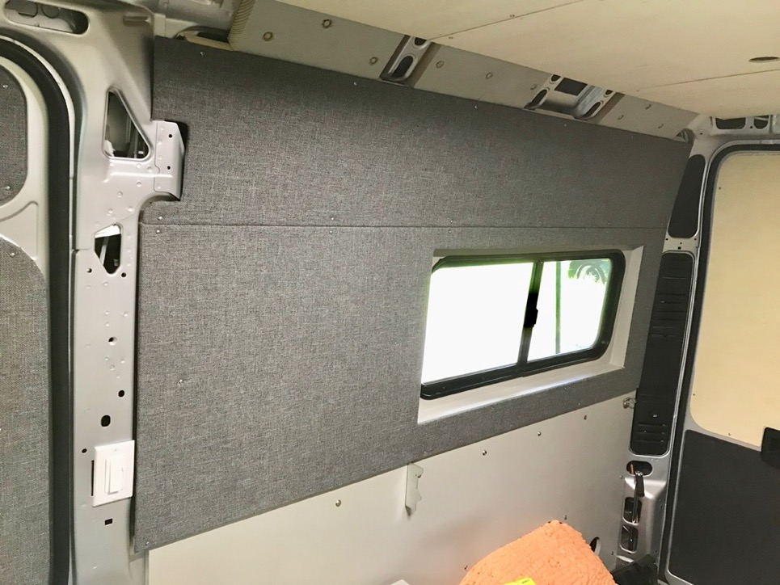
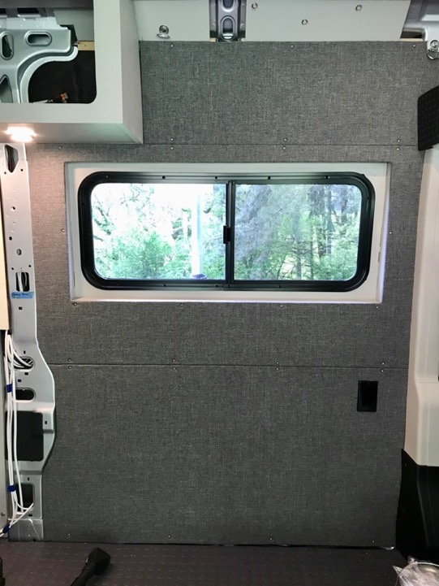
Marathon Fabric Panels
All the walls are covered with a ¼ plywood, 1/8 inch closed cell foam and Marathon Tweed Fabric. The fabric is fire retardant. It gives a soft touch and helps with both sound and temperature insulation. They can easily be removed, if necessary for any repair.

Slide 27
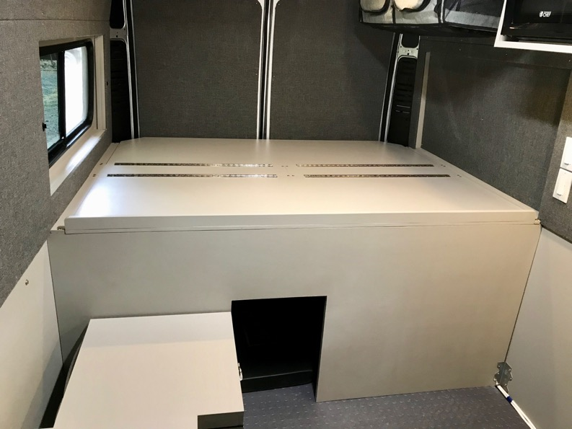
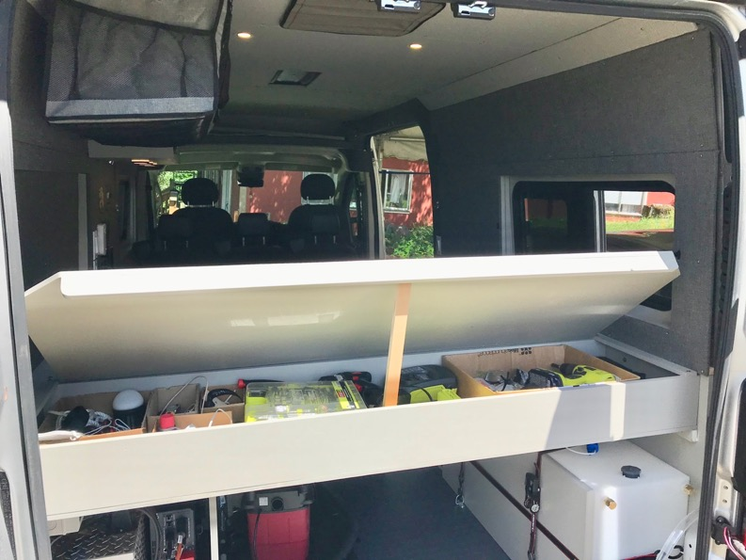
Bed Storage Area
An East/West bed arrangement allows a significant amount of storage. I’ve built a storage cabinet and cover under each half of the bed area. The front storage is often used for clothes and the back area can be used for tools and equipment. I'm regularly surprised when I need a tool and then I remember I have it in the van.

Slide 28
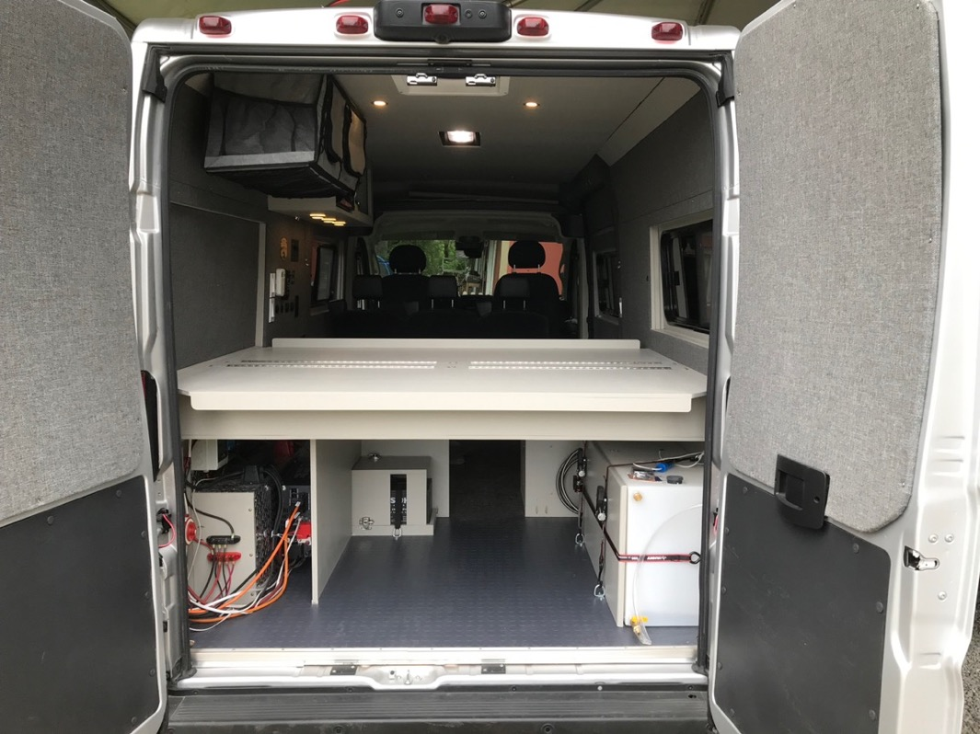
Garage Storage Area
An East/West bed arrangement allows a significant amount of storage in the “garage” area.
The left wheel well area is utilized for electrical equipment and the right is the over the wheel well water tank.
The middle section can store a lot of gear. It is set up for a dog kennel (up to 50 pound dog).
You can even haul 12-foot long lumber through the opening toward the front of the van.

Slide 29
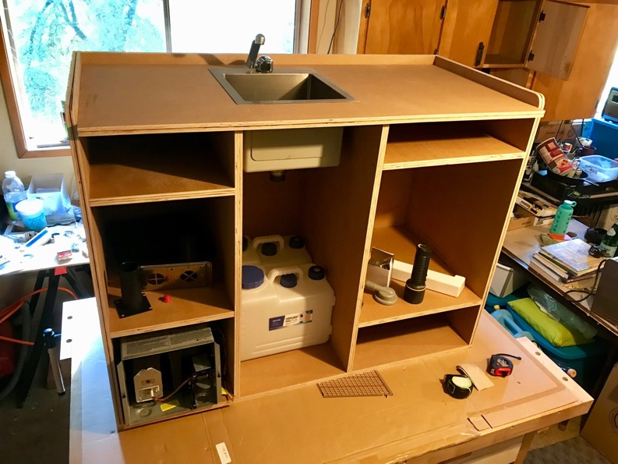
Dumping Grey Water Tanks
I use grey water jugs rather than under the chassis tanks because you have more options to empty them.
The under-chassis tanks can only be emptied in official RV dump sites.
These 2 x 4-gallon gray water tanks are easier to dump than the larger 5, 6 or 7 gallon "jerry jug" tanks.
You can dump a few gallons of biodegradable dishwater in the middle of nowhere. Rest stops, city parks and some campgrounds have public restrooms where it is easy to dump either these grey water.

Slide 30
Under the Kitchen Sink
In other van builds, I was disappointed when building this part of the galley and realized I couldn't store hardly anything under the sink because of the size and shape of the 5 gallon "jerry" cans.
This time I used a 22 gallon over the wheel well tank for fresh water and the shape of these two 4 gallon grey water tanks made room for a lot of the things you normally put under the kitchen sink like: paper towels, TP and the very important garbage can.
The white tray is a non-tipping "tip out tray". It is be good for sponges, etc.
Here is a link to the 4-gallon water jugs.
https://www.amazon.com/gp/product/B07LGNV26V/

Slide 31
Fresh Water System
Many RV water systems utilize a pressure pump with a large number of plumbing connections. In contrast, my plumbing/water system has two connections: one inside the tank where the pump is located and the other at the faucet. Every connection is a potential for failure and plumbing leaks are common in a van build. This is a 22 gallon over the wheel well tank with a submersible pump and this faucet. When you turn on the faucet it activates power to the pump. The photo shows the tank mounting method. It is secure, but easy to remove for cleaning or any other reason.

Slide 32
Suburban Propane Heater versus Others
16,000 BTU heater
No regular maintenance needed
Works at all altitudes, unlike many other heaters.
Thermostat can be set between 45 to 72 degrees. You can leave the system running, even when you’re not in the van.
Reliable operation and available parts.
Add themostat photo

Slide 33
A Few Trips to Test out the Van Design

