Slide 1
God’s work, your response
The Lutheran understanding of the Divine Service

Slide 2
What is the Divine Service?
In the Lutheran Church, we call our Sunday Services “Divine Service” rather than ”Worship Services”
This term comes from the German word, “Gottesdienst.”
This translates to “God’s service”
By calling the Sunday service the “Divine Service,” we are confessing the fact that what is happening in the Service is not our doing anything for God, but God doing for us.
The Divine Service is all about God giving his gifts to us!

Slide 3
Liturgy: the Work in the church
Throughout history, the Church has followed a set rubric for how the service is conducted, called the liturgy.
The term liturgy come from the Greek word, λειτυργία (leitourgia), meaning “work of the people”.
“To the Greeks it meant public burdens, such as tribute, the expense of equipping a fleet, or similar things” (Ap XXIV 81).
But leitourgia isn’t a tax in the way that we think of taxes today, but a work of good faith to the empire for the public good.
The early church used the word to describe what “God the Father was doing in sending His Son for the life of the world, or for the life of all creation.
“The Son’s liturgy is to free the world form the bondage of its fallenness through His bloody death – to take into His own flesh our sin, our sickness, and our death, so that when He was lifted up on that cross, the new creation He brought meant the end of bondage and the beginning of a new, liberated cosmos that waits for the full release at the second coming.

Slide 4
The divine service
No matter which setting of the Divine Service used (at least when considering the setting within Lutheran Service Book) the same sequence is followed, just with different musical settings or scriptural passages.
In the liturgy, the various elements are composed of either driect passages of Scritpure (the Offertory), paraphrases or synopses of Scripture (the Gloria in Excelsis), or historical liturgical texts (the Apostles’ and Nicene Creeds).
In Lutheran Service Book, each element is cited with the Scripture reference or marked as a liturgical text.
Using these various elements of the liturgy, there is a general shape which the service takes: the downward giving of gifts from God followed by an upward giving of thanks as our response of faith.

Slide 5
The divine service
The elements of the liturgy are divided into two categories: proper and ordinary.
The proper elements are the ones which are specific to the day or season of the church year
Introit
Collect of the Day
Gradual
Alleluia and Verse
Proper Preface
The ordinary elements are the parts which are the elements which remain the same
Kyrie
Gloria in Excelsis
Sanctus
Agnus Dei
Nunc Dimittis

Slide 6
The divine service
Entrance
WORD
Preparation
SACRAMENT
Distribution
Confession & Absolution
Introit
Kyrie
Gloria
Collect
Old Testament
Gradual
Epistle
Alleluia
Gospel
Sermon
Creed
Prayer of the Church
Preface
Proper Preface
Sanctus
Lord’s Prayer
Words of Institution
Peace of the Lord
Agnus Dei
Communion Distribution
Canticle
Collect
Benediction
Offering
Offertory

Slide 7
Entrance
Confession and Absolution
Begins with the invocation of the name of the Trinity
Reminder of the name which was placed on you in your baptism.
Responsory of Scripture passages regarding the gift that God has given us of Confession and Absolution.
1 John 1:8-9 (Divine Service, Setting One)
Hebrews 10:22; Psalm 124:8; Psalm 32:5 (Divine Service, Setting Three)
Introit
Literally “the entrance.”
When the baptismal font is located at the back, the Confession and Absolution was performed at the font, and an appropriate Psalm for the day was chanted as the pastor entered the sanctuary.

Slide 8
entrance
Kyrie
Repetition of the Greek phrases “Kyrie eleison. Christe eleison. Kyrie eleison.”
“Lord, have mercy. Christ, have mercy. Lord, have mercy.”
This prayer is prayed either by itself or in conjunction with other prayers for the church and the people.
Gloria in Excelsis
Musical setting of the song of the angels as they proclaimed Jesus’ birth.
Song of praise and thanksgiving sung by the Church for what God has done for her.
Sometimes replaced by the liturgical hymn “This Is the Feast” which is a song of praise relating to Christ’s victory over sin, death, and Satan, given in the Sacrament.

Slide 9
entrance
Salutation
Used as a marker of transition from one part of the service to the next.
When spoken by an ordained pastor, the response is “And with thy spirit,” which is a recognition of the work of the Holy Spirit in the ordination.
When spoken by a lay person, the response is “And also with you.”
Collect of the Day
A prayer which focuses on the themes in the Gospel reading for the day.

Slide 10
Service of the Word
Old Testament Reading
Later addition to the historical liturgy.
The Divine Service in The Lutheran Hymnal did not include the Old Testament reading.
In the modern lectionaries, the Old Testament reading is related to the Gospel reading for the day.
Sometimes replaced by a reading from the books of Acts or Revelation.
Gradual
Spoken or chanted scripture passages related to the season of the Church Year.

Slide 11
Service of the Word
Epistle Reading
A reading from either the Pauline or General Epistles.
In modern lectionaries, the Epistle is selected based on a lectio continua system, where the Epistle is read in consecutive order.
Alleluia and Verse
Triple repetition of Alleluia prior to the reading of the Gospel for the day.
Can be sung once by itself or twice with an appropriate verse for the day chanted between.

Slide 12
Service of the Word
Gospel Reading
A reading from one of the Four Gospels
In the Lutheran Church, we follow one of two lectionaries, a one-year cycle or a three-year cycle.
The one-year cycle follows the historical lectionary of readings, using readings from all four Gospel throughout the year.
The three-year cycle focuses on one of the three Synoptic Gospels (Matthew, Mark, and Luke) with readings from John spread across all three years.
The central theme of the day of the Church Year.
The propers for the day are related to the Gospel reading of the day.
During the Festival Season the Gospel reading is related to the theme of the season.
During the Season of the Church, the Gospel reading follows a lectio continua of the Gospel of the year.

Slide 13
Service of the word
Sermon
Explanation and expansion of the readings of the day.
Usually based on the day’s gospel readings, but can be based on the Old Testament, Epistle, or Psalm of the day.
Proclamation of law and gospel contained in the reading.
Creed
Unified confession of the Christian Faith.
Confessed through one of the three Ecumenical Creeds
Apostles’ Creed is typically used for non-Communion services and baptisms.
Nicene Creed is typically used for Communion services.
Athanasian Creed is typically used for Holy Trinity Sunday.
These patterns may be changed based on local tradition.

Slide 14
Service of the word
Prayer of the Church
Series of prayers and supplications made for the Church at large, the nation, individuals in need, thanksgiving, and any other particular prayer requests made.

Slide 15
Preparation
Offering
Sacrifice of thanksgiving made by the people in response to the gifts which God has given in this life.
In modern times, this gift is usually monetary, but in the ancient Church, the offering was of goods to be distributed to the poor of the congregation as well as the bread and wine to be used in the Sacrament for the day.
Offertory
Musical setting of a Psalm focusing on what God does for us in the Sacrament or as part of the thanksgiving of the offering.
Psalm 116 (Divine Service, Setting One)
Psalm 51 (Divine Service, Setting Three)

Slide 16
Service of the sacrament
Preface
Responsories which prepare the people to receive the body and blood of Christ in the Sacrament.
The oldest part of the liturgy.
Proper Preface
A prayer of thanksgiving for the work of Christ’s sacrifice for all sin and all people.
Changes based on the season or the Day, but still proclaims Christ’s work of atonement.
Sanctus
Latin for “holy.”
Musical setting of the song of the angels from Isaiah 6 and the cries of the people during Jesus’ Triumphal Entry into Jerusalem from Matthew 21.

Slide 17
Service of the sacrament
Prayer of Thanksgiving
Prayer giving thanks to God the Father for his creation and sending of the Son, to God the Son for his work of redemption on the cross and the giving of his body and blood in the Sacrament, and to God the Holy Spirit for enlivening dead sinners and pointing us to Christ as our salvation.
Lord’s Prayer
The prayer of the baptized taught by Christ as the template for prayer.
Words of Institution
The words of Jesus spoken when he instituted the Lord’s Supper.
Lutheran Service Book uses a combination of the words recorded in Matthew, Mark, Luke, and 1 Corinthians.

Slide 18
Service of the Sacrament
Pax Domini
Latin for ”Peace of the Lord.”
Proclamation of the peace given in the sacrament, the peace between God and man in the forgiveness of sins.

Slide 19
The Distribution
Agnus Dei
Latin for “Lamb of God”
Canticle which points the Church to the work of Christ in winning your forgiveness through his death and resurrection which He gives to you in the body and blood of Christ given you to eat and drink.
Communion Distribution
The giving of the body and blood of Christ
During the distribution, the congregation sings hymns which either reinforce the theme of the day or the gifts being given in the Sacrament.

Slide 20
Distribution
Post-Communion Canticle
Usually a musical setting of the Nunc Dimittis, the song sung by Simeon following his encounter with the infant Christ.
By singing this canticle, the Church rejoices in the fact that she has had an encounter with the incarnate Christ in the reception of His body and blood.
Post-Communion Collect
Prayer of thanksgiving prayed by the church for the gifts received in the Sacrament.

Slide 21
Distribution
Benediction
Blessing from God spoken over the people by his representative in the congregation.
Two forms are generally used: the Aaronic or Pauline Benediction
The Aaronic Benediction is the blessing proclaimed by Aaron over the people in Numbers 6
The Pauline benediction is the blessing which Paul used to close his second letter to the Corinthians
Either version of the Benediction emphasizes the blessing from the one, true, triune God.

Slide 22
The Church year
Like a calendar year, the Church Year is marked and governed by seasons and occasions.
Each season or occasion has a color associated with it.
Liturgical Colors:
Blue | Purple/Violet
White | Red
Green | Rose (Pink)
Black

Slide 23
The church year – liturgical Colors
Blue
The color of hope
Reminder of the hope which all Christians have in Christ.
Hope not in the sense of wanting a possibility, but in assurance of what Christ has secured and promised for you.
Used during the Advent season in some places.
White
The color of the righteousness of Christ.
Focuses on the work of Christ in securing your salvation.
Used during the Christmas season, Easter season, Holy Trinity Sunday, and (non-martyred) saints’ days

Slide 24
The church year – liturgical Colors
Green
The color of life.
Reminder of the growth of the church through the ministry of Jesus.
Used during the Epiphany and Pentecost (or Trinity) seasons.
Black
The color of mourning.
Used for the mourning of our sins and the results of sin for ourselves and for Christ.
Used on Ash Wednesday and Good Friday.

Slide 25
The church year – liturgical Colors
Purple/Violet
The color of royalty and the color of repentance
Focuses on what our King did for us in coming to earth and dying for our sins and our repentance for the sins for which Christ died.
Used during Lent and Advent (in some places).
Rose (Pink)
The color of joy
Reminder of the rejoicing which is brought about by salvation in Christ.
Used for Advent 3 (Gaudete), Lent 5 (Laetare), and Easter 4 (Jubilate)

Slide 26
The church year – liturgical Colors
Red
The color of the Holy Spirit and his work.
Reminds us of the working of faith by the Holy Spirit within the church.
Used for the Day of Pentecost, Church events (confirmation, ordination/installation, anniversaries, etc.), Reformation Day, Martyr feast days.

Slide 27
The Church year - Seasons
Advent
Beginning of the Church Year
Focuses on the comings of Christ
First coming at Christmas
Final coming on the Last Day
Current coming in the Word and Sacraments
Uses either blue or violet as the color

Slide 28
The Church year - Seasons
Christmas
Celebration of the nativity of Christ
Focuses on the early life of Jesus.
Uses white as the Color.
Epiphany
Means “appearing” or “manifestation”
Focuses on Christ revealing himself as God through miracles
Uses green as the color.

Slide 29
The Church year - Seasons
Lent
Season of reflection and repentance for the sins which caused Christ to come to this world to die for our sins.
Focuses on what Christ did for us to redeem us from our slavery to sin.
Secondary focus on the death caused by sin.
Uses purple/violet as the color for the season and black for Ash Wednesday and Good Friday.

Slide 30
The Church year - Seasons
Easter
Victory celebration following the resurrection of Christ.
Focuses on the results of Christ’s victory for you.
Uses white as the color.
Pentecost
The season of the Church.
Focuses on the growth of the Church through the preaching and teaching of Christ and the work of the apostles in Christ’s name.
Uses green as the color

Slide 31
The Church year - Seasons
Feast Days
Celebrations of people or events within the church.
Focuses on the life of faith or the work of the Spirit in the individual or event.
Uses either red or white as the color.

Slide 32
Lex orandi, Lex Credendi
How practice reflects the faith of the Church.

Slide 33
God’s work, human hands
In the Divine Service, God uses earthly means to deliver his gifts.
This is most clearly seen in the Sacraments, where God delivers his gifts of forgiveness, life, and salvation through the water of Holy Baptism and the bread and wine of the Lord’s Supper.
However, God uses other earthly means to deliver his gifts, namely the pastor to be God’s hands and mouthpiece in the local congregation.
Just as different congregations will have different practices regarding baptism or use different types of bread and wine in the Sacrament of the altar, each pastor will have different styles and practices despite using the same liturgy as other pastors do.

Slide 34
Clerical Vestments
As part of the confession of the office of the ministry, Lutheran pastors often specific vestments depending on their office and the type of service being held.
These vestments help to make a visual barrier between the office and the man operating within the office.
The similarity of vestments among pastors reinforces the fact that it is the work of the office of the ministry to preach, teach, and administer the sacraments, not the man who holds the office at any given time.

Slide 35
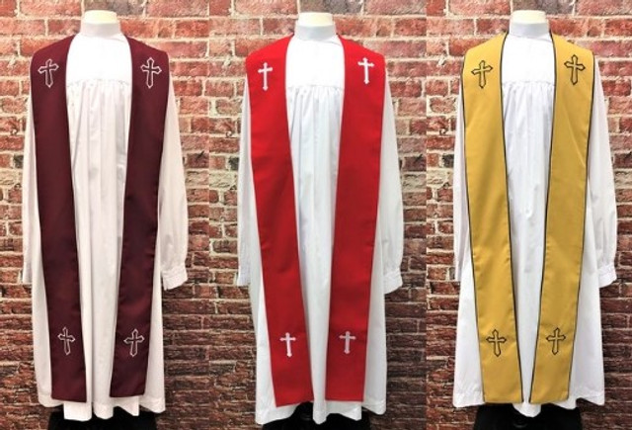
Clerical vestments
Stole
Sign of the office of the ministry and ordination of the individual.
Generally matches the color of the season.
Worn across the neck and shoulders (like a yoke).

Slide 36
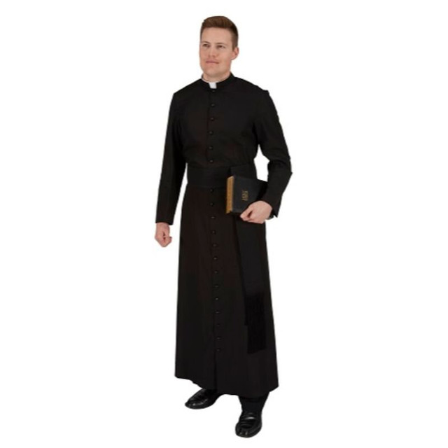
Clerical Vestments
Cassock
Derives from the Roman tradition of wearing a tunic under a toga
Occasionally worn as every day clerical garb, commonly used today as a base layer under other garments.
Can be worn by either clergy or laity assisting in the service.

Slide 37
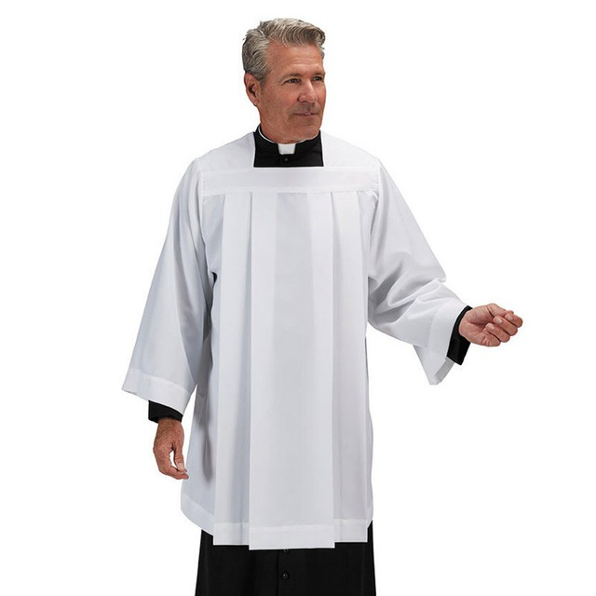
Clerical Vestments
Surplice
White Garment (usually knee-length) worn over a cassock.
Used for non-sacramental services or by assistants to the celebrant in the Divine Service.
The white over black look of the cassock and surplice calls to mind the sinner covered by the righteousness of Christ.
Can be worn by clergy of laity.

Slide 38
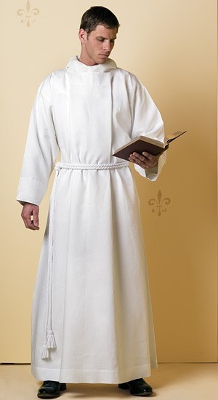
Clerical Vestments
Alb
Wrap-around white garment secured by a cincture.
Can be worn as a stand-alone vestment or underneath other vestments.
Can be worn by clergy or laity.

Slide 39
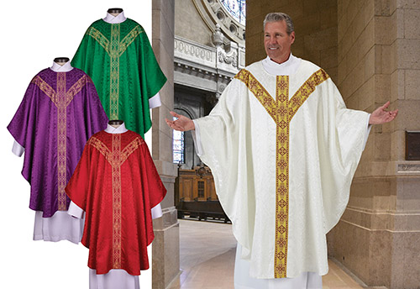
Clerical Vestments
Chasuble
Colored, overlaid garment worn by the celebrant of the Sacrament of the Altar.
The color of the chasuble matches the color of the season or day.
Worn only by clergy.

Slide 40
Liturgical Practice
Chanting
Elevated form of speech derived from the traditional singing of Psalms during the service.
Used today in the church to draw attention to what is being said in the liturgy and the work which God is doing for you in the liturgy.
Also creates a difference between the everyday life and the work of God in the Divine Service.

Slide 41
Liturgical Practice
Genuflecting
An act of reverence signaled by bowing to one knee before the king.
A sign of unworthiness of the one bowing when compared to the one being bowed to.
In the Divine Service, genuflecting is traditionally done in two instances:
At the speaking of “and was made man” during the Nicene Creed
Following the blessing of the bread and wine during the Words of Institution
Both instances are a recognition of the presence of Christ, either in his incarnation or in the true presence of Christ in the Sacrament.

Slide 42
Liturgical Practice
The Reliqua
Latin for “the remaining” and refers to the Communion elements which were prepared and consecrated but not distributed and consumed in the Sacrament.
The Lutheran confession of the Sacrament teaches that the Sacrament of the Altar ”is the true body and blood of our Lord Jesus Christ in and under bread and wine, which we Christians are command by Christ’s Word to eat and to drink.”
The real presence of Christ is not given temporal bounds; there is no end point in which the bread and wine stop being the body and blood of Christ.

Slide 43
Liturgical Practice
The Reliqua (continued)
As the consecrated elements are the body and blood of Christ, the reliqua are to be treated as such.
Scripturally, there is no command regarding what is to be done with the reliqua, but the presence of Christ demands that they be treated reverently.
Reverent handling usually happens in one of three ways:
Returning the elements to the earth
Storing the consecrated elements separately from unconsecrated elements to be used in the future.
Consuming the elements in the presence of the people.

Slide 44
Liturgical Practice
The Reliqua
Returning the elements to the earth
Pro: ensures that the body and blood of Christ are not simply thrown out like garbage or poured down the drain to the sewer
Con: can be seen as wasteful when considering budgets for a congregation.
Storing the elements
Pros: uses the consecrated elements according to Christ’s intent (when used at a later service or for home visits.)
Cons: can be mixed back in with unconsecrated elements
Consuming the elements
Pros: shows that the elements were used according to Christ’s command and will not be abused through later improper use
Cons: can be seen as wasteful like with returning the elements to the earth.

Slide 45
”It’s too catholic”
The word “catholic” come from the Greek phrase, “κατα ὁλη” (cata whole-ay) which means according to the whole or group.
Something that is catholic is something that is common to the confession and practice of the Christian Church
This term is often used interchangeably with ”Roman Catholic” which is a confusion of terms.
Many liturgical practices are catholic, but not exclusively Roman.

Slide 46
Why sing in church?
Singing has been a part of the church for almost as long as the Church has existed.
In a modern, liturgical church, hymns are teaching tools for the faithful.
Music helps a person to remember the content of the lyrics.
Luther even wrote a hymn to help teach the chief parts of the Catechism because music helps a person to retain the information.
The hymns in our hymnal are organized into categories (either seasonal or topical) based on what a particular hymn teaches.
The hymns for a given Sunday are often based on the Gospel reading (or other reading used as the sermon text) but can also be selected based on outside factors (world events, local issues, etc.) to hear scriptural wisdom on a topic.

