Slide 1
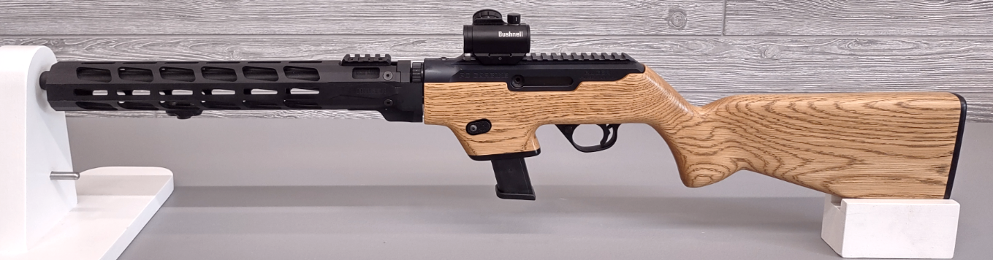
WOOD CHASSIS
INSTALLATION GUIDE
RUGER PC CARBINE, WOODSHOP WEDNESDAY LLC
PCC_WC_INST_R0_2023

Slide 3
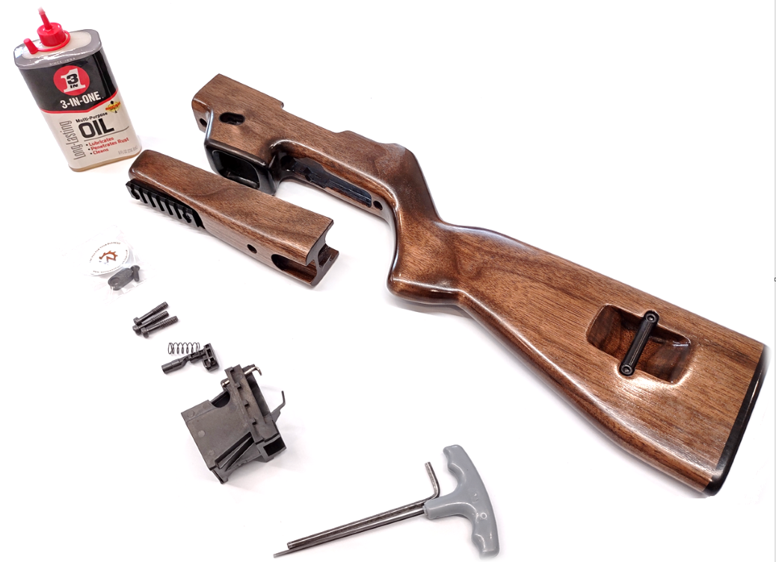
STEP 1:
QUESTIONS? CONTACT US AT
Angela@woodshopwednesday.com
Return Policy
We offer a 100% money back guarantee. If you are unhappy with the product or it is not up to your expectations, please specify the reason in writing and return the stock within 60 days of the purchase date. We will issue a full refund including the return shipping cost provided the stock has not been damaged or altered in any way.
Warranty or Repairs
We warranty the functionality and craftsmanship of the stock for 120 days from the date of purchase. We do not warranty the finish of the stock with respect to scratches, cracks, gauges, or any other type of damage caused by abuse or neglect. Please contact us if your stock ever becomes damaged or unfunctional (even if past this warranty period).
BELOW ARE THE PARTS AND TOOLS REQUIRED FOR THIS INSTALL.
NEW WOODSHOP WEDNESDAY
WOOD CHASSIS & MAGAZINE RELEASE BUTTON
3-1 OIL
(NOT INCLUDED)
FACTORY
MOUNTING
SCREWS
(RE-USE)
GLOCK MAG WELL,
FACTORY MAG CATCH & SPRINGV(RE-USE)
HEX ALLEN KEYS
(NOT INCLUDED)
ENSURE RIFLE IS CLEARED AND TRIGGER SAFETY IS ENGAGED. SEPARATE THE BARREL FROM THE RECEIVER. REMOVE THE RECEIVER FROM THE FACTORY STOCK BY UNSCREWING THE TWO HEX SCREWS UNDER THE STOCK. FULLY REMOVE SCREWS AS THESE WILL BE REUSED WITH THE NEW WOOD CHASSIS.
Woodshop Wednesday LLC
Handcrafted in Massachusetts
REMOVE
FACTORY HEX SCREWS

Slide 4
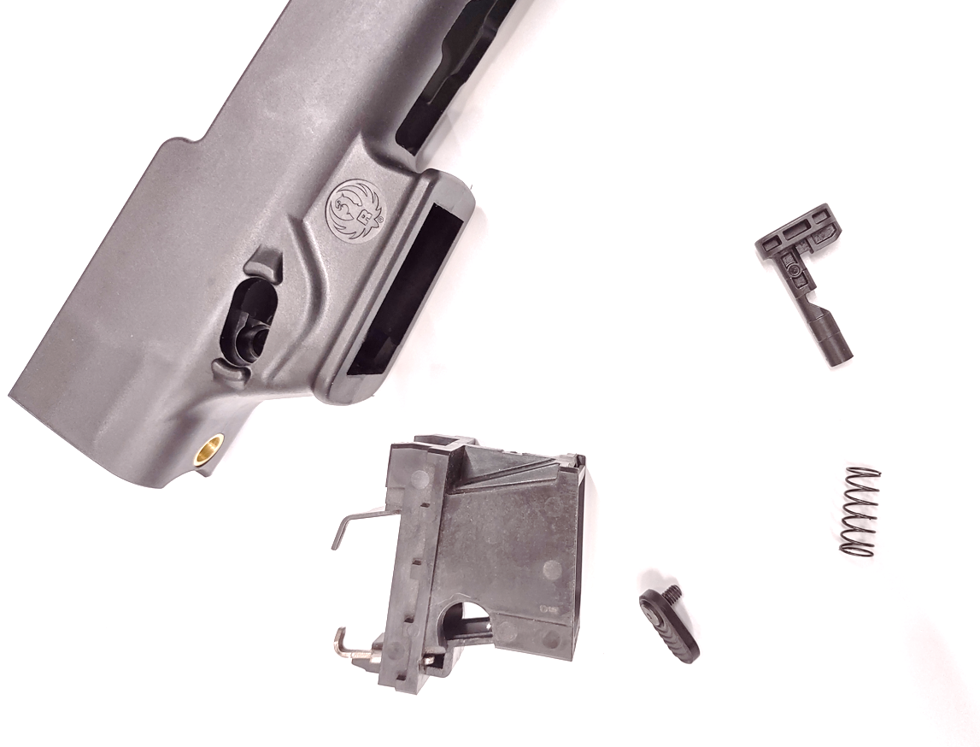
Step 7- Reinstall the barrel and insert a empty magazine. With the empty magazine installed, pull back the charging handle to ensure that the chamber locks back when empty. Your pc9 rifle with your new wood stock is now ready to use!
STEP 2:
STEP 7:
INSTALL YOUR NEW HANDGUARD USING THE ORIGINAL FACTORY RUGER MOUNTING SCREW. TEMPORARILY INSTALL THE BARREL ONTO THE RIFLE WITH THE WOODSTOCK INSTALLED AND ADJUST THE HANDGAURD POSITION TO BE CENTERED WITH THE RIFLE STOCK. ONCE SATISFIED WITH THE POSITION, TIGHTEN THE MOUNTING SCREW TO 10-12 IN-LBS.
DO NOT TORQUE TO THE RUGER’S FACTORY SPEC.
REMOVE THE MAGAZINE WELL FROM THE RECEIVER POCKET. REMOVE THE MAGAZINE RELEASE BUTTON, SPRING, AND RELEASE CATCH. THE SPRING AND CATCH WILL BE REUSED WITH THE WOOD CHASSIS. THE NEW WOOD CHASSIS ONLY WORKS WITH THE GLOCK MAGAZINES.
YOUR NEW WOODSHOP WEDNESDAY CHASSIS INSTALLATION IS NOW COMPLETE. TO DOUBLE CHECK THAT THE STOCK IS INSTALLED CORRECTLY, INSERT AN EMPTY GLOCK MAGAZINE INTO THE MAGAZINE WELL AND CONFIRM THAT THE MAGAZINE CLICKS IN AND RELEASES PROPERLY. WITH THE MAGAZINE INSTALLED, PULL BACK THE CHARGING HANDLE TO ENSURE THAT THE CHAMBER LOCKS BACK. YOUR PC CARBINE WITH NEW WOODSHOP WEDNESDAY CHASSIS IS NOW READY TO USE!
FACTORY CATCH
(RE-USE)
WOODSHOP WEDNESDAY CHASSIS WITH WOOD HANGUARD
FACTORY MAGAZINE WELL
(USE GLOCK ONLY)
SPRING
(RE-USE)
FACTORY RELEASE BUTTON & SCREW
(NOT RE-USED)
MAGAZINE
RELEASE BUTTON
(SCREW MAY BE ON EITHER SIDE,
AMBIDEXTROUS DESIGN)
WOODSHOP WEDNESDAY CHASSIS WITH FACTORY FREE- FLOAT HANDGUARD

Slide 5
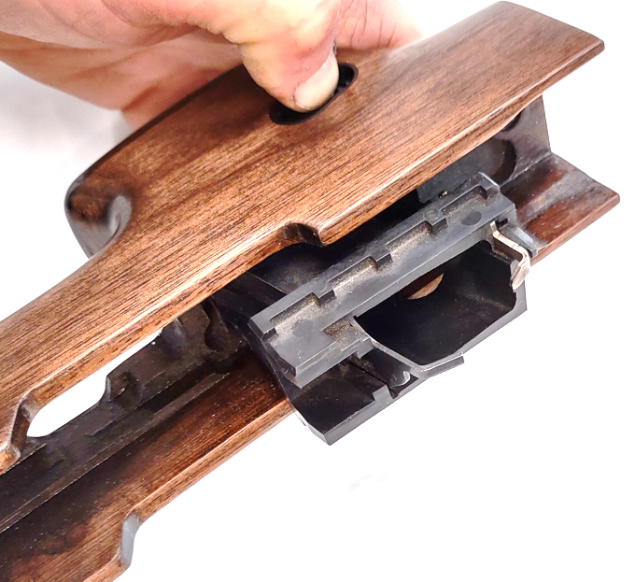
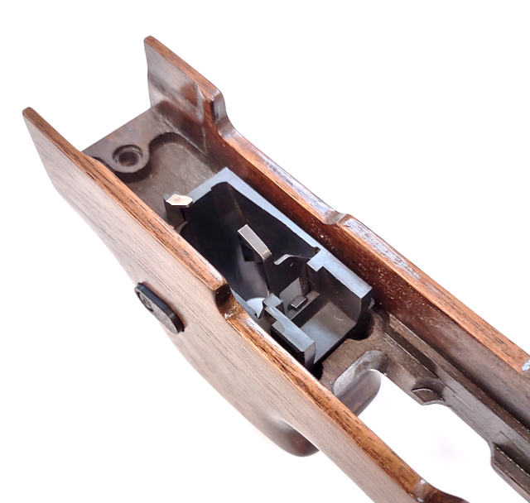
Step 4- Install the Glock magazine well into your new wood stock. The magazine release button needs to be fully depressed while installing the magazine well. Once installed, push the magazine well forward towards the barrel.
STEP 4:
STEP 5:
IF THE MAGAZINE WELL THAT WAS REMOVED IS FOR RUGER SR9 MAGAZINES, IT MUST BE REPLACED WITH THE GLOCK MAGAZINE WELL. THIS WOOD CHASSIS DOES NOT WORK WITH SR9 MAGAZINES.
INSERT THE GLOCK MAGAZINE WELL INTO THE STOCK. THE MAGAZINE BUTTON NEEDS TO BE FULLY DEPRESSED WHILE INSTALLING THE MAGAZINE WELL. ENSURE THE MAGAZINE WELL IS FULLY SEATED.
SLIDE THE RECEIVER INTO THE WOOD CHASSIS. INSTALL THE TWO FACTORY RUGER SCREWS AND EVENLY TIGHTEN SCREWS. TORQUE SCREWS TO 10-12 IN-LBS ENSURING THE RECEIVER IS FULLY SEATED INTO THE RECEIVER POCKET.
DO NOT TIGHTEN THE SCREWS TO FACTORY TORQUE .
SLIDE RECEIVER INTO CHASSIS
PRESS BUTTON FULLY WHILE INSTALLING GLOCK MAGAZINE WELL
RE-INSTALL THE
FACTORY SCREWS
AND TORQUE EVENLY
ENSURE MAGAZINE
WELL IS FULLY
SEATED INTO CHASSIS

Slide 6
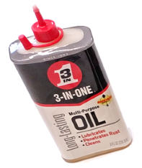
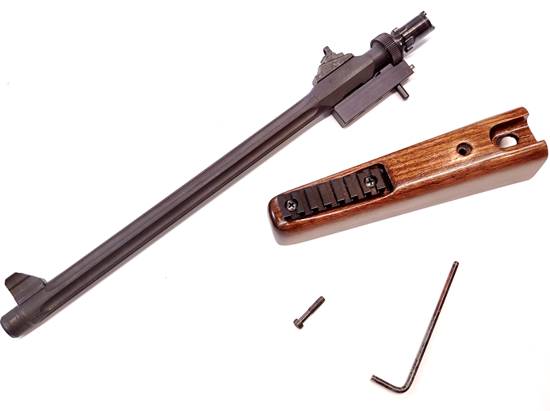
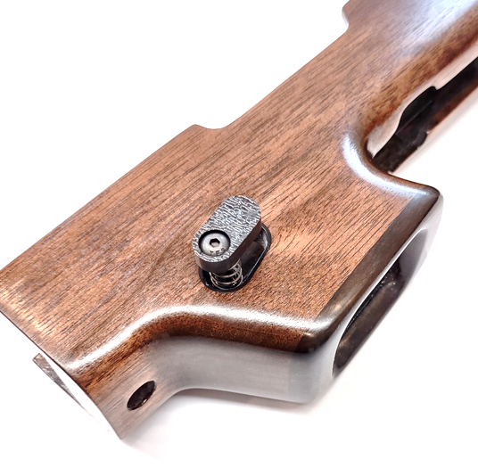
STEP 6: (HANDGUARD MODEL ONLY)
STEP 3:
INSTALL THE BARREL ONTO THE RECEIVER WITH THE NEW WOODEN CHASSIS INSTALLED. REMOVE THE FACTORY HANDGUARD BY REMOVING THE SINGLE SCREW. INSTALL THE NEW WOOD HANDGUARD AND LIGHTLY HAND-TIGHTEN THE SCREW. THE WOOD HANDGUARD HAS SOME ADJUSTABILITY TO CENTER AND ALIGN THE HANDGUARD TO THE STOCK. ONCE SATISFIED WITH THE HANDGUARD POSITION, TIGHTEN SCREW TO 10-12 IN-LBS .
DO NOT TIGHTEN THE SCREWS TO FACTORY TORQUE
APPLY OIL TO THE HOLE INSIDE THE PLASTIC INSERT AS WELL AS THE CATCH. INSERT THE CATCH ON THE OPPOSITE SIDE THAT THE RELEASE BUTTON IS TO BE INSTALLED. INSERT THE SPRING ON THE OPPOSITE SIDE. ENSURING THAT THE SPRING IS FULLY SEATED INTO THE POCKET. INSTALL THE NEW WOODSHOP WEDNESDAY MAGAZINE RELEASE BUTTON AND SCREW. THIS WILL REQUIRE HOLDING THE CATCH FROM THE OPPOSITE SIDE WHILE COMPRESSING THE SPRING WITH THE BUTTON. ONCE INSTALLED, CYCLE BUTTON FULLY IN AND OUT SEVERAL TIMES UNTIL THE ACTION FEELS SMOOTH.
APPLY OIL TO HOLE
AND CATCH,
INSTALL CATCH
(CAN BE INSTALLED
ON EITHER SIDE,
AMBIDEXTROUS DESIGN)
INSTALL SPRING ON
OPPOSITE SIDE
(ENSURE SPRING FULLY
SEATS IN POCKET)
RE-USE FACTORY
SCREW
INSTALL NEW BUTTON AND SCREW
(HOLD CATCH RELEASE FROM
OTHER SIDE WHILE
COMPRESSING SPRING)
CENTER/ ALIGN HANDGUARD TO STOCK BEFORE TIGHTENING SCREW

