Slide 1


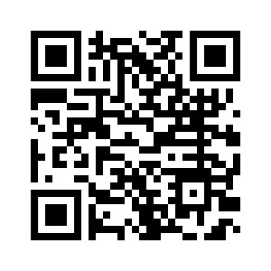
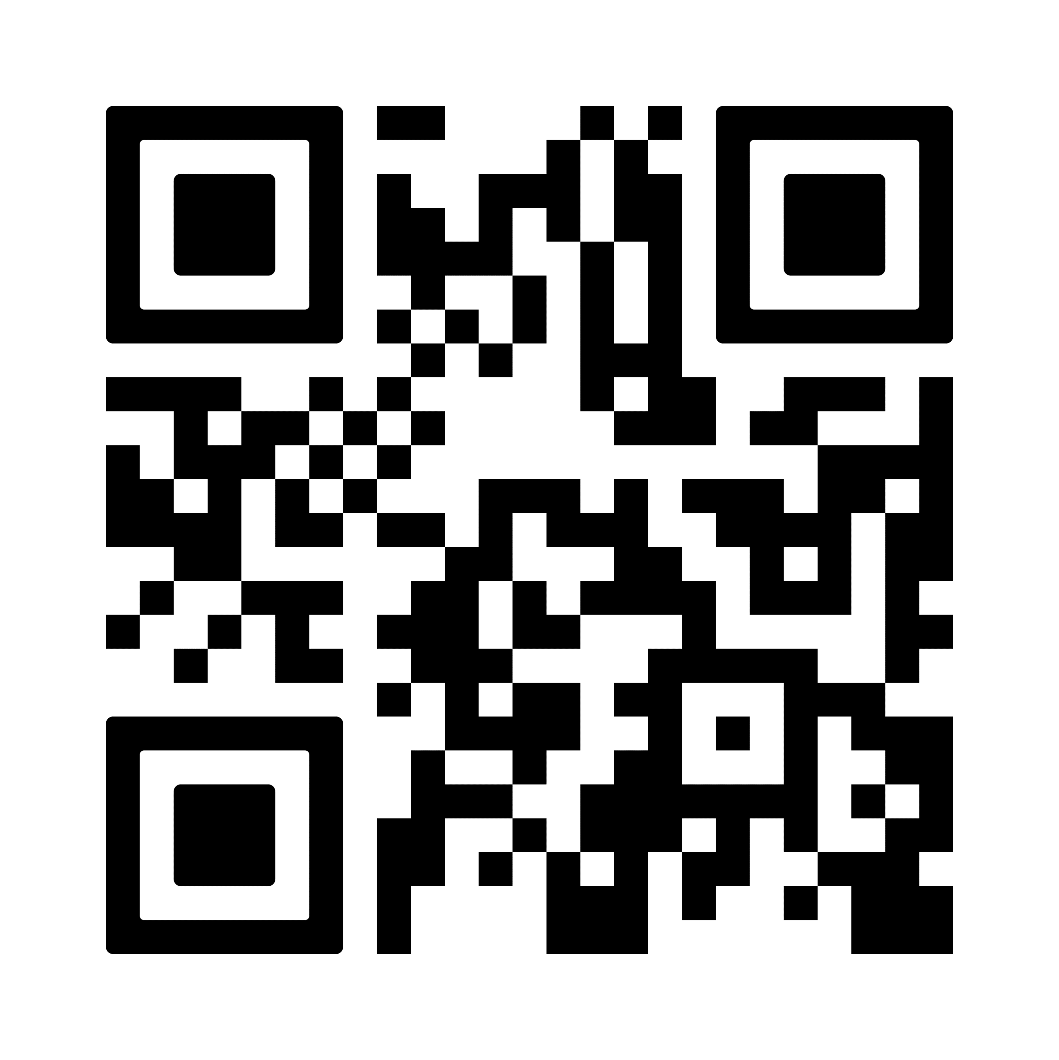

We are a group focussing on wildlife and the environment in Tilehurst.
Anyone is welcome to join whatever their age, background, or experience.
Join us on Facebook, visit our website or email us at wildtilehurst@gmail.com
Bat Walks
Bird walks
Nature Walks
Flower and plant identification
Tiny Nature – Bees and other insects
Nature-friendly gardening
www.wildtilehurst.org.uk

