Slide 1

Abuse Prevention & Reporting Training
CMS | Kentucky PSA | Ky.gov Compliance
Reliant Workforce Solutions dba Reliant Home Care
Mandatory for Employees & Contractors
Notes:
Trainer Script:
- Review slide title: Abuse Prevention & Reporting Training
- Emphasize Kentucky mandatory reporting (KRS 209)
- Reinforce zero-tolerance and non-retaliation
- Ask staff to provide real-world examples

Slide 2
Training Objectives
Understand
- Understand abuse, neglect, exploitation, and misappropriation
Learn
- Learn Kentucky mandatory reporting laws (KRS 209)
Understand
- Understand PSA requirements (907 KAR 1:170)
Know
- Know how and when to report concerns
Reinforce
- Reinforce client rights and professional boundaries
Notes:
Trainer Script:
- Review slide title: Training Objectives
- Emphasize Kentucky mandatory reporting (KRS 209)
- Reinforce zero-tolerance and non-retaliation
- Ask staff to provide real-world examples

Slide 3
Regulatory Authority
- CMS Conditions of Participation (42 CFR §483.12, §484)
- Kentucky Revised Statutes (KRS 209 – Adult Protective Services)
- 907 KAR 1:170 – Personal Services Agencies
- Kentucky Cabinet for Health and Family Services (CHFS)
Notes:
Trainer Script:
- Review slide title: Regulatory Authority
- Emphasize Kentucky mandatory reporting (KRS 209)
- Reinforce zero-tolerance and non-retaliation
- Ask staff to provide real-world examples

Slide 4
Definitions
- Abuse: Physical, verbal, emotional, sexual harm
- Neglect: Failure to provide necessary care or services
- Exploitation: Improper or illegal use of client resources
- Misappropriation: Wrongful use of client property
Notes:
Trainer Script:
- Review slide title: Definitions
- Emphasize Kentucky mandatory reporting (KRS 209)
- Reinforce zero-tolerance and non-retaliation
- Ask staff to provide real-world examples

Slide 5

Click below to Watch Training Video

Slide 6
Client Rights
Right
- Right to dignity and respect
Right
- Right to be free from abuse and exploitation
Right
- Right to voice grievances without retaliation
Right
- Right to participate in care decisions
Notes:
Trainer Script:
- Review slide title: Client Rights
- Emphasize Kentucky mandatory reporting (KRS 209)
- Reinforce zero-tolerance and non-retaliation
- Ask staff to provide real-world examples

Slide 7
Recognizing Warning Signs
- Unexplained injuries or fearfulness
- Sudden financial changes
- Poor hygiene or unmet needs
- Client statements or behavioral changes
Notes:
Trainer Script:
- Review slide title: Recognizing Warning Signs
- Emphasize Kentucky mandatory reporting (KRS 209)
- Reinforce zero-tolerance and non-retaliation
- Ask staff to provide real-world examples

Slide 8
Abuse Prevention Responsibilities
- Maintain professional boundaries
- No gifts, loans, or financial involvement
- Respect privacy and autonomy
- Report concerns immediately
Notes:
Trainer Script:
- Review slide title: Abuse Prevention Responsibilities
- Emphasize Kentucky mandatory reporting (KRS 209)
- Reinforce zero-tolerance and non-retaliation
- Ask staff to provide real-world examples

Slide 9
Mandatory Reporting – Kentucky Law
- All staff are mandatory reporters
- Report suspected abuse immediately
- Do not investigate independently
- Failure to report may result in discipline or legal action
Notes:
Trainer Script:
- Review slide title: Mandatory Reporting – Kentucky Law
- Emphasize Kentucky mandatory reporting (KRS 209)
- Reinforce zero-tolerance and non-retaliation
- Ask staff to provide real-world examples

Slide 10
Reporting Process
- Call 911 if immediate danger
- Notify Supervisor/Administrator immediately
- Complete Incident Report within 24 hours
- Administrator reports to APS/CHFS as required
Notes:
Trainer Script:
- Review slide title: Reporting Process
- Emphasize Kentucky mandatory reporting (KRS 209)
- Reinforce zero-tolerance and non-retaliation
- Ask staff to provide real-world examples

Slide 11
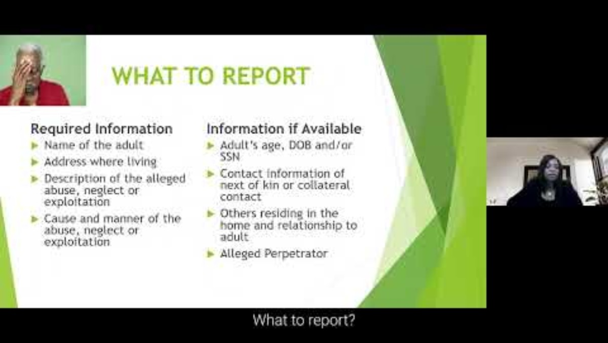
Click the Link Below to Watch Training Video

Slide 12
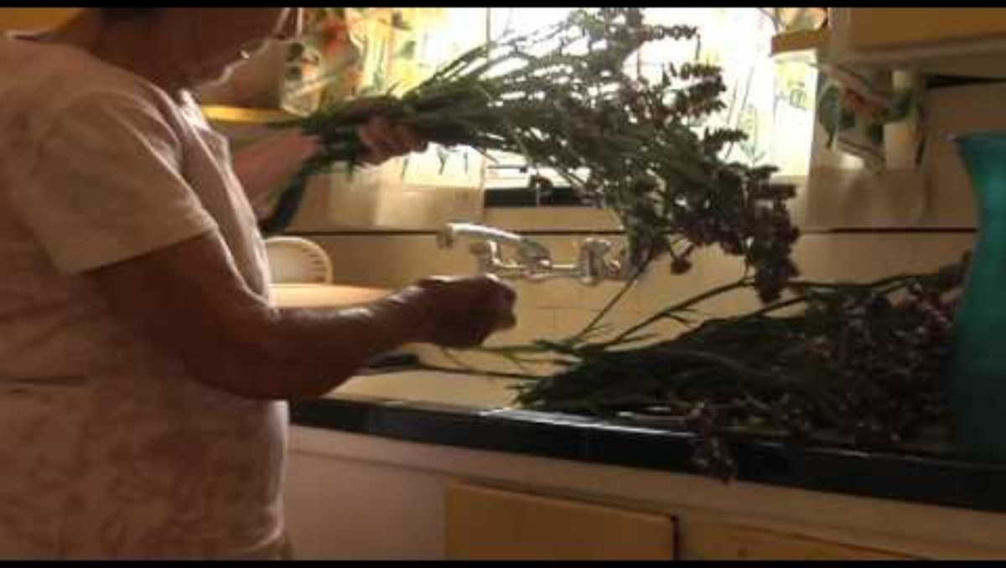
Click the link below to watch the Training Video

Slide 13
Non-Retaliation
- Retaliation is strictly prohibited
- Good-faith reporters are protected
- Violations result in disciplinary action
Notes:
Trainer Script:
- Review slide title: Non-Retaliation
- Emphasize Kentucky mandatory reporting (KRS 209)
- Reinforce zero-tolerance and non-retaliation
- Ask staff to provide real-world examples

Slide 14
Training Videos (Recommended)
- CMS: Abuse Prevention in Home & Community Settings
- Kentucky CHFS: Adult Protective Services Overview
- DOJ/CMS: Protecting Vulnerable Adults
Videos should be viewed annually and documented
Notes:
Trainer Script:
- Review slide title: Training Videos (Recommended)
- Emphasize Kentucky mandatory reporting (KRS 209)
- Reinforce zero-tolerance and non-retaliation
- Ask staff to provide real-world examples

Slide 15

Documentation Requirements
- Incident Reports completed within 24 hours
- Training sign-in sheets maintained
- Personnel files updated annually
- Records retained minimum 5 years
Notes:
Trainer Script:
- Review slide title: Documentation Requirements
- Emphasize Kentucky mandatory reporting (KRS 209)
- Reinforce zero-tolerance and non-retaliation
- Ask staff to provide real-world examples

Slide 16

Knowledge Check & Acknowledgment
- Staff questions and discussion
- Review reporting responsibilities
- Sign training acknowledgment form
Notes:
Trainer Script:
- Review slide title: Knowledge Check & Acknowledgment
- Emphasize Kentucky mandatory reporting (KRS 209)
- Reinforce zero-tolerance and non-retaliation
- Ask staff to provide real-world examples

Slide 17
Required Training Videos
Staff must view the following videos annually:
CMS Video: https://www.cms.gov/medicare/health-safety-standards/quality-safety-oversight-general-information
Kentucky APS Video: https://chfs.ky.gov/agencies/dcbs/dpp/apb/Pages/default.aspx
DOJ Vulnerable Adults: https://www.justice.gov/elderjustice
Notes:
Trainer Script:
- Pause presentation
- Play each video or assign for LMS viewing
- Document attendance and completion

