Slide 1
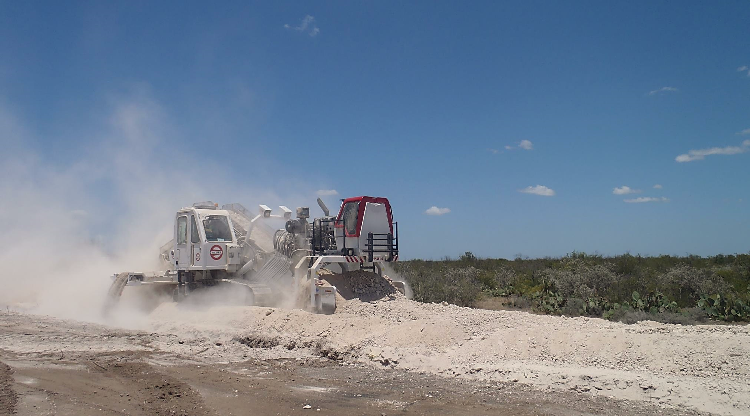
Energy Services Inc.
Presentation to the Annual General Meeting June 6, 2017

Slide 2
Forward Looking Statements
From time to time ESI Energy Services Inc. ("ESI" or the "Company") makes written and verbal forward looking statements. These forward looking statements include, but are not limited to, comments with respect to our objectives and strategies, financial condition, the results of our operations and business, our outlook for the industry and our risk management analysis. Forward looking statements are typically identified with words such as "believe", "expect", "forecast", "anticipate", "intend", "estimate", "plan", and "project" and similar expressions of future or conditional events such as "will", "may", "should", "could", or "would".
By their nature, these forward looking statements involve numerous assumptions, inherent risks and uncertainties, both general and specific, and the risk that predictions and other forward looking statements will not be achieved. We caution readers of this document not to place undue reliance on these forward looking statements as a number of important factors could cause future results to differ materially from the plans, objectives, expectations, estimates and intentions expressed in such forward looking statements.
Forward looking statements may be influenced by the following factors: the level of oil and gas exploration activity in North America, world crude oil prices and North American natural gas prices, new pipeline construction activity in North America, weather, access to capital markets, the state of global capital markets, government legislation and policies, as well as environmental concerns and issues. We caution that the foregoing list of factors is not exhaustive and when relying on forward looking statements to make decisions with respect to ESI, investors and others should carefully consider these foregoing factors as well as other uncertainties and events.

Slide 3
The Business of the Company
ESI is a pipeline equipment rental and sales company with principal operations in Leduc, Alberta and Phoenix, Arizona.
Ozzie’s currently operates in western Canada as well as in the United States. The Company, through its operating subsidiaries ESIPSL and OPI, supplies (rents and sells) Padding Machines.
Ozzie’s Padding Machines are used all over the world by mainline pipeline contractors.
Ozzie’s invented the Padding Machine.

Slide 4
The Business of the Company
Padding Machines are used by mainline pipeline contractors and utility contractors for backfilling pipeline and utility trenches.
Mainline pipeline is essentially transmission pipeline that is larger than 18 Inches in diameter.
It is used for the transmission of petroleum products as well as water.
Padding Machines are also used in renewables construction for backfilling electrical cables that are used to transmit power from solar panels and wind turbines to the power grid.

Slide 5
Pipeline Construction Process
Backfill
Reclamation
Lowering-in
ROW Clearing
Excavation
Welding / Tie-in

Slide 6
Padding
Padding Machines are used to screen rocks and hard material out of the spoil pile, which is located on the side of an excavated pipeline trench, in order to backfill the pipeline which is located on the bottom of the pipeline ditch. Padding Machines are self-propelled and self-loading. They operate by way of a single continuous pass through the spoil pile located parallel to the pipeline trench or ditch.

Slide 7
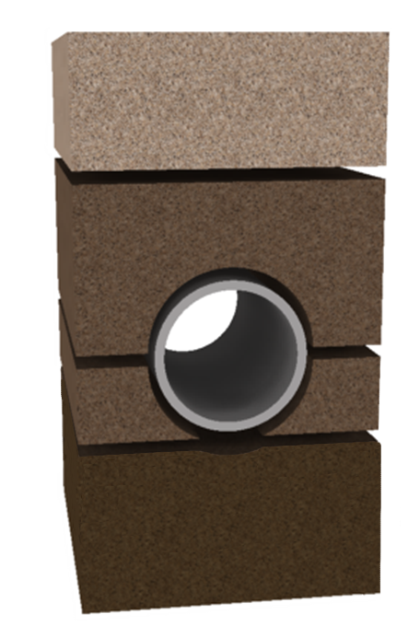
Benefits of Padding
4. Residual backfill
3. Top fill
2. Side fill / haunching
1. Lower bedding / foundation

Slide 8
Benefits of Padding
Pipeline Padding
Reduces damage to the pipeline coating and pipe from rocks and hard materials that may be situated in the spoil pile.
Ensures better and more consistent compaction during the backfill process which contributes to preserving the integrity of the pipeline by securing it in place.
Eliminates issues with “Hanging Pipe”, pipe not completely seated on the bottom of the ditch.
Facilitates maximum ditch soil replacement and soil compaction during the backfill process
Eliminates soil contamination, what comes out of the ditch goes straight back in during the backfill process – a Green alternative

Slide 9
Benefits of Padding
Padding wind and solar cable
protects the cable and cable coating from being damaged by rocks and hard material that may be situated in the spoil pile;
it ensures optimal soil compaction; and
it facilitates heat dissipation.

Slide 10
Operations
The Company designs and engineers
OPP-300 and OPP-200 Padding Machines
Mini-padder heads
Micro-padder heads.
Major fabrication is outsourced to third-party manufacturers.
Machines and padding heads are assembled in-house in both Canada and the United States.

Slide 11
Padding Machines

Slide 12
The Rental Fleet
Machine Model | Screening Capacity per Hour | Number of Machines
OPP-300 | 778 yd³ (595 m³ ) | 17
OPP-200 | 444 yd³ (339 m³ ) | 13
OMS-360 | 300 yd³ (229 m³ ) | 2
OMP (Mini-padder) | 130 yd³ (99 m³ ) | 15
OPM (Micro-padder) | 80 yd³ (61 m³ ) | 3

Slide 13
Financial Highlights
$Thousands expect per share amounts | Years ended December 31
 | 2016 | 2015 | 2014
Revenue | 8,101 | 11,179 | 9,293
EBITDA | 631 | 3,433 | 2,225
Funds flow from operations | 529 | 2,610 | 1,835
Net loss | (5,124) | (2,117) | (8,568)
Loss per share-basic | (0.11) | (0.04) | (0.26)
Loss per share-diluted | (0.11) | (0.04 ) | (0.26)
Working capital | 8,109 | 7,400 | 6,041
Long-term debt | 3,268 | 1,170 | 3,804
Total assets | 38,297 | 45,396 | 48,512

Slide 14
Financial Highlights
$Thousands except per share amounts | Three month period March 31
 | 2017 | 2016
Revenue | 2,138 | 1,507
EBITDA | 286 | (508)
Funds flow from operations | 281 | (559)
Net loss | (1,052) | (1,995)
Loss per share-basic | (0.02) | (0.04)
Loss per share-diluted | (0.02) | (0.04)
Working capital | 10,124 | 8,766
Long-term debt | 2,232 | 3,941
Total assets | 35,875 | 40,648

Slide 15
Revenue Analysis
$Thousands | Three month period March 31
 | 2017 | 2016 | % change
Large Padders
OPP-300 | 369 | 24 | 1438
OPP-200 | 791 | 105 | 653
Mini-padders | 746 | 988 | (24)
Micro-padders | 39 | -
Pipe layers | 124 | 277 | (55)
Pumps | 69 | 113 | (40)
Total | 2,138 | 1,507 | 42

Slide 16
Revenue Analysis
$Thousands | Three month period March 31
 | 2017 |  | 2016
 | $ | % | $ | %
Large padder | 1,160 | 54 | 129 | 9
Mini-padders | 746 | 35 | 988 | 66
Micro-padders | 39 | 2 | - | -
Other | 193 | 9 | 390 | 25
Total | 2,138 | 100 | 1,507 | 100

Slide 17
Operating Highlights-Production Months
Revenue months | Three month period March 31
 | Actual | Actual |  | % Change
 | 2017 | 2016
Large Padders | 19 | 5 |  | 280
OPP-300 | 6 | 3 |  | 100
OPP-200 | 13 | 2 |  | 550
Mini-padders | 23 | 32 |  | (28)

Slide 18
Operating Highlights-Production Months
 | Actual Q1 plus revenue months under contract by quarter
 | 2017
 | Q1 A | Q2 | Q3 | Q4 | Totals
Large Padding Machines | 19 | 51.0 ¹ | 62¹ | 11¹ | 143
OPP-300 | 6 | 26.9 ¹ | 38 ¹ | 8 ¹ | 78.9
OPP-200 | 13 | 24.1 ¹ | 24 ¹ | 3 ¹ | 64.1
Mini-padders | 23 | 33 ² | 35 ² | 24 ² | 115
Notes 1. | Under contract
2. | Forecast

Slide 19
2017 Large Padder Projections and Utilization

Slide 20
Cash at March 31, 2017
$Thousands except per share amounts
Cash and short term investments
Cash | 3,417
Short term investments | 8,061
Total | 11,478
Outstanding shares | 45,000,792
Cash per share | $0.26

Slide 21
Working Capital at March 31, 2017
$Thousands except per share amounts
Working capital
Current assets | 13,099
Current liabilities | 2,975
Working capital | 10,124
Outstanding shares | 45,000,792
Working capital per share | $0.22

Slide 22
Long-term Debt at March 31, 2017
$Thousands except per share amounts
Total long-term debt | 3,642
Less:
Current portion | 1,423
Net long-term debt | 2,219

Slide 23
Book Value at March 31, 2017
$Thousands except per share amounts
Total shareholders’ equity | 30,668
Outstanding shares | 45,000,792
Book value per share | $0.68

Slide 24
Upside Potential
Ozzie’s business model is changing from primarily rental to rental and sales.
The greatest potential for sales is Mini-padder and Micro-padder heads.
We just hired a full-time inside sales person to handle on-line sales of our Mini-padder and Micro-padder heads and machines.

Slide 25
Upside Potential
Management believes that the market for Mini and Micro Padding Machine sales is substantially larger than for large Padding Machines.
Mini-padder and Micro-padder heads offer substantially more applications and provide access to more markets than large padders.
This translates to more opportunities for sales.

Slide 26
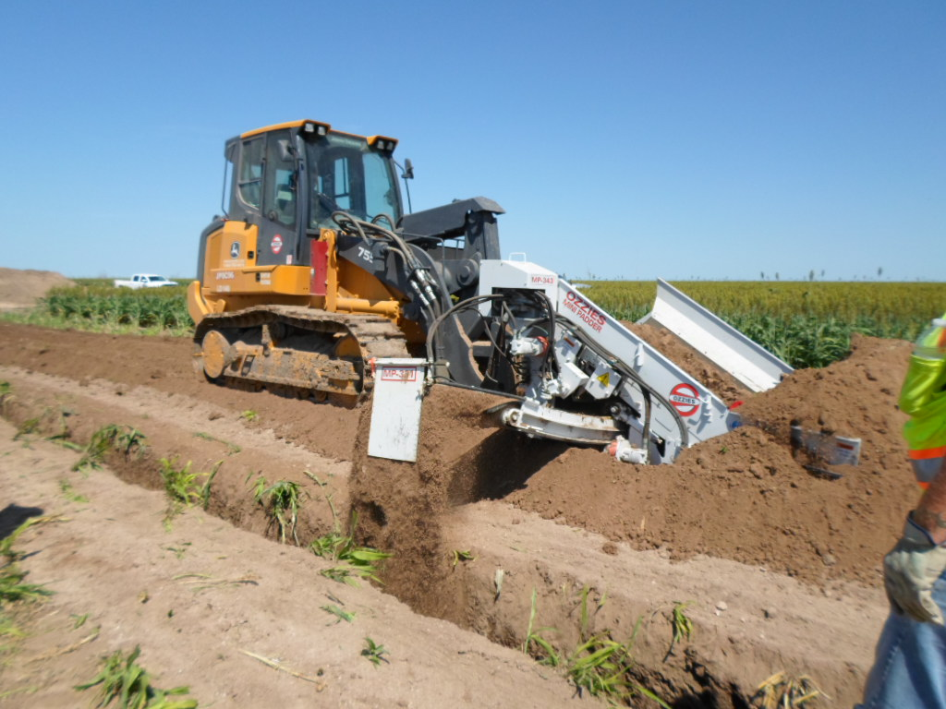
Mini-padder
Mini-padder heads are readily transportable.
The Mini-padder head requires some machine connectivity.
Compatible with all major crawler loader manufacturers

Slide 27
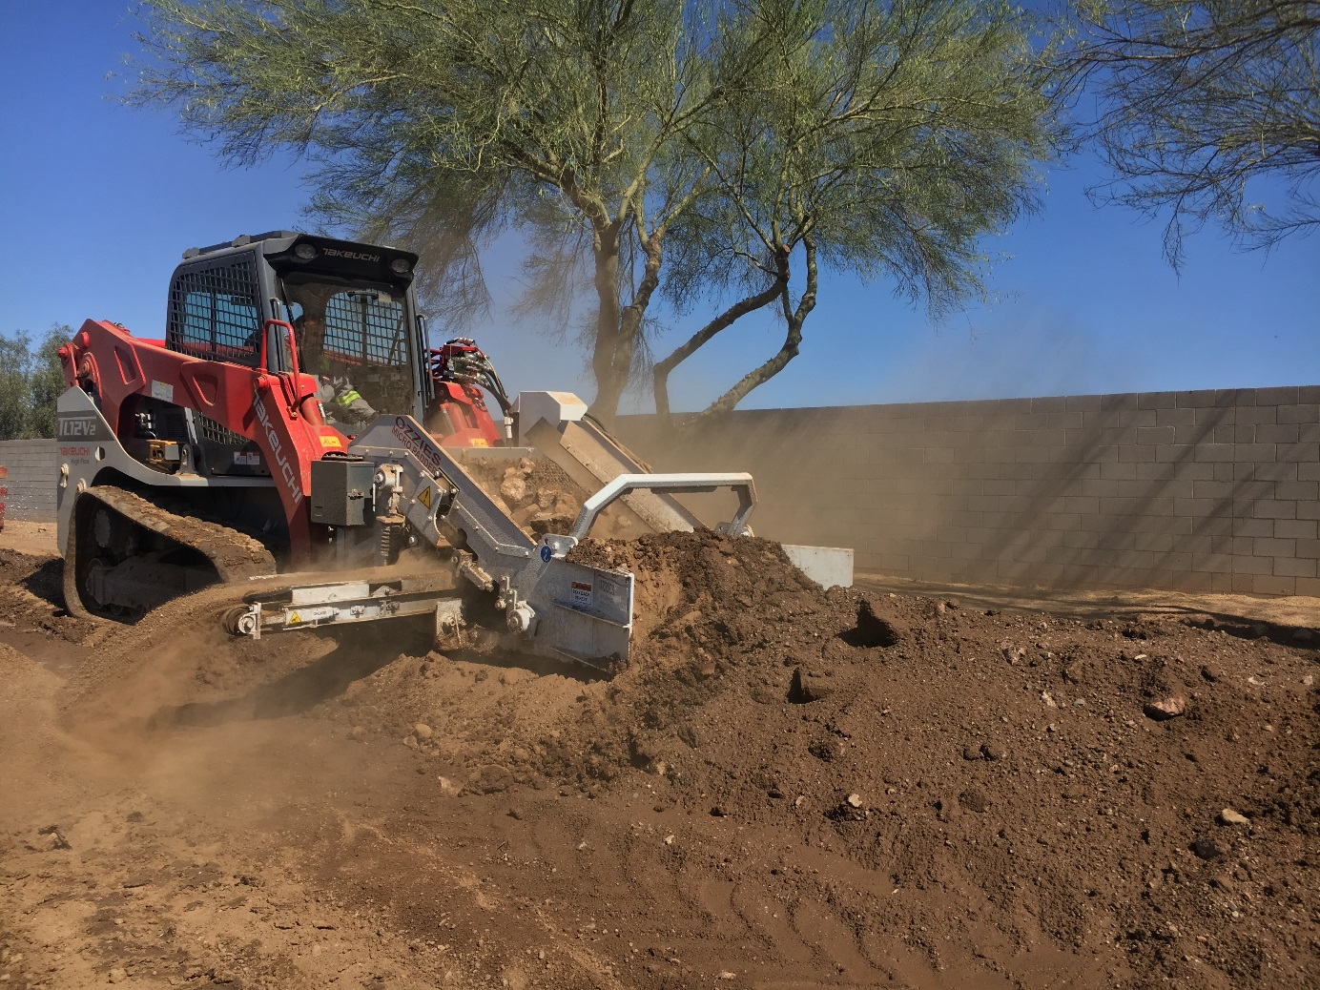
Micro-padder
Micro-padder heads are easily transportable.
The Micro-padder head does not require any machine connectivity.
The Micro-padder will work on most brands of compact track loaders.

Slide 28
Upside Potential
Mini-padders and Micro-padders can be used for a variety of applications including:
Utility pipelines and conduit
Wind and solar
Irrigation
Landscaping.
Mini-padder and Micro-padders are extremely cost effective.

Slide 29
Upside Potential
The market for Mini-padders and Micro-padders is global.
We are selling Mini-padding and Micro-padding machines primarily in the United States.
However, we have been getting enquiries for them from all over the world, including
Canada
New Zealand
Europe and
Australia.

Slide 30
Upside Potential
We have already sold a Mini-padder to an Australia contractor.
We are currently providing quotations for Micro-padders to customers in Australia and New Zealand.

Slide 31
Upside Potential
We are continuously looking for new opportunities relating to:
Upgrading and improving our existing padding applications.
Identifying opportunities and/or products that are complimentary and related to padding.
Identifying strategic acquisitions and/or alliances with other companies.

