Slide 1



Hampshire FA
The Role and Responsibilities of a Respect Steward
Tbc

Slide 2

Hampshire FA Safeguarding Team
Shantell Woodward – Deputy Designated Safeguarding Officer
Shantell.Woodward@hampshirefa.com
Tel: 01256 853012
Michelle Saunders – Deputy Designated Safeguarding Officer
Michelle.Saunders@hampshirefa.com
Tel: 01256 853002
Jackie Binnington – Safeguarding Administrator
Tel: 01256 853014
Jackie.Binnington@hampshirefa.com
Team Inbox: safeguarding@hampshirefa.com
Senior Safeguarding Lead: Mel Gill
Deputy Senior Safeguarding Lead: Darren Parker
Board Safeguarding Champion: Ian Walkom

Slide 3

Session Outline
The Role and Responsibilities of a Respect Steward
Reporting Concerns
Additional Resources
General Notices and Updates
Any Questions

Slide 4

Respect Steward
To support the FA Respect programme Hampshire FA are continuing with the requirement for all teams Home & Away to provide an adult (this should not be the team manager or coach) steward for all youth football teams U16 and below.
Hampshire FA are aware some leagues have mandated that all age groups must provide a Respect Steward. If you are unsure please check with your League Committee.

Slide 5
The Role of a Respect Steward
Ideally not the Manager or a member of Coaching Staff.
An Adult who preferably is someone that is calm but confident in dealing with others within their own Club.
Ideally try to keep the same person every week or a small group of people to carry out the role on a rotational basis.
Make sure they are known to supporters of your team.

Slide 6

Visibility of a Respect Steward
Good visibility makes it easier for the
Referee to identify the Match Respect
Steward prior and during the match -
So introduce yourself!
Resources available to purchase from RespectShop

Slide 7
Matchday Respect Steward
HOW YOU ARE SHOWING YOUR SUPPORT - The Match Respect Steward can help the Club ensure that the Respect Programme is followed for the benefit of all participants. The Respect Steward should use their own knowledge of their own Club spectators to help prevent abuse, foul language or other unacceptable behaviour.
IMPORTANT - The Respect Steward should ensure their own safety at all times and if in doubt about the potential for a situation to escalate they should act in accordance with their concerns.

Slide 8
Responsibilities of a Respect Steward
Ensuring that their own spectators comply with Respect designated spectator area.
Remind own supporters of responsibilities in relation to Respect.
Support the Referee when dealing with any spectator related issue within your own team.
Use common sense at all times and be a visual point of contact for any concerns from the opposition Respect Steward.
Dependent on League procedures the Respect Steward may assist to check registration cards or complete match result cards.
The FA Respect Programme must be considered by the Respect Steward at all times, and any issues should be reported to the League & County Association.

Slide 9


The Hampshire FA Team and Reporting your Concerns
Who do I report my concerns to?
Club Welfare Officer
League Welfare Officer
Hampshire FA Safeguarding - safeguarding@hampshirefa.com
Hampshire FA Discipline - discipline@hampshirefa.com
Hampshire FA Referee Development - andy.moisey@hampshirefa.com

Slide 10

Additional Resources
FA Code of Conduct and Resources Explore - Respect | England Football | England Football
Click on the ’CLUB DIGITAL ASSET’ link above to also to access lots of digital and downloadable posters and resources to use at your club
Your Club’s Code of Conduct
Resources available to purchase from RespectShop Respect Shop
Online Safeguarding course for Parents
Free, online course for parents and carers https://learn.englandfootball.com/courses/safeguarding/safeguarding-awareness-for-parents-and-carers

Slide 11

Did you know?..........

Slide 12
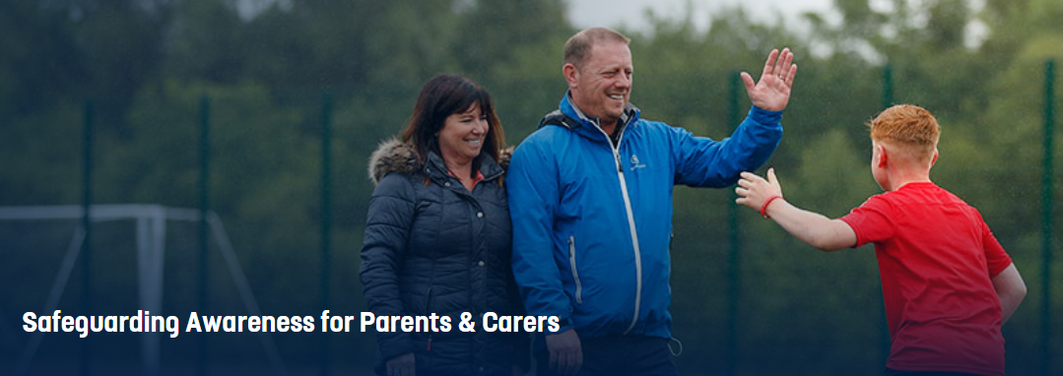
Online Safeguarding course for Parents
FA research indicates that parents are most likely to access the course if they have been asked to do so by their club.
Free, online course for parents and carers
25-30 minutes to complete
Accessed via: https://learn.englandfootball.com/courses/safeguarding/safeguarding-awareness-for-parents-and-carers

Slide 13
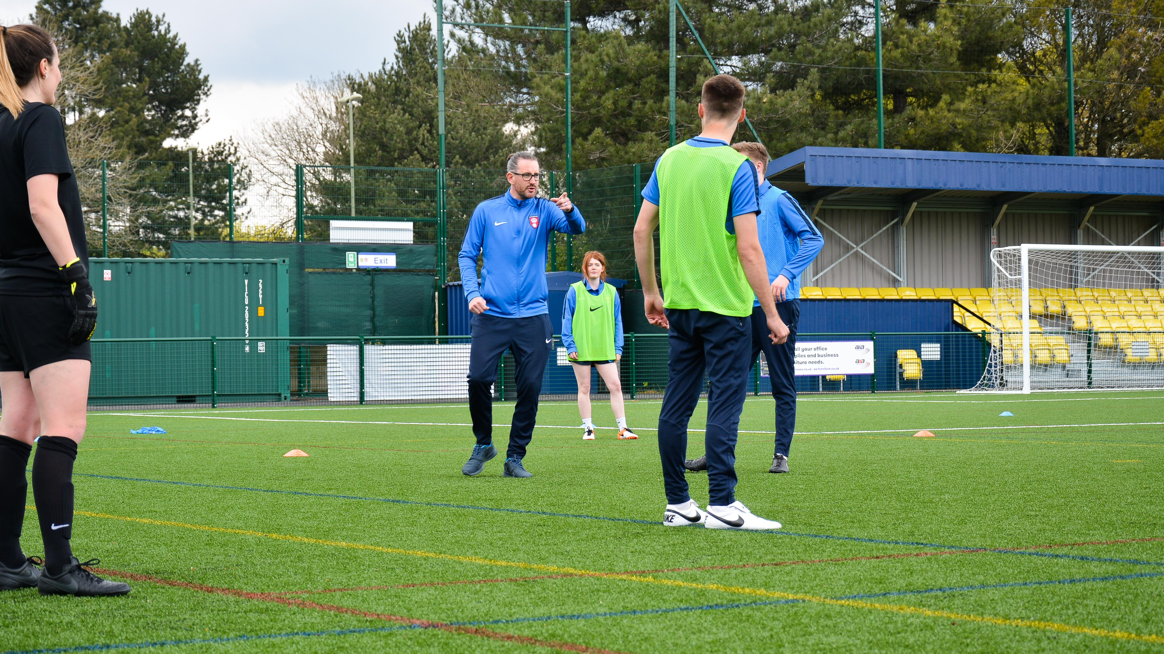

Any Questions?

