Slide 1
Break/Connect (10:15-10:30 a.m.)

Slide 2
Early Intervention Leadership Through an Adult Learning Lens
Dana Childress, PhD ● TX ECI Summit ● April 23, 2025

Slide 3
We will explore leadership through the lens of adult learning!
Review 5 leadership competency sets
1
Connect adult learning to leadership activities
2
Discuss 6 adult learning principles
3
Share lots of strategies
4
Notes:
Today we’re going to think about what leadership looks like and how knowledge of adult learning can be useful when supporting staff.
ASK: Why might it be important to have knowledge of adult learning when you are leading early interventionists?
(field is always changing, working with different families so constantly having to update their skills, and YOU are in a role that inspires and helps others learn and grow so knowing how they do that can be helpful)

Slide 4
Early childhood leadership encompasses both the ability to create and run excellent programs for young children and the ability to be effective and powerful in decision making that affects children and families.
DEC Recommended Practices Glossary (2015, p. 11)

Slide 5
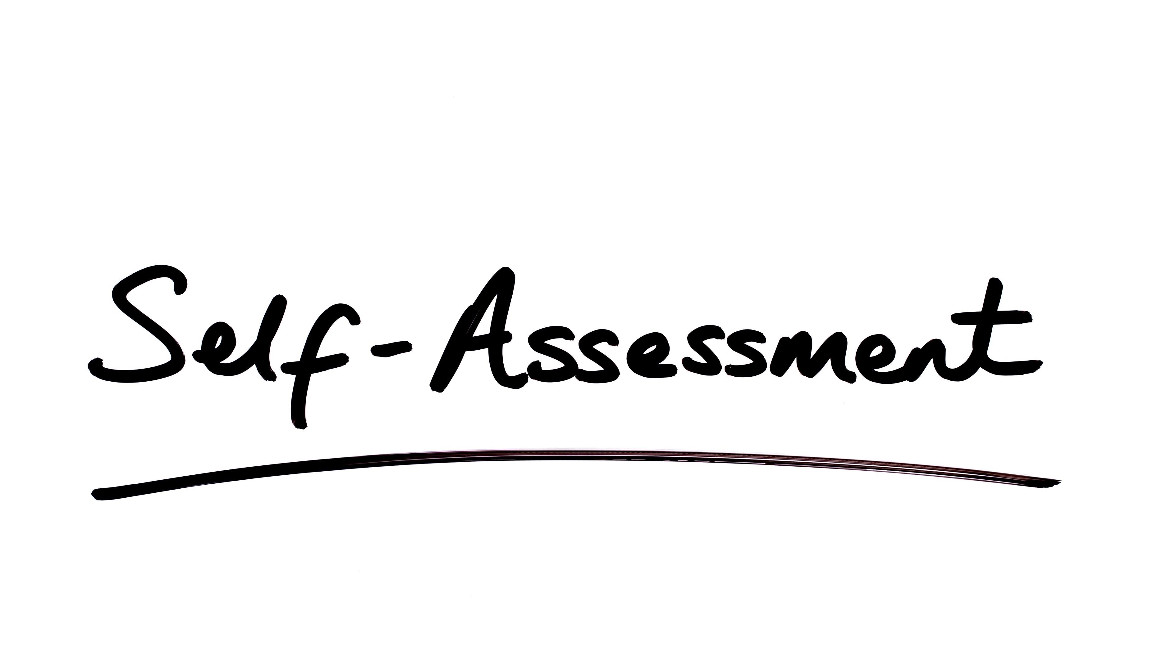
Notes:
Self-assessment – Take 10 minutes to complete the first 2 pages of the self-assessment.
Debrief: What is something you felt confident that you are already doing as a leader?
Put a star or circle any item that you want to pay more attention to. Listen for ideas to help you embrace that strategy.

Slide 6
What does an effective leader KNOW?
Notes:
Ask audience for ideas. Remind them that last year, I mentioned these competencies for EI leaders…

Slide 7
5 Competency Sets for Effective EI/ECSE Leadership (Bruns et al., 2017)
Professional Learning
Effective Relationships
Shared Responsibility
Data Use
Effective Communication
Notes:
In 2017, Bruns and her colleagues gathered information from a sample of experts in 7 states who shared their perspectives on EI leadership. Information from these leaders was used to develop a questionnaire that examined leadership knowledge and competencies. This questionnaire was completed by 820 participants. Interestingly, more than half of respondents were direct service providers (55%). Other respondents included local administrators (21%) and state administrators (8%). The rest included PD specialists, TA providers, higher ed faculty, family members. They identified 5 competency sets for effective leadership in EI and ECSE (onscreen).
Prof Learning – Being and encouraging lifelong learning; being open to new ideas and perspectives, and coaching and being a mentor/model for others
Eff Relationships – having high standards, acting ethically, being adaptable and responsive, understanding day to day practice realities, modeling reflective practice, build/sustain relationships with others
Shared Resp – engaging with others to make decisions and build consensus
Data use – analyze/synthesize info, gather info/data, share and use it
Eff Comm – writes and speaks well, active listener, communicates openly.

Slide 8
EI Leadership
Professional Learning
Effective Relationships
Shared Responsibility
Data Use
Effective Communication
EI Practice
Notes:
So, it’s really important that we remember the parallel process because so many of these components overlap with the work of the service providers and SCs you supervise.
ASK: How do these leadership competencies overlap with competencies and expectations we have of those we supervise?

Slide 10
KNOWLES’
5 ASSUMPTIONS OF ADULT LEARNERS
In 1980, Knowles made 4 assumptions about the characteristics of adult learners (andragogy) that are different from the assumptions about the characteristics of child learners (pedagogy). In 1984, Knowles added the 5th assumption.
1
5
SELF-CONCEPT
MOTIVATION TO LEARN
As a person matures his/her self concept moves from one of being a dependent personality toward one of being a self-directed human being.
As a person matures the motivation to learn is internal (Knowles 1984:12)
CHARACTERISTICS OF ADULT LEARNERS (ANDRAGOGY)
4
ORIENTATION TO LEARNING
2
ADULT LEARNER EXPERIENCE
As a person matures his/her time perspective changes from one of postponed application of knowledge to immediacy of application, and accordingly his/her orientation toward learning shifts from one of subject-centeredness to one of problem centeredness.
As a person matures he/she accumulates a growing reservoir of experience that becomes an increasing resource for learning.
3
READINESS TO LEARN
As a person matures his/her readiness to learn becomes oriented increasingly to the developmental tasks of his/her social roles.

Slide 11
#1: Adults learn best when learning is immediately relevant and useful
Childress, 2021; Knowles, Holton, & Swanson, 2012; Trivette et al., 2009

Slide 12
How do we focus on what is most immediately relevant and useful?
Professional Learning
Connect new policies/procedures/training to individual needs of staff.
Shared Responsibility
Cultivate a culture of shared responsibility so that staff help you understand what IS most immediately relevant and useful.
Notes:
Discuss principle then relate it to the EI leadership competencies using the strategy under each competency category. Keep this brief.

Slide 13
How do we focus on what is most immediately relevant and useful?
Data Use
Use your data to inform what information and training individual staff and groups of staff need.
Effective Relationships
Check in often about the work on individual and program wide levels.

Slide 14
What can happen when information does not seem relevant or useful to your staff?
Notes:
Large group: What can happen when information does not seem relevant and useful to your staff?

Slide 15
Strategies:
Actively connect new information to the day-to-day realities of their work.
Allow staff to contribute to goal setting.
Share data trends with staff.
Notes:
Ask group how they do these things and invite them to share examples.
Specific strategies – keep a record of staff needs, do observations and record reviews to identify strengths and needs to target relevance and usefulness (data collection)
Allow learners to set their own goals (annual reviews?)
Make learning experiences as individualized as possible
Learning must be tied to the goals and dreams of the learner, to help the learner achieve something they want to achieve – make it relevant if it is not automatically clear how the new info is immediately relevant
Tailor learning to individual needs of participants (so ask what they need)

Slide 16
Strategies:
Strategize together to manage challenges.
Circle back later to see if they understand, have what they need, have been successful.

Slide 18
How do we connect new information to prior knowledge and experience?
Effective Relationships & Communication
Find out what staff know. Learn about their beliefs.
Shared Responsibility
Tap into staff expertise.
Professional Learning
Create opportunities for staff to share what they know.
Notes:
Seek to understand how staff view their roles with families and the role of the family. Learn about the cultural backgrounds, values, and beliefs of your staff.

Slide 19
Strategies:
Use open-ended questions/statements to tap into what your staff know and have tried before offering solutions.
Facilitate collaborative problem-solving among staff.
Encourage solution finding.
Notes:
Why do you think that happened?
What have you/we already tried to solve that problem?
What could you/we do differently? Based on your experience, what do you think would help?
Encourage staff to offer solutions to any problem they bring up based on their prior knowledge and skills.

Slide 20
During supervision, Jenna describes a challenge she is having with a family she supports. She tells you that the mother is always texting on her phone or leaving the room. She has tried asking the mother to get down on the floor, but the mother always says she’s fine on the couch. Jenna knows she’s supposed to coach the mother and support her during family routines, but she says the mother doesn’t “get it.”
How can you tap into the first two adult learning principles to support Jenna?
Notes:
Scenario – During supervision, Jenna describes a challenge she is having with a family she supports. She tells you that the parent is always texting on her phone or leaving the room. She has tried asking the mother to get down on the floor with her but the mother always says she’s fine on the couch. Jenna knows she’s supposed to coach the mother but she says the mother doesn’t “get it.” What would you do?
Activity: Talk with your table group and consider how you could implement the strategies we’ve discussed so far. Be specific.
Ideas:
Ask Jenna: what is the goal of the session? Encourage Jenna to ask the mother what SHE views as the goal for the session.
Seek to understand – what does the other understand about the visit. What does Jenna believe about her role? The mother’s role?
Use open-ended questions to help Jenna consider the what/why/how of her practices before offering advice.
Encourage Jenna to talk with colleagues you know are skilled at handling this situation; she could shadow them too.

Slide 22
How do we help staff understand what they need to do, why it’s important, and how to do it?
Effective Communication
Be specific when explaining the WHAT, WHY, and HOW.
Data Use
Use data to help explain the WHAT and WHY.
Professional Learning
Be sure supervision and training address the WHAT, WHY, and HOW.
Notes:
We can again lean on the leadership competencies…
1-State objectives clearly in advance. Present information in a step-by-step model and relate the steps to the realistic implementation of the whole procedure.
2-Share/summarize the data that informed your decision.
3-We often address the what and how, but forget to address the why…

Slide 23
Strategies:
Recognize that anxiety can be a normal part of the learning and change processes.
Help staff understand the reasoning behind new policies and procedures as it connects to program growth/success.
Use open-ended WHAT, WHY, and HOW questions.
Notes:
1-especially when you and your staff face policy and procedure changes
3-Question examples: What do you need right now? What does ___ look like when you do it? Why do you think ____ is hard? How could this work better?

Slide 24
Strategies:
Explore the WHAT in detail – find out what the parent did, what the child did, what the staff person did.
Be specific about requirements then tap into the staff’s prior knowledge and experience to define HOW.
Establish accountability with an action plan.

Slide 25
Scenario
After two months of instituting a new policy on documentation, a record review reveals that Stella is consistently a week behind with entering her documentation into the electronic medical record. During supervision, you discuss what you’ve noticed.
How can you explore the WHAT, WHY, and HOW with her to improve the situation?
Notes:
Activity: Find "sole mates" who have similar shoes and discuss this scenario and what you would do.
WHAT – revisit the new policy and share your data.
WHY – explore with her why she thinks she is struggling with documentation
HOW – work together to come up with ideas to help her improve, establish an action plan with follow-up/accountability

Slide 26
“Authentic leaders act in ways they want others to act” and “model behaviors they want others to display.”
LaRocco & Bruns, 2013 p. 34
Notes:
“Authentic leaders act in ways they want others to act. They lead by example; clarify their value; match their actions to their values; demonstrate honesty, commitment, and competence; and follow through on their commitment.”
ASK: What kinds of behaviors do we model for our staff that we want them to display?

Slide 29
What do we want staff to do to facilitate caregivers’ active practice and participation during visits?
What strategies do you need to model/use with your staff to help them facilitate caregiver practice?
Notes:
1st Q:
Individualize support & intervention based on family interests, priorities, activities, & routines
Help families learn to practice using strategies with their children during and between visits
2nd Q:
Individualizing supervision to meet individual needs
Checking in often to learn what support is needed
Providing/making available training opportunities to support skill building

Slide 30
Strategies:
Make sure YOU understand what high-quality practices look like.
Regularly highlight quality practice indicators and what they look like/don’t look like.
Recognize staff with consistently strong practices and support their roles as mentors.
Notes:
Provide specific information about requirements then tap into the staff’s knowledge and experience to define how to implement a new procedure/practice.

Slide 31
Strategies:
Observe home visits!
Contact families to assess their perceptions of quality.
Watch/listen for signs of burn out and make it easier for staff to take care of themselves.

Slide 33
What strategies do we want staff to use with caregivers to facilitate reflection and feedback?
What strategies do you need to model/use with your staff to help them facilitate reflection and feedback with families?

Slide 34
Strategies:
Schedule regular reflective supervision with staff and protect this time.
Ask open-ended questions then pause to facilitate reflection.
Don’t assume you have to always have the answer.
Notes:
1-Use reflective supervision practices that value staff thoughts, experiences, feelings, and perspectives.
3-Don’t assume you have to always have the answer.

Slide 35
Strategies:
Invite staff feedback before you give yours.
Provide immediate, specific feedback.
Invite feedback from staff on a regular basis and use it to make responsive program changes.
Notes:
Specific feedback – connect it to the what, why, and how

Slide 36
Leadership & learning are indispensable to each other.
John F. Kennedy
Notes:
Learning about yourself as a leader, learning about your staff, learning about leadership – it is all part of being effective at what you do.

Slide 37
Notes:
Self-assessment – Take 5 min to complete the last page of the self-assessment. Turn to a colleague and share one thing you are going to try or keep thinking about based on our discussion.

Slide 38
