Slide 1
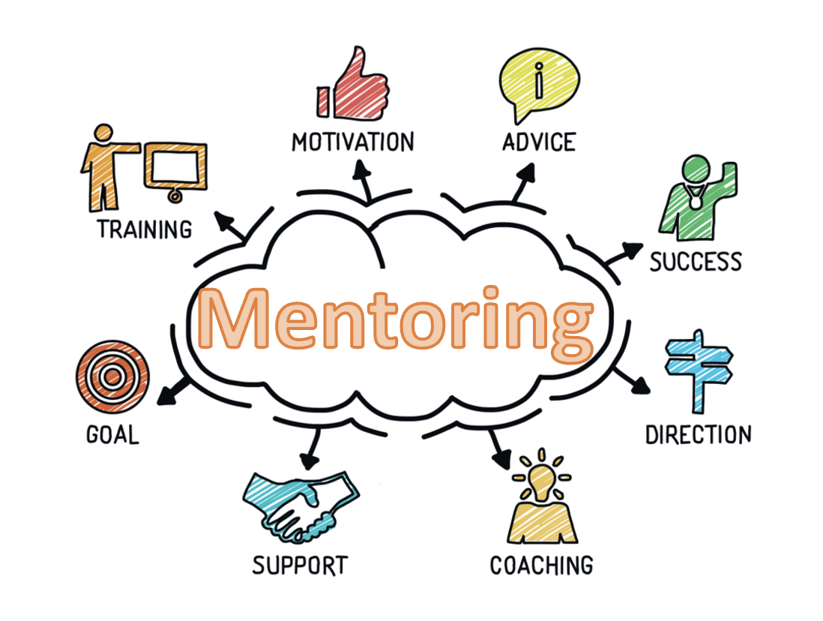
2023 Summer Series Follow-up Session
ECI Leadership
June 14, 2023
Facilitated by Elizabeth Beavers, Ph.D.

Slide 2
Our focused outcomes
Engage in focused reflection of the strengths of your current mentoring practices
Identify strategies for intentionally implementing evidence-based mentoring practices that impact the professional growth of mentees while supporting mentors
Strategize intentional ways to add depth and fidelity to your mentoring program
Identify resources to support your program
Notes:
1 minute

Slide 3
Your Personal Connections with Mentoring
Image source: HR Daily

Slide 4
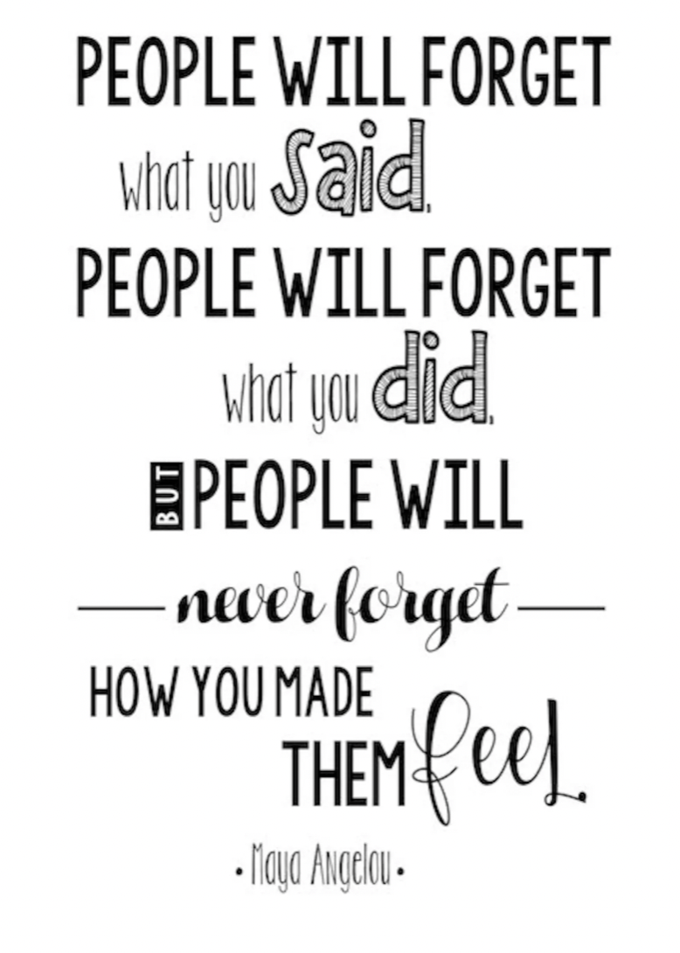
Image source: Zoro.com

Slide 5
In a strategic framework, the pieces must align
Structure of your Model
Values driven (your why)
Measurable goals
Foundation protocol aligned to mentoring goals
Reflective of reasonable resources to support
Funding, Allotments of Time, Willingness
Details within your model
Capacity Building (Mentor training and support: coaching)
Method for identifying and pairing mentors/mentees
Formal Induction Requirements: Timeline
Integration of Professional Learning aligned to performance
measures
Scaffolding of Support and types of experiences
Frequency and Availability: initial parameters (911)
Progressive support options with embedded choices
Data-informed monitoring
Mentors/ Mentee Data
Ongoing feedback
Shared Dialogues
Notes:
Goal: Alignment of actions with purpose (golden circle: why-how-what)
Who is involved in the overall direction of the mentoring program?
Will participation be mandatory or voluntary for mentors?
How long do you imagine the formal aspects of mentoring to last?
What type of mentoring experiences will be available?
How frequently will mentoring activities occur?
What type of mentoring activities will be supported/encouraged?
What forms of support will be provided to the mentors?
How do you ensure the mentor-mentee relationship is emotionally healthy and is protecting confidentiality?
What operational changes need to occur to support an effective mentoring program?
What will your training involve? For mentors…for mentees?
?
?

Slide 6
Formal Mentoring Models
Traditional One-to one (Dyad) | Group Mentoring | Team/Network Mentoring | E-Mentoring
One experienced EIS or service coordinator paired with a new employee | An experienced practitioner is paired with several new employees | Several experienced EISs or related service providers paired with a new employee | Mentoring via e-mail and the Internet (ex: social media) Ie: Distance Mentoring Model
Mentor
Mentee
Mentee
Mentee
Mentee
Mentor
Resources
Mentor
Mentee
mentor
Mentor
E-connections and Resources
Mentee

Slide 7
Forms of Mentoring
Formal
Pairing often with a designated mentor
Organizationally supported structure and progress for mentoring program
Structured with specific goals and targets that align with organizations goals and culture
intentional learning which includes developing people’s capabilities through instructing, coaching, modeling, and advising
Impacts are measured
Intentional or unintentional pairing
Relationships develop naturally
Often more long term than formal mentoring
Often grounded in spontaneous needs
There is no expert training and/or support
Have unspecified or very generalized goals
May offer complementary and overlapping forms of support.
As such, the goal is for formal mentoring to promote mentoring in an informal way throughout the organization as doing so can change the culture of the program into a mentoring culture.
The quality of relationships in both types are a critical factor in job satisfaction, development of professional growth and retention.
Informal
Notes:
2-3 minutes
Anisha example, formal mentoring program: 11 weeks

Slide 8
Your organization’s current mentoring program
Strengths
Areas for potential Growth
https://jamboard.google.com/d/1Ezy-cgw0qdDLeTs07C8X9dV1ee-4uJ-QqophyyJ2q7k/edit?usp=sharing

Slide 9
Debrief

Slide 10
Strategizing intentional ways to add depth and fidelity to your mentoring program

Slide 11
The Reflective Process of being strategic Contemplate 3 Goals

Slide 12
A critical part of the conversation for leaders: Resources
How can we support you?
What resources exists to support one another?
What is needed?
https://jamboard.google.com/d/1Ezy-cgw0qdDLeTs07C8X9dV1ee-4uJ-QqophyyJ2q7k/edit?usp=sharing
Notes:
1 minute

Slide 13
Mentoring
“A collaborative learning relationship that proceeds through purposeful stages over time and has the primary goal of helping mentees acquire the essential competencies needed for success in their chosen career.
It includes using one’s own experience to guide another through an experience that requires personal and intellectual growth and development” (Pfund et al, 2016).
Notes:
2-3 minutes review

Slide 14
Final thoughts
Thank you for YOUR time

