Slide 1
Welcome to the Third ECI Summit! #ecisummit2024
April 24th, 2024

Slide 2
Morning AGENDA
Welcome (8:30 am – 8:45 am)
• Beverley Calvo & Sharon Stone
Recruiting and Retaining ECI Providers from Different Generations (8:45 am - 10:00 am)
• Dana Childress & Beverley Calvo
Break/Connect (10:00 am - 10:15 am)
Generations in the EI workplace Panel & Q&A (10:15 am - 10:35 am)
• Panelists: Dana Dodgen (Warren Center), Stella Moreno (Region 19), Hector Rios (CACOST), Julie Yocham (Brighton)
Wrap-Up Activity (10:35 am - 11:45 am)
• Recruiting a new generation. The values of Job Announcements
Buffet Working Lunch (12:00 pm - 1:00 pm)

Slide 3
Afternoon Agenda
Individual Reflection/Goal Setting (1:00 pm - 1:30 pm)
Elizabeth Beavers
Discussion/Show and Tell (1:30 pm - 2:00 pm)
Break/Connect (2:00 pm - 2:15 pm)
Action Planning Group Rotations (2:15 pm - 3:45 pm)
Group 1 (30 mins): Attract (Recruit, Hire, Induct, Coordinate with Higher Ed.)
Dana, Sharon (HHSC), and Nikki (Spindletop)
Group 2 (30 mins): Prepare (Mentoring, Onboarding, Training)
Elizabeth, Rachel (HHSC), and Julie (Brighton)
Group 3 (30 mins): Retain (Leadership, Management, Positive Climate and Culture)
Beverley, Takoya Tillery (HHSC), and Beatrice Watson (HHSC), Noreen White (Betty Hardwick)
Group Reflection and Individual Program Work (3:45 pm – 4:30 pm)
Job Satisfaction Survey Update (4:30 pm – 4:45 pm)
Kris Yeager – Virtual Presentation
Closing Remarks (4:45 pm – 5:00 pm)
Beverley Calvo & Sharon Stone
Exit Survey

Slide 4
Creating A Multi-Generational Work Environment

Slide 5
Why is this so important?
Employee Retention
Costly to recruit, hire, and train new employees
Research on Generational Differences is mixed but there is evidence that these differences in experience, values and beliefs do impact the workplace
Without empathy and understanding between the generations, conflict can get in the way!
Becton, J. B., Walker, H. J., Jones-Farmer, A. (2014). Generational differences in workplace behavior. Journal of Applied Social Psychology, 44, 175-189.

Slide 6
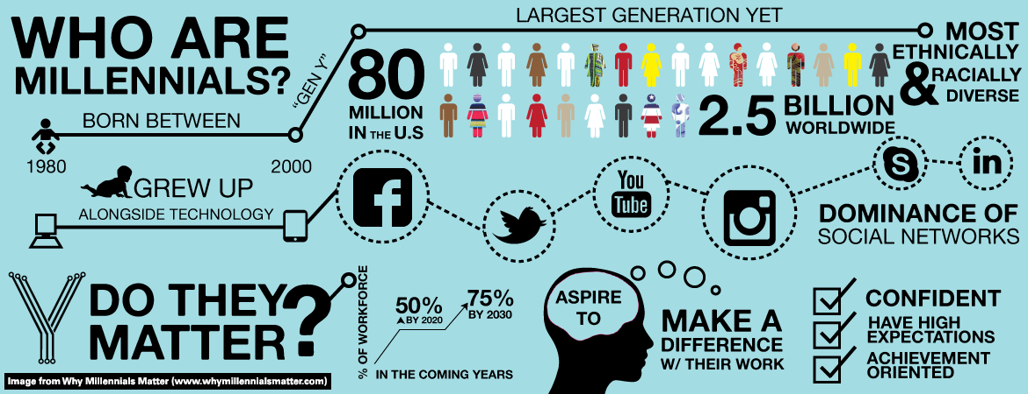
Generation Cohort Theory
“A generation is defined as a group of individuals born and living contemporaneously who share common knowledge and experiences that affect their thoughts, attitudes, values, beliefs and behaviors”
Notes:
This presentation is based on Washington State Department of Social and Health Services- used with permission

Slide 7
Generation Group Activity
Leaders will move to their generation groups according to the images they relate with the most.
Once in your groups, you will draw an ideal job description for an early interventionist based on your generationa on the flip chart/markers paper provided.
After 10 minutes, each generation group will share your illustration with the large group.
Notes:
Debrief by discussing similarities and differences across generational groups.

Slide 8
Notes:
Early, Core, Late Boomers
1953-1957
1957-1963
1963-1969

Slide 9
Notes:
Early Gen X. Core Gen X, Late Gent X
1969-1977
1977-1983
1983-1990

Slide 10
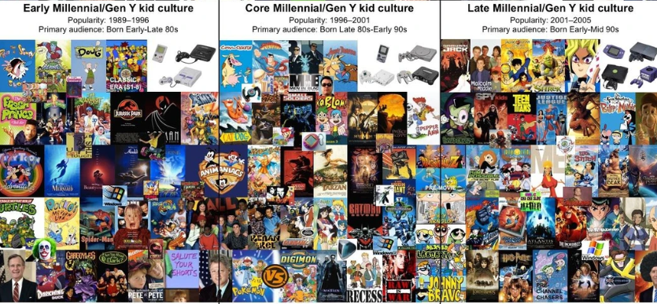
Notes:
Early Millennial – 1989-1996
Core Millennial 1996-2001
Late Millennial 2001-2005

Slide 11
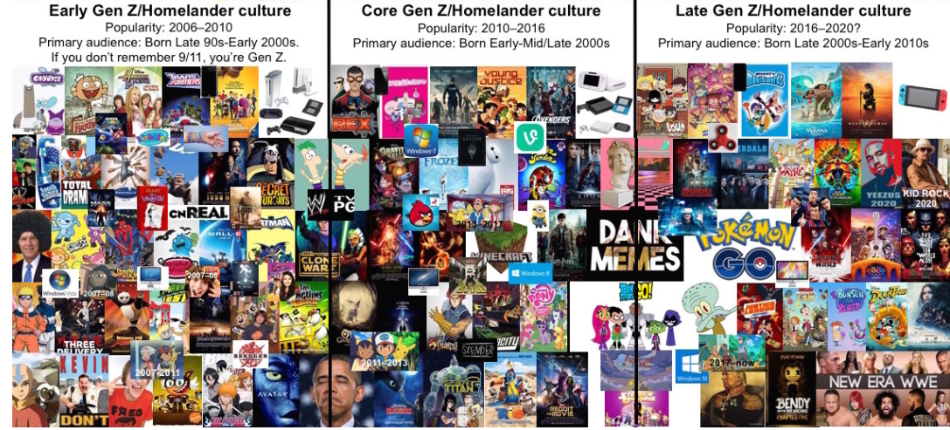
Notes:
Early Gen Z 2006-2010
Core Gen Z 2010-2016
Late Gen Z 2016- 2020 (?)

Slide 12
Multi-Generational Work Environment
Foster a work environment that respects and values differences— rather than downplaying or punishing them.
Remember the research is still showing that individual differences outweigh generational differences. We need to take generational cohort experiences into consideration, but policy should not be developed SOLELY on these generalized differences
Becton, J. B., Walker, H. J., Jones-Farmer, A. (2014). Generational differences in workplace behavior. Journal of Applied Social Psychology, 44, 175-189.

Slide 13
Employers Should Consider
Formal or informal organization-wide mentoring program. Nurture, nurture, nurture!
Team-building activities whenever a new person is hired into the team
MINIMIZE criticism of other generations

Slide 15
Dr. LeaH C. Georges
Associate Professor
Creighton University

Slide 16
Break/Reconnect (Start Back up at 10:45 am)

Slide 17
Panel Participants
Dana Dodgen (Warren Center)
Stella Moreno (Region 19)
Hector Rios (CACOST)
Julie Yocham (Brighton)
Notes:
Ask each topic’s questions to the panelists first then invite the audience to respond and share their thoughts.

Slide 18
Generations in the ECI workplace Panel
Recruitment: What aspects of your agency’s recruitment process might attract future employees from different generations? What about this process might deter future employees? What could you do to make your recruitment process better match what different generations want?
Retention: How do you think you could adapt your supervision style to support and retain staff from different generations?
Goals: How do your goals as an organization and as a leader match or not match with what Boomers, Gen X, Millennials, and Gen Z want in the work environment? (refer to handout) What would you like to change? Why?
Positive Culture: Based on the handout, what strategies would you use to cultivate a positive culture and morale among your employees? What would this look like?

Slide 19
Wrap-Up Activity Revise Job Descriptions
Review the individual job descriptions you brought and compare them with what you have learned today.
Review the Generations in the Workplace handout you have been provided and use it to revise your programs job description.
Discuss at your tables what matches with what you have learned and what you would change.

Slide 20
Work Values | Boomers | Gen X | Millennials
Communication | Face-to-Face or Phone | Voicemail or email | IM or Text
Acknowledgment | Show personal appreciation | Reward with free time or opportunities | Awards and Certificates
How to Show Respect | Treat them as equals | Support training & growth | Value civic duty
Supervision Style That Works Best | Democratic not hierarchical | Give them freedom | Be collaborative
How to Motivate | Tell them “we need you” because | Think globally | Offer coaching & support
How they work best with teams | They are motivated to collaborate but need to know how this fits the mission of the agency | Give them individual assignments and don’t micromanage | Provide flexibility in assignments and participation
Feedback | Ask for and hear their input | Give timely and specific feedback | Tell them how they make a difference
Professional Developmental Needs | Offer flexible schedules or phased retirement | Care about their personal goals | Provide the latest technology
What they want from the Organization | Leverage their knowledge | Make it fun | Promote volunteerism
They value | Teamwork | Diversity | Technical advancements
Notes:
Need to include revised slide with Gen Z

Slide 21
Working Lunch (12:00-1:00)

Slide 22
Individual Reflection
After contemplating the content, experiences, and ideas shared this morning, what are three things that resonate (i.e.: big ideas) with you the most?
How do you create mindfulness of your own generational biases?
The video this morning stressed meeting people in their "only-ness". How do you advocate for your own needs and perspectives as leaders? How are you striving to respect the "only-ness of others"?

Slide 23
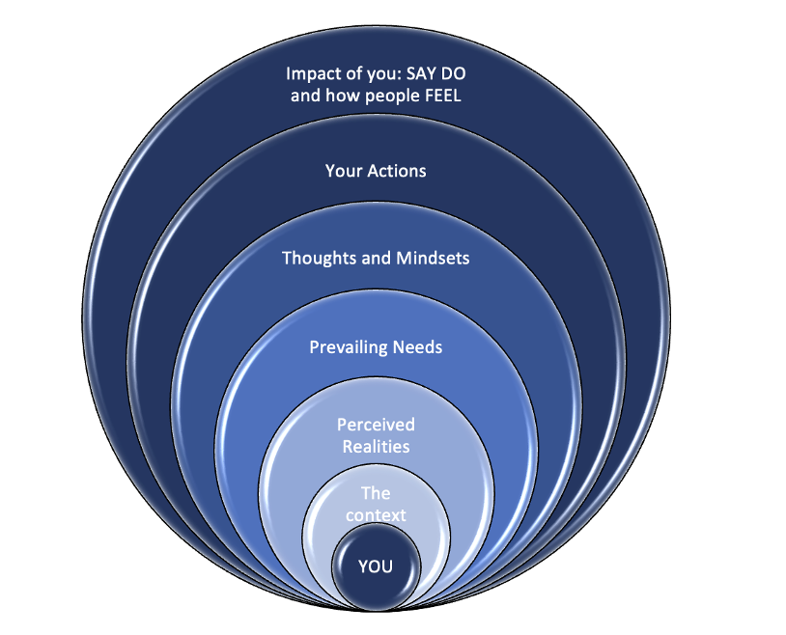
Leadership Ecology: Taking care of you
How do you prioritize what matters and what you let go of?

Slide 24
Goal Setting Prompts:
As a leader, I will…
What will you do as a leader over the next year to attract, prepare, and retain ECI providers in your program?
As an organization, we will…
What will you do as an organization over the next year, to attract, prepare, and retain ECI providers?
As leaders across the state, we will…
What will you do in collaborating as leaders across the state over the next year to attract, prepare , and retain providers in Texas?

Slide 25
Action Planning to Implement Retention Strategies
Why are action plans important:
Provides an opportunity for reflection
Brings people together to address problems to benefit change
Clarifies our focus – what is the change we are after?
Builds consensus
Builds ownership and accountability
Provides a timeframe
Provides measures of success or an opportunity to redirect based on evidence
Notes:
Action plans start with partnerships: We need to know where to start and what to expect’
Partnerships represent a commitment to a long-term, mutually beneficial relationships that allow for joint work
Usually this can be in the form of an MOU-operating principles that provide structure and clarity

Slide 26
Narrowing your focus

Slide 27
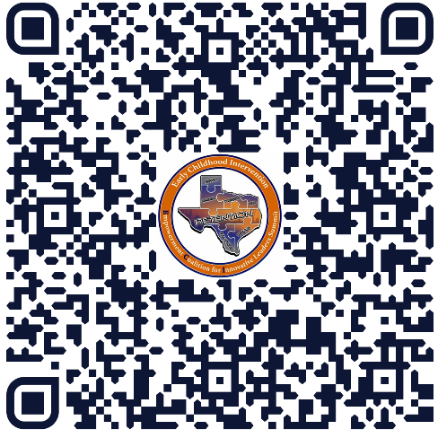
Padlet individual Reflections Goal Setting
Notes:
Individual Reflection/Goal Setting (1-1:30pm)
Prompts:
As a leader, I will…to improve my program’s climate and culture.
As an organization, we will…to improve our systems for recruiting and retaining personnel.
As leaders across the state, we will…to improve our systems for communicating and collaborating across programs.

Slide 28
Small Group Show/TELL

Slide 29
Break/Reconnect (2:00 Start Back up at 2:15)

Slide 30
Dr. Kris Yeager
ECI Research
https://csuci.zoom.us/my/kristopher.yeager
Closing Remarks
Beverley Calvo & Sharon Stone
Exit Survey
ECI website: https://ecileaders.com/

Slide 31
Action Planning Group Rotations (2:15 pm - 3:45 pm)
Group 1 (30 mins): Attract (Recruit, Hire, Induct, Coordinate with Higher Ed.)
Dana, Sharon (HHSC), and Nikki (Spindletop)
Group 2 (30 mins): Prepare (Mentoring, Onboarding, Training)
Elizabeth, Rachel (HHSC), and Julie (Brighton)
Group 3 (30 mins): Retain (Leadership, Management, Positive Climate and Culture)
Beverley, Takoya (HHSC), and Beatrice Watson, Noreen White (HHSC)

Slide 32
Please be thinking about:
What is one strategy you are implementing or would like to implement related to ATTRACTING providers?
What is one strategy you are implementing or would like to implement related to PREPARING providers?
What is one strategy you are implementing or would like to implement related to RETAINING providers?

Slide 33
Post-Breakout Group Reflection

Slide 34
Prizes!!!
https://wheelofnames.com/ede-prz

Slide 35
Individual Programs Meet to work on action plans 3:45 PM – 4:30 PM
Notes:
Over the past year, what have you done to attract, prepare, and retain personnel? What’s worked, what’s not worked, what have you learned, what questions do you have?
ANGIE: Can you find the logos of all the programs that will be attending? Thanks

Slide 36
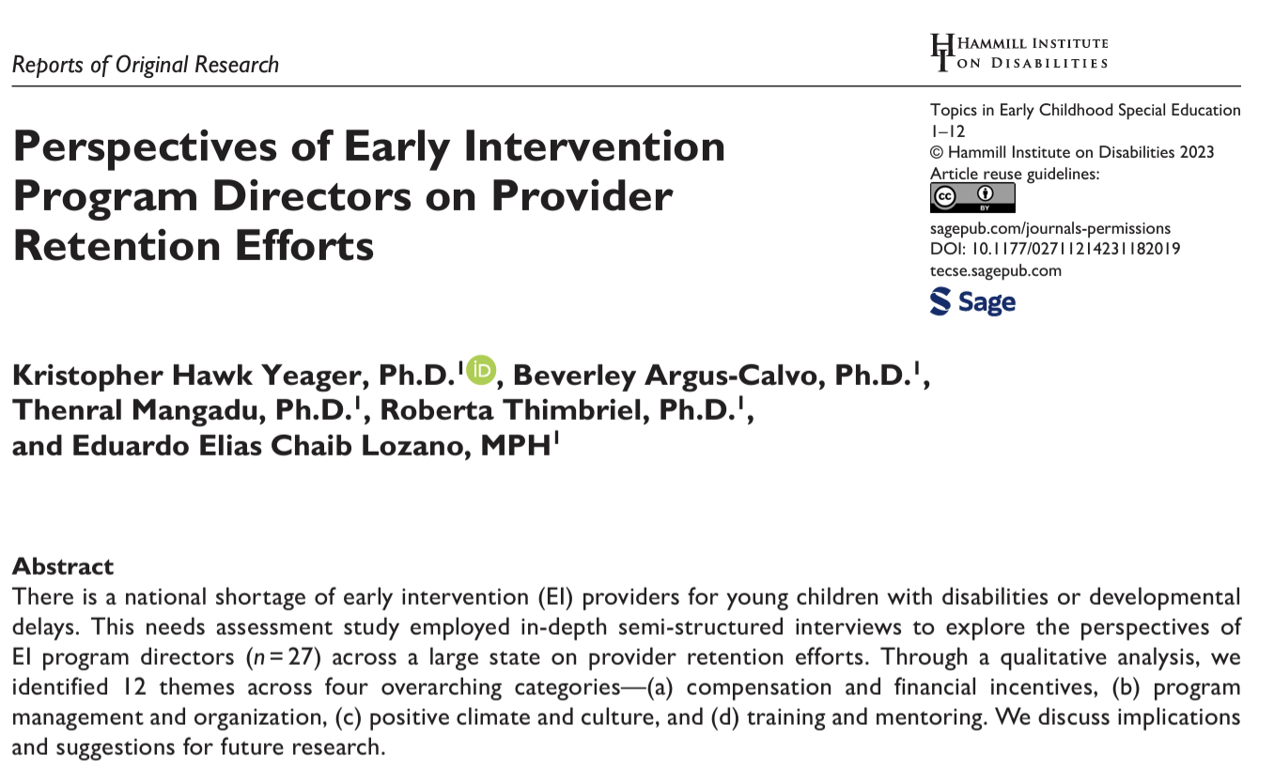
Initial Research Project: Interviews with Program Directors
Link to full text available on the project website (https://ecileaders.com/)

Slide 37
Second Research Project: Survey with ECI Providers
Data analysis completed. Manuscript in final stages.
Working Title: "Factors Influencing Job Satisfaction and Intent to Stay for Early Intervention Professionals"
Working Abstract:
Little research has examined factors that contribute to nationwide shortages of early
intervention (EI) professionals. To inform recruitment and retention efforts, we surveyed 437 EI professionals to examine the relationship between job satisfaction (e.g., compensation, the work, supervisors, co-workers, culture, training/mentoring), work-related variables (e.g., role, years experience, turnover/shortage levels, intent to leave), and socio-demographic variables (e.g., age, race/ethnicity, level of education). Our findings suggest that dissatisfaction with compensation (e.g., fairness of salary, benefits,
opportunities for advancement) and the work (e.g., job duties, schedule, paperwork) were most
closely associated with intent to leave. In addition, we found a relationship between programs with
shortages and dissatisfaction with the work. We discuss implications at the federal-, state-, and
program-levels to improve efforts to recruit and retain EI professionals.

Slide 38
New (THIRD) Research Opportunity
We are seeking 40 ECI Service Coordinators (from a variety of regions across the state) to participate in a 1-hour Zoom interview on workplace wellbeing/burnout
What makes you feel energized/exhausted during work?
What makes you feel optimistic/pessimistic during work?
What makes you feel accomplishment/disappointment during work?
How do staff shortages/turnover contribute to your feelings of wellbeing/burnout?
We will be emailing a flyer/recruitment letter in the coming weeks with a registration link. Please distribute to service coordinators at your program. All participants will receive a $50 gift card.

Slide 39
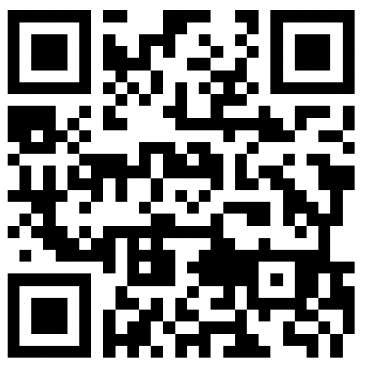
ECI Summit Exit Survey
The purpose of the survey is to (a) evaluate the effectiveness of the ECI Summit and (b) gather feedback to inform future support/events.
The survey takes approximately 5-10 minutes
Participation is confidential and voluntary (take a picture of the QR code or click the link below to begin).
https://utep.questionpro.com/ECI2024
Notes:
https://ecisummit2022.questionpro.com

Slide 40
Recap

Slide 41
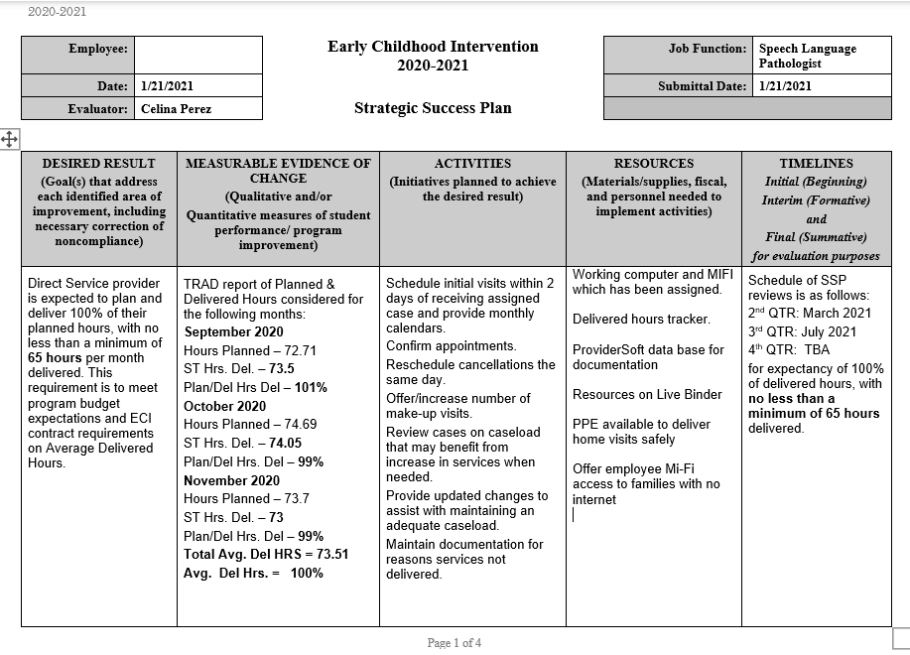

Slide 42
Work values
Acknowledgement
How to show respect
Supervision Styles
How to Motivate
How to best work in teams
Professional Development Needs
What they want from the Organization
They value…
Notes:
Not sure where to insert –only if needed

