Slide 1
Welcome
March 30 - 31, 2023

Slide 3
Focused Outcomes
Identify the elements of a mentoring program and their relationship to one another
Engage in focused reflection of the strengths of your current mentoring practices
Identify strategies for intentionally implementing evidence-based mentoring practices that impact the professional growth of mentees while supporting mentors
Strategize intentional ways to add depth and fidelity to your mentoring program

Slide 4
Mentoring Defined…
“A collaborative learning relationship that proceeds through purposeful stages over time and has the primary goal of helping mentees acquire the essential competencies needed for success in their chosen career.
It includes using one’s own experience to guide another through an experience that requires personal and intellectual growth and development” (Pfund et al, 2016).

Slide 5
At your table discuss the difference (5 minutes)
Mentoring
Training

Slide 6
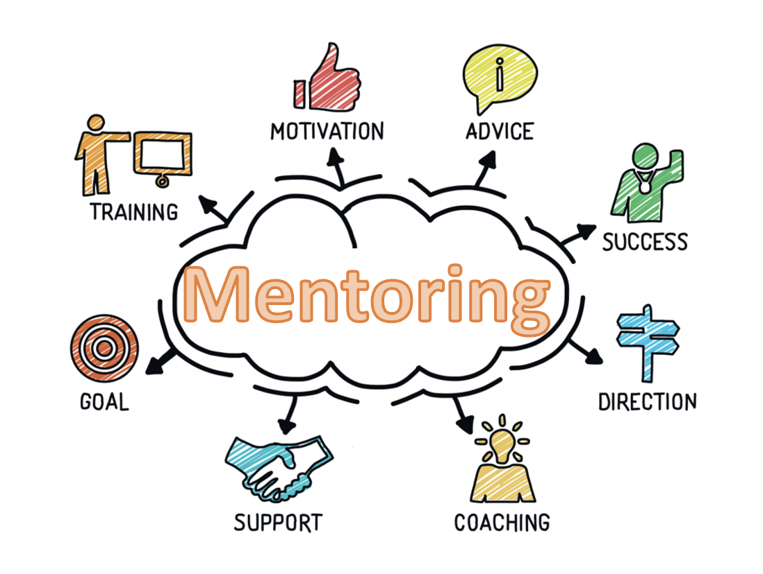
Image source: https://www.cis-spain.com/en/mentorship-programs-for-college-students/

Slide 7
Strategies Each person is asked to share Most Effective Strategy
Mentors
Mentees
Program Design
Support
Guidance and Expectations
Communication, Clarity, Connection, Commitment
Accountability
Other strategies to support the mentors
Scaffolding of Experiences
Pairing/Matching
Integration of Support
Individualization v. Prioritization of Needs
Other strategies to support mentees
Structure
Short term v. Long term
Balance of responsibilities
Oversight
Data
Other strategies
The evolution of mentoring programs is necessary and must allow for, seek to understand, and respect the variances in needs (program, mentors, & mentees).

Slide 8
How are you communicating your mentoring efforts to build, sustain, and evolve your program?

Slide 9
Mentoring is a relationship
With the ingredients of …
Intentionality
Relational Quality
Holistic Support

