Slide 1
Expanding Your Recruitment Web through ECI-University Partnerships
Panel Discussion
August 14, 2023

Slide 2
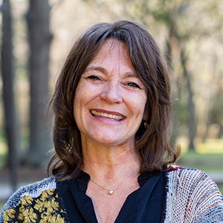
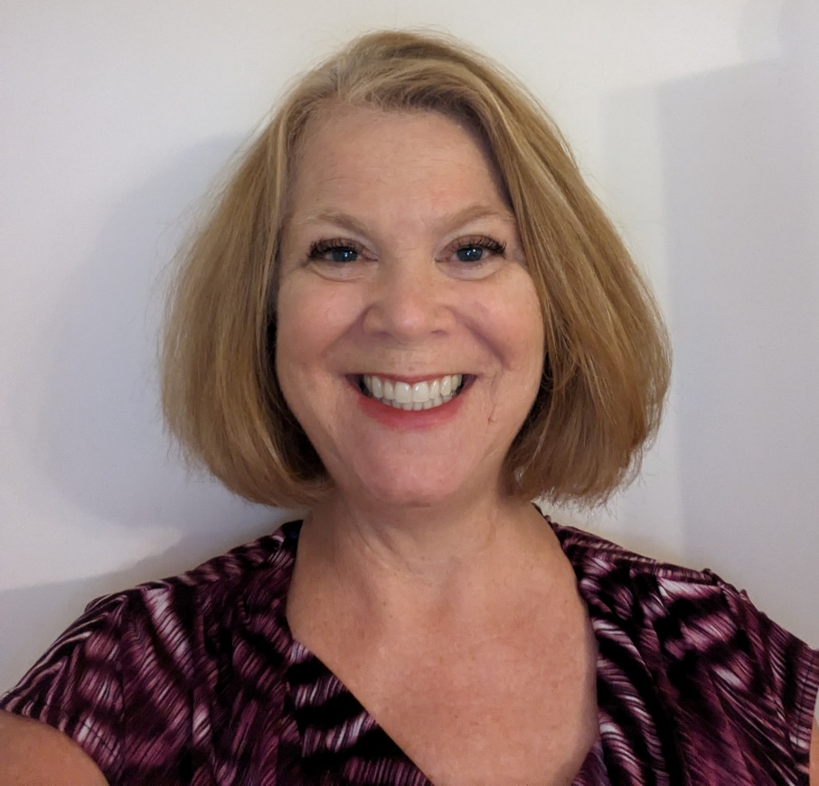
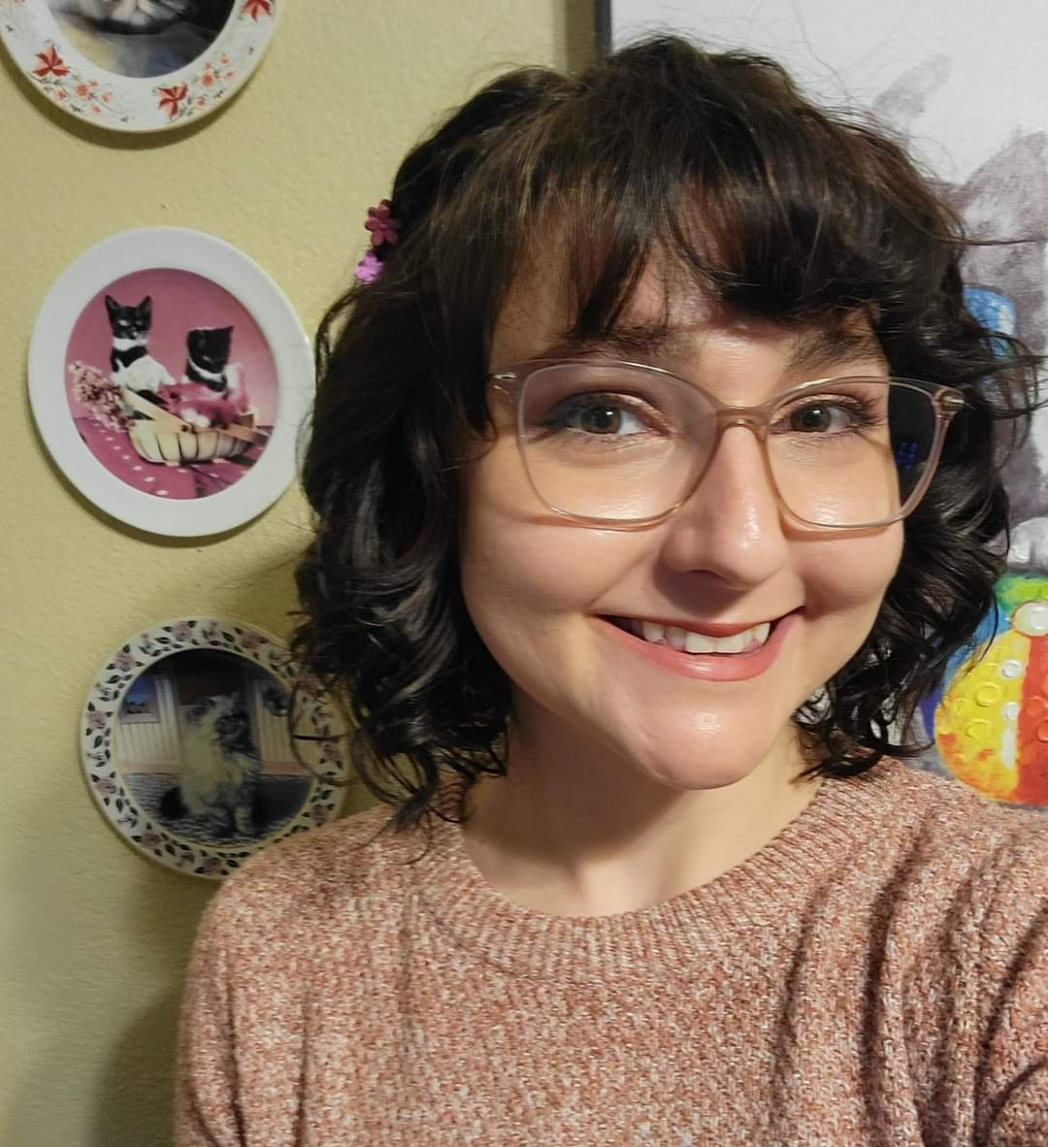
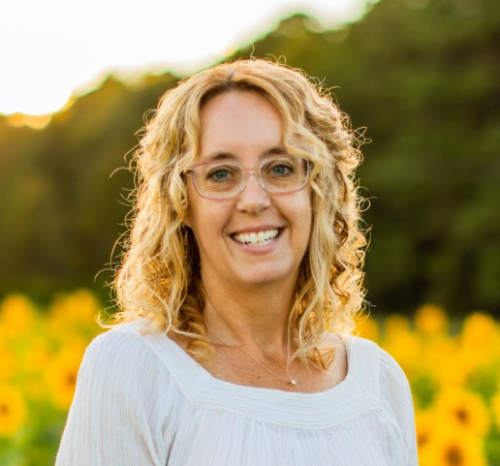
Elizabeth Beavers, PhD
Program Director and Associate Professor of Special Education
University of Houston
Clear Lake
Rachel Phillips, MA
ECI Lead for Policy Medicaid and Billing
Rachel Moyer-Trimyer, MEd
Lecturer at University of Texas at Austin
Senior Policy Analyst for Medicaid and CHIP Texas Health and Human Services
Dana Childress, PhD
Assistant Professor and Program Coordinator of Early Childhood Special Education
Old Dominion University (VA)
Notes:
Introductions – name, role, location
Chat: Ask participants to enter their names, role, connection to ECI recruitment and retention

Slide 3
If we create networks with the sole intention of getting something, we won’t succeed. We can’t pursue the benefits of networks; the benefits ensure from investments in meaningful activities and relationships.
Adam Grant
Notes:
Dana

Slide 4
Notes:
Dana
When we met at the Summit in March, we tossed around a ball of yarn to illustrate the influence of connections and how they affect the experiences of the people in the network. We used a scenario with a family in early intervention and built a web with the yarn to illustrate connections between the family, EI program staff, and community partners. As I read the scenario, the web moved as participants pulled it when the scenario mentioned something stressful, and eased up on the web when something was mentioned that would reduce stress.
CHAT: What was your take-away from that experience?

Slide 5
Local ECI Programs
ECI State Office
Notes:
Dana
Today, we are going to think about the connections and relationships between your programs and the ECI State Office. This is an essential connection so let’s think about how this collaboration can be leveraged for staff recruitment and retention when building relationships with university partners.

Slide 6
Our Plan for Today
Share what is already in place
1
Explore EI Leadership Competency Sets
2
Highlight strategies for expanding your recruitment web
3
Share what’s in the “pipeline” to continue this conversation
4
Notes:
Dana
1-Share what is already in place at the state level to support recruitment
2-Build on Bruin’s work, which we talked about last year
3-Highlight strategies for expanding your recruitment web through ECI-University partnerships
4-Share what’s coming up to continue this conversation and the work to support recruitment and retention

Slide 7
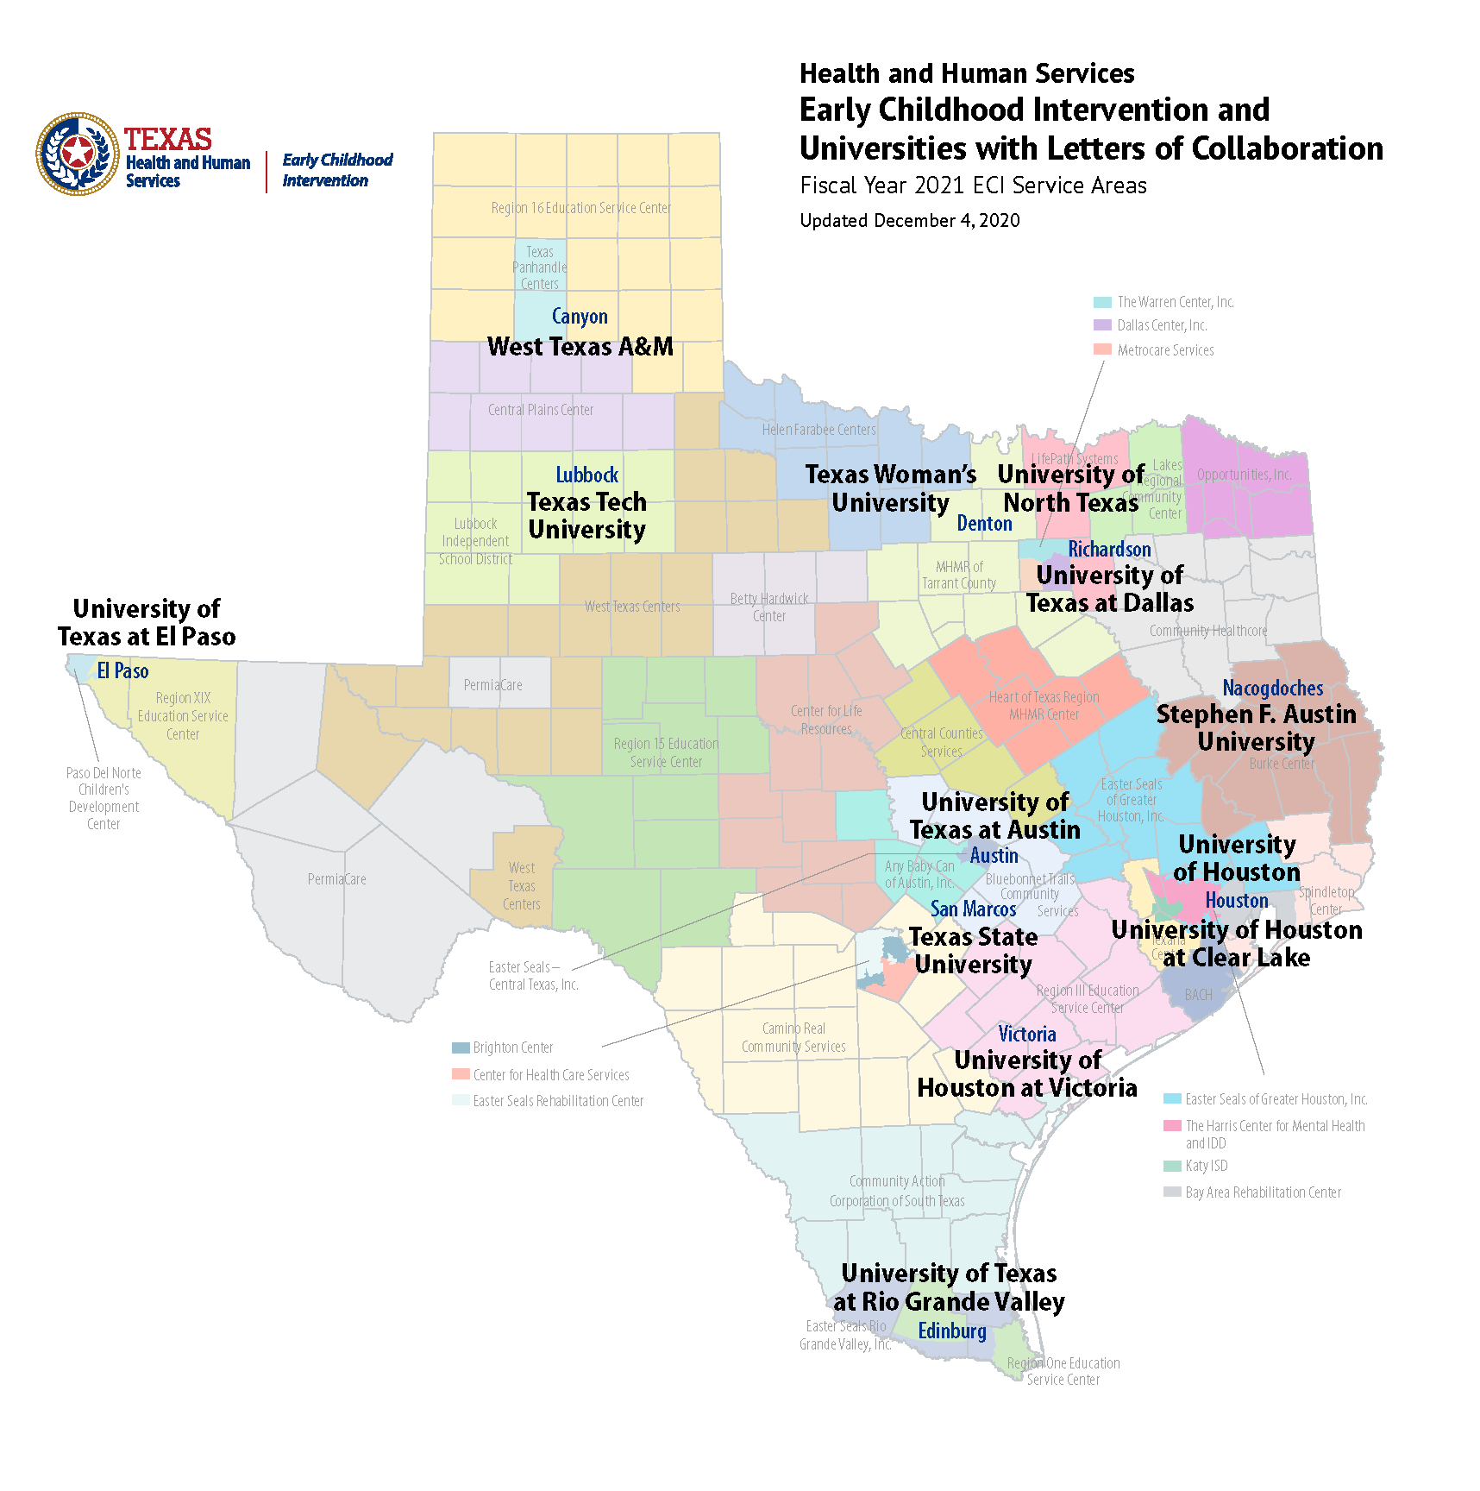
What’s In Place Now?
Letters of Collaboration
Recruitment Flyer
Career Fairs and Recruitment Events
Notes:
Rachel P
What’s in place (state efforts)
Letters of collaboration
Currently 22 letters of collaboration with university programs statewide, focusing on programs and departments in human development and family studies, or early childhood education.
Coursework that meets minimum requirements for EIS credential
Potential for internships, employment, or volunteer opportunities with local ECI programs
Presentations for classes
Working on recruitment flyer
Don’t have a preview ready just yet, but we are working on a recruitment brochure specific to EISes. This brochure will include input from EISes in the field regarding what brought them to ECI.
Career Fairs and Recruitment Events
The ECI state office attends at least 2 recruitment events per fiscal year, usually more. These include therapy association conferences like TOTA, TPTA, or TSHA.
ECI sends a contractor vacancy survey prior to all recruitment events for programs to provide information and job postings about vacant positions.

Slide 8
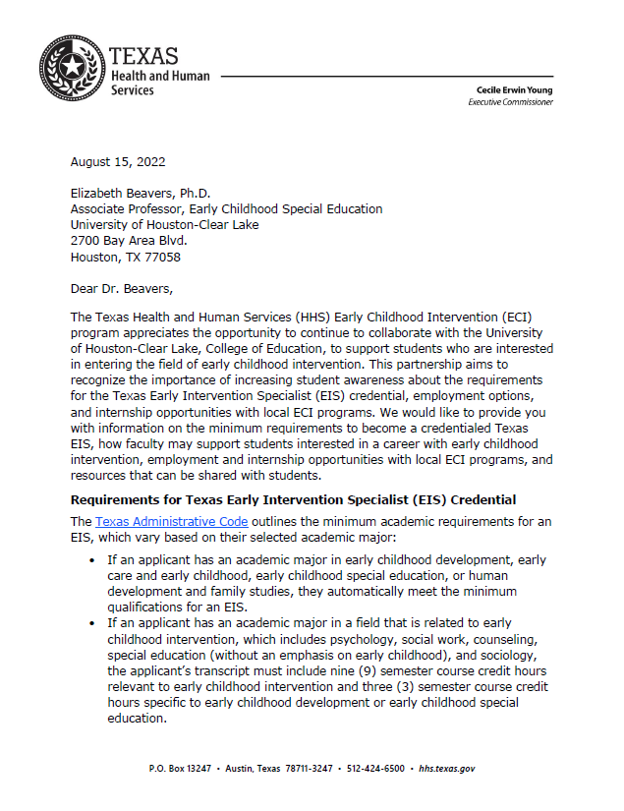
Sample Letter of Collaboration
Notes:
Rachel P
22 early intervention specialist letters of collaboration. Aim to increase awareness and support students and alumni interested in a career in early intervention. Provides:
An overview of the Texas Administrative Code as it relates to early intervention specialists;
Examples of coursework and curriculum that can be applied to the minimum academic requirements for an EIS
Information about careers, internships, and volunteer opportunities with local ECI programs
Resources students can use to learn more about ECI and/or use for class assignments.
Contact information for local ECI programs.
Struggles: Urban vs. Rural: Not a lot of universities in rural areas (e.g., Panhandle, Wichita Falls area)
Only applies to EIS position, not for therapies or other licensures/certifications

Slide 9
Recruitment Flyer
Notes:
Rachel P
You may be familiar with our existing Working in the Field of ECI infographic. This infographic is informative, but fails to address individual program’s needs, and frequently leads to confusion at recruitment events and career fairs. Moving forward, the ECI state office hopes to provide an adjustable recruitment flyer that programs can use to promote their existing vacancies.

Slide 10
5 Competency Sets for Effective EI/ECSE Leadership (Bruns et al., 2017)
Professional Learning
Effective Relationships
Shared Responsibility
Data Use
Effective Communication
Notes:
Dana
ASK: How do these competency sets relate to collaboration with university and community partners?
In 2017, Bruns and her colleagues gathered information from a diverse sample of experts in 7 states who shared their perspectives on EI leadership. Information from these leaders was used to develop a questionnaire that examined leadership knowledge and competencies. This questionnaire was completed by 820 participants. Interestingly, more than half of respondents were direct service providers (55%). Other respondents included local administrators (21%) and state administrators (8%). The rest included PD specialists, TA providers, higher ed faculty, family members. They identified 5 competency sets for effective leadership in EI and ECSE (onscreen).
Prof Learning – Being and encouraging lifelong learning; being open to new ideas and perspectives, and coaching and being a mentor/model for others
Eff Relationships – having high standards, acting ethically, being adaptable and responsive, understanding day to day practice realities, modeling reflective practice, build/sustain relationships with others
Shared Resp – engaging with others to make decisions and build consensus
Data use – analyze/synthesize info, gather info/data, share and use it
Eff Comm – writes and speaks well, active listener, communicates openly
ASK: Which of these competencies do you think are most relevant when we consider the state office’s role in recruitment?
Use stamp tool.

Slide 11
Shared Responsibility
Individual Success
Direct Services
Teaming
Compliance
Program Development
Engaging with others to make decisions and build consensus
Bruns et al., 2017
Bruns et al., 2017
Notes:
Dana
Shared Resp – engaging with others to make decisions and build consensus

Slide 12
What do you think shared responsibility for expanding the preservice pipeline and recruitment web in Texas should look like? Who should be involved in decision-making and consensus-building?

Slide 13
Effective Relationships
Have and expect high, ethical standards
Be adaptable and responsive
Build and sustain relationships
Understand realities of EI work
Model reflective practices
Bruns et al., 2017
Notes:
Dana
Bruns and colleagues:
Eff Relationships – having high standards, acting ethically, being adaptable and responsive, understanding day to day practice realities, modeling reflective practice, build/sustain relationships with others

Slide 14
What needs to be in place to build and sustain effective relationships within your recruitment network?
How can you help your recruitment partners understand the realities of the real world of EI?

Slide 15
Effective Communication
Write and speak well
Actively listen
Communicate openly
Bruns et al., 2017
Notes:
Dana
Eff Comm – writes and speaks well, active listener, communicates openly
Not only are these skills leaders need to use to engage with partners, these are also skills we need students to develop so they are hire-able.

Slide 16
How can we enhance and sustain effective communication within our recruitment web?
How do we support universities in preparing students with “hireable” skills?
Notes:
Expanding Your Recruitment Web through ECI-University Partnerships

Slide 17
What’s in the Pipeline?
Stakeholder Groups
Enhanced University Collaborations
Proactive Presentations
Notes:
Rachel P.
Working on a few initiatives including:
Developing stakeholder groups to plan and enhance existing relationships with universities.
Review curriculum and coursework related to EIS credentialing
Work with ECI programs who have successful relationships with therapy programs at their local universities to share best-practices and strategies to connect with students and offer internships/practicums/rotations
Enhancing those university collaborations to strengthen recruitment efforts, such as:
Re-instigating university Individualized Professional Development Plan progress trackers to provide students with the opportunity to connect coursework with initial training requirements.
Connecting with community colleges for students obtaining a 2-year degree who are considering transferring to a 4-year university.
Connecting with universities outside of Texas, particularly along the border.
Proactive presentations:
Working toward being proactive with offering presentations for all universities
Including ECI field staff
Hope to develop recruitment presentations for various licensures/credentials (EIS, SC, OT/PT/SLP, etc.)

Slide 18
Other thoughts? Questions?

Slide 19
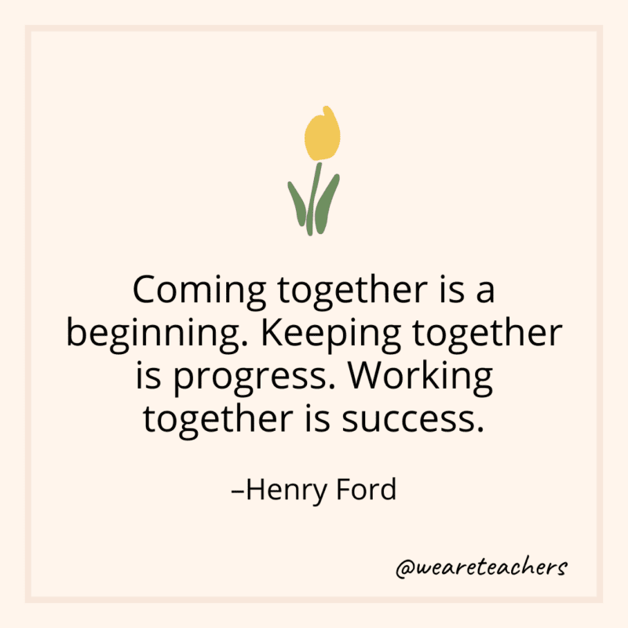
Email us!
Dana Childress
dchildre@odu.edu
Rachel Phillips
rachel.phillips01@hhs.texas.gov
Rachel Moyer-Trimyer
rachelmoyertrimyer@gmail.com
Elizabeth Beavers
beaversea@uhcl.edu

