Slide 1
Findings from the ECI Personnel Survey

Slide 2
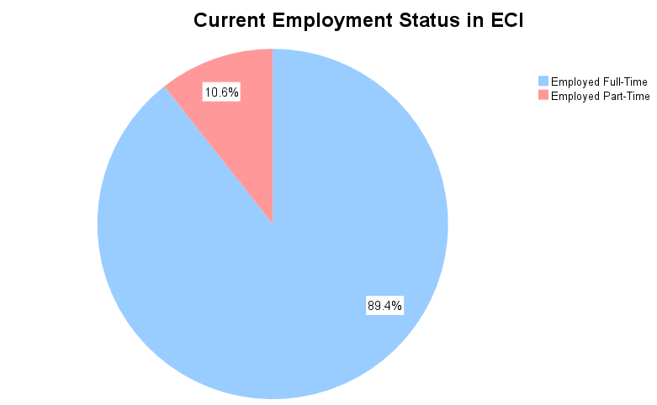
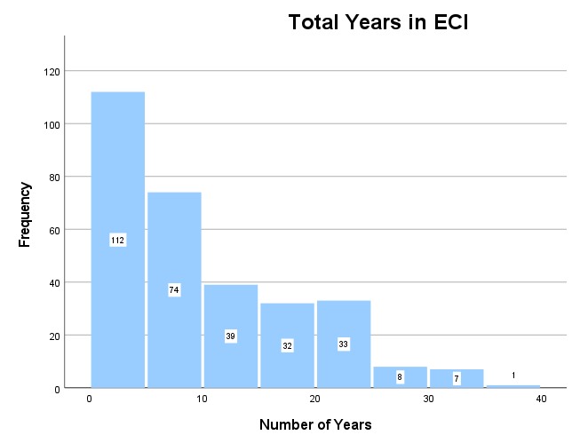
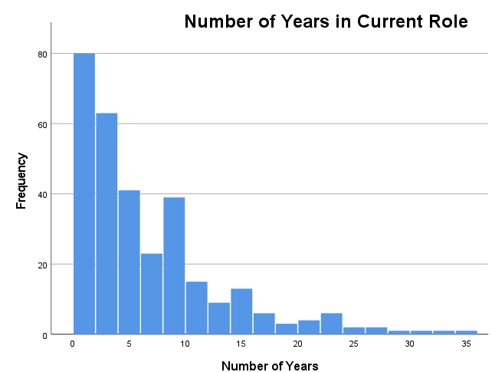
312 Completed Surveys
02/03/23 – 03/04/23 Noon
81.7% Completion Rate
Average time: 18 minutes
Average = 9.8 years
Average = 6.3 years

Slide 3
Characteristics | Percentage
Gender | 96.8 % Women, 3.2% Men
Age | Average age: 41.1 years Range: 22 – 66 years
Hispanic Ethnicity | 43.4%
Race | 1.6% Asian 4.5% Black 2.6% Native American/Indian/Alaska Native 87.8% White
Language | 62.3% English Only 34.9% Spanish
Education | 97.5% College Graduate 47.4% had at least a Master’s Degree
Marital Status | 66.6% Married
Have Children at Home | 45.0%

Slide 4
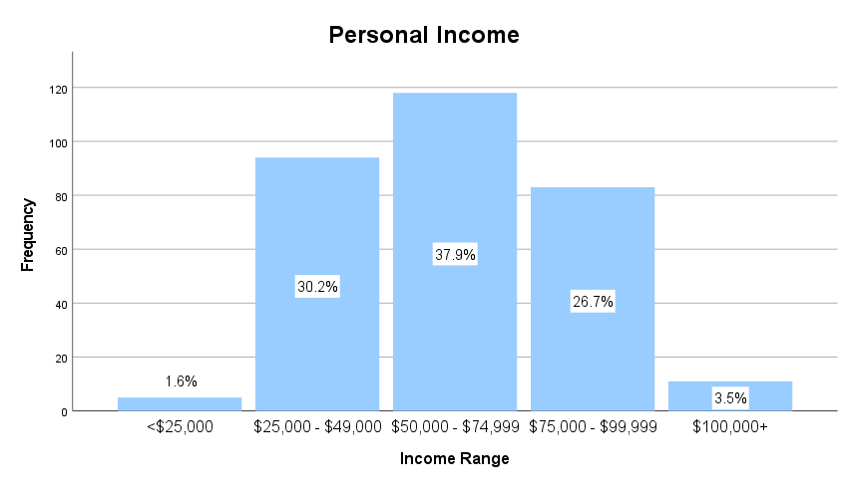

Slide 5
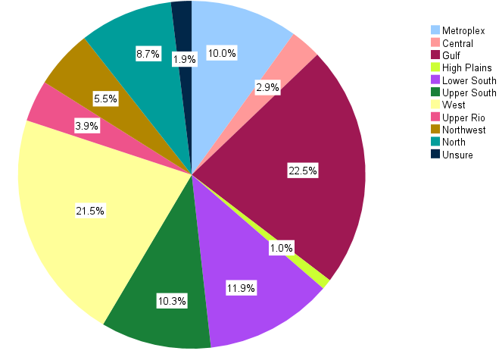
Location of ECI Program
60.0% Private Non-Profit
43.2% Large (> 1,000 children)
52.6% Have Major Staff Shortage
44.6% Have Major Staff Turnover

Slide 6
Types of Direct Services
Approximately 87.5% participants provide direct services to children and/or families
Of those who provide direct services:
The average number of children and families on caseload is 37.7.
59.3% Urban, 47.1% Suburban, 35.9% Rural
85.6% In-person, 58.3% Telehealth
83.4% use own car
4.0% not reimbursed for gas mileage
30.1% work outside of typical work hour once per week or more

Slide 7
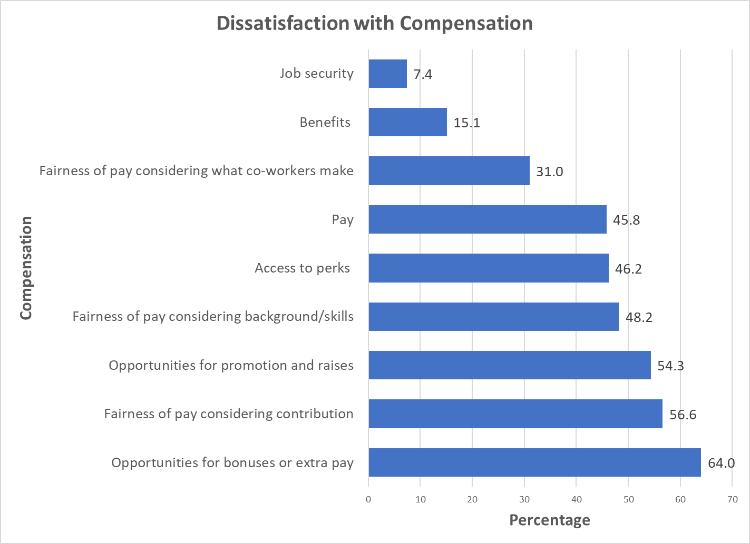

Slide 8
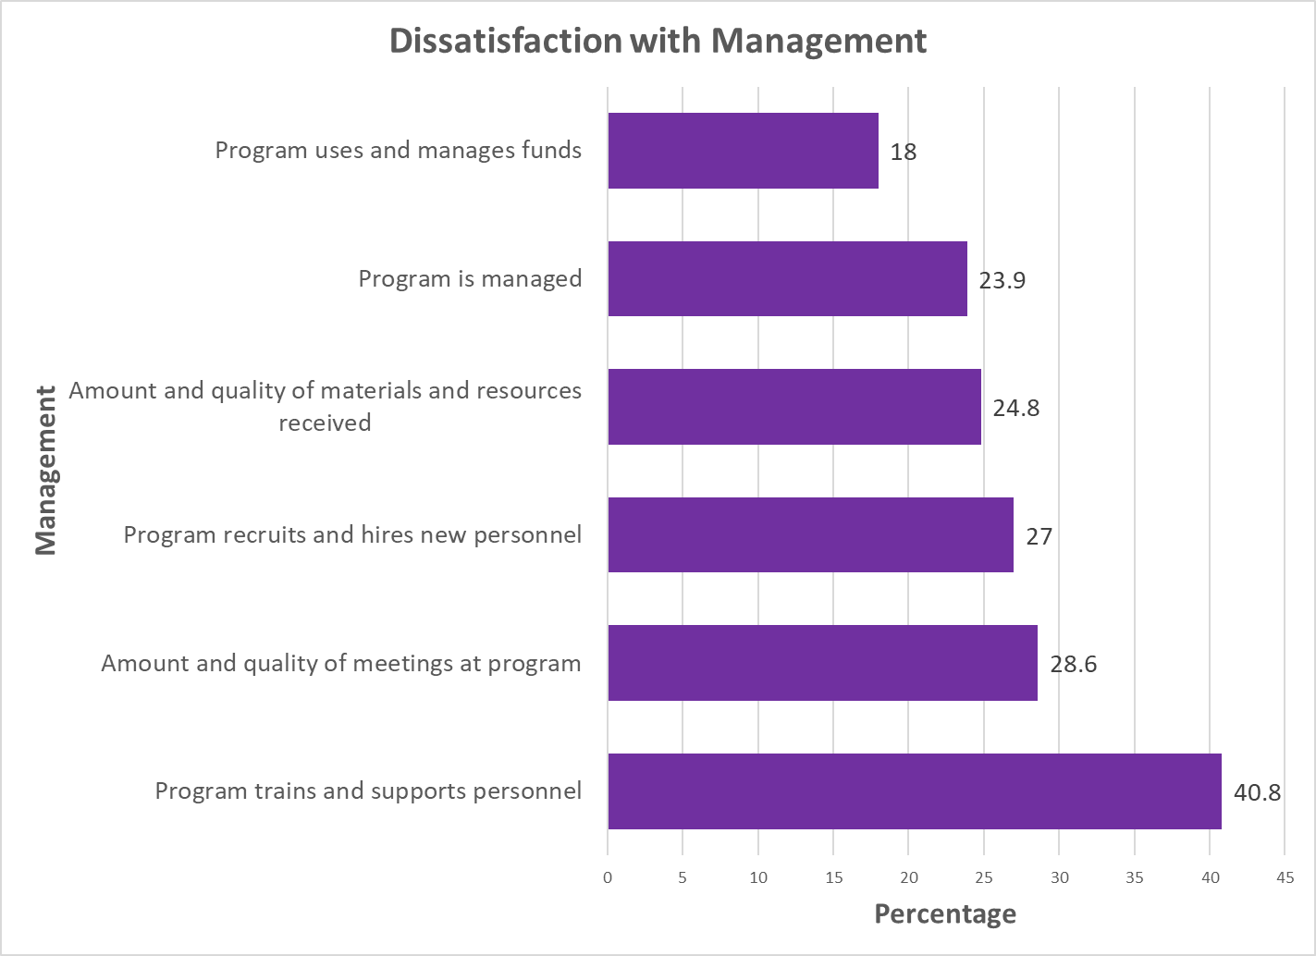

Slide 9
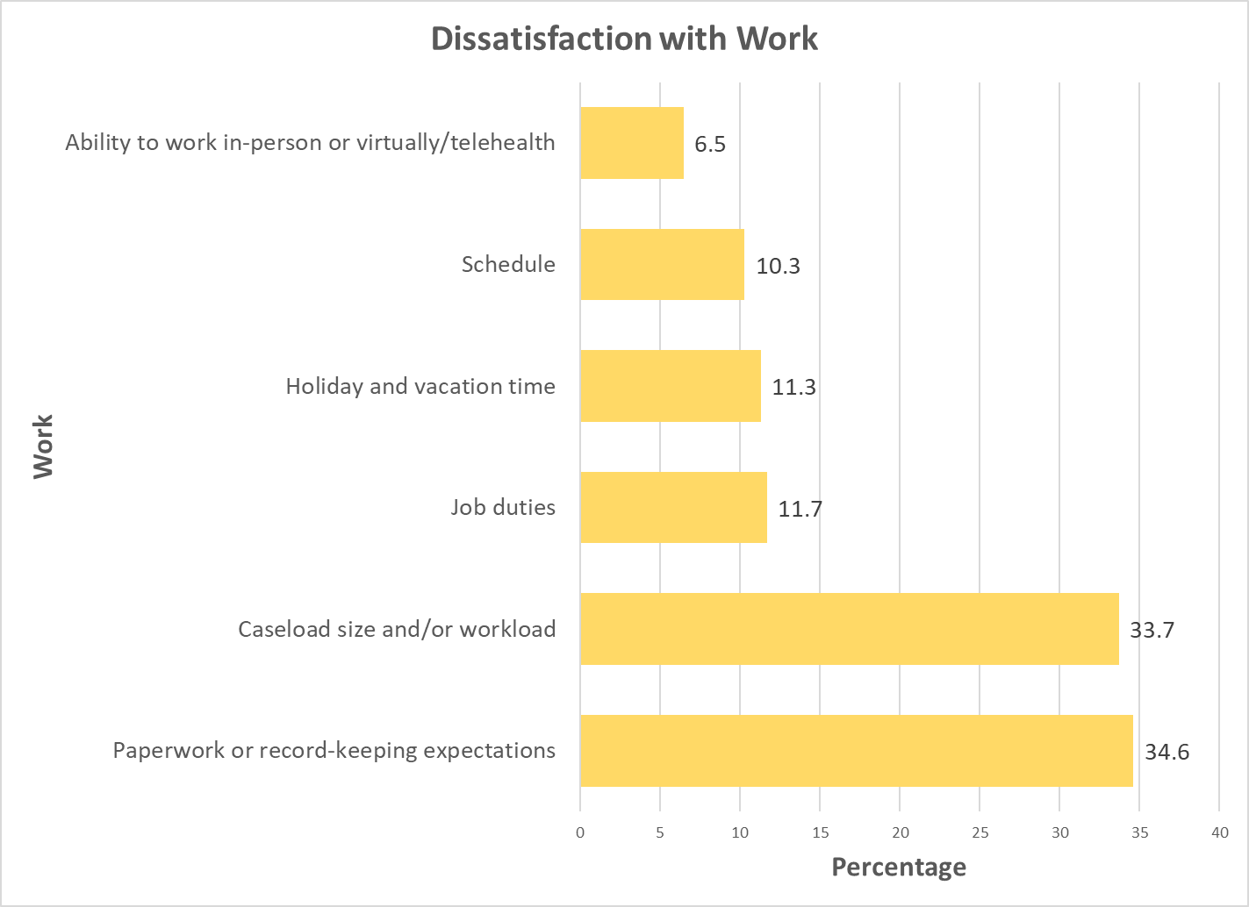

Slide 10
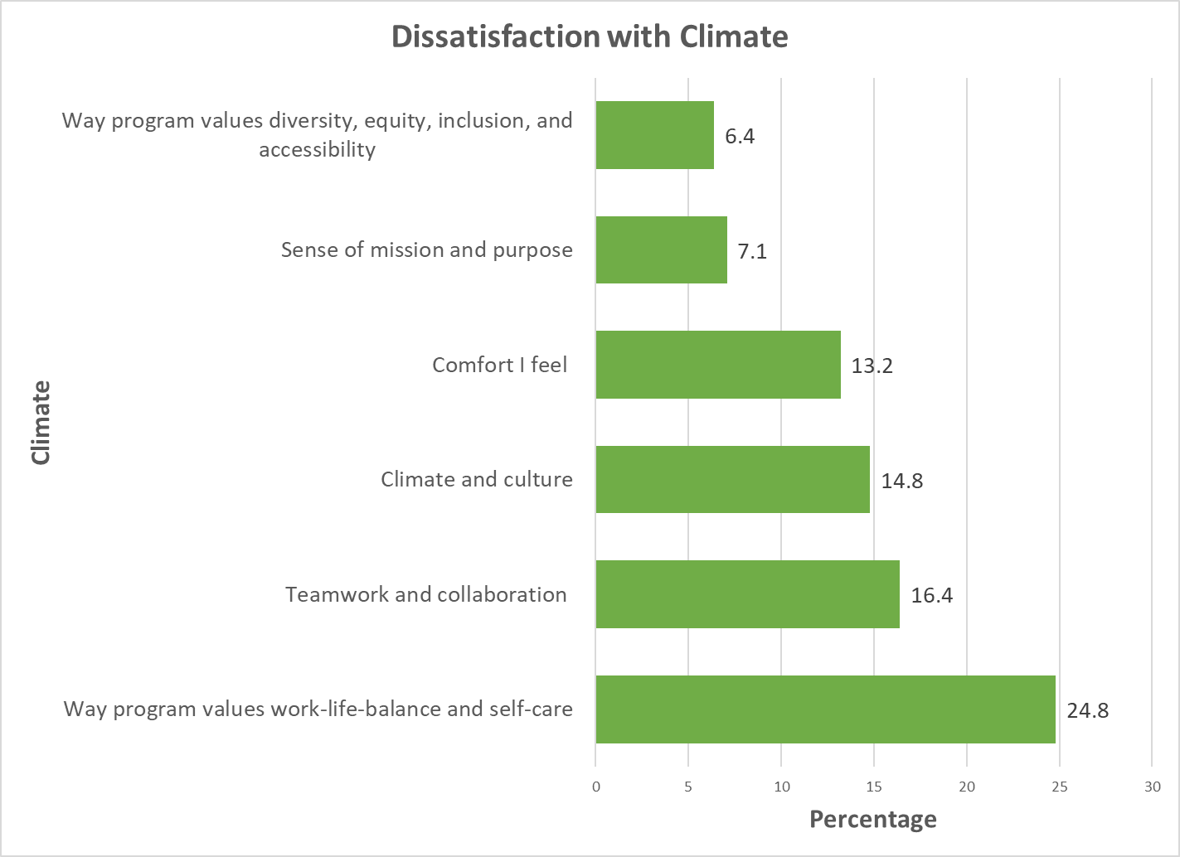

Slide 11
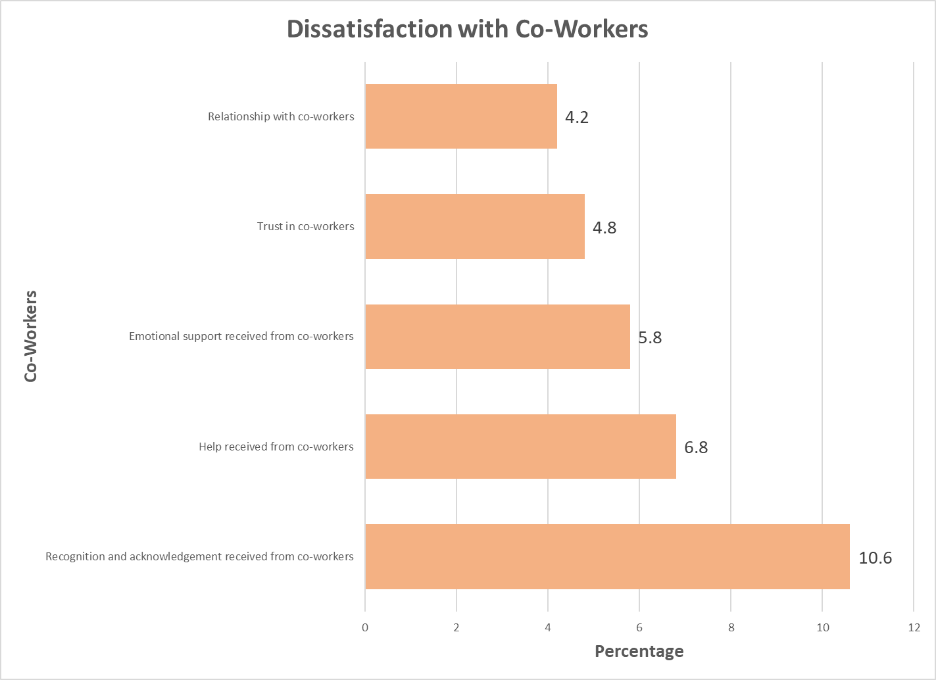

Slide 12
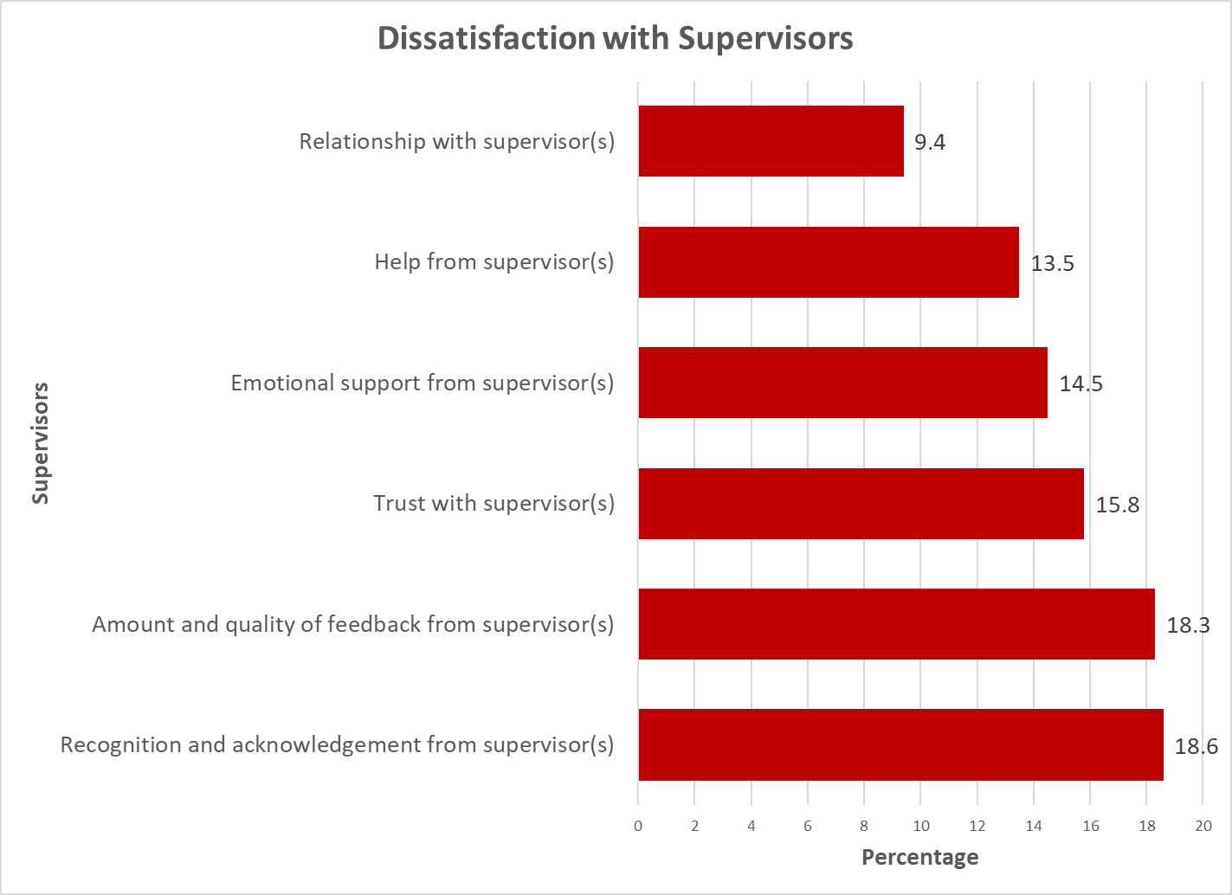

Slide 13
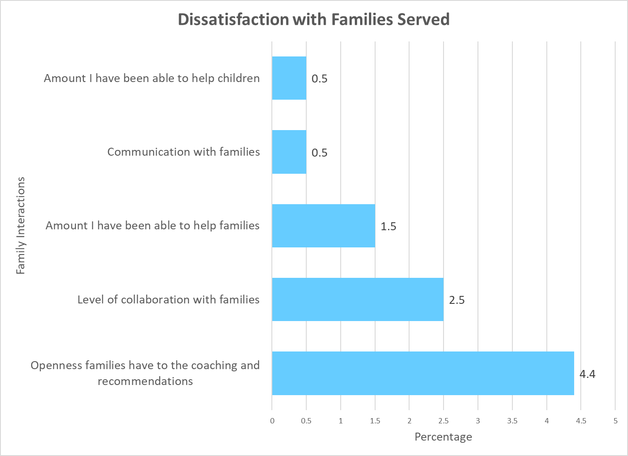

Slide 14
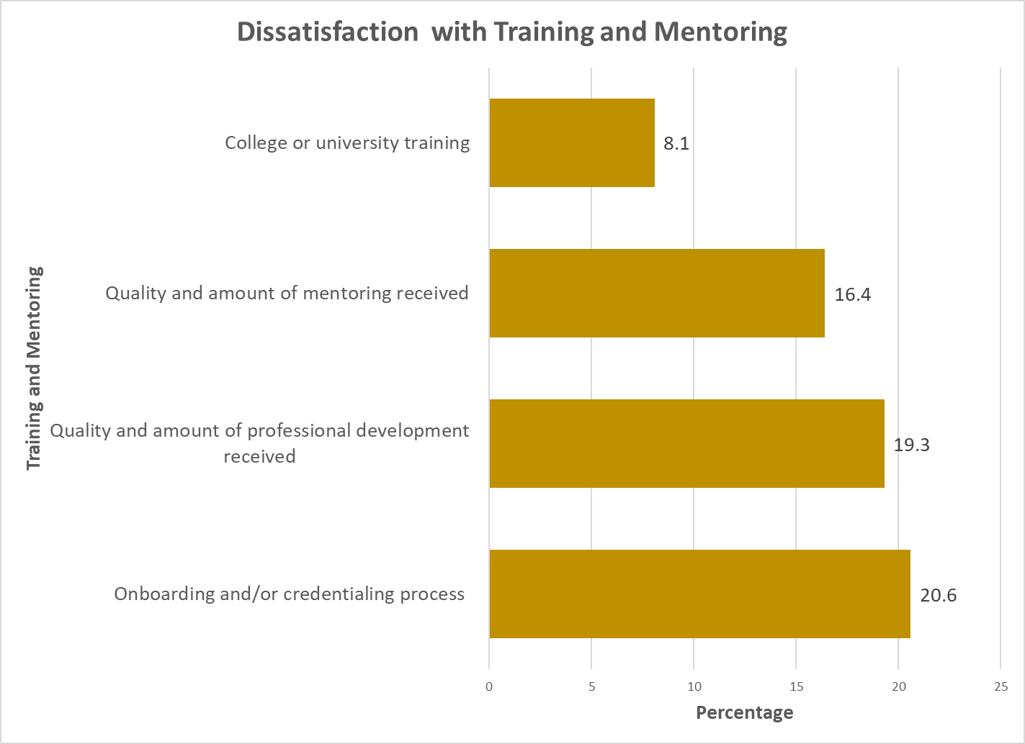

Slide 15
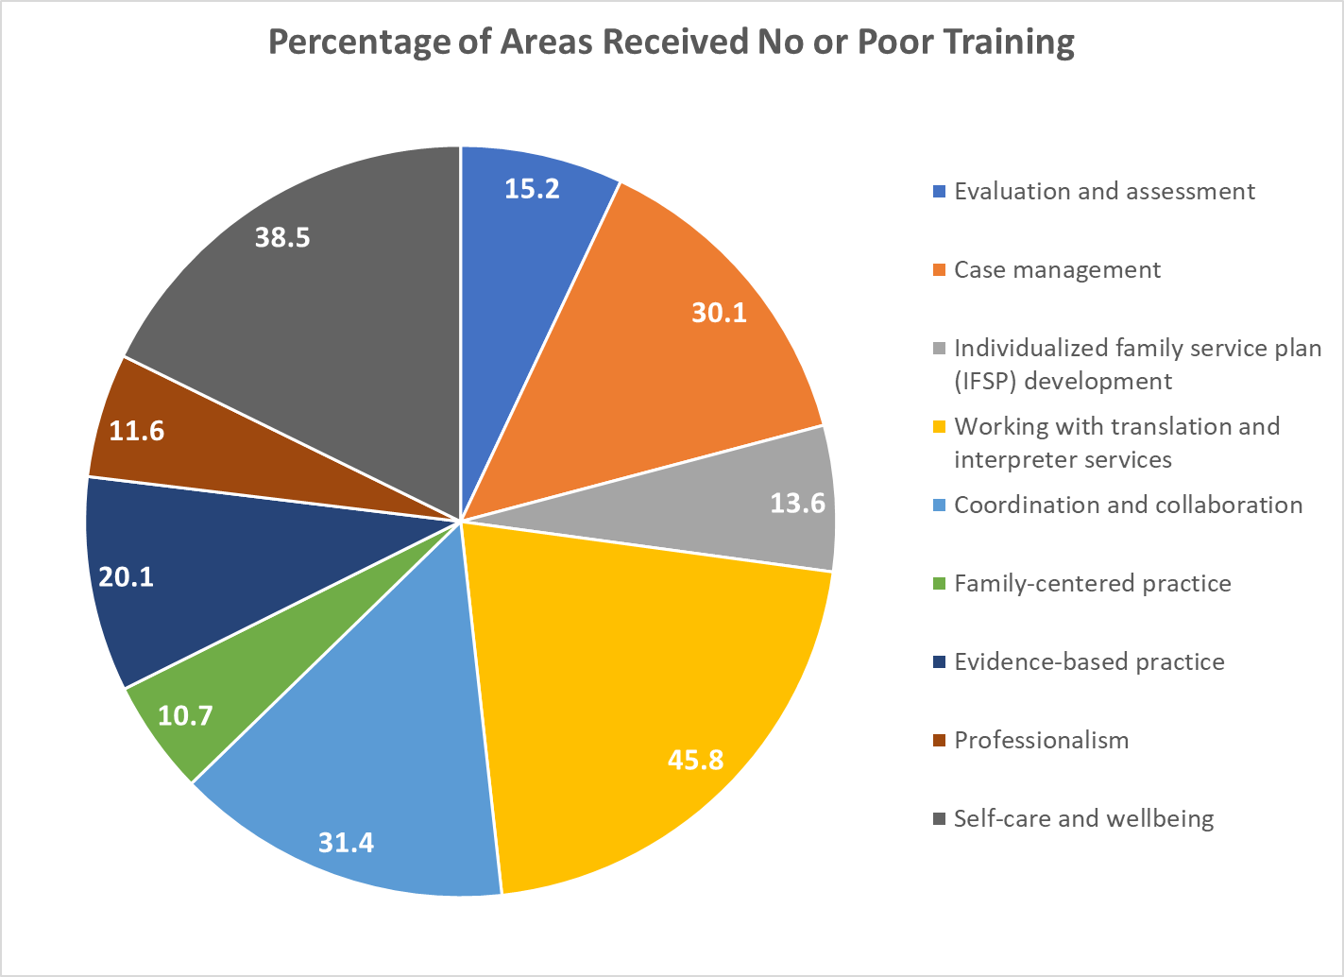

Slide 16
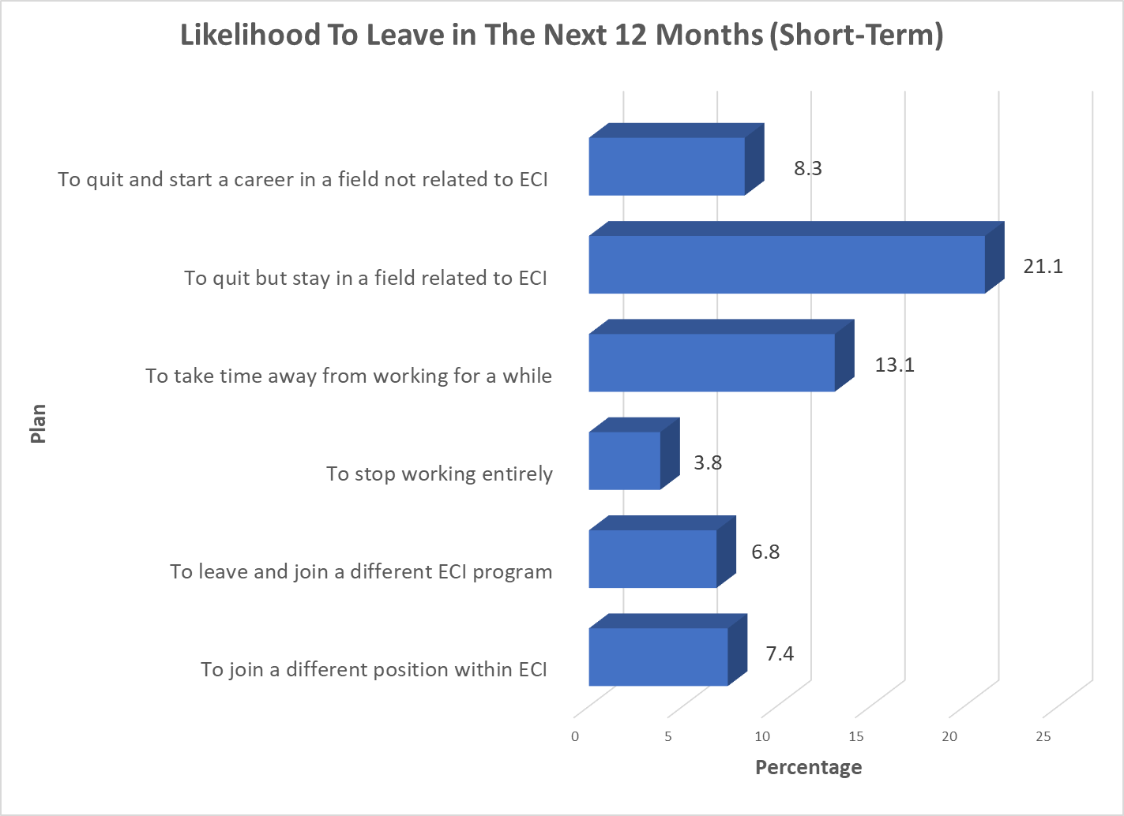

Slide 17
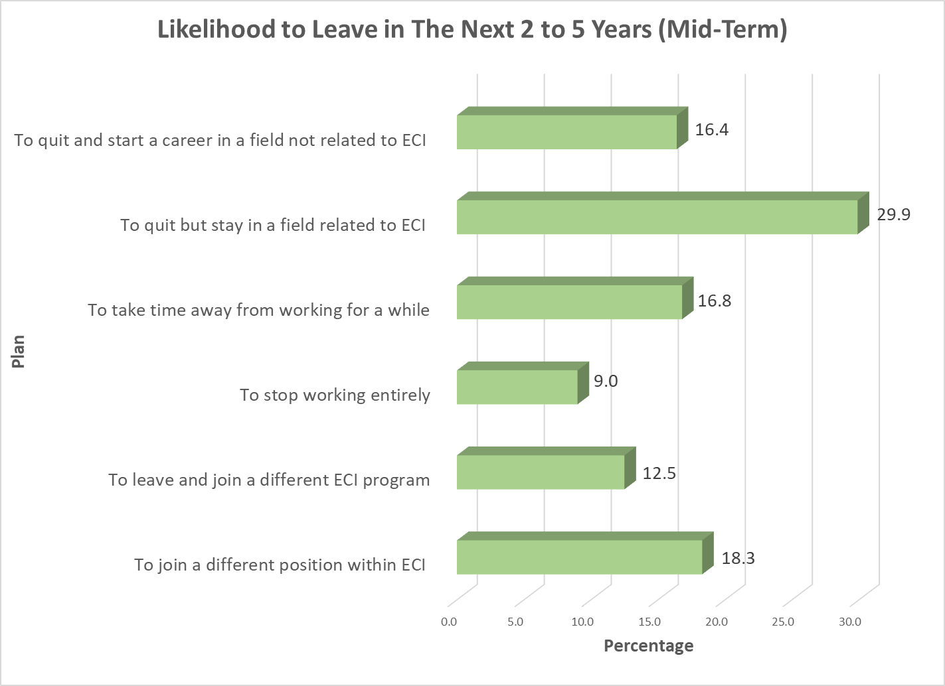

Slide 18
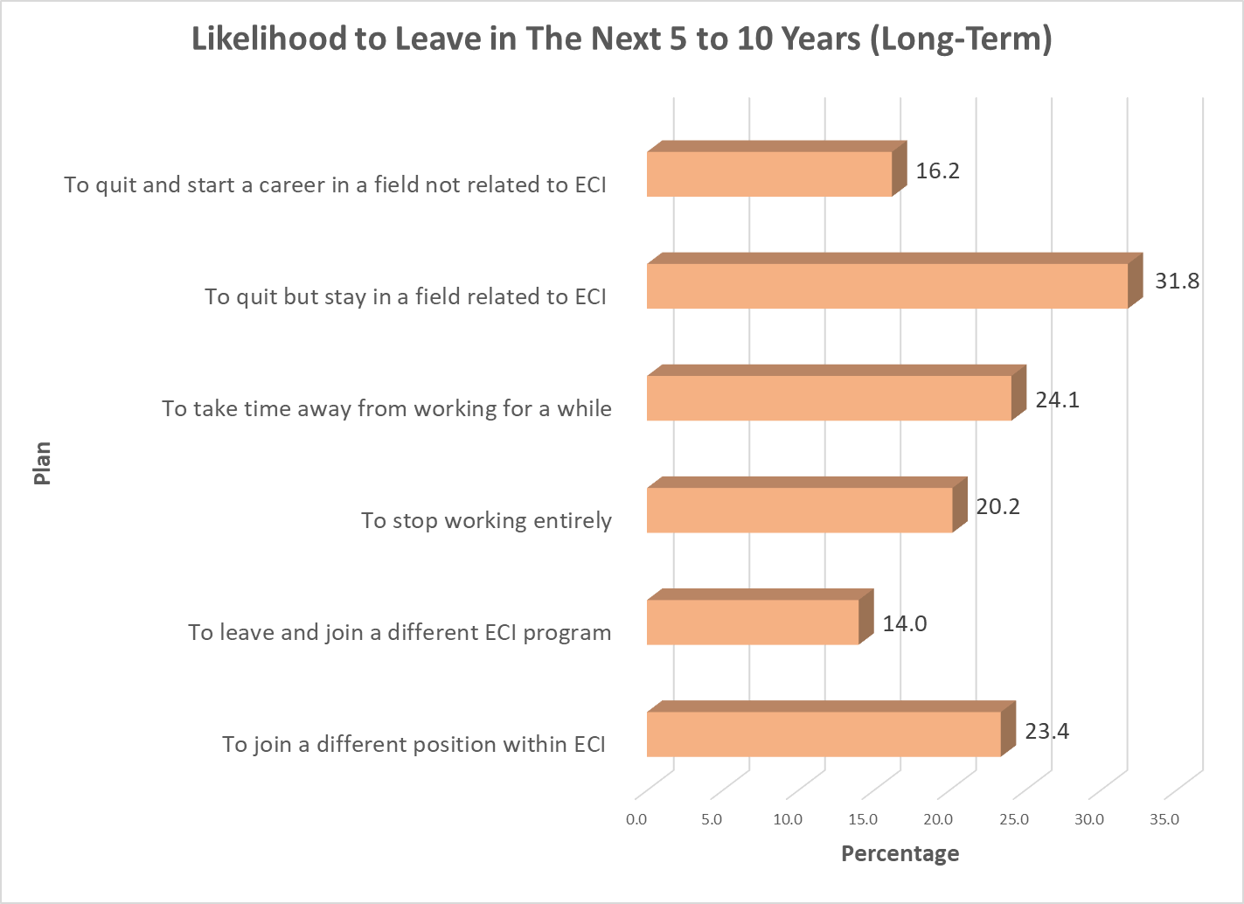

Slide 19
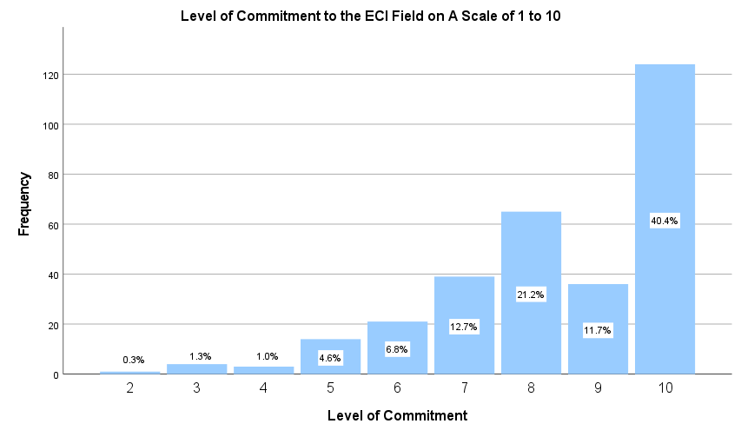

Slide 20
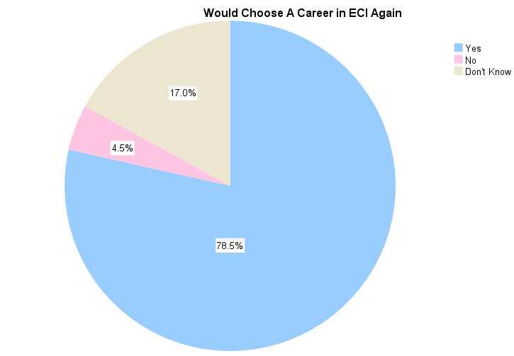

Slide 21
Most Satisfying
“Sense of purpose and investing in future generations.”
“Seeing the progress in children and families, knowing we are helping them. Working with a team of people who believe in the same mission.”
“Seeing progress in families and the flexibility of my job.”
Most Frustrating
“Long hours, paperwork, evening appointments, families who cancel a lot.”
“Lack of resources and pay.”
“Administration micro manages. Highly critical of mistakes and short on recognition of successes.”
“Expectations and stress/burnout.”

Slide 22
What Can Be Done?
“Address work, life balance, and productivity expectations, sometimes it feels the job never ends.”
“Productivity bonuses; well balanced caseloads across the teams.”
“Increased pay. Positive feedback. Stipends for excelling at timelines as an agency. Improved morale.”
“Higher pay, more discipline specific training and mentorship opportunities, more flexibility with co treating [sics].”
“Improve efficiency of systems to increase productivity with less stress on staff.”

