Slide 1
Summer Series Follow-up Session
ECI Summit
March 25, 2022
Facilitated by Elizabeth Beavers, Ph.D.

Slide 2
Intentionally Designed Mentoring: Formal and Informal Paths to Supporting ECI Practitioners
ECI Leadership Training
June 30, 2022
Facilitated by Elizabeth Beavers, Ph.D.

Slide 3
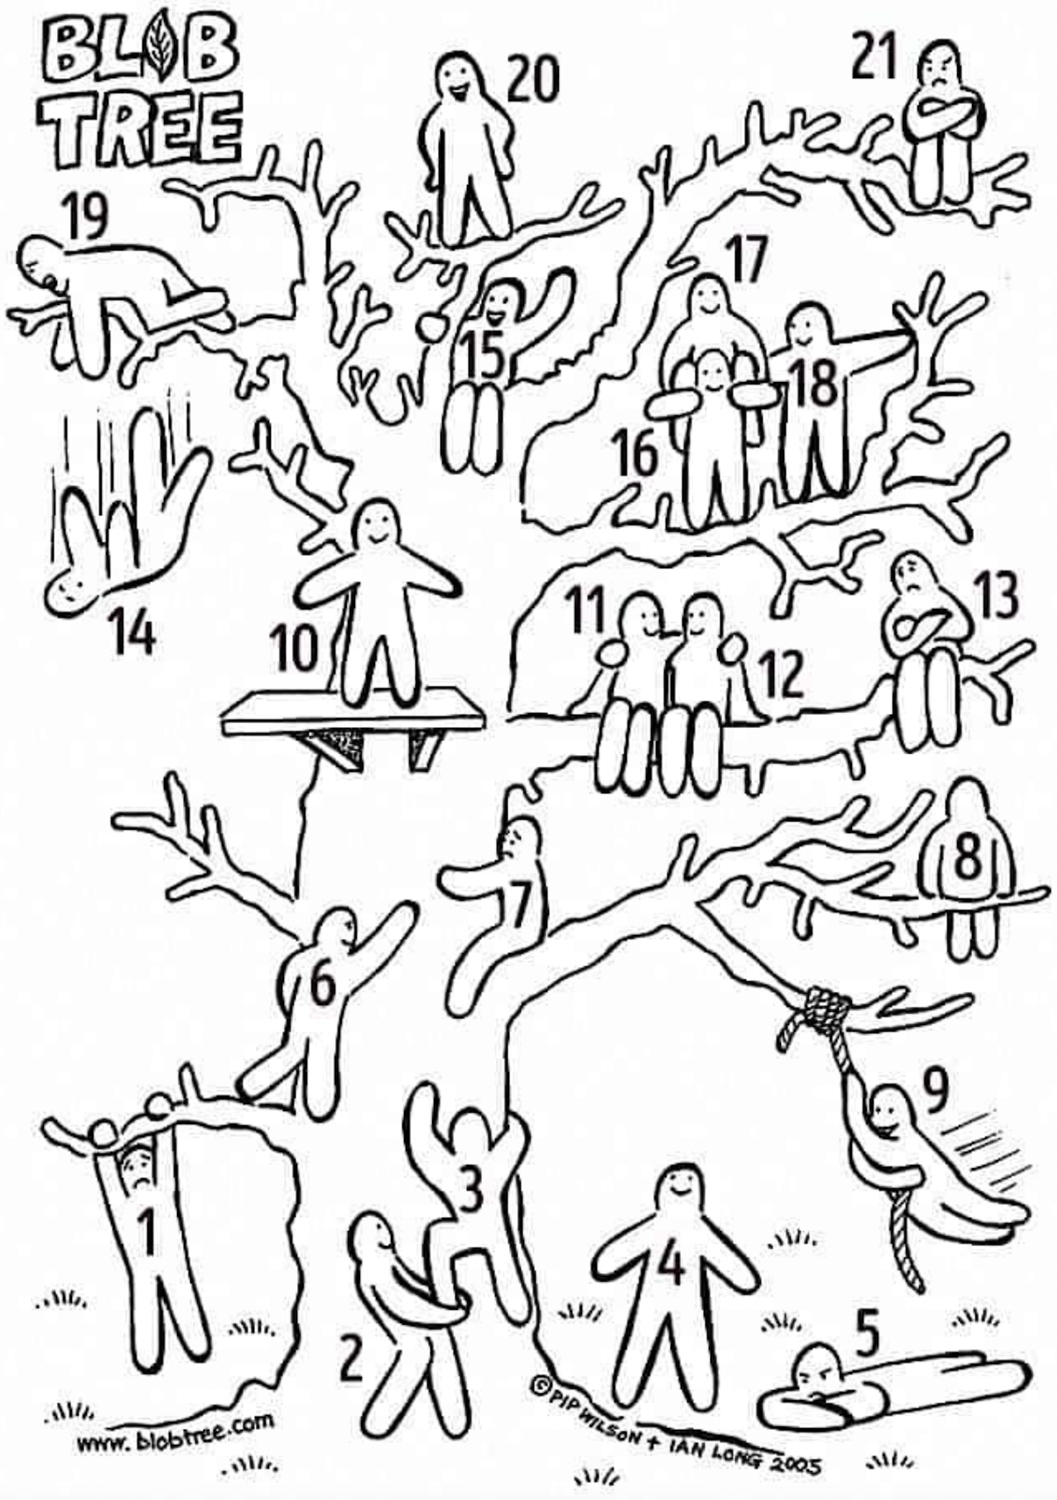
Welcome and Check-In
In the chat, please state which number represents best how you are feeling today?

Slide 4
Our focused outcomes
Identify the elements of a mentoring program and their relationship to one another
Engage in focused reflection of the strengths of your current mentoring practices
Identify strategies for intentionally implementing evidence-based mentoring practices that impact the professional growth of mentees while supporting mentors
Strategize intentional ways to add depth and fidelity to your mentoring program
Notes:
1 minute

Slide 5
In the chat, please share….
What is your goal for the next two hours of your time dedicated to exploring mentoring?
Notes:
1 minute

Slide 6
Mentoring
“A collaborative learning relationship that proceeds through purposeful stages over time and has the primary goal of helping mentees acquire the essential competencies needed for success in their chosen career.
It includes using one’s own experience to guide another through an experience that requires personal and intellectual growth and development” (Pfund et al, 2016).
Notes:
2-3 minutes review

Slide 7
Types of Mentoring
Formal
Pairing often with a designated mentor
Organizationally supported structure and progress for mentoring program
Structured with specific goals and targets that align with organizations goals and culture
intentional learning which includes developing people’s capabilities through instructing, coaching, modeling, and advising
Impacts are measured
Intentional or unintentional pairing
Relationships develop naturally
Often more long term than formal mentoring
Often grounded in spontaneous needs
There is no expert training and/or support
Have unspecified or very generalized goals
May offer complementary and overlapping forms of support.
As such, the goal is for formal mentoring to promote mentoring in an informal way throughout the organization as doing so can change the culture of the program into a mentoring culture.
The quality of relationships in both types are a critical factor in job satisfaction, development of professional growth and retention.
Informal
Notes:
2-3 minutes
Anisha example, formal mentoring program: 11 weeks

Slide 8
“The whole is something besides the parts” Aristotle
The often-misquoted phrase is: “The whole is greater than the sum of the parts.”
This references systems; specifically, a reference to mathematical processes/objects
You may have the parts and yet not have the whole, so that parts and whole cannot be the same
(paraphrased translation from the works of Aristotle)

Slide 9
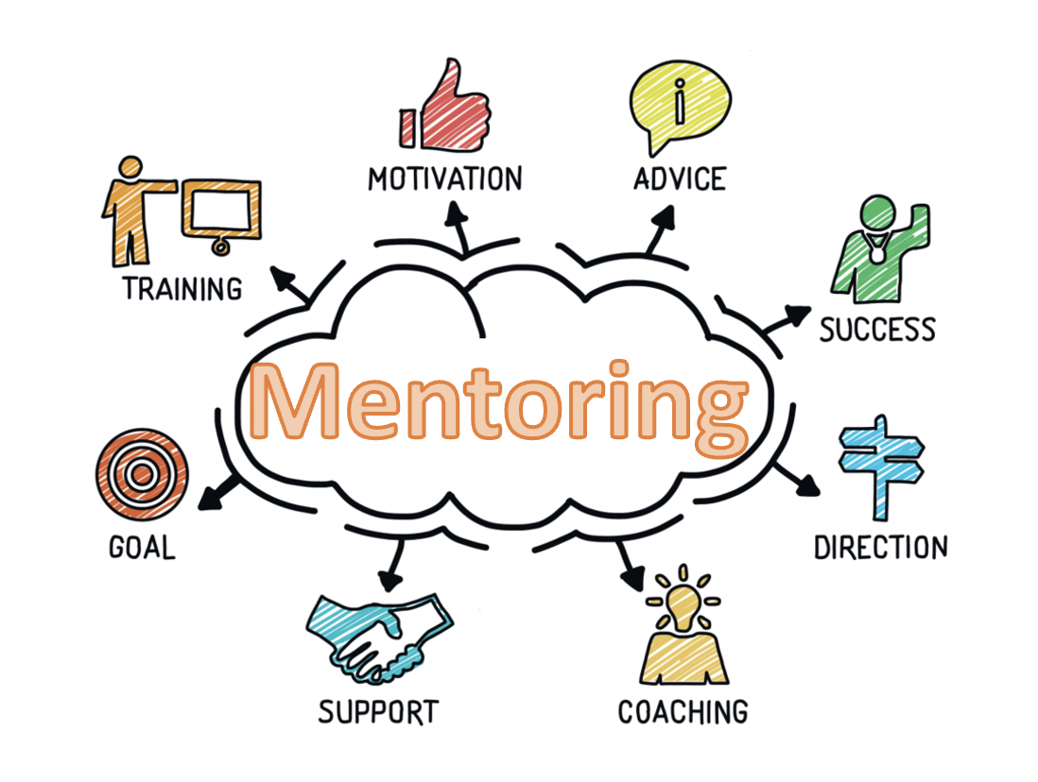
Image source: hiclipart.com

Slide 10
The Details Matter
Guiding Principles to designing your mentoring program
Intentionality
Relational Quality
Holistic Support

Slide 11
Align your actions with your purpose
Sinek, 2006

Slide 12
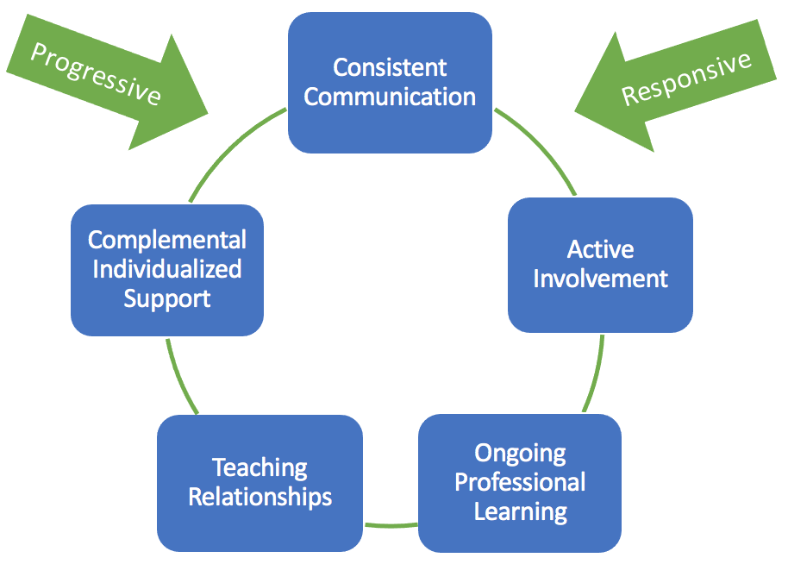
5 ideals evident through two approaches and two paths of engagement
An Example
Our why: to support the personal and professional growth of new teachers
how
what
A variety of clearly delineated supports

Slide 13
In groups, please share:
A strength of your current mentoring program
A component you desire to add, enhance or merge to add depth to mentoring efforts
One person from each group needs to please be prepared to share out after the breakout groups

Slide 14
Design/Revamp your mentoring program with intentionality
Who is involved in the overall direction of the mentoring program?
Will participation be mandatory or voluntary for mentors?
How long do you imagine the formal aspects of mentoring to last?
What type of mentoring experiences will be available?
How frequently will mentoring activities occur?
What type of mentoring activities will be supported/encouraged?
What forms of support will be provided to the mentors?
How do you ensure the mentor-mentee relationship is emotionally healthy and is protecting confidentiality?
What operational changes need to occur to support an effective mentoring program?
What will your training involve? For mentors…for mentees?
?
?

Slide 15
Sharing Strategies
Mentors
Support
Guidance & Expectations
Training
Mentees
Prioritization of Individual Needs
Integration of Support
Scaffolding
Accountability
Experiences

Slide 16
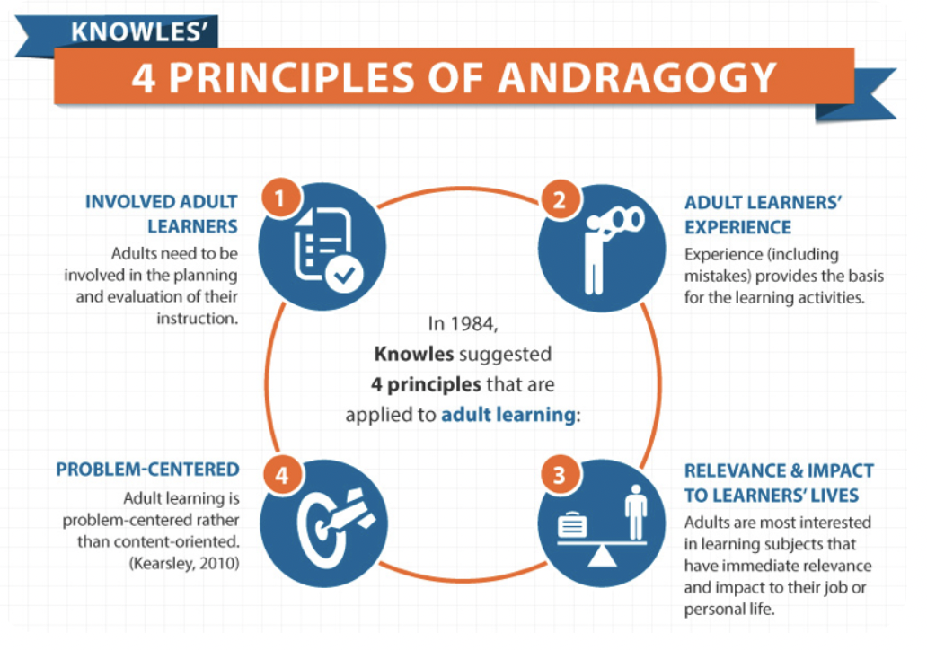
Keep in mind…

Slide 17
Wrap Up
Please state one take-a-way in the chat

Slide 18
“The whole is something besides the parts”

Slide 19
Final thoughts
Thank you for YOUR time

