Slide 1
Early Childhood Intervention Personnel Development
Content and Methods
July 13, 2022
Mary Beth Bruder
University of Connecticut
A.J. Pappanikou
Center for Excellence in Developmental Disabilities
Education, Research, and Service
263 Farmington Avenue, MC6222
Farmington, CT 06030
Phone: (860) 679-1500
Fax: (860) 679-1571
E-mail: bruder@uchc.edu
Website: www.uconnucedd.org

Slide 2



Slide 3
Our Vision for an Equitable
Early Childhood Intervention System
Equitable Access for All Children to Identification, Screening, Referral and Service Provision
Families as Partners
Natural Environments and Inclusionary Practices
Cross Disciplinary Teams
Inter-Agency Early Childhood Collaborations

Slide 4
Are Personnel Prepared and Supported
to do the Job?

Slide 5
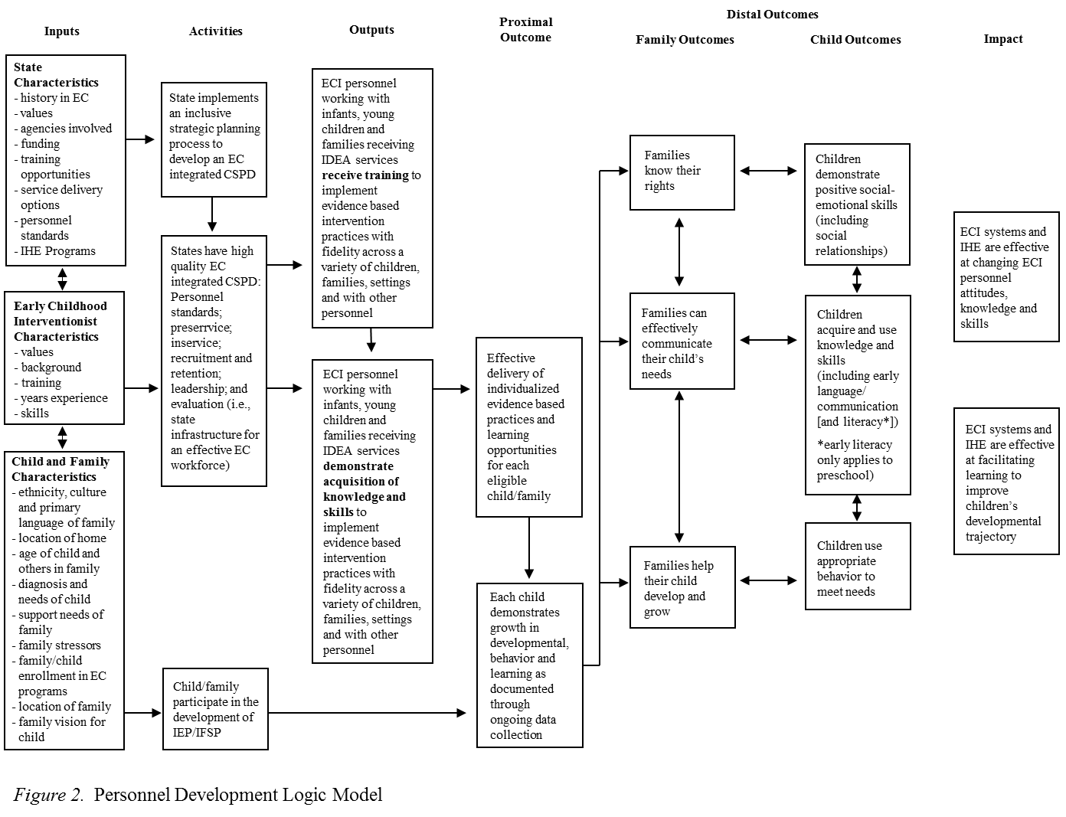
Personnel Development Logic Model

Slide 6
If the Child and Family Outcomes are the Dependent Variables
Personnel Are the…………

Slide 7
a) Independent Variable
b) Dependent Variable
c) Mediator
d) Moderator
e) All of the Above

Slide 8
Conclusion
Personnel Can Have a Powerful Impact....
or NOT

Slide 9
We see things not as they are
But
As we are

Slide 10
If we want improved outcomes for infants and young children with disabilities and their families…….
ECPC’s
focus
More EC leaders and practitioners have the requisite knowledge and skills
Improved effectiveness of EI, ECSE, and
EC services and supports
Improved outcomes for children and families
States have high quality CSPDs
Theory of Action

Slide 11
Are Personnel Prepared and Supported
to do the Job?

Slide 12
Comprehensive System of Personnel Development
Leadership, Coordination & Sustainability
Structures for ongoing support of all personnel development activities
Inservice Training
Ongoing learning activities to maintain and build the competence of the EC workforce
Recruitment and Retention
Strategies to identify, hire and maintain a qualified workforce across sectors and discipline
Evaluation
Plans for evaluating each subcomponent of the CSPD
Preservice Training
Formal program of study at an IHE to prepare for the EC workforce
Personnel Standards
Discipline specific knowledge, skills and competencies for the EC workforce

Slide 13
Preservice and Inservice Systems MUST Align
Preservice
Standards
Inservice
Practices

Slide 14
Continuum of ECI Personnel Competence
Infants and
Young Children with Developmental Delays, Disabilities, and Extreme Challenges
Early Childhood Intervention Personnel with Specialized Training
Early Childhood Personnel with Advanced Training
Infants and Young Children with Various Risk Conditions
All Early Childhood Personnel
All Infants and Young Children

Slide 15
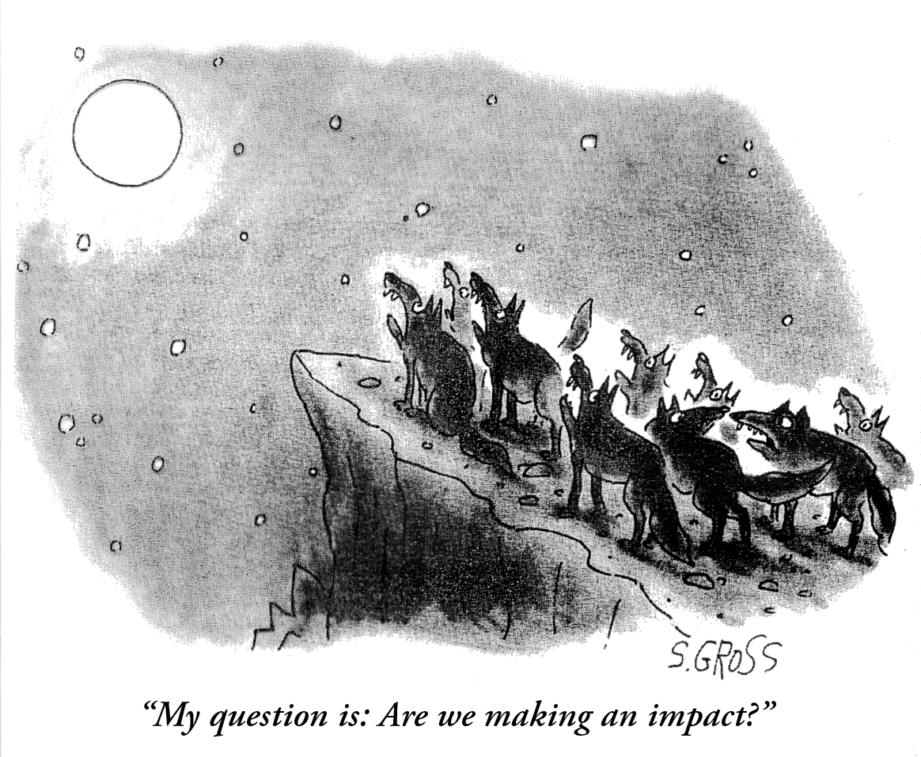

Slide 16
Characteristics Consequences
Processes
Figure 1. Framework for depicting the relationships between the characteristics and consequences of an intervention or practice and the processes operating to explain the relationship between the variables.

Slide 17
What are Evidence Based Practices (EBPs)?
Represent practices with the best of evidence of “what works”
AND (in the most conservative application of the definition)
  Have been classified as such through a FORMAL EVIDENCE-BASED REVIEW

Slide 18

Research Design
Experimental
Quality
Description of context/setting,
participants, interventionist, practice
Implementation fidelity
Internal validity
Outcome measure/data analysis
Quantity
A number of high quality studies
support a practice’s effectiveness
Magnitude of effect
Positive and meaningful effects

Slide 19
A report by the National Research Council (2002) on
scientific inquiry in education noted six scientific principles
that apply in the field of educational research:
Posing significant questions that can be answered empirically,
Linking research to relevant theory,
Using methods that permit direct investigation of the question,
Providing a coherent and explicit chain of reasoning,
Replicating and generalizing across studies, and
Disclosing research to a professional scrutiny and critique.

Slide 20
Reliable Resources
Sources for EBPs:
Organizations that publish their own EBP reviews online
  e.g., WWC
Organizations/sites that link to EBPs
  e.g., IRIS Evidence-based practice summaries
Peer reviewed journals
  independent EBP reviews
Other online reliable resources
Provides practitioners with information regarding effective practices, but may not provide information to whether the practices have undergone FORMAL evidence-based reviews
  varied “levels” of evidence
  May be EBPs, may be “promising” or “potential” EBPs

Slide 21
Online Reliable Resources
Sources for published EBP reviews:
IRIS Evidence-based Practice Summaries
  https://iris.peabody.vanderbilt.edu/resources/ebp_summaries/#content
What Works Clearinghouse:
  http://ies.ed.gov/ncee/wwc/
National Professional Development Center on Autism Spectrum Disorder
  http://autismpdc.fpg.unc.edu/evidence-based-practices
Evidence--based Instructional Practices for Young Children with Autism and Other Disabilities
  https://ebip.vkcsites.org/
Other Reliable Resources
Center for Early Literacy Learning (CELL)
  Research syntheses (no quality review or classification)
    http://www.earlyliteracylearning.org/index.php
Early Childhood Technical Assistance Center
  Links to both EBP review sources and other reliable sources
  https://ectacenter.org/topics/evbased/evbased.asp
The University of Kansas Life Plan Institute
  http://kskits.dept.ku.edu/ta/virtualKits/BecomingAnEvidence.shtml
Notes:
Update right side

Slide 22
Evidence is not value-free.
There are no universal solutions or quick fixes.
Evidence is often incomplete or equivocal.
Evidence can be quite complex.

Slide 23
Key Features of Professional Development
Dunst, C.J., Bruder, M.B. and Hamby, D.W. (2015). Metasynthesis of in-service professional development research: Features associated with positive educator and student outcomes. Educational Research and Reviews, 10(12), 1731-1744.
Professional development specialists’ explicit explanation and illustration of the specific content knowledge and practice to be learned
Active and authentic job-embedded practitioner opportunities to learn to use a practice and to engage in evaluation of their experiences
Explicit inclusion of different types of practices for engaging practitioners in reflection on their understanding and mastery of a practice
Coaching, mentoring, or performance feedback by a professional development specialist during inservice training
Ongoing follow-up supports by professional development specialists, coaches, supervisors, peers, etc. to reinforce inservice learning sessions
Inservice professional development of sufficient duration and intensity to provide multiple opportunities to become proficient in the use of a practice
Inservice professional development that includes all or most of the six sets of key features described above is more likely to be effective compared to professional development including fewer features

Slide 24
Preservice and Inservice Systems MUST Align
Preservice
Standards
Inservice
Practices

Slide 25
Standards, Competencies, and Alignments,
Cross Disciplinary Competencies
EI/ECSE Standards
Part C/619 Leadership Competencies

Slide 26
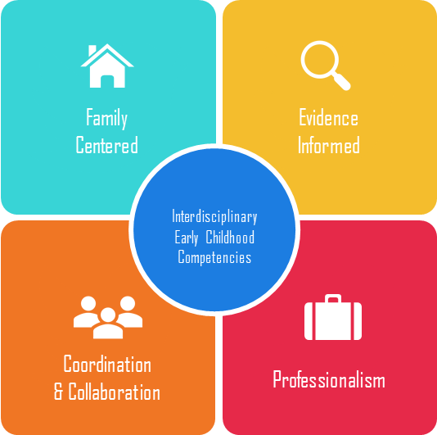

Slide 27
Cross Disciplinary Work Group
  Council for Exceptional Children (CEC)
  Division for Early Childhood (DEC) of the Council for Exceptional Children (CEC)
  National Association for the Education of Young Children (NAEYC)
  American Occupational Therapy Association (AOTA)
  American Physical Therapy Association (APTA)
  American Speech-Language-Hearing Association (ASHA)
  Zero to Three (ZTT)

Slide 28
Methodology
Establish Stakeholder Group
Draft Core Areas & Sub-areas
Review Preliminary Areas & Sub-areas
Identify Personnel Standards and Practice Documents Across Disciplines
Align and Categorize into Competency Areas
Define Personnel Competency Areas
Final Review and Revision of the Four Areas into Observable and Measurable Competencies

Slide 29
Family Centered Practice
The delivery of culturally competent and family responsive early childhood intervention that respects and facilitates a family’s active partnership and participation in the assessment, planning, implementation and monitoring of the interventions delivered to their child and themselves.

Slide 30
Family Centered Practice
Develops a partnership with each child’s caregiving family to support their participation in their child’s intervention and learning
Uses effective communication (listening, speaking, writing) skills with all families across cultural, linguistic and socioeconomic backgrounds
Supports families in their caregiving role
Includes the family in all components of the early childhood intervention service delivery process
Provides information, guidance and education to families about a) child development and their child’s health and safety needs
Provides information, guidance and education to families about regulations, policies, and procedures for eligibility, intervention, and transitions under IDEA and other early childhood programs
Provides information, guidance and education to families about early childhood intervention and inclusive service delivery models
Together with the family, identifies the family’s strengths, need, concerns and priorities
Prepares the family to participate and contribute to the development, implementation and evaluation of their child’s IFSP or IEP, including transition options
Refers families to resources and services to help them meet the needs of their child, their family and themselves
Provides information to the family about parental rights and safeguards and how to advocate for themselves, their family and their child

Slide 31
Coordination and Collaboration
The alignment of early childhood intervention services, interventions and community resources to support a collaborative cross disciplinary and cross agency service delivery process for infants and young children with disabilities and their families.

Slide 32
Coordination and Collaboration
Uses effective communication skills (listening, information and resources with service agencies speaking, writing)
Shares information and resources with service agencies
Demonstrates leadership at meetings with service providers and agencies to facilitate a team approach to early childhood intervention
Demonstrates negotiation skills with service providers and agencies to problem solve and take necessary actions to benefit the child and family
Collaborates with the family, service providers and agencies to develop, implement, monitor (and revise when necessary), an Individualized Family Service Plan (IFSP), Individualized Education Plan (IEP), or an intervention or learning plan
Collaborates with service providers and agencies to identify roles and responsibilities when delivering during intervention
Coordinates the delivery of early childhood intervention services, resources and supports with service providers and agencies
Facilitates transitions from the Part C or 619 programs to another program with the family and service providers from different disciplines and agencies

Slide 33
Evidence Based Practice
The use of scientifically based evidence to inform all screening, assessment, intervention and evaluation practices implemented with a child and family, and the collection of reliable data to document, monitor and make decisions about the effectiveness of the practices used with each child and family

Slide 34
Evidenced Based Intervention
Implements evidence-based assessment and intervention practices which includes the collection of data to make decisions and document child and family progress
Demonstrates knowledge of typical and atypical child development (including risk factors) throughout the intervention process
Uses valid, reliable, nondiscriminatory child focused assessment procedures and instruments to document a) eligibility for IDEA services b) child and family strengths and needs and c) child and family progress as a result of interventions
Identifies and includes evidenced based practices on the intervention plan (IEP/IFSP)
Uses evidenced based practices during interventions with a child, family and/or other caregivers/teachers
Incorporates evidenced based practices across learning opportunities (activities and routines) within the child’s home, community and classroom
Uses evidenced based accommodations, modifications and adaptations to enable a child to participate and learn in inclusive school and community environments
Systematically collects and uses data to monitor child and family progress to revise intervention plans as necessary and document intervention effectiveness

Slide 35
Professionalism
The application of ECI and discipline specific laws, policies, ethical standards and practice guidelines by all service providers who take responsibility for continued learning through self-reflection and professional development, which they share with others through the teaching, mentoring, and coaching and demonstration of advocacy and leadership skills at the local, state and national level.

Slide 36
Professionalism
Follows all IDEA and professional discipline policies, advocacy guidelines, ethics codes and practice standards for early childhood intervention
Demonstrates ethical decision making and professional behavior
Demonstrates knowledge of one’s own discipline practice standards and guidelines
Demonstrates awareness of other disciplines practice standards and guidelines for early childhood intervention
Uses self-reflection and professional development to stay in evidenced based disciplinary and interdisciplinary practices
Learns from, with, and about all team members within an interprofessional collaborative practice framework
Uses collaborative consultation practices when working with service providers and families
Mentors, teaches and provides performance feedback and reflective supervision to other service providers
Demonstrates disciplinary and interdisciplinary leadership skills in the field of early childhood intervention.
Advocates at the local, state and national level for high quality, timely, and effective early childhood intervention services to improve outcomes for children and families.

Slide 37



Family Centered
Evidence Informed
Cross-Disciplinary Early Childhood Competencies
Coordination
& Collaboration
Professionalism

Slide 38
Definitions of Competency Areas
Coordination and Collaboration | The alignment of early childhood services, interventions and community resources to support a collaborative, cross-disciplinary, and cross agency service delivery process for infants and young children with disabilities and their families
Family Centered Practice | The delivery of culturally competent and family responsive early childhood intervention that respects and facilitates a family’s active partnership and participation in the assessment, planning, implementation and monitoring of the interventions delivered to their child and themselves.
Evidenced Based Practice | The use of scientifically based evidence to inform all screening, assessment, intervention and evaluation practices implemented with a child and family, and the collection of reliable data to document, monitor and make decisions about the effectiveness of the intervention practices used with each individual child and family
Professionalism | The application of ECI and discipline specific laws, policies, ethical standards and practice guidelines by service providers who take responsibility for continued learning through self-reflection and professional development which they share with others through teaching, mentoring, and coaching; and the demonstration of advocacy and leadership skills at the local, state and national level.

Slide 39
EI/ECSE Personnel Preparation Standards:
  Child Development and Early Learning
  Partnering with Families
  Collaborating and Teaming
  Assessment Processes
  Application of Curriculum Frameworks in the Planning and Facilitation of Meaningful Learning Experiences
  Using Responsive and Reciprocal Interactions, Interventions, and Instruction
  Professionalism and Ethical Practices
Notes:
There are 7 content standards, listed here, that are built upon the foundation of the overarching themes we just reviewed. – an 8th standard provides guidance to Field/Clinical Experiences for EI/ECSE students in higher education settings.
These standards as a whole define the unique and essential knowledge, skills and dispositions required of EI/ECSE personnel
They are applicable across the early childhood age range and associated settings birth through age 8
Each standard has two or more components for a total of 27 components across the 7 standards. Each component aligns with the standard statement and further explains the standards.
Each component has a supporting explanation and includes activities and multimedia illustrations to bring each of the standard components to life.

Slide 40
Curriculum Modules: EI/ECSE Standards
Overview
Topics and PD Guides
Sample Syllabi
Multimedia Illustrations
Learning Activities
Resources
Websites
Modules
Glossary
References

Slide 41



Leadership Initiatives Partnership
Working in collaboration with IDEA Infant Toddler Coordinator Association, Early Childhood Technical Assistance Center and the Affinity Board for Section 619 coordinators, National Association for State Directors of Special Education.

Slide 42
Methodology For Leadership Curriculum
Scan the Literature for leadership types
Research synthesis as frame
Think Tanks with Part C/619 coordinators (21 states in 2 tanks )
  Job description as a leader: What you do/What do you need to know
  Refined/reduced into critical knowledge and skills by level
  Themed statements of K and S into categories
  Translated into competency statements
Survey/Delphi for validation/consensus with 70 Part C/619 coordinators
Focus groups with Part C/619 coordinators (summer meeting) to revise Delphi
Refined competencies and sequenced into level
Think Tank with Part C/619 (17 states) to further revise and refine
Indicators of K and S developed for each competency
K and S indicators used as self assessment to guide Intensive TA Academy
Intensive Leadership Academy piloted learning activities for K and S (2020-2021)
11. Framework and indicators were refined
12. Curriculum materials will be available for TA and self guided use
13. Cohorts continue

Slide 43
Hierarchy of Curriculum
Competencies (Knowledge and Skills)
Self Assessment (Pre/Post of K and S)
Learning Opportunities Structured By K and S
Peer and Expert Mentoring
Measurement of Acquisition of Competencies
Final Project

Slide 44
ECPC Leadership Curriculum
1.0 Foundational Leadership
1.1 Self Knowledge
1.2 Ethics and Professionalism
1.3 Laws, Regulations and Policy
1.4 Early Learning and Pedagogy
2.0 Operational Leadership
2.1 Communication and Collaboration
2.2 Part C and/or Part B (619) Program Management
3.0 Strategic Leadership
3.1 Leading Others
3.2 Strategic Thinking and Planning
3.3 System Change
Key:
* Diverse (e.g., representing linguistic, racial, ethnic, cultural, socio-economic, educational, and historically underrepresented backgrounds).
**Stakeholders (e.g., including families, administrators, staff, school and other board or council members, community members, faculty, policy makers, and historically underrepresented populations).

Slide 45
Self-Knowledge: After completion of this module, you will be able to develop and implement a professional development plan to guide the acquisition of leadership goals.
Objectives/Performance Indicators:
1.1.1. Describe the history and status of federal and state programs and agencies serving infants and young children and their families.
1.1.2. Identify your personal values, beliefs, strengths, needs, and learning style.
1.1.3. Identify professional development and/or learning communities where you can increase your professional knowledge and skills.
1.1.4. Demonstrate the use of data, reflection, and collective input to guide professional decisions you make about your needs as a leader.
1.1.5. Identify your professional leadership strengths, history, and style.
1.1.6. Identify informal and formal leadership positions national, state, or local organizations you are in now, or wish to be in the future.

Slide 46
3.2 Strategic Thinking and Planning: After completion of this module, you will be able to facilitate *diverse **stakeholder groups to implement a work plan with equitable and measurable goals, objectives, activities, identified resources, timelines, and outcomes to develop or improve and service issue/need for the state Part C and/or Part B (619) service system.
Objectives/Performance Indicators:
3.2.1. Describe the federal and state political, fiscal, and cultural climate that affects the Part C and/or Part B (619) service system.
3.2.2. Describe scenario-planning strategies to guide strategic decisions for the Part C and/or the Part B (619) service system and other early childhood initiatives.
3.2.3. Develop strategic partnerships with programs, agencies, and organizations to meet the needs of all infants and young children with risk conditions, delays, and/or disabilities (birth to five) and their families.
3.2.4. Identify a service system or program need for the Part C and/or Part B (619) service system through the collection of national and state data, including data from *diverse **stakeholders.
3.2.5. Facilitate *diverse **stakeholders to develop a shared and equitable vision and collective mission to address an issue/need in the Part C and/or Part B (619) service system or program.
3.2.6. Develop a collaborative work plan through a problem-solving process with *diverse **stakeholders that has equitable and measurable goals, objectives, activities, identified resources, timelines, and outcomes to meet the Part C and/or Part B (619) service system or program issue/need.
3.2.7. Facilitate the implementation and ongoing evaluation of the work plan (s), and revise it as needed, in collaboration with *diverse **stakeholders.
3.2.8. Evaluate the outcomes of the strategic work plan(s) with *diverse **stakeholders through the collection and analysis of data from multiple sources.

Slide 47
ECPC Adult Learning Tool
Who | Education/training practices for adult learning | Identify how you are going to teach adult learners
 |  | TOPIC:
Instructor/ Trainer | Introduction: Explain the practice/topic/ concept
Instructor/ Trainer | Illustration: Show the practice/topic/ concept
Learner | Authentic learning: Implement the practice/topic/concept
Learner | Reflection: Discuss with others how the practice/ topic/concept works
Instructor/ Trainer | Guidance: Prompt and guide the implementation of the practice/topic/ concept
Instructor/ Trainer | Performance feedback: Give concrete reinforcement or corrections
Instructor/ Trainer Learner | Follow-up activities: Plan for ongoing guidance and reflection for generalization and maintenance of the practice/topic/concept

Slide 48
ECPC Adult Learning Tool
Seven evidence-based adult learning practices derived from a metasynthesis of 15 research reviews of professional development which included 550 studies and 50,000 teachers and practitioners
(Dunst, Bruder, & Hamby, 2015).
Who | Education/training practices for adult learning | Identify how you are going to teach adult learners
 |  | TOPIC: Using authentic child assessment practices
Instructor/ Trainer | Introduction: Explain the practice/topic/ concept | Example: Introduce and explain authentic child assessment practices by saying “Authentic child assessment practices involve the purposeful gathering of information when observing the everyday activities of a child. This includes identifying child behavior during the activity and determining the adult behavior and/or materials that influence the child’s actions and behavior. Using this information, you can decide the activities, adult behaviors and materials that can be used as naturally occurring learning opportunities for the child and family.” Use the ECPC e-learning lesson, practice guide, and checklist as learning resources for authentic child assessment practices..
Instructor/ Trainer | Illustration: Show the practice/topic/ concept | Example: Share the ECPC e-learning video about authentic child assessment practices. Show students specific practices as they occur during each segment including the adult’s behaviors, child-lead activities, and materials the child interacts with during the activity that support child learning.
Learner | Authentic learning: Implement the practice/topic/concept | Example: Using the ECPC e-learning authentic child assessment checklist, have students implement assessment practices by observing one child at the campus childcare facility. Have students identify the behaviors the child is learning during the activity, and the adult behaviors (interactions and instruction) that are helping to promote child learning.
Learner | Reflection: Discuss with others how the practice/ topic/concept works | Example: In small groups, have students discuss the authentic child assessment practices observed and share what child learning may have occurred.

Slide 49
Core Elements of Technical Assistance
The following are the core elements that were found in a scoping review of technical Assistance models and frameworks (Dunst, Annas, Wilkie & Hamby, 2019) and incorporated into this self assessment as you prepare to deliver technical assistance to an program, organization or system.
Preparation
❑ | Needs Assessment | Did you determine the gap between current conditions, practices and outcomes?
❑ | Decision Making | Did you involve staff to identify priorities that fit the organizations mission or goals?
❑ | Visioning | Did you determine how the organization would look if it made the desired change?
❑ | Readiness for Change | Did you have the staff commitment to change program, organization, or systems practice to achieve desired changes or outcomes?
❑ | Organizational Capacity | Did you have the ability to commit resources needed for program, organization or systems changes to produce desired results?

Slide 50
Action Plan Evaluation Tool
Criteria | Yes | No | Improvements Needed:
Value: Objectives in the plan are clearly and directly related to the goal (e.g. development of CSPD).
Value: Activities in the plan target the system at multiple levels (e.g. state & local administration, providers, practitioners, service recipients)
Value: The plan addresses most of the elements of quality in the CSPD framework
Value: Activities in the plan, when completed, can reasonably be expected to result in achieving the objective
Ethical: Activities in the plan include clearly identified feedback loops (e.g. eliciting stakeholder input; providing information; seeking feedback)
Ethical: Criteria (e.g. will include these elements; will address these issues; will meet this standard) and purpose(s) (e.g. in order to…; to be used by…) are clearly stated in objectives and select activities
Feasibility: Activities in the plan are logical in sequence
Feasibility: Timelines are realistic and the plan is feasible given the time and resources
Measurable: Progress is documented at least monthly, and the plan is revised as necessary based on accomplishments, unanticipated events, performance data, feedback, and so forth
Measurable: The plan identifies measurable results/outcomes that are credible and feasible given the scope of the plan
Timing: Action plans are complete, including timelines, dates, and individual responsibilities and assignments

Slide 51
Change is not magic or inspiration.
It’s completing many undramatic, small steps successfully.
Danziel & Schoonover, 1988

Slide 52
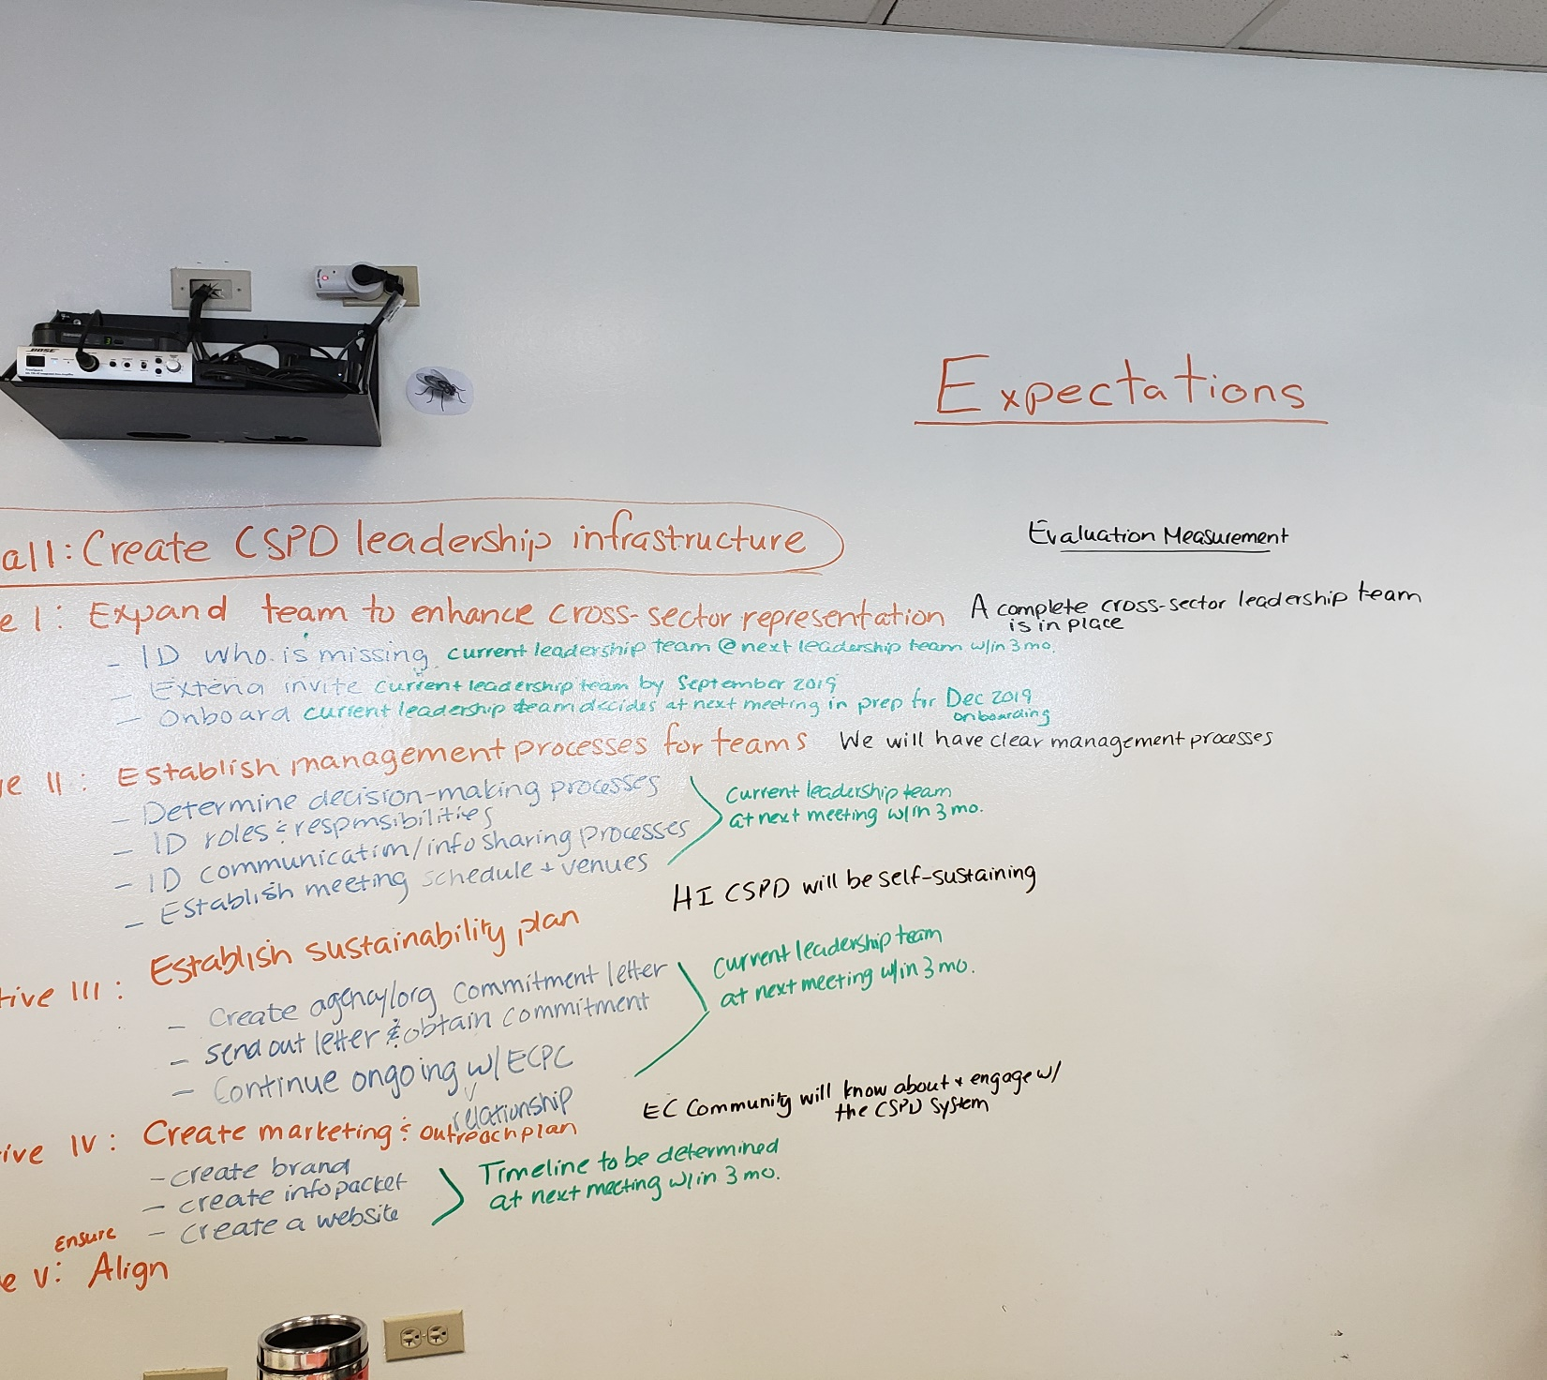

Slide 53
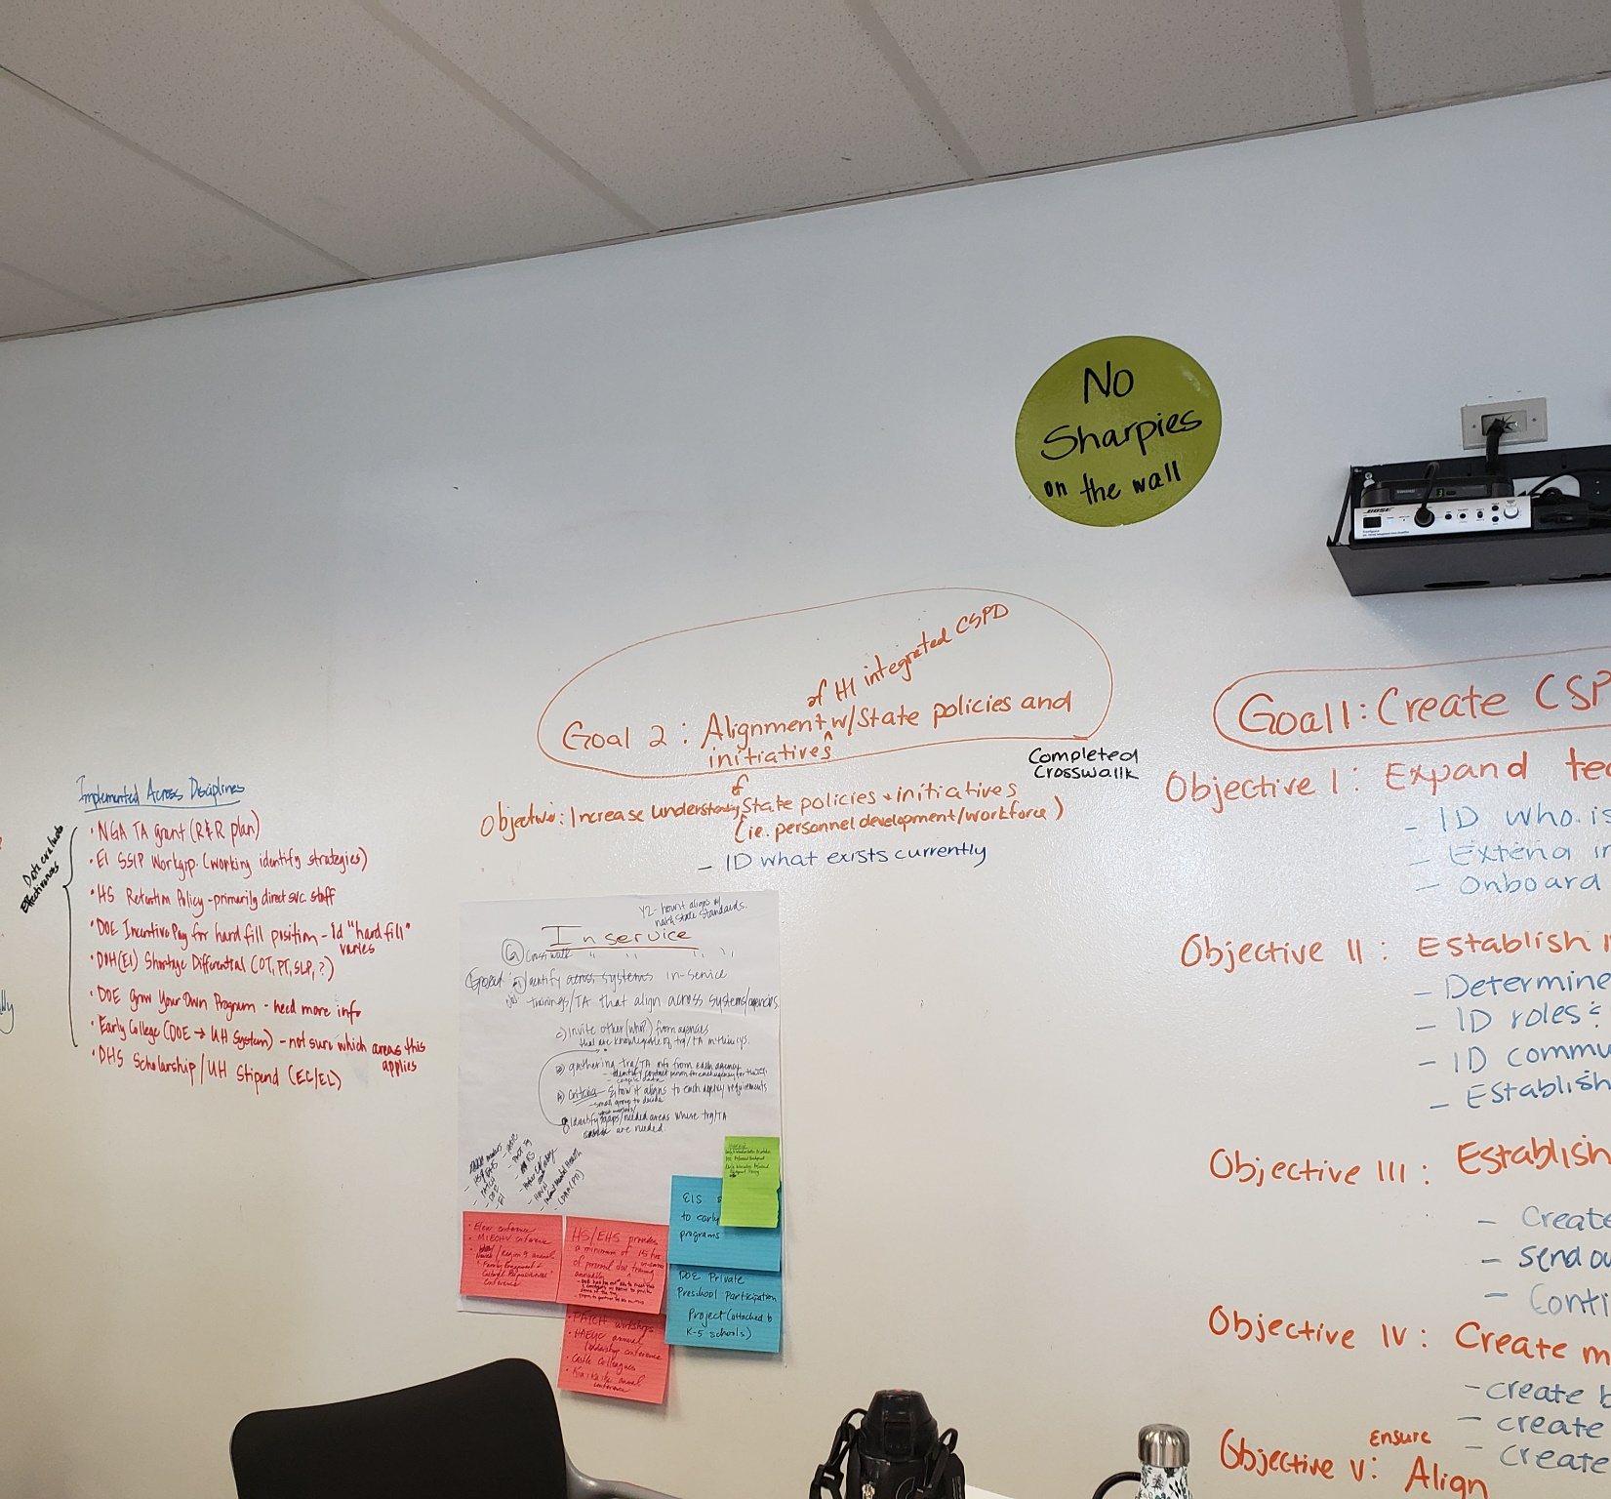

Slide 54


Slide 55
Elements of Change
Where are we now?
Where do we want to be?
What do we need to do to get from here to there?

Slide 56
Next Steps

Slide 57
Start at the Beginning:
Define your EBP. What do you and your staff need to know to do your job well?
Define your target population. Who needs to know what for each child, and family?
Needs Assessment. How do you document knowledge and skill levels of you, and your staff?

Slide 58
Next Steps

