Slide 1
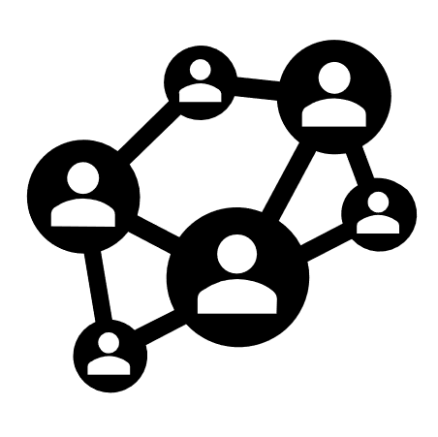
Lunch (12:00-1:00)

Slide 2
Self-leadership
“Nothing so conclusively proves a person’s ability to lead others as what he does from day to day to lead himself”
Thomas Watson (CEO of IBM)

Slide 3
Self-Leadership
The practice of understanding who you are, identifying your desired experiences and intentionally guiding yourself toward them.
It spans the determination of what we do, why we do it, and how we do it.
Notes:
First described by Manz (1983), the practice of understanding who you are, identifying your desired experiences and intentionally guiding yourself toward them.
It spans the determination of what we do, why we do it, and how we do it.

Slide 4
“Comprehensive self-influence perspective that concerns leading oneself toward performance of naturally motivating tasks as well as managing oneself to do work that must be done but is not naturally motivating”
(Manz, 1986)
“Positive self-leadership refers to the capacity to identify and apply one’s signature strengths to initiate, maintain, or sustain self-influencing behaviors.”
(Du Plessis, 2019)
“Self-leadership at the individual level is consistently related to improvement in both work attitudes and performance…Another conclusion that emerges from our review of the literature is the critical interplay between self leadership and external leadership. Empowering and shared leadership have been shown to be critical forces that influence internal self-leadership.”
(Stewart et al., 2011).

Slide 5
Manz (1986) outlined the process of self-leadership as how one influences one’s own behavior through the following:
Work context strategies (e.g., choosing preferred work settings)
Task performance process strategies (e.g., self-reward, self-punishment, self-observation)
Strategies to influence one’s thought patterns (e.g., managing one’s own beliefs and assumptions, self-talk, use of mental imagery)
Flores, H. R., Jiang, X., & Manz, C. C. (2018).

Slide 7
Core Competencies and Skills
Self-awareness and self-knowledge
Identifying desired experiences
Constructive thought and decision making
Planning and goal setting
Optimizing motivation
Harnessing the ecosystem
Amplifying performance
Embracing failure and cultivating grit

Slide 8
Self-Leadership Strategies
Higher level self-leadership is comprised of the following:
Authenticity
Responsibility
Expanded capacity
“Self-observation, self-goal setting, self-reinforcement, and self-criticism are among the primary behavior-focused self-leadership strategies…effective self-leaders are likely to place greater value and exert more effort to pursue a higher degree of self-awareness than others.”

Slide 9
Self-Leadership: Self Assessment
INSTRUCTIONS: Read each of the following items carefully and decide how true the statement is in describing you.
I make a point to keep track of how well I’m doing at work (self-observation)
Not at all accurate
Somewhat accurate
A little accurate
Mostly accurate
Completely accurate

Slide 10
Discussion

Slide 11
Strategies for Self-Leadership
Engage in self-dialogue
Use mental imagery
Challenge our beliefs and assumptions
Willingness to accept feedback- how to process feedback and using it to adjust
Self-leadership is grounded in thought management which can enhance cognitive process behaviors (decision-making) and affective response (Neck and Manz, 1996).
Notes:
Engage in Self-dialogue (reflect upon what we covertly tell ourselves, Ellis, 1962)
Use Mental imagery ( explore the symbolic experience of imagined results of our behavior before we actually perform, Manz, 1992)
Challenge our beliefs and assumptions
Willingness to accept feedback- how to process feedback and using it to adjust
Self-leadership is grounded in thought management which can enhance cognitive process behaviors (decision-making) and affective response (Neck and Manz, 1996).

Slide 12
Self-leadership starts with where you are and your mindset for growing yourself.

Slide 13
In order to optimize opportunities to grow ourselves, we must let go of who we think we ought to be and embrace who we are.
The work of thought management involves challenging our beliefs and assumptions.
One way to accomplish this is looking at ourselves through the eyes of others.
There is a difference between worrying about what others think, how you perceive your behaviors are received, AND how you can use the lens of others to enhance a meta perspective of yourself and contexts in order to gain leverage from expanded perspectives.

Slide 14
Take 5 minutes to reflect upon the following questions…
Where am I defending myself and/or pretending I have it all together when I should instead be gracefully accepting criticism and striving to improve?
What behaviors or actions am I overlooking or failing to acknowledge in myself that may impact my interactions with others?
Where am I currently taking the shorter or easier road instead of making the more difficult choice that is likely to help me be a better leader?

Slide 15
Strategies for Self-Leadership Growth
How can I grow in areas for which opportunities exist?
Engage in self-dialogue (reflect upon what we covertly tell ourselves, Ellis, 1962)
Use mental imagery (explore the symbolic experience of imagined results of our behavior before we actually perform, Manz, 1992)
Challenge our beliefs and assumptions – being able to adapt to community and cultural aspects of our environments
What additional strategies do you use for self-leadership?

Slide 16
Gallery Walk

Slide 17
Break/Reconnect (2:00 - 2:15)

Slide 18
Activity: The Many Hats You Wear as a Leader

Slide 19
The Ecological Perspective of Leadership

Slide 20
Ecology
Early intervention faces adaptive challenges with significant implications for leadership, necessitating a shift from traditional leadership models.
Traditionally, leadership was perceived as a technical role focused on diagnosing organizational problems and implementing fixes, with a top-down, power-driven approach to control.
In contrast, an ecological perspective allows for a meaningful understanding leadership, recognizing the complexities and interconnections of one’s spheres of influence.

Slide 21
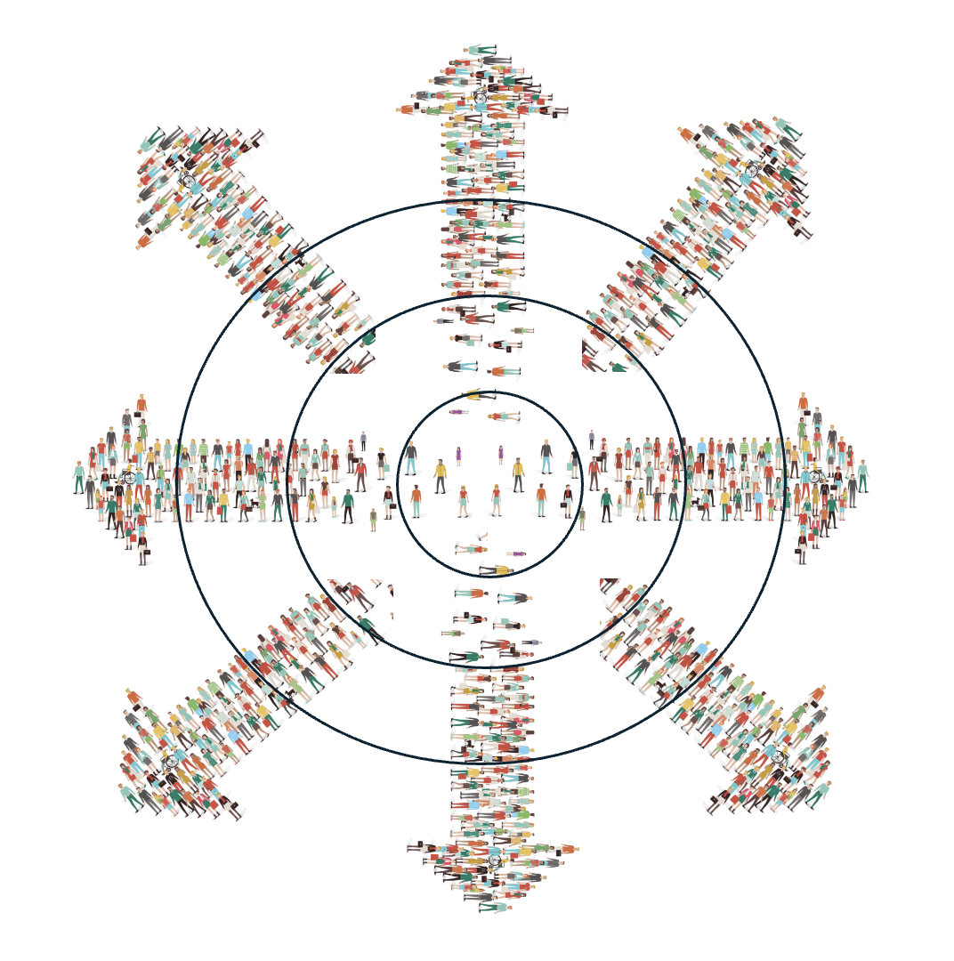
Leadership is relational, not isolated or individual.
It exists within interdependent networks of relationships.
These networks include families, professional peers, the organization(s), and communities.
Interdependence among systems is often overlooked in leadership studies.
Understanding leadership requires a focus on relationships, not just the individual leader.
Context matters…

Slide 23
Individually, reflect upon the following:
Considering your context.
What are some of the perceived (and/or real) realities?
What are some of the prevailing needs?
What are the general mindsets and attitudes of others?
How do you perceive your actions/efforts align with the complexities within your work ecology?
As a group, discuss:
How do circumstances, such as staffing challenges and funding, etc. change the scope of your work and what do you need in terms of your own self-leadership so that you facilitate ripples of impact in your ecology?

Slide 24
What is (or could be) your mantra for self-leadership?

Slide 25
Activity Wrap-up: The Many Hats You Wear as a Leader

Slide 26
Prizes!!!
https://wheelofnames.com/ede-prz

Slide 27
Closing Remarks
Beverley Calvo
The slides for today’s ECI summit can be found in:
ECI website: https://ecileaders.com/
A repository of prior summit and summer series recordings, slides, handouts, and other resources on retention strategies.
Thank you for all your hard work!

Slide 28
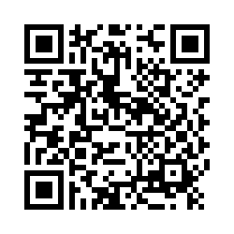
ECI Summit Exit Survey
The purpose of the survey is to (a) evaluate the effectiveness of the ECI Summit and (b) gather feedback to inform future support/events.
The survey takes approximately 5-10 minutes
Participation is confidential and voluntary (take a picture of the QR code or click the link below to begin).

