Slide 1
ECI SUMMER SERIES 2024
July 29, 2024
Notes:
Elizabeth

Slide 2
Reconceptualizing Recruitment by Focusing on Mindful Onboarding
Dr. Elizabeth Beavers
Dr. Dana Childress
July 29, 2024
Notes:
Elizabeth
Tell them handouts will come afterwards and be available on the website.

Slide 3
There is a clear connection between recruitment, onboarding, and staff retention!
Today, we will:
Gain a shared understanding of onboarding
Reflect on the onboarding process in your agencies
Consider 4 goals of onboarding
Identify components of a structured onboarding process
Recognize what goes well, what is challenging, and what you’d like to change
Notes:
Elizabeth
We’ve talked a lot about recruitment in the past. Today, we are doing to focus on an important step between recruitment and retention: onboarding. Research suggests that there is a clear connection between all three, so today we will…

Slide 4
“Onboarding, also known as induction or orientation, refers to the process of integrating new employees into an organization and facilitating their transition to becoming productive members of the team.”
Patel & Mohanty, 2023, p. 40
Notes:
Dana
First, let’s make sure we all understanding what “onboarding” is.

Slide 5
Onboarding is:
Associated with employee engagement, job satisfaction, and long-term retention
A good investment for developing loyalty and positively impacting productivity and performance
Closely related to employees’ sense of belonging and morale
Patel & Mohanty, 2023
Notes:
Dana

Slide 6
What does the onboarding process look like in your agency?
Requirements? Who does what? Length of time?
Notes:
Dana (Elizabeth jump in)
Breakout groups (10 min) – Share in your groups (grouped by program size) what the onboarding process is like in your agency/program? Identify a group member to come back to the main room and summarize your discussion. Debrief by inviting groups to summarize their discussion highlights and noting common practices, innovative ideas, etc.

Slide 7
Onboarding is the #1 component of managing employees that is overlooked by organizations.
Cesário & Chambel, 2019
Notes:
Dana
It’s is important not to forget about or rush onboarding. In fact…
CHAT: Why do you think onboarding is so often overlooked?

Slide 8
Onboarding is also:
Time and resource intensive
Hard to personalize
Hard to measure if it’s working
Patel & Mohanty, 2023
Notes:
Dana
Some reasons why it might be overlooked include… Also, once hired, we are often in a hurry to get the new employee in the field seeing families. We are often facing staff shortages, lots of referrals and increased need for services. It’s easy to want to skip from recruitment and hiring to having the new employee get to work. When we do this, we risk retention. Let’s talk about how we can think about onboarding as a process that promotes retention so that all of the work you put into recruitment, hiring, and onboarding new employees works for you so that employee stays.

Slide 9
3. Help achieve effective performance as quickly as possible
2. Create positive perceptions of the program
4. Decrease the likelihood of the employee leaving the program
1. Make it easier for the new employee to integrate into the program
4 Goals of Onboarding
Stephen, 2020
Notes:
Dana
Talk through each of these goals and ask what leaders are doing now to address them. Have them use annotation tool to drop a stamp (or use chat). Connect this discussion to retention.

Slide 10
Design a structured onboarding system that:
Includes organizational, manager, and coworker welcoming
Provides information about the mission/vision, values, and culture of the program
Clearly explains roles, responsibilities, and expectations
Cesário & Chambel, 2019; Godinho et al., 2023; Patel & Mohanty, 2023
Notes:
Dana
In order to meet these goals, research suggests that organizations should have structured onboarding systems that include specific components…
Review each component then ask participants how each component is implemented in their agency.

Slide 11
Design a structured onboarding system that:
Encourages social connections and a sense of belonging
Prioritizes open communication and accessible support
Involves the new employee in meaningful work from the beginning
Cesário & Chambel, 2019; Godinho et al., 2023; Patel & Mohanty, 2023
Notes:
Dana
Review each component then ask participants how each component is implemented in their agency.

Slide 12
State Requirements
All new employees must complete a 3-part orientation:
Making It Work for Texas Children and Families (14 hours including observations and demonstration of services) or Making It Work for Therapists (4.5 hours)
Staff Self-Assessment
Creation and Implementation of an Individualized Professional Development Plan (IPDP) for continued PD
Notes:
Elizabeth
There is also a structure to what Texas Health and Human Services requires of new EI staff once they are hired, so we could consider these requirements to be part of the onboarding process. Let’s review them.

Slide 13
State Requirements
Additional Requirements for Early Intervention Specialists:
Review and sign the EIS Code of Ethics
If needed, complete the required 40 clock hours in EC development or ECSE and/or 40 clock hours related to ECI
Notes:
Elizabeth

Slide 14
What do you think works well with onboarding new employees?
Consider agency and state requirements.
Notes:
Elizabeth
We will discuss what goes well and challenges. We’ll also drop a jamboard link in chat so you can add your ideas there too about what aligns or hinders recruitment and retention.
Dana will drop jamboard link into chat, then show jamboard on screen. Elizabeth will talk them through how to add a sticky note to add their thoughts.
Chat: Ask to share in chat or unmute mics to share what works well.

Slide 15
What challenges do you face with onboarding new employees?
Consider agency and state requirements.
Notes:
Elizabeth
Chat: Ask to share in chat or unmute mics to share what works well.

Slide 16
How do onboarding requirements align or hinder recruitment and retention?
Notes:
Elizabeth
Send them to the jamboard to answer the question…
Angie will drop the jamboard in chat. https://jamboard.google.com/d/175PTqOuC2B1ug4c5ZfiRnU2e8lG5JhwUz_zsD68OIXc/edit?usp=sharing

Slide 17
You can only control what you can control.
With this in mind, what would you like to change? What would improvement to the onboarding process look like?
Notes:
Elizabeth
Breakout groups (15 min) or Discussion (if we need the time) – Send to breakout room to work in small and large organizations to share challenges and brainstorm solutions. Each group will identify a speaker to summarize and share top 2 ideas when we return to the main room.

Slide 18
How do your ideas align?
Includes organizational, manager, and coworker welcoming
Provides information about the mission/vision, values, and culture of the program
Clearly explains roles, responsibilities, and expectations
Encourages social connections and a sense of belonging
Prioritizes open communication and accessible support
Involves the new employee in meaningful work from the beginning
Notes:
Dana
Let’s consider how your ideas align with the components of a structured onboarding program. I bet we’ll see some overlap here. We encourage you to take what we’ve discussed today and consider how your agency’s process aligns (or doesn’t). Hopefully you’ve heard an idea or had the space today to think of your own way to improve your onboarding process.

Slide 19
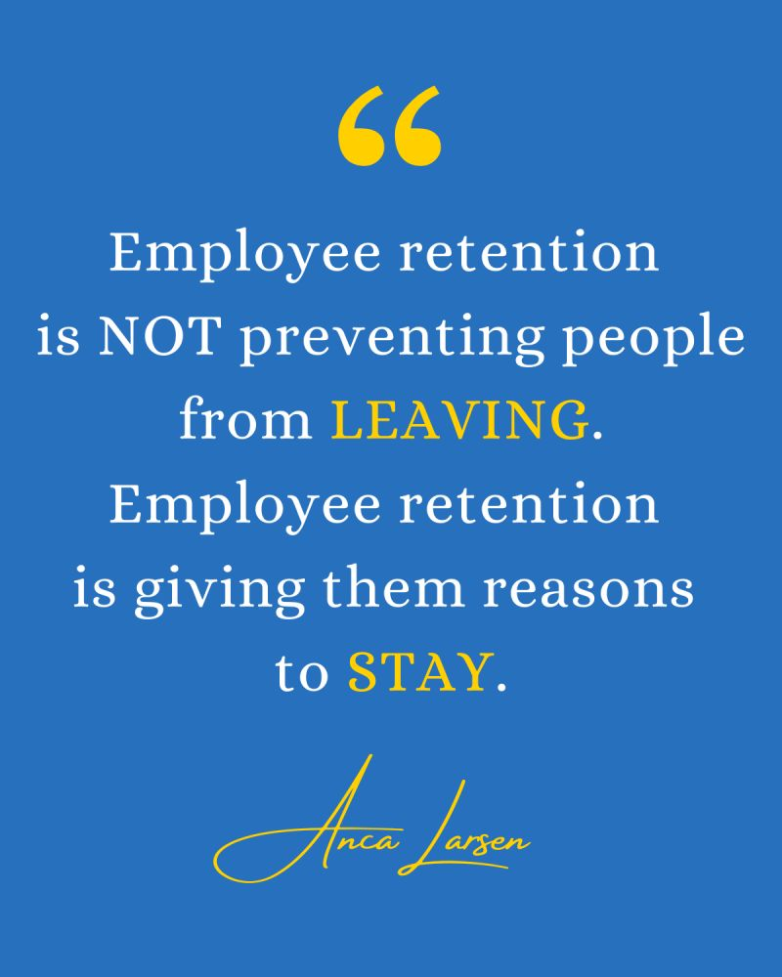
Notes:
Dana
Keep this perspective in mind over the next few weeks.

Slide 20
Join us next time to consider solutions-oriented best practices and strategies for recruitment and onboarding! August 19th 11-12:30 CST
Notes:
Dana
We hope you’ll join us as we continue this discussion in August! Please complete the survey (link to be dropped in chat by Angie).

