Slide 1
Lions Youth Cheerleading
2023 Season
Annual Membership Meeting
Thursday April 27, 2023
LIONS YOUTH CHEERLEADING WEBSITE

Slide 2
Agenda
Welcome Back - Introduce the Board
Switch from GroupMe to Team Snap
Registration Process for 2023
Types of Teams for 2023
Traditional Competition Cheer
Game Day Competition Cheer
Attendance Policy
Field Cheer
Coaches Responsibilities /Interviews
Code of Conduct
Tentative Summer Practice Schedule
Choreography
Tumbling at Divine with Cheryl Sesto
Varsity Cheerleading Camp
Uniform
Fundraising Opportunities

Slide 3
Registration Process 2023
Due to the success of our 2022 season, the Lions Youth Cheerleading program is growing in popularity! We’ve had a lot of inquiries coming in from new parents with interest in their child joining cheerleading. Unfortunately for our Competition Cheerleading program, the teams will be capped at 28 cheerleaders on the mat (with the exception of the 5 year old team, which will be capped at 20 cheerleaders). A decision was made by the Board to give returning athletes that were a part of our Competition Cheerleading program in 2022 first priority for a 2023 competitive cheer roster spot. If a team reaches capacity, the Board will assess how many roster spots remain on each level and will open up registration to the community. In the event that more registrations come in than Competition spots are available for any level, evaluations and selections will be held to fill the roster.

Slide 4
TYPES OF TEAMS
Traditional Competition Team
Game Day
Field Cheer
Look at the numbers

Slide 5
TRADITIONAL COMPETITION CHEER
After early registration, a lot of roster spots on the competition teams have been filled. When you register, there will be an option to register for an evaluation for $25 for a Competition Team, an option for Game Day or an option for Field Cheer. For those that choose the $25 evaluation for a remaining spot on a Competition Team, after selections are made everyone will be placed in one of our programs and the $25 fee will be applied to the applicable registration fee.
Competition Team Registration fee: $260
Below are the available # of roster spots left per age group:
5 Year Olds: Opens April 10th. 20 roster spots available on a first come, first serve basis.
6 Year Olds: 7 available roster spots
7 Year Olds: This roster is full. We are still opening the evaluations to gauge the additional interest however there are no guarantees that a spot will open for this division
8 Year Olds: 3 available roster spots
9 Year Olds: 2 available roster spots
10 Year Olds: 10 available roster spots
11 Year Olds: 7 available roster spots
12 Year Olds: 24 available roster spots
*Please note that a minimum of 12 team members are needed to open the team. If at the close of registration less than 12 roster spots are filled, the team will be closed and refunds will be issued*

Slide 6
,
,

Slide 7
GAME DAY INFORMATION
SCYCA teams participating in the Competitive Game Day division in 2023:
Connetquot Deer Park
Rocky Point Sharks
Brentwood Sachem (if they can find a coach)
Riverhead
Game Day is Competition Cheer in the Game Day division
Compete against other leagues' Game Day teams in our local competitions
Learn traditional sideline cheer
Cheer on sidelines at games for the West Islip Youth Football league
Registration Fee: $260 includes choreography, music, props, team's registration fees to competitions, bow, socks & t-shirt
West Islip Varsity Cheerleading - Game Day

Slide 8
ATTENDANCE POLICY
ABSENCES:
Every cheerleader must be present at all practices unless it is an excused absence approved by a coach. This applies to ANY cheerleading event (practice, game, competition, fundraisers etc.) All absences should be communicated at least 48 hours prior to the event so each coach is given ample amount of time to choreograph or fill in a substitute for the upcoming event. In the event of an illness, notify your coaches as soon as reasonably possible. Two types of absences exist: excused and unexcused.
Excused absences: funeral or death in the family, required school or church activities, religious holidays, sickness, and family vacations. *After September 1st, vacations will not be an excused absence unless it was planned and booked prior to the start of the season and board approval was granted.
Unexcused absences: sleepovers, playdates, homework, school events that are not required, birthday parties, being tired or any absence that was not received and approved by your coaches.

Slide 9
ATTENDANCE POLICY
Three unexcused absences, could result in removal from the team which will be reviewed and decided by the Lions Youth Cheerleading Board. Excessive absences overall may be subject to removal from a stunt or specific spot in the routine as deemed necessary by a coach or the Board. In order for your child's team to perform at their best, every member must be in attendance to all of our events. If your child is not prioritizing cheer or willing to commit, it is only fair that after 3 unexcused absences the Board may remove the child from the team and if applicable, may replace the child with someone on the waitlist.

Slide 10
FIELD CHEER
Sideline Cheer at WI Youth Football Games
March in Homecoming Parade
Learn basic motions and technique
Registration Fee: $150
Volunteers welcome! If you're interested in helping us out with this program please let us know!

Slide 11
COACHES RESPONSIBILITIES/INTERVIEWS
Maintain a practice schedule of at least 2x a week August-November.
Ensure that all components of the routine are legal, safely performed and age appropriate
Must attend Lions coaches meetings
Competition coaches must attend SCYCA safety clinic
Behave appropriately in front of the children of the program at all times
Communicate with the board immediately with any problems that present themselves on your team, or with other teams
Work together with other coaches on your staff to create a routine that is individual and unique to your team and our program
Interviews will take place via Google Meet on May 10th from 7:00 - 9:00 PM.

Slide 12
CODE OF CONDUCT

Slide 13
TENTATIVE SUMMER PRACTICE SCHEDULE
at Divine Rhythms Acro Room
We will do our best to keep the Fall practice schedule consistent with the schedule above for our competition teams. The Fall schedule it contingent on permits issued by the West Islip School District.
Practices for Field Cheer also require a permit. Practice will be held on field space that will be provided by the school district. As soon as the permit is approved those dates will be released.

Slide 14
SUMMER 2023 CHOREOGRAPHY
Choreography for the Lions Cheerleading competition teams for the 2023 season will occur from July 31 through August 11 at Long Island Cheer. Each team will have 6 hours of Choreography at some point during those two weeks.

Slide 15
TUMBLING WITH CHERYL SESTO AT DIVINE RHYTHMS

Slide 16
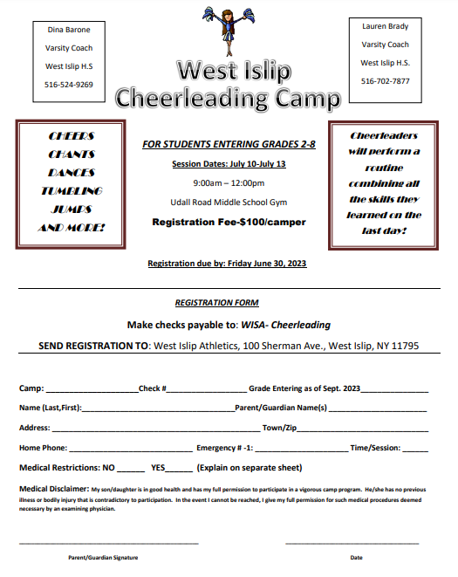
WEST ISLIP CHEERLEADING CAMP HOSTED BY THE VARSITY CHEERLEADERS
JULY 10TH - 14TH

Slide 17
*UNIFORMS
What does it look like
How much will it cost ($257 by check or zelle)
Check payable to Lions Youth Cheerleading
Zelle: wilionscheerleading@gmail.com
We are placing the order on June 15th to ensure we have them by September 1st.
Two fitting sessions will take place at The West Islip Public Library
Wednesday May 30th 5:30 - 7:30
Thursday June 1s 5:30 - 7:30
Parents are responsible for the cost of the uniform and sneakers
Lions tee shirt, socks, bows, signs and poms were all included in the registration fee.

Slide 18
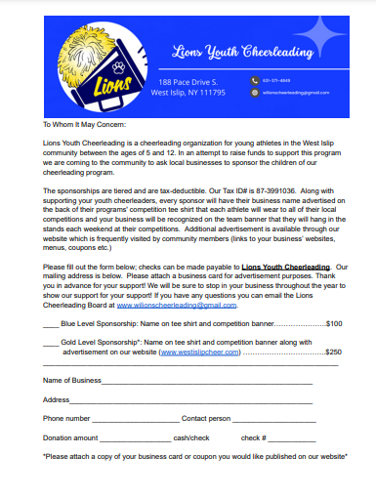
SPONSORSHIP FUNDRAISER

Slide 19
Fundraising
CARD BOX FUNDRAISER
CARD BOX - WEBSITE
$30 PER BOX YOU PROFIT $13

