Slide 1
Capacity Building Program Joint Venture Workshop
One Judiciary Square, 441 4th St NW, Washington, DC 20001
Thursday, September 28, 2023

Slide 2
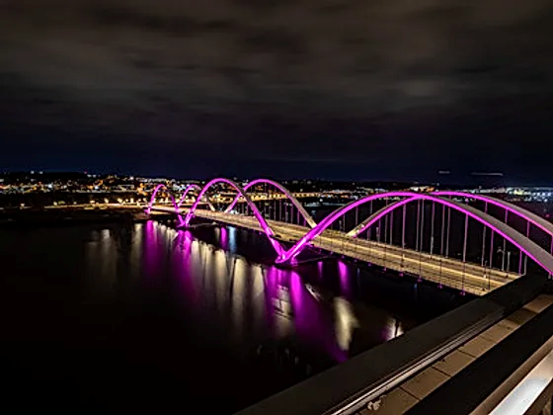
District Department of Transportation
Mission
The District Department of Transportation’s mission is to equitably deliver a safe, sustainable and reliable multimodal transportation network for all residents and visitors of the District of Columbia.
Vision
The District Department of Transportation will continue to be a national leader in creating safety and mobility solutions for the existing and emerging transportation challenges within our community. We will prioritize building safer infrastructure across all 8 wards, utilize innovative technologies and strategies to reduce congestion and greenhouse gas emissions and expand our transit systems to connect residents to economic opportunities.

Slide 3
HOUSEKEEPING
Mute cell phones
Restrooms
Emergency exits
Slides
Surveys

Slide 5
Joint Venture Workshop
Agenda
8:00 am - 8:30 am: Registration
8:30 am - 8:45 am: Opening Address and Welcome
8:45 am – 10:00 am: Legal Structure and Requirements of Joint Ventures
10:05 am - 10:10 am: Networking Break
10:15 am – 10:30 am: Joint Venture Company Highlight
10:30 am - 11:45 am: Accounting, Tax, & Financial Considerations of Joint Ventures
11:50 pm - 12:00 pm: Wrap-up and Next Steps

Slide 6
Edsel M. Brown Jr., Esq.
1. Edsel has a distinguished 29-year career as a Public Servant at the U.S. Small Business Administration, where he held various managerial roles, including overseeing the nation's largest Public Seed Capital Programs like SBIR and STTR.
2. As an Accredited Small Business Consultant (ASBC), certified by the Association of Accredited Small Business Consultants (AASBC), Edsel brings a wealth of expertise to his professional endeavors.
3. Currently, Edsel serves as Chairman of the Southern Maryland Minority Chamber of Commerce, and he is the Owner and Managing Member of a D.C. based Law Firm specializing in Intellectual Property, Business, Entertainment, and Government Contracting.
4. Edsel's educational background includes a B.A. in Government/Political Science, an M.A. in Public Administration from Ohio University, and a J.D. from the University of Toledo College of Law, where he served as President of the Black Law School Association.
5. Edsel has received recognition for his contributions, including the President's Award from the Maryland State NAACP and the Black Wall Street Award from BMORE News. He is also a life member of the NAACP and a member of Alpha Phi Alpha Fraternity, Inc.

Slide 7
Calvin C. Brockington
1. Calvin holds a degree in accounting with a minor in Economics from Howard University, and he is licensed as both a tax preparer and realtor in Maryland.
2. With over 50 years of experience, Calvin has built a successful career working with various private companies since 1970. Currently, he serves as an officer in two family-owned businesses, Optimum Homes, Inc. (a woman-owned small business with an MBE designation) and Optimum Business Services, Inc. These companies offer a wide range of services, including accounting, tax, property management, and business development services.
3. Calvin's accomplishments include managing the sale of tens of millions of dollars in real estate properties, assisting in the formation of over 500 organizations, preparing thousands of tax returns for individuals and businesses, and writing business plans, grants, and loan applications.
4. In his 20-year career with the US Department of Health and Human Services, Calvin served as a senior internal auditor for 21 years and a community economic development program manager for 10 years. He led audit teams and managed federal grant funds exceeding $175 million, partnering with Community Development Corporations (CDCs) to promote economic development in low-income communities.
5. Calvin's commitment to community development extends beyond his professional career. He chaired and served as the executive director of Reid Community Development Corporation for a decade, where he established a sustainable business incubator and provided economic empowerment seminars and business development assistance to micro-small businesses. Additionally, he is an avid golfer and plays an active role as a founding trustee, member, and church deacon at "Abundant Life Christian Ministries."

Slide 8
Joseph W. Wilson III, CPA
1. Joseph is a native of Washington, DC, where he grew up with his parents and one sibling. He completed his education at Spingarn High School and Virginia State University, earning an accounting degree.
2. He is a licensed Certified Public Accountant (CPA) in both Washington, DC, and Maryland. With over 40 years of experience, Joseph has a diverse background in financial management, auditing, accounting, taxation, government procurement, and overall management.
3. Joseph's expertise spans various industries, including private enterprises, governmental agencies, and nonprofit organizations. He possesses advanced knowledge in financial reporting, financial analysis, attestations, Cost Accounting Standards, GAAP, and the Federal Acquisition Regulations.
4. Currently, Joseph is the owner of Joseph W. Wilson III CPA, specializing in providing tax and accounting services to the public. In addition to his professional achievements, he is an avid golfer and maintains an active workout routine at a local gym.
5. Joseph's extensive career includes a 21-year tenure at the Washington Metropolitan Area Transit Authority (WMATA), where he held various auditing positions, culminating in his role as Deputy Inspector General for Audits. He managed audit teams, reviewed audit findings, and presented engagement summaries to stakeholders. He also has prior experience in financial analyst positions at a major computer company and various auditing roles at a local CPA firm.

Slide 9
SAVE the DATE!
DBE Summit
Date: Friday, November 3, 2023
Time: 8:30 a.m. until 2 p.m.
Location: Kellogg Conference Center, Gallaudet University
Upcoming Events

