Slide 1
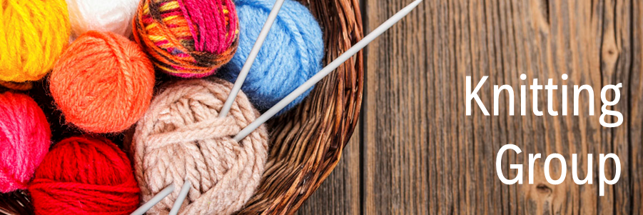
Knitting Group
Come join our knitting group. Knit for yourselves, knit for charity, make new friends and find new ideas of what to knit from others. A fun time for all.
Register online or in-branch.
This program is offered in partnership and with the support of the Barrhaven Seniors' Council.
For your safety all in-person programs will follow capacity limits depending on the size of the space. Participants are expected to remain physically distanced, to wear masks at all times and to follow other COVID-19 protocols as required. Each registrant must have their own individual Library card in order to register. If you need a Library card get one here: https://biblioottawalibrary.ca/en/getacard
Ruth E. Dickinson
October 18th to December 20th
Mondays, 1:30-3:30 pm

