Slide 1
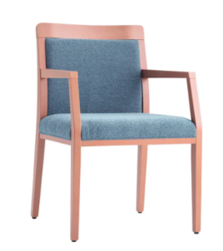
Dr. Ross’ Guidelines for Good Posture and to Eliminate Pain
Do not sit on a sofa that has no back or hip support
Sleep on your back with a flat pillow
Keep your car seat back straight up and not leaning back
Sit in a kitchen chair or office chair with a straight back. Arm rests are ok.
Do not use the lumbar support in office chairs or the lumbar support devices even in your car
Do no sit in a booth at a restaurant – sit in a chair with good back support
Do not cross your legs or feet
Do not sit up in bed and read
Avoid bending your head down looking at a computer or phone. Make certain your screen is eye level.
When going down stairs go one step at a time keeping your pelvis straight
If you have an injury, use ice 20 min. on and 40 min. off

