Slide 1
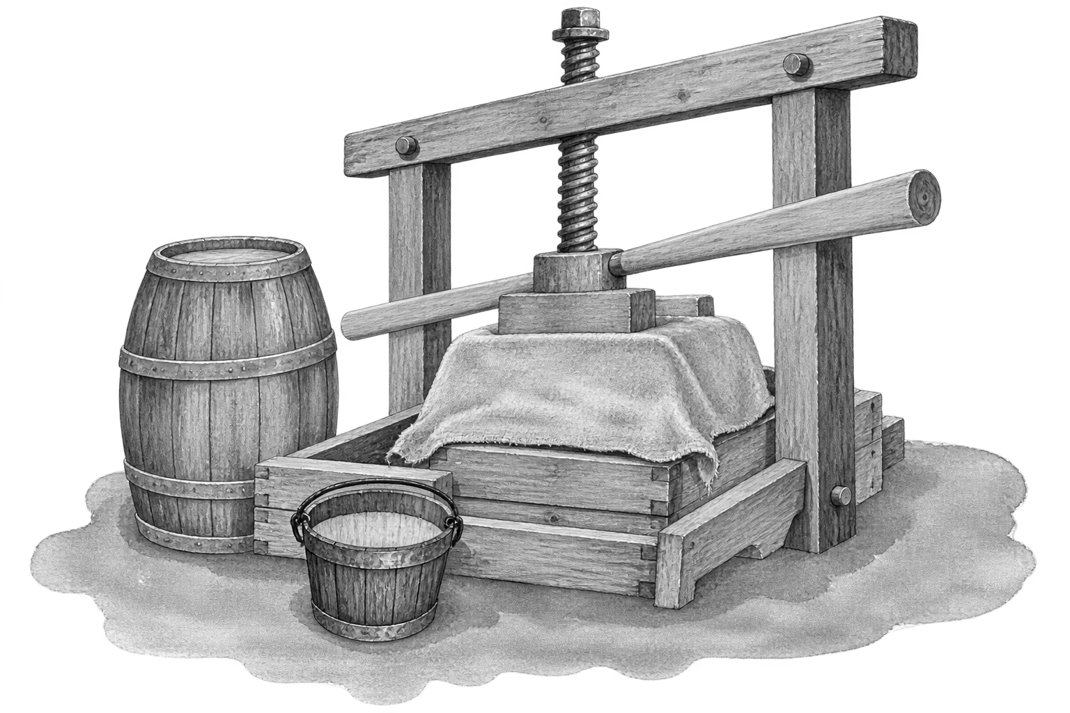

Dinner
Starters
Pan Fried Mushrooms(v) £6
On thick cut sourdough toast with garlic butter sauce
Melt in the Middle Fish Cake £6.5
Salmon, Cod & Haddock with mature cheddar molten centre. Served with a rocket salad
Po-ta-cho’s (v, gf) £6.5
Crispy potato skins topped with either:
Chilli (beef or vegan) or Cheese & bacon
Bar Snacks
Sausage Roll £2.5
Cheese & Olives £3.5
Scotch Egg £3.5
Sides
Chips(v, gf) £3.5
Cheesy Chips £4
Onion Rings (v) £3.5
Garlic Bread £3.5
Cheesy Garlic Bread £4
Side Salad (v, gf) £3.5
If you have any allergies or intolerances, please let us know.

Slide 2
Dinner
Mains
Country Ham, Egg & Chips £14
Thick cut gammon, 2 fried eggs and chunky chips
Good Ol’ Bangers & Mash £14.5
3 Country sausages, mustard mash and caramelised onion gravy
Cyder Presse Burger £15
Mushroom (v) or beef patty
Served with tomato, lettuce, onion, chips and house slaw
Pie and Mash £15
Pie of the Day, served with chips or mash and seasonal vegetables
Luxurious Fish Pie £16
Salmon, Cod, Prawn & Haddock, creamy parsley & dill sauce, leeks, peas & a mash top
Served with sourdough bread
If you have any allergies or intolerances, please let us know.

