Slide 1

Medicare Educational Seminar
Medicare Insurance Advisors Is not connected with or endorsed by the
United States government or the Federal Medicare program.
Notes:
Introduce yourself.
Just a reminder, this event is only for educational purposes. No plan-specific benefits or details will be shared.
Medicare is an insurance program not unlike your employer group coverage or your private health policy. It helps pay for covered health issues and like most private policies Medicare is a shared expense plan. You can elect to purchase additional insurance to cover some of the costs that Medicare doesn’t or leave Medicare and have private carriers provide Medicare Advantage Plans.

Slide 2

When do you sign up for Medicare?
  Initial Enrollment Period
  General Enrollment Period
  Special Enrollment Period
Notes:
Medicare is for 3 basic groups of people. 1. People ages 65 and older. 2. People under age 65 with certain disabilities. And 3. People of all ages with end-stage renal disease. For today, we’re going to assume you are in the first group.
Most people enroll around their 65th birthday. You can enroll during the 3 months before your birth month, the month of your birth and 3 months after that month giving you a 7-month initial enrollment period. Depending on when you enroll, coverage can start as early as the month of your 65th birthday.
If you miss your Initial Enrollment, you can sign up every year between January 1st and March 31. If you enroll at that time, your coverage is effective July 1st of that year.
Under certain circumstances, you may be eligible for a special Enrollment Period. If you have questions about that, please talk to me after the program.
If you are still working and covered under employee group insurance, you can either enroll in Medicare and drop your group coverage or you may be able to delay enrollment and stay with your employee program. You need to compare your plan at work side by side with your Medicare coverage and decide which is better for you. Before deciding to leave your employer plan, always discuss all your options with your benefits administrator, insurer, or plan provider. In most cases once you leave, you cannot return to the employer plan.

Slide 3

How do you sign up for Medicare?
Collecting Social Security…
  Enrollment in Medicare is Automatic
  Card arrives in the mail about 3 or 4 months before your 65th birthday
65th Birthday!
Notes:
If you are collecting Social Security, enrollment in Medicare is automatic and you will receive a card in the mail 3 to 4 months before your birthday. Call your Social Security contact if you have questions.

Slide 4

How do you sign up for Medicare?
Not Collecting Social Security…
100 Days before your birth month!
You can enroll two different ways:
Call Social Security to
schedule an appointment
800-772-1213
Sign up at medicare.gov
Notes:
If you are NOT collecting Social Security, you can enroll in Medicare in 2 different ways. 1. Call Social Security at 800 772-1213 to schedule an appointment around 100 days prior to your 65th birthday. 2. you can sign up at Medicare.gov.

Slide 5
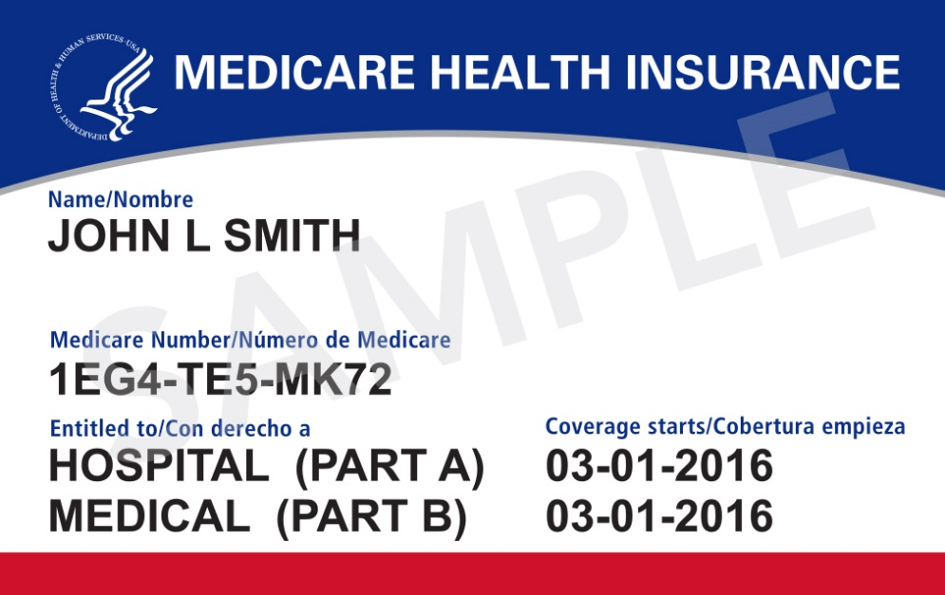
Original Medicare
Notes:
The original Medicare program was signed into law on July 30th, 1965. Former President Harry Truman and his wife were the very first beneficiaries. Today over 56 million Americans are enrolled in the Medicare program. That’s most Americans ages 65 and older, regardless of their income or health status.
You’re going to hear a lot about Medicare Supplement policies A through N. Original Medicare has only 2 parts: A and B. Part A is for hospital care and Part B is for medical services. Let’s start there.
Medicare Part A is usually free to you but you have to enroll. Once you do that – you can rely on the basic coverage or purchase supplemental coverage for additional protection.

Slide 6

Part A Hospital Care
Premium Free for most people
  First 60 days covered 100%
  First 20 days of skilled nursing covered 100%
  $1,408 deductible per occurrence*
* for 2020 plans
Notes:
Again, Medicare Part A is for hospital care. It covers things like your hospital room, meals, general nursing and hospital services and supplies. It does not cover private duty nursing, comfort or convenience items.
Coverage is for up to 90 days per Benefit Period and the first 60 days are covered at 100% after the Medicare Part A Deductible is met. You pay an out of pocket cost for any days after 60. There is an additional 60 days of coverage called lifetime reserve days, but it can only be used once.
It’s important to note that the deductible is $1,408 and applies to any new Benefit Period. So if you go into the hospital for a couple of days, get discharged and then return a week later – you are still in the same Benefit Period and will not be charged again for the $1408 Part A Deductible that you incurred on the first confinement.
If you are out of the hospital and/or Skilled Nursing Facility for at least 60 days in a row, a return to the hospital would begin a new Benefit Period and you would owe the Part A Deductible.
There are usually no premiums for Part A. Questions?

Slide 7

Part B Medical Services
$144.60 monthly premium*
Covers medical services outside the hospital
    Doctor visits, lab work, x-rays, ambulance, emergency room, outpatient surgery
An 80-20 plan with Medicare paying 80%
    $198 annual deductible
*For 2020 the standard Part B premium amount is $144.60 (or higher depending on your income).
Notes:
Medicare Part B is optional. It covers things like doctor’s visits, lab work and x-rays outside a hospital stay. It is an 80 – 20 plan meaning Medicare pays 80% of the approved expenses and you are responsible for the remaining 20%. The premium for Part B starts at $135.50 per month (or higher depending on your income). There is a $198 deductible but the deductible is for the whole calendar year, not per occurrence. If you collect a Social Security check, your premium will most likely be deducted.

Slide 8
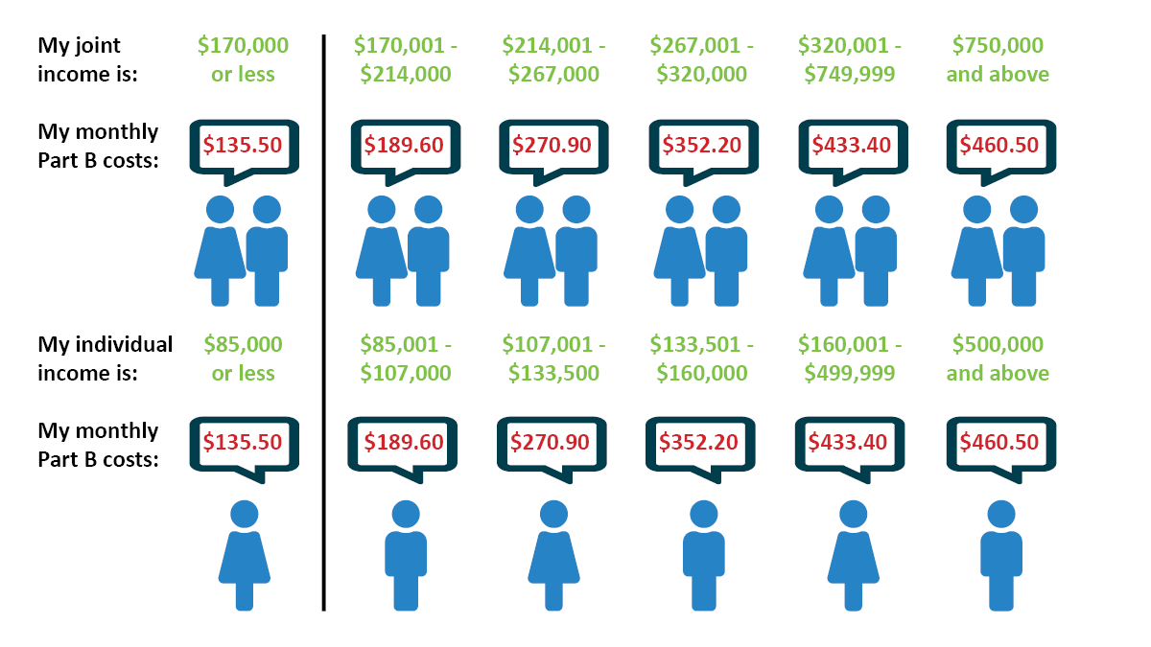
About that Part B Premium
*For 2019,the standard Part B premium amount is $135.50 (or higher depending on your income).
Notes:
This chart shows you that if you are a single person with an income of $87,000 or less OR a married couple with an income of $174,000 or less – the premium is $144.60 per month. That covers a lot of people, however, depending on your income, the monthly premium can go up to $491.60. That would apply only to singles making $500,000 and above and to married couples with a combined income of $750,000 and above.
Any questions on Part B premiums?

Slide 9




What you don’t get with A&B
Original Medicare doesn’t cover
    Dental
    Vision
    Prescription Drugs
    Hearing
    Help with long term care
Notes:
Here’s a potential problem with Medicare. You will probably need health care beyond your hospital and doctor. For example, Parts A & B do not cover things like dental, vision, hearing and the big one…prescription drugs. We’ll address that later. For now, just remember that Parts A & B don’t cover everything.

Slide 10
When you DELAY Part B
You are working and covered under an employer group health plan…
You are covered under a spouse’s employer group health plan…
No Penalties
No loss of Options
Notes:
You can enroll in Part A but delay Medicare Part B under certain circumstances. Depending on the size of the employer, you may be able to delay Part B if you are still working and covered under an employer health plan at your job or your spouse’s job.

Slide 11

Now Where Do You Go…
Supplement
Advantage
Employer
Group Health Plan
Note: Retiree coverage is not creditable coverage if delaying enrollment into Medicare Part B.
Notes:
Do you enroll in Part A, Parts A & B, Medicare Advantage or even a Medicare Supplement plan or do you continue with employer group health coverage or possibly union coverage? Note: You may also have the option of retiree coverage for health care after you retire but it does not count as creditable coverage for delaying enrollment into Medicare Part B, and neither does COBRA.

Slide 12

Retiree* or Union Plan
Ask questions
  Are there copays and deductibles?
  Does it include a drug plan?
  If I opt out, can I opt back in later?
  What’s the cost?
  Does it include dental and vision coverage?
*Note: Retiree coverage is not creditable coverage if delaying enrollment into Medicare Part B.
Notes:
First, if you have the option of continuing on an employer group health plan, a union plan or a retiree plan, you will want to compare it to Medicare A & B. Medicare suggests that you talk with your Employee Health Benefits administrator and ask these questions. Just remember that retiree coverage for health care after you retire does not count as creditable coverage for delaying enrollment into Medicare Part B, and neither does COBRA. (read the slide)

Slide 13
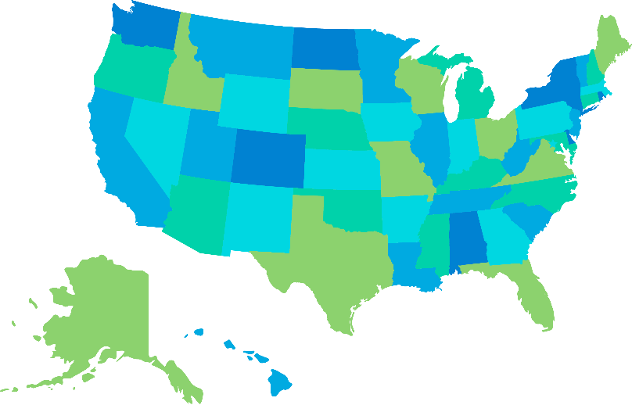
Medicare Supplement
  Federally standardized Medigap
  plans offered in all states and DC.
  10 Plans A – N offered in most states
  All policies offer the same basic benefits.
  Effective 1/1/20, Plan F available to those first eligible prior to 2020 only.
Notes:
If you want to explore Medicare Supplemental insurance or Medigap, there are lots of options. You must have Medicare Parts A and B but then purchase a Medicare Supplement policy to cover certain costs that Medicare does not. There are 10 federally standardized Medicare Supplement insurance plans that are offered in most states – Plans A through N. They are offered by many different insurance companies.
Here’s what’s important. All Medicare supplement plans contain the same basic benefits and all plans with the same Plan letter are identical in medical expenses no matter where you buy them. Plans have the same standardized benefits for each letter category, only the premiums may vary. Your policy may have a different cost depending on the insurance company, but still have the same coverage (although there may be a policy with an additional innovative benefit available in your area). Look at proposed plans along side each other and compare those to what you already have with Medicare A & B, then decide.

Slide 14
When is a supplement the best path?
  Want to budget medical costs
  Travel and may need to see a doctor away from home
  See any doctor or specialist, no referrals
  Some plans have no co-pays, no deductibles
  Assured to get it and keep it
Notes:
Medicare Supplement Insurance can help you pay for the gaps in Medicare coverage. It helps if you want to budget your medical costs or if you travel often and may need to see someone other than your hometown doctor. If you want health care coverage for things outside Parts A & B, like vision and dental, you can purchase additional insurance coverage.
Medicare Supplement policies are guaranteed renewable.

Slide 15
Medicare Advantage
Part C becomes primary and can include Part D
PPO or HMO network of doctors
  Usually one or more plans available in a county
  Includes a Maximum Out of Pocket
Notes:
Medicare Advantage is another option. Medicare Advantage plans require that you have original Medicare Parts A & B. It provides coverage though provider networks also called HMOs, PPO, and MSAs. Medicare Advantage Part C basically replaces original Medicare Parts A and B and can include coverage for Medicare Part D. The key benefit is that Medicare Advantage plans include a maximum out of pocket feature to help you control costs.

Slide 16

When it’s the best path
Pay a lower premium
Use as a backup for VA services
Like the network of doctors
On a low-income subsidy for Medicare
Additional benefits beyond Original Medicare
Notes:
Medicare Advantage is good if you like the network of doctors in your area and want to pay a lower premium. Medicare Advantage is a good idea if you are a veteran and use VA services or if you have a low-income subsidy for Medicare.

Slide 17

Prescription Drugs
Part D
Prices vary by county, depending on the plan
Included with some retirement plans
Late enrollment penalties may be imposed
Vets exempted from the requirement to enroll, but may choose to do so
Notes:
Now back to prescription drugs. Part D covers prescription drugs – think D for drugs. Costs vary by county depending on the plan. Part D may or may not be part of employee group health plan, a union plan or retiree coverage. Veterans are exempted from the requirement to enroll in the coverage, but may choose to do so.

Slide 18
Extra Help with Rx
Apply for a low-income subsidy
Annual income less than $18,210 for singles and $24,690 for couples*
Resources less than $14,100 for singles and $28,150 for couples*
May also help with deductibles, co-pays and premiums
* Amounts based on yearly income and resources in 2018. These amounts may change in 2019.

Slide 19
2020 Rx Gap
Coverage gap begins when you and your drug plan spends $4,020*
From $4,021 to $6,350
  You pay 25% of generic drugs
  You pay 25% of brand-name drugs, but 95% counts toward your out-of-pocket
Catastrophic coverage after $6,350*
* for 2020 plans
Notes:
You may have heard of the prescription drug plan gap or the “donut hole.” What that means is that if you require over $3,820 worth of prescriptions during a year, you will pay a higher part of the cost. In other words, your plan covers the first $3,820 of drugs as usual. But then from $3,821 to $5,100 you pay 25% of brand-name drugs and 37% of generics. Then, once you hit $5,100 in out-of-pocket expenses, catastrophic coverage begins and you will only be responsible for a small co-pay or co-insurance for drugs purchased during the rest of the calendar year.

Slide 20

Have questions?
The decisions you make can
impact your health care
coverage for a long time.
Notes:
I know this is a lot to take in and you’ll want to take some time reviewing all the different options. Does anyone have a question at this time?
….Q & A……

Slide 21
Medicare Insurance Advisors
Holt Health Insurance
Old Hickory, TN 37138
615-456-3240
www.holthealthinsurance.com

