Slide 1
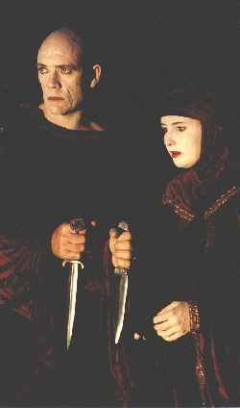
Intro to Macbeth
Notes:
1

Slide 2
When?
1034 Duncan became King, founding the first and only dynasty of Scotland
The play begins 6 years later, set in 1040
Scotland was still unsettled
Feudal society: thanes (lords) were very powerful

Slide 3
Clans were key to Scottish life
Loyalty was to one’s clan and clan leader rather than to country and to king
Blood Feuds: Lady Macbeth was from a clan that had long been involved in a blood feud w/Duncan’s clan
Hospitality was revered
Travelers depended on strangers for food, shelter & protection

Slide 4
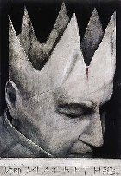
Violence: it was a very dangerous time to be king
17 kings ruled Scotland from 844 to 1057, 12/17 were assassinated

Slide 5
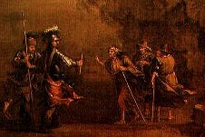
Daily life: food and water were scarce, especially for the common people
The strength of Scots was spent in fighting each other and the Vikings

Slide 6
Vikings (from Scandinavia) had ruled sections of Scotland for several centuries and the invading Norwegians may have been trying to bolster Viking domination
Freedom barely exisited but was eagerly sought: Scots “hold it foul sloth if any man dieth in bed & great worship if he die in the field.”

Slide 7
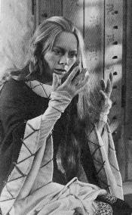
Shakespeare wrote 37 plays, only this 1 was set in Scotland
Macbeth is his shortest tragedy
Queen Eliz. I died in 1603, leaving no children
Nearest relative was James VI, King of Scotland, so James VI became James 1 of England

Slide 8
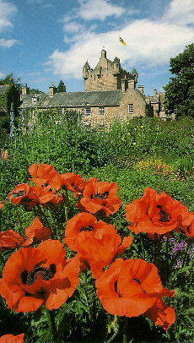
James was an odd man, against tobacco & fascinated by witches
A fervent believe in witchcraft, he spent much time ferreting out old women & torturing them until they confessed they were witches
In 1606 James was anticipating a visit from his brother-in-law, King Christian of Denmark
A new play needed to be written for the visit: Shakespeare was called upon

Slide 9
King James was a descendant of Banquo and indirectly of Duncan
James believed in ghosts
James was proud of his ancestry

Slide 10
Themes:
greed
prophecy
combat
murder
false blame
tyranny
madness
recompense
downfall
Motifs:
Intervention of a ghost in human affairs
Burden of knowing the future
Misguided plot to kill adversaries
A false sense of security

Slide 11
Review and stay on top of the vocab for easy assignment points
It’s on www.mrmooney.com
Use No Fear Macbeth if you can; if you can’t, read the footnotes

